Slide 1
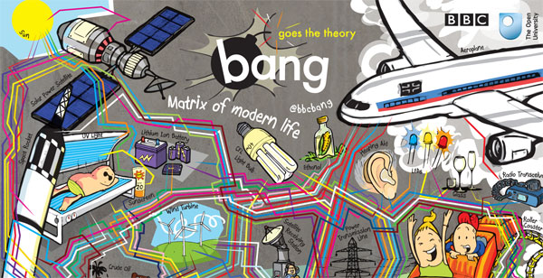
Science, Engineering, Technology and Society
Dr. B.Satyanarayana ▪ Scientific Officer (G)
Department of High Energy Physics ▪ Tata Institute of Fundamental Research
Homi Bhabha Road ▪ Colaba ▪ Mumbai ▪ 400005 ▪ INDIA
T: 09987537702 ▪ E: bsn@tifr.res.in ▪ W: http://www.tifr.res.in/~bsn

Slide 2
What do I plan to talk to you...
Science, engineering and technology are not only interconnected, but they are even interdependent.
So much so that the boundaries between them often seem non-existing.
Like in case of other endeavours, these three seemingly distinct academic pursuits too strive to improve the societal wealth - be it materialistic, intellectual or well-being.
Science not only unravels the hidden mysteries of nature, but also gives birth to and nurtures the ideas which change the way the world exists.
I will attempt to untangle this interplay using some case studies from modern experimental physics.

Slide 3
Definitions
Science is the reasoned investigation or study of natural phenomena with the objective of discovering new principles and knowledge of natural phenomena.
Technology is the practical application of science. Technology includes the skill, technique and knowledge of the manipulation of nature for human purposes, using scientific results and knowledge.
Engineering is the professional art of using technology for achieving the optimum conversion of the resources of nature for the benefit of humankind.
A Scientist studies nature, a Technologist manipulates nature and an Engineer exploits technology for human purposes.
So, it looks like the Engineer is the one who is most useful to society and humankind! ©Vikram Karve 2010

Slide 4
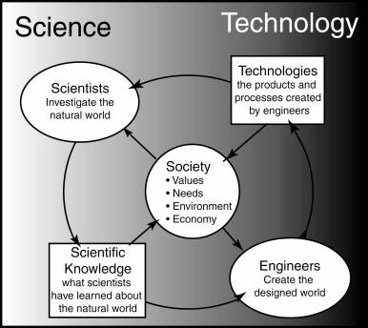
The interplay ...

Slide 5
Some examples
Electron and applications
Laser applications – medical and industry
Particle accelerators and physics detectors for medical imaging and therapy
Statistical mechanical applications to traffic and crowd management
Space and remote sensing applications
Weather forecast – computing system and algorithms
GPS: Science-Engineering-Technology-Science-...

Slide 6
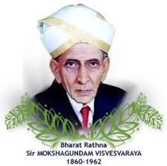
September 15: Engineer’s Day

Slide 7
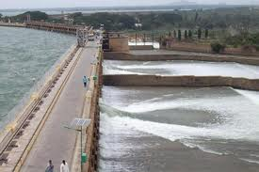
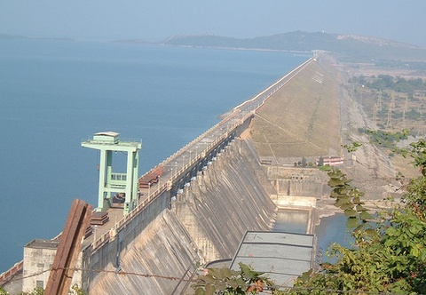
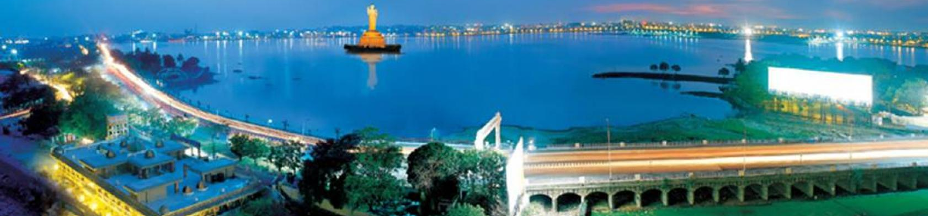
Sir Mokshagundam Visvesvaraya:
A visionary Engineer par Excellence
Taming rivers and optimally using water resources…
Water works at Ahmedabad, Belgaum, Bijapur, Dharwar, Khandesh, Kolhapur, Pune, Sukkur, Surat and Visakhapatnam
Hirakud, Hyderabad tank bund, Krishnarajasagar, Khadakvasla and Tigara dams

Slide 8
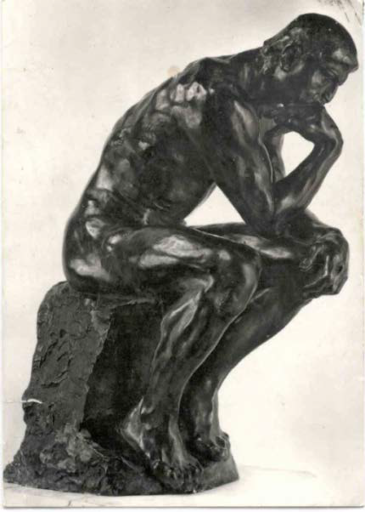
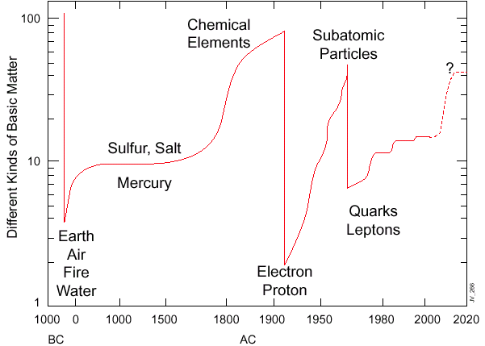
History of constituents of matter

Slide 9
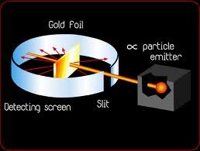
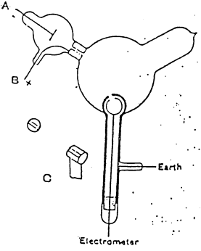
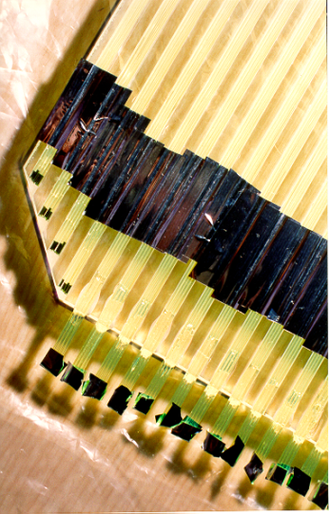
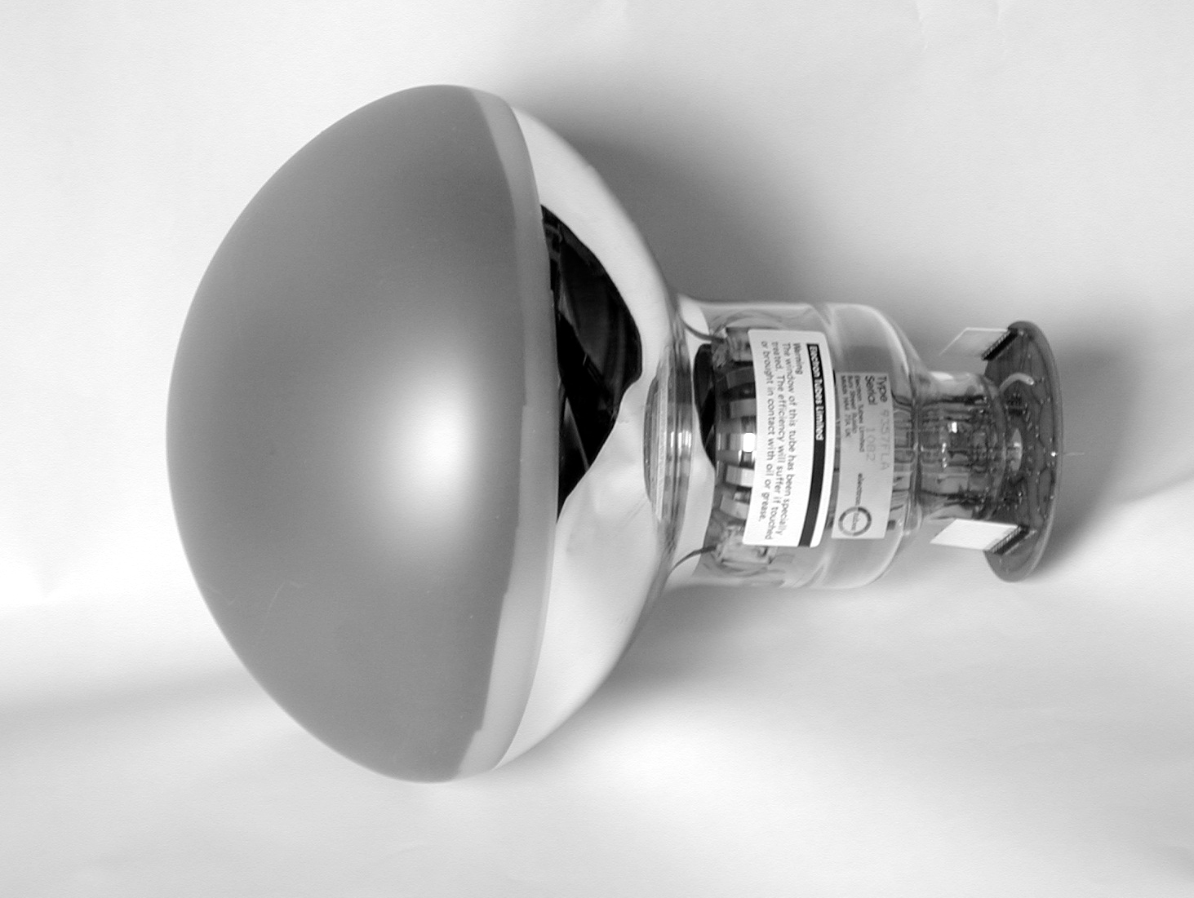
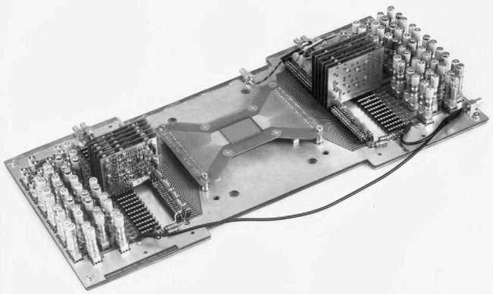
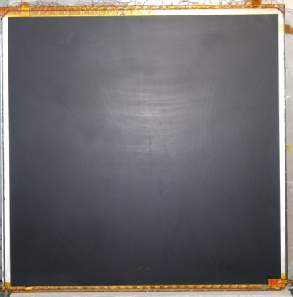
Detectors aided major discoveries
Crookes Tubes: Sir William Crookes (1869-75)
Cloud chamber: Charles Thomas Rees Wilson (1894), Nobel Prize in Physics (1927)
Electron: J.J.Thomson (1897) using Crookes Tubes
“Gold foil apparatus”: Hans Geiger & Ernest Marsden (1909)
Proton: E.Rutherford (1911) using “Gold foil apparatus”
Photon: A.Compton (1923)
Neutron: J.Chadwick (1932)
Positron: C.Anderson (1932)
Muon: C.Anderson & S.Neddermeyer (1937)
Neutral Kaon: G.Rochester & C.Butler (1947) using cloud chamber triggered by Geiger counters
Charged Pion: C.Powell (1947) using photographic emulsions carried aloft by balloons
Lambda: (1947)
Neutral Pion: R.Bjorkland (1949)
Bubble chamber : D.Glaser (1952), Nobel Prize in Physics (1960)
Synchrotron: (1952)
Xi minus: R.Armenteros (1952)
Sigma plus: G.Tomasini (1953) using emulsion technique
Sigma minus: W.Fowler (1953)
Antiproton: W.Segrè (1955)
Antineutron: B.Cork (1956)
MOS transistors: Kahng & Atalla (1960), electronic counters
Multi-Wire Proportional Counter: G.Charpak (1968), Nobel Prize in Physics (1992)
Time Projection Chamber: D.R.Nygren (1974)
Charm quark: SLAC & BNL collaborations (1974)
Super Proton Synchrotron: John Adams et al (1976)
Stochastic cooling: Van der Meer, Nobel Prize in Physics (1984)
Large area (20”) PMT: Hamamatsu (1980)
Resistive Plate Chamber: R.Santonico (1981)
W & Z bosons: UA1 and UA2 collaborations (1983)
Micro Strip Gas Chamber: A.Oed (1988)
Top quark: D0 & CDF collaborations (1995)
Gas Electron Multiplier: F.B.Sauli (1996)
Neutrino oscillation: Super-Kamiokande Collaboration (1998)

Slide 10
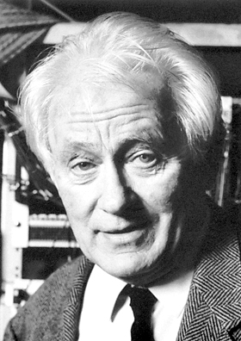
Nobel Prize for detector builder
The Nobel Prize in Physics 1992 was awarded to Georges Charpak "for his invention and development of particle detectors, in particular the multi-wire proportional chamber".
“The discoveries of the W and Z bosons at CERN, the charm quark at SLAC and Brookhaven and the top quark at Fermilab would not have been possible without this type of detector, and current research in high energy physics continues to depend on these devices”.
Georges Charpak (1924–2010)

Slide 11
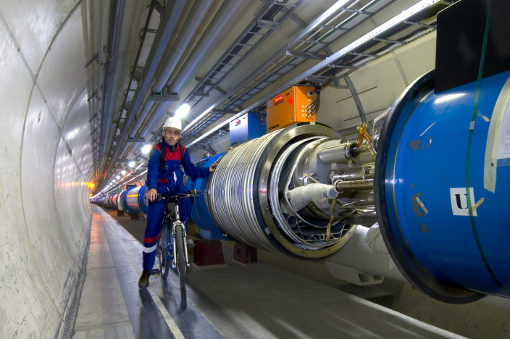
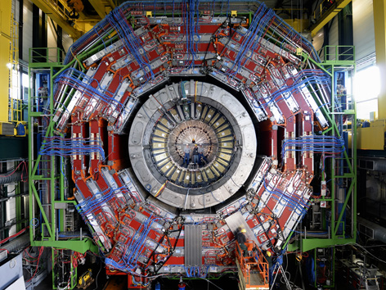
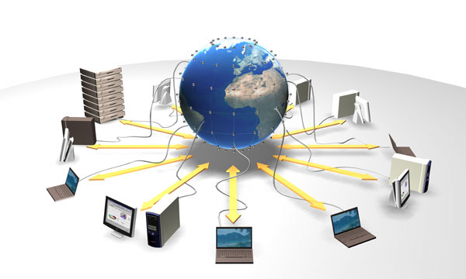
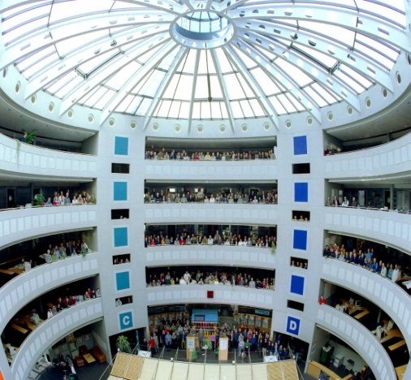
Recipe for modern discoveries
Accelerators: powerful machines capable of accelerating particles to extremely high energies and bring them into collision with other particles
Detectors: gigantic instruments that record the particles as they “stream” out from the point of collision.
Computers: to collect, store, distribute and analyse the vast amount of data produced by the detectors
People Only a worldwide collaboration of thousands of scientists, engineers, technicians and support staff can design, build and soon operate such complex “machines”

Slide 12
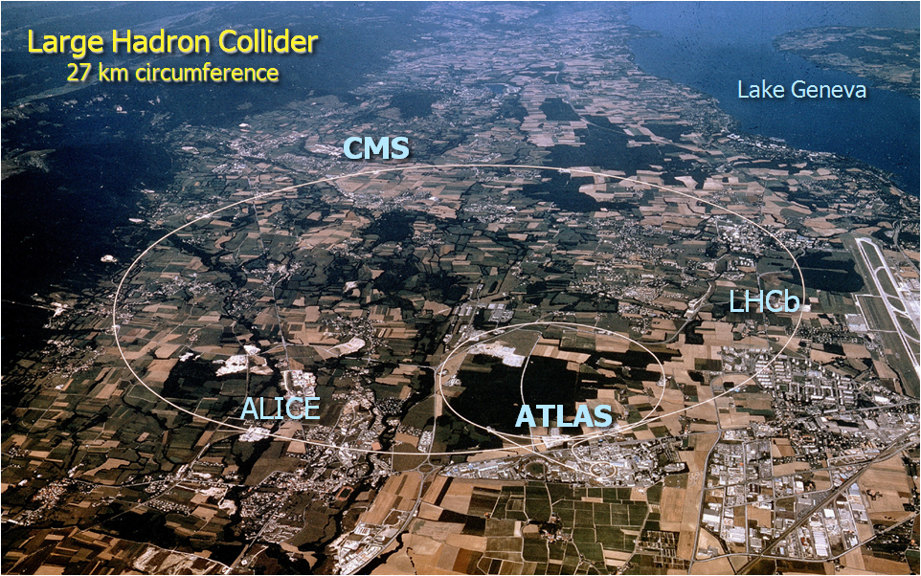
CERN Site

Slide 13
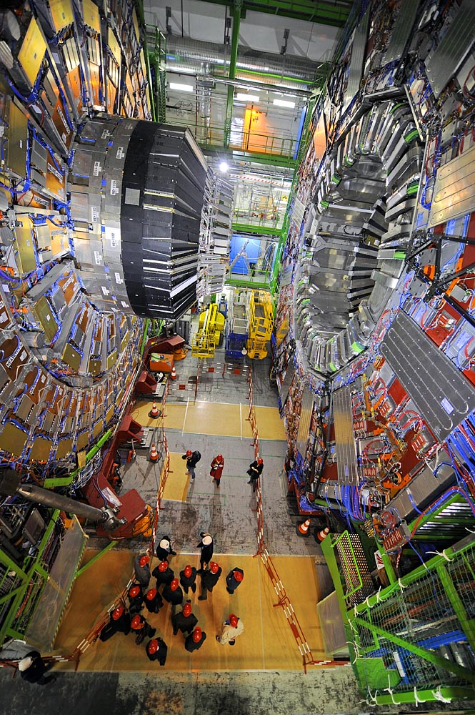
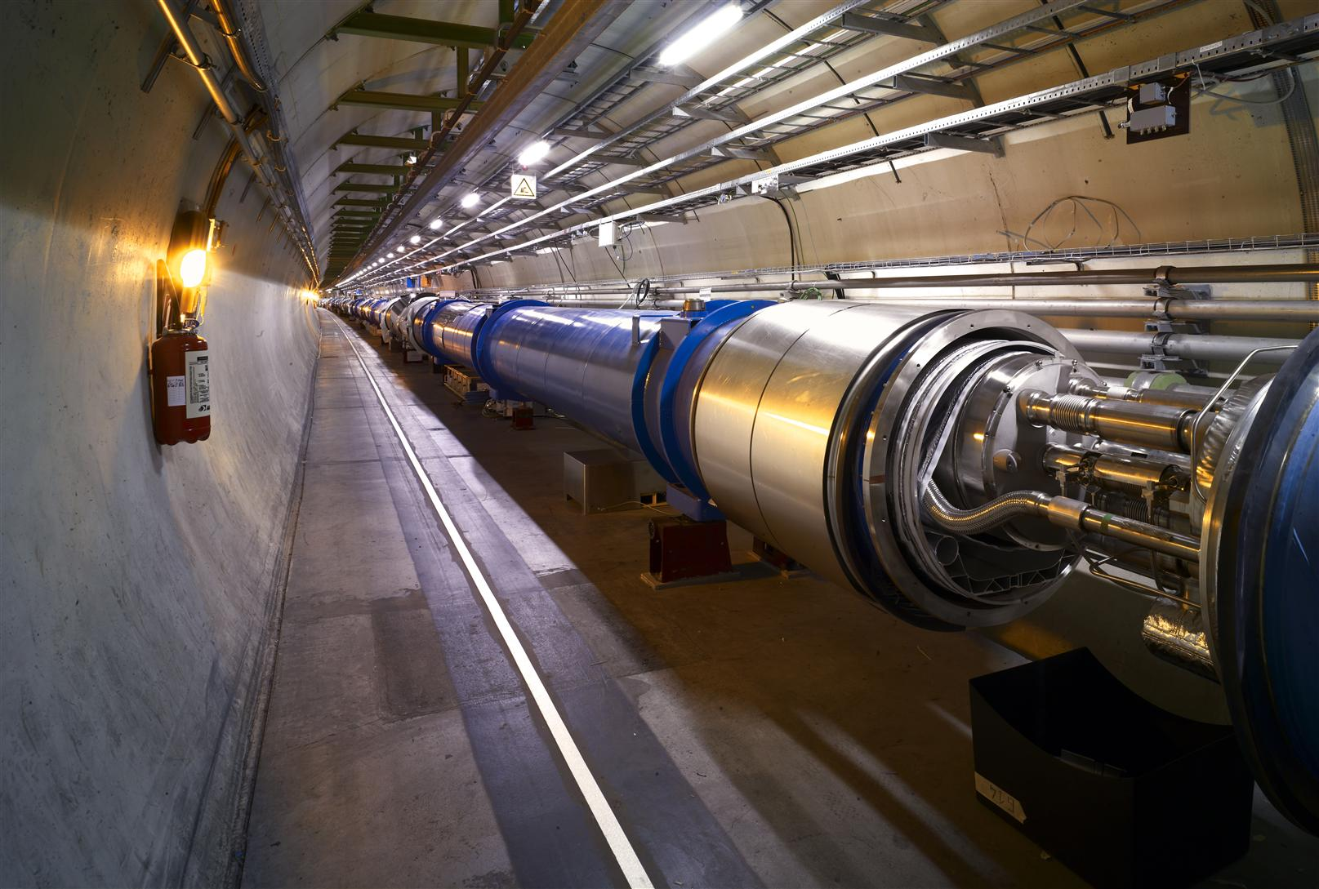
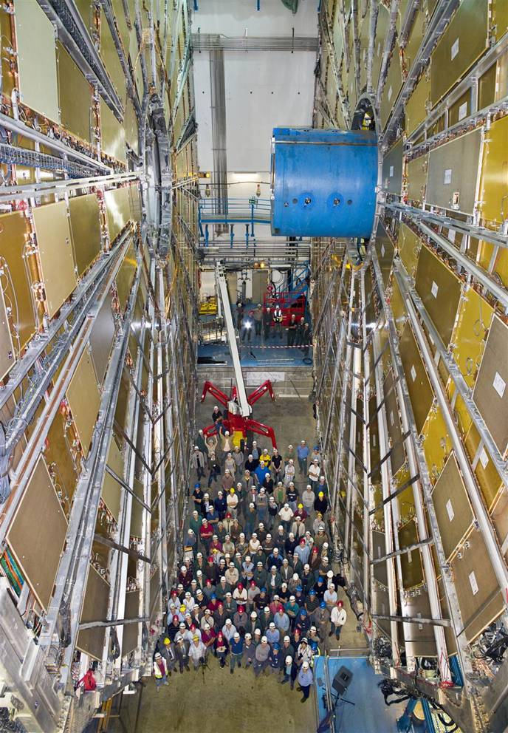
The machine, the detectors and the detectives!
CMS Experiment LHC beam pipe ATLAS experiment

Slide 14
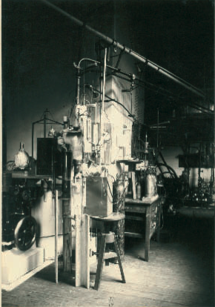
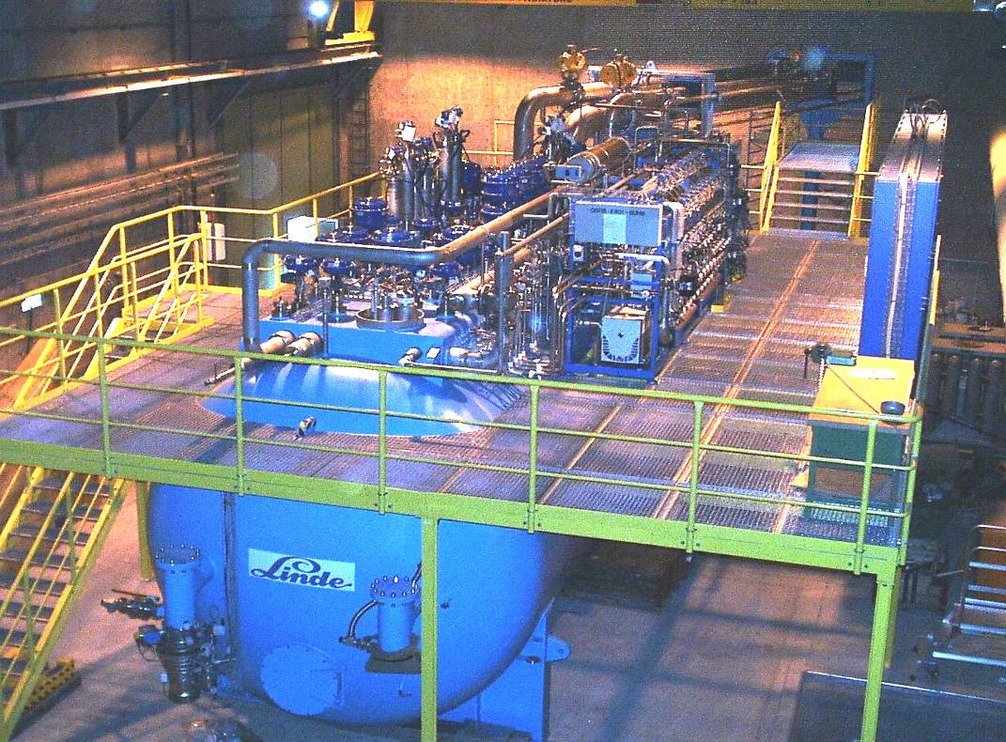
Cryogenics (1908 to 2008)
100 years ago: in July 1908 Kamerlingh Onnes first liquefied Helium in Leiden (60 ml in 1 hour)
LHC today: 32000 liters of He liquefied per hour by eight big cryogenic plants

Slide 15
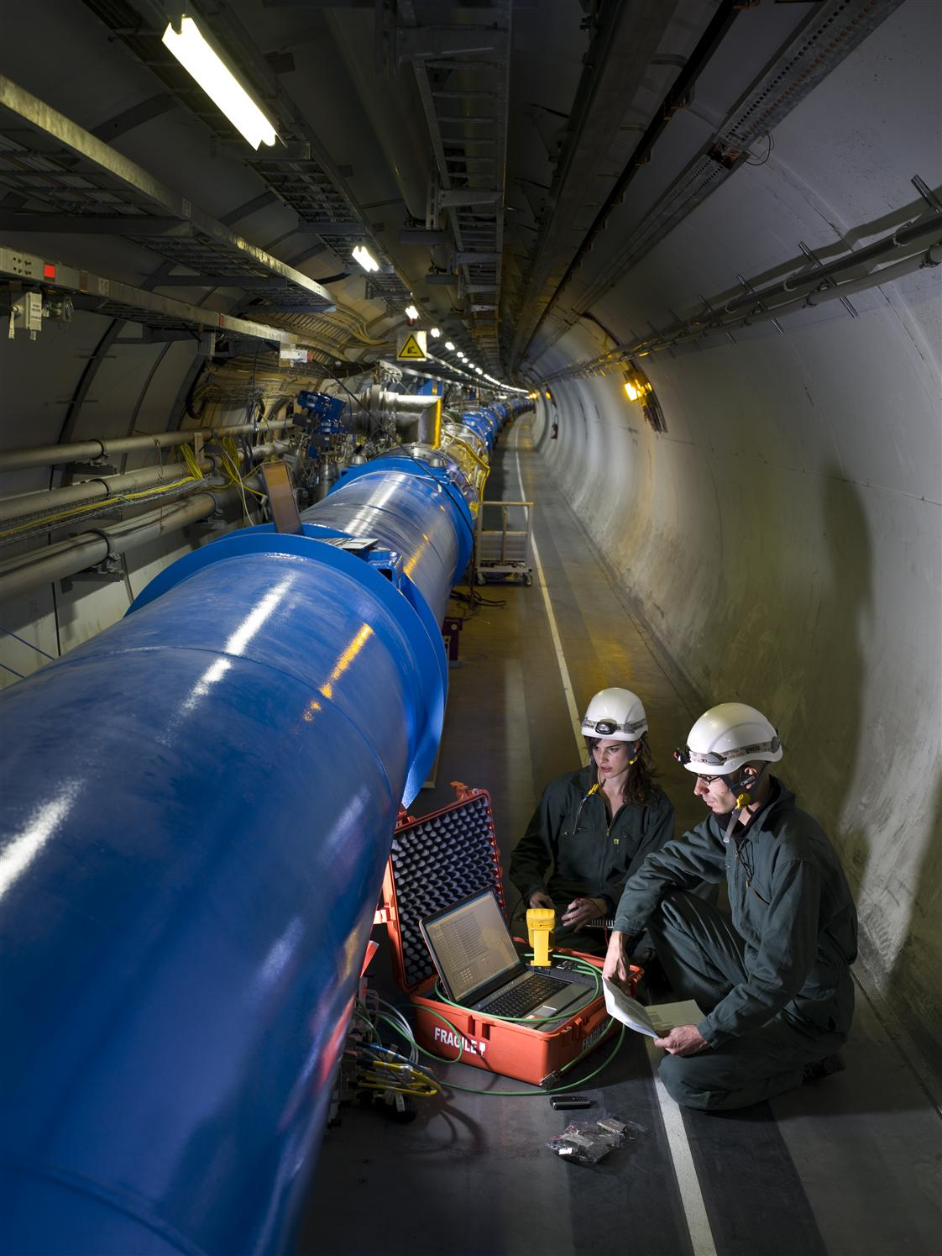
The LHC Accelerator
Protons are accelerated by powerful electric fields. And are guided around their circular orbits by powerful superconducting dipole magnets.
To reach the required energy in the existing tunnel, the s.c. dipoles operate at 8.3T (200’000 x Earth’s magnetic field) & 1.9 K (-271°C) in super-fluid helium.
Protons travel in a tube with better vacuum and colder than inter-planetary space.
Comparison with Tevatron (USA)
  Energy (14 TeV) x 7
  Luminosity (10³⁴cm⁻²s⁻¹) x 30

Slide 16
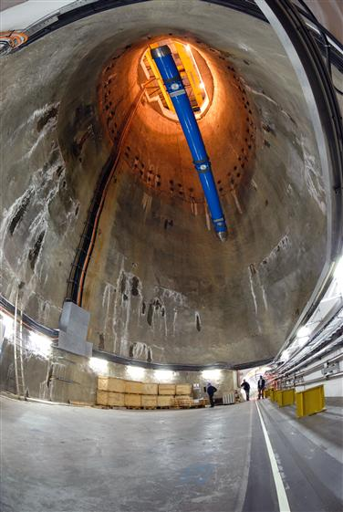
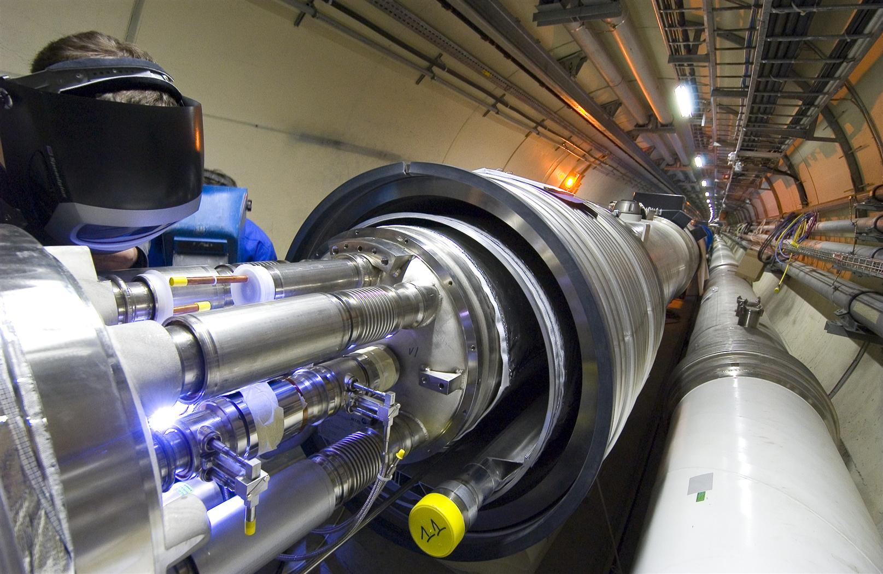
Superconducting Dipole Magnets
Superconducting magnets are cooled down in a bath of ~120 tons of super-fluid helium:
a very interesting engineering material!

Slide 17
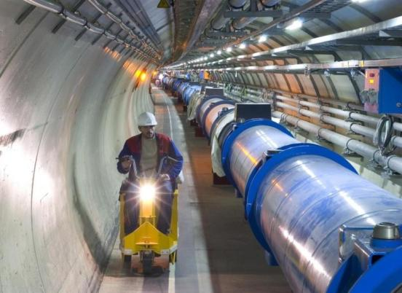
What is special with LHC machine ?
The highest field accelerator magnets: 8.3T (ultimate: 9T)
Proton-Proton machine : Twin-aperture main magnets
The largest superconducting magnet system (~8000 magnets)
The largest 1.9 K cryogenics installation (super-fluid helium)
The highest currents controlled with high precision (up to 13 kA)
The highest precision ever demanded from the power converters, a few ppm
A sophisticated and ultra-reliable magnet quench protection system

Slide 18
Fascinating facts about LHC
When the 27-km long circular tunnel was excavated, between Lake Geneva and the Jura mountain range, the two ends met up to within 1 cm.
Each of the 6400 superconducting filaments of niobium–titanium in the cable produced for the LHC is about 0.007 mm thick, about 10 times thinner than a normal human hair. If you added all the filaments together they would stretch to the Sun and back five times with enough left over for a few trips to the Moon.
All protons accelerated at CERN are obtained from standard hydrogen. Although proton beams at the LHC are very intense, only 2 nano grams of hydrogen are accelerated each day. Therefore, it would take the LHC about 1 million years to accelerate 1 gram of hydrogen.
The central part of the LHC will be the world’s largest fridge. At a temperature colder than deep outer space, it will contain iron, steel and the all important superconducting coils.
The pressure in the beam pipes of the LHC will be about ten times lower than on the Moon. This is an ultrahigh vacuum.
Each proton will go round the 27 km ring more than 11,000 times a second.
At full energy, each of the two proton beams in the LHC will have a total energy equivalent to a 400t train (like the French TGV) travelling at 150 km/h. This is enough energy to melt 500 kg of copper.
The CMS experiment magnet system contains about 10,000t of iron, which is more iron than in the Eiffel Tower.
The data recorded by each of the big experiments at the LHC will be enough to fill around 5,000,000 DVDs every year

Slide 19
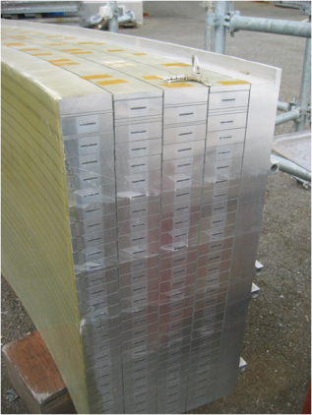
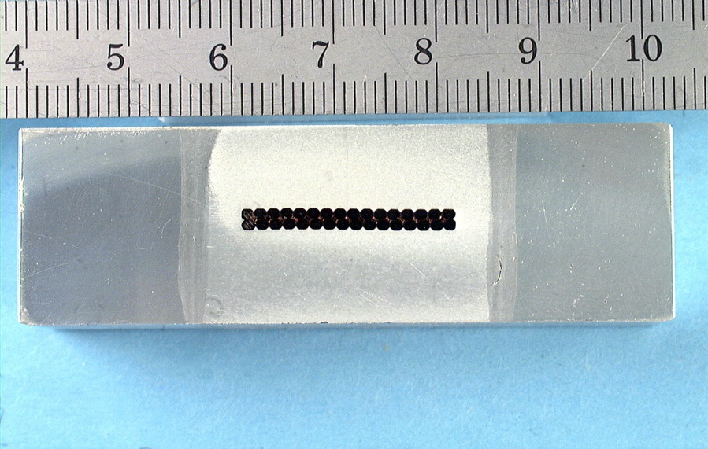
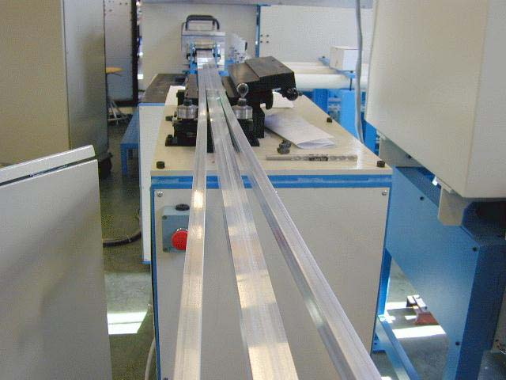
CMS Superconducting cables
Al stabilized NbTi conductor
Indirectly cooled at 4.5K by thermo siphon circuits
Inner winding vacuum impregnated with epoxy resin
Mechanically reinforced conductor (to contain magnetic forces)
4 Layers (because of needed Ampere-turns)
5 modules (to limit unit length of conductor)
SC cable
Al alloy
Al alloy
Insert Pure Al
EB welds

Slide 20
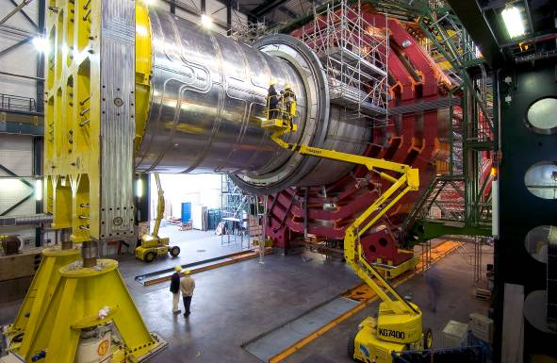
Superconducting Solenoid
13m long, 6m inner diameter; largest superconducting
solenoid ever made.
Niobium-Titanium wires
Cooled to -271ºC carry 20000 Amps to provide a 4 Tesla
magnetic field – about
100000 times stronger than
that of the earth

Slide 21
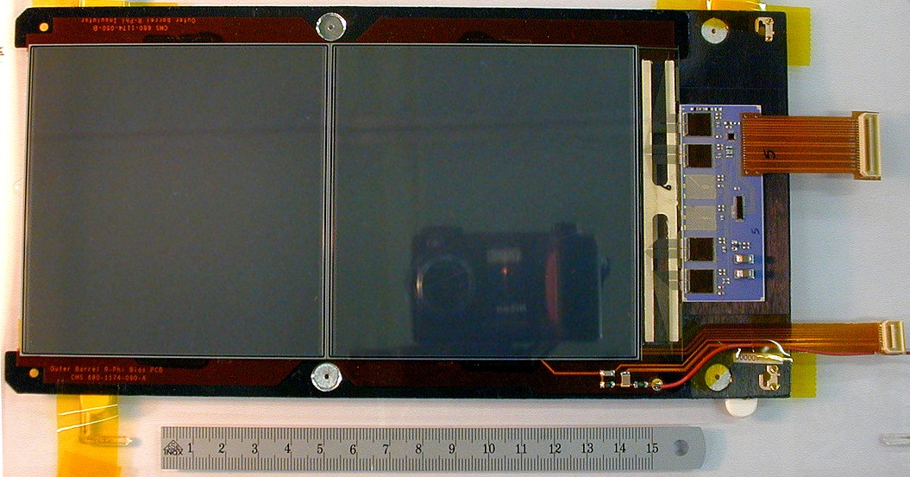
Si modules and Electronics chain
Riding on the technology wave
75k chips using
0.25μm technology
Si Sensors
Pixels: ~1 m² of silicon sensors,
65 M pixels, 100x150 μm² , r = 4, 7, 11 cm
Si μstrips: 223 m² of silicon sensors,
10 M strips, 10 pts, r = 20 – 120 cm

Slide 22
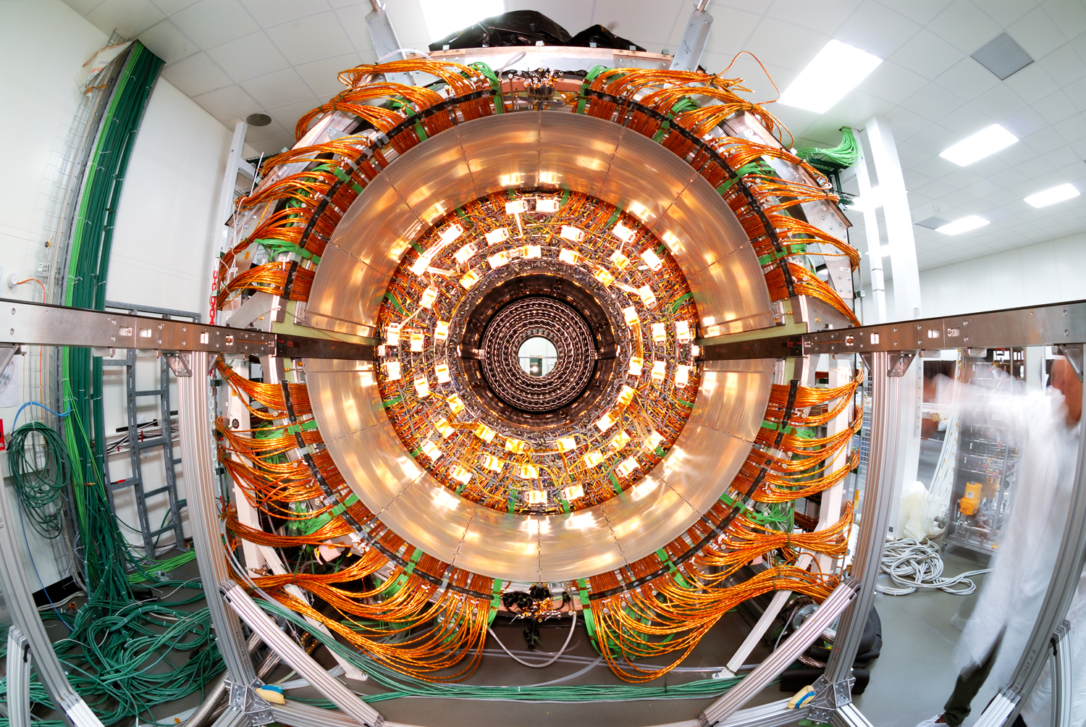
Fully assembled Si disk

Slide 23
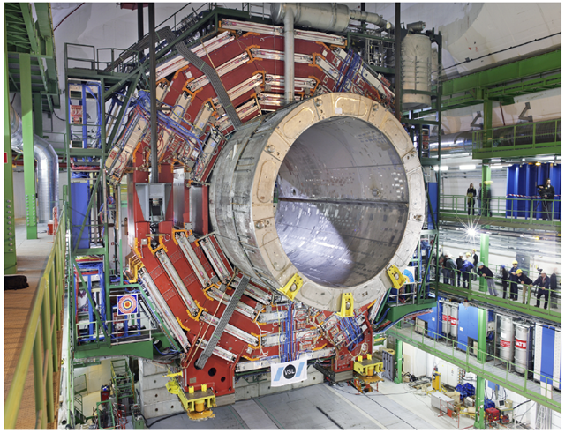
Lowering very heavy elements

Slide 24
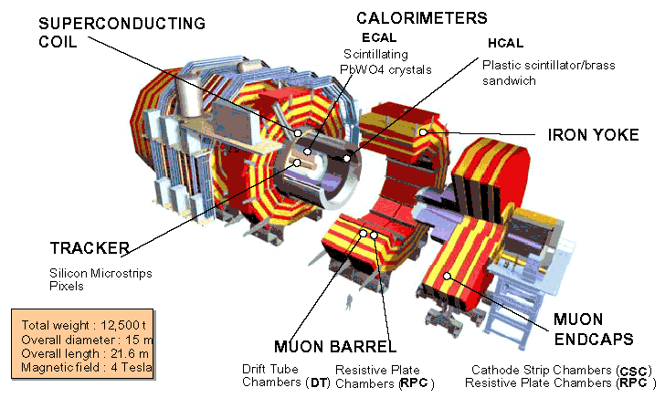
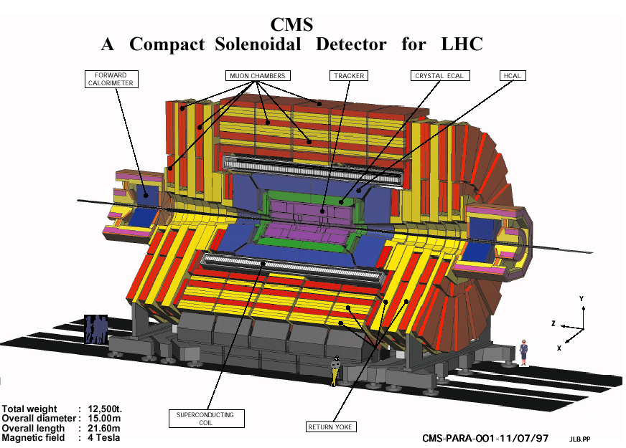
Compact Muon Solenoid (CMS) Detector

Slide 25
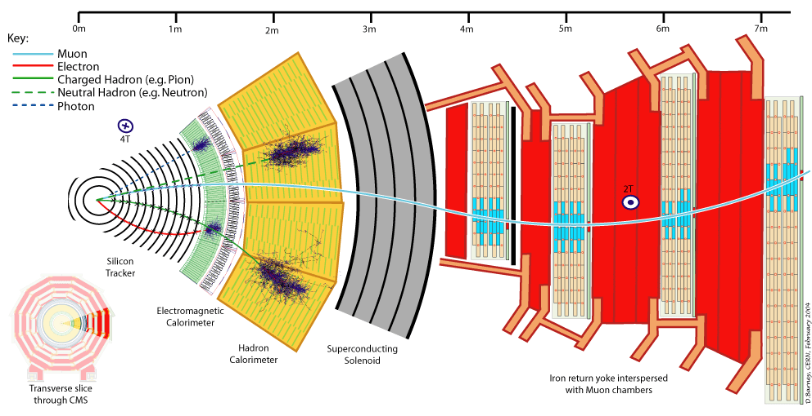
A slice of CMS experiment

Slide 26
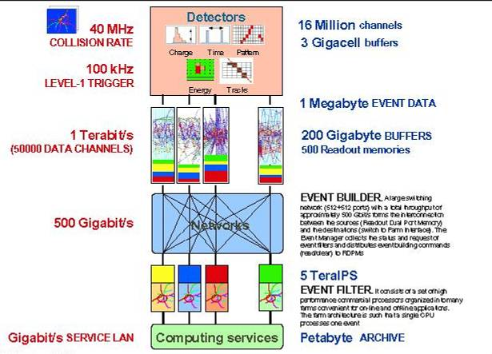
Trigger rates and data sizes

Slide 27
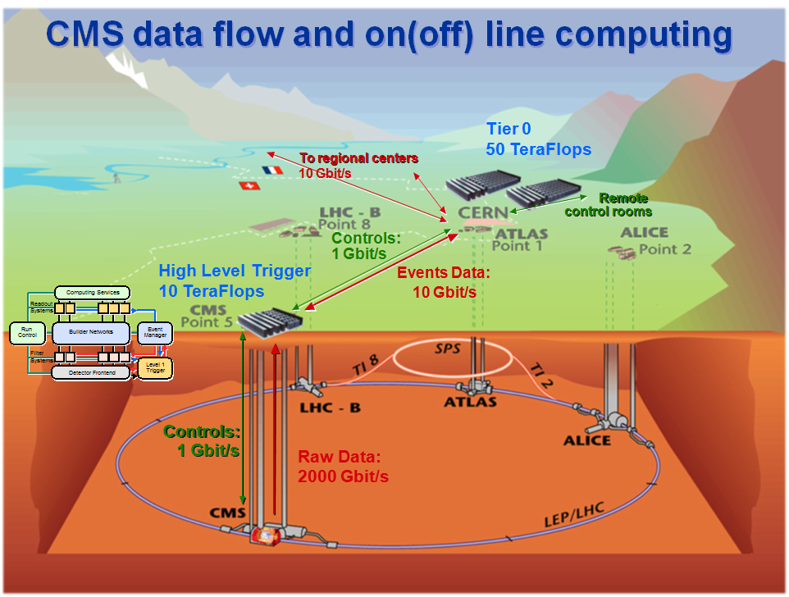
LHC Tier2 Grid computing centres for CMS and ALICE in India

Slide 28
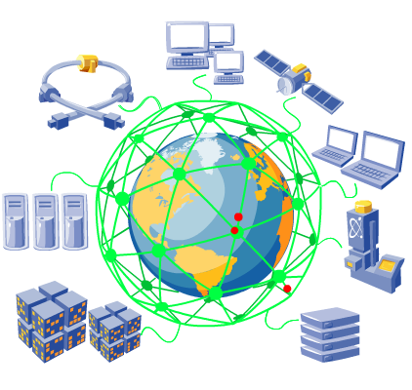
The LHC Computing Grid
The Grid unites computing resources of particle physics institutions around the world.
The World Wide Web (invented at CERN) provides seamless access to information that is stored in many millions of different geographical locations.
The Grid is an infrastructure that provides seamless access to computing power and data storage capacity distributed over the globe.

Slide 29
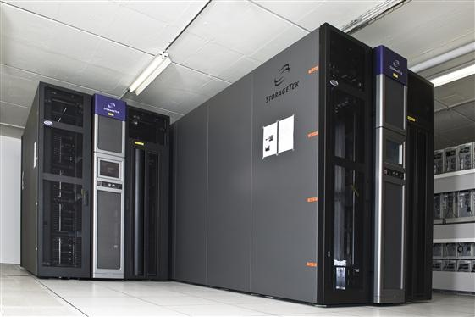
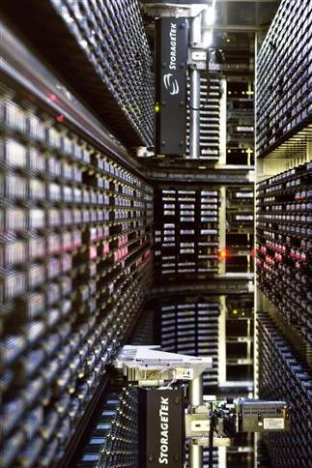
Giant computing systems
The World Wide Web (invented at CERN) provides seamless access to information that is stored in many millions of different geographical locations.
The Grid is an infrastructure that provides seamless access to computing power and data storage capacity distributed over the globe.

Slide 30
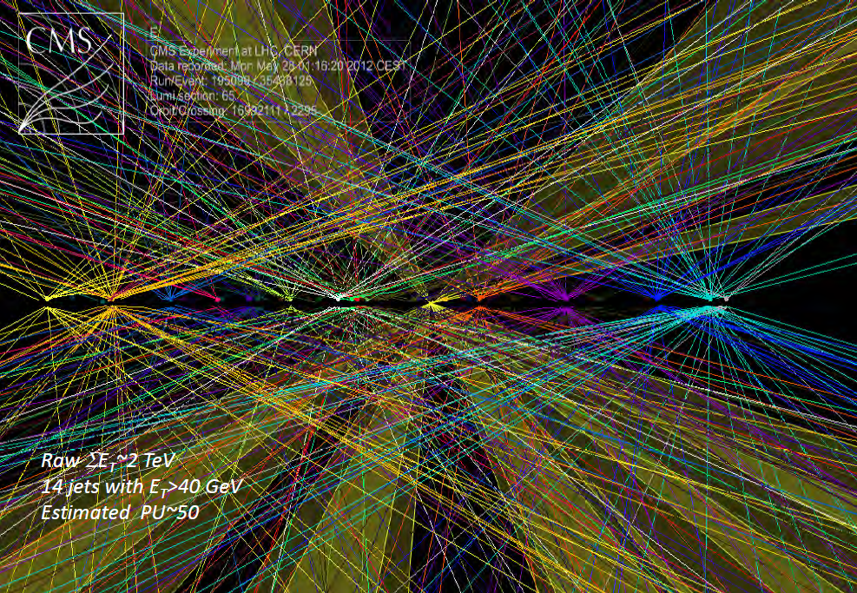
Typical event in the detector

Slide 31
Complex pattern recognition
CMS
ALICE
Physics events in CMS and ALICE experiments at LHC, CERN
Identifying useful signatures from thousands of tracks.
Highly sophisticated software algorithms were developed.
These find diverse applications in many other fields, including medical imaging etc.

Slide 32
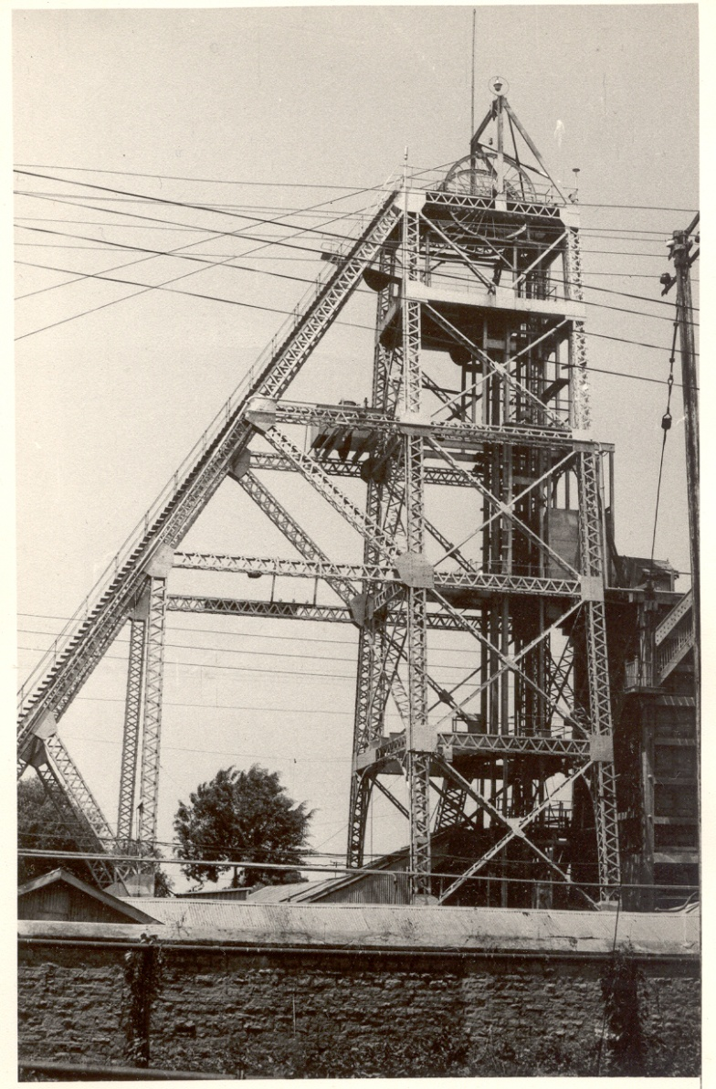
History of neutrino physics in India
India had a long tradition of carrying out High Energy Physics research using deepest underground laboratories in the world at Kolar Gold Fields during 1952-92.
Muon intensities and angular distributions at various depths were studied.
Indian initiative in neutrino physics goes back to nearly 50 years.
Demonstrated for the first time, the feasibility of doing neutrino experiments at KGF.
International collaboration experiment to detect atmospheric neutrinos started at KGF in 1964.
First atmospheric neutrino was detected at KGF at a depth of 2.3km way back in 1965 by the TIFR-Osaka-Durham group.
During early 80s dedicated detectors were setup at KGF by TIFR-Osaka collaboration to look for proton decay
Bounds on neutrino masses using cosmological data.
Estimation of atmospheric neutrino flux.
KGF underground shaft

Slide 33
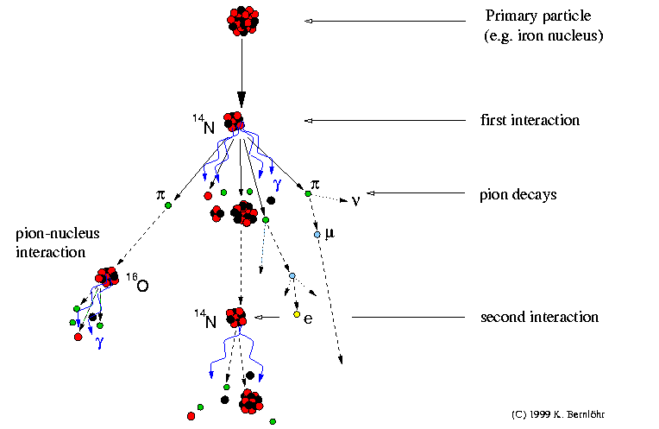
Production of cosmic rays

Slide 34
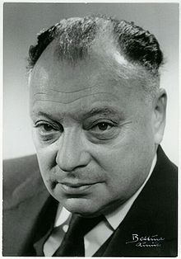
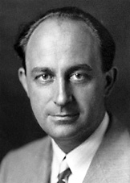
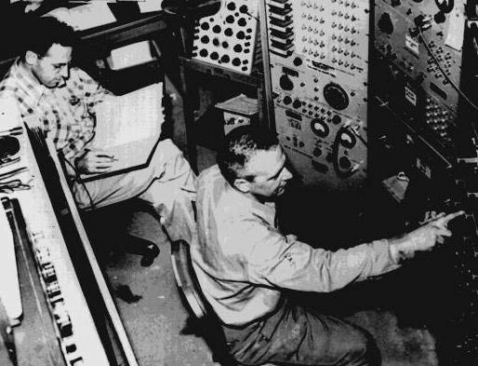
Neutrino (ν)
Proposed by Wolfgang Pauli in 1930 to explain beta decay.
Named by Enrico Fermi in 1931.
Discovered by Frederick Reines and Clyde Cowan in 1956.
Created during the Big Bang, Supernova, in the Sun, from cosmic rays, in nuclear reactors, in particle accelerators etc.
Interactions involving neutrinos are mediated by the weak force.

Slide 35

Unique features of neutrinos
The second most abundant particles in the universe
  Cosmic microware background photons: 400/cm³
  Cosmic microware background neutrinos: 300/cm³
The lightest massive particles
  A million times lighter than the electron
  No direct mass measurement yet
The most weakly interacting particles
  Invisible: Do not interact with light
  Stopping α, β, γ radiation: 50cm lead shielding
  Stopping neutrinos from the sun: Several light years!
About 100 trillion neutrinos from the sun and other such objects are going through our body every second without doing any harm.

Slide 36


Standard model of particle physics
<2.2eV
<170keV
<15.5MeV

Slide 37


Tradition of underground physics
Proton decay experiments
Atmospheric neutrino detector at Kolar Gold Fields

Slide 38





Pioneering detectors and electronics in the b/w era

Slide 39
India-based Neutrino Observatory project
The primary goal of INO is neutrino physics.
A national collaboration of scientists from more than 26 groups belonging to DAE institutions, IITs and Universities.
The total cost of the project is expected to be about Rs.1500 crores.
The project includes:
  construction of an underground laboratory and associated surface facilities,
  construction of a Iron Calorimeter (ICAL) detector for neutrinos,
  setting up of National Centre for High energy Physics (NCHEP).
The project is expected to be completed within seven years beginning April 2012.
A successful INO-Industry interface developed because of the large scale of experimental science activity involved.
INO Graduate Training Programme under the umbrella of Homi Bhabha National Institute (HBNI) - a deemed-to-be University within DAE is in its fifth year.

Slide 40

Site for the INO project
A mega science complex coming up near Madurai

Slide 41

Underground Laboratory Layout
Length of the tunnel | 2.1 km (approx.)
Tunnel cross-section | 7.5m wide and 7.5m high
Tunnel gradient | 1:15
Rock overburden | 1300m (4000 mwe)
Rock type and density | Charnockite, 2.9 gm/cc
Number of caverns | 3 (one big and two small)
Size of the main cavern | 132m × 26m × 20m (high)
Distance from CERN | 7100 km
Distance from JPARC | 6600 km
Future nuclear reactor | 9000 Mwe, 205 km
Basic features

Slide 42



ICAL detector and construction
Magnet coils
4000mm×2000mm
×56mm low carbon iron sheets
RPC handling trolleys
RPC
Total weight: 50Ktons
4832 * 3 sheets

Slide 43
Factsheet of ICAL detector
No. of modules | 3
Module dimensions | 16m × 16m × 14.5m
Detector dimensions | 48.4m × 16m × 14.5m
No. of layers | 150
Iron plate thickness | 56mm
Gap for RPC trays | 40mm
Magnetic field | 1.3Tesla
RPC dimensions | 1,950mm × 1,840mm × 24mm
Readout strip pitch | 3 0mm
No. of RPCs/Road/Layer | 8
No. of Roads/Layer/Module | 8
No. of RPC units/Layer | 192
No. of RPC units | 28,800 (97,505m²)
No. of readout strips | 3,686,400

Slide 44

Schematic of a basic RPC

Slide 45
Deployment of RPCs in running experiments
Experiment | Area (m²) | Electrodes | Gap(mm) | Gaps | Mode | Type
PHENIX | ? | Bakelite | 2 | 2 | Avalanche | Trigger
NeuLAND | 4 | Glass | 0.6 | 8 | Avalanche | Timing
FOPI | 6 | Glass | 0.3 | 4 | Avalanche | Timing
HADES | 8 | Glass | 0.3 | 4 | Avalanche | Timing
HARP | 10 | Glass | 0.3 | 4 | Avalanche | Timing
COVER-PLASTEX | 16 | Bakelite | 2 | 1 | Streamer | Timing
EAS-TOP | 40 | Bakelite | 2 | 1 | Streamer | Trigger
STAR | 50 | Glass | 0.22 | 6 | Avalanche | Timing
CBM TOF | 120 | Glass | 0.25 | 10 | Avalanche | Timing
ALICE Muon | 140 | Bakelite | 2 | 1 | Streamer | Trigger
ALICE TOF | 150 | Glass | 0.25 | 10 | Avalanche | Timing
L3 | 300 | Bakelite | 2 | 2 | Streamer | Trigger
BESIII | 1200 | Bakelite | 2 | 1 | Streamer | Trigger
BaBar | 2000 | Bakelite | 2 | 1 | Streamer | Trigger
Belle | 2200 | Glass | 2 | 2 | Streamer | Trigger
CMS | 2953 | Bakelite | 2 | 2 | Avalanche | Trigger
OPERA | 3200 | Bakelite | 2 | 1 | Streamer | Trigger
YBJ-ARGO | 5630 | Bakelite | 2 | 1 | Streamer | Trigger
ATLAS | 6550 | Bakelite | 2 | 1 | Avalanche | Trigger
ICAL | 97,505 | Both | 2 | 1 | Both | Trigger

Slide 46













Data acquisition systems for high energy physics research
200 boards of 13 types
Custom designed using
FPGA,CPLD,HMC,FIFO,SMD

Slide 47


Highly complex electronic chips:
Made for research, useful elsewhere
CMEMS is also coming up with an ASIC with similar specs.

Slide 48

RPC tomography using cosmic ray muons

Slide 49

Accelerators: developed in physics labs are used in hospitals
Hadron Therapy
Around 9000 of the 17000 accelerators operating in the World today are used for medicine.
Courtesy of IBA

Slide 50

Detectors: developed in physics labs are used for medical imagery
PET (Positron Emission Tomography) is a very important technique for localising and studying certain types of cancer using the Fluor-18 isotope produced by particle accelerators.

Slide 51
WWW:
Greatest spin-off of science
The first website built was at CERN and was first put online on 6 August 1991
Sir Timothy John "Tim" Berners-Lee

Slide 52

The cell is part of our body

Slide 53
Fundamental research:
A driving force for innovation
For GPS to work, we have to take into account the correction due to time dilation. Otherwise, there would be a position error of around 10m after just 5 minutes of travel-time!
Relativity
A. Einstein
Telephones use electromagnetic waves to communicate
Electromagnetism
J.C. Maxwell

Slide 54

Homi J Bhabha
I seriously say to you that business or job as an engineer is not the thing for me. It is totally foreign to my nature and radically opposed to my temperament and opinions. Physics is my line. I know I shall do great things here. For, each man can do best and excel in only that thing of which he is passionately fond, in which he believes, as I do, that he has the ability to do it, that he is in fact born and destined to do it. My success will not depend on what A or B thinks of me. My success will be what I make of my work. Besides, India is not a land where science cannot be carried on.
I am burning with a desire to do physics. I will and must do it sometime. It is my only ambition. I have no desire to be a “successful” man or the head of a big firm. There are intelligent people who like that and let them do it. I hear you saying “But you are not Socrates or Einstein”. No—and that is what Berlioz's father said to Berlioz. He called him a useless musician when he was young—Hector Berlioz who now accepted as one of the world's greatest geniuses and France's greatest musician. How can anybody else know at what time what one will do, if there is nothing to show. ... It is no use saying to Beethoven ”You must be a scientist for it is great thing” when he did not care two hoots for science; or to Socrates “Be an engineer; it is work of intelligent man”. It is not in the nature of things. I therefore earnestly implore you to let me do physics.

Slide 55

Philosophy of Science
To me there has never been a higher source of earthly honour or distinction than that connected with advances in science.
I seem to have been only like a boy playing on the seashore, and diverting myself in now and then finding a smoother pebble or a prettier shell than ordinary, whilst the great ocean of truth lay all undiscovered before me.
Sir Isaac Newton

Slide 56
Thank you for your attention
Best wishes for bright career

Slide 57


Slide 58


Slide 59

Significance of a result

