Slide 1
Signal Processing Electronics
B.Satyanarayana
Tata Institute of Fundamental Research, Mumbai
Contact: bsn@tifr.res.in

Slide 2
Plan of the course
Lecture – 1
Basic concepts, from signals to DAQ systems
Lecture – 2
Signal transmission, preamplifiers, shaping amplifiers, discriminators, coincidence circuits and instrumentation standards
Lecture – 3
Analog-to-Digital, Time-to-Digital Converters and modern DAQ system elements
Examples from CMS, ALICE and INO experiments

Slide 3
Lecture - I Friday, July 1, 2011
Acknowledgements & References: G.Hall, ALICE collaboration, CMS collaboration, INO collaboration, ATLAS collaboration, P.W.Nicholson, G.G.Eichholz & J.W.Poston, E.Fenyves & O.Haiman

Slide 4
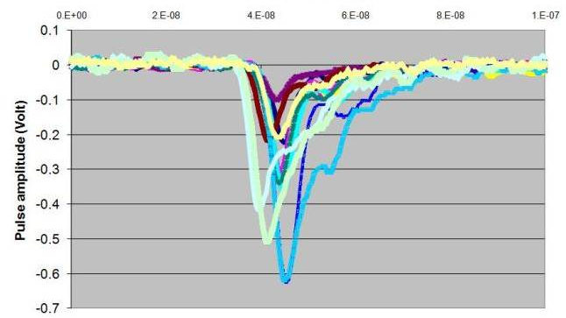
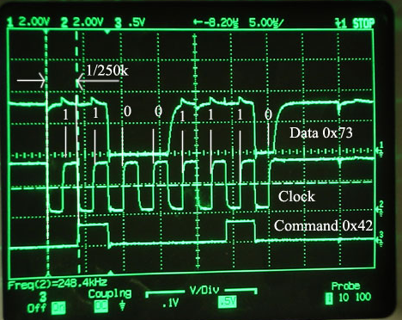
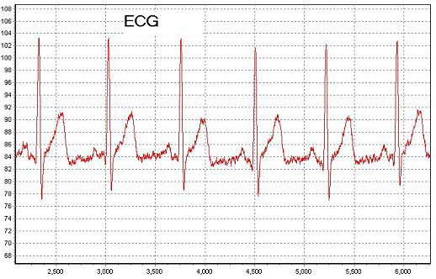
Signals
Generalised name for inputs into the instrumentation system
Might seem logical to consider signals even before the sensors, though they can not be captured or seen
Wide range of signal types are possible:
Depends on sensors
Depends on any further transformation – for ex. light to electrical
Most common types of signals:
Short, random pulses, usually current, amplitude carries information - typical of radiation sensors
Trains of pulses, often current, usually binary - typical of communication systems
Continuous, usually of slowly varying quantity – for ex. current or voltage

Slide 5
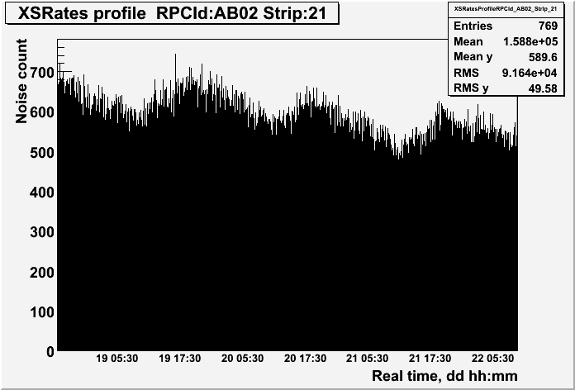
Issues on signal production
Issues in practical applications
Duration
Radiation: depends on transit time through sensor and details of charge induction process in external circuit
Linearity
Most radiation sensors are characterised or chosen for linearity
Commercial components can expect non-linearity, offset and possible saturation
Reproducibility
Many signals are temperature dependent in magnitude - mobility of charges, other effects easily possible as well
Ageing
Sensor signals can changed with time for many reasons
Natural degradation of sensor, variation in operating conditions, radiation damage, etc.
All these issues mean that one should always be checking or calibrating measurements intended for accuracy, as best one can

Slide 6
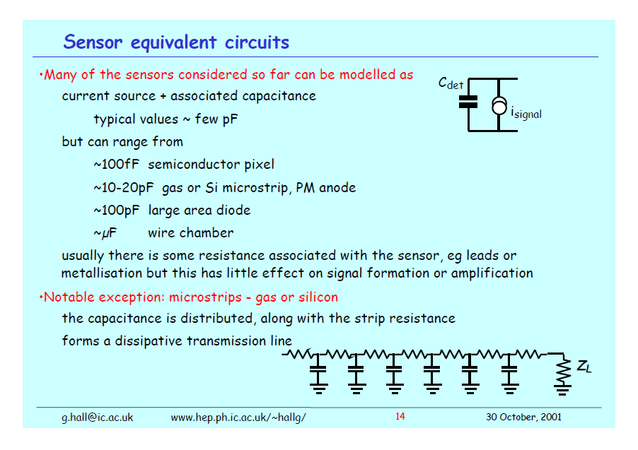
Sensor equivalent circuits
Many of the sensors considered so far can be modelled as current source + associated capacitance of typical values ~ few pF
But the capacitance of detectors vary considerably:
100fF for semiconductor pixel
10-20pF for gas or Si microstrip, PM anode
100pF for large area diode
μF for wire chamber
Usually there is some resistance associated with the sensor, for ex. leads or metallisation but this has little effect on signal formation or amplification
Notable exceptions: microstrips - gas or silicon
The capacitance is distributed, along with the strip resistance
Forms a dissipative transmission line

Slide 7
Dynamic range of signals
In most systems, there will be a smallest measurable signal
If there is noise present, it is most likely to be related to the smallest signal distinguishable from noise
and a largest measurable signal
most likely set by apparatus or instrument, eg. saturation
Dynamic range = ratio of largest to smallest signal often expressed in dB or bits
For ex. 8 bits = dynamic range is 256₁₀ = 48dB (if signal is voltage)
Decibels (dB)
Signal magnitudes cover wide range, so frequently logarithmic scale is preferred.
Number of dB = 10log₁₀(P₂/P₁)
Often measuring voltages in system: dB =20 log₁₀(V₂/V₁)

Slide 8
Precision of signal measurement
Many measurements involve detection of particle or radiation quantum (photon)
Simple presence or absence sometimes sufficient = binary (0 or 1)
Other measurements are of energy
Why do we need such observations?
Primary measurement may be energy
Ex. medical imaging using gammas or high energy x-rays, astro-particle physics
Extra information to improve data quality
Removes experimental background, for ex. Compton scattered photons mistaken for real signal
Optical communications - pressure to increase “bandwidth” – eg. number of telephone calls carried per optical fibre
Wavelength division multiplexing - several “colours” or wavelengths in same fibre simultaneously

Slide 9
ALICE experiment
The ALICE Collaboration built a dedicated heavy-ion detector to exploit the unique physics potential of nucleus-nucleus interactions at LHC energies. Their aim is to study the physics of strongly interacting matter at extreme energy densities, where the formation of a new phase of matter, the quark-gluon plasma, is expected.
The existence of such a phase and its properties are key issues in QCD for the understanding of confinement and of chiral-symmetry restoration.
For this purpose, they intend to carry out a comprehensive study of the hadrons, electrons, muons and photons produced in the collision of heavy nuclei.
Alice will also study proton-proton collisions both as a comparison with lead-lead collisions and in physics areas where Alice is competitive with other LHC experiments.

Slide 10
Detectors of the ALICE experiment
The Overview
First one needs to know the initial conditions, namely how powerful the collision was: this is done by measuring the remnants of the colliding nuclei in detectors made of high density materials located about 110 meters on both sides of ALICE (the ZDC’s) and by measuring with the FMD, V0 and T0 the number of particles produced in the collision and their spatial distribution. T0 also measures with high precision the time when the event takes place.
Tracking particles
An ensemble of cylindrical detectors (from inside out: ITS Pixels (ITS Drift, ITS Strips, TPC, TRD) measures at many points (over 100 just the TPC ) the passage of each particle carrying an electric charge, so that its trajectory is precisely known. The ALICE tracking detectors are embedded in a magnetic field (produced by the huge red magnet!) bending the trajectories of the particles: from the curvature of the tracks one can find their momentum. The ITS is so precise that particles which are generated by the decay of other particles with a very short life time can be identified by seeing that they do not originate from the point where the interaction has taken place (the “vertex” of the event) but rather from a point at a distance of as small as a tenth of a millimeter.
The particles' Identity
ALICE also wants to know the identity of each particle, whether it is an electron, or a proton, a kaon or a pion. In addition to the information given by ITS and TPC, more specialized detectors are needed: the TOFmeasures, with a precision better than a tenth of a billionth of a second, the time that each particle takes to travel from the vertex to reach it, so that one can measure its speed, while the HMPID measures the faint light patterns generated by fast particles and the TRD measures the special radiation very fast particles emit when crossing different materials, thus allowing to identify electrons. Muons are measured by exploiting the fact that they penetrate matter more easily than most other particles: in the forward region a very thick and complex absorber stops all other particles and muons are measured by a dedicated set of detectors: the muon spectrometer.
Catching Photons
The photons (particles of light), like the light emitted from a hot object, tell us about the temperature of the system. To measure them, special detectors are necessary: the crystals of the PHOS, which are as dense as lead and as transparent as glass, will measure them with fantastic precision in a limited region, while the PMD and in particular the EMCal will measure them over a very wide area. The EMCal will also measure groups of close particles (called “jets”) which have a memory of the early phases of the event.

Slide 11
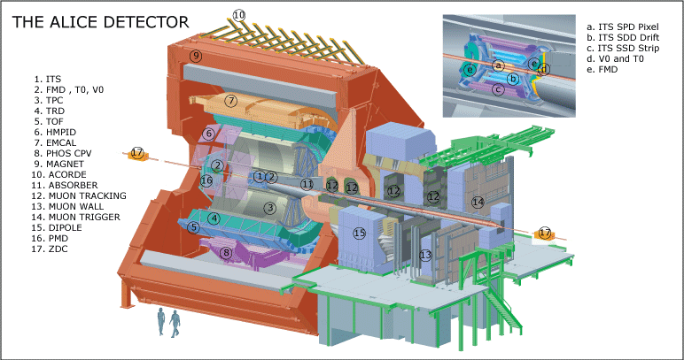
ALICE experiment

Slide 12
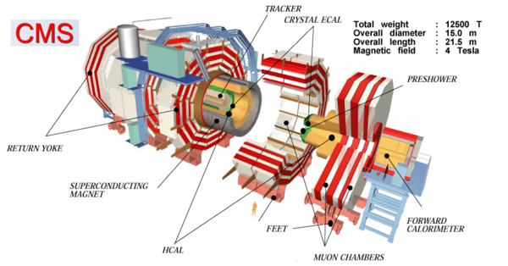
CMS experiment

Slide 13
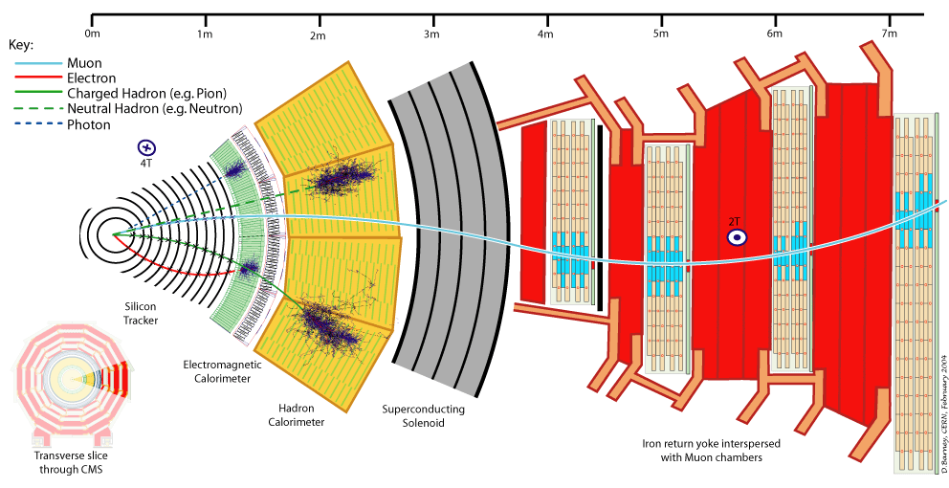
A slice of CMS experiment

Slide 14
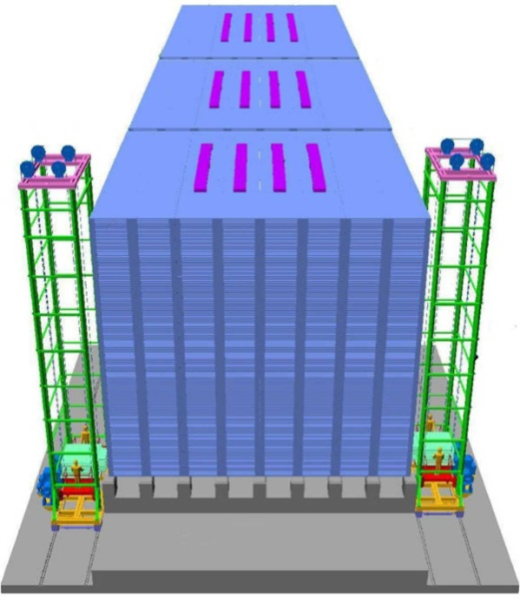
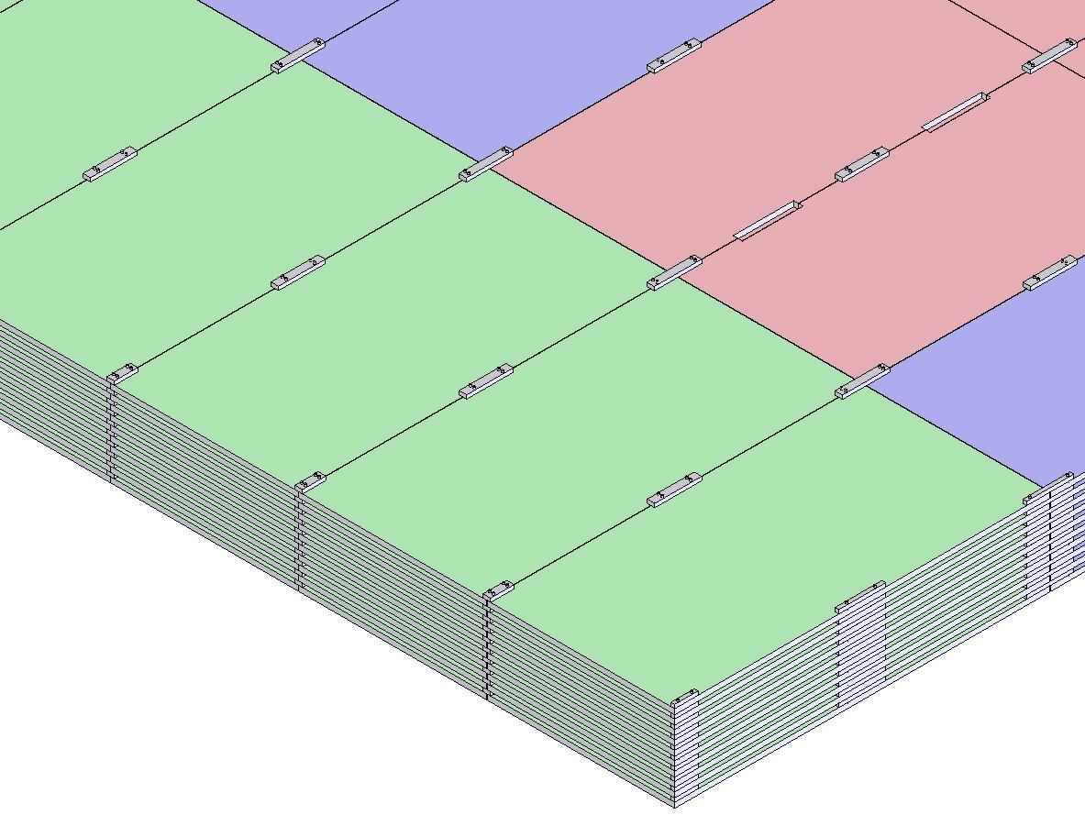
INO's ICAL detector
Magnet coils
4000mm × 2000mm
× 56mm low carbon iron sheets
RPC handling trolleys
Total weight: 50Ktons

Slide 15
Factsheet of ICAL detector
No. of modules | 3
Module dimensions | 16m × 16m × 14.5m
Detector dimensions | 48.4m × 16m × 14.5m
No. of layers | 150
Iron plate thickness | 56mm
Gap for RPC trays | 40mm
Magnetic field | 1.3Tesla
RPC dimensions | 1,950mm × 1,840mm × 26mm
Readout strip pitch | 30mm
No. of RPCs/Road/Layer | 8
No. of Roads/Layer/Module | 8
No. of RPC units/Layer | 192
No. of RPC units | 28,800 (97,505m²)
No. of readout strips | 3,686,400

Slide 16
Electronic requirements for detectors
Detector | Physics | Technical
Tracking | High spatial precision Large channel count Limited energy precision Limited dynamic range | Low power ~mW/channel High radiation levels ~10Mrad
Calorimeter (EM/Hadron) | High energy resolution Large energy range Excellent linearity Very stable over time | Intermediate radiation levels ~0.5Mrad Power constraints
Muon | Very large area Moderate spatial resolution Accurate alignment & stability | Low radiation levels

Slide 17
Measurements & measuring elements
Some primary and some derived
Light
Energy
Charge/Current
Pulse shape
Pulse height/Voltage
Relative timing
Position/Particle track
Amplifiers and Comparators
Analog to Digital Converters
Charge to Digital Converters
Time to Digital Converters
Waveform digitisers
Latches and Registers
Memories
Logic/trigger systems
Hybrids

Slide 18
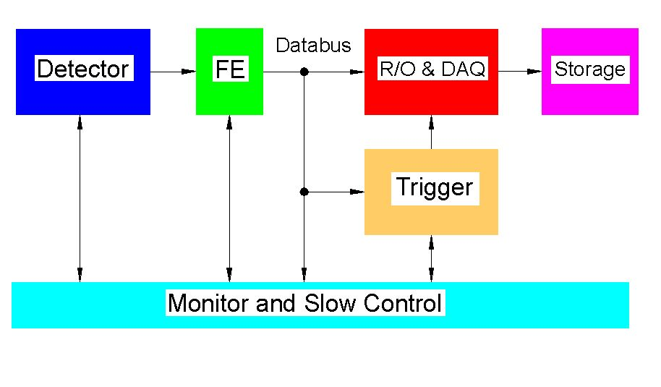
Concept of HEP instrumentation

Slide 19
Amplifier systems for spectroscopy
Typical application - precise measurements of x-ray or gamma-ray energies
Pre-amplifier - first stage of amplification
Main amplifier - adds gain and provides bandwidth limiting
ADC - analog to digital conversion - signal amplitude to binary number
Fast amplifier and logic
Start ADC ("gate") and flag interesting "events" to DAQ system
Most signals arrive randomly in time.
Other logic required to maximise chance of "good" event, ex. second detector

Slide 20
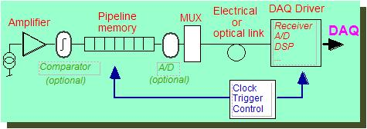
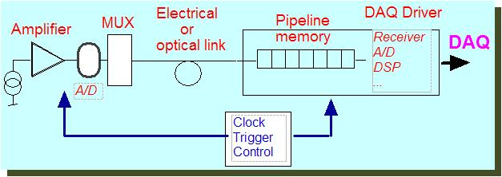
Generic HEP detector readout systems
Functions required by all systems
Amplification and filtering
Analog to digital conversion
Association to beam crossing
Storage prior to trigger
Dead time free readout
Pre-DAQ storage
Calibration
Control
Monitoring
Calorimeter and muon detector functions
First level trigger primitive generation
Optional
Location of digitisation & memory

Slide 21
ALICE trigger and DAQ systems
For every bunch crossing in the LHC machine, the Central Trigger Processor (CTP) decides within less than one microsecond whether to collect the data resulting from a particular collision.
The trigger decision is distributed to the front-end electronics (FEE) of each detector via the corresponding Local Trigger Unit (LTU) and an optical broadcast system: the Trigger, Timing and Control system (TTC).
Upon reception of a positive decision, the data are transferred from the detectors over the 400 optical Detector Data Links (DDL) via PCI adapters (RORC) to a farm of 300 individual computers; the Local Data Concentrator/Front-End Processors (LDC/FEP).
The several hundred different data fragments corresponding to the information from one event are checked for data integrity, processed and assembled into sub events.
These sub events are then sent over a network for the event building to one of the 40 Global Data Collector computers (GDC), which can process up to 40 different events in parallel.
20 Global Data Storage Servers (GDS) store the data locally before their migration and archive in the CERN computing center where they become available for the offline analysis.
The hardware of the ALICE DAQ system is largely based on commodity components: PC's running Linux and standard Ethernet switches for the event building network. The required performances are achieved by the interconnection of hundreds of these PC's into a large DAQ fabric.
The software framework of the ALICE DAQ is called DATE (ALICE Data Acquisition and Test Environment). DATE was used during the construction and testing phase of the experiment, while evolving gradually towards the final production system.

Slide 22
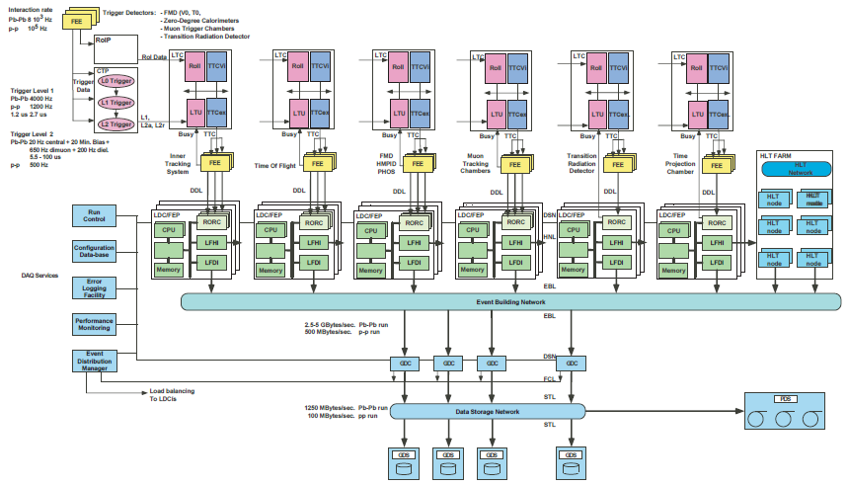
ALICE DAQ system

Slide 23
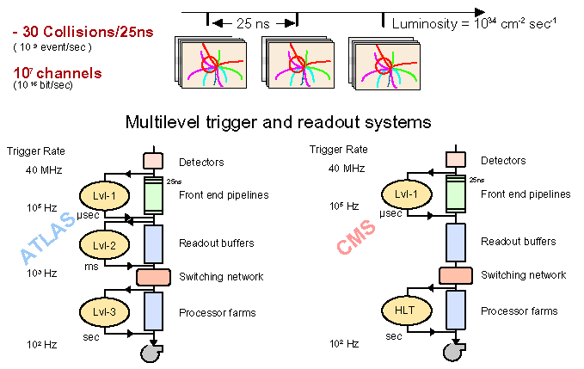
ATLAS/CMS Trigger architectures

Slide 24
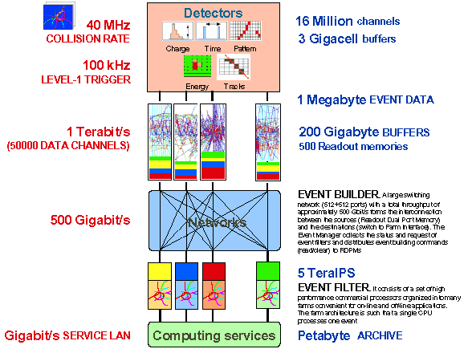
Principle of CMS DAQ

Slide 25
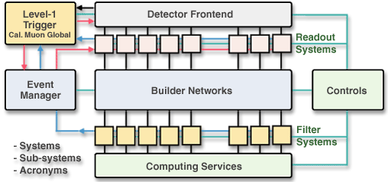
DAQ scheme of CMS experiment

Slide 26
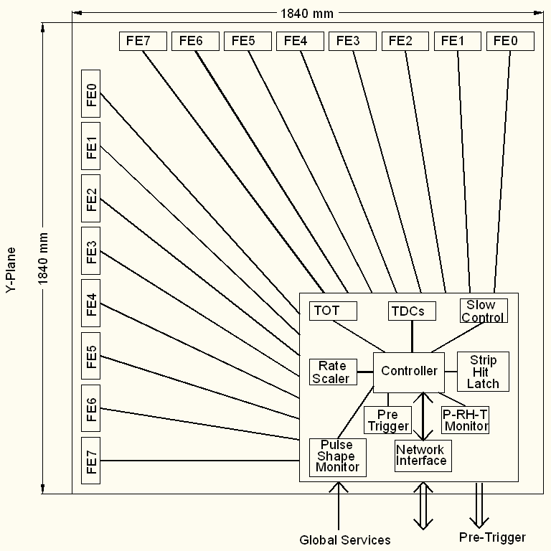
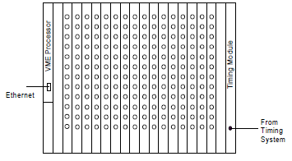
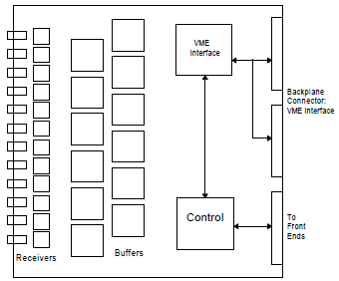
Functional diagram of ICAL DAQ
On detector
Back-end

Slide 27
Lecture - II Saturday, July 2, 2011
Acknowledgements & References: G.Hall, W.R.Leo, ALICE collaboration, M.C.S.Williams, L.B.Robinson, G.F.Knoll

Slide 28
Transmission of data
•Real systems are often distributed
Data source is remote from signal processing
Instruments in hazardous or very remote environment
Eg. satellites, HEP, nuclear reactors,..,
But also applies to much shorter distances - like nearby labs or instruments in the same room
Need to transfer data from source to receiver
And usually send messages (eg. control signals) back
Need to understand
Practical ways of doing this
Issues: power, speed, noise,… other physical constraints
Methods - a mixture
Electrical, but increasing use of optical fibres,
Radio for satellites and space, mobile telephones,...

Slide 29
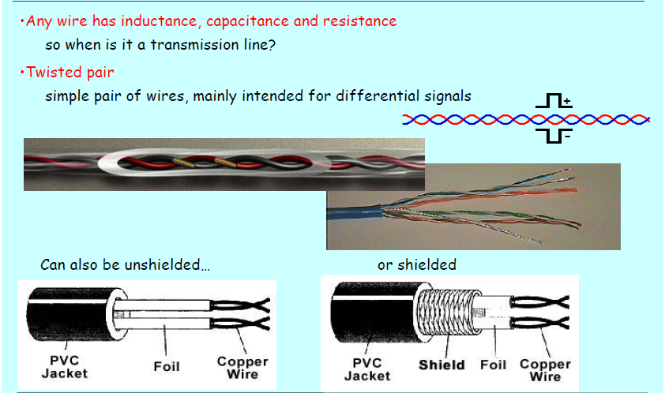
Cables

Slide 30
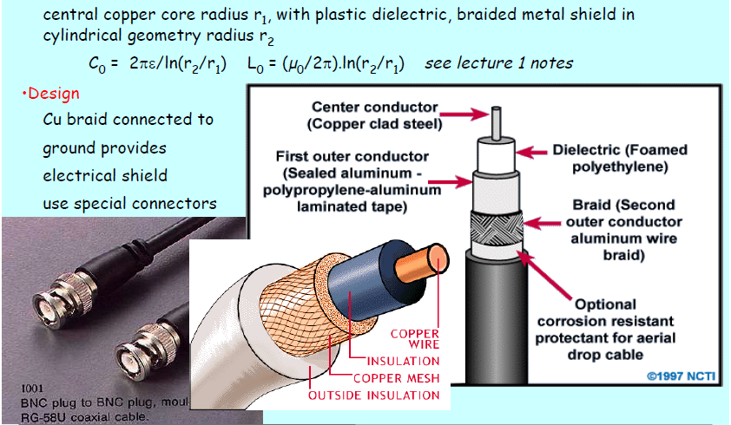
Coaxial cable

Slide 31
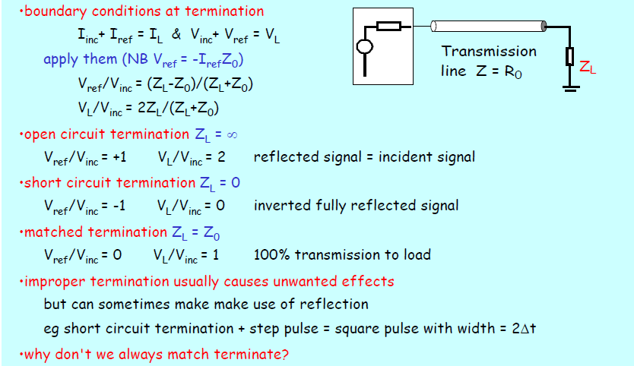
Termination and Matching

Slide 32
To match or not? (i)
Impedance matching is a general question, not only for transmission lines
Match if
to transfer maximum power to load (source must be capable)
eg audio speakers
minimise reflections from load
very important in audio, fast (high frequency) systems, to avoid ringing
or multiple pulses (eg in counting systems)
fast pulses
pulse properties can contain important information
usually don't want to change
sometimes we wish to do this with "too fast" signals - "spoiling"
Usually match by choosing impedances, adding voltage buffers
transformer matching is another method if this is impractical

Slide 33
To match or not? (ii)
Don't match if
High impedance source with small current signals - typical of many sensors
photodiode, or other sensors must drive high impedance load
short cables are required to avoid difficulties
Weak voltage source, where drawing power from source would affect result
eg bridge circuits
require to change properties of fast pulse
eg pulse widening for ease of detection
electronics with limited drive capabilities
eg logic circuits, many are designed to drive other logic, not long lines
CMOS circuits, even with follower, are an example
If you get this wrong, often end up with new time constants in the system
or prevent system from working at all, eg diode with low R load

Slide 34
Coaxial cable limits
Transmission speed and bandwidth limiting
all cables have finite resistance (though remarkably small)
for long cables, RC time constant per unit length becomes noticeable
therefore expect delay, attenuation and finite rise time in fast pulses
When is a cable a transmission line?
not reasonable to assume transmission line behaviour unless length of line is at least ~ 1/8 wavelength
Other forms of transmission line
in high speed circuits, tracks must be laid out carefully using knowledge of the characteristics of the boards to control delays, rise times and signal velocities
eg parallel tracks,...
often need measurement to define parameters precisely
ultra high frequencies need waveguides or alternative

Slide 35
Amplifiers
Inescapable in electronic instruments
amplifiers are needed for many instruments
even if not used to boost signals, amplifiers are the basis of most important functional blocks
In many circumstances amplification, in the sense of “boosting” signals, is vital
signals to be measured or observed are often small
defined by source - or object being observed
and sensor - it is not usually easy to get large signals
data have to be transferred over long distances without errors
safest with “large” signals

Slide 36
Amplifiers in systems
Amplification
Role of preamplifier
single gain stage rarely sufficient
add gain to avoid external noise eg to transfer signals from detector
practical designs depend on detailed requirements
constraints on power, space,… cost in large systems
e.g. ICs use limited supply voltage which may constrain dynamic range
Noise will be an important issue in many situations
most noise originates at input as first stage of amplifier dominates
often refer to Preamplifier = input amplifier
may be closest to sensor, subsequently transfer signal further away
In principle, several possible choices
V sensitive (Conventional)
I sensitive (Used with low impedance detectors)
Q sensitive (Used with semiconductor detectors)

Slide 37
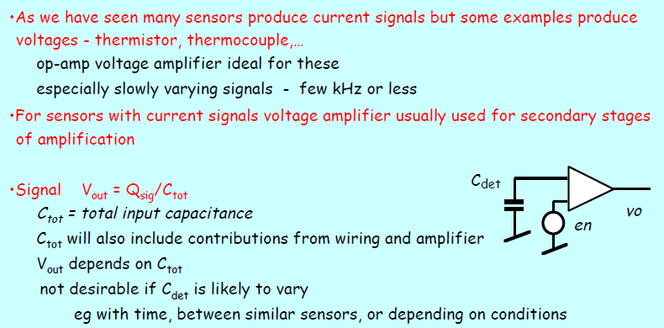
Voltage sensitive amplifier

Slide 38
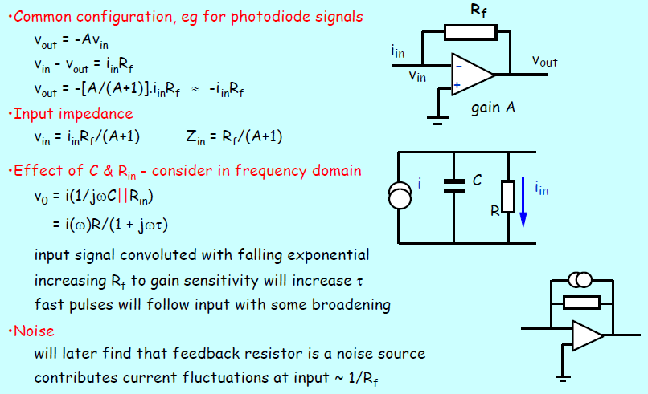
Current sensitive amplifier

Slide 39
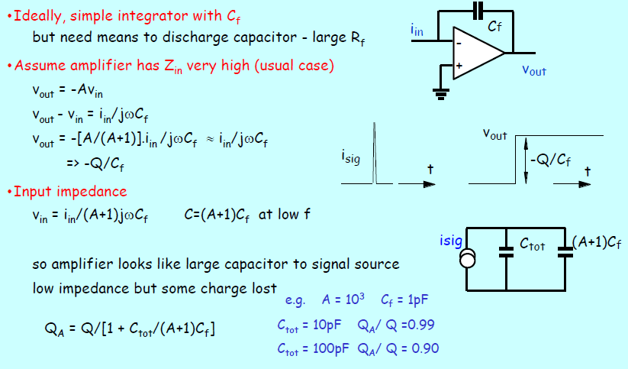
Charge sensitive amplifier

Slide 40
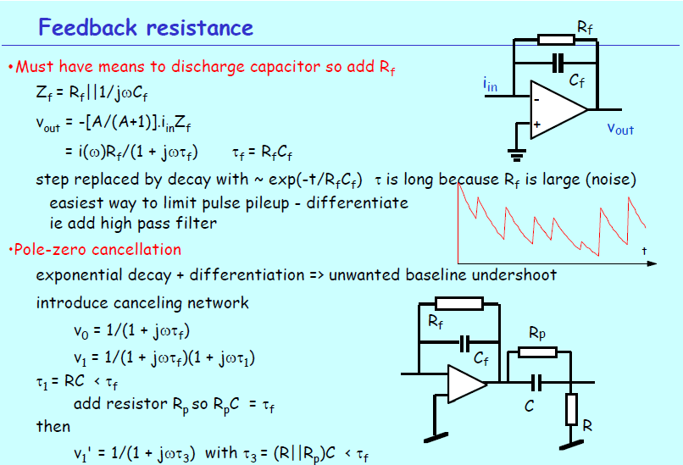

Slide 41
Pulse shaping
Amplifiers must preserve the information of interest
If timing required: fast response
If pulse height required: strict proportionality, limit bandwidth
Preamplifier pulse
Exponential with long tail
Pulse pileup: Reduce counting rate or reshape
Optimization of signal-to-noise ratio
For a given noise spectrum, there exists an optimum pulse shape to improve the S/N
For ex: Tail pulses in presence of typical noise spectra are not ideal
Triangular or Gaussian – symmetric pulse shapes are ideal
Fast amplifiers: No or very little shaping
What to do in case you need good timing and pulse height information?

Slide 42
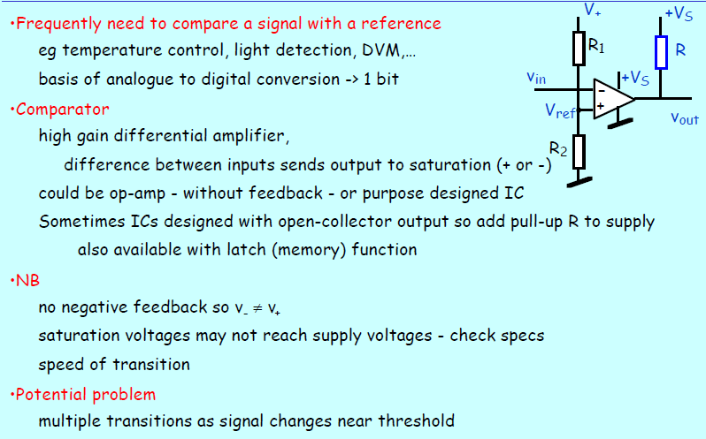
Discriminators

Slide 43
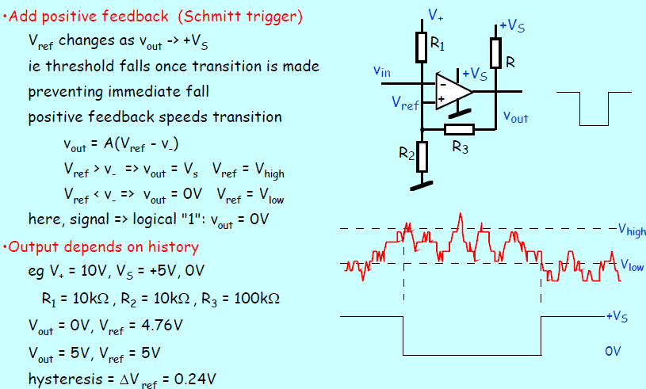
Hysteresis

Slide 44
Considerations for discriminators
Two common problems
Walk
Jitter
Time-Pickoff methods
Leading edge triggering
Fast zero-crossing triggering
Constant fraction triggering
Amplitude and risetime compensated triggering

Slide 45
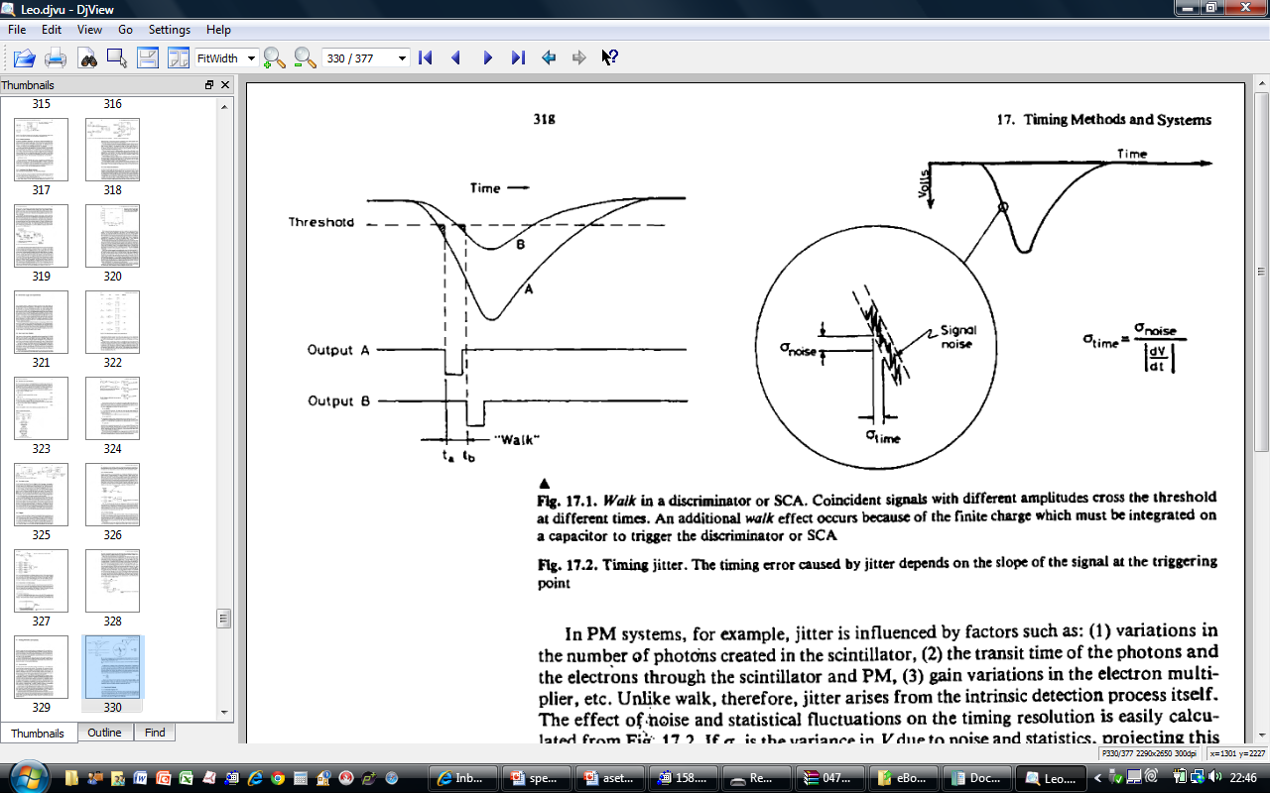
Timewalk and jitter

Slide 46
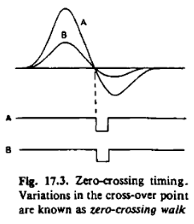
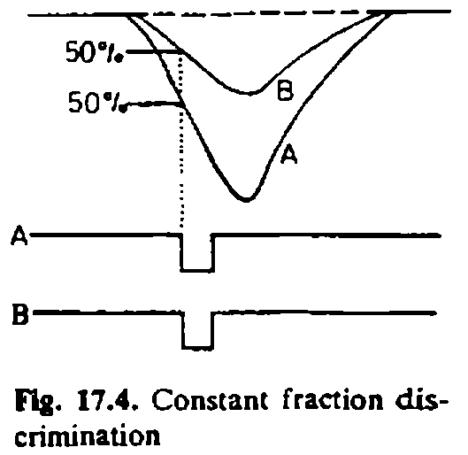
Zero-crossing and Constant fraction

Slide 47
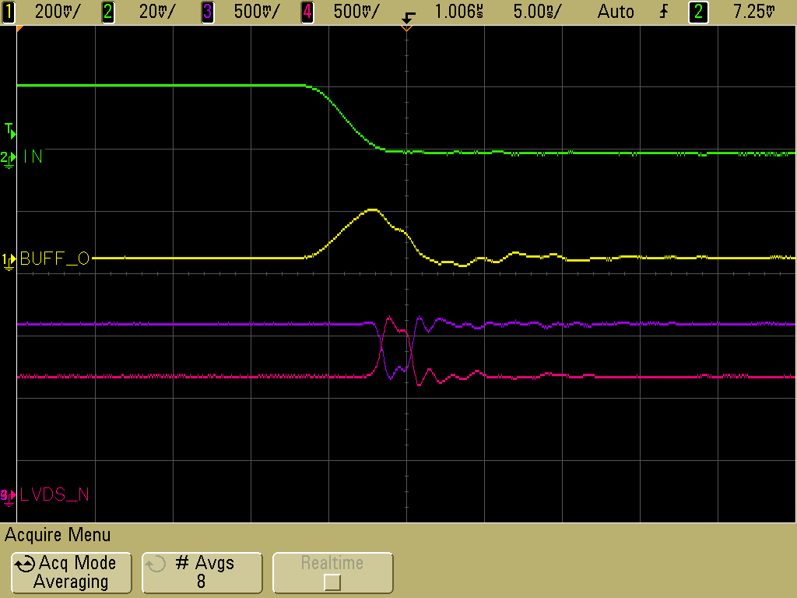
Functional diagram of FE ASIC
Common threshold
Ch-0
Regulated Cascode Transimpedance Amplifier
Differential Amplifier
Comparator
LVDS output driver
LVDS_out0
Channel-0
8:1 Analog Multiplexer
Output Buffer
Amp_out
Channel-7
Ch-7
Regulated Cascode Transimpedance Amplifier
Differential Amplifier
Comparator
LVDS output driver
LVDS_out7

Slide 48
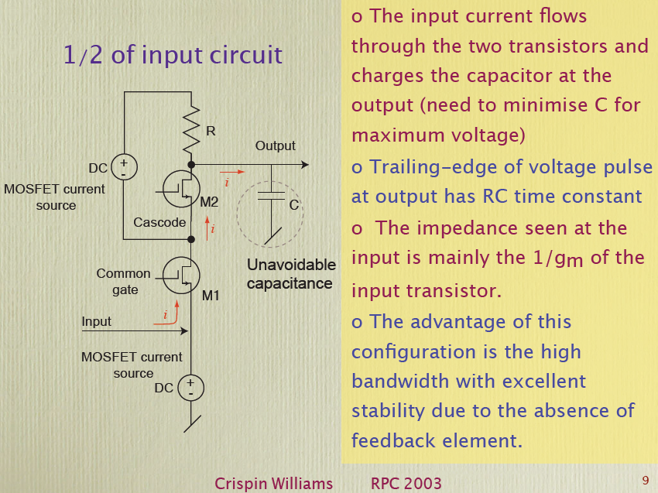
NINO Input stage

Slide 49
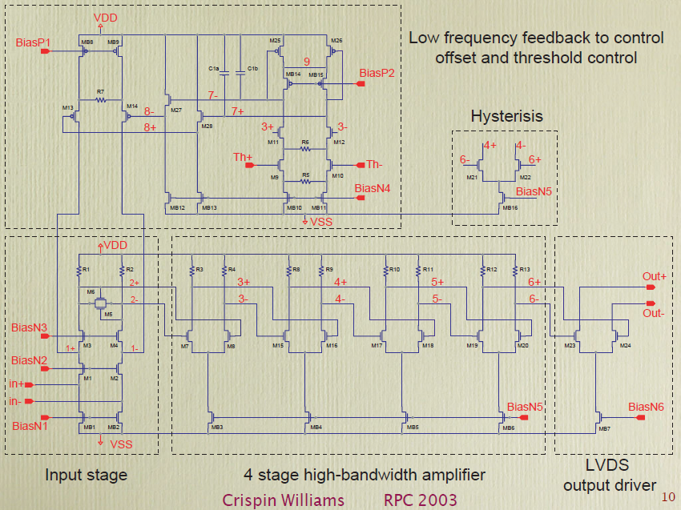
Complete circuit of NINO chip

Slide 50
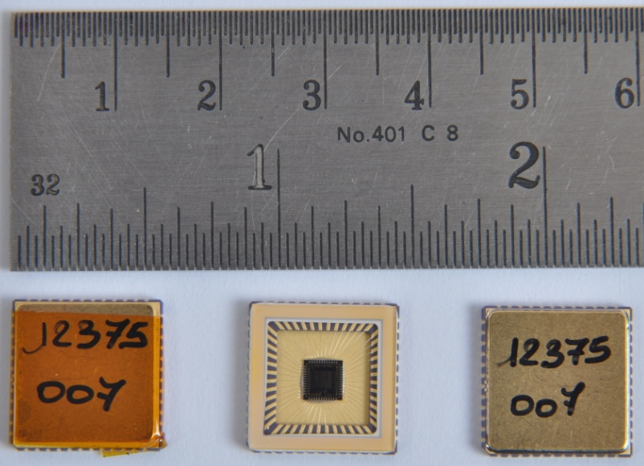
Features of ICAL FE ASIC
IC Service: Europractice (MPW), Belgium
Service agent: IMEC, Belgium
Foundry: austriamicrosystems
Process: AMSc35b4c3 (0.35μm CMOS)
Input dynamic range:18fC – 1.36pC
Input impedance: 45Ω @350MHz
Amplifier gain: 8mV/μA
3-dB Bandwidth: 274MHz
Rise time: 1.2ns
Comparator’s sensitivity: 2mV
LVDS drive: 4mA
Power per channel: < 20mW
Package: CLCC48(48-pin)
Chip area: 13mm²

Slide 51
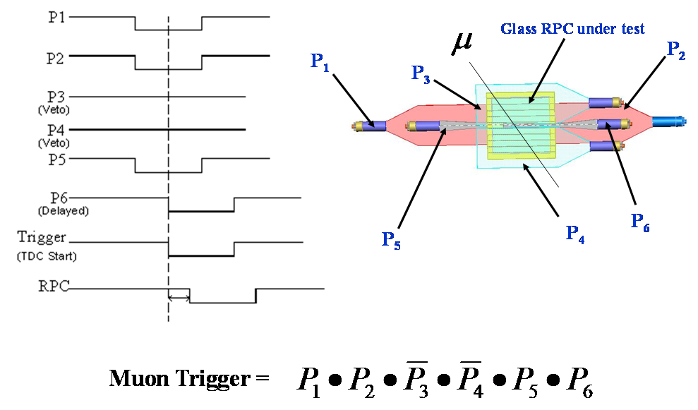
Coincidence scheme for cosmic telescope

Slide 52
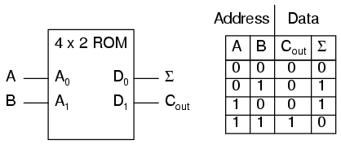
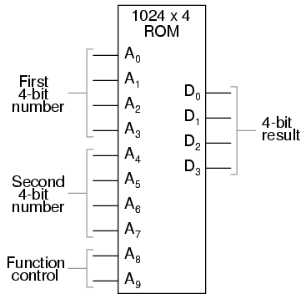
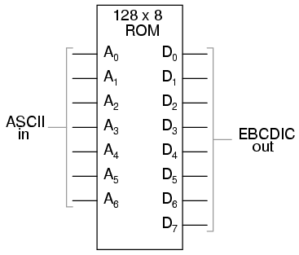
Memory-lookup tables
Can be implemented in memories or modern VLSI devices, adds flexibility to the system.

Slide 53
Introduction to NIM
The NIM (Nuclear Instrumentation Methods) standard established in 1964 for the nuclear and high energy physics communities. The goal of NIM was to promote a system that allows for interchangeability of modules.
Standard NIM modules are required to have a height of 8.75", width in multiples of 1.35". Modules with a width of 1.35" are referred to as single width modules and modules with a width of 2.7" are double width modules, etc. The NIM crate, or NIM bin, is designed for mounting in EIA 19" racks, providing slots for 12 single-width modules. The power supply, which is in general, detachable from the NIM bin, is required to deliver voltages of +6 V, -6 V, +12 V, -12 V, +24 V, and -24 V.
The NIM standard also specifies three sets of logic levels.
In fast-negative logic, usually referred to as NIM logic, logic levels are defined by current ranges. Since the standard also requires 50 ohm input/out impedances, these current ranges correspond to voltages of 0 V and -0.8 V for logic 0 and 1 respectively. Fast-negative logic circuitry can provide NIM signal with rise times of order 1 nsec.
Slow-positive logic, is rarely used in fast-pulse electronics due to the slow rise times involved.
Specifications for ECL (emitter-coupled logic) voltage levels and interconnections have been added to the NIM subsequently.

Slide 54
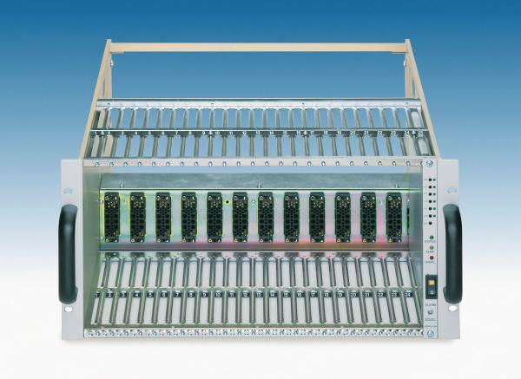
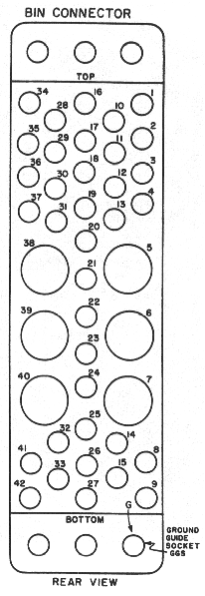
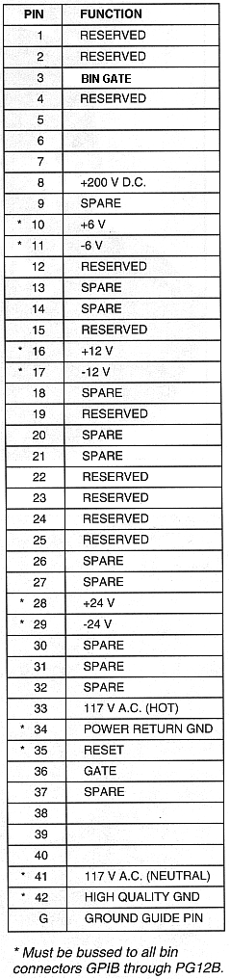
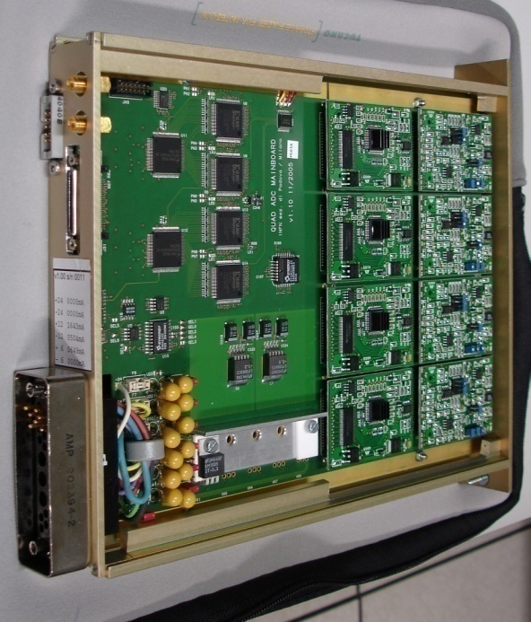
NIM crate and power supplies

Slide 55
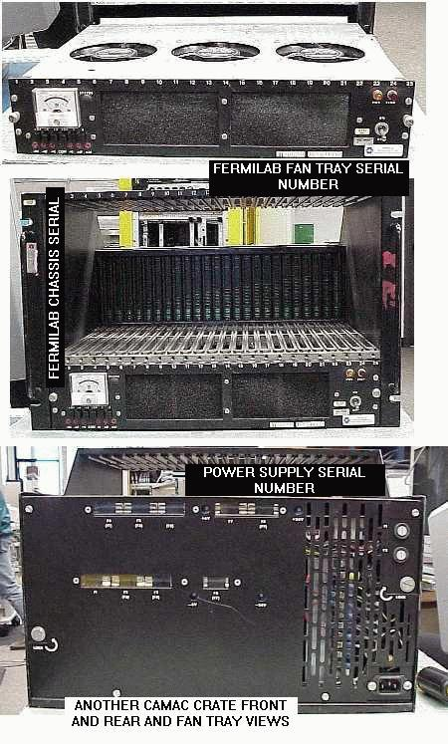
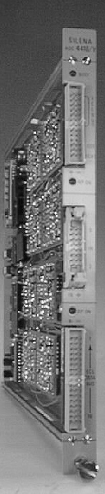
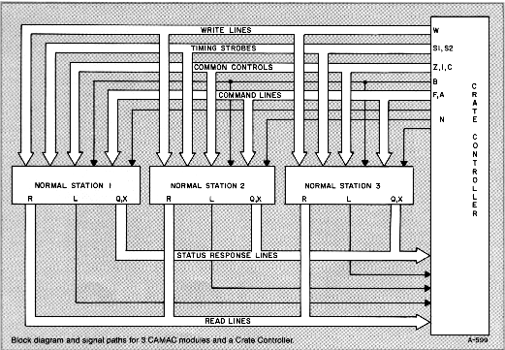
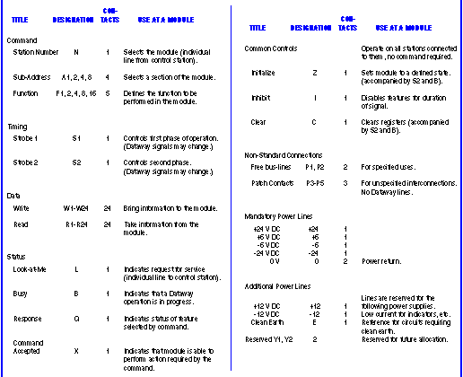
CAMAC hardware and signals

Slide 56
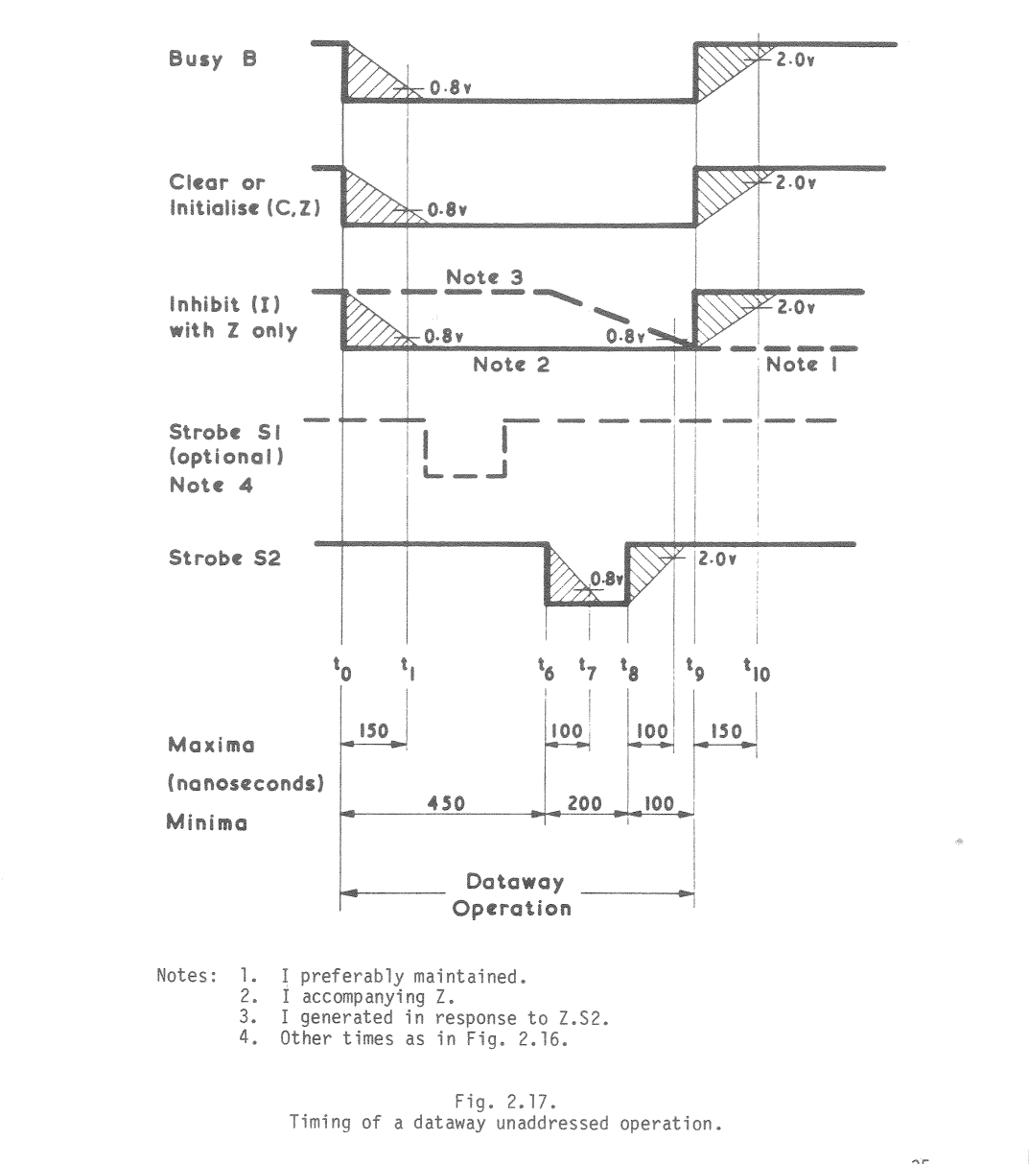
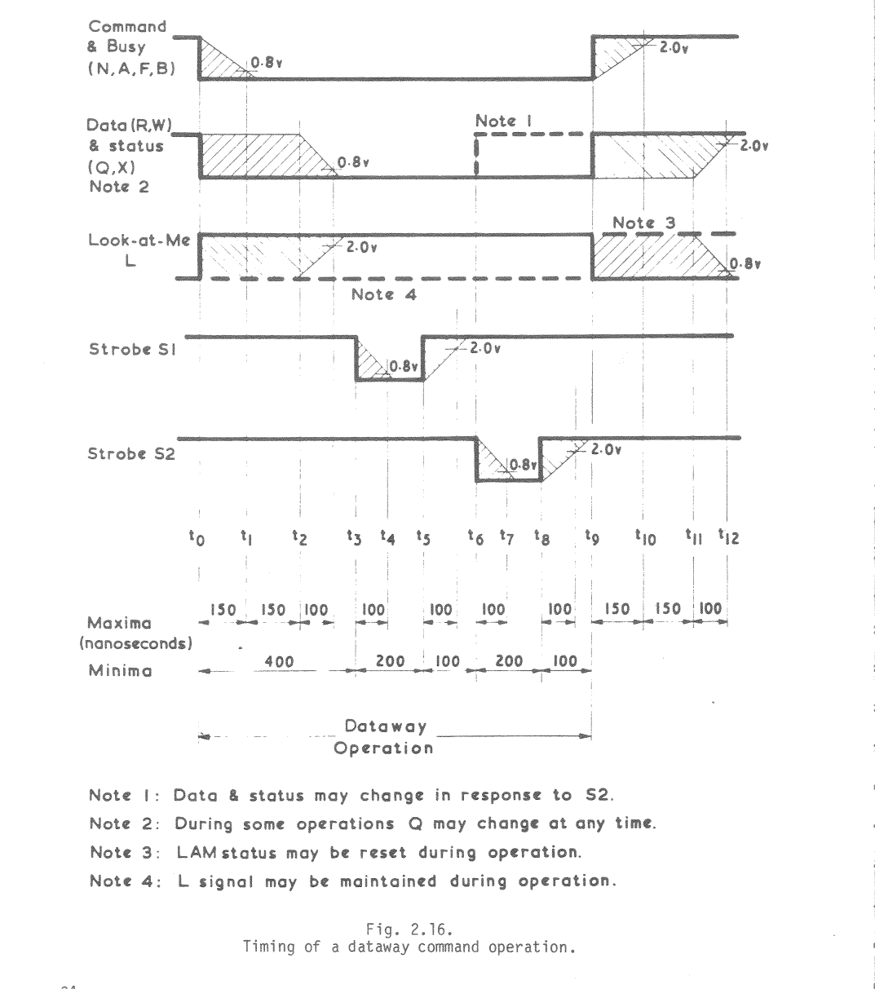
CAMAC dataway timing charts
Computer Automated Measurement and Control

Slide 57
CAMAC system development
System layers
CAMAC Hardware
CAMAC controller and PC interface
Serial, Parallel, GPIB, USB and Ethernet interfaces
Driver software
Operating System specific
Application program
DAQ system specific
Software library
Programming Language specific

Slide 58



VME system hardware components
“VERSA-module Europe”
A modern fast, high density, modular, scientific instrumentation standard.
Bandwidth up to 40MBytes/s (compare with 1MByes/s of CAMAC)

Slide 59
Custom VME Module
JTAG
FPGA Configuration Logic
On board logic analyser port
Transceiver
Data Bus
VME Interface
Logic
(FPGA)
VME Data
OE
DIR
LVDS Tx OUT
Transceiver
VME Addr
Address Bus
LVDS Rx IN
VME
BUS
OE
DIR
Front panel LEDs
Buffer
AM, DS, WR, SYSRST, IACK..
VME Control Signals
Data
Interface for V1495s piggy boards
DATCK, IACKOUT, IRQs, BERR
Buffer
Board Address

Slide 60
Lecture - III Monday, July 4, 2011
Acknowledgements & References: G.Hall, W.R.Leo, JÖrgen Christiansen, GRAPES collaboration, Ortec, P.Horowitz & W.Hill, C.F.G.Delaney, Stefan Ritt, INO collaboration

Slide 61
Analogue to Digital Conversion
Turns electrical input (voltage/charge) into numeric value
Parameters and requirements
Resolution
the granularity of the digital values
Integral Non-Linearity
proportionality of output to input
Differential Non-Linearity
uniformity of digitisation increments
Conversion time
how much time to convert signal to digital value
Count-rate performance
how quickly a new conversion can begin after a previous event
Stability
how much values change with time

Slide 62
Analog-to-Digital Converters (ADCs)
Peak-sensing
Maximum of the voltage signal is digitised
Ex: Signal of the PMT in voltage mode (slow signals, already integrated)
Charge sensitive
Total integrated current digitised
Ex: Signal of the PMT in the current mode (fast signals)
Time of integration or the time period over which the ADC seeks a maximum is determined by the width of the gate signal

Slide 63
Types of ADCs
Ramp or Wilkinson
Successive approximation
Flash or parallel
Sigma-delta ADC
Hybrid (Wilkinson + successive approximation)
Tracking ADC
Parallel ripple ADC
Variable threshold flash ADC
…

Slide 64


Ramp or Wilkinson ADC

Slide 65

Successive approximation ADC

Slide 66

Flash or parallel ADC
Flash ADC is the fastest ADC type available. The digital equivalent of the analog signal will be available right away at it output – hence the name “flash”.
The number of required comparators is 2^{n} -1, where n is the number of output bits.
Since Flash ADC comparisons are set by a set of resistors, one could set different values for the resistors in order to obtain a non-linear output, i.e. one value would represent a different voltage step from the other values.

Slide 67

Sigma-delta ADC

Slide 68


Integral non-linearity
Output value D should be linearly proportional to V
Check with plot
For more precise evaluation of INL fit to line and plot deviations
Plot D_{i}-D_{fit} vs nchan

Slide 69

Differential non-linearity
Measures non-uniformity in channel profiles over range
DNL = DV _{i}/<DV> - 1
DV _{i} = width of channel i
<DV> = average width
RMS or worst case values may be quoted
DNL ~ 1% is typical but 10⁻³ can be achieved
can show up systematic effects, as well as random

Slide 70

Resolution

Slide 71
Other variables
Conversion time
finite time is required for conversion and storage of values
may depend on signal amplitude
gives rise to dead time in system
i.e. system cannot handle another event during dead time
may need accounting for, or risk bias in results
Rate effects
results may depend on rate of arrival of signals
typically lead to spectral broadening
Stability
temperature effects are a typical cause of variations
A partial solution to most of these problems is regular calibration, preferably under real operating conditions, as well as control of variables

Slide 72


Why TDCs?
TDCs are used to measure time or intervals
Start – Stop measurement
Measurement of time interval between two events:
Start signal – Stop signal
Used to measure relatively short time intervals with high precision
Like a stop watch used to measure sport competitions
Time tagging
Measure time of occurrence of events with a given time reference:
Time reference (Clock)
Events to be measured (Hits)
Used to measure relative occurrence of many events on a defined time scale:
Such a time scale will have limited range; like 12/24 hour
time scale on your watch when having no date and year
Start
Stop
Time scale (clock)
Hits

Slide 73
Where TDCs?
Special needs for High Energy Physics
Many thousands of channels needed
Rate of measurements can be very high
Very high timing resolution
A mechanism to store measurements during a given interval and extract only those related to an interesting event, signaled by a trigger, must be integrated with TDC function
Other applications
Laser/radar ranging to measure distance between cars
Time delay reflection to measure location of broken fiber
Most other applications only needs one or a few channels

Slide 74
How to compare TDCs?
Merits
Resolution
Bin size and effective resolution (RMS, INL, DNL)
Dynamic range
Stability
Use of external reference
Drift (e.g. temperature)
Jitter and Noise
Integration issues
Digital / analog
Noise / power supply sensitivity
Sensitivity to matching of active elements
Required IC area
Common timing block per channel
Time critical block must be implemented on chip together with noisy digital logic
Use in final system
Can one actually use effectively very high time resolution in large systems (detectors)
Calibration - stability
Distribution of timing reference (start signal or reference clock)
Other features: data buffering, triggering, readout, test, radiation, etc.

Slide 75


Basic TDC types - I
Counter type
Advantages
Simple; but still useful!
Digital
large dynamic range possible
Easy to integrate many channels per chip
Disadvantages
Limited time resolution (1ns using modern CMOS technology)
Meta stability (use of Gray code counter)
Single Delay chain type
Cable delay chain (distributed L-C)
Very good resolution (5ps mm)
Not easy to integrate on integrated circuits
Simple delay chain using active gates
Good resolution (~100ps using modern tech)
Limited dynamic range (long delay chain and register)
Only start-stop type
Large delay variations between chips and with temperature and supply voltage

Slide 76


Basic TDC types - II
Single Delay chain type (Contd …)
Delay locked loop
Self calibrating using external frequency reference (clock)
Allows combination with counter
Delicate feedback loop design (jitter)
R-C delay chain
Very good resolution
Signal slew rate deteriorates
Delay chain with losses; so only short delay chain possible
Large sensitivity to process parameters (and temperature)

Slide 77


Basic TDC types - III
Multiple delay chain type
Vernier delay chain types
Resolution determined by delay difference between two chains. Delay difference can be made very small and very high resolution can be obtained.
Small dynamic range (long chains)
Delay chains can not be directly calibrated using DLL
Matching between delay cells becomes critical
Coupled delay locked loops
Sub-delay cell resolution (¼)
All DLLs use common time reference (clock)
Common timing generator for multiple channels
Jitter analysis not trivial

Slide 78


Basic TDC types - IV
Charge integration
Using ADC (TAC)
High resolution
Low dynamic range
Sensitive analog design
Low hit rate
Requires ADC
Using double slope (time stretcher)
No need for ADC (substituted with a counter)
Multiple exotic architectures
Heavily coupled phase locked loops
Beating between two PLLs
Re-circulating delay loops
Summing of signals with different slew rates
Start
Stop
Stretched time

Slide 79

Architecture of HPTDC (ALICE TOF)
Application Specific Integrated Circuit

Slide 80


Delay Locked Loop (DLL)
Three major components:
Chain of 32 delay elements; adjustable delay
Phase detector between clock and delayed signal
Charge pump & level shifter generating control voltage to the delay elements
Jitter in the delay chain
Lock monitoring
Dynamics of the control loop
Programmable charge pump current level

Slide 81

Coarse time count
Dynamic range of the fine time measurement, extracted from the state of DLL is expanded, by
Storing the state of a clock synchronous counter
Hit signal is synchronous to the clocking, so
Two count values, ½ a clock cycle out of phase stored
At reset, coarse time counter loaded with time offset

Slide 83
HPTDC's DNL/INL data correction
The fixed pattern in the INL is caused by 40 MHz cross talk from the logic part of the chip to the time measurement part .
As this crosstalk comes from the 40MHz clock, which is also the time reference of the TDC, the integral non linearity have a stable shape between chips and can therefore be compensated for using the LSB bits of the measurements.
Test Condition | Effective resolution (RMS)
98ps resolution | 64ps
98ps resolution after INL correction | 34ps
24ps resolution | 58ps
24ps resolution after INL correction | 17ps
83

Slide 84

Concept of a vernier TDC
Two clocks of slightly different periods T₁ and T₂ (T₁ > T₂) are employed.
START pulse will start the slow oscillator (T₁) and STOP pulse will start the fast oscillator (T₂).
Since T₂ < T₁, fast oscillator will catch up with the slow one.
The time interval between the START and STOP can be measured as:
τ = (N₁ − 1) T₁ − (N₂ − 1) T₂
Two counters for N₁ and N₂ are needed.

Slide 85
Schematic of a vernier TDC
Coincidence
detector
Ring Osc
slow
n_{st}
Ring Osc
fast
Fine counter
Subtractor
X
Start Interpolator
Calibrator
Start
Clk
Coarse Counter
N_{c}
X
Adder
Stop
n_{sp}
Fine Counter
Ring Osc
fast
Controller
Data
Transfer
Ring Osc
slow
Coincidence
detector
Stop Interpolator

Slide 86

Structure of an FPGA
Field Programmable Gate Array (FPGA)

Slide 87
Digital waveform samplers
Versatile element, which can perform simultaneously functions of several DAQ building blocks discussed so far:
Peak sensing Analog to Digital Conversion
Charge to Digital Conversion
Time to Digital Conversion
Hit registering
Pulse width measurement
Pulse profile monitor
Pulse shape discrimination
Counting rate scaler
And so on …
Made possible due to breakthroughs in VLSI technology and other techniques
On flipside, it produces a large data size to be handled

Slide 88
Switched Capacitor Array
0.2-2 ns
Inverter “Domino” ring chain
IN
Waveform
stored
Out
Clock
Shift Register
“Time stretcher” GHz → MHz

Slide 89

Data acquisition through DRS chip

Slide 90
Thank you
For your attention.
Lecture notes will be made available on my web page:
http://www.tifr.res.in/~bsn/INO

