Slide 1
Resistive Plate Chambers & INO’s ICAL detector
B.Satyanarayana, Tata Institute of Fundamental Research, Mumbai

Slide 2
Lecture – I
Saturday, July 2, 2011

Slide 3
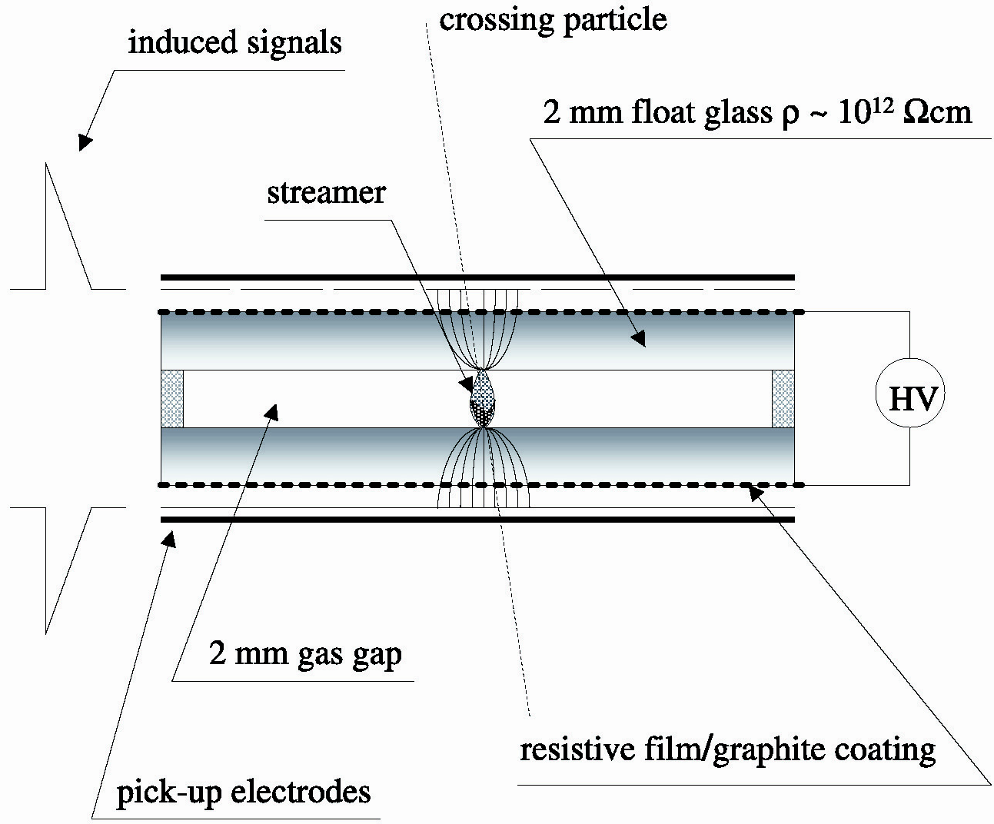
Schematic of a basic RPC
3

Slide 4
Principle of operation
Electron-ion pairs produced in the ionisation process drift in the opposite directions.
All primary electron clusters drift towards the anode plate with velocity v and simultaneously originate avalanches
A cluster is eliminated as soon as it reaches the anode plate
The charge induced on the pickup strips is q = (-eΔx_{e} + eΔx_{I})/g
The induced current due to a single pair is i = dq/dt = e(v + V)/g ≈ ev/g, V « v
Prompt charge in RPC is dominated by the electron drift

Slide 5
RPC operating mode definitions
Let, n₀ = No. of electrons in a cluster
α = Townsend coefficient (No.
of ionisations/unit length)
β = Attachment coefficient (No.
of electrons captured by the
gas/unit length)
Then, the no. of electrons reaching
the anode,
n = n₀e^{(α- β)x}
Where x = Distance between anode
and the point where the cluster
is produced.
Gain of the detector, M = n / n₀
A planar detector with resistive electrodes ≈ Set of independent discharge cells
Expression for the capacitance of a planar condenser → Area of such cells is proportional to the total average charge, Q that is produced in the gas gap.
Where, d = gap thickness
V = Applied voltage
ε₀ = Dielectric constant of the gas
Lower the Q; lower the area of the cell (that is ‘dead’ during a hit) and hence higher the rate handling capability of the RPC

Slide 6
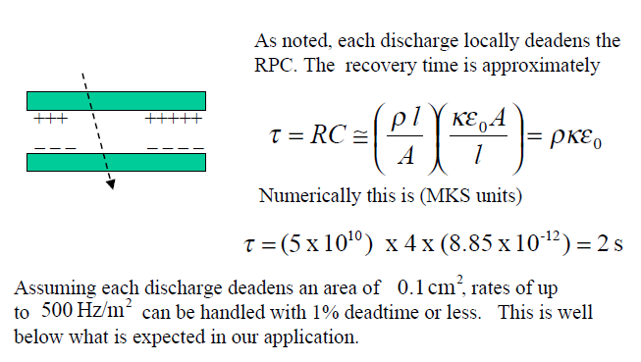
Rate capability of a streamer RPC

Slide 7
Control of avalanche process
Role of RPC gases in avalanche control
Argon is the ionising gas
R134a to capture free electrons and localise avalanche
e⁻ + X → X⁻ + hν (Electron attachment)
X⁺ + e⁻ → X + hν (Recombination)
Isobutane to stop photon induced streamers
SF₆ for preventing streamer transitions
Growth of the avalanche is governed by dN/dx = αN
The space charge produced by the avalanche shields (at about αx = 20) the applied field and avoids exponential divergence
Townsend equation should be dN/dx = α(E)N

Slide 8
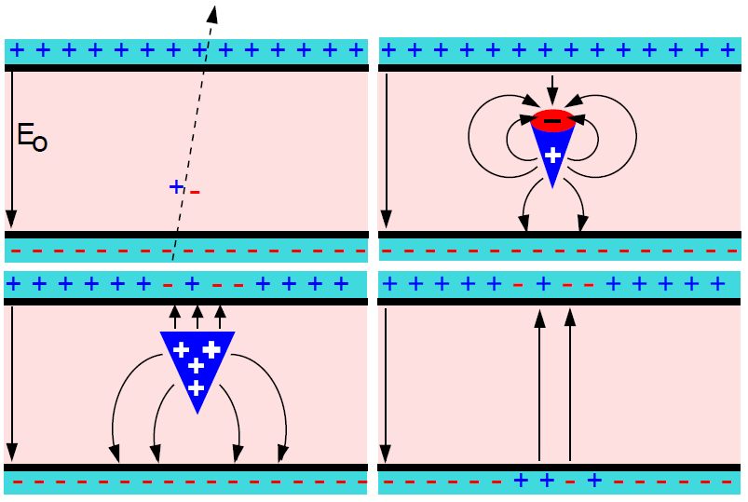
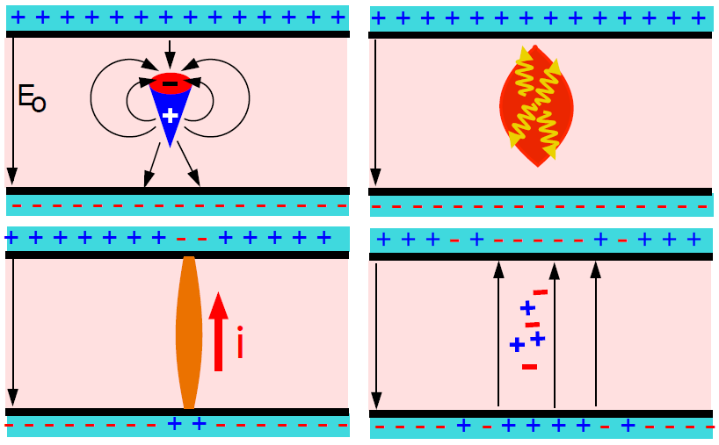
Two modes of RPC operation
Avalanche mode
Streamer mode
Gain of the detector << 10⁸
Charge developed ~1pC
Needs a preamplifier
Longer life
Typical gas mixture Fr:iB:SF₆::94.5:4:0.5
Moderate purity of gases
Higher counting rate capability
Gain of the detector > 10⁸
Charge developed ~ 100pC
No need for a preamplier
Relatively shorter life
Typical gas mixture Fr:iB:Ar::62.8:30
High purity of gases
Low counting rate capability

Slide 9
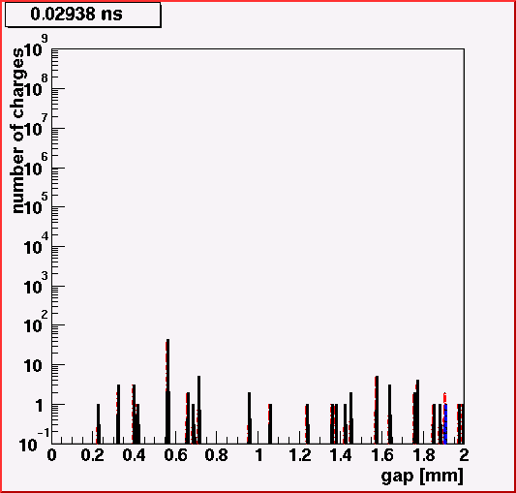
Avalanche development in RPC
RPC volume
2mm glass resistive plates
2mm gap
Gas mixture
C₂F₄H₂ (97%)
iC₄H₁₀ (2.5%)
SF₆ (0.5%)
HV applied
10.0kV
Particle legend
Red: Positive ions
Blue: Negative ions
Black: Electrons
Credit: Christian Lippmann

Slide 10
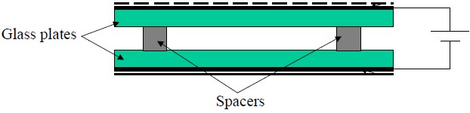
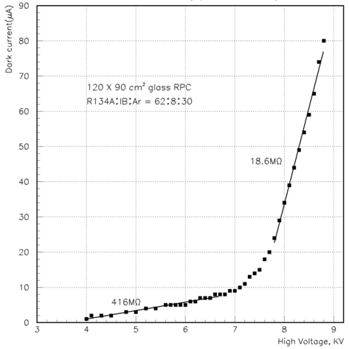
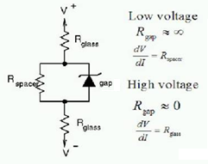
V-I characteristics of RPC
Glass RPCs have a distinctive and readily understandable current versus voltage relationship.

Slide 11
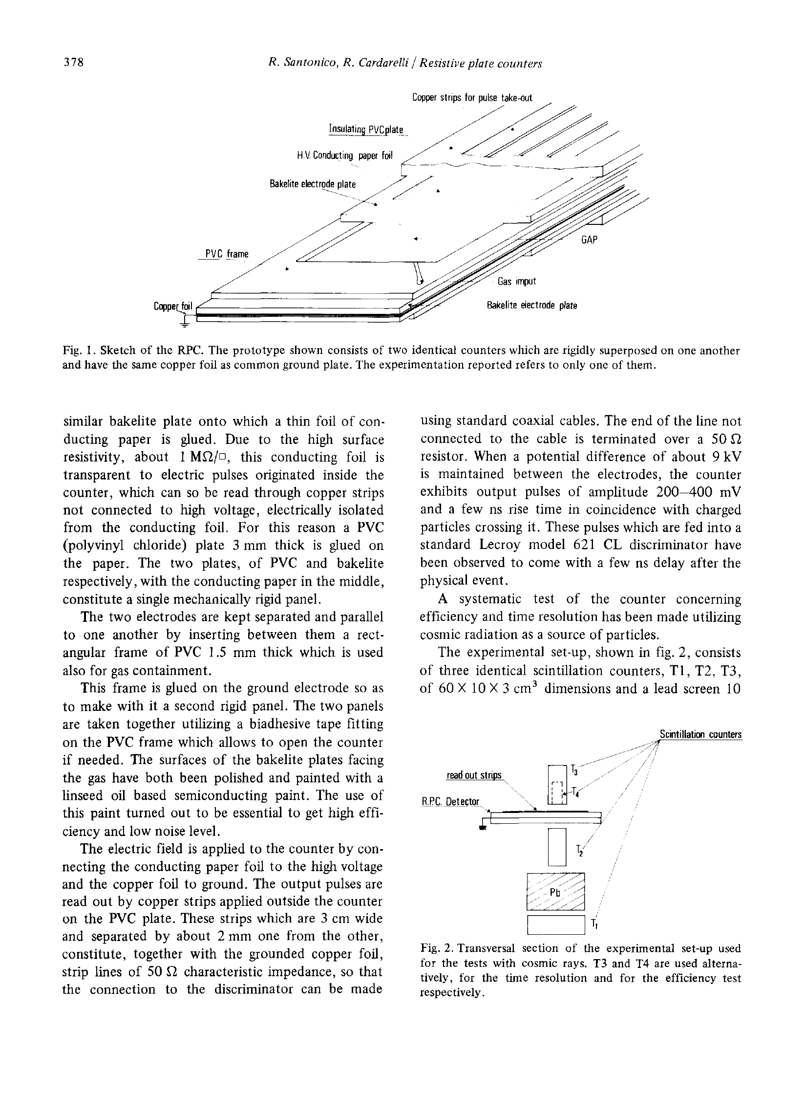
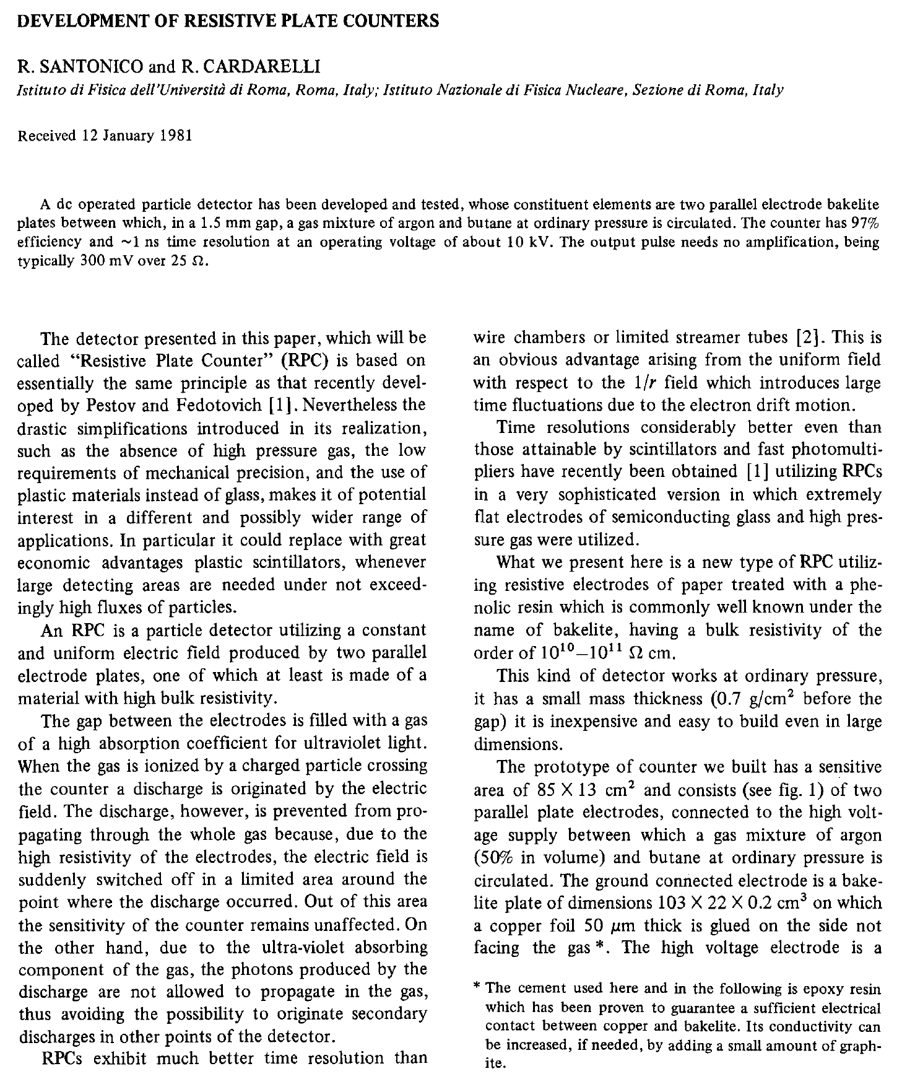
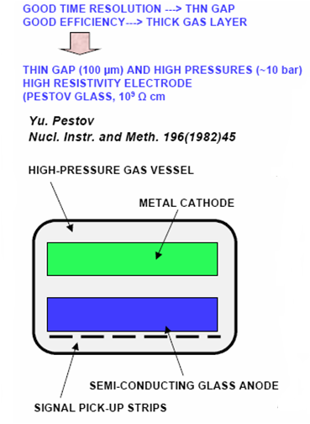
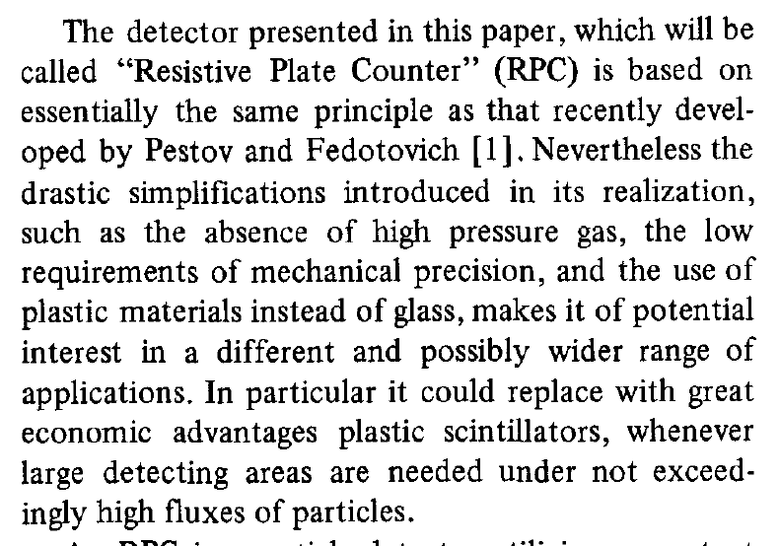
Birth of the RPC

Slide 12
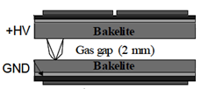
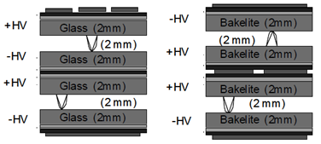
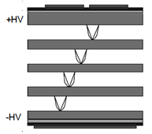
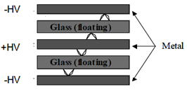
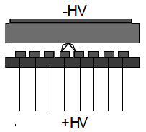
Application driven RPC designs
Single gap RPC
Double gap RPC
Multi gap RPC
Hybrid RPC
Micro RPC

Slide 13
Deployment of RPCs in running experiments
Experiment | Area (m²) | Electrodes | Gap(mm) | Gaps | Mode | Type
PHENIX | ? | Bakelite | 2 | 2 | Avalanche | Trigger
NeuLAND | 4 | Glass | 0.6 | 8 | Avalanche | Timing
FOPI | 6 | Glass | 0.3 | 4 | Avalanche | Timing
HADES | 8 | Glass | 0.3 | 4 | Avalanche | Timing
HARP | 10 | Glass | 0.3 | 4 | Avalanche | Timing
COVER-PLASTEX | 16 | Bakelite | 2 | 1 | Streamer | Timing
EAS-TOP | 40 | Bakelite | 2 | 1 | Streamer | Trigger
STAR | 50 | Glass | 0.22 | 6 | Avalanche | Timing
CBM TOF | 120 | Glass | 0.25 | 10 | Avalanche | Timing
ALICE Muon | 140 | Bakelite | 2 | 1 | Streamer | Trigger
ALICE TOF | 150 | Glass | 0.25 | 10 | Avalanche | Timing
L3 | 300 | Bakelite | 2 | 2 | Streamer | Trigger
BESIII | 1200 | Bakelite | 2 | 1 | Streamer | Trigger
BaBar | 2000 | Bakelite | 2 | 1 | Streamer | Trigger
Belle | 2200 | Glass | 2 | 2 | Streamer | Trigger
CMS | 2953 | Bakelite | 2 | 2 | Avalanche | Trigger
OPERA | 3200 | Bakelite | 2 | 1 | Streamer | Trigger
YBJ-ARGO | 5630 | Bakelite | 2 | 1 | Streamer | Trigger
ATLAS | 6550 | Bakelite | 2 | 1 | Avalanche | Trigger
ICAL | 97,505 | Both | 2 | 1 | Both | Trigger
Experiment | Coverage(m²) | Electrodes | Gap(mm) | Gaps | Mode
BaBar | 2000 | Bakelite | 2 | 1 | Streamer
Belle | 2000 | Glass | 2 | 2 | Streamer
ALICE Muon | 72 | Bakelite | 2 | 1 | Streamer
ATLAS | 7000 | Bakelite | 2 | 1 | Avalanche
CMS | 6000 | Bakelite | 2 | 2 | Avalanche
STAR | 60 | Glass | 0.22 | 5 | Avalanche
ALICE TOF | 160 | Glass | 0.25 | 10 | Avalanche
OPERA | 3000 | Bakelite | 2 | 1 | Streamer
YBJ-ARGO | 5600 | Bakelite | 2 | 1 | Streamer
BESIII | 1500 | Bakelite | 2 | 1 | Streamer
HARP | 10 | Glass | 0.3 | 4 | Avalanche
Also deployed in COVER_PLASTEX,EAS-TOP, L3 experiments

Slide 14
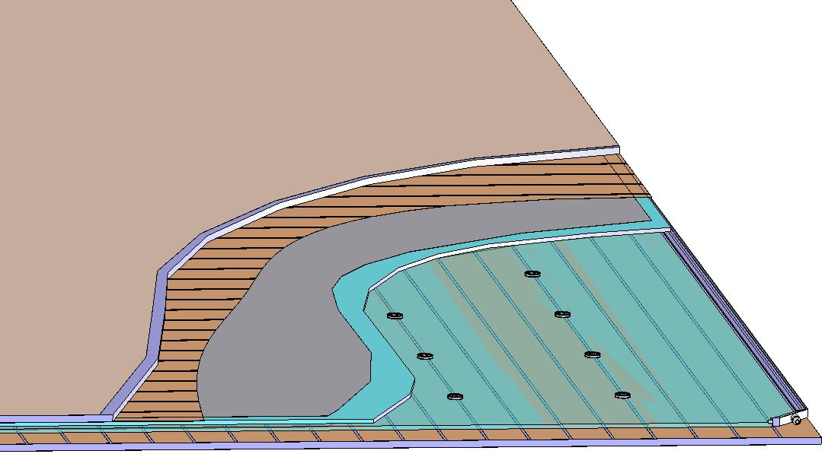
Basic construction of an RPC
Signal reference plane.1
Plastic honey comb.2
Copper pickup strips.3
Graphite/Paint.4
Top glass.5
Button spacer.6
Bottom glass.7
Edge spacer.8
Gas nozzle.9
Bottom pickup panel.A
8
1
2
3
4
5
6
7
9
A

Slide 15
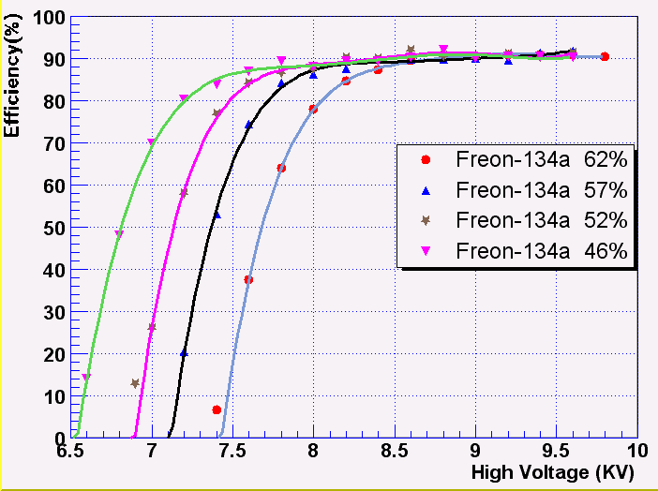
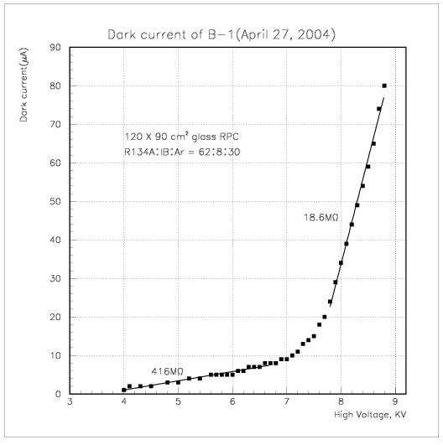
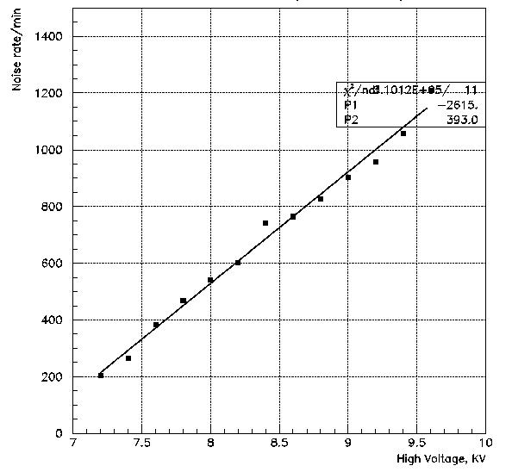
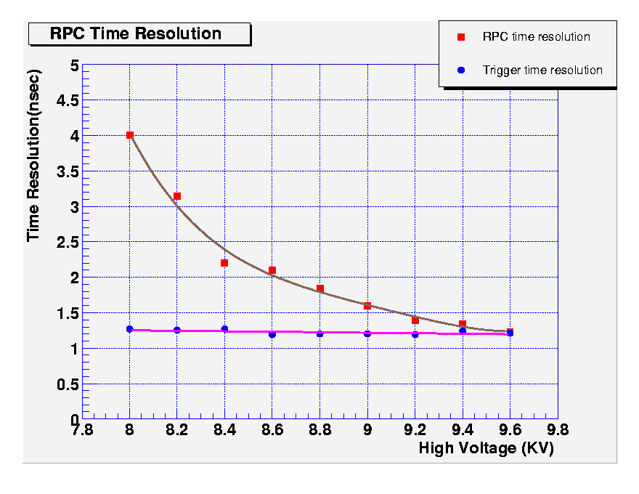
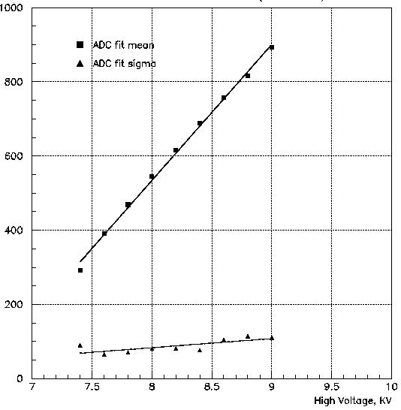
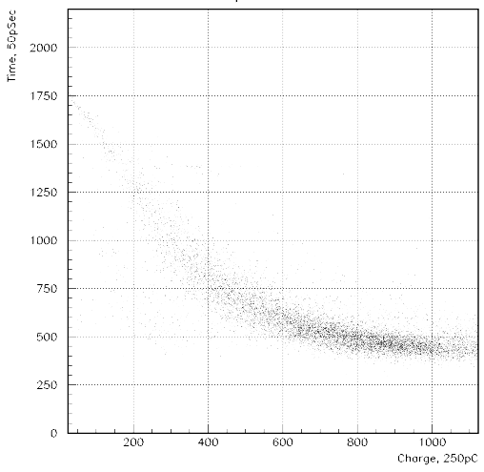
Some early encouraging results

Slide 16
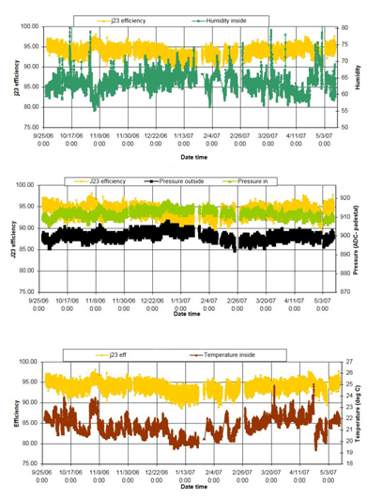
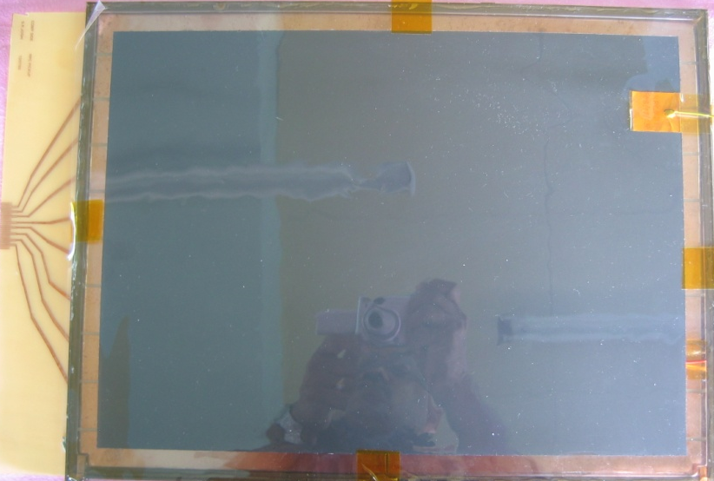
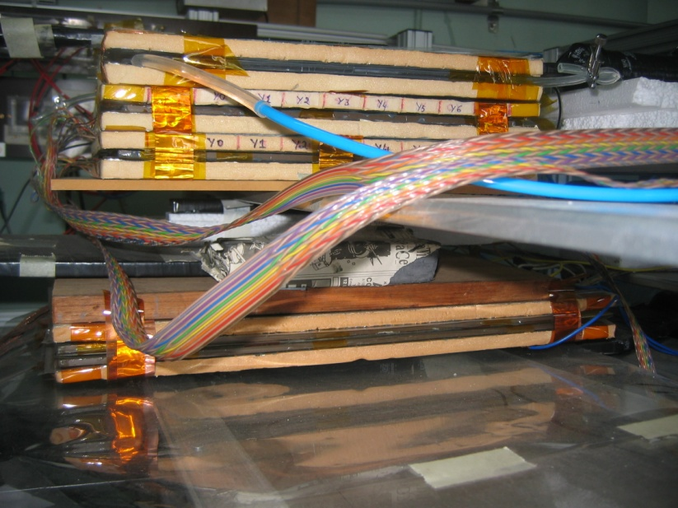
Long-term stability study of RPC
Two RPCs of 40cm × 30cm in size were built using 2mm glass for electrodes
Readout by a common G-10 based signal pickup panel sandwiched between the RPCs
Operated in avalanche mode (R134a: 95.5% and the rest Isobutane) at a high voltage of 9.3KV
Round the clock monitoring of RPC and ambient parameters – temperature, relative humidity and barometric pressure
Were under continuous operation for more than three years
Chamber currents, noise rate, combined efficiencies etc. were stable
Long-term stability of RPCs is thus established
Relative humidity
Pressure
Temperature

Slide 17
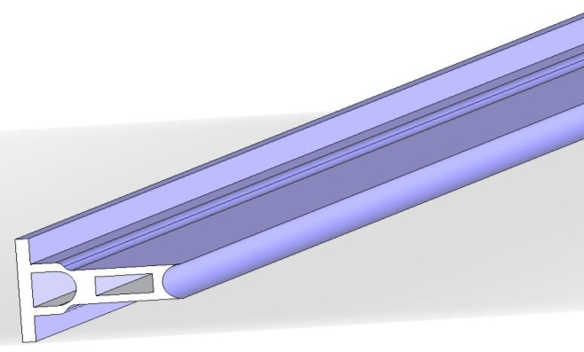
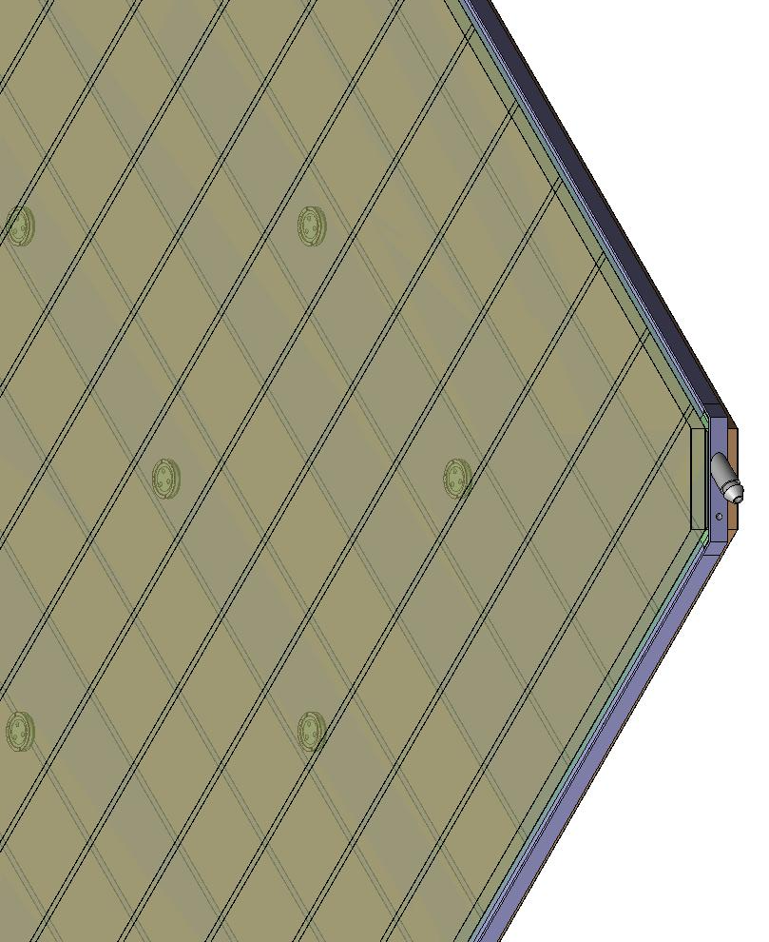
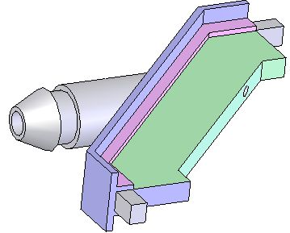
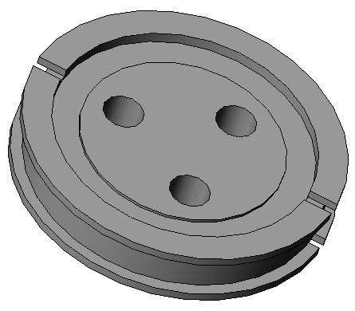
Materials for gas volume fabrication
Edge spacer
Schematic of an assembled gas volume
Gas nozzle
Glass spacer

Slide 18
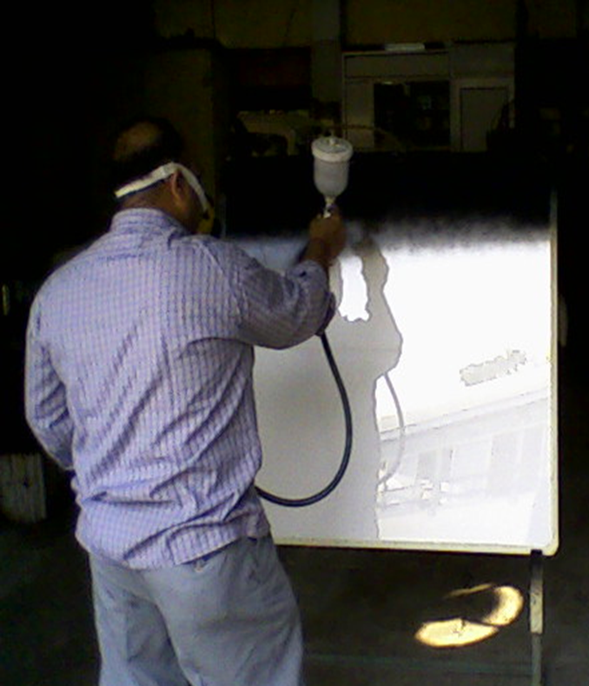
Electrode coating techniques
Graphite paint prepared using colloidal grade graphite powder(3.4gm), lacquer(25gm) and thinner(40ml)
Sprayed on the glass electrodes using an automobile spray gun.
A uniform and stable graphite coat of desired surface resistivity (1MΩ/◻) was obtained by this method.

Slide 19
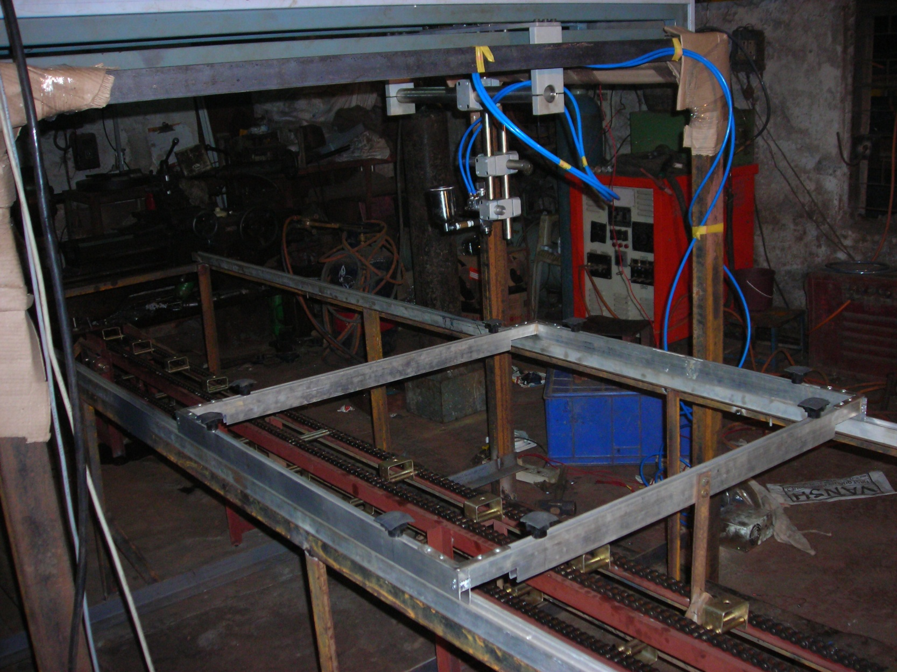
Automatic spray paint plant
Drive for Y-movement
Automatic spray gun
Control and drive panel
Glass holding tray
Drive for X-movement

Slide 20
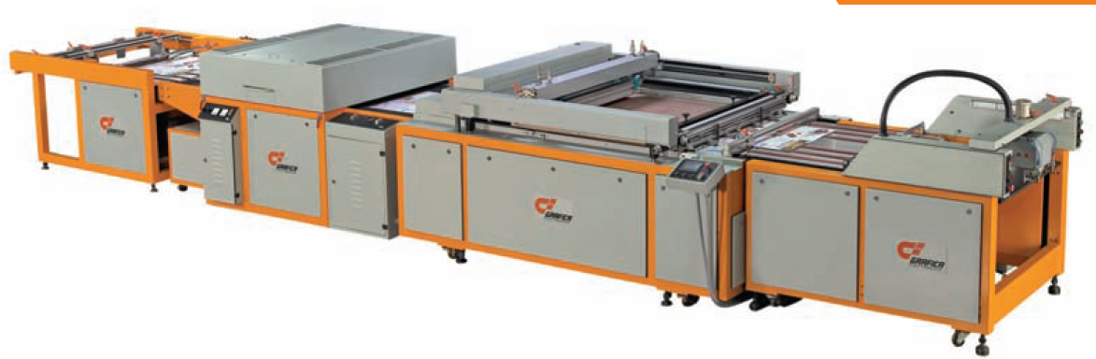
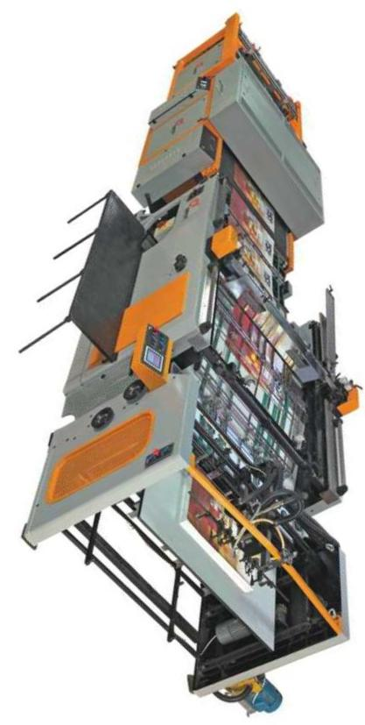
Screen printing techniques
On glass
On films

Slide 21
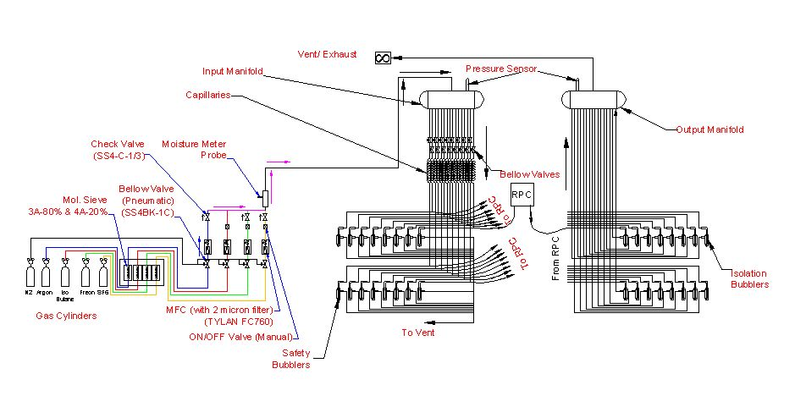
Schematic of gas system

Slide 22
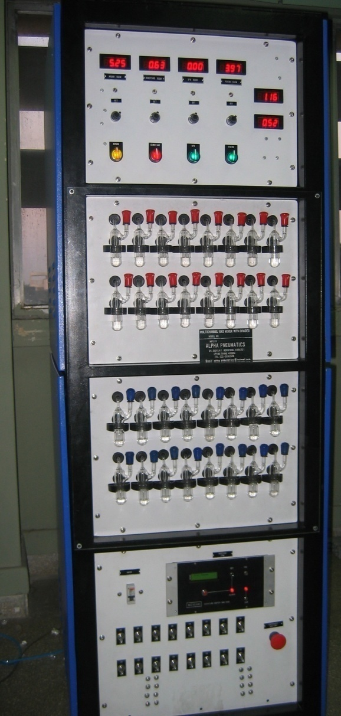
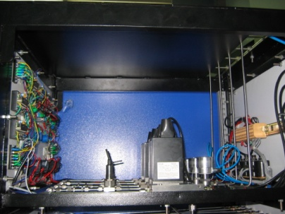
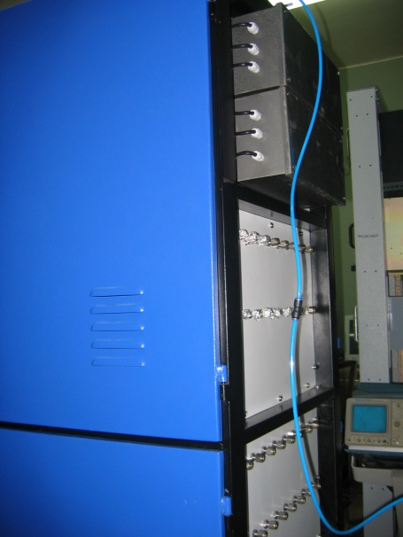
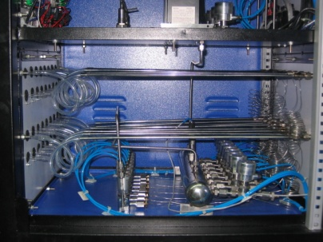
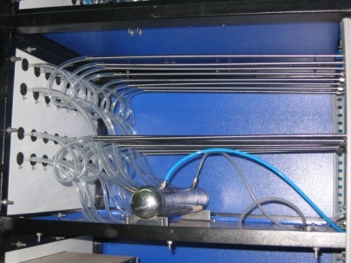
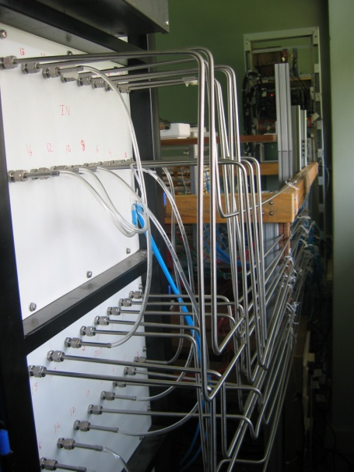
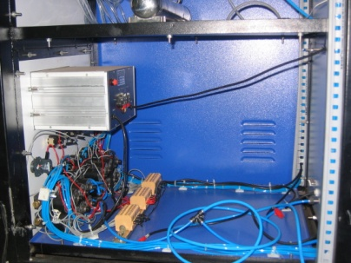
Constructional details of the gas system
Internal view
Front view
Rear view

Slide 23
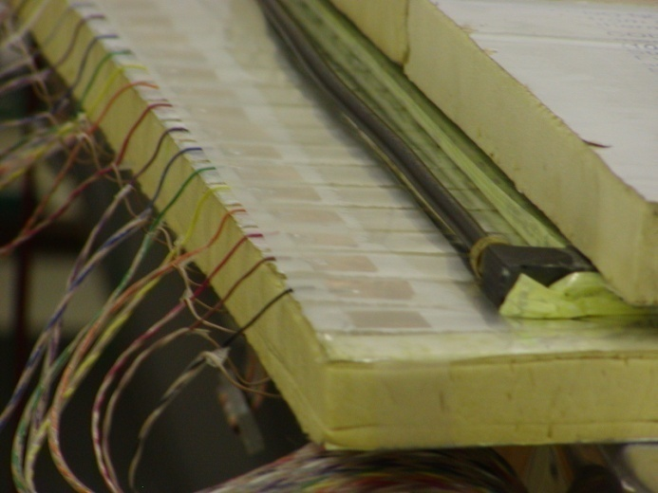
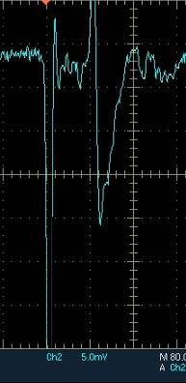
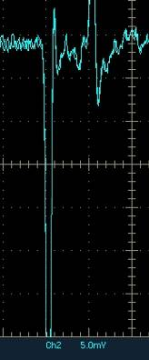
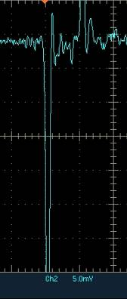
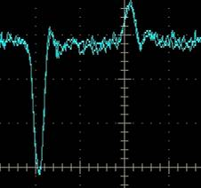
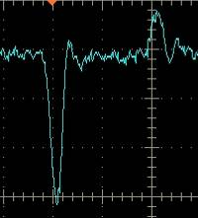
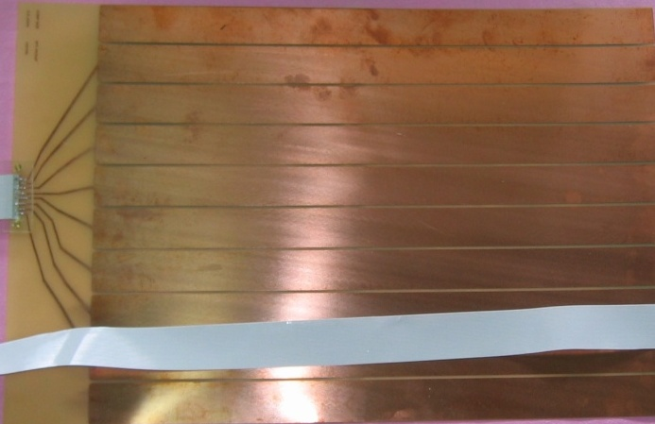

Development and characterisation of signal pickup panels
Foam panel
48.2Ω
G-10 panel
Open
100Ω
51Ω
47Ω
Z₀: Inject a pulse into the strip; tune the terminating resistance at the far end, until its reflection disappears.
Honeycomb panel

Slide 24
Transmission line impedance
Readout strips
w
ε_{r}
h
Ground plane

Slide 25

Fully assembled large area RPC
1m × 1m

Slide 26




RPC parameter characterisation

Slide 27













Design and implementation of the data acquisition system
200 boards of 13 types
Custom designed using
FPGA,CPLD,HMC,FIFO,SMD

Slide 28


A couple of interesting events

Slide 29

Strip hit map of an RPC

Slide 30


RPC strip rate time profile
Temperature

Slide 31
Lecture – II
Monday, July 4, 2011

Slide 32
Neutrino physics using ICAL
Reconfirm atmospheric neutrino oscillation
Improved measurement of oscillation parameters
Search for potential matter effect in neutrino oscillation
Determining the mass hierarchy using matter effect
Study of ultra high energy neutrinos and muons
Long baseline target for neutrino factories
7,100km from CERN – Magic baseline distance!

Slide 33

Up-Down asymmetry measurement
Atmospheric neutrino energy > 1.3GeV, Δm² ~2-3×10⁻³ eV²
Downward muon neutrino are not affected by oscillation
They may constitute a near reference source
Upward neutrino are instead affected by oscillation since the L/E ratio ranges up to 10⁴ Km/GeV
They may constitute a far source
Thus, oscillation studies with a single detector and two sources

Slide 34

Matter effects and neutrino mass hierarchy
Matter effects help to cleanly determine the sign of the Δm²
Neutrinos and anti-neutrinos interact differently with matter
ICAL can distinguish this by detecting charge of the produced muons, due to its magnetic field
Helps in model building for neutrino oscillations

Slide 35

Site for INO underground facility

Slide 36

Schematic of the underground labs
Basic features of the labs
Length of the tunnel | 2.1 km (approx.)
Tunnel cross-section | 7.5m wide and 7.5m high
Tunnel gradient | 1:15
Rock overburden | 1300m (4000 mwe)
Rock type and density | Charnockite, 2.9 gm/cc
Number of caverns | 3 (one big and two small)
Size of the main cavern | 132m × 26m × 20m (high)
Distance from CERN | 7100 km
Distance from JPARC | 6600 km
Future nuclear reactor | 9000 Mwe, 205 km

Slide 37
The choice of detector: ICAL
Use (magnetised) iron as target mass and RPCs as active detector elements.
Use atmospheric neutrinos as source
Atmospheric neutrinos have large L and E range. So ICAL has large target mass: 50kton in its current design.
Nearly 4π coverage in solid angle (except near horizontal).
Upto 20 GeV muons contained in fiducial volume; most interesting region for observing matter effects in 2–3 sector is 5–15 GeV.
Good tracking and energy resolution.
ns time resolution for up/down discrimination; good directionality.
Good charge resolution; magnetic field ∼1.5 Tesla.
Ease of construction (modular; 3 modules of 17 kTons each).
Note: ICAL is sensitive to muons only, very little sensitivity to electrons; Electrons leave few traces (radiation length 1.8 (11) cm in iron (glass)).

Slide 38



INO cavern and the ICAL detector
Magnet coils
Vertical rock coverage: 1300m
RPC handling trolleys
4000mm×2000mm low carbon iron slab
Total weight: 50Ktons

Slide 39



RPCs in the ICAL detector
RPC
Iron absorber
Gas, LV & HV
← ⎯ ⎯ ⎯ Road ⎯ ⎯ ⎯ →
One module

Slide 40
DAQ system requirements
Information to record on trigger
Strip hit (1-bit resolution)
Timing (200ps LC)
Time Over Threshold (used for time-walk correction)
TDC can measure TOT as well.
Pulse profile (using waveform sampler, 200ps LC)
Rates
Individual strip background rates on surface ~300Hz
Underground rates differ: depth, rock radiation etc.
Muon event rate ~10Hz
On-line monitor
RPC parameters (High voltage, current)
Ambient parameters (T, P, RH)
D.C. power supplies, thresholds
Gas systems and magnet control and monitoring

Slide 41
Factsheet of ICAL detector
No. of modules | 3
Module dimensions | 16m × 16m × 14.5m
Detector dimensions | 48.4m × 16m × 14.5m
No. of layers | 150
Iron plate thickness | 56mm
Gap for RPC trays | 40mm
Magnetic field | 1.3Tesla
RPC dimensions | 1,840mm × 1,840mm × 24mm
Readout strip pitch | 3 0mm
No. of RPCs/Road/Layer | 8
No. of Roads/Layer/Module | 8
No. of RPC units/Layer | 192
No. of RPC units | 28,800 (97,505m²)
No. of readout strips | 3,686,400

Slide 42
Why ICAL chose RPC?
Large detector area coverage, thin (~10mm), small mass thickness
Flexible detector and readout geometry designs
Solution for tracking, calorimeter, muon detectors
Trigger, timing and special purpose design versions
Built from simple/common materials; low fabrication cost
Ease of construction and operation
Highly suitable for industrial production
Detector bias and signal pickup isolation
Simple signal pickup and front-end electronics; digital information acquisition
High single particle efficiency (>95%) and time resolution (~1nSec)
Particle tracking capability; 2-dimensional readout from the same chamber
Scalable rate capability (Low to very high); Cosmic ray to collider detectors
Good reliability, long term stability
Under laying Physics mostly understood!

Slide 43

Prototype RPC stack (TIFR)

Slide 44






A collage of interesting events

Slide 45





Prototype detector magnet (VECC)
13 layer sandwich of 50mm thick low carbon iron (Tata A-grade) plates (35ton absorber)
Detector is magnetised to 1.5Tesla, enabling momentum measurement of 1-10Gev muons produced by ν_{μ} interactions in the detector.

Slide 46


The final frontier: 2m × 2m RPCs
RPC fabrication stand
RPC test stand

Slide 47




Characterisation of 2m × 2m RPCs
V-I characteristics
Noise rate linearity
Efficiency plateau
Noise rate profile

Slide 48

Absolute time resolution plots

Slide 49




Some results from prototype stack
Impact position distribution
Tomography of the RPC
Hit position residue distribution
Hit multiplicity distribution

Slide 50


RPC strip rate monitoring
Temperature dependence on
noise rate
Strip noise rate profile
Strip noise rate histogram
Temperature

Slide 51


Lon-term stability of glass RPCs

Slide 52

Zenith angle distribution of cosmic ray muons through RPC stack

Slide 53

Beta distribution of cosmic ray muons through RPC stack

Slide 54

Simulation of ICAL’s physics

Slide 55







Hierarchical trigger system for ICAL
Muon
CC
Resonant
QE
DI

Slide 56


Industrial production of ICAL RPCs

Slide 57
Requirement of gases in ICAL
Total number of RPCs in ICAL = 3 × 150 × 64 = 28,800
Total gas volume = 28,800 × 184cm × 184cm × 0.2cm = 195,010 litres
For example:
One volume change/day with 10% gas top-up in a re-circulating scheme
Approximate running gas cost = Rs 30,000/day (R134a from Mafron)
Gas | Avalanche (%) | Streamer (%) | Maximum (%) | Volume (L) | Density (g/L) | Weight (Kg) | Cost (Rs/Kg)
Argon | 0.0 | 30.0 | 30.0 | 58,503 | 1.784 | 104.4
R134a | 95.5 | 62.0 | 95.5 | 186,234.6 | 4.25 | 791.5
Isobutane | 4.3 | 8.0 | 8.0 | 15,600.8 | 2.51 | 39.16
SF₆ | 0.2 | 0.0 | 0.2 | 390 | 6.164 | 2.40

Slide 58

Study of gas sealed RPCs

Slide 59

Closed loop gas system for ICAL

Slide 60



Functional diagram of ICAL DAQ

Slide 61

Features of ICAL FE ASIC
IC Service: Europractice (MPW), Belgium
Service agent: IMEC, Belgium
Foundry: austriamicrosystems
Process: AMSc35b4c3 (0.35μm CMOS)
Input dynamic range:18fC – 1.36pC
Input impedance: 45Ω @350MHz
Amplifier gain: 8mV/μA
3-dB Bandwidth: 274MHz
Rise time: 1.2ns
Comparator’s sensitivity: 2mV
LVDS drive: 4mA
Power per channel: < 20mW
Package: CLCC48(48-pin)
Chip area: 13mm²

Slide 62

Timing device for ICAL

Slide 63
INO is the place of happening!
A mega basic science project, first of its kind in the country
Centre for doing cutting edge physics
Physics simulations & software development
Detector R&D for science and societal applications
World’s largest electro magnet
World’s largest deployment of RPCs and other infrastructure
State-of-the-art electronics, DAQ and on-line software development
Dedicated scientific manpower development programme
Centre for particle physics and detector development
Domestic industrial development is one of the important spin-offs
Aggressive public outreach and science popularisation
Indeed, truly a world class laboratory in the making
Stay tuned – still better, participate

Slide 64
Thank you
For your attention.
Lecture notes will be made available on my web page:
http://www.tifr.res.in/~bsn/INO

