Slide 1
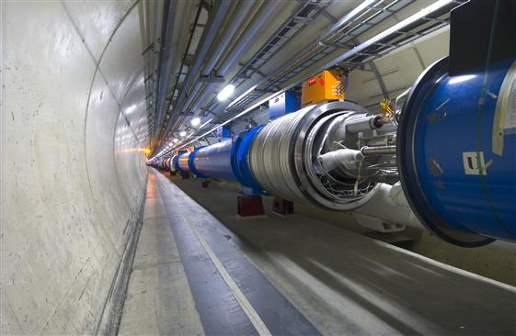

Engineering marvels at work to unravel nature’s secrets
B.Satyanarayana
Department of High Energy Physics
bsn@tifr.res.in, www.tifr.res.in/~bsn

Slide 2
Science and engineering
Science is a systematic enterprise that builds and organizes knowledge in the form of testable explanations and predictions about the universe (Wikipedia).
The strongest arguments prove nothing so long as the conclusions are not verified by experience. Experimental science is the queen of sciences and the goal of all speculation (Roger Bacon).
Engineering is the discipline, art, skill and profession of acquiring and applying scientific, mathematical, economic, social, and practical knowledge, in order to design and build structures, machines, devices, systems, materials and processes that safely realize improvements to the lives of people (Wikipedia).

Slide 3
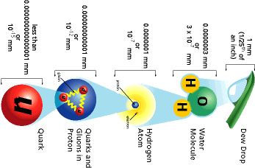
Powers of ten - How small is small?

Slide 4
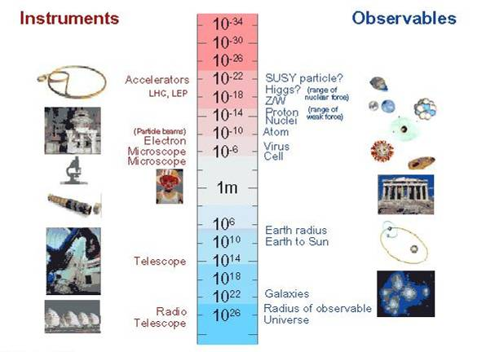
Instruments and Observables

Slide 5
Particle Physics
Particle physics is a modern name for centuries old effort to understand the laws of nature.
Aims to answer the two following questions:
What are the elementary constituents of matter ?
What are the forces that control their behaviour at the most basic level?
Get particles to interact and study the resulting products and features.
Aim to measure the energy, the direction and the identity of these products as precisely as possible.

Slide 6
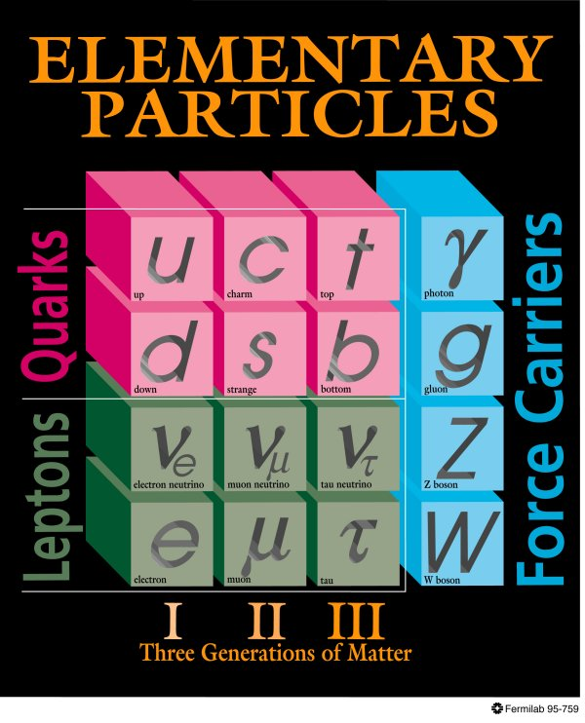
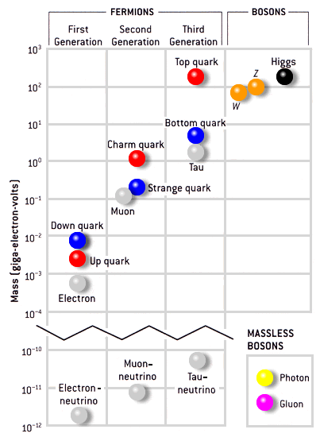
Standard Model of particle Physics

Slide 7
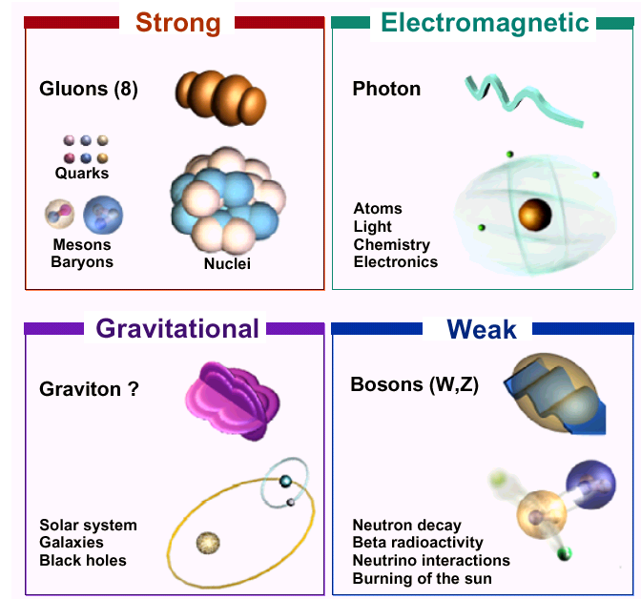
Four forces of nature

Slide 8
Particle accelerators
Accelerate particles to high energies.
The higher energies allow us to:
look deeper into matter (E α 1/size) (powerful microscopes)
discover new heavier particles (E = mc²)
probe conditions of early universe (E = kT)
revisit the earlier moments of our ancestral universe (powerful telescopes)
observe phenomena and particles normally no longer visible or existing in our time
All in a controlled way in the laboratory

Slide 9
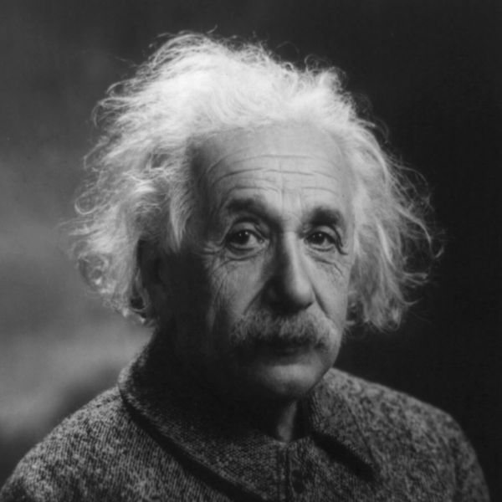
Speed of light; E=mc²

Slide 10
Why the LHC?
The LHC (Large Hadron Collider) was built to help scientists to answer key unresolved questions in particle physics. The unprecedented energy it achieves may even reveal some unexpected results that no one has ever thought of!
For the past few decades, physicists have been able to describe with increasing detail the fundamental particles that make up the Universe and the interactions between them.
This understanding is encapsulated in the Standard Model of particle physics, but it contains gaps and cannot tell us the whole story. To fill in the missing knowledge requires experimental data, and the next big step to achieving this is with LHC.

Slide 11
Newton's unfinished business...
What is mass?
What is the origin of mass? Why do tiny particles weigh the amount they do? Why do some particles have no mass at all?
At present, there are no established answers to these questions. The most likely explanation may be found in the Higgs boson, a key undiscovered particle that is essential for the Standard Model to work. First hypothesised in 1964, it has yet to be observed.

Slide 12
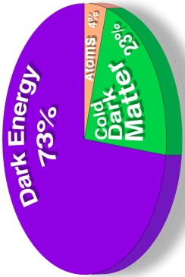
An invisible problem...
What is 96% of the universe made of?
Everything we see in the Universe, from an ant to a galaxy, is made up of ordinary particles. These are collectively referred to as matter, forming 4% of the Universe.
Dark matter and dark energy are believed to make up the remaining proportion, but they are incredibly difficult to detect and study.
Investigating the nature of dark matter and dark energy is one of the biggest challenges today in the fields of particle physics and cosmology.

Slide 13
Why is there no more antimatter?
We live in a world of matter – everything in the Universe, including ourselves, is made of matter.
Antimatter is like a twin version of matter, but with opposite electric charge.
At the birth of the Universe, equal amounts of matter and antimatter should have been produced in the Big Bang.
But when matter and antimatter particles meet, they annihilate each other, transforming into energy.
Somehow, a tiny fraction of matter must have survived to form the Universe we live in today, with hardly any antimatter left.
Why does Nature appear to have this bias for matter over antimatter?

Slide 14
Secrets of the Big Bang
What was matter like within the first second of the Universe’s life?
Matter, from which everything in the Universe is made, is believed to have originated from a dense and hot cocktail of fundamental particles.
Today, the ordinary matter of the Universe is made of atoms, which contain a nucleus composed of protons and neutrons, which in turn are made of quarks bound together by other particles called gluons.
The bond is very strong, but in the very early Universe conditions would have been too hot and energetic for the gluons to hold the quarks together.
Instead, it seems likely that during the first microseconds after the Big Bang the Universe would have contained a very hot and dense mixture of quarks and gluons called quark–gluon plasma.

Slide 15
Big Bang – Part 1

Slide 16
Big Bang – Part 2

Slide 17
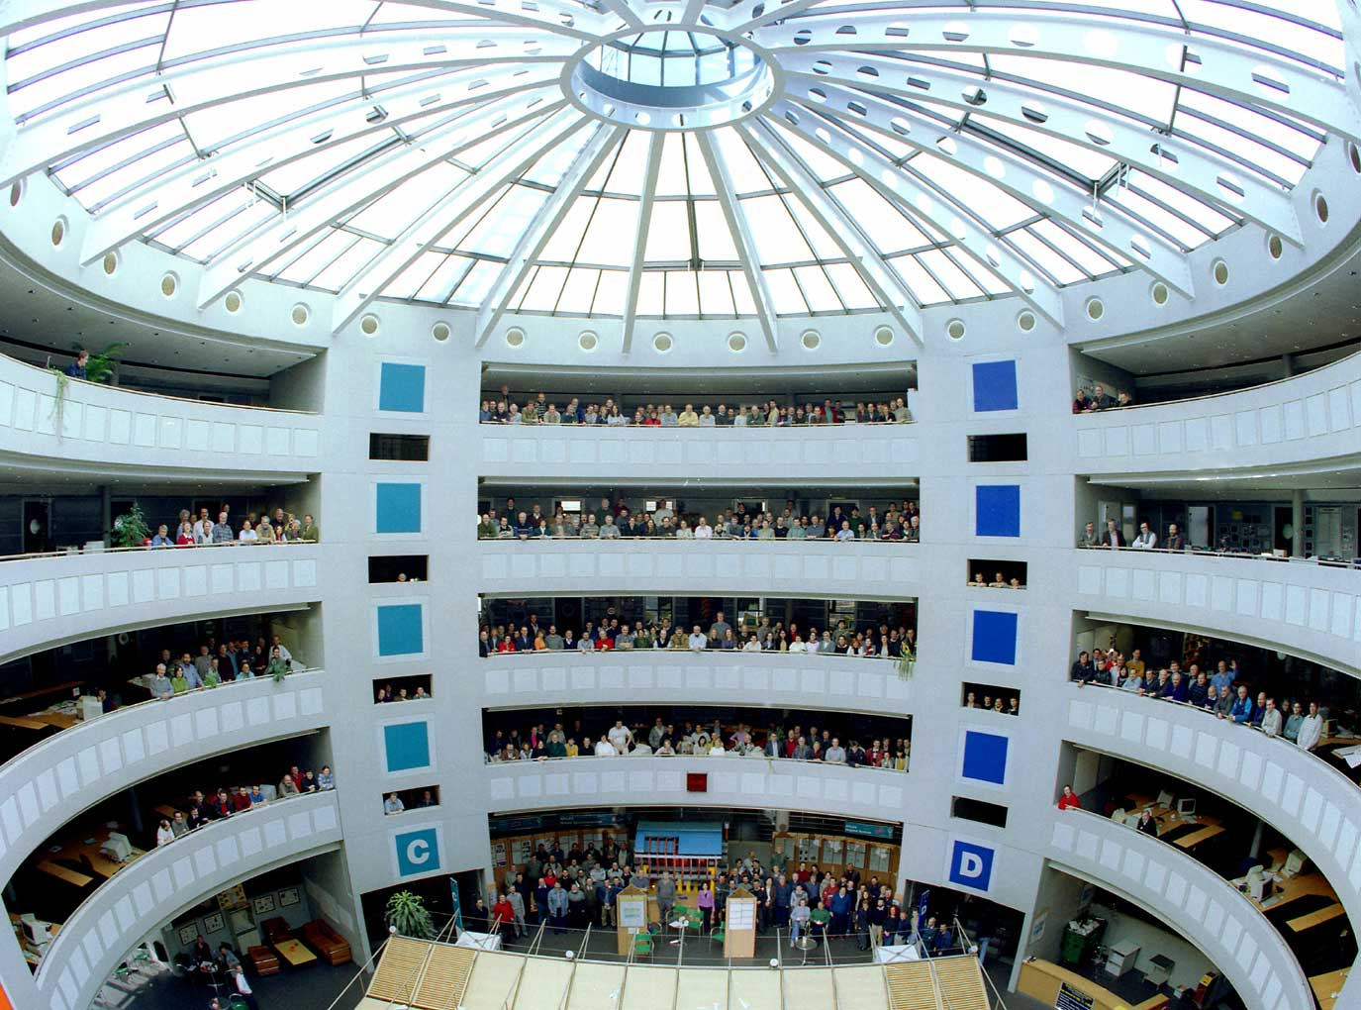
The tools of the trade
Accelerators: powerful machines capable of accelerating particles up to extremely high energies and bringing them into collision with other particles.
Detectors: gigantic instruments recording the particles spraying out from the collisions.
Computers: collecting, stocking, distributing and analysing the enormous amounts of data produced by the detectors.
People: only a collaboration of thousands of scientists, engineers, technicians and support staff can design, build and operate these amazing machines

Slide 18

CERN: A world laboratory

Slide 19
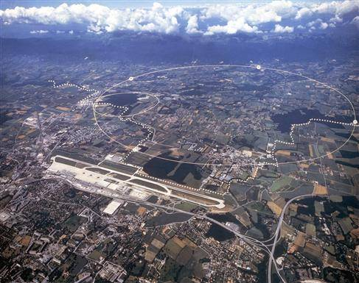
Large Hadron Collider timeline
1982: First studies for the LHC project
1984: Workshop on a Large Hadron Collider
1987: Rubbia Committee recommends LHC
1990: ECFA LHC Workshop
1992: General meeting on LHC Physics and Detectors
1993: Letters of Intent (ATLAS and CMS selected by LHCC)
1994: Technical proposals approved
1996: Approval to move to construction (ceiling of 475 MCHF)
1998: Memorandum of Understanding for construction signed
1998: Construction begins
2000: CMS assembly begins above ground
2004: CMS Underground caverns completed
2008: CMS ready for first proton-proton collisions
2009-2030: Physics operation
27 km ring of superconducting magnets built underground across two countries – Switzerland and France

Slide 20
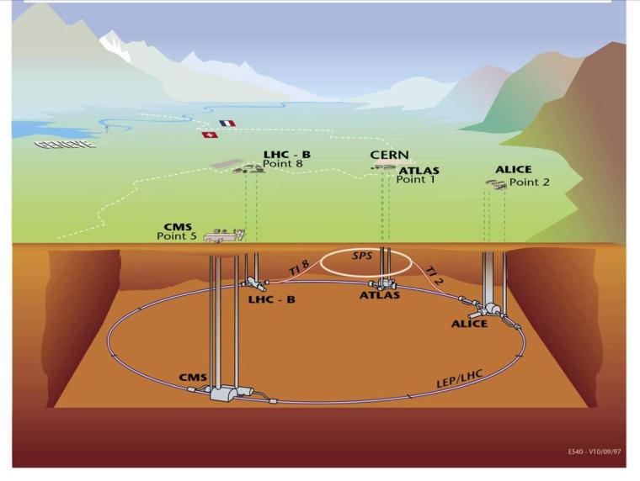
Overall layout of LHC
Four very large particle physics experiments

Slide 21
LHC: Some of the technical challenges
Circumference (km) | 26.7 | 100-150m underground
Number of dipoles | 1232 | Cable Nb-Ti, cold mass 37million kg
Length of dipole (m) | 14.3
Dipole field strength (Tesla) | 9 | Results from the high beam energy needed
Operating temperature (K) | 1.9 | Superconducting magnets needed
Current in dipole coils (A) | 13000 | Due to high magnetic field 1ppm resolution
Beam intensity (A) | 0.5 | 2.2.10⁻⁶ loss causes quench
Beam stored energy (MJ) | 2*360 | Due to high beam energy and high beam current
Magnet stored energy (MJ/sector) | 1100 | Results from the high magnetic field
Sector powering circuit | 8 | 1612 different electrical circuits

Slide 22
Fascinating facts about LHC
When the 27-km long circular tunnel was excavated, between Lake Geneva and the Jura mountain range, the two ends met up to within 1 cm.
Each of the 6400 superconducting filaments of niobium–titanium in the cable produced for the LHC is about 0.007 mm thick, about 10 times thinner than a normal human hair. If you added all the filaments together they would stretch to the Sun and back five times with enough left over for a few trips to the Moon.
All protons accelerated at CERN are obtained from standard hydrogen. Although proton beams at the LHC are very intense, only 2 nano grams of hydrogen are accelerated each day. Therefore, it would take the LHC about 1 million years to accelerate 1 gram of hydrogen.
The central part of the LHC will be the world’s largest fridge. At a temperature colder than deep outer space, it will contain iron, steel and the all important superconducting coils.
The pressure in the beam pipes of the LHC will be about ten times lower than on the Moon. This is an ultrahigh vacuum.
Protons at full energy in the LHC will be travelling at 0.999999991 times the speed of light. Each proton will go round the 27 km ring more than 11,000 times a second.
At full energy, each of the two proton beams in the LHC will have a total energy equivalent to a 400t train (like the French TGV) travelling at 150 km/h. This is enough energy to melt 500 kg of copper.
The CMS experiment magnet system contains about 10,000t of iron, which is more iron than in the Eiffel Tower.
The data recorded by each of the big experiments at the LHC will be enough to fill around 5,000,000 DVDs every year.

Slide 23

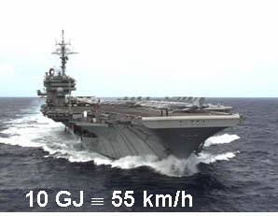
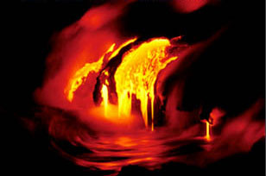
Energy management challenges
10 GJ ≅ flying 700 km/h
700 MJ melt one ton of copper
Energy stored in the magnet system ≈ 10GJ
700 MJ dissipated in 88ms
700.106 / 88.106 ≈ 8TW
World electrical installed capacity ≈ 3.8TW
Energy stored in the two beams: 720MJ
90 kg of TNT per beam
23
Notes:
23
Aircraft carrier

Slide 24
Are the LHC collisions dangerous?
Radiation?
Radiation is unavoidable at particle accelerators like the LHC.
The particle collisions that allow us to study the origin of matter also generate radiation.
CERN uses active and passive protection means, radiation monitors and various procedures to ensure that radiation exposure to the staff and the surrounding population is as low as possible and well below the international regulatory limits.
For comparison, note that natural radioactivity — due to cosmic rays and natural environmental radioactivity — is about 2400μSv/year in Switzerland.
The LHC tunnel is housed 100m underground, so deep that both stray radiation generated during operation and residual radioactivity will not be detected at the surface.
Studies have shown that radioactivity released in the air will contribute to a dose to members of the public of no more than 10μSv/year.

Slide 25
Are the LHC collisions dangerous?
Black holes?
Massive black holes are created in the Universe by the collapse of massive stars, which contain enormous amounts of gravitational energy that pulls in surrounding matter.
The gravitational pull of a black hole is related to the amount of matter or energy it contains — the less there is, the weaker the pull.
Some physicists suggest that microscopic black holes could be produced in the collisions at the LHC.
However, these would only be created with the energies of the colliding particles (equivalent to the energies of mosquitoes), so no microscopic black holes produced inside the LHC could generate a strong enough gravitational force to pull in surrounding matter.
If the LHC can produce microscopic black holes, cosmic rays of much higher energies would already have produced many more. Since the Earth is still here, there is no reason to believe that collisions inside the LHC are harmful.

Slide 26

Visualisation of a blackhole

Slide 27
Are the LHC collisions dangerous?
Unprecedented energy collisions?
Accelerators only recreate the natural phenomena of cosmic rays under controlled laboratory conditions.
Cosmic rays are particles produced in outer space in events such as supernovae or the formation of black holes, during which they can be accelerated to energies far exceeding those of the LHC.
Cosmic rays travel throughout the Universe, and have been bombarding the Earth’s atmosphere continually since its formation 4.5 billion years ago.
Since the much higher-energy collisions provided by nature for billions of years have not harmed the Earth, there is no reason to think that any phenomenon produced by the LHC will do so.
Cosmic rays also collide with the Moon, Jupiter, the Sun and other astronomical bodies.
The total number of these collisions is huge compared to what is expected at the LHC. The fact that planets and stars remain intact strengthens our confidence that LHC collisions are safe.
The LHC’s energy, although powerful for an accelerator, is modest by nature’s standards.

Slide 28
Are the LHC collisions dangerous?
Mini big bangs?
Although the energy concentration (or density) in the particle collisions at the LHC is very high, in absolute terms the energy involved is very low compared to the energies we deal with every day or with the energies involved in the collisions of cosmic rays.
However, at the very small scales of the proton beam, this energy concentration reproduces the energy density that existed just a few moments after the Big Bang—that is why collisions at the LHC are sometimes referred to as mini big bangs.

Slide 29
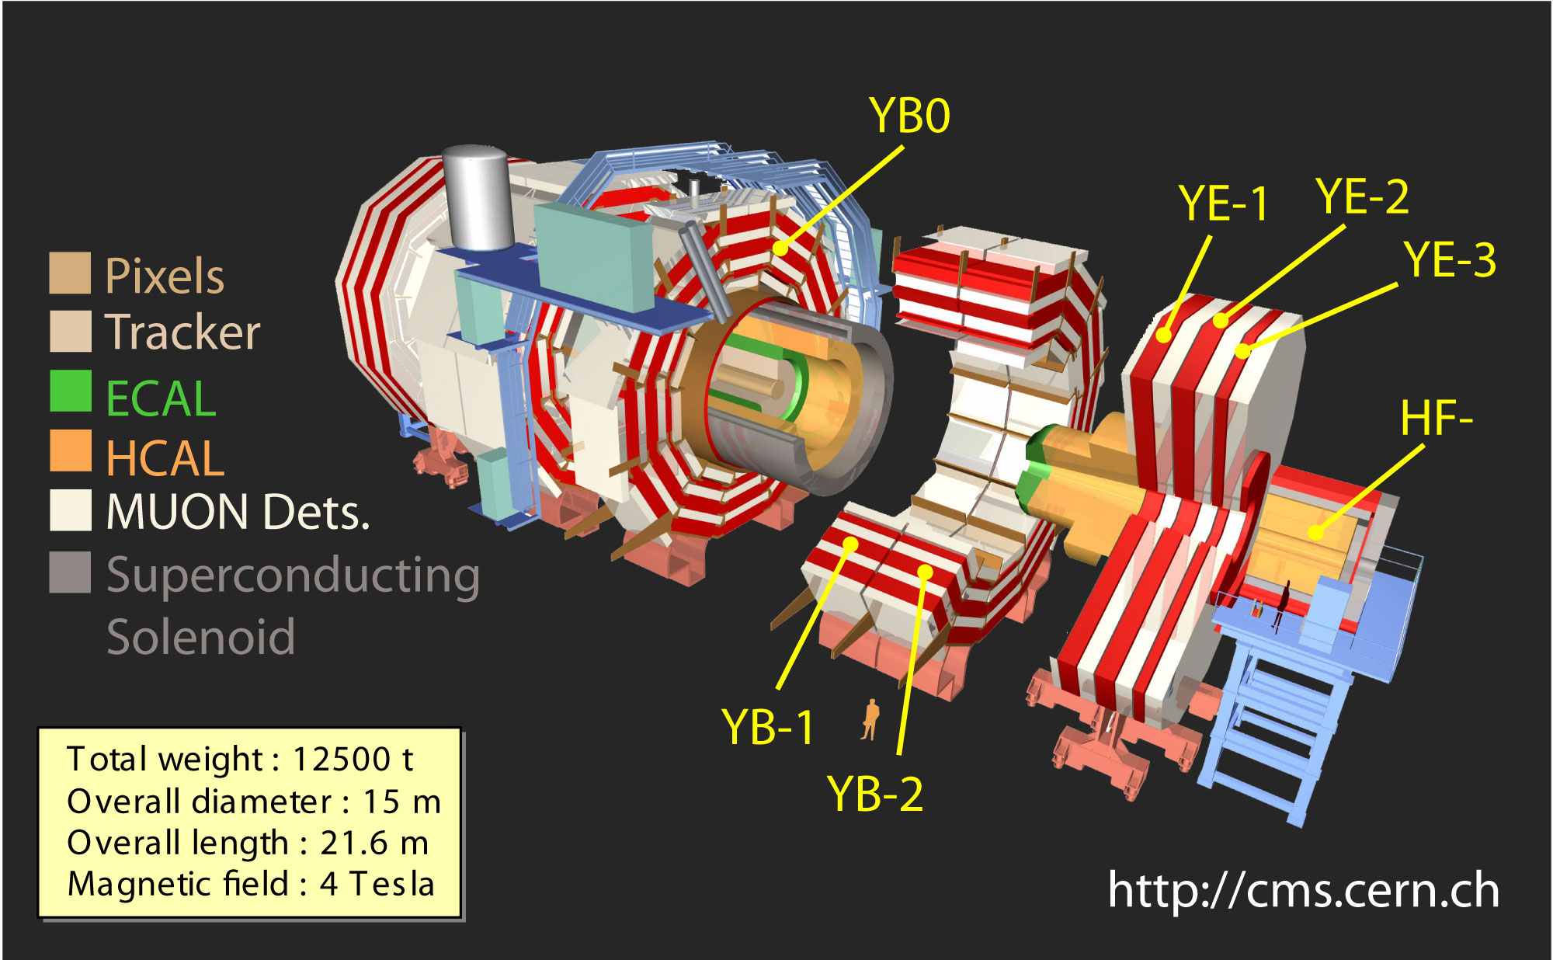
CMS – One of the experiments on LHC

Slide 30
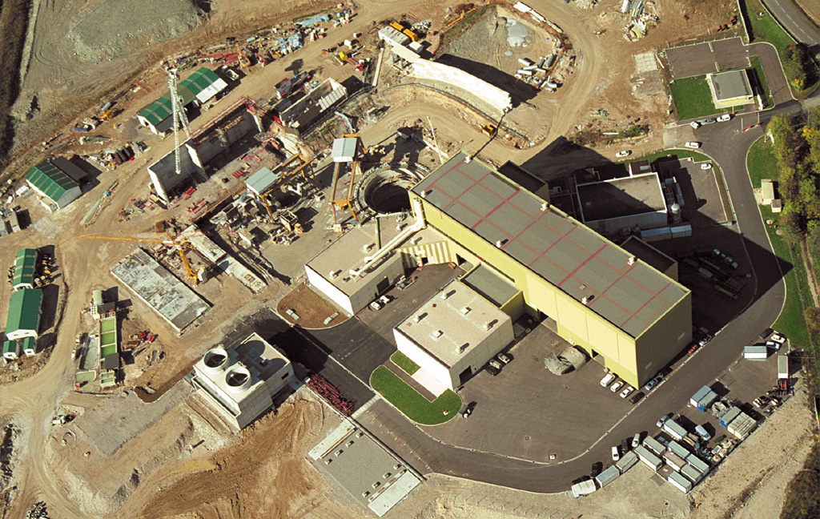
CMS Experiment under construction

Slide 31
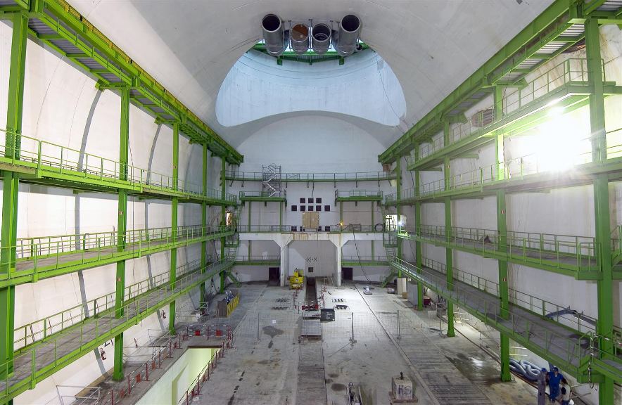
Home ready for CMS detector

Slide 32
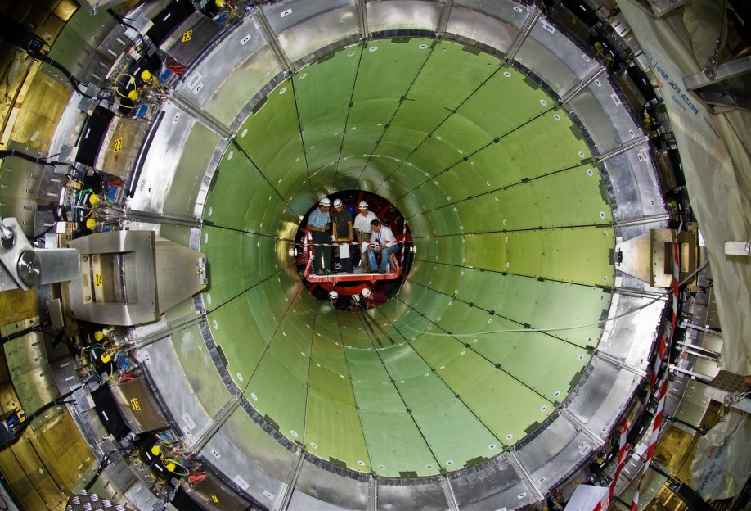
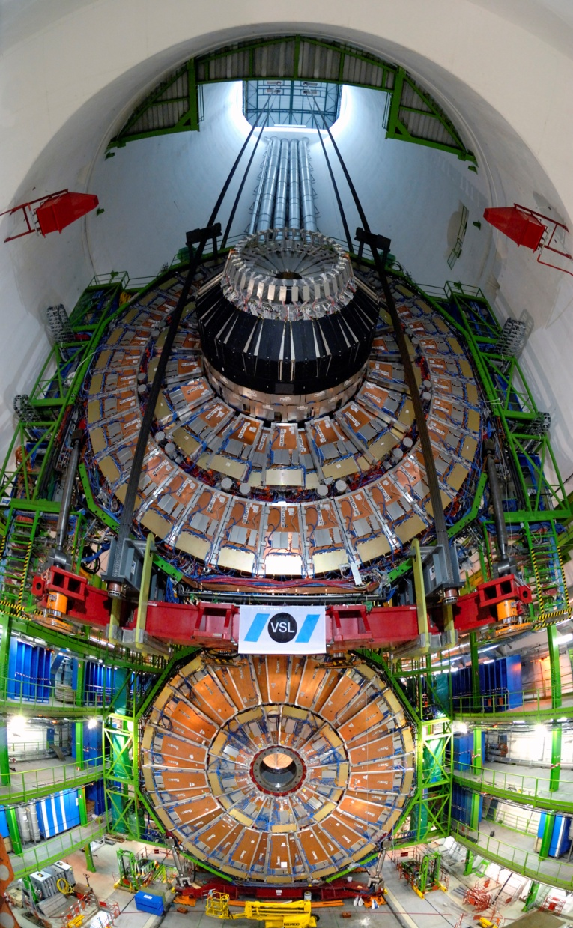
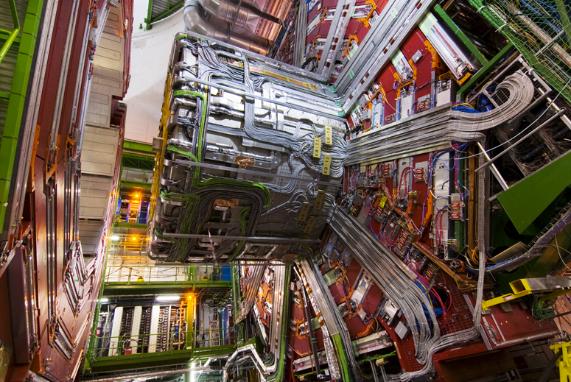
Extreme engineering

Slide 33
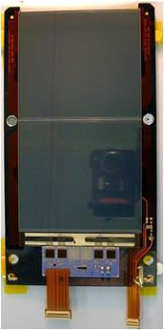
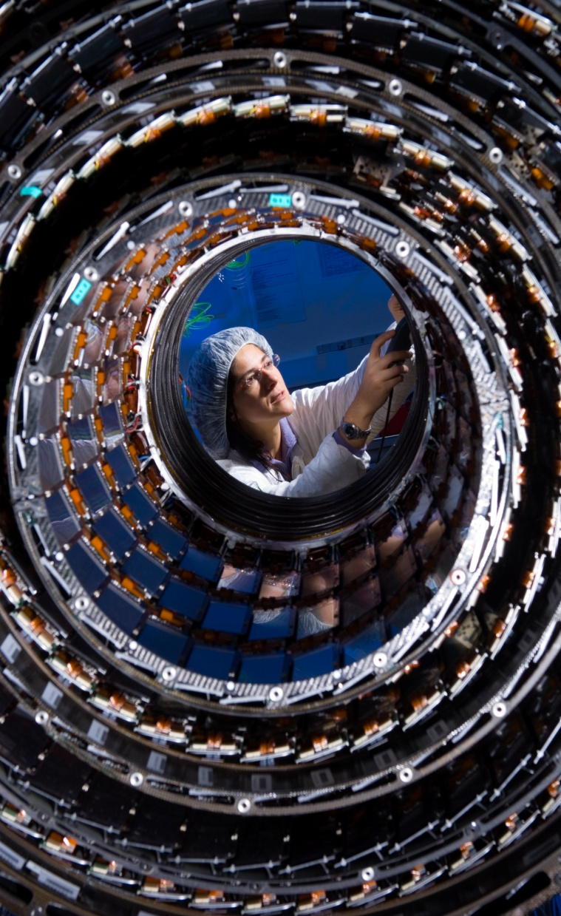
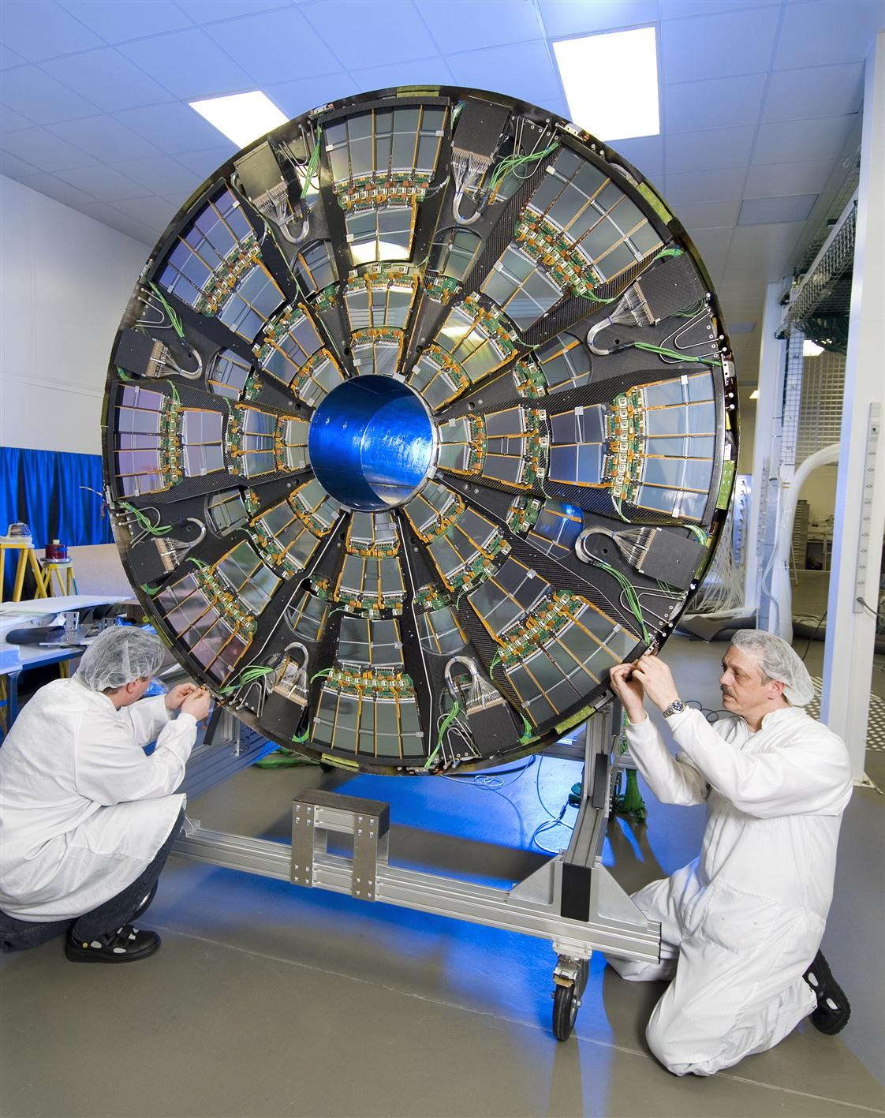
Riding on Silicon technology wave
75k chips using
0.25μm technology

Slide 34
Typical particle collisions at the LHC

Slide 35
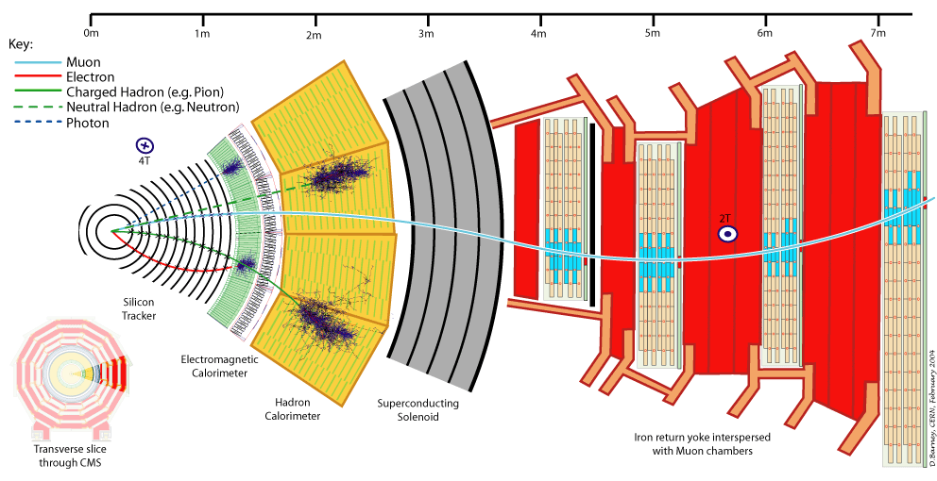
Slice of an accelerator physics experiment

Slide 36
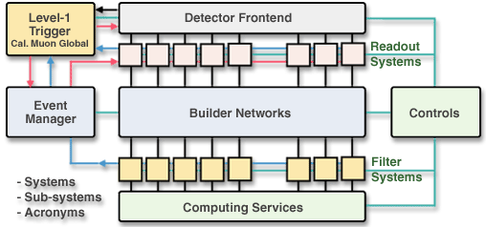
Trigger and data acquisition system

Slide 37
Acquiring and recording data of Interest

Slide 38
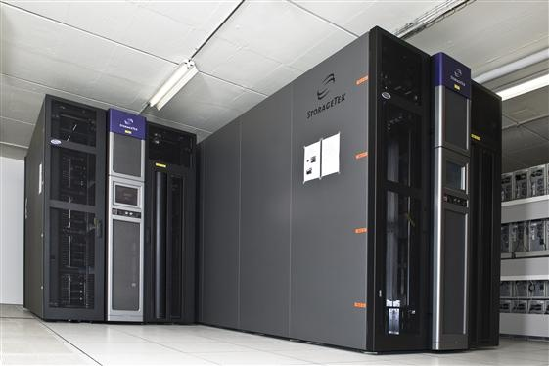
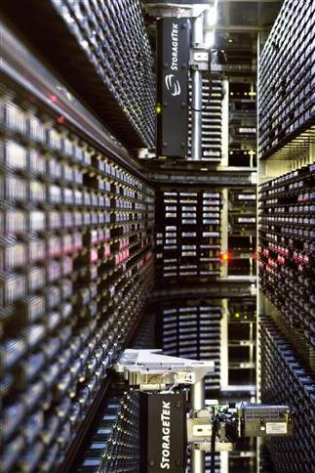
Giant computing systems
The World Wide Web (invented at CERN) provides seamless access to information that is stored in many millions of different geographical locations.
The Grid is an infrastructure that provides seamless access to computing power and data storage capacity distributed over the globe.

Slide 39
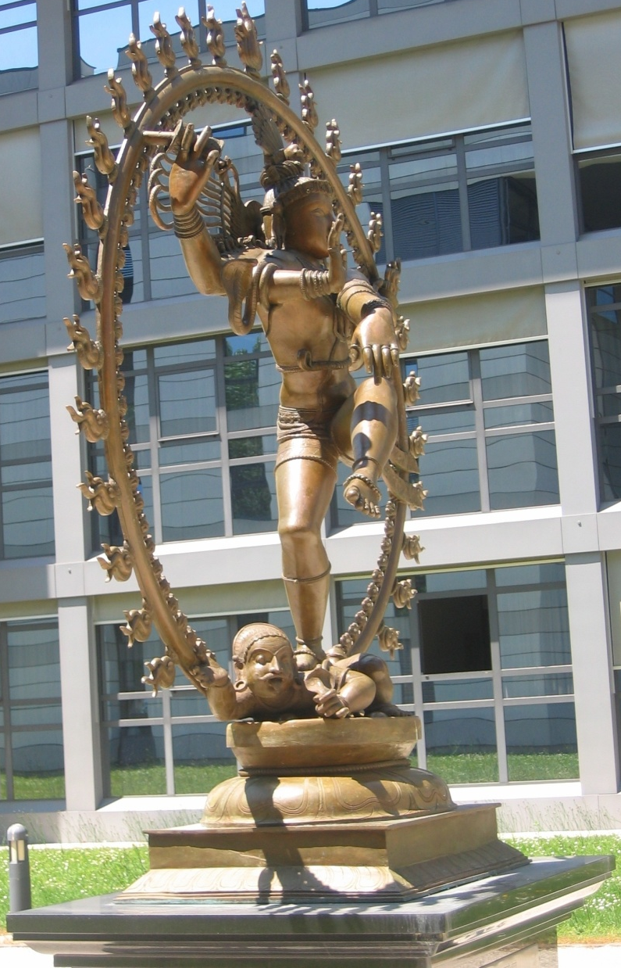
Indians@LHC
Large number of Indian scientists and engineers have worked for the LHC.
Built a large number of magnets as well as very crucial components required for LHC machine.
Built parts of two big experiments on LHC, namely CMS and ALICE.
Built computer GRIDs for performing very fast calculations.
Developed physics analysis software and many sophisticated software tools.
Indian contributions towards LHC project are crucial and well recognised.
nataraj@cern.ch

Slide 40
What is your take?

Slide 41
Summary
The LHC project (the accelerator and experiments) was conceived and designed to answer the questions in particle physics (and science).
The LHC accelerator and the experiments are unprecedented in complexity and is being operated in an unprecedented and hostile environment.
Driven by the science, many technologies have been pushed to their limits.
The project has required a long and painstaking effort on a global scale.
The accelerator and the experiments are unparalleled scientific instrument(s) - a powerful microscope as well as a powerful telescope.
All expectations are that what we find at the LHC will reform our understanding of nature at the most fundamental level.
Only experiments reveal/confirm Nature’s inner secrets.

Slide 42
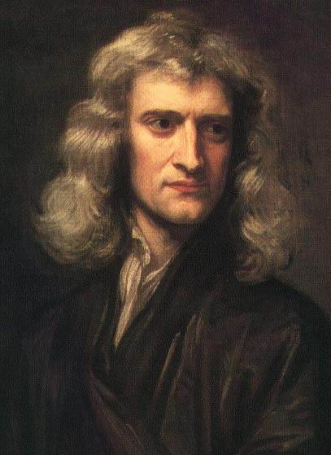
Philosophy of Science
To me there has never been a higher source of earthly honour or distinction than that connected with advances in science.
I seem to have been only like a boy playing on the seashore, and diverting myself in now and then finding a smoother pebble or a prettier shell than ordinary, whilst the great ocean of truth lay all undiscovered before me.
Sir Isaac Newton

Slide 43
Backup slides

Slide 44
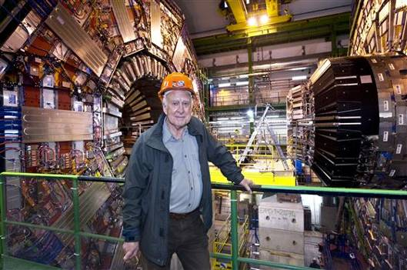
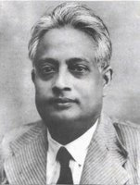
Higgs and Bose

Slide 45
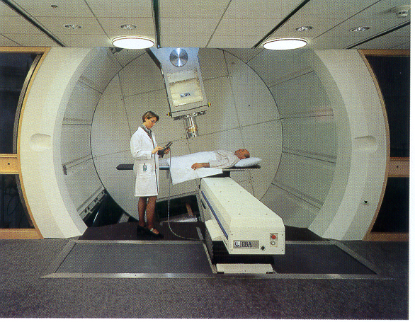
Accelerators: developed in physics labs are used in hospitals
Hadron Therapy
Courtesy of IBA
Around 9000 of the 17000 accelerators operating in the World today are used for medicine.

Slide 46
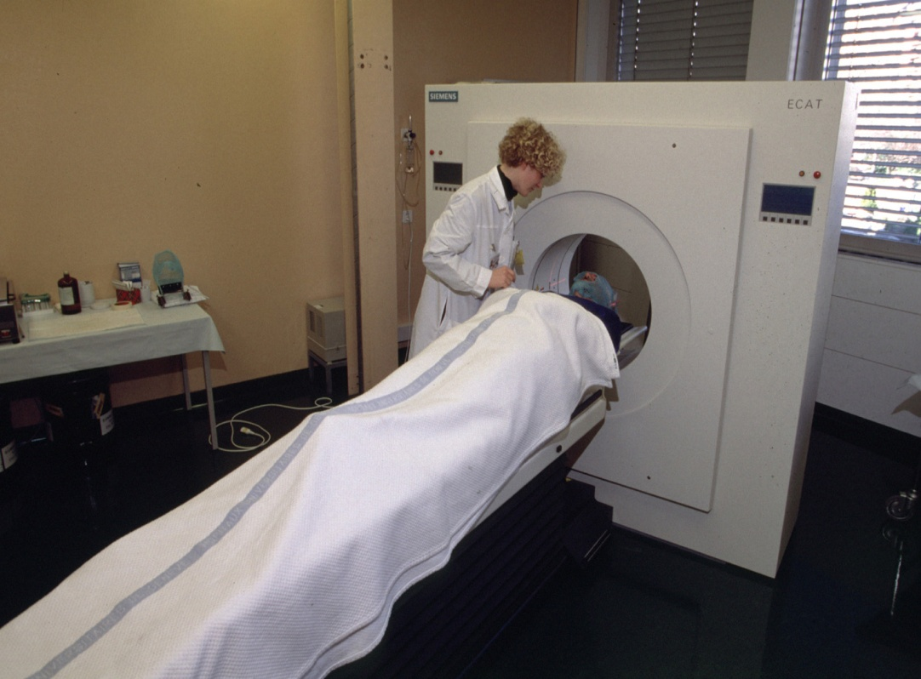
Detectors: developed in physics labs are used for medical imagery
PET (Positron Emission Tomography) is a very important technique for localising and studying certain types of cancer using the Fluor-18 isotope produced by particle accelerators. PET uses antimatter (positrons).

Slide 47
Other spinoffs include… WWW

Slide 48
Fundamental research has always been a driving force for innovation
For GPS to work, we have to take into account the correction due to time dilation. Otherwise, there would be a position error of around 10m after just 5 minutes of travel-time!
Relativity
A. Einstein
Telephones use electromagnetic waves to communicate
Electromagnetism
J.C. Maxwell

