Slide 1
Pollution: Why should I care?
Dr. B.Satyanarayana ▪ Scientific Officer (G)
Department of High Energy Physics ▪ Tata Institute of Fundamental Research
Homi Bhabha Road ▪ Colaba ▪ Mumbai ▪ 400005 ▪ INDIA
T: 09987537702 ▪ E: bsn@tifr.res.in ▪ W: http://www.tifr.res.in/~bsn

Slide 2
Terminology & definitions
Pollutants: substances that contaminate air, water and or soil.
Contaminate: to pollute or infect, or make water, soil or air unclean or impure.
Bio-degradable: The ability of a substance to be broken down into simpler substances by the natural process of decay – example: crop wastes etc.
Non biodegradable: Substance that cannot be broken down into simple substances by the natural process of decay, e.g., heavy metals or radioactive materials etc.
Noise pollution

Slide 3
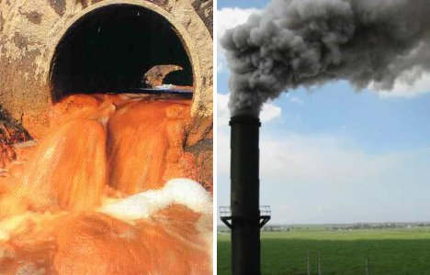
A startling fact
40% of all deaths worldwide are linked to water, air and soil pollution.

Slide 4
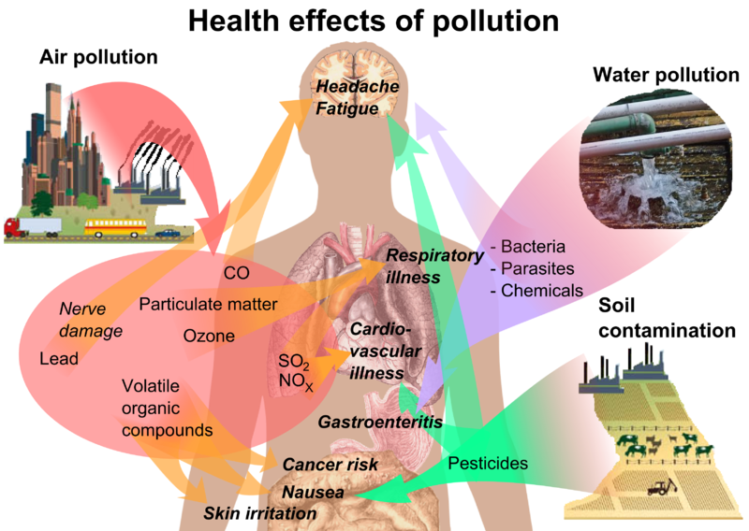
Health effects of pollution

Slide 5
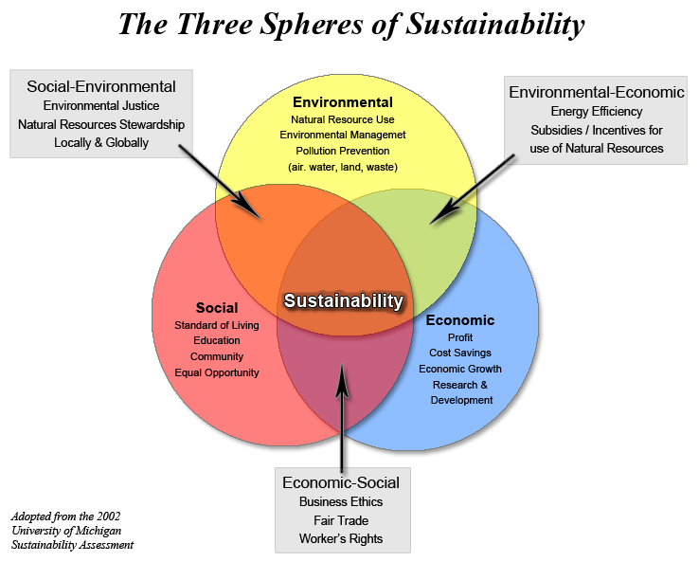
Three Spheres of Sustainability

Slide 6

Energy and environment
Clean and safe power

Slide 7
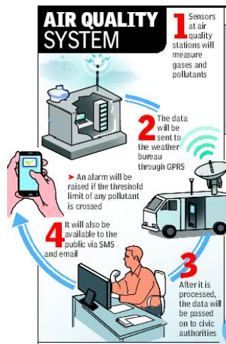
Air quality monitoring in cities
The Times Of India: Date: Aug 1, 2013
Mumbai to get pollution info on 15 screens.
Real-time weather information and pollution levels will soon be available at big traffic intersections in the city. Under the System of Air Quality Forecasting and Research (SAFAR), the data generated by the air quality stations will be sent to the weather bureau through GPRS, and after it is processed, passed on to civic authorities. Localized weather and pollution data to be available on SMS & email soon. If the threshold of any pollutant is crossed, an alarm will be raised.

Slide 8
Preventing air pollution
The use of lead-free petrol will prevent the release of lead into the atmosphere.
Special filters will reduce smoke emissions from factories and industries. This will require government legislation and drastic intervention.
Strict policies to prevent the release of gases like CFCs and nitrogen oxide into the air, should be formulated.
Electrical motorcars and trucks should be developed to reduce the CO2 and CO emissions into the atmosphere.
More efficient public transport systems to reduce traffic congestion reduce fuel usage and reduce air pollution, should be introduced.

Slide 9
Water pollution
Educate the community about the importance of recycling.
Enforce large fines for the illegal dumping of sewage into rivers and streams.
Enforce strict laws to prevent factories from dumping wastes into rivers, streams, dams and seas.
Check oil tankers thoroughly checked for seaworthiness before they leave harbours.
Enforce strict laws and very large penalties when oil tankers leak or sink and spill oil. Hold the oil companies accountable for cleaning up any oil spills.
Encourage the use of organic fertilisers instead of inorganic fertilisers.
Encourage farmers to use natural pesticides and natural enemies instead of artificial pesticides and herbicides.

Slide 10
Soil pollution
Educate people to reduce, re-use and recycle.
Enforce legislation to prevent dumping in unauthorised areas with strict fines.
Large fines levied when people litter, e.g., Hong Kong and Singapore.
Use only indigenous trees for afforestation.
Educate farmers to ensure crop rotation.
Form action groups in communities to clean up polluted areas.

Slide 11
Noise pollution
Noise pollution has become a common feature of our daily life. But very loud noise makes us irritable.
It is not only in metropolitan cities or cities but also in villages and towns that experience noise pollution.
Tourist places can also be a problem that creates noise pollution.
High noise levels can contribute to cardiovascular effects in humans, increased blood pressure and increased stress and vasoconstriction, and an increased incidence of coronary artery disease.
In animals, noise may increase the risk of death by altering predator or prey detection and contribute to permanent hearing loss.
Escalation procedures vary by country, and may include action in conjunction with local authorities

Slide 12
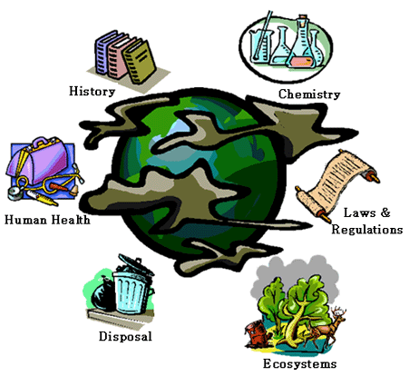
Environment in curriculum

Slide 13

Research on the environment

Slide 14
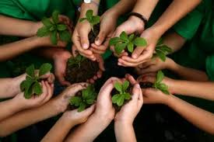
Let us join hands to ...

Slide 15
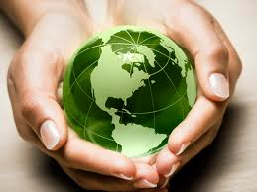
to preserve our dear earth

Slide 16
Congratulations
To the young children who participated in the event and displayed their thought processes in tackling this very important problem facing the world.
To the their teachers and parents who inculcated positive thinking in these young minds and also encouraged them to participate and express.
Irrespective who will be named the winners, every participant in this inspiring event is a winner.
These events offer fantastic opportunities for the students to discover themselves early on and also interact with peers of their level and maturity.
Excellent efforts by the PSNA CET, media and the sponsors must be highly appreciated.

