Slide 1
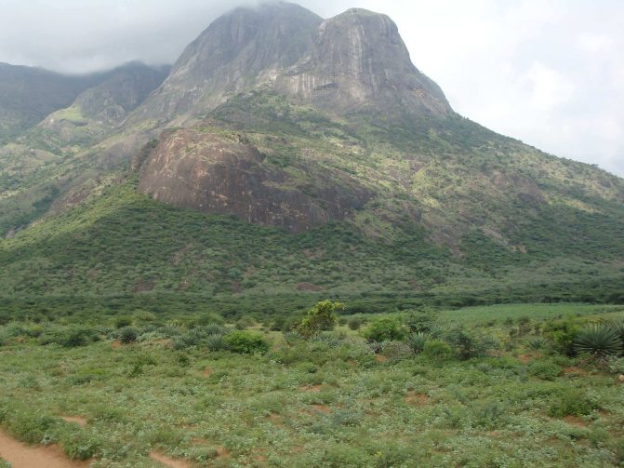
Introduction to the
India-based Neutrino Observatory (INO) Project
B.Satyanarayana
Department of High Energy Physics
Tata Institute of Fundamental Research, Mumbai
E: bsn@tifr.res.in, W: http://www.tifr.res.in/~bsn

Slide 2
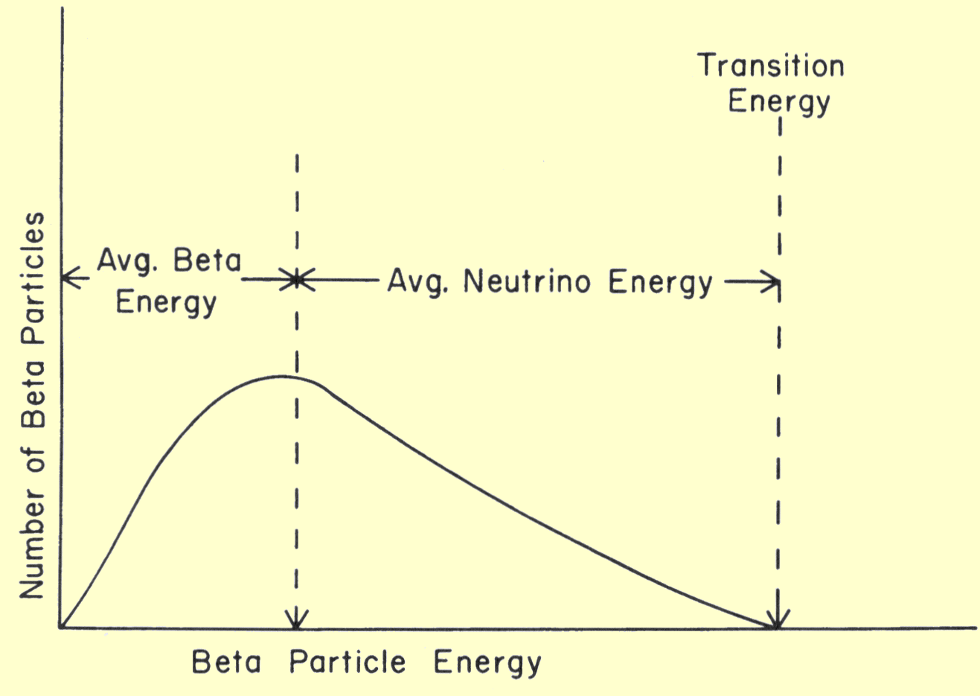
Neutrino (ν)
Proposed by Wolfgang Pauli in 1930 to explain beta decay.
Named by Enrico Fermi in 1931.
Discovered by F.Reines and C.L.Cowan in 1956.
Created during the Big Bang, Supernova, in the Sun, from cosmic rays, in nuclear reactors, in particle accelerators etc.
Interactions involving neutrinos are mediated by the weak force.
Available energy for the decay is shared between the β-particle and the (anti-) neutrino which goes undetected

Slide 3
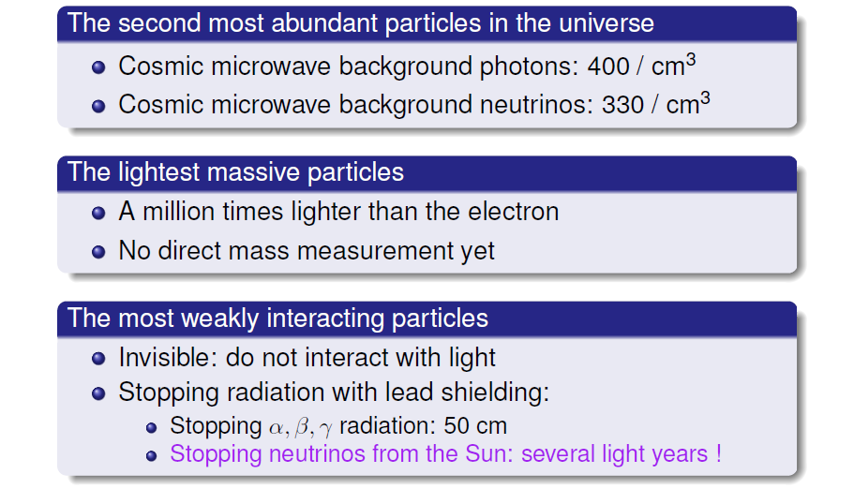
Unique features of neutrinos

Slide 4
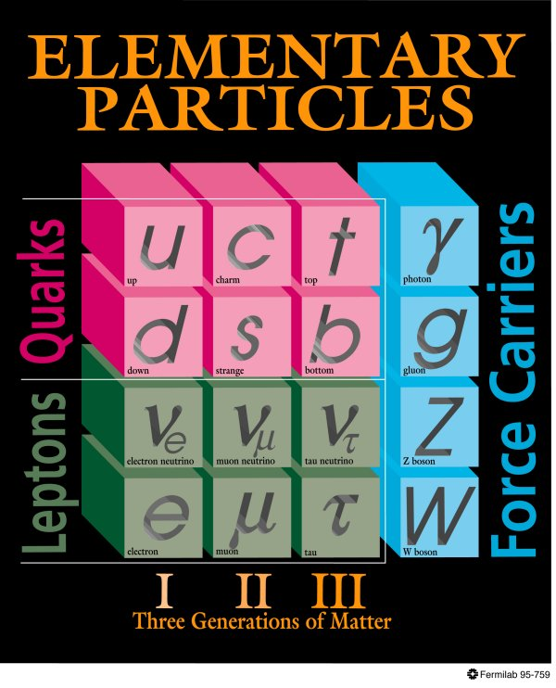
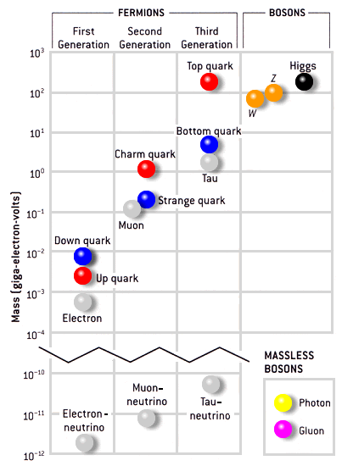
Standard model of particle physics
<2.2eV
<170keV
<15.5MeV

Slide 5
Neutrino oscillations
It is now known that neutrinos of one flavour oscillate to those of another flavour.
The oscillation mechanism is possible only if the neutrinos are massive.
Neutrino experiments are setting the stage for extension of Standard Model itself.
Massive neutrinos have ramifications on nuclear physics, astro physics cosmology, geo physics apart from particle physics
Electron and muon neutrinos (ν_{e} and ν_{μ}) are the flavour eigen states. They are super positions of the mass eigen states (ν₁ and ν₂)
If at t = 0, an eigen state ν (0) = ν_{e,} then any time t
Then the oscillation probability is
And the oscillation length is

Slide 6
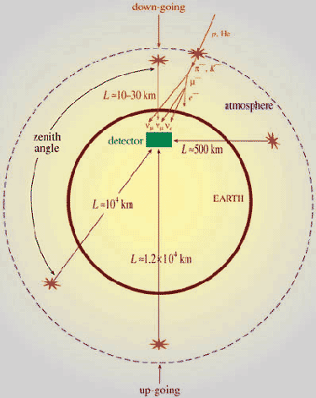
Up-Down asymmetry measurement
Atmospheric neutrino energy > 1.3GeV Δm² ~2-3×10⁻³ eV²
Downward muon neutrino are not affected by oscillation
They may constitute a near reference source
Upward neutrino are instead affected by oscillation since the L/E ratio ranges up to 10⁴ Km/GeV
They may constitute a far source
Thus, oscillation studies with a single detector and two sources

Slide 7
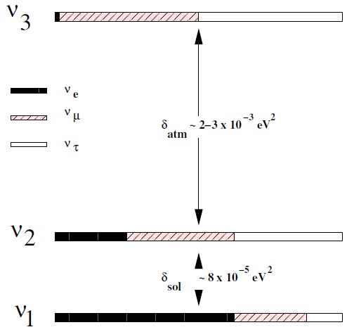
Matter effects and neutrino mass hierarchy
Matter effects help to cleanly determine the sign of the Δm²
Neutrinos and anti-neutrinos interact differently with matter
ICAL can distinguish this by detecting charge of the produced muons, due to its magnetic field
Helps in model building for neutrino oscillations

Slide 8
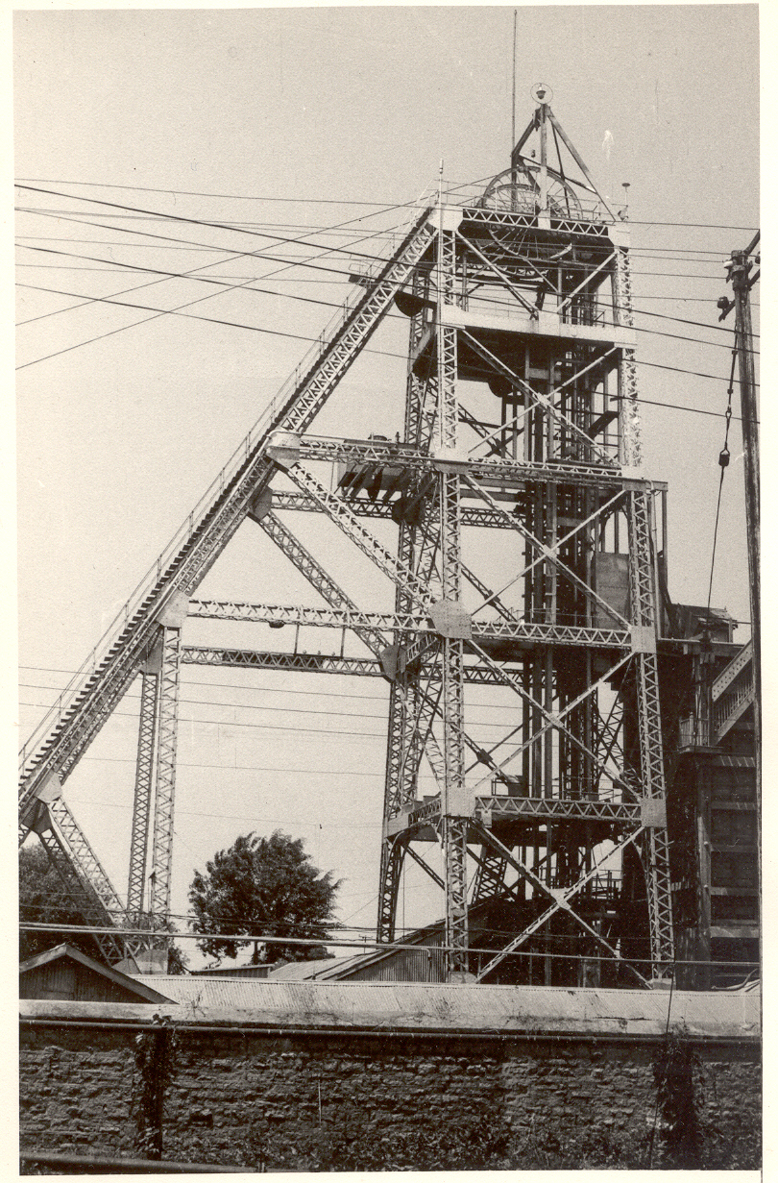
History of neutrino physics in India
High Energy Physics research using underground detectors at Kolar Gold Fields during 1952-92.
Muon intensities and angular distributions at various depths.
Indian initiative in neutrino physics goes back to more than 35 years.
Demonstrated for the first time the feasibility of doing neutrino experiment at KGF in south India.
International collaboration experiment to detect atmospheric neutrinos started at KGF in 1964.
Detection of atmospheric neutrino in 1965.
KGF data during the proton decay era was used to look for ultra high energy neutrino sources in the sky.
Bounds on neutrino masses using cosmological data.
Estimation of atmospheric neutrino flux.
KGF underground shaft

Slide 9
India-based Neutrino Observatory project
The primary goal of INO is neutrino physics.
A national collaboration of scientists from more than 20 groups belonging to DAE institutions, IITs and Universities.
The total cost of the project is expected to be about `1500 crores.
The project includes:
  construction of an underground laboratory and associated surface facilities,
  construction of a Iron Calorimeter (ICAL) detector for neutrinos,
  setting up of National Centre for High energy Physics (NCHEP),
  other experiments and future proposals.
The project is expected to be completed within seven years beginning April 2012.
A successful INO-Industry interface developed because of the large scale of experimental science activity involved.
INO Graduate Training Programme under the umbrella of Homi Bhabha National Institute (HBNI) is in its fifth year (about 25 INO students)

Slide 10
National Centre for HEP (NCHEP)
To be setup in Madurai, close to the INO facility.
Human resource development in basic experimental science research.
Responsible for operation of the INO facilities.
Will develop full-fledged manpower to operate and maintain the INO laboratory.
Development of detector technology and its varied applications, such as in medical imaging, material science, industrial control and geological survey.

Slide 11
Physics possibilities with ICAL
ICAL is capable of shedding light on the neutrino mass hierarchy, or the ordering of neutrino masses, due to its unique capability to identify lepton charge.
Determining the hierarchy would be a crucial pointer to the physics that lies beyond the Standard Model.
ICAL can significantly aid in improving the precision of the atmospheric mass squared difference and the associated mixing angle.
Using effects primarily due to earth's matter, it can also shed light on the octant of the atmospheric mixing angle.
ICAL is capable of substantially adding to our present knowledge of very high energy cosmic ray muons due to its unique capability to access hitherto unexplored energy regions in this sector.
Several studies have also explored ICAL's capabilities as an end detector for a neutrino factory or a beta beam. This would allow precise measurements of very important parameters like the CP phase and the small mixing between two of the neutrino mass states.

Slide 12
Main physics goals of NDBD
The mass and nature of neutrinos play an important role in theories beyond the Standard Model.
The nuclear β decay and double beta decay can provide the information on absolute effective mass of the neutrinos.
At present, neutrino-less double beta decay is perhaps the only experiment that can tell us whether the neutrino is a Dirac or a Majorana particle.
Determining type of mass hierarchy (normal, inverted or quasi-degenerated).
Probing CP violation in the leptonic sector.

Slide 13
Other proposed experiments at INO
Work on a dark matter experiment using Silicon crystals (DINO) in progress.
Proposal for a low energy accelerator for experimental nuclear astrophysics studies; utilising the low back-ground environment inside the INO facility.
The INO facility will develop into a centre for other studies in physics, biology, geology, etc., which will exploit the special conditions existent deep underground.

Slide 14
INO Collaboration
Spokesperson: N.K. Mondal, TIFR, Mumbai
Home page: http://www.ino.tifr.res.in
Ahmedabad: Physical Research Laboratory (PRL)
S. Goswami, A.S. Joshipura
Aligarh: Aligarh Muslim University (AMU)
S. Ahmed, M. Sajjad Athar, R. Hasan, S.K. Singh
Allahabad: Harish Chandra Research Institute (HRI)
S. Choubey, R.Gandhi, A.Raychaudhuri
Calicut: University of Calicut (UC)
B.R.S. Babu, A.M. Vinodkumar
Chandigarh: Panjab University (PU)
V.K. Bhandari, V. Bhatnagar, M.M. Gupta, A. Kumar, J.S. Shahi, B. Singh,
J.B. Singh
Chennai: Indian Institute of Technology, Madras (IITM)
N. Chandrachoodan, N. Krishnapurna, J. Libby, A. Prabhakar
Chennai: The Institute of Mathematical Sciences (IMSc)
D. Indumathi, H.S. Mani, M.V.N. Murthy, G. Rajasekaran, N.Sinha
Delhi: Delhi University (DU)
S.K. Chamoli, B.C. Choudhary, D. Choudhury, D. Kaur, A. Kumar,
S. Kumar, S. Mandal, Md. Naimuddin, Shahnawaz, S. Verma, S.K. Verma
Guwahati: Indian Institute of Technology (IITG)
B.Bhuyan, P. Paulose, A. Sil
Hawaii (USA): University of Hawaii (UHW)
S. Pakvasa
Indore: Indian Institute of Technology (IITI)
S. Rakshit
Jammu: University of Jammu (JU)
A. Bhasin, A. Gupta, R. Gupta, S. Mahajan, S.S. Sambyal
Kalpakkam: Indira Gandhi Center for Atomic Research (IGCAR)
J. Jayapandian, C.S. Sundar
Kolkata: Ramakrishna Mission Vivekananda University (RMVU)
Abhijit Samanta
Kolkata: Saha Institute of Nuclear Physics (SINP)
P. Bhattacharya, S. Bhattacharya, Kamales Kar, D. Majumdar, S. Saha
Kolkata: University of Calcutta (CU)
S. Bandyopadhyay, A. Banerjee, D. Jana, G. Gangopadhyay
Kolkata: Variable Energy Cyclotron Centre (VECC)
R.K. Bhandari, S. Chattopadhyay, A.K. Dubey, S.A. Khan, S. Muhuri,
T.K. Nayak, S. Saha, J. Saini, P.R. Sarma, R.N. Singaraju, V. Singhal,
S.K. Thakur, Y.P. Viyogi
Lucknow: Lucknow University (LU)
Jyotsna Singh
Madurai: American College (AC)
S.P.M. Deborrah, K. Gnanasekar, S.R. Inbanathan, K. Moorthy
Mumbai: Bhabha Atomic Research Centre (BARC)
V. Arumugam, Anita Behere, M.S. Bhatia, V.B. Chandratre, V.M. Datar,
M.P. Diwakar, G. Gouthaman, Suresh Kumar, P.K. Mukhopadhyay,
L.M. Pant, B.J. Roy, K. Srinivas, V. Sugadan
Mumbai: Indian Institute of Technology, Bombay (IITB)
Basanta Nandi, S. Uma Sankar, Raghav Varma
Mumbai: Tata Institute of Fundamental Research (TIFR),
B.S. Acharya, S. Banerjee, M.Bhuyan, A. Dighe, K.S. Gothe,
S.D. Kalmani, S. Lahamge, G.Majumder, N.K. Mondal, P. Nagaraj,
B.K. Nagesh, S.K. Rao, L.V. Reddy, A. Redij, D. Samuel, M. Saraf,
B. Satyanarayana, S. Upadhya, P. Verma
Mysore: University of Mysore (MU)
S. Krishnaveni, C. Ranganathaiah, H.B. Ravikumar
Sambalpur: Sambalpur University (SU)
S. N. Nayak
Srinagar: University of Kashmir (UK)
W. Bari, N. Iqbal
Varanasi: Banaras Hindu University (BHU)
B.K. Singh, C.P. Singh, V. Singh

Slide 15
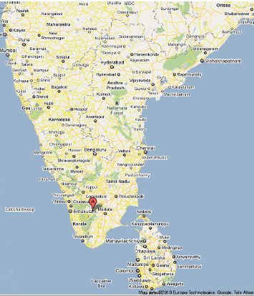
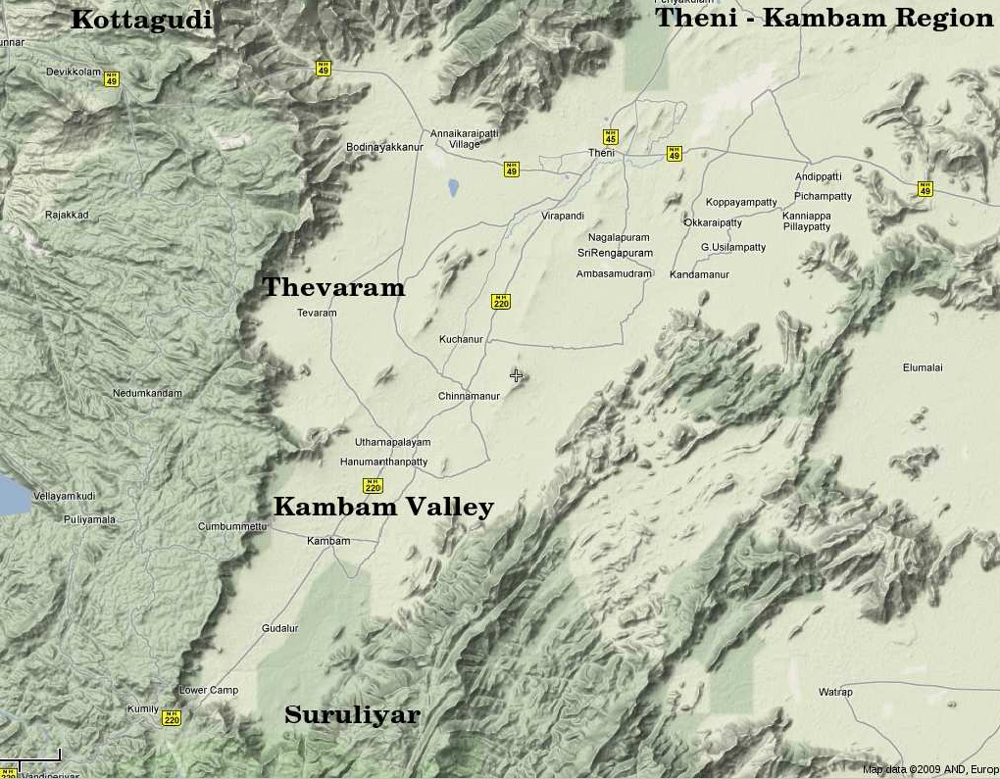
INO coming soon:
Inside a mountain near you!
Location: 9º58′ North; 77º16′ East, 110km from Madurai (South India)

Slide 16
INO coming soon:
Inside a mountain near you!
Location: 9º58′ North; 77º16′ East, 110km from Madurai (South India)
Site for INO underground facility

Slide 17
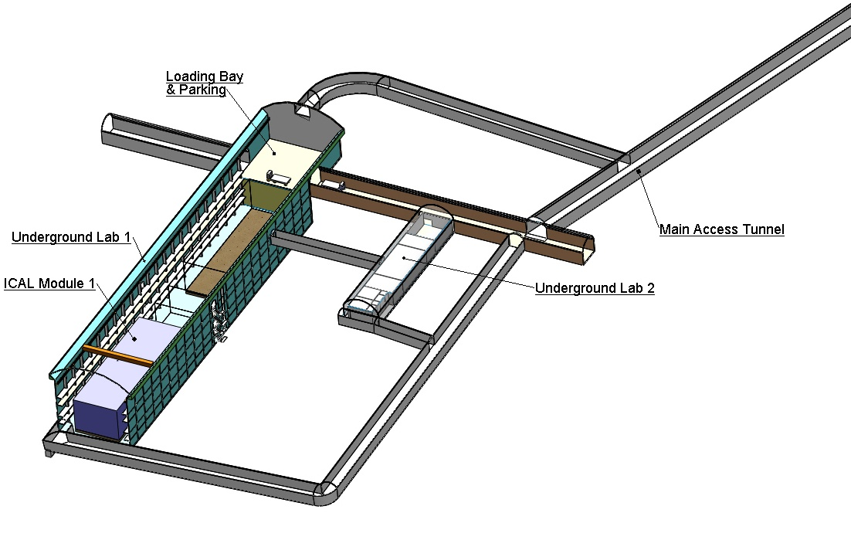
Schematic of the underground labs
Basic features
Length of the tunnel | 2.1 km (approx.)
Tunnel cross-section | 7.5m wide and 7.5m high
Tunnel gradient | 1:15
Rock overburden | 1300m (4000 mwe)
Rock type and density | Charnockite, 2.9 gm/cc
Number of caverns | 3 (one big and two small)
Size of the main cavern | 132m × 26m × 20m (high)
Distance from CERN | 7100 km
Distance from JPARC | 6600 km
Future nuclear reactor | 9000 Mwe, 205 km

Slide 18
Neutrino sources and detector choice
Source of neutrinos
  Use atmospheric neutrinos as source
  Need to cover a large L/E range
    Large L range
    Large E_{ν} range
  Upto 20 GeV muons contained in fiducial volume; most interesting region for observing matter effects in 2–3 sector is 5–15 GeV
  ICAL is sensitive to muons only, very little sensitivity to electrons; Electrons leave few traces (radiation length 1.8 (11) cm in iron (glass))
Physics driven detector requirements
  Should have large target mass (50-100 kT)
  Good tracking and energy resolution (tracking calorimeter)
  Good directionality, up/down discrimination (< 1 nSec time resolution)
  Nearly 4π coverage in solid angle (except near horizontal)
  Good charge identification capability (magnetic field ∼1.5 Tesla)
  Modularity and ease of construction (3 modules of ~17 kTons each)
  Compliment capabilities of existing and proposed detectors
Use magnetised iron as target mass and RPC as active detector medium

Slide 19
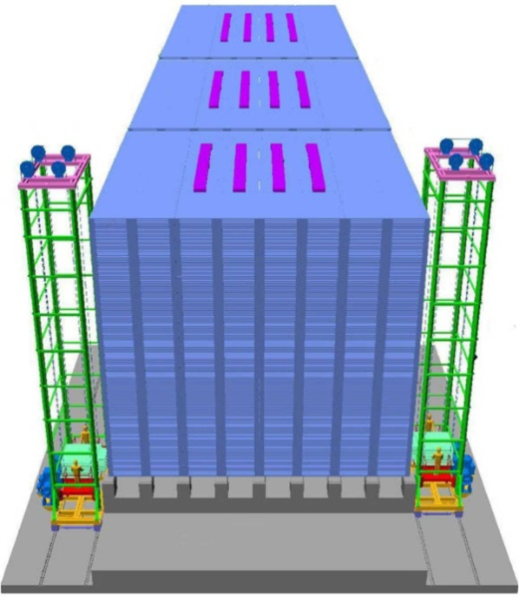
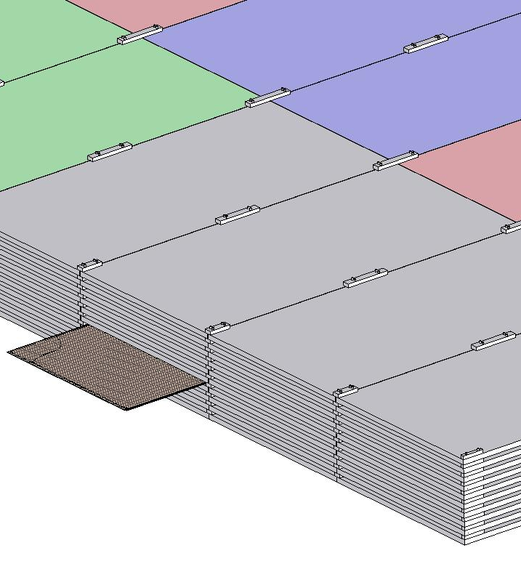
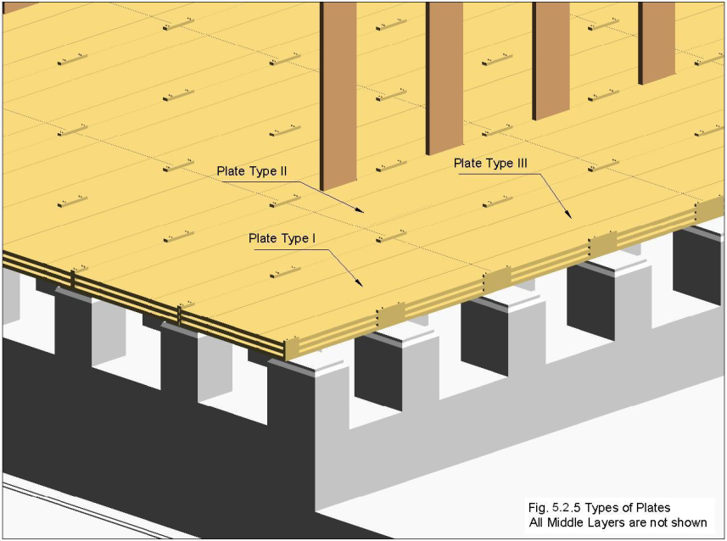
ICAL detector and construction
Magnet coils
4000mm×2000mm
×56mm low carbon iron sheets
RPC handling trolleys
RPC
Total weight: 50Ktons

Slide 20
Factsheet of ICAL detector
No. of modules | 3
Module dimensions | 16m × 16m × 14.5m
Detector dimensions | 48.4m × 16m × 14.5m
No. of layers | 150
Iron plate thickness | 56mm
Gap for RPC trays | 40mm
Magnetic field | 1.3Tesla
RPC dimensions | 1,950mm × 1,840mm × 24mm
Readout strip pitch | 3 0mm
No. of RPCs/Road/Layer | 8
No. of Roads/Layer/Module | 8
No. of RPC units/Layer | 192
No. of RPC units | 28,800 (97,505m²)
No. of readout strips | 3,686,400

Slide 21
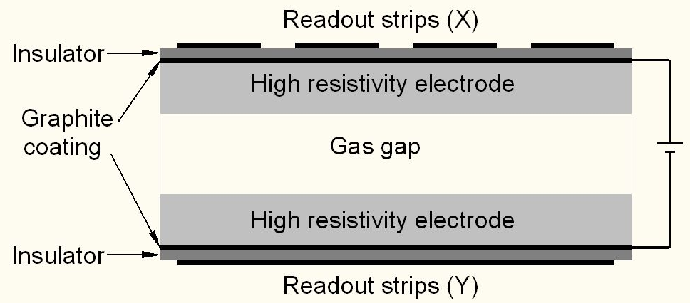
Schematic of a basic RPC

Slide 22
Deployment of RPCs in running experiments
Experiment | Area (m²) | Electrodes | Gap(mm) | Gaps | Mode | Type
PHENIX | ? | Bakelite | 2 | 2 | Avalanche | Trigger
NeuLAND | 4 | Glass | 0.6 | 8 | Avalanche | Timing
FOPI | 6 | Glass | 0.3 | 4 | Avalanche | Timing
HADES | 8 | Glass | 0.3 | 4 | Avalanche | Timing
HARP | 10 | Glass | 0.3 | 4 | Avalanche | Timing
COVER-PLASTEX | 16 | Bakelite | 2 | 1 | Streamer | Timing
EAS-TOP | 40 | Bakelite | 2 | 1 | Streamer | Trigger
STAR | 50 | Glass | 0.22 | 6 | Avalanche | Timing
CBM TOF | 120 | Glass | 0.25 | 10 | Avalanche | Timing
ALICE Muon | 140 | Bakelite | 2 | 1 | Streamer | Trigger
ALICE TOF | 150 | Glass | 0.25 | 10 | Avalanche | Timing
L3 | 300 | Bakelite | 2 | 2 | Streamer | Trigger
BESIII | 1200 | Bakelite | 2 | 1 | Streamer | Trigger
BaBar | 2000 | Bakelite | 2 | 1 | Streamer | Trigger
Belle | 2200 | Glass | 2 | 2 | Streamer | Trigger
CMS | 2953 | Bakelite | 2 | 2 | Avalanche | Trigger
OPERA | 3200 | Bakelite | 2 | 1 | Streamer | Trigger
YBJ-ARGO | 5630 | Bakelite | 2 | 1 | Streamer | Trigger
ATLAS | 6550 | Bakelite | 2 | 1 | Avalanche | Trigger
ICAL | 97,505 | Both | 2 | 1 | Both | Trigger

Slide 23
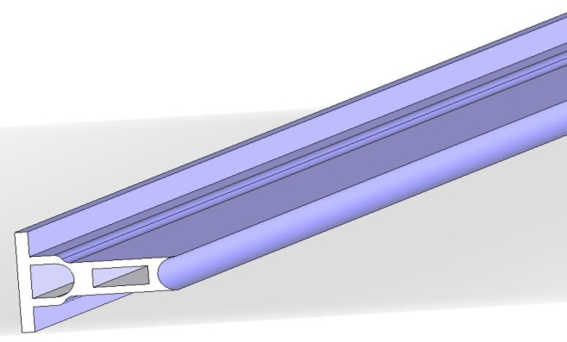
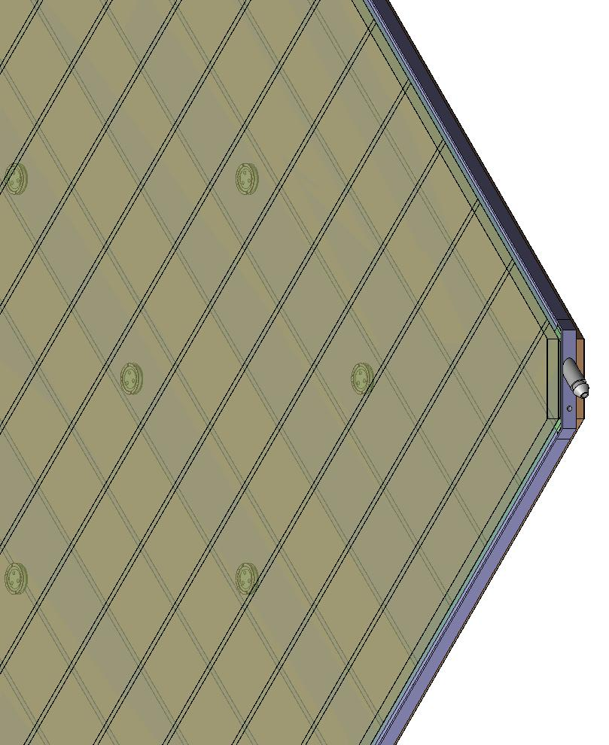
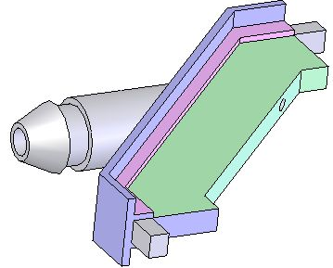
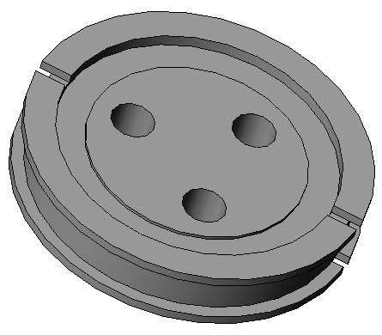
Materials for gas volume fabrication
Edge spacer
Schematic of an assembled gas volume
Gas nozzle
Glass spacer

Slide 24
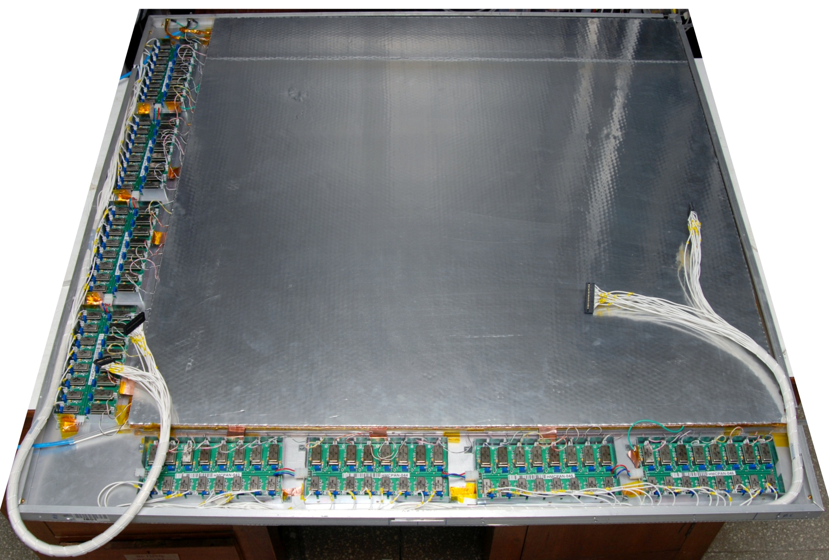
Fully assembled large area RPC
1m × 1m

Slide 25
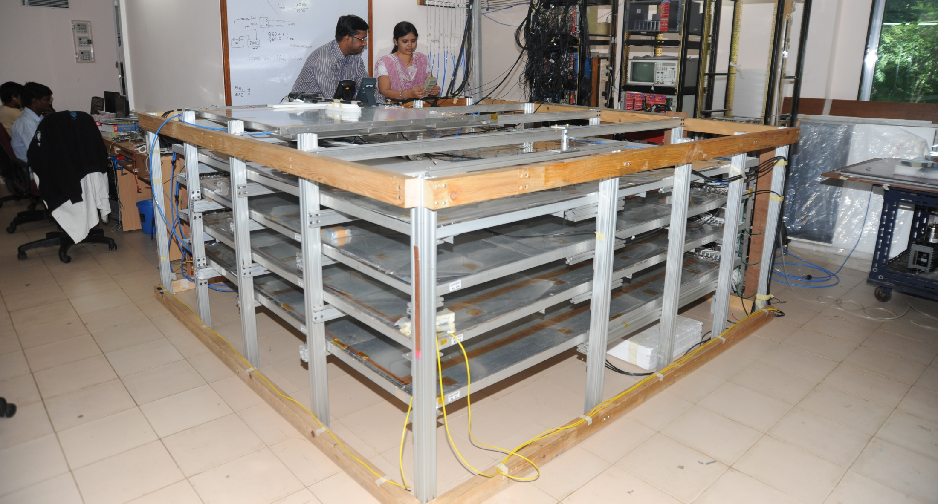
Stack of 2m × 2m RPCs

Slide 26
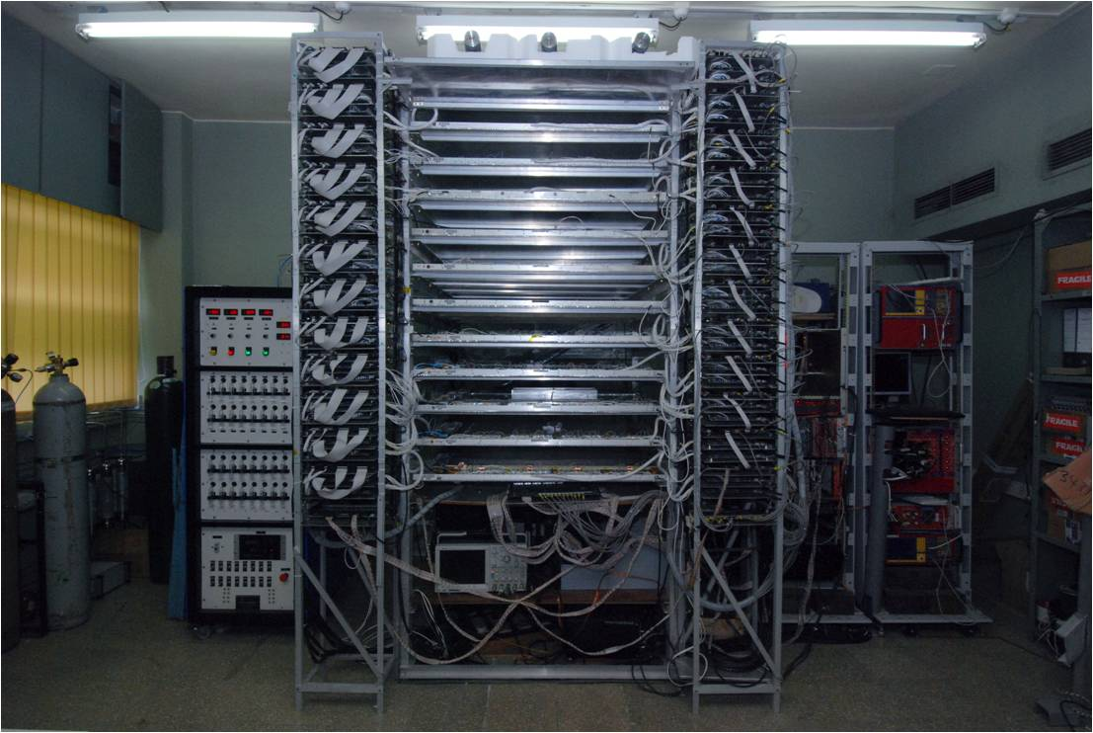
Prototype RPC stack

Slide 27
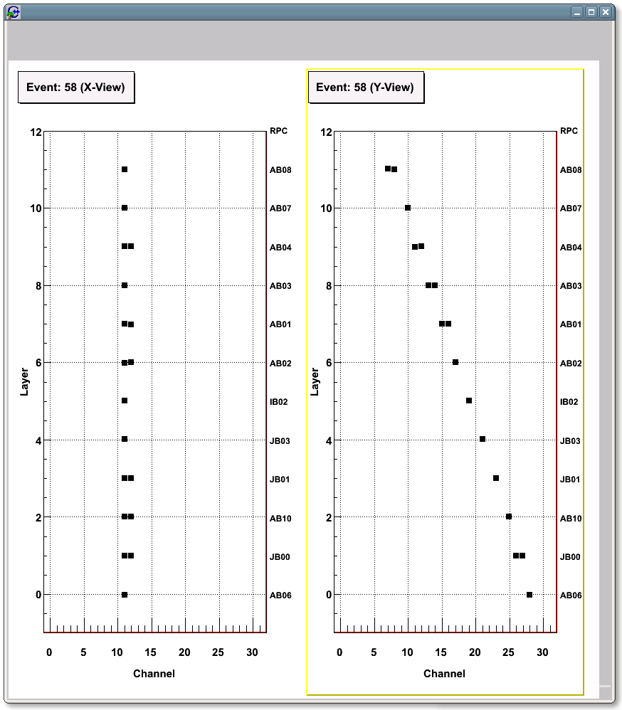
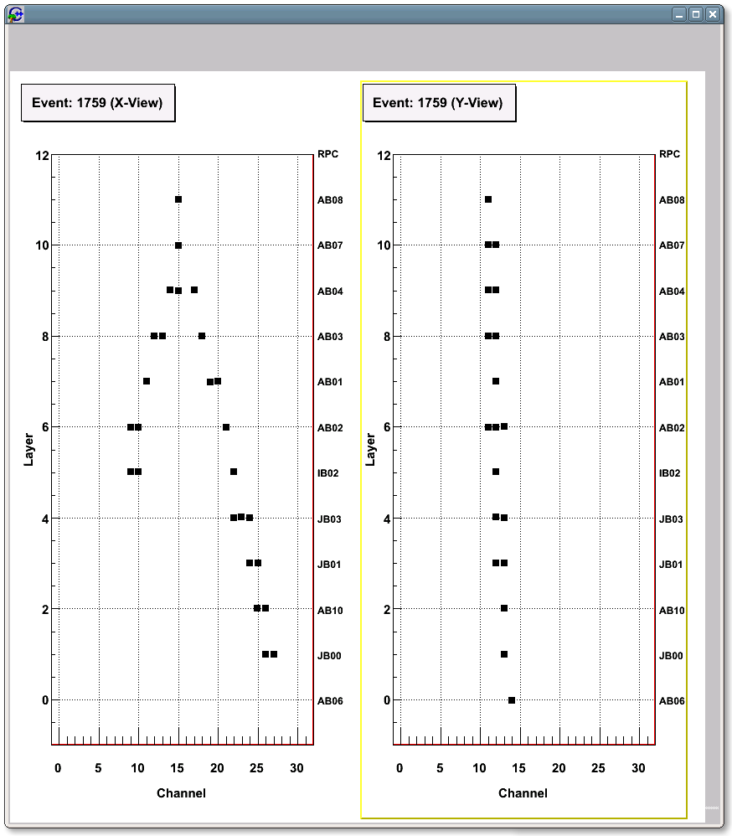
A couple of interesting events

Slide 28
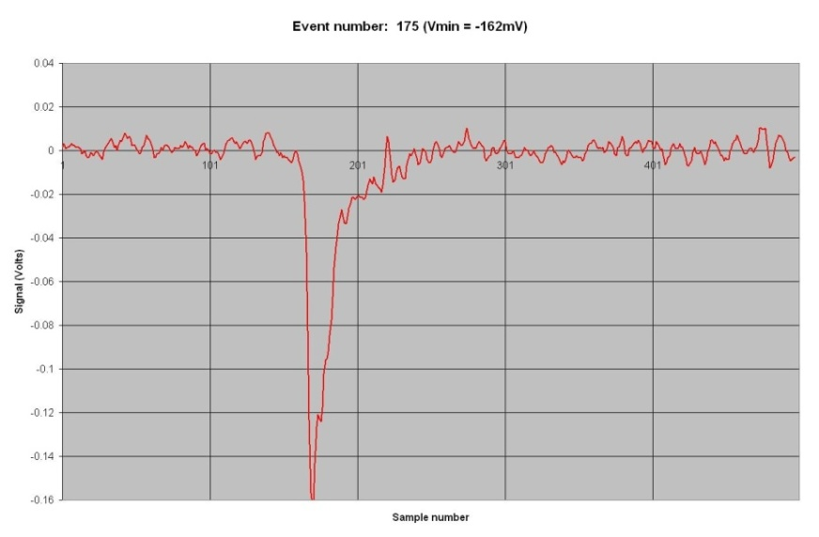
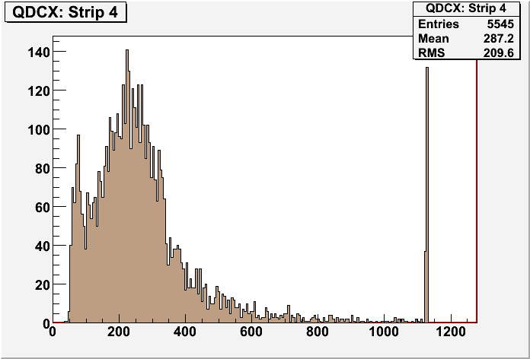
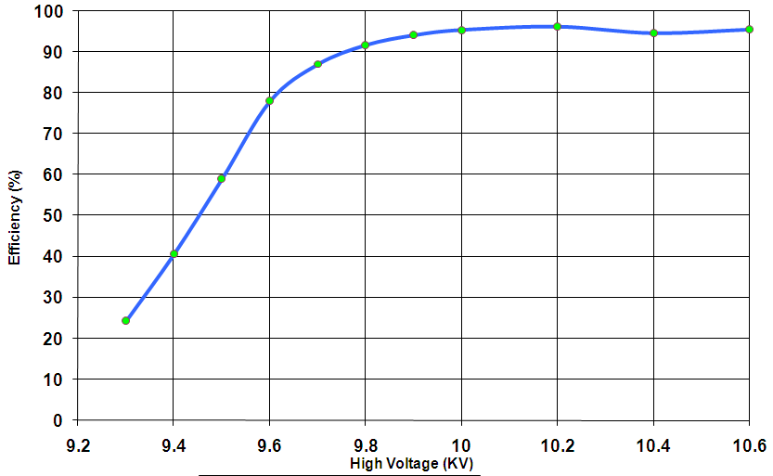
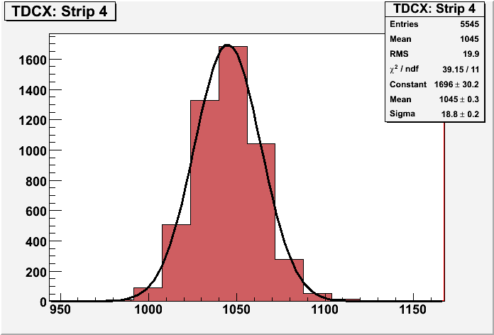
RPC parameter characterisation

Slide 29
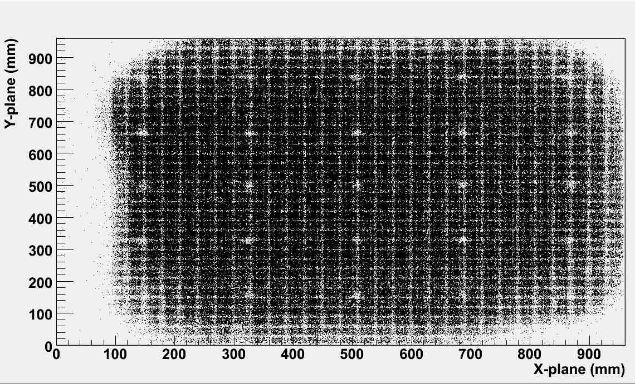
RPC tomography using cosmic ray muons

Slide 30
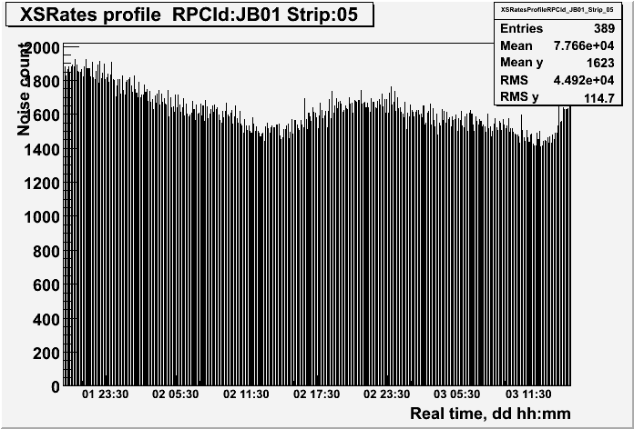
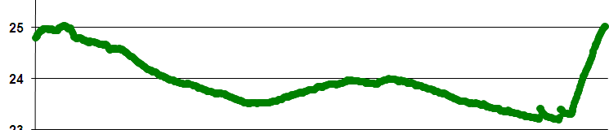
RPC strip rate time profile
Temperature

Slide 31
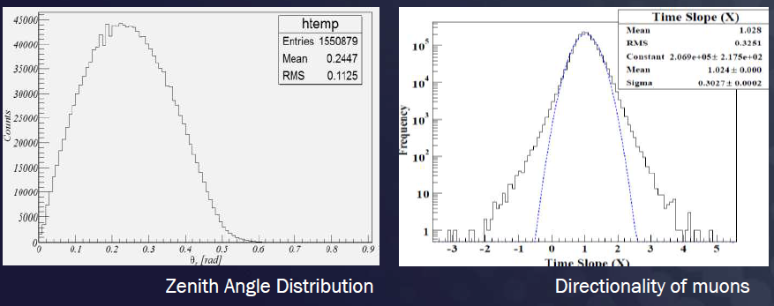
Studies with detector stacks

Slide 32
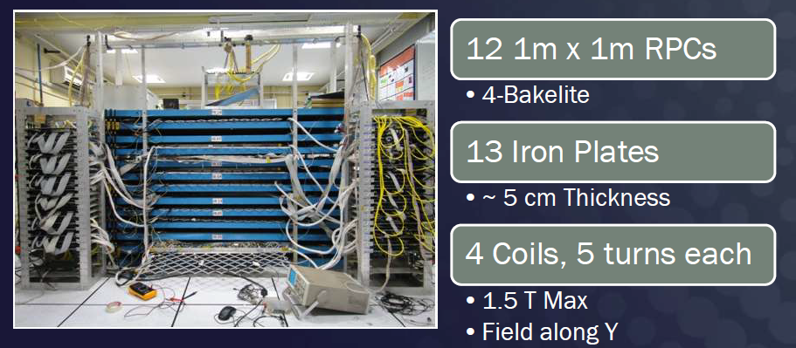
ICAL prototype at VECC

Slide 33
Requirement of gases in ICAL
Total number of RPCs in ICAL = 3 × 150 × 64 = 28,800
Total gas volume = 28,800 × 184cm × 184cm × 0.2cm = 195,010 litres
For ex: One volume change/day with 10% gas top-up in a re-circulating scheme
Approximate running gas cost = Rs 30,000/day (R134a from Mafron)
Gas | Avalanche (%) | Streamer (%) | Maximum (%) | Volume (L) | Density (g/L) | Weight (Kg) | Cost (Rs/Kg)
Argon | 0.0 | 30.0 | 30.0 | 58,503 | 1.784 | 104.4
R134a | 95.5 | 62.0 | 95.5 | 186,234.6 | 4.25 | 791.5
Isobutane | 4.3 | 8.0 | 8.0 | 15,600.8 | 2.51 | 39.16
SF₆ | 0.2 | 0.0 | 0.2 | 390 | 6.164 | 2.40

Slide 34
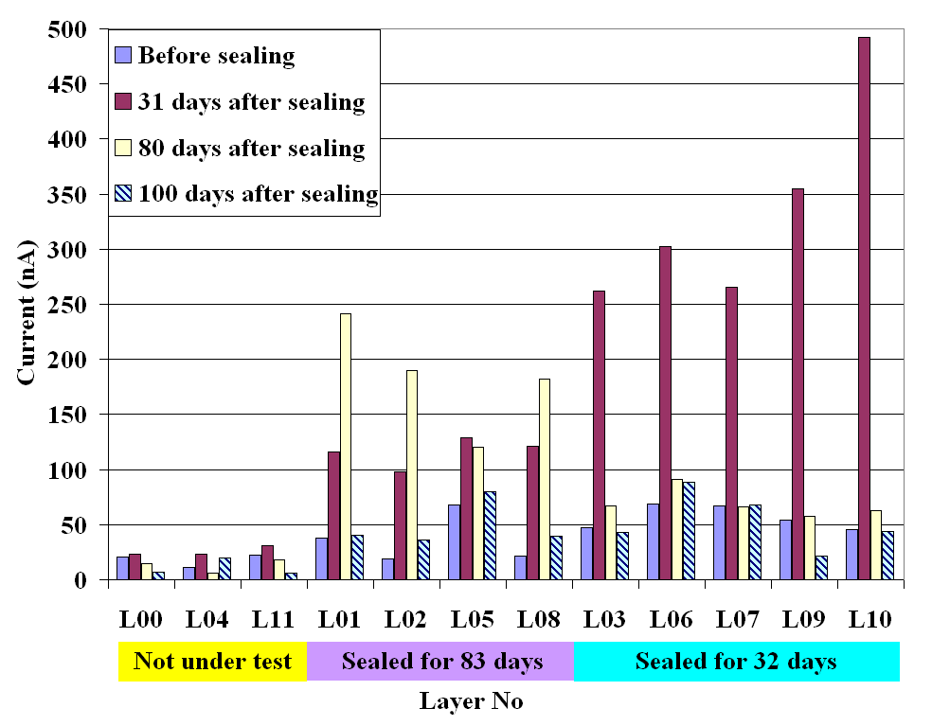
Optimization of gas flow rate for RPCs
Variation in Noise rate and Dark current attributed to different leak rates
If proper sealing, as part of QC is done, then the detectors can operate satisfactorily for more than a month with single gas fill and hence reduce the cost of replenishing gas!

Slide 35
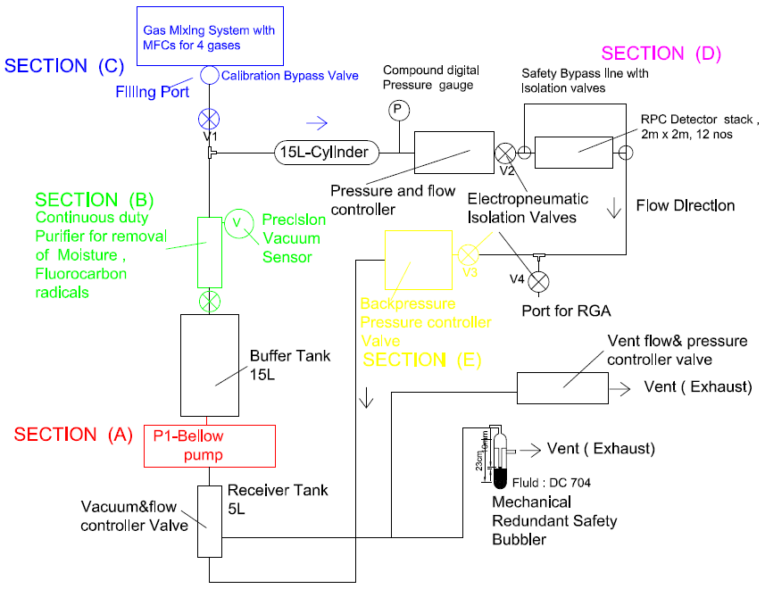
Closed-loop gas recirculation system
4 channel gas mixing module (filling/topup of Iso-butane, Freon R134A, Argon and SF6)
Total Capacity: 140 litres
Continuous duty gas purification system to remove moisture, and other radicals
Contamination removal upto 2ppm.

Slide 36
INO induced RPC R&D in India
Laboratories set up at:
  TIFR
  SNIP
  VECC
  BARC
  IIT Bombay
  IIT Madras
  Aligarh Muslim University
  Banaras Hindu University
  Panjab University
  Delhi University
  More to follow …
Training of large number of students and faculty members
Industrial interface and spinoffs
Aggressive outreach programmes
Theses
  Design and Characterisation Studies of Resistive Plate Chambers
  Development of High Resolution Gas Filled Detector for High Energy Physics Experiments (Saikat Biswas)
  Development of Track Reconstruction and Data Analysis Techniques for Neutrino Experiments (Tapasi Ghosh)
  Sumanta Pal (Physics with ICAL prototype)
  Moon Moon Devi (Development of MRPCs)
  Salim Mohammed (RPC simulations)
  Animesh Chatterjee
  Rajesh Ganai
  Ravindrababu Karnam
  Varchaswi Kashyap …
Dozens of publications, proceedings and reports resulted already

Slide 37
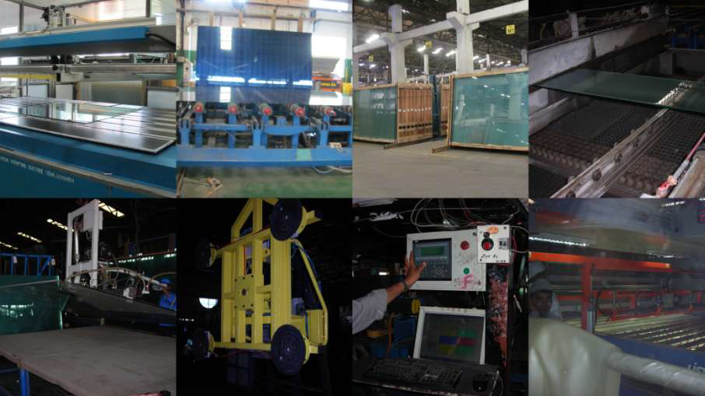
Large scale production of RPCs

Slide 38
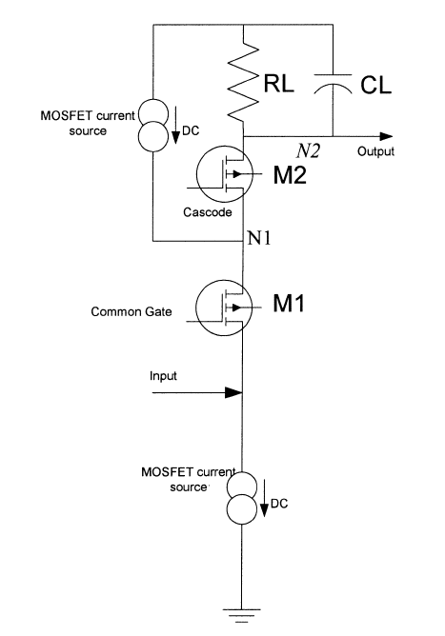
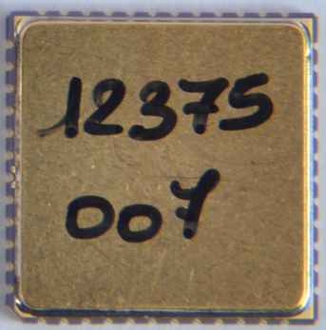
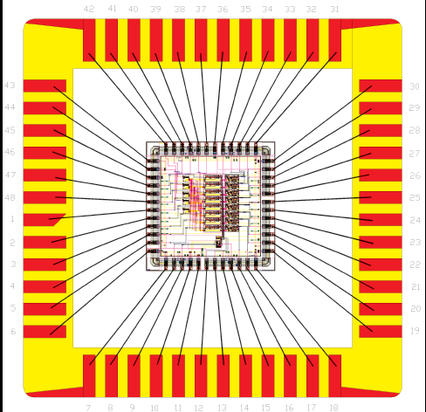
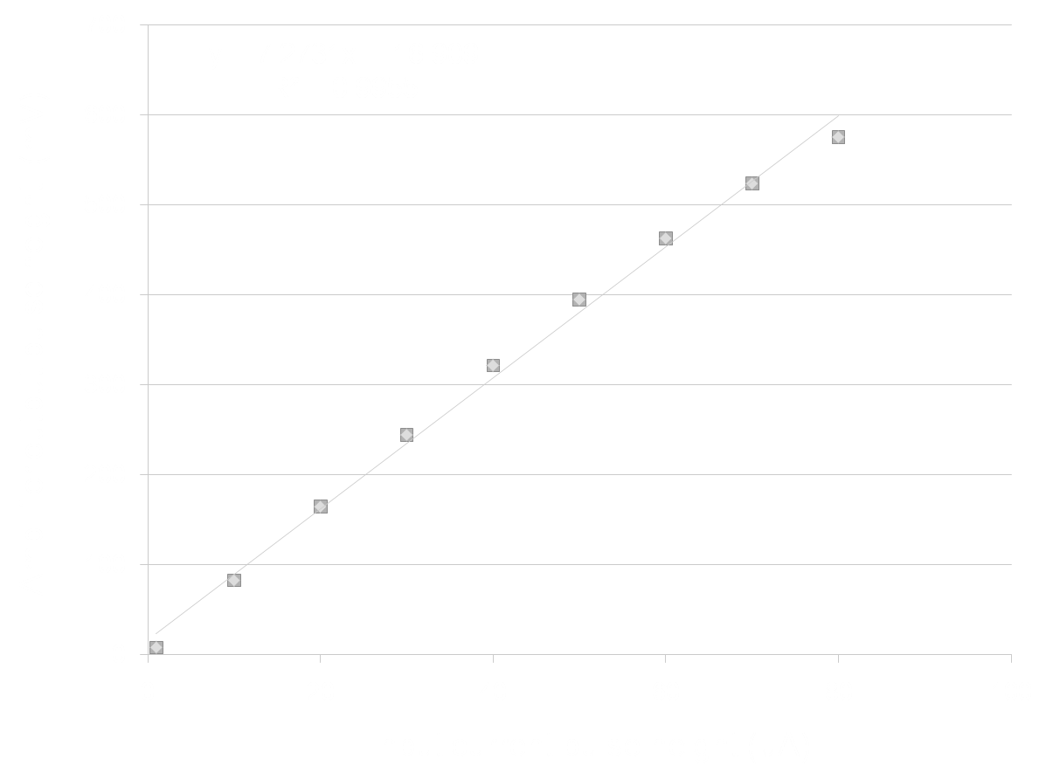
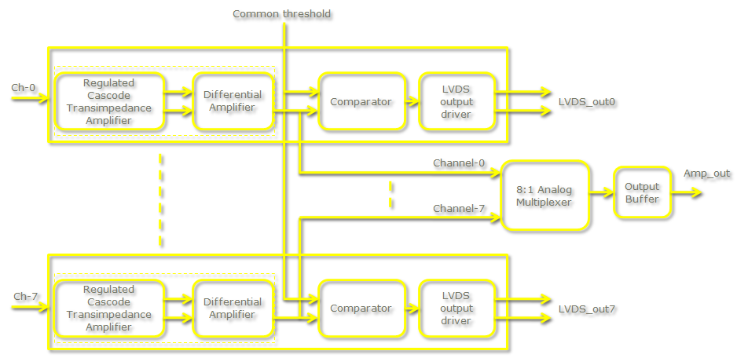
Picking up the tiny charges
Process: AMSc35b4c3 (0.35um CMOS)
Input dynamic range:18fC – 1.36pC
Input impedance: 45Ω @350MHz
Amplifier gain: 8mV/μA
3-dB Bandwidth: 274MHz
Rise time: 1.2ns
Comparator’s sensitivity: 2mV
LVDS drive: 4mA
Power per channel: < 20mW
Package: CLCC48(48-pin)
Chip area: 13mm²

Slide 39
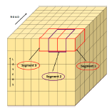
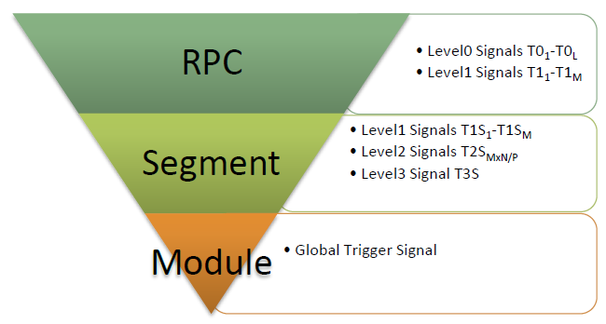
Features of ICAL trigger system
Physicist’s mind decoded!
Insitu trigger generation
Autonomous; shares data bus with readout system
Distributed architecture
For ICAL, trigger system is based only on topology of the event; no other measurement data is used
Huge bank of combinatorial circuits
Programmability is the game, FPGAs, ASICs are the players

Slide 40
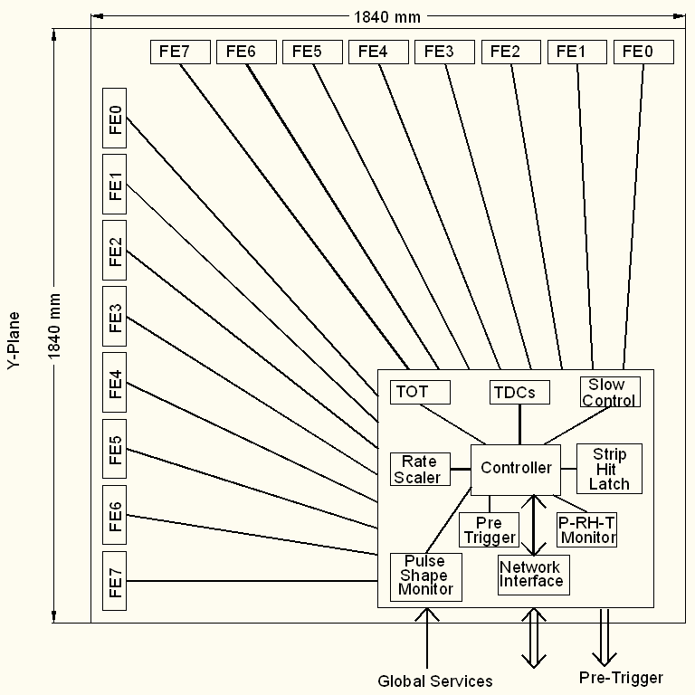
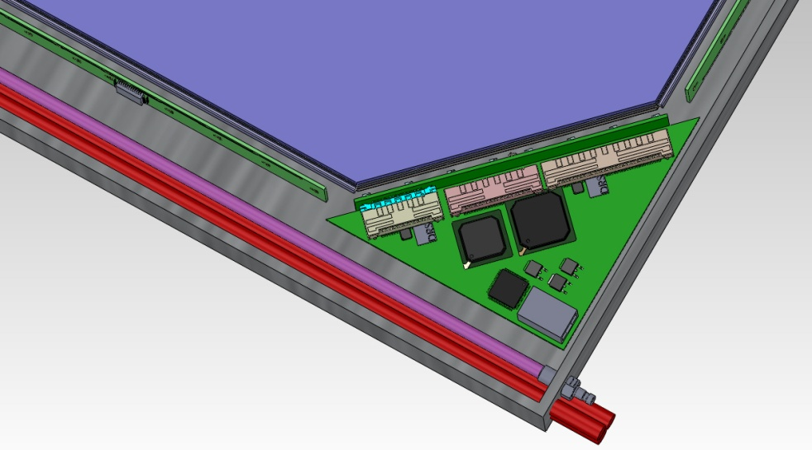
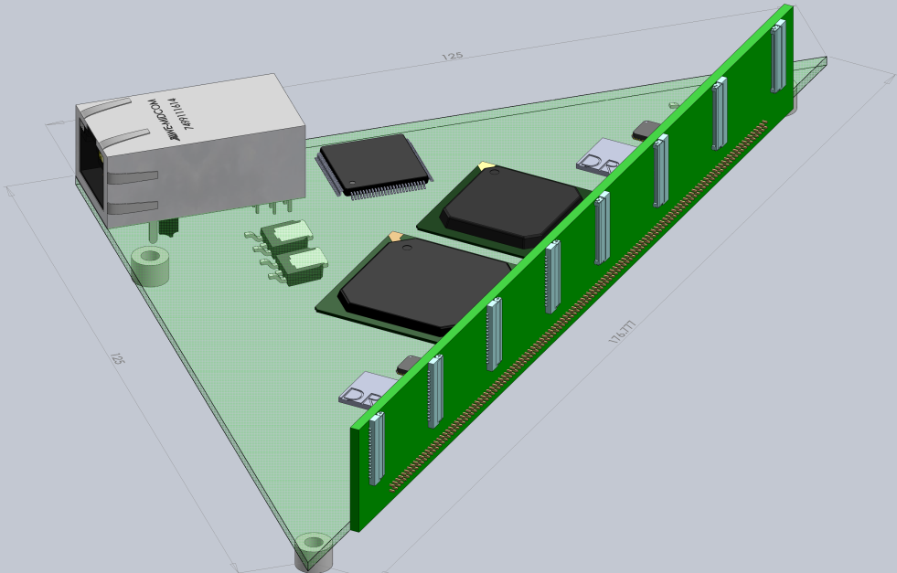
Functions & integration of FE-DAQ

Slide 41
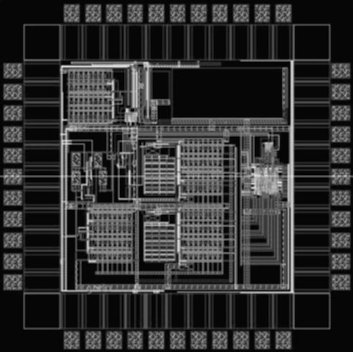
ASIC based TDC device
Principle
  Two fine TDCs to measure start/stop distance to clock edge (T₁, T₂)
  Coarse TDC to count the number of clocks between start and stop (T₃)
  TDC output = T₃+T₁-T₂
Specifications
  Currently a single-hit TDC, can be adapted to multi-hit
  20 bit parallel output
  Clock period, T_{c} = 4ns
  Fine TDC interval, T_{c}/32 = 125ps
  Fine TDC output: 5 bits
  Coarse TDC interval: 2¹⁵ * T_{c} = 131.072μs
  Coarse TDC output: 15 bits
selftest
delay
(self
test)
LVDS
Bypass cap.
Coarse TDC
DLL
Fine TDC
(start/stop)
Back
end

Slide 42
Detector and Physics simulations
The response and sensitivity of the ICAL detector and the sensitivity to the neutrino oscillation parameters.
We estimate the momentum of a neutrino from the measured momentum of the charged leptons (at lower energies) and hadrons (at higher energies) produced by the neutrino interactions.
Neutrino event generators NUANCE and GENIE are being studied and adapted.
Reconstruction code validation, Hadron energy calibration and Oscillation analysis
RPC device level simulation, code development
Software tools developed: iDaq, iRoot, Vice, etc.
ICAL magnet simulation and field calculations

Slide 43
Career opportunities in INO
Research Scholars
  Applicants must have a minimum qualification of M.Sc. degree in Physics or B.E./B.Tech. degree in any one of Electronics, E & CE, Instrumentation and Electrical Engineering subjects with strong motivation for and proficiency in Physics.
  The selected candidates will be enrolled as Ph.D. students of the Homi Bhabha National Institute (HBNI), a Deemed to be University, with constituent institutions that include BARC, HRI, IGCAR, IMSc, SINP and VECC.
  They will take up 1 year course work at TIFR, Mumbai in both theoretical and experimental high energy physics and necessary foundation courses specially designed to train people to be good experimental physicists.
  Successful candidates after the course work will be attached to Ph.D. guides at various collaborating institutions for a Ph. D. degree in Physics on the basis of their INO related work.
Career opportunities for bright engineers in Electronics, Instrumentation, Computer Science, Information technology, Civil, Mechanical and Electrical engineers

Slide 44
Closing remarks
INO is an exciting mega basic science project
It is being planned on an unprecedented scale and budget
ICAL and other experiments will produce highly competitive physics
Beyond neutrino physics, INO is going to be an invaluable facility for many future experiments
It provides wonderful opportunities for science and engineering students alike
Detector and instrumentation R&D, scientific human resource development are INO’s major trust areas
It offers a large number of engineering challenges and many spin-offs such as medical applications

