Slide 1
ICAL Electronics: Current thoughts
B.Satyanarayana, For INO Collaboration

Slide 2
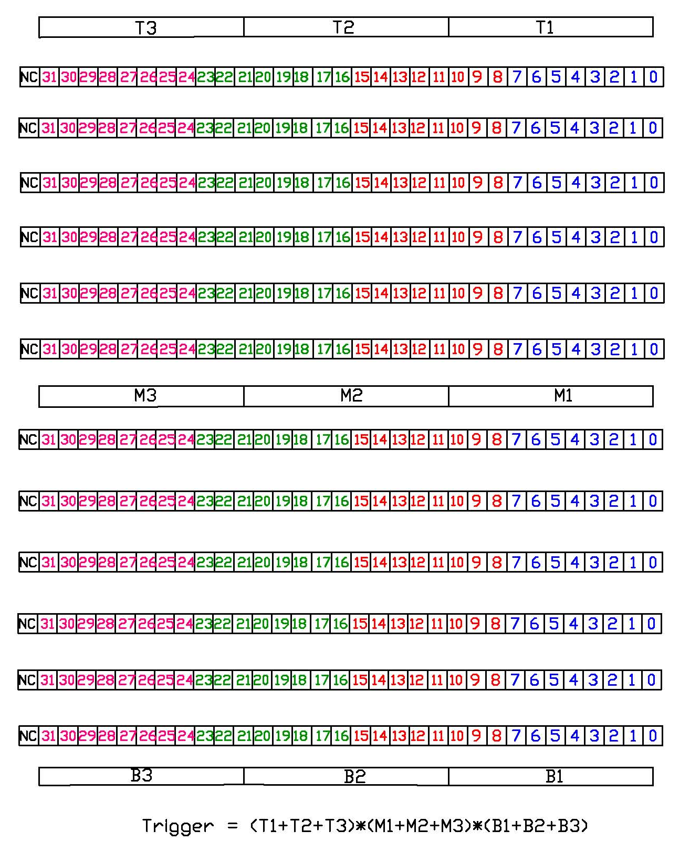
Schematic of ICAL prototype detector segmentation
12, 1m² RPC layers
Two readout planes (X & Y)
32 channels/plane
Total 768 readout channels
Trigger on muons using:
Scintillator paddle layers
RPC strip signals
Recorded information:
Strip hits
Timing
Monitoring data:
Chamber parameters
High voltage and current
Strip noise rates
Cosmic muon efficiency
Ambient parameters
Temperature
Relative humidity
Barometric pressure
Magnet control and monitor
Gas system control & monitor

Slide 3
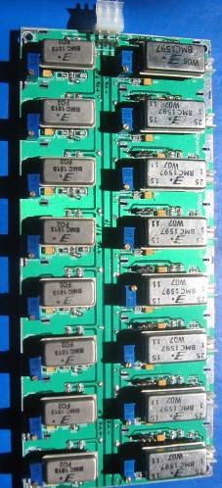
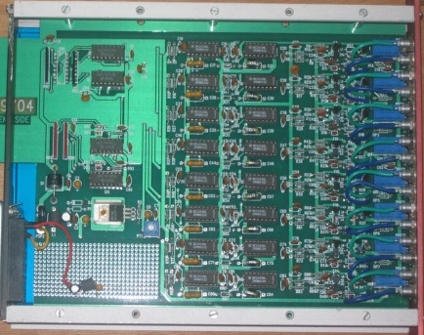
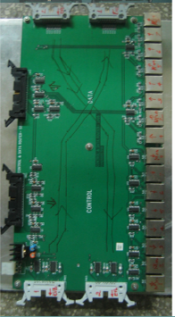
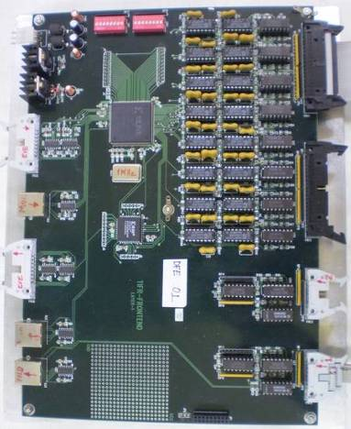
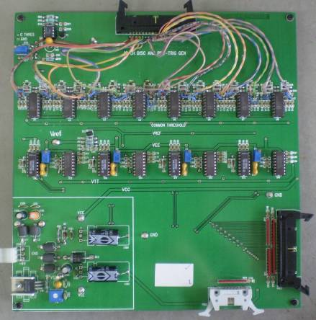
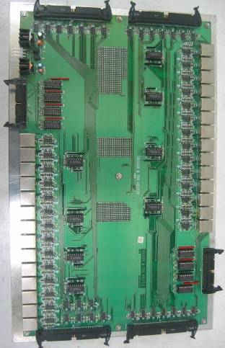
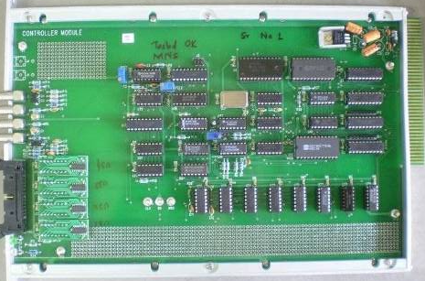
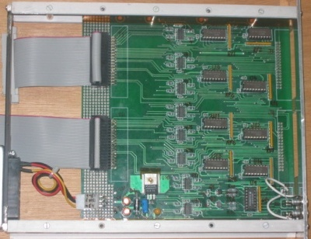
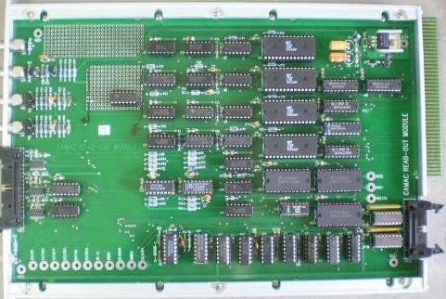
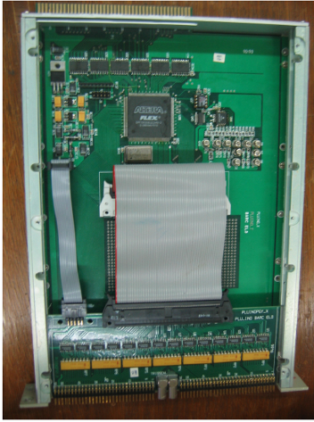
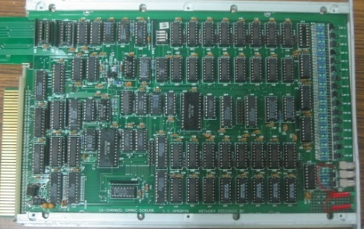
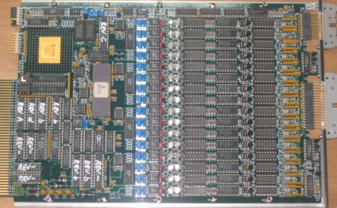
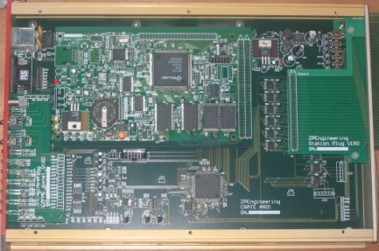
Design and implementation of the data acquisition system
200 boards of 13 types
Custom designed using
FPGA,CPLD,HMC,FIFO,SMD

Slide 4
Challenges of ICAL electronics
Huge number of electronic data readout channels. This necessitates large scale integration and/or multiplexing of electronics. The low to moderate rates of individual channels allow this integration/multiplexing.
Large dimensions of one unit of RPC. This has bearing on the way the signals from the detector are routed to the front-end electronic units and matching the track lengths of the signals, irrespective of the geographical position of the signal source. We need to do this in order to maintain equal timing of signals from individual channels.
Road structure for the mounting of RPCs. This necessarily imposes constraint that signals from both X & Y planes of the RPC unit, along with other service and power supply lines are brought out only from the transverse direction of the detector.
About 25cms gap is available between the faces of the detector and the trolleys. Any installations on the face of the detector have to be designed with this consideration.
About 40mm gap between iron layers is available for the RPC detector, out of which thickness of the RPC unit is expected to at least 24mm. Leaving another 5-6mm for various tolerances, realistically about 10mm is the available free space in the RPC slot for routing out cables etc.
On the sides adjacent to the RPC unit in the gap, free space is available for routing out power supply cables, gas lines etc.

Slide 5
More design inputs
RPC signal’s rise time is of the order of 500-800nSec. Therefore, we will need a resolution of about 200nSec for the timing devices used for recording RPC signal arrival times w.r.t to ICAL trigger.
The opening width of the amplified signals is of the order of 25nSecs. The minimum width of the RPC pulse over the threshold in the avalanche mode is as low as a few nSecs. This is an important input for the front-end electronics design.
The amplifier in the avalanche mode preferably should have a fixed gain in the range 100-200 depending on the noise levels obtainable and hence the minimum discriminator levels settable.
Discriminator overhead (ratio of average peak pulse height to discriminator level) of 3-4 is preferable for reliable performance. Variable (but common) threshold in the range of ±10 to ±50mV for the discriminators should be supported.
The pulse shaping of the discriminator output pulse should be in the range of 50-100nSec (but fixed). However, if the facility of pulse width monitoring has to be supported, this specification has to be relooked.

Slide 6
Important considerations
Information to record on trigger
  Strip hit
  Timing
Rates
  Individual strip background rates ~100Hz
  Event rate ~10Hz
On-line monitor
  RPC parameters
  Ambient parameters
  Services, supplies

Slide 7
Front-end considerations
RPC strip pitch versus front-end packaging
  n-in-1 ASIC or PCB: Routing of tracks
  1-in-1 ASIC: Mounted on pickup panels
  LSI versus large signal source dimensions!
Low voltage distribution
DC-DC converters, one per RPC to generate high voltage supply
Output signal routing

Slide 8
Sub-systems
Front-ends
Latch and timing units
Pipelines and fiber
Backend (VME) data collectors
Trigger system and Central clock
Slow control and monitoring
  Gas, magnet, power supplies
  Ambient parameters
  Safety and interlocks
Computer, networking and security issues
On-line data quality monitors
Voice and video communications
Remote access protocols to detector sub-systems and data

Slide 9
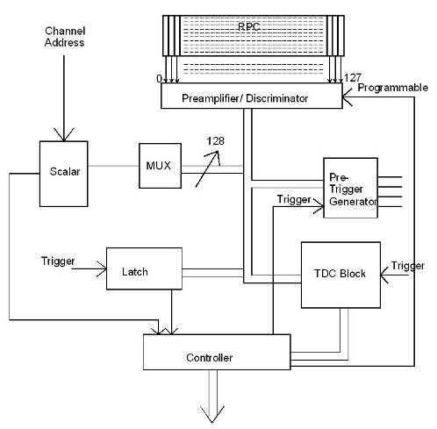
Triggered scheme
RPC , a unit for front-end processing
Conventional architecture
Dedicated sub-system blocks for performing various data readout tasks
Need for Hardware based on-line trigger system
Trigger latency issues and how do we take care in implementation
Synchronisation of trigger/global clock signals

Slide 10
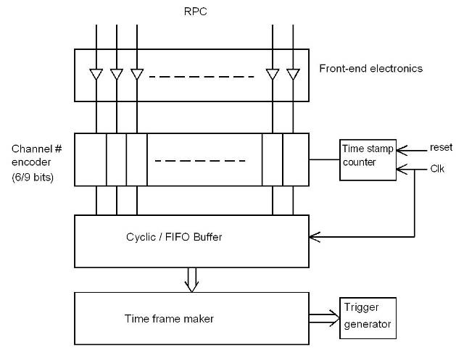
Trigger-less scheme
Suitable for low event rate and low background/noise rates
On-off control and V_{th} control to disable noisy channels
Clock frequency considerations (PLL?)

Slide 11
Trigger system segmentation
Pre-trigger signals (1F, 2F, 3F, …) generated on the RPC unit (Level-0)
Signal driving issues permitting, eight local trigger generating stations (Level-1). Could be more; trade-off with segment overlapping issues.
Level-1 trigger used for data acquisition
Final data validating using Level-2 global trigger

Slide 12
RPC strip rate considerations
RPC strip signal rates mainly contributed by the surrounding low energy activities such as stray radioactivity, local electrical discharges, dark currents of the detector and other electrical/electronic disturbances.
For a given RPC, installed at particular location, operating at a particular high voltage, and a gas mixture, the average counting rate or noise rate is fairly constant and is in fact commonly used to monitor the stability of the above mentioned RPC operating parameters.
One of the main background tasks (while not collecting event data) of the ICAL DAQ system is to sequentially monitor individual strip rates of all the RPCs in the detector, with a reasonable (of the order of 1 hour cycle time for a strip) frequency.
The noise rate has consequences on the design of trigger system. The threshold of the trigger system is such that it shouldn’t generate triggers due to chance coincidence of noise rates.

Slide 13
Other critical issues
Power requirement and thermal management
  25mW/channel → 100KW/detector
  Magnet power
  Front-end positioning; use absorber to good use!
  Do we need forced, water cooled ventilation?
Suggested cavern conditions
  Temperature: 20±2ºC
  Relative humidity: 50±5%

Slide 14
Event rates and event data sizes
Event rates:
  Input from simulations: 1.5Hz for full ICAL
  Comparable chance coincidence rates if the current trigger scheme is used
Event data sizes:
  Very low occupancy
  Number of channels grouped for timing, essentially decides the data size
  Data reduction at the front-end

Slide 15
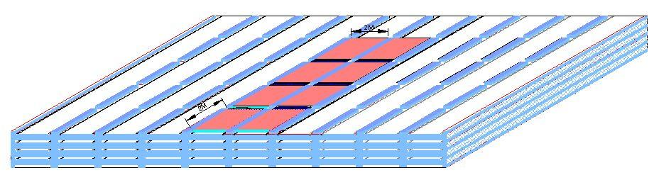
Concept of ICAL building

Slide 16
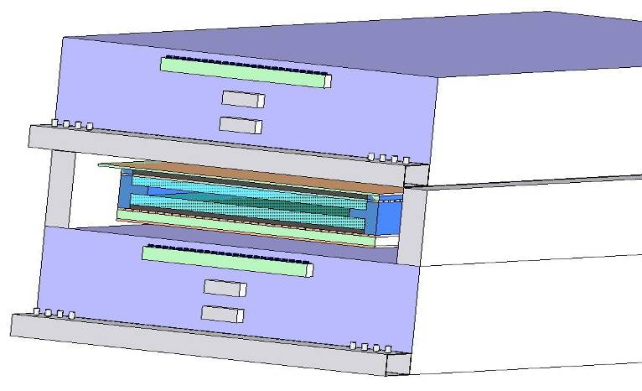
DAQ & services’ sub-stations
Iron absorber
RPC
Iron spacer
DAQ
HV
Gas
LV
Gas
Iron absorber

Slide 17
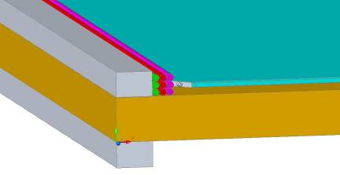
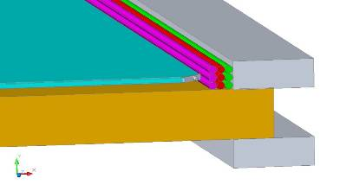
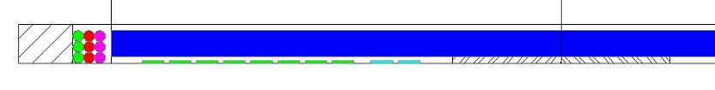
Cables & services routing
RPC
Iron absorber
Gas, LV & HV cables from RPCs
RPC
Signal cables from RPCs

