Slide 1
Update and status of
ICAL electronics
B.Satyanarayana, TIFR, Mumbai

Slide 2
Parallel Session 1 - ICAL Electronics
Date and time: 11th July 2011, 10am
Venue: Ajay Divatia Lecture Hall, VECC, Kolkata
Update and status of ICAL Electronics activities: B.Satyanarayana, TIFR
Study of Anusparsh based front-end board with RPCs: B.Satyanarayana, TIFR
Report on chip development activities at IITM: Anil Prabhakar, IITM
Development of prototype RPC-DAQ module: Mandar Saraf, TIFR
Feasibility studies of DRS for ICAL Electronics: Deepak Samuel, TIFR
Alternate approach for ICAL backend DAQ: P.Nagaraj, TIFR
Validation of ICAL trigger scheme: Sudeshna Dasgupta, TIFR
Progress on ICAL power supply systems: Satyajit Saha, SINP (to be confirmed)
Roadmap and action plan till the next meeting: All
This is a brain-storming session. So, durations of presentations are not specified!

Slide 3
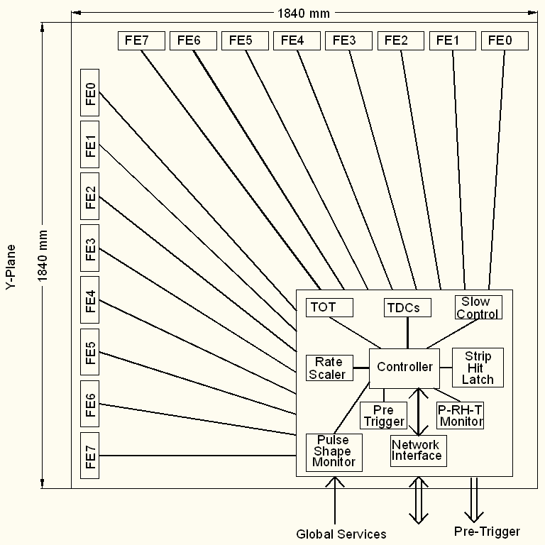
Functional diagram of RPC-DAQ
Front-end to
RPC-DAQ bus
8, LVDS pairs of unshaped comparator signals (I)
1, amplified & multiplexed RPC pulse on 50Ω (I)
3-bit channel address bus for multiplexer (O)
Power supplies (O)
Threshold control (d.c. or DAC bus) (O)

Slide 4
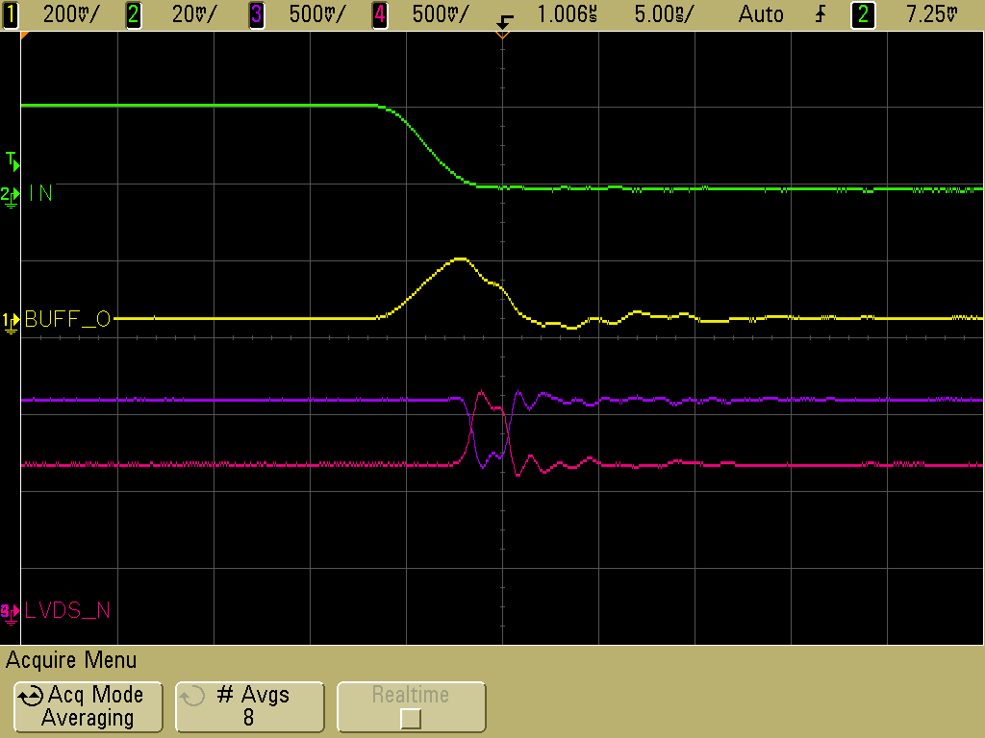
Architecture of front-end ASIC
Common threshold
Ch-0
Regulated Cascode Transimpedance Amplifier
Differential Amplifier
Comparator
LVDS output driver
LVDS_out0
Channel-0
8:1 Analog Multiplexer
Output Buffer
Amp_out
Channel-7
Ch-7
Regulated Cascode Transimpedance Amplifier
Differential Amplifier
Comparator
LVDS output driver
LVDS_out7

Slide 5
Testing of front-end board on RPC

Slide 6
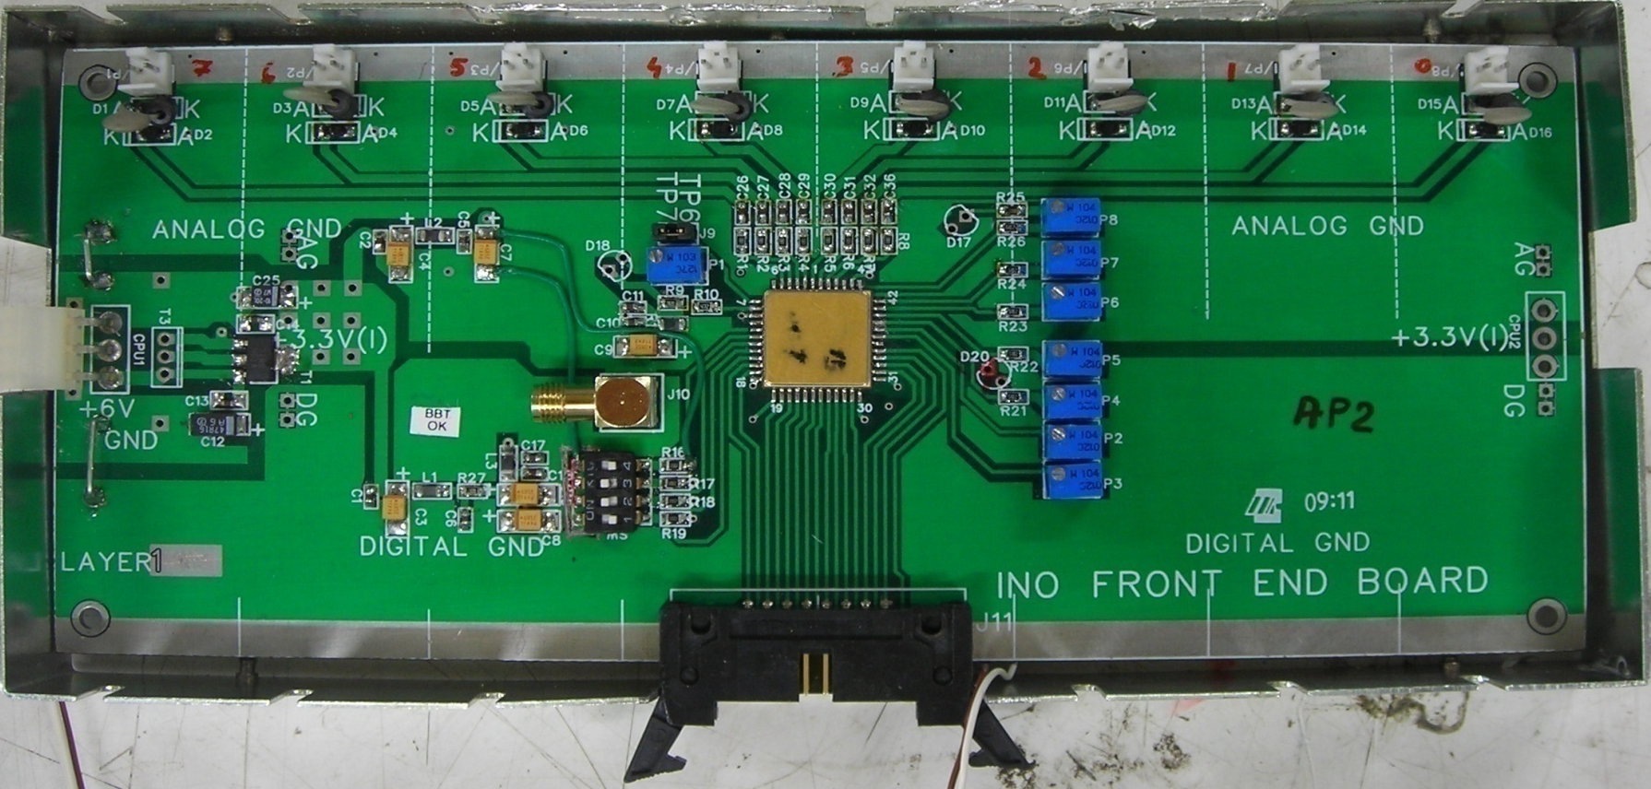
8-channel front-end board

Slide 7
Features of the front-end board
8 amplifier + discriminator channels
Gain = Output voltage/ Input current
Typical gain obtained with the test setup 4-5mV/μA
The designed gain was 8mV/μA; but reduced on board to contain instability
0.1μF capacitor is placed at input as RPC strips are terminated using 50Ω Resistors. Multiplexed buffered analog (inverted) output available
Buffered analog signal = ½ actual output (due to 50Ω termination)
Comparator threshold = Voltage@pin38 – Voltage@pin9
Discriminator output in LVDS logic (4mA)

Slide 8
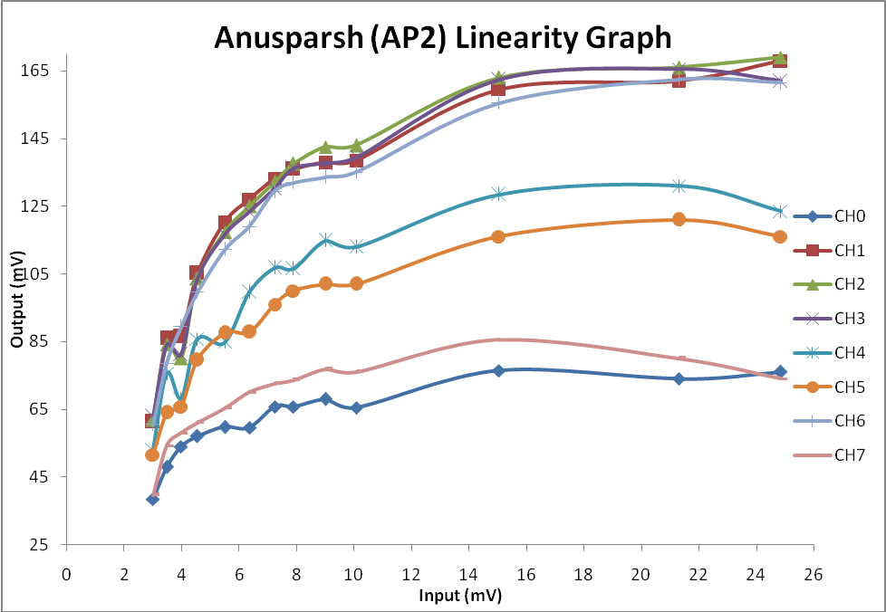
Linearity studies of the front-end board
Channel-to-channel gain variation is a concern

Slide 9
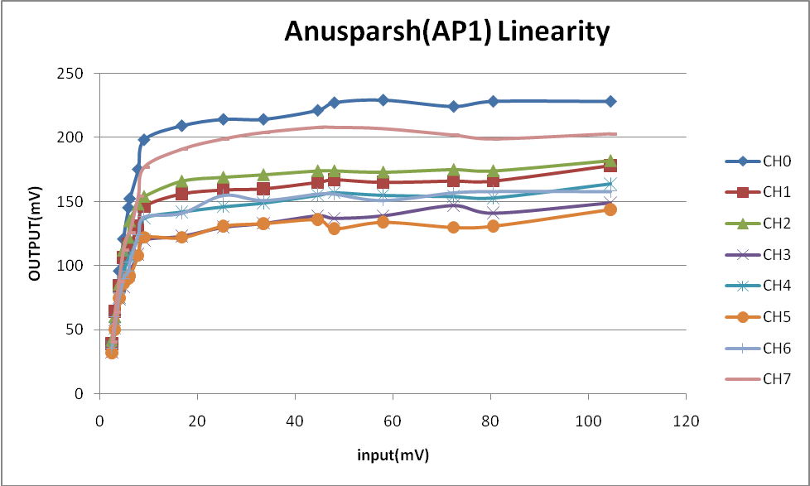
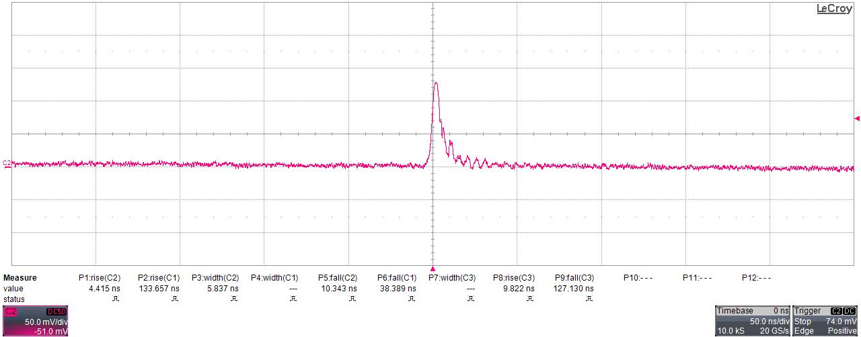
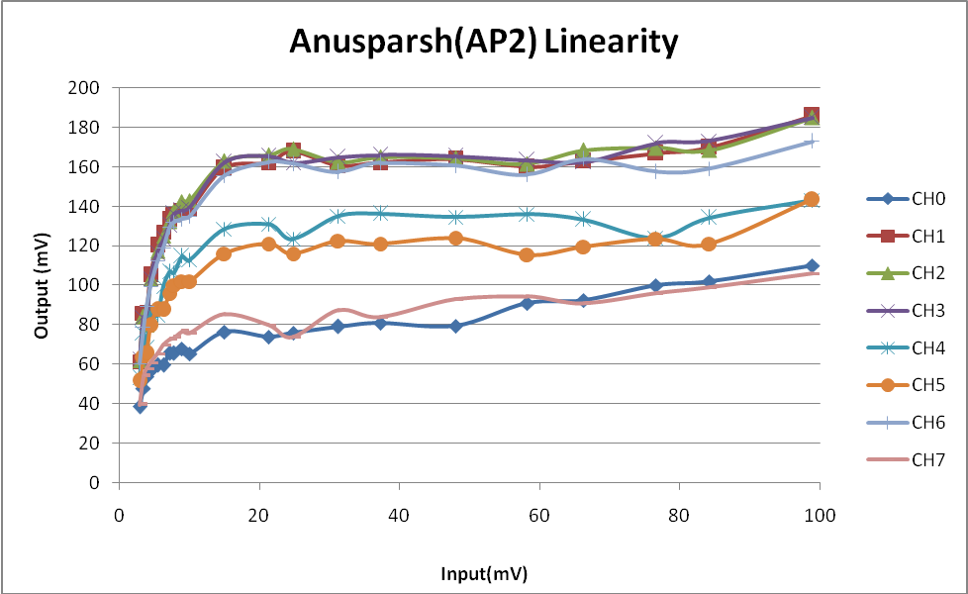
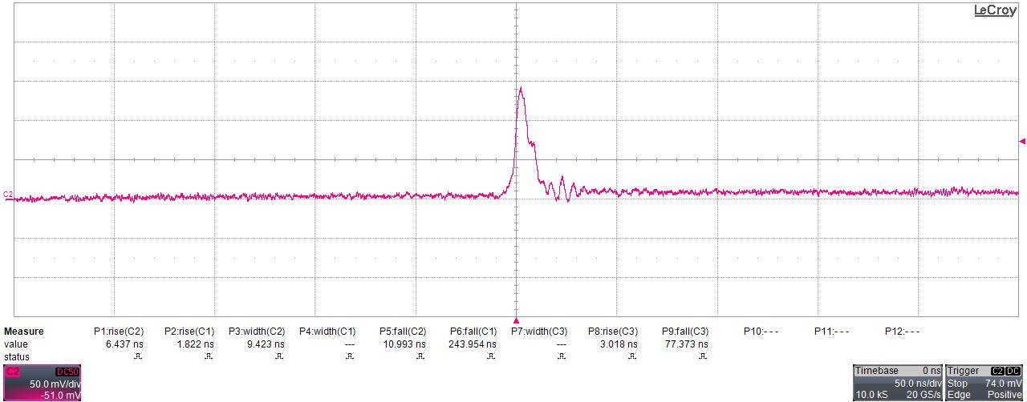
Testing of front-end boards with pulser
FEB - 1
FEB - 2

Slide 10
Work in progress and action plan
Study of amplifier gain and buffer output signal linearity using external pulser
Detailed study of threshold adjustment and its stability
Try finer threshold adjustment by connecting a 100KΩ resistor to either side of P2 trim-pot (which is100KΩ)
Calibration of threshold for RPC using noise rate and efficiency parameters
Integration of front-end board with RPC stack at TIFR
Revision of the chip
  Solve instability problem while the multiplexer is turned on
  Separate chips for positive and negative inputs as well as amplifier and discriminator might anyway solve this problem

Slide 11
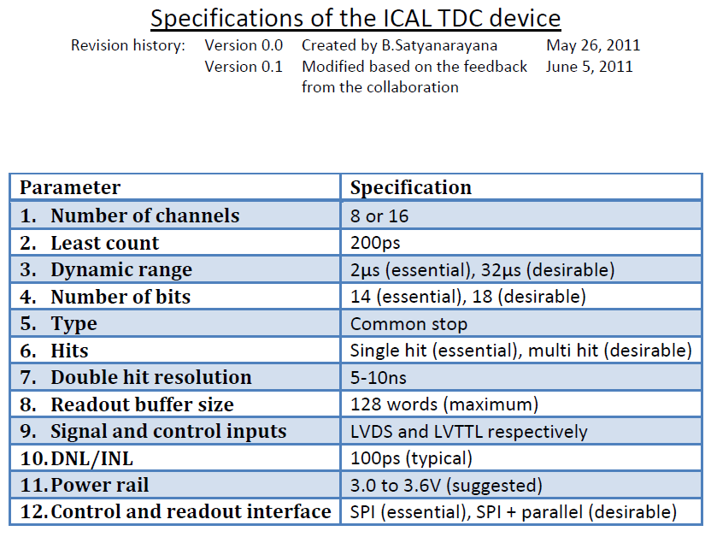

Slide 12
Design tools for TDC design
Agreement with IMEC
Already have an agreement for 0.35μm for the front-end ASIC
Now signed UMC NDA and IP agreement for
  0.18μm mixed mode + RF (L180 MMRF) technology design kit & process
  Europractice Faraday standard cell libraries

Slide 13
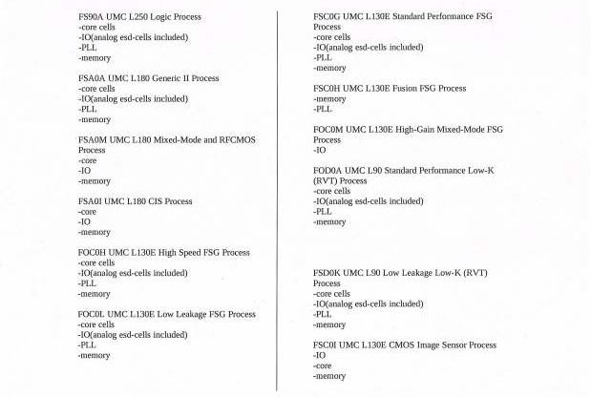
Licensed IPs

Slide 14
Discussions at the ICAL Electronics Meeting,
IIT Madras, August 9-11, 2010
Interconnection between RPC strips and preamp inputs (SINP/TIFR)
Problems with FPGA TDC (Hari, Sudeshna)
Problem with ASIC TDC (3rd stage interpolation, Pooja)
ASIC or FPGA TDC?
If FPGA TDC, can we include all other logic (+ data transmitter) into it?
Can the 8-in-one FE board have TDC as well? This automatically means we will have TDC data for all channels.
FE output in LVDS? Depends on the above
Power supplies (LV and HV), distribution and monitoring – indigenous, commercial, semi-commercial, dc-hvdc (SINP/VECC)
Network interface from RPC to the backend: Ethernet, fibre, w/l (IITM)
  Controller, n/w controller, Beegle board, Msp430 TI chip
  6-9 weeks
Problem regarding FPGA as trigger element (Mandar)
Calibration/synchronisation of global signals and data paths
Backend standard, alternate to VME
Distributed backend?
Trigger system – segmentation (James, Mandar, Sudeshna, Pooja)
Trigger-less system – any takers, on back foot for now?
Supernova trigger?
Waveform sampler (Nagendra)
GPS based RTC

Slide 15
Role of waveform sampler for ICAL
Walk correction of TDC data
Leading edge discriminator
Time over threshold information
Pulse profile, height and width monitoring
Remote display of RPC signals

Slide 16
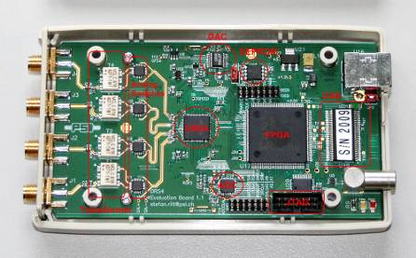
Specifications of DRS4 waveform sampler
8+1 channels, 1024 cells
700MSPS to 6 GSPS
2.5V supply, 140 to 320mW
Multiplexed or parallel output
Differential I/O (950MHz BW)
Maximum readout of 40MHz
Cascading of channels or chips allows deeper sampling depth

Slide 17
Chip design activities at IIT Madras
Front end amplifier (gain ~100, BW ~500MHz)
Time to digital converter (delay line based, 50ps)
Analog memory (64 samples, 2GSPS, 8-bit 10MHz ADC)
More on these developments from Anil

Slide 18
Proof of principle effort (RPC-DAQ)
Can be tested today on the RPC stacks
Front-end board with the current board’s form-factor, but using ASICs
RPC-DAQ board with:
  TDC
  Waveform sampler
  Strip-hit latch and rate monitor
  Controller + data transreceiver
  Firmware for the above
  Pre-trigger front-end
  TPH monitoring
  Pulse width monitoring
  Front-end control
  Signal buffering scheme
  and GP area or ports for accommodating new blocks
VME data concentrator module
Result: Complete readout chain is tested
Can we use this for RPC QC test stands or what?
Discussion meeting on ICAL Electronics SINP, Kolkata, April 29-30, 2011

Slide 19
Prototyping of RPC-DAQ module
Using IITM designed MSP430 board
Digital logic (rate scalers, latches etc.) in FPGA on a trainer kit
SPI interface between the two
Serial interface between the MSP board and the PC/host
Appropriate signal translators for the existing system
Will lead to a pilot RPC-DAQ board design

Slide 20
Discussions at the ICAL Electronics Meeting,
IIT Madras, August 9-11, 2010
Interconnection between RPC strips and preamp inputs (SINP/TIFR)
Problems with FPGA TDC (Hari, Sudeshna)
Problem with ASIC TDC (3rd stage interpolation, Pooja)
ASIC or FPGA TDC?
If FPGA TDC, can we include all other logic (+ data transmitter) into it?
Can the 8-in-one FE board have TDC as well? This automatically means we will have TDC data for all channels.
FE output in LVDS? Depends on the above
Power supplies (LV and HV), distribution and monitoring – indigenous, commercial, semi-commercial, dc-hvdc (SINP/VECC)
Network interface from RPC to the backend: Ethernet, fibre, w/l (IITM)
  Controller, n/w controller, Beegle board, Msp430 TI chip
  6-9 weeks
Problem regarding FPGA as trigger element (Mandar)
Calibration/synchronisation of global signals and data paths
Backend standard, alternate to VME
Distributed backend?
Trigger system – segmentation (James, Mandar, Sudeshna, Pooja)
Trigger-less system – any takers, on back foot for now?
Supernova trigger?
Waveform sampler (Nagendra)
GPS based RTC

Slide 21
Networked DAQ scheme
Alternate approach for VME back-end
Choose appropriate controller
Simplified system design, cabling
Speed, switching, protocols

Slide 22
Trigger scheme for ICAL
Validation of the trigger schemes
Ready to go for implementation
Integration issues
  Segment trigger module positions
  Pre-trigger signal driving issues
Specifications:
  Coincidence window: 100ns
  Maximum trigger latency: 1us
  Singles rate for RPC detector pickup strips: 250 Hz
  The skew and jitter in arrival instant of the global trigger at different RPCs should be as low possible
News: BARC team (Anita Behere et al) joined the trigger team for implementation

Slide 23
Software components
RPC-DAQ controller firmware
Backend online DAQ system
Local and remote shift consoles
Data packing and archival
Event and monitor display panels
Event data quality monitors
Slow control and monitor consoles
Database standards
Plotting and analysis software standards
OS and development platforms

Slide 24
Software
News: BARC team (Diwakar, Padmini et al) joined the software team
Backend Data Acquisition and Monitoring System
  Event Data Acquisition
  Periodic Online Monitoring of RPC Parameters
  Event Data Quality Monitoring
  Control and Monitoring Console
  Local and Remote Consoles
Front-end firmware/software will be responsibility of the TIFR group
Scope for more players (especially physicists)

Slide 25
Power supply issues
SINP, ECIL

Slide 26
Integration issues
Mounting of electronics on top of RPC is not liked – wasting of space/volume
Suggestion to mount on the sides
Increase the shamperred areas on four corners of the RPC
Mount DAQ for two planes (X & Y) and power supplies (LV, HV) in these areas
Front-ends to be mounted along the planes
Issue of pickup-strips to the front-end solved automatically!
Modeling and prototyping in progress
Industrial dimensions of glass is helping this scheme

