Slide 1
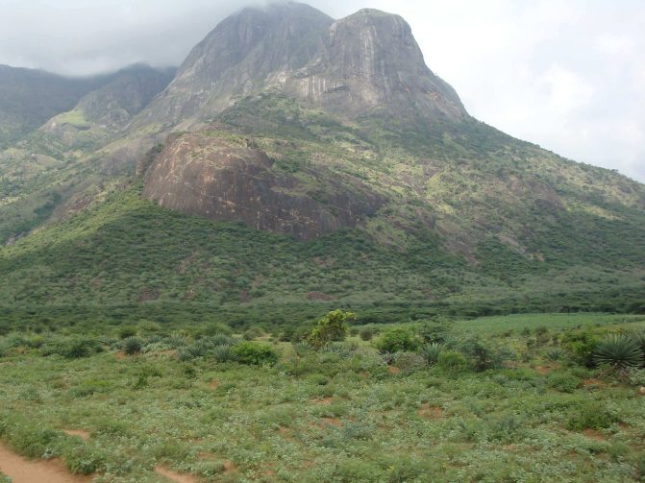
Engineering aspects of INO's ICAL experiment
Neutrino is the most tiny quantity of reality ever imagined by a human being.
Frederick Reines
Co-discoverer & Nobel Laureate
Dr. B.Satyanarayana ▪ Scientific Officer (G)
Department of High Energy Physics ▪ Tata Institute of Fundamental Research
Homi Bhabha Road ▪ Colaba ▪ Mumbai ▪ 400005 ▪ INDIA
T: 09987537702 ▪ E: bsn@tifr.res.in ▪ W: http://www.tifr.res.in/~bsn

Slide 2
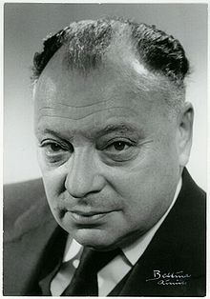
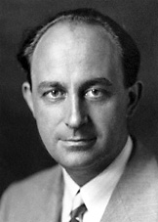
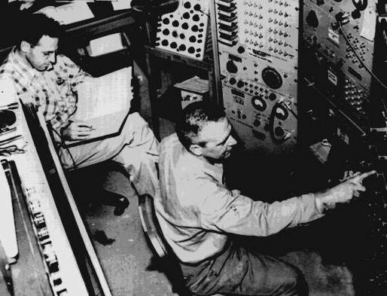
Neutrino (ν)
Proposed by Wolfgang Pauli in 1930 to explain beta decay.
Named by Enrico Fermi in 1931.
Discovered by Frederick Reines and Clyde Cowan in 1956.
Created during the Big Bang, Supernova, in the Sun, from cosmic rays, in nuclear reactors, in particle accelerators etc.
Interactions involving neutrinos are mediated by the weak force.

Slide 3
Unique features of neutrinos
The second most abundant particles in the universe
Cosmic microware background photons: 400/cm³
Cosmic microware background neutrinos: 300/cm³
The lightest massive particles
A million times lighter than the electron
No direct mass measurement yet
The most weakly interacting particles
Invisible: Do not interact with light
Stopping α, β, γ radiation: 50cm lead shielding
Stopping neutrinos from the sun: Several light years!
About 100 trillion neutrinos from the sun and other such objects are going through our body every second without doing any harm.

Slide 4
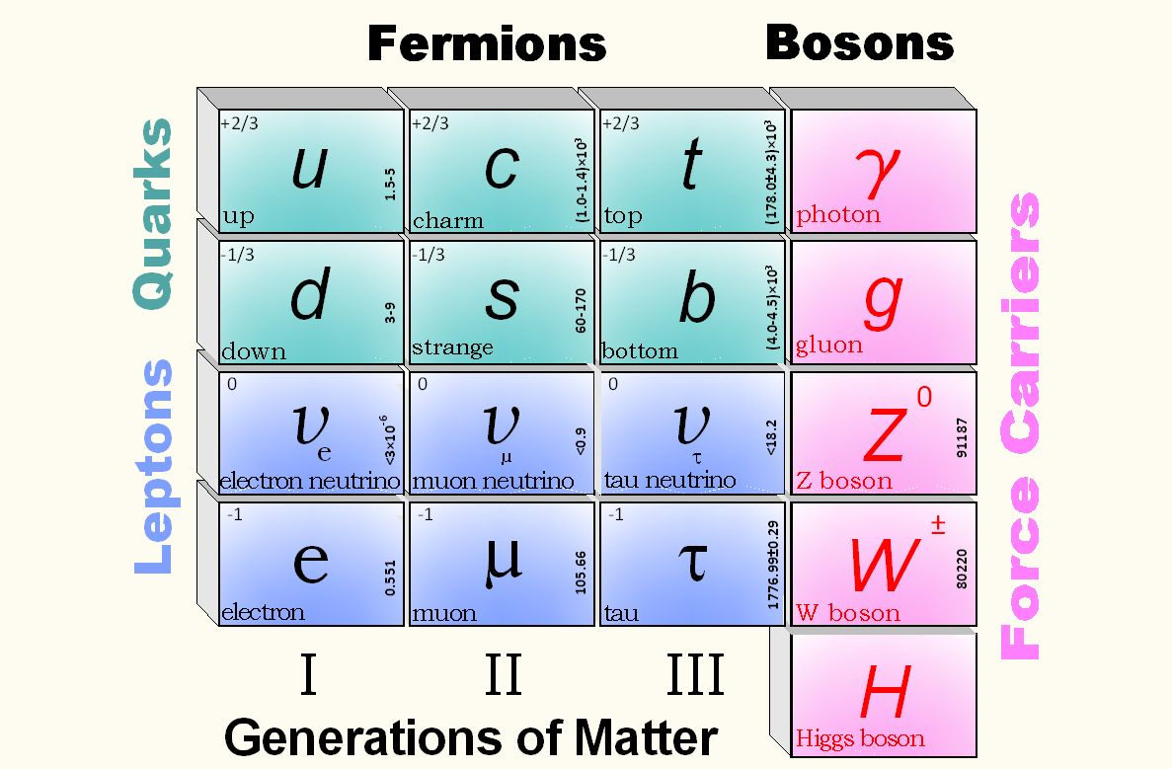
Standard model of particle physics

Slide 5
Neutrino oscillations
It is now known that neutrinos of one flavour oscillate to those of another flavour.
The oscillation mechanism is possible only if the neutrinos are massive.
Neutrino experiments are setting the stage for extension of Standard Model itself.
One of the main goals of the INO experiment is to precisely measure the parameters that govern the neutrino oscillations.

Slide 6
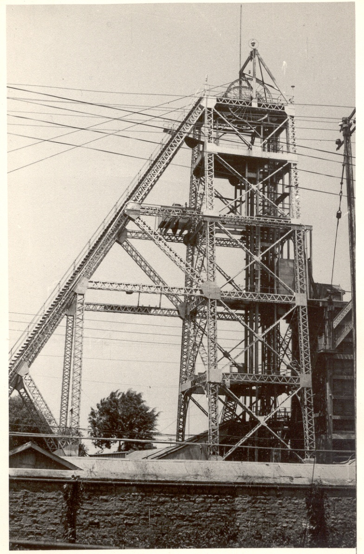
History of neutrino physics in India
India had a long tradition of carrying out High Energy Physics research using deepest underground laboratories in the world at Kolar Gold Fields during 1952-92.
Indian initiative in neutrino physics goes back to nearly 50 years.
Demonstrated for the first time, the feasibility of doing neutrino experiments at KGF.
International collaboration experiment to detect atmospheric neutrinos started at KGF in 1964.
First atmospheric neutrino was detected at KGF at a depth of 2.3km way back in 1965 by the TIFR-Osaka-Durham group.
During early 80s dedicated detectors were setup at KGF by TIFR-Osaka collaboration to look for proton decay.
KGF underground shaft

Slide 7
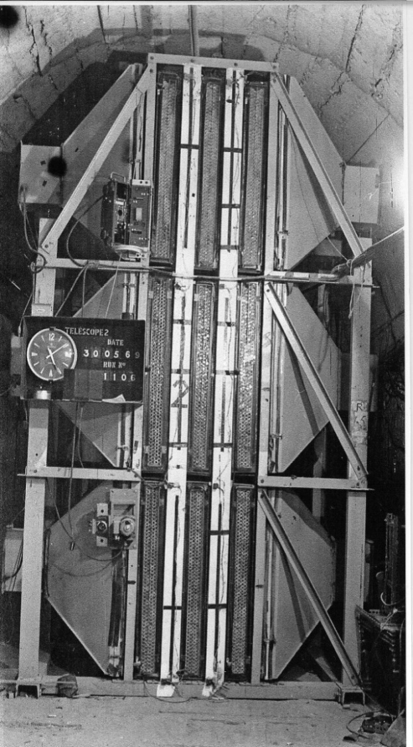
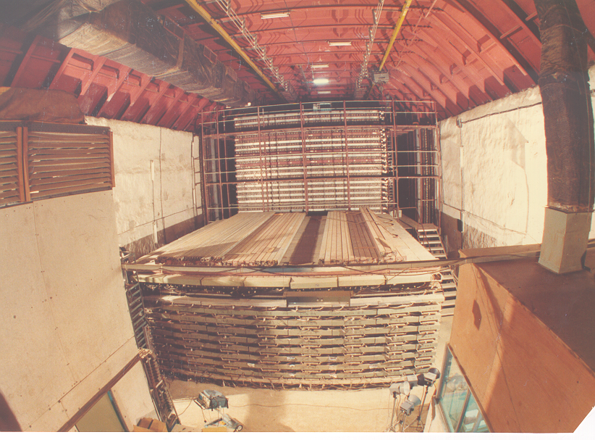
Tradition of underground physics
Proton decay experiments
Atmospheric neutrino detector at Kolar Gold Fields

Slide 8
India-based Neutrino Observatory (INO) project
The primary goal of INO is neutrino physics.
A national collaboration of scientists from more than 26 groups belonging to DAE institutions, IITs and Universities.
The total cost of the project is expected to be about Rs.1500 crores.
The project includes:
construction of an underground laboratory and associated surface facilities,
construction of a Iron Calorimeter (ICAL) detector for neutrinos,
setting up of National Centre for High energy Physics (NCHEP).
The project is expected to be completed within seven years beginning April 2012.
A successful INO-Industry interface developed because of the large scale of experimental science activity involved.
INO Graduate Training Programme under the umbrella of Homi Bhabha National Institute (HBNI) - a deemed-to-be University within DAE, is in its sixth year (25 Ph.D. students in Physics, detectors and electronics).

Slide 9
Other experiments at INO
Search for neutrino less double beta decay (NDBD) using Tin (¹²⁴Sn) via cryogenic bolometer.
Cryogenic Silicon based dark matter experiment at INO (DINO).
Measurement of nuclear cross sections of astrophysical interest using 500kV accelerator; utilising the low back-ground environment inside the INO facility.
The INO facility will develop into a centre for other studies in physics, biology, geology, material research etc., which will exploit the special conditions existent deep underground.

Slide 10
Inter Institutional Centre for High Energy Physics (IICHEP)
To be setup on a 13 hectares land very close to the Madurai Kamaraj University in the city of Madurai.
Will act as the nodal centre for all INO activities. Responsible for operation of the INO facilities.
Will develop full-fledged manpower to operate and maintain the INO laboratory. Human resource development in basic experimental science research. INO Graduate Training program will move to NCHEP when ready.
Will have a major detector development laboratory. Development of detector technology and its varied applications, such as in medical imaging, material science, industrial control and geological survey.

Slide 11
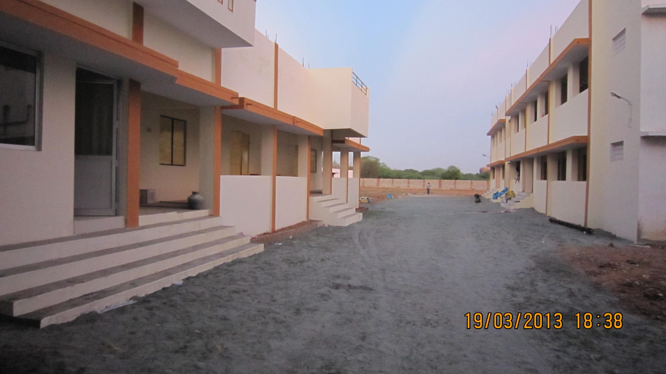
Transit campus for IICHEP

Slide 12
INO Collaboration
Spokesperson: N.K. Mondal, TIFR, Mumbai
Home page: http://www.ino.tifr.res.in
Ahmedabad: Physical Research Laboratory (PRL)
S. Goswami, A.S. Joshipura
Aligarh: Aligarh Muslim University (AMU)
S. Ahmed, M. Sajjad Athar, R. Hasan, S.K. Singh
Allahabad: Harish Chandra Research Institute (HRI)
S. Choubey, R.Gandhi, A.Raychaudhuri
Calicut: University of Calicut (UC)
B.R.S. Babu, A.M. Vinodkumar
Chandigarh: Panjab University (PU)
V.K. Bhandari, V. Bhatnagar, M.M. Gupta, A. Kumar, J.S. Shahi, B. Singh,
J.B. Singh
Chennai: Indian Institute of Technology, Madras (IITM)
N. Chandrachoodan, N. Krishnapurna, J. Libby, A. Prabhakar
Chennai: The Institute of Mathematical Sciences (IMSc)
D. Indumathi, H.S. Mani, M.V.N. Murthy, G. Rajasekaran, N.Sinha
Delhi: Delhi University (DU)
S.K. Chamoli, B.C. Choudhary, D. Choudhury, D. Kaur, A. Kumar,
S. Kumar, S. Mandal, Md. Naimuddin, Shahnawaz, S. Verma, S.K. Verma
Guwahati: Indian Institute of Technology (IITG)
B.Bhuyan, P. Paulose, A. Sil
Hawaii (USA): University of Hawaii (UHW)
S. Pakvasa
Indore: Indian Institute of Technology (IITI)
S. Rakshit
Jammu: University of Jammu (JU)
A. Bhasin, A. Gupta, R. Gupta, S. Mahajan, S.S. Sambyal
Kalpakkam: Indira Gandhi Center for Atomic Research (IGCAR)
J. Jayapandian, C.S. Sundar
Kolkata: Ramakrishna Mission Vivekananda University (RMVU)
Abhijit Samanta
Kolkata: Saha Institute of Nuclear Physics (SINP)
P. Bhattacharya, S. Bhattacharya, Kamales Kar, D. Majumdar, S. Saha
Kolkata: University of Calcutta (CU)
S. Bandyopadhyay, A. Banerjee, D. Jana, G. Gangopadhyay
Kolkata: Variable Energy Cyclotron Centre (VECC)
R.K. Bhandari, S. Chattopadhyay, A.K. Dubey, S.A. Khan, S. Muhuri,
T.K. Nayak, S. Saha, J. Saini, P.R. Sarma, R.N. Singaraju, V. Singhal,
S.K. Thakur, Y.P. Viyogi
Lucknow: Lucknow University (LU)
Jyotsna Singh
Madurai: American College (AC)
S.P.M. Deborrah, K. Gnanasekar, S.R. Inbanathan, K. Moorthy
Mumbai: Bhabha Atomic Research Centre (BARC)
V. Arumugam, Anita Behere, M.S. Bhatia, V.B. Chandratre, V.M. Datar,
M.P. Diwakar, G. Gouthaman, Suresh Kumar, P.K. Mukhopadhyay,
L.M. Pant, B.J. Roy, K. Srinivas, V. Sugadan
Mumbai: Indian Institute of Technology, Bombay (IITB)
Basanta Nandi, S. Uma Sankar, Raghav Varma
Mumbai: Tata Institute of Fundamental Research (TIFR),
B.S. Acharya, S. Banerjee, M.Bhuyan, A. Dighe, K.S. Gothe,
S.D. Kalmani, S. Lahamge, G.Majumder, N.K. Mondal, P. Nagaraj,
B.K. Nagesh, S.K. Rao, L.V. Reddy, A. Redij, D. Samuel, M. Saraf,
B. Satyanarayana, S. Upadhya, P. Verma
Mysore: University of Mysore (MU)
S. Krishnaveni, C. Ranganathaiah, H.B. Ravikumar
Sambalpur: Sambalpur University (SU)
S. N. Nayak
Srinagar: University of Kashmir (UK)
W. Bari, N. Iqbal
Varanasi: Banaras Hindu University (BHU)
B.K. Singh, C.P. Singh, V. Singh

Slide 13
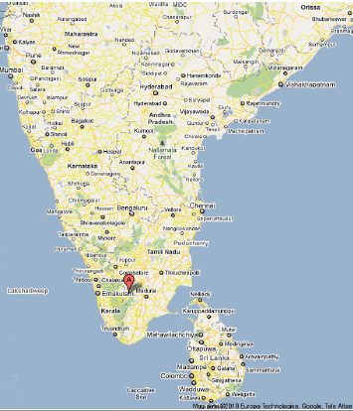
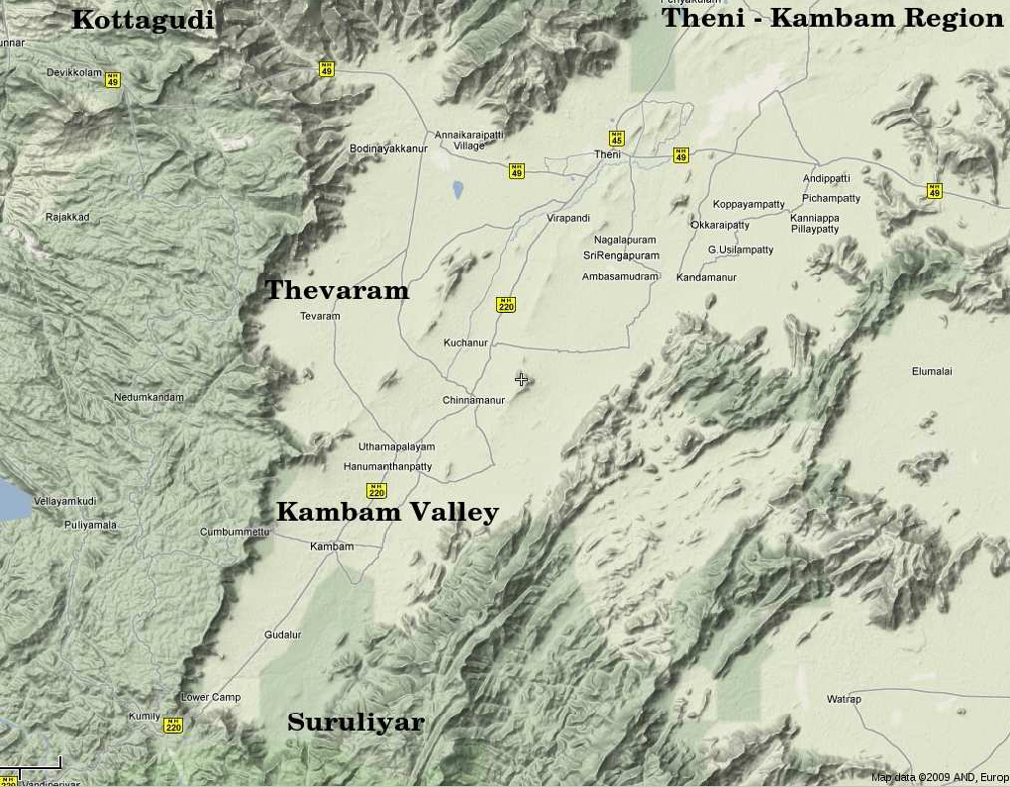
INO coming soon: Inside a mountain near you!
Location: 9º58′ North; 77º16′ East, 110km from Madurai (South India)

Slide 14
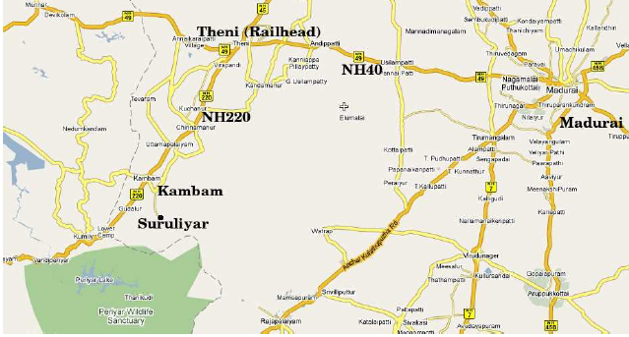
Location and site of the INO
Location: 9º58′ North; 77º16′ East, 110km from Madurai (South India)
Site for INO underground facility

Slide 15
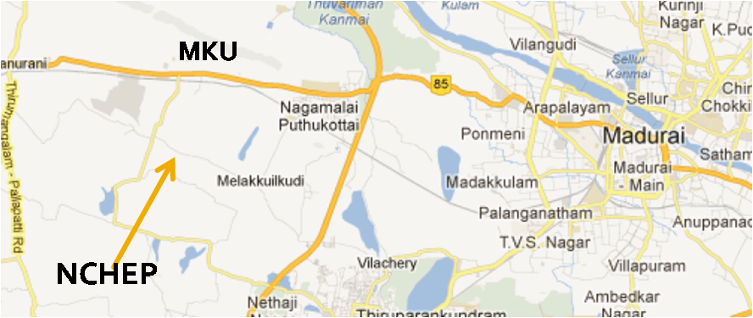
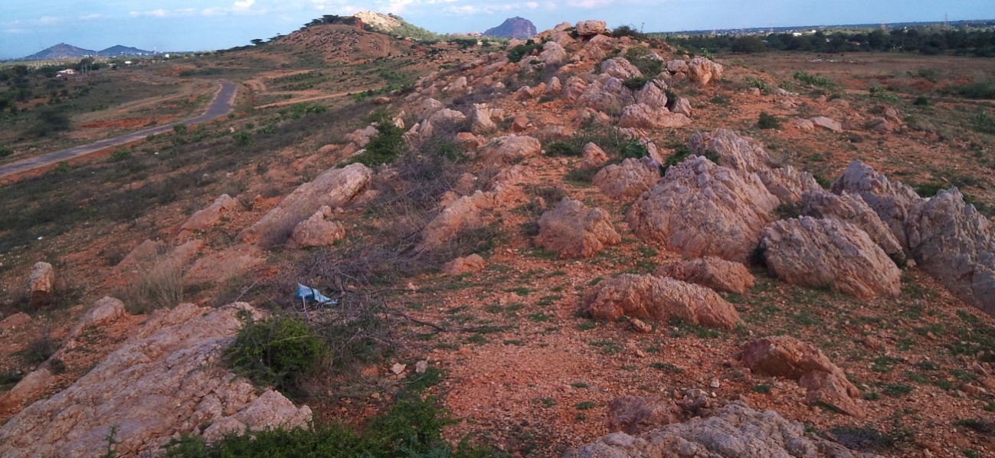
Location and site for Inter-Institutional Centre for High Energy Physics (IICHEP)

Slide 16
Neutrino sources and detector choice
Source of neutrinos
Use atmospheric neutrinos as source
Need to cover a large L/E range
Large L range
Large E_{ν} range
Physics driven detector requirements
Should have large target mass (50kTons)
Good tracking and energy resolution (tracking calorimeter)
Good directionality (~1nSec time resolution)
Charge identification capability (magnetic field)
Modularity and ease of construction
Cost and time considerations
Compliment capabilities of existing and proposed detectors
Use magnetised iron as target mass and RPC as active detector medium

Slide 17
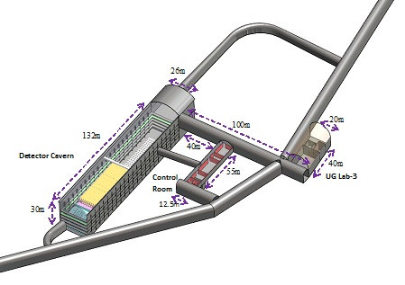
Underground Laboratory Layout
Length of the tunnel | 2.1 km (approx.)
Tunnel cross-section | 7.5m wide and 7.5m high
Tunnel gradient | 1:15
Rock overburden | 1300m (4000 mwe)
Rock type and density | Charnockite, 2.9 gm/cc
Number of caverns | 3 (one big and two small)
Size of the main cavern | 132m × 26m × 20m (high)
Distance from CERN | 7100 km
Distance from JPARC | 6600 km
Future nuclear reactor | 9000 Mwe, 205 km
Basic features

Slide 18
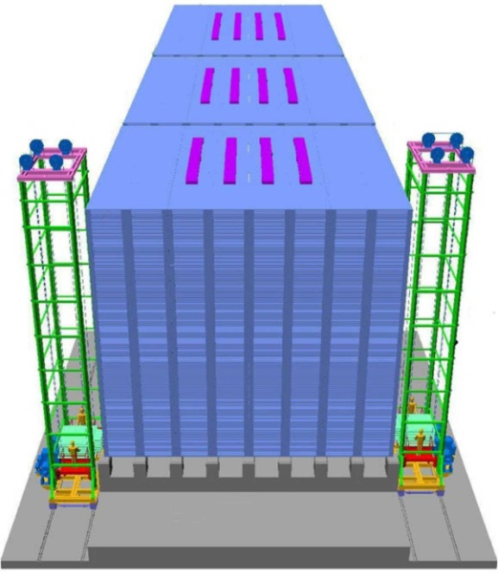
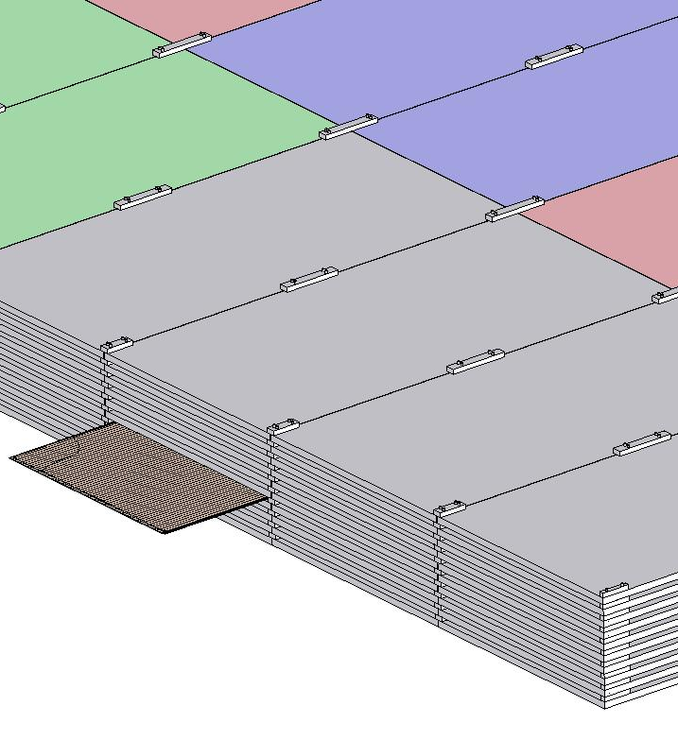
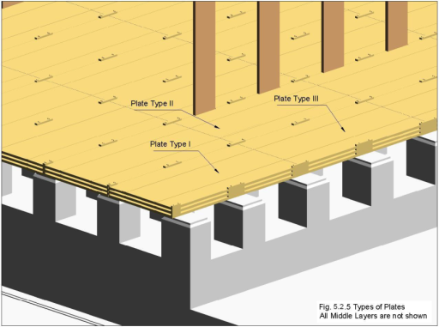
ICAL detector and construction
Magnet coils
4000mm×2000mm
×56mm low carbon iron sheets
RPC handling trolleys
RPC
Total weight: 50Ktons
4832 * 3 sheets

Slide 19
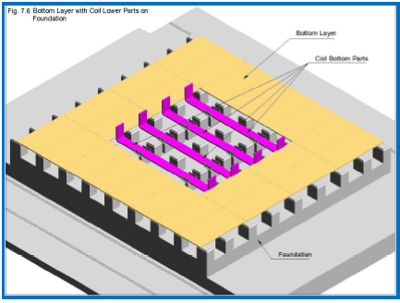
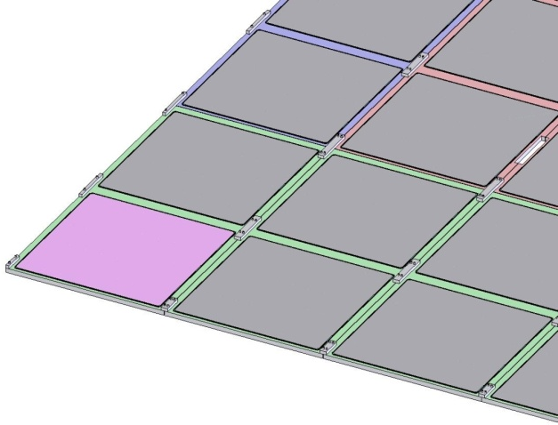
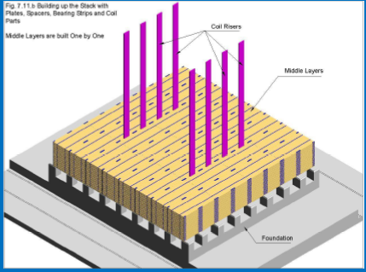
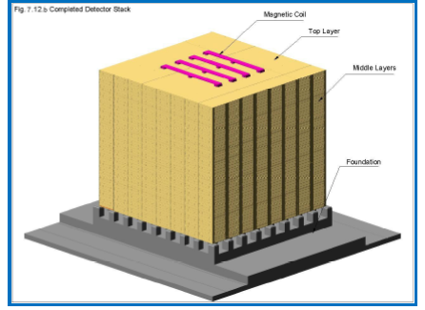
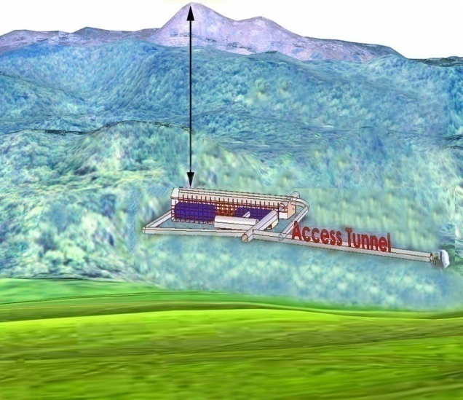
Construction of ICAL Magnet

Slide 20
Factsheet of ICAL detector
No. of modules | 3
Module dimensions | 16m × 16m × 14.5m
Detector dimensions | 48.4m × 16m × 14.5m
No. of layers | 150
Iron plate thickness | 56mm
Gap for RPC trays | 40mm
Magnetic field | 1.3Tesla
RPC dimensions | 1,950mm × 1,840mm × 24mm
Readout strip pitch | 3 0mm
No. of RPCs/Road/Layer | 8
No. of Roads/Layer/Module | 8
No. of RPC units/Layer | 192
No. of RPC units | 28,800 (97,505m²)
No. of readout strips | 3,686,400

Slide 21

Animation of ICAL construction

Slide 22
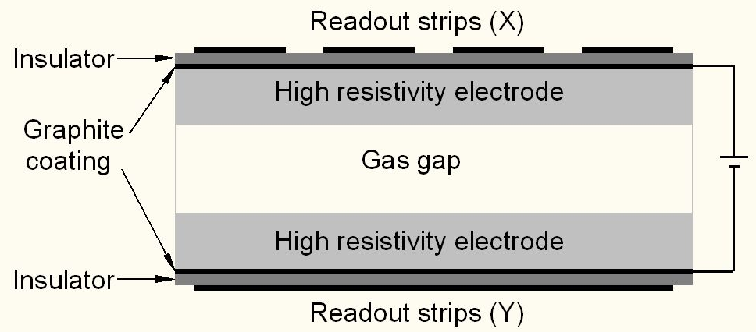
Schematic of a basic RPC

Slide 23
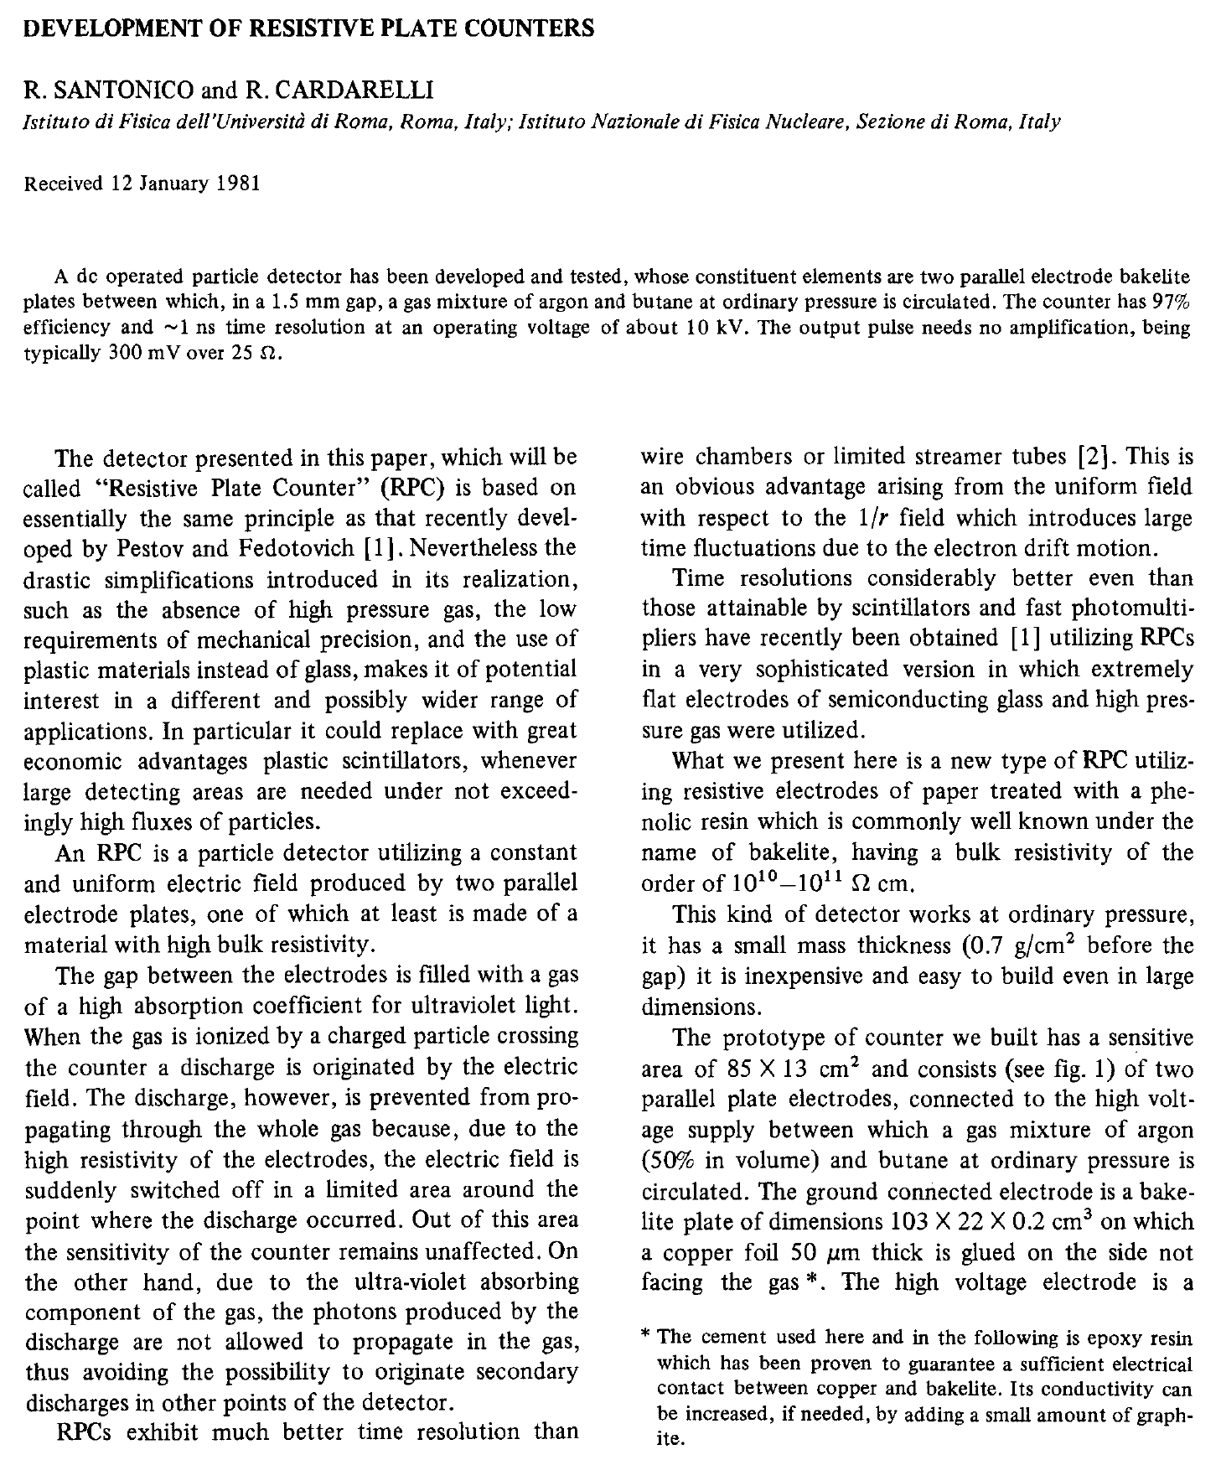
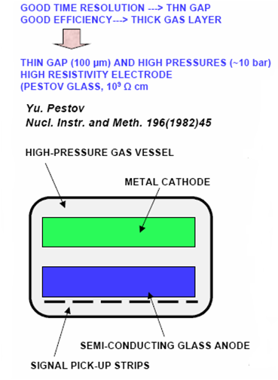
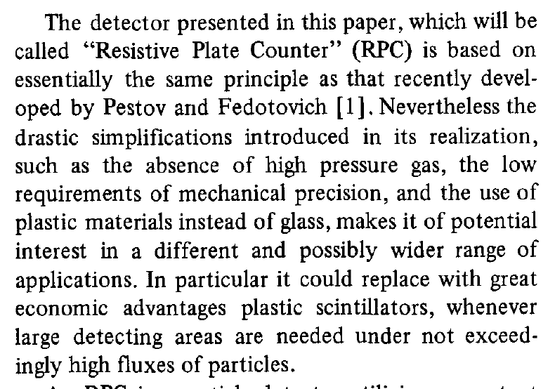
Birth of the RPC

Slide 24
Principle of operation
Electron-ion pairs produced in the ionisation process, drift in the opposite directions.
All primary electron clusters drift towards the anode plate with velocity v and simultaneously originate avalanches.
A cluster is eliminated as soon as it reaches the anode plate.
The charge induced on the pickup strips is q = (-eΔx_{e} + eΔx_{I})/g
The induced current due to a single pair is i = dq/dt = e(v + V)/g ≈ ev/g, V « v
Prompt charge in RPC is dominated by the electron drift.

Slide 25
RPC operating mode definitions
Let, n₀ = No. of electrons in a cluster
α = Townsend coefficient (No.
of ionisations/unit length)
β = Attachment coefficient (No.
of electrons captured by the
gas/unit length)
Then, the no. of electrons reaching
the anode,
n = n₀e^{(α- β)x}
Where x = Distance between anode
and the point where the cluster
is produced.
Gain of the detector, M = n / n₀
A planar detector with resistive electrodes ≈ Set of independent discharge cells
Expression for the capacitance of a planar condenser → Area of such cells is proportional to the total average charge, Q that is produced in the gas gap.
Where, d = gap thickness
V = Applied voltage
ε₀ = Dielectric constant of the gas
Lower the Q; lower the area of the cell (that is ‘dead’ during a hit) and hence higher the rate handling capability of the RPC

Slide 26
Control of avalanche process
Role of RPC gases in avalanche control
Argon is the ionising gas
R134a to capture free electrons and localise avalanche
e⁻ + X → X⁻ + hν (Electron attachment)
X⁺ + e⁻ → X + hν (Recombination)
Isobutane to stop photon induced streamers
SF₆ for preventing streamer transitions
Growth of the avalanche is governed by dN/dx = αN
The space charge produced by the avalanche shields (at about αx = 20) the applied field and avoids exponential divergence
Townsend equation should be dN/dx = α(E)N

Slide 27
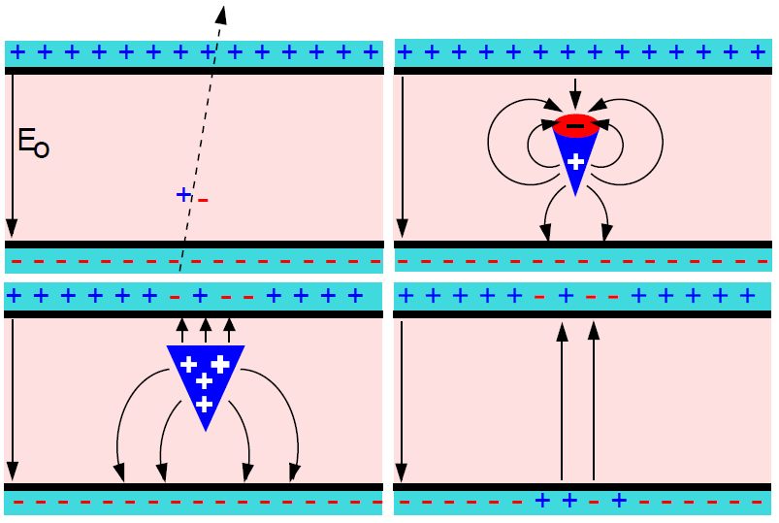
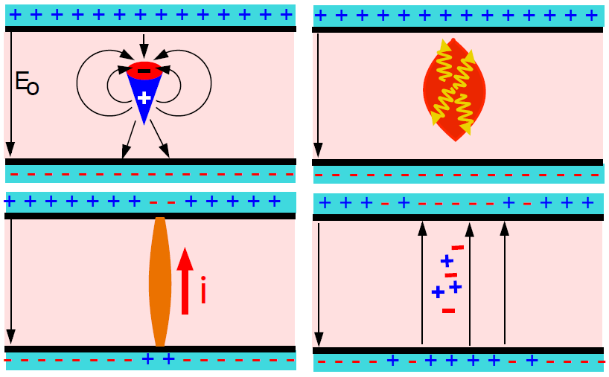
Two modes of RPC operation
Avalanche mode
Streamer mode
Gain of the detector << 10⁸
Charge developed ~1pC
Needs a preamplifier
Longer life
Typical gas mixture Fr:iB:SF₆::94.5:4:0.5
Moderate purity of gases
Higher counting rate capability
Gain of the detector > 10⁸
Charge developed ~ 100pC
No need for a preamplier
Relatively shorter life
Typical gas mixture Fr:iB:Ar::62.8:30
High purity of gases
Low counting rate capability

Slide 28
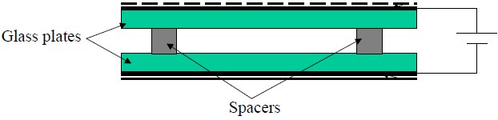
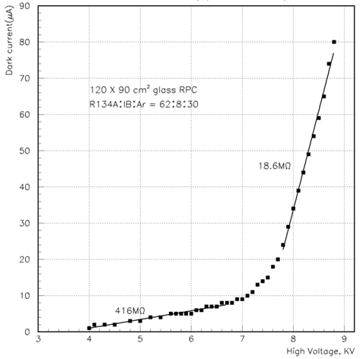
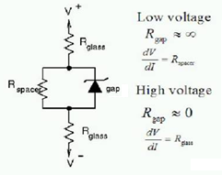
V-I characteristics of RPC
Glass RPCs have a distinctive and readily understandable current versus voltage relationship.

Slide 29
Why ICAL chose RPC?
Large detector area coverage, thin (~10mm), small mass thickness
Flexible detector and readout geometry designs
Solution for tracking, calorimeter, muon detectors
Trigger, timing and special purpose design versions
Built from simple/common materials; low fabrication cost
Ease of construction and operation
Highly suitable for industrial production
Detector bias and signal pickup isolation
Simple signal pickup and front-end electronics; digital information acquisition
High single particle efficiency (>95%) and time resolution (~1nSec)
Particle tracking capability; 2-dimensional readout from the same chamber
Scalable rate capability (Low to very high); Cosmic ray to collider detectors
Good reliability, long term stability
Under laying Physics mostly understood!

Slide 30
Deployment of RPCs in running experiments
Experiment | Area (m²) | Electrodes | Gap(mm) | Gaps | Mode | Type
PHENIX | ? | Bakelite | 2 | 2 | Avalanche | Trigger
NeuLAND | 4 | Glass | 0.6 | 8 | Avalanche | Timing
FOPI | 6 | Glass | 0.3 | 4 | Avalanche | Timing
HADES | 8 | Glass | 0.3 | 4 | Avalanche | Timing
HARP | 10 | Glass | 0.3 | 4 | Avalanche | Timing
COVER-PLASTEX | 16 | Bakelite | 2 | 1 | Streamer | Timing
EAS-TOP | 40 | Bakelite | 2 | 1 | Streamer | Trigger
STAR | 50 | Glass | 0.22 | 6 | Avalanche | Timing
CBM TOF | 120 | Glass | 0.25 | 10 | Avalanche | Timing
ALICE Muon | 140 | Bakelite | 2 | 1 | Streamer | Trigger
ALICE TOF | 150 | Glass | 0.25 | 10 | Avalanche | Timing
L3 | 300 | Bakelite | 2 | 2 | Streamer | Trigger
BESIII | 1200 | Bakelite | 2 | 1 | Streamer | Trigger
BaBar | 2000 | Bakelite | 2 | 1 | Streamer | Trigger
Belle | 2200 | Glass | 2 | 2 | Streamer | Trigger
CMS | 2953 | Bakelite | 2 | 2 | Avalanche | Trigger
OPERA | 3200 | Bakelite | 2 | 1 | Streamer | Trigger
YBJ-ARGO | 5630 | Bakelite | 2 | 1 | Streamer | Trigger
ATLAS | 6550 | Bakelite | 2 | 1 | Avalanche | Trigger
ICAL | 97,505 | Both | 2 | 1 | Both | Trigger

Slide 31
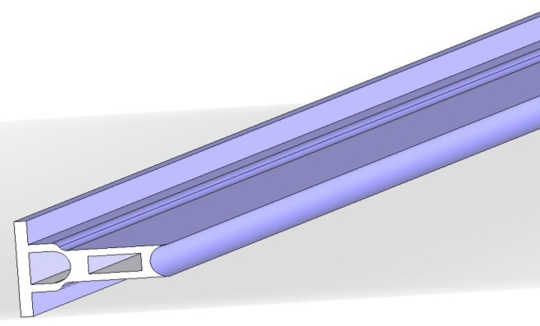
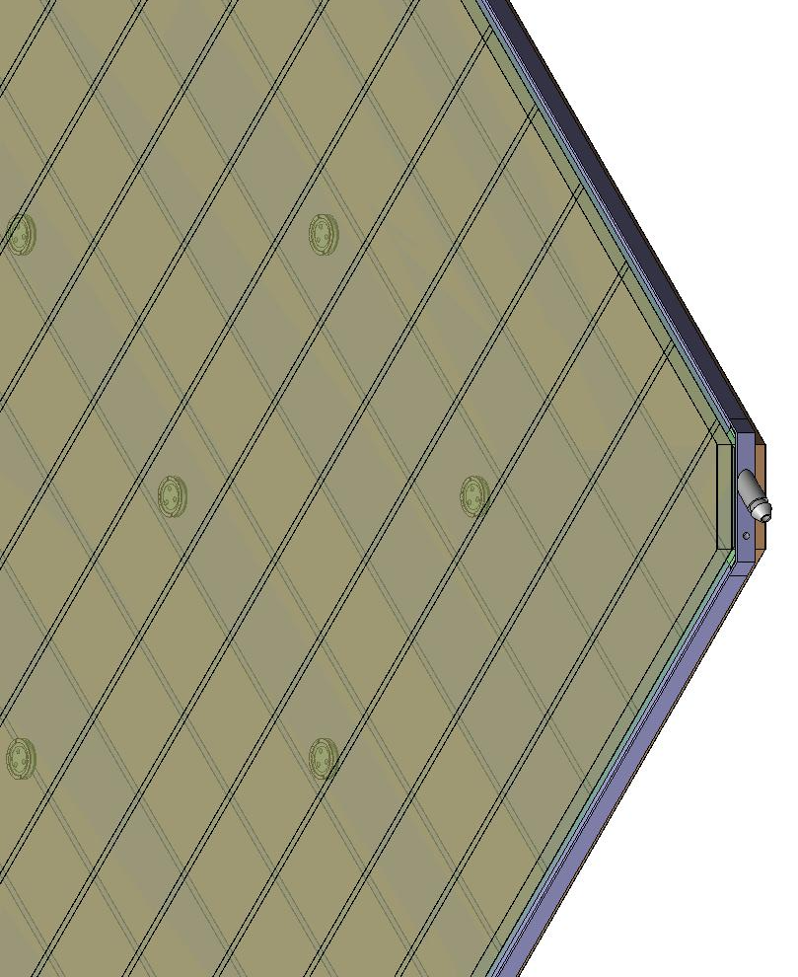
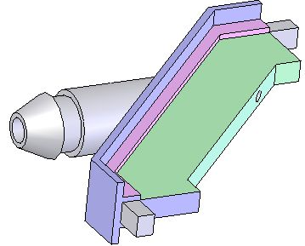
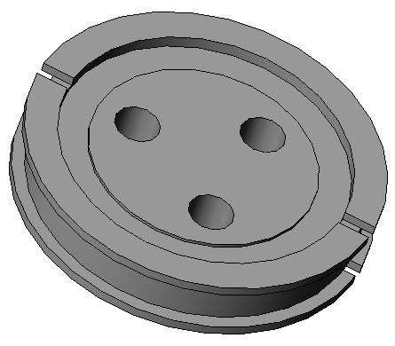
Materials for gas volume fabrication
Edge spacer
Schematic of an assembled gas volume
Gas nozzle
Glass spacer

Slide 32
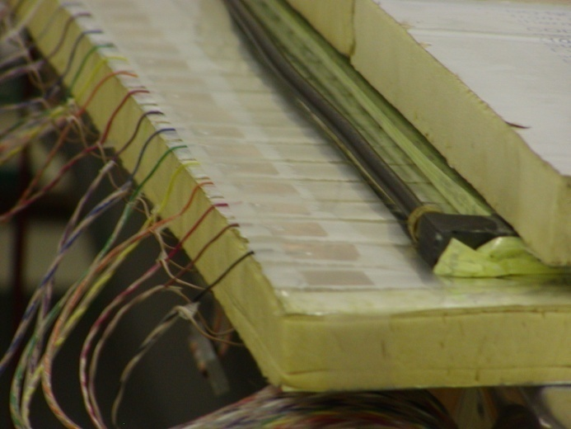
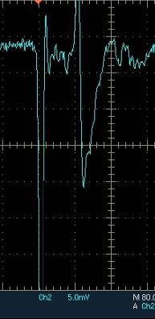
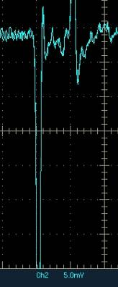
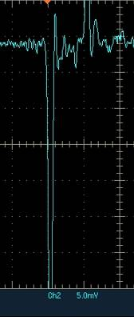
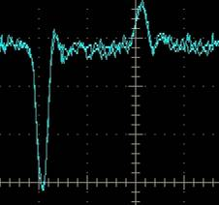
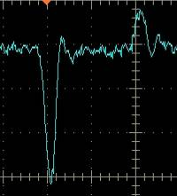
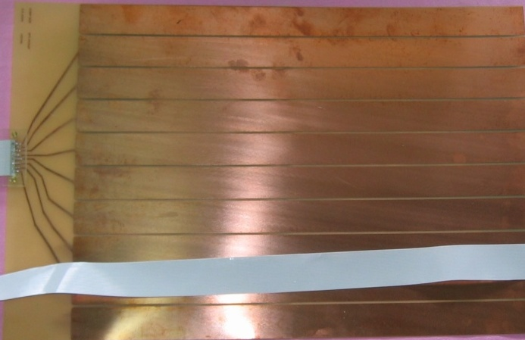
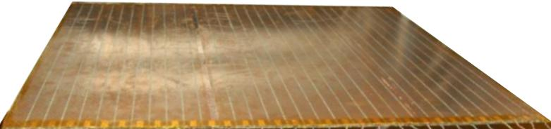
Development and characterisation of signal pickup panels
Foam panel
48.2Ω
G-10 panel
Open
100Ω
51Ω
47Ω
Z₀: Inject a pulse into the strip; tune the terminating resistance at the far end, until its reflection disappears.
Honeycomb panel

Slide 33
Impedance of transmission line
w
Readout strips
ε_{r}
h
Ground plane

Slide 34
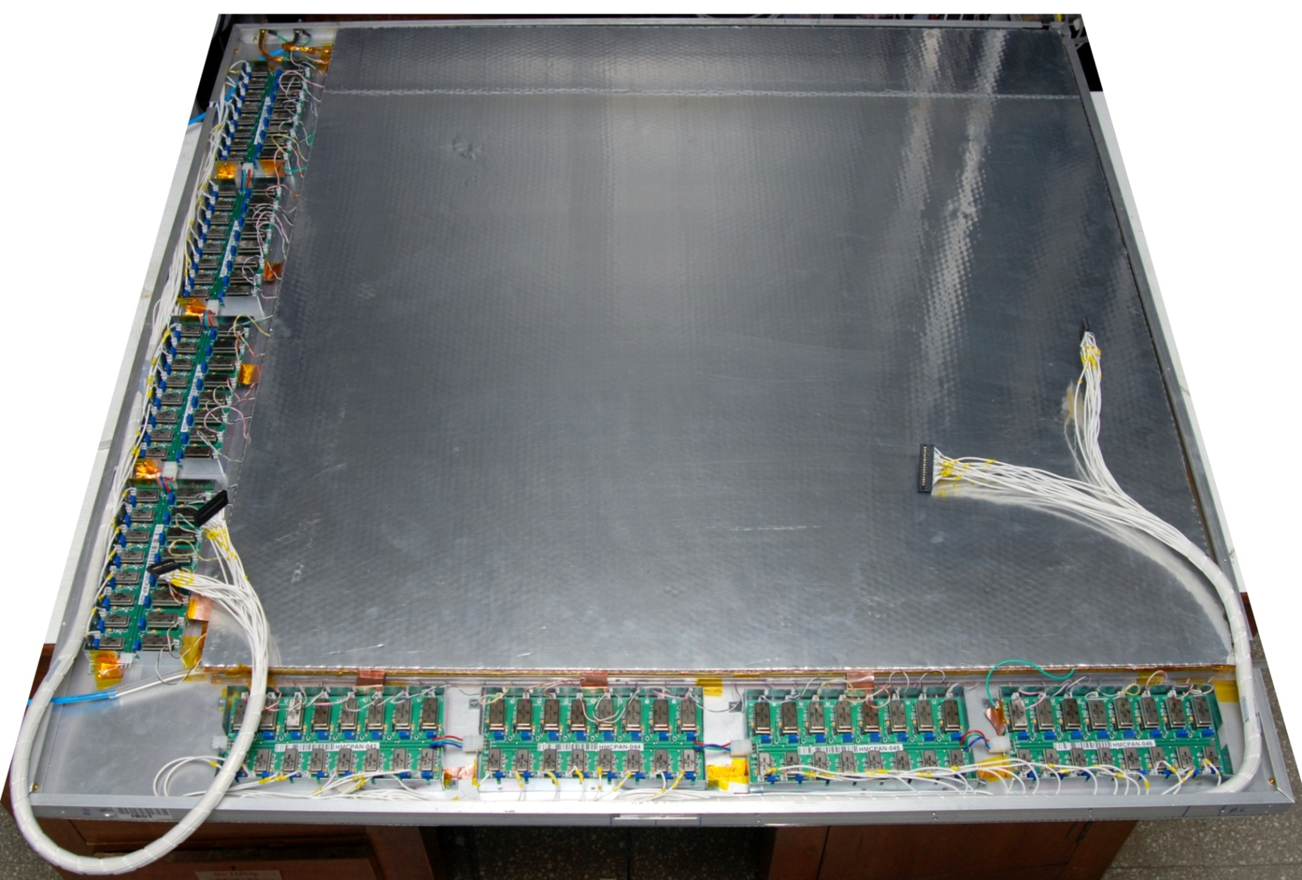
Fully assembled large area RPC
1m × 1m

Slide 35
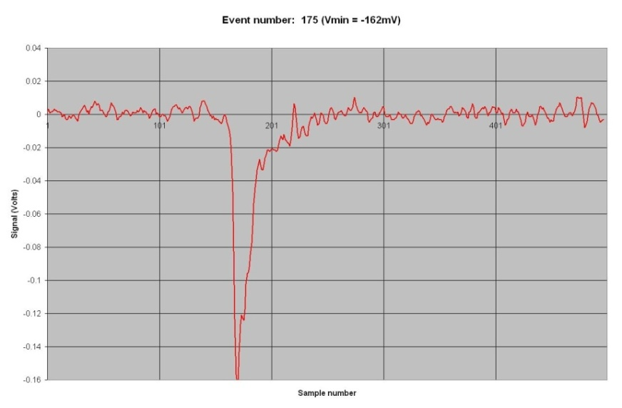
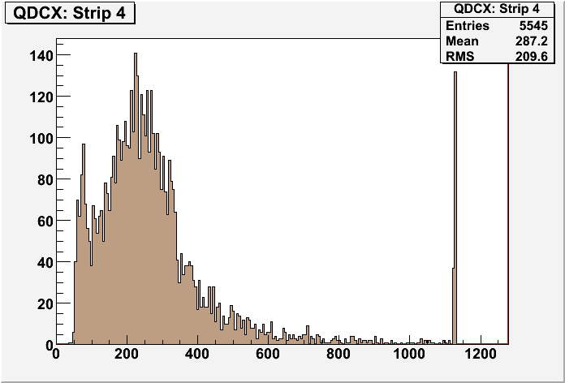
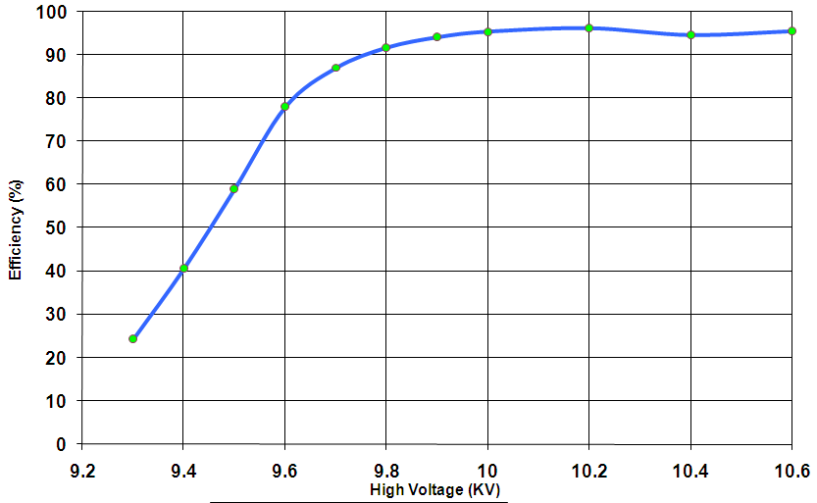
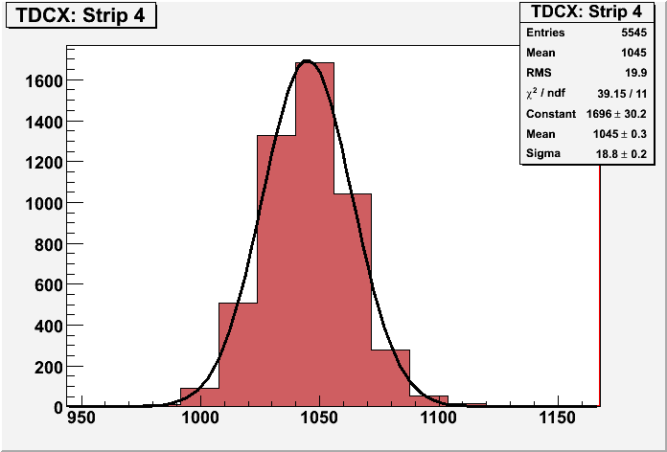
RPC parameter characterisation

Slide 36
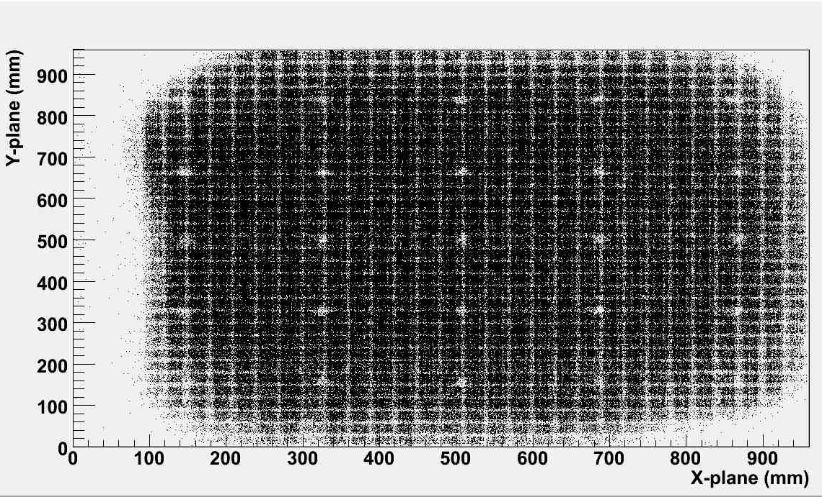
RPC tomography using cosmic ray muons

Slide 37


Studying long-term stability

Slide 38
Requirement of gases in ICAL
Total number of RPCs in ICAL = 3 × 150 × 64 = 28,800
Total gas volume = 28,800 × 184cm × 184cm × 0.2cm = 195,010 litres
For ex: One volume change/day with 10% gas top-up in a re-circulating scheme
Approximate running gas cost = Rs 30,000/day
Gas | Avalanche (%) | Streamer (%) | Maximum (%) | Volume (L) | Density (g/L) | Weight (Kg) | Cost (Rs/Kg)
Argon | 0.0 | 30.0 | 30.0 | 58,503 | 1.784 | 104.4
R134a | 95.5 | 62.0 | 95.5 | 186,234.6 | 4.25 | 791.5
Isobutane | 4.3 | 8.0 | 8.0 | 15,600.8 | 2.51 | 39.16
SF₆ | 0.2 | 0.0 | 0.2 | 390 | 6.164 | 2.40

Slide 39

Schematic of gas system

Slide 40







Constructional details of the gas system
Internal view
Front view
Rear view

Slide 41
Closed loop gas system
Total number of RPCs in the ICAL = 3 x150 x 64 = 28,800
Total gas volume = 28,800 x 195cm x 191cm x 0.2cm = 214,531 litres
Standard gas composition for the avalanche mode:
R134a(C₂H₂F₄):Isobutane(C₄H₁₀):Sulphur Hexaflouide(SF₆)::95.5:4.3:0.2
What is the minimum gas flow required in a RPC detector, which results in an optimum uniformity of gas concentration - by simulation and by monitoring the current and noise rate of an RPC.
Some deciding factors: Expensive and hazardous gases, green house effect, handling high volume of gases in the cavern
Operational consideration: How many RPC’s can be connected in series and/or in parallel? Many RPCs in series will add to pressure gradient, leading to gas flow problems

Slide 42

Study of gas sealed RPCs
If the RPC gas gaps are produced without leaks (less than 1.75 mm WC in more than 33 hours), then the detectors can be operated without appreciable degradation in their performance for more than a month with a single gas fill. The
cost of gas replenishing could thus be reduced considerably, by up to a factor of 30.

Slide 43
Gas purification process
Gas mixture quality: Presence of impurities in the return gas from the RPCs
Possible worsening of RPC performance due to impurities
Removal of water vapour by combination of 3A and 5A molecular sieves continuous duty purifier.
Removal of oil vapours by 3X molecular sieves
Removal of radicals (F⁻, HF etc.) by disposable activated Alumina
Removal of Oxygen by CuZn and Ni-NiO on activated Alumina/Silica by continuous duty purifier using standard cartridges
Final goal was to achieve the moisture and Oxygen levels to less than 2 ppm

Slide 44

Line diagram of the close loop gas recirculation and purification system
Displacers
PT 2
Molecular Sieves
Molecular Sieves
Pneumatic Cylinders
Low pressure
Radical Remover
High pressure
Diaphragm
Pump
PT 1
Exhaust
Gas purifiers
Receiver tank inlet
PT 3
MFC 5
Hygrometer
Non-return valve
N₂ input
Bypass
Feeder valve
Vacuum
Pump
PT 6
Storage Tank Outlet
1
2
3
4
RPC stack (this part is outside the gas unit cabinet)
PT 5
Mass flow controllers
MFC 1,2,3,4
Exhaust
PT 4
MFC 6
Gas Mixing (On-line)
Gas Recirculation
Gas Purification system
Control System (PLC)
Low pressure regulator

Slide 45



Newly developed gas recirculation system

Slide 46

System with 2 RPCs auto-refill in 20 days

Slide 47






Effect of SF₆ on RPC characteristics
Chamber current
Signal charge
Efficiency
Noise rate
Time response
Time resolution

Slide 48

1m × 1m RPC stack at TIFR, Mumbai

Slide 49

2m × 2m RPC stack at TIFR, Mumbai

Slide 50

ICAL prototype at VECC, Kolkata

Slide 51













Design and implementation of the data acquisition system
200 boards of 13 types
Custom designed using
FPGA,CPLD,HMC,FIFO,SMD

Slide 52


A couple of interesting events

Slide 53


RPC strip rate time profile
Temperature

Slide 54



Some results from prototype stack
Impact position distribution
Tomography of the RPC
Hit position residue distribution
Hit multiplicity distribution

Slide 55

Overall scheme of ICAL electronics
Major elements
Front-end board
RPCDAQ board
Segment Trigger Module
Global Trigger Module
Global Trigger Driver
Tier1 Network Switch
Tier2 Network Switch
DAQ Server

Slide 56



Functions & integration of FE-DAQ

Slide 57





Picking up the tiny charges
Process: AMSc35b4c3 (0.35um CMOS)
Input dynamic range:18fC – 1.36pC
Input impedance: 45Ω @350MHz
Amplifier gain: 8mV/μA
3-dB Bandwidth: 274MHz
Rise time: 1.2ns
Comparator’s sensitivity: 2mV
LVDS drive: 4mA
Power per channel: < 20mW
Package: CLCC48(48-pin)
Chip area: 13mm²

Slide 58

Picking up the tiny charges
Process: AMSc35b4c3 (0.35um CMOS)
Input dynamic range:18fC – 1.36pC
Input impedance: 45Ω @350MHz
Amplifier gain: 8mV/μA
3-dB Bandwidth: 274MHz
Rise time: 1.2ns
Comparator’s sensitivity: 2mV
LVDS drive: 4mA
Power per channel: < 20mW
Package: CLCC48(48-pin)
Chip area: 13mm²

Slide 59

RPCDAQ module
Design of the shaded building blocks completed.
Waveform sampler is not part of the board for the engineering module

Slide 60

ICAL TDC specifications

Slide 61

ASIC based TDC device
Principle
Two fine TDCs to measure start/stop distance to clock edge (T₁, T₂)
Coarse TDC to count the number of clocks between start and stop (T₃)
TDC output = T₃+T₁-T₂
Specifications
Currently a single-hit TDC, can be adapted to multi-hit
20 bit parallel output
Clock period, T_{c} = 4ns
Fine TDC interval, T_{c}/32 = 125ps
Fine TDC output: 5 bits
Coarse TDC interval: 2¹⁵ * T_{c} = 131.072μs
Coarse TDC output: 15 bits
The chip has arrived, evaluation tests are in progress it IITM
CMEMS is also coming up with an ASIC with similar specs.

Slide 62


Network interface specifications
Data traffic into RPC-DAQ is Configuration/ commands – Beginning or rarely Broad cast/ Multicast – UDP protocol with/higher layer check
Data traffic out of RPC-DAQ is relatively high (45/332kbps)
We will use a TCP/IP based network interface to send and receive data from front-end to the back-end. TCP/IP over UTP or optical fiber is a reliable protocol over long distances.
Hardwired network protocol – Wiznet 5300 chip is used

Slide 63

Data network architecture

Slide 64

Passive Optical Network

Slide 65

N/W switches on the face of spacers

Slide 66
Features of ICAL trigger system
Physicist’s mind decoded!
Insitu trigger generation
Autonomous; shares data bus with readout system
Distributed architecture
For ICAL, trigger system is based only on topology of the event; no other measurement data is used
Huge bank of combinatorial circuits
Programmability is the game, FPGAs, ASICs are the players

Slide 67

ICAL Trigger Scheme

Slide 68


Implementation layout

Slide 69
Power supply options
High voltage (Central scheme)
Two options: a channel at 12kV or two channels at ±6kV (Imax ~2mA)
Consider powering 4 RPC with a single HV channel (10μA current)
Cable diameter an integration issues, connectors a cost issue
Ripple less than a volt at 6KV
High voltage (Distributed scheme)
DC-DCHV converters (proportional – high ripple or regulated)
Each RPC has to be identical to the others?
Each RPC will have its own DC-HVDC converter for generating HV and LV
Control and monitoring modules interfaced to the RPCDAQ module
Low voltage
Power budget 25W per RPC – for the purpose of power supply design
How many low voltages? – one for now.
Voltage Set/Monitor resolution 5 mV
Current Set/Monitor resolution10 mA
Voltage ripple ~20mV PP
Input, topology, efficiency and size
Voltage Drop compensation via sense wires?
Load regulation ±0.3 %
Fringe magnetic fields and space for DC-DC converters inside the RPC unit are the design and integration issues

Slide 70



Slide 71

DC-HVDC supply control & monitoring
Controls and monitors 2 channels
A μC (with built in 12-bit ADCs and DACs) based.
Communicates with RPCDAQ module on SPI.
Controls high voltage, ramp rate etc.
Monitors voltages and currents
Compact and small form-factor

Slide 72


Signal and power cable distribution
ICAL
Detector
Cable
Trays
Gas Pipes
Φ 16mm
24 Digital I/O
Φ 11.2mm
24 Power
Φ 10.5mm
48 HV Lines
Φ 5mm
Cross-section of a Cable
Tray

Slide 73
Software requirements
RPC-DAQ controller firmware
Backend online DAQ system
Local and remote shift consoles
Data packing and archival
Event and monitor display panels
Event data quality monitors
Slow control and monitor consoles
Database standards
Data analysis and presentation software standards
Operating System and development platforms

Slide 74
Technology development for Industrial production of RPCs
Development of graphite coating by automatic spray painting.
Demonstration of successful operation of automatic button and glue dispenser.
Development of glass chamfering and glass Engraving.
Pickup panel development.
Tray design.
Computer modeling of RPC & its assembly in ICAL.
Physical RPC models to study push-pull assembly in ICAL magnet gap.
Some of these items are at advanced stages of development.

Slide 75
QC procedures for RPC gap
Visual inspection: All the glasses, buttons, spacers etc. are to be inspected before taking up the fabrication work. This should be done by an experienced staff and the same person need to certify the acceptance of the material provided with proper documentation.
Dimension conformance
Leak test of Gaps*: A RPC-gap “leak test system” should be developed, so that the RPC gaps so produced are qualified for the required pressure test.
The QC sheets (traveler sheet) need to be filled at each and every step and should be carried forward along with gap.
*Leak test:
The gaps need to be checked for any leak and the leak rate should be less then 10⁻⁴ SCCM and the gaps should hold at least 6mbar pressure.

Slide 76






Steps towards Industrial production of RPCs

Slide 77




RPC fabrication at Asahi Float Glass

Slide 78




Chamfering and engraving of glass

Slide 79



Painting/curing of glass plates

Slide 80

Animation of glass painting

Slide 81




Automatic RPC gap making

Slide 82
Animation of RPC gap fabrication

Slide 83




RPC holding tray
Self weight + 100kg load
Finite Element Analysis
Max. deflection
4.4mm
Spec.
5mm
Max. stress
8.2MPa
FRP
25MPa
Extra thickness in selected sections
Three-line support
Fabricated tray
Down side view

Slide 84

Prototypes of RPC holding trays

Slide 85

RPC fabrication facility

Slide 86
Career opportunities in INO
Research Scholars
Applicants must have a minimum qualification of M.Sc. degree in Physics or B.E./B.Tech. degree in any one of Electronics, E & CE, Instrumentation and Electrical Engineering subjects with strong motivation for and proficiency in Physics.
The selected candidates will be enrolled as Ph.D. students of the Homi Bhabha National Institute (HBNI), a Deemed to be University, with constituent institutions that include BARC, HRI, IGCAR, IMSc, SINP and VECC.
They will take up 1 year course work at TIFR, Mumbai in both theoretical and experimental high energy physics and necessary foundation courses specially designed to train people to be good experimental physicists.
Successful candidates after the course work will be attached to Ph.D. guides at various collaborating institutions for a Ph. D. degree in Physics on the basis of their INO related work.
Career opportunities for bright engineers in Electronics, Instrumentation, Computer Science, Information technology, Civil, Mechanical and Electrical engineers

Slide 87
Current status
RPC detector R&D concluded quite a while ago. The RPC stacks are being used even for some physics studies.
Scaling up and industrial adaptation of lab technology – by an industry, is almost complete.
Extensive vendor development for material fabrication, process development, design of SPMs and for large scale production of RPCs.
Ready for engineering module.
Tenders for RPC production for engineering module are about to be floated.
Further fine-tuning of chamber design, operating parameters and maintenance related practices will continue.

Slide 88
Closing remarks
INO is an exciting mega basic science project
It is being planned on an unprecedented scale and budget
ICAL and other experiments will produce highly competitive physics
Beyond neutrino physics, INO is going to be an invaluable facility for many future experiments
It provides wonderful opportunities for science and engineering students alike
Detector and instrumentation R&D, scientific human resource development are INO’s major trust areas
It offers a large number of engineering challenges and many spin-offs such as medical applications

Slide 89

Thank you for your attention

Slide 90
Backup slides

Slide 91
Design considerations & constraints
Data rates are low.
Physical dimensions: Owing to severe space constraints on the RPC, triangular space of about 160cm² only is available for this extremely high density board.
Service life of the electronics is expected to be more than15 years, component spares availability/replaceability is a concern.
Since the temperature and humidity inside the cavern will be controlled for RPCs, the electronic components need not be even of industrial grade - Commercial grade will do.
Low power consumption. It is highly desirable to have minimum power consumption.
Cost: Since the volumes are high, cost is also a major consideration

Slide 92
Data sizes and rates – Event
TDC data = 1 channel for 8 strips and both the edges per hit, up to 4 hits per channel per event = 16 channels x 2 edges x 4 hits x 16 bits = 2048 bits
Hit data per RPC = 128 bits
RPC ID = 32 bits
Event ID = 32 bits
Time Stamp = 64 bits
DRS data = 16 channels x 1000 samples x 16 bits = 256000 bits
(DRS data comes in event data only if we get summed analog outputs from the preamplifier)
Data size per event per RPC
With DRS data, DR = 2048 + 128 + 32 + 32 + 64 + 256000 = 258,304 bits
Without DRS data, DR = 2048 + 128 + 32 + 32 + 64 = 2,304 bits
Considering 1Hz trigger rate, Maximum data rate per RPC = 252.25 kbps

Slide 93
Data sizes and rates - Monitoring
We require to monitor 1 pick-up strip per plane per RPC.
Monitor Data per strip = 24 bits
Channel ID = 8 bits
RPC ID = 32 bits
Mon Event ID = 32 bits
Ambient Sensors’ data = 3 x 16 bits = 48 bits
Time Stamp = 64 bits
DRS data = 1000 pulses (if noise rate is 100Hz) x 16 bits x 100 samples = 1600000 bits
(DRS data comes in monitoring data only if we get multiplexed analog outputs from the preamplifier)
Data size per 10 seconds per RPC
With DRS data = 24 + 8 + 32 + 32 + 48 + 64 + 2048 + 1600000 = 1,602,256 bits
Without DRS data = 24 + 8 + 32 + 32 + 48 + 64 + 2048 = 2,256 bits
Maximum data rate with 10 second monitoring period per RPC = 156.47 kbps

Slide 94


Calibration procedures of the gas systems
Calibration done using water displacement method
Calibrated against the MFC monitor voltage
Cross-calibration procedure
Glass/hard plastic tube with precise inner diameter chosen. Placed on a perfectly horizontal surface.
Water droplet introduced through an opening on one end of the tube
Gas connected to this end
Gas moves the water droplet forward α gas flow
Distance, time intervals measured
Gas volume computed and compared with displayed value

Slide 95




Calibration results of the gas systems
Argon
SF₆
Isobutane
R134a

Slide 96
Typical expected parameters
No. of clusters in a distance g follows Poisson distribution with an average of
Probability to have n clusters
Intrinsic efficiency
ε_{max} depends only on gas and gap
Intrinsic time resolution
σ_{t} does not depend on the threshold
Gas: 96.7/3/0.3
Electrode thickness: 2mm
Gas gap: 2mm
Relative permittivity: 10
Mean free path: 0.104mm
Avg. no. of electrons/cluster: 2.8
Charge threshold: 0.1pC
HV: 10.0KV
Townsend coefficient: 13.3/mm
Attachment coefficient: 3.5/mm
Efficiency: 90%
Time resolution: 950pS
Total charge: 200pC
Induced charge: 6pC

Slide 97

Neutrino (ν)
Proposed by Wolfgang Pauli in 1930 to explain beta decay.
Named by Enrico Fermi in 1931.
Discovered by F.Reines and C.L.Cowan in 1956.
Created during the Big Bang, Supernova, in the Sun , from cosmic rays, in nuclear reactors, in particle accelerators etc.
Interactions involving neutrinos are mediated by the weak force.

Slide 98
Neutrino oscillations
It is now known that neutrinos of one flavour oscillate to those of another flavour.
The oscillation mechanism is possible only if the neutrinos are massive.
Neutrino experiments are setting the stage for extension of Standard Model itself.
Massive neutrinos have ramifications on nuclear physics, astro physics cosmology, geo physics apart from particle physics
Electron and muon neutrinos (ν_{e} and ν_{μ}) are the flavour eigen states. They are super positions of the mass eigen states (ν₁ and ν₂)..
If at t = 0, an eigen state ν (0) = ν_{e,} then any time t
Then the oscillation probability is
And the oscillation length is

