Slide 1
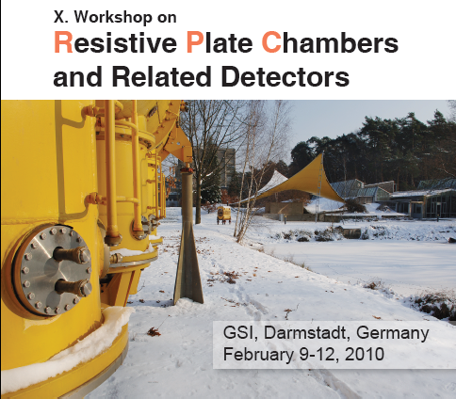
A summary of
http://www-aix.gsi.de/conferences/rpc2010/Program_RPC_2010_Linked.html

Slide 2
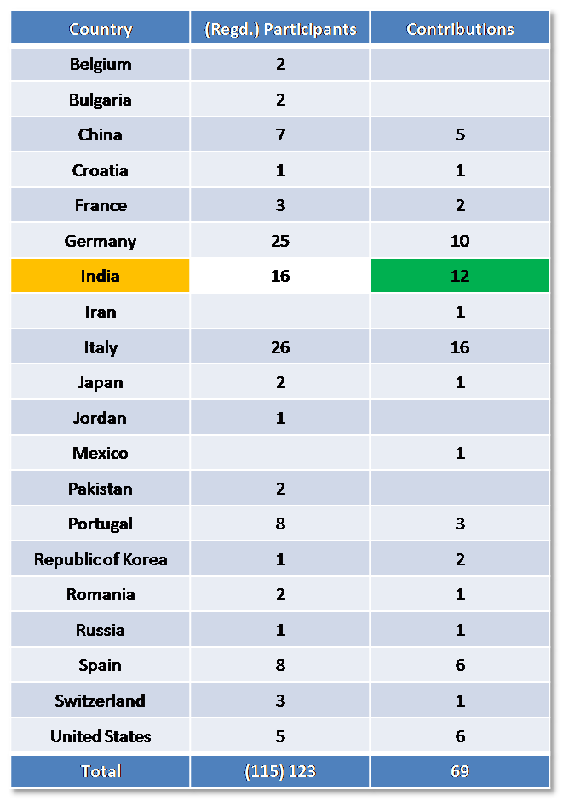
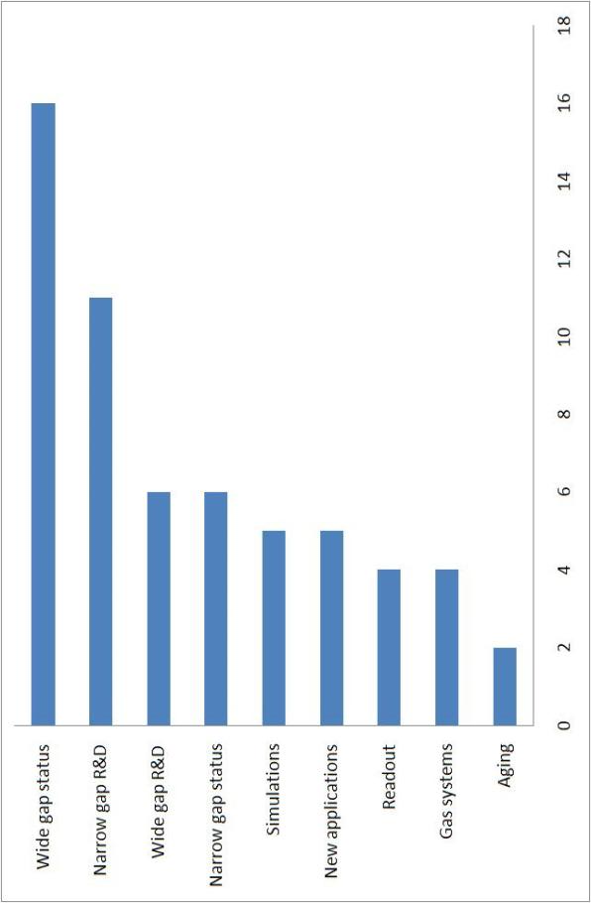
Some statistics first …
Contribution type | Number
Oral presentations | 61
Posters | 16

Slide 3
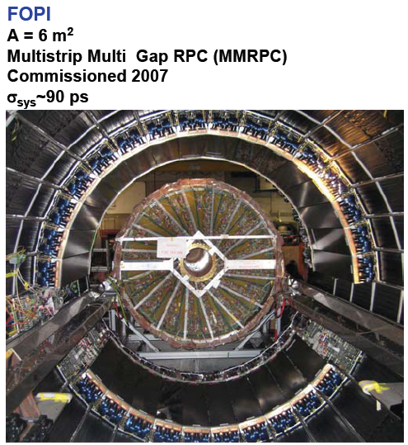
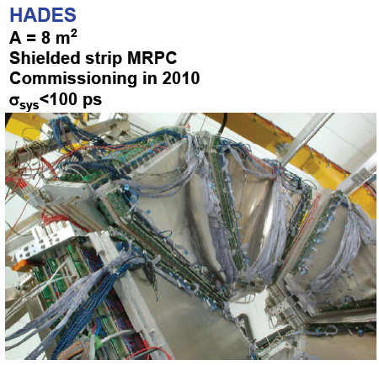
RPCs at GSI
Pestov spark counters development for ALICE experiment during 1995-2000

Slide 4
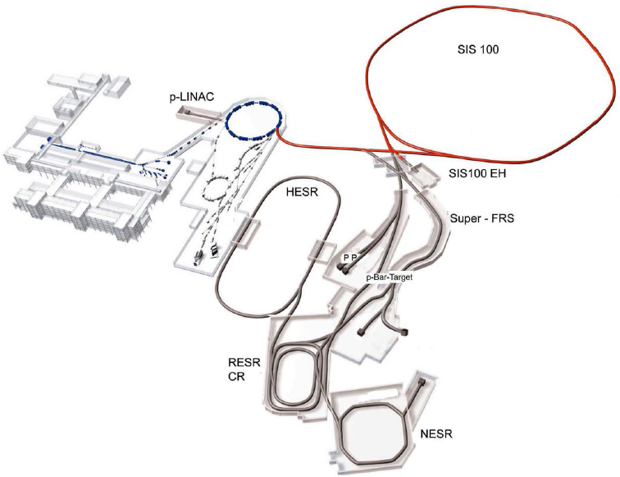
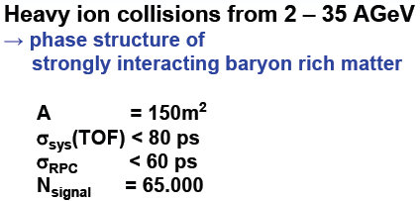
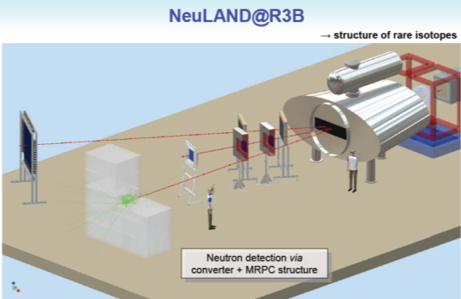
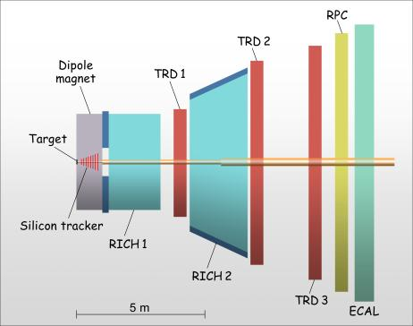
RPCs in FAIR projects
CBM

Slide 5
Status and performance of wide-gap RPC systems

Slide 6
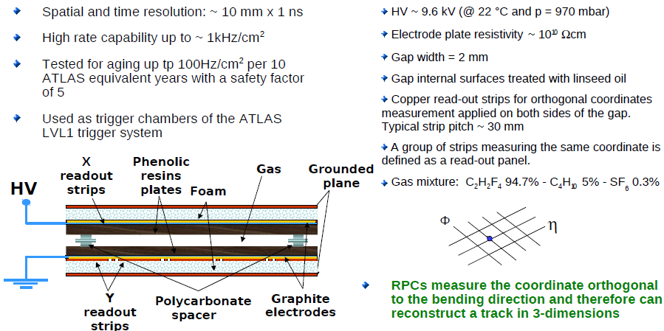
Performance of the ATLAS Resistive Plate Chambers Giordano Cattani

Slide 7
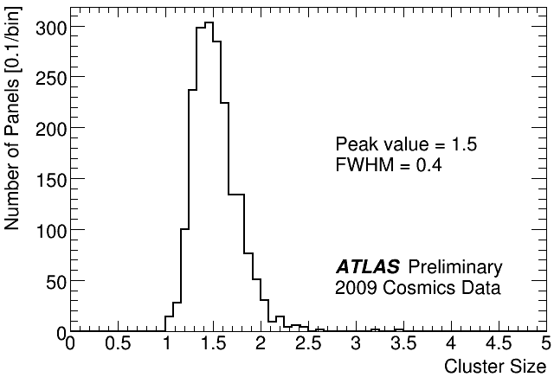
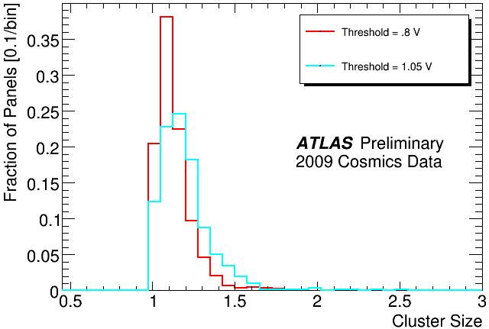
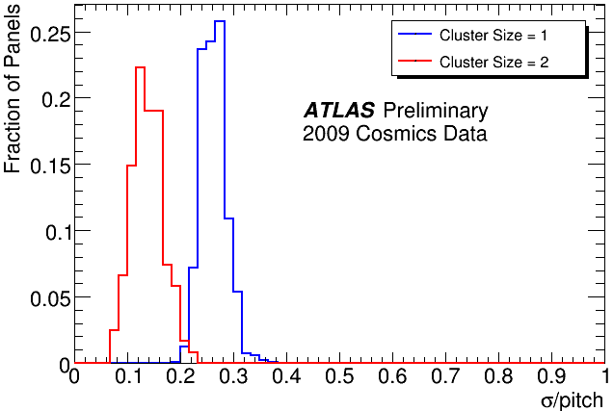
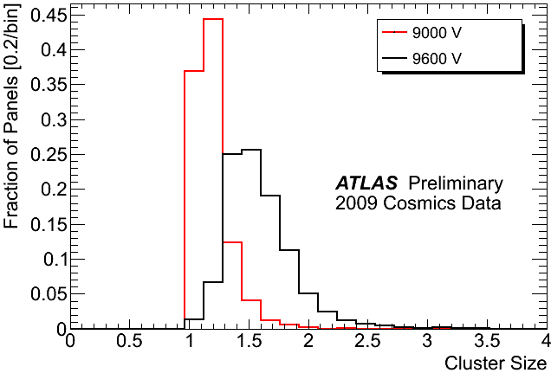
Vth = 1000 mV
HV = 9600 V
HV = 9600 V
Mean value = 0.27
Mean value = 0.14

Slide 8
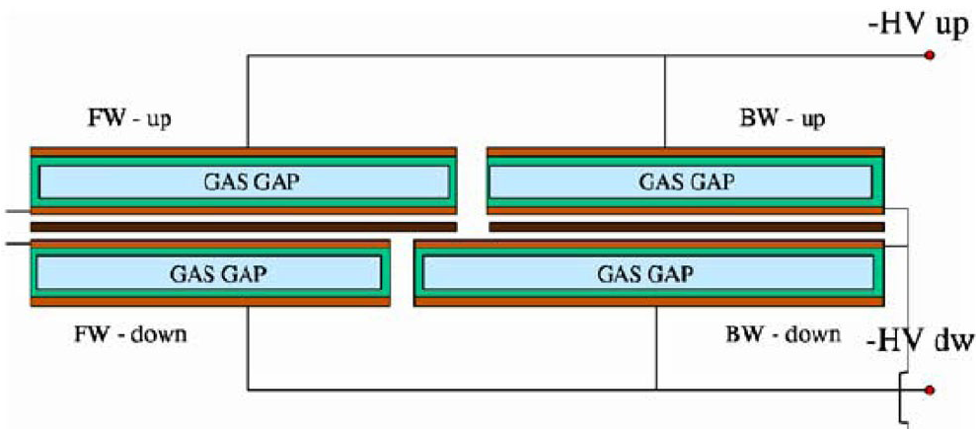
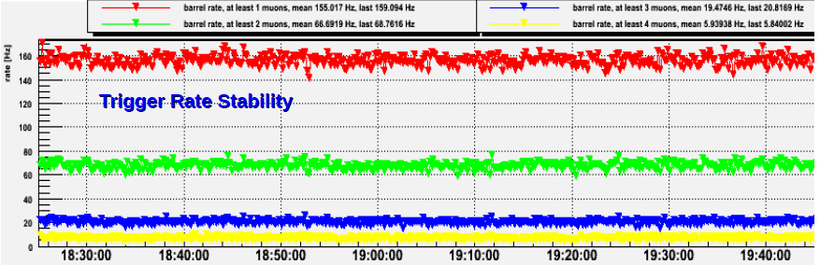
The CMS RPC project, results from 2009 cosmics data taking
Camilo Carrillo
RPC coverage ~2953 m²

Slide 9
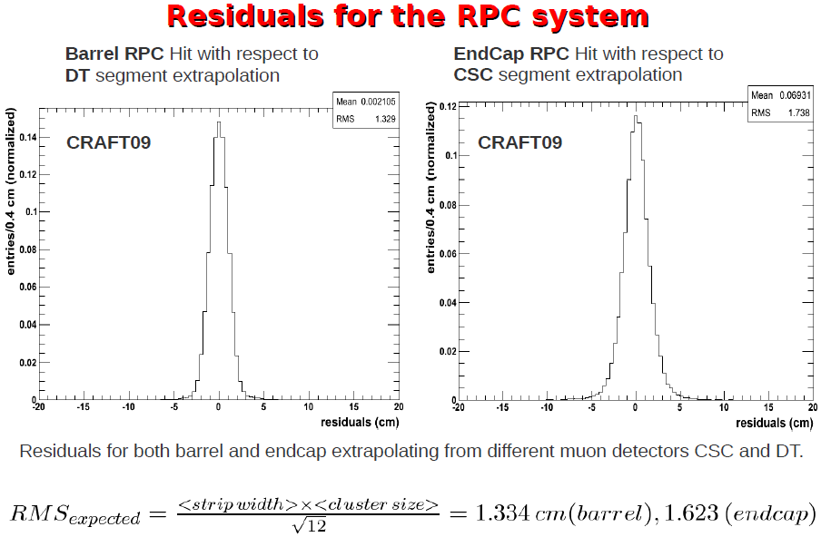

Slide 10
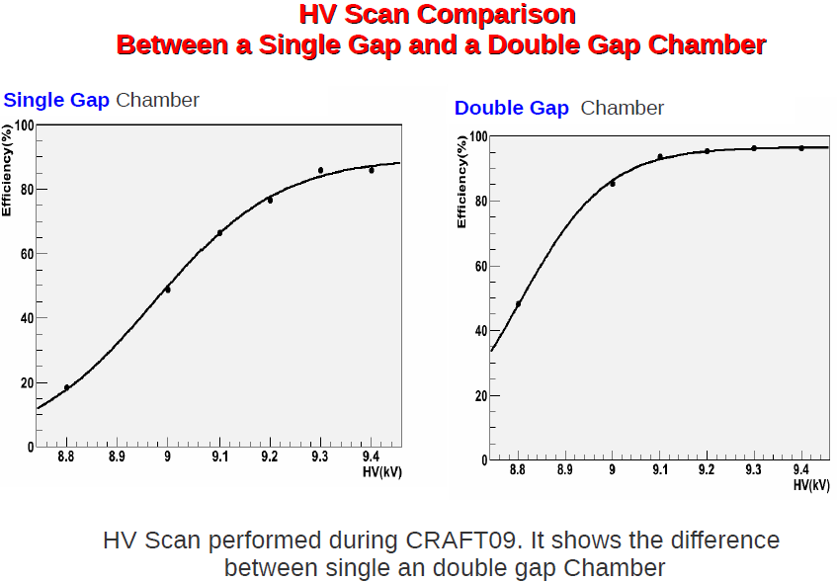

Slide 11
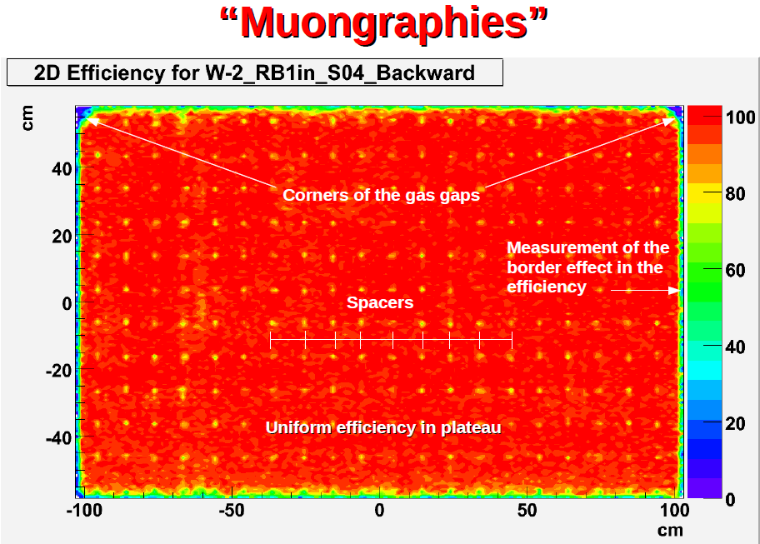

Slide 12
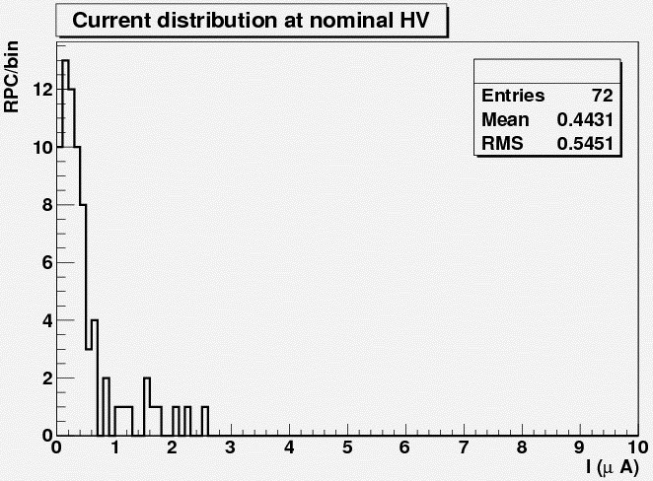
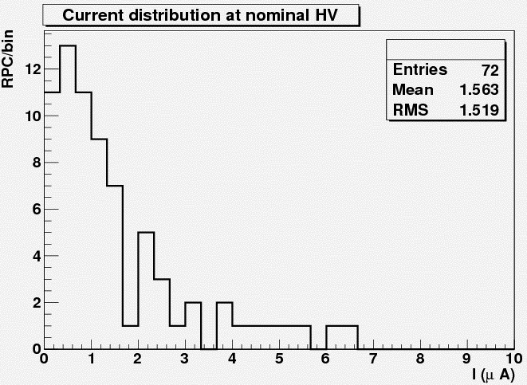
Commissioning of the RPCs for the ALICE muon arm
M. Gagliardi
Streamer, HV ~ 8 kV
Avalanche, HV ~ 10.3 kV

Slide 13
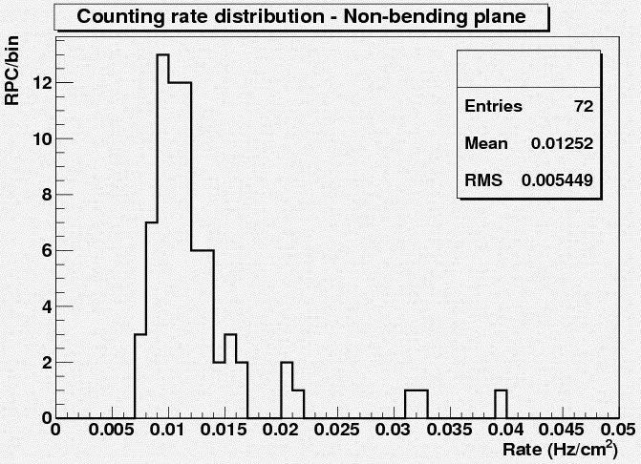
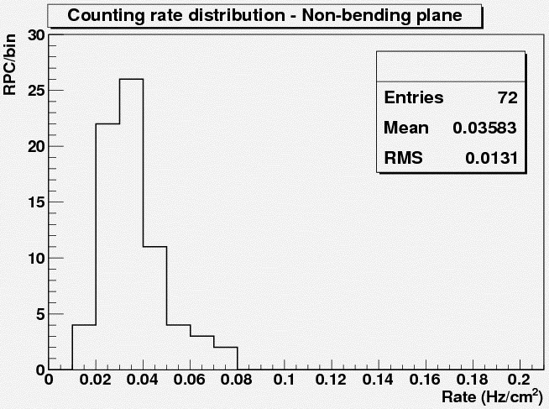
Streamer, HV ~ 8 kV
Avalanche, HV ~ 10.3 kV

Slide 14
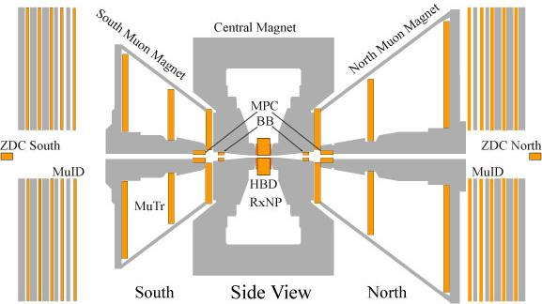
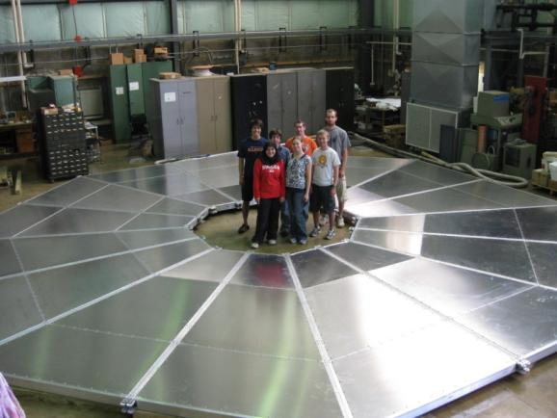
RPC based Muon Trigger Upgrade for the PHENIX Experiment at RHIC Young Jin Kim
RPC 1
RPC1: 16 RPC detector modules (384 read-out channels)
RPC3: 96 RPC detector modules (11488 read-out channels)
RPC 3
RPC 3
PHENIX RPC detector requirement
Efficiency | > 95%
Time resolution | ≤ 3 ns
Average cluster size | ≤ 2 strips
Rate capability | 0.5 kHz/cm²
Number of streamers | < 10 %

Slide 15
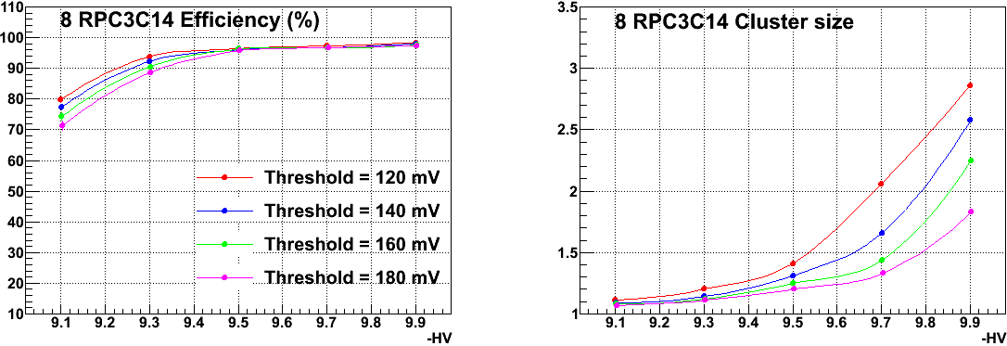
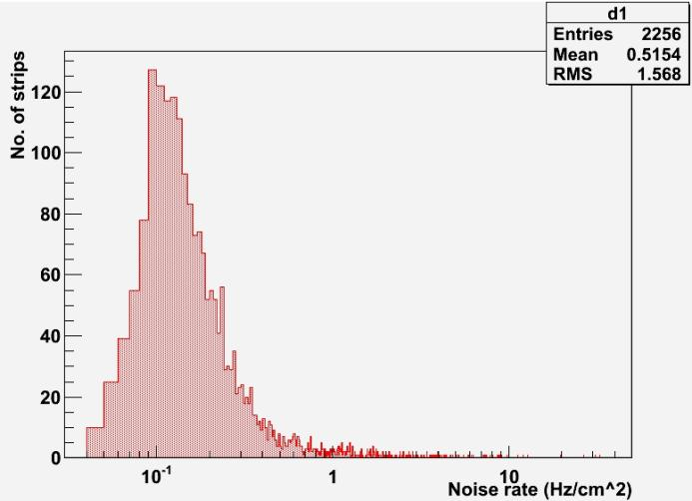
# of strips vs. noise rate
all 48 modules
H.V = 9.5 kV
FEE Threshold = 160 mV
<noise rate> = 0.5154 Hz/cm²
7 strips are over 10 Hz/cm²

Slide 16
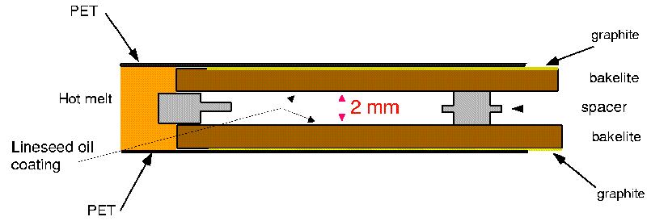
Performance and aging of OPERA RPCs A. Paoloni
Inside 2 cm gaps between iron slabs:
Track reconstruction inside magnet
Showers leakage measurement
Trigger & Timing for the drift tubes
High resistivity bakelite electrodes (low rate expected): ρ>5∗10¹¹ Ω cm @ 20ºC
Special curved contour chambers
Streamer mode operation (large signals)
Read-out by means of ~8 m strips with 2.6 (3.5) cm pitch for bending (orthogonal) view
1 layer = 21 RPCs of size (2.9*1.1) m²
1 spectrometer = 504 RPCs/XPCs
details of the first
spectrometer
1 row= basic unit for HV/gas
8 meters
RPC sketch
8.75 meters
Total surface of the system ~ 3200 m²
Number of digital electronics channels ~ 28000

Slide 17
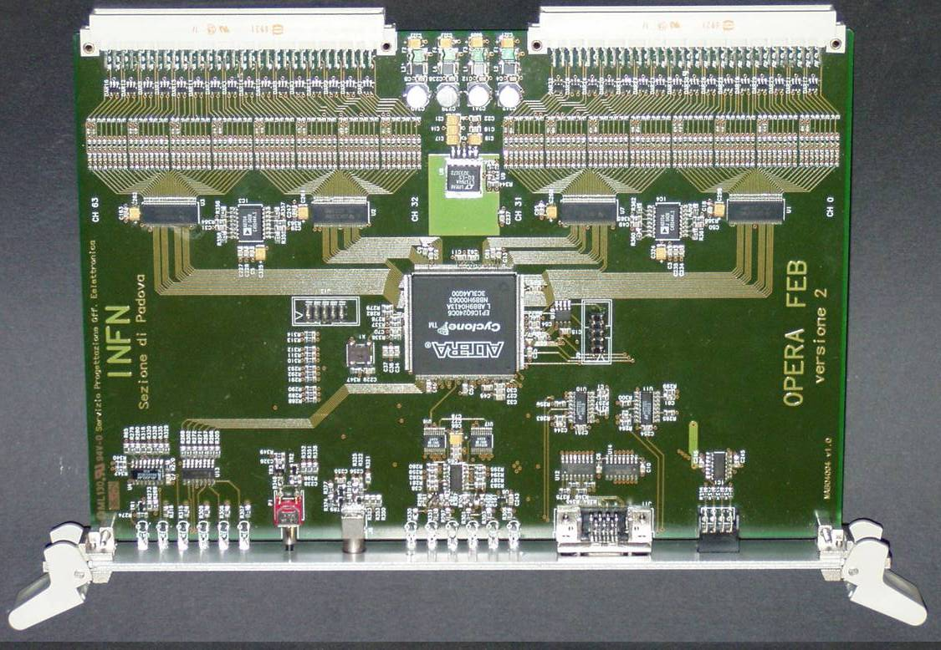
RPC Front End Card
Located on top platform and connected to the read-out strips through twisted-pair flat cables as long as 13m
64 channels inputs
Self triggerable on 32 ch. FastOR signal
Can work with external trigger
Programmable threshold (-150mV < V_{th} < 150mV) and polarity in groups of 32 ch
Each channel can be individually masked
LVDS Receivers used as discriminator
Digital section in low cost FPGA
Serial link to the controller board

Slide 18
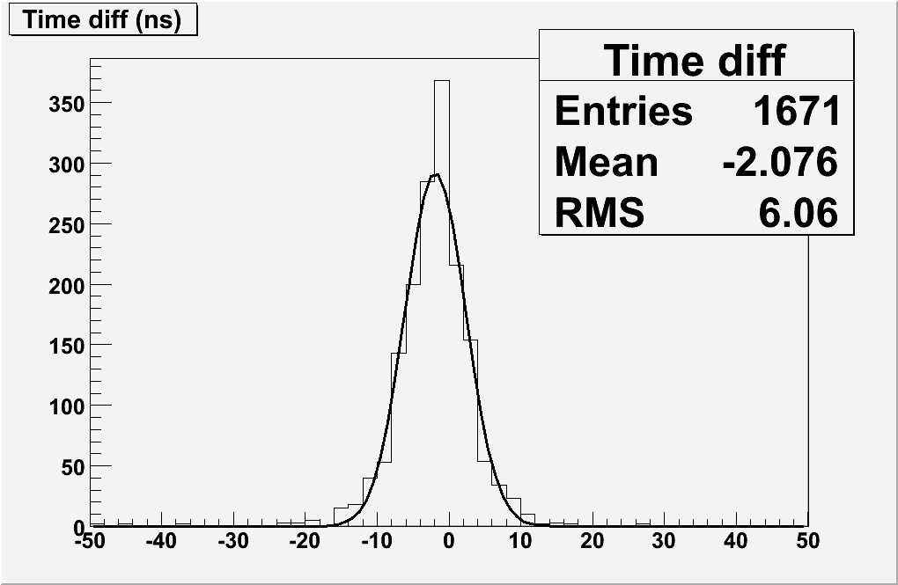
Time resolution
Measurement method:
Consider the distribution of the time difference between consecutive layers
Correction for the muon TOF and the strip propagation delay
Gaussian fit
Time resolution defined as σ/√2
σ(RPC) ~ 3 ns
TDC binning=1.5 ns
Measured Drift Tubes space-resolution within specifications (~300 μm).

Slide 19
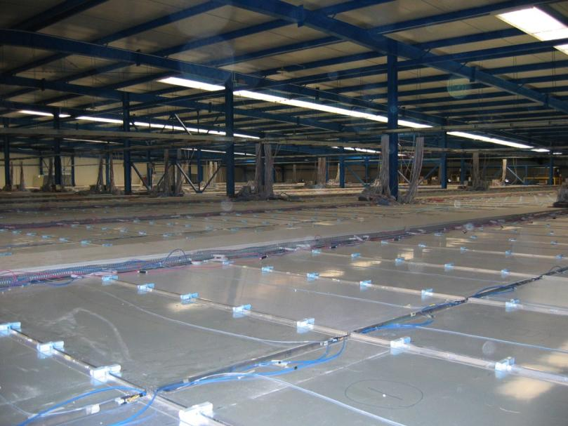
RPC monitoring and results from the ARGO-YBJ experiment Paolo Camarri
Gas mixture: Ar / i-C₄H₁₀ / C₂H₂F₄ = 15/10/75
Operating voltage = 7.2 kV (10.2 kV at sea level)
Single RPC absorption current @ 7.2 kV = 3 - 4 μA
Single RPC count rate @ 7.2 kV = 4 kHz
Time resolution @ 7.2 kV: 1-2 ns
Data taking since November 2007
Duty cycle ~ 90%
Trigger rate 3.6 kHz
Dead time 4%
220 GB/day transferred to CNAF
2 operation modes
Scaler mode (counting rate, > 1 GeV)
Shower mode (full reconstruction, > 300 GeV)

Slide 20
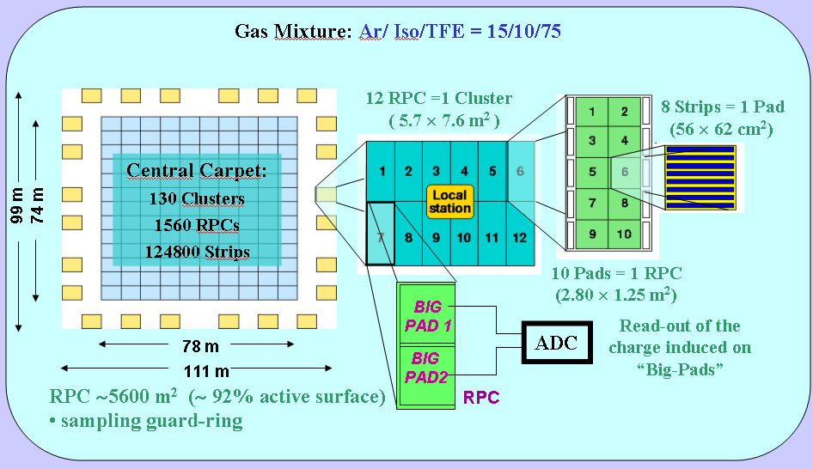
The ARGO-YBJ detector

Slide 21
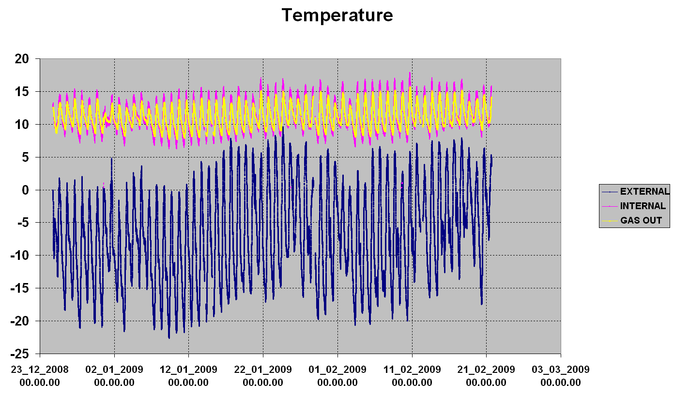
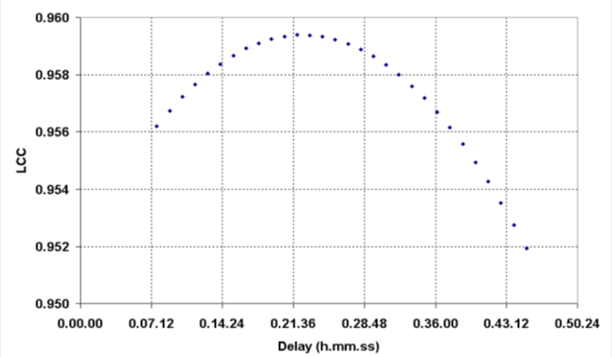
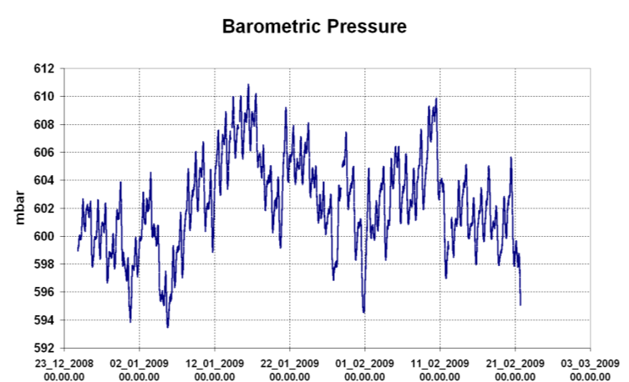
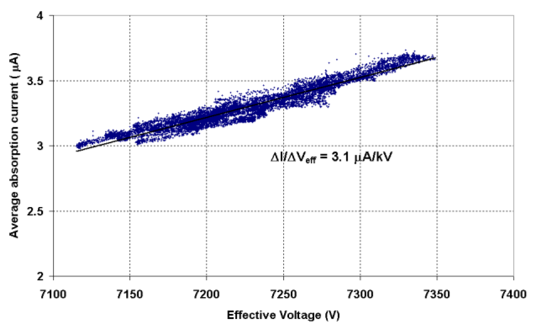
V_{eff} – I linear correlation coefficient vs delay of I with respect to V_{eff}
V_{eff} – I correlation plot accounting for the delay maximizing the LCC

Slide 22
Design and Performance of the Atlas RPC Detector Control System A.Polini
DCS Design Requirements
Reliable system to control and operate safely the detector
Expandable, scalable system, Simple and Expert interfaces
FSM operation, alarm handling
standardized data archiving, DB (Oracle) interface
Specific RPC Requirements:
Detailed monitoring of the detector conditions
Precise measurements of the current of each Gas Gap
Precise and granular monitoring of LV drawn
Highly segmented fine tuning of trigger/readout threshold
Large use of local sensors for monitoring of environment conditions (Atm. Pressure, Temperature, R. Humidity, Gas Flow)
System required to be Radiation Magnetic Field tolerant
Advanced in-built problem tracing and analysis tools

Slide 23




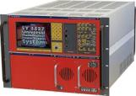






RPC Hardware Choice
➔ Commercial Solution: CAEN EASY system
Scalable system with huge number of HV/LV channels to control
Mainframe (SY1527) + branch controller boards in counting room
Boards can operate in radiation area and magnetic field (up to 2kG)
Dedicated modules High Voltage (12 KV, A3512AP)
Power (A3486) and Low Voltage (A3009, A3025B)
ADC module (A3801) with mean and peak measurement (~3100 ch.)
DAC 128-channel ADC (A3802) ~ 6400 channels
Communication via standard OPC server and TCP
AC/DC converter
48V
48V
OPC
…
…
Crate1
Crate2
Mainframe
Branch
Controllers
Counting Room
HV/LV Boards
Hostile Area
23

Slide 24

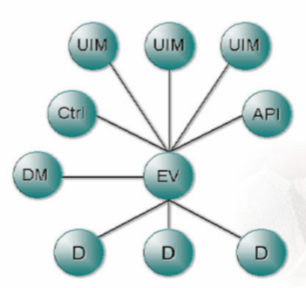
ATLAS Detector Control System
Hierarchical approach:
Separation of frontend (process) and supervisory layer
Commercial SCADA System + CERN JCOP Framework
+ Detector Specific Developments, Scalable, Distributed
Interfaces to Central Database (History Archiving, ConditionDB, ConfigurationDB)
PVSS Manager concept (ETM)
24

Slide 25
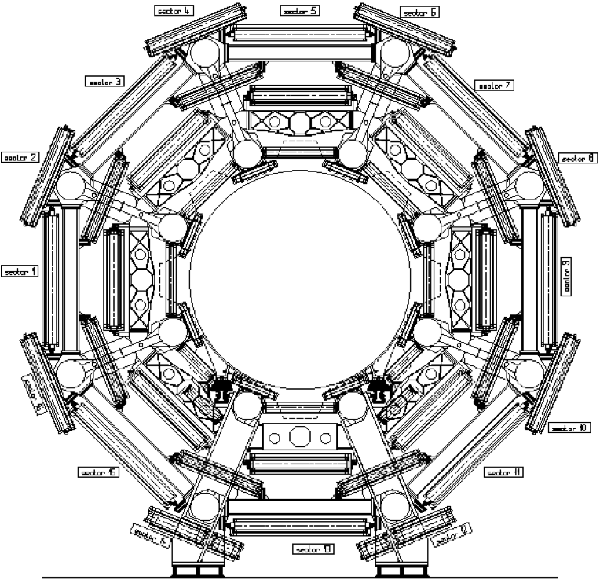
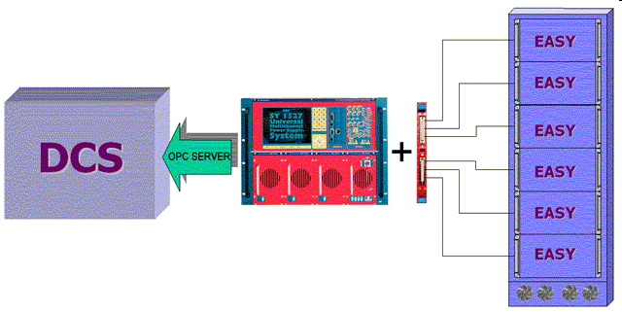
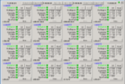
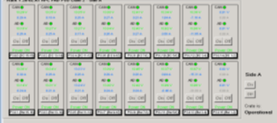
RPC Detector Control System
Distributed SCADA Environment
DAQ, LHC, etc.
Gas Monitoring etc.
VME Crates
ELMB
Power Distribution:
Primary Power (48V,2kW)
High/Low Voltage
Threshold Settings (DAC)
Readback Channels (ADC)
Environment Sensors
Power System
100 CAEN EASY crates controlling overall about 50.000 parameters

Slide 26

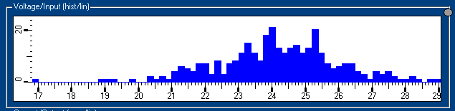
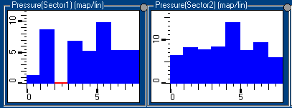
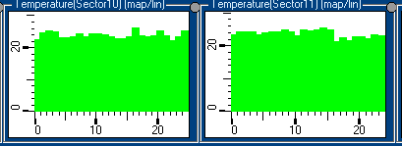
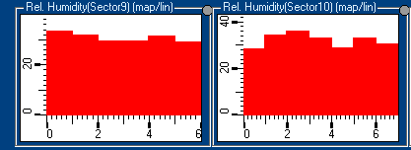
Monitoring of Environment Variables
Extended monitoring of the environment
Read-out done by DCS via ADC channels
330 temperature sensors of exposed detector surfaces: Honeywell HEL775-B-U-1
The atmospheric relative humidity 40 sensors: Honeywell HIH-4602-C
60 sensors sample the gas in and out relative humidity
Gas line overpressure 128 sensors Honeywell DC2R5BDC4
The atmospheric pressure (2 sensors)

Slide 27
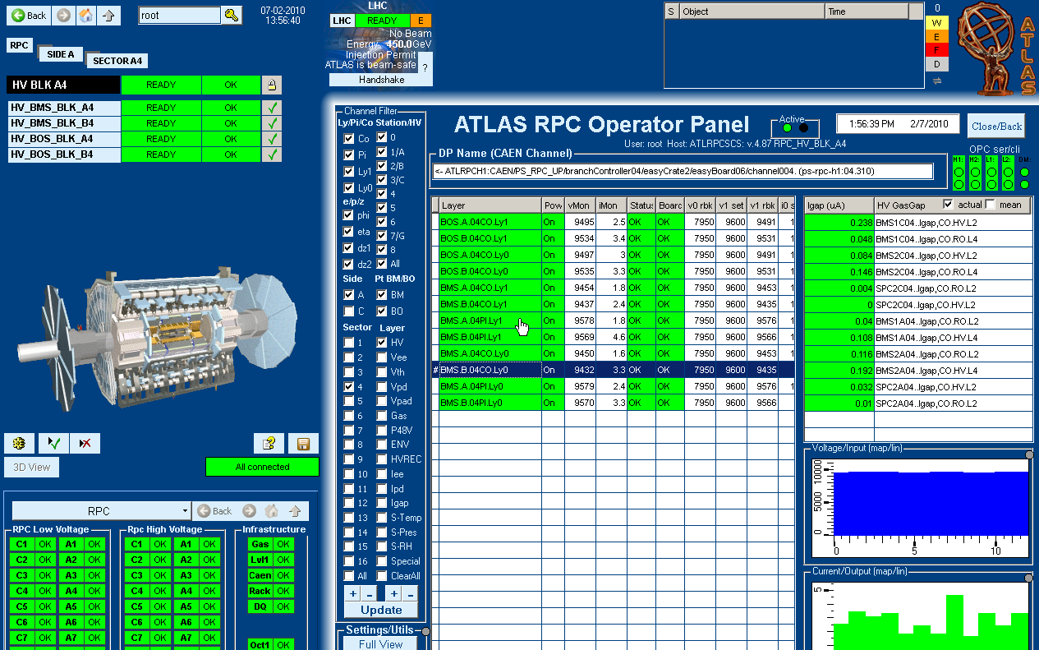
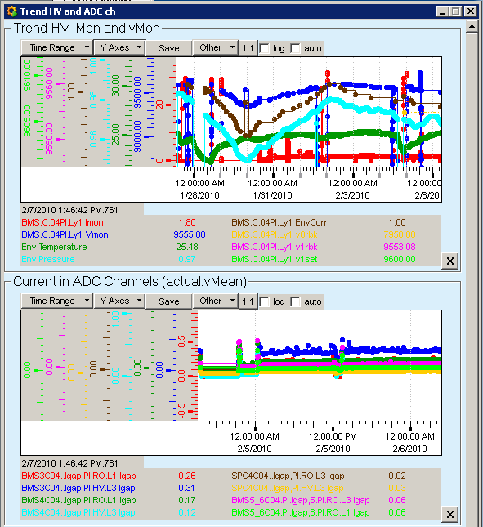
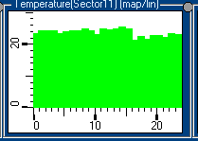
HV Working Point Correction
Local T/P correction to the HV applied to the detector
V_{eff} = V_{appl} * (T/T₀) * (P₀/P)
➔ Dedicated manager and PVSS Command Conversion
Atm. Pressure
Corrected HV
Temperature Sensors
27

Slide 28
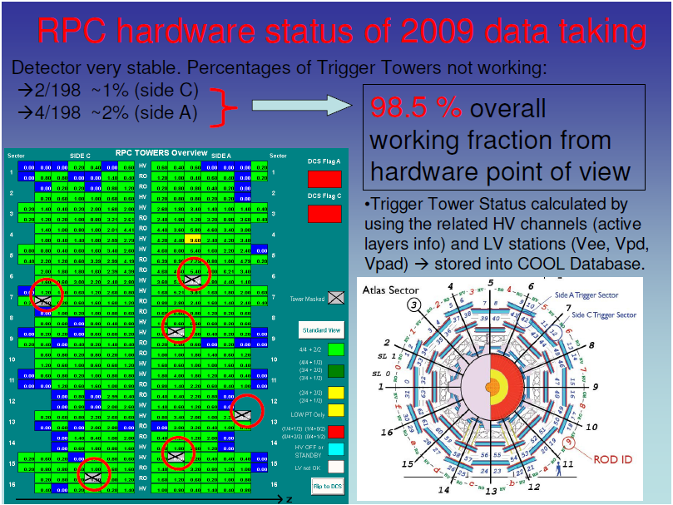
Monitoring and calibration of ATLAS RPC detector via DCS Marcello Bindi

Slide 29


Slide 30




Offline monitoring and data quality of the ATLAS Resistive Plate chambers at CERN Tier-0 facility Angelo Guida

Slide 31





Slide 32

Commissioning and first operational experience of the CMS RPC Detector Control System at LHC Giovanni Polese

Slide 33


Slide 34


Slide 35


Slide 36
Performance of the CMS RPC L1 Trigger with cosmic ray data A.Orso M. Iorio
The L1 CMS Muon Trigger: requirements
The CMS Level 1 Muon Trigger main requirements:
-Muon identification: up to 4 candidate muons per event.
-Unambiguous identification of the Bunch Crossing: each candidate must be associated to a 25 ns interval.
-Output rate of the L1: maximum 100 kHz with the design input rate (40 MHz).

Slide 37


The results on 2009 data: efficiency zeta-phi
Efficiency:Top part of the detector ( y > 0 )
Run 110409 @ 9.4 kV
Wheel -2 Wheel +2
1
Sector 7
Sector 1
0.9
2009 data
HV : 9.4 kV
0.8
0.7
0.6
0.5
0.4
0.3
0.2
0.1
0
Region with two layers missing
Cooling Chimneys of the Solenoid

Slide 38
A data-driven performance evaluation method for
CMS RPC trigger through CMS muon trigger
Archana Sharma
GMT algorithm keeps trace of the muon sub-system which provided the candidates measurement(s)
Such feature can be exploited for evaluating in a data-driven fashion the trigger performance of each muon sub-system
By considering the trigger candidates provided by a given sub-detector using its complementary one as reference.
Motivation
Such method is relevant in cross section calculation scenarios, for trigger efficiency evaluation unbiased by MC guesses

Slide 39

Commissioning of the ALICE Muon Spectrometer Trigger at LHC A. Blanc

Slide 40


Slide 41

Quality Control of RPCs for the PHENIX Trigger Upgrade Rusty Towell
Efficiency Tests with Cosmics
25 data sets taken at 5 HV values and 5 different thresholds
The efficiency curve has a plateau that starts from about 9.5 kV HV.
Cluster size is under 2 when we use 9.5 kV HV.

Slide 42


Calibration of the RPC charge readout in the ARGO-YBJ experiment Xiangdong Sheng
Fig. Sketch map of the calibration telescope.
Fig. Schematic diagram of the electronics and DAQ

Slide 43




Fig. Amplitude distribution of one scintillation detector in case of single particles.
Fig. Charge readout of one RPC in case of single particles.
Fig. Number of charged particles VS. RPC charge readout, a linear fit is performed to the data.
Fig. Nonlinearity of the calibration.

Slide 44
R&D for wide-gap RPC systems

Slide 45
Oiled Multigap Resistive Plate Chambers K. S. Lee
R & D aiming to develop multigap RPCs with high rate capability ~ 5 kHz/cm²
Higher rate capability ← lower avalanche charge
- Rate capability ~ 1/ ρ (ρ : resistivity of electrode material)
- Rate capability ~ 1 /<q_{e}> (actually depends on <Q_{e}>)
Typical glass multigap RPCs
- <Q_{e}> more than 10 times smaller compared to CMS RPCs
- ρ ~ 10¹³ Ωcm for glass RPCs Rate capability < 1 kHz/cm² for glass timing RPCs
Then, what if multigap RPCs with high-pressure laminated (HPL) plates ?
- <Q_{e}> ~ 10 times smaller compared to the current CMS RPCs
- HPL : Melamine + Phenol → ρ ≤ 10¹¹ Ωcm
- Oiling required to reduce noises
Further advantage : smaller induced charges → less aging effect
7.5 mm
16.0 mm

Slide 46

CMS double-gap RPCs and 6-gap RPCs
Thickness of each gap
Total thickness of gas gaps
2.5 ~5.0 pC
0.6 ~1.0 pC
80 ~150 fC
Resistivity of HPL
~
Multigap RPCs working in the current environment of the CMS forward RPCs ?
- Same gas system → same gas mixture
- Same electronics → same front-end-electronics (FEE) and so on
→ The detector characteristics should lie between the standard double-gap and the timing RPCs.

Slide 47


Efficiencies & mean fast charges for a 6-gap RPC
TDC threshold = 1 mV
ADC thresholds = 80 ~ 150 fC (in offline analysis)
Mean q_{e} at the efficiency plateau region
→ At 11.8 kV, ε = 0.97 (by TDC) and q_{e} = 0.61 pC
→ At 12.4 kV, ε = 0.98 (by TDC) and q_{e} = 0.86 pC
ε = 0.96
ε = 0.96

Slide 48


Characterization of CMS End-Cap RPCs assembled in India L.M.Pant
Efficiency plots for eight chambers measured in ISR Lab., with the cosmic hodoscope

Slide 49



Development of 2m × 2m size glass RPCs for INO B.Satyanarayana
Successful fabrication and characterisation of large area RPCs required for INO’s ICAL experiment
Two more 2m x 2m will be made; more detailed studies to follow
Timing studies with long pickup strips, in particular
Poster by Deepak Samuel et al & Sumanta Pal et al
Gas systems’ studies with RGA
Cascading of gas lines; optimisation of gas flow, cost considerations
Studies using new pickup panel designs, cost considerations
Engineering Design Report (EDR) on large scale industrial production of RPCs needed for ICAL, is under preparation

Slide 50




Cosmic Ray test of INO RPC stack N.K.MONDAL
Average layer-wise time plot for muon tracks
Particle direction using time information
Velocity (β) distribution
( log)
Velocity (β) distribution
( linear)

Slide 51




Study of RPC performance using cosmic muons
Strip Multiplicity due to crossing muons
Track residue in mm
Strip noise rate vs time
Image of a RPC using muons

Slide 52
Performances of silicone coated high resistive bakelite RPC Saikat Biswas
Bakelite based RPCs, made in India
Grade: P-120,NEMA LI1989, GradeXXX
Resistivity: 3.67 × 10¹² Ω cm
Inner-side coated with silicone to make the surface smooth
Used gas: Argon, Iso-butane, R-134a (34:7:59) (Streamer) R-134a, Iso-butane, SF₆ (95:4.5:0.5) (Avalanche)
Dimension (cm²) | Mode of operation | Efficiency (%) | Time resolution (ns)
30 × 30 | Streamer / Avalanche | 92 / 90 | 2.4 / 2.5
100 × 100 | Streamer / Avalanche | 90 / 93 | 3.0
10 × 10 | Streamer / Avalanche | 90 / 94 | 2.4

Slide 53
Conclusions and Outlook
Performance of Silicone coated bakelite RPC (Streamer mode):
High efficiency (>90%)
Low counting rate (~0.1-0.2 Hz/cm²)
Time resolution ~2 ns.
Charge ~ 100 pC.
Tested for 130 days continuously and stable (Efficiency >90%, Leakage current (~500 nA) and Counting rate (~0.1 Hz/cm²)
Performances of Silicone coated bakelite RPC (Avalanche mode):
Efficiency ~90%
Charge ~ 1.5 pC
Streamer quenches with SF₆
Large (1 m × 1 m) RPC has been fabricated and tested satisfactorily
Silicone coated bakelite RPC is a viable alternative to semiconductive glass based RPC for use in the ICAL detector of the INO.

Slide 54
Status and performance of narrow-gap RPC systems

Slide 55

The MRPC-based ALICE Time-Of-Flight detector: commissioning and first performance Andrea Alici
The ALICE TOF MRPCs are designed as strips of 7.4 x 120 cm² active area.
Ten 250 μm width gas gaps grouped into two stacks placed on both side around a central anode.
Resistive plates are made of 400 μm width soda – lime glass with a bulk resistivity of ≈ 10¹³ Ωcm.
Electrodes are obtained with a specially developed acrylic paint loaded with metal oxydes giving an average surface resistivity between 2 and 25 MΩ/□
Avalanche mode with E ~ 100 kV/cm

Slide 56



Cilindrical surface of ~ 150 m² of area with an inner radius of 3.7 m;
Full azimuthal acceptance;
Polar acceptance |η| ≤ 0.9;
Φ segmentation : 18 – fold (sectors or SuperModules);
91 MRPCs for SuperModule for a total of 1593 MRPCs;
96 readout channels of ~ 10 cm² of area for MRPC for a total of 152928 channels.
pp collisions @ 900 GeV
Protons
Kaons
Pions

Slide 57

Multigap RPCs in STAR W.J.Llope

Slide 58

RPC HADES-TOF wall cosmic ray test performance A. Blanco

Slide 59

FOPI MMRPC TOF Barrel Mladen Kiš

Slide 60


Slide 61

Study of the cosmic data taken with the ALICE TOF detector at the LHC Daniele De Gruttola
TOF Supermodule

Slide 62





TRM : TDC Readout Module (10/9 TRMs per crate)
DRM : Data Readout Module (1 per crate)
LTM : Local Trigger Module (1 per crate)
CPDM : Clock and Pulser Distribution Module
(1 per 2 crates)
MRPC
FEA
HPTDC
VME master
TRM readout
DAQ via DDL
L0,L1,L2 via TTC
Slow control
TRM
FEA LV monitor
FEA thresh. set and monitor
FEAC temperature monitor
FEA OR signals to CTTM
Pulser to MRPC
Clock distribution
CPDM
DRM
LTM

Slide 63



Muon selection using TOF
distance between the hit pads on the opposite sectors
vs
difference between the hit times
correlation between the
time-of-flight
and the track length
→

Slide 64
R&D for narrow-gap RPC systems

Slide 65




Progress of R&D and production of timing RPC in Tsinghua University Wang Yi

Slide 66



Production tools
66

Slide 67



Production of graphite electrodes
Transmission
Spraying gun
Controller
glass
Colloidal graphite
Notes:
This colloidal graphite has to be diluted by acetine.

Slide 68



Prototypes of high rate MRPC for CBM TOF Jingbo Wang
colloidal graphite
Guarding line
Diameter:1.5mm
Hole size:0.5mm
1.5mm
5mm
Width:0.508mm
Top and bottom layers
Glass type: silicate / common
HV electrode: colloidal graphite
Number of gaps: 10
Gap width: 0.25mm
Glass thickness: 0.7mm
Gas mixture:
Freon/iso-butane/SF6
96.5%/3%/0.5%
3mm
22mm
240mm

Slide 69

Target
Silicon
Tsinghua RPC
Main beam
PM12
PM34
PM5
≈ 10 m

Slide 70

Toward a high granularity, high counting rate differential read-out RPC M. Petris

Slide 71


Slide 72
The CBM Time-of Flight wall Ingo Deppner
RPC type | res. material | efficiency | time resolution | rate capability | cross talk
Pad MRPC | sem. glass | 95 % | 75 ps | not meas. | not meas.
Ceramic MRPC | ceramic | 95 % | 110 – 140 ps | 500 kHz/cm² | not meas.
Pad „mini“-RPC | ultrathin glass | 75 % (1 Gap) | 75 – 100 ps | 1,5 kHz/cm² | no
narrow strip RPC | float glass | 85 % | 50 ps | not meas. | < 5 %
Wide Strip (Beijing) | sem. glass | 95 % | 75 ps | 20 kHz/cm² | 10 – 20 %
Wide Strip (USTC) | float glass | 95 % | 65 ps | not meas. | 1- 3 %
Wide Strip (UHD) | float glass | 95 % | 75 ps | not meas. | 1- 3 %

Slide 73


NeuLAND: MRPC-based time-of-flight detector for 1 GeV neutrons Daniel Bemmerer
20 x 40 cm prototypes built (FZD, GSI) and parameters tested
Interstrip spacing varied between 0.3 and 3.0 mm
Number of gaps varied: 2x2, 2x3, 2x4
Glass thickness varied: 0.55 and 0.95 mm
Strips with straight or tapered ends
Frontend electronics: FOPI FEE1, PADI, ALICE

Slide 74




Prototype tests at ELBE (by FZD and GSI groups, every 2 months)
Raw timing spectrum
Time [1 Ch=25 ps]
Charge [1 Ch =25 fC]
Time [ 1 Ch=25 ps ]
Timing spectrum after correction for time walk, σ ~ 90 ps
Time [ 1 Ch=25 ps ]

Slide 75

Some results of the R&D of a ToF-Wall to identify relativistic heavy ions E.Casarejos

Slide 76


Slide 77
Simulations of RPC detectors

Slide 78
Progress in the simulation of Resistive Plate Chambers with multi-strip readout Diego González-Díaz (GSI-Darmstadt)
HADES-SIS
FOPI-SIS
ALICE-LHC
-V
-V
V
V
-V
-V
STAR-RHIC
-V
-V
V
V
V
!
-V
all these schemes are equivalent regarding the underlying avalanche dynamics... but the RPC is also a strip-line, a fact that is manifested after the avalanche current has been induced. And all these strip-lines have a completely different electrical behavior.
V
-V
V

Slide 79
Summary
We performed various simulations and in-beam measurements of Timing RPCs in multi-strip configuration.
Contrary to previous very discouraging experience (Blanco, 2002) multi-strip configuration seems to be well suited for a multi-hit environment, if adequate 'a priori' optimization is provided.
Cross-talk levels below 3% have been obtained, with a modest degradation of the time resolution down to 110 ps, affecting mainly the first neighbor.
This resolution is partly affected by the poor statistics of multiple hits in the environment studied.

Slide 80
A new approach in modeling RPC response S. Colafranceschi
A new approach based on Neural Network has been used to model the response of RPC detectors. Preliminary results obtained with data from the CMS RPC GGM system were presented and described.
The model, once trained on the response of a detector works well within the parameter space (p, T,H) and is able to predict the response in other periods with a better than 10% accuracy.
Further studies are in progress to determine and cure the residual non-gaussian tails of the errors distributions, to deal with training and prediction on detectors with different high voltage supply, to widen the sample of environmental conditions, and in adding new dimension to the parameter space such as radiation levels.

Slide 81

The RPC current time structure G. Aielli

Slide 82


Slide 83
New applications of RPC detectors

Slide 84
SPATIAL RESOLUTION OF HUMAN 3D RPC-PET SYSTEM M. Couceiro
Detailed simulations suggest that RPC-PET will show a sensitivity advantage of more than 1 order of magnitude over current technology. May trigger a paradigm-shift in PET clinical use.
We studied the factors influencing the image spatial resolution of human single-bed RPC-PET
Physics limitation (source + detector): ~ 0.44 mm FWHM
Readout granularity (X,Y + 3.4 mm DOI):
3.4 mm DOI: ~ 0.8 mm FWHM
1mm XY + 3.4 mm DOI: ~ 1.4 mm FWHM
2mm XY + 3.4 mm DOI: ~ 2.1 mm FWHM

Slide 85

Study on the Performance of Large Area MRPC with high position resolution WU Yu-Cheng

Slide 86

Resistive Electrode Approach in Micropattern Gaseous Detectors V.Peskov
Mesh #1 had a thickness t= 20μm, hole’s diameter d=70 μm and hole spacing a=140 μm, resistivity –a few MΩ/□
it was made from resistive Kapton by a laser drilling technique

Slide 87
From these stretched meshes different detectors could be assembled:
Drift mesh
a)
c)
Spacers
Resistive mesh
PPAC,
G=1-3mm
GEM,
G=0.05-0.1mm
Amplifier
b)
d)
MICROMEGAS,
G=-0.1-0.3mm
GEM,G=0.2mm+
MICROMEGAS
G=0.01-0.3mm

Slide 88

Construction of a Digital Hadron Calorimeter with Resistive Plate Chambers Lei Xia
Tests of a Digital Hadron Calorimeter José Repond
Description
Readout of 1 x 1 cm² pads with one threshold (1-bit) → Digital Calorimeter
40 layers each ~ 1 x 1 m²
Each layer with 3 RPCs, each 32 x 96 cm²
~400,000 readout channels
Layers to be inserted into the existing CALICE
Analog (scintillator) HCAL structure
Purpose
Validate DHCAL concept
Gain experience running large RPC system
Measure hadronic showers in great detail
Validate hadronic shower models

Slide 89
RPC Readout

Slide 90

RPC performance vs Front-End Roberto Cardarelli
Streamer : discriminator
Saturated multi-avalanche: preamp+discriminator
Saturated avalanche: preamp (high amplification and bandwidth)
+ discriminator
If the gas mixture and the gap of the RPC chamber are set, the front-end performance sets the working mode of the RPC
Sensitivity 2 mV/fC
Noise 2 fC RMS
Latch capability 100 pS
B.W. 50 MHz
Power consumption 6 mW
V_{th} > 15 mV
Q_{th} > 6 fC
Tunable input impedance from a few Ohm to 100 Ohm (maximum)
The charge threshold is about a factor 10 lower with respect to the present ATLAS Front-End.
The rate capability has been increased accordingly.
streamer
Saturated multi-avalanche
Saturated avalanche

Slide 91

The Multipurpose Trigger Readout Board (TRB) Marek Palka

Slide 92


Slide 93
Gas systems for RPC detector systems

Slide 94


Performance of the Prototype Gas Recirculation System with built-in RGA for INO RPC system S.D.Kalmani

Slide 95




Slide 96

DECOMPOSITION OF SF₆-R134a EFFLUENT BY RF PLASMA AVINASH V. JOSHI

Slide 97
New gas mixtures for Resistive Plate Chambers operated in avalanche mode M. Abbrescia
New mixtures containing He
Standard mixture used as a reference… then
“A” mixture
62.5/2.3/0.2/35 C₂H₂F₄ /C₄H₁₀/SF₆/He
“B” mixture
48.1/1.75/0.15/50 C₂H₂F₄ /C₄H₁₀/SF₆/He
“C” mixture
48/1.7/0.3/50 C₂H₂F₄ /C₄H₁₀/SF₆/He
“A” and “B” essentially
standard mix. + Helium
“C” increased SF₆ fraction

Slide 98
The “smart” solution
Ideally, operating RPC a ½ Atm would reduce of a factor 2 the operating voltage and meet at least 2 of the wishlist
Not practically feasible in large systems
Helium is a noble gas with no vibrational or rotational degrees of freedom, with an ionization potential greater than C₂H₂F₄
Undergoes mainly elastic scattering with electrons;
Takes part only partially in the avalanche processes;
In first approximation behaves only like a space holder;
Essentially reduces the partial pressure of the active mixture
Effect similar (in first approximation) to operate at a reduced pressure

Slide 99
Conclusions
It is a “smart” solution and works
general idea verified
corrections at high He content
inelastic scattering, Penning effect, etc.
New gas mixtures allow:
reduction of the operating voltage (2-3 kV at least)
reduced flammability problems (increase i-C₄H₁₀?)
good (> 95%) efficiency and time resolution (< 2ns)
Good starting point for studies in this field
definition for a new “standard” mixture

Slide 100

Optimization of the closed loop gas system for the RPC operation at the LHC experiments R. Guida
The gas systems for the two biggest RPC systems at LHC (ATLAS and CMS) are working stably since two years in despites of the relevant complexity.

Slide 101
Conclusions
Gas systems for RPC detectors at LHC are performing well
Two sets of RPCs (one working in open mode and the other in closed loop) are being operated under a high gamma radiation at the CERN-GIF (Gamma Irradiation Facility).
Many impurities, present in the RPC return gas mixture, have been identified (Fluoride ion, hydrocarbons, other Freon,..).
A systematic study of cleaning agents has been performed:
allowing to select the “best” combination for a long-term closed loop operation under high gamma radiation (long-term validation on-going).
Simulation studies of the gas flow in RPCs show regions where gas molecules move very slowly. This can lead to a local accumulation of impurities, affecting the overall RPC performance. We are studying realistic ways to optimize the flow gas distribution.

Slide 102
Summary of summary!
Rinaldo Santonico’s
opening remarks!!

Slide 103
Perspectives for a new R&D phase
It is best time to invest in R&D and to reproduce the effort that some 10-15 years ago put the bases for creating the systems presently in operation
What are the targets for the next generation RPCs?
Combine the large areas of the 2mm gap RPCs with the high time resolution of the timing-RPCs
Increase the rate capability in order to cope with the applications of the generation experiments
Increase the resistance to ageing effects
Improve the space resolution
Look for alternative gas mixtures: C₂H₂F₄ and SF₆ are the result of a long search to optimize the RPC gas. However, apart cost problems, their use could be restricted in the future due to the impact on the environment

Slide 104
How to improve the rate capability?
Golden rule: reduce the charge delivered in the gas per detector count (as we have learned when we switched from streamer to avalanche mode)
This is much safer, specially for large areas, than to reduce (eg. to 10⁸-10⁹ Ohm-cm) the electrode resistivity. The main goal is indeed to increase the rate at constant operating current which also means without accelerate ageing processes
This means to transfer to the front end electronics a substantial part of the gas amplification and requires an adequate front end improvement
Thinner gaps exhibit intrinsically lower charge: multi-gap RPCs indeed have achieved a significant rate capability even with a high resistivity material like standard glass. This looks very promising for high rate applications

Slide 105
RPCs visibility in science and medicine
A number of very relevant experiments presently working use RPCs as an important sub-detector or even as the main detector
To pursue the target of achieving relevant physics results with them is crucial for communities who spent huge efforts for preparing detectors; detector building and data analysis should not be seen as mutually exclusive activities
Reliability and stable performance are necessary crucial conditions for a detector but its visibility depends mainly on the quality of the physics that can be produced with it
Fully exploit the RPC potential both in basic research and in industrial applications such as, imaging PET, muon tomography…

Slide 106
Physics targets for RPCs in the next years
Search of the Higgs boson and SUSY particles at LHC
Neutrino oscillation physics with Opera: Search for neutrino oscillation for the first time in appearance mode
In the next generation neutrino physics INO could study atmospheric neutrino oscillations discriminating neutrino and anti-neutrino by the sign of the out coming muon

Slide 107

Hiedelberg town seen from a balcony of the Hiedelberg castle

