Slide 1
Performance of gas sealed RPCs
M.Bhuyan, S.D.Kalmani, N.K.Mondal, S.Pal, Deepak Samuel, B.Satyanarayana and R.R.Shinde
Gouranga Kole, Chiraag Lala and Kanishka Rawat

Slide 2
Requirement of gases in ICAL
Total number of RPCs in ICAL = 3 × 150 × 64 = 28,800
Total gas volume = 28,800 × 184cm × 184cm × 0.2cm = 195,010 litres
For example:
One volume change/day with 10% gas top-up in a re-circulating scheme
Approximate running gas cost = Rs 30,000/day (R134a from Mafron)
Gas | Avalanche (%) | Streamer (%) | Maximum (%) | Volume (L) | Density (g/L) | Weight (Kg) | Cost (Rs/Kg)
Argon | 0.0 | 30.0 | 30.0 | 58,503 | 1.784 | 104.4
R134a | 95.5 | 62.0 | 95.5 | 186,234.6 | 4.25 | 791.5
Isobutane | 4.3 | 8.0 | 8.0 | 15,600.8 | 2.51 | 39.16
SF₆ | 0.2 | 0.0 | 0.2 | 390 | 6.164 | 2.40

Slide 3
Motivation for this study
Recycling of gas mixture for reduction of gas cost and complying with environmental regulations.
Further reduction in the operating cost of ICAL in the long run without compromising on the detector efficiency and performance.
Study contamination and formation of radicals in the gas mixture flowing through the RPCs.
These kind of studies do not seem to have been performed by other researchers.

Slide 4
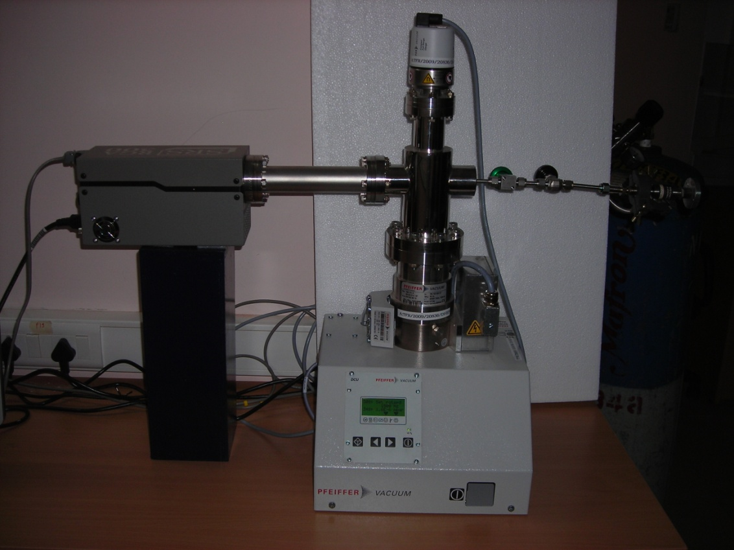
The first study
One 1m×1m RPC (called AB13) was sealed on February 5, 2010. Its operating parameters such as strip rate and current were monitored 24×7, along with laboratory temperature and relative humidity.
After 130 days of uninterrupted operation, the gas inside RPC was analyzed using a Residual Gas Analyzer (RGA)

Slide 5
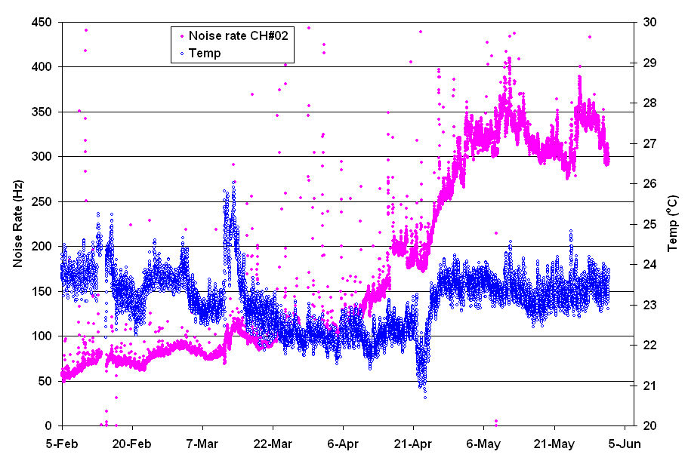
Lab temperature & noise rate

Slide 6
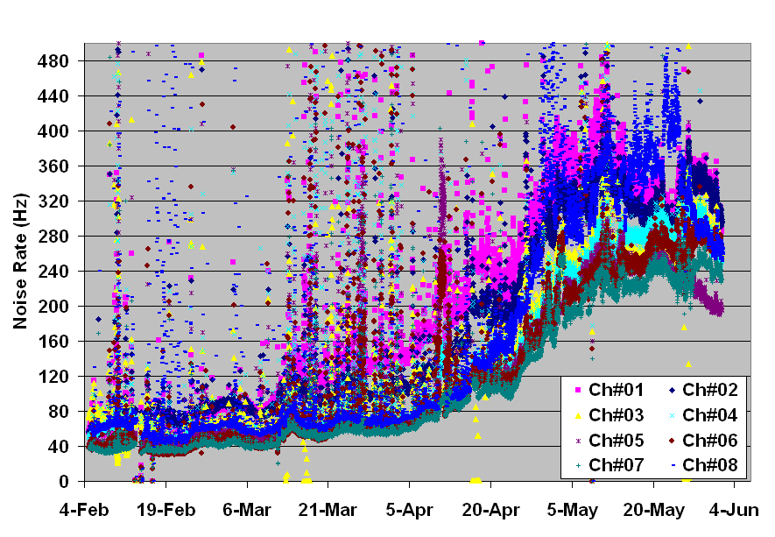
Noise rates of 8 strips

Slide 7
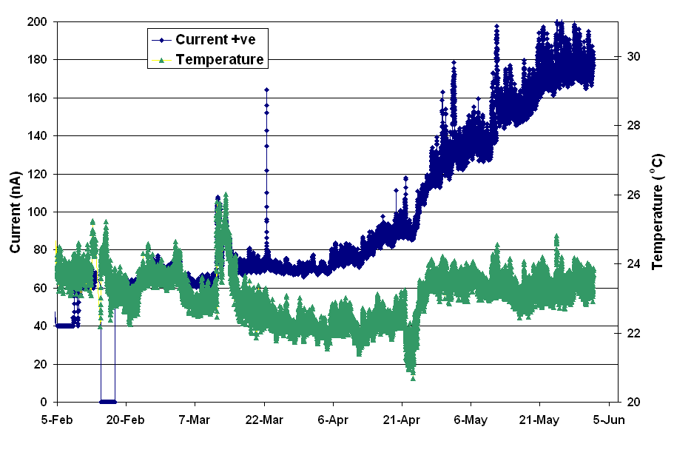
Lab temperature & current

Slide 8
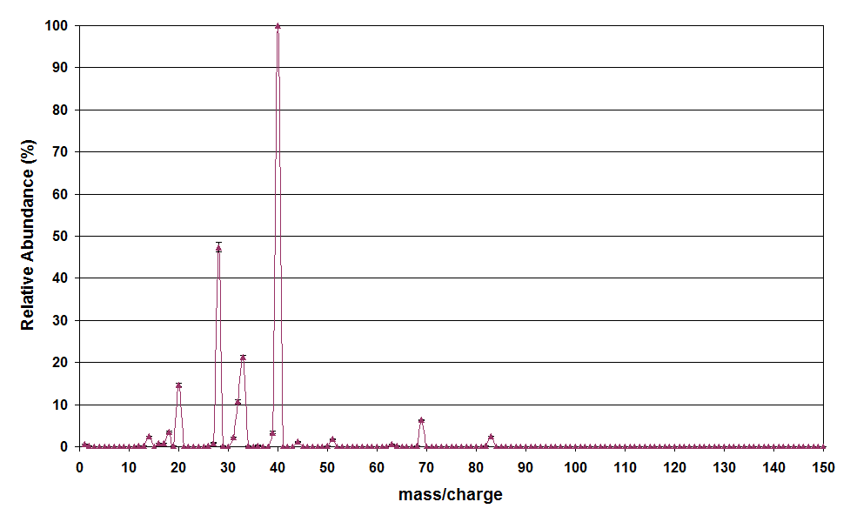
RGA analysis - 1
40
RGA spectra was collected with background of Argon.
28
33
20
69

Slide 9
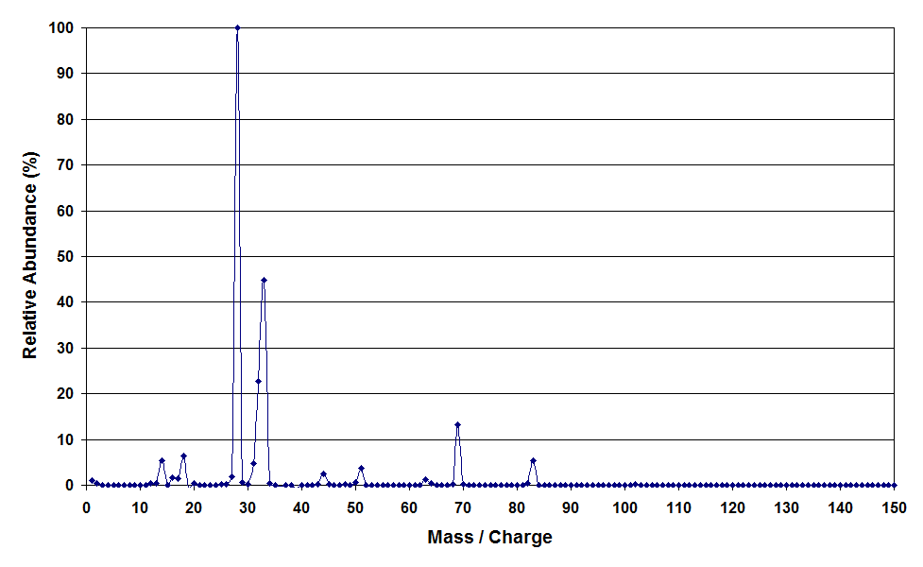
RGA analysis – 2
28
Removing the background Argon spectra, major fragment was at mass no. 28
33
69
83

Slide 10
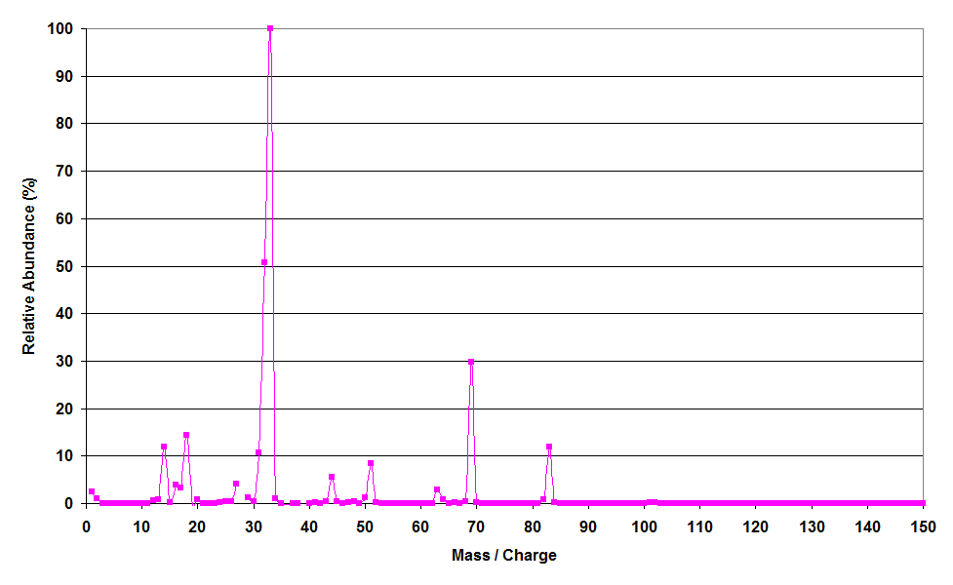
RGA analysis - 3
33
Removing the air background , major fragment was at mass no. 33
69
83
51

Slide 11
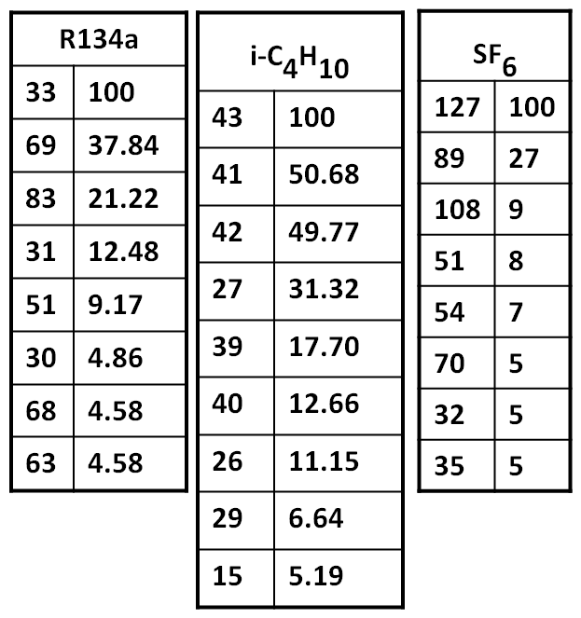
Summary of RGA
Major fragments of pure gases
RGA spectra contains nearly 50% air and 3% water vapour.
RPC AB13 was sealed for 130 days.
Amount of air accumulated ~1000ml.
Therefore, the leak rate ~8ml/day.

Slide 12
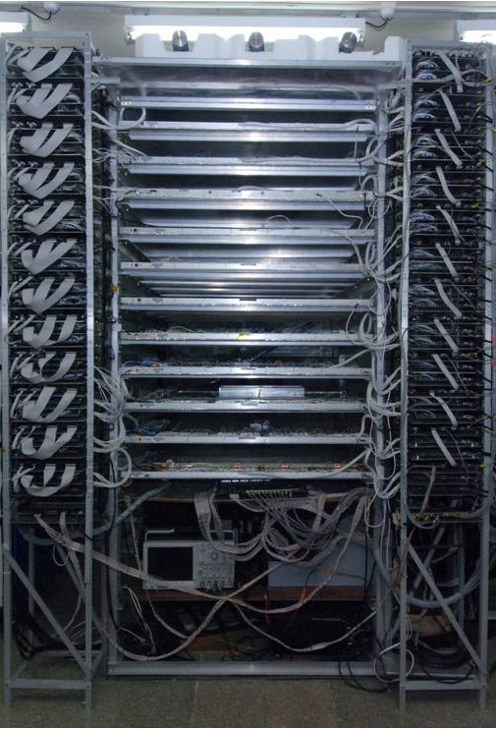
Sealed gas test for C217 stack
Stack of 12 1m×1m RPCs
L0, L4 and L11 were used as reference
Other RPCs sealed on April 27, 2010
Summary of the study

Slide 13
Reference and sealed RPC
Reference RPC
A
B
A= RPC Sealed for 32 days B = Gas flow restarted

Slide 14
RPCs sealed for 83 days
A
B
A
B

Slide 15
Comparison of leaky RPCs
A = Sealed (L05, L06) B = Flow started (L06) C = Flow started (L05)

Slide 16
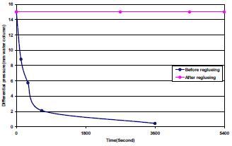
Repair of leaky RPCs
Pressurise the chamber to 20-30mm water column.
Look for the leak.
Locate the leaks using gas sniffer.
Plug the leaks with glue.
Redo the above till all the leaks are plugged.

Slide 17
Summary of sealed gas test
Layer | RPC Id | Test | L rate | I end | I begin | ΔI | I rate | R end | R begin | ΔR | R rate
 |  | (Days) | (mm/hr) | (nA) | (nA) | (nA) | (nA/day) | (Hz) | (Hz) | (Hz) | (Hz/day)
0 | AB06 | (Ref) | TBD | - | - | - | - | - | - | - | -
1 | AB07 | 83 | TBD | 241 | 38 | 203 | 2.4 | 416 | 15 | 401 | 4.8
2 | AB10 | 83 | 1.3 | 190 | 19 | 171 | 2.1 | 505 | 30 | 475 | 5.7
3 | AB11 | 34 | 12 | 262 | 47 | 215 | 6.3 | 377 | 81 | 296 | 8.7
4 | AB09 | 1 | 72 | - | - | - | - | - | - | - | -
5 | IB02 | 83 | TBD | 120 | 68 | 52 | 0.6 | 100 | 40 | 60 | 0.7
6 | AB02 | 32 | TBD | 302 | 69 | 233 | 7.3 | 377 | 37 | 340 | 10.6
7 | AB01 | 32 | TBD | 266 | 67 | 199 | 6.2 | 344 | 45 | 299 | 9.3
8 | AB03 | 83 | TBD | 182 | 21 | 161 | 1.9 | 256 | 52 | 204 | 2.5
9 | AB04 | 32 | TBD | 355 | 55 | 300 | 9.4 | 1067 | 70 | 997 | 31.2
10 | AB12 | 31 | 10 | 492 | 46 | 446 | 14.4 | 934 | 31 | 903 | 29.1
11 | AB08 | (Ref) | 12 | - | - | - | - | - | - | - | -

Slide 18
Conclusions
Different rate of change of strip rate and current with time may be attributed to different leak rate for different RPCs.
With proper sealing condition, the detector can run for at least one month, once filled, reducing the cost by factor of 30.
The gas can be recovered efficiently with more contaminants by reusing the same gas for longer period of time.
All the RPC parameters have come back to their earlier values after reflowing fresh gas through RPCs.

Slide 19
Tracking efficiency & Multiplicity (L0,L04,L11)

Slide 20
Tracking efficiency & Multiplicity (L3,L6,L7,L9)

Slide 21
Tracking Efficiency & Multiplicity (L1,L2,L5,L8)

Slide 22
