Slide 1
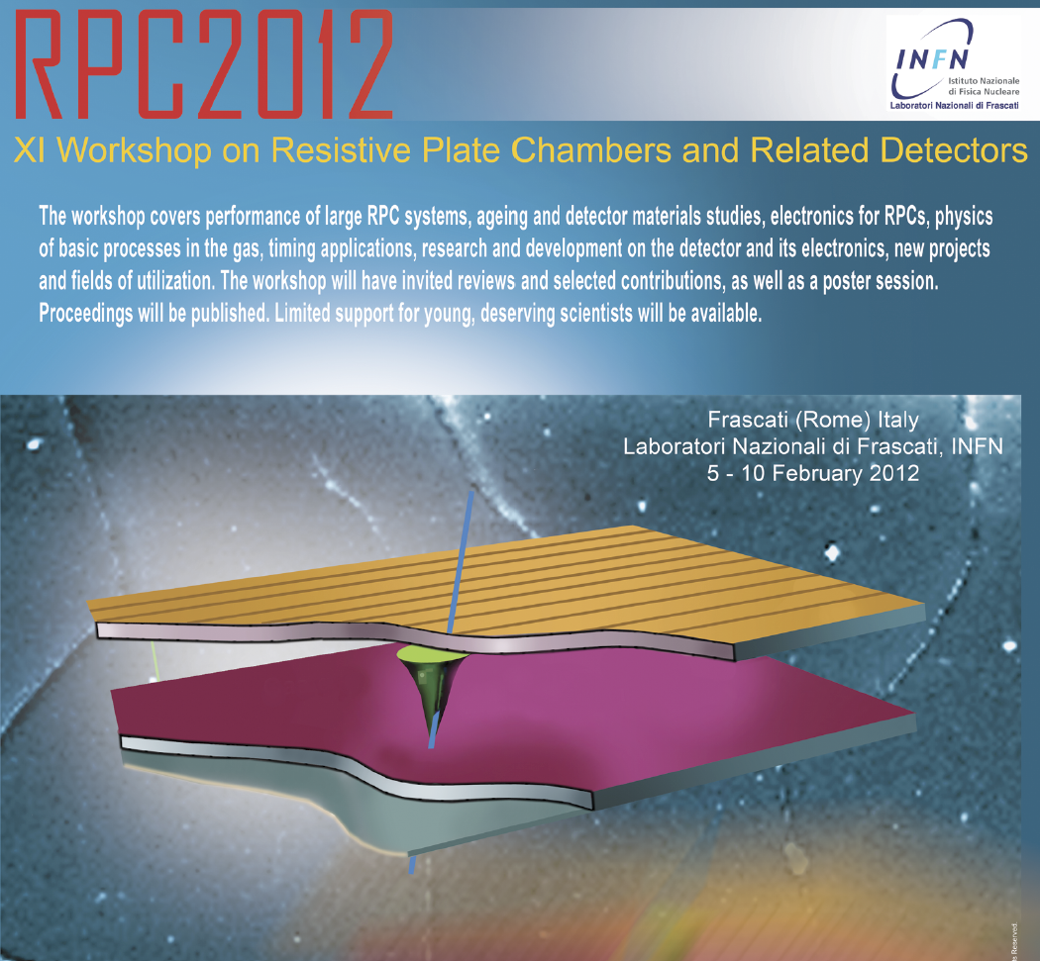
A summary of RPC2012
B.Satyanarayana
Department of High Energy Physics
TIFR, Mumbai

Slide 2
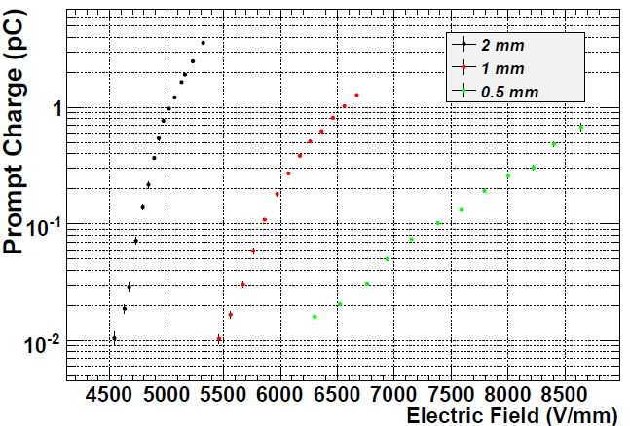
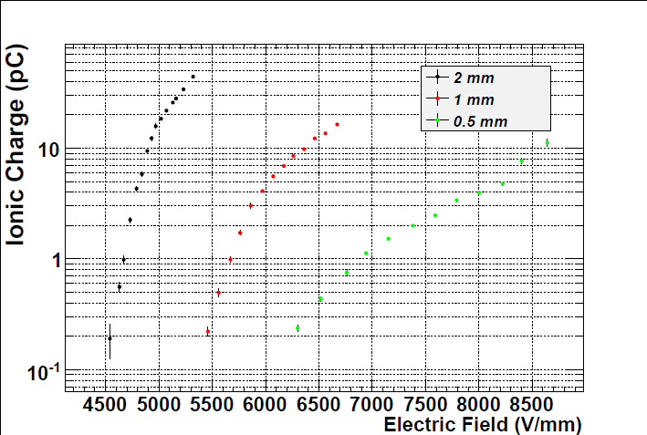
Keynote talk by Rinaldo Santonico
“Some ideas on how to optimize the RPC for different applications of the next future”
Operation at very high rate
The RPC’s rate capability depends on:
Electrode’s thickness and resistivity
Gas gap size and multiplicity (multi-gap structure)
Front-end electronics sensitivity and signal to noise ratio

Slide 3
The “serial” multi-gap RPC
+V
+2V
X_{e}
X_{e}
--------
--------
g
g
X_{i}
X_{i}
Floating
(+V)
V=0
--------
Mono-gap:
Q_{prompt} = Q_{tot} X_{e}/g, Q_{ion} = Q_{tot} X_{i}/g
V=0
A multi-gap structure gives in average the same prompt ionic charge as a single gap
But the charge distribution is √2 (√n in the general case) times narrower than the single gap (σ_{average}= σ/√n): a big advantage to reduce inefficiencies (Q_{prompt} < Q_{threshold})
Serial multi-gap:
Q_{prompt} = (Q_{tot1} + Q_{tot2} ) X_{e}/2g = <Q_{tot}>X_{e}/g
Q_{ion} = (Q_{tot1} + Q_{tot2} ) X_{i}/2g = <Q_{tot}> X_{i}/g

Slide 4
The “parallel” bigap RPC
A parallel bi-gap gives an extra bonus of a factor of 2 prompt charge which should allow it to work at even lower gas gain
But
can not be scaled to a number of gaps n > 2
not compatible with bi-dimensional readout
X_{e}
--------
g
X_{i}
--------
+V
Parallel bi-gap:
Q_{prompt} = (Q_{tot1} + Q_{tot2} ) X_{e}/g =2 <Q_{tot}>X_{e}/g
Q_{ion} = (Q_{tot1} + Q_{tot2} ) X_{i}/g = 2 <Q_{tot}> X_{i}/g

Slide 5
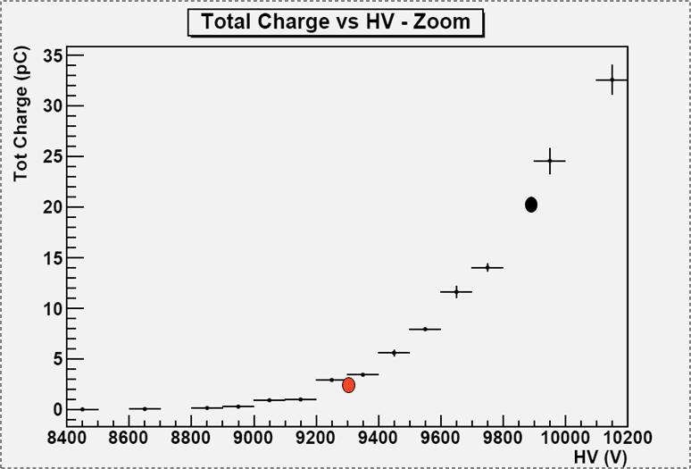
Performance vs Front-end electronics
The main task of the front end electronics to increase the rate capability is to achieve an excellent sensitivity and SNR for extremely small and short signals.
This allows to operate the detector at very low gas gain because a substantial fraction of the gas gain is transferred to the front end circuit.
A new series of circuits of much better performance with respect to the ones working for instance in Atlas gave very promising results in view of increasing the rate capability.
The higher sensitivity of the new front end circuit allows to lower the operating voltage by about 600V, thus substantially reducing the gas gain.

Slide 6
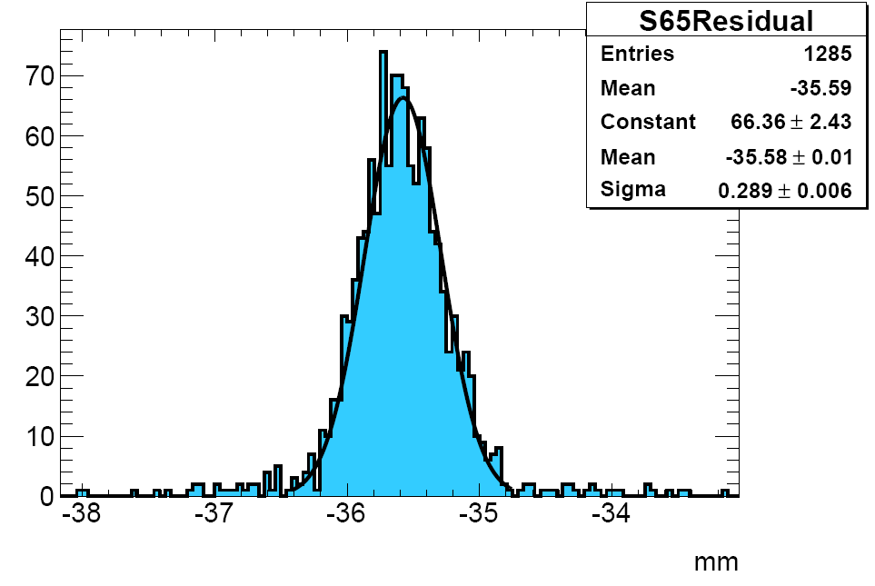
Precision tracking with RPCs
The method of the charge centroid applied to the RPCs allows in principle to obtain a space resolution of the order of 0.1 mm on both coordinates in asymmetric way. This makes the RPCs an excellent tracker.
For a tracking trigger, the time required for the DAQ and the centroid calculation would be however too long. In this case a hardware device like a very fast “maximum selector” circuit can solve the problem
Preliminary beam tests have shown a spatial resolution better than 0.3 mm is achievable.
Single layer RPC Spatial Resolution

Slide 7
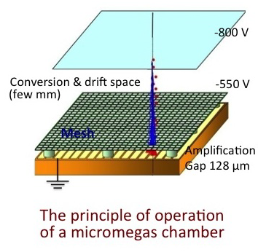
Comparison with Micromegas (MM)
The MM keep the idea of a drift region separated from the multiplication region
The drift region however is a planar one, which somewhat improves the time resolution w.r.t. the cylindrical one
Resistive layer taken from RPC fundamental to solve the sparking problem
They get very high rate capability due to the low gas gain (few x 10⁴) i.e. to the small signals produced
But a small signal requires an adequate front end electronics to be detected
This is the same problem as for the RPCs: the higher the front-end sensitivity and signal to noise separation the higher is the achievable rate capability
As a conclusion, with an optimal choice of front end electronics and gap size (and multiplicity), RPCs should achieve the same rate capability as the MM, with a much better time resolution

Slide 8
Gas distribution for sampling arrays
A full coverage array like Argo is based on a large detector area concentrated in a single place
Possibility of a laboratory
Possibility of a single gas system coupled to a short distance gas distribution
In a sampling array extended over a large area (with low coverage) the gas distribution has to cover much larger distances. It is not obvious that the gas could be supplied by a single gas system and distributed to all the array
Is it conceivable that each station is equipped with its own gas reservoir?
A brilliant idea in this direction would solve a relevant problem for an important RPC application

Slide 9
Performance of RPC systems

Slide 10
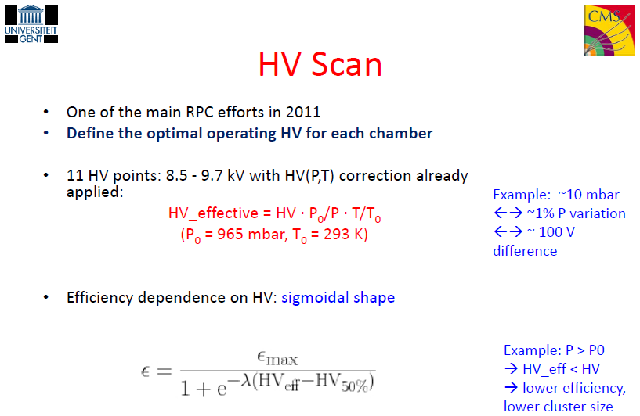
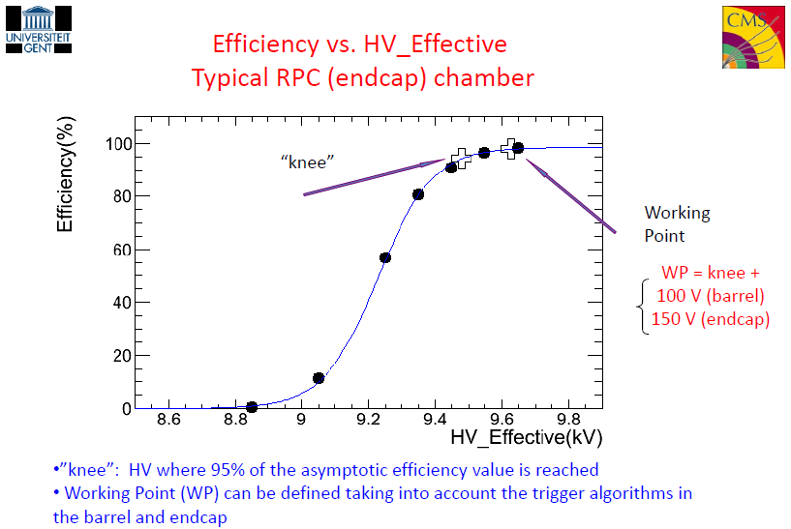
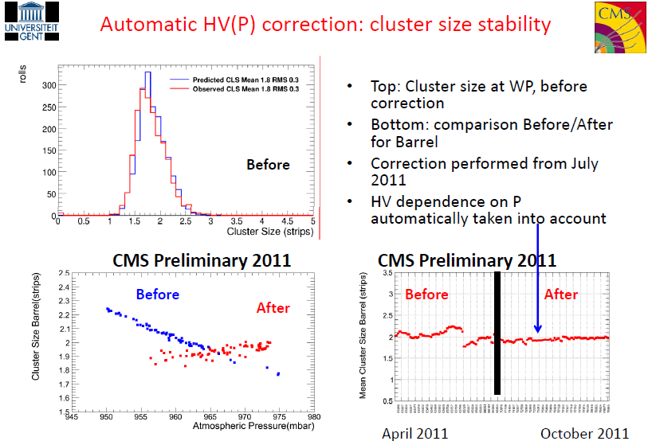
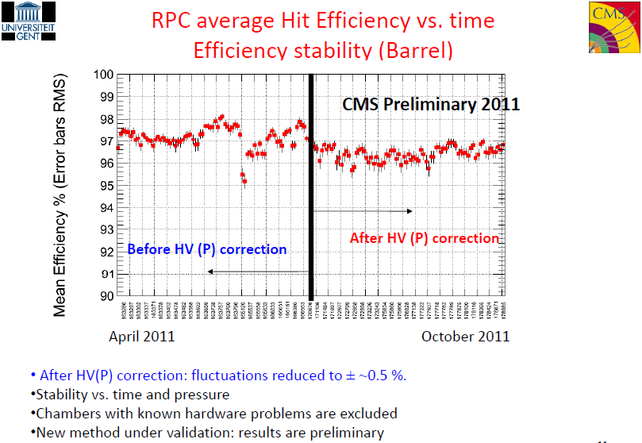
Calibration of the RPC working voltage CMS
(COSTANTINI, Silvia)

Slide 11
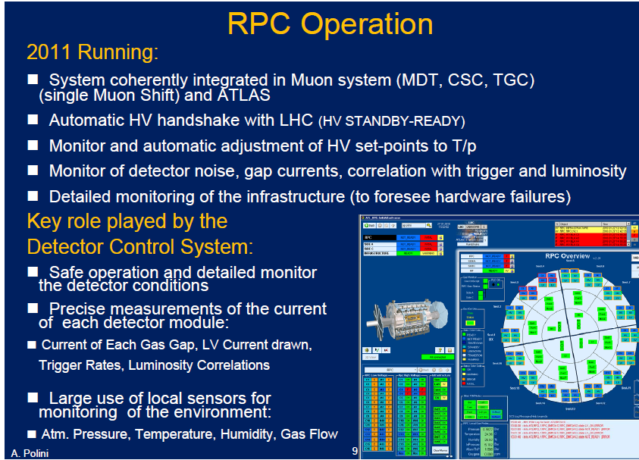
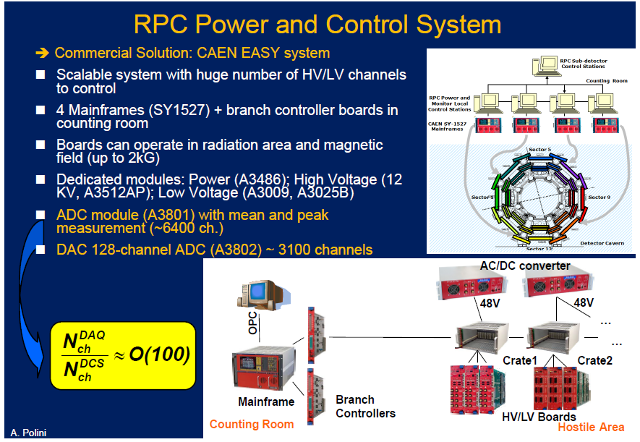
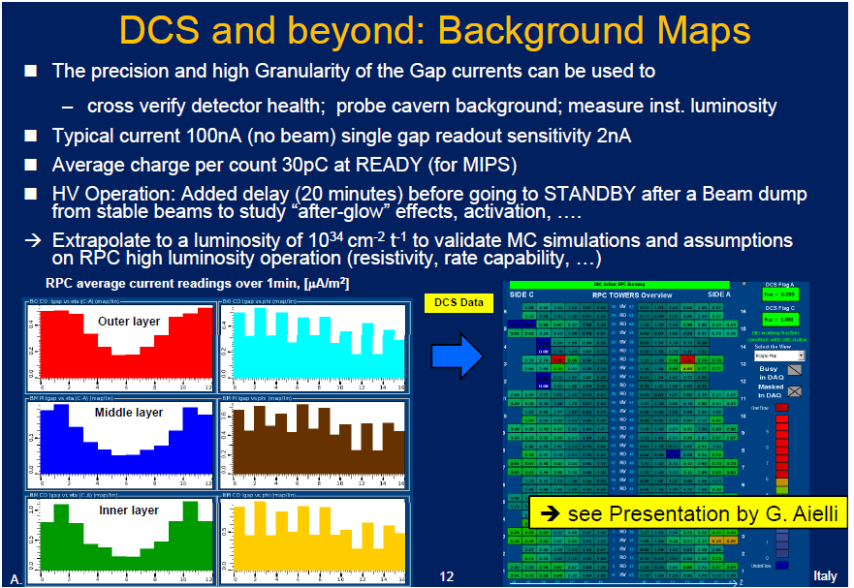
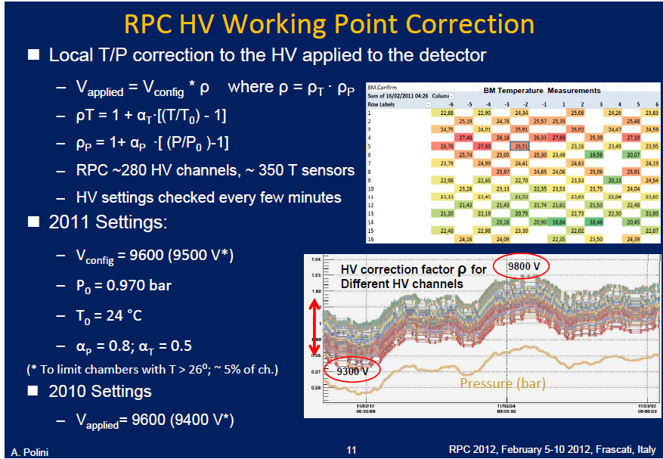
Performance and operation of the ATLAS
POLINI, Alessandro

Slide 12
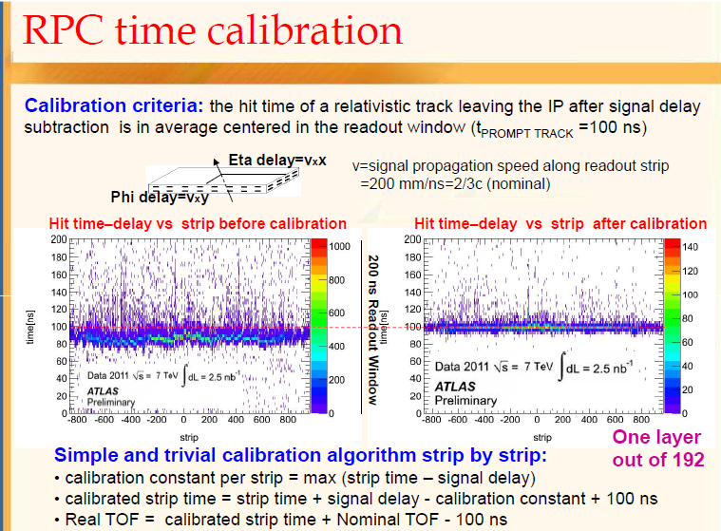
ATLAS RPC TOF performance
CHIODINI, Gabriele

Slide 13
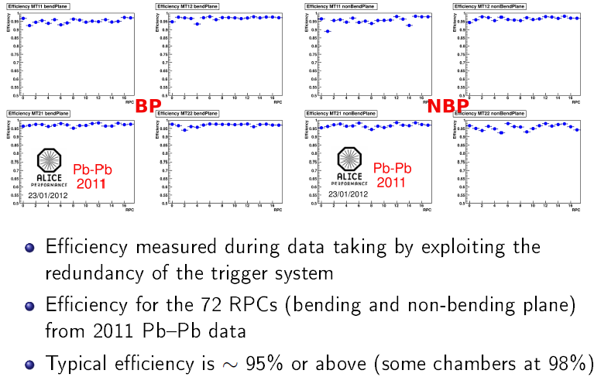
Performance of the ALICE muon trigger system
MARCHISONE, Massimiliano
Best Talk

Slide 14
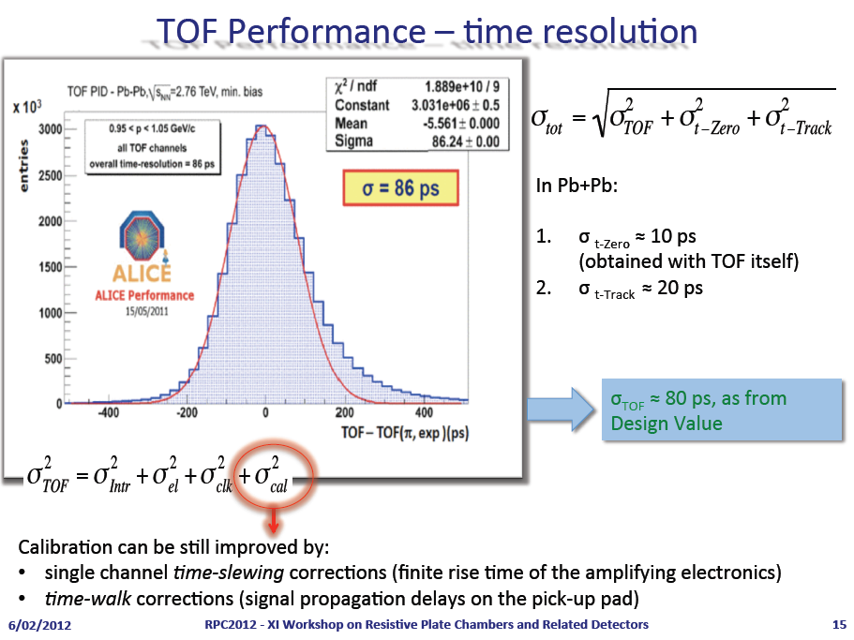
Performance of the MRPC based TOF at ALICE
ALICI, Andrea

Slide 15
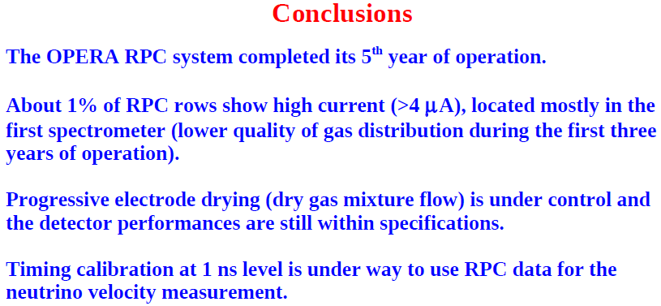
Performance of OPERA bakelite RPCs
PAOLONI, Alessandro

Slide 16
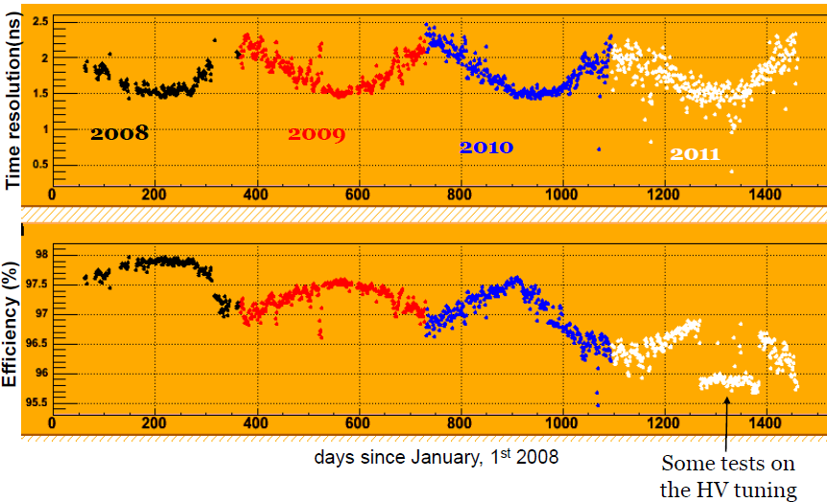
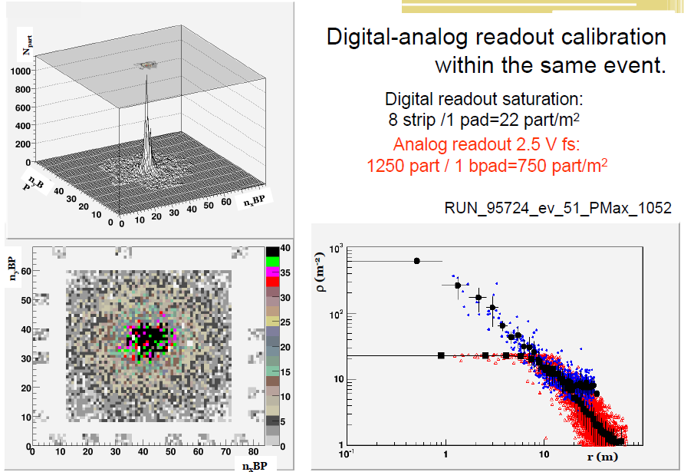
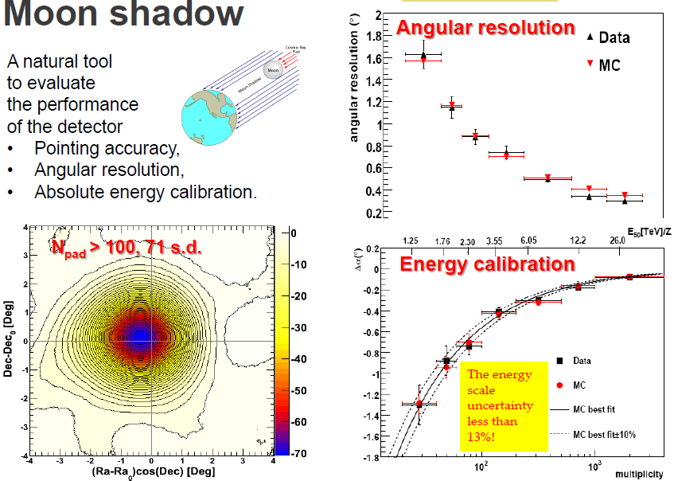
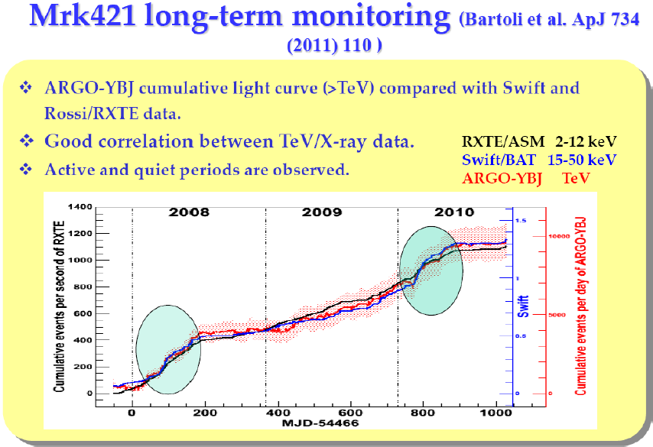
Results from the ARGO-YBJ
IUPPA, Roberto
2nd Best Talk

Slide 17
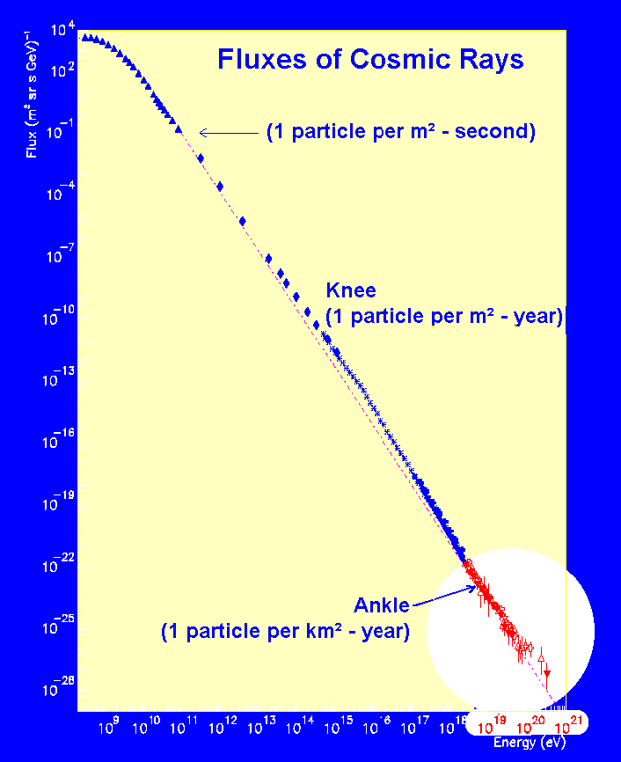

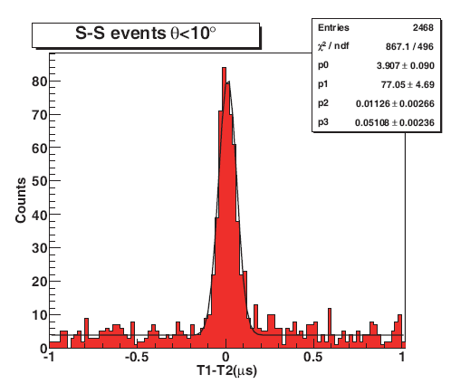
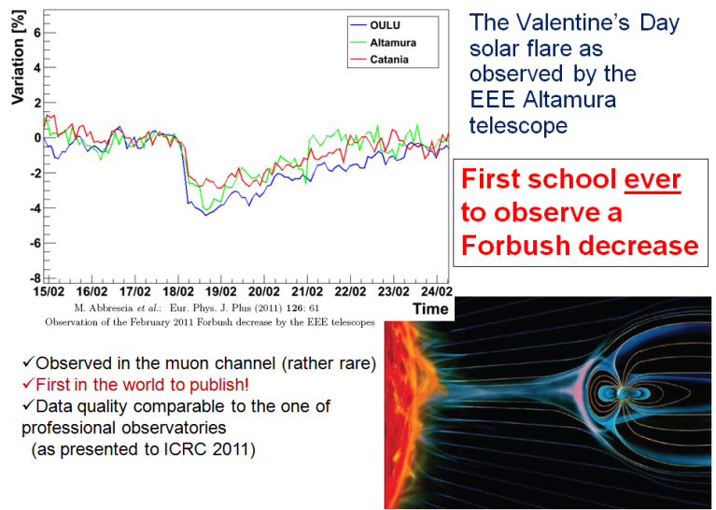
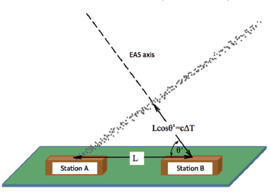
Multigap RPCs & high school students
M. Abbrescia

Slide 18
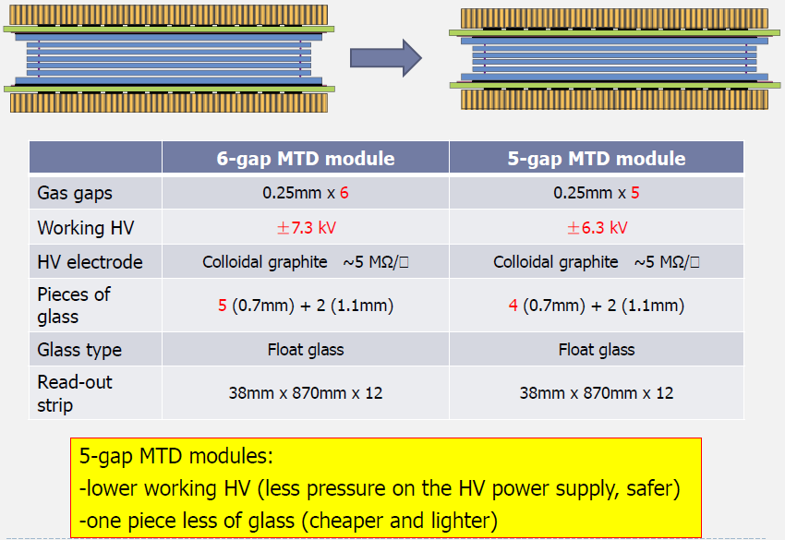
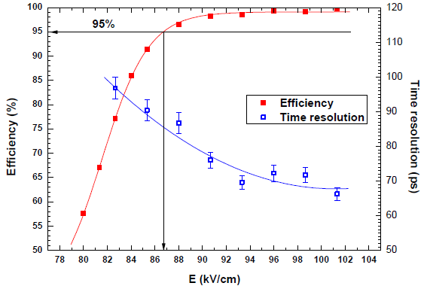
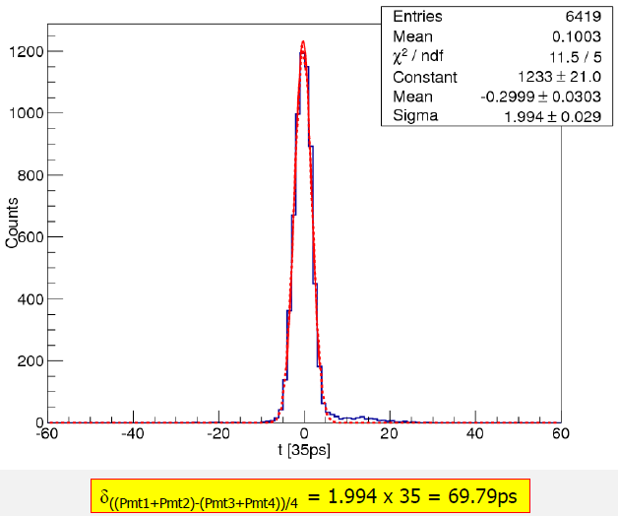
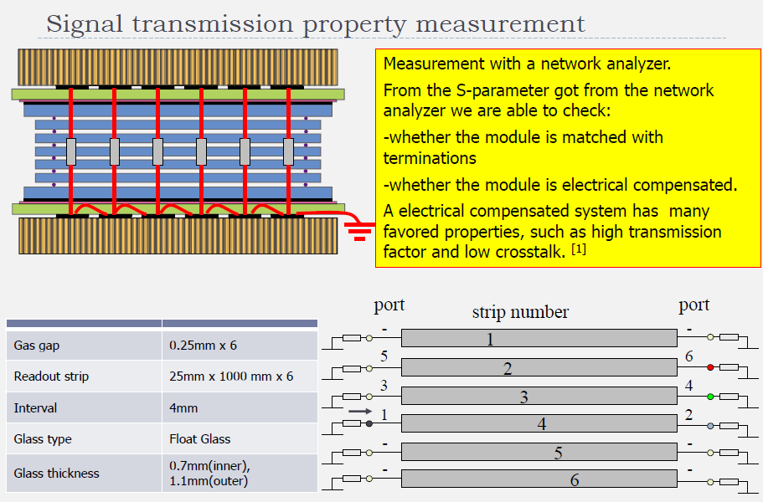
R&D and production of LMRPCs for the STAR-MTD
CHEN, Huangshan

Slide 19
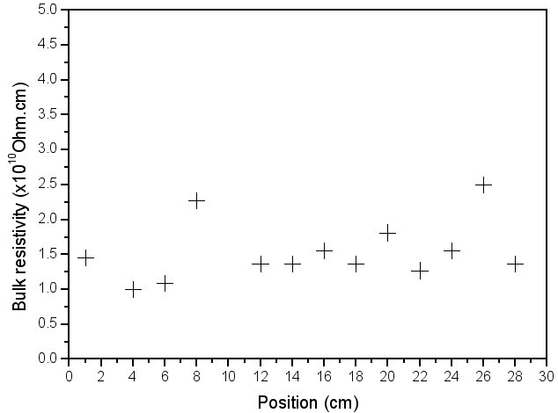
Aging test of high rate MRPC
Wang Yi
The low resistive glass shows very promising performance and passed HV aging test.
Within 300h’s operation, the performance of high rate MRPC module has shown the hardiness against irradiation. A dose rate of 2.16×10⁻³Gy/h or a counting rate of 15kHz/cm² does not cause obvious aging effect.
Compared to common glass MRPC, high rate MRPC responds and reaches a stable state faster.
Variation: <30%

Slide 20
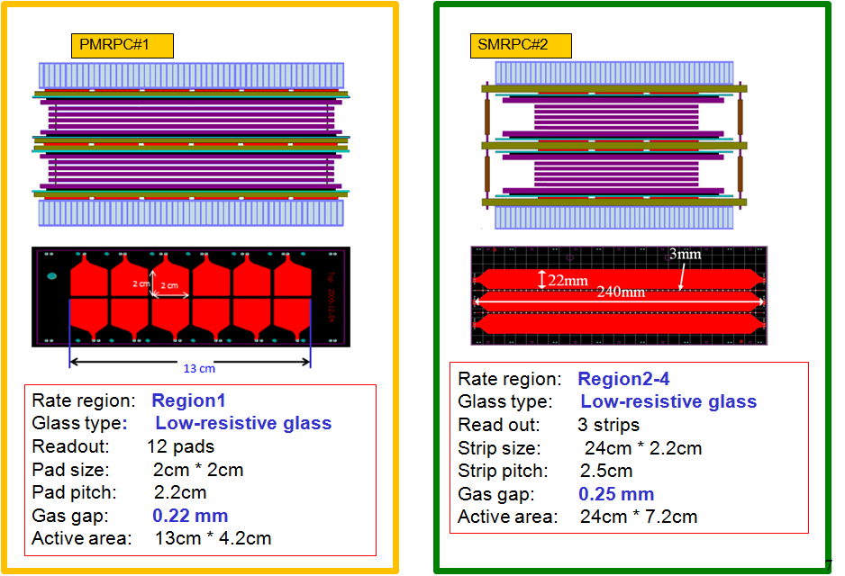
CBM-TOF wall with Chinese doped glass
WANG, Jingbo

Slide 21
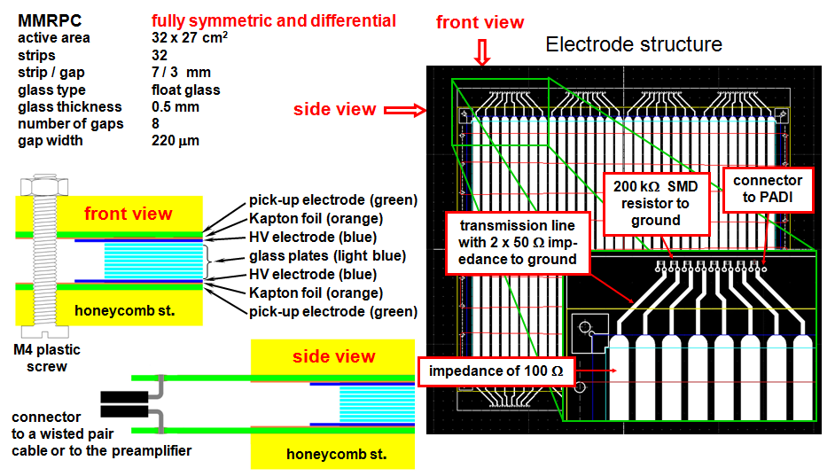
A Multistrip-MRPC for CBM TOF
DEPPNER, Ingo

Slide 22
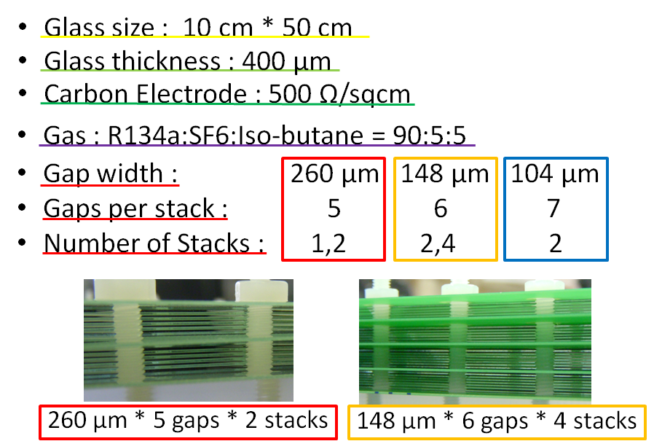
Large area, high resolution RPCs for LEPS2
Laser Electron Photon experiment at SPring-8
TOMIDA, Natsuki

Slide 23
Phenolic MRPCs for high trigger rates at CMS
R&D on Oiled Phenolic 4- and 6-gap Panel-type RPCs
Prototype detectors: manufactured with the same technology as the one applied for the double-gap RPCs for the CMS experiments.
For 2-gap RPCs (Thr. ~200 fC), mean q_{e} ~4.0 pC
For 4-gap RPCs (Thr. ~150 fC), mean q_{e} ~1.5 pC
For 6-gap RPCs (Thr. ~100 fC), mean q_{e} ~0.9 pC
Size of efficiency plateaus ≥ 600 V for both 4- & 6-gap RPCs
Technical issue: 6-gap structure seems to be marginal to manufacture real size panel–type detectors.
Low stiffness of HPL → Technical difficulty in manufacturing gaps
Adding water vapor deforms the thin HPLs (1.0 mm) → lost the gap uniformity
Aging issue: Small pulses will be really conductive to reduce radiation-induced aging at high rate environments
LEE, Kyong Sei

Slide 24
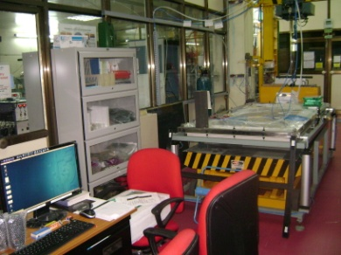
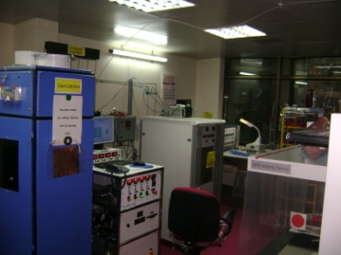
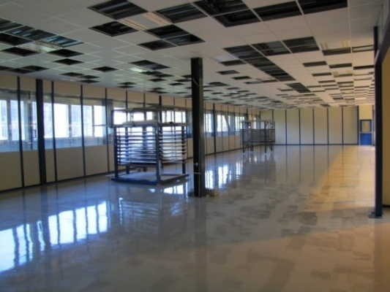
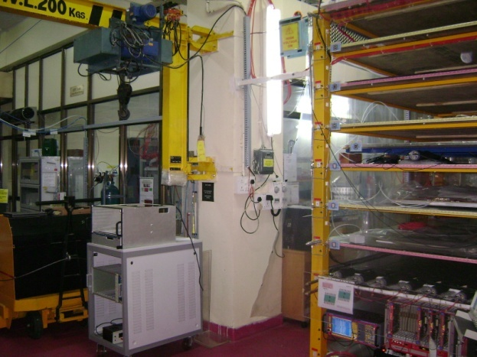
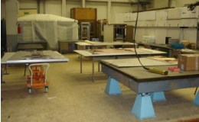
Construction of RPCS for CMS upgrade
Production on three different sites : CERN, GHENT, BARC (50/50/50)
CERN site (904) will coordinate logistic & setting up protocols for QA/QC
Common technical specification and protocols for production and QC discussed and agreed among the three sites
Detailed DB for production and test in preparation
BARC
PANT, Lalit
CERN 904
GHENT

Slide 25
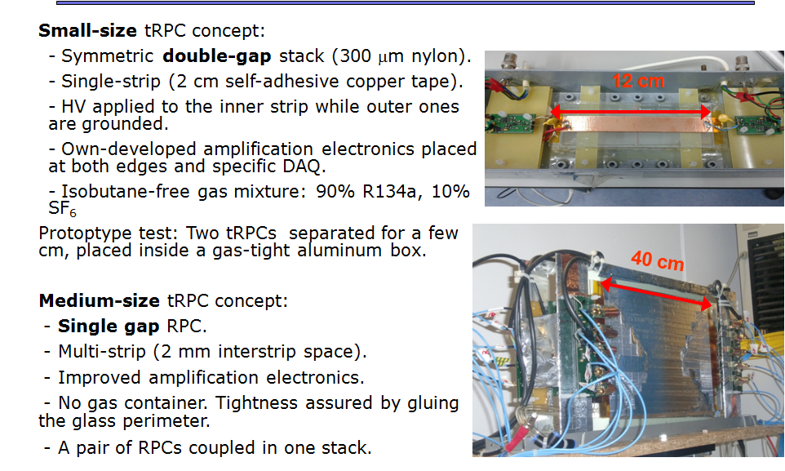
Performance of timing-RPCs using relativistic heavy ions
PARADELA DOBARRO, Carlos
Two different types of tRPCs have been tested in beams for studying their time resolution performances.
Resolutions close to 40ps have been obtained for reduce ion rates (a few Hz/cm²), but they are worse for increasing rates.
Time resolution also worsens drastically for the high voltage region where streamers are expected (above 100 kV/cm).
For a HV plateau about 2.9 kV, the single-gap RPC prototype we have tested fulfill the main requirements: 95% efficiency and 50 ps σ for one detector at less than 10 Hz/cm².

Slide 26
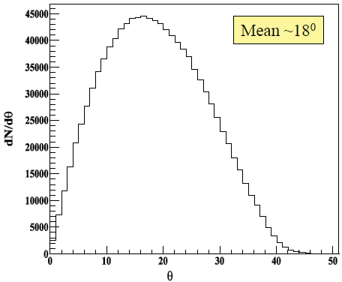
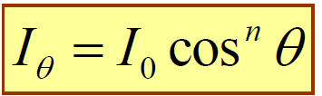


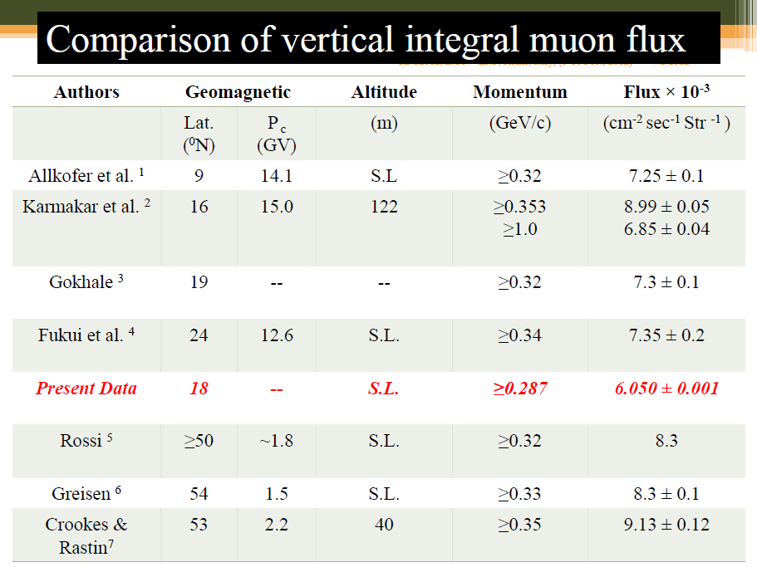
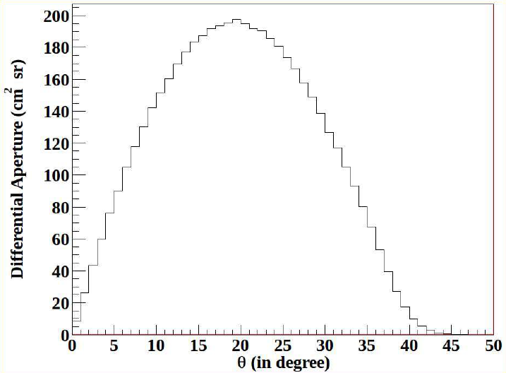
Angular Distribution of muons using INO-ICAL Prototype
PAL, Sumanta
Zenith angle distribution

Slide 27
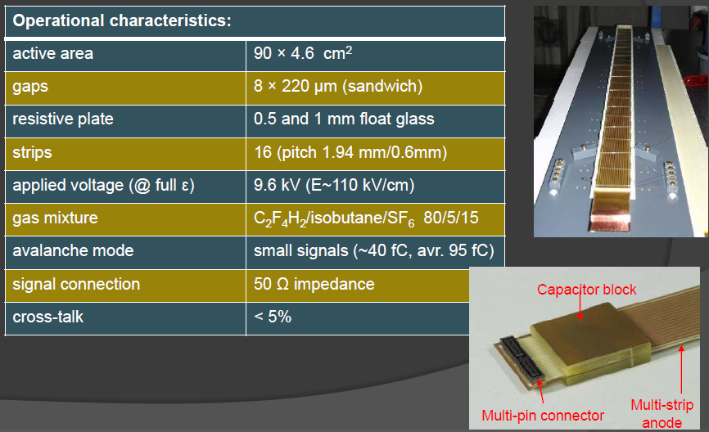
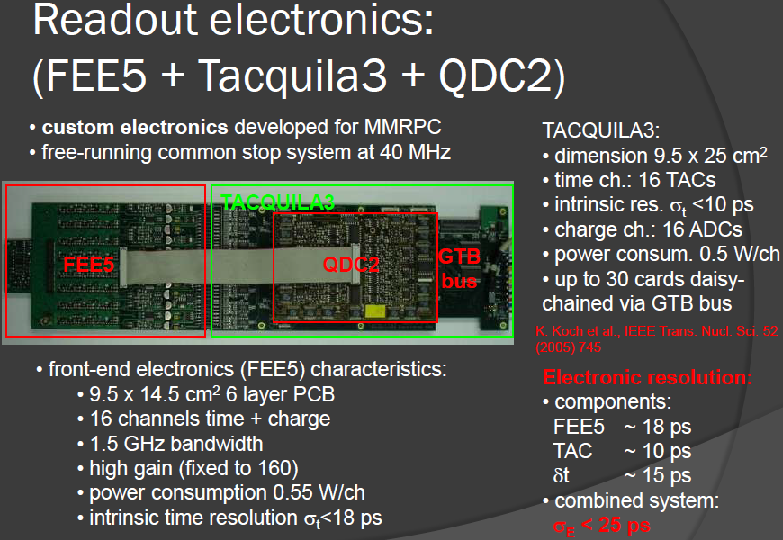
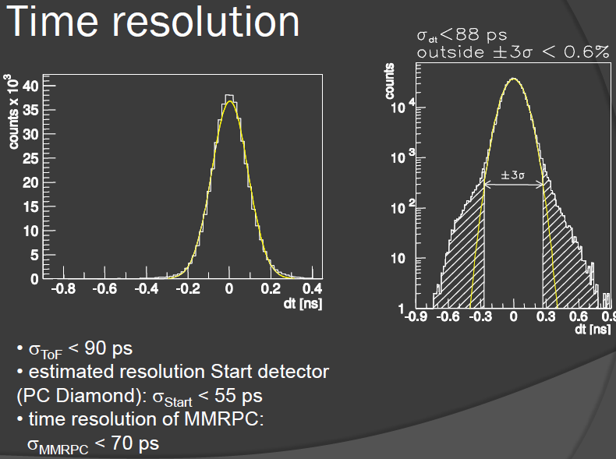
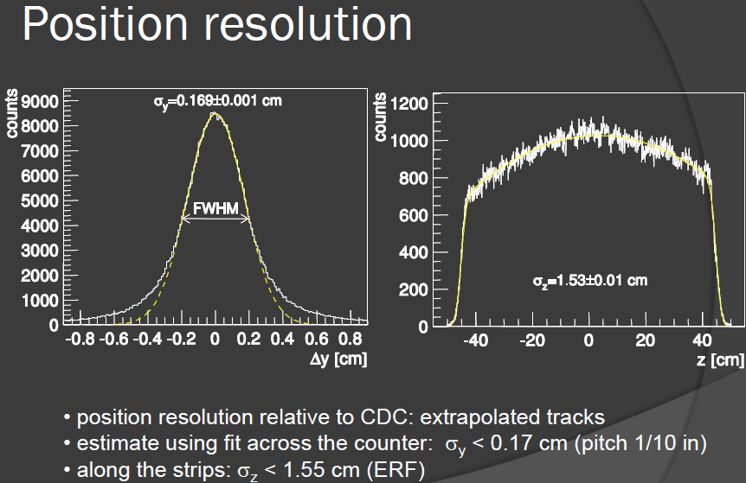
Performance of FOPI MMRPC
KIš, Mladen

Slide 28
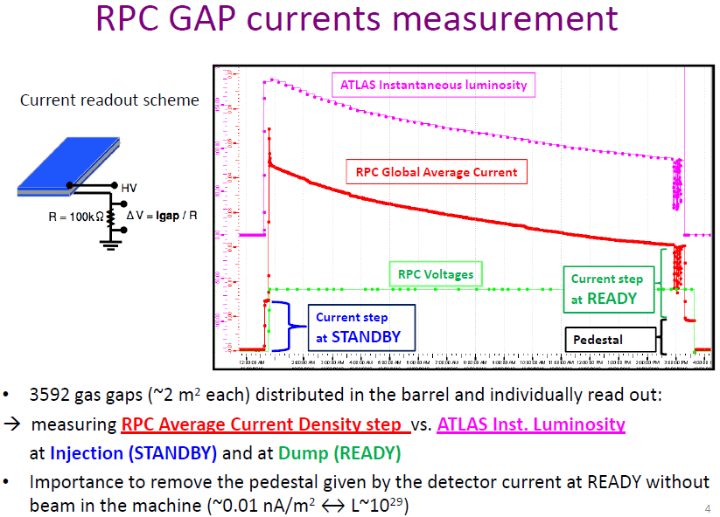
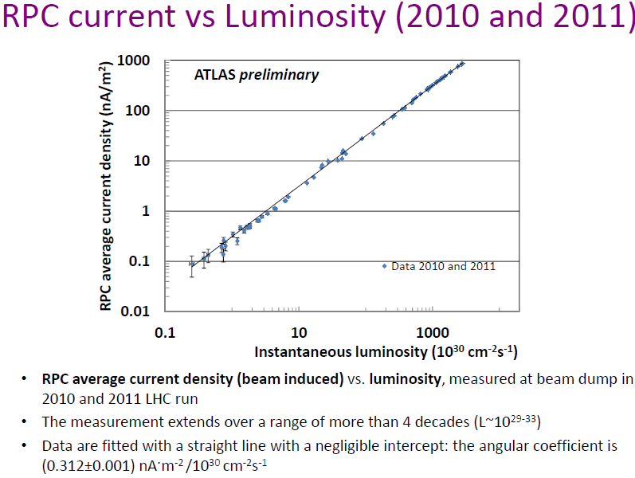


ATLAS RPCs for Luminosity monitor
BINDI, Marcello

Slide 29
Simulations and modeling

Slide 30
Review of Simulation and Modelling
RPC structures
DC polarization and rate capability. Fluctuations.
Signal induction
Views of the charge induction mechanism
Analytical solutions for RPC
Influence of the plates conductivity
Signal propagation in strips. Crosstalk.
Charge generation
The Townsend avalanche
Space-charge effect – empirical models
Space-charge effect – exact numerical models
Timing
Intrinsic time response of RPCs
Extrinsic time fluctuations
Conclusion
Most of the rich RPC physics has been theoretically treated.
Some aspects still lacking:
Response of timing RPCs to gamma photons. Calculations are completely at odds with measurements.
Details of the space-charge effect and match to careful measurements in different gap sizes.
Streamer mechanism! Gas self-photoionization is a very unsatisfactory mechanism.
The role of SF₆ in streamer suppression.
Time-charge correlation in timing RPCs. Some say it is just electronics slew correction.
P.Fonte

Slide 31

Simulation studies on the Effect of SF6
HEED
Calculates the energy loss and ionisation produced by the particle traversing through the RPC [3].
Developed by I.Smirnov.
neBEM
nearly exact Boundary Element Method (neBEM) is used for field calculation [5].
Developed by S.Mukhopadhyay and N.Majumdar
MAGBOLTZ
Computes electron transport parameters [4].
Developed by S.Biagi.
SF₆ fraction (%) | With DAQ (pC) | With CRO (pC) | Simulated at 3.6kV/mm (fC) | Simulated at 5.0kV/mm (pC)
0.1 | 0.57 | 1.29 | 0.96 | 122.48
0.2 | 0.35 | 0.85 | 0.99 | 101.2
0.3 | 0.27 | 0.66 | 0.16 | 93.86
0.4 | 0.19 | 0.51 | 0.11 | 77.36
Salim Mohammed

Slide 32
RPC simulations from a current stand-point
Induced current vs induced charge. Which one to chose as the fundamental magnitude for evaluating the induction process?
Introduction to the 'induction+transmission' model and assumptions.
Circuit Theory (C-T) vs Multi-conductor Transmission Line Theory (MTL-T). Results for long strips.
Structure of the solutions of the transmission line equations. Signal dispersion in long strips and how to compensate.
Comparison with data for the main multi-strip characteristics.
Diego González-Díaz

Slide 33
Charge signal diffusion through resistive strip read-outs.
Resistive micromegas technology has proven good reliability under extreme conditions (high intensity pion, neutron, high intensity x-ray beams, …). However this new technology still requires further study for a complete understanding of the detector response.
A simple model and the methodology to solve it has been introduced. This model can be considered as a first step towards a more complex structure. The full mathematical description could allow to connect with field solvers.
Characterization of different prototype geometries undergoing will allow to increase our understanding and optimize key parameters.
Resistive strip signals to be read using dedicated electronic read-out, peaking time to be optimized for each read-out group.
GALAN, Javier

Slide 34




The CMS RPC performance & simulation
An algorithm for simulation of the RPC response is implemented in the CMSSW
The algorithm uses following parameters:
efficiency parameter for each readout strip;
noise parameter for each readout strip;
timing parameter for each chamber;
cluster size distribution for each chamber
The parameters are regularly updated
A dedicated validation procedure is developed
The simulation is in a good agreement with the experimental data
HADJIISKA, Roumyana Mileva

Slide 35
A MRPC based detector for gamma rays
Two main goals (The aim is to use RPC in a PET system)
To increase the efficiency for 511 keV photons
To suppress Compton scattered photons
The simulations are performed, using Geant 4
• Compton scattering, photo-effect
• multiple scattering, ionization, Bremsstrahlung
Detector „basic unit“:
two glass plates, 2 mm
gas gap 300 μm
Gas composition (for material budget): 85% C₂H₂F₄ + 5% i-C₄H₁₀ + 10% SF₆
Two designs are considered:
Gas-Converter (GC)
Gas-Converter-Insulator (GCI)
Borislav Pavlov

Slide 36




Simulations of a TOF detector for high energy neutrons based on iron-less RPCs
JORGE, Machado

Slide 37
Ageing and interactions with materials:

Slide 38


Ageing and conductivity of electrodes of high rate RPCs from an ion conductivity approach
MORALES, Miguel

Slide 39

Cavern background measurement with the ATLAS RPC system
AIELLI, Giulio

Slide 40
Study on Surface Asperities in Bakelite-RPC
The present simulation in general seems to under-predict the induced signal in Bakelite RPC in comparison to the measurements.
Possible reasons for the disagreement of the simulation with experiment may be:
improper field simulation
underestimated transport properties, iii) experimental uncertainties.
Field has been simulated by neBEM V1.8.7 which produced field values in agreement with analytical ones. However, more accurate configuration can be achieved by introducing more precise geometrical and physical parameters.
The transport properties of TFE based mixtures may require some attention since Magboltz 8.9.3 indicates very low amplification in the relevant parameter space.
Experimentally, there can be uncertainties arising in the geometrical parameters, as well as electrical permittivity of various dielectric media.
The presence of surface asperities has been found to significantly distort the otherwise uniform field configuration depending on their shape and amplitude.
The distorted field can be responsible for localized large currents following larger amplification.
Far from the asperity, present calculation shows slightly larger induced current in surface-treated RPC in comparison to that without surface treatment.
MAJUMDAR, Nayana

Slide 41

Preliminary results on optimization of gas flow rate for RPCs
KALMANI, Suresh
Variation in Noise rate and Dark current attributed to different leak rates
If proper sealing, as part of QC is done, then the detectors can operate satisfactorily for more than a month with single gas fill and hence reduce the cost of replenishing gas!

Slide 42

Development of small, easy to build and low gas consuming timing RPCs
MORALES, Miguel

Slide 43


Long Term Validation of the Optimal Filters Configuration for RPCs Gas System at LHC
MANDELLI, Beatrice

Slide 44


Quality assurance of large area RPC detector: Techniques for measurement of gas leak rate
Quantitative Definition of “Acceptable range of leak rate” for 2 m x 2m glass RPCs
Reliable testing method for Acceptable leak rate, Highly Sensitive and Time Accelerated
Equipment and Procedure for measuring leak rate
RPC Production techniques to ensure high yield of RPCs with acceptable leak rate at reduced uncertainty
JOSHI, AVINASH

Slide 45


Production of RPC gaps for CMS upgrade
RE4/2 and RE4/3 of 660 Gaps for CMS upgrade are being produced at KODEL.
Productivity improvement is expected by the use of the KODEL Robot.
Quality assurance for gaps is effective.
Procedure of mass production for gaps is proven to be mature.
PARK, Sung Keun

Slide 46
Triggering at high rates

Slide 47








Performance of the ALICE RPC-based muon trigger system in the first two years of data taking at the LHC
Average efficiency (~95%) is stable within ~0.5% after two years
pp
Pb-Pb
GAGLIARDI, Martino BOSSù, Francesco

Slide 48


The RPC based muon trigger of the CMS
As the PAC algorithm is implemented in the reprogrammable FPGAs, it can be easily changed, e.g. to correct bugs, improve performance, or implement new features.
BUNKOWSKI, Karol

Slide 49

Trigger rate dependence and gas mixture of MRPC for the LEPS2 experiment
HSIEH, Chia-Yu

Slide 50

The RPC based proposal for the ATLAS forward muon trigger upgrade in view of super-LHC
ZHU, Junjie

Slide 51


Phase 1 extension of the CMS end-cap RPCs
TYTGAT, Michael
With the addition of a 4th endcap station, CMS will upgrade its RPC system to be ready for the nominal LHC Phase I operating conditions
200 new RE4/2-3 Bakelite based chambers will be constructed in 2012-2013 and should be installed in CMS during the upcoming Long Shutdown I in 2013-2014

Slide 52


Thin-gap RPC Test Results
Thin gap of 1.2mm results in good time resolution, <1.1ns, dominated by readout electronics precision
With fine readout pitch as 1.27mm, position resolution ~300μm can be achieved, dominated by RPC alignment uncertainty
Bakelite 10¹⁰Ω·cm bi-gap chamber, fully functions in 7kHz/cm² high rate test
HAN, Liang

Slide 53

Test for upgrading the RPCs at very high counting rate
PAOLOZZI, Lorenzo
3rd Best Talk

Slide 54


Ceramic Resistive Plate Chambers for High Rate Environments
LASO GARCIA, Alejandro

Slide 55

High counting rate, differential, strip read-out, multi gap RPC
PETROVICI, Mihai

Slide 56


Proposed Trigger Scheme for the ICAL Detector of India-based Neutrino Observatory
Average noise rate/ RPC strip (200 cm x 3 cm) |  | Coincidence Window (ns)
Surface Rate (Hz) | Underground Rate (Hz)
200 | 10* | 100
Special Mention
DASGUPTA, Sudeshna
H_{S} | V_{S} | Segment Dimension | Total Segments | Trigger Criteria Set 1 |  | Trigger Criteria Set 2
 |  |  |  | Surface Rate (Hz) | Underground Rate (Hz) | Surface Rate (Hz) | Underground Rate (Hz)
4 (2x2) | 10 | 4 m x 4 m x 1 m | 735 | 87 | 2.7 x 10⁻⁵ | 1.4 x 10⁴ | 8.5 x 10⁻²
 | 20 | 4 m x 4 m x 2 m | 392 | 87 | 2.7 x 10⁻⁵ | 1.4 x 10⁴ | 8.5 x 10⁻²
 | 40 | 4 m x 4 m x 4 m | 196 | 87 | 2.7 x 10⁻⁵ | 1.4 x 10⁴ | 8.5 x 10⁻²
9 (3x3) | 30 | 6 m x 6 m x 3 m | 180 | 3.7 x 10³ | 1.1 x 10⁻³ | 2.6 x 10⁵ | 1.6
 | 40 | 6 m x 6 m x 4 m | 144 | 3.7 x 10³ | 1.1 x 10⁻³ | 2.6 x 10⁵ | 1.6
 | 60 | 6 m x 6 m x 6 m | 108 | 3.7 x 10³ | 1.1 x 10⁻³ | 2.6 x 10⁵ | 1.6
16 (4x4) | 40 | 8 m x 8 m x 4 m | 100 | 4.5 x 10⁴ | 1.4 x 10⁻² | 1.8 x 10⁶ | 11.1
 | 60 | 8 m x 8 m x 6 m | 75 | 4.5 x 10⁴ | 1.4 x 10⁻² | 1.8 x 10⁶ | 11.1
 | 80 | 8 m x 8 m x 8 m | 50 | 4.5 x 10⁴ | 1.4 x 10⁻² | 1.8 x 10⁶ | 11.1

Slide 57


A fast electronics for RPC based precision tracking muon trigger at high luminosity LHC
Amp and Maximum
Selector
Maximum Selector
1 fC signal with SiGe amplifier
N strips are processed at the same time (N can vary reasonably in the range of ~10)
The threshold is chosen to have one or two strips firing (cluster size 1 or 2)
The decoder transforms the simple digital pattern into a number representing the hit coordinate on the chamber
The processing time of (7-10 ns) is highlighted in figure
CARDARELLI, Roberto

Slide 58
New ideas

Slide 59
Resistive microstrip and microdot detectors: a novel approach in developing spark protected micropattern detectors
● We introduced micropttern gaseous detetctors with segmented resistive electrodes :
R-MSGCs R-MHSP R-Microdot and microstrip RPC(first results).
● They have several important advantages over other designs of resistive micropattern detectors, for example: fewer parts, simpler design, easier to assemble large area R-MSGCs from patches with practically no dead spaces and so on.
In mass production an automatic procedure can be applied which will dramatically reduce the cost compared to other micropttern detectors
● We already tested R-MSGC combined with a CsI–RETGEM as a candidate for the ALICE VHMPID, and preliminary results are very encouraging
● The spark-protected hybrid R-MSGC will be an attractive option for the detection of charge and light from the LXe TPC with a CsI photocathode immerses inside the liquid.
● Another option for the LXe TPC, which is currently under the study in our group, is to use LXe doped with low ionization potential substances. In this detector the feedback will be also a problem and thus hybrid R-MSGC or R-Microdot will be also an attractive option.
PESKOV, Vladimir

Slide 60



Development of spark-resistance MICROMEGAS with resistive anode strips
BYSZEWSKI, Marcin

Slide 61


SiOx coated plastic fiber optic sensor for gas monitoring in RPC
GRASSINI, Sabrina

Slide 62


Use of fiber optic technology for Relative Humidity monitoring in RPC detectors
CAPONERO, michele
Basic features of FBGs
‘Intrinsic’ optical sensor,
directly integrated in the fiber:
no power supply at the sensing point.
Many sensors can be connected in series
on the same optical fiber: reduced cabling.
Underlying spectroscopic technique:
long term stability for quasi-static measurements;
no electro-magnetic disturbances.
Hostile environment endurance, Radiation Hardness.
Fibre Bragg Grating (FBG) optical sensors:
a novel technology that can allow developing distributed monitoring sensing systems for gas-based detectors in large HEP experiments

Slide 63


Technical design of the RPC-based TOF wall (iTOF) for the R3B experiment at FAIR
Reactions with Relativistic Radioactive Beams
CASAREJOS, Enrique

Slide 64




Construction and Calibration of the DHCAL of a Digital Hadron Calorimeter with RPCs
REPOND, Jose
XIA, Lei
Muons
Pions

Slide 65




Development of large GRPC for an ultra-granular Semi-Digital Hadronic Calorimeter
LAKTINEH, imad

Slide 66



Performance of the HADES-TOF RPC wall
RPC-TOF fully integrated in the HADES spectrometer and commissioned in Au + Au beam
Uniform time resolution <80> ps σ in a Au + Au environment, fullfilling the desing requirements
Ready for production beam time (April 2012).
BLANCO CASTRO, Alberto

Slide 67




Muon scattering tomography with RPCs
BAESSO, Paolo

Slide 68


A 2m x 0.5m prototype of a MRPC-based neutron detector with steel converter plates
ROEDER, Marko

Slide 69
TOF tracker: combination of time-of-flight and high-accuracy bi-dimensional tracking in a single gaseous detector
1 - PID by TOF is a combination of tracking and timing. To have both measurements in a single detector may have advantages. For instance, each particle would be measured several times, improving accuracy (although on a shorter path) and there is no need for an external T₀ detector (frequently problematic).
2 – Explore the limits of RPC position resolution by classical charge interpolation (for which there is ample hardware support) and combine it with accurate timing in a limited number of channels.
Position resolution below 50 µm can be achieved in multi-gap RPCs by analog charge readout (high accuracy digital readout is limited to single-gap) of 4 mm pitch strips.
Bi-dimensional localization demonstrated at the level of 70 µm.
In combination with 80 ps accuracy timing.
It was observed a strong position dependence of the time-charge correction. Hypothesized to be due to signal dispersion, “rounding” the pulse. The signal propagation conditions must be reviewed.
t₀
t₁
t₂
t₃
FONTE, Paulo

Slide 70


A Free-Streaming Readout for the CBM Time of Flight wall
LOIZEAU, Pierre-Alain

Slide 71

Best Poster

Slide 72
RPC2014 Tsinghua University Beijing, China (Diego González-Díaz & Wang Yi)

