Slide 1
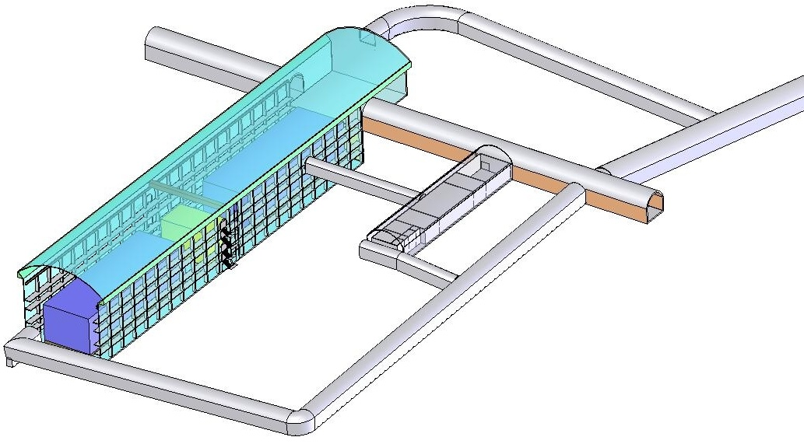
Development of 2m × 2m size glass RPCs for INO
M. Bhuyan¹, V.M. Datar², S.D. Kalmani¹, S.M. Lahamge¹, S. Mohammed³, N.K. Mondal¹,
P. Nagaraj¹, A. Redij¹, D. Samuel¹, M.N. Saraf¹, B. Satyanarayana^{1*}, R.R. Shinde¹ and P. Verma¹
India-based Neutrino Observatory (INO) Collaboration
¹Department of High Energy Physics, Tata Institute of Fundamental Research, Mumbai 400005, India
²Nuclear Physics Division, Bhabha Atomic Research Centre, Mumbai 400085, India
³Department of Physics, Aligarh Muslim University, Aligarh 202002, India
*Corresponding author (bsn@tifr.res.in)

Slide 2
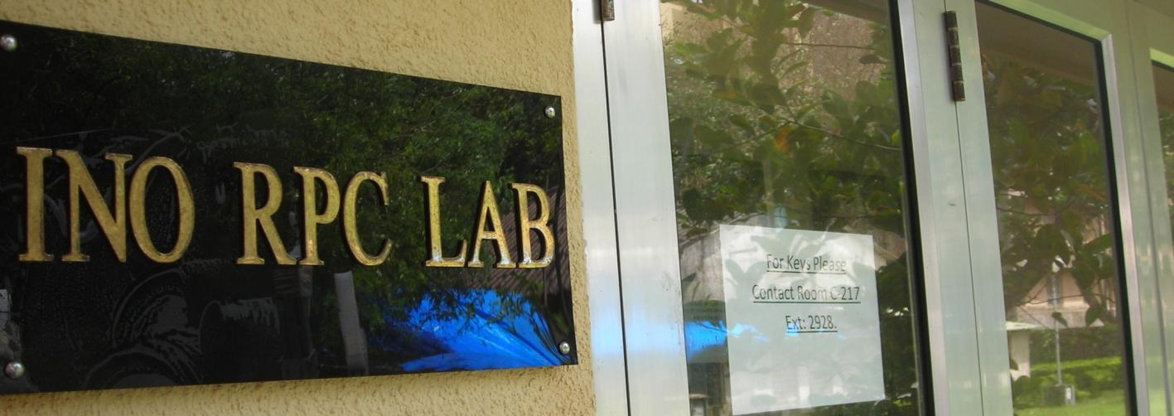
Plan of the talk
Introduction
RPC fabrication procedure
Basic characterisation studies
Studies with SF₆ gas mixtures
Summary and outlook

Slide 3
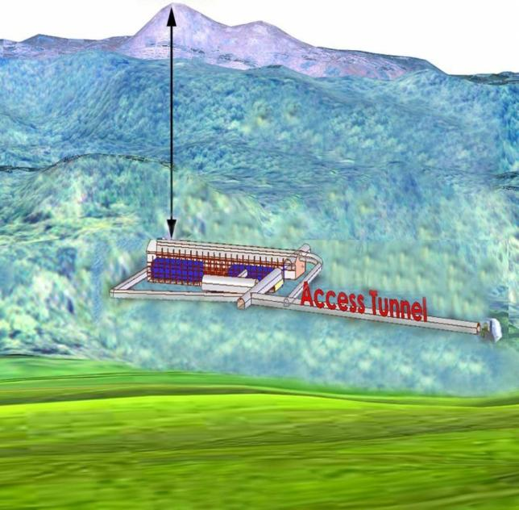
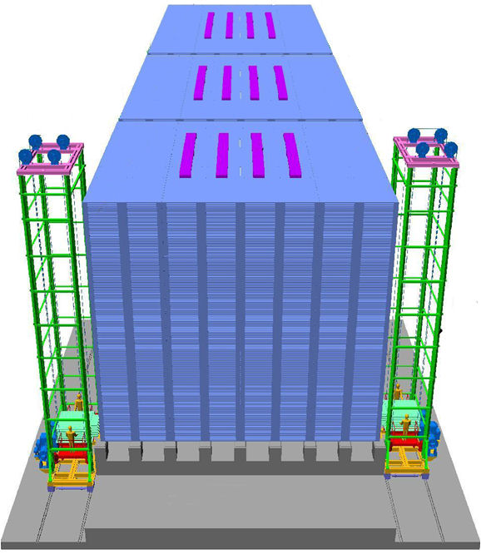
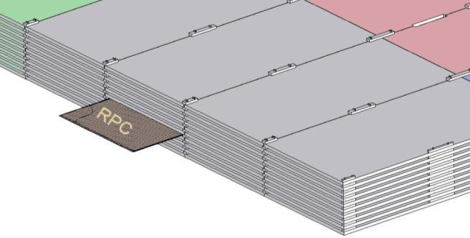
INO cavern and the ICAL detector
Magnet coils
Vertical rock coverage: 1300m
RPC handling trolleys
4000mm×2000mm low carbon iron slab
Total weight: 50Ktons

Slide 4
Factsheet of ICAL detector
No. of modules | 3
Module dimensions | 16m × 16m × 14.5m
Detector dimensions | 48.4m × 16m × 14.5m
No. of layers | 150
Iron plate thickness | 56mm
Gap for RPC trays | 40mm
Magnetic field | 1.3Tesla
RPC dimensions | 1,840mm × 1,840mm × 24mm
Readout strip pitch | 3 0mm
No. of RPCs/Road/Layer | 8
No. of Roads/Layer/Module | 8
No. of RPC units/Layer | 192
No. of RPC units | 28,800 (97,505m²)
No. of readout strips | 3,686,400

Slide 5
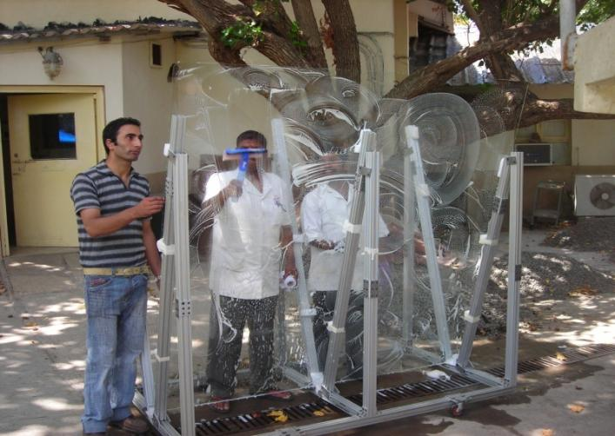
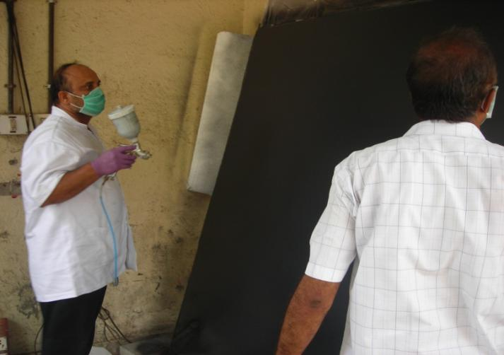
Glass electrode preparation
Glass cleaning
Cleaned with Labolene soap solution and rinsed with distilled water
Left to natural drying
Wiped with iso-propyl alcohol
Spray painting
Using auto garage compressor and paint spray gun
Left to natural drying
Currently scaling-up an automated paint plant used for 1m x 1m glass

Slide 6
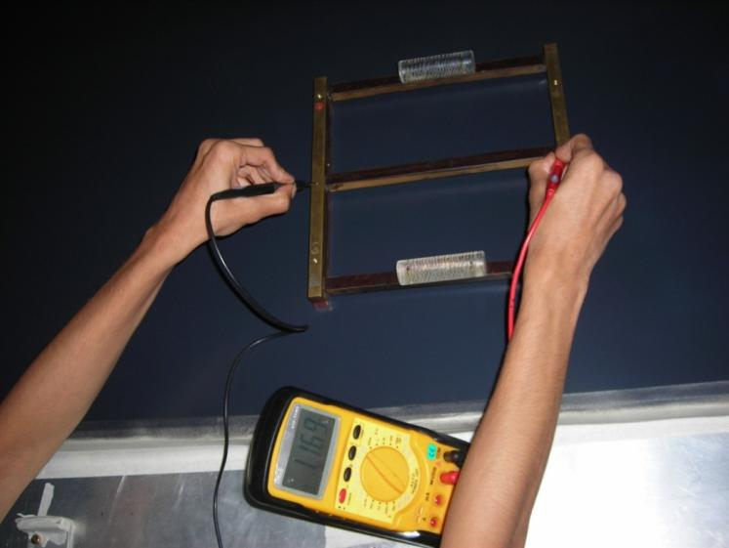
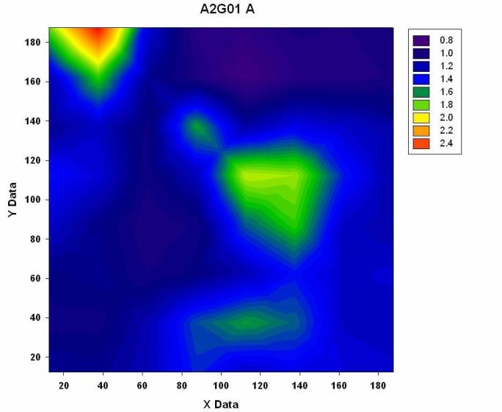
Surface resistivity measurement
Measurement jig
Developed a simple technique
Fabricated jigs of various sizes to suit for measurements of different grid sizes
Measurement data
Reasonably uniform
Needs improvement at the edges
Better uniformity obtained on sheets painted by automatic paint plant

Slide 7
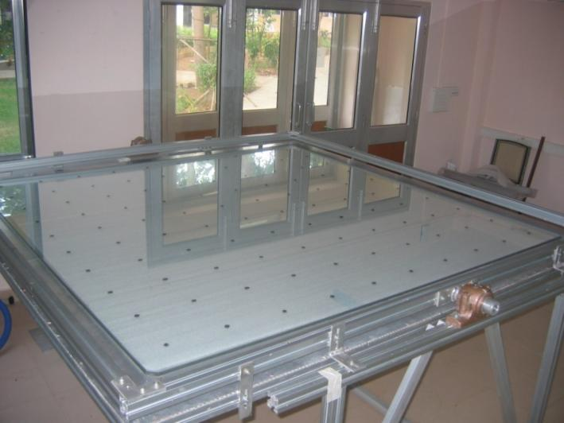
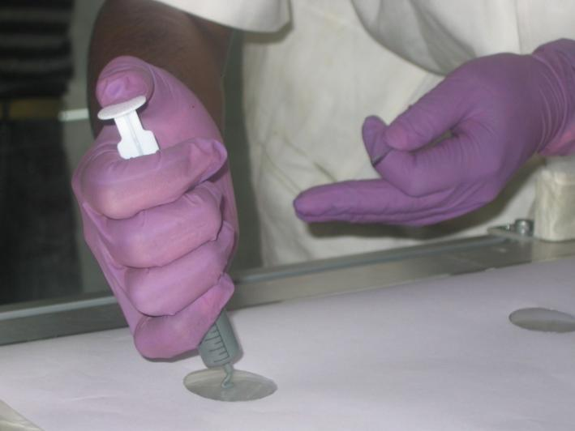
2mx2m RPC: Gas gap preparation-1
Bottom glass in place
Template for button positions placed below the bottom glass
Buttons placed on 20cm x 20cm grid
Gluing of buttons
Currently glue dispensed manually
Protective template placed on the glass
Auto timer-based glue dispenser being designed

Slide 8
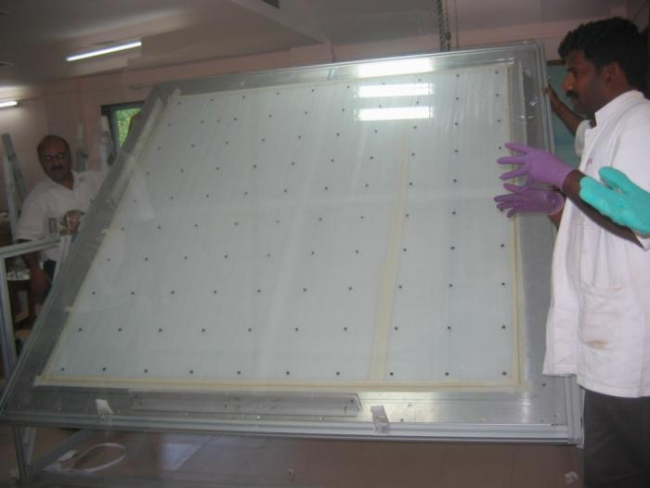
2mx2m RPC: Gas gap preparation-2
Placing the top glass
Tilting the work table for placing the top glass electrode
Precise stoppers mounted on the table for guiding the top glass
Vacuum jig for gluing
A simple vacuum jig designed for perfect and efficient gluing of the gas gap
Technique suggested by Carlo Gustavino

Slide 9
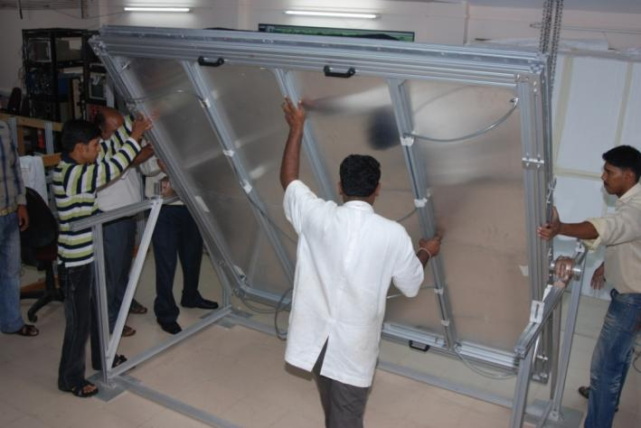
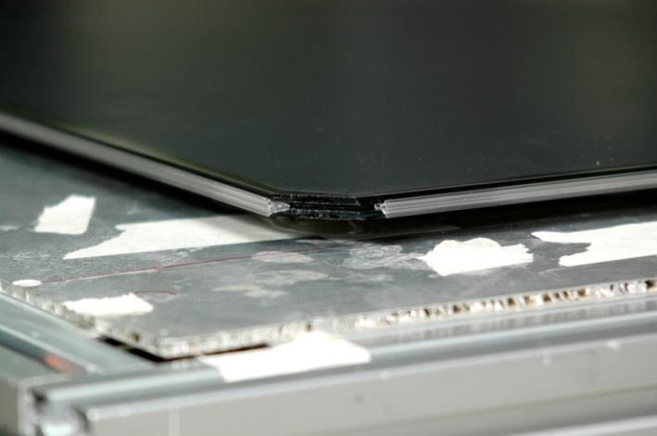
2mx2m RPC: Gas gap preparation-3
Preparing to glue bottom-side
Rotating the work table for gluing bottom-side spacers
Suitable work-table design and over-head crane for easy handling of glasses and gaps
Ready to glue top-side spacers
Last step before closing the gas gap
Gas nozzles on all four corners of the gap – two each used for gas inlet and outlet

Slide 10
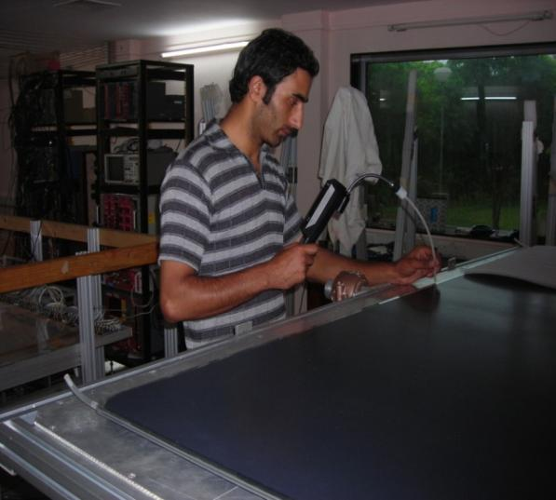
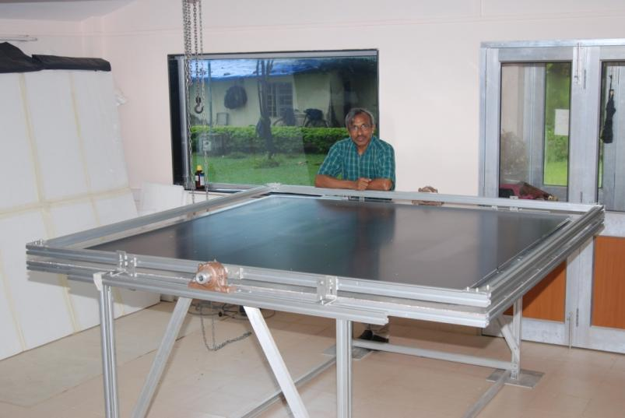
2mx2m RPC: Gas gap preparation-4
Leak testing the gap
The gap pressurised marginally above atmosphere with R134a gas
Tested for leaks with R134a leak detector
Leaks plugged
Fully fabricated gas gap
Gap ready to be assembled as an RPC detector chamber

Slide 11
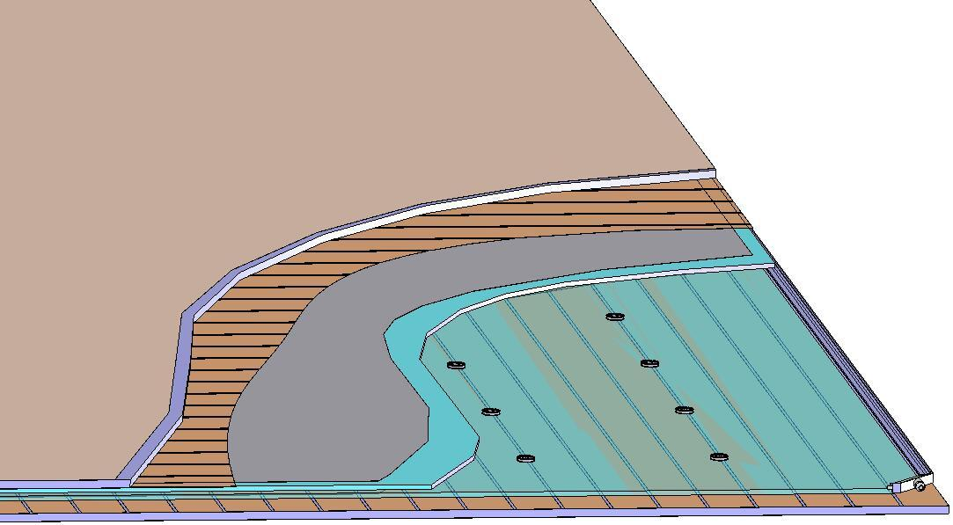
Construction of an RPC detector
Signal reference plane.1
Plastic honey comb.2
Copper pickup strips.3
Graphite/Paint.4
Top glass.5
Button spacer.6
Bottom glass.7
Edge spacer.8
Gas nozzle.9
Bottom pickup panel.A
8
1
2
3
4
5
6
7
9
A

Slide 12
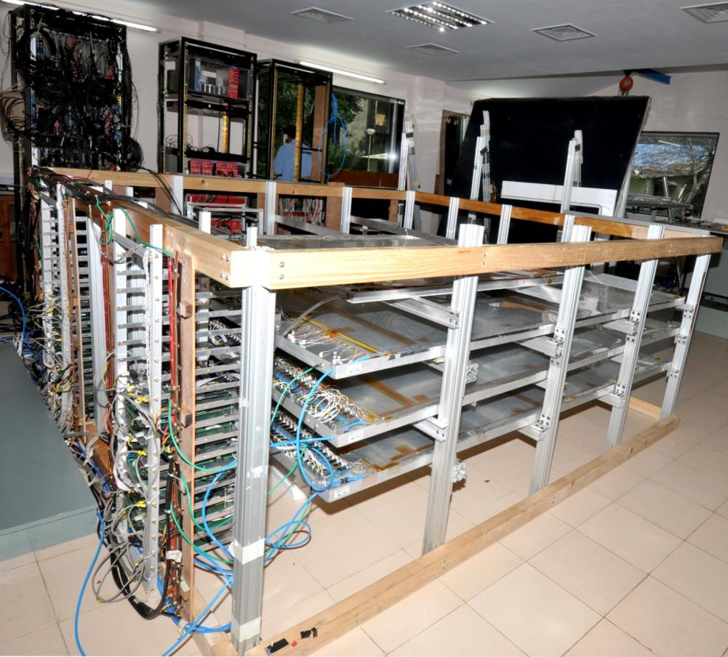
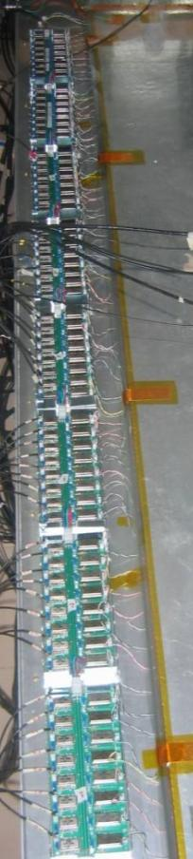
2mx2m RPCs in Cosmic test stand
Front-end electronics

Slide 13
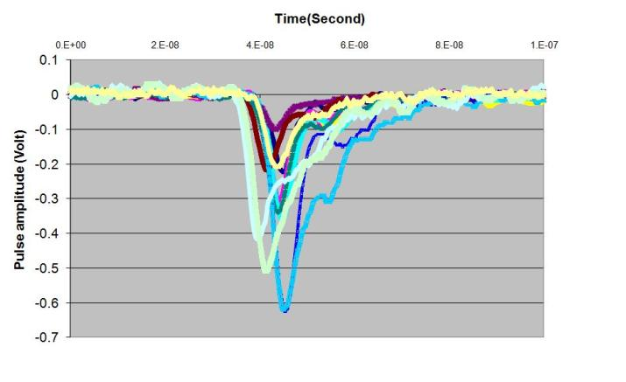
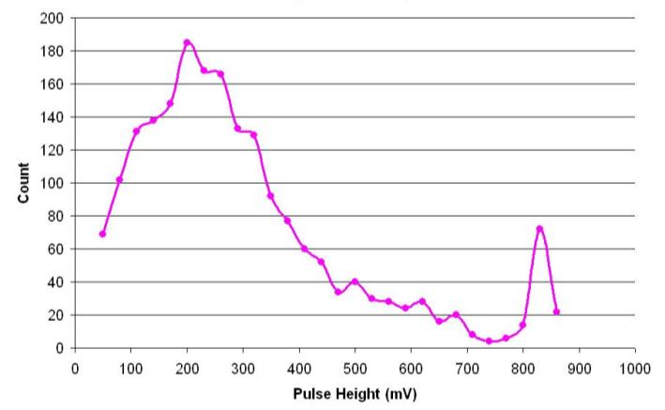
RPC pulse height studies
Preamplifier pulse shots
Pulse height distribution
Mean pulse height from the RPC: 2.5-3mV

Slide 14
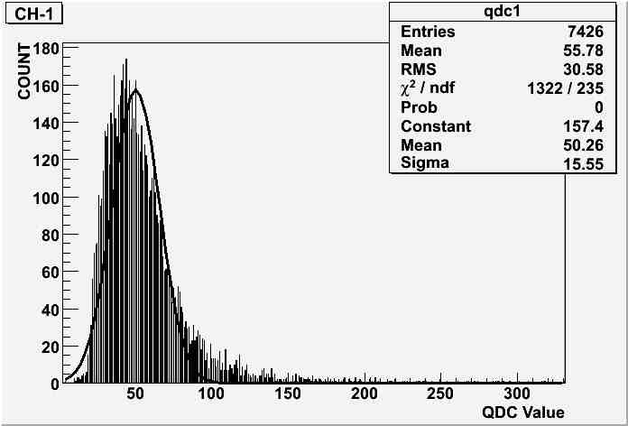
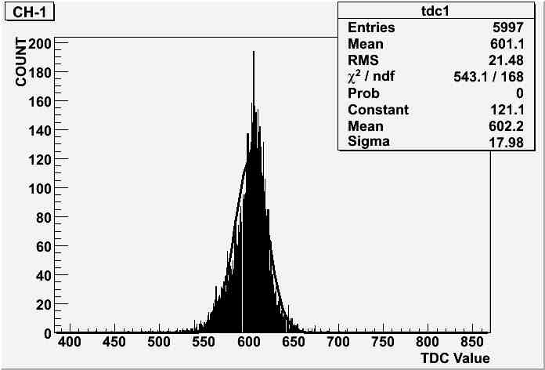
Charge and time distributions
Charge
Timing

Slide 15
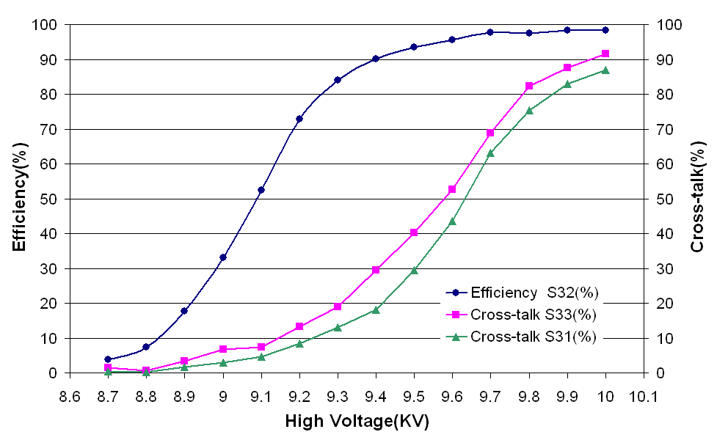
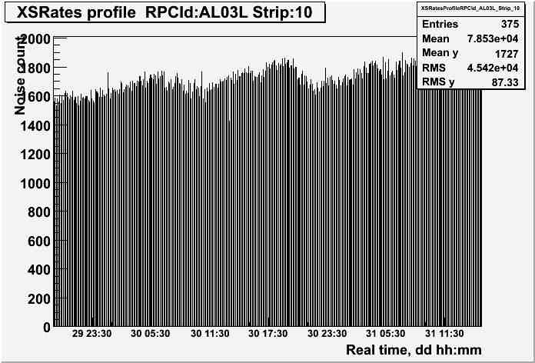
Monitoring operating parameters
Efficiency plateau
Noise rate profile

Slide 16
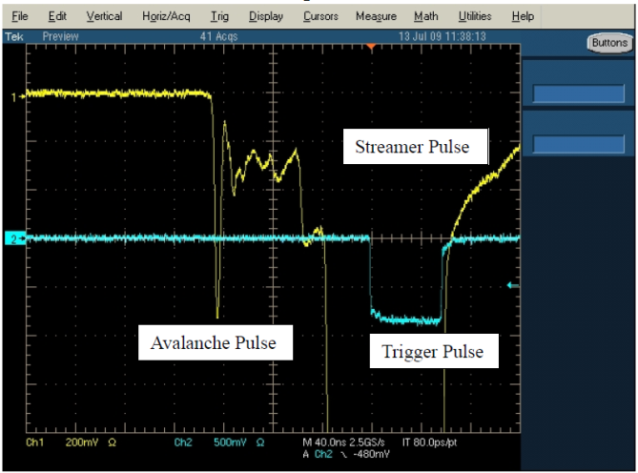
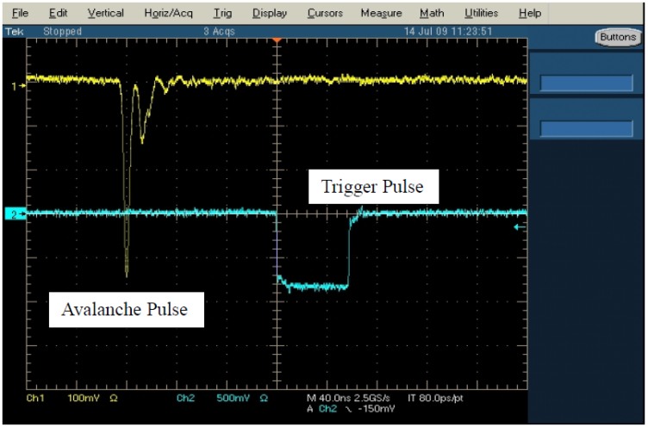
SF₆ studies: RPC pulse profile
SF₆ = 0%
SF₆ = 0.32%

Slide 17
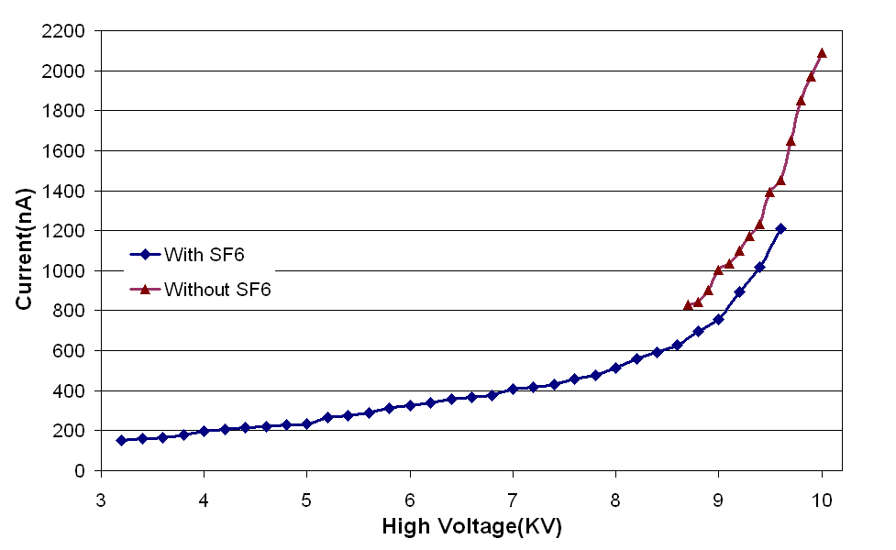
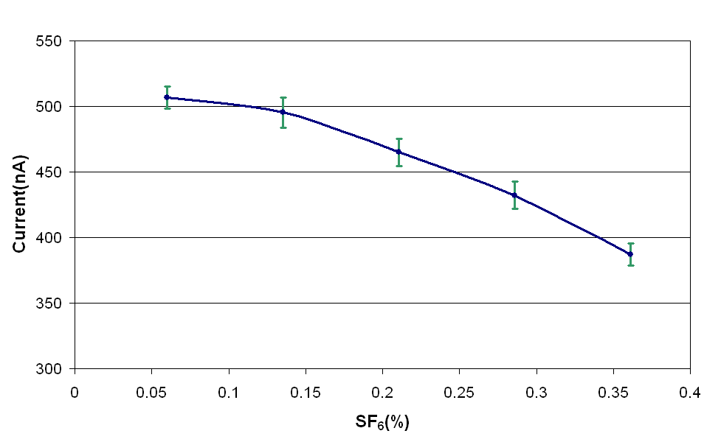
SF₆ studies: Chamber current
V-I characteristics
Chamber current

Slide 18
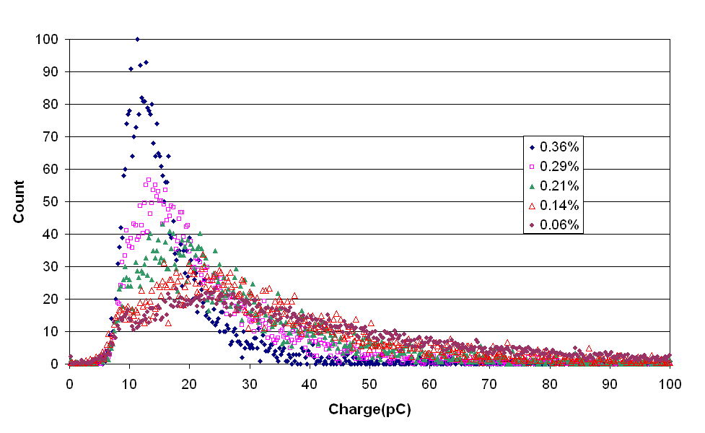
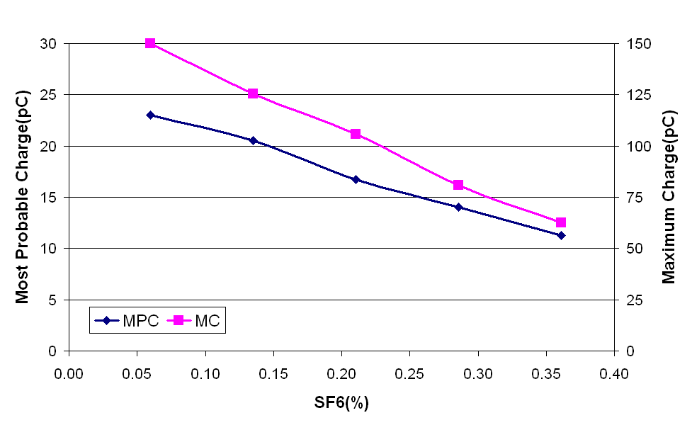
SF₆ studies: Collected signal charge
Charge distributions
Charge parameters

Slide 19
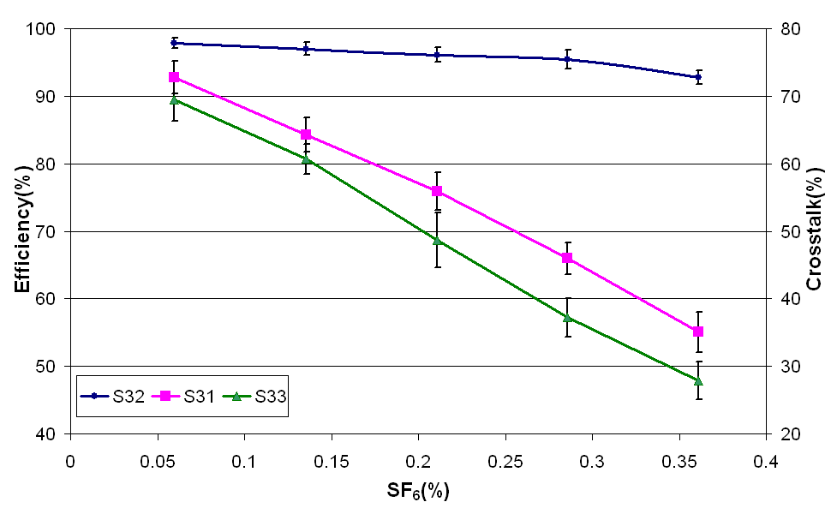
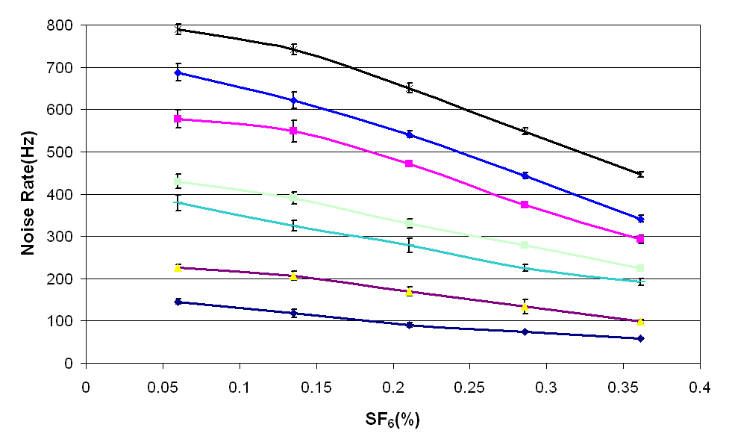
SF₆ studies: Important operating parameters
Efficiency
Noise Rate

Slide 20
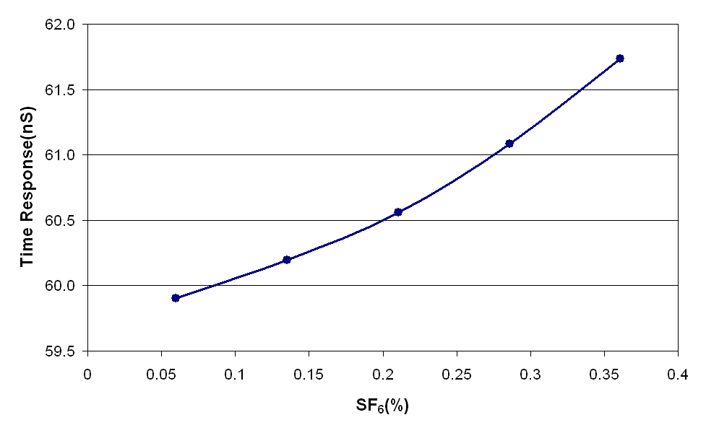
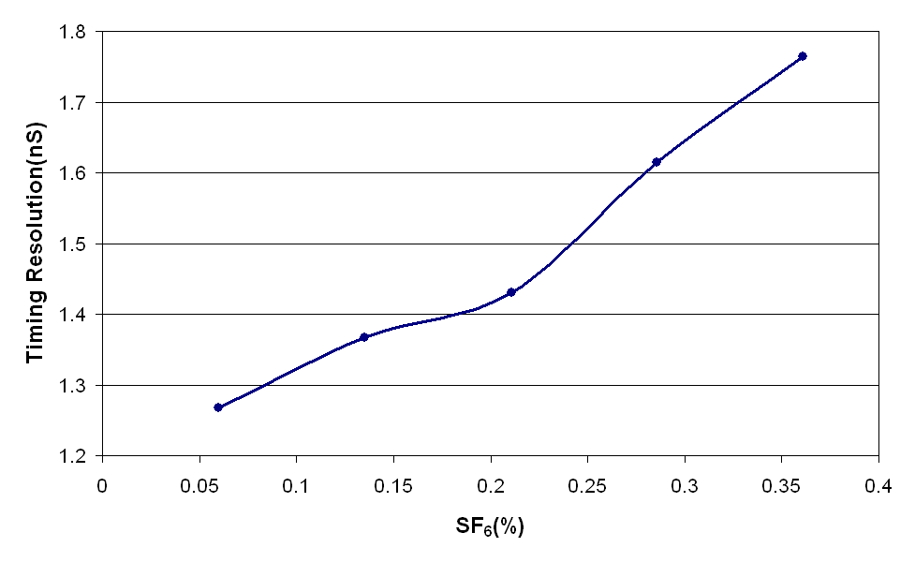
SF₆ studies: Timing characteristics
Time response
Time resolution

Slide 21
Summary and outlook
Successful fabrication and characterisation of large area RPCs required for INO’s ICAL experiment
Two more 2m x 2m will be made; more detailed studies to follow
Timing studies with long pickup strips, in particular
Poster by Deepak Samuel et al & Sumanta Pal et al
Gas systems’ studies with RGA
Presentations by S.D.Kalmani et al & Avinash Joshi
Cascading of gas lines; optimisation of gas flow, cost considerations
Studies using new pickup panel designs, cost considerations
Essentially –
1m x 1m RPC stack continued to be used for long-term, cosmic, tracking studies, Presentation by Naba Mondal et al
2m x 2m RPC stand being used for optimising RPC design for industrial production and testing for ICAL operating conditions
Engineering Design Report (EDR) on large scale industrial production of RPCs needed for ICAL, is under preparation

