Slide 1
Report on ICAL electronics to the INO Collaboration
B.Satyanarayana, TIFR, Mumbai
For and on behalf of ICAL electronics team

Slide 2
Parallel Session 1 - ICAL Electronics
Date and time: 11th July 2011, 10am
Venue: Ajay Divatia Lecture Hall, VECC, Kolkata
Update and status of ICAL Electronics activities: B.Satyanarayana, TIFR
Study of Anusparsh based front-end board with RPCs: B.Satyanarayana, TIFR
Report on chip development activities at IITM: Anil Prabhakar, IITM
Development of prototype RPC-DAQ module: Mandar Saraf, TIFR
Feasibility studies of DRS for ICAL Electronics: Deepak Samuel, TIFR
Alternate approach for ICAL backend DAQ: P.Nagaraj, TIFR
Validation of ICAL trigger scheme: Sudeshna Dasgupta, TIFR
Progress on ICAL power supply systems: Satyajit Saha, SINP
Roadmap and action plan till the next meeting: All

Slide 3
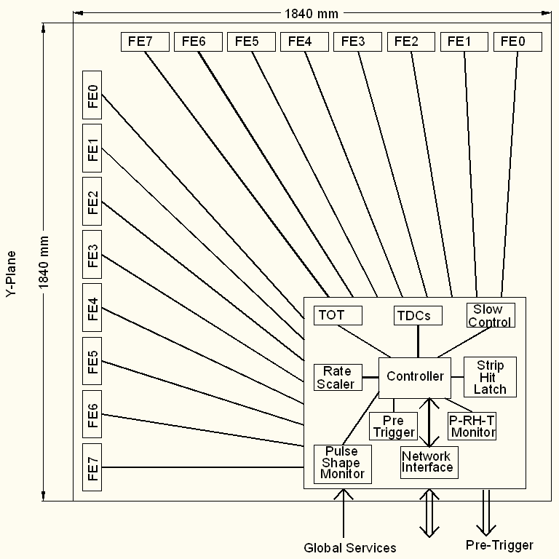
Functional diagram of RPC-DAQ
Front-end to
RPC-DAQ bus
8, LVDS pairs of unshaped comparator signals (I)
1, amplified & multiplexed RPC pulse on 50Ω (I)
3-bit channel address bus for multiplexer (O)
Power supplies (O)
Threshold control (d.c. or DAC bus) (O)

Slide 4
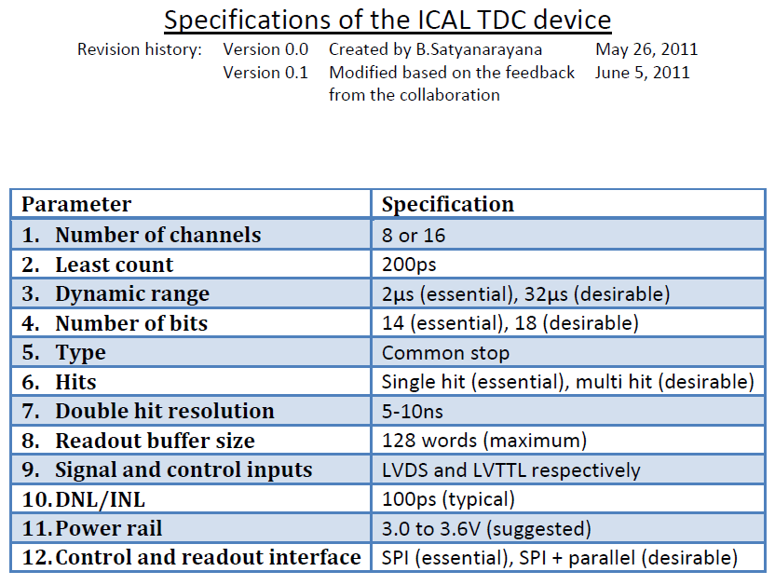

Slide 5
Design tools for TDC design
Agreement with IMEC
Already have an agreement for 0.35μm for the front-end ASIC
Now signed UMC NDA and IP agreement for
  0.18μm mixed mode + RF (L180 MMRF) technology design kit & process
  Europractice Faraday standard cell libraries

Slide 6
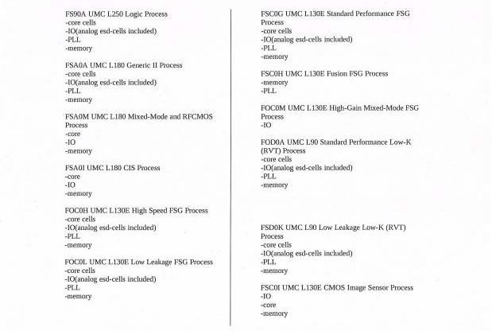
Licensed IPs

Slide 7
Chip design activities at IIT Madras
Front end amplifier (gain ~100, BW ~500MHz)
Time to digital converter (delay line based, 50ps)
Analog memory (64 samples, 2GSPS, 8-bit 10MHz ADC)
  Comment: Right now DRS seems a good solution. Indigenous developments with similar capabilities will be welcomed
Designs will be submitted next month (August 2011)
Chips expected sometime in October 2011
Characterisation and benchmarking will follow
Requested detailed specifications of all these chips
FPGA based TDC efforts are in good shape – 8-channel chip seems possible. Useful right away

Slide 8
Networked DAQ scheme
Alternate to the “conventional” VME backend scheme
The idea:
  RPC module gets the capability to “acquire” and store its own data. Call this “Level 0” data
  One “data concentrator server”, (one per N number of RPC's) collects RPC data, by either push or pull method, on master trigger. Call this “Level 1” data
  One higher “Level 2” machine reads all “level 1” data
Benefits:
  Simple, standard, cheaper, hierarchical scheme
  Software development is easier
  Simpler data cabling (because terminated on local hubs)
  Interrupt driven data acquisition (level 0), client-server based DAQ (level 1), monitoring and slow control are all handled this way
  Complete testing of RPC with a laptop and a HV/LV supply

Slide 9
SBC's based on ARM9
32 bit ARM9 cpu, fanless, 0.25W to 2W
Board sizes 65mm x 65mm (approx)
Example: Atmel Corp's AT91SAM9M10-CU, 400MHz
Price: $18 per piece for MOQ of 100‘s
Connectivities: Ethernet (Fast), USB, SPI
General purpose digital i/o lines (few 10's of them), 2 x 12-bit ADC
64KB ROM, 128KB RAM
Linux 2.6, RTOS..

Slide 10
Work to be done
Study rates of data i/o in controlled network environment, using normal servers/desktops with Linux/RTLinux
Obtain a few of the sample boards to get hands on experience
Understand network performance
Integrating/interfacing, read out RPC signals

Slide 11
Trigger scheme for ICAL
Validation of the trigger schemes; document in good shape
Ready to go for implementation
Integration issues
  Segment trigger module positions
  Pre-trigger signal driving issues
Specifications:
  Coincidence window: 100ns
  Maximum trigger latency: 1us
  Singles rate for RPC detector pickup strips: 250 Hz
  The skew and jitter in arrival instant of the global trigger at different RPCs should be as low possible
News: BARC team (Anita Behere et al) joined the trigger team for implementation
Document on the implementation scheme is not yet place

Slide 12
Software
News: BARC team (Diwakar, Padmini et al) joined the software team
Backend Data Acquisition and Monitoring System
  Event Data Acquisition
  Periodic Online Monitoring of RPC Parameters
  Event Data Quality Monitoring
  Control and Monitoring Console
  Local and Remote Consoles
Front-end firmware/software will be responsibility of the TIFR group
Scope for more players (especially physicists)
Technical document which will form part of the ICAL Electronics TDR initiated

Slide 13
Power supply issues
HV (RPCs) and LV (electronics)
  Generation, distribution, control and monitoring (V & I)
Centralised versus local (DC-DC/DC-HVDC)
Solutions for both schemes identified
Technical, integration and cost considerations
Consolidated proposals based on prototype development and studies are needed urgently
Only then the collaboration can choose one or the other scheme
Efforts to be led by SINP, ECIL, etc.
Man power requirement from SINP

Slide 14
Integration issues
Mounting of electronics on top of RPC is not liked – wasting of space/volume
Suggestion to mount on the sides
Increase the shamperred areas on four corners of the RPC
Mount DAQ for two planes (X & Y) and power supplies (LV, HV) in these areas
Front-ends to be mounted along the planes
Issue of pickup-strips to the front-end solved automatically!
Modeling and prototyping in progress
Industrial dimensions of glass is helping this scheme

Slide 15
More electrons well come
Happy to listen to Samit Mandal’s talk
It will be nice to direct and integrate these efforts towards ICAL Electronics
We all must all work in the same “cave” – the cave where ICAL will be located
There are many unclaimed areas that could be grabbed
Slow control and monitoring
Signal fan-out, synchronisation and calibration issues

Slide 16
Documentation and refereeing
TDC specifications finalised, thanks for your feedback
Specifications of trigger system will be announced very soon
Recent work and characterisation done (ref. DRS studies etc.) helped improve front-end specifications
Reflection problem encountered during DRS studies needs further understanding about impedance matching. Or is there something that we are missing?
Progress towards preparing the ICAL electronics document is not satisfactory. Is the end of this year a reasonable deadline?
The document should be wetted by a panel of external experts (national and international)

Slide 17
Additional tools
For effective communication – among the collaborators (not chips for a change)
Anil Prabhakar proposed a package called “Redmine”. Will explore and setup
Improvements to INO Wiki were suggested
BTW: If you have not subscribed to HyperNews already, please do it TODAY – it is a pain to send mass mails, always with a potential danger of missing some key names
Please write to pn@tifr.res.in with your name, affiliating institute/university, groups to be subscribed to by default etc.
Everybody will be subscribed to “News and Announcements” and “Meetings” groups by default

Slide 18
Questions to the Collaboration
Noise rates and trigger rates underground
  Noise rate numbers used by Sudeshna
  Trigger rate numbers in the Blue book
  My proposed experiments with sealed RPCs
Pitch and number of pickup strips
Area(s) of RPC gas gaps

Slide 19
Backup slides

Slide 20
Discussions at the ICAL Electronics Meeting,
IIT Madras, August 9-11, 2010
Interconnection between RPC strips and preamp inputs (SINP/TIFR)
Problems with FPGA TDC (Hari, Sudeshna)
Problem with ASIC TDC (3rd stage interpolation, Pooja)
ASIC or FPGA TDC?
If FPGA TDC, can we include all other logic (+ data transmitter) into it?
Can the 8-in-one FE board have TDC as well? This automatically means we will have TDC data for all channels.
FE output in LVDS? Depends on the above
Power supplies (LV and HV), distribution and monitoring – indigenous, commercial, semi-commercial, dc-hvdc (SINP/VECC)
Network interface from RPC to the backend: Ethernet, fibre, w/l (IITM)
  Controller, n/w controller, Beegle board, Msp430 TI chip
  6-9 weeks
Problem regarding FPGA as trigger element (Mandar)
Calibration/synchronisation of global signals and data paths
Backend standard, alternate to VME
Distributed backend?
Trigger system – segmentation (James, Mandar, Sudeshna, Pooja)
Trigger-less system – any takers, on back foot for now?
Supernova trigger?
Waveform sampler (Nagendra)
GPS based RTC

Slide 21
Discussions at the ICAL Electronics Meeting,
IIT Madras, August 9-11, 2010
Interconnection between RPC strips and preamp inputs (SINP/TIFR)
Problems with FPGA TDC (Hari, Sudeshna)
Problem with ASIC TDC (3rd stage interpolation, Pooja)
ASIC or FPGA TDC?
If FPGA TDC, can we include all other logic (+ data transmitter) into it?
Can the 8-in-one FE board have TDC as well? This automatically means we will have TDC data for all channels.
FE output in LVDS? Depends on the above
Power supplies (LV and HV), distribution and monitoring – indigenous, commercial, semi-commercial, dc-hvdc (SINP/VECC)
Network interface from RPC to the backend: Ethernet, fibre, w/l (IITM)
  Controller, n/w controller, Beegle board, Msp430 TI chip
  6-9 weeks
Problem regarding FPGA as trigger element (Mandar)
Calibration/synchronisation of global signals and data paths
Backend standard, alternate to VME
Distributed backend?
Trigger system – segmentation (James, Mandar, Sudeshna, Pooja)
Trigger-less system – any takers, on back foot for now?
Supernova trigger?
Waveform sampler (Nagendra)
GPS based RTC

Slide 22
Software components
RPC-DAQ controller firmware
Backend online DAQ system
Local and remote shift consoles
Data packing and archival
Event and monitor display panels
Event data quality monitors
Slow control and monitor consoles
Database standards
Plotting and analysis software standards
OS and development platforms

Slide 23
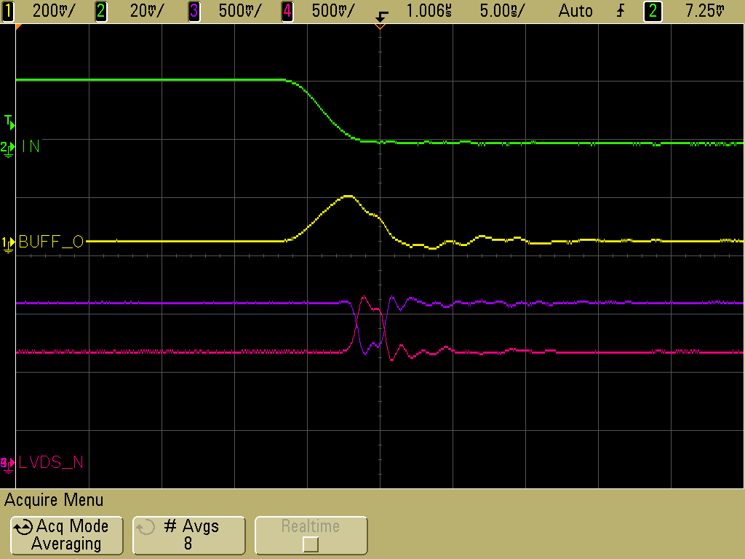
Architecture of front-end ASIC
Common threshold
Ch-0
Regulated Cascode Transimpedance Amplifier
Differential Amplifier
Comparator
LVDS output driver
LVDS_out0
Channel-0
8:1 Analog Multiplexer
Output Buffer
Amp_out
Channel-7
Ch-7
Regulated Cascode Transimpedance Amplifier
Differential Amplifier
Comparator
LVDS output driver
LVDS_out7

Slide 24
Testing of front-end board on RPC

Slide 25
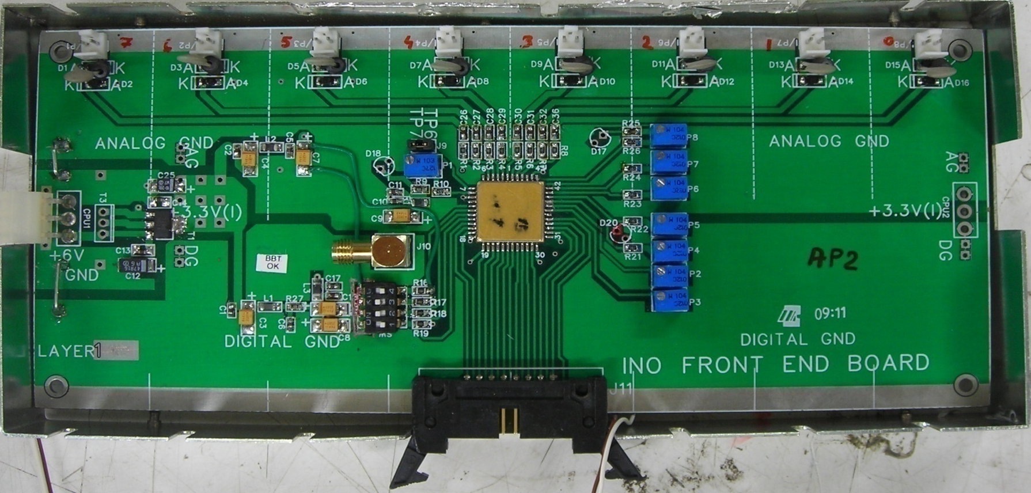
8-channel front-end board

Slide 26
Features of the front-end board
8 amplifier + discriminator channels
Gain = Output voltage/ Input current
Typical gain obtained with the test setup 4-5mV/μA
The designed gain was 8mV/μA; but reduced on board to contain instability
0.1μF capacitor is placed at input as RPC strips are terminated using 50Ω Resistors. Multiplexed buffered analog (inverted) output available
Buffered analog signal = ½ actual output (due to 50Ω termination)
Comparator threshold = Voltage@pin38 – Voltage@pin9
Discriminator output in LVDS logic (4mA)

Slide 27
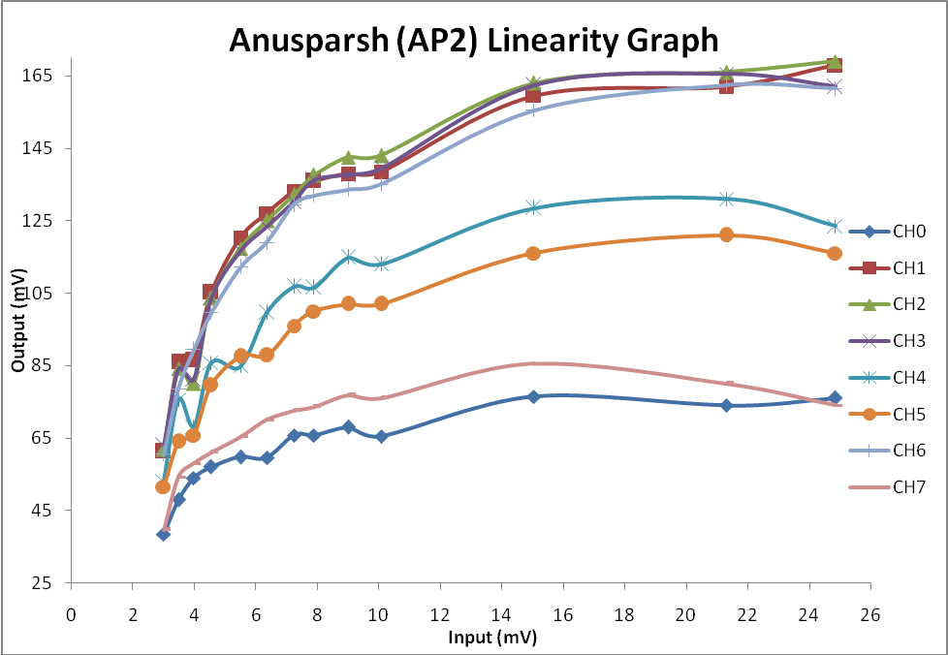
Linearity studies of the front-end board
Channel-to-channel gain variation is a concern

Slide 28
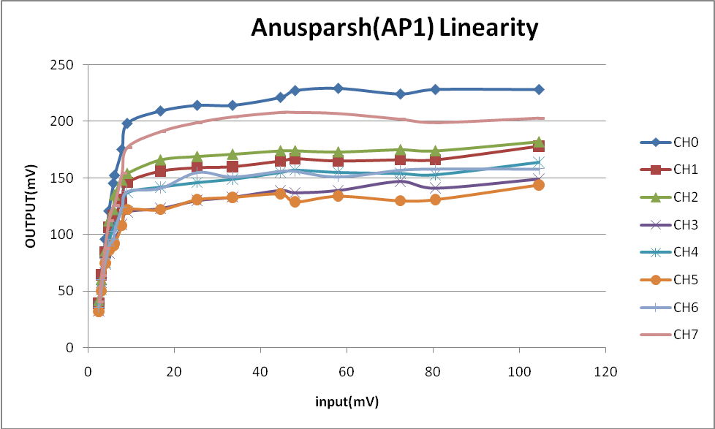
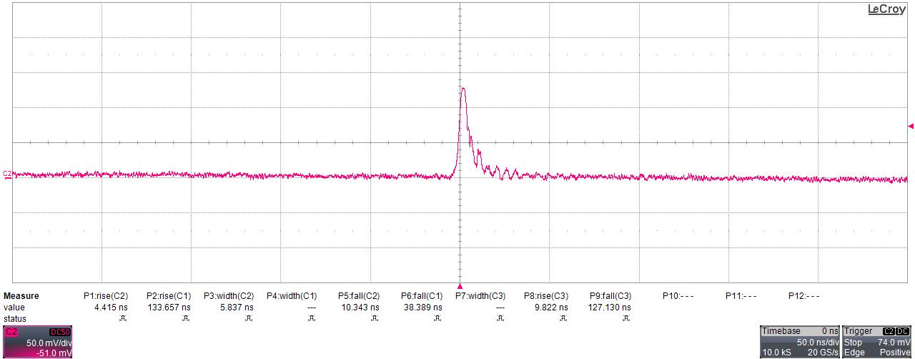
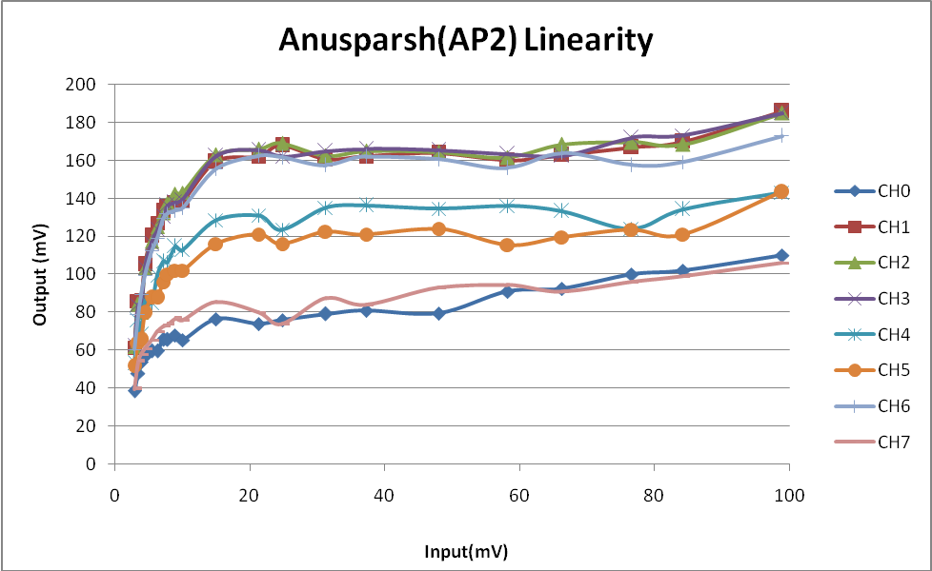
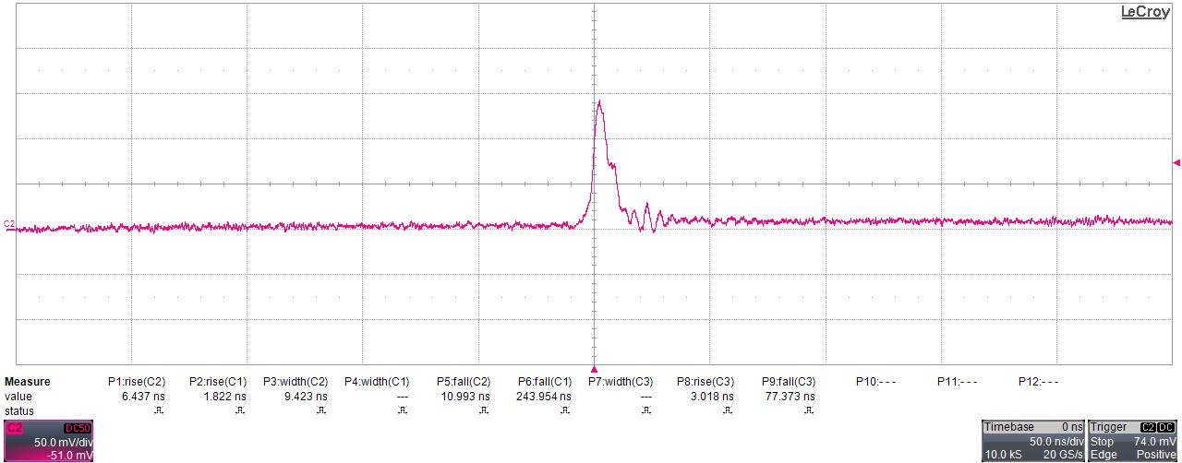
Testing of front-end boards with pulser
FEB - 1
FEB - 2

Slide 29
Work in progress and action plan
Study of amplifier gain and buffer output signal linearity using external pulser
Detailed study of threshold adjustment and its stability
Try finer threshold adjustment by connecting a 100KΩ resistor to either side of P2 trim-pot (which is100KΩ)
Calibration of threshold for RPC using noise rate and efficiency parameters
Integration of front-end board with RPC stack at TIFR
Revision of the chip
  Solve instability problem while the multiplexer is turned on
  Separate chips for positive and negative inputs as well as amplifier and discriminator might anyway solve this problem

Slide 30
Role of waveform sampler for ICAL
Walk correction of TDC data
Leading edge discriminator
Time over threshold information
Pulse profile, height and width monitoring
Remote display of RPC signals

Slide 31
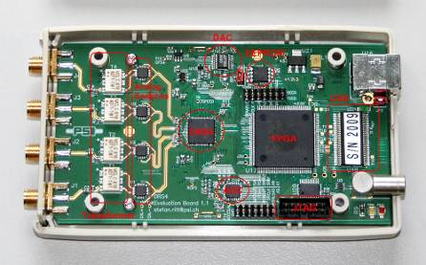
Specifications of DRS4 waveform sampler
8+1 channels, 1024 cells
700MSPS to 6 GSPS
2.5V supply, 140 to 320mW
Multiplexed or parallel output
Differential I/O (950MHz BW)
Maximum readout of 40MHz
Cascading of channels or chips allows deeper sampling depth

Slide 32
Proof of principle effort (RPC-DAQ)
Can be tested today on the RPC stacks
Front-end board with the current board’s form-factor, but using ASICs
RPC-DAQ board with:
  TDC
  Waveform sampler
  Strip-hit latch and rate monitor
  Controller + data transreceiver
  Firmware for the above
  Pre-trigger front-end
  TPH monitoring
  Pulse width monitoring
  Front-end control
  Signal buffering scheme
  and GP area or ports for accommodating new blocks
VME data concentrator module
Result: Complete readout chain is tested
Can we use this for RPC QC test stands or what?
Discussion meeting on ICAL Electronics SINP, Kolkata, April 29-30, 2011

Slide 33
Prototyping of RPC-DAQ module
Using IITM designed MSP430 board
Digital logic (rate scalers, latches etc.) in FPGA on a trainer kit
SPI interface between the two
Serial interface between the MSP board and the PC/host
Appropriate signal translators for the existing system
Will lead to a pilot RPC-DAQ board design

