Slide 1
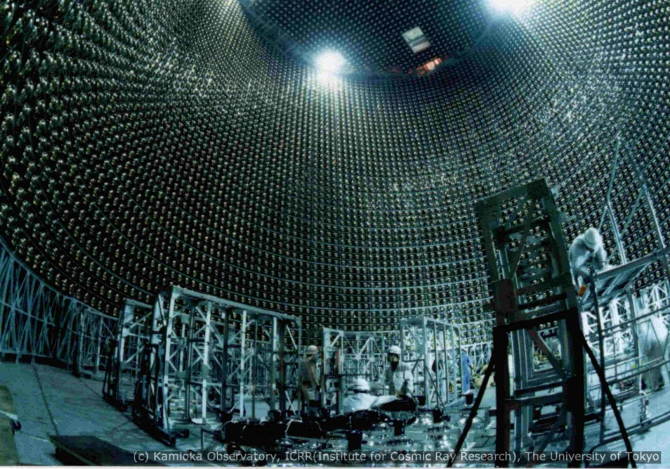
Mega Science of a Tiny Particle
Neutrino is the most tiny quantity of reality ever imagined by a human being.
Frederick Reines
Co-discoverer & Nobel Laureate
Dr. B.Satyanarayana
Department of High Energy Physics
Tata Institute of Fundamental Research, Mumbai
M: 09987537702, E: bsn@tifr.res.in, W: http://www.tifr.res.in/~bsn

Slide 2
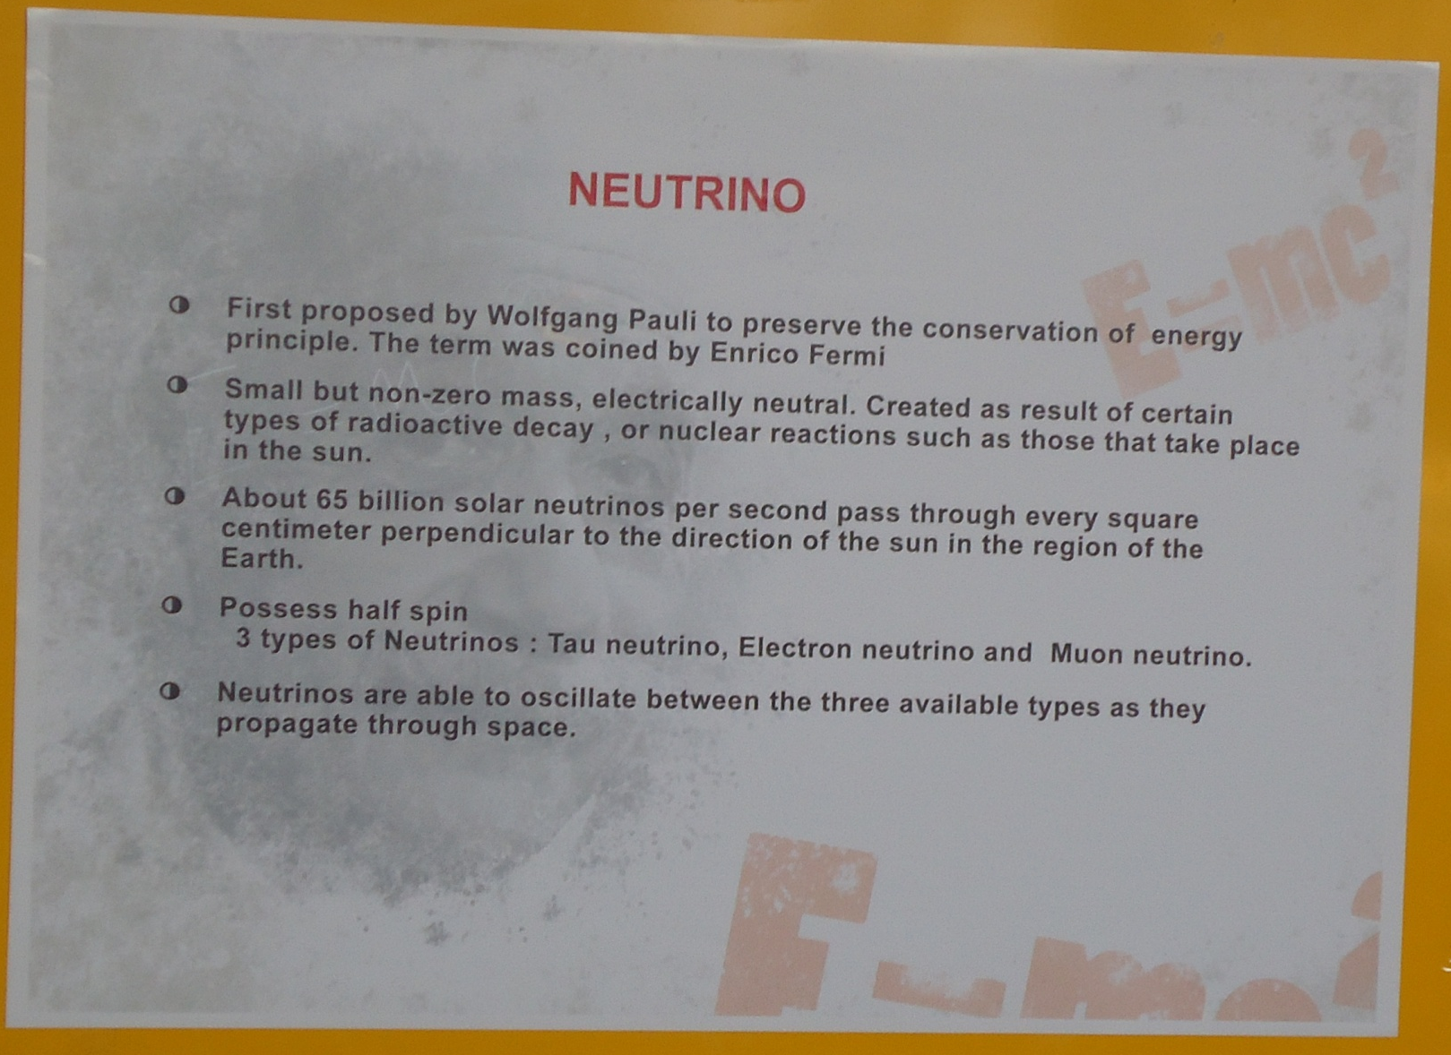
Poster in Vidyut’s Exhibition

Slide 3
Plan of the talk
Introduction to neutrino physics
Recent excitements in neutrino physics
India-based Neutrino Observatory (INO)
ICAL detector and its physics potential
Civil and mechanical engineering aspects
R&D on Resistive Plate Chambers (RPC)
Gas systems for ICAL detector
ICAL Electronics and Data acquisition systems
Networking and software requirements
Career opportunities in INO and TIFR
Closing remarks

Slide 4
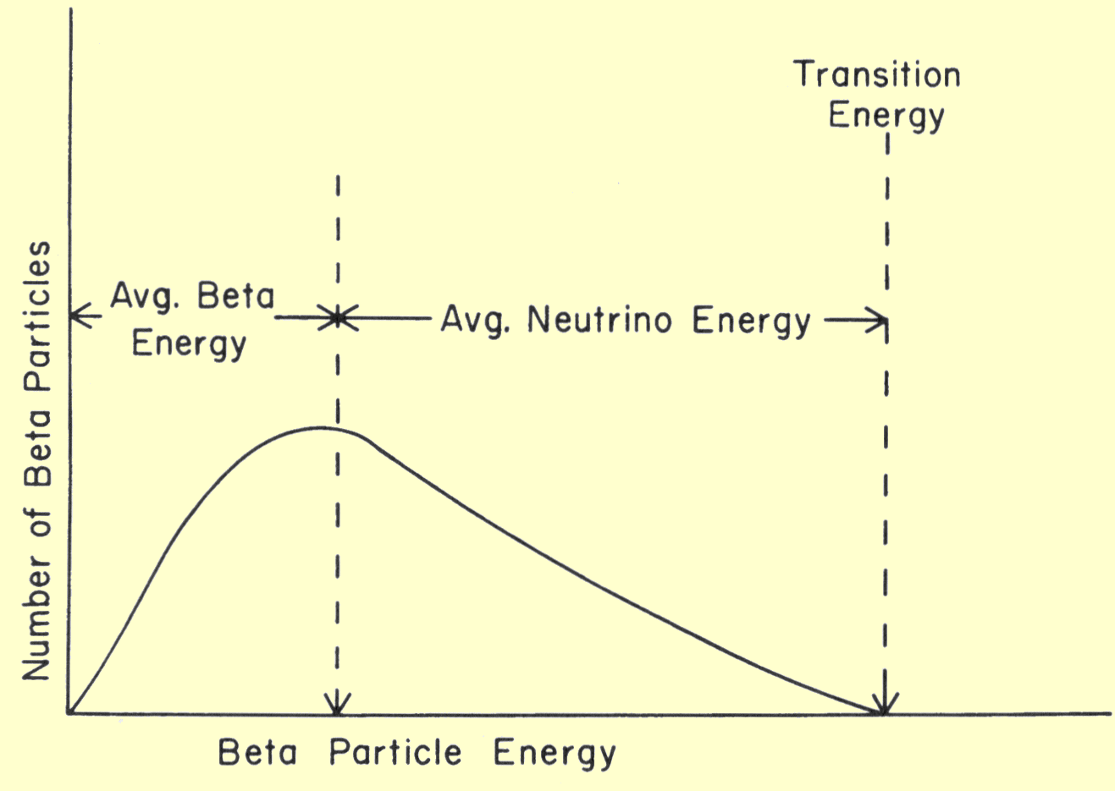
Neutrino (ν)
Proposed by Wolfgang Pauli in 1930 to explain beta decay.
Named by Enrico Fermi in 1931.
Discovered by F.Reines and C.L.Cowan in 1956.
Created during the Big Bang, Supernova, in the Sun, from cosmic rays, in nuclear reactors, in particle accelerators etc.
Interactions involving neutrinos are mediated by the weak force.
Available energy for the decay is shared between the β-particle and the (anti-) neutrino which goes undetected

Slide 5
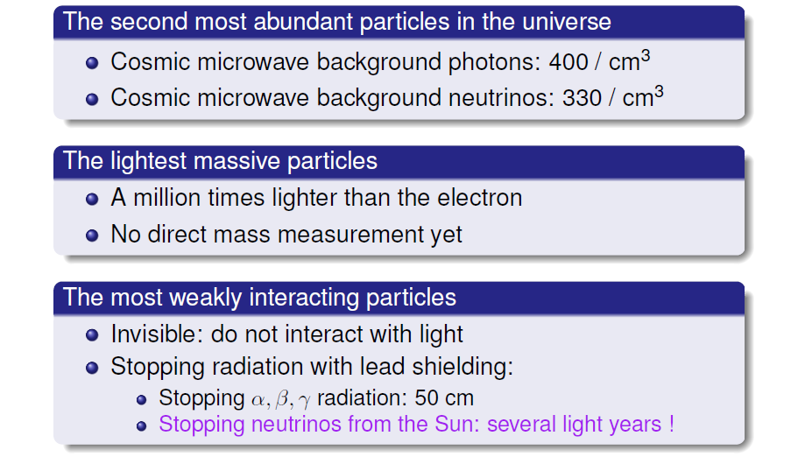
Unique features of neutrinos

Slide 6
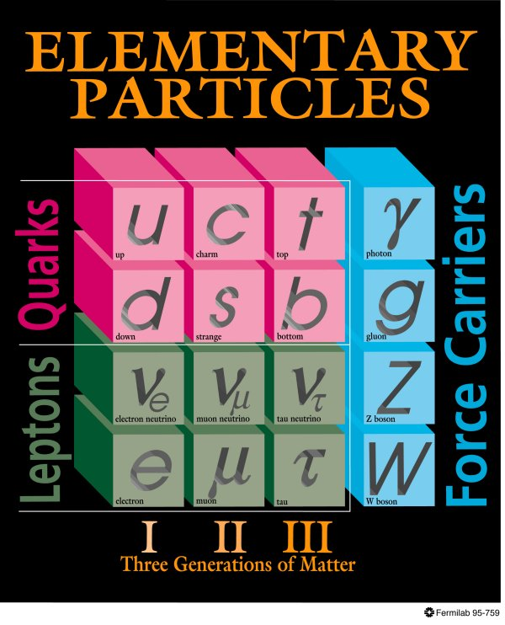
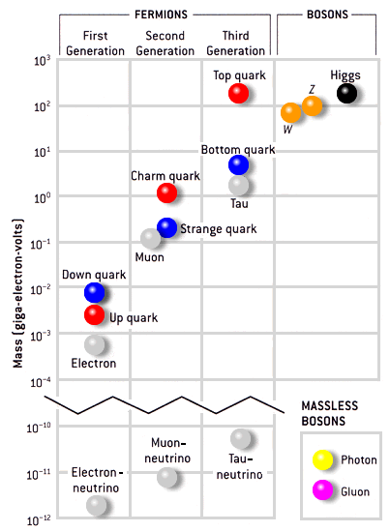
Standard model of particle physics
<2.2eV
<170keV
<15.5MeV

Slide 7
Neutrino oscillations
It is now known that neutrinos of one flavour oscillate to those of another flavour.
The oscillation mechanism is possible only if the neutrinos are massive.
Neutrino experiments are setting the stage for extension of Standard Model itself.
Massive neutrinos have ramifications on nuclear physics, astro physics cosmology, geo physics apart from particle physics
Electron and muon neutrinos (ν_{e} and ν_{μ}) are the flavour eigen states. They are super positions of the mass eigen states (ν₁ and ν₂)
If at t = 0, an eigen state ν (0) = ν_{e,} then any time t
Then the oscillation probability is
And the oscillation length is

Slide 8
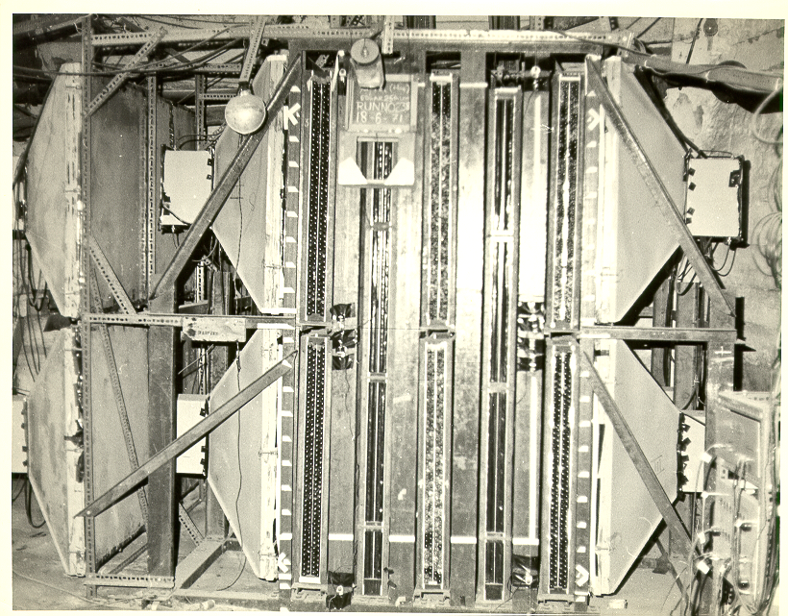
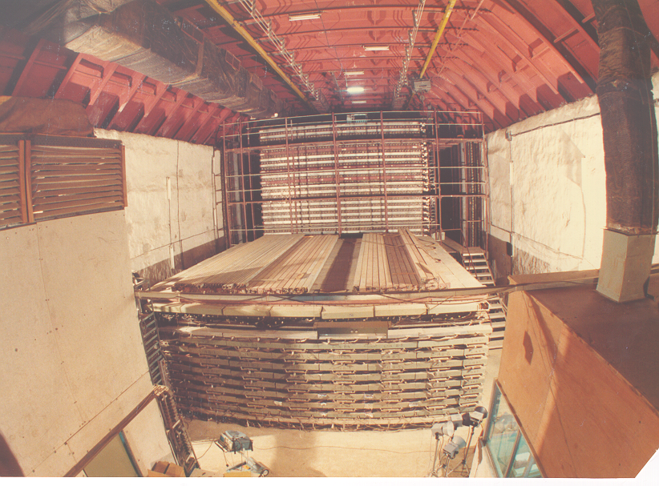
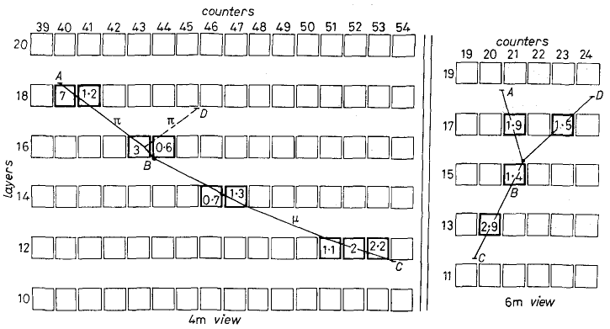
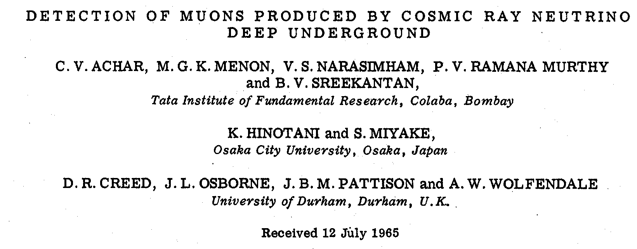
Tradition of underground physics
Atmospheric neutrino detector
at Kolar Gold Fields –1965
Proton decay experiments

Slide 9
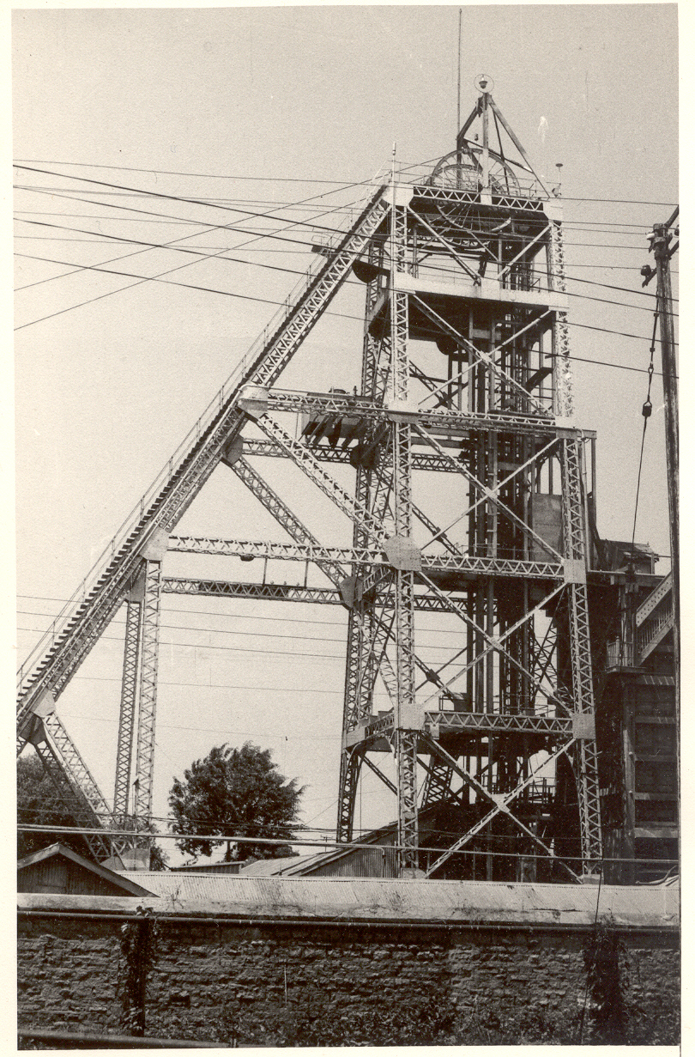
History of neutrino physics in India
High Energy Physics research using underground detectors at Kolar Gold Fields during 1952-92.
Muon intensities and angular distributions at various depths.
Indian initiative in neutrino physics goes back to more than 35 years.
Demonstrated for the first time the feasibility of doing neutrino experiment at KGF in south India.
International collaboration experiment to detect atmospheric neutrinos started at KGF in 1964.
Detection of atmospheric neutrino in 1965.
KGF data during the proton decay era was used to look for ultra high energy neutrino sources in the sky.
Bounds on neutrino masses using cosmological data.
Estimation of atmospheric neutrino flux.
KGF underground shaft

Slide 10
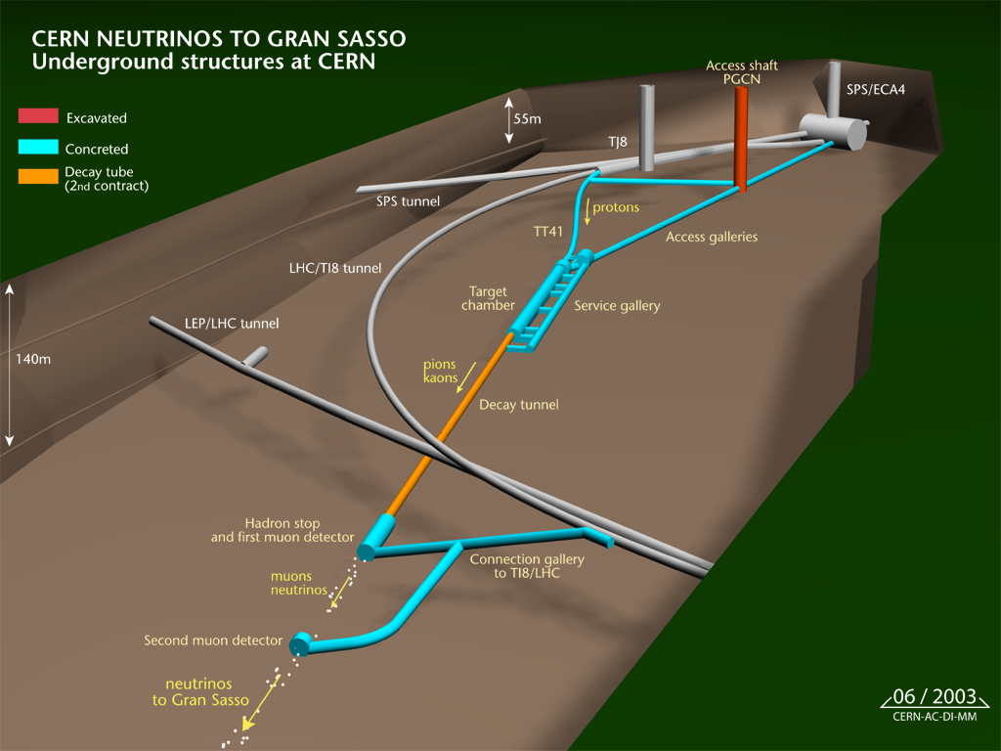
Artistic view of SPS/CNGS layout
Courtesy: OPERA Experiment

Slide 11
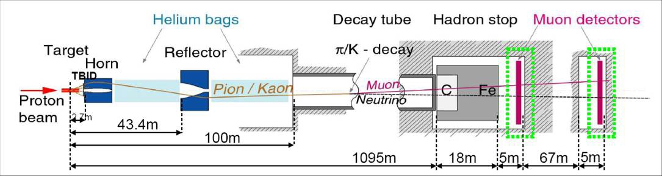
Layout of the CNGS beam line
Courtesy: OPERA Experiment
Baseline: 731.278km (measured with a precision of 20cm, geodesy campaign, GPS bench marks)
400GeV/c from SPS on graphite neutrino production target (average ν energy 17GeV)
Data recorded during 2009-2011, 10²⁰ protons, 15223 ν events
Early arrival time w.r.t. light: 57.8ns
Relative difference of ν_{μ} w.r.t. light, (v-c)/c: 2.37
Long bunch time structure: 10.5μs (separated by 50ms, total cycle is 6s long)
Reconfirmed results at single interaction level using short-bunch time-structure
Short-bunch time-structure: Four bunches, 3ns long, separated by 524ns, 4×10¹⁶ protons, 36 ν events

Slide 12
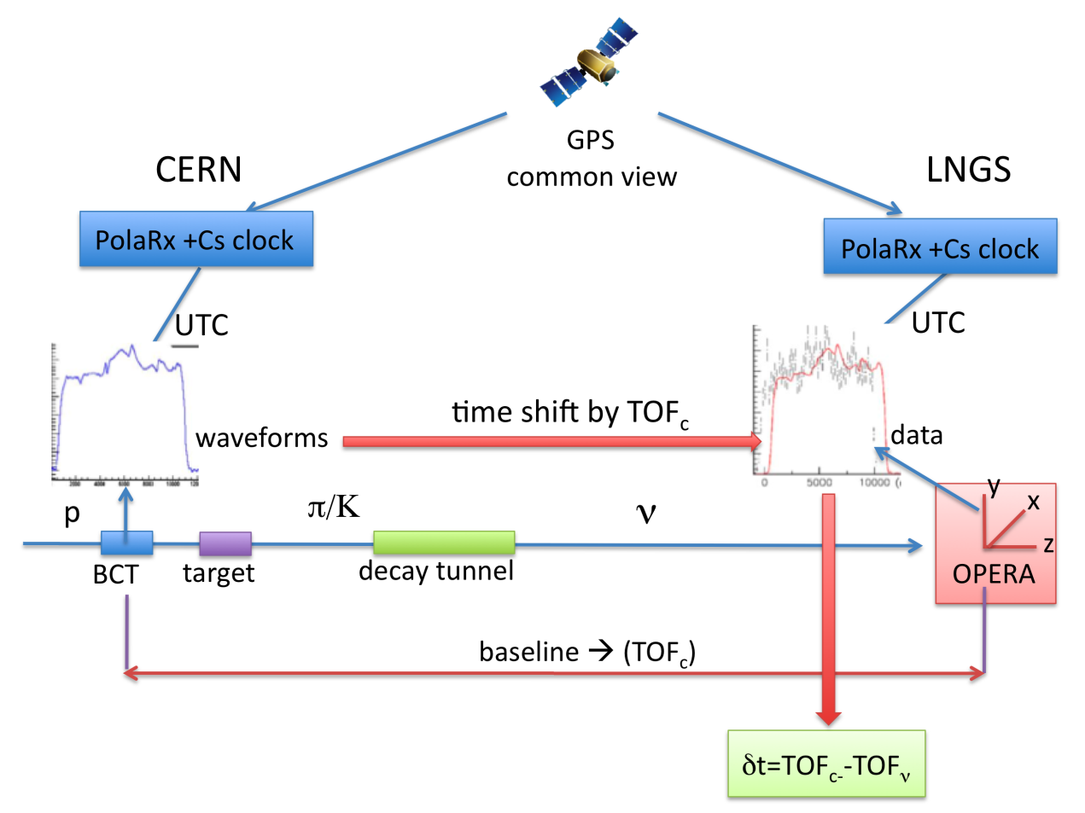
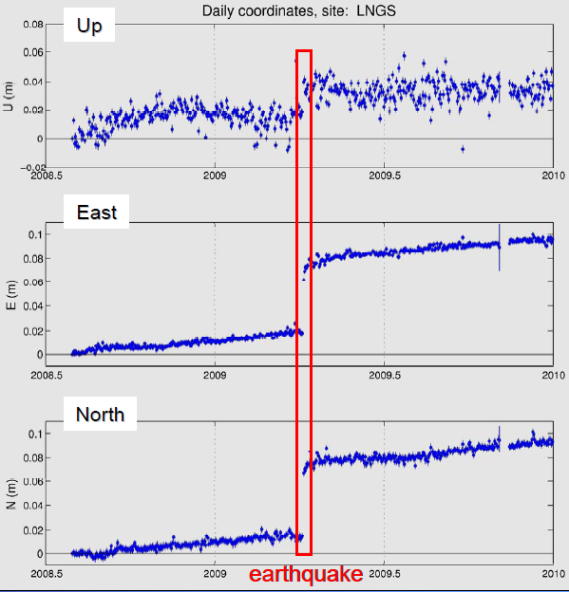
Precise time & distance measurement
Courtesy: OPERA Experiment
Earthquake April 2009, displacement 7cm

Slide 13
India-based Neutrino Observatory project
The primary goal of INO is neutrino physics.
A national collaboration of scientists from more than 20 groups belonging to DAE institutions, IITs and Universities.
The total cost of the project is expected to be about `1500 crores.
The project includes:
construction of an underground laboratory and associated surface facilities,
construction of a Iron Calorimeter (ICAL) detector for neutrinos,
setting up of National Centre for High energy Physics (NCHEP).
The project is expected to be completed within seven years beginning April 2012.
A successful INO-Industry interface developed because of the large scale of experimental science activity involved.
INO Graduate Training Programme under the umbrella of Homi Bhabha National Institute (HBNI) - a deemed-to-be University within DAE is in its fifth year.

Slide 14
Possible new proposals at INO
The INO facility will develop into a centre for other studies in physics, biology, geology, etc., which will exploit the special conditions existent deep underground.
Low energy accelerator for experimental nuclear astrophysics studies; utilising the low back-ground environment inside the INO facility.

Slide 15
National Centre for HEP (NCHEP)
To be setup in Madurai, close to the INO facility.
Human resource development in basic experimental science research.
Responsible for operation of the INO facilities.
Will develop full-fledged manpower to operate and maintain the INO laboratory.
Development of detector technology and its varied applications, such as in medical imaging, material science, industrial control and geological survey.

Slide 16
INO Collaboration
Spokesperson: N.K. Mondal, TIFR, Mumbai
Home page: http://www.ino.tifr.res.in
Ahmedabad: Physical Research Laboratory (PRL)
S. Goswami, A.S. Joshipura
Aligarh: Aligarh Muslim University (AMU)
S. Ahmed, M. Sajjad Athar, R. Hasan, S.K. Singh
Allahabad: Harish Chandra Research Institute (HRI)
S. Choubey, R.Gandhi, A.Raychaudhuri
Calicut: University of Calicut (UC)
B.R.S. Babu, A.M. Vinodkumar
Chandigarh: Panjab University (PU)
V.K. Bhandari, V. Bhatnagar, M.M. Gupta, A. Kumar, J.S. Shahi, B. Singh,
J.B. Singh
Chennai: Indian Institute of Technology, Madras (IITM)
N. Chandrachoodan, N. Krishnapurna, J. Libby, A. Prabhakar
Chennai: The Institute of Mathematical Sciences (IMSc)
D. Indumathi, H.S. Mani, M.V.N. Murthy, G. Rajasekaran, N.Sinha
Delhi: Delhi University (DU)
S.K. Chamoli, B.C. Choudhary, D. Choudhury, D. Kaur, A. Kumar,
S. Kumar, S. Mandal, Md. Naimuddin, Shahnawaz, S. Verma, S.K. Verma
Guwahati: Indian Institute of Technology (IITG)
B.Bhuyan, P. Paulose, A. Sil
Hawaii (USA): University of Hawaii (UHW)
S. Pakvasa
Indore: Indian Institute of Technology (IITI)
S. Rakshit
Jammu: University of Jammu (JU)
A. Bhasin, A. Gupta, R. Gupta, S. Mahajan, S.S. Sambyal
Kalpakkam: Indira Gandhi Center for Atomic Research (IGCAR)
J. Jayapandian, C.S. Sundar
Kolkata: Ramakrishna Mission Vivekananda University (RMVU)
Abhijit Samanta
Kolkata: Saha Institute of Nuclear Physics (SINP)
P. Bhattacharya, S. Bhattacharya, Kamales Kar, D. Majumdar, S. Saha
Kolkata: University of Calcutta (CU)
S. Bandyopadhyay, A. Banerjee, D. Jana, G. Gangopadhyay
Kolkata: Variable Energy Cyclotron Centre (VECC)
R.K. Bhandari, S. Chattopadhyay, A.K. Dubey, S.A. Khan, S. Muhuri,
T.K. Nayak, S. Saha, J. Saini, P.R. Sarma, R.N. Singaraju, V. Singhal,
S.K. Thakur, Y.P. Viyogi
Lucknow: Lucknow University (LU)
Jyotsna Singh
Madurai: American College (AC)
S.P.M. Deborrah, K. Gnanasekar, S.R. Inbanathan, K. Moorthy
Mumbai: Bhabha Atomic Research Centre (BARC)
V. Arumugam, Anita Behere, M.S. Bhatia, V.B. Chandratre, V.M. Datar,
M.P. Diwakar, G. Gouthaman, Suresh Kumar, P.K. Mukhopadhyay,
L.M. Pant, B.J. Roy, K. Srinivas, V. Sugadan
Mumbai: Indian Institute of Technology, Bombay (IITB)
Basanta Nandi, S. Uma Sankar, Raghav Varma
Mumbai: Tata Institute of Fundamental Research (TIFR),
B.S. Acharya, S. Banerjee, M.Bhuyan, A. Dighe, K.S. Gothe,
S.D. Kalmani, S. Lahamge, G.Majumder, N.K. Mondal, P. Nagaraj,
B.K. Nagesh, S.K. Rao, L.V. Reddy, A. Redij, D. Samuel, M. Saraf,
B. Satyanarayana, S. Upadhya, P. Verma
Mysore: University of Mysore (MU)
S. Krishnaveni, C. Ranganathaiah, H.B. Ravikumar
Sambalpur: Sambalpur University (SU)
S. N. Nayak
Srinagar: University of Kashmir (UK)
W. Bari, N. Iqbal
Varanasi: Banaras Hindu University (BHU)
B.K. Singh, C.P. Singh, V. Singh

Slide 17
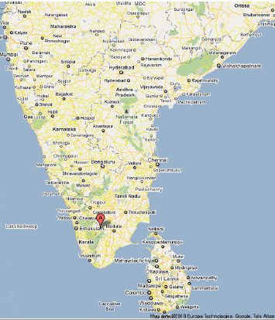
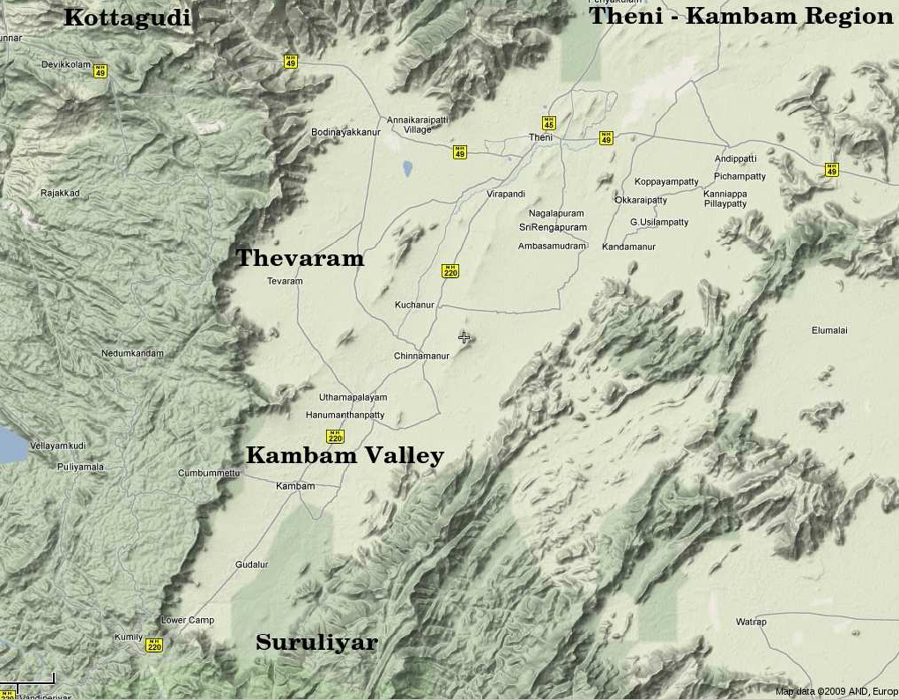
INO coming soon: Inside a mountain near you!
Location: 9º58′ North; 77º16′ East, 110km from Madurai (South India)

Slide 18
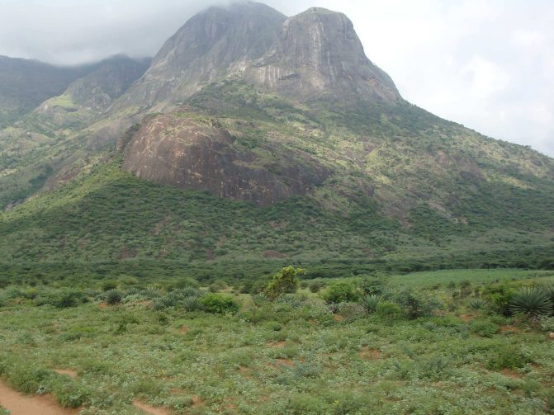
INO coming soon: Inside a mountain near you!
Location: 9º58′ North; 77º16′ East, 110km from Madurai (South India)
Site for INO underground facility

Slide 19
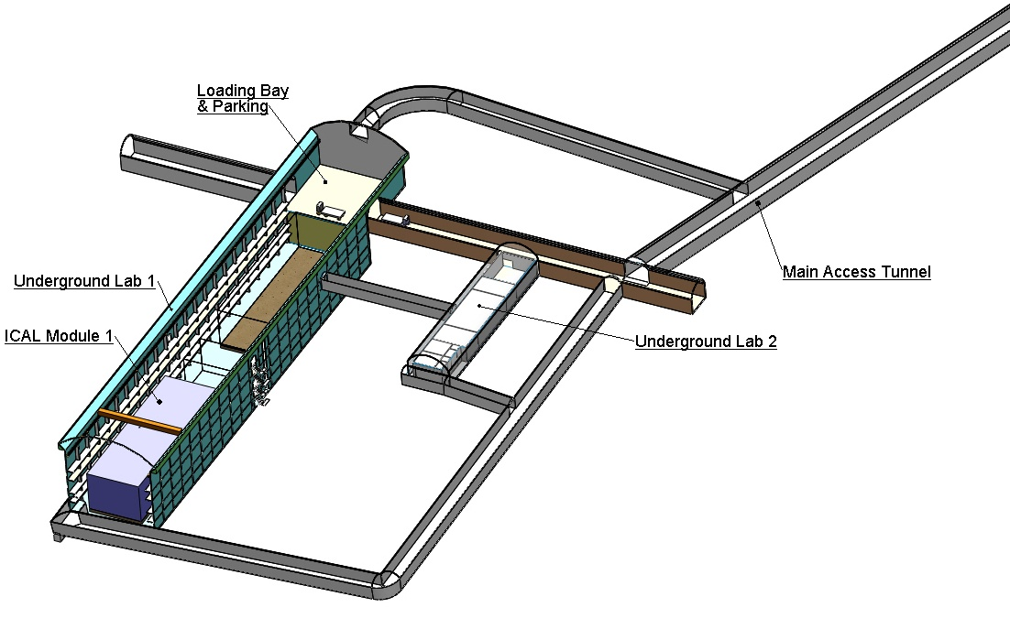
Schematic of the underground labs
Basic features
Length of the tunnel | 2.1 km (approx.)
Tunnel cross-section | 7.5m wide and 7.5m high
Tunnel gradient | 1:15
Rock overburden | 1300m (4000 mwe)
Rock type and density | Charnockite, 2.9 gm/cc
Number of caverns | 3 (one big and two small)
Size of the main cavern | 132m × 26m × 20m (high)
Distance from CERN | 7100 km
Distance from JPARC | 6600 km
Future nuclear reactor | 9000 Mwe, 205 km

Slide 20
Neutrino sources and detector choice
Source of neutrinos
Use atmospheric neutrinos as source
Need to cover a large L/E range
Large L range
Large E_{ν} range
Upto 20 GeV muons contained in fiducial volume; most interesting region for observing matter effects in 2–3 sector is 5–15 GeV
ICAL is sensitive to muons only, very little sensitivity to electrons; Electrons leave few traces (radiation length 1.8 (11) cm in iron (glass))
Physics driven detector requirements
Should have large target mass (50-100 kT)
Good tracking and energy resolution (tracking calorimeter)
Good directionality, up/down discrimination (< 1 nSec time resolution)
Nearly 4π coverage in solid angle (except near horizontal)
Good charge identification capability (magnetic field ∼1.5 Tesla)
Modularity and ease of construction (3 modules of ~17 kTons each)
Compliment capabilities of existing and proposed detectors
Use magnetised iron as target mass and RPC as active detector medium

Slide 21
Physics possibilities with ICAL
ICAL detector is expected to play a significant and pioneering role in the global experimental particle physics program over the next several decades.
ICAL is capable of shedding light on the neutrino mass hierarchy, or the ordering of neutrino masses, due to its unique capability to identify lepton charge.
Determining the hierarchy would be a crucial pointer to the physics that lies beyond the Standard Model.
ICAL can significantly aid in improving the precision of the atmospheric mass squared difference and the associated mixing angle.
Using effects primarily due to earth's matter, it can also shed light on the octant of the atmospheric mixing angle.
ICAL's capability to set bounds on the violation of CPT has also been explored.
Its sensitivity to new long range forces has been studied.
ICAL is capable of substantially adding to our present knowledge of very high energy cosmic ray muons due to its unique capability to access hitherto unexplored energy regions in this sector.
Several studies have also explored ICAL's capabilities as an end detector for a neutrino factory or a beta beam. This would allow precise measurements of very important parameters like the CP phase and the small mixing between two of the neutrino mass states.
Extensive simulation studies are under progress to refine and sharpen the physics capabilities ICAL.

Slide 22
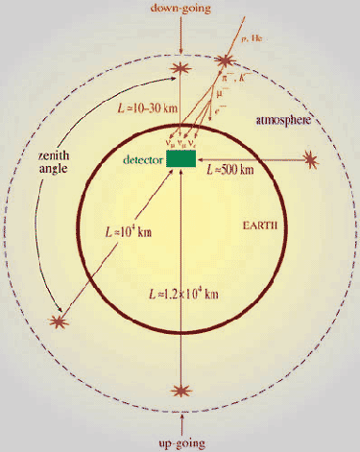
Up-Down asymmetry measurement
Atmospheric neutrino energy > 1.3GeV Δm² ~2-3×10⁻³ eV²
Downward muon neutrino are not affected by oscillation
They may constitute a near reference source
Upward neutrino are instead affected by oscillation since the L/E ratio ranges up to 10⁴ Km/GeV
They may constitute a far source
Thus, oscillation studies with a single detector and two sources

Slide 23
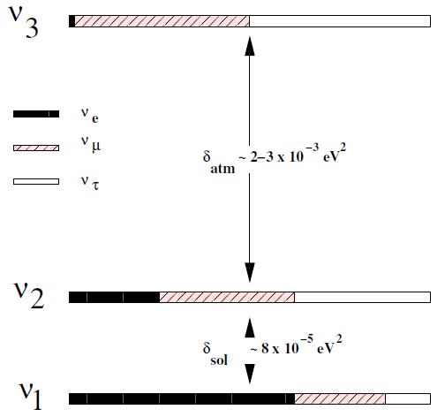
Matter effects and neutrino mass hierarchy
Matter effects help to cleanly determine the sign of the Δm²
Neutrinos and anti-neutrinos interact differently with matter
ICAL can distinguish this by detecting charge of the produced muons, due to its magnetic field
Helps in model building for neutrino oscillations

Slide 24
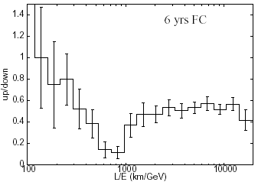
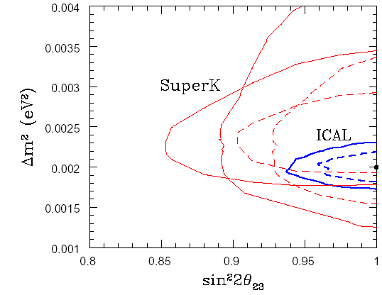
Using atmospheric neutrinos
Up/down ratio of fully contained muon events as a function of L/E obtained from GEANT simulated data for 6 years exposure at INO.
Exclusion plot of Δm² and sin² 2θ₂₃ from ICAL and its comparison with the Super Kamiokande experiment results

Slide 25
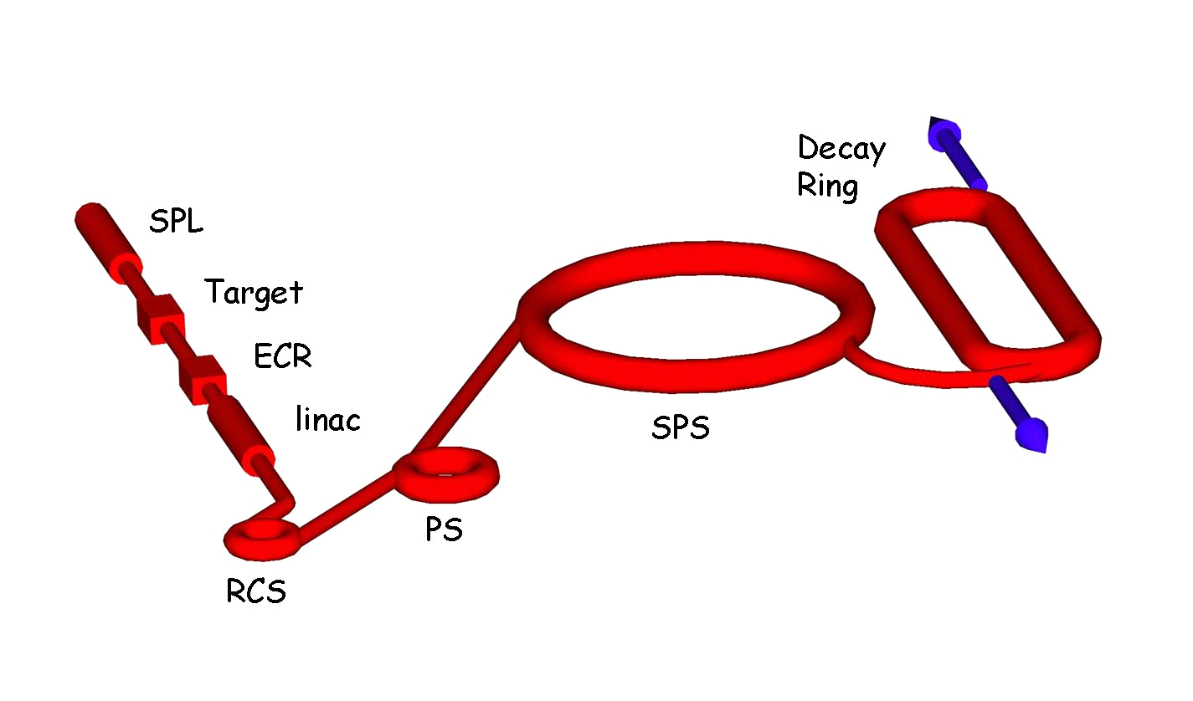
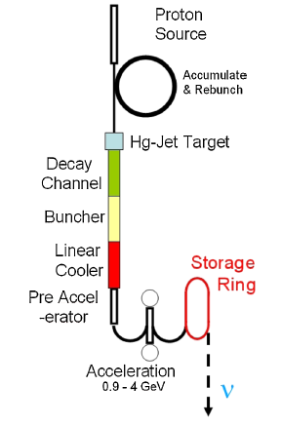
Accelerator-produced neutrinos
Beta Beam facility is based on decays of a stored beam of beta-unstable ions. Produces low energy neutrinos.
Neutrino Factory is based on the decays of a stored muon beam.
Produces high energy neutrinos. Precursor to eventual Muon Collider.
Superbeam facility is based on the decays of an intense pion beam.

Slide 26
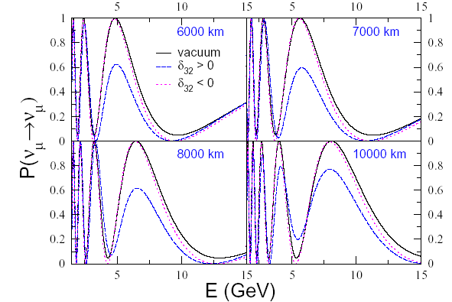
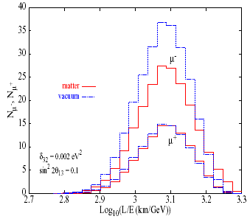
Using long-baseline neutrinos
The muon neutrino survival probability in vacuum and in matter for both signs of Δ₂₃ plotted against the neutrino energy for different values of baseline lengths
Μ± event rates for the normal mass hierarchy and an exposure of 1000 kton year for a restricted choice of L and E range

Slide 27
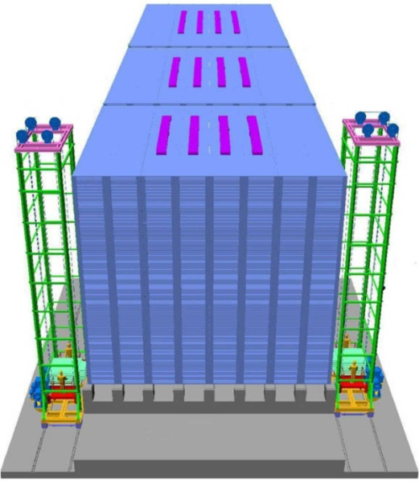
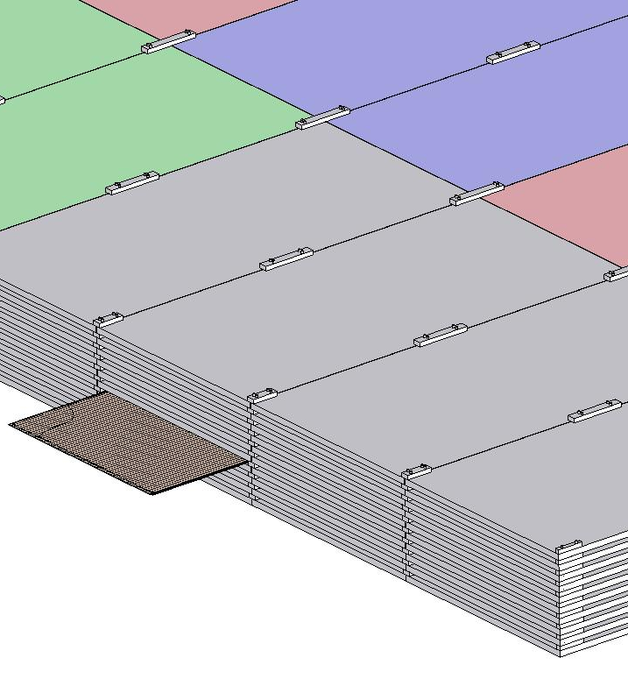
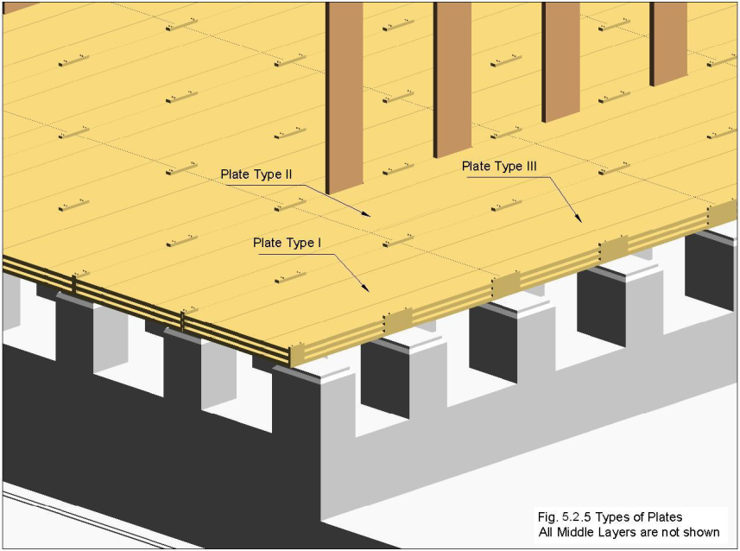
ICAL detector and construction
Magnet coils
4000mm×2000mm
×56mm low carbon iron sheets
RPC handling trolleys
RPC
Total weight: 50Ktons

Slide 28
Factsheet of ICAL detector
No. of modules | 3
Module dimensions | 16m × 16m × 14.5m
Detector dimensions | 48.4m × 16m × 14.5m
No. of layers | 150
Iron plate thickness | 56mm
Gap for RPC trays | 40mm
Magnetic field | 1.3Tesla
RPC dimensions | 1,950mm × 1,840mm × 24mm
Readout strip pitch | 3 0mm
No. of RPCs/Road/Layer | 8
No. of Roads/Layer/Module | 8
No. of RPC units/Layer | 192
No. of RPC units | 28,800 (97,505m²)
No. of readout strips | 3,686,400

Slide 29
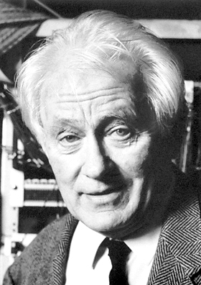
Science and Instrumentation
The Nobel Prize in Physics 1992 was awarded to Georges Charpak "for his invention and development of particle detectors, in particular the multi-wire proportional chamber".
“The discoveries of the W and Z bosons at CERN, the charm quark at SLAC and Brookhaven and the top quark at Fermilab would not have been possible without this type of detector, and current research in high energy physics continues to depend on these devices”.
Georges Charpak (1924–2010)

Slide 30
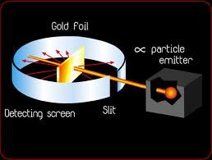
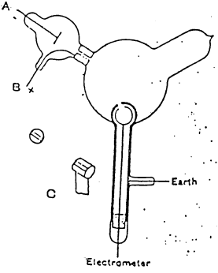
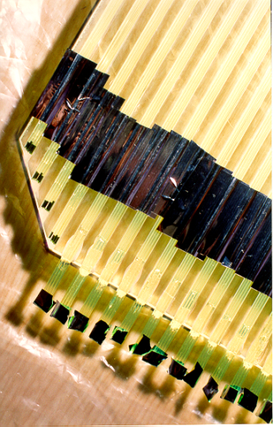
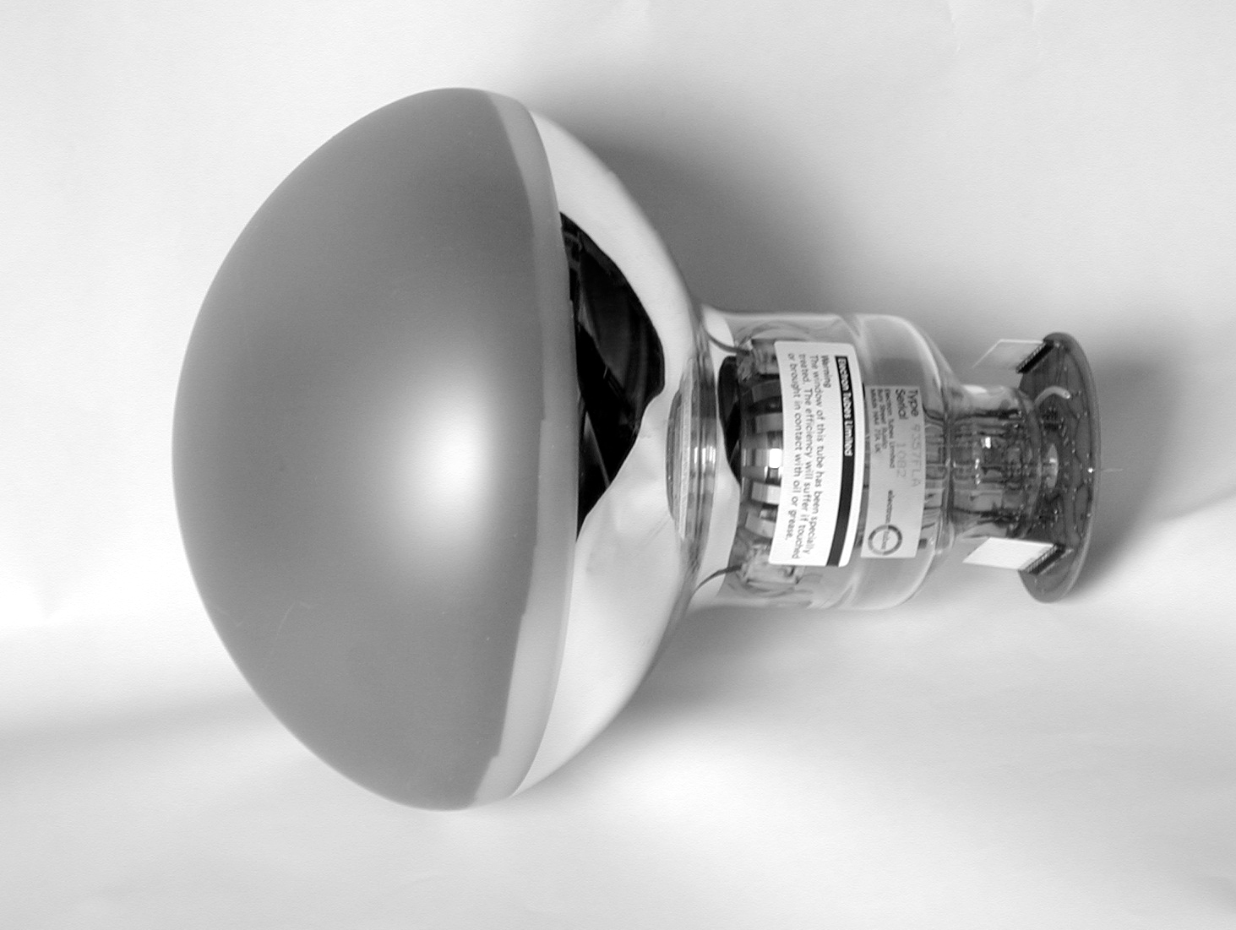
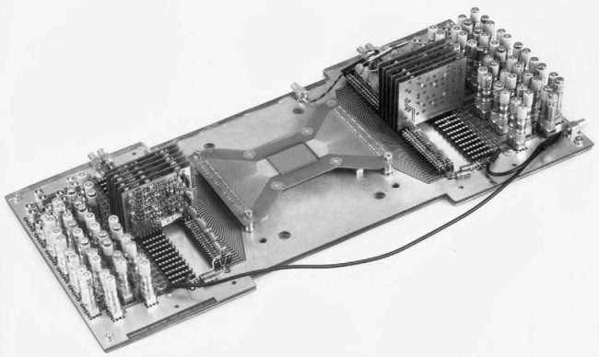
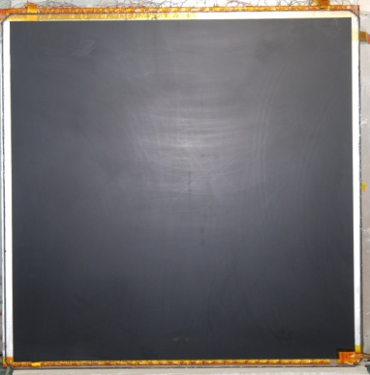
Detectors aided major discoveries
Crookes Tubes: Sir William Crookes (1869-75)
Cloud chamber: Charles Thomas Rees Wilson (1894), Nobel Prize in Physics (1927)
Electron: J.J.Thomson (1897) using Crookes Tubes
“Gold foil apparatus”: Hans Geiger & Ernest Marsden (1909)
Proton: E.Rutherford (1911) using “Gold foil apparatus”
Photon: A.Compton (1923)
Neutron: J.Chadwick (1932)
Positron: C.Anderson (1932)
Muon: C.Anderson & S.Neddermeyer (1937)
Neutral Kaon: G.Rochester & C.Butler (1947) using cloud chamber triggered by Geiger counters
Charged Pion: C.Powell (1947) using photographic emulsions carried aloft by balloons
Lambda: (1947)
Neutral Pion: R.Bjorkland (1949)
Bubble chamber : D.Glaser (1952), Nobel Prize in Physics (1960)
Synchrotron: (1952)
Xi minus: R.Armenteros (1952)
Sigma plus: G.Tomasini (1953) using emulsion technique
Sigma minus: W.Fowler (1953)
Antiproton: W.Segrè (1955)
Antineutron: B.Cork (1956)
MOS transistors: Kahng & Atalla (1960), electronic counters
Multi-Wire Proportional Counter: G.Charpak (1968), Nobel Prize in Physics (1992)
Time Projection Chamber: D.R.Nygren (1974)
Charm quark: SLAC & BNL collaborations (1974)
Super Proton Synchrotron: John Adams et al (1976)
Stochastic cooling: Van der Meer, Nobel Prize in Physics (1984)
Large area (20”) PMT: Hamamatsu (1980)
Resistive Plate Chamber: R.Santonico (1981)
W & Z bosons: UA1 and UA2 collaborations (1983)
Micro Strip Gas Chamber: A.Oed (1988)
Top quark: D0 & CDF collaborations (1995)
Gas Electron Multiplier: F.B.Sauli (1996)
Neutrino oscillation: Super-Kamiokande Collaboration (1998)

Slide 31
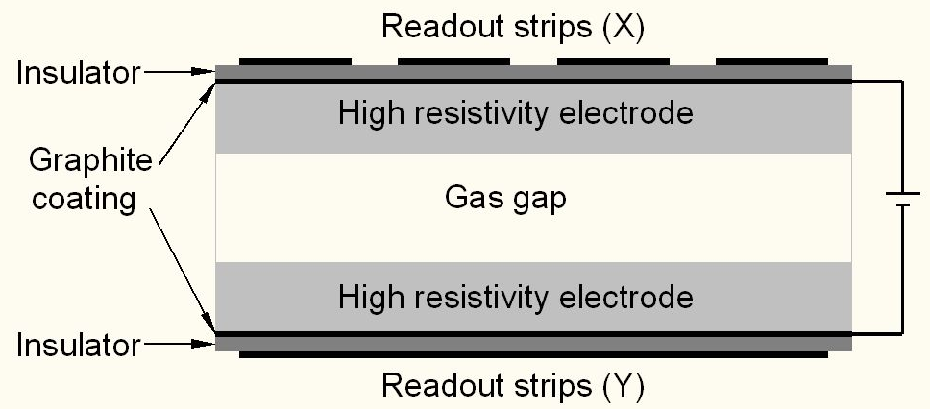
Schematic of a basic RPC

Slide 32
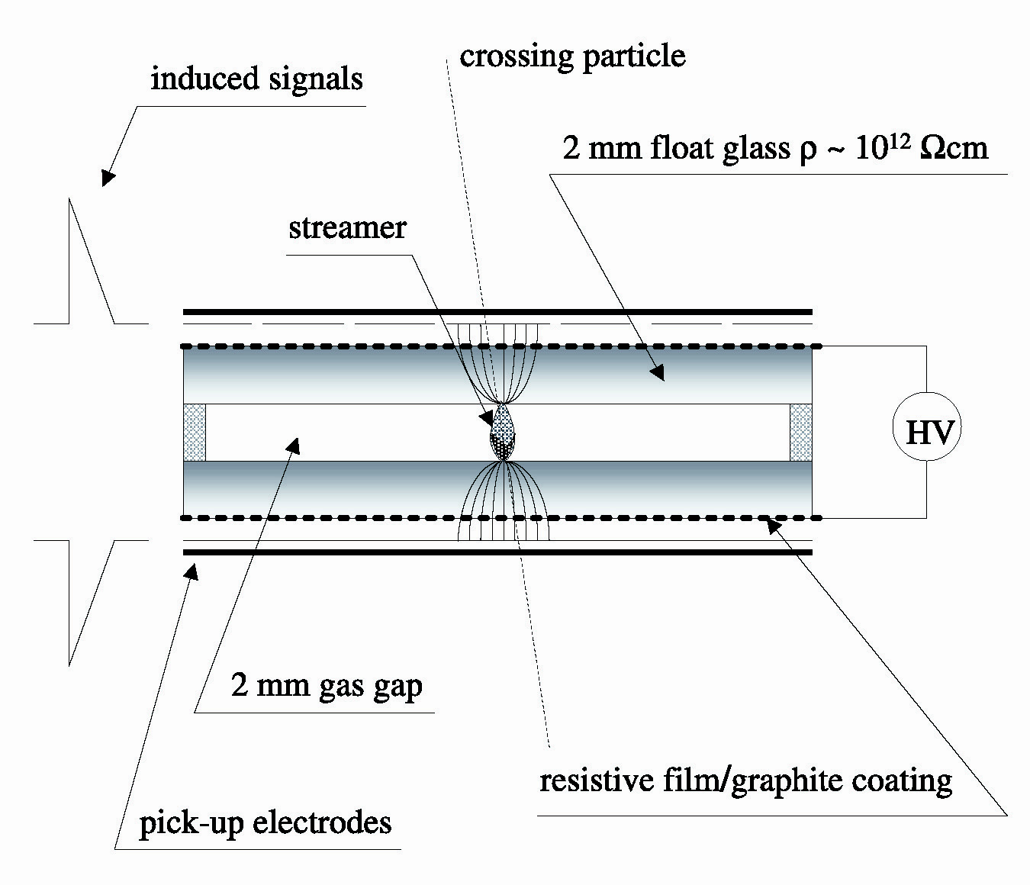
Schematic of a basic RPC
3

Slide 33
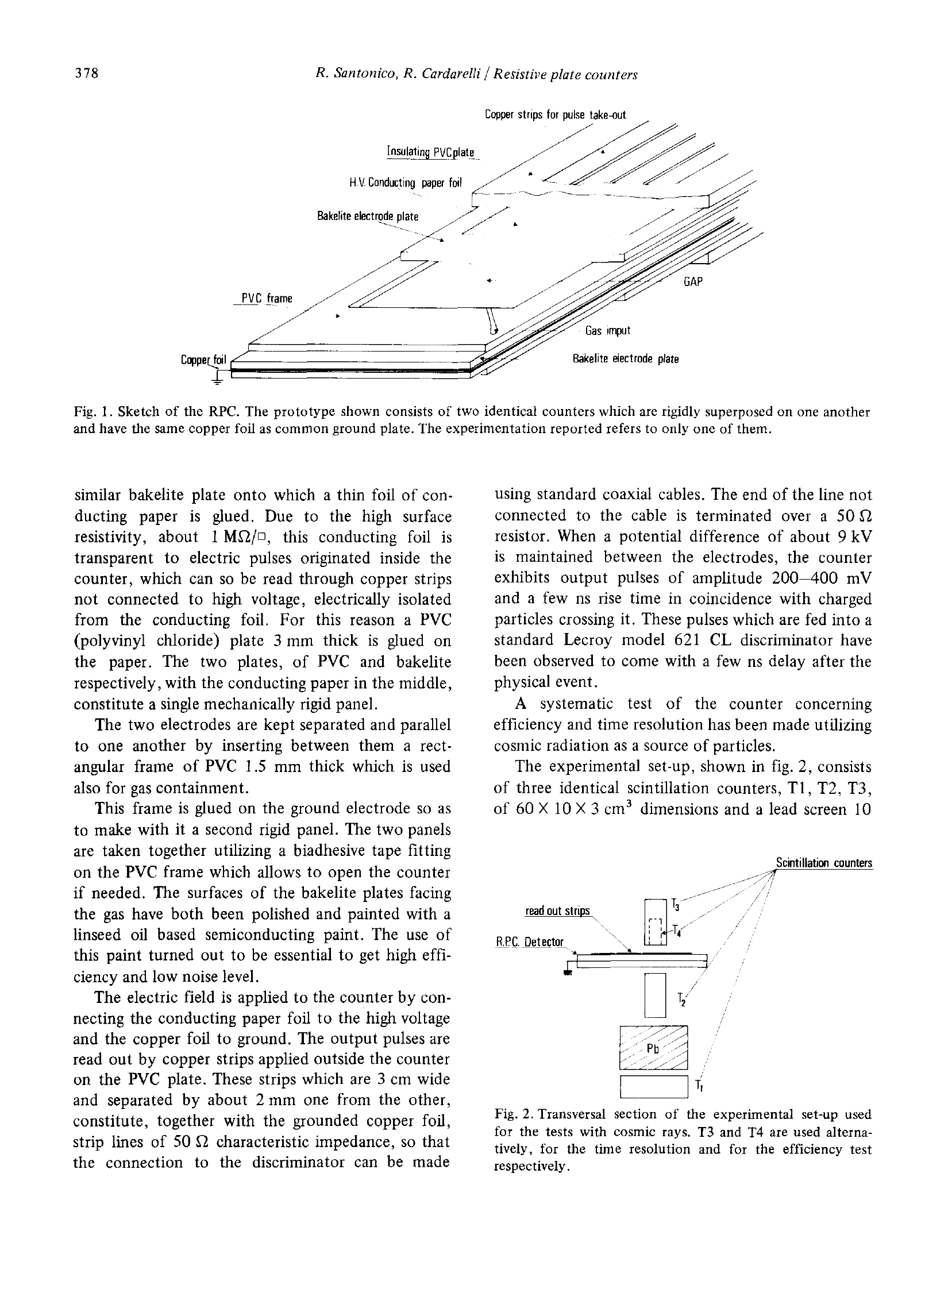
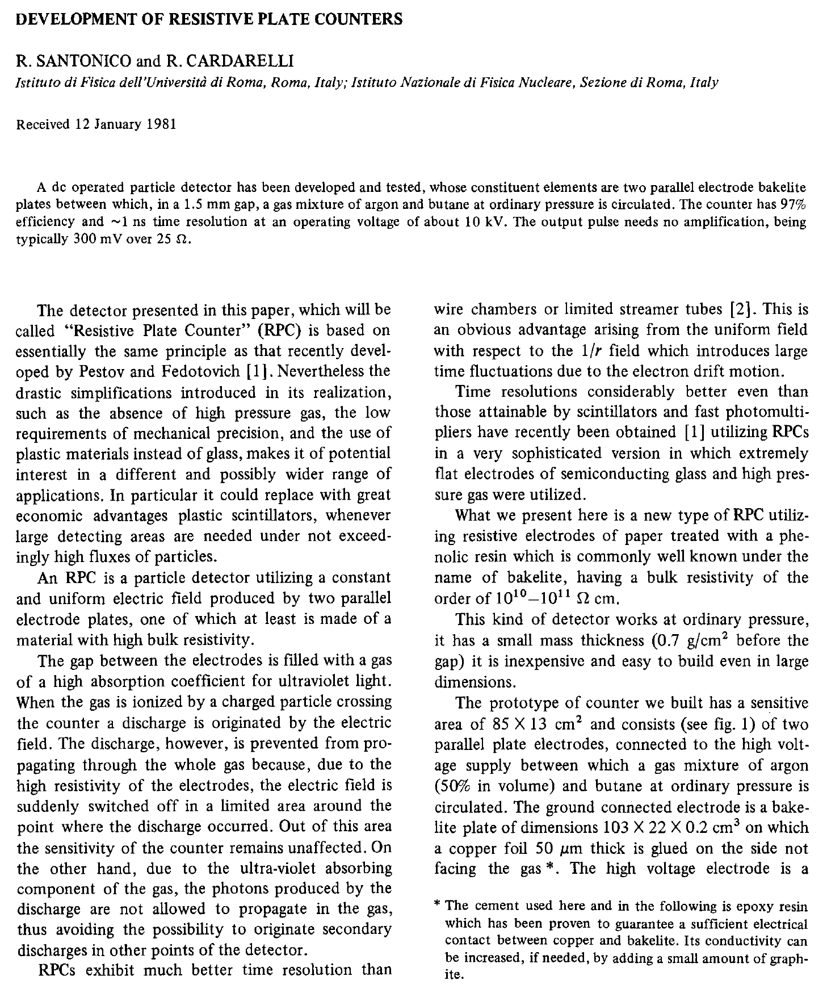
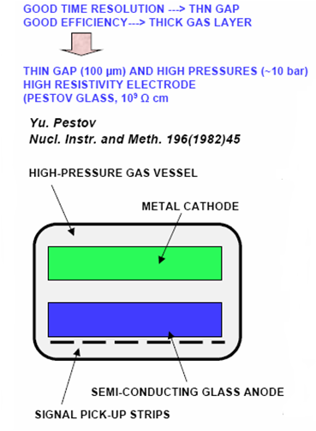
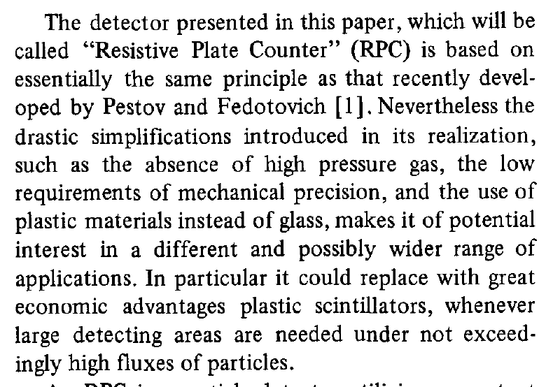
Birth of the RPC

Slide 34
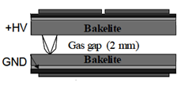
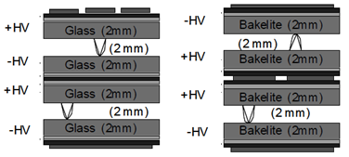
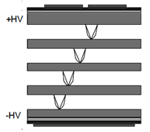
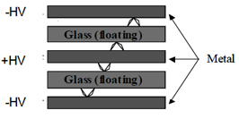
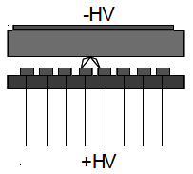
Application driven RPC designs
Single gap RPC
Double gap RPC
Multi gap RPC
Hybrid RPC
Micro RPC

Slide 35
Why ICAL chose RPC?
Large detector area coverage, thin (~10mm), small mass thickness
Flexible detector and readout geometry designs
Solution for tracking, calorimeter, muon detectors
Trigger, timing and special purpose design versions
Built from simple/common materials; low fabrication cost
Ease of construction and operation
Highly suitable for industrial production
Detector bias and signal pickup isolation
Simple signal pickup and front-end electronics; digital information acquisition
High single particle efficiency (>95%) and time resolution (~1nSec)
Particle tracking capability; 2-dimensional readout from the same chamber
Scalable rate capability (Low to very high); Cosmic ray to collider detectors
Good reliability, long term stability
Under laying Physics mostly understood!

Slide 36
Deployment of RPCs in running experiments
Experiment | Area (m²) | Electrodes | Gap(mm) | Gaps | Mode | Type
PHENIX | ? | Bakelite | 2 | 2 | Avalanche | Trigger
NeuLAND | 4 | Glass | 0.6 | 8 | Avalanche | Timing
FOPI | 6 | Glass | 0.3 | 4 | Avalanche | Timing
HADES | 8 | Glass | 0.3 | 4 | Avalanche | Timing
HARP | 10 | Glass | 0.3 | 4 | Avalanche | Timing
COVER-PLASTEX | 16 | Bakelite | 2 | 1 | Streamer | Timing
EAS-TOP | 40 | Bakelite | 2 | 1 | Streamer | Trigger
STAR | 50 | Glass | 0.22 | 6 | Avalanche | Timing
CBM TOF | 120 | Glass | 0.25 | 10 | Avalanche | Timing
ALICE Muon | 140 | Bakelite | 2 | 1 | Streamer | Trigger
ALICE TOF | 150 | Glass | 0.25 | 10 | Avalanche | Timing
L3 | 300 | Bakelite | 2 | 2 | Streamer | Trigger
BESIII | 1200 | Bakelite | 2 | 1 | Streamer | Trigger
BaBar | 2000 | Bakelite | 2 | 1 | Streamer | Trigger
Belle | 2200 | Glass | 2 | 2 | Streamer | Trigger
CMS | 2953 | Bakelite | 2 | 2 | Avalanche | Trigger
OPERA | 3200 | Bakelite | 2 | 1 | Streamer | Trigger
YBJ-ARGO | 5630 | Bakelite | 2 | 1 | Streamer | Trigger
ATLAS | 6550 | Bakelite | 2 | 1 | Avalanche | Trigger
ICAL | 97,505 | Both | 2 | 1 | Both | Trigger

Slide 37
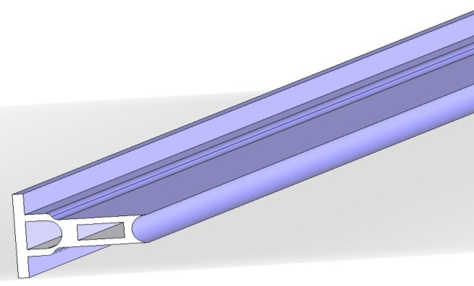
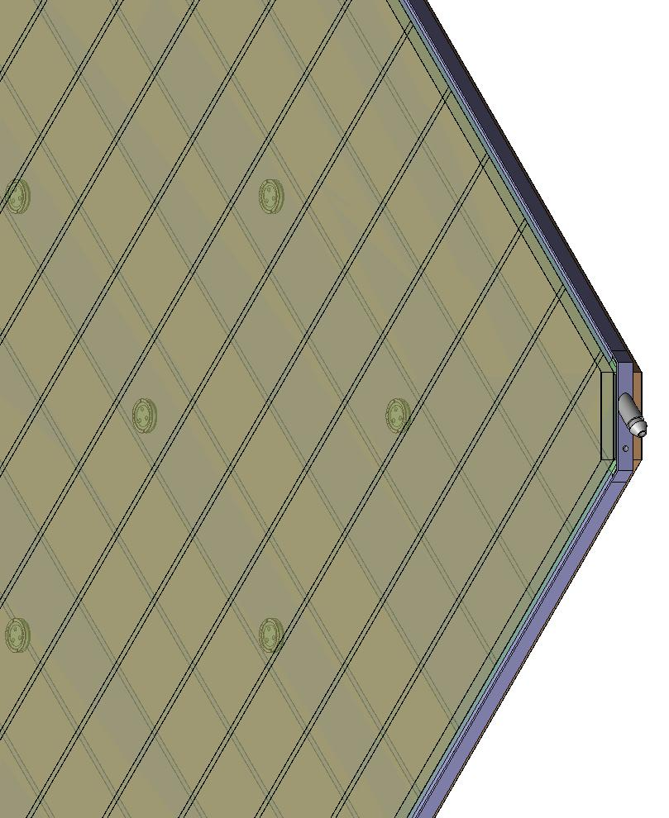


Materials for gas volume fabrication
Edge spacer
Schematic of an assembled gas volume
Gas nozzle
Glass spacer

Slide 38

Electrode coating techniques
Graphite paint prepared using colloidal grade graphite powder(3.4gm), lacquer(25gm) and thinner(40ml)
Sprayed on the glass electrodes using an automobile spray gun.
A uniform and stable graphite coat of desired surface resistivity (1MΩ/◻) was obtained by this method.

Slide 39

Automatic spray paint plant
Drive for Y-movement
Automatic spray gun
Control and drive panel
Glass holding tray
Drive for X-movement

Slide 40


Screen printing techniques
On glass
On films

Slide 41
Schematic of RPC assembly jig

Slide 42








Development and characterisation of signal pickup panels
Foam panel
48.2Ω
G-10 panel
Open
100Ω
51Ω
47Ω
Z₀: Inject a pulse into the strip; tune the terminating resistance at the far end, until its reflection disappears.
Honeycomb panel

Slide 43

Basic construction of an RPC
Signal reference plane.1
Plastic honey comb.2
Copper pickup strips.3
Graphite/Paint.4
Top glass.5
Button spacer.6
Bottom glass.7
Edge spacer.8
Gas nozzle.9
Bottom pickup panel.A
8
1
2
3
4
5
6
7
9
A

Slide 44

Fully assembled large area RPC
1m × 1m

Slide 45




RPC parameter characterisation

Slide 46

RPC tomography using cosmic ray muons

Slide 47



Long-term stability study of RPC
Two RPCs of 40cm × 30cm in size were built using 2mm glass for electrodes
Readout by a common G-10 based signal pickup panel sandwiched between the RPCs
Operated in avalanche mode (R134a: 95.5% and the rest Isobutane) at a high voltage of 9.3KV
Round the clock monitoring of RPC and ambient parameters – temperature, relative humidity and barometric pressure
Were under continuous operation for more than three years
Chamber currents, noise rate, combined efficiencies etc. were stable
Long-term stability of RPCs is thus established
Relative humidity
Pressure
Temperature

Slide 48
Requirement of gases in ICAL
Total number of RPCs in ICAL = 3 × 150 × 64 = 28,800
Total gas volume = 28,800 × 184cm × 184cm × 0.2cm = 195,010 litres
For ex: One volume change/day with 10% gas top-up in a re-circulating scheme
Approximate running gas cost = Rs 30,000/day (R134a from Mafron)
Gas | Avalanche (%) | Streamer (%) | Maximum (%) | Volume (L) | Density (g/L) | Weight (Kg) | Cost (Rs/Kg)
Argon | 0.0 | 30.0 | 30.0 | 58,503 | 1.784 | 104.4
R134a | 95.5 | 62.0 | 95.5 | 186,234.6 | 4.25 | 791.5
Isobutane | 4.3 | 8.0 | 8.0 | 15,600.8 | 2.51 | 39.16
SF₆ | 0.2 | 0.0 | 0.2 | 390 | 6.164 | 2.40

Slide 49

Schematic of gas system

Slide 50
Features of the gas system
16 pneumatically controlled outputs
Molecular sieve based input filter columns
Nippon Tylan made model FC-760 MFCs
Parker made fine filters on the mixed gas
On-line moister readout on mixed gas
Output flow control by SS 0.3mm capillaries
Bleeder bubblers for RPC protection
Facility to add controlled moister into the mixture
Computer interface for control and monitoring

Slide 51







Constructional details of the gas system
Internal view
Front view
Rear view

Slide 52

Prototype RPC stack

Slide 53

Schematic of prototype detector DAQ system

Slide 54













Design and implementation of the data acquisition system
200 boards of 13 types
Custom designed using
FPGA,CPLD,HMC,FIFO,SMD

Slide 55


A couple of interesting events

Slide 56

RPC time resolution plots

Slide 57


RPC strip rate time profile
Temperature

Slide 58



Functions & integration of FE-DAQ

Slide 59





Picking up the tiny charges
Process: AMSc35b4c3 (0.35um CMOS)
Input dynamic range:18fC – 1.36pC
Input impedance: 45Ω @350MHz
Amplifier gain: 8mV/μA
3-dB Bandwidth: 274MHz
Rise time: 1.2ns
Comparator’s sensitivity: 2mV
LVDS drive: 4mA
Power per channel: < 20mW
Package: CLCC48(48-pin)
Chip area: 13mm²

Slide 60

Picking up the tiny charges
Process: AMSc35b4c3 (0.35um CMOS)
Input dynamic range:18fC – 1.36pC
Input impedance: 45Ω @350MHz
Amplifier gain: 8mV/μA
3-dB Bandwidth: 274MHz
Rise time: 1.2ns
Comparator’s sensitivity: 2mV
LVDS drive: 4mA
Power per channel: < 20mW
Package: CLCC48(48-pin)
Chip area: 13mm²

Slide 61


Features of ICAL trigger system
Physicist’s mind decoded!
Insitu trigger generation
Autonomous; shares data bus with readout system
Distributed architecture
For ICAL, trigger system is based only on topology of the event; no other measurement data is used
Huge bank of combinatorial circuits
Programmability is the game, FPGAs, ASICs are the players

Slide 62
ASIC based TDC devices
HPTDC (J.Christiansen, CERN)
Channels: 32/8
σ_{T}: 261/64/48/40/17ps
AMT (Yasuo Arai, KEK)
Channels: 24
σ_{t}: 305ps

Slide 63

FPGA basedTDC devices

Slide 64
Pulse shape monitor
0.2-2 ns
Inverter “Domino” ring chain
IN
Stefan Ritt, Paul Scherrer Institute, Switzerland
Waveform
stored
Out
Clock
Shift Register
“Time stretcher” GHz → MHz

Slide 65

Data network interfaces

Slide 66
Software requirements
RPC-DAQ controller firmware
Backend online DAQ system
Local and remote shift consoles
Data packing and archival
Event and monitor display panels
Event data quality monitors
Slow control and monitor consoles
Database standards
Data analysis and presentation software standards
Operating System and development platforms

Slide 67
Career opportunities in INO
Research Scholars
Applicants must have a minimum qualification of M.Sc. degree in Physics or B.E./B.Tech. degree in any one of Electronics, E & CE, Instrumentation and Electrical Engineering subjects with strong motivation for and proficiency in Physics.
The selected candidates will be enrolled as Ph.D. students of the Homi Bhabha National Institute (HBNI), a Deemed to be University, with constituent institutions that include BARC, HRI, IGCAR, IMSc, SINP and VECC.
They will take up 1 year course work at TIFR, Mumbai in both theoretical and experimental high energy physics and necessary foundation courses specially designed to train people to be good experimental physicists.
Successful candidates after the course work will be attached to Ph.D. guides at various collaborating institutions for a Ph. D. degree in Physics on the basis of their INO related work.
Career opportunities for bright engineers in Electronics, Instrumentation, Computer Science, Information technology, Civil, Mechanical and Electrical engineers

Slide 68
Career opportunities in TIFR
Visiting Students’ Research Programme (VSRP)
Physics/Chemistry : Pre-final year students of M.Sc./B.E./B.Tech.
Biology: Pre-final year students of M.Sc./B.E./B.Tech. Students doing M.Pharm., Medicine/Engineering will be also be considered.
Mathematics: Pre-final and final year students of M.A./M.Sc./M-Stat./B.Tech. Exceptionally bright pre-final and final year students of B.Sc./B.Stat./B.Math. will also be considered.
Computer & Systems Sciences: Pre-final year students of B.E./B.Tech./M.Sc./M.C.A./M.E./M.Tech.
Research opportunities for exceptionally talented and strongly motivated students
TIFR is India's premier institution for advanced research in fundamental sciences. The Institute runs a graduate programme leading to the award of Ph.D. degree, as well as M.Sc. and Integrated Ph.D. in certain subjects.
The Graduate Programme at TIFR is classified into the following Subjects - Mathematics, Physics, Chemistry, Biology, Computer & Systems Sciences and Science Education.
Career opportunities for bright engineers in Electronics, Instrumentation, Computer Science, Information technology, Civil, Mechanical and Electrical engineers

Slide 69
Closing remarks
INO is an exciting mega basic science project
It is being planned on an unprecedented scale and budget
ICAL and other experiments will produce highly competitive physics
Beyond neutrino physics, INO is going to be an invaluable facility for many future experiments
It provides wonderful opportunities for science and engineering students alike
Detector and instrumentation R&D, scientific human resource development are INO’s major trust areas
It offers a large number of engineering challenges and many spin-offs such as medical applications

Slide 70

Thank you
To the organisers for giving me this wonderful opportunity. I feel honoured.
To the student volunteers - to Harikrishnan in particular, for their warm hospitality.
To you for your attention.

