Slide 1
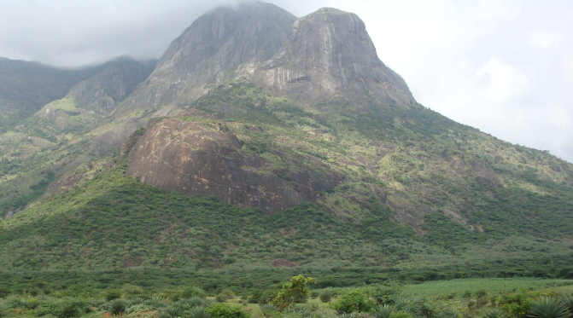
INO: A mega project of Science and Engineering
Neutrino is the most tiny quantity of reality ever imagined by a human being.
Frederick Reines
Co-discoverer & Nobel Laureate
Dr. B.Satyanarayana, TIFR, Mumbai
Kalasalingam University, Anand Nagar
December 17, 2012

Slide 2
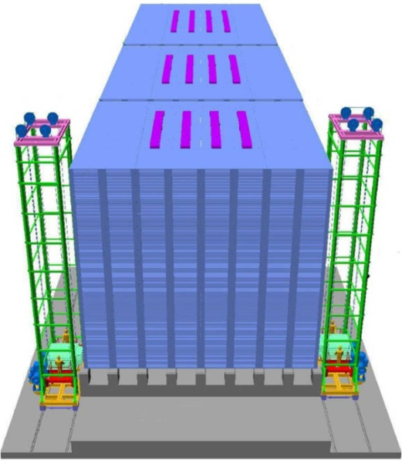
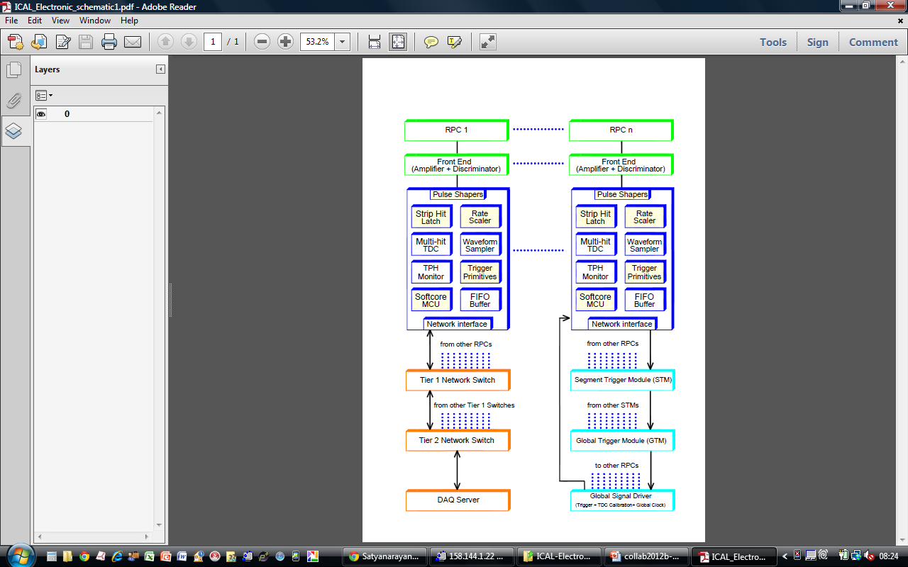
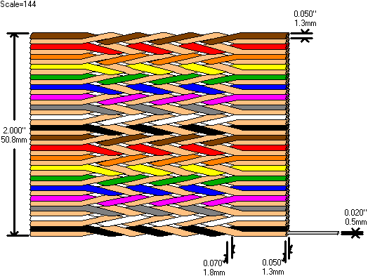
Instrumenting the ICAL detector
Dr. B.Satyanarayana ▪ Scientific Officer (G)
Department of High Energy Physics ▪ Tata Institute of Fundamental Research
Homi Bhabha Road ▪ Colaba ▪ Mumbai ▪ 400005 ▪ INDIA
T: 09987537702 ▪ E: bsn@tifr.res.in ▪ W: http://www.tifr.res.in/~bsn

Slide 3
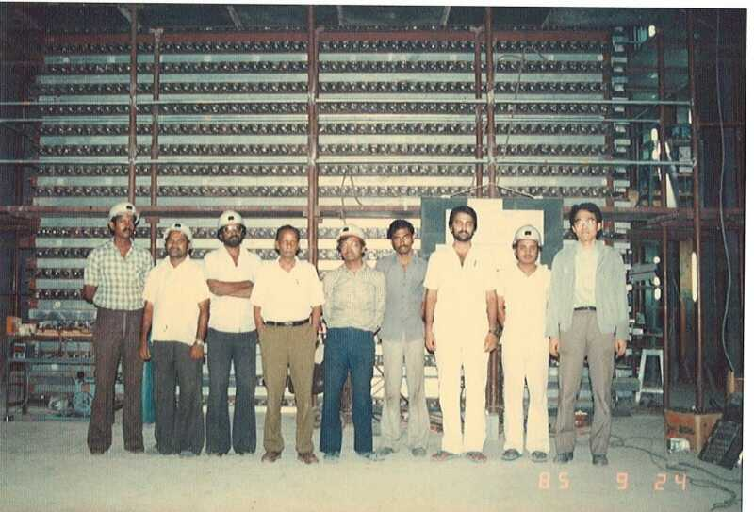
KGF Proton Decay Experiment

Slide 4
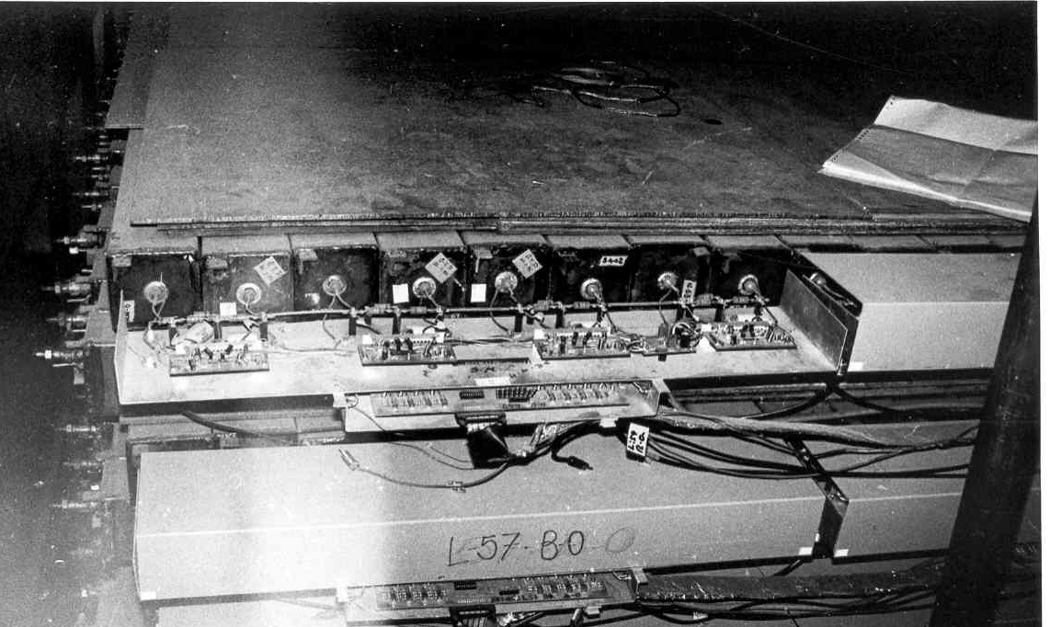
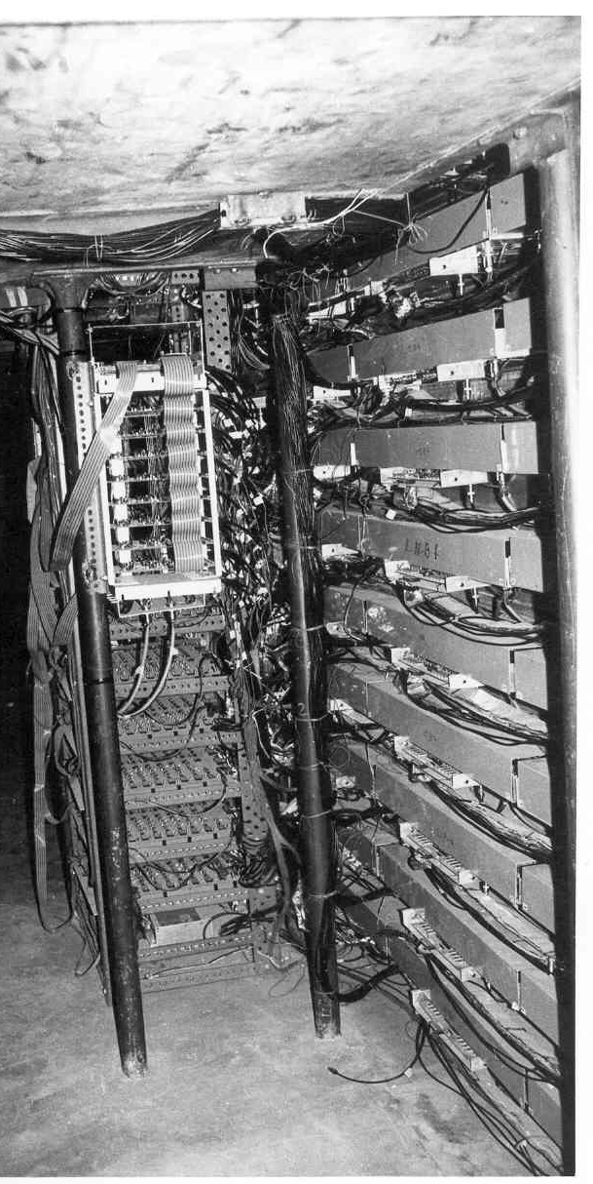
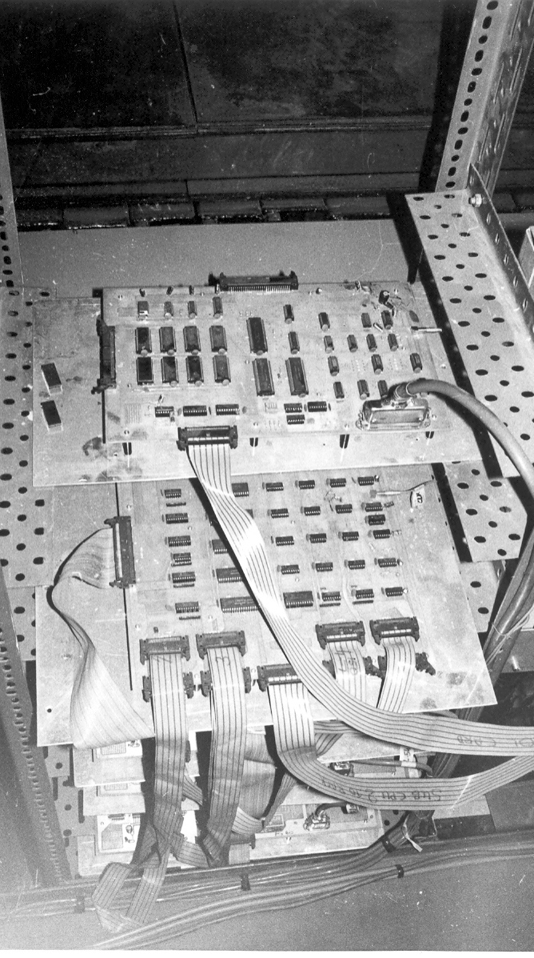
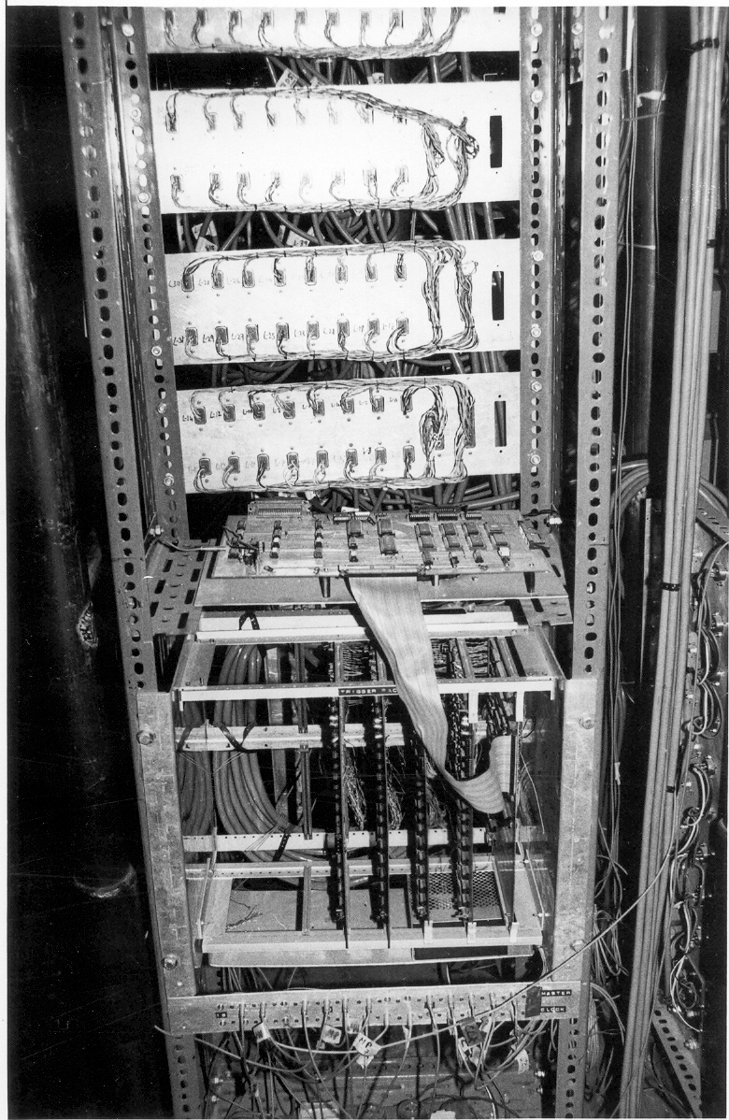
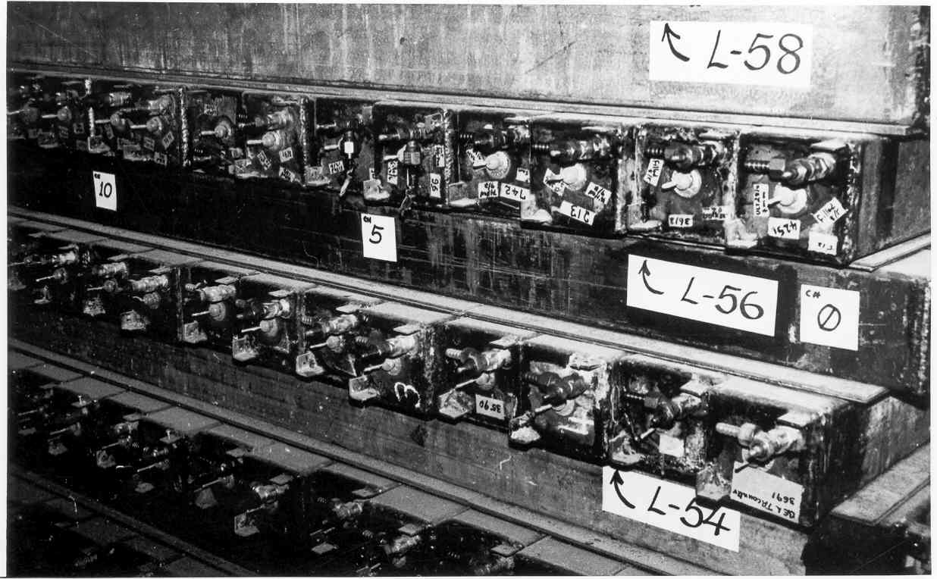
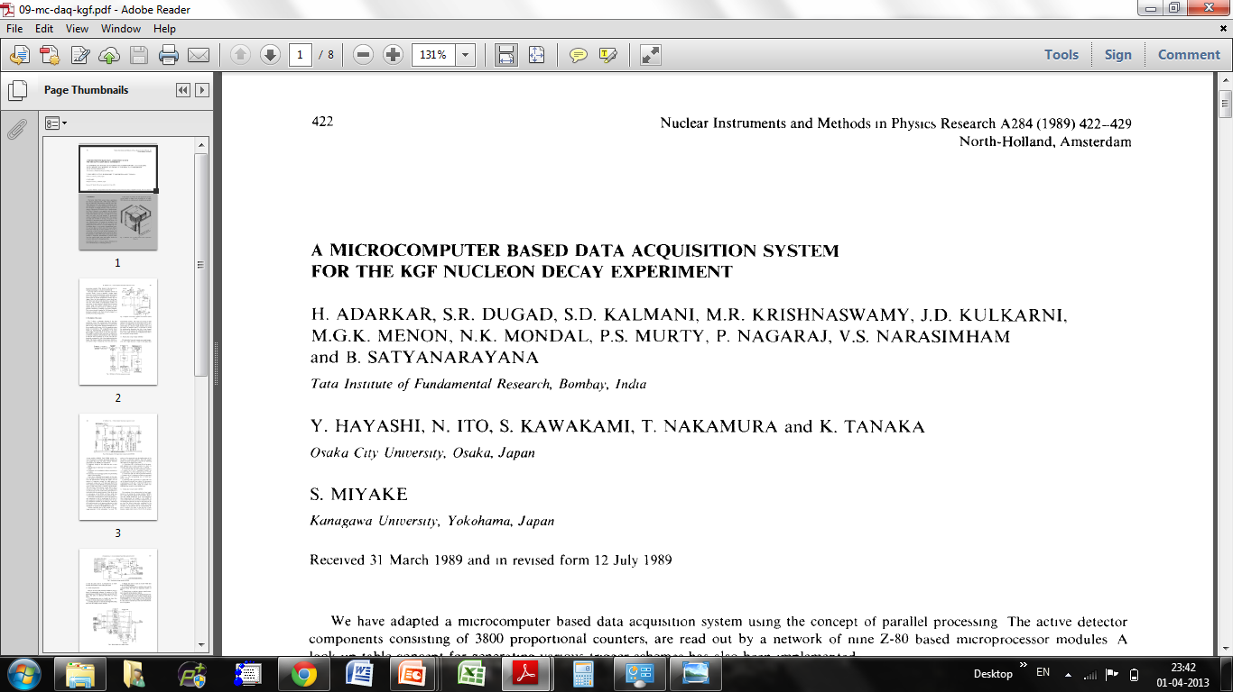
Black and white electronics!

Slide 5
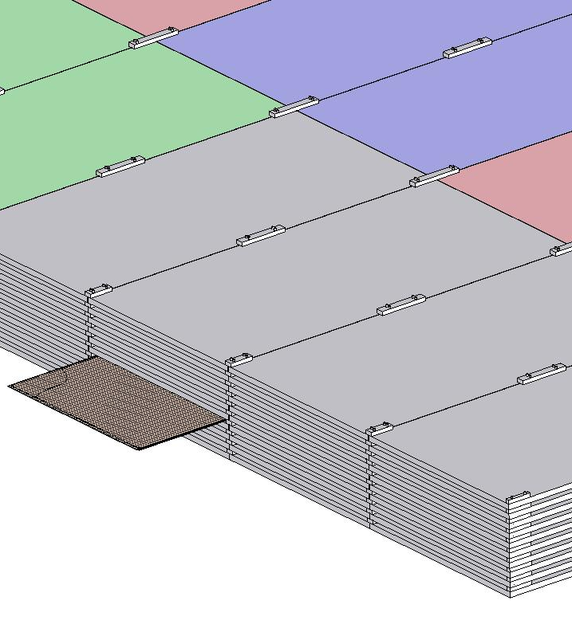
ICAL detector and construction
Magnet coils
4000mm×2000mm
×56mm low carbon iron sheets
RPC handling trolleys
RPC
Total weight: 50Ktons

Slide 6
Factsheet of ICAL detector
No. of modules | 3
Module dimensions | 16m × 16m × 14.5m
Detector dimensions | 48.4m × 16m × 14.5m
No. of layers | 150
Iron plate thickness | 56mm
Gap for RPC trays | 40mm
Magnetic field | 1.3Tesla
RPC dimensions | 1,950mm × 1,840mm × 24mm
Readout strip pitch | 3 0mm
No. of RPCs/Road/Layer | 8
No. of Roads/Layer/Module | 8
No. of RPC units/Layer | 192
No. of RPC units | 28,800 (97,505m²)
No. of readout strips | 3,686,400

Slide 7
30 years of HEP instrumentation
Parameter | KGF experiment | ICAL experiment
Year | 1983 | 2013
Size (m) | 6 × 6 × 6 | 48 × 16 × 16
Weight of the detector (tons) | 350 | 50000
Interacting path in detector (mm) | 100 | 2
Detector pitch (mm) | 100 | 30
Readout channels | 3600 | 3,686,400
Rise time of the signal | 1μs | 1ns
Approx. budget (crores) | 1.5 | 1500
My take home salary (Rs) | 1 | 50☺

Slide 8
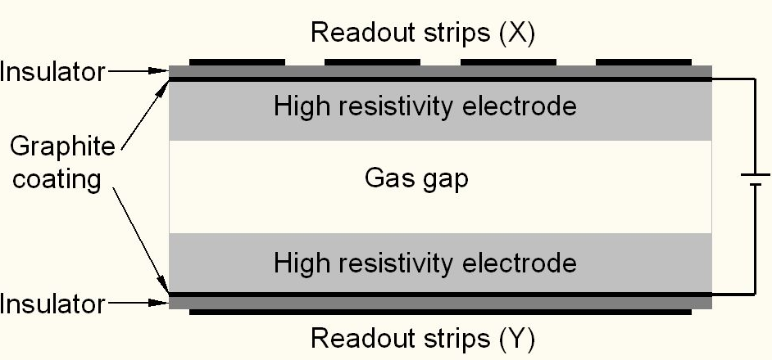
Schematic of a basic RPC

Slide 9
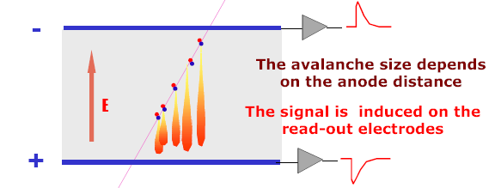
Signal development in an RPC
Each primary electron produced in the gas gap starts an avalanche until it hits the electrode.
Avalanche development is characterized by two gas parameters, Townsend coefficient (α) and Attachment coefficient (η).
Average number of electrons produced at a distance x, n(x) ⁼ e^{(α- η)x}
Current signal induced on the electrode, i(t) = E_{w} • v • e₀ • n(t) / V_{w}, where E_{w} / V_{w} = ε_{r} / (2b + dε_{r}).

Slide 10
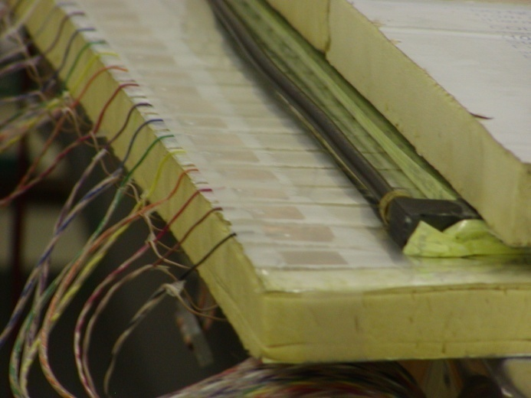
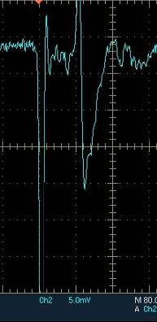
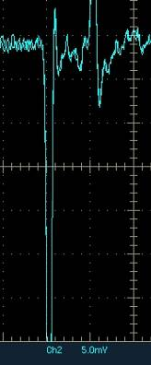
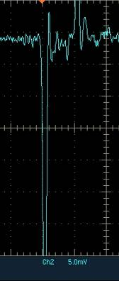
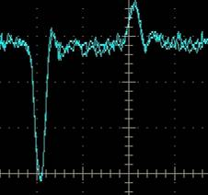
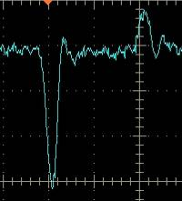
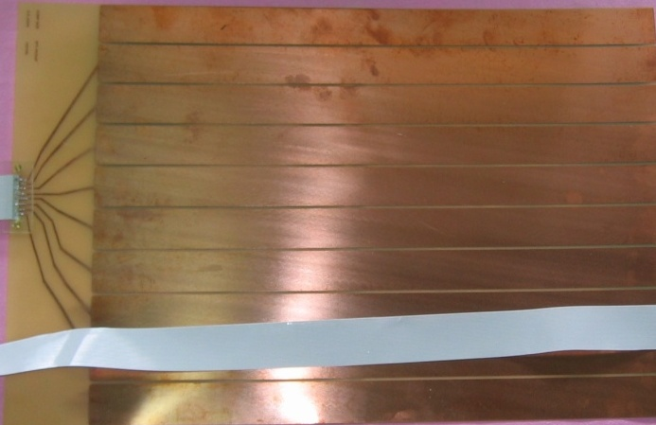
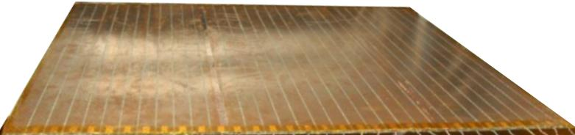
Development and characterisation of signal pickup panels
Foam panel
48.2Ω
G-10 panel
Open
100Ω
51Ω
47Ω
Z₀: Inject a pulse into the strip; tune the terminating resistance at the far end, until its reflection disappears.
Honeycomb panel

Slide 11
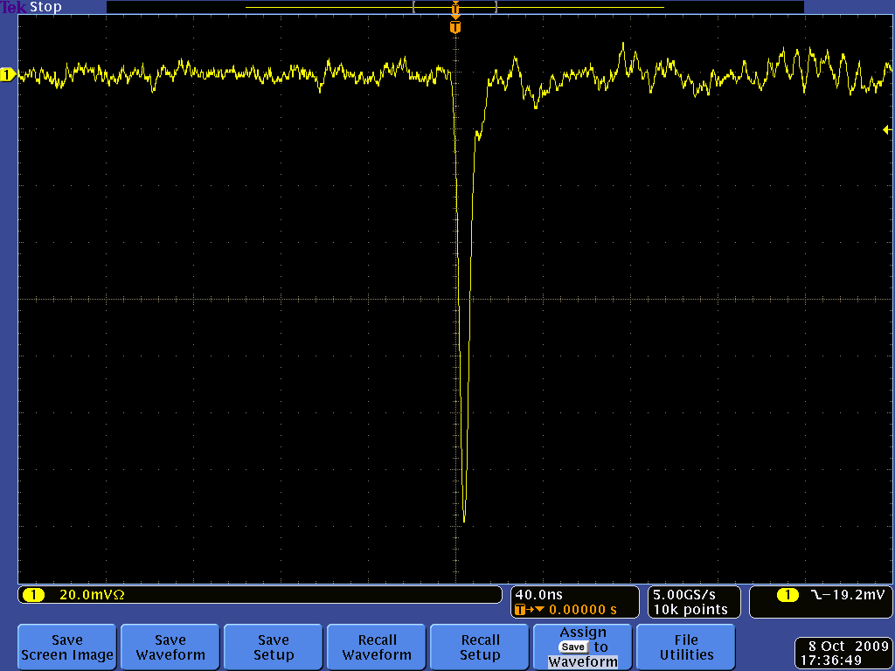
Post amplifier RPC pulse profile

Slide 12
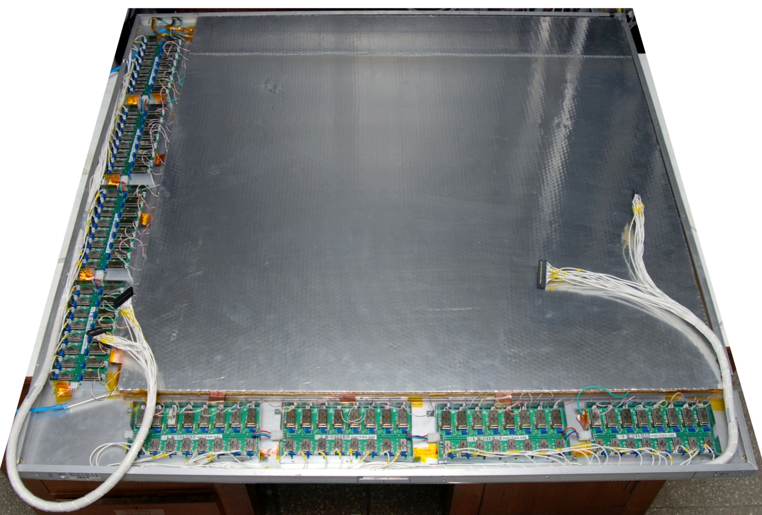
Fully assembled large area RPC
1m × 1m

Slide 13
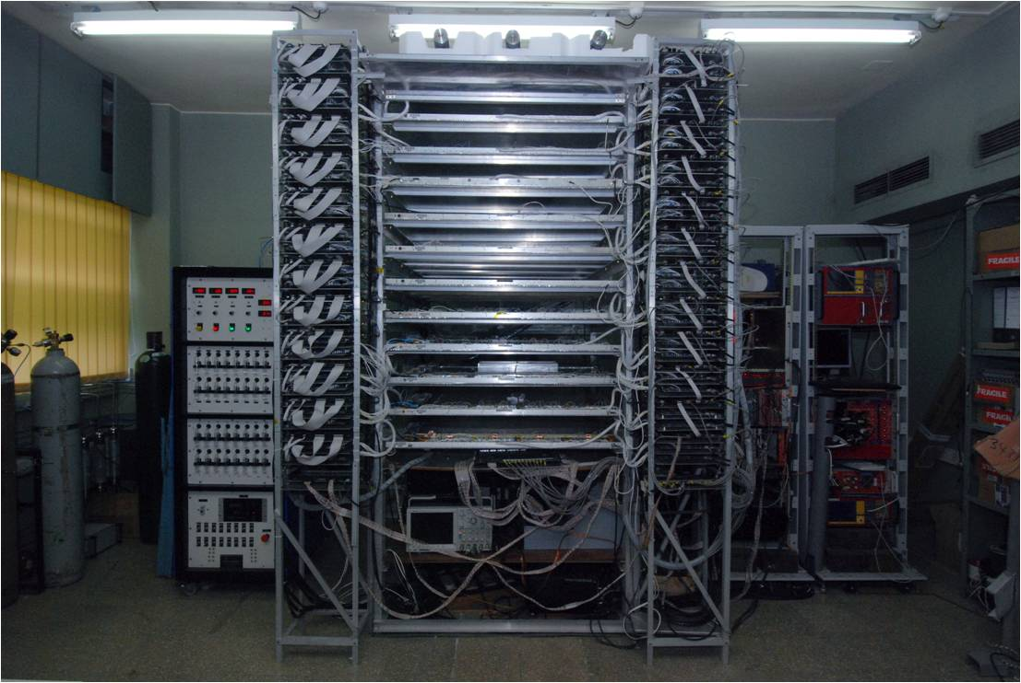
1m × 1m RPC stack at TIFR, Mumbai

Slide 14
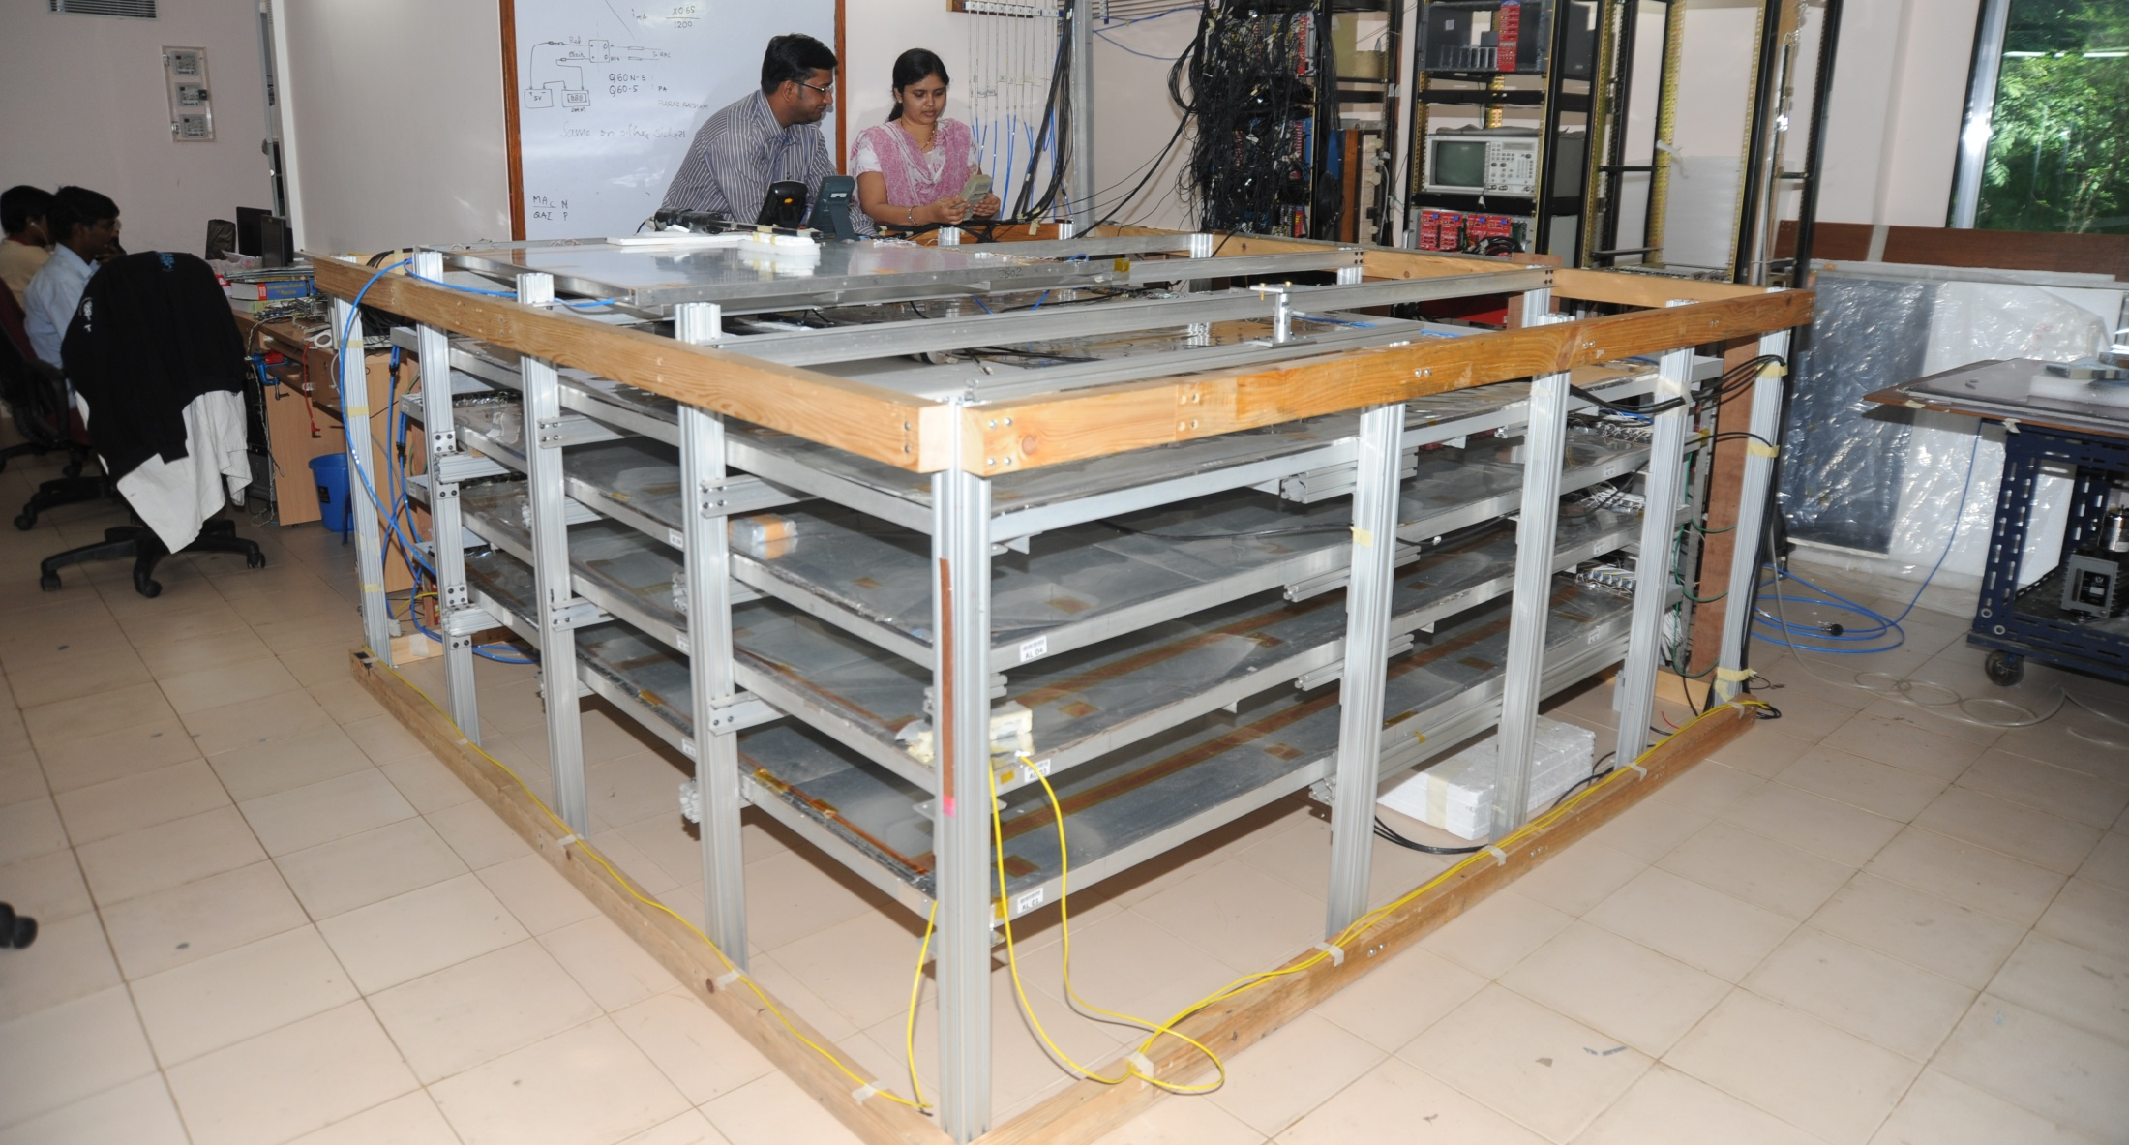
2m × 2m RPC stack at TIFR, Mumbai

Slide 15
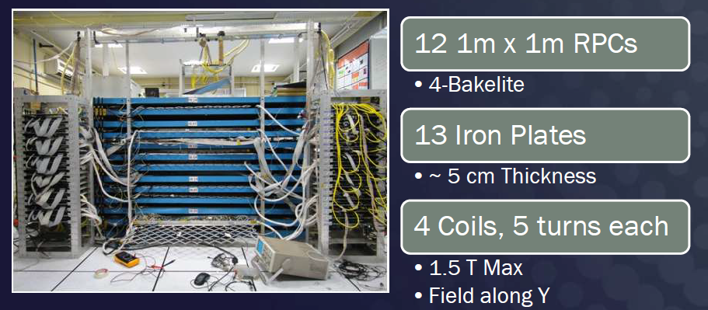
ICAL prototype at VECC, Kolkata

Slide 16
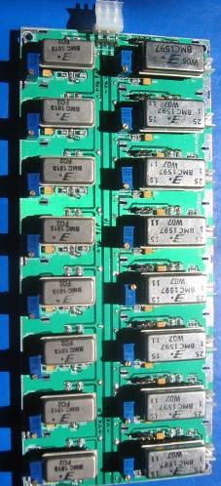
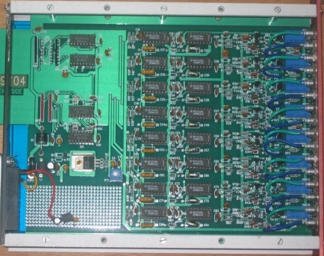
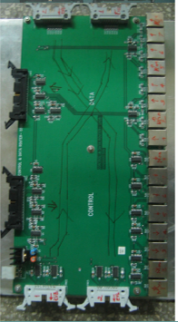
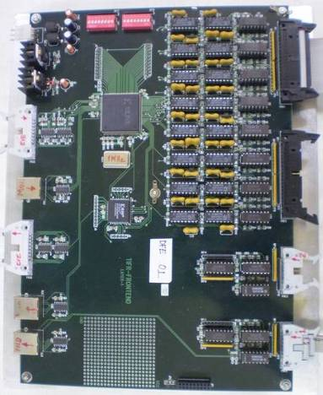
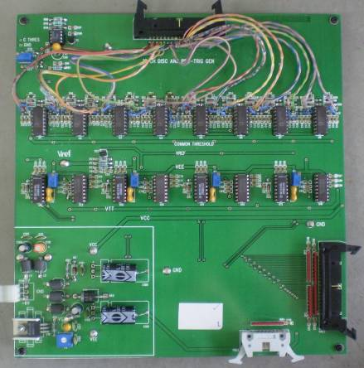
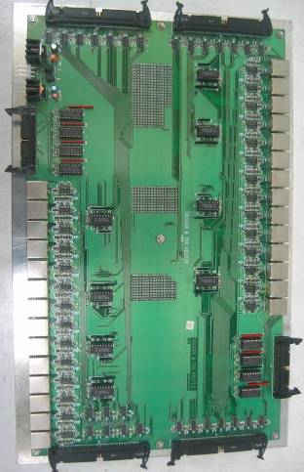
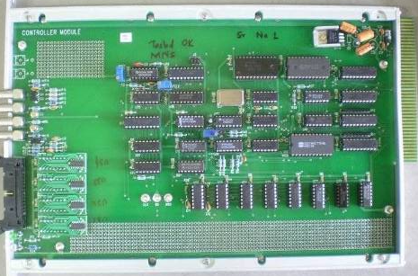
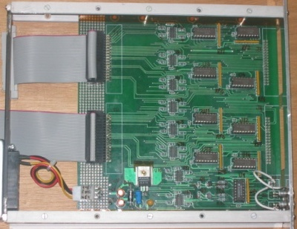
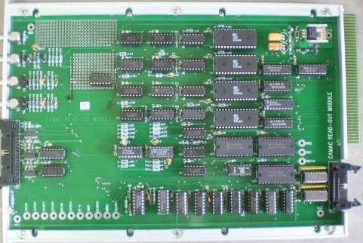
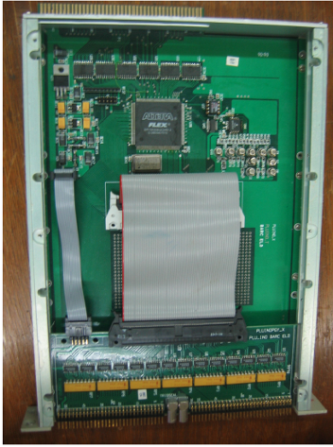
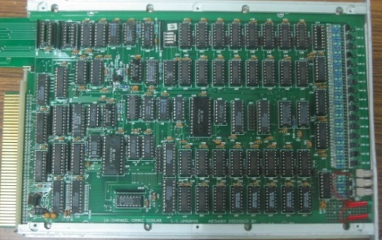
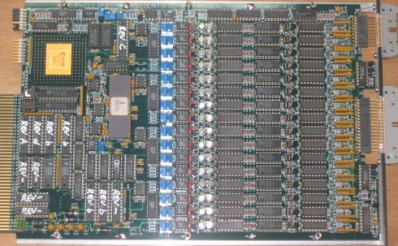
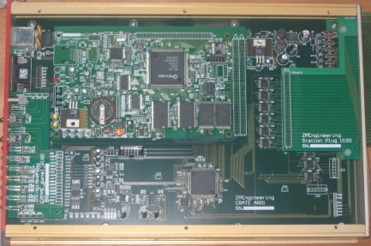
DAQ system for the RPC stacks
200 boards of 13 types
Custom designed using
FPGA,CPLD,HMC,FIFO,SMD

Slide 17
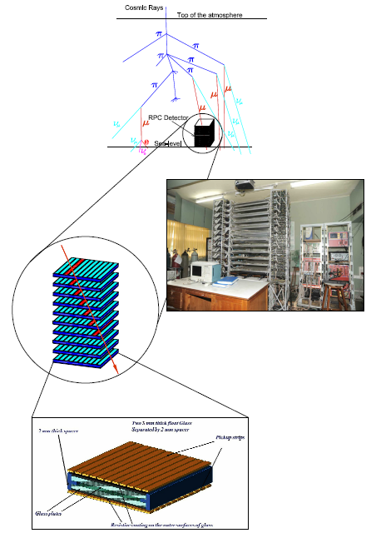
ICAL DAQ system requirements
Information to record on trigger
Strip hit (1-bit resolution)
Timing (200ps LC)
Time-Over-Threshold
Rates
Individual strip background rates ~300Hz
Event rate ~10Hz
On-line monitor
RPC parameters (High voltage, current)
Ambient parameters (T, RH, P)
Services, supplies (Gas systems, magnet, low voltage power supplies, thresholds)
Start
Stop

Slide 18
Design considerations & constraints
Data rates are low.
Physical dimensions: Owing to severe space constraints on the RPC, triangular space of about 160cm² only is available for this extremely high density board.
Service life of the electronics is expected to be more than15 years, component spares availability/replaceability is a concern.
Since the temperature and humidity inside the cavern will be controlled for RPCs, the electronic components need not be even of industrial grade - Commercial grade will do.
Low power consumption. It is highly desirable to have minimum power consumption.
Cost: Since the volumes are high, cost is also a major consideration

Slide 19
Challenges of ICAL electronics
Huge number of electronic data readout channels. This necessitates large scale integration and/or multiplexing of electronics. The low to moderate rates of individual channels allow this integration/multiplexing.
Large dimensions of one unit of RPC. This has bearing on the way the signals from the detector are routed to the front-end electronic units and matching the track lengths of the signals, irrespective of the geographical position of the signal source. We need to do this in order to maintain equal timing of signals from individual channels.
Large dimensions of the entire detector. This will pose constraints on the cable routing, signal driving and related considerations.
Road structure for the mounting of RPCs. This necessarily imposes constraint that signals from both X & Y planes of the RPC unit, along with other service and power supply lines are brought out only from the transverse direction of the detector.
Eight RPC units are going to be installed in a road. We can at best bring out signal cables from four of them from one side of the detector and the other four from other direction.
About 25cms gap is available between the faces of the detector and the trolleys. Any installations on the face of the detector have to be designed with this consideration.
About 40mm gap between iron layers is available for the RPC detector, out of which thickness of the RPC unit is expected to at least 24mm. Leaving another 5-6mm for various tolerances, realistically about 10mm is the available free space in the RPC slot for routing out cables etc.
On the sides adjacent to the RPC unit in the gap, free space is available for routing out power supply cables, gas lines etc.
The gap between three modules is about 20cms. It is not advisable plan any installations on these faces.

Slide 20
Sub-systems of ICAL instrumentation
Signal pickup and front-end electronics
Strip latch
Timing units
Background rate monitors
Front-end controller
Network interface and data network architecture
Trigger system
Event building, databases, data storage systems
Slow control and monitoring
Gas, magnet, power supplies
Ambient parameters
Safety and interlocks
Computer, back-end networking and security issues
On-line data quality monitors
Voice and video communications
Remote access protocols to detector sub-systems and data

Slide 21
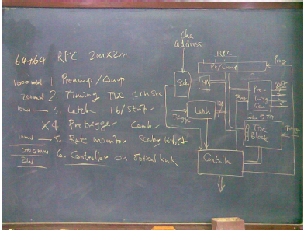
First sketch of ICAL readout scheme
July 10, 2008

Slide 22
Overall scheme of ICAL electronics
Major elements of DAQ system
Front-end board
RPCDAQ board
Segment Trigger Module
Global Trigger Module
Global Trigger Driver
Tier1 Network Switch
Tier2 Network Switch
DAQ Server

Slide 23
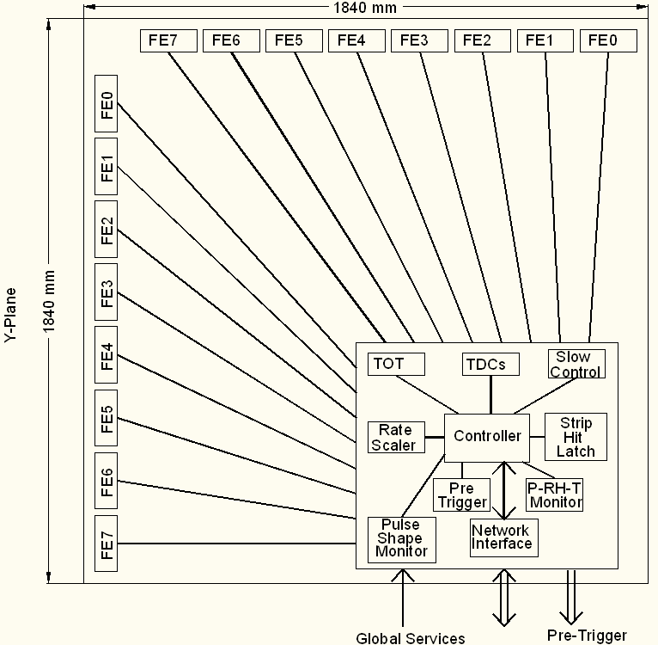
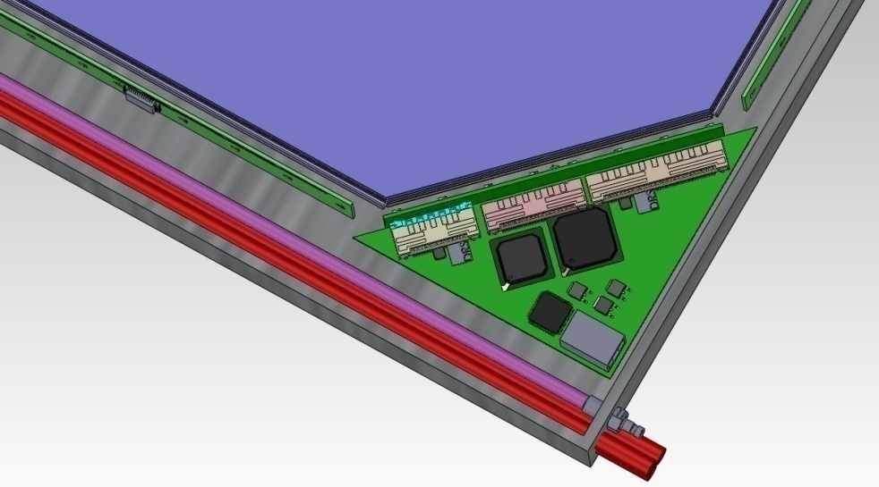
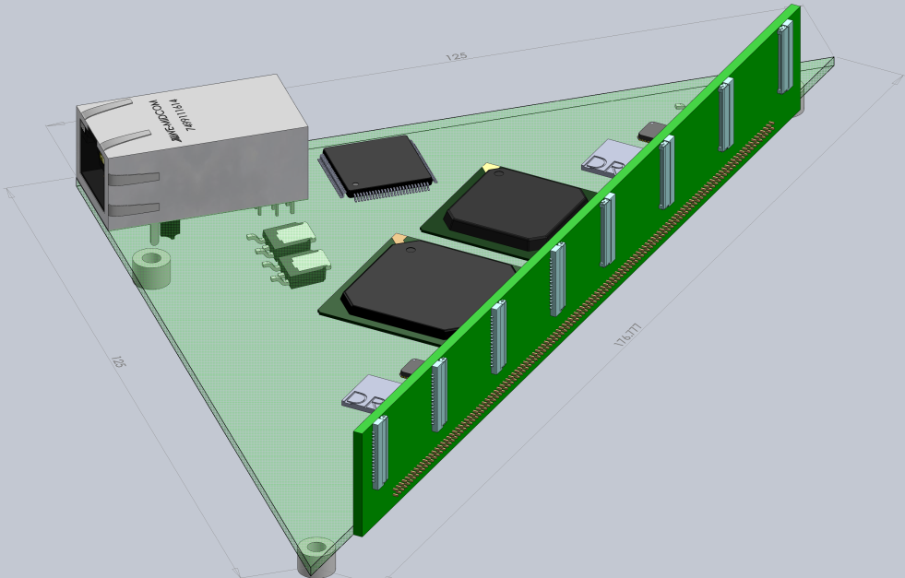
Functions & integration of FE-DAQ

Slide 24
Design inputs for the front-end
RPC signal’s rise time is of the order of 500-800nSec. Therefore, we will need a resolution of about 200nSec for the timing devices used for recording RPC signal arrival times w.r.t to ICAL trigger.
The opening width of the amplified signals is of the order of 25nSecs. The minimum width of the RPC pulse over the threshold in the avalanche mode is as low as a few nSecs. This is an important input for the front-end electronics design.
The amplifier in the avalanche mode preferably should have a fixed gain in the range 100-200 depending on the noise levels obtainable and hence the minimum discriminator levels settable.
Discriminator overhead (ratio of average peak pulse height to discriminator level) of 3-4 is preferable for reliable performance. Variable (but common) threshold in the range of ±10 to ±50mV for the discriminators should be supported.
The pulse shaping of the discriminator output pulse should be in the range of 50-100nSec (but fixed). However, if the facility of pulse width monitoring has to be supported, this specification has to be relooked.

Slide 25
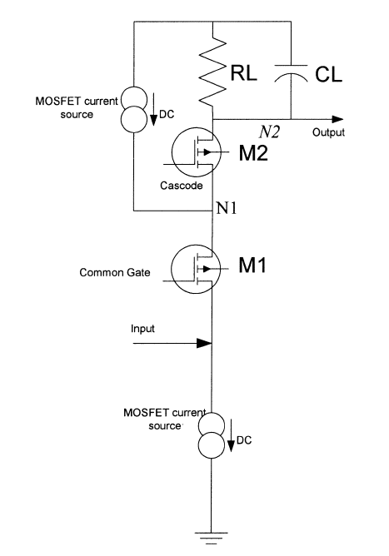
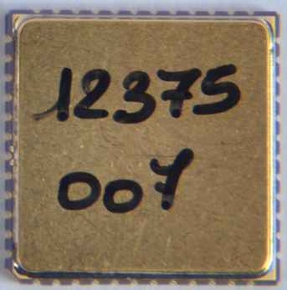
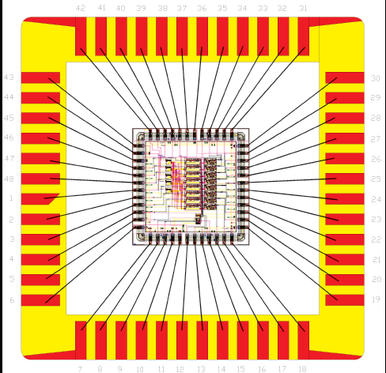
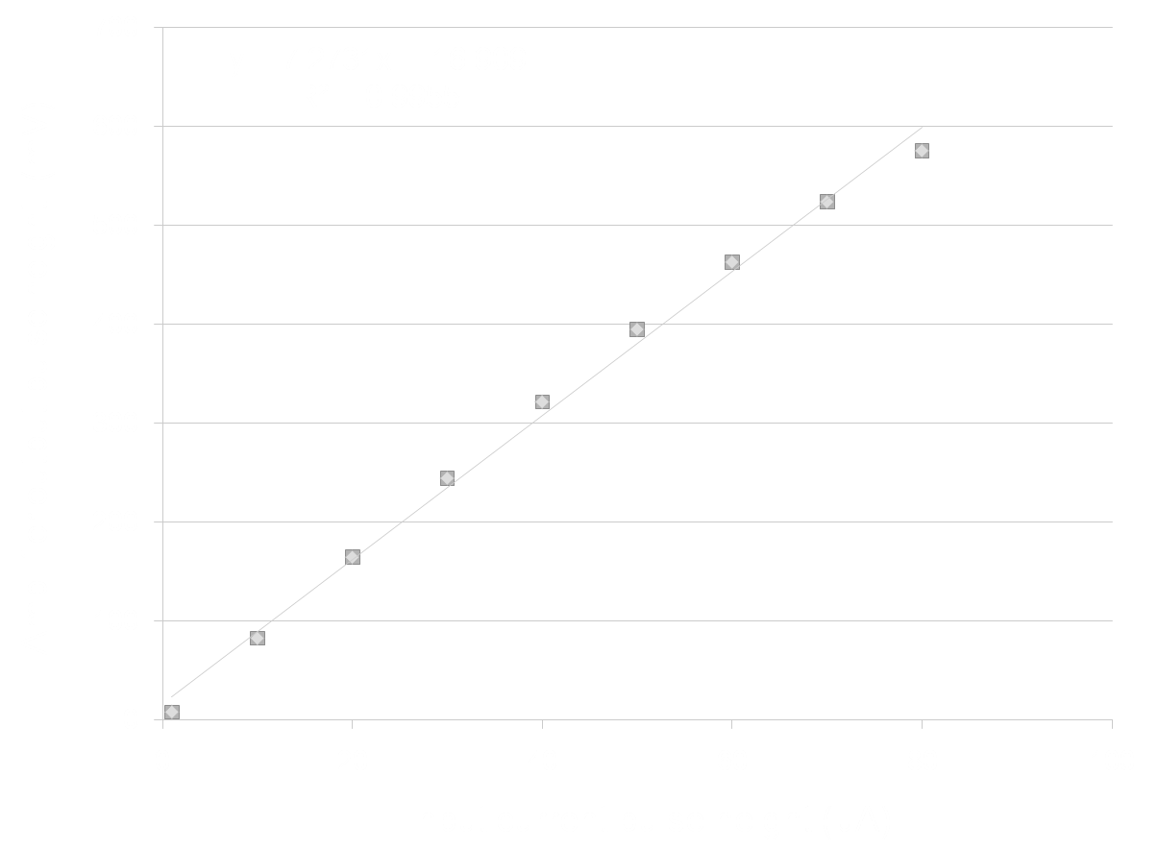
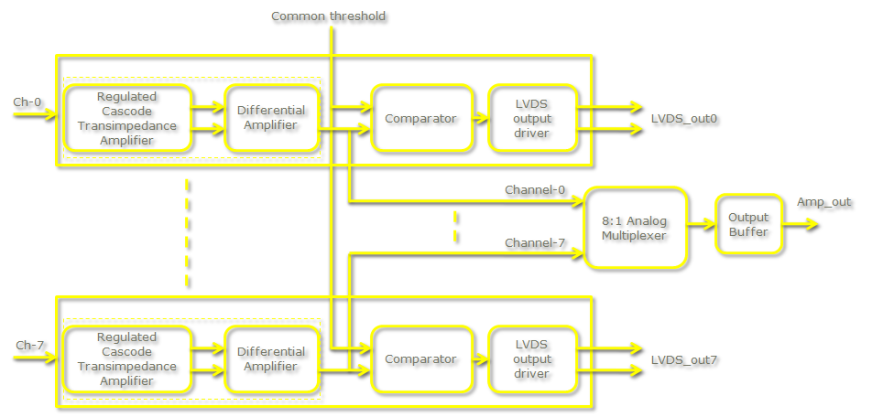
Picking up the tiny charges
Process: AMSc35b4c3 (0.35um CMOS)
Input dynamic range:18fC – 1.36pC
Input impedance: 45Ω @350MHz
Amplifier gain: 8mV/μA
3-dB Bandwidth: 274MHz
Rise time: 1.2ns
Comparator’s sensitivity: 2mV
LVDS drive: 4mA
Power per channel: < 20mW
Package: CLCC48(48-pin)
Chip area: 13mm²

Slide 26

Picking up the tiny charges
Process: AMSc35b4c3 (0.35um CMOS)
Input dynamic range:18fC – 1.36pC
Input impedance: 45Ω @350MHz
Amplifier gain: 8mV/μA
3-dB Bandwidth: 274MHz
Rise time: 1.2ns
Comparator’s sensitivity: 2mV
LVDS drive: 4mA
Power per channel: < 20mW
Package: CLCC48(48-pin)
Chip area: 13mm²

Slide 27

Preamplifier Board
23
403
Current Anusparsh-2 chip dimensions does not fit to this design
Next iteration might shrink the size
Package the chip in the rectangular shape
Go for chip bonding (for example: ATLAS’s RPC front-end)

Slide 28

RPCDAQ module – the workhorse
Unshaped, digitized, LVDS RPC signals from 128 strips (64x + 64y)
16 analog RPC signals, each signal is a summed or multiplexed output of 8 RPC amplified signals.
Global trigger
TDC calibration signals
TCP/IP connection to backend for command and data transfer

Slide 29
RPC strip rate considerations
RPC strip signal rates mainly contributed by the surrounding low energy activities such as stray radioactivity, local electrical discharges, dark currents of the detector and other electrical/electronic disturbances.
For a given RPC, installed at particular location, operating at a particular high voltage, and a gas mixture, the average counting rate or noise rate is fairly constant and is in fact commonly used to monitor the stability of the above mentioned RPC operating parameters.
One of the main background tasks (while not collecting event data) of the ICAL DAQ system is to sequentially monitor individual strip rates of all the RPCs in the detector, with a reasonable (of the order of 1 hour cycle time for a strip) frequency.
The noise rate has consequences on the design of trigger system. The threshold of the trigger system is such that it shouldn’t generate triggers due to chance coincidence of noise rates.

Slide 30




RPC strip rate monitoring
Temperature dependence on noise rate
Strip noise rate profile
Strip noise rate histogram
Temperature

Slide 31

TPH monitor module

Slide 32

Pulse shape monitor
0.2-2 ns
Inverter “Domino” ring chain
IN
Waveform
stored
Out
Clock
Shift Register
“Time stretcher” GHz → MHz

Slide 33

ICAL TDC specifications

Slide 34

ASIC based TDC device
Principle
Two fine TDCs to measure start/stop distance to clock edge (T₁, T₂)
Coarse TDC to count the number of clocks between start and stop (T₃)
TDC output = T₃+T₁-T₂
Specifications
Currently a single-hit TDC, can be adapted to multi-hit
20 bit parallel output
Clock period, T_{c} = 4ns
Fine TDC interval, T_{c}/32 = 125ps
Fine TDC output: 5 bits
Coarse TDC interval: 2¹⁵ * T_{c} = 131.072μs
Coarse TDC output: 15 bits
The chip has arrived, evaluation tests are in progress it IITM
CMEMS is also coming up with an ASIC with similar specs.

Slide 35


Anupal based DAQ board
Accepts NIM, LVTTL, LVCMOS and LVDS inputs.
FPGA for delay generation, noise rate and efficiency measurements.
SPI interface between ASIC and microcontroller.
RS232 serial interface for PC.
Labwindows CVI based software for data analysis on the PC

Slide 36


Network interface specifications
Data traffic into RPC-DAQ is Configuration/ commands – Beginning or rarely Broad cast/ Multicast – UDP protocol with/higher layer check
Data traffic out of RPC-DAQ is relatively high (45/332kbps)
We will use a TCP/IP based network interface to send and receive data from front-end to the back-end. TCP/IP over UTP or optical fiber is a reliable protocol over long distances.
Hardwired network protocol – Wiznet 5300 chip is used

Slide 37

Data network schematic

Slide 38


Passive Star Optical Networks

Slide 39
Front-end switches
Atleast 16 (24, preferable) 1G copper ports PLUS a 1G fiber uplink ports, all duplex capable
Layer 2, unmanaged Ethernet switch with “store and forward” non-blocking architecture.
Atleast 512KB packet buffer, 1K MAC address table
Fan-less design, dc power supply
Severe constraints on place for mounting FE Switch, ( 40cm x 60cm x ~200cm)
Next gen 8 port switches in market will fit our size requirement
Present day chipsets small enough, only limited by size of RJ45 connectors
Contacted couple of Ethernet chip set makers, positive response for 16+1 port switch

Slide 40
Back-end Ethernet switches
Proposal is for up-linking the FE Switches to back end switches to which the computers are also connected.
BE Switches: Commercial 48 port gigabit switches (copper/fiber) with atleast 4 10G uplink ports
Rack size is 1U (all current models)
Many models have MAC address table exceeding 10k, so can store location information of all RPC's of one ICAL module. Implications are (to be tested):
the Master computer can quickly address any RPC
no need of L3 functionality, L2 functionality will do
but time taken to gather the MAC table.. to be understood
IP segmentation using separate class C subnet for each 3 layers

Slide 41
Data collecting computers
Worst case data rate from even 4 layers together is within the capacity of modern multi core CPUs ( real case tests to be done)
Broadly, the specs are:
High density 1U rack mountable servers
diskless, remote OS installation/configuration (Quattor, ROCKS, or even Kickstart)
one gigabit port for RPC's + one 10G port for networking with other “DCC”'s and upstream event builder/master computer
Example: rack space requirement 3U for 12 RPC layers
with 3 layers RPC for each DCC – 3U rack space
1U for 48 port switch, 2U for 4 high performance servers

Slide 42
Data sizes and rates – Event
TDC data = 1 channel for 8 strips and both the edges per hit, up to 4 hits per channel per event = 16 channels x 2 edges x 4 hits x 16 bits = 2048 bits
Hit data per RPC = 128 bits
RPC ID = 32 bits
Event ID = 32 bits
Time Stamp = 64 bits
DRS data = 16 channels x 1000 samples x 16 bits = 256000 bits
(DRS data comes in event data only if we get summed analog outputs from the preamplifier)
Data size per event per RPC
With DRS data, DR = 2048 + 128 + 32 + 32 + 64 + 256000 = 258,304 bits
Without DRS data, DR = 2048 + 128 + 32 + 32 + 64 = 2,304 bits
Considering 1Hz trigger rate, Maximum data rate per RPC = 252.25 kbps

Slide 43
Data sizes and rates - Monitoring
We require to monitor 1 pick-up strip per plane per RPC.
Monitor Data per strip = 24 bits
Channel ID = 8 bits
RPC ID = 32 bits
Mon Event ID = 32 bits
Ambient Sensors’ data = 3 x 16 bits = 48 bits
Time Stamp = 64 bits
DRS data = 1000 pulses (if noise rate is 100Hz) x 16 bits x 100 samples = 1600000 bits
(DRS data comes in monitoring data only if we get multiplexed analog outputs from the preamplifier)
Data size per 10 seconds per RPC
With DRS data = 24 + 8 + 32 + 32 + 48 + 64 + 2048 + 1600000 = 1,602,256 bits
Without DRS data = 24 + 8 + 32 + 32 + 48 + 64 + 2048 = 2,256 bits
Maximum data rate with 10 second monitoring period per RPC = 156.47 kbps

Slide 44
Features of ICAL trigger system
Physicist’s mind decoded!
Insitu trigger generation
Autonomous; shares data bus with readout system
Distributed architecture
For ICAL, trigger system is based only on topology of the event; no other measurement data is used
Huge bank of combinatorial circuits
Programmability is the game, FPGAs, ASICs are the players

Slide 45

ICAL Trigger Scheme

Slide 46


Implementation layout

Slide 47
Back-end communication for trigger modules
Configuration of the LTM FPGAs to implement new trigger criteria.
User specifications
Selective masking of signals at different levels of trigger generation.
Data readout
Trigger rates
Latch information
VME Back-end
Standard electrical and mechanical specifications
Custom Back-end
Custom specifications
Standard data transfer protocol
Custom processor, interface
Standard controller, PCI-VME bridge
Custom data transfer protocol

Slide 48
Power supply options
High voltage (Central scheme)
Two options: a channel at 12kV or two channels at ±6kV (Imax ~2mA)
Consider powering 4 RPC with a single HV channel (10μA current)
Cable diameter an integration issues, connectors a cost issue
Ripple less than a volt at 6KV
High voltage (Distributed scheme)
DC-DCHV converters (proportional – high ripple or regulated)
Each RPC has to be identical to the others?
Each RPC will have its own DC-HVDC converter for generating HV and LV
Control and monitoring modules interfaced to the RPCDAQ module
Low voltage
Power budget 25W per RPC – for the purpose of power supply design
How many low voltages? – one for now.
Voltage Set/Monitor resolution 5 mV
Current Set/Monitor resolution10 mA
Voltage ripple ~20mV PP
Input, topology, efficiency and size
Voltage Drop compensation via sense wires?
Load regulation ±0.3 %
Fringe magnetic fields and space for DC-DC converters inside the RPC unit are the design and integration issues

Slide 49
Estimate of power requirement
Power estimate for major components of RPCDAQ
FPGA: Roughly 1.5W
HPTDC: In low resolution low power mode, 40MHz clock and with TTL inputs: 0.45W
Wiznet W5300: Auto-negotiation of internal PHY: 0.825W
DRS4: @ 6GSPS: 0.35W
Total estimated power is less than 5W (3.125W), i.e. less than 2A @ 3.3V
If we have a bus voltage of 5V, then regulators drop 1.7V and waste less than 4W of power
Power requirement for RPCDAQ module: 10W
Front-end boards’ power requirement: 6W
Total power for electronics on the RPC: 16W
Forced air cooling of front-end and RPCDAQ planned.

Slide 50
Software requirements
RPC-DAQ controller firmware
Backend online DAQ system
Local and remote shift consoles
Data packing and archival
Event and monitor display panels
Event data quality monitors
Slow control and monitor consoles
Database standards
Data analysis and presentation software standards
Operating System and development platforms

Slide 51
Career opportunities in INO
Research Scholars
Applicants must have a minimum qualification of M.Sc. degree in Physics or B.E./B.Tech. degree in any one of Electronics, E & CE, Instrumentation and Electrical Engineering subjects with strong motivation for and proficiency in Physics.
The selected candidates will be enrolled as Ph.D. students of the Homi Bhabha National Institute (HBNI), a Deemed to be University, with constituent institutions that include BARC, HRI, IGCAR, IMSc, SINP and VECC.
They will take up 1 year course work at TIFR, Mumbai in both theoretical and experimental high energy physics and necessary foundation courses specially designed to train people to be good experimental physicists.
Successful candidates after the course work will be attached to Ph.D. guides at various collaborating institutions for a Ph. D. degree in Physics on the basis of their INO related work.
Career opportunities for bright engineers in Electronics, Instrumentation, Computer Science, Information technology, Civil, Mechanical and Electrical engineers

Slide 52
Closing remarks
INO is an exciting multi-engineering project and a mega science experiment.
It is being planned on an unprecedented scale and budget.
ICAL and other experiments will produce highly competitive physics.
Beyond neutrino physics, INO is going to be an invaluable facility for many future experiments.
It provides wonderful opportunities for science and engineering students alike.
Detector and instrumentation R&D and scientific human resource development are INO’s major trust areas.
It offers a large number of engineering challenges and many spin-offs such as medical applications.

Slide 53

Thank you
To the Kalasalingam University for giving this wonderful opportunity to share my excitement of building this unique mega science project.
To you all for your kind attention.

