Slide 1
ICAL Electronics: Status summary
B.Satyanarayana, For INO Collaboration

Slide 2
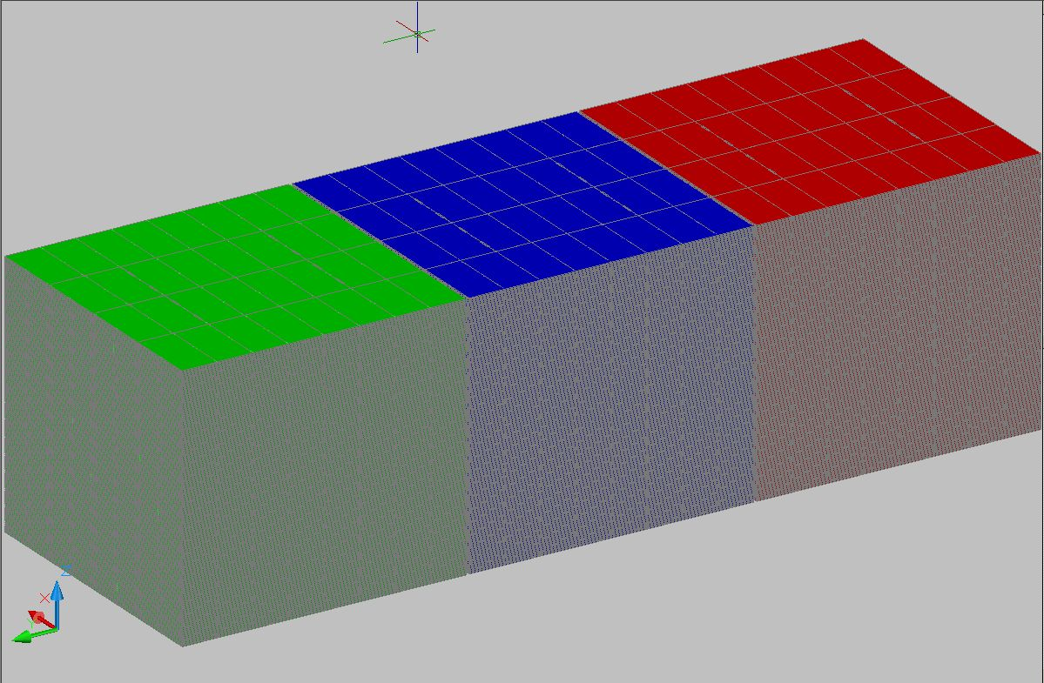
ICAL detector
To study atmospheric neutrinos and to make precision measurements of the parameters related to neutrino oscillations
16m
Good tracking, energy and time resolutions as well as charge identification of the detecting particles are the essential capabilities
14.5m
48.4m

Slide 3
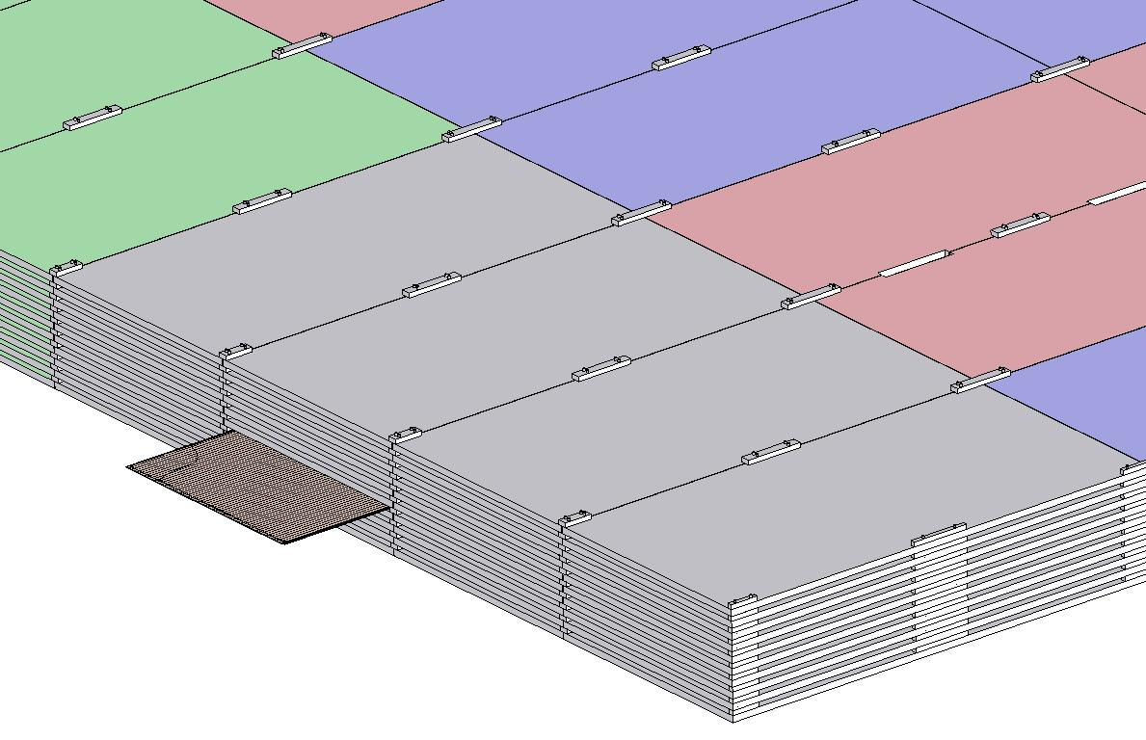
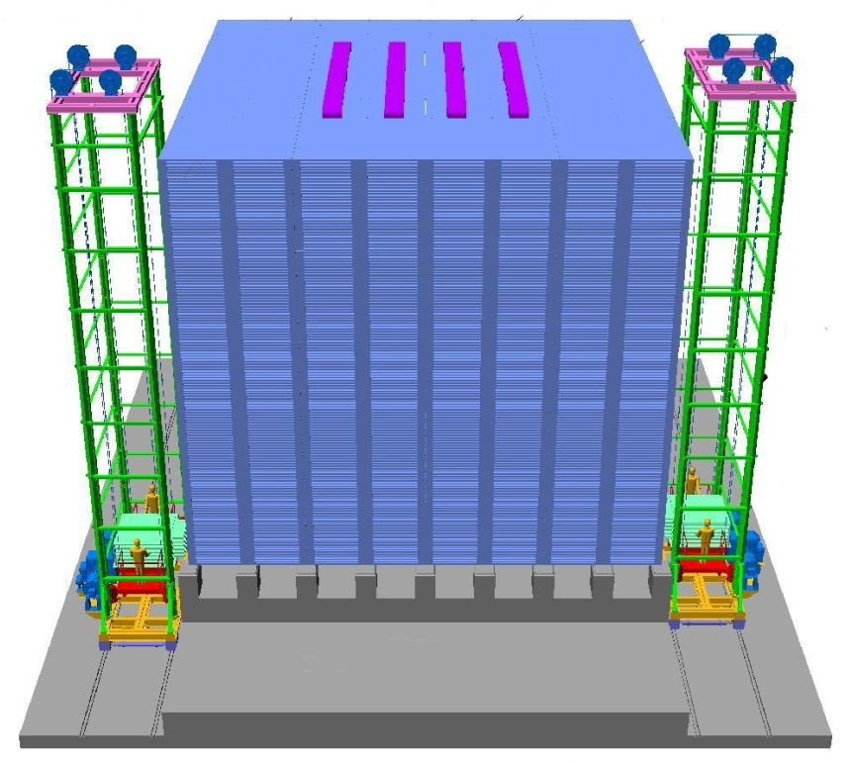
Assembly of ICAL detector
4000m m×2000mm×56mm low carbon iron slab
RPC
16m × 16m × 14.5m

Slide 4
Factsheet of ICAL detector
No. of modules | 3
Module dimensions | 16m × 16m × 14.5m
Detector dimensions | 48.4m × 16m × 14.5m
No. of layers | 150
Iron plate thickness | 56mm
Gap for RPC trays | 40mm
Magnetic field | 1.3Tesla
RPC dimensions | 1,840mm × 1,840mm × 24mm
Readout strip pitch | 3 0mm
No. of RPCs/Road/Layer | 8
No. of Roads/Layer/Module | 8
No. of RPC units/Layer | 192
No. of RPC units | 28,800 (97,505m²)
No. of readout strips | 3,686,400

Slide 5
Why ICAL chose RPC?
Large detector area coverage, thin (~10mm), small mass thickness
Flexible detector and readout geometry designs
Solution for tracking, calorimeter, muon detectors
Built from simple/common materials; low fabrication cost
Ease of construction and operation
Highly suitable for industrial production
High single particle efficiency (>95%) and time resolution (~1nSec)
Scalable rate capability (Low to very high); Cosmic ray to collider detectors
Good reliability, long term stability
Under laying Physics mostly understood!
Particle tracking capability; 2-dimensional readout from the same chamber
Trigger, timing and special purpose design versions
Detector bias and signal pickup isolation
Simple signal pickup and front-end electronics; digital information acquisition

Slide 6
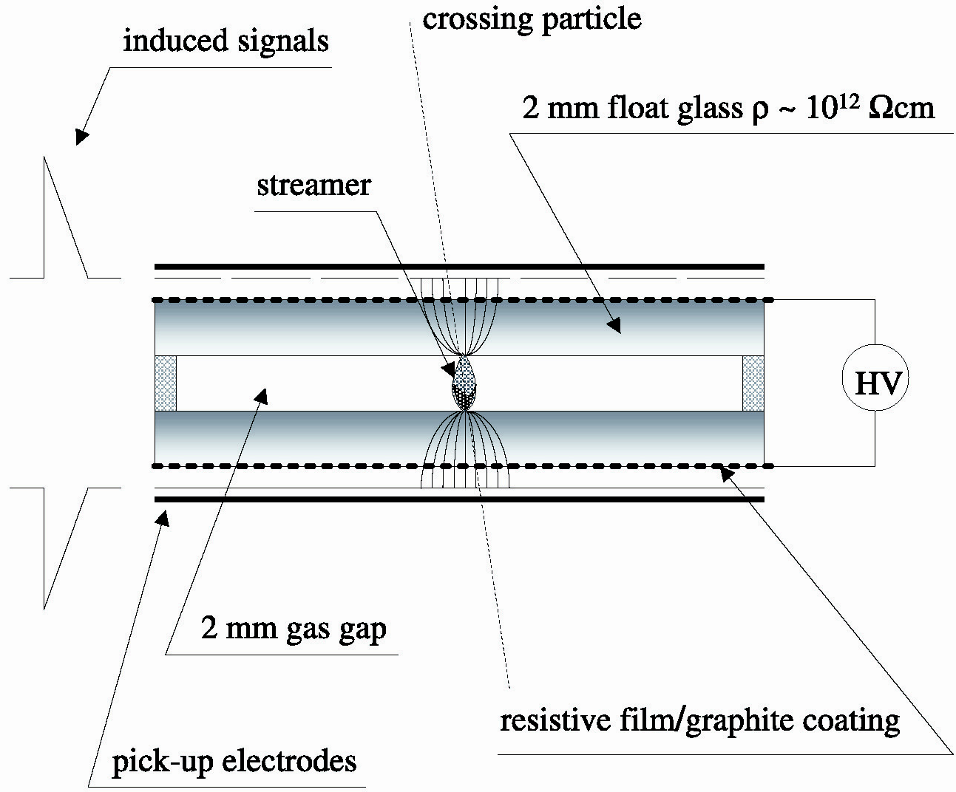
Schematic of a basic RPC
3

Slide 7
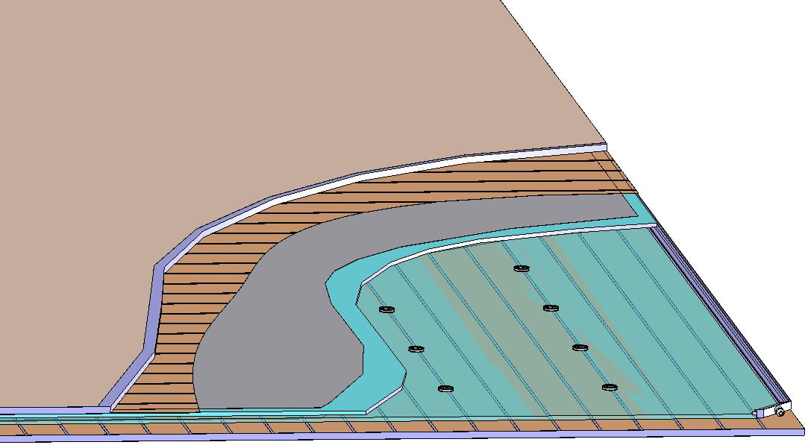
Basic construction of an RPC
Signal reference plane.1
Plastic honey comb.2
Copper pickup strips.3
Graphite/Paint.4
Top glass.5
Button spacer.6
Bottom glass.7
Edge spacer.8
Gas nozzle.9
Bottom pickup panel.A
8
1
2
3
4
5
6
7
9
A

Slide 8
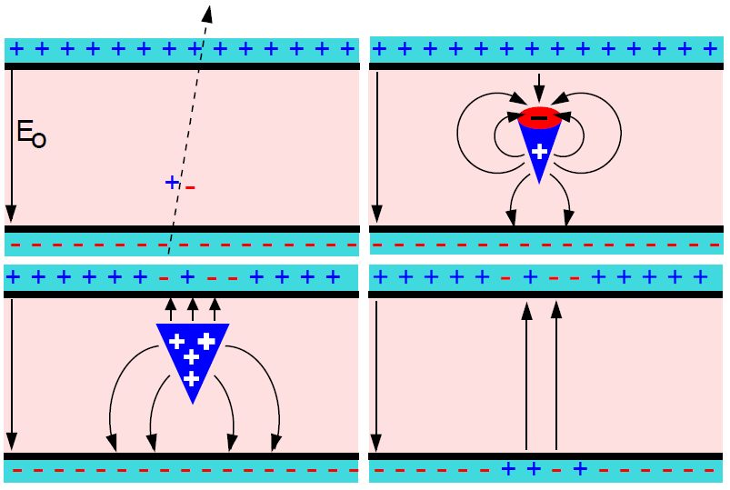
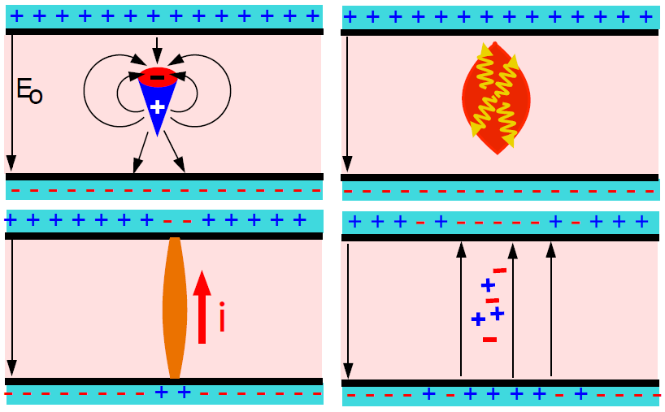
Two modes of RPC operation
Avalanche mode
Streamer mode
Gain of the detector << 10⁸
Charge developed 1-2pC
Needs a preamplifier
Longer life
Typical gas mixture Fr:iB:SF₆::94.5:4:0.5
Moderate purity of gases
Higher counting rate capability
Gain of the detector > 10⁸
Charge developed 100-200pC
No need for a preamplier
Relatively shorter life
Typical gas mixture Fr:iB:Ar::62.8:30
High purity of gases
Low counting rate capability

Slide 9
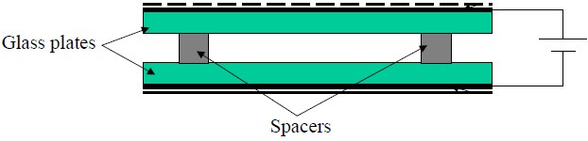
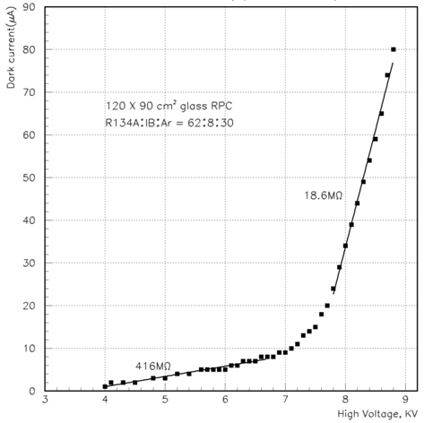
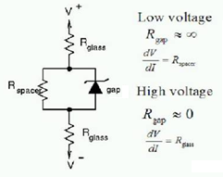
V-I characteristics of RPC
Glass RPCs have a distinctive and readily understandable current versus voltage relationship.

Slide 10
Typical expected parameters
Gas: 96.7/3/0.3
Electrode thickness: 2mm
Gas gap: 2mm
Relative permittivity: 10
Mean free path: 0.104mm
Townsend coefficient: 13.3/mm
Attachment coefficient: 3.5/mm
Avg. no. of electrons/cluster: 2.8
HV: 10.0KV
Efficiency: 90%
Time resolution: 950pS
Total charge: 200pC
Induced charge: 6pC
Charge threshold: 0.1pC

Slide 11
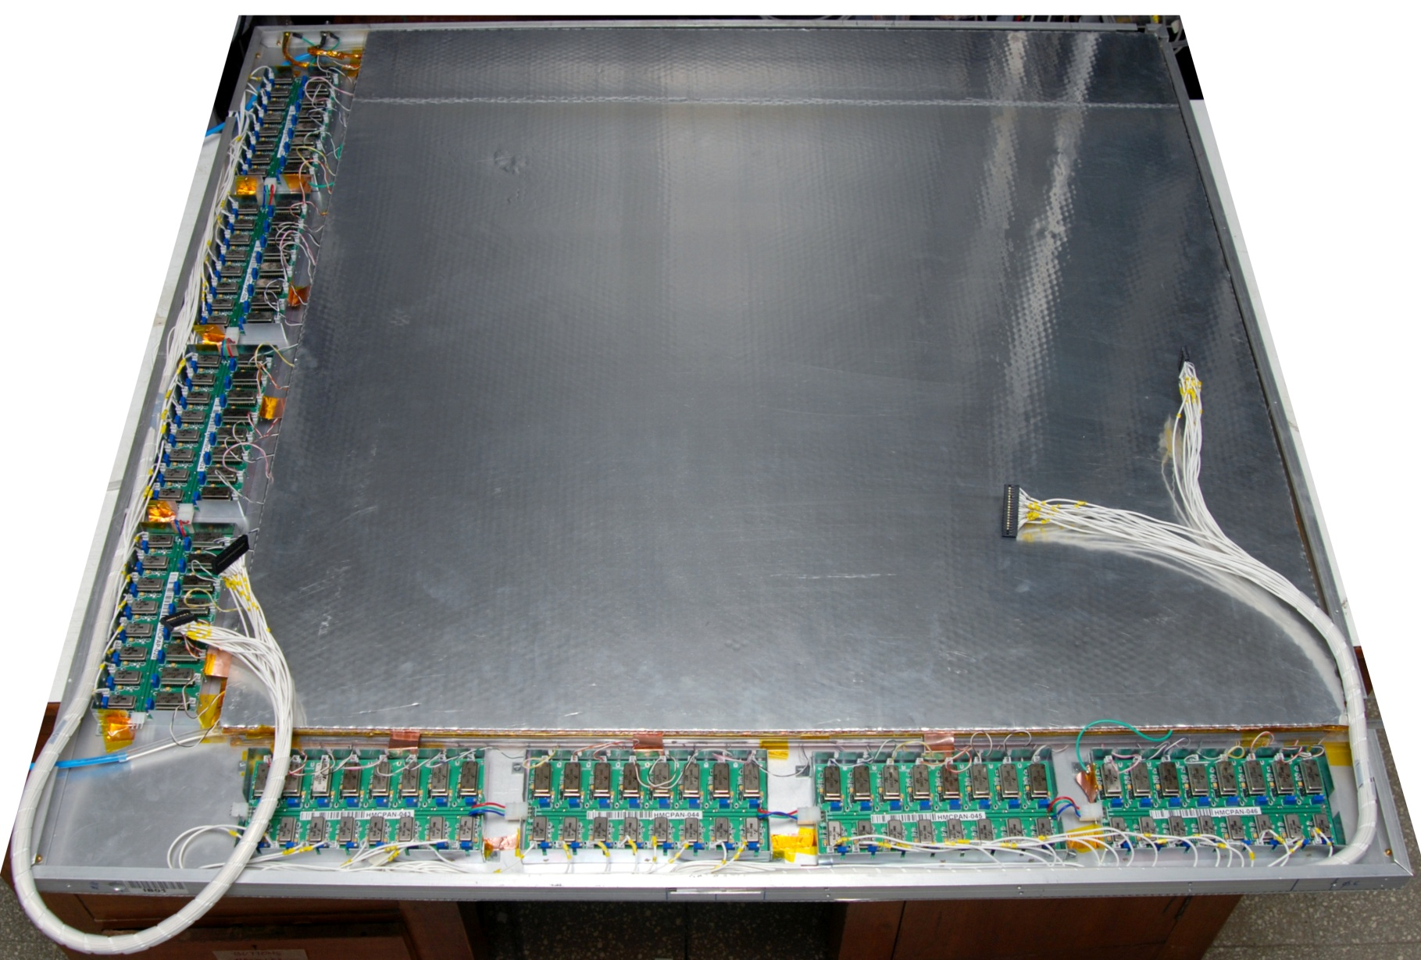
Fully assembled prototype RPC
1m × 1m

Slide 12
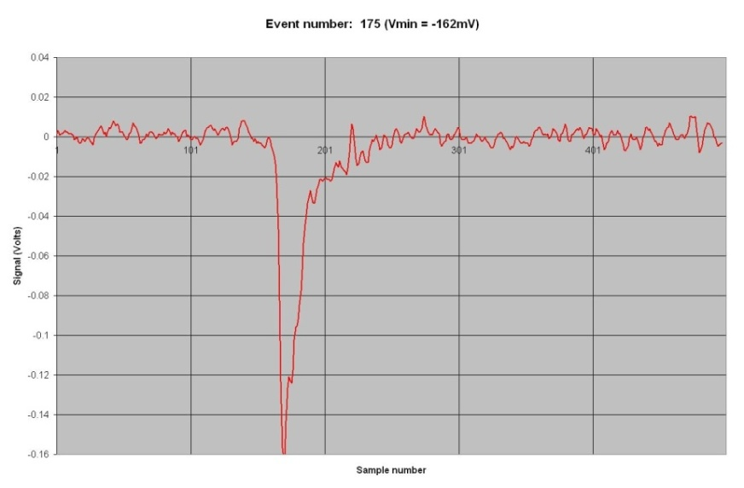

RPC signal characterisation

Slide 13
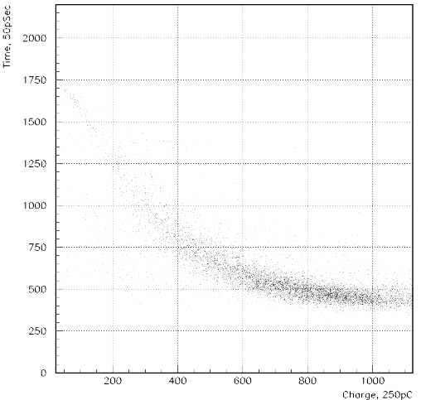
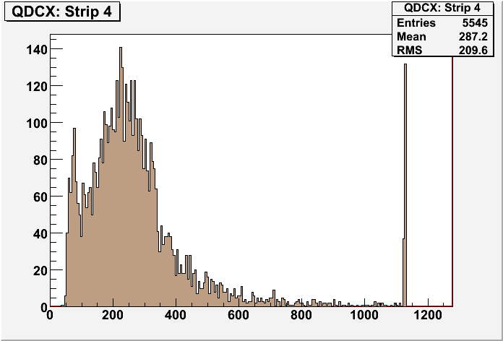
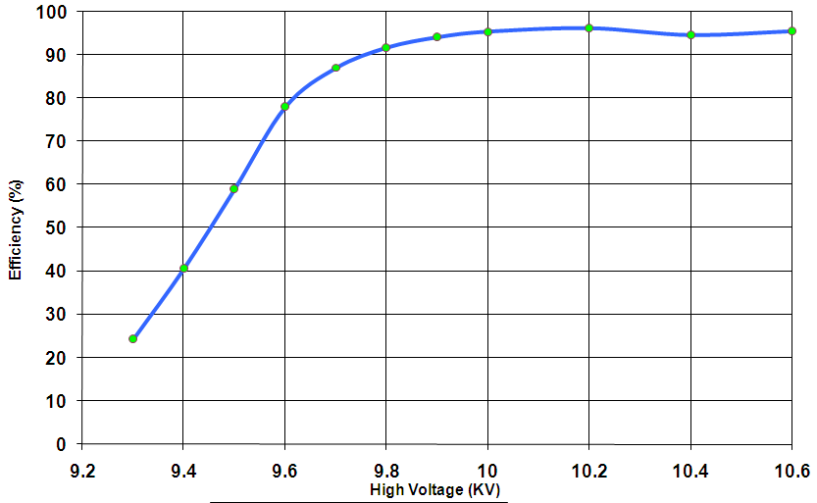
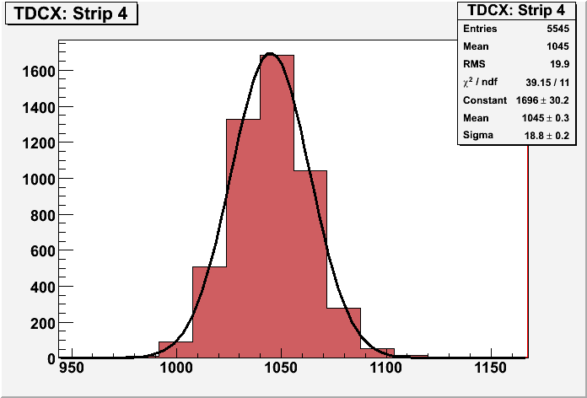
RPC parameter characterisation

Slide 14
Challenges of ICAL electronics
Huge number of electronic data readout channels. This necessitates large scale integration and/or multiplexing of electronics. The low to moderate rates of individual channels allow this integration/multiplexing.
Large dimensions of one unit of RPC. This has bearing on the way the signals from the detector are routed to the front-end electronic units and matching the track lengths of the signals, irrespective of the geographical position of the signal source. We need to do this in order to maintain equal timing of signals from individual channels.
Large dimensions of the entire detector. This will pose constraints on the cable routing, signal driving and related considerations.
Road structure for the mounting of RPCs. This necessarily imposes constraint that signals from both X & Y planes of the RPC unit, along with other service and power supply lines are brought out only from the transverse direction of the detector.
Eight RPC units are going to be installed in a road. We can at best bring out signal cables from four of them from one side of the detector and the other four from other direction.
About 25cms gap is available between the faces of the detector and the trolleys. Any installations on the face of the detector have to be designed with this consideration.
About 40mm gap between iron layers is available for the RPC detector, out of which thickness of the RPC unit is expected to at least 24mm. Leaving another 5-6mm for various tolerances, realistically about 10mm is the available free space in the RPC slot for routing out cables etc.
On the sides adjacent to the RPC unit in the gap, free space is available for routing out power supply cables, gas lines etc.
The gap between three modules is about 20cms. It is not advisable plan any installations on these faces.

Slide 15
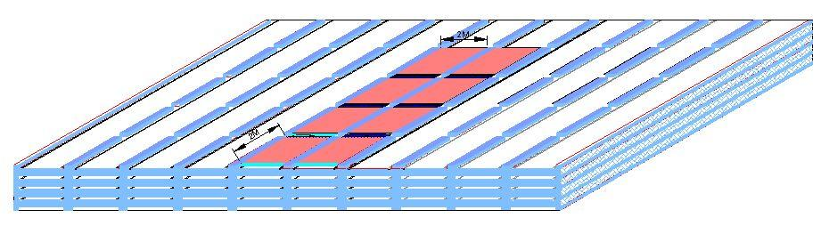
Concept of ICAL building

Slide 16
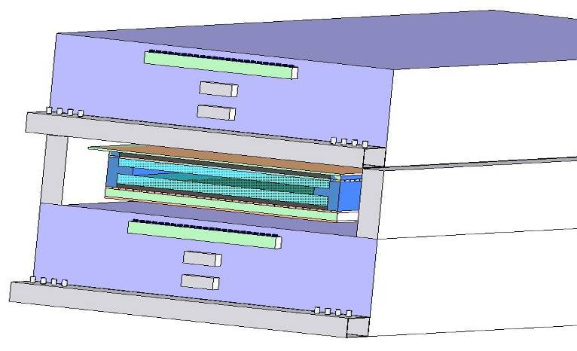
DAQ & services’ sub-stations
Iron absorber
RPC
Iron spacer
DAQ
HV
Gas
LV
Gas
Iron absorber

Slide 17
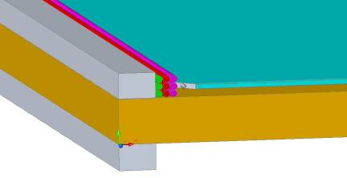
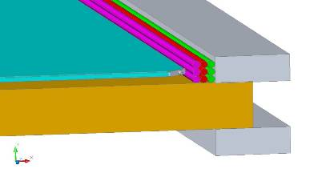
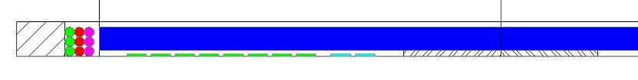
Cables & services routing
RPC
Iron absorber
Gas, LV & HV cables from RPCs
RPC
Signal cables from RPCs

Slide 18
More design inputs
RPC signal’s rise time is of the order of 500-800nSec. Therefore, we will need a resolution of about 200nSec for the timing devices used for recording RPC signal arrival times w.r.t to ICAL trigger.
The opening width of the amplified signals is of the order of 25nSecs. The minimum width of the RPC pulse over the threshold in the avalanche mode is as low as a few nSecs. This is an important input for the front-end electronics design.
The amplifier in the avalanche mode preferably should have a fixed gain in the range 100-200 depending on the noise levels obtainable and hence the minimum discriminator levels settable.
Discriminator overhead (ratio of average peak pulse height to discriminator level) of 3-4 is preferable for reliable performance. Variable (but common) threshold in the range of ±10 to ±50mV for the discriminators should be supported.
The pulse shaping of the discriminator output pulse should be in the range of 50-100nSec (but fixed). However, if the facility of pulse width monitoring has to be supported, this specification has to be relooked.

Slide 19
Important considerations
Information to record on trigger
Strip hit
Timing
Rates
Individual strip background rates ~100Hz
Event rate ~10Hz
On-line monitor
RPC parameters
Ambient parameters
Services, supplies

Slide 20
RPC strip rate considerations
RPC strip signal rates mainly contributed by the surrounding low energy activities such as stray radioactivity, local electrical discharges, dark currents of the detector and other electrical/electronic disturbances.
For a given RPC, installed at particular location, operating at a particular high voltage, and a gas mixture, the average counting rate or noise rate is fairly constant and is in fact commonly used to monitor the stability of the above mentioned RPC operating parameters.
One of the main background tasks (while not collecting event data) of the ICAL DAQ system is to sequentially monitor individual strip rates of all the RPCs in the detector, with a reasonable (of the order of 1 hour cycle time for a strip) frequency.
The noise rate has consequences on the design of trigger system. The threshold of the trigger system is such that it shouldn’t generate triggers due to chance coincidence of noise rates.

Slide 21
Sub-systems
Front-ends
Latch and timing units
Pipelines and fiber
Backend (VME) data collectors
Trigger system
Central clock
Slow control and monitoring
Gas, magnet, power supplies
Ambient parameters
Safety and interlocks
Computer, networking and security issues
On-line data quality monitors
Voice and video communications
Remote access protocols to detector sub-systems and data

Slide 22
Front-end considerations
RPC strip pitch versus front-end packaging
n-in-1 ASIC or PCB: Routing of tracks
1-in-1 ASIC: Mounted on pickup panels
Low voltage distribution
DC-DC converters, one per RPC to generate high voltage supply
Output signal routing

Slide 23
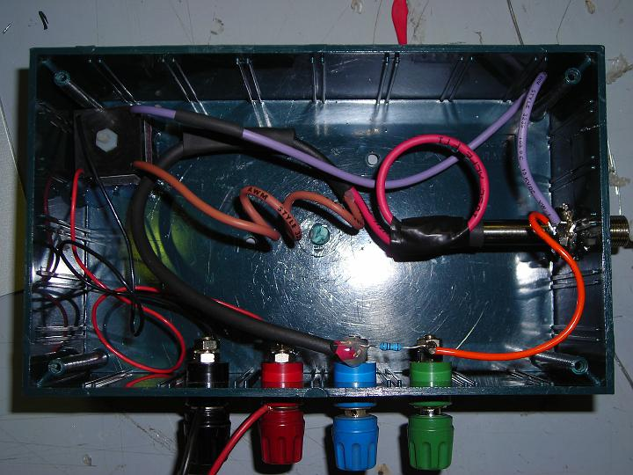
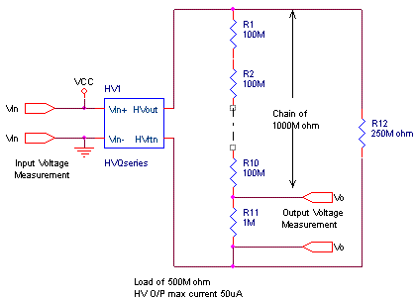
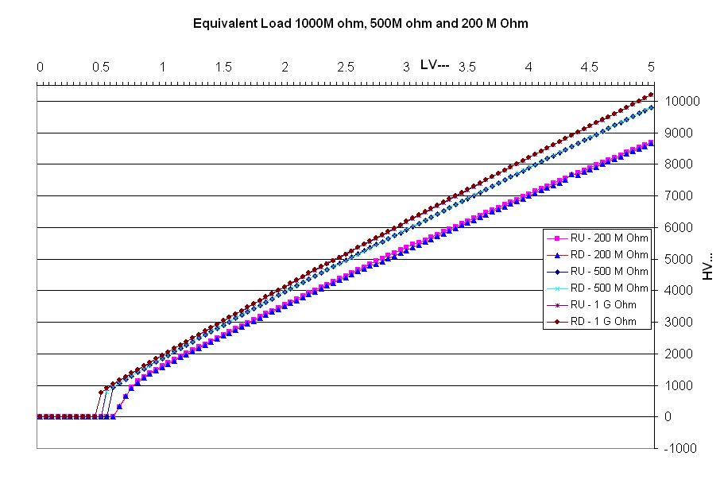
A promising DC-HVDC chip
Can this be good cheaper alternative to commercial solution?

Slide 24
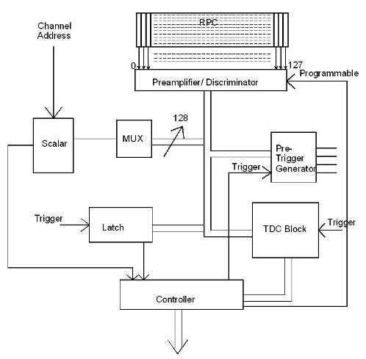
Triggered scheme
RPC , a unit for front-end processing
Conventional architecture
Dedicated sub-system blocks for performing various data readout tasks
Need for Hardware based on-line trigger system
Trigger latency issues and how do we take care in implementation
Synchronisation of trigger/global clock signals

Slide 25
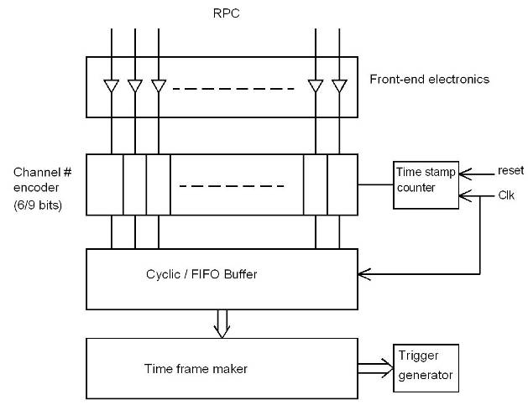
Trigger-less scheme
Suitable for low event rate and low background/noise rates
On-off control and V_{th} control to disable noisy channels
Clock frequency considerations

Slide 26
Trigger system segmentation
Pre-trigger signals (1F, 2F, 3F, …) generated on the RPC unit (Level-0)
Signal driving issues permitting, eight local trigger generating stations (Level-1). Could be more; trade-off with segment overlapping issues.
Level-1 trigger used for data acquisition
Final data validating using Level-2 global trigger

Slide 27
Event rates and event data sizes
Event rates:
Input from simulations: 1.5Hz for full ICAL
Comparable chance coincidence rates if the current trigger scheme is used
Event data sizes:
Very low occupancy
Number of channels grouped for timing, essentially decides the data size
Data reduction at thefront-end

Slide 28
Other critical issues
Power requirement and thermal management
25mW/channel → 100KW/detector
Magnet power
Front-end positioning; use absorber to good use!
Do we need forced, water cooled ventilation?
Suggested cavern conditions
Temperature: 20±2ºC
Relative humidity: 50±5%

Slide 29
Industries’ role
What should be INO’s modus operandi for involving industries?
Jobs like chip fabrication of course will be handled by industries (govt. or pvt.)
Can we out source some design jobs as well?
Industries are very eager and quite willing to!
Tools, design standards, fab facilities

Slide 30
Plan for the parallel sessions
Discussion on overall scheme
Going over each sub-system critically
Suitability, alternate schemes for backup
Identifying existing methods, designs and capabilities
Documenting about firm design inputs needed from physics and other detector elements as well as constraints
Identifying well-defined independent design jobs which could be taken up immediately

