Slide 1
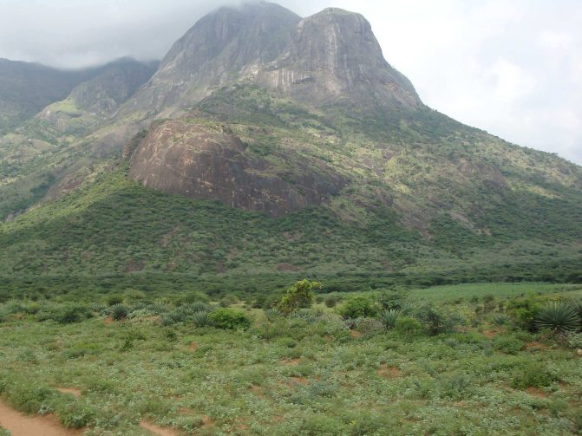
Engineering Challenges of the India-based Neutrino Observatory (INO) Project
Neutrino is the most tiny quantity of reality ever imagined by a human being.
Frederick Reines
Co-discoverer & Nobel Laureate
Dr. B.Satyanarayana ▪ Scientific Officer (G)
Department of High Energy Physics ▪ Tata Institute of Fundamental Research
Homi Bhabha Road ▪ Colaba ▪ Mumbai ▪ 400005 ▪ INDIA
T: 09987537702 ▪ E: bsn@tifr.res.in ▪ W: http://www.tifr.res.in/~bsn

Slide 2
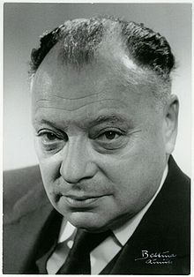
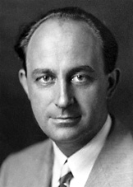
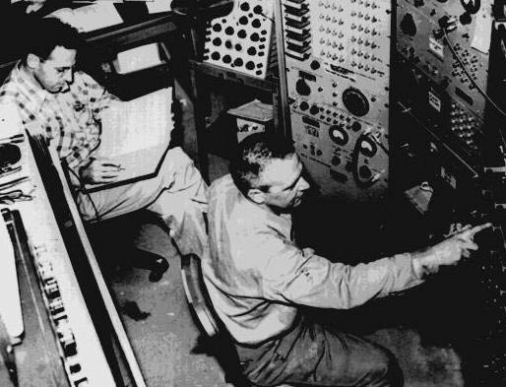
Neutrino (ν)
Proposed by Wolfgang Pauli in 1930 to explain beta decay.
Named by Enrico Fermi in 1931.
Discovered by Frederick Reines and Clyde Cowan in 1956.
Created during the Big Bang, Supernova, in the Sun, from cosmic rays, in nuclear reactors, in particle accelerators etc.
Interactions involving neutrinos are mediated by the weak force.

Slide 3
Unique features of neutrinos
The second most abundant particles in the universe
Cosmic microware background photons: 400/cm³
Cosmic microware background neutrinos: 300/cm³
The lightest massive particles
A million times lighter than the electron
No direct mass measurement yet
The most weakly interacting particles
Invisible: Do not interact with light
Stopping α, β, γ radiation: 50cm lead shielding
Stopping neutrinos from the sun: Several light years!
About 100 trillion neutrinos from the sun and other such objects are going through our body every second without doing any harm.

Slide 4

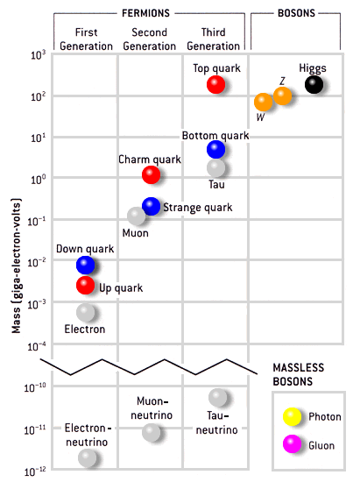
Standard model of particle physics
<2.2eV
<170keV
<15.5MeV

Slide 5
Neutrino oscillations
It is now known that neutrinos of one flavour oscillate to those of another flavour.
The oscillation mechanism is possible only if the neutrinos are massive.
Neutrino experiments are setting the stage for extension of Standard Model itself.
Massive neutrinos have ramifications on nuclear physics, astro physics, cosmology, geophysics apart from particle physics.

Slide 6
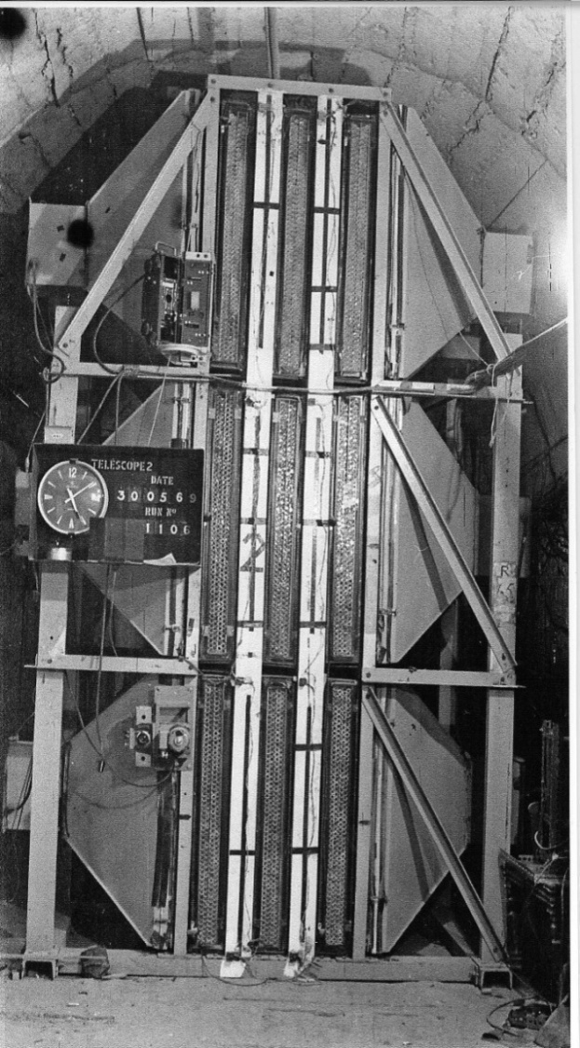
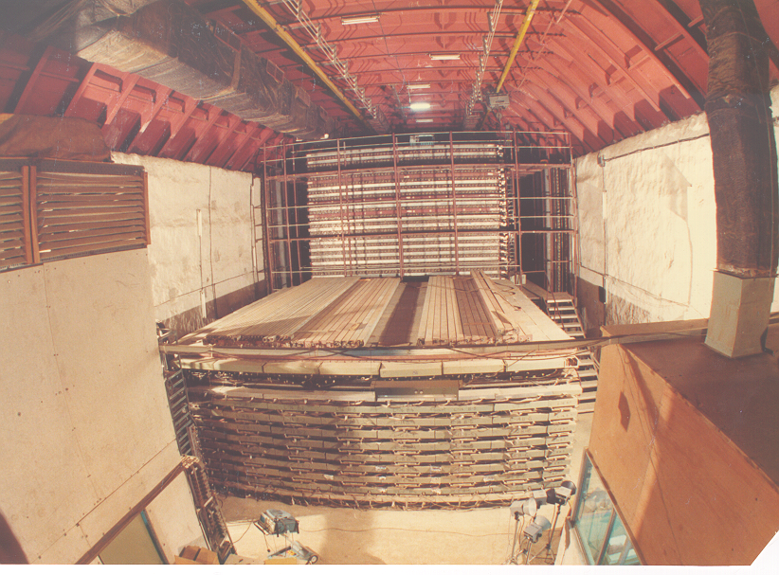
Tradition of underground physics
Proton decay experiments
Atmospheric neutrino detector at Kolar Gold Fields

Slide 7
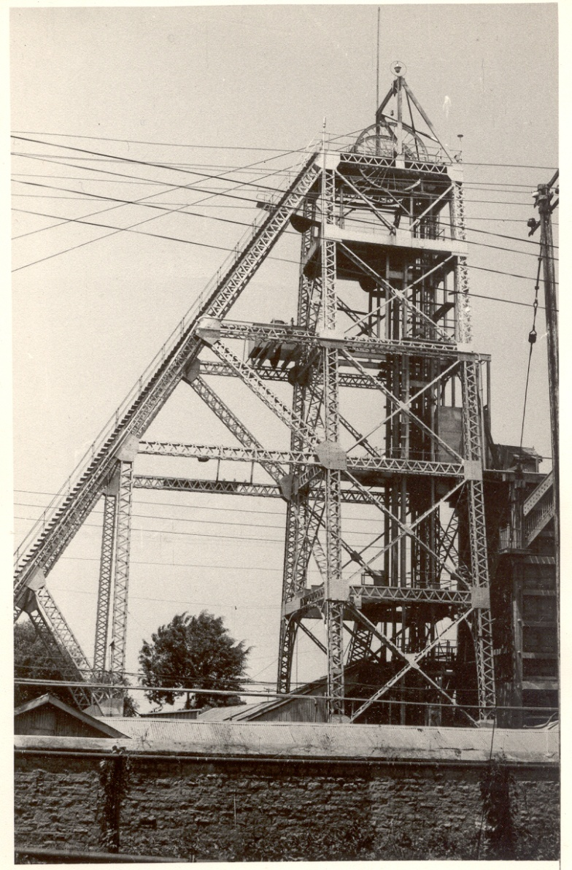
History of neutrino physics in India
India had a long tradition of carrying out High Energy Physics research using deepest underground laboratories in the world at Kolar Gold Fields during 1952-92.
Muon intensities and angular distributions at various depths were studied.
Indian initiative in neutrino physics goes back to nearly 50 years.
Demonstrated for the first time, the feasibility of doing neutrino experiments at KGF.
International collaboration experiment to detect atmospheric neutrinos started at KGF in 1964.
First atmospheric neutrino was detected at KGF at a depth of 2.3km way back in 1965 by the TIFR-Osaka-Durham group.
During early 80s dedicated detectors were setup at KGF by TIFR-Osaka collaboration to look for proton decay
Bounds on neutrino masses using cosmological data.
Estimation of atmospheric neutrino flux.
KGF underground shaft

Slide 8
India-based Neutrino Observatory project
The primary goal of INO is neutrino physics.
A national collaboration of scientists from more than 26 groups belonging to DAE institutions, IITs and Universities.
The total cost of the project is expected to be about Rs.1500 crores.
The project includes:
construction of an underground laboratory and associated surface facilities,
construction of a Iron Calorimeter (ICAL) detector for neutrinos,
setting up of National Centre for High energy Physics (NCHEP).
The project is expected to be completed within seven years beginning April 2012.
A successful INO-Industry interface developed because of the large scale of experimental science activity involved.
INO Graduate Training Programme under the umbrella of Homi Bhabha National Institute (HBNI) - a deemed-to-be University within DAE is in its fifth year.

Slide 9
Possible new proposals at INO
Search for neutrino less double beta decay (NDBD) using ¹²⁴Sn via cryogenic bolometer.
Cryogenic Silicon/Germanium based dark matter experiment at INO (DINO).
Measurement of nuclear cross sections of astrophysical interest using 500kV accelerator; utilising the low back-ground environment inside the INO facility.
The INO facility will develop into a centre for other studies in physics, biology, geology, etc., which will exploit the special conditions existent deep underground.

Slide 10
National Centre for HEP (NCHEP)
To be setup in Madurai, close to the INO facility.
Human resource development in basic experimental science research.
Responsible for operation of the INO facilities.
Will develop full-fledged manpower to operate and maintain the INO laboratory.
Development of detector technology and its varied applications, such as in medical imaging, material science, industrial control and geological survey.

Slide 11
INO Collaboration
Spokesperson: N.K. Mondal, TIFR, Mumbai
Home page: http://www.ino.tifr.res.in
Ahmedabad: Physical Research Laboratory (PRL)
S. Goswami, A.S. Joshipura
Aligarh: Aligarh Muslim University (AMU)
S. Ahmed, M. Sajjad Athar, R. Hasan, S.K. Singh
Allahabad: Harish Chandra Research Institute (HRI)
S. Choubey, R.Gandhi, A.Raychaudhuri
Calicut: University of Calicut (UC)
B.R.S. Babu, A.M. Vinodkumar
Chandigarh: Panjab University (PU)
V.K. Bhandari, V. Bhatnagar, M.M. Gupta, A. Kumar, J.S. Shahi, B. Singh,
J.B. Singh
Chennai: Indian Institute of Technology, Madras (IITM)
N. Chandrachoodan, N. Krishnapurna, J. Libby, A. Prabhakar
Chennai: The Institute of Mathematical Sciences (IMSc)
D. Indumathi, H.S. Mani, M.V.N. Murthy, G. Rajasekaran, N.Sinha
Delhi: Delhi University (DU)
S.K. Chamoli, B.C. Choudhary, D. Choudhury, D. Kaur, A. Kumar,
S. Kumar, S. Mandal, Md. Naimuddin, Shahnawaz, S. Verma, S.K. Verma
Guwahati: Indian Institute of Technology (IITG)
B.Bhuyan, P. Paulose, A. Sil
Hawaii (USA): University of Hawaii (UHW)
S. Pakvasa
Indore: Indian Institute of Technology (IITI)
S. Rakshit
Jammu: University of Jammu (JU)
A. Bhasin, A. Gupta, R. Gupta, S. Mahajan, S.S. Sambyal
Kalpakkam: Indira Gandhi Center for Atomic Research (IGCAR)
J. Jayapandian, C.S. Sundar
Kolkata: Ramakrishna Mission Vivekananda University (RMVU)
Abhijit Samanta
Kolkata: Saha Institute of Nuclear Physics (SINP)
P. Bhattacharya, S. Bhattacharya, Kamales Kar, D. Majumdar, S. Saha
Kolkata: University of Calcutta (CU)
S. Bandyopadhyay, A. Banerjee, D. Jana, G. Gangopadhyay
Kolkata: Variable Energy Cyclotron Centre (VECC)
R.K. Bhandari, S. Chattopadhyay, A.K. Dubey, S.A. Khan, S. Muhuri,
T.K. Nayak, S. Saha, J. Saini, P.R. Sarma, R.N. Singaraju, V. Singhal,
S.K. Thakur, Y.P. Viyogi
Lucknow: Lucknow University (LU)
Jyotsna Singh
Madurai: American College (AC)
S.P.M. Deborrah, K. Gnanasekar, S.R. Inbanathan, K. Moorthy
Mumbai: Bhabha Atomic Research Centre (BARC)
V. Arumugam, Anita Behere, M.S. Bhatia, V.B. Chandratre, V.M. Datar,
M.P. Diwakar, G. Gouthaman, Suresh Kumar, P.K. Mukhopadhyay,
L.M. Pant, B.J. Roy, K. Srinivas, V. Sugadan
Mumbai: Indian Institute of Technology, Bombay (IITB)
Basanta Nandi, S. Uma Sankar, Raghav Varma
Mumbai: Tata Institute of Fundamental Research (TIFR),
B.S. Acharya, S. Banerjee, M.Bhuyan, A. Dighe, K.S. Gothe,
S.D. Kalmani, S. Lahamge, G.Majumder, N.K. Mondal, P. Nagaraj,
B.K. Nagesh, S.K. Rao, L.V. Reddy, A. Redij, D. Samuel, M. Saraf,
B. Satyanarayana, S. Upadhya, P. Verma
Mysore: University of Mysore (MU)
S. Krishnaveni, C. Ranganathaiah, H.B. Ravikumar
Sambalpur: Sambalpur University (SU)
S. N. Nayak
Srinagar: University of Kashmir (UK)
W. Bari, N. Iqbal
Varanasi: Banaras Hindu University (BHU)
B.K. Singh, C.P. Singh, V. Singh

Slide 12
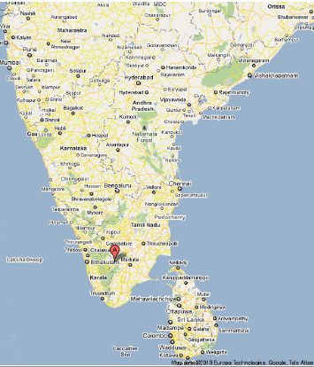
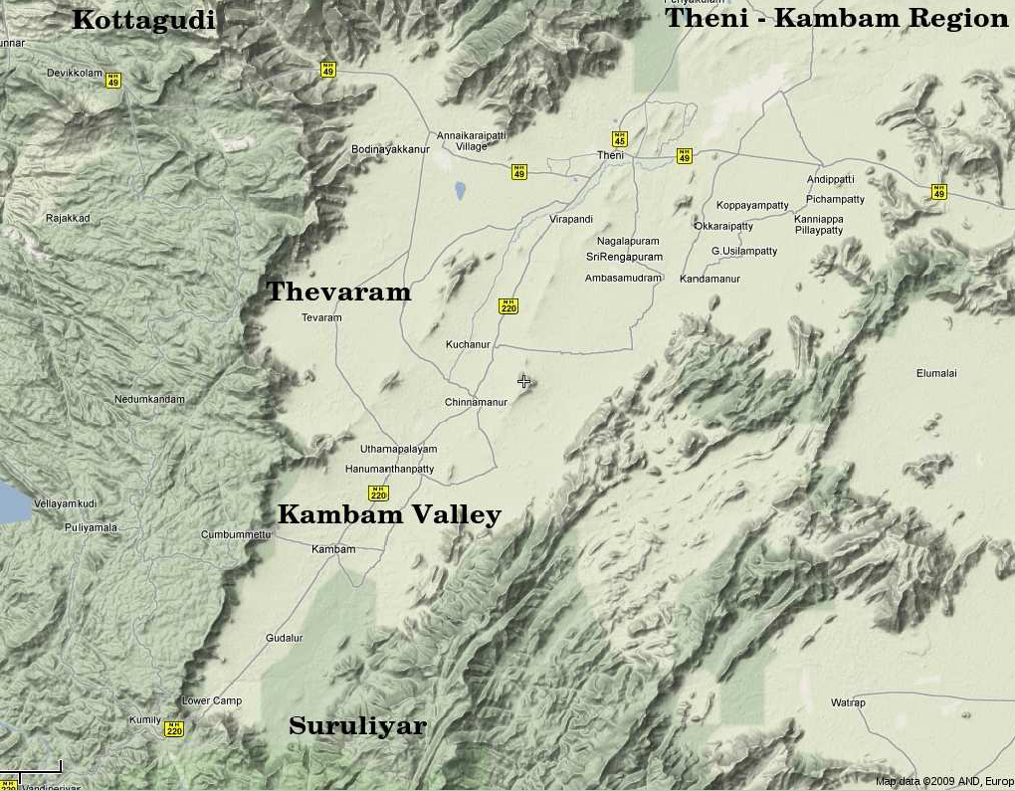
INO coming soon: Inside a mountain near you!
Location: 9º58′ North; 77º16′ East, 110km from Madurai (South India)

Slide 13
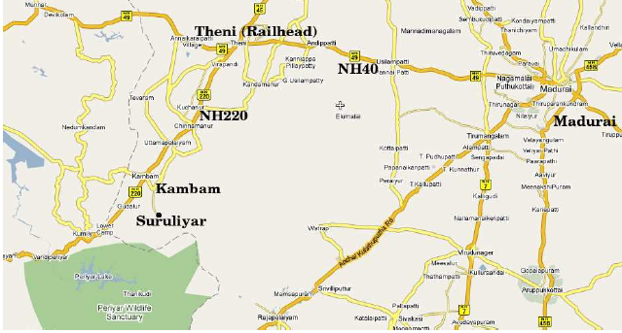
INO coming soon: Inside a mountain near you!
Location: 9º58′ North; 77º16′ East, 110km from Madurai (South India)
Site for INO underground facility

Slide 14

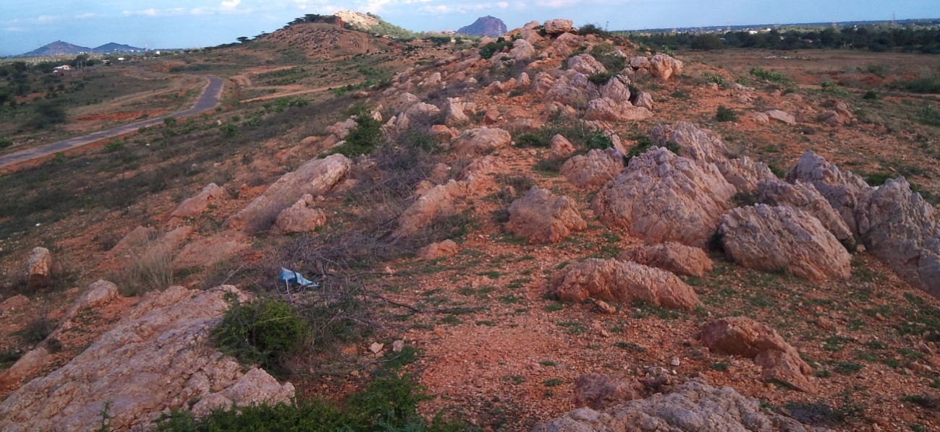
Location and site for National Centre for High Energy Physics
To be located on a 13Ha land very close to the Madurai Kamaraj University (Vadapalanchi and Karadipatti Village) in the city of Madurai.
Will act as the nodal centre for all INO activities.
Will have a major detector development laboratory.
INO Graduate Training program will move to NCHEP when ready.
MKU
NCHEP

Slide 15
Ownership and Management
Infrastructural facilities to be created at Pottipuram (underground lab & surface facilities) as well as those at Madurai (NCHEP) will be under the Department of Atomic Energy (DAE).
National Centre for High Energy Physics (NCHEP) will be the nodal unit of DAE for administrative control of underground laboratory, project monitoring, HRD, Detector R&D etc. TIFR to act as the host institute.
ICAL detector will be funded jointly by DAE and DST.
ICAL detector will be constructed by the members of INO-ICAL collaboration from various research institutes, universities and IITs.

Slide 16
INO Management Structure
Apex Committee chaired jointly by Secretary DAE and Secretary DST and having Directors/Heads of major participating institutes/universities including HBNI.
NCHEP Management Board chaired by Director of the INO host institute.
Project Management Committee chaired by the NCHEP Centre Director.
Project Implementation committees at major participating institutes.
Scientific Advisory Committee chaired by the Director of the INO host institute.

Slide 17
Status of INO sites
Forest land above the INO tunnel and cavern
Received stage II clearance to use 4.12ha of forest land to construct the cavern and the access tunnel under Bodi West Hill reserve forest from Ministry of Environment and Forest.
Land at Pottipuram
26.82.5ha of revenue land at Pottipuram village to establish the INO surface facilities was transferred to the DAE.
Transfer document signed on December 28, 2011.
Land at Madurai
12.5.5ha of land at Madurai to establish the National Centre for High Energy Physics ( NCHEP) against a payment of Rs. 17.14 crores was transferred to the DAE on November 17, 2012.

Slide 18
Civil construction activities
Tendering process on for
Detailed survey work and clearing of jungle at NCHEP site at Madurai and INO site at P0ttipuram.
Construction of barbed wire fencing with RCC posts over random rubble masonry wall around NCHEP site at Madurai and INO site at Pottipuram.
Tender documents under preparation for
Architectural/Engineering services consultancy for INO surface facility buildings at Pottipuram and NCHEP building at Madurai including landscape and horticulture.
Geotechnical survey at Pottipuram and Madurai.
Tender documents yet to be prepared for
Prefabricated laboratory buildings at NCHEP site.
Initial activities of the project to start soon in the rented premises in Madurai.

Slide 19
Civil works carried out through TN government agencies
MoU with the Tamil Nadu Water Supply and Drainage Board (TWAD) signed for water supply infrastructure development for Pottipuram site. Cost of the work package: 592 Lakhs.
Improvement/construction of 9km approach road to INO site from Rasingapuram to Pottipuram (Km. 21/10 of Palayam-Bodi Road (SH100), 0/0 – 10/6). To be taken up by Tamil Nadu Highways Department. Cost of the work package Rs. 2045 Lakhs including Rs. 297 Lakhs centage charges.
Funds also approved for the temporary electricity connection for Pottipuram site.
Rs. 300 Lakhs approved for local area development.

Slide 20
Neutrino sources and detector choice
Source of neutrinos
Use atmospheric neutrinos as source
Need to cover a large L/E range
Large L range
Large E_{ν} range
Upto 20 GeV muons contained in fiducial volume; most interesting region for observing matter effects in 2–3 sector is 5–15 GeV
ICAL is sensitive to muons only, very little sensitivity to electrons; Electrons leave few traces (radiation length 1.8 (11) cm in iron (glass))
Physics driven detector requirements
Should have large target mass (50-100 kT)
Good tracking and energy resolution (tracking calorimeter)
Good directionality, up/down discrimination (< 1 nSec time resolution)
Nearly 4π coverage in solid angle (except near horizontal)
Good charge identification capability (magnetic field ∼1.5 Tesla)
Modularity and ease of construction (3 modules of ~17 kTons each)
Compliment capabilities of existing and proposed detectors
Use magnetised iron as target mass and RPC as active detector medium

Slide 21
Physics possibilities with ICAL
ICAL detector is expected to play a significant and pioneering role in the global experimental particle physics program over the next several decades.
ICAL is capable of shedding light on the neutrino mass hierarchy, or the ordering of neutrino masses, due to its unique capability to identify lepton charge.
Determining the hierarchy would be a crucial pointer to the physics that lies beyond the Standard Model.
ICAL can significantly aid in improving the precision of the atmospheric mass squared difference and the associated mixing angle.
Using effects primarily due to earth's matter, it can also shed light on the octant of the atmospheric mixing angle.
ICAL's capability to set bounds on the violation of CPT has also been explored.
Its sensitivity to new long range forces has been studied.
ICAL is capable of substantially adding to our present knowledge of very high energy cosmic ray muons due to its unique capability to access hitherto unexplored energy regions in this sector.
Several studies have also explored ICAL's capabilities as an end detector for a neutrino factory or a beta beam. This would allow precise measurements of very important parameters like the CP phase and the small mixing between two of the neutrino mass states.
Extensive simulation studies are under progress to refine and sharpen the physics capabilities ICAL.

Slide 22
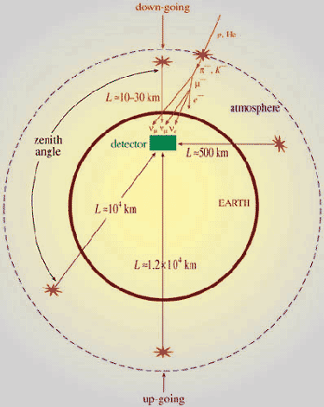
Up-Down asymmetry measurement
Atmospheric neutrino energy > 1.3GeV Δm² ~2-3×10⁻³ eV²
Downward muon neutrino are not affected by oscillation
They may constitute a near reference source
Upward neutrino are instead affected by oscillation since the L/E ratio ranges up to 10⁴ Km/GeV
They may constitute a far source
Thus, oscillation studies with a single detector and two sources

Slide 23
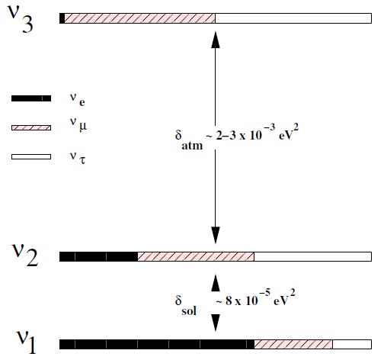
Matter effects and neutrino mass hierarchy
Matter effects help to cleanly determine the sign of the Δm²
Neutrinos and anti-neutrinos interact differently with matter
ICAL can distinguish this by detecting charge of the produced muons, due to its magnetic field
Helps in model building for neutrino oscillations

Slide 24
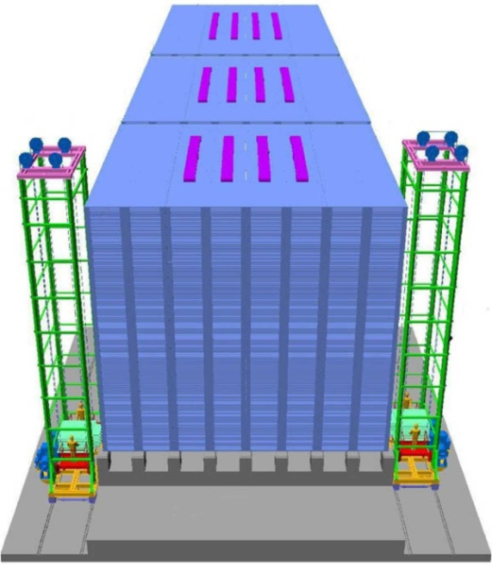
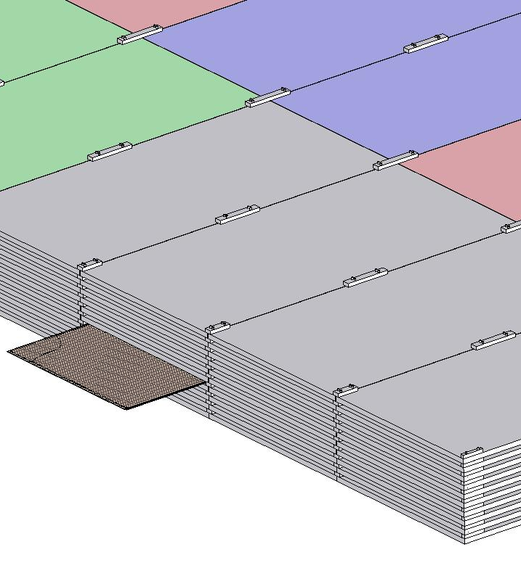
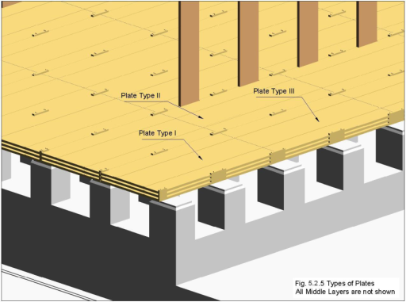
ICAL detector and construction
Magnet coils
4000mm×2000mm
×56mm low carbon iron sheets
RPC handling trolleys
RPC
Total weight: 50Ktons
4832 * 3 sheets

Slide 25
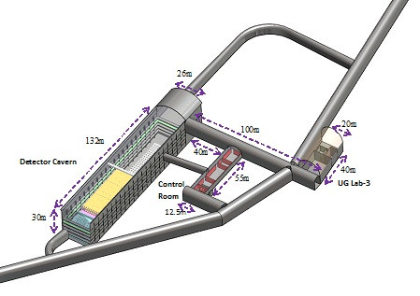
Underground Laboratory Layout
Length of the tunnel | 2.1 km (approx.)
Tunnel cross-section | 7.5m wide and 7.5m high
Tunnel gradient | 1:15
Rock overburden | 1300m (4000 mwe)
Rock type and density | Charnockite, 2.9 gm/cc
Number of caverns | 3 (one big and two small)
Size of the main cavern | 132m × 26m × 20m (high)
Distance from CERN | 7100 km
Distance from JPARC | 6600 km
Future nuclear reactor | 9000 Mwe, 205 km
Basic features

Slide 26
Power requirement
Main Hall
200KW for cooling electronic circuits of one 50 kton detector assembly (4 million channels, each consuming 50mW). That is 400KW for two.
The magnet power requirements is about 450KW for one set up i.e. 900KW for two set ups.
Control room/lab
Neutrino-less Double Beta Decay experiment (NDBD) will require about 20KW for cooling of associated electronics.
The NDBD experimental set up requires a helium compressor of 10litre/day capacity, which will be driven by a 50KW motor.
The AC, ventilation, mechanical, material handling and lighting loads.

Slide 27
Mains power
The electric power will be received from nearby TNEB substation through 2, 11KV feeders at the utility building. This will in turn feed 2, 11KV/433V dry type transformers of adequate capacity located in the same building and 2 transformers at the cavern.
Further distribution will be at 415Volts .
The Transformers will be sized to meet all the loads including emergency, DC and UPS.
Emergency power
2 silent DG sets of adequate capacity, will be located in the utility building.
Emergency loads will be restricted to 10KW for NDBD experiment (Dilution refrigerant equipment.), high voltage supply to the detectors and gas flow monitors.
Magnets and Detector electronics do not require emergency power.
No common UPS will be provided.
Small independent UPS will be procured and installed wherever required, as part of scientific equipment.
Similarly DC supplies for the magnets also will be procured separately. The DC system and UPS systems must be capable of receiving 415V, 50Hz, 3 phase supply.

Slide 28
AC/ Ventilation
The main experimental hall will be maintained at 21 ± 3 ºC and RH <55%.
Isobutane , being denser than air, may collect at the floor level. A separate duct system (or return grills at his level) for sucking this may be designed.
It would be desirable, if simple ventilation system with air washers can be designed to meet the ambient conditions required in the main hall, considering the lower temperature in the cavern interior, which is about 1300m below ground and has a earth cover of 1000m all around.
The NDBD area need not be air conditioned. Normal human comfort level AC may be maintained in the control room. All other areas will have minimum air changes required for human comfort.

Slide 29
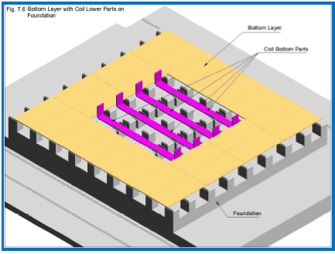
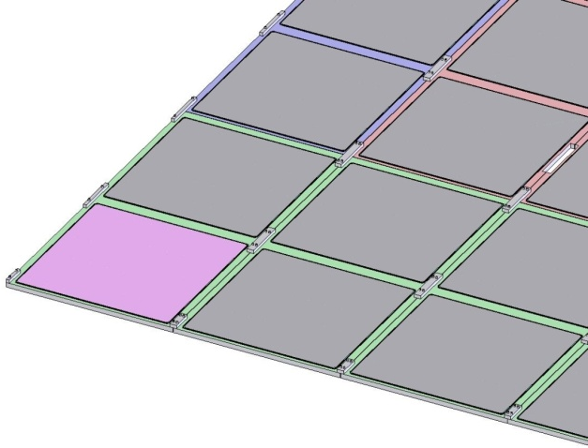
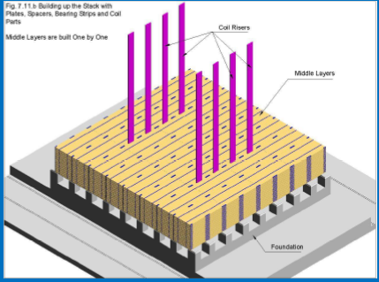
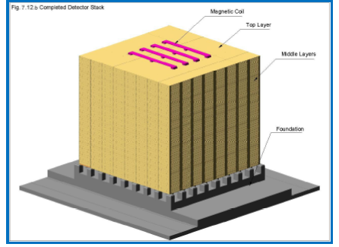
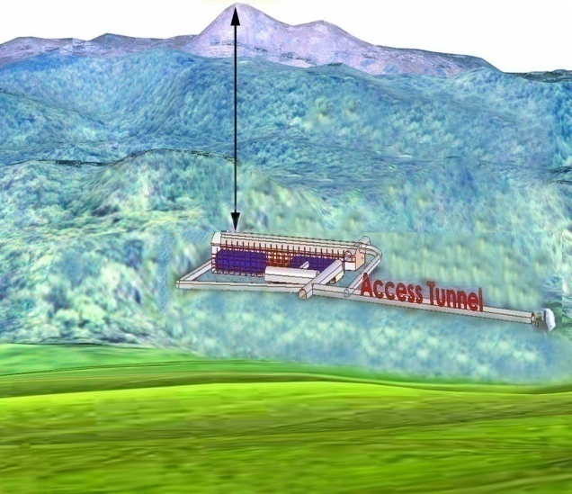
Construction of ICAL Magnet

Slide 30

Animation of ICAL construction

Slide 31
Factsheet of ICAL detector
No. of modules | 3
Module dimensions | 16m × 16m × 14.5m
Detector dimensions | 48.4m × 16m × 14.5m
No. of layers | 150
Iron plate thickness | 56mm
Gap for RPC trays | 40mm
Magnetic field | 1.3Tesla
RPC dimensions | 1,950mm × 1,840mm × 24mm
Readout strip pitch | 3 0mm
No. of RPCs/Road/Layer | 8
No. of Roads/Layer/Module | 8
No. of RPC units/Layer | 192
No. of RPC units | 28,800 (97,505m²)
No. of readout strips | 3,686,400

Slide 32
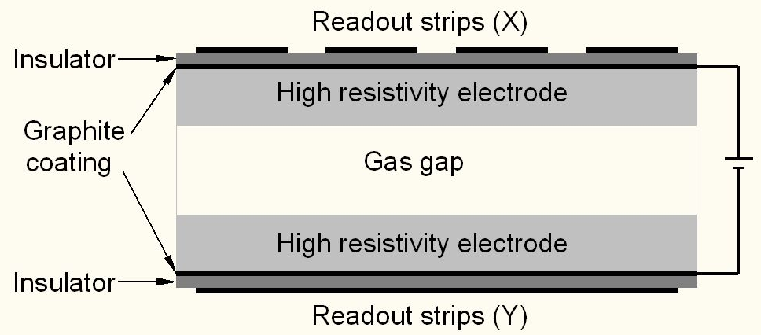
Schematic of a basic RPC

Slide 33
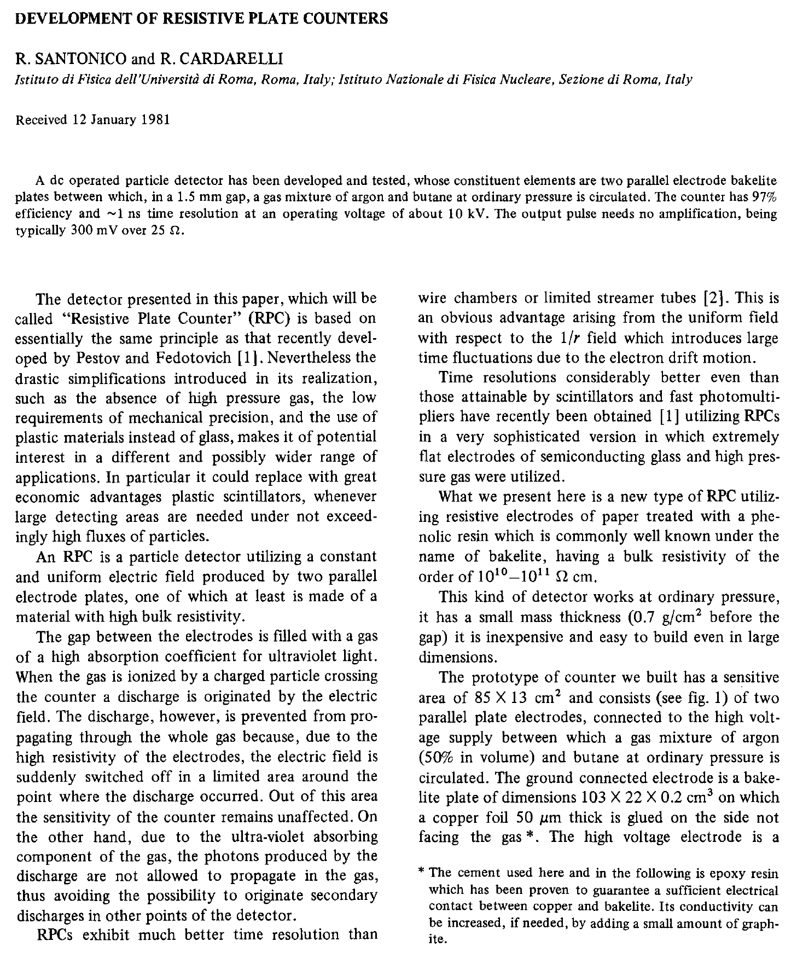
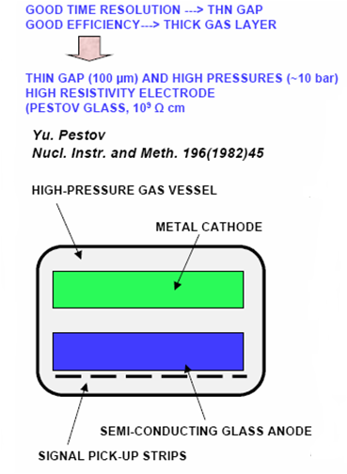
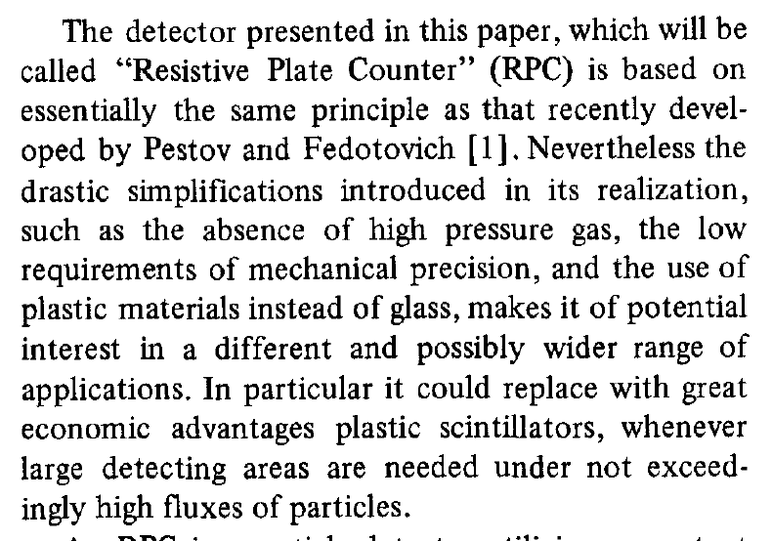
Birth of the RPC

Slide 34
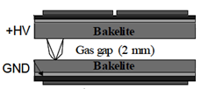
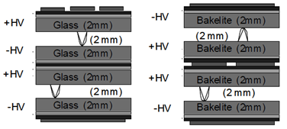
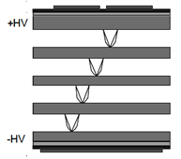
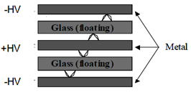
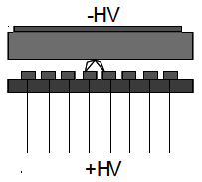
Application driven RPC designs
Single gap RPC
Double gap RPC
Multi gap RPC
Hybrid RPC
Micro RPC

Slide 35
Why ICAL chose RPC?
Large detector area coverage, thin (~10mm), small mass thickness
Flexible detector and readout geometry designs
Solution for tracking, calorimeter, muon detectors
Trigger, timing and special purpose design versions
Built from simple/common materials; low fabrication cost
Ease of construction and operation
Highly suitable for industrial production
Detector bias and signal pickup isolation
Simple signal pickup and front-end electronics; digital information acquisition
High single particle efficiency (>95%) and time resolution (~1nSec)
Particle tracking capability; 2-dimensional readout from the same chamber
Scalable rate capability (Low to very high); Cosmic ray to collider detectors
Good reliability, long term stability
Under laying Physics mostly understood!

Slide 36
Deployment of RPCs in running experiments
Experiment | Area (m²) | Electrodes | Gap(mm) | Gaps | Mode | Type
PHENIX | ? | Bakelite | 2 | 2 | Avalanche | Trigger
NeuLAND | 4 | Glass | 0.6 | 8 | Avalanche | Timing
FOPI | 6 | Glass | 0.3 | 4 | Avalanche | Timing
HADES | 8 | Glass | 0.3 | 4 | Avalanche | Timing
HARP | 10 | Glass | 0.3 | 4 | Avalanche | Timing
COVER-PLASTEX | 16 | Bakelite | 2 | 1 | Streamer | Timing
EAS-TOP | 40 | Bakelite | 2 | 1 | Streamer | Trigger
STAR | 50 | Glass | 0.22 | 6 | Avalanche | Timing
CBM TOF | 120 | Glass | 0.25 | 10 | Avalanche | Timing
ALICE Muon | 140 | Bakelite | 2 | 1 | Streamer | Trigger
ALICE TOF | 150 | Glass | 0.25 | 10 | Avalanche | Timing
L3 | 300 | Bakelite | 2 | 2 | Streamer | Trigger
BESIII | 1200 | Bakelite | 2 | 1 | Streamer | Trigger
BaBar | 2000 | Bakelite | 2 | 1 | Streamer | Trigger
Belle | 2200 | Glass | 2 | 2 | Streamer | Trigger
CMS | 2953 | Bakelite | 2 | 2 | Avalanche | Trigger
OPERA | 3200 | Bakelite | 2 | 1 | Streamer | Trigger
YBJ-ARGO | 5630 | Bakelite | 2 | 1 | Streamer | Trigger
ATLAS | 6550 | Bakelite | 2 | 1 | Avalanche | Trigger
ICAL | 97,505 | Both | 2 | 1 | Both | Trigger

Slide 37
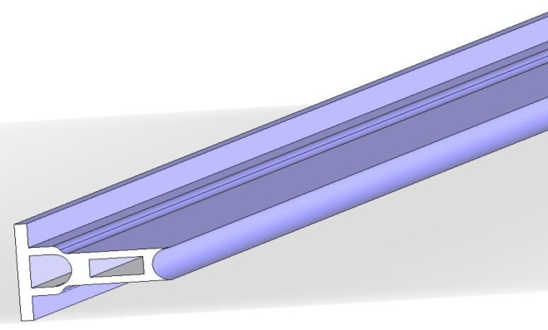
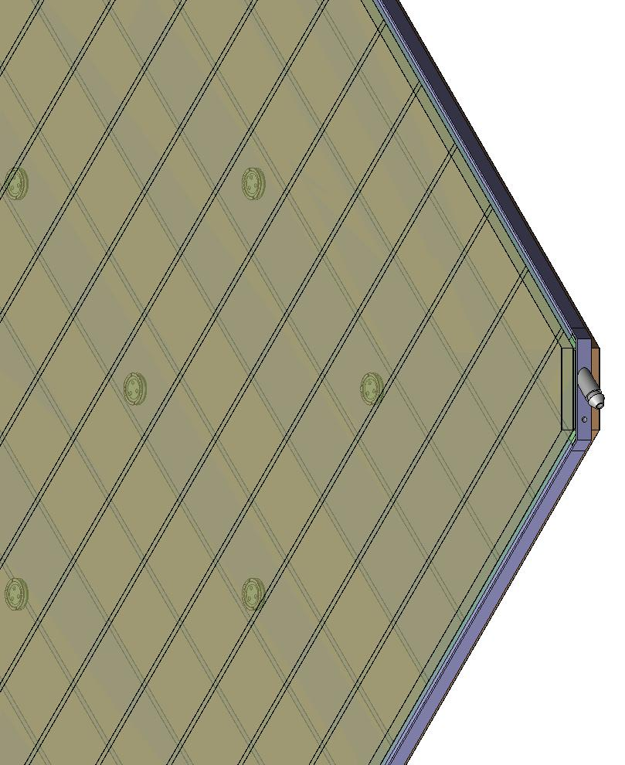
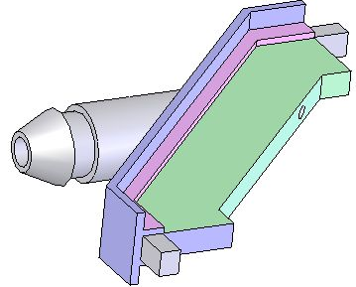
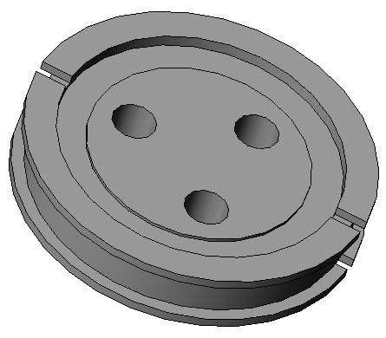
Materials for gas volume fabrication
Edge spacer
Schematic of an assembled gas volume
Gas nozzle
Glass spacer

Slide 38
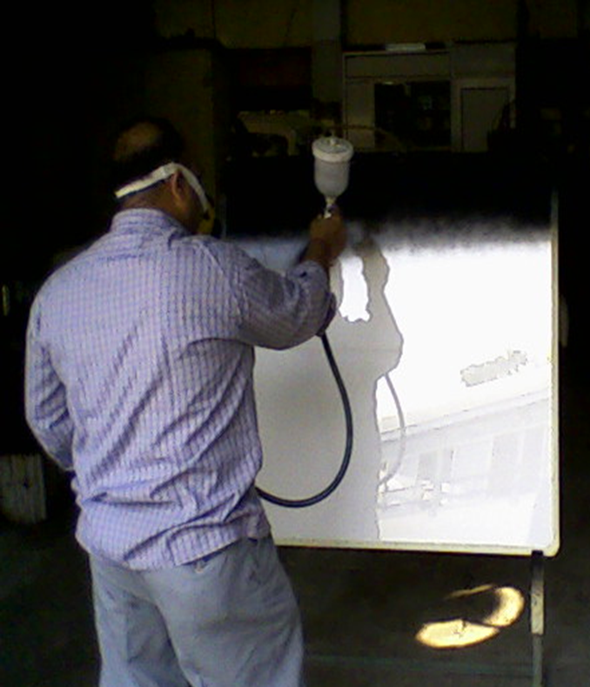
Electrode coating techniques
Graphite paint prepared using colloidal grade graphite powder(3.4gm), lacquer(25gm) and thinner(40ml)
Sprayed on the glass electrodes using an automobile spray gun.
A uniform and stable graphite coat of desired surface resistivity (1MΩ/◻) was obtained by this method.

Slide 39
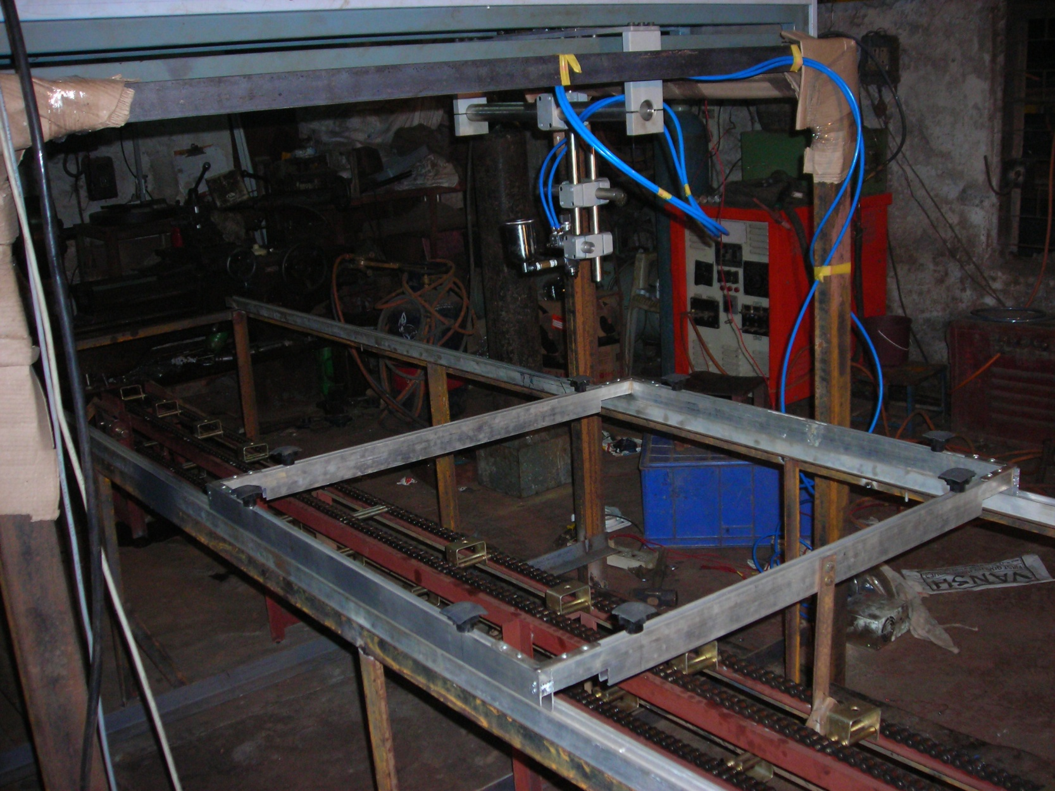
Automatic spray paint plant
Drive for Y-movement
Automatic spray gun
Control and drive panel
Glass holding tray
Drive for X-movement

Slide 40
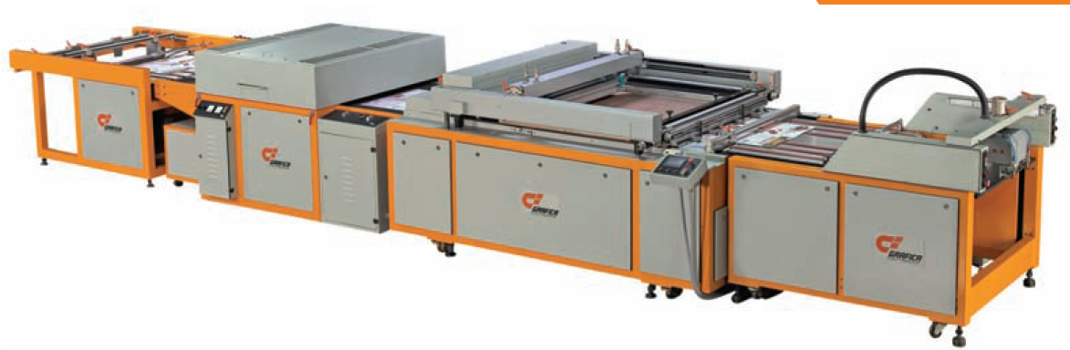
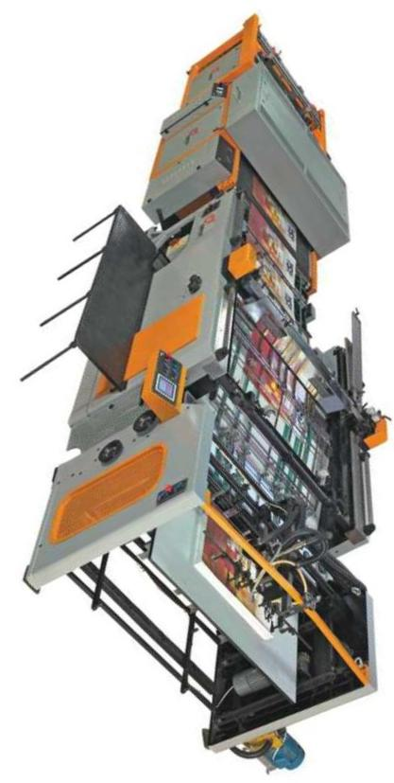
Screen printing techniques
On glass
On films

Slide 41
Schematic of RPC assembly jig

Slide 42
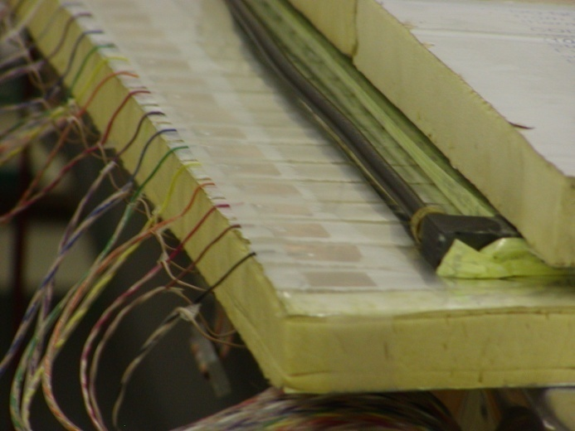
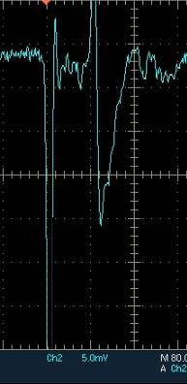
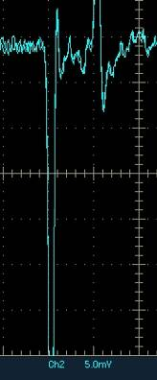
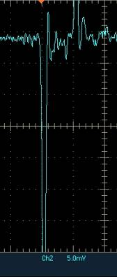
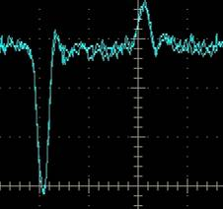
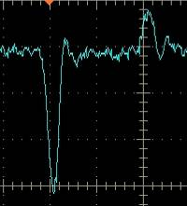
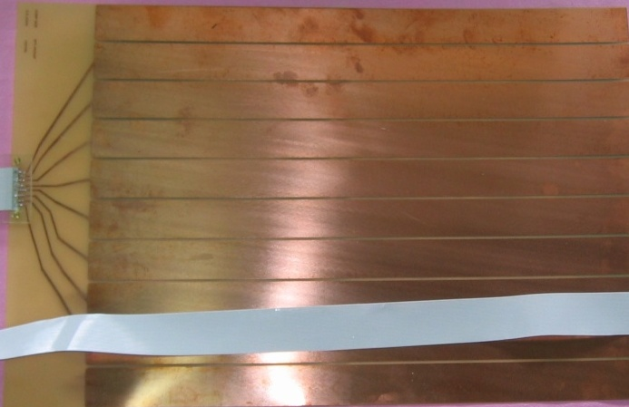
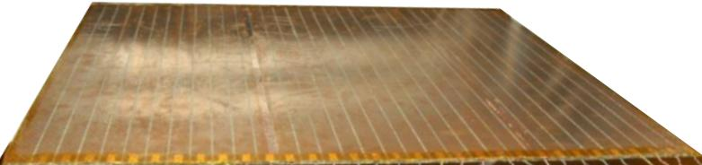
Development and characterisation of signal pickup panels
Foam panel
48.2Ω
G-10 panel
Open
100Ω
51Ω
47Ω
Z₀: Inject a pulse into the strip; tune the terminating resistance at the far end, until its reflection disappears.
Honeycomb panel

Slide 43
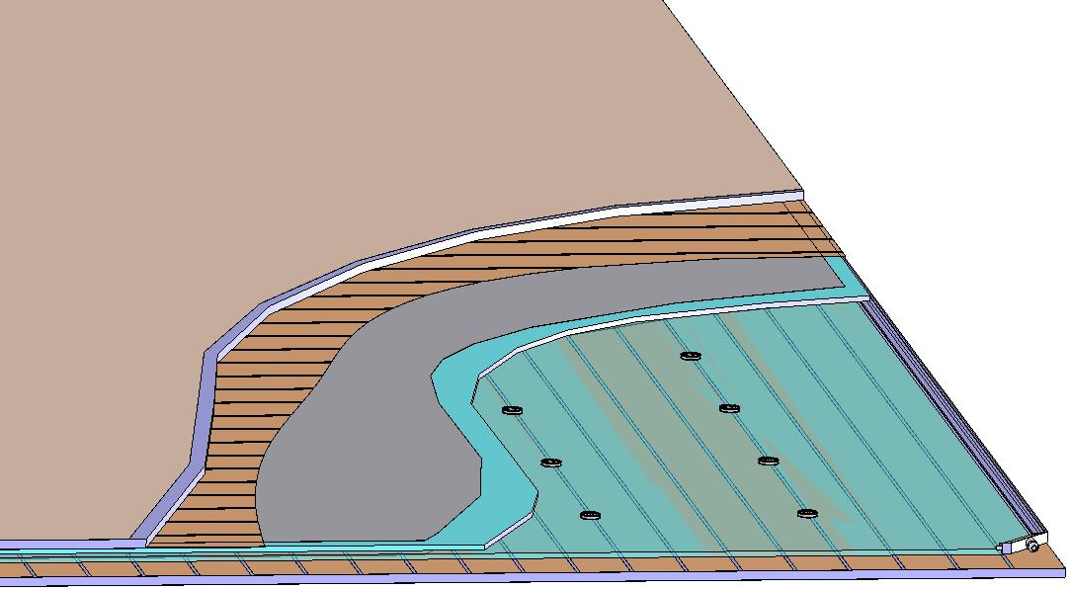
Basic construction of an RPC
Signal reference plane.1
Plastic honey comb.2
Copper pickup strips.3
Graphite/Paint.4
Top glass.5
Button spacer.6
Bottom glass.7
Edge spacer.8
Gas nozzle.9
Bottom pickup panel.A
8
1
2
3
4
5
6
7
9
A

Slide 44
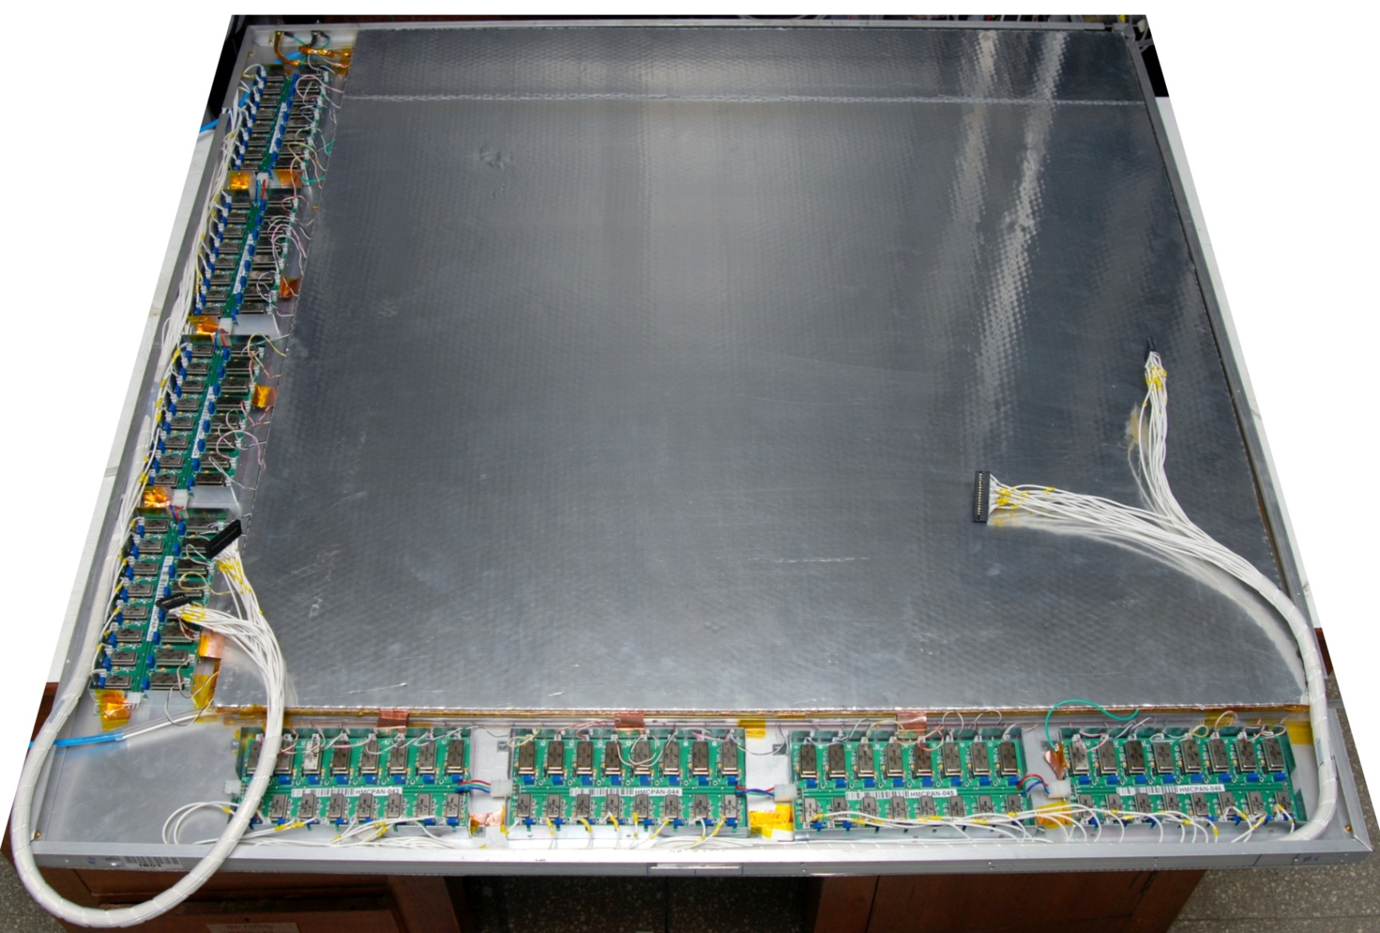
Fully assembled large area RPC
1m × 1m

Slide 45




RPC parameter characterisation

Slide 46

RPC tomography using cosmic ray muons

Slide 47


Studying long-term stability

Slide 48
Requirement of gases in ICAL
Total number of RPCs in ICAL = 3 × 150 × 64 = 28,800
Total gas volume = 28,800 × 184cm × 184cm × 0.2cm = 195,010 litres
For ex: One volume change/day with 10% gas top-up in a re-circulating scheme
Approximate running gas cost = Rs 30,000/day
Gas | Avalanche (%) | Streamer (%) | Maximum (%) | Volume (L) | Density (g/L) | Weight (Kg) | Cost (Rs/Kg)
Argon | 0.0 | 30.0 | 30.0 | 58,503 | 1.784 | 104.4
R134a | 95.5 | 62.0 | 95.5 | 186,234.6 | 4.25 | 791.5
Isobutane | 4.3 | 8.0 | 8.0 | 15,600.8 | 2.51 | 39.16
SF₆ | 0.2 | 0.0 | 0.2 | 390 | 6.164 | 2.40

Slide 49

Schematic of gas system

Slide 50
Features of the gas system
16 pneumatically controlled outputs
Molecular sieve based input filter columns
Nippon Tylan made model FC-760 MFCs
Parker made fine filters on the mixed gas
On-line moister readout on mixed gas
Output flow control by SS 0.3mm capillaries
Bleeder bubblers for RPC protection
Facility to add controlled moister into the mixture
Computer interface for control and monitoring

Slide 51







Constructional details of the gas system
Internal view
Front view
Rear view

Slide 52

Optimization of gas flow rate for RPCs
Variation in Noise rate and Dark current attributed to different leak rates
If proper sealing, as part of QC is done, then the detectors can operate satisfactorily for more than a month with single gas fill and hence reduce the cost of replenishing gas!

Slide 53

Closed-loop gas recirculation system
4 channel gas mixing module (filling/top-up of Iso-butane, Freon R134A, Argon and SF6)
Total Capacity: 140 litres
Continuous duty gas purification system to remove moisture, and other radicals
Contamination removal up to 2ppm.

Slide 54



Newly developed gas recirculation system

Slide 55

Prototype RPC stack

Slide 56

Stack of 2m × 2m RPCs

Slide 57

ICAL prototype at VECC

Slide 58

Schematic of prototype detector DAQ system

Slide 59













Design and implementation of the data acquisition system
200 boards of 13 types
Custom designed using
FPGA,CPLD,HMC,FIFO,SMD

Slide 60


A couple of interesting events

Slide 61


RPC strip rate time profile
Temperature

Slide 62

Studies with detector stacks

Slide 63

Overall scheme of ICAL electronics
Major elements
Front-end board
RPCDAQ board
Segment Trigger Module
Global Trigger Module
Global Trigger Driver
Tier1 Network Switch
Tier2 Network Switch
DAQ Server

Slide 64



Functions & integration of FE-DAQ

Slide 65





Picking up the tiny charges
Process: AMSc35b4c3 (0.35um CMOS)
Input dynamic range:18fC – 1.36pC
Input impedance: 45Ω @350MHz
Amplifier gain: 8mV/μA
3-dB Bandwidth: 274MHz
Rise time: 1.2ns
Comparator’s sensitivity: 2mV
LVDS drive: 4mA
Power per channel: < 20mW
Package: CLCC48(48-pin)
Chip area: 13mm²

Slide 66

Picking up the tiny charges
Process: AMSc35b4c3 (0.35um CMOS)
Input dynamic range:18fC – 1.36pC
Input impedance: 45Ω @350MHz
Amplifier gain: 8mV/μA
3-dB Bandwidth: 274MHz
Rise time: 1.2ns
Comparator’s sensitivity: 2mV
LVDS drive: 4mA
Power per channel: < 20mW
Package: CLCC48(48-pin)
Chip area: 13mm²

Slide 67

Preamplifier Board
23
403
Current Anusparsh-2 chip dimensions does not fit to this design
Next iteration might shrink the size
Package the chip in the rectangular shape
Go for chip bonding (for example: ATLAS’s RPC front-end)

Slide 68

Preamplifiers to RPC-DAQ
Cable: Molex 5020-0171
0.50mm Pitch Premo-Flex™ FFC Jumper, Same Side Contacts (Type A), 16 Circuits, 0.152m Cable Length, 0.27mm Cable Thickness, Gold (Au) Plating
We studied the LVDS signal transmission characteristics over FFC cable of 1m length.
The observations have indicated that the crosstalk between channels is zero.
Also the data transmission is reliable as every bit sent is received by the destination upto the input signal frequency of 40 MHz.

Slide 69

RPCDAQ module – the workhorse
Unshaped, digitized, LVDS RPC signals from 128 strips (64x + 64y)
16 analog RPC signals, each signal is a summed or multiplexed output of 8 RPC amplified signals.
Global trigger
TDC calibration signals
TCP/IP connection to backend for command and data transfer

Slide 70
Functions of the RPCDAQ module
RPCDAQ board records the following data from the front-end signals
Asynchronous event data on each trigger
Strip hit data: event pattern across the 128 strips.
Timing data: relative arrival times of pulses (belonging to the same event) with respect to each other
Pulse width of the event pulses, to be measured from the timing data taken on both the edges of the input pulses
Pulse profile
Periodic data (in the background)
Strip rates: Noise rates for each strip. Strip rate counting may be multiplexed.
Ambient parameters: Temperature, relative Humidity and Pressure.
RPC high voltage and current, if HV is generated locally using HV DC-HVDC

Slide 71
Design considerations & constraints
Data rates are low.
Physical dimensions: Owing to severe space constraints on the RPC, triangular space of about 160cm² only is available for this extremely high density board.
Service life of the electronics is expected to be more than15 years, component spares availability/replaceability is a concern.
Since the temperature and humidity inside the cavern will be controlled for RPCs, the electronic components need not be even of industrial grade - Commercial grade will do.
Low power consumption. It is highly desirable to have minimum power consumption.
Cost: Since the volumes are high, cost is also a major consideration

Slide 72
Data sizes and rates – Event
TDC data = 1 channel for 8 strips and both the edges per hit, up to 4 hits per channel per event = 16 channels x 2 edges x 4 hits x 16 bits = 2048 bits
Hit data per RPC = 128 bits
RPC ID = 32 bits
Event ID = 32 bits
Time Stamp = 64 bits
DRS data = 16 channels x 1000 samples x 16 bits = 256000 bits
(DRS data comes in event data only if we get summed analog outputs from the preamplifier)
Data size per event per RPC
With DRS data, DR = 2048 + 128 + 32 + 32 + 64 + 256000 = 258,304 bits
Without DRS data, DR = 2048 + 128 + 32 + 32 + 64 = 2,304 bits
Considering 1Hz trigger rate, Maximum data rate per RPC = 252.25 kbps

Slide 73
Data sizes and rates - Monitoring
We require to monitor 1 pick-up strip per plane per RPC.
Monitor Data per strip = 24 bits
Channel ID = 8 bits
RPC ID = 32 bits
Mon Event ID = 32 bits
Ambient Sensors’ data = 3 x 16 bits = 48 bits
Time Stamp = 64 bits
DRS data = 1000 pulses (if noise rate is 100Hz) x 16 bits x 100 samples = 1600000 bits
(DRS data comes in monitoring data only if we get multiplexed analog outputs from the preamplifier)
Data size per 10 seconds per RPC
With DRS data = 24 + 8 + 32 + 32 + 48 + 64 + 2048 + 1600000 = 1,602,256 bits
Without DRS data = 24 + 8 + 32 + 32 + 48 + 64 + 2048 = 2,256 bits
Maximum data rate with 10 second monitoring period per RPC = 156.47 kbps

Slide 74
RPCDAQ components
FPGA:
It is the heart of the RPCDAQ Module
The FPGA will accept LVDS signals from the preamps and process them
It will house all the logic required for daq, in addition to housing the on board microprocessor
We require an FPGA with 400 + user I/Os including 140 LVDS pairs
Presently we are testing our systems on Altera Cyclone II & IV FPGAs
Looking at Xilinx Spartan 6 LX100 and Altera Cyclone IV CE115 FPGA
Microprocessor:
From the block diagram it is clear that there are multiple sources of data
Data from these sources needs to be packed and streamlined into two separate streams
Combinatorial + Sequential logic alone using the FPGA is extremely difficult to use
We are using the NIOS II Soft-Core Processor for Altera FPGAs

Slide 75
NIOS II soft-core microprocessor
The NIOS II soft-Core processor from Altera
It is a Reduced Instruction Set Computer (RISC) processor core with Harvard memory architecture and the following salient features:
Full 32-bit instruction set, data path, and address space
32 general-purpose registers
32 interrupt sources
External interrupt controller interface for more interrupt sources
Software development environment based on the GNU C/C++ tool chain and the NIOS II EDS for Eclipse
Programming and debugging using FPGA’s JTAG port
Peripherals are added to the NIOS II Processors through the Avalon Interface Bus which contains the necessary logic to interface the processor with off-the-shelf IP cores or custom made peripherals
Its available with IP cores for standard peripherals for free for educational and research purposes

Slide 76

TDC
Timing information will be required to find the up or down direction of Muon tracks
This can be inferred from the relative arrival times of pulses across the vertical direction of ICAL
Hence the need of a TDC
A multi-hit TDC can be used to measure pulse width
We are currently planning to use HPTDCs available with us, for the first prototype
An adapter board developed, being debugged
HPTDC: High Performance Time to Digital Converter
Developed at CERN for time-of-flight measurement experiments
32-channel Multi Hit TDC
0.25 μm CMOS technology
Resolution of up to 17ps in HiRes mode

Slide 77

TDC implementation in an FPGA at IITM

Slide 78

ASIC based TDC device
Principle
Two fine TDCs to measure start/stop distance to clock edge (T₁, T₂)
Coarse TDC to count the number of clocks between start and stop (T₃)
TDC output = T₃+T₁-T₂
Specifications
Currently a single-hit TDC, can be adapted to multi-hit
20 bit parallel output
Clock period, T_{c} = 4ns
Fine TDC interval, T_{c}/32 = 125ps
Fine TDC output: 5 bits
Coarse TDC interval: 2¹⁵ * T_{c} = 131.072μs
Coarse TDC output: 15 bits
The chip has arrived, evaluation tests are in progress it IITM
CMEMS is also coming up with an ASIC with similar specs.

Slide 79
Pulse shape monitor
0.2-2 ns
Inverter “Domino” ring chain
IN
Stefan Ritt, Paul Scherrer Institute, Switzerland
Waveform
stored
Out
Clock
Shift Register
“Time stretcher” GHz → MHz

Slide 80

Waveform sampler
It is desirable to have pulse profile information in ICAL
This way we can find pulse amplitudes, charge information etc, which would not be possible without a sampler
The pulse profile data can also be used for debugging of the electronics
We can use the DRS4 chip developed by Stefan Ritt at the Paul Scherrer Institute (PSI)
No plan to have this for engineering module
DRS4 does not quite match to our DAQ specification as we understand its operation today
There is good scope for design of our own chip, which has many potential applications besides INO.
CMEMS and IITM did design these chips in the past, but their specifications fall short.

Slide 81

Data network interfaces

Slide 82


Network interface specifications
Data traffic into RPC-DAQ is Configuration/ commands – Beginning or rarely Broad cast/ Multicast – UDP protocol with/higher layer check
Data traffic out of RPC-DAQ is relatively high (45/332kbps)
We will use a TCP/IP based network interface to send and receive data from front-end to the back-end. TCP/IP over UTP or optical fiber is a reliable protocol over long distances.
Hardwired network protocol – Wiznet 5300 chip is used

Slide 83
Wiznet W5300 specifications
Hardwired TCP/IP Protocols: TCP, UDP, ICMP, Ipv4, ARP, IGMPv2, PPPoE Ethernet
Data Communication- After initialization, W5300 can transmit or receive data by opening the SOCKET as TCP, UDP,IPRAW, or MACRAW mode.
8 independent SOCKETs simultaneously (1-server 7-clients)
Internal 128kbytes memory for RX /TX buffers (16K/16Kx7)
Embedded 10BaseT/100BaseT Ethernet PHY
High network performance : Up to 50Mbps
8/ 16 bit host interface
Direct / Indirect host access to internal Registers
3.3 V @ 180mA(Typical) /250mA (Maximum)
0.18 μm CMOS technology
100LQFP 14X14 Lead-Free Package (16mm x 16mm x 1.6mm)

Slide 84
Network interface test results
While using Wiznet in TCP mode Data Transmission is reliable as every byte sent is received correctly at the destination.
Majority of time spent in “writing to FIFO”. Aim should be to reduce this time to increase data rate.
We are able to achieve 18 Mbps data rate (for single socket) by increasing the NIOS II clock frequency up to 100MHz. If we can reduce the FIFO write time up to 50ns/byte (minimum time as per datasheet of W5300) then the throughput rate estimation is coming near to 50 Mbps.
Also we observed that the optimal packet size for data transfer is 1280 bytes.
One socket can be used as server in UDP with top layer reliability check for configuration as well as any occasional commands in interrupt mode
7 sockets as clients in TCP/IP as back ground job in RPC DAQ program which will be used for flushing RPC data to PC servers as when DAQ buffer is filled.
Prototype can be made to uplink many devices to PC servers

Slide 85

Data network schematic

Slide 86
Front-end switches
Atleast 16 (24, preferable) 1G copper ports PLUS a 1G fiber uplink ports, all duplex capable
Layer 2, unmanaged Ethernet switch with “store and forward” non-blocking architecture.
Atleast 512KB packet buffer, 1K MAC address table
Fan-less design, dc power supply
Severe constraints on place for mounting FE Switch, ( 40cm x 60cm x ~200cm)
Next gen 8 port switches in market will fit our size requirement
Present day chipsets small enough, only limited by size of RJ45 connectors
Contacted couple of Ethernet chip set makers, positive response for 16+1 port switch

Slide 87
Back-end Ethernet switches
Proposal is for up-linking the FE Switches to back end switches to which the computers are also connected.
BE Switches: Commercial 48 port gigabit switches (copper/fiber) with atleast 4 10G uplink ports
Rack size is 1U (all current models)
Many models have MAC address table exceeding 10k, so can store location information of all RPC's of one ICAL module. Implications are (to be tested):
the Master computer can quickly address any RPC
no need of L3 functionality, L2 functionality will do
but time taken to gather the MAC table.. to be understood
IP segmentation using separate class C subnet for each 3 layers

Slide 88

N/W switches on the face of spacers

Slide 89
Alternative to the bulky RJ45
Bulky RJ45 is just a industry standard, not a technical standard, smaller connector feasible
Fast Ethernet needs only two pairs of wires for full duplex
So we tried out 4 pin “Relimate” connector..
modified standard network cards with it
modified all 8 ports of commercial 8 port switch
cables are two pairs of 50 core twisted pair cable, with 4 pin “Relimate” connectors.
It worked, so implications are:
much smaller real estate on RPC's FE card
cable much thinner than commercial UTP cable
possibly 24+1 port FE Switch for our size specs

Slide 90
TCP versus UDP
Recent studies with Wiznet 5300 threw up issues of UDP vis-a-vis TCP.
UDP is faster, unreliable (by design), TCP is slower, has overhead of connection establishment
New proposal – use TCP, but with one long socket connection, spanning the length of one run.
In other words, each RPC at start-up time establishes a unique connection to a dedicated socket on its Data Collection Computer, closes at end of runtime.
The DCC must have about 200 simultaneous sessions – ok for contemporary computers, but needs to be tested under simulated conditions.

Slide 91
Data collecting computers
Worst case data rate from even 4 layers together is within the capacity of modern multi core CPUs ( real case tests to be done)
Broadly, the specs are:
High density 1U rack mountable servers
diskless, remote OS installation/configuration (Quattor, ROCKS, or even Kickstart)
one gigabit port for RPC's + one 10G port for networking with other “DCC”'s and upstream event builder/master computer
Example: rack space requirement 3U for 12 RPC layers
with 3 layers RPC for each DCC – 3U rack space
1U for 48 port switch, 2U for 4 high performance servers

Slide 92

RPCDAQ to Backend: Digital I/O and Ethernet
Cable: Samtec FFTP-13-D-18.00-01-N
Twisted Pair female IDC Assembly, Centerline 1,27mm

Slide 93
Features of ICAL trigger system
Physicist’s mind decoded!
Insitu trigger generation
Autonomous; shares data bus with readout system
Distributed architecture
For ICAL, trigger system is based only on topology of the event; no other measurement data is used
Huge bank of combinatorial circuits
Programmability is the game, FPGAs, ASICs are the players

Slide 94

ICAL Trigger Scheme

Slide 95


Implementation layout

Slide 96



Slide 97

ICAL Engineering Module
Detector dimension | 8 m x 8 m x 2 m
Layers | 20
RPCs/ layer | 16
Total RPCs | 320
Segment dimension | 4 m x 4 m x 2.7 m
RPCs per segment | 27 x 4 = 108
Total segments | 9
Total LTMs | 9
GTM | 1
Trigger latency | 640 ns
Coincidence window | 200 ns

Slide 98

LTM specifications
Total inputs | RPC-end (trigger signals): 27 x 4 x8 = 864 RPC-end (global signals): 20 x 4 x 3 = 240 GTM-end: 1
Total outputs | Pre-trigger fan-out: 20 x 3 x 8 + 7 x 4 x 8 = 704 GTM-end: 2 RPC-end: 20 x 4 = 80
Total I/O | 1891

Slide 99

T1ST2S blocks | 4+4 = 8
Inputs per T1ST2S block | 27x4 = 108
Outputs per T1ST2S block | 20x3+7x4+1 = 89
Total I/O per T1ST2S block | 108+89 = 197
T3S blocks | 1
Inputs per T3S block | 4+4 = 8
Outputs per T3S block | 2
Total I/O per T3S block | 10
Global trigger fan-out | 1:80
Total FPGAs | 9

Slide 100

50 pin connector
FPGA
10 pin connector
114 pin connector
Backplane connector
228 pin connector

Slide 101

GTM specifications
Total inputs | 9 x 2 = 18
Total outputs | 9
Global trigger fan-out | 1:9
FPGA | 1

Slide 102
Back-end communication for trigger modules
Configuration of the LTM FPGAs to implement new trigger criteria.
User specifications
Selective masking of signals at different levels of trigger generation.
Data readout
Trigger rates
Latch information
VME Back-end
Standard electrical and mechanical specifications
Custom Back-end
Custom specifications
Standard data transfer protocol
Custom processor, interface
Standard controller, PCI-VME bridge
Custom data transfer protocol

Slide 103
Studying suitability of FPGAs
Vendor | RPC-DAQ board |  | Trigger system
 | Family | Device | Family | Device
Altera | Cyclone 4 | EP4CE115F29 | Cyclone 5 | 5CEBA7F31
Xilinx | Spartan 6 | XC6SLX100FGG676 | Spartan 6 | XC6SLX100FGG676

Slide 104
Power supply options
High voltage (Central scheme)
Two options: a channel at 12kV or two channels at ±6kV (Imax ~2mA)
Consider powering 4 RPC with a single HV channel (10μA current)
Cable diameter an integration issues, connectors a cost issue
Ripple less than a volt at 6KV
High voltage (Distributed scheme)
DC-DCHV converters (proportional – high ripple or regulated)
Each RPC has to be identical to the others?
Each RPC will have its own DC-HVDC converter for generating HV and LV
Control and monitoring modules interfaced to the RPCDAQ module
Low voltage
Power budget 25W per RPC – for the purpose of power supply design
How many low voltages? – one for now.
Voltage Set/Monitor resolution 5 mV
Current Set/Monitor resolution10 mA
Voltage ripple ~20mV PP
Input, topology, efficiency and size
Voltage Drop compensation via sense wires?
Load regulation ±0.3 %
Fringe magnetic fields and space for DC-DC converters inside the RPC unit are the design and integration issues

Slide 105



Slide 106
DC-HVDC supply control & monitoring
Controls and monitors 2 channels
A μC (with built in 12-bit ADCs and DACs) based.
Communicates with RPCDAQ module on SPI.
Controls high voltage, ramp rate etc.
Monitors voltages and currents
Compact and small form-factor

Slide 107
Estimate of power requirement
Power estimate for major components of RPCDAQ
FPGA: Roughly 1.5W
HPTDC: In low resolution low power mode, 40MHz clock and with TTL inputs: 0.45W
Wiznet W5300: Auto-negotiation of internal PHY: 0.825W
DRS4: @ 6GSPS: 0.35W
Total estimated power is less than 5W (3.125W), i.e. less than 2A @ 3.3V
If we have a bus voltage of 5V, then regulators drop 1.7V and waste less than 4W of power
Power requirement for RPCDAQ module: 10W
Front-end boards’ power requirement: 6W
Total power for electronics on the RPC: 16W
Forced air cooling of front-end and RPCDAQ planned.

Slide 108
Cables in the Cable Tray
Power cables for the FE
24 cables of 2 core wires rated at 20A, for 24 half roads
Finolex Flexible Cables, PVC insulation, dia = 10.5mm
Digital I/O from backend to FE
8 pre-trigger out + 1 trigger in + 2 calibration + 1 global clocks) x 4 RPCs = 48
24 cables of 48 twisted pairs for 24 half roads
3M Round, Shielded/Jacketed, Discrete Cable, 50 pairs, dia = 11.2mm
Network Connection from backend to FE for data
12 cables of 2 core fiber optic cable, 4mm x 2mm
HV Connection
48 cables rated at 6kV, for dual HV supply of 24 half roads

Slide 109
Electronics/DAQ for RPC system
An in-house front end amp-disc ASIC front end has been designed by the BARC electronics team and fabricated by Euro Practice IC Services. Tested the first version and a revised version has now been fabricated. It is under test.
Overall electronics and DAQ architecture under discussion. Designate RPC as the minimum stand alone unit.
High performance FPGA (featuring a μC softcore), TDC and waveform sampler based RPC-DAQ board is being prototyped.
Data network architecture and hardware being designed to transmit digitized data to the back-end using RPC-DAQ network interface.
Integration of electronics and DAQ hardware with the RPC detector is being finalised. The entire ICAL detector becomes a large Ethernet LAN, suitably segmented, with RPC units as LAN hosts together with the back end DAQ computers
1st version of ICAL trigger scheme in place. Many implementation aspects tested, integration issues being addressed.

Slide 110


Cable trays
Gas Pipes
Φ 16mm
24 Digi I/O
Φ 11.2mm
24 Power
Φ 10.5mm
48 HV Lines
Φ 5mm

Slide 111
Software requirements
RPC-DAQ controller firmware
Backend online DAQ system
Local and remote shift consoles
Data packing and archival
Event and monitor display panels
Event data quality monitors
Slow control and monitor consoles
Database standards
Data analysis and presentation software standards
Operating System and development platforms

Slide 112
Current status: RPC making
Full size RPCs (2m × 2m) are now being fabricated not only in our lab but also by the Industry.
We have identified several Industrial partners keen to participate in mass production of RPCs.
They are also involved in producing components needed for RPC making and also for designing tools for mass production of RPCs.
List of current industrial partners
Asahi India Glass Ltd., Taloja
Walchand Nagar Industries, Pune
Electronics Corporation of India Limited, Hyderabad
Oswin Plastics Pvt. Ltd, Mumbai
Alpha Pneumatics, Mumbai
Global Engineering, Mumbai
Partner Institute
Institute of Chemical Technology, Mumbai
Multiple vendor development will help us to distribute the RPC
Fabrication job will be shared among several industrial partners.

Slide 113
Technology development for Industrial production of RPCs
Development of graphite coating by automatic spray painting.
Demonstration of successful operation of automatic button and glue dispenser.
Development of glass chamfering and glass Engraving.
Pickup panel development.
Tray design.
Computer modeling of RPC & its assembly in ICAL.
Physical RPC models to study push-pull assembly in ICAL magnet gap.
Some of these items are at advanced stages of development.

Slide 114
Industrial production of RPCs
Documents are being prepared to float tender for the production of 400 RPCs for the engineering module to be assembled at Madurai.
Gas Recirculation System
Prototype close loop gas recirculation system is under test at TIFR RPC lab.
Gas system required for ICAL experiment is being discussed.

Slide 115
Main components of RPC gap
Two identical dielectric parallel plates of dimension 2m × 2m (approx.)
Material should have very high bulk resistivity (~10¹⁰ to 10¹² Ω-cm) Eg. Float glass or bakelite
Plate thickness should be 3 mm
Plates should be uniformly thick
Plates should have a very good surface quality
Polycarbonate button spacers
As per design (with allowed tolerances)
All spacers should have a uniform thickness of 2 mm.
Polycarbonate (extruded) side spacers
As per design (with allowed tolerances)
Uniform thickness/dimension all along the length of the spacer
Rigid yet flexible!!
Polycarbonate nozzles for gas inlet/outlet
As per design (with allowed tolerances)
Dimensions of steps should be identical to that of the side spacer
Dimension of inserts should match that of the slot/hole in side spacer

Slide 116
Glass cleaning
Requirement
Level of cleanliness: Dust free environment with class 1000
No dust, no oil layer, no grime, no foreign material etc.
Currently the followings steps are being followed in the laboratory
The glasses are cleaned with Ethyl/Iso-propyl (L.R grade) alcohol to remove any dust and oil on the glass.
Cleaned with distilled water.
Labolene/ Soap solution is applied on the glass surfaces and edges and then left for about 10 minutes.
Cleaned with distilled water.
Water droplets from the glass surface are removed using lint free paper.
The above method of cleaning glasses / equivalent should be followed and the cleaned glasses to be stored in dust free environment with proper covering.
Automated machine cleaning is preferred.

Slide 117
Glass painting
One surface of each glass need to be coated with conductive paint by masking on all the edges (~10mm) of the glass.
The painting can be done by using automated spray gun(s) with X,Y movement or using a screen printing machine.
In both cases, the coat thickness need to be less than 60 microns and uniform resistance of ~1.2 MΩ/□ is must, after necessary IR curing.
The surface resistance to be measured using a proper tool for at least 25 points in each direction.

Slide 118
QC procedures for RPC gap
Visual inspection: All the glasses, buttons, spacers etc. are to be inspected before taking up the fabrication work. This should be done by an experienced staff and the same person need to certify the acceptance of the material provided with proper documentation.
Dimension conformance
Leak test of Gaps*: A RPC-gap “leak test system” should be developed, so that the RPC gaps so produced are qualified for the required pressure test.
The QC sheets (traveler sheet) need to be filled at each and every step and should be carried forward along with gap.
*Leak test:
The gaps need to be checked for any leak and the leak rate should be less then 10⁻⁴ SCCM and the gaps should hold at least 6mbar pressure.

Slide 119






Steps towards Industrial production of RPCs

Slide 120




RPC fabrication at Asahi Float Glass

Slide 121




Chamfering and engraving of glass

Slide 122



Painting/curing of glass plates

Slide 123

Animation of glass painting

Slide 124




Automatic RPC gap making

Slide 125
Animation of RPC gap fabrication

Slide 126




RPC holding tray
Self weight + 100kg load
Finite Element Analysis
Max. deflection
4.4mm
Spec.
5mm
Max. stress
8.2MPa
FRP
25MPa
Extra thickness in selected sections
Three-line support
Fabricated tray
Down side view

Slide 127

RPC fabrication facility

Slide 128
Career opportunities in INO
Research Scholars
Applicants must have a minimum qualification of M.Sc. degree in Physics or B.E./B.Tech. degree in any one of Electronics, E & CE, Instrumentation and Electrical Engineering subjects with strong motivation for and proficiency in Physics.
The selected candidates will be enrolled as Ph.D. students of the Homi Bhabha National Institute (HBNI), a Deemed to be University, with constituent institutions that include BARC, HRI, IGCAR, IMSc, SINP and VECC.
They will take up 1 year course work at TIFR, Mumbai in both theoretical and experimental high energy physics and necessary foundation courses specially designed to train people to be good experimental physicists.
Successful candidates after the course work will be attached to Ph.D. guides at various collaborating institutions for a Ph. D. degree in Physics on the basis of their INO related work.
Career opportunities for bright engineers in Electronics, Instrumentation, Computer Science, Information technology, Civil, Mechanical and Electrical engineers

Slide 129
Current status
RPC detector R&D concluded quite a while ago. The RPC stacks are being used even for some physics studies.
Scaling up and industrial adaptation of lab technology – by an industry, is almost complete.
Extensive vendor development for material fabrication, process development, design of SPMs and for large scale production of RPCs.
Ready for engineering module.
Tenders for RPC production for engineering module are about to be floated.
Further fine-tuning of chamber design, operating parameters and maintenance related practices will continue.

Slide 130
Closing remarks
INO is an exciting mega basic science project
It is being planned on an unprecedented scale and budget
ICAL and other experiments will produce highly competitive physics
Beyond neutrino physics, INO is going to be an invaluable facility for many future experiments
It provides wonderful opportunities for science and engineering students alike
Detector and instrumentation R&D, scientific human resource development are INO’s major trust areas
It offers a large number of engineering challenges and many spin-offs such as medical applications

Slide 131

Thank you
To the IE(I), Madurai Local Centre for giving me this wonderful opportunity to share the excitement of building this unique mega science project. I feel honoured.
To you all for your kind attention.

Slide 132
Backup slides

Slide 133


Slide 134


Slide 135


Slide 136


Slide 137


Slide 138


Slide 139


Slide 140


Slide 141


Slide 142


Slide 143


