Slide 1
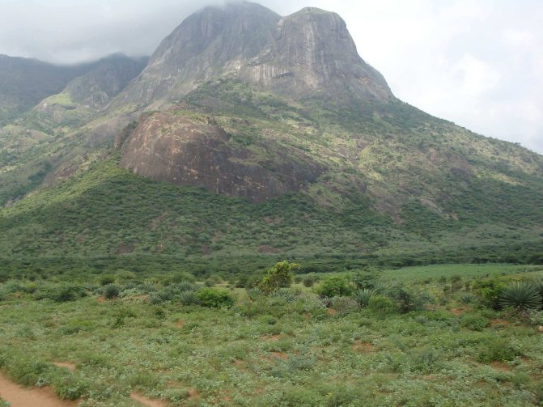
Engineering challenges to enable
Scientific opportunities at INO
Neutrino is the most tiny quantity of reality ever imagined by a human being.
Frederick Reines
Co-discoverer & Nobel Laureate
Dr. B.Satyanarayana ▪ Scientific Officer (G)
Department of High Energy Physics ▪ Tata Institute of Fundamental Research
Homi Bhabha Road ▪ Colaba ▪ Mumbai ▪ 400005 ▪ INDIA
T: 09987537702 ▪ E: bsn@tifr.res.in ▪ W: http://www.tifr.res.in/~bsn

Slide 2
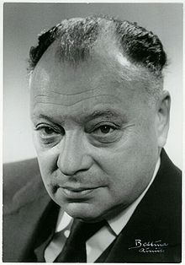
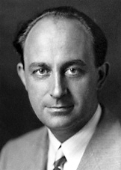
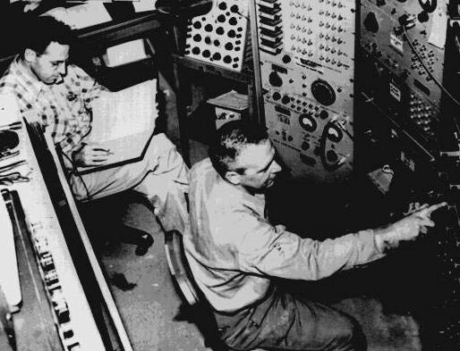
Neutrino (ν)
Proposed by Wolfgang Pauli in 1930 to explain beta decay.
Named by Enrico Fermi in 1931.
Discovered by Frederick Reines and Clyde Cowan in 1956.
Created during the Big Bang, Supernova, in the Sun, from cosmic rays, in nuclear reactors, in particle accelerators etc.
Interactions involving neutrinos are mediated by the weak force.

Slide 3
Unique features of neutrinos
The second most abundant particles in the universe
  Cosmic microware background photons: 400/cm³
  Cosmic microware background neutrinos: 300/cm³
The lightest massive particles
  A million times lighter than the electron
  No direct mass measurement yet
The most weakly interacting particles
  Invisible: Do not interact with light
  Stopping α, β, γ radiation: 50cm lead shielding
  Stopping neutrinos from the sun: Several light years!
About 100 trillion neutrinos from the sun and other such objects are going through our body every second without doing any harm.

Slide 4
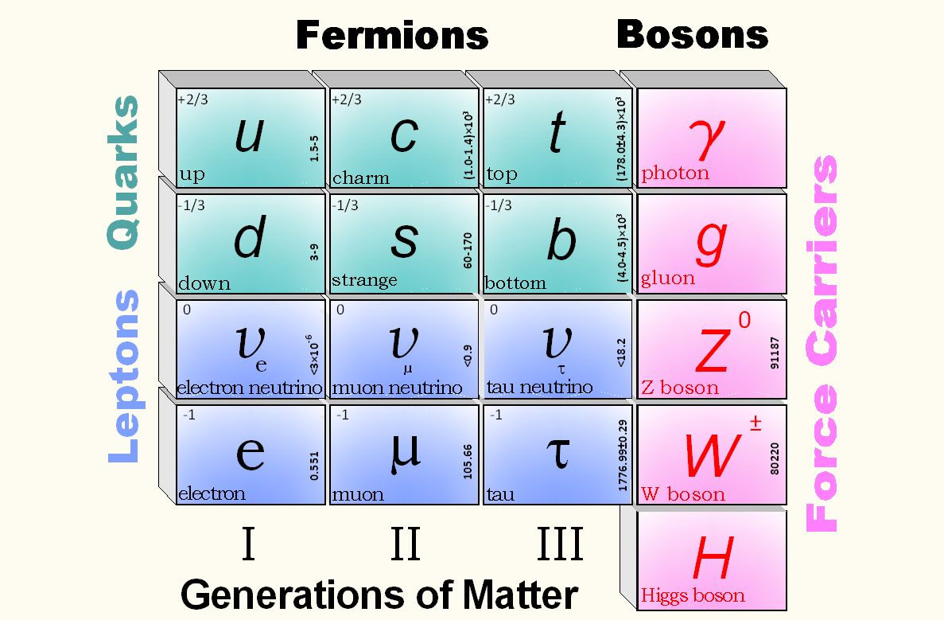
Standard model of particle physics

Slide 5
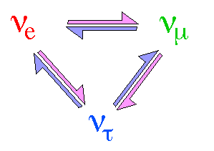
Neutrino oscillations
It is now known that neutrinos of one flavour oscillate to those of another flavour.
The oscillation mechanism is possible only if the neutrinos are massive.
Neutrino experiments are setting the stage for extension of Standard Model itself.
One of the main goals of the INO experiment is to precisely measure the parameters that govern the neutrino oscillations.

Slide 6
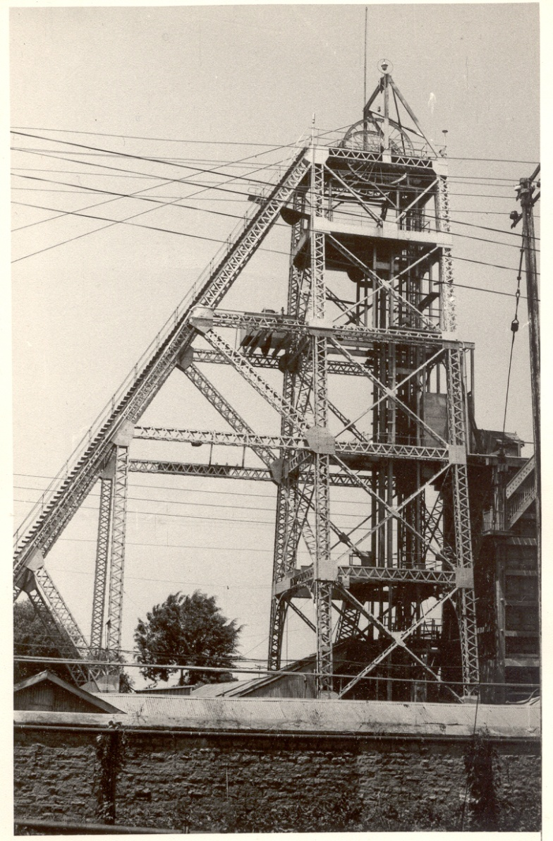
History of neutrino physics in India
India had a long tradition of carrying out High Energy Physics research using deepest underground laboratories in the world at Kolar Gold Fields during 1952-92.
Indian initiative in neutrino physics goes back to nearly 50 years.
Demonstrated for the first time, the feasibility of doing neutrino experiments at KGF.
International collaboration experiment to detect atmospheric neutrinos started at KGF in 1964.
First atmospheric neutrino was detected at KGF at a depth of 2.3km way back in 1965 by the TIFR-Osaka-Durham group.
During early 80s dedicated detectors were setup at KGF by TIFR-Osaka collaboration to look for proton decay.
KGF underground shaft

Slide 7
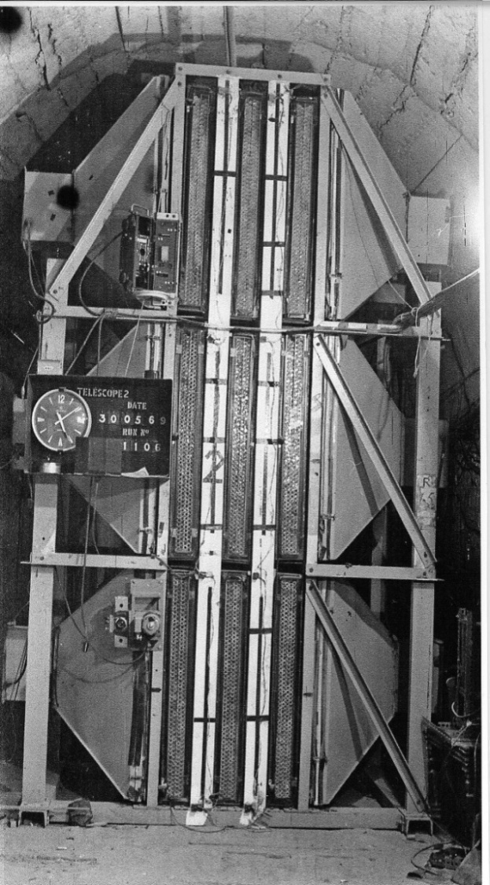
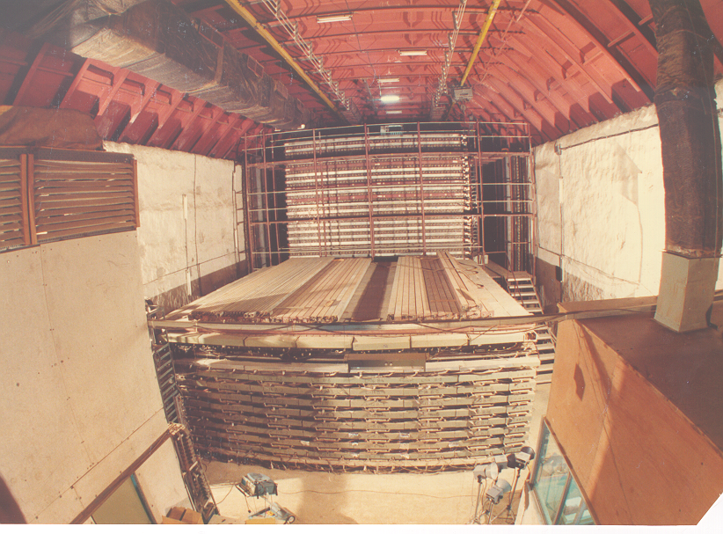
Tradition of underground physics
Proton decay experiments
Atmospheric neutrino detector at Kolar Gold Fields

Slide 8
India-based Neutrino Observatory (INO) project
The primary goal of INO is neutrino physics.
A national collaboration of scientists from more than 26 groups belonging to DAE institutions, IITs and Universities.
The total cost of the project is expected to be about Rs.1500 crores.
The project includes:
  construction of an underground laboratory and associated surface facilities,
  construction of a Iron Calorimeter (ICAL) detector for neutrinos,
  setting up of National Centre for High energy Physics (NCHEP).
The project is expected to be completed within seven years beginning April 2012.
A successful INO-Academia-Industry interface is expected to develop because of the large scale of experimental science activity involved.
INO Graduate Training Programme under the umbrella of Homi Bhabha National Institute (HBNI) - a deemed-to-be University within DAE, is in its fifth year (25 Ph.D. students in Physics, detectors and electronics).

Slide 9
Possible new proposals at INO
Search for neutrino less double beta decay (NDBD) using Tin (¹²⁴Sn) via cryogenic bolometer.
Cryogenic Silicon/Germanium based dark matter experiment at INO (DINO).
Measurement of nuclear cross sections of astrophysical interest using 500kV accelerator; utilising the low back-ground environment inside the INO facility.
The INO facility will develop into a centre for other studies in physics, biology, geology, material research etc., which will exploit the special conditions existent deep underground.

Slide 10
National Centre for
High Energy Physics (NCHEP)
To be setup on a 13 hectares land very close to the Madurai Kamaraj University (Vadapalanchi and Karadipatti Village) in the city of Madurai.
Will act as the nodal centre for all INO activities. Responsible for operation of the INO facilities.
Will develop full-fledged manpower to operate and maintain the INO laboratory. Human resource development in basic experimental science research. INO Graduate Training program will move to NCHEP when ready.
Will have a major detector development laboratory. Development of detector technology and its varied applications, such as in medical imaging, material science, industrial control and geological survey.

Slide 11
INO Collaboration
Spokesperson: N.K. Mondal, TIFR, Mumbai
Home page: http://www.ino.tifr.res.in
Ahmedabad: Physical Research Laboratory (PRL)
S. Goswami, A.S. Joshipura
Aligarh: Aligarh Muslim University (AMU)
S. Ahmed, M. Sajjad Athar, R. Hasan, S.K. Singh
Allahabad: Harish Chandra Research Institute (HRI)
S. Choubey, R.Gandhi, A.Raychaudhuri
Calicut: University of Calicut (UC)
B.R.S. Babu, A.M. Vinodkumar
Chandigarh: Panjab University (PU)
V.K. Bhandari, V. Bhatnagar, M.M. Gupta, A. Kumar, J.S. Shahi, B. Singh,
J.B. Singh
Chennai: Indian Institute of Technology, Madras (IITM)
N. Chandrachoodan, N. Krishnapurna, J. Libby, A. Prabhakar
Chennai: The Institute of Mathematical Sciences (IMSc)
D. Indumathi, H.S. Mani, M.V.N. Murthy, G. Rajasekaran, N.Sinha
Delhi: Delhi University (DU)
S.K. Chamoli, B.C. Choudhary, D. Choudhury, D. Kaur, A. Kumar,
S. Kumar, S. Mandal, Md. Naimuddin, Shahnawaz, S. Verma, S.K. Verma
Guwahati: Indian Institute of Technology (IITG)
B.Bhuyan, P. Paulose, A. Sil
Hawaii (USA): University of Hawaii (UHW)
S. Pakvasa
Indore: Indian Institute of Technology (IITI)
S. Rakshit
Jammu: University of Jammu (JU)
A. Bhasin, A. Gupta, R. Gupta, S. Mahajan, S.S. Sambyal
Kalpakkam: Indira Gandhi Center for Atomic Research (IGCAR)
J. Jayapandian, C.S. Sundar
Kolkata: Ramakrishna Mission Vivekananda University (RMVU)
Abhijit Samanta
Kolkata: Saha Institute of Nuclear Physics (SINP)
P. Bhattacharya, S. Bhattacharya, Kamales Kar, D. Majumdar, S. Saha
Kolkata: University of Calcutta (CU)
S. Bandyopadhyay, A. Banerjee, D. Jana, G. Gangopadhyay
Kolkata: Variable Energy Cyclotron Centre (VECC)
R.K. Bhandari, S. Chattopadhyay, A.K. Dubey, S.A. Khan, S. Muhuri,
T.K. Nayak, S. Saha, J. Saini, P.R. Sarma, R.N. Singaraju, V. Singhal,
S.K. Thakur, Y.P. Viyogi
Lucknow: Lucknow University (LU)
Jyotsna Singh
Madurai: American College (AC)
S.P.M. Deborrah, K. Gnanasekar, S.R. Inbanathan, K. Moorthy
Mumbai: Bhabha Atomic Research Centre (BARC)
V. Arumugam, Anita Behere, M.S. Bhatia, V.B. Chandratre, V.M. Datar,
M.P. Diwakar, G. Gouthaman, Suresh Kumar, P.K. Mukhopadhyay,
L.M. Pant, B.J. Roy, K. Srinivas, V. Sugadan
Mumbai: Indian Institute of Technology, Bombay (IITB)
Basanta Nandi, S. Uma Sankar, Raghav Varma
Mumbai: Tata Institute of Fundamental Research (TIFR),
B.S. Acharya, S. Banerjee, M.Bhuyan, A. Dighe, K.S. Gothe,
S.D. Kalmani, S. Lahamge, G.Majumder, N.K. Mondal, P. Nagaraj,
B.K. Nagesh, S.K. Rao, L.V. Reddy, A. Redij, D. Samuel, M. Saraf,
B. Satyanarayana, S. Upadhya, P. Verma
Mysore: University of Mysore (MU)
S. Krishnaveni, C. Ranganathaiah, H.B. Ravikumar
Sambalpur: Sambalpur University (SU)
S. N. Nayak
Srinagar: University of Kashmir (UK)
W. Bari, N. Iqbal
Varanasi: Banaras Hindu University (BHU)
B.K. Singh, C.P. Singh, V. Singh

Slide 12
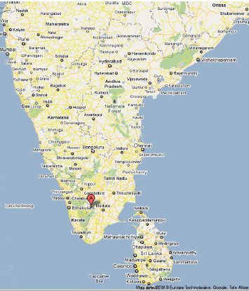
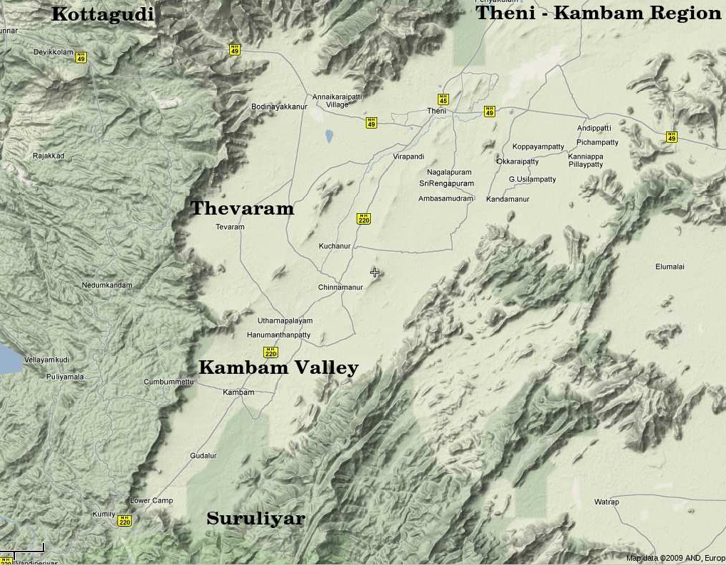
INO coming soon:
Inside a mountain near you!
Location: 9º58′ North; 77º16′ East, 110km from Madurai (South India)

Slide 13
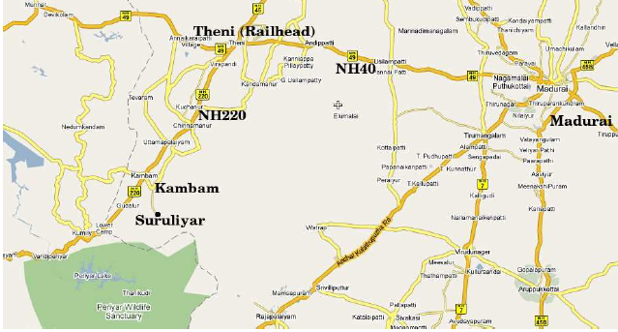
INO coming soon:
Inside a mountain near you!
Location: 9º58′ North; 77º16′ East, 110km from Madurai (South India)
Site for INO underground facility

Slide 14
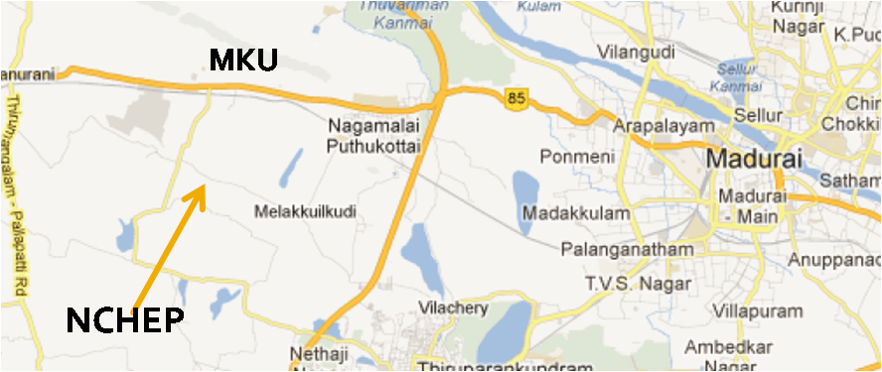
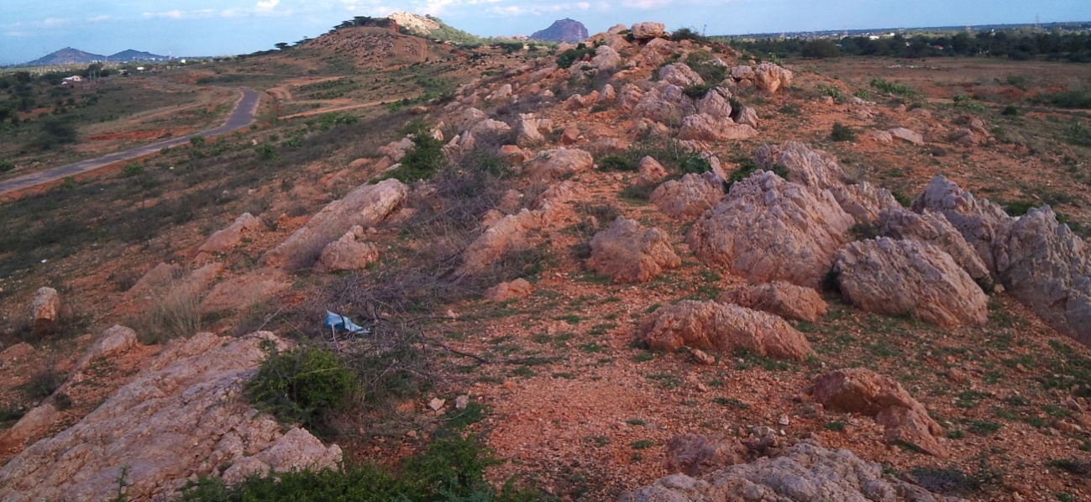
Location and site for
National Centre for High Energy Physics

Slide 15
Ownership and Management
Infrastructural facilities to be created at Pottipuram (underground lab & surface facilities) as well as those at Madurai (NCHEP) will be under the Department of Atomic Energy (DAE).
National Centre for High Energy Physics (NCHEP) will be the nodal unit of DAE for administrative control of underground laboratory, project monitoring, HRD, Detector R&D etc. TIFR to act as the host institute.
ICAL detector will be funded jointly by DAE and DST.
ICAL detector will be constructed by the members of INO-ICAL collaboration from various research institutes, universities and IITs.

Slide 16
INO Management Structure
Apex Committee chaired jointly by Secretary DAE and Secretary DST and having Directors/Heads of major participating institutes/universities including HBNI.
NCHEP Management Board chaired by Director of the INO host institute (TIFR).
Project Management Committee chaired by the NCHEP Centre Director.
Project Implementation committees at major participating institutes.
Scientific Advisory Committee chaired by the Director of the INO host institute (TIFR).

Slide 17
Status of INO sites
Forest land above the INO tunnel and cavern
  Received stage II clearance to use 4.12 hectares of forest land to construct the cavern and the access tunnel under the Bodi West Hill reserve forest from Ministry of Environment and Forests.
Land at Pottipuram
  26.82.5 hectares of revenue land at Pottipuram village to establish the INO surface facilities was transferred to the DAE.
  Transfer document signed on December 28, 2011.
Land at Madurai
  12.5.5 hectares of land at Madurai to establish the National Centre for High Energy Physics ( NCHEP) against a payment of Rs. 17.14 crores was transferred to the DAE on November 17, 2012.

Slide 18
Civil construction activities
Tendering process on for
  Detailed survey work and clearing of jungle at NCHEP site at Madurai and INO site at P0ttipuram.
  Construction of barbed wire fencing with RCC posts over random rubble masonry wall around NCHEP site at Madurai and INO site at Pottipuram.
Tender documents under preparation for
  Architectural/Engineering services consultancy for INO surface facility buildings at Pottipuram and NCHEP building at Madurai including landscape and horticulture.
  Geotechnical survey at Pottipuram and Madurai.
Tender documents yet to be prepared for
  Prefabricated laboratory buildings at NCHEP site.
Initial activities of the project to start soon in the rented premises in Madurai.

Slide 19
Civil works carried out through TN government agencies
MoU with the Tamil Nadu Water Supply and Drainage Board (TWAD) signed for water supply infrastructure development for Pottipuram site. Cost of the work package: 592 Lakhs.
Improvement/construction of 9km approach road to INO site from Rasingapuram to Pottipuram (Km. 21/10 of Palayam-Bodi Road (SH100), 0/0 – 10/6). To be taken up by Tamil Nadu Highways Department. Cost of the work package Rs. 2045 Lakhs.
Funds also approved for the temporary electricity connection by TNEB for the Pottipuram site.
Rs. 300 Lakhs approved for local area and community development.

Slide 20
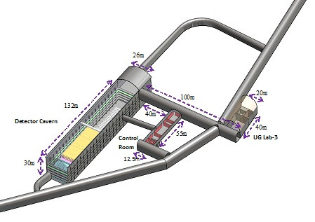
Underground Laboratory Layout
Length of the tunnel | 2.1 km (approx.)
Tunnel cross-section | 7.5m wide and 7.5m high
Tunnel gradient | 1:15
Rock overburden | 1300m (4000 mwe)
Rock type and density | Charnockite, 2.9 gm/cc
Number of caverns | 3 (one big and two small)
Size of the main cavern | 132m × 26m × 20m (high)
Distance from CERN | 7100 km
Distance from JPARC | 6600 km
Future nuclear reactor | 9000 Mwe, 205 km
Basic features

Slide 21
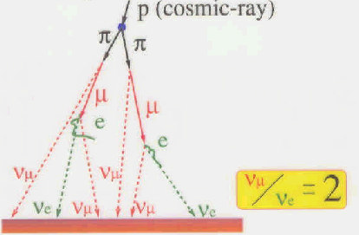
Neutrino sources and detector choice
Source of neutrinos
  Use atmospheric neutrinos as source
  Need to cover a large L/E range
    Large L range
    Large E_{ν} range
  Upto 20 GeV muons contained in fiducial volume; most interesting region for observing matter effects in 2–3 sector is 5–15 GeV
  ICAL is sensitive to muons only, very little sensitivity to electrons; Electrons leave few traces (radiation length 1.8 (11) cm in iron (glass))
Physics driven detector requirements
  Should have large target mass (50-100 kT)
  Good tracking and energy resolution (tracking calorimeter)
  Good directionality, up/down discrimination (< 1 nSec time resolution)
  Nearly 4π coverage in solid angle (except near horizontal)
  Good charge identification capability (magnetic field ∼1.5 Tesla)
  Modularity and ease of construction (3 modules of ~17 kTons each)
  Compliment capabilities of existing and proposed detectors
Use magnetised iron as target mass and RPC as active detector medium

Slide 22
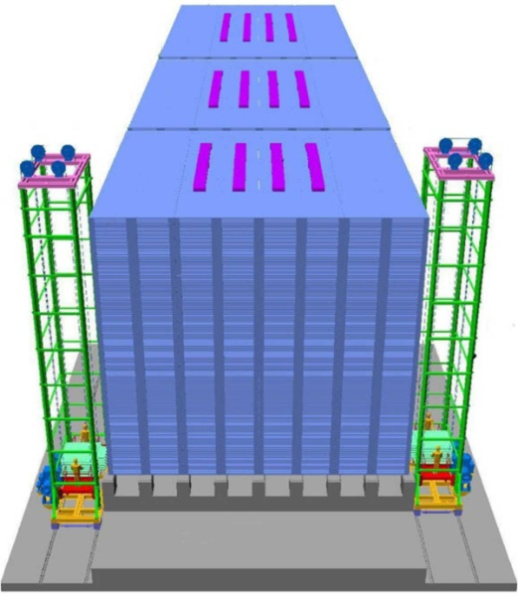
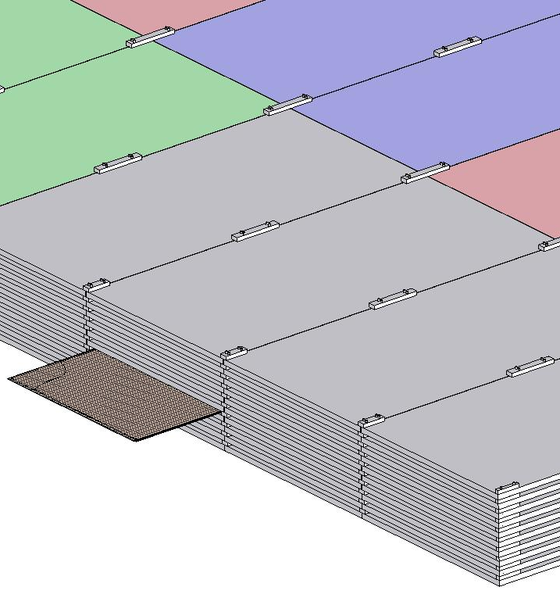
ICAL detector and construction
Magnet coils
4000mm×2000mm
×56mm low carbon iron sheets
RPC handling trolleys
RPC
Total weight: 50Ktons
4832 * 3 sheets

Slide 23
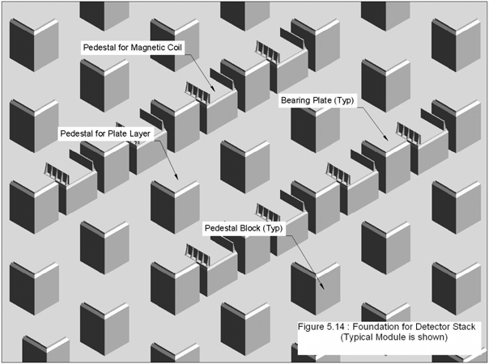
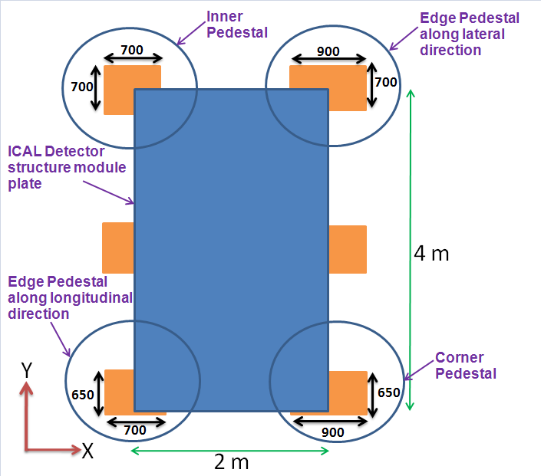
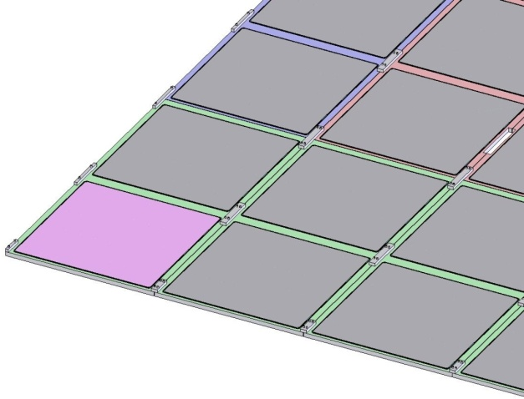
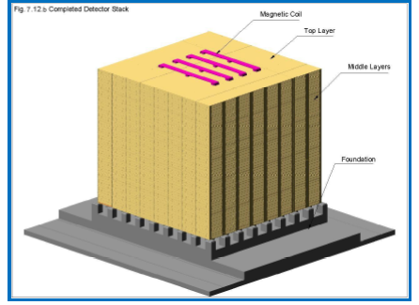
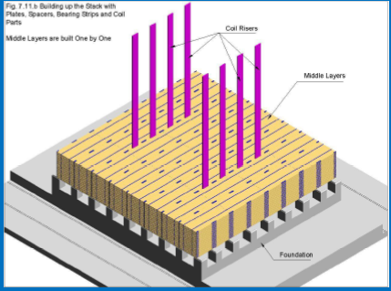
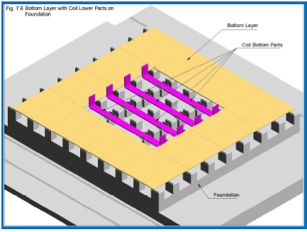
Construction of ICAL Magnet

Slide 24

Animation of ICAL construction

Slide 25
Factsheet of ICAL detector
No. of modules | 3
Module dimensions | 16m × 16m × 14.5m
Detector dimensions | 48.4m × 16m × 14.5m
No. of layers | 150
Iron plate thickness | 56mm
Gap for RPC trays | 40mm
Magnetic field | 1.3Tesla
RPC dimensions | 1,950mm × 1,840mm × 24mm
Readout strip pitch | 3 0mm
No. of RPCs/Road/Layer | 8
No. of Roads/Layer/Module | 8
No. of RPC units/Layer | 192
No. of RPC units | 28,800 (97,505m²)
No. of readout strips | 3,686,400

Slide 26
Power requirement
Main Hall
  200KW for cooling electronic circuits of one 50 kton detector assembly (4 million channels, each consuming 50mW). That is 400KW for 100 kton detector.
  The magnet power requirements is about 450KW for 50 kton detector i.e. 900KW for 100 kton detector.
Control room/lab
  Neutrino-less Double Beta Decay (NDBD) experiment will require about 20KW for cooling of associated electronics.
  The NDBD experimental set up requires a helium compressor of 10litre/day capacity, which will be driven by a 50KW motor.
The AC, ventilation, mechanical, material handling and lighting loads.

Slide 27
Mains power
The electric power will be received from nearby TNEB substation through two, 11KV feeders at the utility building. This will in turn feed two, 11KV/433V dry type transformers of adequate capacity located in the same building and two transformers at the cavern.
Further distribution will be at 415Volts .
The Transformers will be sized to meet all the loads including emergency, DC and UPS.
Emergency power
  2 silent DG sets of adequate capacity, will be located in the utility building.
  Emergency loads will be restricted to 10KW for NDBD experiment (Dilution refrigerant equipment.), high voltage supply to the detectors and gas flow monitors.
Magnets and Detector electronics do not require emergency power.
  No common UPS will be provided.
  Small independent UPS will be procured and installed wherever required, as part of scientific equipment.
  Similarly DC supply for the magnets also will be procured separately. The DC system and UPS systems must be capable of receiving 415V, 50Hz, 3 phase supply.

Slide 28
Air conditioning and Ventilation
The main experimental hall will be maintained at 21 ± 3 ºC and RH <55%.
Isobutane - being denser than air, may collect at the floor level. A separate duct system (or return grills at his level) for sucking this may be designed.
It would be desirable, if simple ventilation system with air washers can be designed to meet the ambient conditions required in the main hall, considering the lower temperature in the cavern interior, which is about 1300m below ground and has a earth cover of 1000m all around.
The NDBD area need not be air conditioned. Normal human comfort level AC may be maintained in the control room. All other areas will have minimum air changes required for human comfort.

Slide 29
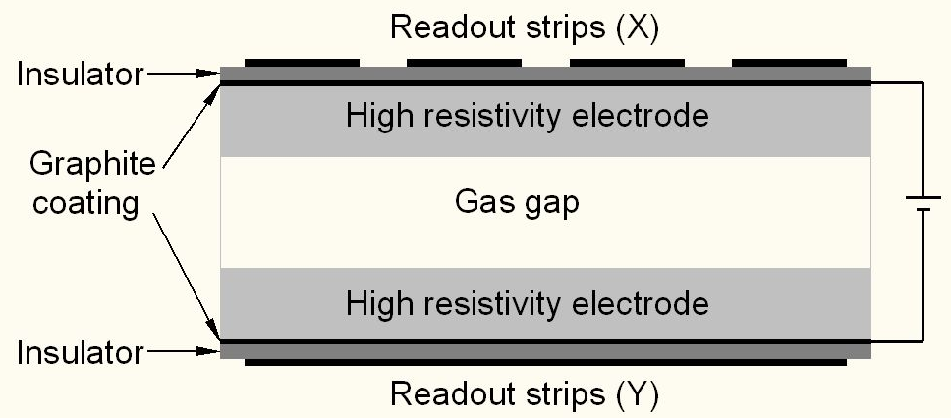
Schematic of a basic RPC

Slide 30
Deployment of RPCs in running experiments
Experiment | Area (m²) | Electrodes | Gap(mm) | Gaps | Mode | Type
PHENIX | ? | Bakelite | 2 | 2 | Avalanche | Trigger
NeuLAND | 4 | Glass | 0.6 | 8 | Avalanche | Timing
FOPI | 6 | Glass | 0.3 | 4 | Avalanche | Timing
HADES | 8 | Glass | 0.3 | 4 | Avalanche | Timing
HARP | 10 | Glass | 0.3 | 4 | Avalanche | Timing
COVER-PLASTEX | 16 | Bakelite | 2 | 1 | Streamer | Timing
EAS-TOP | 40 | Bakelite | 2 | 1 | Streamer | Trigger
STAR | 50 | Glass | 0.22 | 6 | Avalanche | Timing
CBM TOF | 120 | Glass | 0.25 | 10 | Avalanche | Timing
ALICE Muon | 140 | Bakelite | 2 | 1 | Streamer | Trigger
ALICE TOF | 150 | Glass | 0.25 | 10 | Avalanche | Timing
L3 | 300 | Bakelite | 2 | 2 | Streamer | Trigger
BESIII | 1200 | Bakelite | 2 | 1 | Streamer | Trigger
BaBar | 2000 | Bakelite | 2 | 1 | Streamer | Trigger
Belle | 2200 | Glass | 2 | 2 | Streamer | Trigger
CMS | 2953 | Bakelite | 2 | 2 | Avalanche | Trigger
OPERA | 3200 | Bakelite | 2 | 1 | Streamer | Trigger
YBJ-ARGO | 5630 | Bakelite | 2 | 1 | Streamer | Trigger
ATLAS | 6550 | Bakelite | 2 | 1 | Avalanche | Trigger
ICAL | 97,505 | Both | 2 | 1 | Both | Trigger

Slide 31
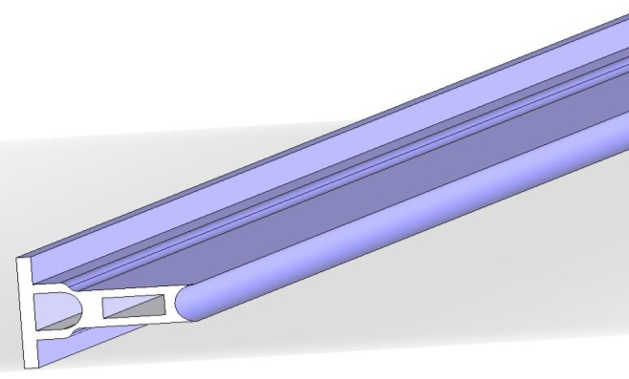
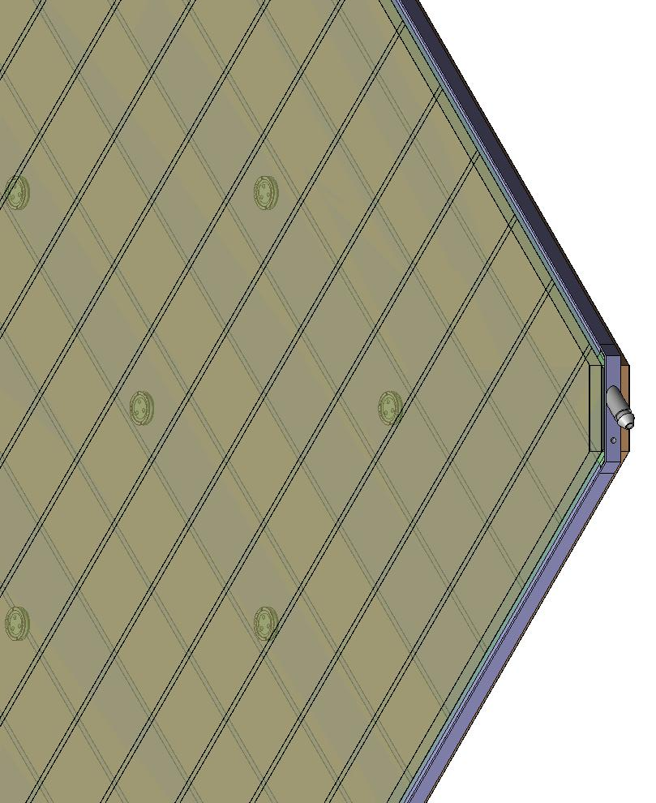
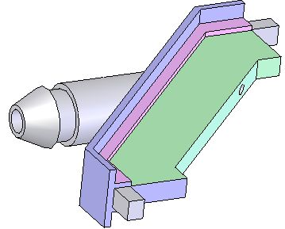
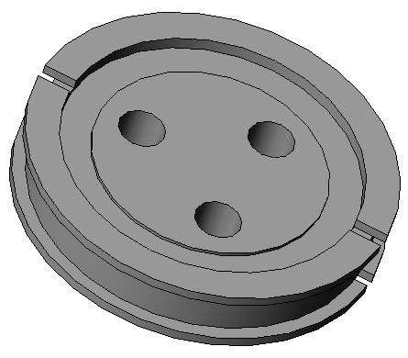
Materials for gas volume fabrication
Edge spacer
Schematic of an assembled gas volume
Gas nozzle
Glass spacer

Slide 32
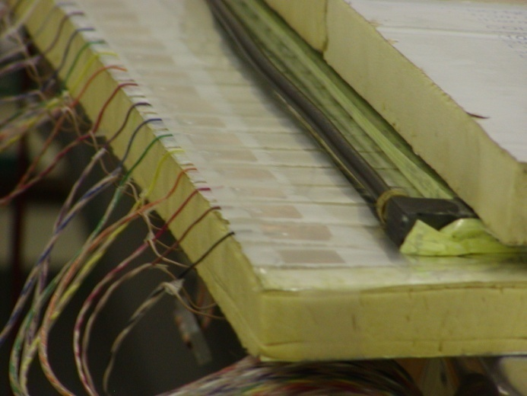
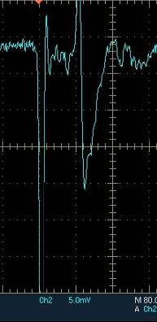
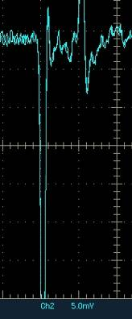
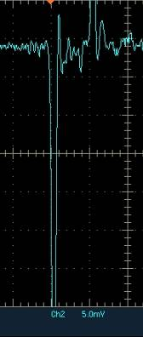
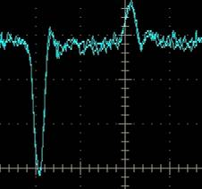
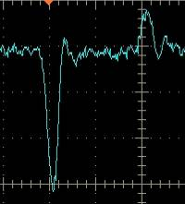
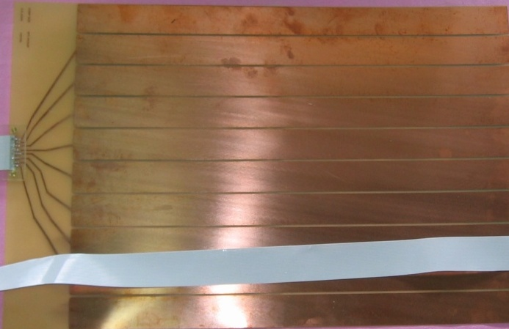
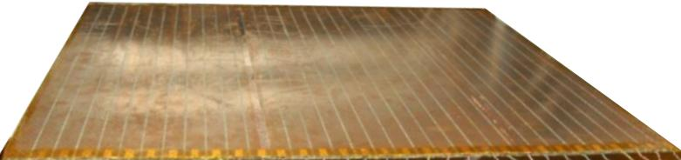
Development and characterisation of signal pickup panels
Foam panel
48.2Ω
G-10 panel
Open
100Ω
51Ω
47Ω
Z₀: Inject a pulse into the strip; tune the terminating resistance at the far end, until its reflection disappears.
Honeycomb panel

Slide 33
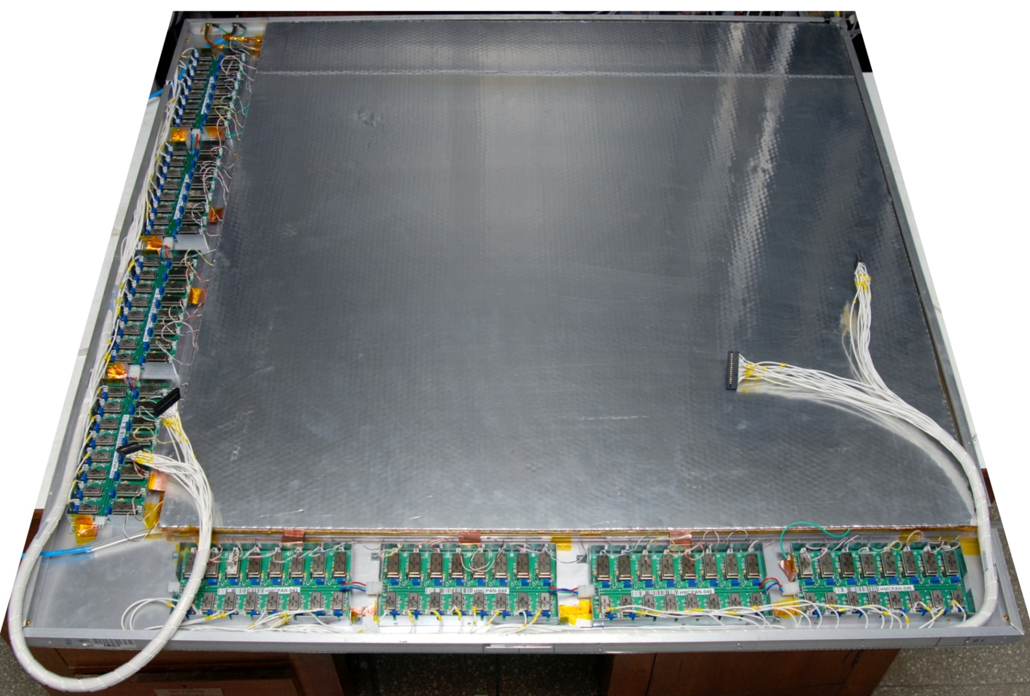
Fully assembled large area RPC
1m × 1m

Slide 34
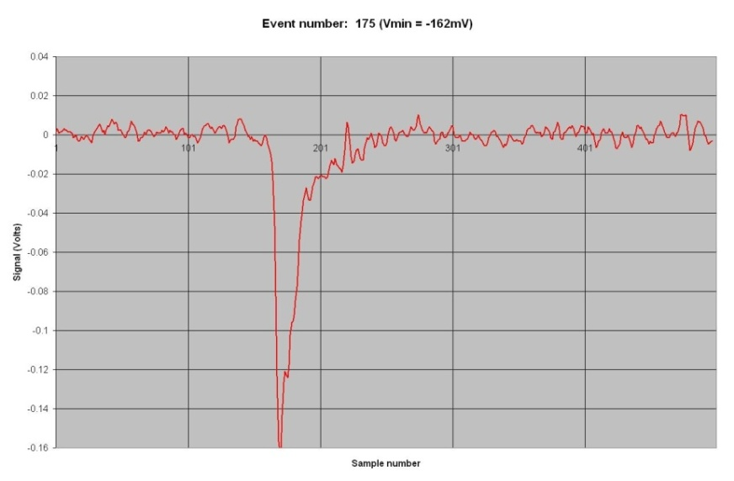
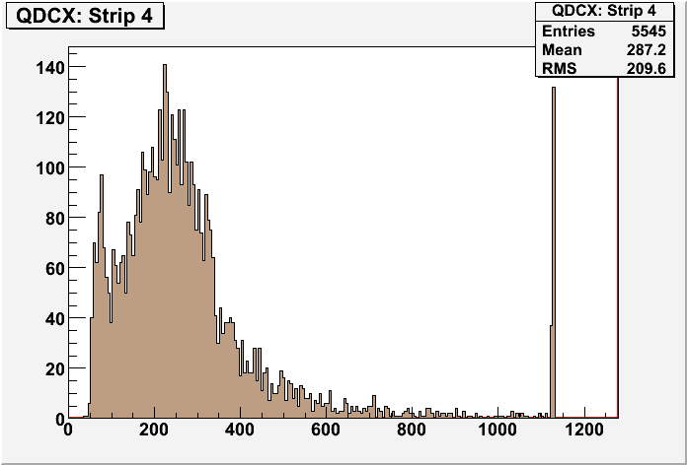
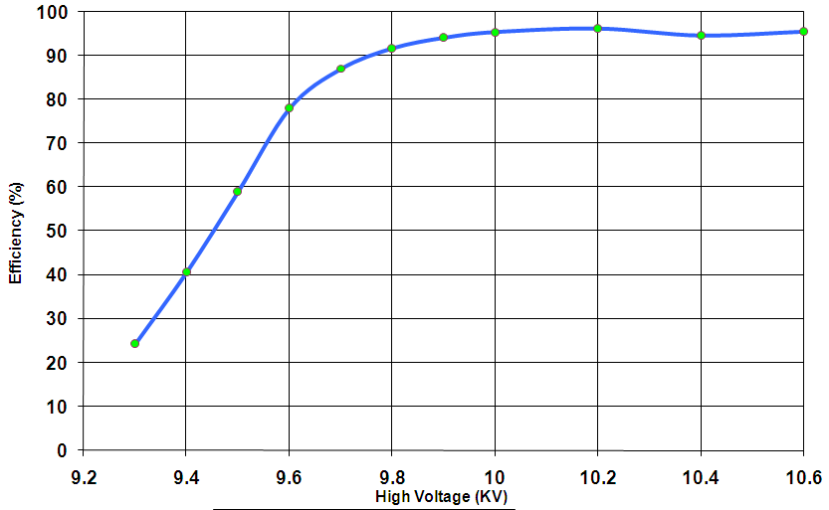
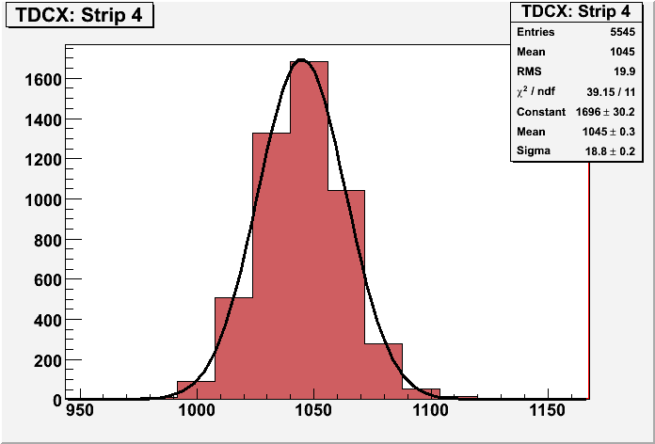
RPC parameter characterisation

Slide 35
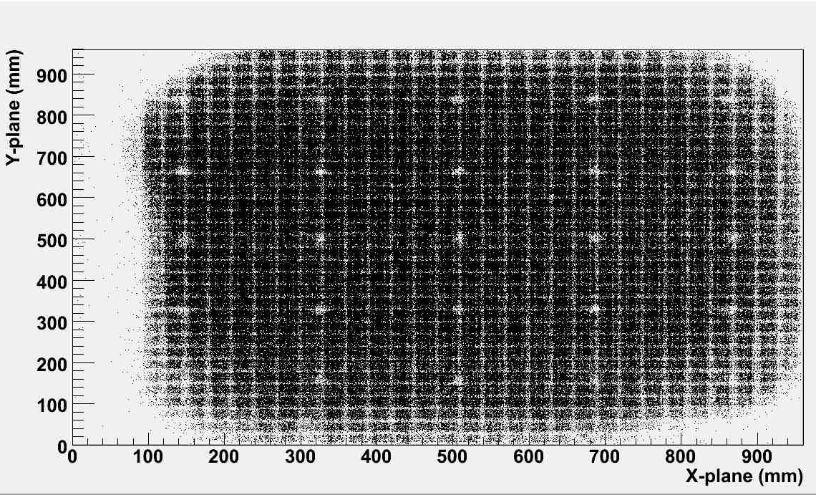
RPC tomography using cosmic ray muons

Slide 36
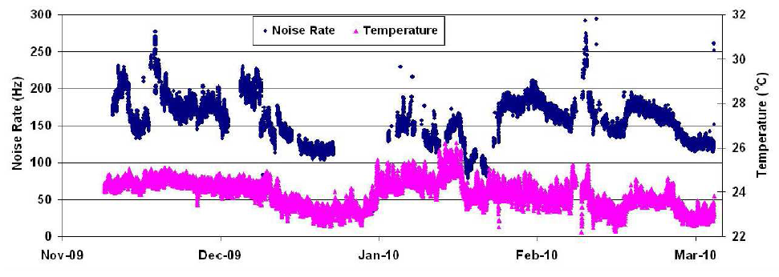
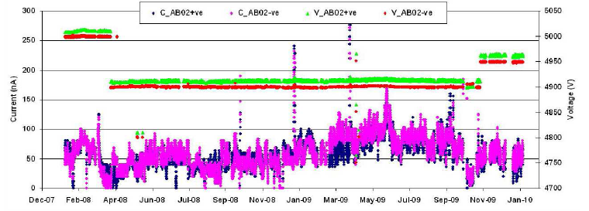
Studying long-term stability

Slide 37
Requirement of gases in ICAL
Total number of RPCs in ICAL = 3 × 150 × 64 = 28,800
Total gas volume = 28,800 × 184cm × 184cm × 0.2cm = 195,010 litres
For ex: One volume change/day with 10% gas top-up in a re-circulating scheme
Approximate running gas cost = Rs 30,000/day
Gas | Avalanche (%) | Streamer (%) | Maximum (%) | Volume (L) | Density (g/L) | Weight (Kg) | Cost (Rs/Kg)
Argon | 0.0 | 30.0 | 30.0 | 58,503 | 1.784 | 104.4
R134a | 95.5 | 62.0 | 95.5 | 186,234.6 | 4.25 | 791.5
Isobutane | 4.3 | 8.0 | 8.0 | 15,600.8 | 2.51 | 39.16
SF₆ | 0.2 | 0.0 | 0.2 | 390 | 6.164 | 2.40

Slide 38
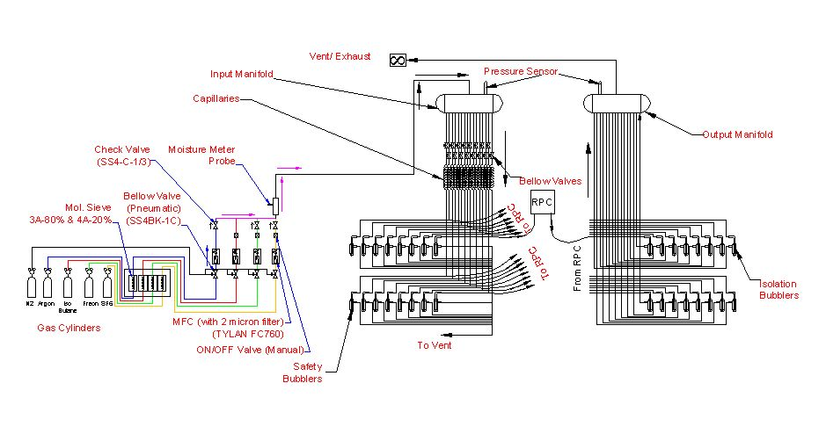
Schematic of gas system

Slide 39
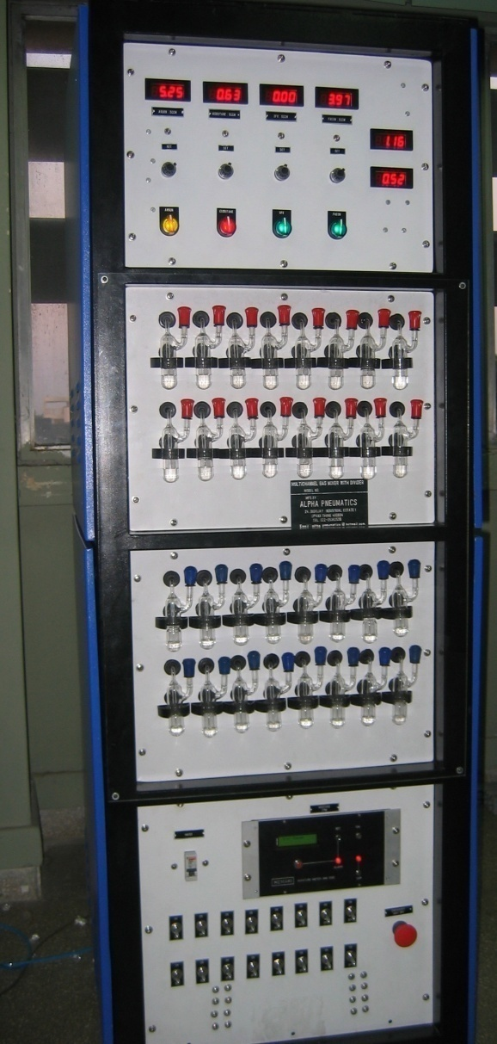
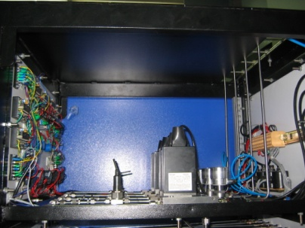
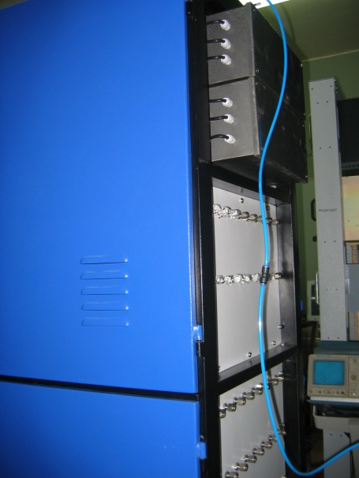
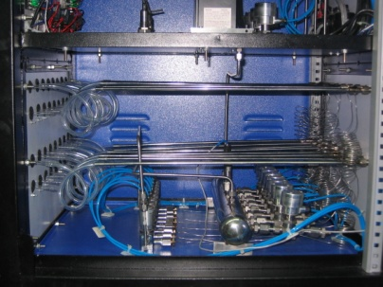



Constructional details of the gas system
Internal view
Front view
Rear view

Slide 40

Closed-loop gas recirculation system
4 channel gas mixing module (filling/top-up of Iso-butane, Freon R134A, Argon and SF6)
Total Capacity: 140 litres
Continuous duty gas purification system to remove moisture, and other radicals
Contamination removal up to 2ppm.

Slide 41



Newly developed gas recirculation system

Slide 42

1m × 1m RPC stack at TIFR, Mumbai

Slide 43

2m × 2m RPC stack at TIFR, Mumbai

Slide 44

ICAL prototype at VECC, Kolkata

Slide 45













Design and implementation of the data acquisition system
200 boards of 13 types
Custom designed using
FPGA,CPLD,HMC,FIFO,SMD

Slide 46


A couple of interesting events

Slide 47


RPC strip rate time profile
Temperature

Slide 48

Overall scheme of ICAL electronics
Major elements
  Front-end board
  RPCDAQ board
  Segment Trigger Module
  Global Trigger Module
  Global Trigger Driver
  Tier1 Network Switch
  Tier2 Network Switch
  DAQ Server

Slide 49



Functions & integration of FE-DAQ

Slide 50





Picking up the tiny charges
Process: AMSc35b4c3 (0.35um CMOS)
Input dynamic range:18fC – 1.36pC
Input impedance: 45Ω @350MHz
Amplifier gain: 8mV/μA
3-dB Bandwidth: 274MHz
Rise time: 1.2ns
Comparator’s sensitivity: 2mV
LVDS drive: 4mA
Power per channel: < 20mW
Package: CLCC48(48-pin)
Chip area: 13mm²

Slide 51

Picking up the tiny charges
Process: AMSc35b4c3 (0.35um CMOS)
Input dynamic range:18fC – 1.36pC
Input impedance: 45Ω @350MHz
Amplifier gain: 8mV/μA
3-dB Bandwidth: 274MHz
Rise time: 1.2ns
Comparator’s sensitivity: 2mV
LVDS drive: 4mA
Power per channel: < 20mW
Package: CLCC48(48-pin)
Chip area: 13mm²

Slide 52

Preamplifier Board
23
403
Current Anusparsh-2 chip dimensions does not fit to this design
Next iteration might shrink the size
Package the chip in the rectangular shape
Go for chip bonding (for example: ATLAS’s RPC front-end)

Slide 53

RPCDAQ module – the workhorse
Unshaped, digitized, LVDS RPC signals from 128 strips (64x + 64y)
16 analog RPC signals, each signal is a summed or multiplexed output of 8 RPC amplified signals.
Global trigger
TDC calibration signals
TCP/IP connection to backend for command and data transfer

Slide 54
Design considerations & constraints
Data rates are low.
Physical dimensions: Owing to severe space constraints on the RPC, triangular space of about 160cm² only is available for this extremely high density board.
Service life of the electronics is expected to be more than15 years, component spares availability/replaceability is a concern.
Since the temperature and humidity inside the cavern will be controlled for RPCs, the electronic components need not be even of industrial grade - Commercial grade will do.
Low power consumption. It is highly desirable to have minimum power consumption.
Cost: Since the volumes are high, cost is also a major consideration

Slide 55
Data sizes and rates – Event
Event header = 32 bits
TDC data = 1 channel for 8 strips and both the edges per hit, up to 4 hits per channel per event = 16 channels x 2 edges x 4 hits x 32 bits = 4096 bits
Hit data per RPC = 128 bits
RPC ID = 32 bits
Event ID = 32 bits
Time Stamp = 64 bits
DRS data = 16 channels x 1000 samples x 16 bits = 256000 bits
(DRS data comes in event data only if we get summed analog outputs from the preamplifier)
Data size per event per RPC
  With DRS data, DR = 32 + 4096 + 128 + 32 + 32 + 64 + 256000 = 260,384 bits
  Without DRS data, DR = 32 + 4096 + 128 + 32 + 32 + 64 = 4,384 bits
Considering 1Hz trigger rate, Maximum data rate per RPC = 254.25 kbps
Considering 10Hz trigger rate, Maximum data rate per RPC = 2.5425 Mbps

Slide 56
Data sizes and rates - Monitoring
We require to monitor 16 pick-up strips per RPC.
Monitor header = 32 bits
Monitor data = 32 bits/strip x 16 strips = 512 bits
Channel ID = 32 bits
RPC ID = 32 bits
Mon Event ID = 32 bits
Ambient Sensors’ data = 3 x 16 bits = 48 bits
Time Stamp = 64 bits
DRS data = 1000 pulses (if noise rate is 100Hz) x 16 bits x 100 samples x 16 strips = 25600000 bits
(DRS data comes in monitoring data only if we get multiplexed analog outputs from the preamplifier)
Data size per 10 seconds per RPC
  With DRS data = 32 + 512 + 32 + 32 + 32 + 48 + 64 + 25600000 = 25600752 bits
  Without DRS data = 32 + 512 + 32 + 32 + 32 + 48 + 64 = 752 bits
Maximum data rate with 10 second monitoring period per RPC = 2.500 Mbps

Slide 57

ASIC based TDC device
Principle
  Two fine TDCs to measure start/stop distance to clock edge (T₁, T₂)
  Coarse TDC to count the number of clocks between start and stop (T₃)
  TDC output = T₃+T₁-T₂
Specifications
  Currently a single-hit TDC, can be adapted to multi-hit
  20 bit parallel output
  Clock period, T_{c} = 4ns
  Fine TDC interval, T_{c}/32 = 125ps
  Fine TDC output: 5 bits
  Coarse TDC interval: 2¹⁵ * T_{c} = 131.072μs
  Coarse TDC output: 15 bits
The chip has arrived, evaluation tests are in progress it IITM
CMEMS is also coming up with an ASIC with similar specs.

Slide 58


Network interface specifications
Data traffic into RPC-DAQ is Configuration/ commands – Beginning or rarely Broad cast/ Multicast – UDP protocol with/higher layer check
Data traffic out of RPC-DAQ is relatively high (45/332kbps)
We will use a TCP/IP based network interface to send and receive data from front-end to the back-end. TCP/IP over UTP or optical fiber is a reliable protocol over long distances.
Hardwired network protocol – Wiznet 5300 chip is used

Slide 59

Data network schematic

Slide 60
Front-end switches
Atleast 16 (24, preferable) 1G copper ports PLUS a 1G fiber uplink ports, all duplex capable
Layer 2, unmanaged Ethernet switch with “store and forward” non-blocking architecture.
Atleast 512KB packet buffer, 1K MAC address table
Fan-less design, dc power supply
Severe constraints on place for mounting FE Switch, ( 40cm x 60cm x ~200cm)
Next gen 8 port switches in market will fit our size requirement
Present day chipsets small enough, only limited by size of RJ45 connectors
Contacted couple of Ethernet chip set makers, positive response for 16+1 port switch

Slide 61
Back-end Ethernet switches
Proposal is for up-linking the FE Switches to back end switches to which the computers are also connected.
BE Switches: Commercial 48 port gigabit switches (copper/fiber) with atleast 4 10G uplink ports
Rack size is 1U (all current models)
Many models have MAC address table exceeding 10k, so can store location information of all RPC's of one ICAL module. Implications are (to be tested):
  the Master computer can quickly address any RPC
  no need of L3 functionality, L2 functionality will do
  but time taken to gather the MAC table.. to be understood
IP segmentation using separate class C subnet for each 3 layers

Slide 62

N/W switches on the face of spacers

Slide 63
Data collecting computers
Worst case data rate from even 4 layers together is within the capacity of modern multi core CPUs ( real case tests to be done)
Broadly, the specs are:
  High density 1U rack mountable servers
  diskless, remote OS installation/configuration (Quattor, ROCKS, or even Kickstart)
  one gigabit port for RPC's + one 10G port for networking with other DCCs and upstream event builder/master computer
  Example: rack space requirement 3U for 12 RPC layers
    with 3 layers RPC for each DCC – 3U rack space
    1U for 48 port switch, 2U for 4 high performance servers

Slide 64
Features of ICAL trigger system
Physicist’s mind decoded!
Insitu trigger generation
Autonomous; shares data bus with readout system
Distributed architecture
For ICAL, trigger system is based only on topology of the event; no other measurement data is used
Huge bank of combinatorial circuits
Programmability is the game, FPGAs, ASICs are the players

Slide 65

ICAL Trigger Scheme

Slide 66


Implementation layout

Slide 67
Back-end communication for trigger modules
Configuration of the LTM FPGAs to implement new trigger criteria.
User specifications
  Selective masking of signals at different levels of trigger generation.
Data readout
  Trigger rates
  Latch information
VME Back-end
Standard electrical and mechanical specifications
Custom Back-end
Custom specifications
Standard data transfer protocol
Custom processor, interface
Standard controller, PCI-VME bridge
Custom data transfer protocol

Slide 68
Studying suitability of FPGAs
Vendor | RPC-DAQ board |  | Trigger system
 | Family | Device | Family | Device
Altera | Cyclone 4 | EP4CE115F29 | Cyclone 5 | 5CEBA7F31
Xilinx | Spartan 6 | XC6SLX100FGG676 | Spartan 6 | XC6SLX100FGG676

Slide 69
Power supply options
High voltage (Central scheme)
  Two options: a channel at 12kV or two channels at ±6kV (Imax ~2mA)
  Consider powering 4 RPC with a single HV channel (10μA current)
  Cable diameter an integration issues, connectors a cost issue
  Ripple less than a volt at 6KV
High voltage (Distributed scheme)
  DC-DCHV converters (proportional – high ripple or regulated)
  Each RPC has to be identical to the others?
  Each RPC will have its own DC-HVDC converter for generating HV and LV
  Control and monitoring modules interfaced to the RPCDAQ module
Low voltage
  Power budget 25W per RPC – for the purpose of power supply design
  How many low voltages? – one for now.
  Voltage Set/Monitor resolution 5 mV
  Current Set/Monitor resolution10 mA
  Voltage ripple ~20mV PP
  Input, topology, efficiency and size
  Voltage Drop compensation via sense wires?
  Load regulation ±0.3 %
Fringe magnetic fields and space for DC-DC converters inside the RPC unit are the design and integration issues

Slide 70



Slide 71
DC-HVDC supply control & monitoring
Controls and monitors 2 channels
A μC (with built in 12-bit ADCs and DACs) based.
Communicates with RPCDAQ module on SPI.
Controls high voltage, ramp rate etc.
Monitors voltages and currents
Compact and small form-factor

Slide 72


Cable trays
Gas Pipes
Φ 16mm
24 Digi I/O
Φ 11.2mm
24 Power
Φ 10.5mm
48 HV Lines
Φ 5mm

Slide 73
Software requirements
RPC-DAQ controller firmware
Backend online DAQ system
Local and remote shift consoles
Data packing and archival
Event and monitor display panels
Event data quality monitors
Slow control and monitor consoles
Database standards
Data analysis and presentation software standards
Operating System and development platforms

Slide 74
Technology development for Industrial production of RPCs
Development of graphite coating by automatic spray painting.
Demonstration of successful operation of automatic button and glue dispenser.
Development of glass chamfering and glass Engraving.
Pickup panel development.
Tray design.
Computer modeling of RPC & its assembly in ICAL.
Physical RPC models to study push-pull assembly in ICAL magnet gap.
Some of these items are at advanced stages of development.

Slide 75
QC procedures for RPC gap
Visual inspection: All the glasses, buttons, spacers etc. are to be inspected before taking up the fabrication work. This should be done by an experienced staff and the same person need to certify the acceptance of the material provided with proper documentation.
Dimension conformance
Leak test of Gaps*: A RPC-gap “leak test system” should be developed, so that the RPC gaps so produced are qualified for the required pressure test.
The QC sheets (traveler sheet) need to be filled at each and every step and should be carried forward along with gap.
*Leak test:
The gaps need to be checked for any leak and the leak rate should be less then 10⁻⁴ SCCM and the gaps should hold at least 6mbar pressure.

Slide 76






Steps towards Industrial production of RPCs

Slide 77




RPC fabrication at Asahi Float Glass

Slide 78




Chamfering and engraving of glass

Slide 79



Painting/curing of glass plates

Slide 80

Animation of glass painting

Slide 81




Automatic RPC gap making

Slide 82
Animation of RPC gap fabrication

Slide 83




RPC holding tray
Self weight + 100kg load
Finite Element Analysis
Max. deflection
4.4mm
Spec.
5mm
Max. stress
8.2MPa
FRP
25MPa
Extra thickness in selected sections
Three-line support
Fabricated tray
Down side view

Slide 84

RPC fabrication facility

Slide 85
Career opportunities in INO
Research Scholars
  Applicants must have a minimum qualification of M.Sc. degree in Physics or B.E./B.Tech. degree in any one of Electronics, E & CE, Instrumentation and Electrical Engineering subjects with strong motivation for and proficiency in Physics.
  The selected candidates will be enrolled as Ph.D. students of the Homi Bhabha National Institute (HBNI), a Deemed to be University, with constituent institutions that include BARC, HRI, IGCAR, IMSc, SINP and VECC.
  They will take up 1 year course work at TIFR, Mumbai in both theoretical and experimental high energy physics and necessary foundation courses specially designed to train people to be good experimental physicists.
  Successful candidates after the course work will be attached to Ph.D. guides at various collaborating institutions for a Ph. D. degree in Physics on the basis of their INO related work.
Career opportunities for bright engineers in Electronics, Instrumentation, Computer Science, Information technology, Civil, Mechanical and Electrical engineers

Slide 86
Current status
RPC detector R&D concluded quite a while ago. The RPC stacks are being used even for some physics studies.
Scaling up and industrial adaptation of lab technology – by an industry, is almost complete.
Extensive vendor development for material fabrication, process development, design of SPMs and for large scale production of RPCs.
Overall electronics scheme finalised
ASICs are being validated on the detector
Electronic boards are being designed and prototyped
FPGAs, other components, cables and connectors are being finalised and procured

Slide 87
Closing remarks
INO is an exciting mega basic science project
It is being planned on an unprecedented scale and budget
ICAL and other experiments will produce highly competitive physics
Beyond neutrino physics, INO is going to be an invaluable facility for many future experiments
It provides wonderful opportunities for science and engineering professionals and students
Detector and instrumentation R&D, scientific human resource development are INO’s major trust areas
It offers a large number of engineering challenges and many spin-offs such as medical applications

Slide 88

Thank you
To the IE(I), Chennai State Centre for giving me this wonderful opportunity to share the excitement of building this unique mega science project.
To you all for your kind attention.

Slide 89
Backup slides

Slide 90


Slide 91

ICAL detector construction

Slide 92
ICAL detector construction

Slide 93
ICAL detector construction

Slide 94

ICAL detector construction

Slide 95

ICAL detector construction

Slide 96

ICAL detector construction

Slide 97

ICAL detector construction

Slide 98

ICAL detector construction

Slide 99

ICAL detector construction

Slide 100

ICAL detector construction

