Slide 1
Report on
ICAL electronics*
B.Satyanarayana, TIFR, Mumbai
*With some updates from ICAL Electronics meeting held on Jan 23 in Madurai

Slide 2
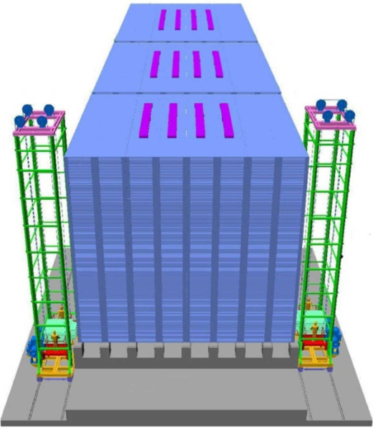
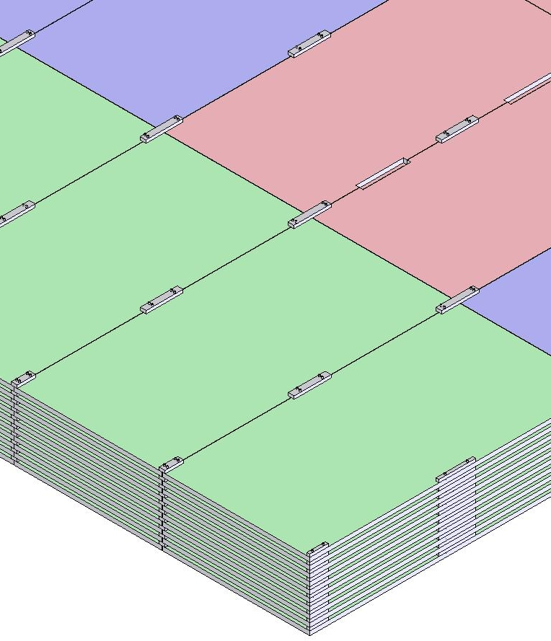
ICAL detector and construction
Magnet coils
4000mm×2000mm
×56mm low carbon iron sheets
RPC handling trolleys
Total weight: 50Ktons

Slide 3
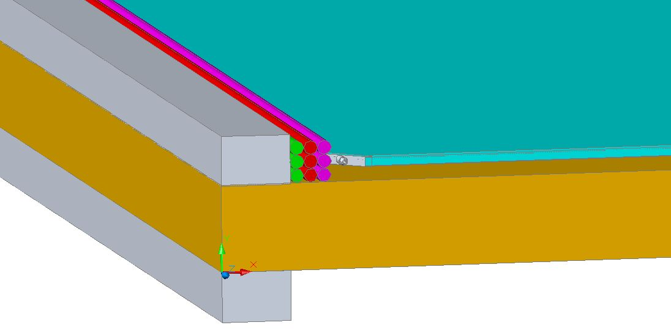
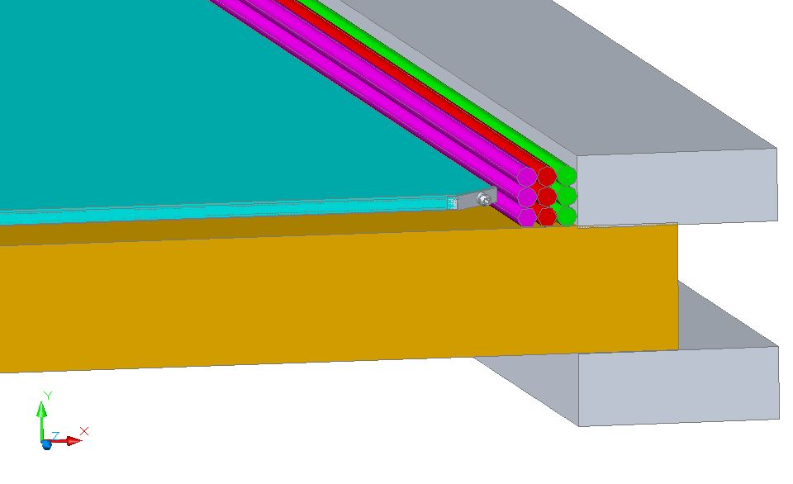
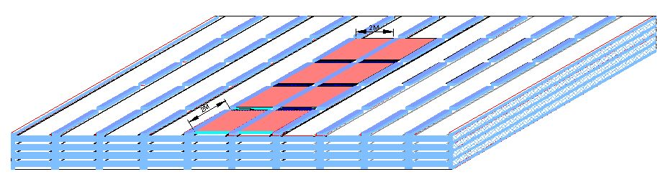
RPC in the ICAL detector
RPC
Iron absorber
Gas, LV & HV

Slide 4
Factsheet of ICAL detector
No. of modules | 3
Module dimensions | 16m × 16m × 14.5m
Detector dimensions | 48.4m × 16m × 14.5m
No. of layers | 150
Iron plate thickness | 56mm
Gap for RPC trays | 40mm
Magnetic field | 1.3Tesla
RPC dimensions | 1,950mm × 1,840mm × 26mm
Readout strip pitch | 30mm
No. of RPCs/Road/Layer | 8
No. of Roads/Layer/Module | 8
No. of RPC units/Layer | 192
No. of RPC units | 28,800 (97,505m²)
No. of readout strips | 3,686,400

Slide 5
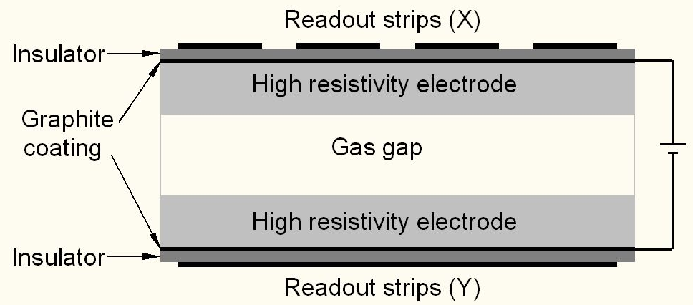
Schematic of a basic RPC
Glass (bakelite) for electrodes
Special paint mixture for semi-resistive coating
Plastic honey-comb laminations as pick-up panel
Special plastic films for insulation
Avalanche (streamer) mode of operation
Gas: R134a+Iso-butane+SF₆ = 95.5+4.2+0.3 (R134a+Iso-butane+Argon=56+7+37)

Slide 6
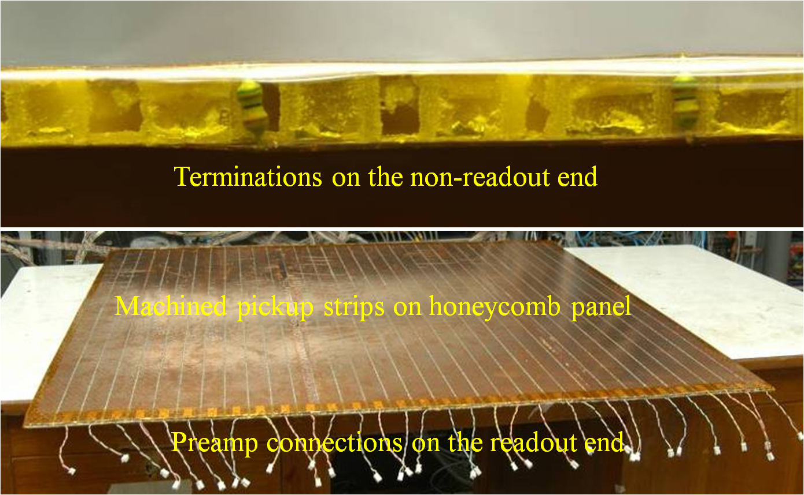
Honeycomb pickup panel

Slide 7
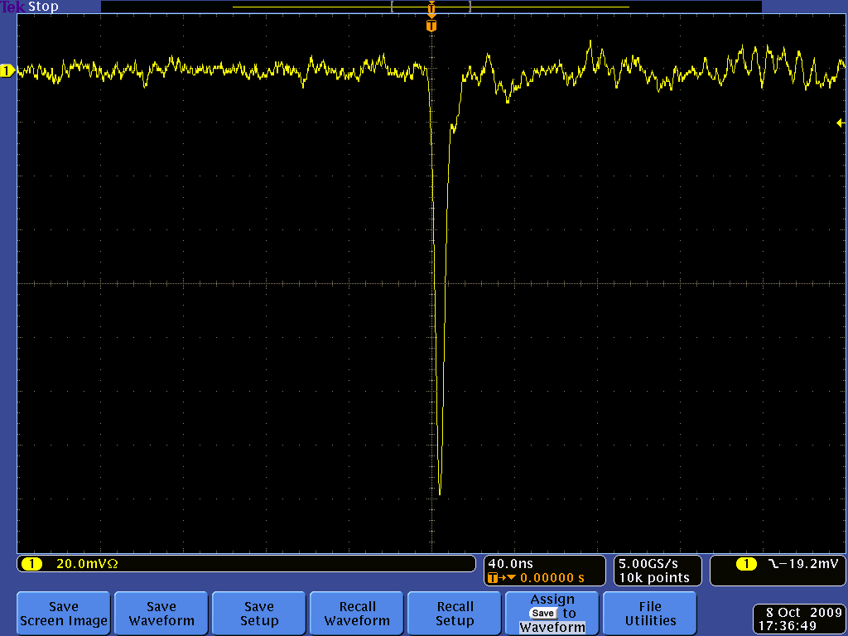
Post amplifier RPC pulse profile

Slide 8
DAQ system requirements
Information to record on trigger
  Strip hit (1-bit resolution)
  Timing (200ps) LC
  Pulse profile or Time Over Threshold (for time-walk correction). TDC can measure TOT as well.
Rates
  Individual strip background rates on surface ~300Hz
    Underground rates differ: depth, rock radiation etc.
  Muon event rate ~10Hz (The ‘blue’ book says ~2Hz)
On-line monitor
  RPC parameters (High voltage, current)
  Ambient parameters (T, P, RH)
  D.C. power supplies, thresholds
  Gas systems and magnet control and monitoring

Slide 9
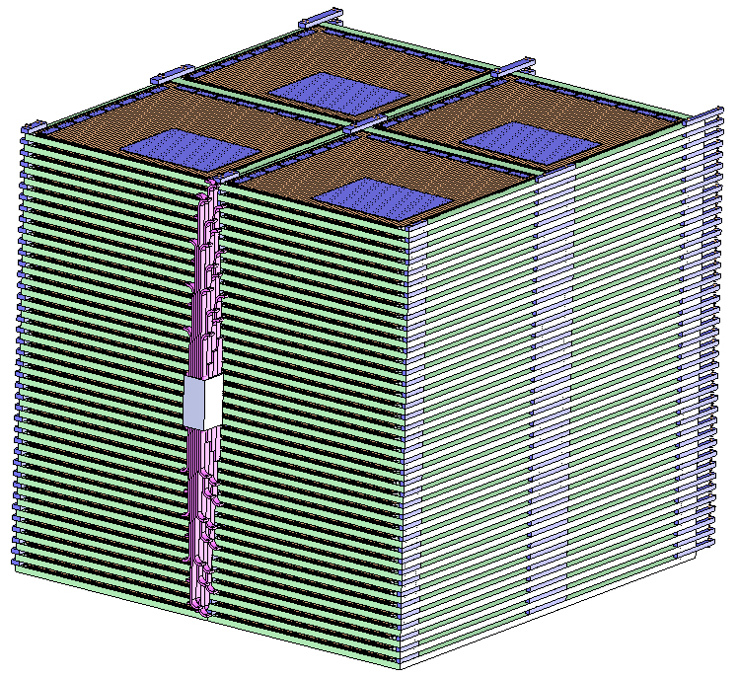
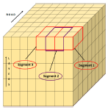
Segmentation of ICAL

Slide 10
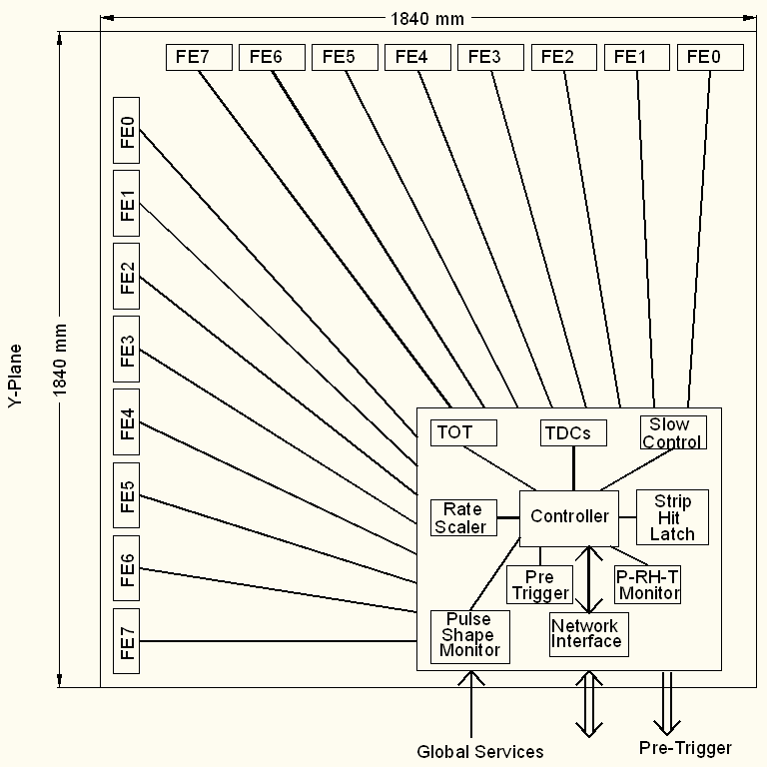
Functional diagram of RPC-DAQ

Slide 11
Functional diagram of FE ASIC
Common threshold
Ch-0
Regulated Cascode Transimpedance Amplifier
Differential Amplifier
Comparator
LVDS output driver
LVDS_out0
Channel-0
8:1 Analog Multiplexer
Output Buffer
Amp_out
Channel-7
Ch-7
Regulated Cascode Transimpedance Amplifier
Differential Amplifier
Comparator
LVDS output driver
LVDS_out7
V.B.Chandratre, Jan 24

Slide 12
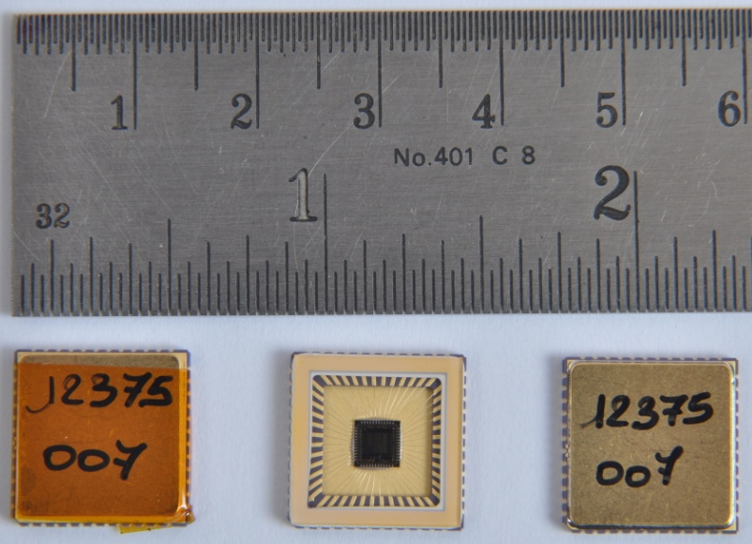
Features of ICAL FE ASIC
IC Service: Europractice (MPW), Belgium
Service agent: IMEC, Belgium
Foundry: austriamicrosystems
Process: AMSc35b4c3 (0.35μm CMOS)
Input dynamic range:18fC – 1.36pC
Input impedance: 45Ω @350MHz
Amplifier gain: 8mV/μA
3-dB Bandwidth: 274MHz
Rise time: 1.2ns
Comparator’s sensitivity: 2mV
LVDS drive: 4mA
Power per channel: < 20mW
Package: CLCC48(48-pin)
Chip area: 13mm²

Slide 13
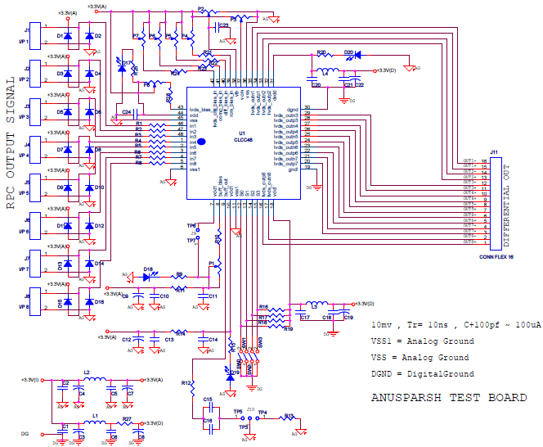
FE ASIC evaluation board

Slide 14
An important issue on FE ASIC
Separate chips for amplifier and discriminator
Helps better to support FE for glass and bakelite versions of RPC
Also helps trying out for example, different designs for comparator. For example: CFD
Does not matter much for the FE board – it is matter of one versus two ASIC chips onboard.
Alternative: Amplifier bypass option in the current ASIC (amp+comp) chip.

Slide 15
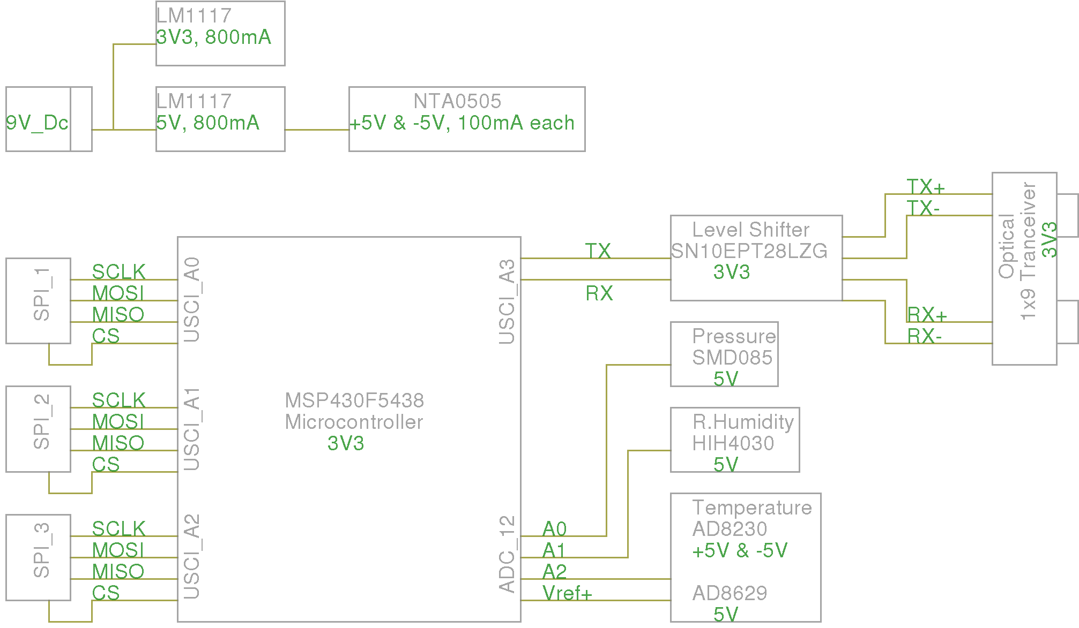
Scheme of RPC-DAQ controller
James Libby, Jan 24

Slide 16
Pulse shape monitor
0.2-2 ns
Inverter “Domino” ring chain (SCA)
IN
Stefan Ritt, Paul Scherrer Institute
Waveform
stored
Out
Clock
Shift Register
“Time stretcher” GHz → MHz
Also ANUSMRITI ASIC: 500MHz Transient Waveform Sampler
V.B.Chandratre et al (BARC)
S.S.Upadhya, Jan 24

Slide 17
ICAL timing device
ASIC (3-stage interpolation technique) – Pooja
  The new approach is to mix and match ASIC+FPGA techniques/architectures
  To be delivered in about 6 months
FPGA (Vernier technique) – Hari
FPGA (Differential delay line technique) – Sudeshna
  The FPGA efforts will continue
  Some issues (delay matching, routing etc.) to be solved
Good and bad of an FPGA solution
FPGA is a lesser travelled path (only used in CKM experiment, Fermilab)
V.B.Chandratre & Sudeshna, Jan 24

Slide 18
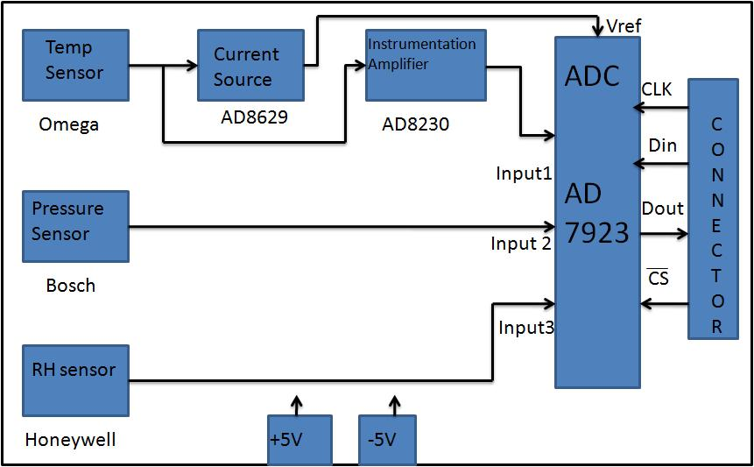
TPH monitor module

Slide 19
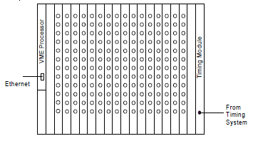
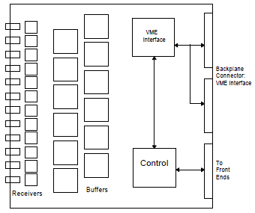
Back-end issues
VME is the ICAL’s backend standard
Global services (trigger, clock etc.), calibration
Data collector modules
Computer and data archival
On-line DAQ software
On-line data quality monitors
Networking and security issues
Remote access protocols to detector sub-systems and data
Voice and video communications
Drawings courtesy: Gary Drake

Slide 20
VME Interface Logic
V
M
E
B
U
S
LVDS
I/O
FPGA
Address
Address
Decoder
Front Panel Out
Front Panel In
Data
Addr. Modifier
Piggy Brd Data
Piggy
Board
Conn
Data
Router
Piggy Board ID
256
Deep
FIFO
Interrupt Ctrl
Interrupt Gen
And Handler
Int1, Int2
M.Saraf, Jan 24

Slide 21
Custom VME Module
JTAG
FPGA Configuration Logic
On board logic analyser port
Transceiver
Data Bus
VME Interface
Logic
(FPGA)
VME Data
OE
DIR
LVDS Tx OUT
Transceiver
VME Addr
Address Bus
LVDS Rx IN
VME
BUS
OE
DIR
Front panel LEDs
Buffer
AM, DS, WR, SYSRST, IACK..
VME Control Signals
Data
Interface for V1495s piggy boards
DATCK, IACKOUT, IRQs, BERR
Buffer
Board Address

Slide 22
Features of ICAL trigger system
Insitu trigger generation
Autonomous; shares data bus with readout system
Distributed architecture
For ICAL, trigger system is based only on topology of the event; no other measurement data is used
Huge bank of combinatorial circuits
Programmability is the game, FPGAs, ASICs are the players

Slide 23
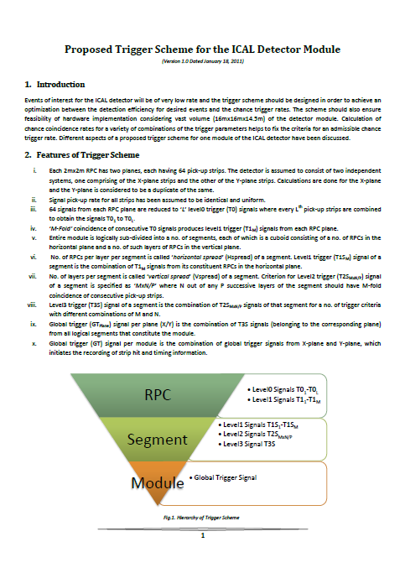
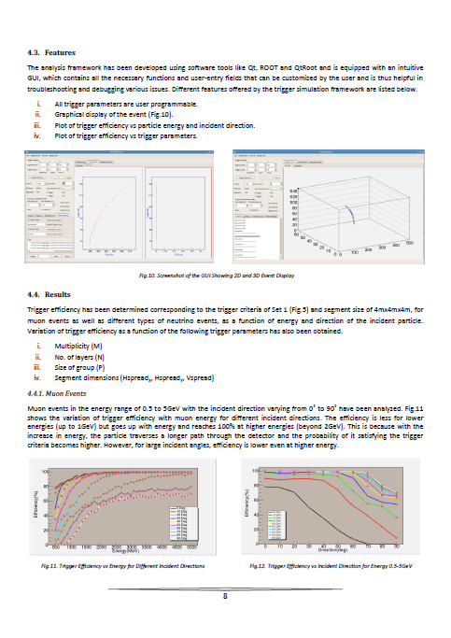
Proposed trigger scheme
S.Dasgupta, Jan 24

Slide 24
Power supplies
High voltage for RPCs
  Voltage: 10kV (nominal for Glass, less for Bakelite)
  Current: 6mA (approx., 200nA per chamber)
  Ramp up/down, on/off, monitoring
Low voltage for electronics
  Voltages and current budgets still not available
Commercial and/or semi-commercial solutions
  Buy supplies, design distribution( and control)?
DC-DC and DC-HVDC converters; cost considerations
S.Saha, Jan 24

Slide 25
Cables and interconnects
RPC to front-end boards – the toughest!
  Integration with pickup panel fabrication
Front-end boards to RPC-DAQ board
  LVDS signals (any alternatives?, prefer differential)
  Channel address
  Analog pulse
  Power
RPC-DAQ boards to trigger sub-systems
  Four pairs, Copper, multi-line, flat cable?
RPC-DAQ boards to back-end
  Master trigger
  Central clock
  Data cable (Ethernet: copper/fibre, …)

Slide 26
Other critical issues
Power requirement and thermal management
  If 50mW/channel → 200KW/detector
  Magnet power (500KW?)
  Front-end positioning; use absorber to good use!
  Do we need forced, water cooled ventilation?
  UPS, generator power requirements
    High voltage supplies, critical controls, computers on UPS
Suggested cavern conditions
  Temperature: 20±2ºC
  Relative humidity: 50±5%

Slide 27
Roll of electronics industries
Chip fabrication
Board design, fabrication, assembly and testing
Cabling and interconnects
Crates and mechanics
Slow control and monitoring
  Control and monitoring systems for gas systems and magnet
Industries (both public and private) are looking forward to work with INO
Krishnamurthy , Jan 24

Slide 28
Future plan
VECC, IITM, BARC groups will send reports on their work and future plans shortly.
ICAL Electronics Report needs these inputs and will be finalised soon.
ASIC and FPGA based TDC designs is the priority.
Pilot RPC-DAQ (without TDC chip) board will be developed and tested on the RPC detector stack.
VME interface development will naturally lead to development of data concentrator module
Several technical issues including many interconnects etc. to be addressed immediately
Interaction with industrial houses and figure out areas in which we can benefit by their expertise and abilities

Slide 29
Data size for triggered scheme
Assuming 8 channel grouping for Trigger and TDC in each RPC
TDC:512nsec range & 100ps resolution, 16Hit
  Start-Stop delay: Pulse width format
  16x2x16x16+16x16(Channel identity)=8192bits+256 (worst case)
Pickup strip Hit pattern (128 bits)
Event arrival time up to 100psec resolution (50bit)
RPC identity (16 bit)
Event identity(32bit)
Packet information(16bit)
Event data per RPC
  Worst case =8192+256+128+50+16+32+16=8690 bits
  Typical case = 512+256+128+50+16+32+16=1010 bits
Total data
  266Mb[16hit TDC] or 31Mb[1 Hit TDC] per event [ All data] or 20% data = 6Mb per event [Non-zero data]
  Assuming 500Hz trigger rate , Total data = 133 Gbps or 15.5 Gbps 0r 3.1Gbps

