Slide 1
Status REPORT on ICAL electronics
B.Satyanarayana, TIFR, Mumbai

Slide 2
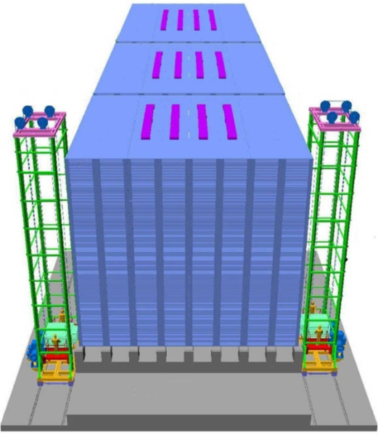
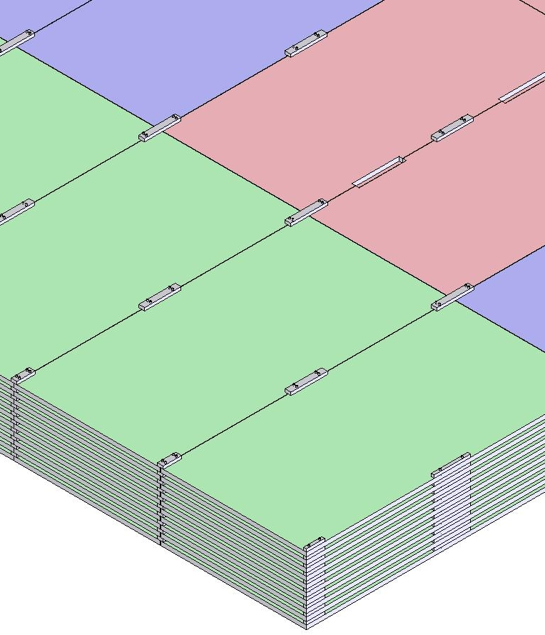
ICAL detector and construction
Magnet coils
4000mm×2000mm
×56mm low carbon iron sheets
RPC handling trolleys
Total weight: 50Ktons

Slide 3
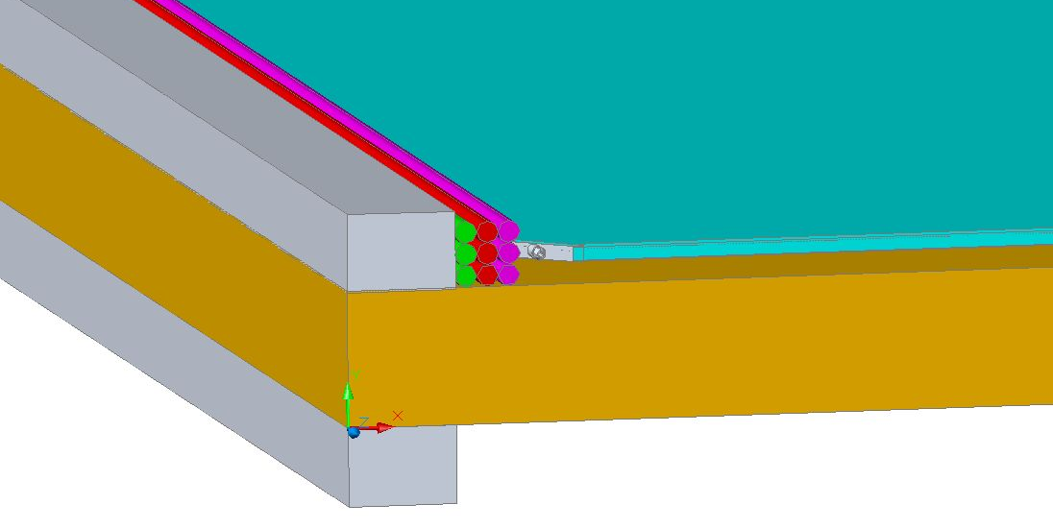
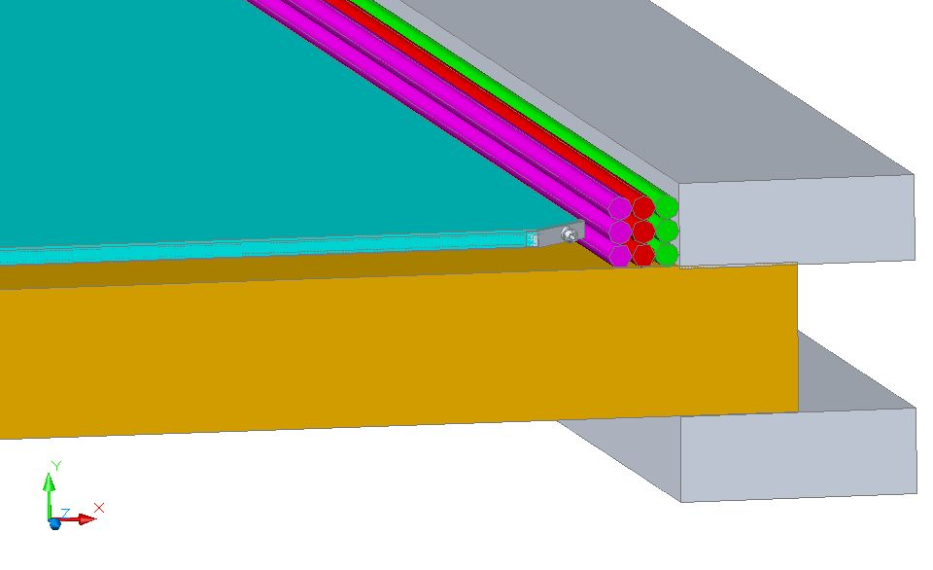
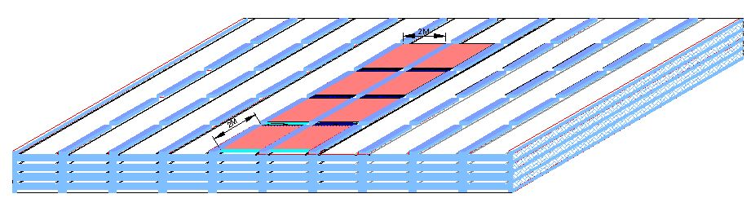
RPC in the ICAL detector
RPC
Iron absorber
Gas, LV & HV

Slide 4
Factsheet of ICAL detector
No. of modules | 3
Module dimensions | 16m × 16m × 14.5m
Detector dimensions | 48.4m × 16m × 14.5m
No. of layers | 150
Iron plate thickness | 56mm
Gap for RPC trays | 40mm
Magnetic field | 1.3Tesla
RPC dimensions | 1,950mm × 1,840mm × 26mm
Readout strip pitch | 30mm
No. of RPCs/Road/Layer | 8
No. of Roads/Layer/Module | 8
No. of RPC units/Layer | 192
No. of RPC units | 28,800 (97,505m²)
No. of readout strips | 3,686,400

Slide 5
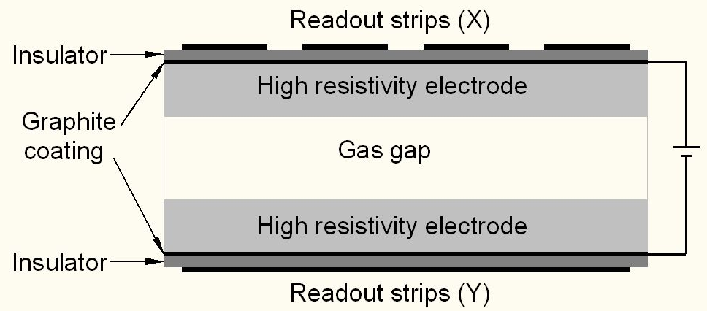
Schematic of a basic RPC
Glass (bakelite) for electrodes
Special paint mixture for semi-resistive coating
Plastic honey-comb laminations as pick-up panel
Special plastic films for insulation
Avalanche (streamer) mode of operation
Gas: R134a+Iso-butane+SF₆ = 95.5+4.2+0.3 (R134a+Iso-butane+Argon=56+7+37)

Slide 6
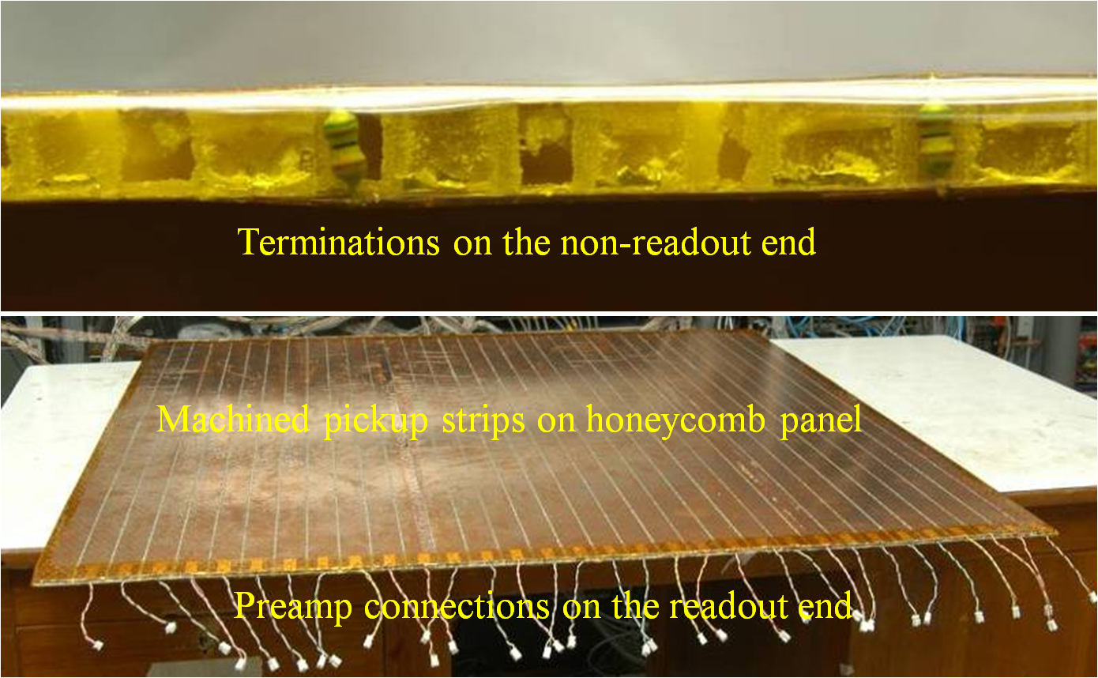
Honeycomb pickup panel

Slide 7
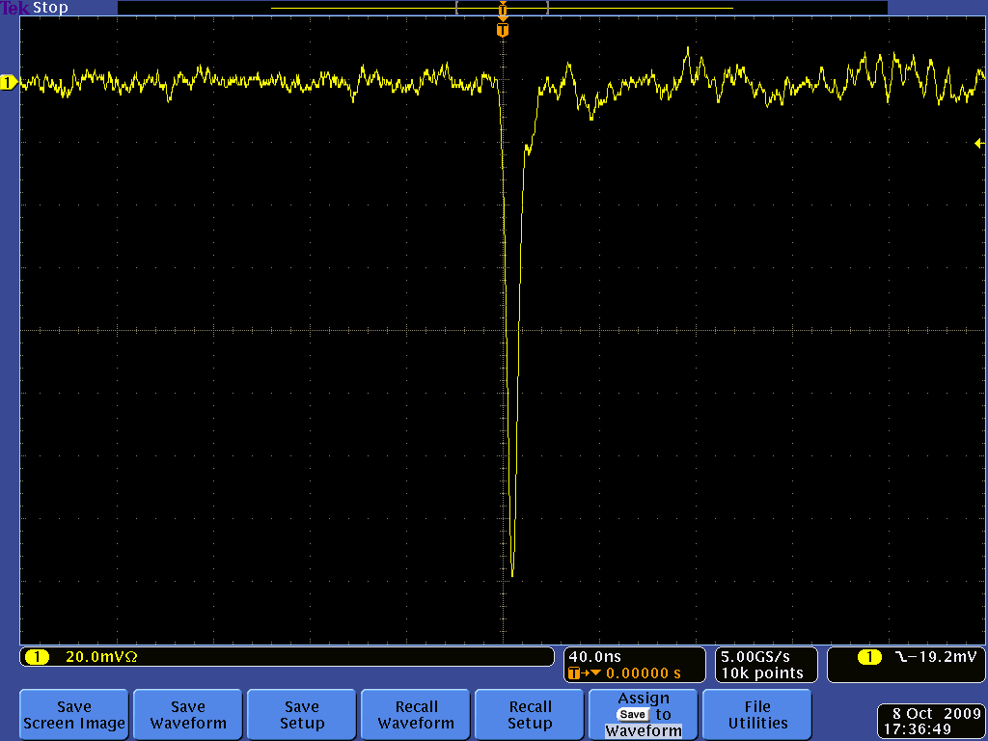
Post amplifier RPC pulse profile

Slide 8
DAQ system requirements
Information to record on trigger
Strip hit (1-bit resolution)
Timing (200ps) LC
Pulse profile or Time Over Threshold (for time-walk correction). TDC can measure TOT as well.
Rates
Individual strip background rates on surface ~300Hz
Underground rates differ: depth, rock radiation etc.
Muon event rate ~10Hz (The ‘blue’ book says ~2Hz)
On-line monitor
RPC parameters (High voltage, current)
Ambient parameters (T, P, RH)
D.C. power supplies, thresholds
Gas systems and magnet control and monitoring

Slide 9
Expected data sizes and rates
Pickup strip data – 128bits
TDC data: 16 channel s (8 strips ORed), dual edges, 16 hits /ch, 16-bits - 16 x 2 x 16 x 16 = 8192bits
RPC id - 16bits
Event id - 32bits
Ambient sensors (TPH) - 3 x 16 = 48bits
Noise rate data (1 second, all channels: worst case) - 1kbps
Time stamp - 100bits
Event size - 8516bits
Assume trigger rate to be 10Hz
Estimated data rate/RPC - 85160 bps + 1kbps = 84.16kbps
Add formatters, headers etc. – 100kbps/RPC
Add data from at least 8 RPCs = 8 x 100kbps = 800kbps
No data compression or zero suppression considered.
Channel occupancy a few%

Slide 10
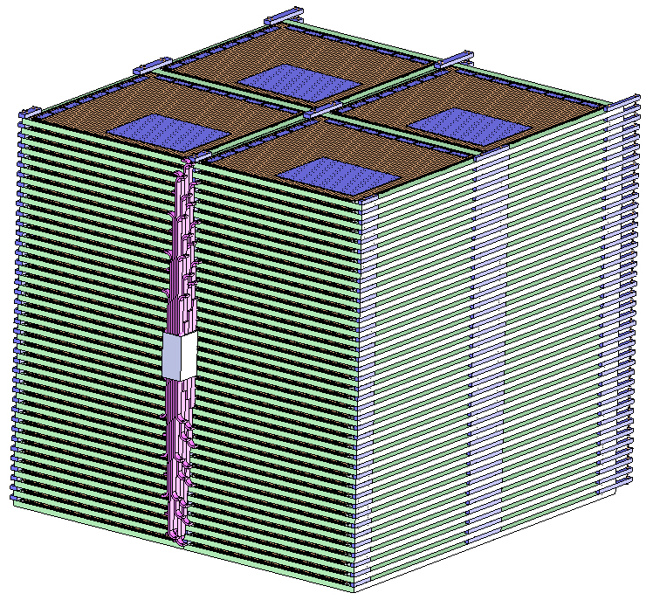
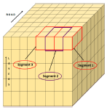
Segmentation of ICAL

Slide 11
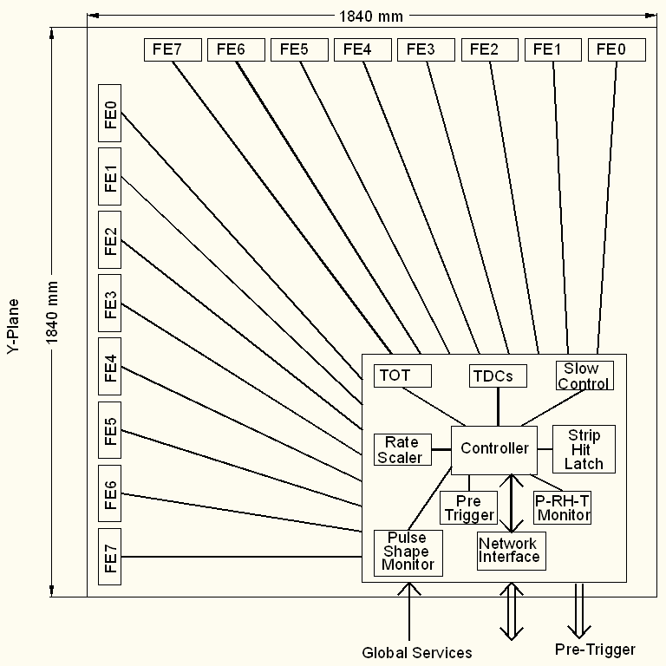
Functional diagram of RPC-DAQ

Slide 12
Functional diagram of FE ASIC
Common threshold
Ch-0
Regulated Cascode Transimpedance Amplifier
Differential Amplifier
Comparator
LVDS output driver
LVDS_out0
Channel-0
8:1 Analog Multiplexer
Output Buffer
Amp_out
Channel-7
Ch-7
Regulated Cascode Transimpedance Amplifier
Differential Amplifier
Comparator
LVDS output driver
LVDS_out7

Slide 13
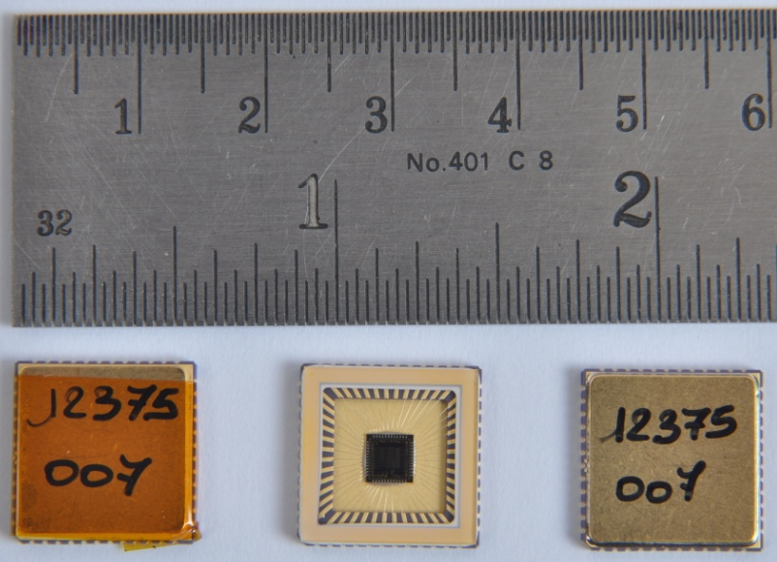
Features of ICAL FE ASIC
IC Service: Europractice (MPW), Belgium
Service agent: IMEC, Belgium
Foundry: austriamicrosystems
Process: AMSc35b4c3 (0.35μm CMOS)
Input dynamic range:18fC – 1.36pC
Input impedance: 45Ω @350MHz
Amplifier gain: 8mV/μA
3-dB Bandwidth: 274MHz
Rise time: 1.2ns
Comparator’s sensitivity: 2mV
LVDS drive: 4mA
Power per channel: < 20mW
Package: CLCC48(48-pin)
Chip area: 13mm²

Slide 14
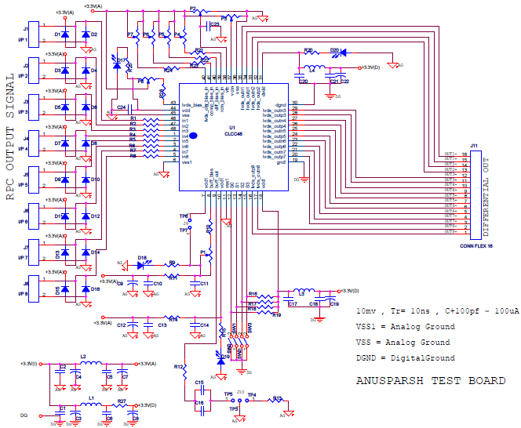
FE ASIC evaluation board

Slide 15
An important issue on FE ASIC
Separate chips for amplifier and discriminator
Helps better to support FE for glass and bakelite versions of RPC
Also helps trying out for example, different designs for comparator. For example: CFD
Does not matter much for the FE board – it is matter of one versus two ASIC chips onboard.
Alternative: Amplifier bypass option in the current ASIC (amp+comp) chip.

Slide 16
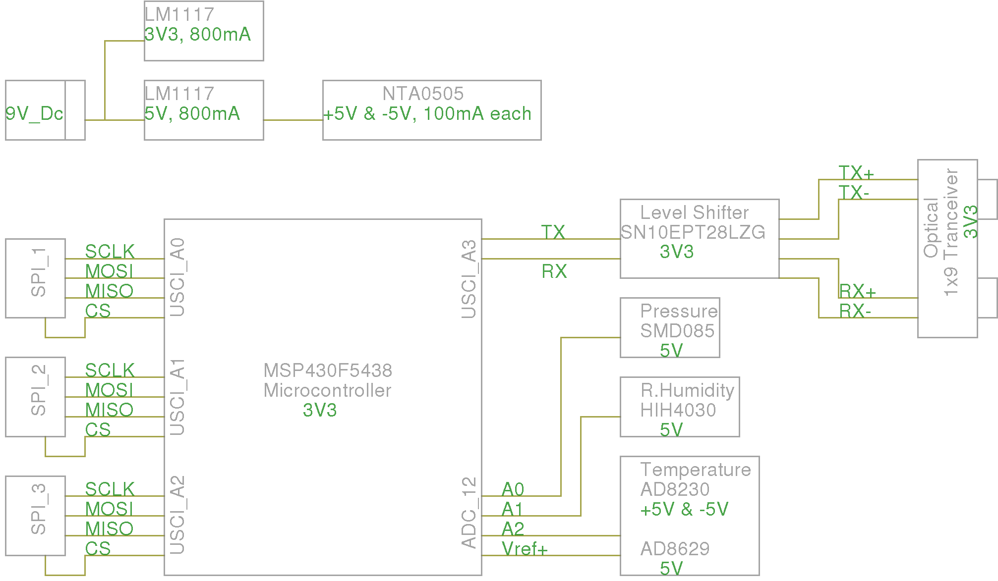
Scheme of RPC-DAQ controller

Slide 17
Pulse shape monitor
0.2-2 ns
Inverter “Domino” ring chain (SCA)
IN
Stefan Ritt, Paul Scherrer Institute
Waveform
stored
Out
Clock
Shift Register
“Time stretcher” GHz → MHz
Also ANUSMRITI ASIC: 500MHz Transient Waveform Sampler
V.B.Chandratre et al (BARC)

Slide 18
ICAL timing device
ASIC (3-stage interpolation technique) – Pooja
The new approach is to mix and match ASIC+FPGA techniques/architectures
To be delivered in about 6 months
FPGA (Vernier technique) – Hari
FPGA (Differential delay line technique) – Sudeshna
The FPGA efforts will continue
Some issues (delay matching, routing etc.) to be solved
Good and bad of an FPGA solution
FPGA is a lesser travelled path (only used in CKM experiment, Fermilab)

Slide 19
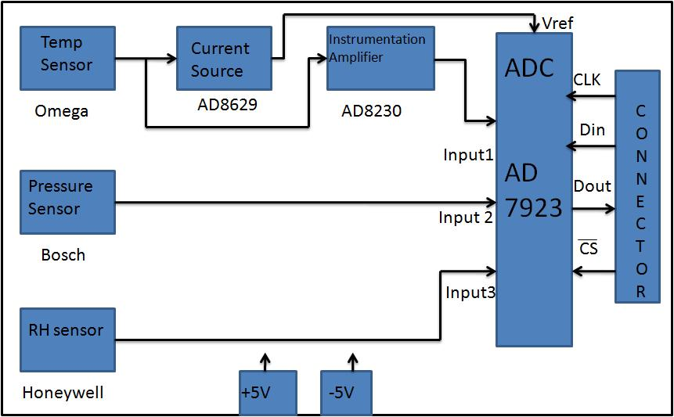
TPH monitor module

Slide 20
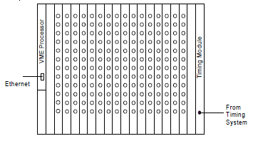
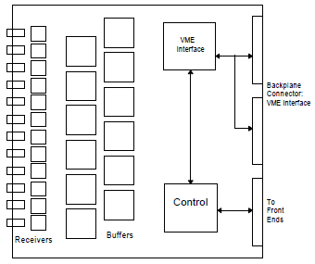
Back-end issues
VME is the ICAL’s backend standard
Global services (trigger, clock etc.), calibration
Data collector modules
Computer and data archival
On-line DAQ software
On-line data quality monitors
Networking and security issues
Remote access protocols to detector sub-systems and data
Voice and video communications
Drawings courtesy: Gary Drake

Slide 21
VME Interface Logic
V
M
E
B
U
S
LVDS
I/O
FPGA
Address
Address
Decoder
Front Panel Out
Front Panel In
Data
Addr. Modifier
Piggy Brd Data
Piggy
Board
Conn
Data
Router
Piggy Board ID
256
Deep
FIFO
Interrupt Ctrl
Interrupt Gen
And Handler
Int1, Int2

Slide 22
Custom VME Module
JTAG
FPGA Configuration Logic
On board logic analyser port
Transceiver
Data Bus
VME Interface
Logic
(FPGA)
VME Data
OE
DIR
LVDS Tx OUT
Transceiver
VME Addr
Address Bus
LVDS Rx IN
VME
BUS
OE
DIR
Front panel LEDs
Buffer
AM, DS, WR, SYSRST, IACK..
VME Control Signals
Data
Interface for V1495s piggy boards
DATCK, IACKOUT, IRQs, BERR
Buffer
Board Address

Slide 23
Features of ICAL trigger system
Insitu trigger generation
Autonomous; shares data bus with readout system
Distributed architecture
For ICAL, trigger system is based only on topology of the event; no other measurement data is used
Huge bank of combinatorial circuits
Programmability is the game, FPGAs, ASICs are the players

Slide 24
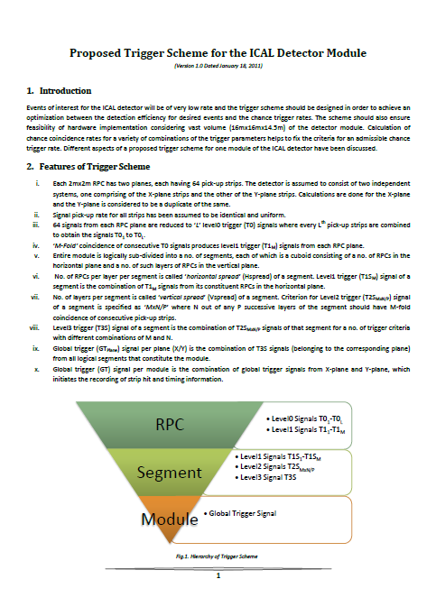
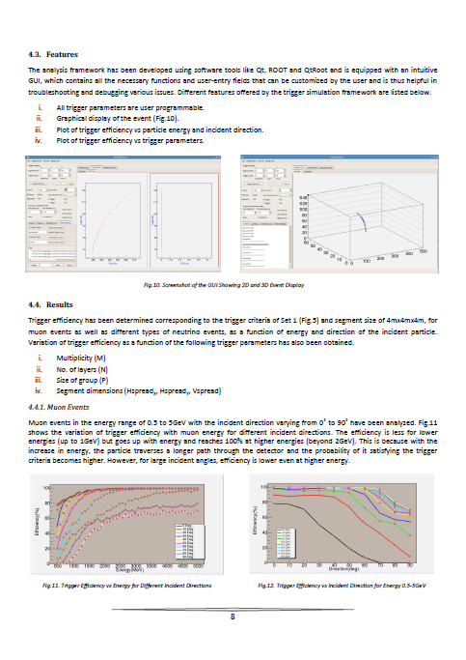
Proposed trigger scheme

Slide 25
Power supplies
High voltage for RPCs
Voltage: 10kV (nominal for Glass, less for Bakelite)
Current: 6mA (approx., 200nA per chamber)
Ramp up/down, on/off, monitoring
Low voltage for electronics
Voltages and current budgets still not available
Commercial and/or semi-commercial solutions
Buy supplies, design distribution( and control)?
DC-DC and DC-HVDC converters; cost considerations

Slide 26
Cables and interconnects
RPC to front-end boards – the toughest!
Integration with pickup panel fabrication
Front-end boards to RPC-DAQ board
LVDS signals (any alternatives?, prefer differential)
Channel address
Analog pulse
Power
RPC-DAQ boards to trigger sub-systems
Four pairs, Copper, multi-line, flat cable?
RPC-DAQ boards to back-end
Master trigger
Central clock
Data cable (Ethernet: copper/fibre, …)

Slide 27
Other critical issues
Power requirement and thermal management
If 50mW/channel → 200KW/detector
Magnet power (500KW?)
Front-end positioning; use absorber to good use!
Do we need forced, water cooled ventilation?
UPS, generator power requirements
High voltage supplies, critical controls, computers on UPS
Suggested cavern conditions
Temperature: 20±2ºC
Relative humidity: 50±5%

Slide 28
Roll of electronics industries
Chip fabrication
Board design, fabrication, assembly and testing
Cabling and interconnects
Crates and mechanics
Slow control and monitoring
Control and monitoring systems for gas systems and magnet
Industries (both public and private) are looking forward to work with INO

Slide 29
Future plan
VECC, IITM, BARC groups will send reports on their work and future plans shortly.
ICAL Electronics Report needs these inputs and will be finalised soon.
ASIC and FPGA based TDC designs is the priority.
Pilot RPC-DAQ (without TDC chip) board will be developed and tested on the RPC detector stack.
VME interface development will naturally lead to development of data concentrator module
Several technical issues including many interconnects etc. to be addressed immediately
Interaction with industrial houses and figure out areas in which we can benefit by their expertise and abilities

Slide 30
Work packages – Part 1
Signal pickup panels
RPC to front-end interconnects
Front-end
RPC-DAQ module
TDC
Waveform sampler
Strip-hit latch and rate monitor
Controller + data transreceiver
Firmware for the above
Pre-trigger front-end
TPH monitoring
Pulse width monitoring
Front-end control
Signal buffering scheme
Trigger system
DAQ backend

Slide 31
Work packages – Part 2
Software
Power supplies
Power requirement and thermal management
Integration issues
Routing of strip signals to the front-ends
Mounting of front-ends and RPC-DAQ module on the RPC unit
Routing of LV, HV (along with gas) lines to the RPC
Routing of LV, HV, data, trigger lines (along with gas) on the magnet
Locating and routing of pre-trigger lines into segment trigger stations
Location of backend VME crates and final trigger system
Power supplies’ mains and distribution
Production and QC
Board and module design
Production, QC, programming and calibration
Cabling and connectorisation etc. (specifications decided by the collaboration)
Crates, racks and other mechanics
Installation and commissioning
Operation considerations

