Slide 1
ICAL Electronics meeting
Hotel Arasan Sapthagiri, Madurai
January 23, 2011

Slide 2
Last ICAL Electronics meeting
Held at IIT Madras, Chennai
During August 9-11, 2010
Groups attended: IITM, BARC, SINP and TIFR

Slide 3
To do list – then!
Interconnection between RPC strips and preamp inputs (SINP/TIFR)
Problems with FPGA TDC (Hari, Sudeshna)
Problem with ASIC TDC (3rd stage interpolation, Pooja)
ASIC or FPGA TDC?
If FPGA TDC, can we include all other logic (+ data transmitter) into it?
Can the 8-in-one FE board have TDC as well?
This automatically means we will have TDC data for all channels.
FE output in LVDS? Depends on above
Power supplies (LV and HV), distribution and monitoring
Indigenous, commercial, semi-commercial, dc-hvdc (SINP/VECC)
Controller (MSP430 TI chip) and data interface from RPC to the backend (IITM)
Data interface: Ethernet, fibre, wire-less
Problem regarding FPGA as trigger element (Mandar)
Calibration/synchronisation of global signals and data paths
Backend standard, alternate to VME, Distributed backend?
Trigger system – segmentation (James, Mandar, Sudeshna, Pooja)
Trigger-less system: Any takers, on back foot for now?
Supernova trigger? Proposed by M.V.N.Murthy
Waveform sampler (Nagendra)
GPS based RTC

Slide 4
Agenda for today’s meeting
Pickup from where we last left!
Try to consolidate at least some areas
Agree to responsibilities and timelines
Form groups and means of communication
Agree on methods and standards
Listen to and discuss any new requirements
Take more (younger) people on board

Slide 5
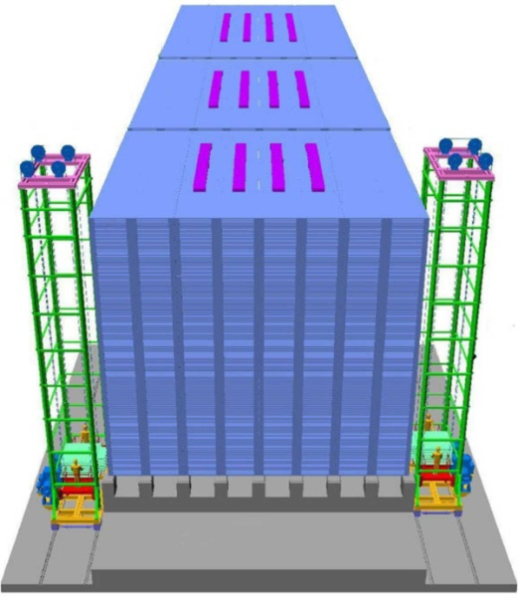
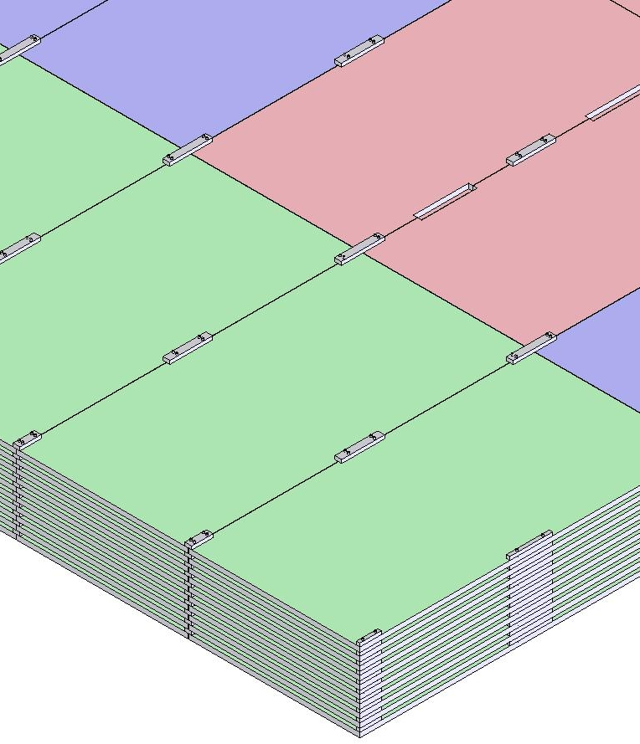
ICAL detector and construction
Magnet coils
4000mm×2000mm
×56mm low carbon iron sheets
RPC handling trolleys
Total weight: 50Ktons

Slide 6
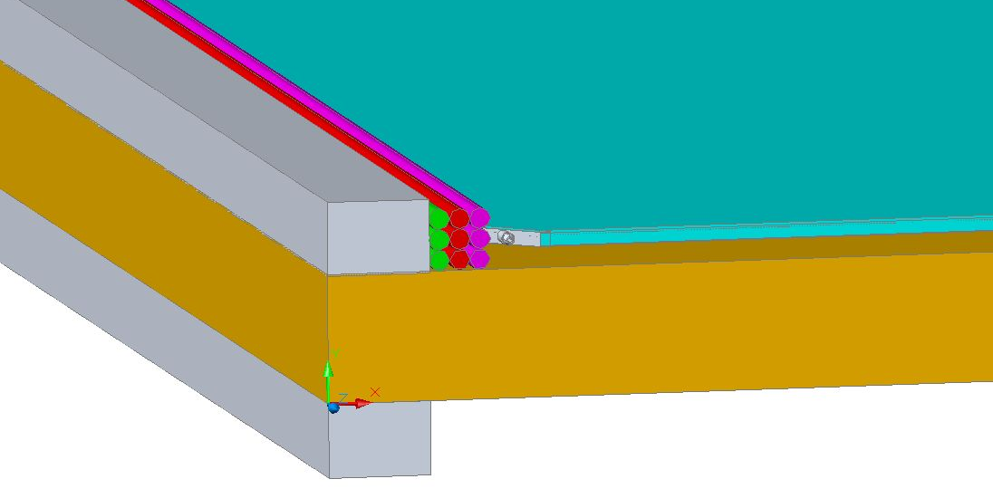
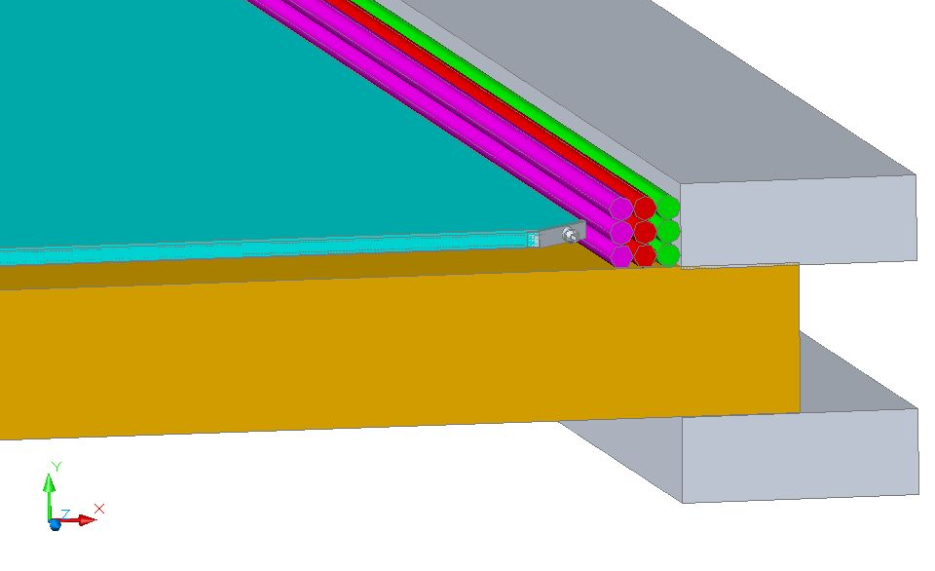
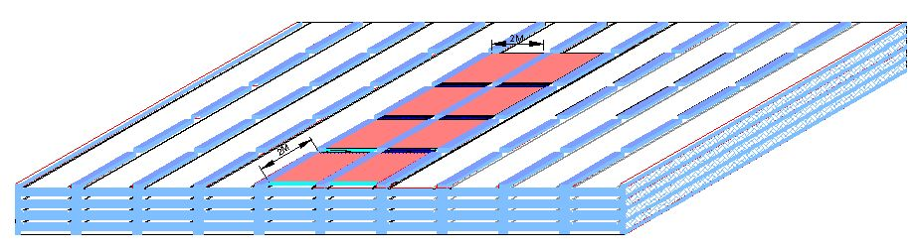
RPC in the ICAL detector
RPC
Iron absorber
Gas, LV & HV

Slide 7
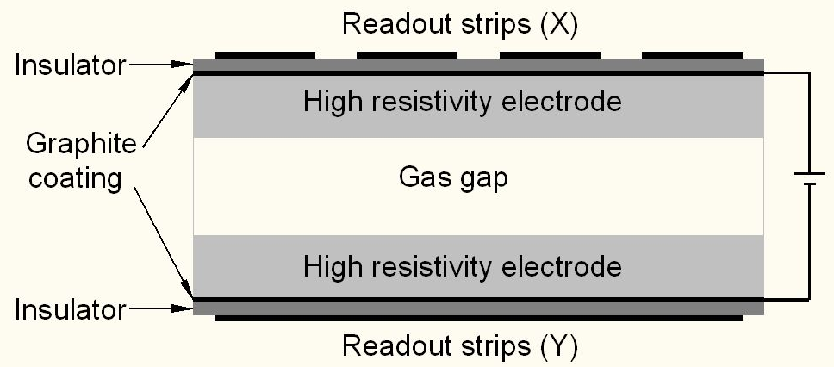
Schematic of a basic RPC
Glass or bakelite for electrodes
Special paint mixture for semi-resistive coating
Plastic honey-comb laminations as pick-up panel
Special plastic films for insulation
Avalanche (limited proportional) mode of operation
Standard gas mixture: R134a+Iso-butane+SF6 = 95.5+4.2+0.3

Slide 8
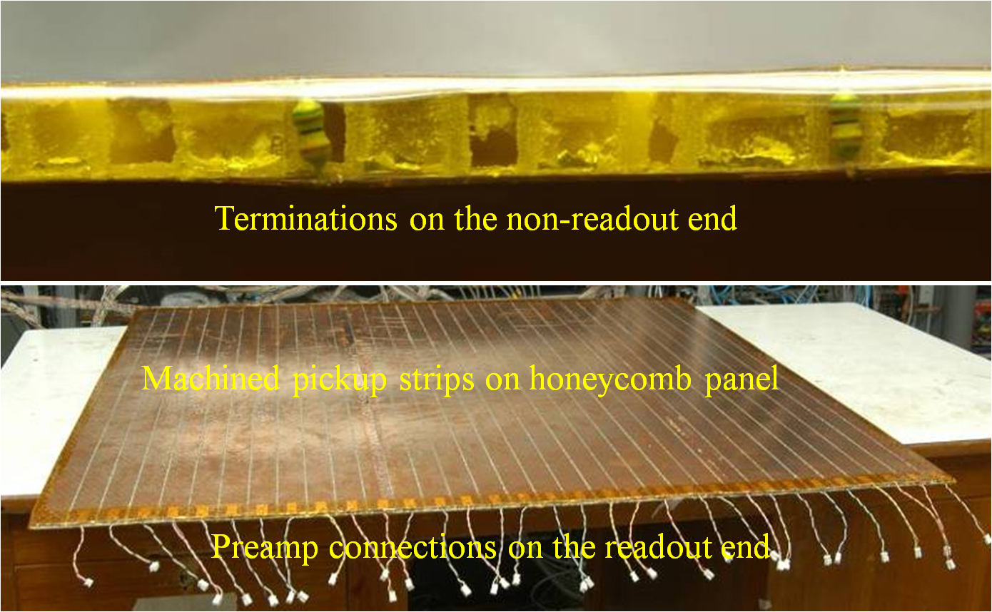
Honeycomb pickup panel

Slide 9
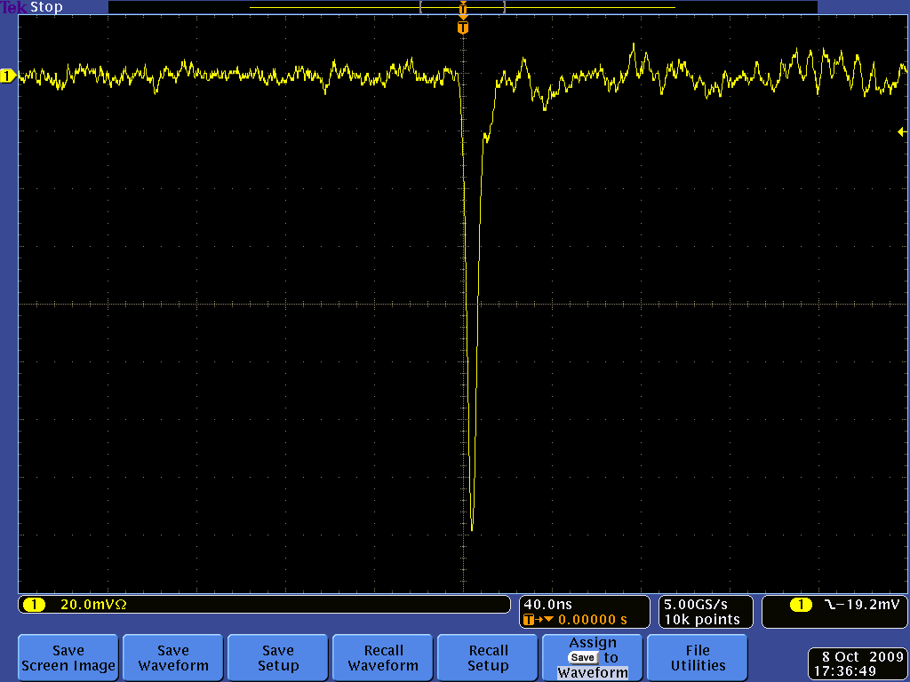
Post amplifier RPC pulse profile

Slide 10
DAQ system requirements
Information to record on trigger
Strip hit (1-bit resolution)
Timing (200ps) LC
Time Over Threshold (for time-walk correction)
Rates
Individual strip background rates ~300Hz
Event rate ~10Hz
On-line monitor
RPC parameters (High voltage, current)
Ambient parameters (T, P, RH)
Services, supplies (Gas systems, magnet, low voltage power supplies, thresholds)

Slide 11
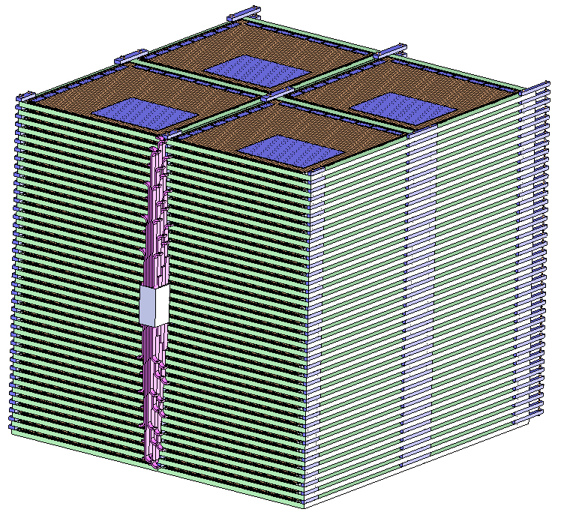
Segmentation of ICAL

Slide 12
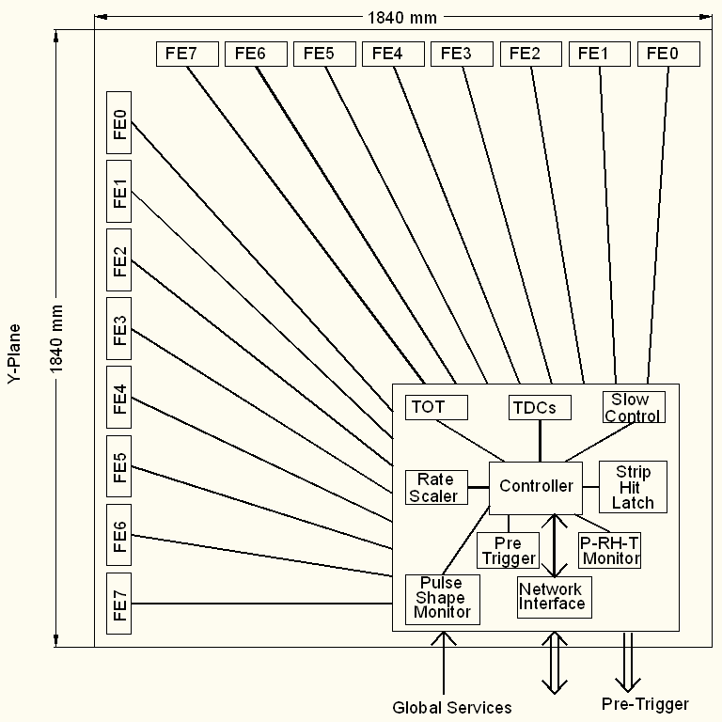
Functional diagram of RPC-DAQ

Slide 13
Functional diagram of FE ASIC
Common threshold
Ch-0
Regulated Cascode Transimpedance Amplifier
Differential Amplifier
Comparator
LVDS output driver
LVDS_out0
Channel-0
8:1 Analog Multiplexer
Output Buffer
Amp_out
Channel-7
Ch-7
Regulated Cascode Transimpedance Amplifier
Differential Amplifier
Comparator
LVDS output driver
LVDS_out7
V.B.Chandratre, Jan 24

Slide 14
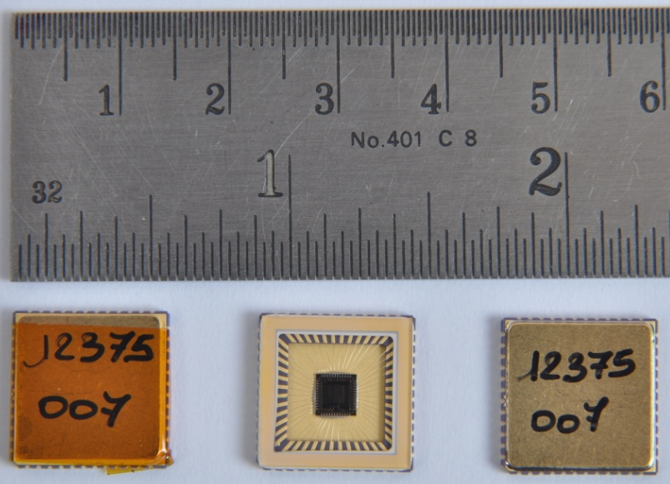
Features of ICAL FE ASIC
IC Service: Europractice (MPW), Belgium
Service agent: IMEC, Belgium
Foundry: austriamicrosystems
Process: AMSc35b4c3 (0.35um CMOS)
Input dynamic range:18fC – 1.36pC
Input impedance: 45Ω @350MHz
Amplifier gain: 8mV/μA
3-dB Bandwidth: 274MHz
Rise time: 1.2ns
Comparator’s sensitivity: 2mV
LVDS drive: 4mA
Power per channel: < 20mW
Package: CLCC48(48-pin)
Chip area: 13mm²

Slide 15
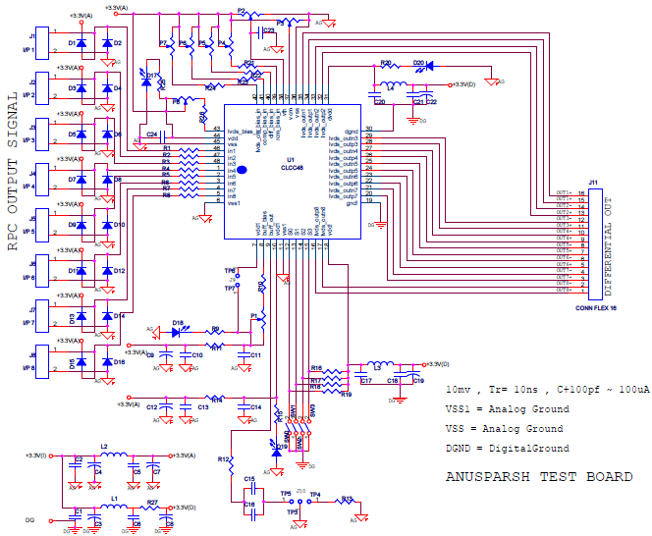
Front-end evaluation board

Slide 16
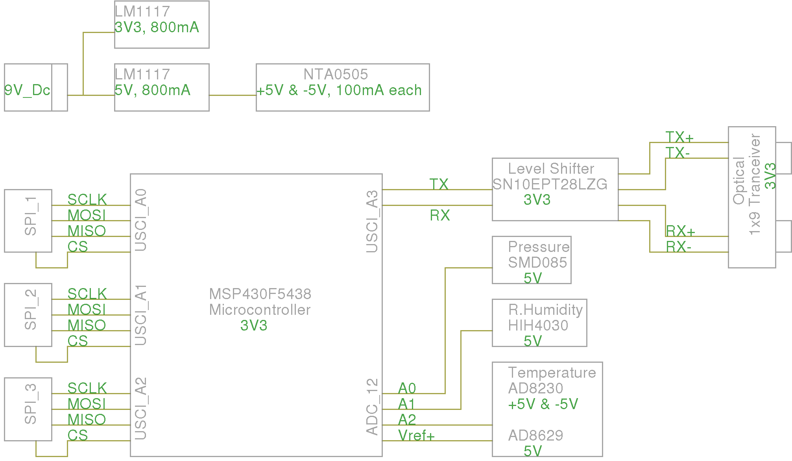
Scheme of RPC-DAQ controller
James Libby, Jan 24

Slide 17
Switched Capacitor Array
0.2-2 ns
Inverter “Domino” ring chain
IN
Stefan Ritt, Paul Scherrer Institute, Switzerland
Waveform
stored
Out
Clock
Shift Register
“Time stretcher” GHz → MHz
S.S.Upadhya, Jan 24

Slide 18
ICAL timing device
Most important component of ICAL electronics, but no clear roadmap yet on this.
ASIC (3-stage interpolation technique) – Pooja
FPGA (Vernier technique) – Hari
FPGA (Differential delay line technique) – Sudeshna
May be we should continue both of the above approaches at least for now
Advantages of FPGA solution
But, do we know any successful deployment of these chips?
V.B.Chandratre, Jan 24

Slide 19
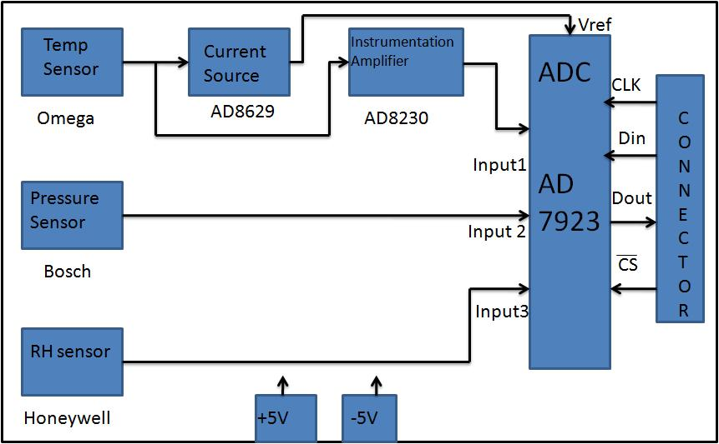
TPH monitor module
B.Satyanarayana, Jan 24

Slide 20
Back-end issues
VME is the ICAL’s backend standard
Global services (trigger, clock etc.), calibration
Data collector modules
Computer and data archival
On-line DAQ software
On-line data quality monitors
Networking and security issues
Remote access protocols to detector sub-systems and data
Voice and video communications

Slide 21
VME Interface Logic
V
M
E
B
U
S
LVDS
I/O
FPGA
Address
Address
Decoder
Front Panel Out
Front Panel In
Data
Addr. Modifier
Piggy Brd Data
Piggy
Board
Conn
Data
Router
Piggy Board ID
256
Deep
FIFO
Interrupt Ctrl
Interrupt Gen
And Handler
Int1, Int2
M.Saraf, Jan 24

Slide 22
Custom VME Module
JTAG
FPGA Configuration Logic
On board logic analyser port
Transceiver
Data Bus
VME Interface
Logic
(FPGA)
VME Data
OE
DIR
LVDS Tx OUT
Transceiver
VME Addr
Address Bus
LVDS Rx IN
VME
BUS
OE
DIR
Front panel LEDs
Buffer
AM, DS, WR, SYSRST, IACK..
VME Control Signals
Data
Interface for V1495s piggy boards
DATCK, IACKOUT, IRQs, BERR
Buffer
Board Address

Slide 23
Features of ICAL trigger system
Physicist’s mind decoded!
Autonomous; shares data bus with readout system
Distributed architecture
For ICAL, trigger system is based only on topology of the event; no other measurement data is used
Huge bank of combinatorial circuits
Programmability is the game, FPGAs, ASICs are the players

Slide 24
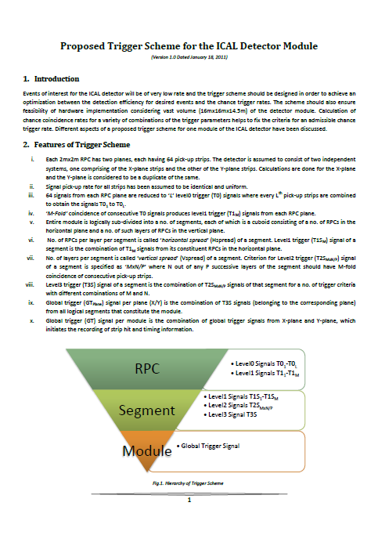
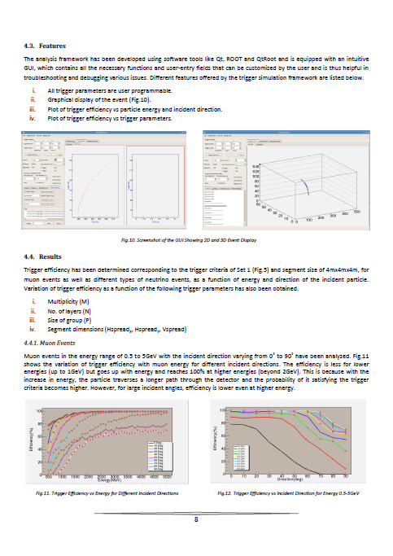
Proposed trigger scheme
S.Dasgupta, Jan 24

Slide 25
Power supplies
High voltage for RPCs
Voltage: 10kV (nominal)
Current: 6mA (approx.)
Ramp up/down, on/off, monitoring
Low voltage for electronics
Voltages and current budgets still not available at this time
Commercial and/or semi-commercial solutions
DC-DC and DC-HVDC converters; cost considerations
S.Saha, Jan 24

Slide 26
Cables and interconnects
RPC to front-end boards – the toughest!
Integration with pickup panel fabrication
Front-end boards to RPC-DAQ board
LVDS signals
Channel address
Analog pulse
Power
RPC-DAQ boards to trigger sub-systems
Copper, multi-line, flat cable?
RPC-DAQ boards to back-end
Master trigger
Central clock
Data cable (Ethernet, fibre, …)

Slide 27
Other critical issues
Power requirement and thermal management
50mW/channel → 200KW/detector
Magnet power (500KW?)
Front-end positioning; use absorber to good use!
Do we need forced, water cooled ventilation?
UPS, generator power requirements
Suggested cavern conditions
Temperature: 20±2ºC
Relative humidity: 50±5%

Slide 28
Roll of electronics industries
Chip fabrication
Board design, fabrication, assembly and testing
Slow control and monitoring
Industries are looking forward to work with INO

Slide 29
Data size for triggered scheme
Assuming 8 channel grouping for Trigger and TDC in each RPC
TDC:512nsec range & 100ps resolution, 16Hit
Start-Stop delay: Pulse width format
16x2x16x16+16x16(Channel identity)=8192bits+256 (worst case)
Pickup strip Hit pattern (128 bits)
Event arrival time up to 100psec resolution (50bit)
RPC identity (16 bit)
Event identity(32bit)
Packet information(16bit)
Event data per RPC
Worst case =8192+256+128+50+16+32+16=8690 bits
Typical case = 512+256+128+50+16+32+16=1010 bits
Total data
266Mb[16hit TDC] or 31Mb[1 Hit TDC] per event [ All data] or 20% data = 6Mb per event [Non-zero data]
Assuming 500Hz trigger rate , Total data = 133 Gbps or 15.5 Gbps 0r 3.1Gbps

