Slide 1
ICAL Electronics:
Requirements and Challenges
B.Satyanarayana
TIFR, Mumbai

Slide 2
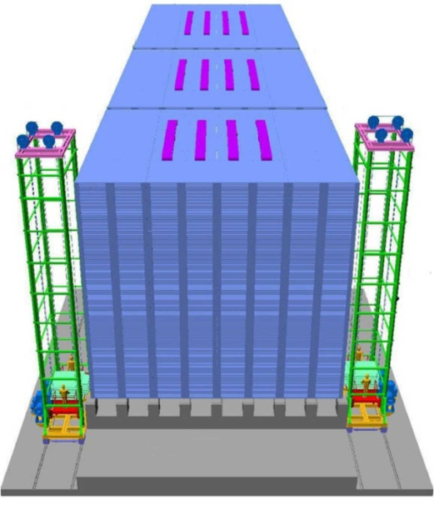
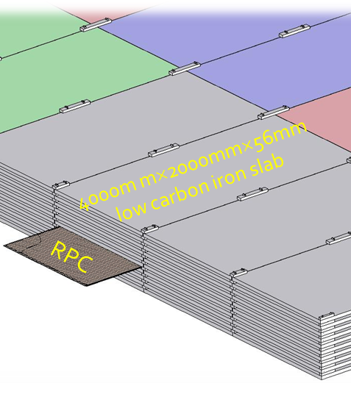
ICAL detector

Slide 3
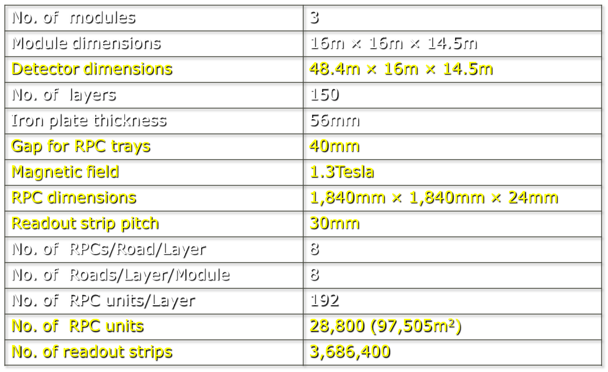
Factsheet of ICAL detector

Slide 4
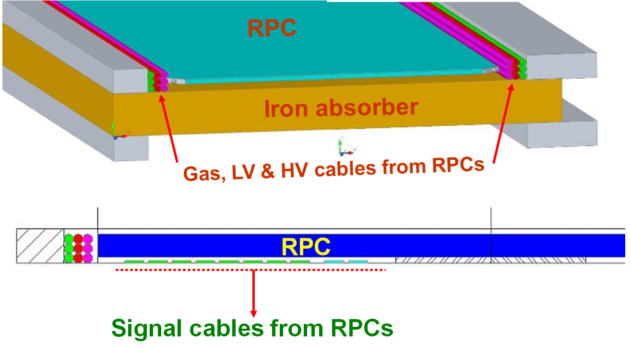
Cables & services routing

Slide 5
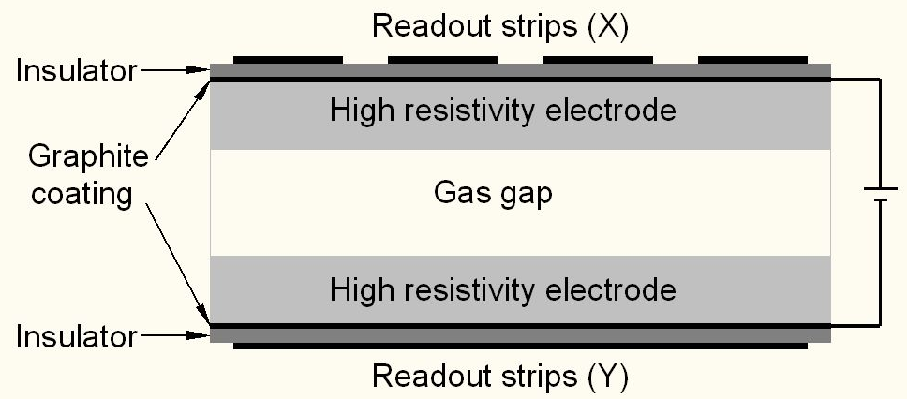
Schematic of a basic RPC

Slide 6
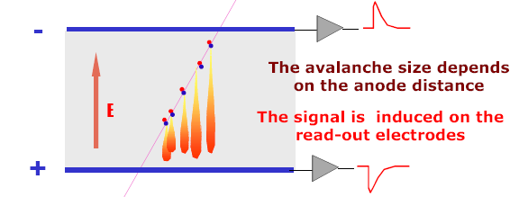
Signal development in an RPC
  Each primary electron produced in the gas gap starts an avalanche until it hits the electrode.
  Avalanche development is characterized by two gas parameters, Townsend Coefficient (α) and Attachment coefficient (η).
  Average number of electrons produced at a distance x, n(x) = e^{(α− η)x}
  Current signal induced on the electrode, i(t) = E_{w} • v • e₀ • N(t) / V_{w}, where E_{w} / V_{w} = ε_{r} / (2b + dε_{r}).

Slide 7
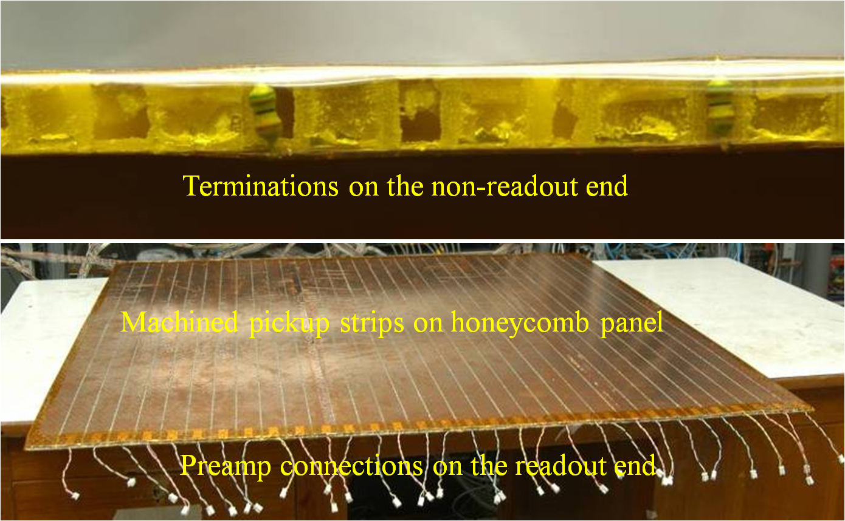
Honeycomb pickup panel

Slide 8
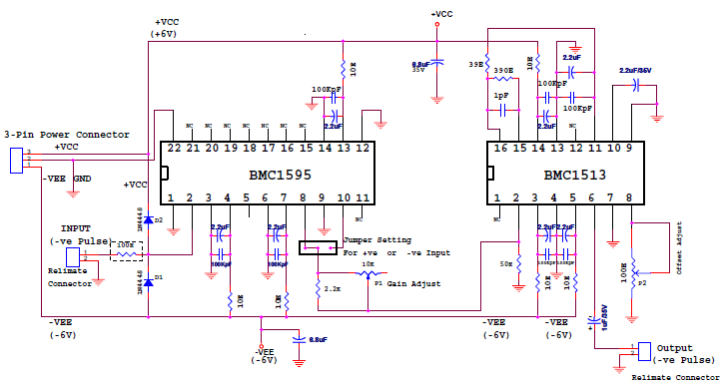
HMC based preamplifier

Slide 9
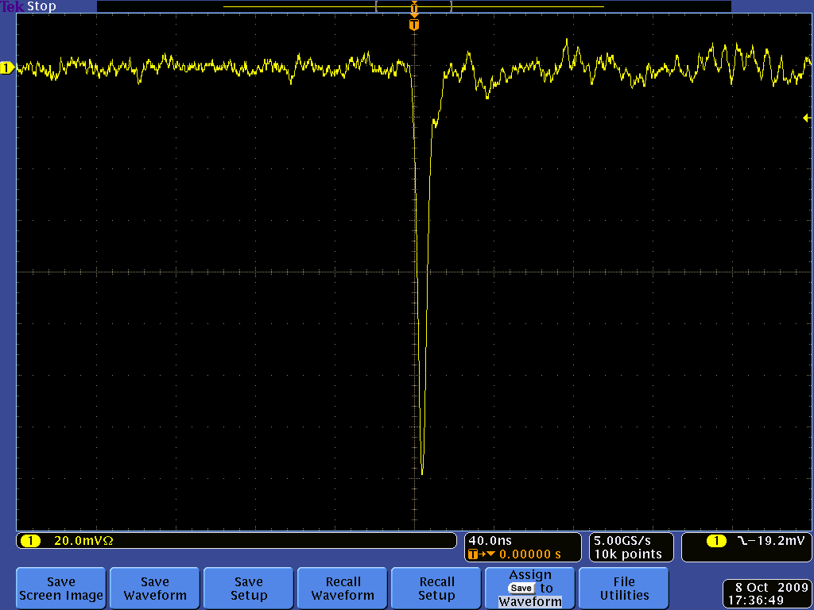
Post amplifier RPC pulse profile

Slide 10
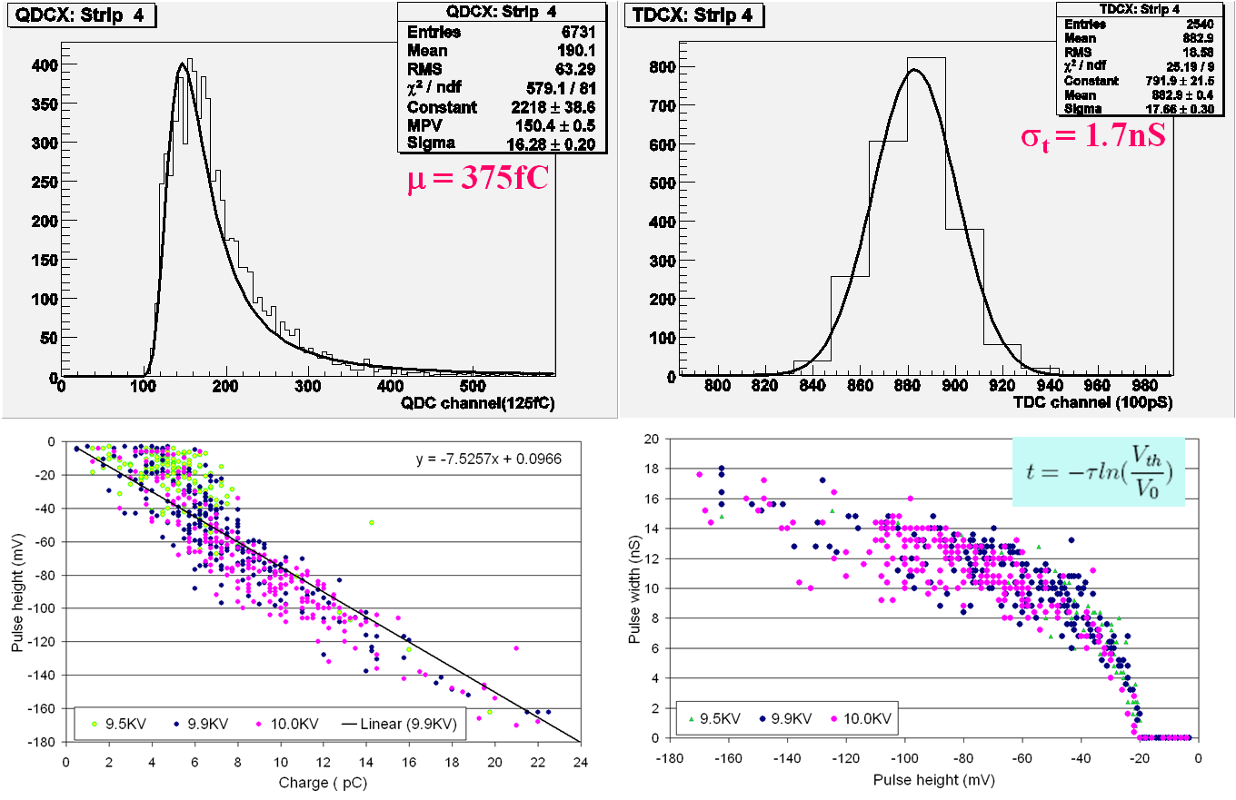
Characteristics of RPC pulse

Slide 11
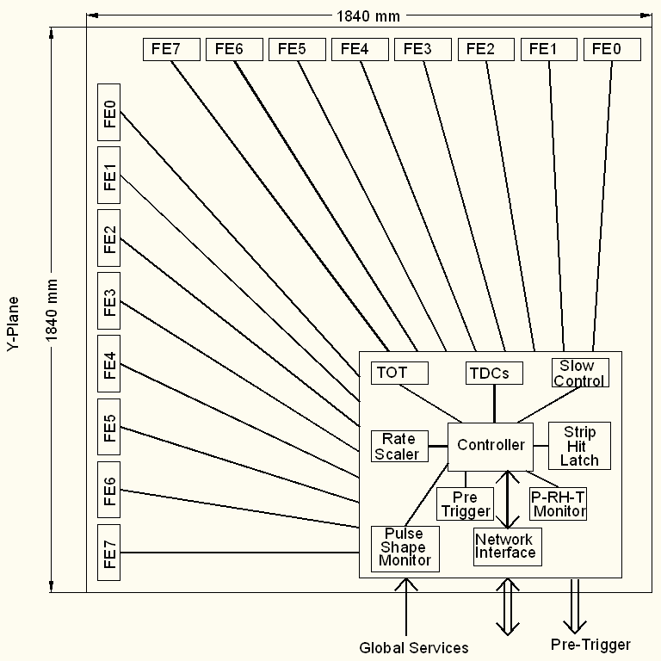
Triggered DAQ scheme
Conventional architecture
Dedicated sub-system blocks for performing various data readout tasks
Need for Hardware based on-line trigger system
Trigger latency issues and how do we take care in implementation

Slide 12
Trigger system
Physicist’s mind decoded!
Autonomous; shares data bus with readout system
Distributed architecture
For ICAL, trigger system is based only on topology of the event; no other measurement data is used
Huge bank of combinatorial circuits
Programmability is the key, FPGAs, ASICs are the players

Slide 13
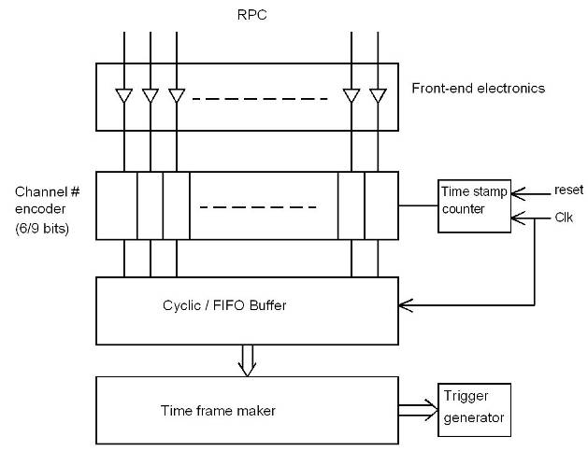
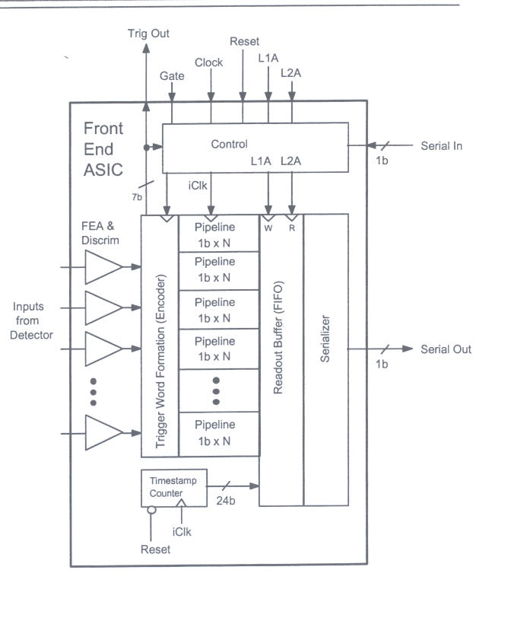
Trigger-less DAQ scheme
Gary Drake & Charlie Nelson
Suitable for low event rate and low background/noise rates
On-off control and V_{th} control to disable noisy channels

Slide 14
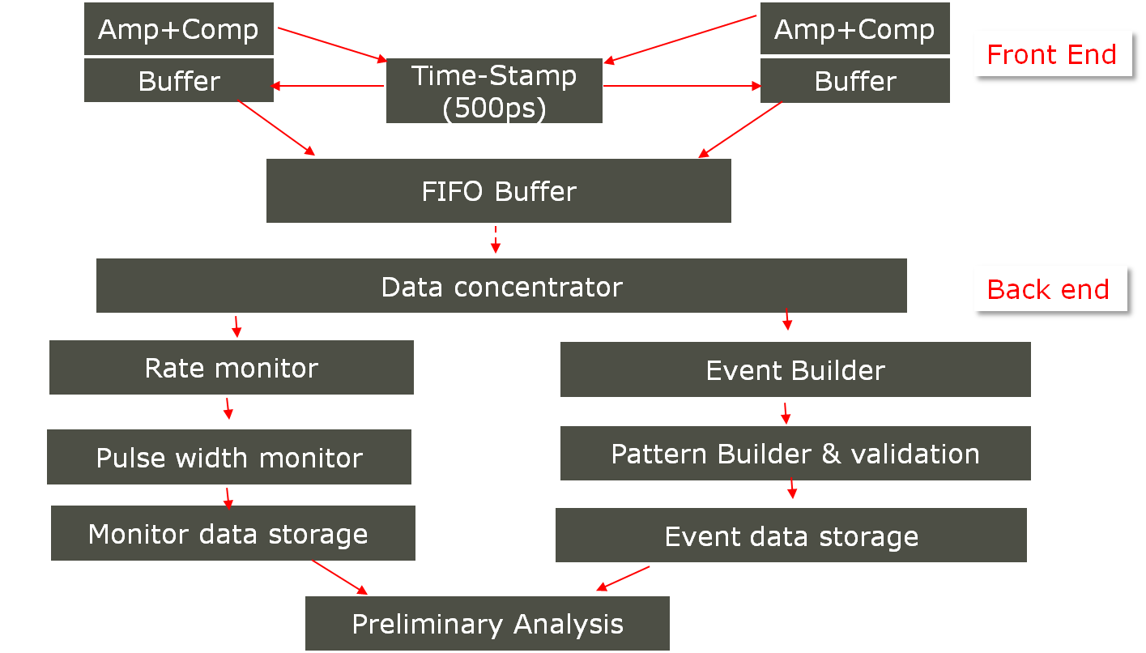
Implementing trigger-less scheme

Slide 15
DAQ system requirements
Information to record on trigger
  Strip hit (1-bit resolution)
  Timing (< 500ps)
  Time Over Threshold (for time-walk correction)
Rates
  Individual strip background rates ~300Hz
  Event rate ~10Hz
On-line monitor
  RPC parameters (High voltage, current)
  Ambient parameters (T, P, RH)
  Services, supplies (Gas systems, magnet, low voltage power supplies, thresholds)

Slide 16
Front-end specifications
No input matching circuit needed, HCP strips give ~50Ω characteristic impedance
Avalanche mode, pulse amplitude: 2.5 -3mV
Gain (100-200, fixed) depends on the electronic noise obtainable
No gain needed if operated in streamer mode, option to by-pass gain stage
Rise time: < 500ps
Discriminator overhead: 3-4 preferable
Variable V_{th} for discriminator ±10mV to ±50mV
Pulse shaping (fixed) 50-100nS
Pulse shaping removes pulse height information; do we need the latter?

Slide 17
Functional diagram of the FE ASIC
Common threshold
Ref: Veena Salodia’s presentation
Ch-0
Regulated Cascode Transimpedance Amplifier
Differential Amplifier
Comparator
LVDS output driver
LVDS_out0
Channel-0
8:1 Analog Multiplexer
Amp_out
Output Buffer
Channel-7
Ch-7
Regulated Cascode Transimpedance Amplifier
Differential Amplifier
Comparator
LVDS output driver
LVDS_out7

Slide 18
Information on FE ASIC
IC Service: Europractice (MPW), Belgium
Service agent: IMEC, Belgium
Foundry: austriamicrosystems
Process: AMSc35b4c3 (0.35um CMOS)
Input dynamic range:18fC – 1.36pC
Input impedance: 45Ω @350MHz
Amplifier gain: 8mV/μA
3-dB Bandwidth: 274MHz
Rise time: 1.2ns
Comparator’s sensitivity: 2mV
LVDS drive: 4mA
Power per channel: < 20mW
Package: CLCC48(48-pin)
Chip area: 13mm²
Cost: € 11,000 for just 30 pcs!

Slide 19
Timing devices
ASIC chips
  HPTDC (J.Christiansen, CERN), 32/8 channels, σ_{t}: 261/64/48/40/17ps
  AMT (Yasuo Arai, KEK), 24 channels, σ_{t} = 305ps
  3-stage interpolated TDC ASIC (Ref: Pooja Saxena’s presentation)
FPGA based solutions
  Vernier (Ref: Hari Kolla’s presentation)
  Differential Delay Line Ref: Sudeshna Dasgupta’s presentation)
  IITM’s design?

Slide 20
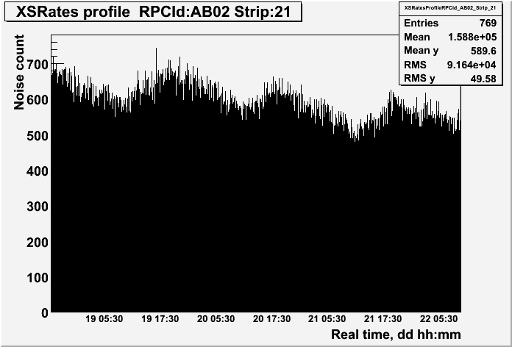
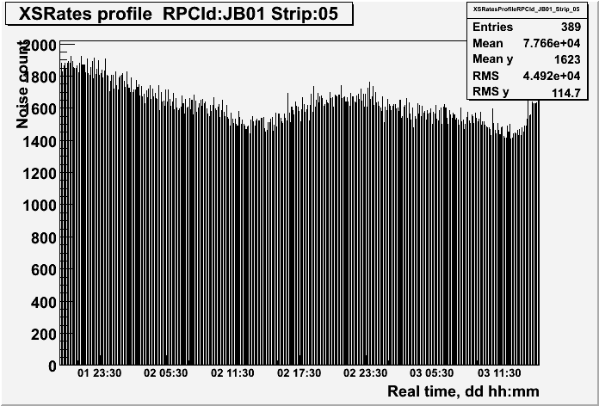
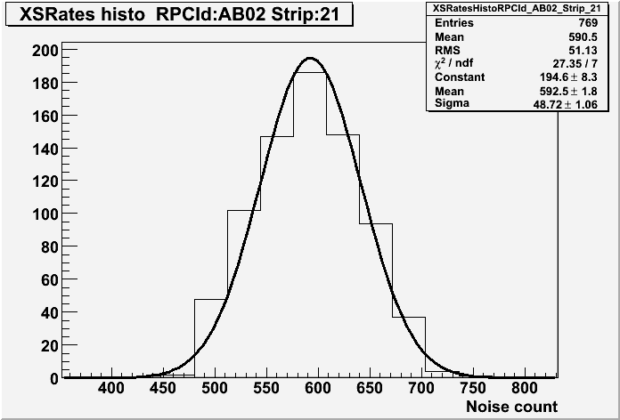
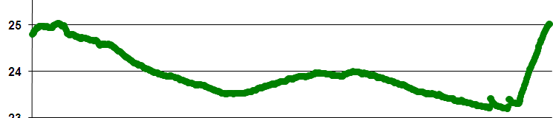
RPC strip rate monitoring
Temperature dependence on noise rate
Strip noise rate profile
Strip noise rate histogram
Temperature

Slide 21
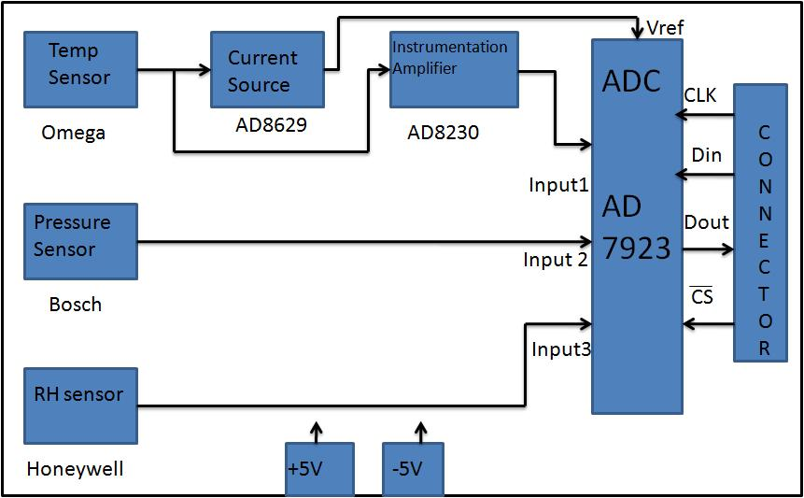
TPH monitor module
Ref: Shekhar Lahamge’s presentation

Slide 22
Back-end issues
VME is the ICAL’s backend standard (Ref: Mandar Saraf’s presentation)
Global services (trigger, clock etc.), calibration
Data collectors and frame transmitters
Trigger farms in trigger-less scheme
Computer and data archival
On-line DAQ software
On-line data quality monitors
Networking and security issues
Remote access protocols to detector sub-systems and data
Voice and video communications

Slide 23
Power supplies
High voltage for RPCs
  Voltage: 10kV (nominal)
  Current: 6mA (approx.)
  Ramp up/down, on/off, monitoring
Low voltage for electronics
  Voltages and current budgets still not available at this time
Commercial and/or semi-commercial solutions
DC-DC and DC-HVDC converters; cost considerations

Slide 24
Other critical issues
Power requirement and thermal management
  25mW/channel → 100KW/detector
  Magnet power (500KW?)
  Front-end positioning; use absorber to good use!
  Do we need forced, water cooled ventilation?
  UPS, generator power requirements
Suggested cavern conditions
  Temperature: 20±2ºC
  Relative humidity: 50±5%

Slide 25
Summary and future outlook
Almost all the RPC parameters and requirements understood.
Overall electronics and DAQ specifications need to be firmed up.
Design and prototyping of well defined sub-systems is already in progress (eg. FE, TDC, ambient parameter monitors etc.).
Identification of off-the-shelf solutions (data links, power supplies, even some chips) – both from commercial and research groups should be exploited.
Work and responsibilities by the ICAL collaborating institutes and universities.
Roll of electronics industries is crucial:
  Chip fabrication
  Board design, fabrication, assembly and testing
  Slow control and monitoring
  Industries are looking forward to work with INO
Truly exciting and challenging opportunities ahead in VLSI design, system integration, data communication, process control, power supplies, on-line software …

Slide 26
Data size for triggered scheme
Assuming 8 channel grouping for Trigger and TDC in each RPC
TDC:512nsec range & 100ps resolution, 16Hit
  Start-Stop delay: Pulse width format
  16x2x16x16+16x16(Channel identity)=8192bits+256 (worst case)
Pickup strip Hit pattern (128 bits)
Event arrival time up to 100psec resolution (50bit)
RPC identity (16 bit)
Event identity(32bit)
Packet information(16bit)
Event data per RPC
  Worst case =8192+256+128+50+16+32+16=8690 bits
  Typical case = 512+256+128+50+16+32+16=1010 bits
Total data
  266Mb[16hit TDC] or 31Mb[1 Hit TDC] per event [ All data] or 20% data = 6Mb per event [Non-zero data]
  Assuming 500Hz trigger rate , Total data = 133 Gbps or 15.5 Gbps 0r 3.1Gbps

Slide 27
Data size for trigger-less scheme
Pickup strip rate estimation
  Assuming Cosmic ray rate of 10K/min/ m²
  For RPC area of 4 m², Rate is 40K/min
  Pick strip rate = 40K/64=10.4Hz
Pickup signal data
  Signal arrival time-stamp up to 100psec resolution (50bit)
  Pulse width information (10 bit for 100nsec)
  Channel identity(8 bit for 64 in X and Y planes )
  RPC identity (16 bit)
  Packet information(10bit)
  Total = 94 … aprox. 100 bit
Data rate
  RPC data = 10x128x100= 128Kbps
  Detector data = 128Kx30720 = 3.932 Gbps
Trigger rate (Assuming 3/min/m³ of prototype detector)
  Trigger rate for whole detector is 500Hz
Data collection per second is aprox. 2000 Gbps
Conventional Scheme:
  Data collection : 133 Gbps(16hit TDC) or 15.5 Gbps (1Hit TDC) 0r 3.1Gbps(Non-zero data)

