Slide 1
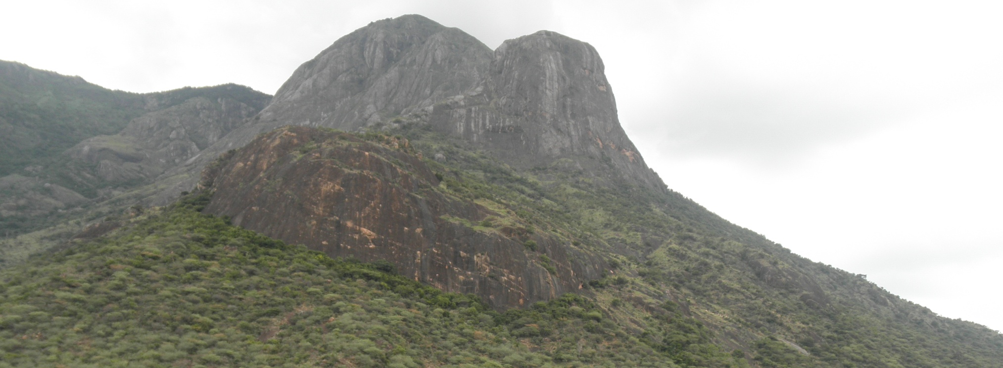
ICAL Instrumentation Challenges &/ Opportunities
B.Satyanarayana
TIFR, Mumbai

Slide 2
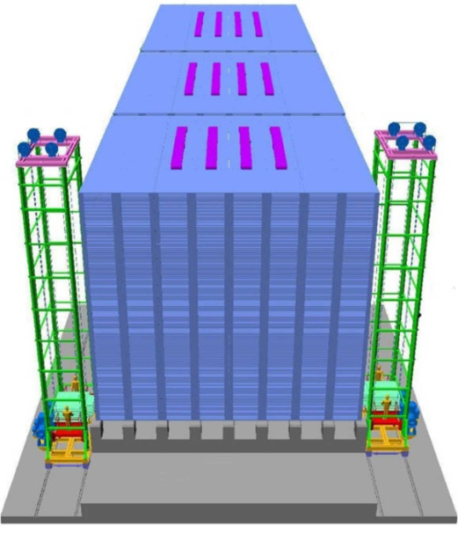
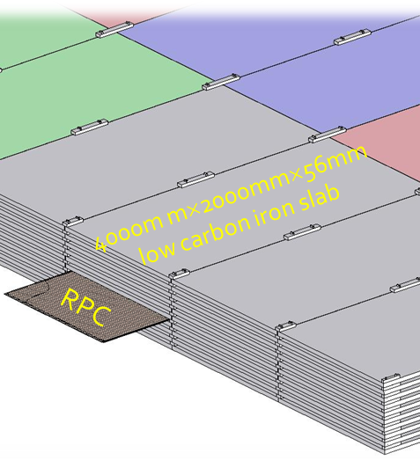
ICAL detector

Slide 3
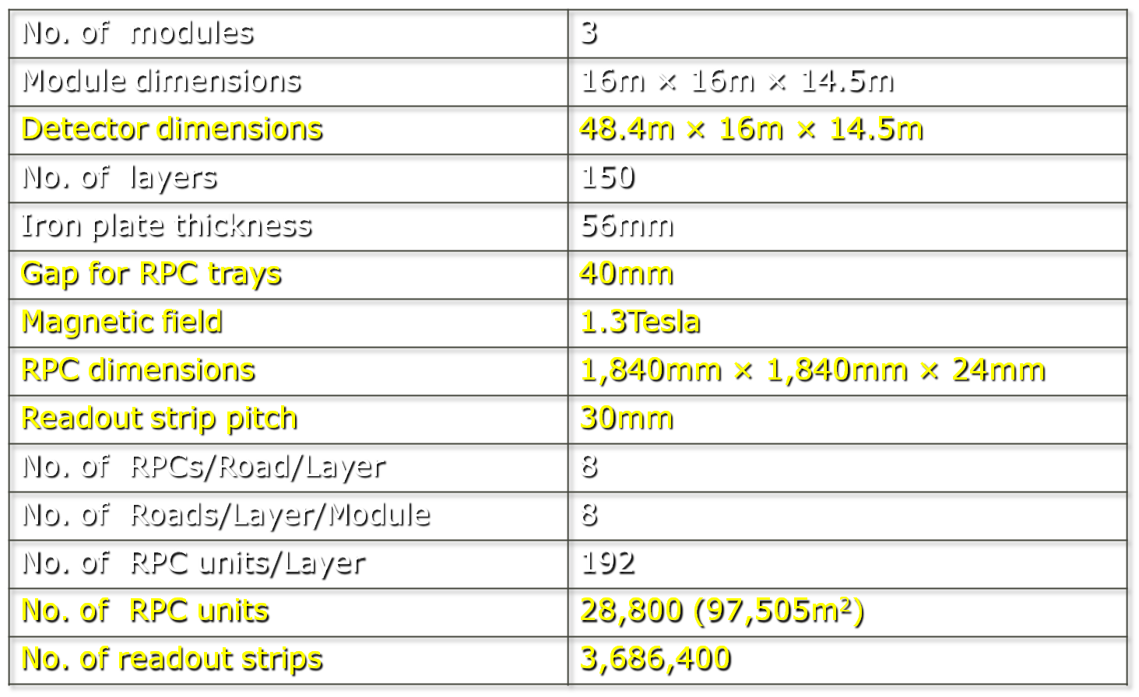
Factsheet of ICAL detector

Slide 4
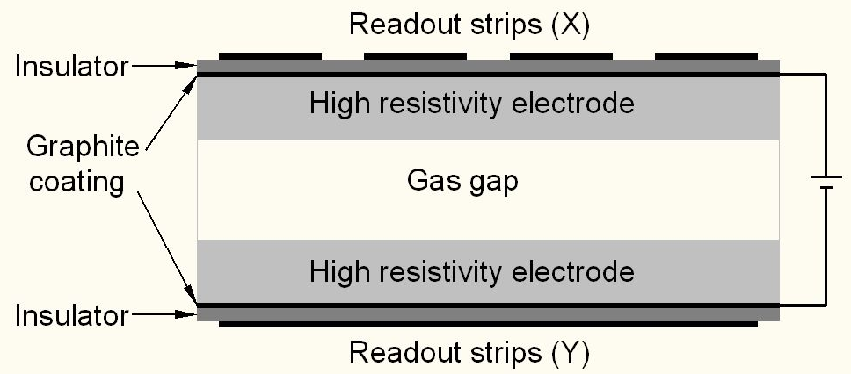
Schematic of a basic RPC

Slide 5
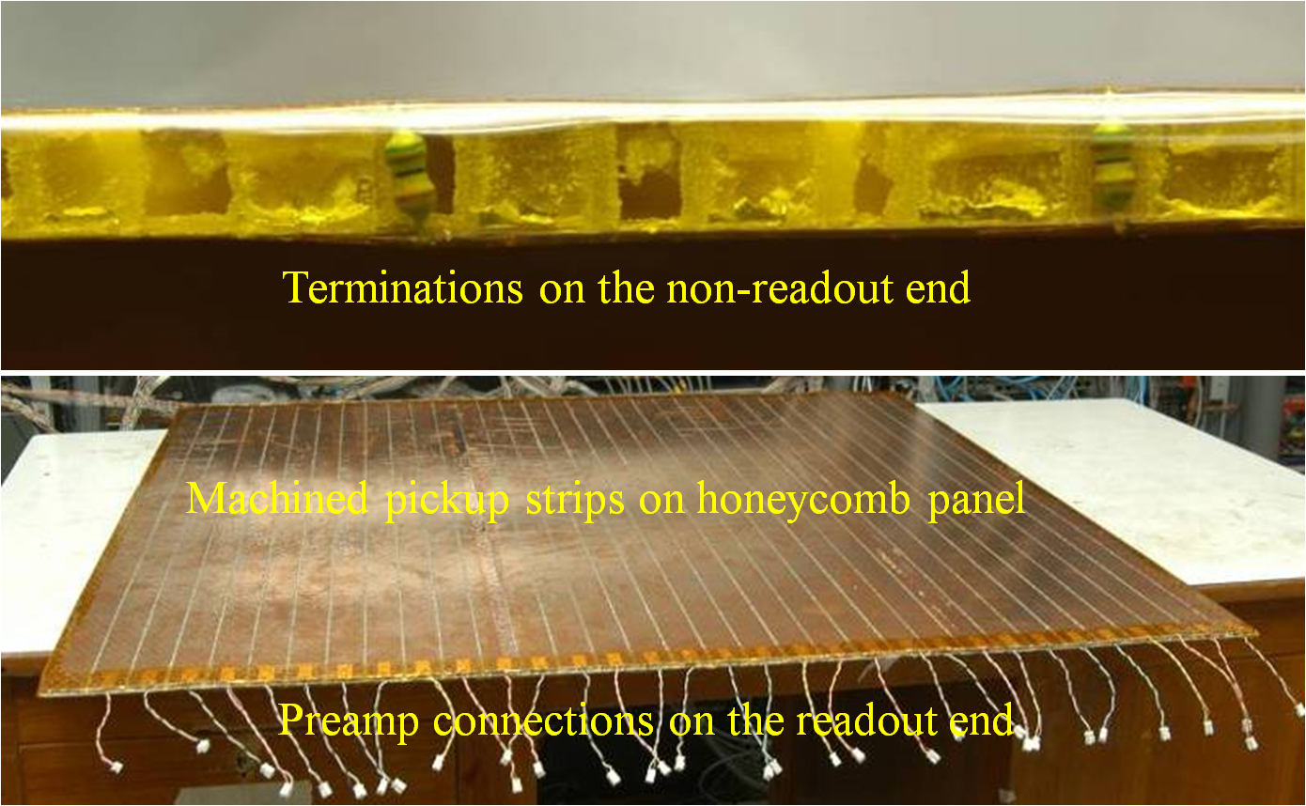
Honeycomb pickup panel
►Interconnection between RPC strips and preamp inputs

Slide 6
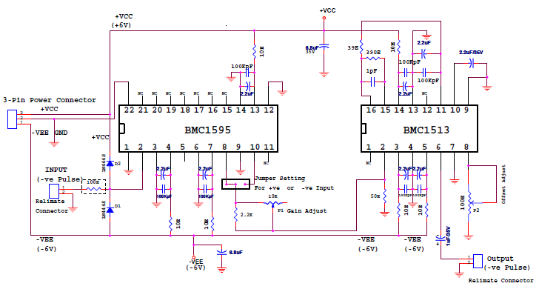
HMC based preamplifier

Slide 7
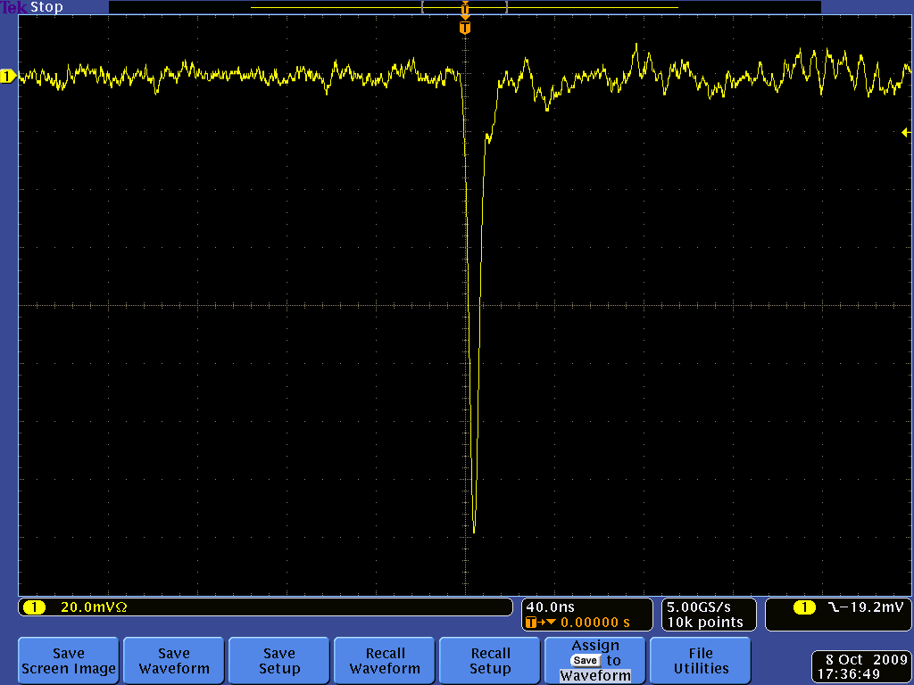
Post amplifier RPC pulse profile

Slide 8
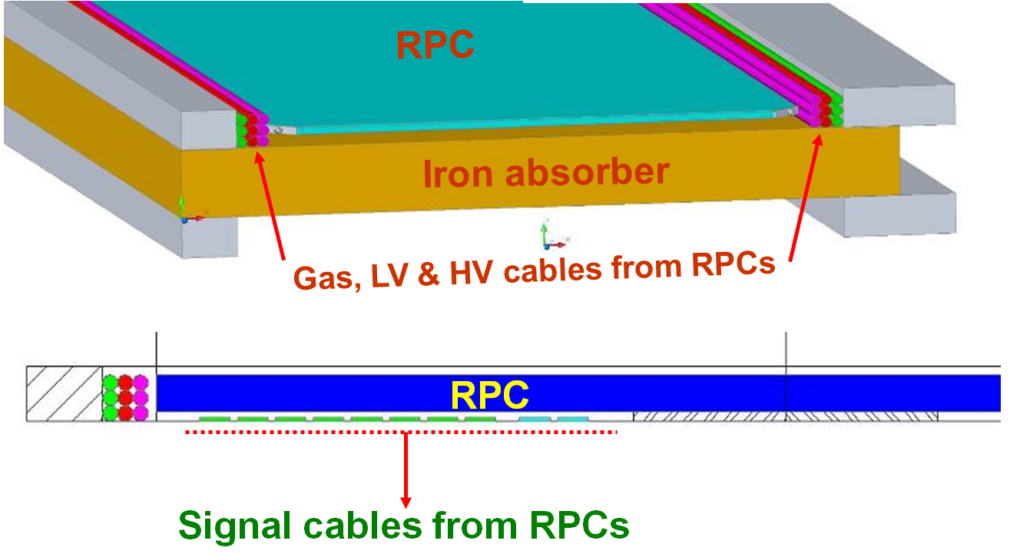
Cables & services routing

Slide 9
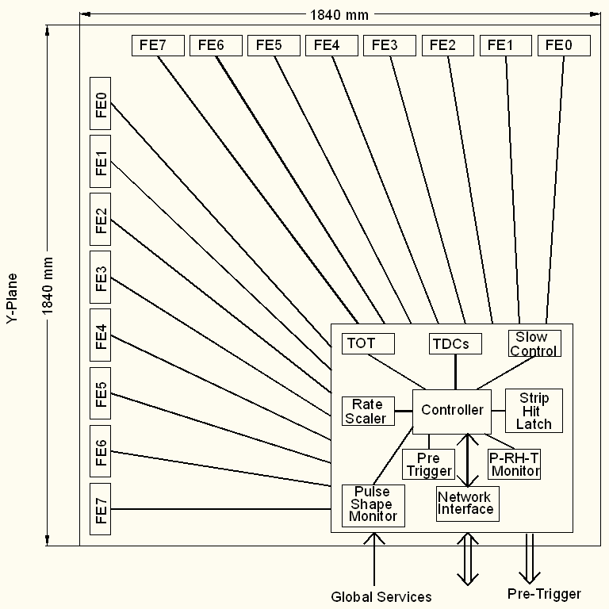
Triggered DAQ scheme
Conventional architecture
Dedicated sub-system blocks for performing various data readout tasks
Need for Hardware based on-line trigger system
Trigger latency issues and how do we take care in implementation

Slide 10
Data collector module
VME interface for data readout
9U × 400mm modules for efficient packaging
Receives data streams from fiber optic cables
Saves data in one of the two buffers
Reads buffers via VME bus
Also provides control for front-end systems

Slide 11
Trigger system
Physicist’s mind decoded!
Autonomous; shares data bus with readout system
Modular and distributed architecture
For ICAL, trigger system is based only on topology of the event; no other measurement data is used
Huge bank of combinatorial circuits
Programmability is the key - FPGAs, ASICs are the players

Slide 12
DAQ system requirements
Information to record on trigger
Strip hit (1-bit resolution)
Timing (< 500ps)
Time Over Threshold (for time-walk correction)
Rates
Individual strip background rates ~300Hz
Event rate ~10Hz
On-line monitor
RPC parameters (High voltage, current)
Ambient parameters (T, P, RH)
Services, supplies (Gas systems, magnet, low voltage power supplies, thresholds)

Slide 13
Front-end specifications
No input matching circuit needed, HCP strips provide ~50Ω characteristic impedance
Avalanche mode, pulse amplitude: 2.5 -3mV
Gain (100-200, fixed) depends on the electronic noise obtainable
No gain needed if operated in streamer mode, option to by-pass gain stage
Rise time: < 500ps
Discriminator overhead: 3-4 preferable
Variable V_{th} for discriminator - ±10mV to ±50mV
Pulse shaping (fixed) 50-100nS
Pulse shaping removes pulse height information; do we need the latter?

Slide 14
Functional diagram of the FE ASIC
Common threshold
Ch-0
Regulated Cascode Transimpedance Amplifier
Differential Amplifier
Comparator
LVDS output driver
LVDS_out0
Channel-0
8:1 Analog Multiplexer
Amp_out
Output Buffer
Channel-7
Ch-7
Regulated Cascode Transimpedance Amplifier
Differential Amplifier
Comparator
LVDS output driver
LVDS_out7

Slide 15
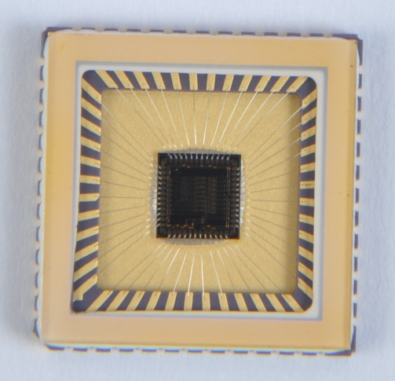
Information on FE ASIC
IC Service: Europractice (MPW), Belgium
Service agent: IMEC, Belgium
Foundry: austriamicrosystems
Process: AMSc35b4c3 (0.35um CMOS)
Input dynamic range:18fC – 1.36pC
Input impedance: 45Ω @350MHz
Amplifier gain: 8mV/μA
3-dB Bandwidth: 274MHz
Rise time: 1.2ns
Comparator’s sensitivity: 2mV
LVDS drive: 4mA
Power per channel: < 20mW
Package: CLCC48(48-pin)
Chip area: 13mm²

Slide 16
Timing devices
ASIC chips
HPTDC (J.Christiansen, CERN), 32/8 channels, σ_{t}: 261/64/48/40/17ps
AMT (Yasuo Arai, KEK), 24 channels, σ_{t} = 305ps
3-stage interpolated TDC ASIC
FPGA based solutions
Vernier TDC
Differential Delay Line TDC

Slide 17
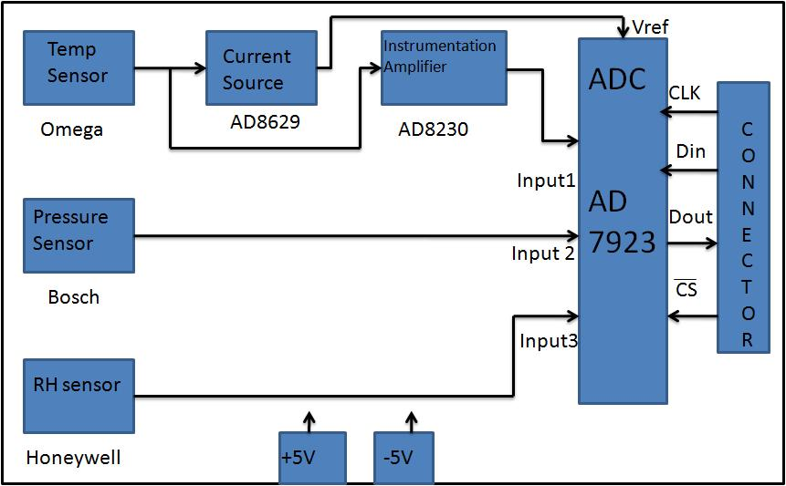
TPH monitor module

Slide 18
Slow control and monitor
Gas system
Channel on/off
Flow rate monitors
On-line gas quality monitors
Magnet
Ramp up/down
Monitoring voltages and currents
Fringe field measurements outside detector

Slide 19
Back-end issues
VME is the ICAL’s backend
Data collectors and frame transmitters
Global services - trigger, clock etc.
Signal synchronisation and calibration
Computer and data archival
On-line DAQ software
On-line data quality monitors
Networking and security issues
Remote access protocols to detector sub-systems and data
Voice and video communications

Slide 20
Power supplies
High voltage for RPCs
Voltage: 10kV (nominal)
Current: 6mA (approx.)
Ramp up/down, on/off, monitoring
Low voltage for electronics
Voltages and current budgets still not available at this time
Commercial and/or semi-commercial solutions
DC-DC and DC-HVDC converters; cost considerations
Modular solutions

Slide 21
Other critical issues
Development of jigs and testing of various chips
Fabrication, assembly, programming and testing of large number of boards and modules
Connectorisation and cabling
Design and fabrication of back-end crates, controllers
GPS based Real Time Clock (RTC) module for centralised time stamping

Slide 22
Summary
Massive hunt for a mass-less particle
A basic research project on an unprecedented scale
Healthy collaboration among research institutes, universities and local industries
Gold mine of opportunities for world class science, scientific man power development and strengthening academia-industry relationship

Slide 23
Summary and future outlook
Almost all the RPC parameters and requirements understood.
Overall electronics and DAQ specifications need to be firmed up.
Design and prototyping of well defined sub-systems is already in progress (eg. FE, TDC, ambient parameter monitors etc.).
Identification of off-the-shelf solutions (data links, power supplies, even some chips) – both from commercial and research groups should be exploited.
Work and responsibilities by the ICAL collaborating institutes and universities.
Roll of electronics industries is crucial:
Chip fabrication
Board design, fabrication, assembly and testing
Slow control and monitoring
Industries are looking forward to work with INO
Truly exciting and challenging opportunities ahead in VLSI design, system integration, data communication, process control, power supplies, on-line software …

Slide 24
Data size for triggered scheme
Assuming 8 channel grouping for Trigger and TDC in each RPC
TDC:512nsec range & 100ps resolution, 16Hit
Start-Stop delay: Pulse width format
16x2x16x16+16x16(Channel identity)=8192bits+256 (worst case)
Pickup strip Hit pattern (128 bits)
Event arrival time up to 100psec resolution (50bit)
RPC identity (16 bit)
Event identity(32bit)
Packet information(16bit)
Event data per RPC
Worst case =8192+256+128+50+16+32+16=8690 bits
Typical case = 512+256+128+50+16+32+16=1010 bits
Total data
266Mb[16hit TDC] or 31Mb[1 Hit TDC] per event [ All data] or 20% data = 6Mb per event [Non-zero data]
Assuming 500Hz trigger rate , Total data = 133 Gbps or 15.5 Gbps 0r 3.1Gbps

Slide 25
Data size for trigger-less scheme
Pickup strip rate estimation
Assuming Cosmic ray rate of 10K/min/ m²
For RPC area of 4 m², Rate is 40K/min
Pick strip rate = 40K/64=10.4Hz
Pickup signal data
Signal arrival time-stamp up to 100psec resolution (50bit)
Pulse width information (10 bit for 100nsec)
Channel identity(8 bit for 64 in X and Y planes )
RPC identity (16 bit)
Packet information(10bit)
Total = 94 … aprox. 100 bit
Data rate
RPC data = 10x128x100= 128Kbps
Detector data = 128Kx30720 = 3.932 Gbps
Trigger rate (Assuming 3/min/m³ of prototype detector)
Trigger rate for whole detector is 500Hz
Data collection per second is aprox. 2000 Gbps
Conventional Scheme:
Data collection : 133 Gbps(16hit TDC) or 15.5 Gbps (1Hit TDC) 0r 3.1Gbps(Non-zero data)

Slide 26
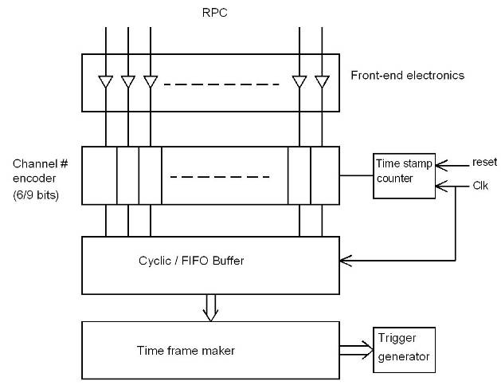
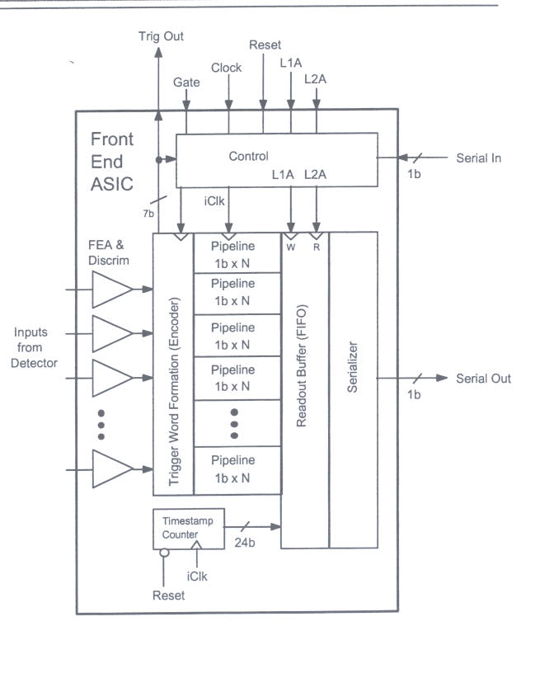
Trigger-less DAQ scheme
Gary Drake & Charlie Nelson
Suitable for low event rate and low background/noise rates
On-off control and V_{th} control to disable noisy channels

Slide 27
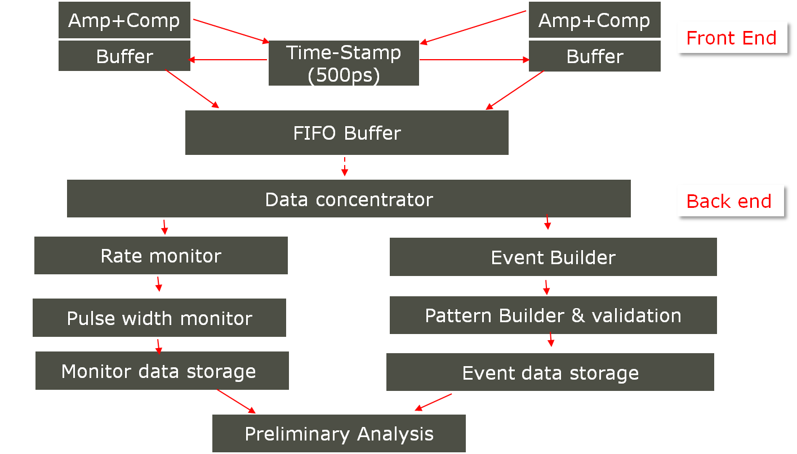
Implementing trigger-less scheme

Slide 28
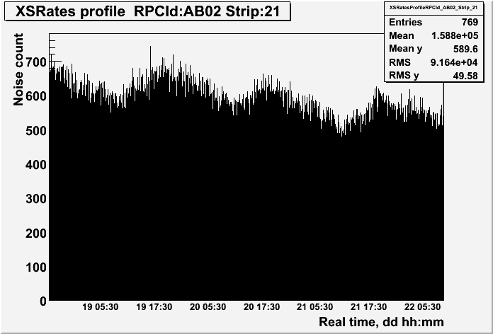
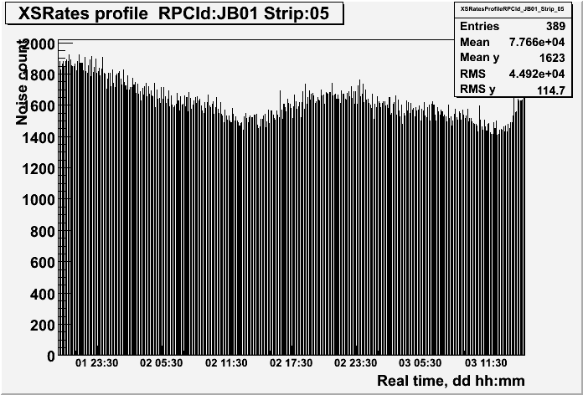
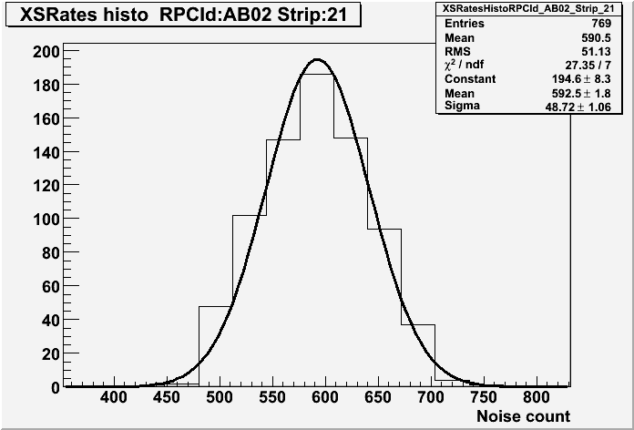
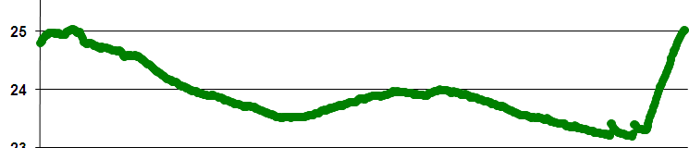
RPC strip rate monitoring
Temperature dependence on noise rate
Strip noise rate profile
Strip noise rate histogram
Temperature

Slide 29
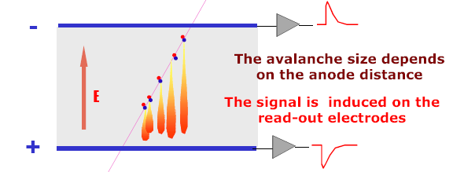
Signal development in an RPC
Each primary electron produced in the gas gap starts an avalanche until it hits the electrode.
Avalanche development is characterized by two gas parameters, Townsend Coefficient (α) and Attachment coefficient (η).
Average number of electrons produced at a distance x, n(x) = e^{(α− η)x}
Current signal induced on the electrode, i(t) = E_{w} • v • e₀ • N(t) / V_{w}, where E_{w} / V_{w} = ε_{r} / (2b + dε_{r}).

Slide 30
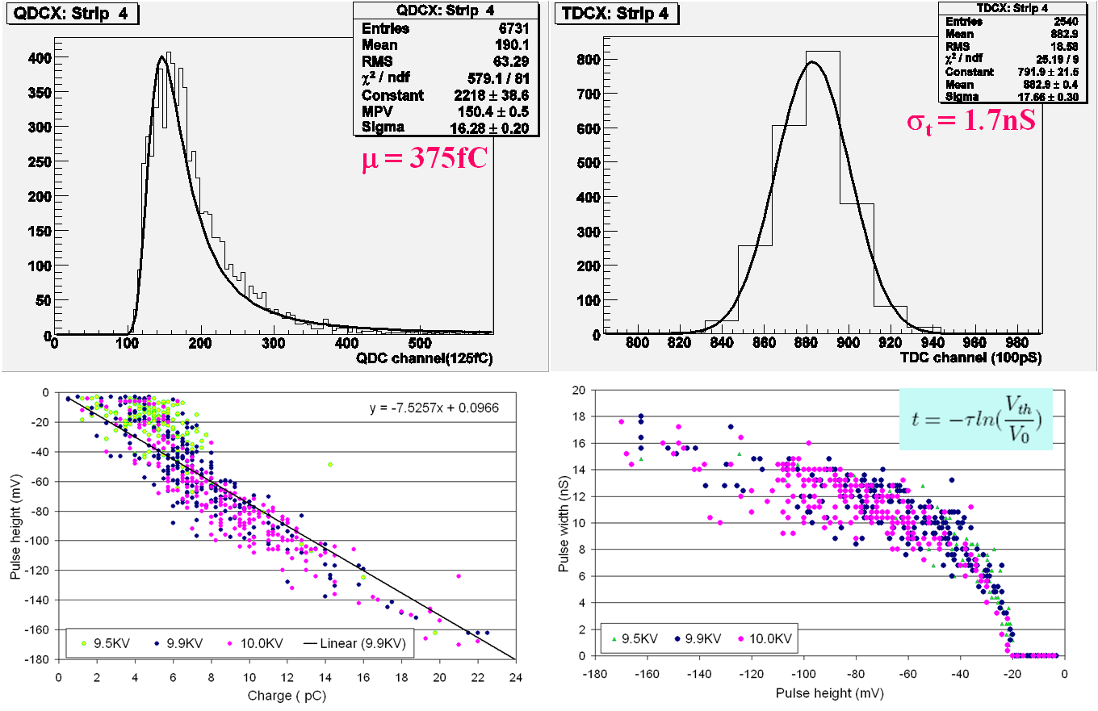
Characteristics of RPC pulse

