Slide 1
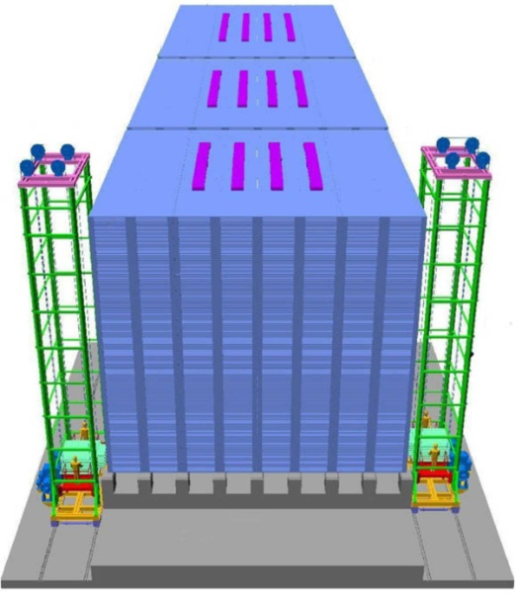
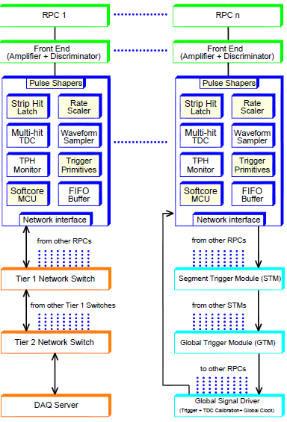
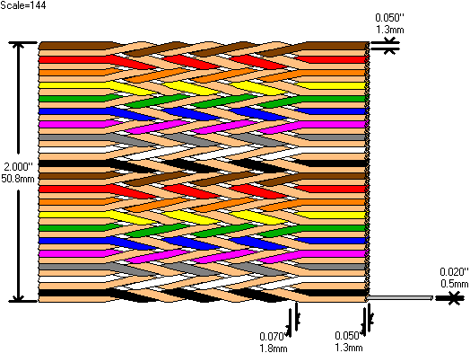
Detector and instrumentation Development for ICAL experiment
B. Satyanarayana, TIFR, Mumbai
E: bsn@tifr.res.in ▪ W: www.tifr.res.in/~bsn

Slide 2
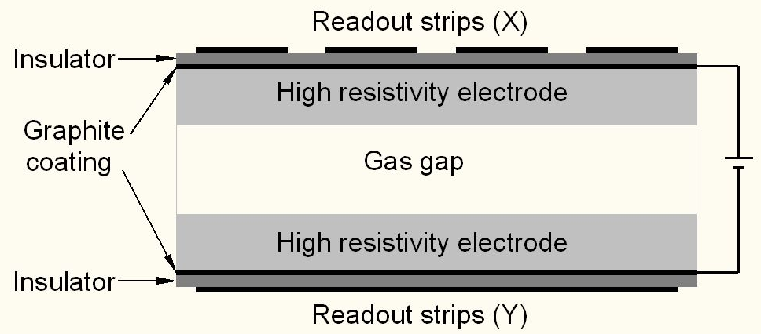
Schematic of a basic RPC

Slide 3
Deployment of RPCs in running experiments
Experiment | Area (m²) | Electrodes | Gap(mm) | Gaps | Mode | Type
PHENIX | ? | Bakelite | 2 | 2 | Avalanche | Trigger
NeuLAND | 4 | Glass | 0.6 | 8 | Avalanche | Timing
FOPI | 6 | Glass | 0.3 | 4 | Avalanche | Timing
HADES | 8 | Glass | 0.3 | 4 | Avalanche | Timing
HARP | 10 | Glass | 0.3 | 4 | Avalanche | Timing
COVER-PLASTEX | 16 | Bakelite | 2 | 1 | Streamer | Timing
EAS-TOP | 40 | Bakelite | 2 | 1 | Streamer | Trigger
STAR | 50 | Glass | 0.22 | 6 | Avalanche | Timing
CBM TOF | 120 | Glass | 0.25 | 10 | Avalanche | Timing
ALICE Muon | 140 | Bakelite | 2 | 1 | Streamer | Trigger
ALICE TOF | 150 | Glass | 0.25 | 10 | Avalanche | Timing
L3 | 300 | Bakelite | 2 | 2 | Streamer | Trigger
BESIII | 1200 | Bakelite | 2 | 1 | Streamer | Trigger
BaBar | 2000 | Bakelite | 2 | 1 | Streamer | Trigger
Belle | 2200 | Glass | 2 | 2 | Streamer | Trigger
CMS | 2953 | Bakelite | 2 | 2 | Avalanche | Trigger
OPERA | 3200 | Bakelite | 2 | 1 | Streamer | Trigger
YBJ-ARGO | 5630 | Bakelite | 2 | 1 | Streamer | Trigger
ATLAS | 6550 | Bakelite | 2 | 1 | Avalanche | Trigger
ICAL | 97,505 | Both | 2 | 1 | Both | Trigger

Slide 4
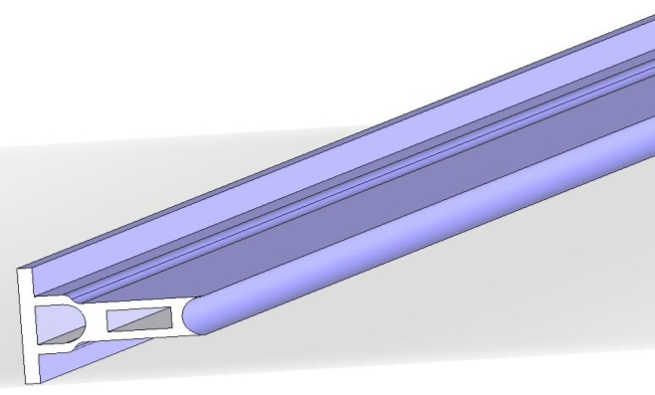
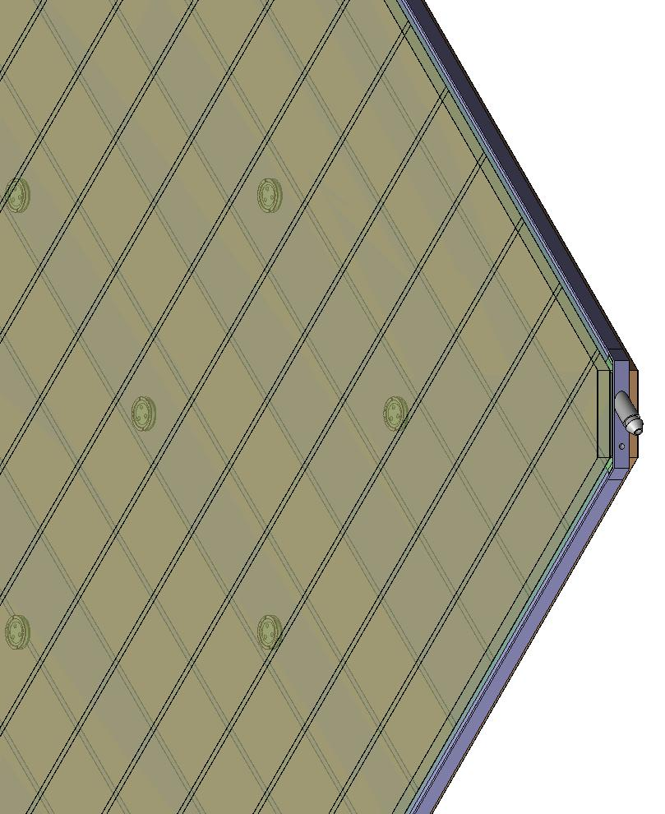
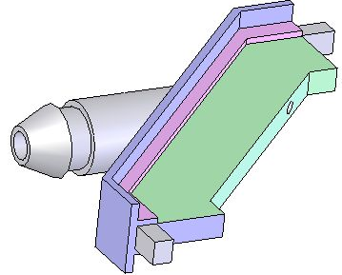
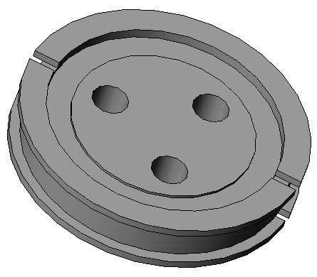
Some of the materials for the gas gap fabrication
Edge spacer
Schematic of an assembled gas volume
Gas nozzle
Glass spacer

Slide 5
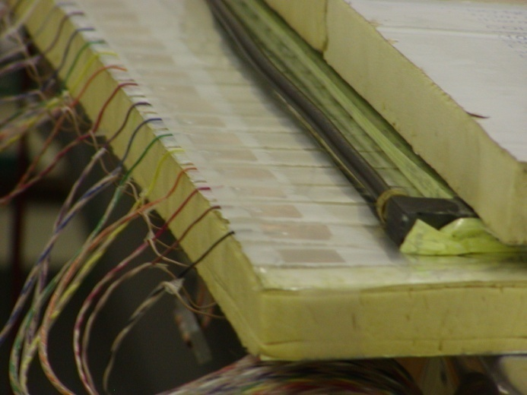
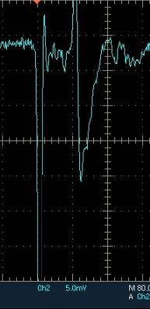
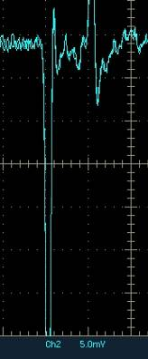
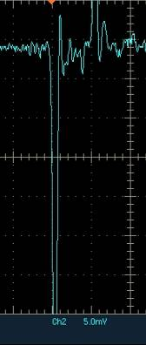
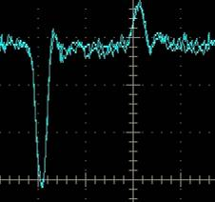
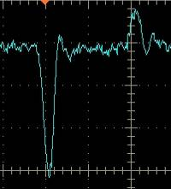
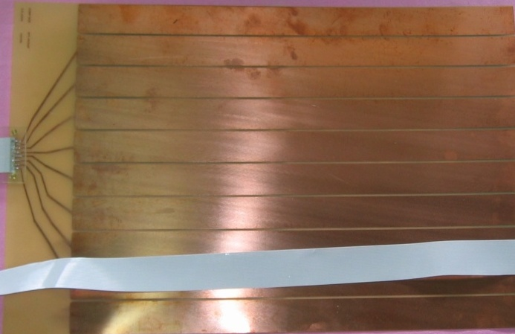
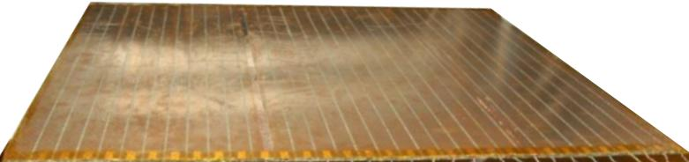
Development and characterisation of signal pickup panels
Foam panel
48.2Ω
G-10 panel
Open
100Ω
51Ω
47Ω
Z₀: Inject a pulse into the strip; tune the terminating resistance at the far end, until its reflection disappears.
Honeycomb panel

Slide 6
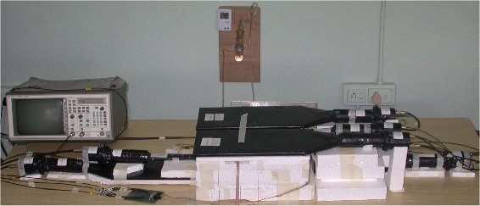
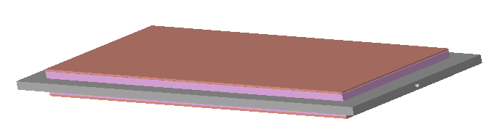
This is where it began ...
First RPC setup in TIFR
First RPC 30cm × 10cm

Slide 7
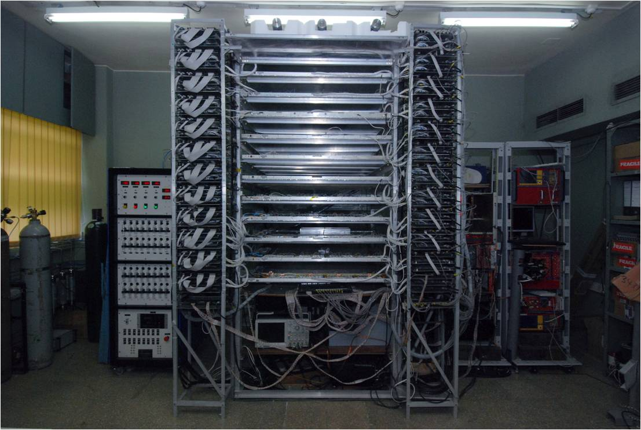
1m × 1m RPC stack at TIFR, Mumbai

Slide 8
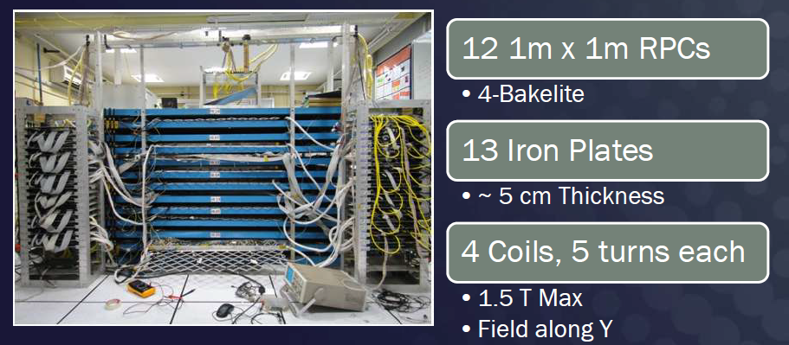
ICAL prototype at VECC, Kolkata

Slide 9
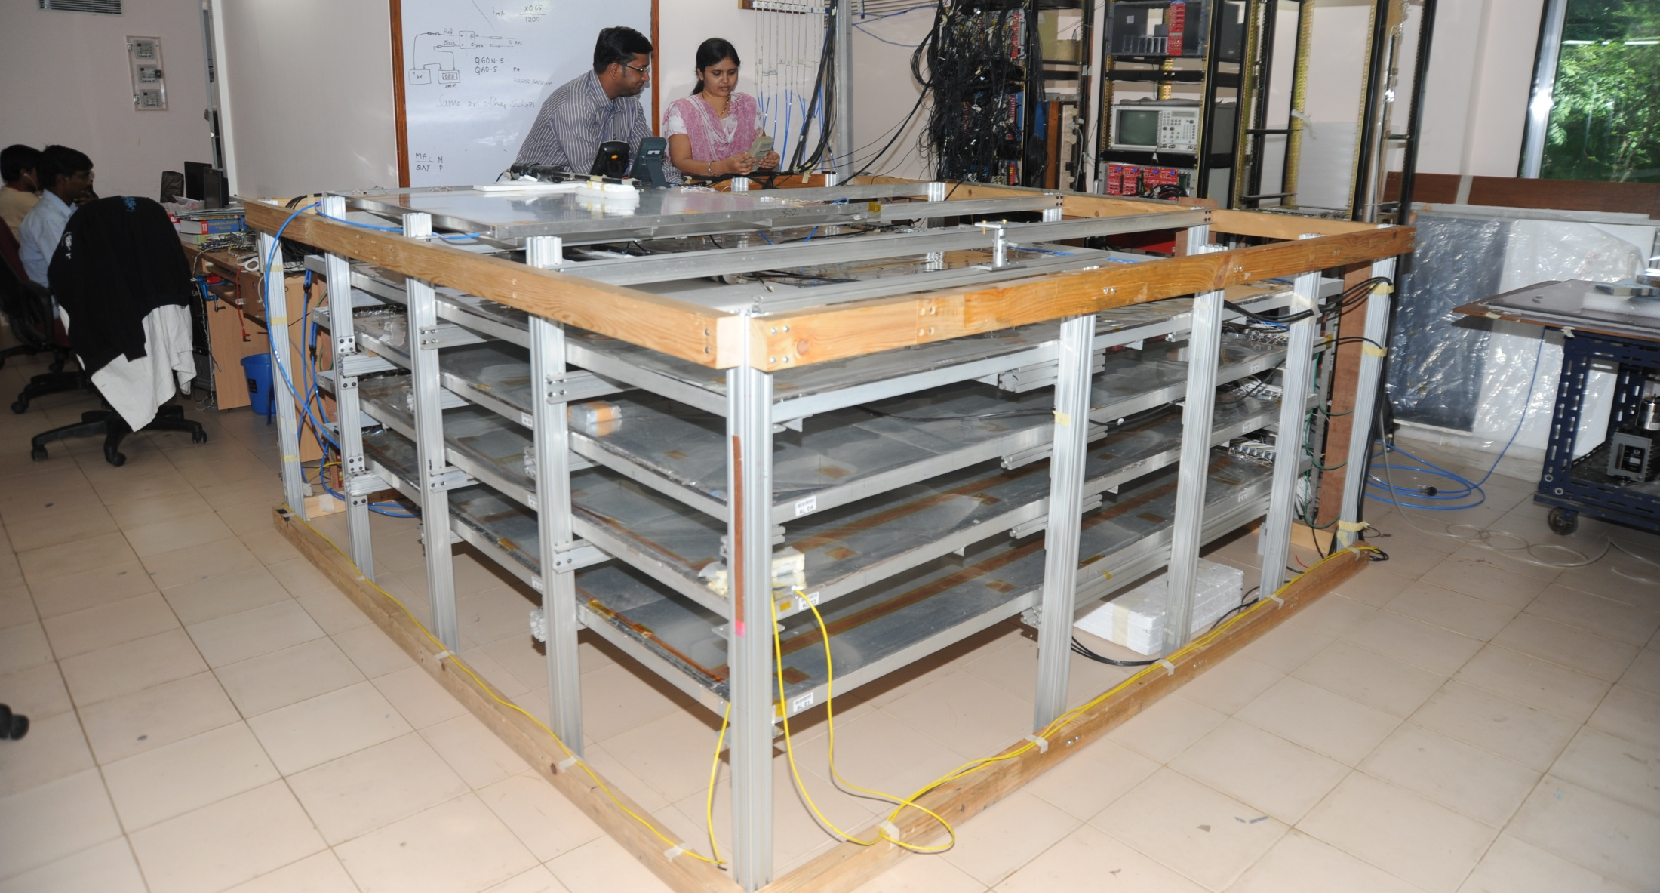
2m × 2m RPC stack at TIFR, Mumbai

Slide 10
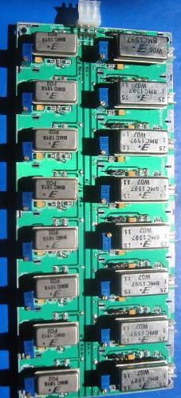
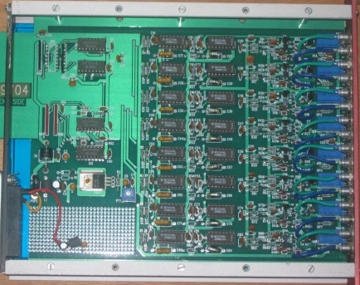
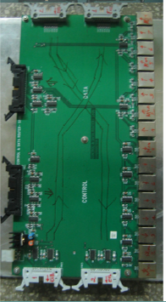
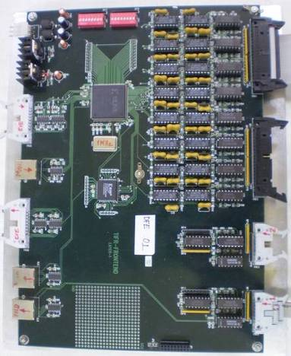
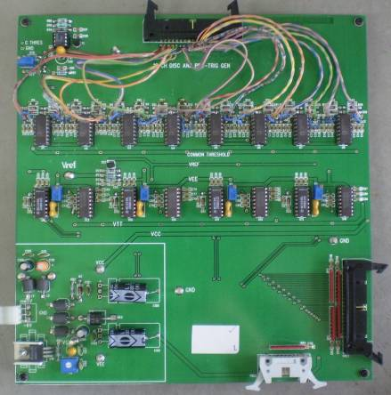
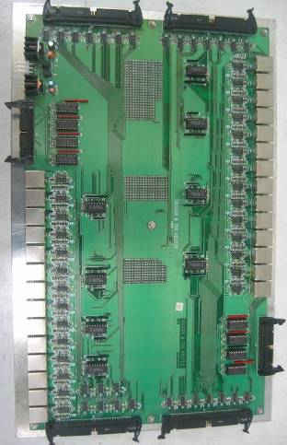
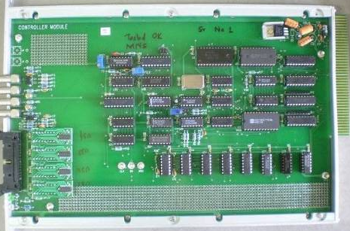
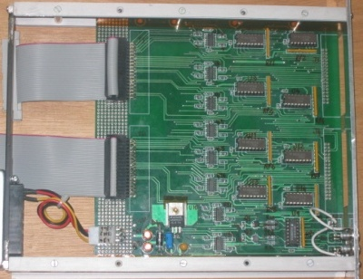
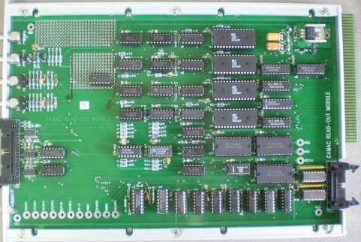
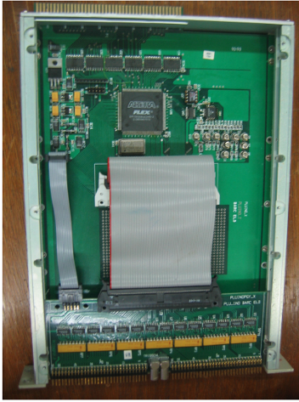
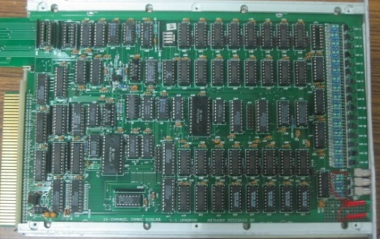
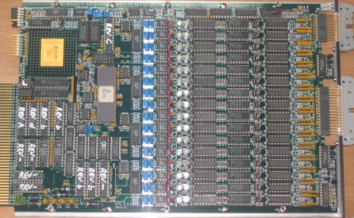
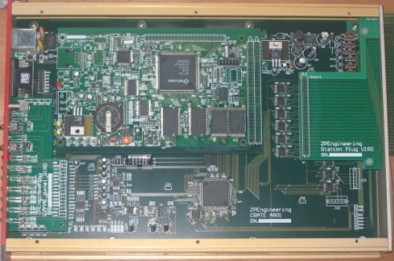
Design and implementation of the data acquisition system
200 boards of 13 types
Custom designed using
FPGA,CPLD,HMC,FIFO,SMD

Slide 11
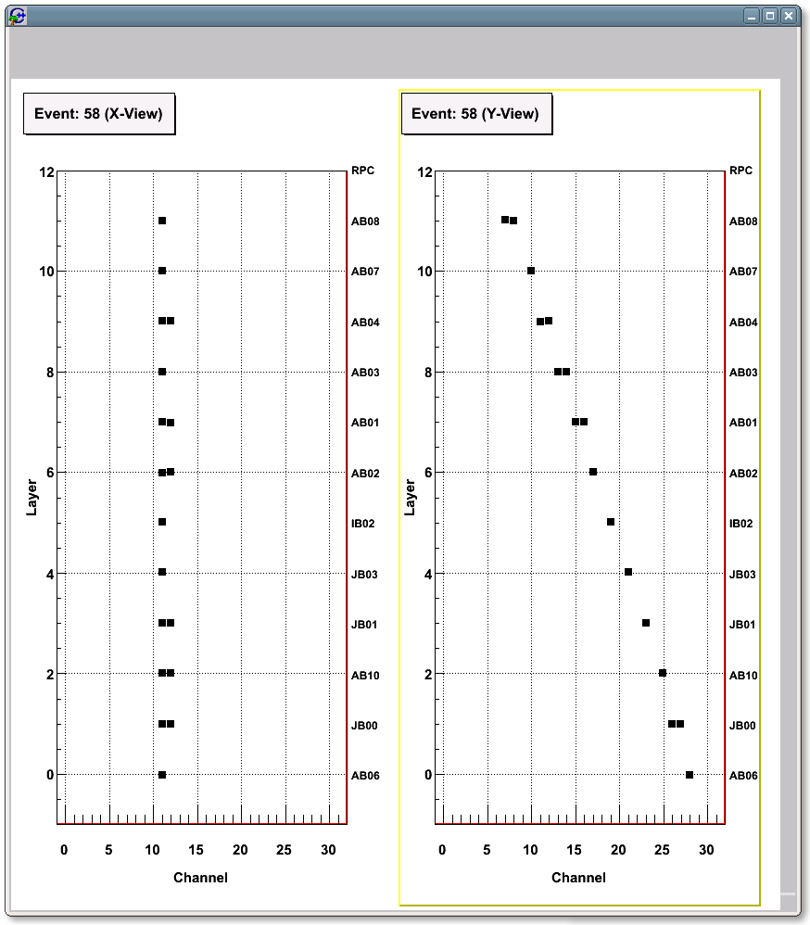
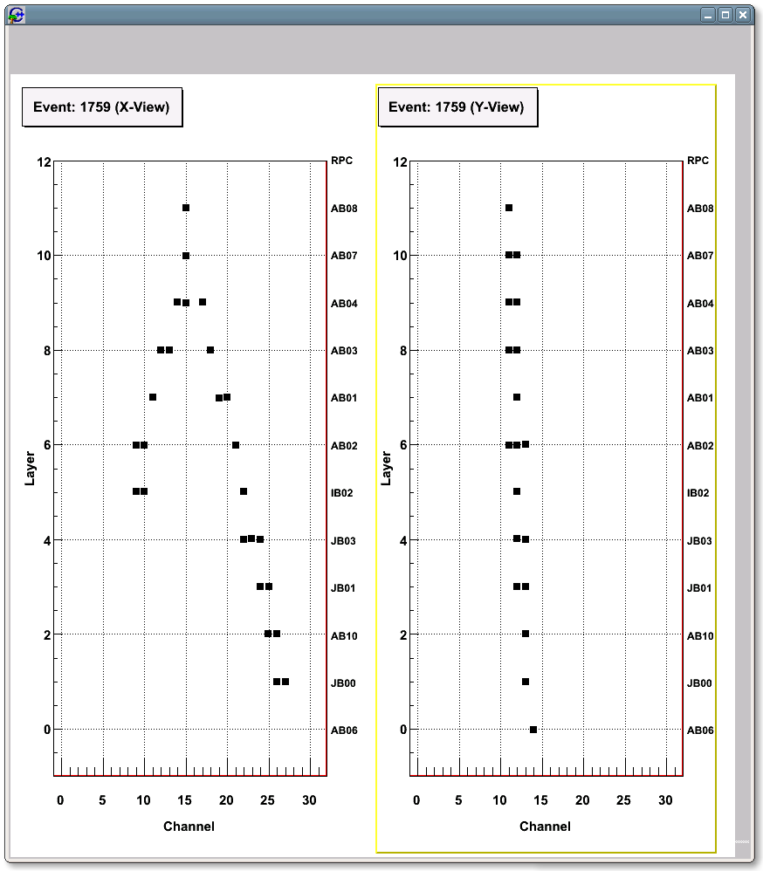
A couple of interesting events

Slide 12
ICAL versus ICAL-EM
Parameter | ICAL | ICAL-EM
No. of modules | 3 | 1
Module dimensions | 16.2m × 16m × 14.5m | 8m × 8m × 7.25m
Detector dimensions | 49m × 16m × 14.5m | 8m × 8m × 7.25m (25:1)
No. of layers | 150 | 75
Iron plate thickness | 56mm | 56mm
Gap for RPC trays | 40mm | 40mm
Magnetic field | 1.3Tesla | 1.3Tesla
RPC dimensions | 1,950mm × 1,910mm × 24mm | 1,950mm × 1,910mm × 24mm
Readout strip pitch | 30mm | 30mm
No. of RPCs/Road/Layer | 8 | 4
No. of Roads/Layer/Module | 8 | 4
No. of RPC units/Layer | 192 | 16
No. of RPC units | 28,800 (107,266m²) | 1200 (4,469m²) (24:1)
No. of readout strips | 3,686,400 | 153,600 (24:1)

Slide 13
Technology development for Industrial production of RPCs
Development of glass chamfering and glass engraving.
Development of graphite coating by automatic spray painting.
Demonstration of successful operation of automatic button and glue dispenser.
Pickup panel development.
Design of RPC holding tray
Computer modeling of RPC & its assembly in ICAL.
Physical RPC models to study push-pull assembly in ICAL magnet gap.

Slide 14
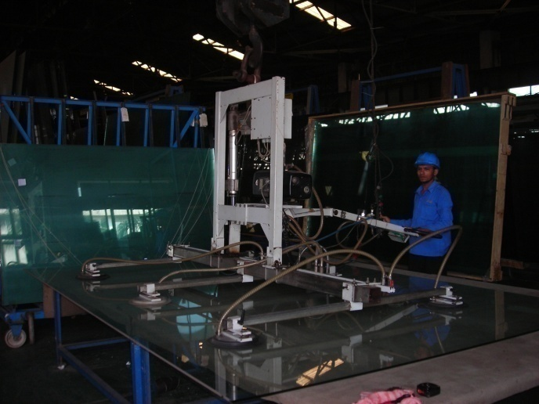
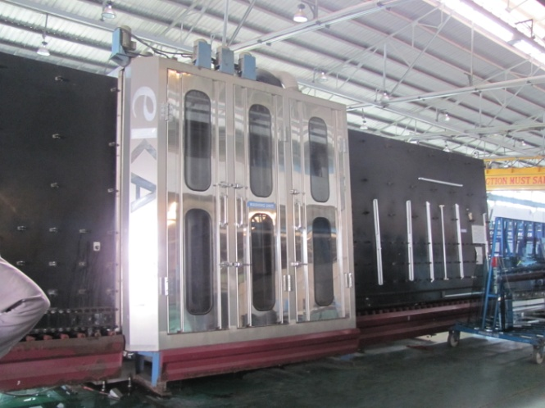
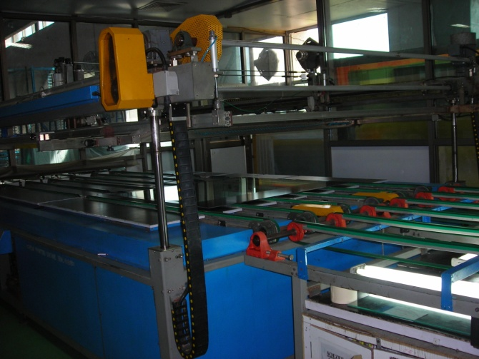
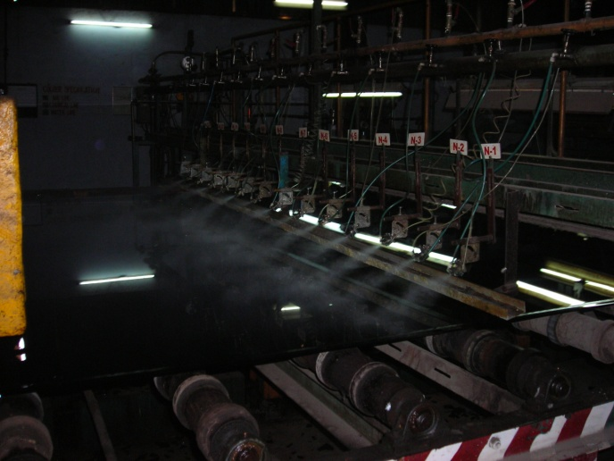
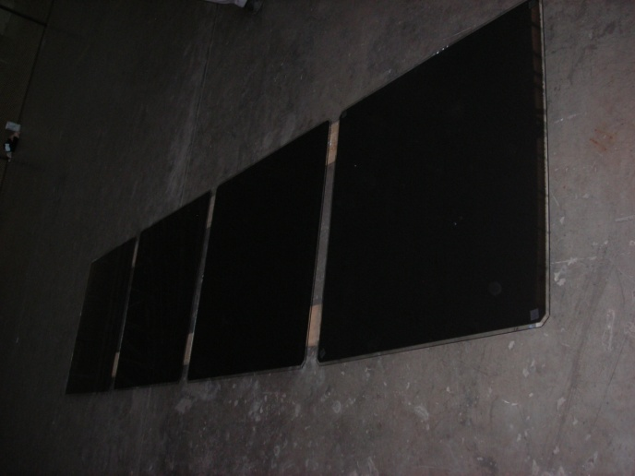
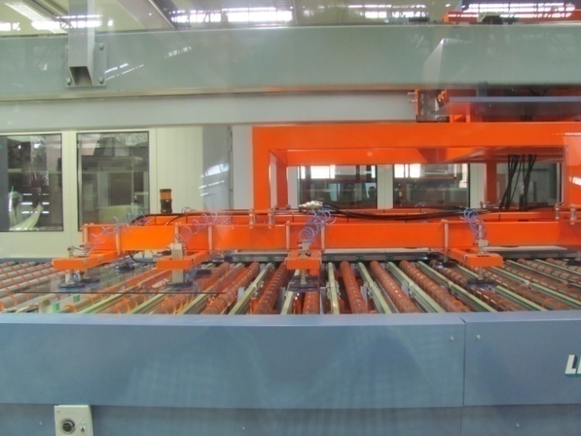
Steps towards Industrial production of RPCs

Slide 15
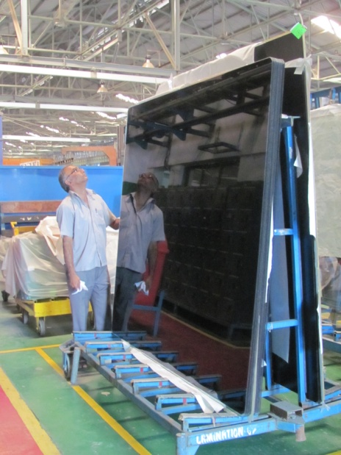
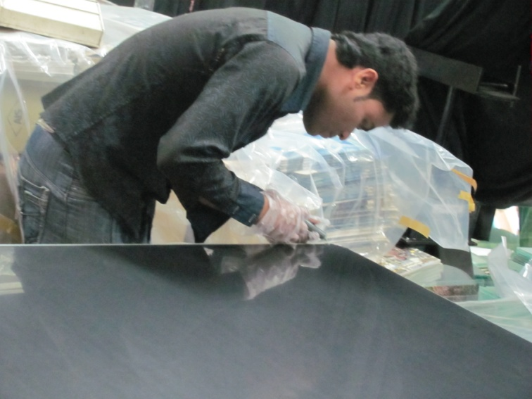
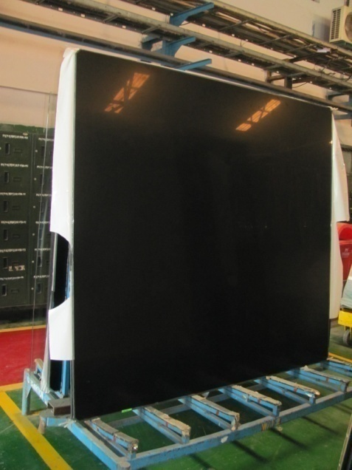
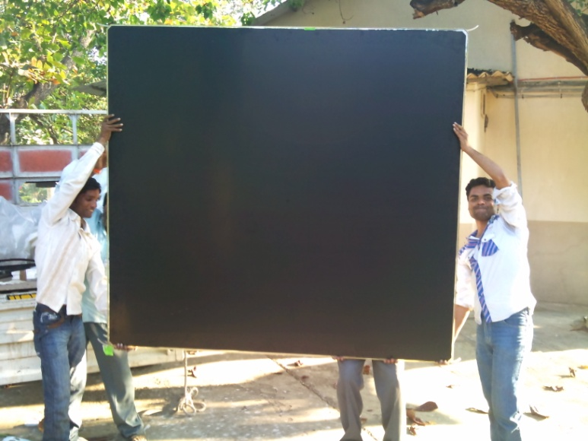
RPC fabrication at Asahi Float Glass

Slide 16
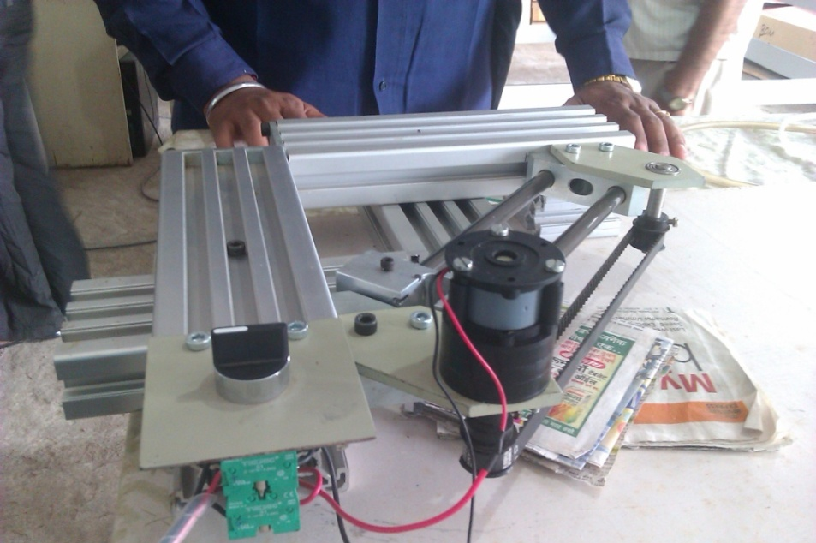
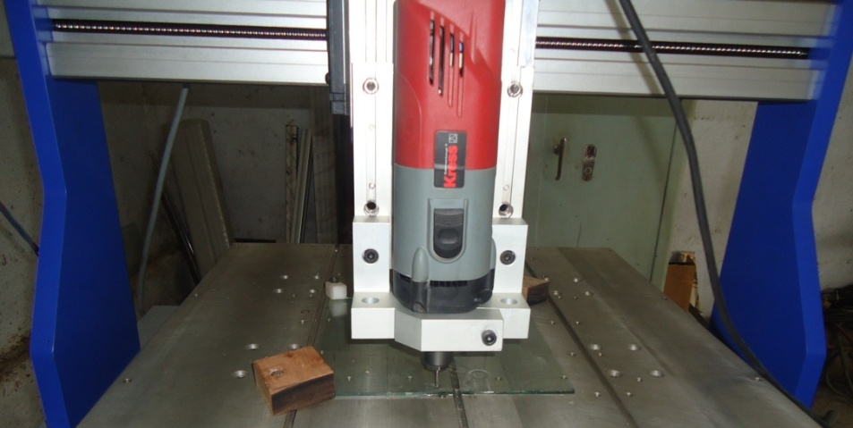
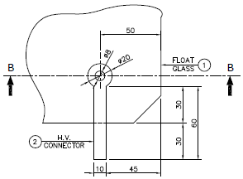
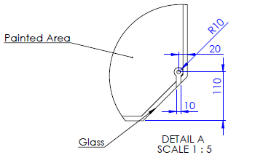
Chamfering and engraving of glass

Slide 17


Glass chamfering details

Slide 18

Design of the HV contact lug
Engraving methods:
CNC
Chemical
Laser
Sand blasting

Slide 19



Pickup panel from Walchand
Open
Z₀=58.5Ω
Large size pickup panels are being fabricated

Slide 20



Painting/curing of glass plates

Slide 21

A video clip of glass painting

Slide 22

Automatic coating parameters
Needs further optimisation

Slide 23

Breakdown test of PET film lamination
Resistance without lamination :
5 x 10¹³ Ω-cm
Resistivity with lamination:
6.67 x 10¹⁴ Ω-cm

Slide 24
1m × 1m and 2m × 2m glass painting by Walchand Industries
0.71 | 0.57 | 0.51 | 0.86 | 1.8
0.52 | 0.45 | 0.42 | 0.52 | 1.2
0.54 | 0.45 | 0.43 | 0.57 | 1.3
0.52 | 0.45 | 0.4 | 0.58 | 1.3
0.75 | 0.64 | 0.54 | 1 | 1.9
0.74 | 0.64 | 0.6 | 1.1 | 1.7
0.49 | 0.46 | 0.54 | 0.5 | 1.1
0.53 | 0.44 | 0.42 | 0.53 | 0.98
0.54 | 0.47 | 0.4 | 0.57 | 1.1
0.94 | 0.78 | 0.72 | 0.86 | 1.7
0.76 | 0.62 | 0.6 | 0.58 | 0.53 | 0.59 | 0.57 | 0.96
0.48 | 0.62 | 0.36 | 0.32 | 0.32 | 0.33 | 0.55 | 0.54
0.47 | 0.36 | 0.33 | 0.29 | 0.27 | 0.3 | 0.28 | 0.49
0.38 | 0.29 | 0.29 | 0.26 | 0.37 | 0.25 | 0.26 | 0.32
0.36 | 0.29 | 0.32 | 0.25 | 0.24 | 0.24 | 0.23 | 0.37
0.46 | 0.4 | 0.31 | 0.31 | 0.34 | 0.34 | 0.32 | 0.29
0.8 | 0.64 | 0.59 | 0.6 | 0.55 | 0.66 | 0.55 | 0.94
0.47 | 0.36 | 0.34 | 0.36 | 0.32 | 0.34 | 0.5 | 0.54
0.42 | 0.33 | 0.28 | 0.27 | 0.25 | 0.27 | 0.24 | 0.39
0.39 | 0.27 | 0.28 | 0.24 | 0.25 | 0.23 | 0.23 | 0.31
0.33 | 0.26 | 0.36 | 0.26 | 0.24 | 0.33 | 0.34 | 0.38
0.37 | 0.46 | 0.35 | 0.35 | 0.56 | 0.67 | 0.36 | 0.27

Slide 25




Automatic RPC gap making

Slide 26
A video clip of RPC gap fabrication

Slide 27




FRP base RPC holding tray
Self weight + 100kg load
Finite Element Analysis
Max. deflection
4.4mm
Spec.
5mm
Max. stress
8.2MPa
FRP
25MPa
Extra thickness in selected sections
Three-line support
Fabricated tray
Down side view

Slide 28

Prototypes of RPC holding trays

Slide 29
Closed loop gas system
Total number of RPCs in the ICAL = 3 x150 x 64 = 28,800
Total gas volume = 28,800 x 195cm x 191cm x 0.2cm = 214,531 litres
Standard gas composition for the avalanche mode:
R134a(C₂H₂F₄):Isobutane(C₄H₁₀):Sulphur Hexaflouide(SF₆)::95.5:4.3:0.2
What is the minimum gas flow required in a RPC detector, which results in an optimum uniformity of gas concentration - by simulation and by monitoring the current and noise rate of an RPC.
Some deciding factors: Expensive and hazardous gases, green house effect, handling high volume of gases in the cavern
Operational consideration: How many RPC’s can be connected in series and/or in parallel? Many RPCs in series will add to pressure gradient, leading to gas flow problems

Slide 30

Study of gas sealed RPCs
If the RPC gas gaps are produced without leaks (less than 1.75 mm WC in more than 33 hours), then the detectors can be operated without appreciable degradation in their performance for more than a month with a single gas fill. The
cost of gas replenishing could thus be reduced considerably, by up to a factor of 30.

Slide 31
Gas purification process
Gas mixture quality: Presence of impurities in the return gas from the RPCs
Possible worsening of RPC performance due to impurities
Removal of water vapour by combination of 3A and 5A molecular sieves continuous duty purifier.
Removal of oil vapours by 3X molecular sieves
Removal of radicals (F⁻, HF etc.) by disposable activated Alumina
Removal of Oxygen by CuZn and Ni-NiO on activated Alumina/Silica by continuous duty purifier using standard cartridges
Final goal was to achieve the moisture and Oxygen levels to less than 2 ppm

Slide 32

Line diagram of the close loop gas recirculation and purification system
Displacers
PT 2
Molecular Sieves
Molecular Sieves
Pneumatic Cylinders
Low pressure
Radical Remover
High pressure
Diaphragm
Pump
PT 1
Exhaust
Gas purifiers
Receiver tank inlet
PT 3
MFC 5
Hygrometer
Non-return valve
N₂ input
Bypass
Feeder valve
Vacuum
Pump
PT 6
Storage Tank Outlet
1
2
3
4
RPC stack (this part is outside the gas unit cabinet)
PT 5
Mass flow controllers
MFC 1,2,3,4
Exhaust
PT 4
MFC 6
Gas Mixing (On-line)
Gas Recirculation
Gas Purification system
Control System (PLC)
Low pressure regulator

Slide 33



Some pictures of close loop gas system
Rear
Front

Slide 34

System with 2 RPCs auto-refill in 20 days

Slide 35
Summary on detector development
Tender document for production of RPCs meant for the engineering module, is ready.
Many industries – government and private, are interested in the gas gap and RPC production.
In fact, Asahi Float has taken up sample of production of gas gaps

Slide 36
INO RPC detector labs
AMU
BARC
BHU
DU
IITB
IITM
PU
TIFR
VECC/SINP
More to follow...
Setting up full-fledged labs
Training students and others
Participating in detector R&D, design and optimisation jobs
Sharing production and QC of ICAL RPCs
Installation, commissioning, operation and maintenance of the detector

Slide 37

Scheme of ICAL electronics
8

Slide 38
Front-end
Challenges:
Fast amplification: detector operated in Avalanche mode
Fast leading edge discrimination for precision time measurement (~200ps LC)
Low power for catering to ~3.6 million RPC channels
High packaging density since limited by ~22 mm in size in one dimension
Require to handle complementary but single ended inputs from X-Y strips, requires higher noise immunity
Impedance matching with RPC strip strip’s characteristic impedance (Z₀= ~50Ω)
Two solutions:
Fast amplifier family of Hybrid Micro Circuits (HMC) for RPC test stands
Multi-channel, fast amplifier and discriminator ASIC in 0.35μm mixed CMOS process for ICAL (Anusparsh)
Both designed by the BARC/CMEMS teams

Slide 39

8-channel preamp-discriminator
LVDS out architecture with improved gain stability, noise immunity, comparator jitter and substrate coupling.
Complete layout revised in 0.35μm mixed CMOS technology, packaged in CLCC-68.

Slide 40

Anusparsh status
A revised test board with appropriate LVDS connectors and cables designed by BARC, fabricated and assembled by TIFR. It is being tested on a 1m x 1m RPC at TIFR.
Test and characterization strategy: Noise rate, Efficiency and timing measurement with the same new DAQ system for HMC and Anusparsh-II ASIC.
Noise rate of ~75Hz and RPC efficiency of ~83% obtained with HMC amplifier.
Noise rate of 25-30Hz and RPC efficiency of ~66% recorded for the same RPC with Anusparsh-II.
Operated with lower than designed gain (about half). Going down on threshold makes the board unstable.
Current chip’s power estimate: 45mw/ch
Aimed at a gain about two times better than that obtained by the HMC cascade.
PCB size, may want to other options for packaging of the chip

Slide 41

RPCDAQ module
Design of the shaded building blocks completed.
Waveform sampler is not part of the board for the engineering module

Slide 42

ICAL TDC specifications

Slide 43

Anupal: A new TDC chip from BARC
4-channel, 126ps TDC ASIC, designed in 0.35μm mixed CMOS process for BARC internal R&D.
Vernier oscillator based architecture with SPI interface.

Slide 44

IITM’s TDC device
Principle
Two fine TDCs to measure start/stop distance to clock edge (T₁, T₂)
Coarse TDC to count the number of clocks between start and stop (T₃)
TDC output = T₃+T₁-T₂
Specifications
Currently a single channel, single-hit, classical start-stop type TDC
Can be adapted to multi-hit
Clock period, T_{c} = 4ns (250MHz clock!)
Fine TDC interval, T_{c}/32 = 125ps
Fine TDC output: 5 bits
Coarse TDC interval: 2¹⁵ * T_{c} = 131.072μs
Coarse TDC output: 15 bits
20 bit parallel output
Tiny power supply rails : 1.2V!

Slide 45

HPTDC
Multi-hit, high resolution device.
Workhorse of the LHC experiments.
Chips obtained from CERN.
Work in progress to characterise and explore possibility of configuring it as ICAL TDC device

Slide 46



TPH sensor module
FPGA
On the RPCDAQ module

Slide 47



Preamp and RPCDAQ boards
Isosceles and right angled RPCDAQ.
Two sides of 125mm length.
Width/height: ~22mm (thin strip)
Front-end board

Slide 48



Mock-up of RPC integration

Slide 49
Procurement of FPGAs, drivers
FPGAs from two vendors identified.
Current designs of RPCDAQ and trigger system are based on these chips
Limited number of these chips are being procured
TI’s LVDS driver samples obtained
Cable characterisation and final selection is in progress
Vendor | RPC-DAQ board |  | Trigger system
 | Family | Device | Family | Device
Altera | Cyclone 4 | EP4CE115F29 | Cyclone 5 | 5CEBA7F31
Xilinx | Spartan 6 | XC6SLX100FGG676 | Spartan 6 | XC6SLX150FGG676

Slide 50
Cables and connectors
Pickup strips to the preamp boards, flexi cables
Front-end to the RPCDAQ module
Digital I/O from backend to RPPCDAQ
8 pre-trigger out + 1 trigger in + 2 calibration + 1 global clocks) x 4 RPCs = 48
24 cables of 48 twisted pairs for 24 half roads
3M Round, Shielded/Jacketed, Discrete Cable, 50 pairs, dia = 11.2mm
High density cables and connectors for inter-board links in the trigger system
Network connection from backend to RPCDAQ for data
12 cables of 2 core fiber optic cable, 4mm x 2mm
Power cables for the front-end
24 cables of 2 core wires rated at 20A, for 24 half roads
Finolex Flexible Cables, PVC insulation, dia = 10.5mm
HV supply connections
48 cables rated at 6kV, for dual HV supply of 24 half roads

Slide 51

Preamplifiers to RPC-DAQ
Cable: Molex 5020-0171
0.50mm Pitch Premo-Flex™ FFC Jumper, Same Side Contacts (Type A), 16 Circuits, 0.152m Cable Length, 0.27mm Cable Thickness, Gold (Au) Plating
We studied the LVDS signal transmission characteristics over FFC cable of 1m length.
The observations have indicated that the crosstalk between channels is zero.
Also the data transmission is reliable as every bit sent is received by the destination upto the input signal frequency of 40 MHz.

Slide 52

RPCDAQ to Backend
Cable: Samtec FFTP-25-D-xx.00-01-N
Twisted Pair female IDC Assembly, Centerline 1.27mm
Connector: Samtec SHF-113-01-L-D-RA
Discussing with the company and options, evaluation and availability

Slide 53
Features of ICAL trigger system
Physicist’s mind decoded!
Insitu trigger generation
Autonomous; shares data bus with readout system
Distributed architecture
For ICAL, trigger system is based only on topology of the event; no other measurement data is used
Huge bank of combinatorial circuits
Programmability is the game, FPGAs, ASICs are the players

Slide 54

ICAL Trigger Scheme

Slide 55


Implementation layout

Slide 56
Back-end communication for trigger modules
Configuration of the LTM FPGAs to implement new trigger criteria.
User specifications
Selective masking of signals at different levels of trigger generation.
Data readout
Trigger rates
Latch information
VME Back-end
Standard electrical and mechanical specifications
Custom Back-end
Custom specifications
Standard data transfer protocol
Custom processor, interface
Standard controller, PCI-VME bridge
Custom data transfer protocol

Slide 57
ICAL Trigger System
Baseline scheme (overlapping type) designed
Evaluated using simulation data as well as using the RPC detector stack at TIFR
Design for the engineering module finalised
Board designs for segment and global trigger modules in progress.
Some issues needs to be sorted out and finalised
LV DS drivers
Cables and connectors
Backend standard (VME, μTCA)

Slide 58

Data network architecture

Slide 59

Passive Optical Network

Slide 60
HV and LV solutions
High voltage (Central scheme)
Two options: a channel at 12kV or two channels at ±6kV (Imax ~2mA)
Consider powering 4 RPC with a single HV channel (10μA current)
Cable diameter an integration issues, connectors a cost issue
Ripple less than a volt
Preferred option for engineering module is centralised/commercial.
High voltage (Distributed scheme)
DC-DCHV converters (proportional – high ripple or regulated)
Each RPC has to be identical to the others?
Each RPC will have its own DC-HVDC converter for generating HV and LV
Control and monitoring modules interfaced to the RPCDAQ module
Pprototype being built, expensive as per current limited MOQ rates for HV-DCHV units
Low voltage
Power budget 25W per RPC – for the purpose of power supply design
How many low voltages? – one for now.
Voltage Set/Monitor resolution 5mV
Current Set/Monitor resolution 10mA
Voltage ripple ~20mV PP
Input, topology, efficiency and size
Voltage Drop compensation via sense wires?
Load regulation ±0.3%
Magnetic field
Fringe field mostly is below 100 Gauss
But some places between 100 and 1000 Gauss
Difference between 100 and 1000 Gauss is relevant for the design of the DC-HVDC

Slide 61


Signal and power cable distribution
ICAL
Detector
Cable
Trays
Gas Pipes
Φ 16mm
24 Digital I/O
Φ 11.2mm
24 Power
Φ 10.5mm
48 HV Lines
Φ 5mm
Cross-section of a Cable
Tray

Slide 62
Issues to be followed up
Event synchronisation: using trigger number and/or RTC
Overall delay measurement/calibration scheme. A simple scheme is in place as part of the trigger system.
Magnetic field in the gap, its effect on electronics
Alternate network device/scheme (PON by IITM) on the RPCDAQ module, special IP cores (Cu and fibre)
LVDS driving scheme for worst case scenario, precise estimation of jitters/delays in the entire chain.
Front-end control (threshold, test pulses) through RPCDAQ
Additional features needed for front-end needed for waveform sampler

Slide 63

Thank you for your attention
Sun set over Sutlej on April 20, 2013

Slide 64
Backup slides

Slide 65
Data sizes and rates – Event
Event header = 32 bits
TDC data = 1 channel for 8 strips and both the edges per hit, up to 4 hits per channel per event = 16 channels x 2 edges x 4 hits x 32 bits = 4096 bits
Hit data per RPC = 128 bits
RPC ID = 32 bits
Event ID = 32 bits
Time Stamp = 64 bits
DRS data = 16 channels x 1000 samples x 16 bits = 256000 bits
(DRS data comes in event data only if we get summed analog outputs from the preamplifier)
Data size per event per RPC
With DRS data, DR = 32 + 4096 + 128 + 32 + 32 + 64 + 256000 = 260,384 bits
Without DRS data, DR = 32 + 4096 + 128 + 32 + 32 + 64 = 4,384 bits
Considering 1Hz trigger rate, Maximum data rate per RPC = 254.25 kbps
Considering 10Hz trigger rate, Maximum data rate per RPC = 2.5425 Mbps

Slide 66
Data sizes and rates - Monitoring
We require to monitor 16 pick-up strips per RPC.
Monitor header = 32 bits
Monitor data = 32 bits/strip x 16 strips = 512 bits
Channel ID = 32 bits
RPC ID = 32 bits
Mon Event ID = 32 bits
Ambient Sensors’ data = 3 x 16 bits = 48 bits
Time Stamp = 64 bits
DRS data = 1000 pulses (if noise rate is 100Hz) x 16 bits x 100 samples x 16 strips = 25600000 bits
(DRS data comes in monitoring data only if we get multiplexed analog outputs from the preamplifier)
Data size per 10 seconds per RPC
With DRS data = 32 + 512 + 32 + 32 + 32 + 48 + 64 + 25600000 = 25600752 bits
Without DRS data = 32 + 512 + 32 + 32 + 32 + 48 + 64 = 752 bits
Maximum data rate with 10 second monitoring period per RPC = 2.500 Mbps

