Slide 1
Design and characterisation studies of Resistive Plate Chambers
B.Satyanarayana, Department of High Energy Physics

Slide 2
Plan of the talk
Introduction
The INO Iron Calorimeter (ICAL)
Principle of operation of RPC
Review of RPC detector developments
Design and studies of small RPC prototypes
Development of RPC materials and procedures
Large area RPC development
Construction of ICAL prototype detector
Data analysis and results
Summary and future outlook
Acknowledgements

Slide 3
Introduction
RPC R&D was motivated by its choice for INO’s neutrino experiment.

Slide 4
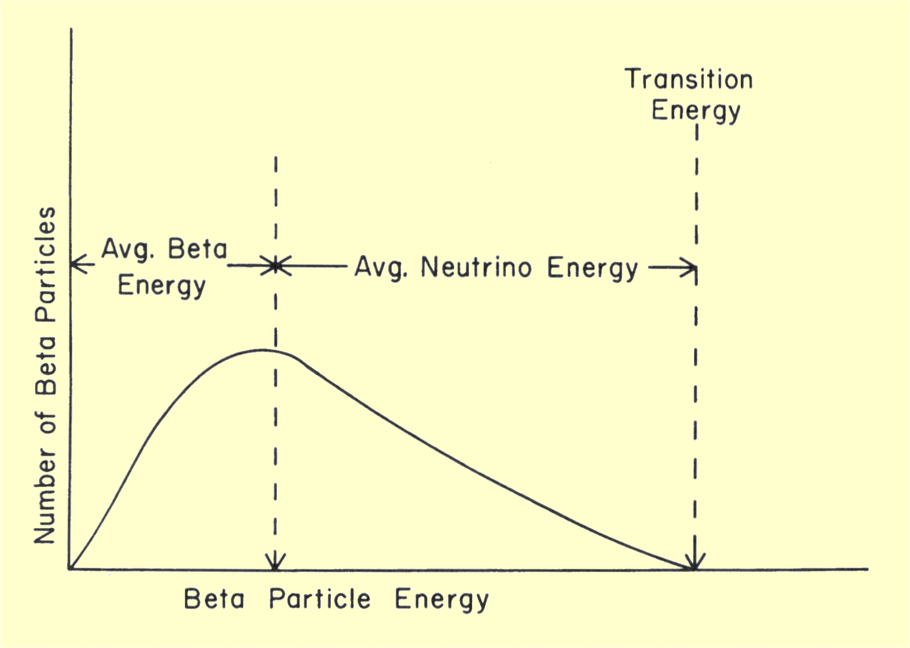
Neutrino (ν)
Proposed by Wolfgang Pauli in 1930 to explain beta decay.
Named by Enrico Fermi in 1931.
Discovered by F.Reines and C.L.Cowan in 1956.
Created during the Big Bang, Supernova, in the Sun , from cosmic rays, in nuclear reactors, in particle accelerators etc.
Interactions involving neutrinos are mediated by the weak force.

Slide 5
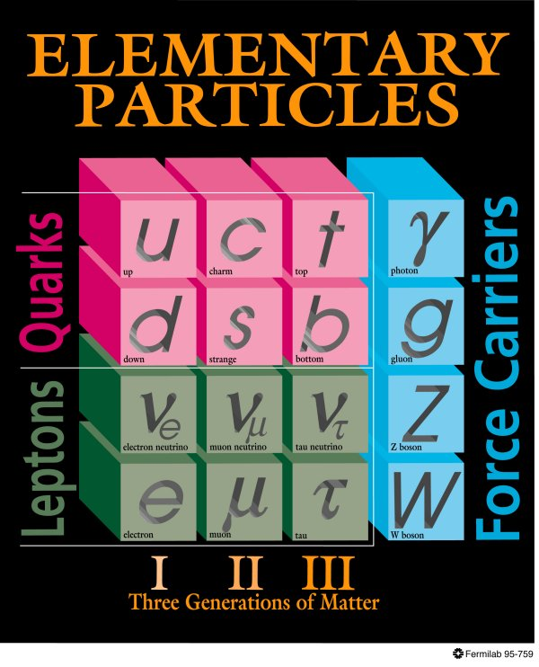
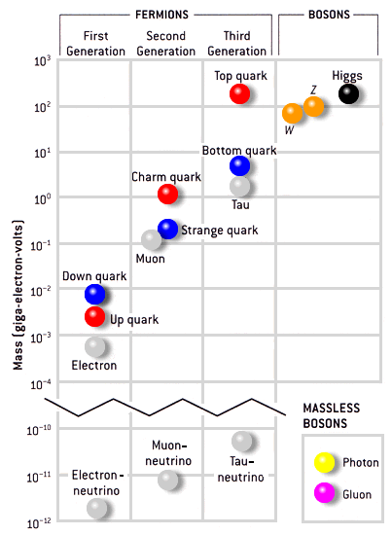
Standard model of particle physics
<2.2eV
<170keV
<15.5MeV

Slide 6
Neutrino oscillations
It is now known that neutrinos of one flavour oscillate to those of another flavour.
The oscillation mechanism is possible only if the neutrinos are massive.
Neutrino experiments are setting the stage for extension of Standard Model itself.
Massive neutrinos have ramifications on nuclear physics, astro physics cosmology, geo physics apart from particle physics
Electron and muon neutrinos (ν_{e} and ν_{μ}) are the flavour eigen states. They are super positions of the mass eigen states (ν₁ and ν₂)..
If at t = 0, an eigen state ν (0) = ν_{e,} then any time t
Then the oscillation probability is
And the oscillation length is

Slide 7
The INO
Iron Calorimeter (ICAL)
India-based Neutrino Observatory (INO) is a consortium of a large number of research centres and universities.

Slide 8
Neutrino physics using ICAL
Reconfirm atmospheric neutrino oscillation
Improved measurement of oscillation parameters
Search for potential matter effect in neutrino oscillation
Determining the mass hierarchy using matter effect
Study of ultra high energy neutrinos and muons
Long baseline target for neutrino factories

Slide 9
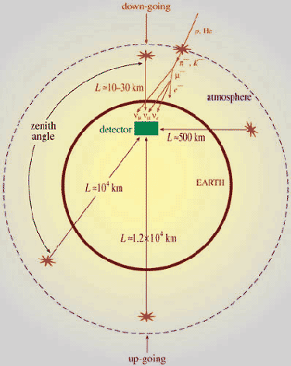
Up-Down asymmetry measurement
Atmospheric neutrino energy > 1.3GeV Δm² ~2-3×10⁻³ eV²
Downward muon neutrino are not affected by oscillation
They may constitute a near reference source
Upward neutrino are instead affected by oscillation since the L/E ratio ranges up to 10⁴ Km/GeV
They may constitute a far source
Thus, oscillation studies with a single detector and two sources

Slide 10
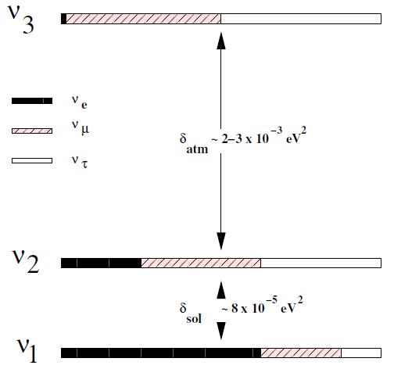
Matter effects and neutrino mass hierarchy
Matter effects help to cleanly determine the sign of the Δm²
Neutrinos and anti-neutrinos interact differently with matter
ICAL can distinguish this by detecting charge of the produced muons, due to its magnetic field
Helps in model building for neutrino oscillations

Slide 11
Neutrino sources and detector choice
Source of neutrinos
  Use atmospheric neutrinos as source
  Need to cover a large L/E range
    Large L range
    Large E_{ν} range
Physics driven detector requirements
  Should have large target mass (50-100 kT)
  Good tracking and energy resolution (tracking calorimeter)
  Good directionality (< 1 nSec time resolution)
  Charge identification capability (magnetic field)
  Modularity and ease of construction
  Compliment capabilities of existing and proposed detectors
Use magnetised iron as target mass and RPC as active detector medium

Slide 12

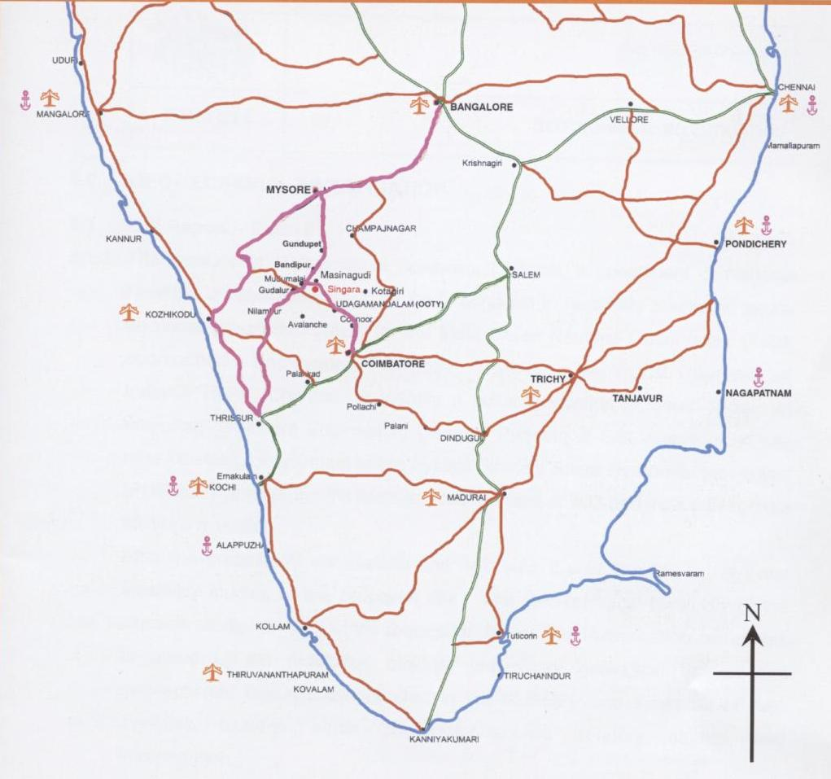
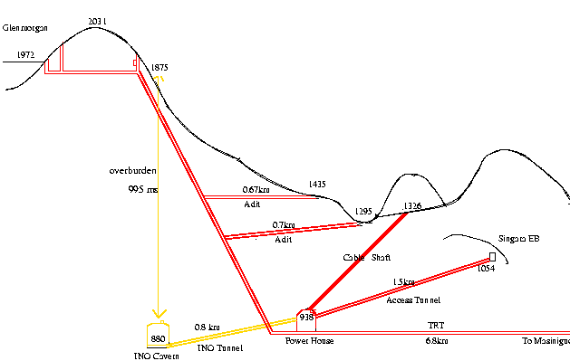
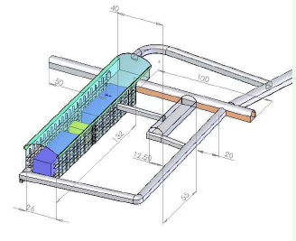
INO cavern: Location and design
Singara, about 105km south of Mysore or about 35km north of Ooty.
About 6km from the TNEB’s PUSHEP established township in Masinagudi.
The INO cavern will be built at about 2.3 km from the INO under ground tunnel portal.
7,100km from CERN, Geneva – Magic baseline distance!
Wealth of information on the site, geology ,seismicity, and rock quality etc.
INO Peak (2203m)

Slide 13
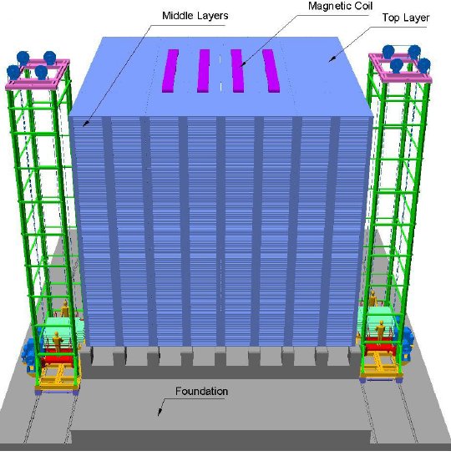
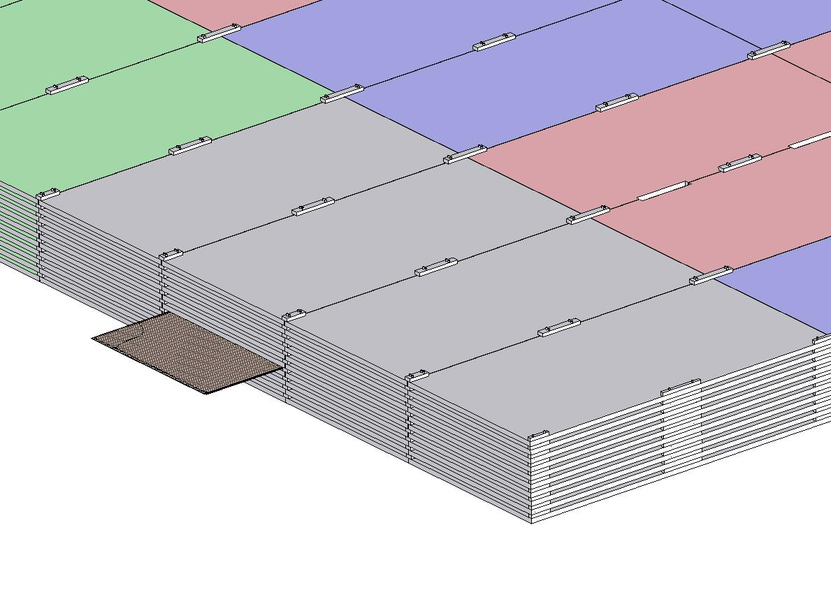
Assembly of ICAL detector
4000m m×2000mm×56mm low carbon iron slab
RPC
16m × 16m × 14.5m

Slide 14
Principle of operation of RPC
Gaseous detector of planar geometry, high resistive electrodes,
wire-less signal pickup

Slide 15
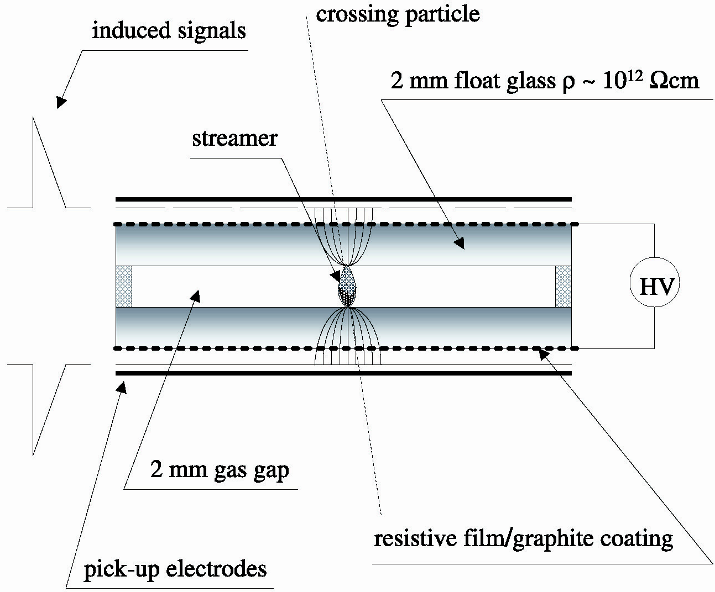
Schematic of a basic RPC
3

Slide 16
Principle of operation
Electron-ion pairs produced in the ionisation process drift in the opposite directions.
All primary electron clusters drift towards the anode plate with velocity v and simultaneously originate avalanches
A cluster is eliminated as soon as it reaches the anode plate
The charge induced on the pickup strips is q = (-eΔx_{e} + eΔx_{I})/g
The induced current due to a single pair is i = dq/dt = e(v + V)/g ≈ ev/g, V « v
Prompt charge in RPC is dominated by the electron drift

Slide 17
RPC operating mode definitions
Let, n₀ = No. of electrons in a cluster
α = Townsend coefficient (No.
of ionisations/unit length)
β = Attachment coefficient (No.
of electrons captured by the
gas/unit length)
Then, the no. of electrons reaching
the anode,
n = n₀e^{(α- β)x}
Where x = Distance between anode
and the point where the cluster
is produced.
Gain of the detector, M = n / n₀
A planar detector with resistive electrodes ≈ Set of independent discharge cells
Expression for the capacitance of a planar condenser → Area of such cells is proportional to the total average charge, Q that is produced in the gas gap.
  Where, d = gap thickness
  V = Applied voltage
  ε₀ = Dielectric constant of the gas
Lower the Q; lower the area of the cell (that is ‘dead’ during a hit) and hence higher the rate handling capability of the RPC

Slide 18
Control of avalanche process
Role of RPC gases in avalanche control
  Argon is the ionising gas
  R134a to capture free electrons and localise avalanche
    e⁻ + X → X⁻ + hν (Electron attachment)
    X⁺ + e⁻ → X + hν (Recombination)
  Isobutane to stop photon induced streamers
  SF₆ for preventing streamer transitions
Growth of the avalanche is governed by dN/dx = αN
The space charge produced by the avalanche shields (at about αx = 20) the applied field and avoids exponential divergence
Townsend equation should be dN/dx = α(E)N

Slide 19
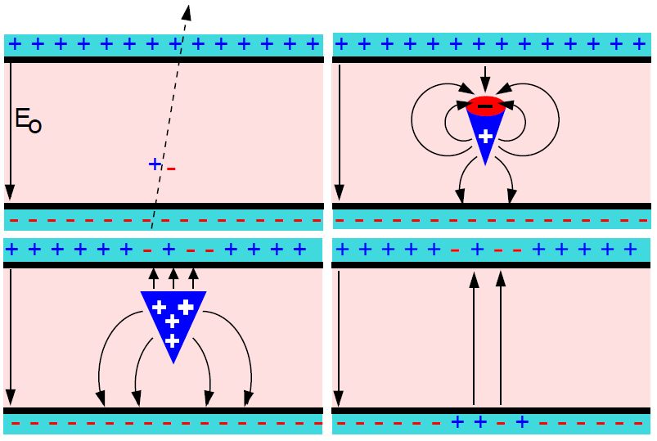
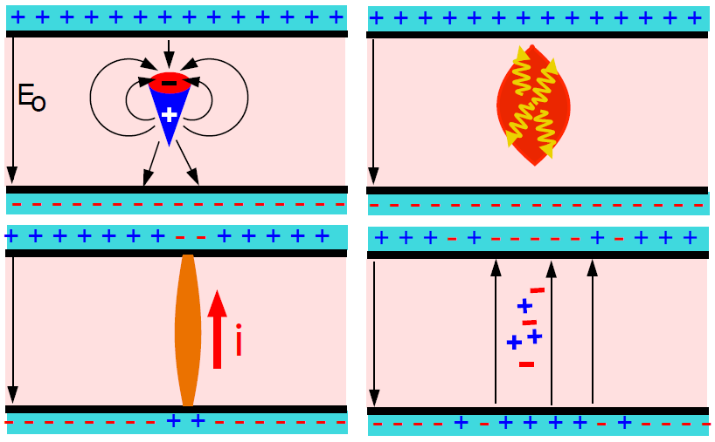
Two modes of RPC operation
Avalanche mode
Streamer mode
Gain of the detector << 10⁸
Charge developed ~1pC
Needs a preamplifier
Longer life
Typical gas mixture Fr:iB:SF₆::94.5:4:0.5
Moderate purity of gases
Higher counting rate capability
Gain of the detector > 10⁸
Charge developed ~ 100pC
No need for a preamplier
Relatively shorter life
Typical gas mixture Fr:iB:Ar::62.8:30
High purity of gases
Low counting rate capability

Slide 20
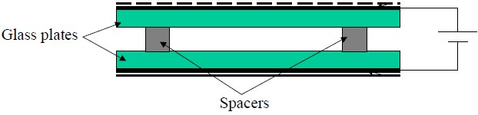
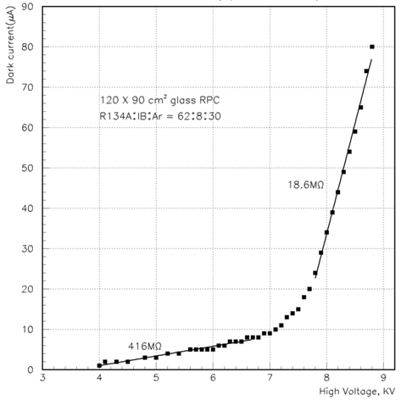
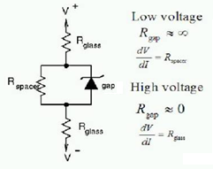
V-I characteristics of RPC
Glass RPCs have a distinctive and readily understandable current versus voltage relationship.

Slide 21
Typical expected parameters
No. of clusters in a distance g follows Poisson distribution with an average of
Probability to have n clusters
Intrinsic efficiency
ε_{max} depends only on gas and gap
Intrinsic time resolution
σ_{t} doesn’t depend on the threshold
Gas: 96.7/3/0.3
Electrode thickness: 2mm
Gas gap: 2mm
Relative permittivity: 10
Mean free path: 0.104mm
Avg. no. of electrons/cluster: 2.8
Charge threshold: 0.1pC
HV: 10.0KV
Townsend coefficient: 13.3/mm
Attachment coefficient: 3.5/mm
Efficiency: 90%
Time resolution: 950pS
Total charge: 200pC
Induced charge: 6pC

Slide 22
Review of
RPC detector developments
Creativity aided by intrinsic tunability of the RPC device

Slide 23
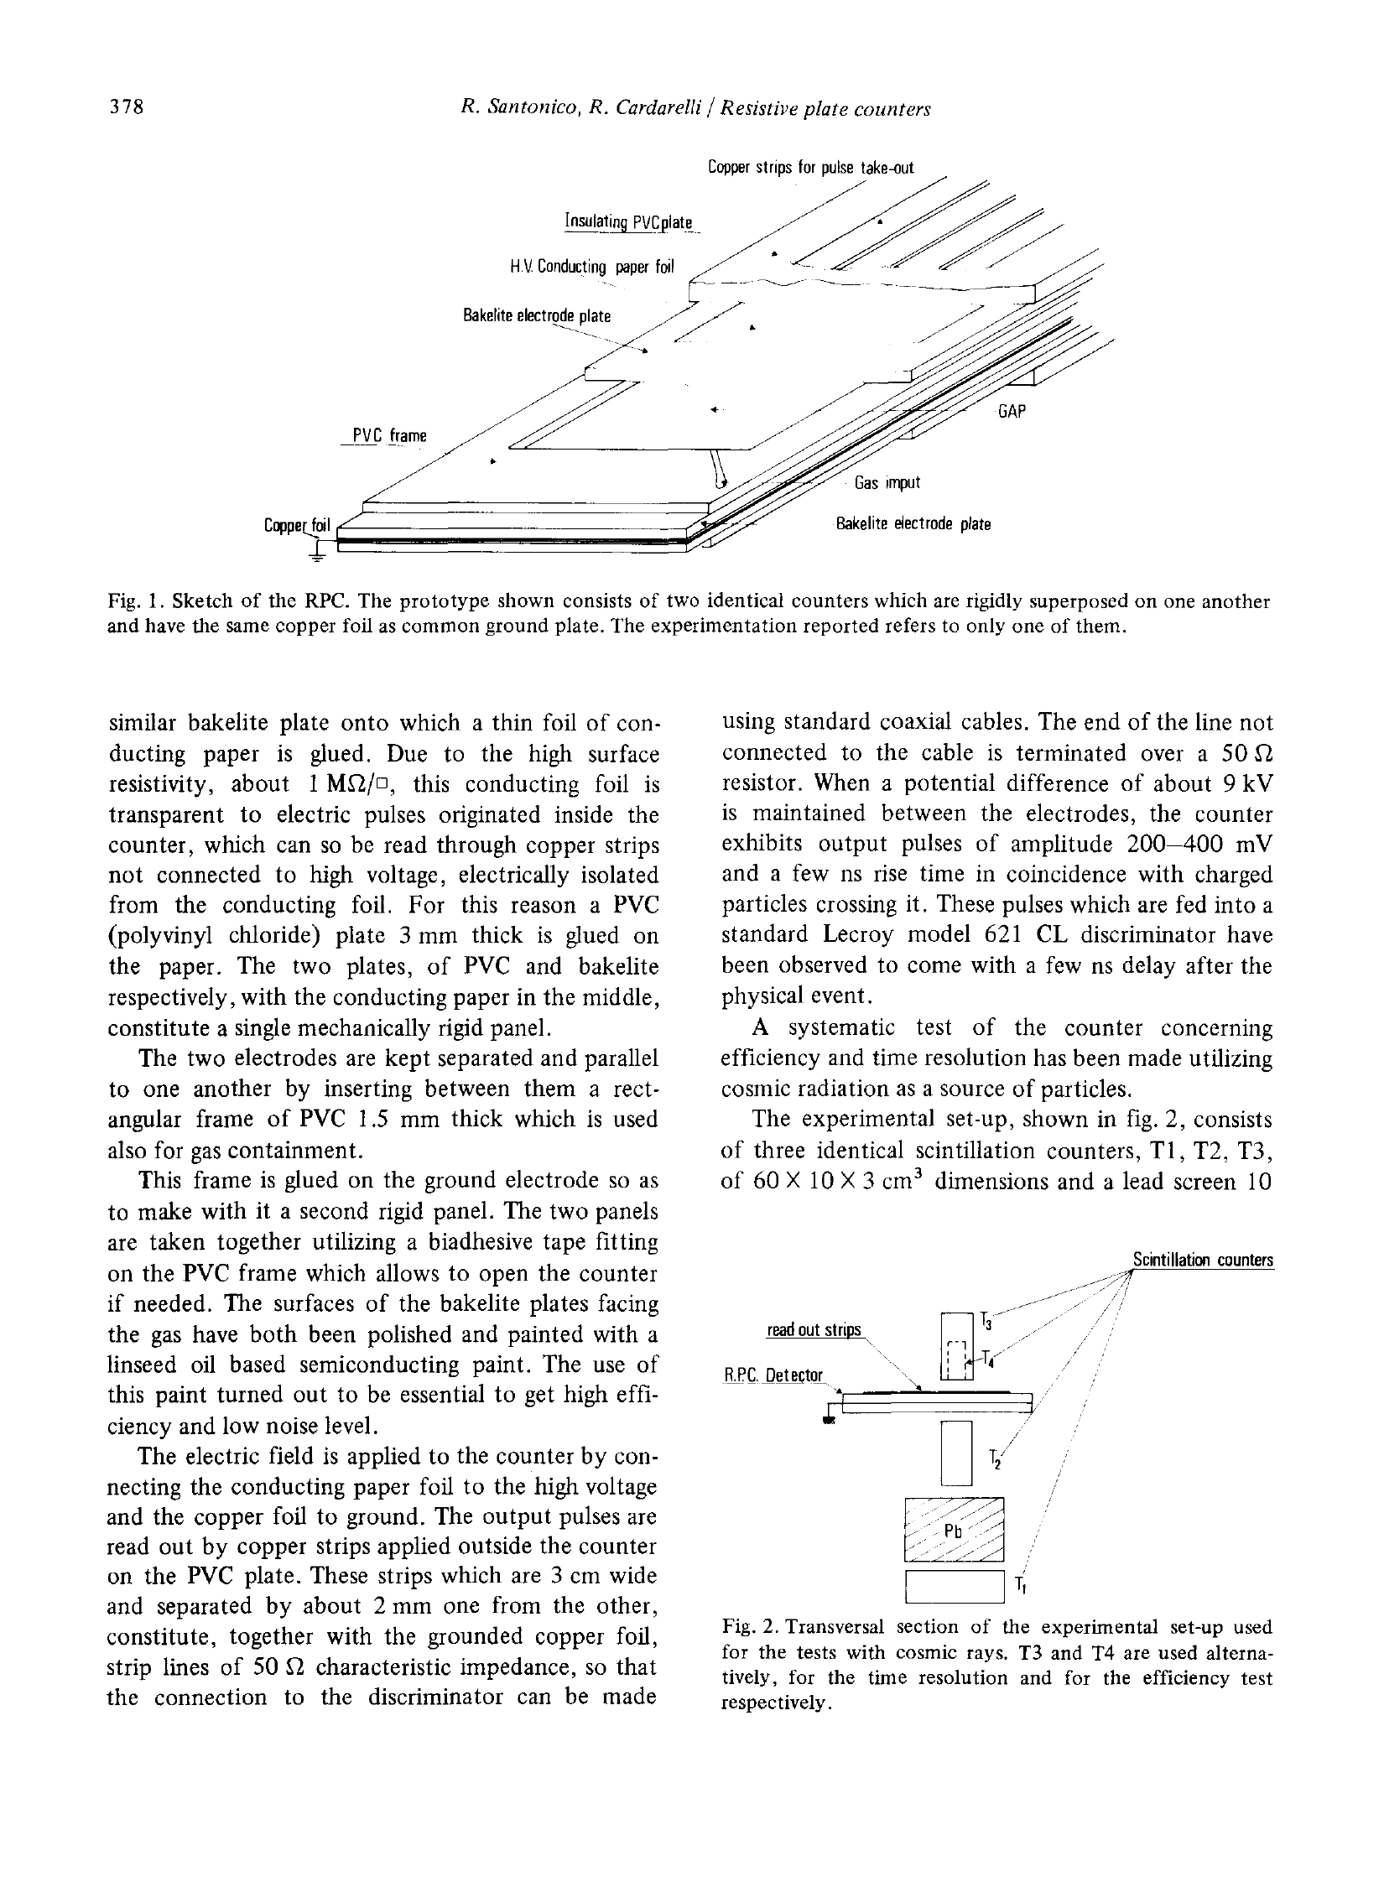
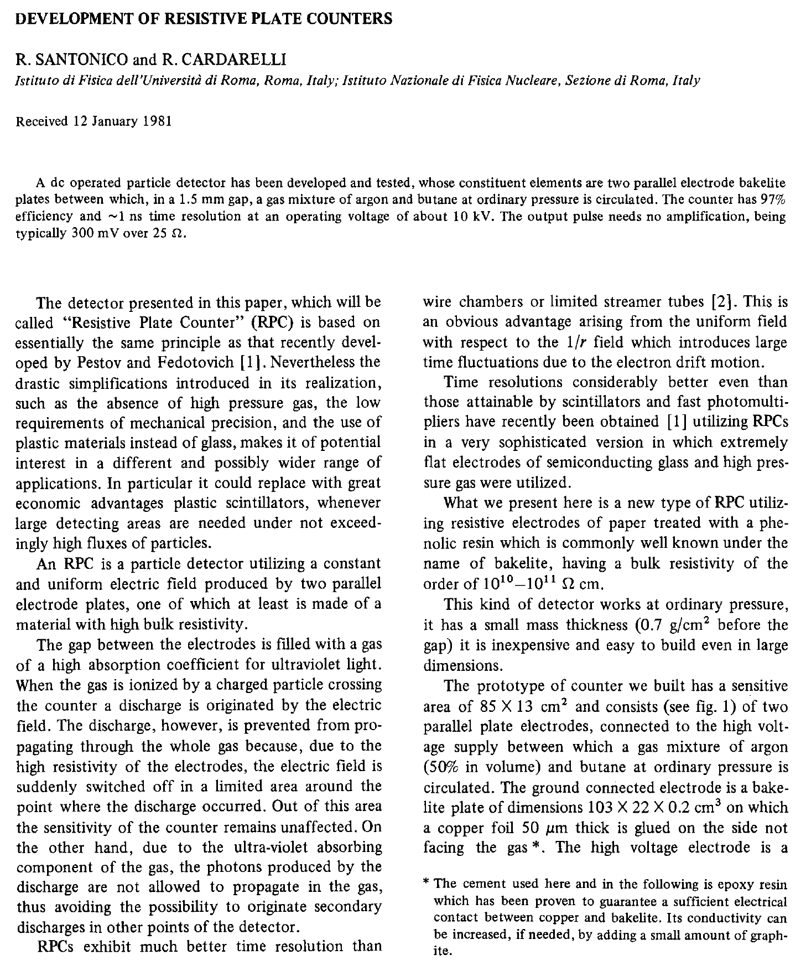
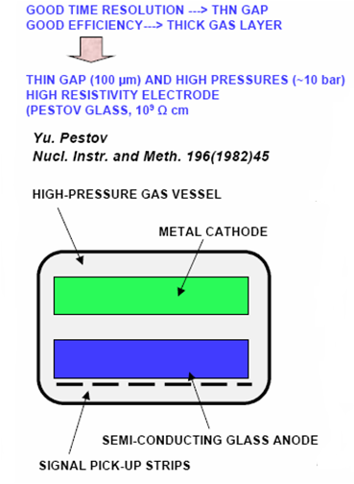
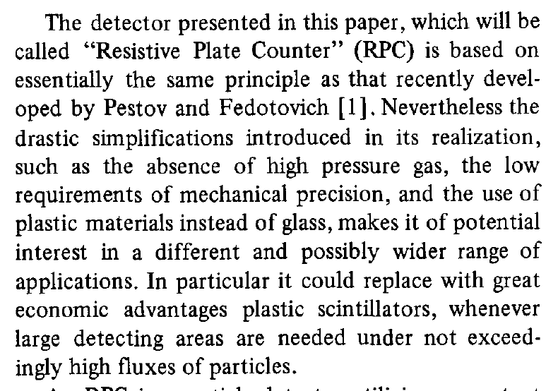
Birth of the RPC

Slide 24
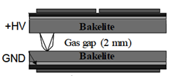
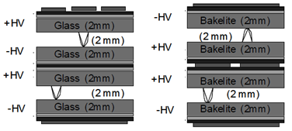
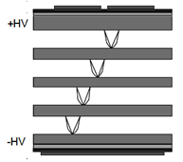
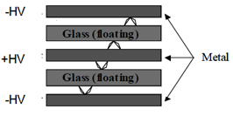
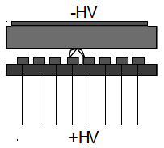
Application driven RPC designs
Single gap RPC
Double gap RPC
Multi gap RPC
Hybrid RPC
Micro RPC

Slide 25
Deployment of RPCs in running experiments
Experiment | Coverage(m²) | Electrodes | Gap(mm) | Gaps | Mode
BaBar | 2000 | Bakelite | 2 | 1 | Streamer
Belle | 2000 | Glass | 2 | 2 | Streamer
ALICE Muon | 72 | Bakelite | 2 | 1 | Streamer
ATLAS | 7000 | Bakelite | 2 | 1 | Avalanche
CMS | 6000 | Bakelite | 2 | 2 | Avalanche
STAR | 60 | Glass | 0.22 | 5 | Avalanche
ALICE TOF | 160 | Glass | 0.25 | 10 | Avalanche
OPERA | 3000 | Bakelite | 2 | 1 | Streamer
YBJ-ARGO | 5600 | Bakelite | 2 | 1 | Streamer
BESIII | 1500 | Bakelite | 2 | 1 | Streamer
HARP | 10 | Glass | 0.3 | 4 | Avalanche
Also deployed in COVER_PLASTEX,EAS-TOP, L3 experiments

Slide 26
Design and studies of small RPC prototypes
The first RPC built at TIFR was 30cm × 10cm!

Slide 27
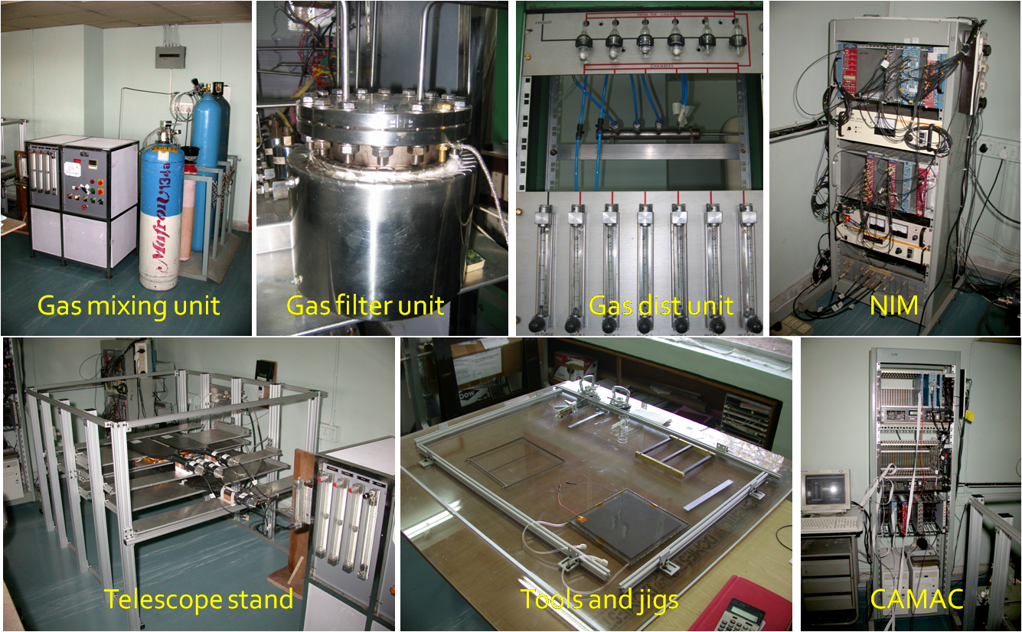
Initial infrastructure for RPC R&D

Slide 28
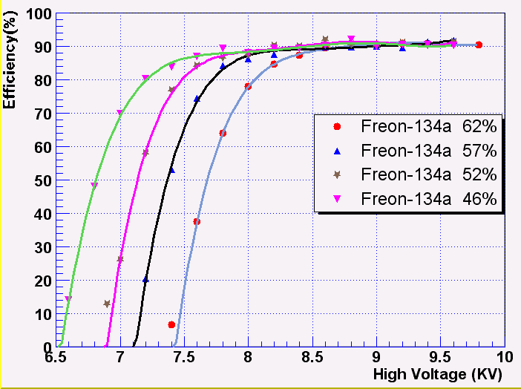
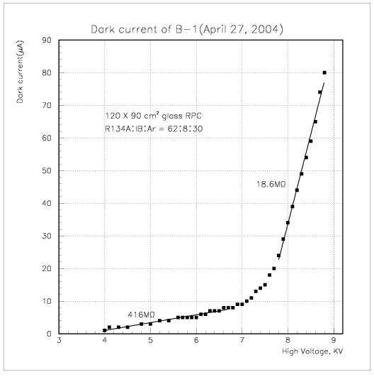
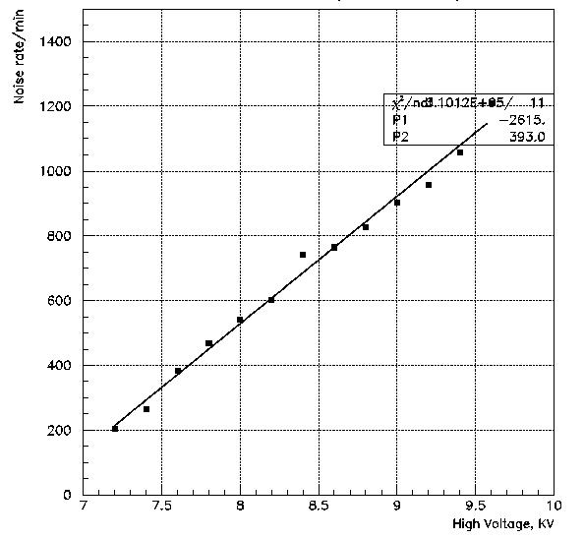
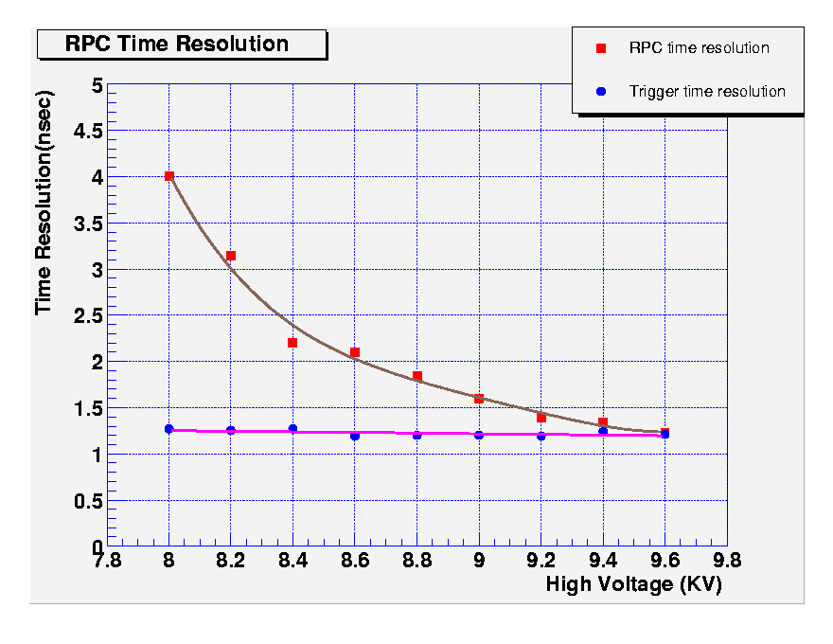
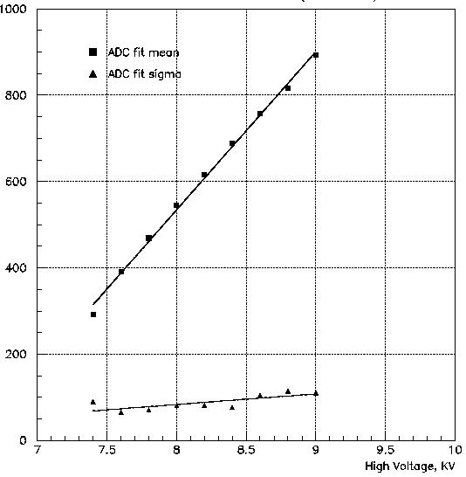
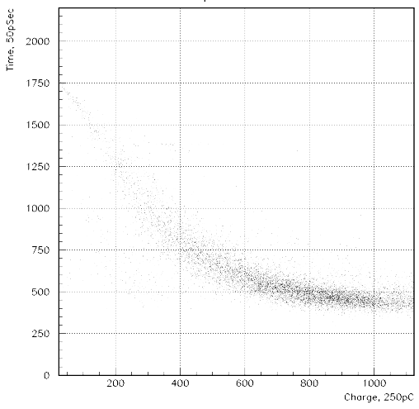
Some early encouraging results

Slide 29
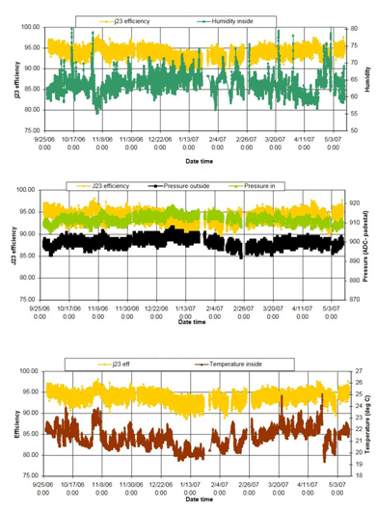
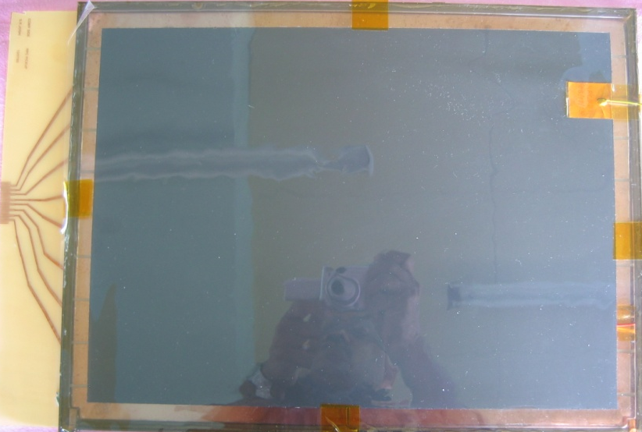
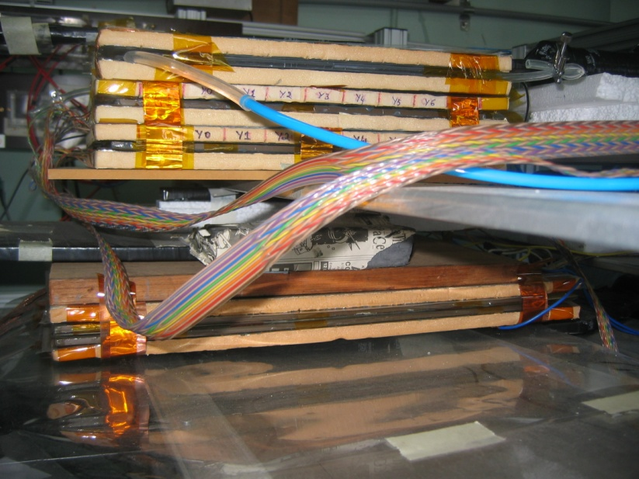
Long-term stability study of RPC
Two RPCs of 40cm × 30cm in size were built using 2mm glass for electrodes
Readout by a common G-10 based signal pickup panel sandwiched between the RPCs
Operated in avalanche mode (R134a: 95.5% and the rest Isobutane) at a high voltage of 9.3KV
Round the clock monitoring of RPC and ambient parameters – temperature, relative humidity and barometric pressure
Were under continuous operation for more than three years
Chamber currents, noise rate, combined efficiencies etc. were stable
Long-term stability of RPCs is thus established
Relative humidity
Pressure
Temperature

Slide 30
Development of
RPC materials and procedures
Continuous interaction with local industry and quality control standards

Slide 31
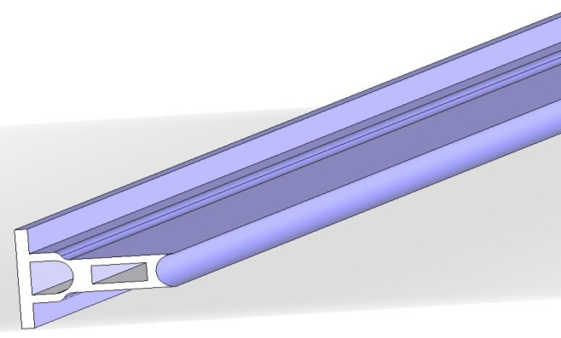
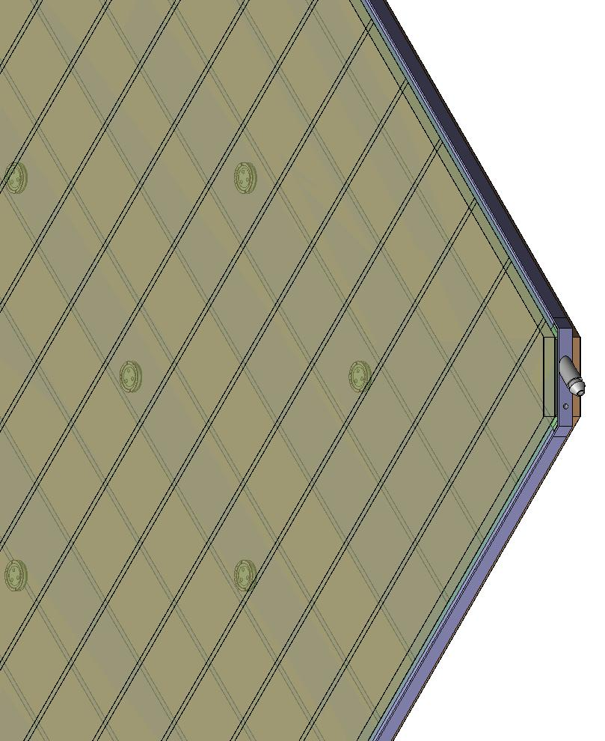
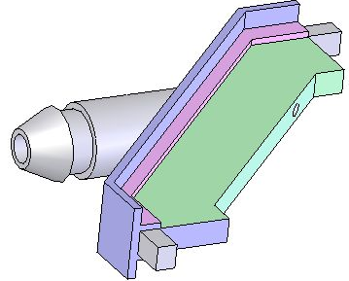
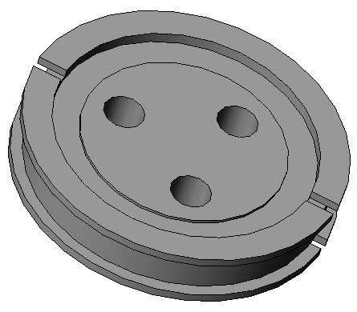
Materials for gas volume fabrication
Edge spacer
Schematic of an assembled gas volume
Gas nozzle
Glass spacer

Slide 32
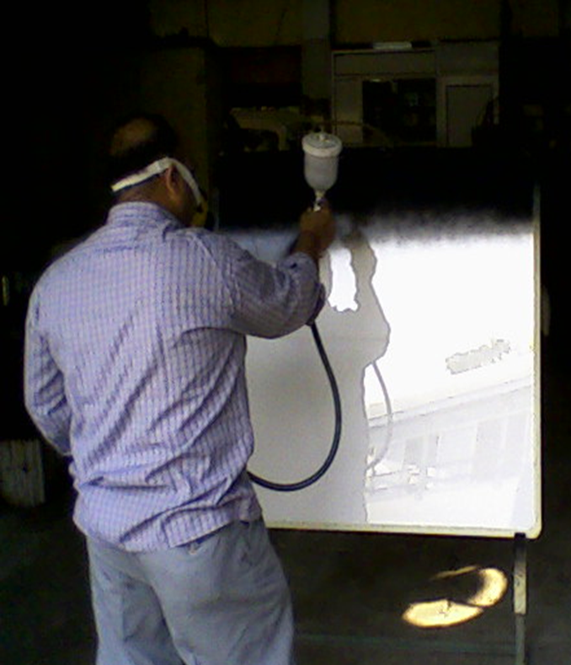
Electrode coating techniques
Graphite paint prepared using colloidal grade graphite powder(3.4gm), lacquer(25gm) and thinner(40ml)
Sprayed on the glass electrodes using an automobile spray gun.
A uniform and stable graphite coat of desired surface resistivity (1MΩ/◻) was obtained by this method.

Slide 33
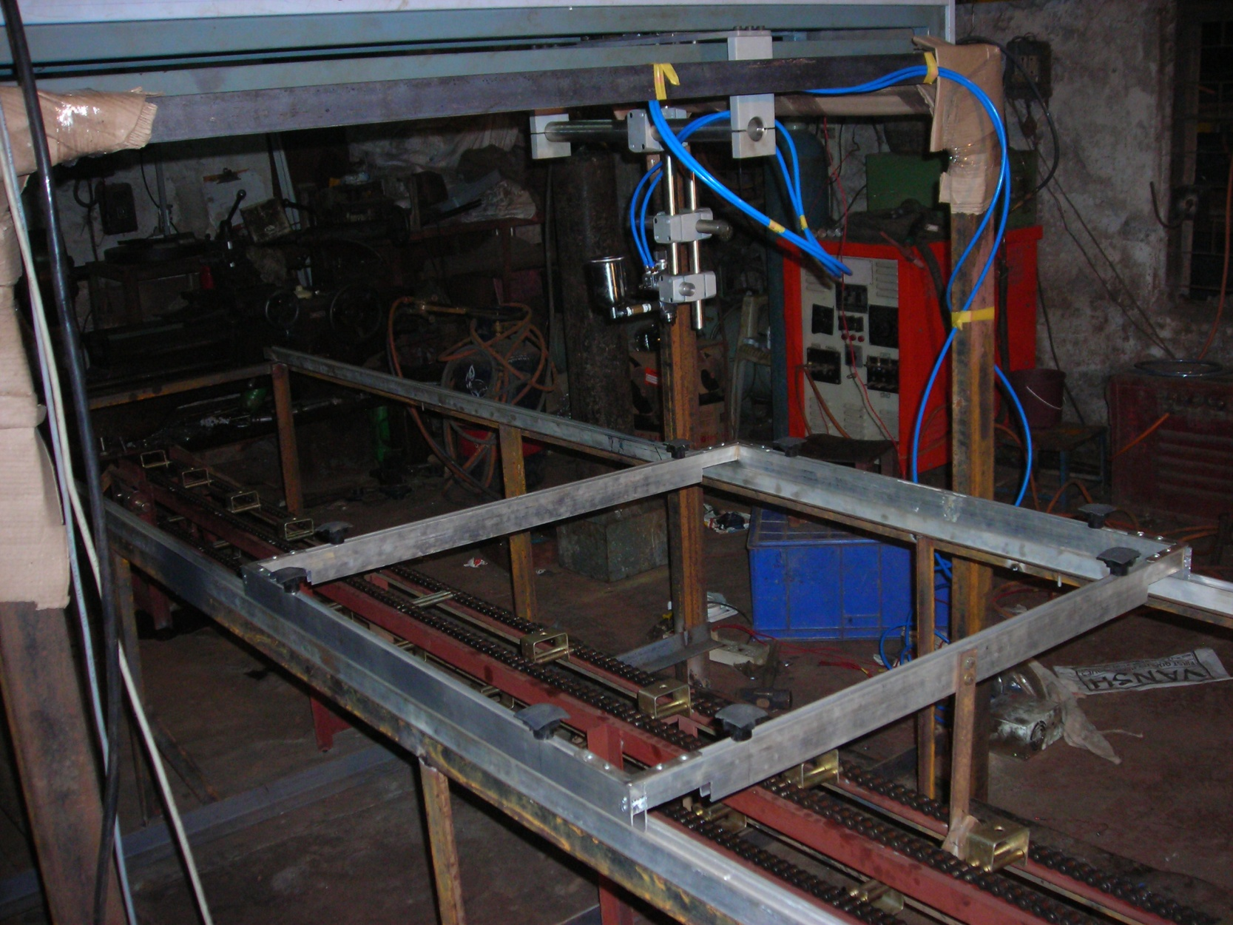
Automatic spray paint plant
Drive for Y-movement
Automatic spray gun
Control and drive panel
Glass holding tray
Drive for X-movement

Slide 34
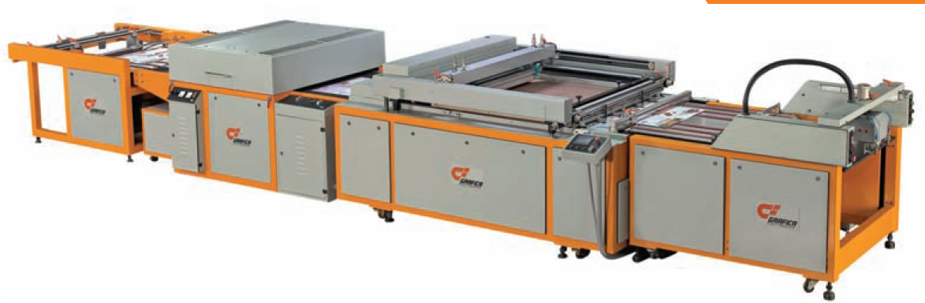
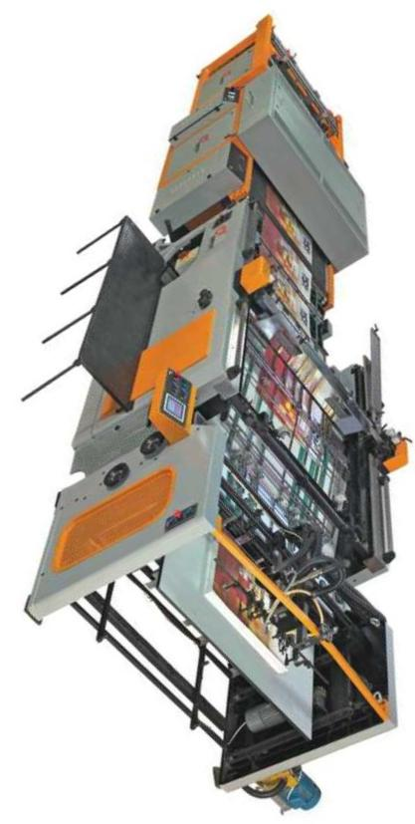
Screen printing techniques
On glass
On films

Slide 35
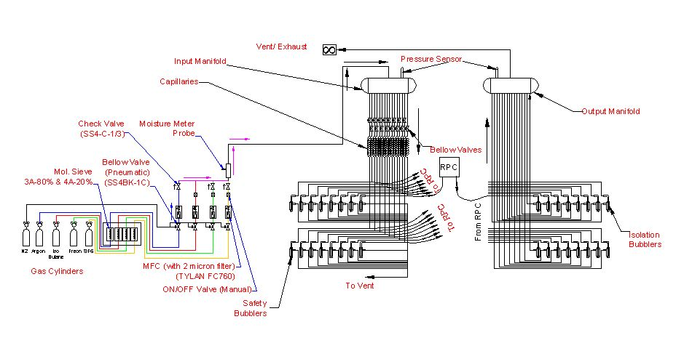
Schematic of gas system

Slide 36
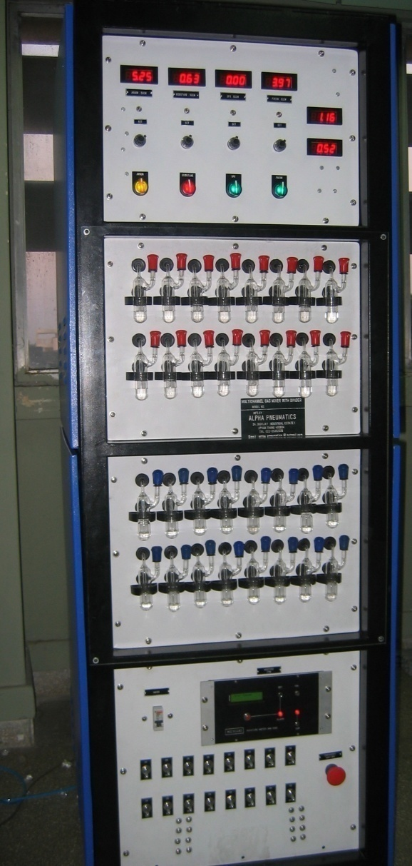
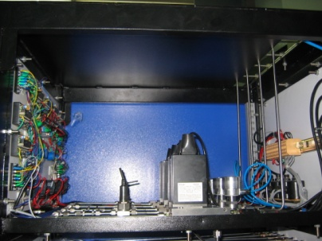
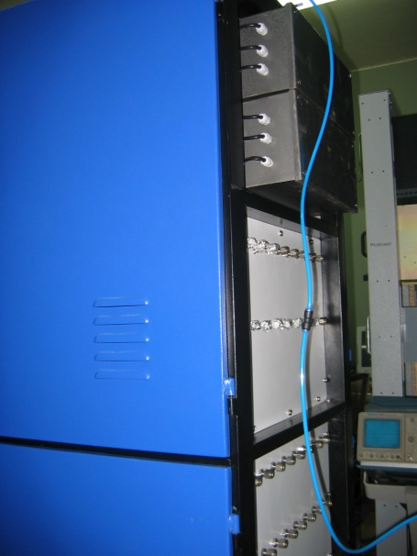
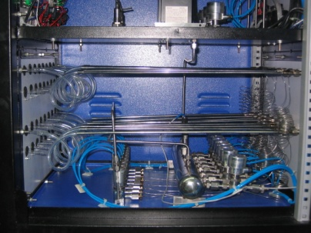
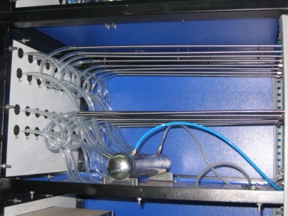
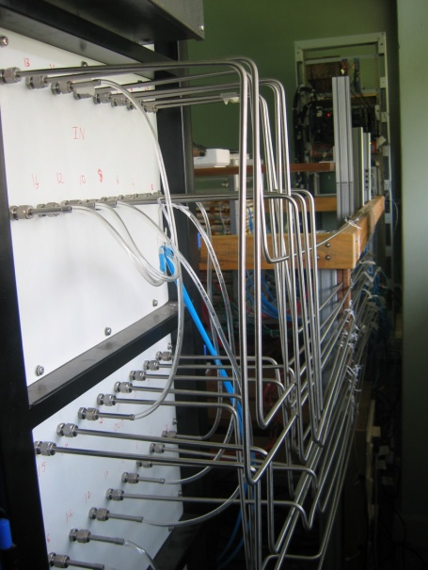

Constructional details of the gas system
Internal view
Front view
Rear view

Slide 37








Development and characterisation of signal pickup panels
Foam panel
48.2Ω
G-10 panel
Open
100Ω
51Ω
47Ω
Z₀: Inject a pulse into the strip; tune the terminating resistance at the far end, until its reflection disappears.
Honeycomb panel

Slide 38
Large area RPC development
Scaling up dimensions without deterioration of characteristics

Slide 39

Fully assembled large area RPC
1m × 1m

Slide 40




RPC parameter characterisation

Slide 41
Construction of
ICAL prototype detector
Want to check if everything works as per design!

Slide 42


Prototype detector magnet
13 layer sandwich of 50mm thick low carbon iron (Tata A-grade) plates (35ton absorber)
Detector is magnetised to 1.5Tesla, enabling momentum measurement of 1-10Gev muons produced by ν_{μ} interactions in the detector.

Slide 43

Prototype RPC stack

Slide 44













Design and implementation of the data acquisition system
200 boards of 13 types
Custom designed using
FPGA,CPLD,HMC,FIFO,SMD

Slide 45
Data analysis and results
Using a ROOT based package BigStackV3.8

Slide 46


A couple of interesting events

Slide 47

Strip hit map of an RPC

Slide 48


RPC strip rate time profile
Temperature

Slide 49


On-line monitoring of ambient parameters
Temperature
R.H
Current

Slide 50
Summary and future outlook
RPC: Is it the best thing happened after MWPC?

Slide 51
Why ICAL chose RPC?
Large detector area coverage, thin (~10mm), small mass thickness
Flexible detector and readout geometry designs
Solution for tracking, calorimeter, muon detectors
Trigger, timing and special purpose design versions
Built from simple/common materials; low fabrication cost
Ease of construction and operation
Highly suitable for industrial production
Detector bias and signal pickup isolation
Simple signal pickup and front-end electronics; digital information acquisition
High single particle efficiency (>95%) and time resolution (~1nSec)
Particle tracking capability; 2-dimensional readout from the same chamber
Scalable rate capability (Low to very high); Cosmic ray to collider detectors
Good reliability, long term stability
Under laying Physics mostly understood!

Slide 52
Summary and future R&D plans
Starting from modest 30cm × 30cm chambers …
Now, 100cm × 100cm RPCs are being routinely fabricated and characterised in detail
Long-term stability of these chambers is established
ICAL prototype detector is being assembled
Almost all the required materials and procedures designed and optimised for production
Fabrication and testing of 200cm × 200cm RPCs to start soon
Detailed studies using the prototype detector stack will continue
Design and optimisation of gas recirculation system

Slide 53
Deployment of RPCs in ICAL
Incorporating and optimisation of ICAL specific parameters and constraints in the production designs
Large scale production of RPCs is being thought about
Parallel production of chambers at multiple assembly centres with common quality control standards

Slide 54
Acknowledgements
Growth is necessarily built around people …

Slide 55
Anita Behere, M.S.Bhatia, V.B.Chandratre, V.M.Datar, M.D.Ghodgaonkar, S.K.Mohammed, S.K.Kataria, P.K.Mukhopadhyay, S.M.Raut, R.S.Shastrakar, Vaishali Shedam
Bhabha Atomic Research Centre, Mumbai
Amitava Raychaudhuri
Harish-Chandra Research Institute, Allahabad
Satyajit Jena, Basanta Nandi, S.Uma Sankar, Raghava Varma
Indian Institute of Technology Bombay, Mumbai
D.Indumathi, M.V.N.Murthy, G.Rajasekaran, D.Ramakrishna
Institute of Mathematical Sciences, Chennai
Y.P.Viyogi
Institute of Physics, Bhubaneswar
Sudeb Bhattacharya, Suvendu Bose, Satyajit Saha, Manoj Saran, Sandip Sarkar, Swapan Sen
Saha Institute of Nuclear Physics, Kolkata
B.S.Acharya, V.V.Asgolkar, Sarika Bhide, Manas Bhuyan, Santosh Chavan, Amol Dighe, M.Elangovan, G.K.Ghodke, P.R.Joseph, V.S.Jeeva, S.R.Joshi, S.D.Kalmani, Darshana Koli,
Shekhar Lahamge, Vidhya Lotankar, G.Majumder, N.K.Mondal, P.Nagaraj, B.K.Nagesh, G.K.Padmashree, Subhendu Rakshit, K.V.Ramakrishnan, Shobha Rao, L.V.Reddy, Asmita Redij,
Deepak Samuel, Mandar Saraf, S.B.Shetye, R.R.Shinde, Noopur Srivastava, S.Upadhya,
Piyush Verma, Central Services, Central Workshop, Visiting Students
Tata Institute of Fundamental Research, Mumbai
Saikat Biswas, Subhasish Chattopadhyay
Variable Energy Cyclotron Centre, Kolkata
UICT, Mumbai & Local Industries

Slide 56
Ian Crotty, Christian Lippmann, Archana Sharma, Igor Smirnov, Rob Veenhof
CERN, Switzerland
Adam Para, Makeev Valeri
Fermilab, USA
Carlo Gustavino, M.C.S.Williams
INFN, Italy
Kazuo Abe, Daniel Marlow
Belle Experiment, Japan
Jianxin Cai
Peking University, China
Rinaldo Santonico
University of Roma, Italy

Slide 57
Thank you
For further information
INO homepage: http://www.imsc.res.in/~ino
TIFR INO homepage: http://www.ino.tifr.res.in
My INO homepage: http://www.hecr.tifr.res.in/~bsn/ino

