Slide 1
testing of Anusparsh FE ASIC in Tifr RPC Detector stack
B.Satyanarayana, TIFR, Mumbai

Slide 2
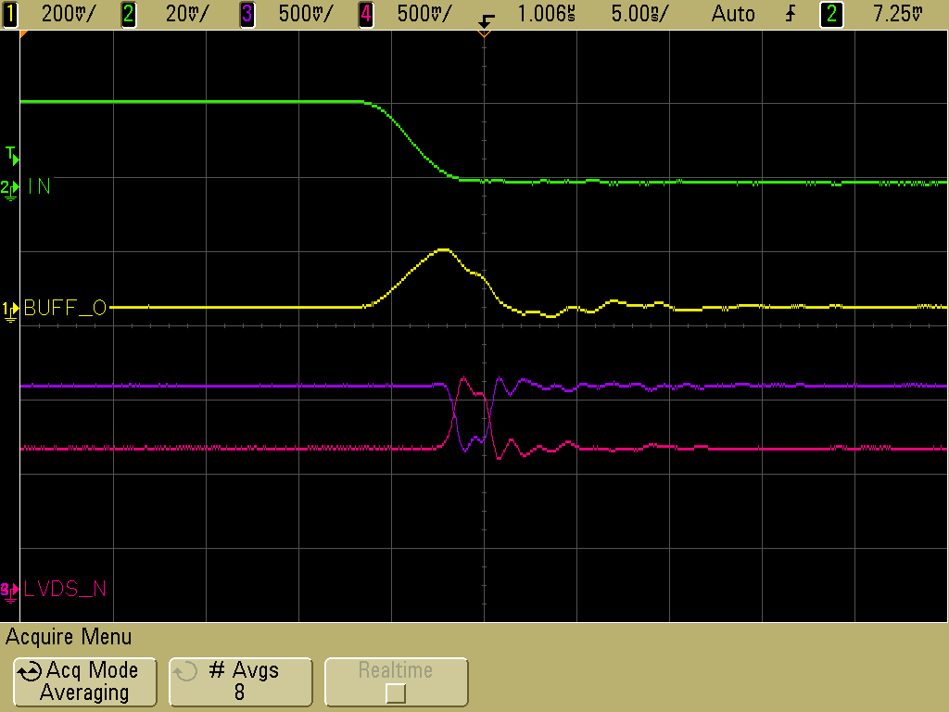
Architecture of front-end ASIC
Common threshold
Ch-0
Regulated Cascode Transimpedance Amplifier
Differential Amplifier
Comparator
LVDS output driver
LVDS_out0
Channel-0
8:1 Analog Multiplexer
Output Buffer
Amp_out
Channel-7
Ch-7
Regulated Cascode Transimpedance Amplifier
Differential Amplifier
Comparator
LVDS output driver
LVDS_out7

Slide 3
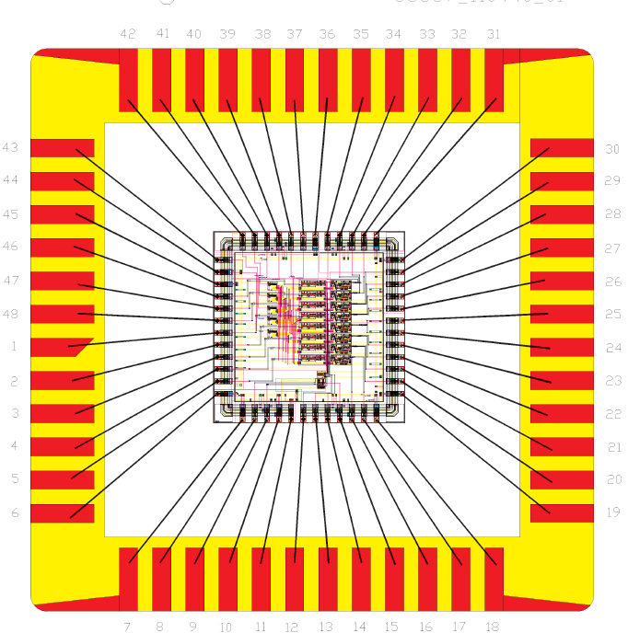
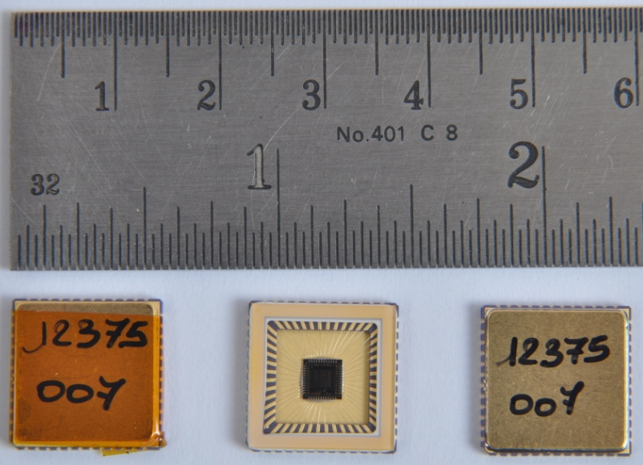
Features of ICAL FE ASIC
IC Service: Europractice (MPW), Belgium
Service agent: IMEC, Belgium
Foundry: austriamicrosystems
Process: AMSc35b4c3 (0.35μm CMOS)
Input dynamic range:18fC – 1.36pC
Input impedance: 45Ω @350MHz
Amplifier gain: 8mV/μA
3-dB Bandwidth: 274MHz
Rise time: 1.2ns
Comparator’s sensitivity: 2mV
LVDS drive: 4mA
Power per channel: ~20mW
Package: CLCC48(48-pin)
Chip area: 13mm²
Pilot production: 30 chips

Slide 4
Schematic of front-end evaluation board

Slide 5
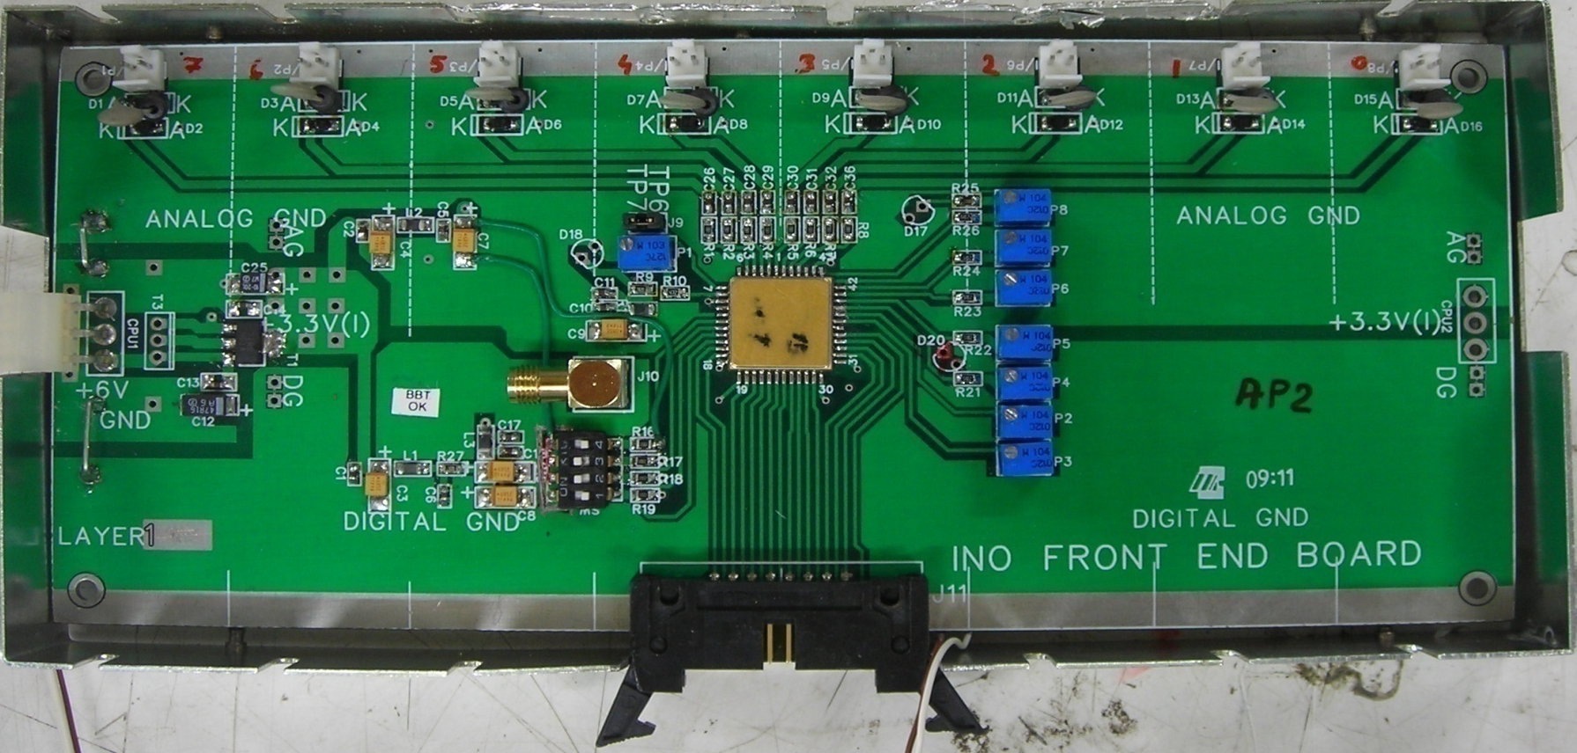
8-channel front-end board (Version 2)
Two boards, AP1 and AP2 are being tested

Slide 6
Features of the front-end board
8 amplifier + discriminator channels
0.1μF series capacitors placed on the inputs as RPC strips are terminated using 50Ω resistors on the far-end
Gain = Output voltage ÷ Input current
Typical gain obtained with the test setup 4-5mV/μA
The designed gain was 8mV/μA; but reduced on board to contain instability
Multiplexed buffered (50Ω) inverted analog output available
Buffered analog signal = ½ actual output (due to 50Ω termination)
Comparator threshold = Voltage@pin38 – Voltage@pin9
Comparator outputs in LVDS logic (4mA drive)

Slide 7
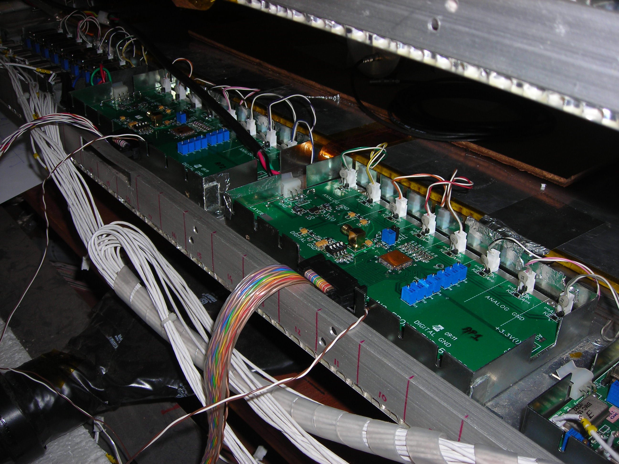
Front-end boards in TIFR RPC stack
Layer 0, Channels: 8 to 23

Slide 8
Bias and threshold measurements
Point | AP1 | AP2 | Buffer (AP1) [Pin 9] |  |  | Buffer (AP2) [Pin 9]
Pin 38 | 1.838 | 1.644 | Enable |  | Disable | Enable |  | Disable
P3 | 1.191 | 1.271 | CRO | DMM | DMM | CRO | DMM | DMM
P4 | 0.698 | 0.705 | 1.56 | 1.56 | 0.232 | 1.56 | 1.556 | 0.232
P5 | 0.630 | 0.637 | 1.48 | 1.48 | 0.234 | 1.48 | 1.476 | 0.234
P6 | 0.649 | 0.650 | 1.38 | 1.39 | 0.234 | 1.38 | 1.386 | 0.234
P7 | 0.650 | 0.654 | 1.49 | 1.48 | 0.234 | 1.49 | 1.481 | 0.234
P8 | 0.650 | 0.657 | 1.3 | 1.31 | 0.234 | 1.3 | 1.306 | 0.234
 |  |  | 1.495 | 1.45 | 0.234 | 1.495 | 1.451 | 0.234
 |  |  | 1.42 | 1.36 | 0.234 | 1.42 | 1.362 | 0.234
 |  |  | 1.425 | 1.36 | 0.234 | 1.425 | 1.362 | 0.234

Slide 9
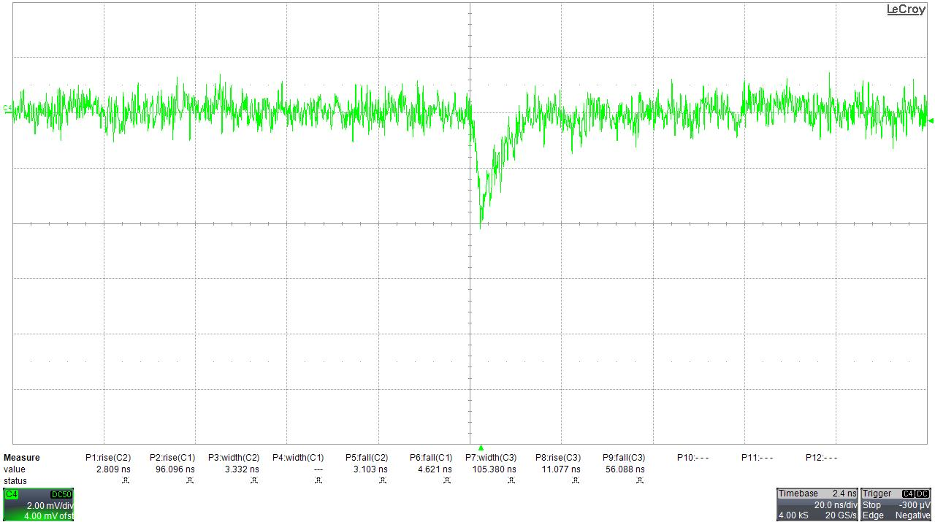
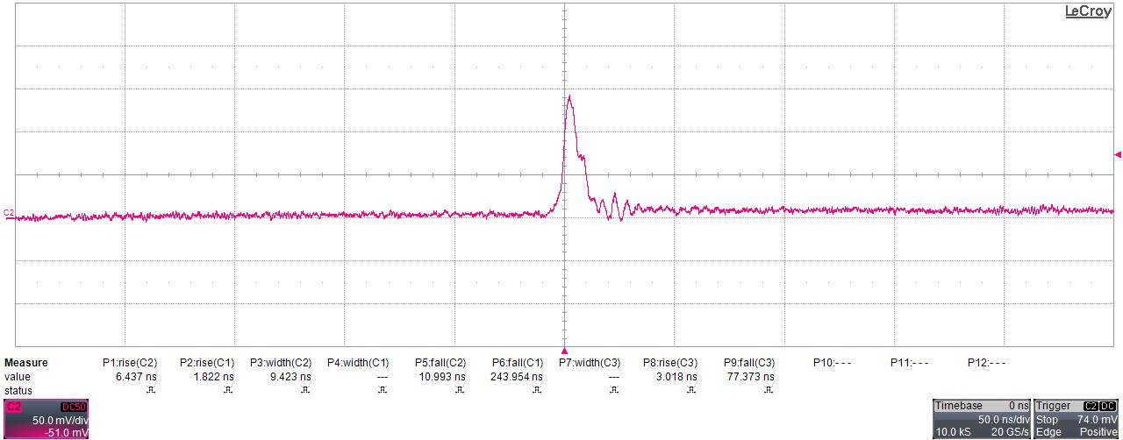
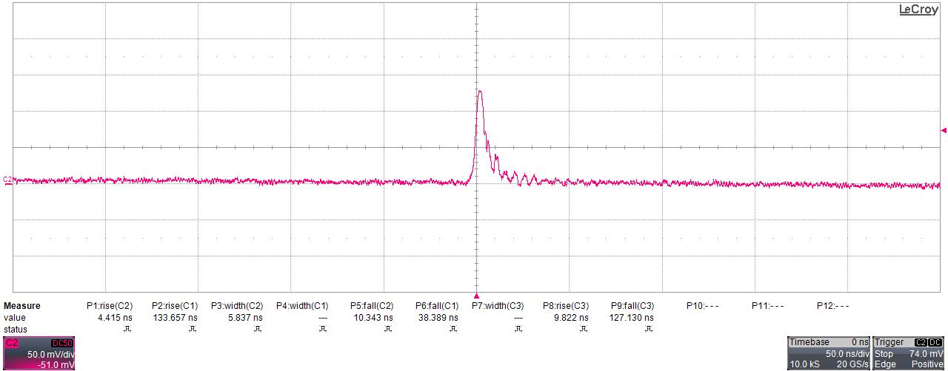
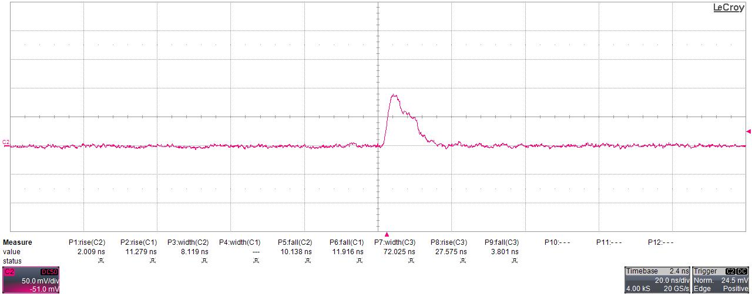
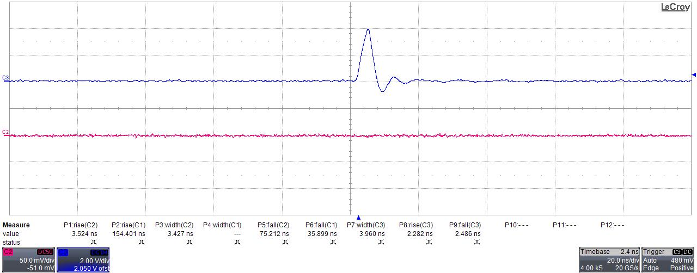
Some signals and traces!
AP1 Buffer output with RPC
Pulser input
AP2 Buffer output with RPC
Buffer output
Comparator output with RPC (TTL)

Slide 10
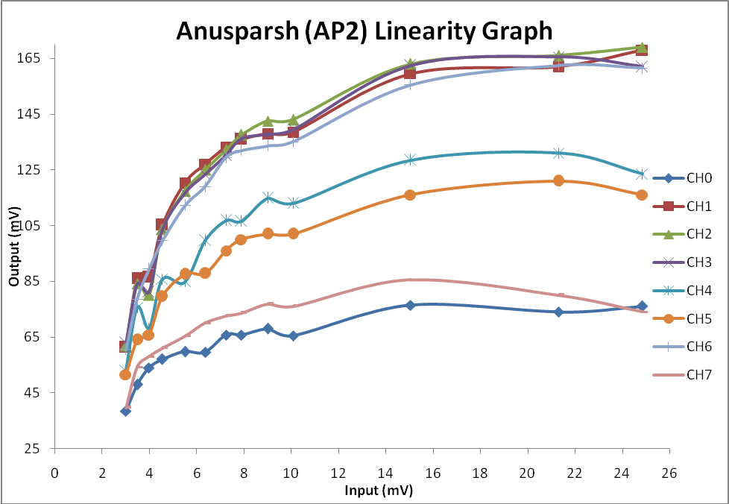
Linearity studies of the front-end board
Channel-to-channel gain variation is a concern

Slide 11
Preliminary power measurements
Power per channel estimated by the designers: ~20mW (Chip only); @3.3V
Board = ASIC + support circuitry
A number of bias circuits, terminations, protection diodes – they all consume power
Measured current for the board:
Multiplexer and buffer off: 70mA @6V, ~50mW/ch
Multiplexer and buffer on: 110mA @6V, ~80mW/ch
Certainly there is an ample scope for optimising the circuit and in particular for power reduction

Slide 12
Work in progress and action plan
Study of amplifier gain and buffer output signal linearity using external pulser
Detailed study of threshold adjustment and its stability
Try finer threshold adjustment by connecting a 100KΩ resistor to either side of 100KΩ trim-pot (P2)
Calibration of threshold for RPC using noise rate and efficiency parameters
Integration of atleast four front-end boards with RPC stack
Revision of the chip
Solve instability problem while the multiplexer is turned on
Separate chips for positive and negative inputs as well as amplifier and discriminator might anyway solve this problem
Start repackaging the board for ICAL - to fit in zero volume!

