Slide 1
Close Loop Gas Recirculation and Purification System for INO RPC System
A.V.Joshi¹, S.D.Kalmani², N.K.Mondal², B.Satyanarayana², P.Verma²
¹Alpha Pneumatics, Thane, Mumbai, 400602
²Tata Institute of Fundamental Research, Colaba, Mumbai, 400005

Slide 2
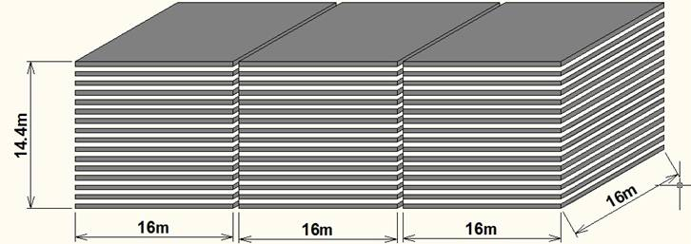
INO’s 50kt magnetised ICAL detector
The basic function of the gas system is to mix the gas components in the appropriate proportion, to distribute the mixture to the individual chambers as well as to purify and recycle the used gas. The large detector volume and the relatively expensive gases make a Closed Loop System mandatory. It is observed that, the performance of RPC largely depends on the quality of the gas mixture used. The current drawn by the chambers increases with poor quality of gas mixture. So, it is very important to assure a good quality of gas in the RPC system.

Slide 3
Purpose and motivation
Total number of RPCs in the ICAL = 3 x150 x 64 = 28,800
Total gas volume = 28,800 x 195cm x 191cm x 0.2cm = 214,531 litres
Standard gas composition for the avalanche mode:
  R134a(C₂H₂F₄):Isobutane(C₄H₁₀):Sulphur Hexaflouide(SF₆)::95.5:4.3:0.2
What is the minimum gas flow required in a RPC detector, which results in an optimum uniformity of gas concentration - by simulation and by monitoring the current and noise rate of an RPC.
Some deciding factors: Expensive and hazardous gases, green house effect, handling high volume of gases in the cavern
Operational consideration: How many RPC’s can be connected in series and/or in parallel? Many RPCs in series will add to pressure gradient, leading to gas flow problems

Slide 4
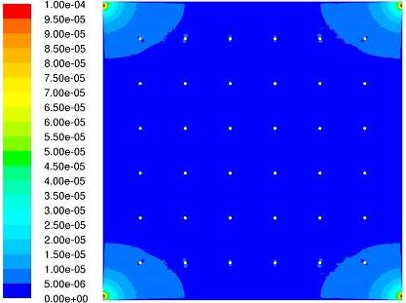
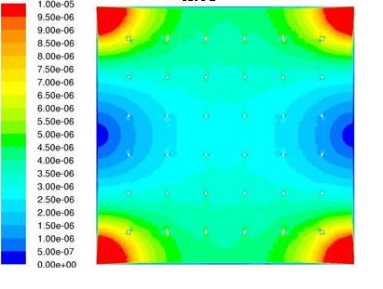
Gas flow distribution in 1m x 1m RPCs
(Simulation results)
0.2 Volume changes/day
0.5 Volume changes/day

Slide 5
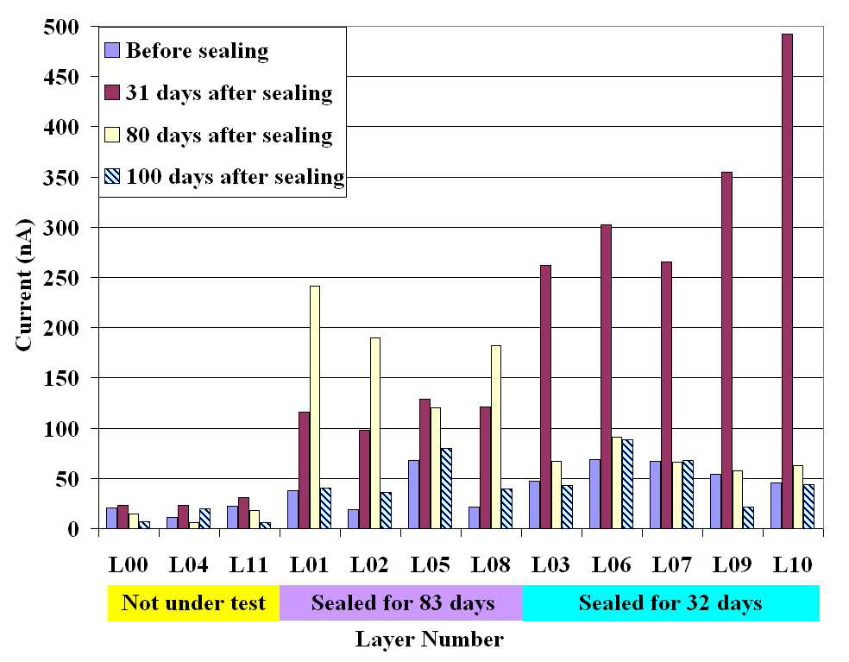
Study of gas sealed RPCs
If the RPC gas gaps are produced without leaks (less than 1.75 mm WC in more than 33 hours), then the detectors can be operated without appreciable degradation in their performance for more than a month with a single gas fill. The
cost of gas replenishing could thus be reduced considerably, by up to a factor of 30.

Slide 6
Gas purification process
Gas mixture quality: Presence of impurities in the return gas from the RPCs
Possible worsening of RPC performance due to impurities
Removal of water vapour by combination of 3A and 5A molecular sieves continuous duty purifier.
Removal of oil vapours by 3X molecular sieves
Removal of radicals (F⁻, HF etc.) by disposable activated Alumina
Removal of Oxygen by CuZn and Ni-NiO on activated Alumina/Silica by continuous duty purifier using standard cartridges
Final goal was to achieve the moisture and Oxygen levels to less than 2 ppm

Slide 7
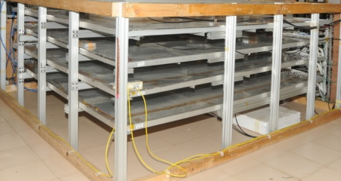
Line diagram of the close loop gas recirculation and purification system
Displacers
PT 2
Molecular Sieves
Molecular Sieves
Pneumatic Cylinders
Low pressure
Radical Remover
High pressure
Diaphragm
Pump
PT 1
Exhaust
Gas purifiers
Receiver tank inlet
PT 3
MFC 5
Hygrometer
Non-return valve
N₂ input
Bypass
Feeder valve
Vacuum
Pump
PT 6
Storage Tank Outlet
1
2
3
4
RPC stack (this part is outside the gas unit cabinet)
PT 5
Mass flow controllers
MFC 1,2,3,4
Exhaust
PT 4
MFC 6
Gas Mixing (On-line)
Gas Recirculation
Gas Purification system
Control System (PLC)
Low pressure regulator

Slide 8
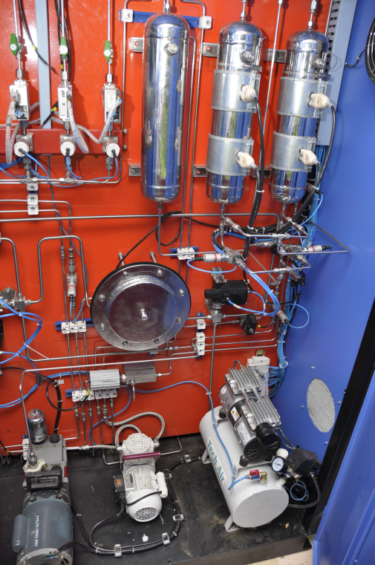
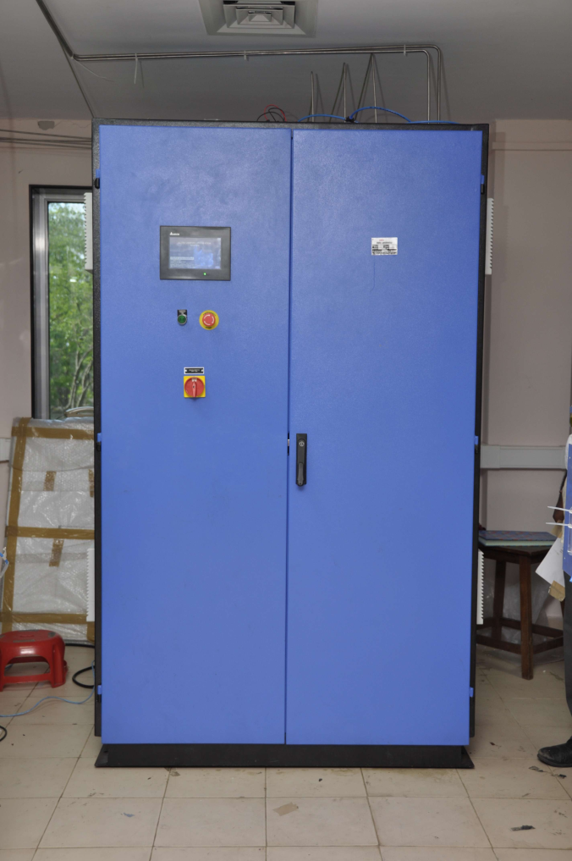
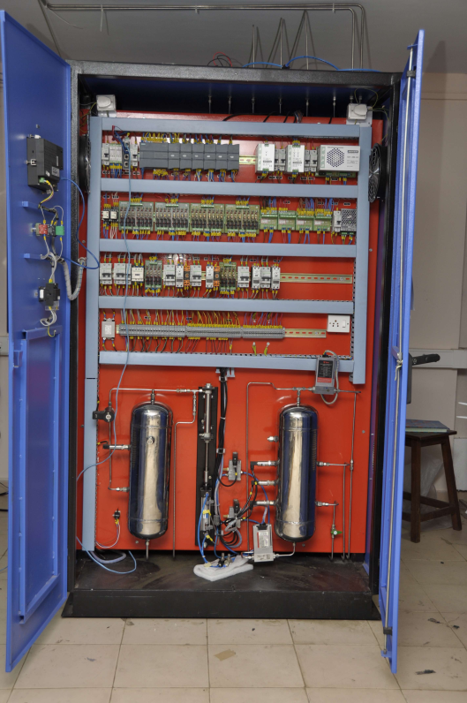
Some pictures of close loop gas system
Rear
Front

Slide 9
Design parameters of the pilot system
RPCs (12) →8litres x 12 = 96litres +20litres (main cylinder) +20litres (buffer cylinder)
Total Gas in the close loop system ~180litres
If filled at 10/20SCCM → will take1000 hours. So high filling rate of say 15litres/min → 10Hours is required.
Loop flow = 1litre per minute (80cc/RPC) and top up = 10cc
Positive pressure to be maintained for smooth gas flow through RPCs (1.006 bar to 1.009 bar, i.e. 3mbar difference).
Lab pressure changes between 1.004bar to 1.010bar twice a day.
Auto-refill starts at 1.150bar (set value)
Filled pressure (PT5) is 1.450 bar (set value)
Manual refill after evacuation (Fast refilling)
Provision for exhaust through MFC5

Slide 10
Some resulting numbers
Total gas volume in the system= 101 litres
  Main cylinder = 20litres, buffer cylinder = 20litres
  Three purifier cylinders = 3x15 = 45litres
  Two RPCs = 2x8 = 16Litres
Auto refilling pressure = 1.150bar, auto refill up to = 1.450bar, difference = 0.300bar
Volume of cylinder = 20litres, so gas refilled = 20 x 0.300 = 6litres.
We refill only 6 litres. So, we are filling only about 6 % of the total volume once in 20 days.

Slide 11
Performance of close loop system
Depends on maintaining pressure balance, flow rate and efficiency of purification process.
Depends very much on the leak integrity of RPC.
Both factors must be carefully addressed to achieve good efficiency of close loop recirculation.
Operates at very low pressure difference. Typically 10 to 20mmWC. Hence the system is sensitive to changes in the ambient room pressure.
Therefore removed the “High pressure to low pressure regulator” and capillary are connected at the input of RPCs
Removal of Contaminations: Air, Water vapour along with air and break down radicals specially of SF₆

Slide 12
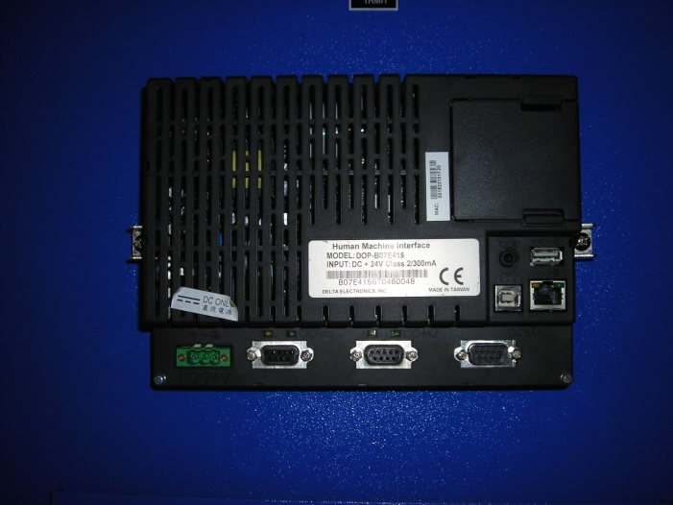
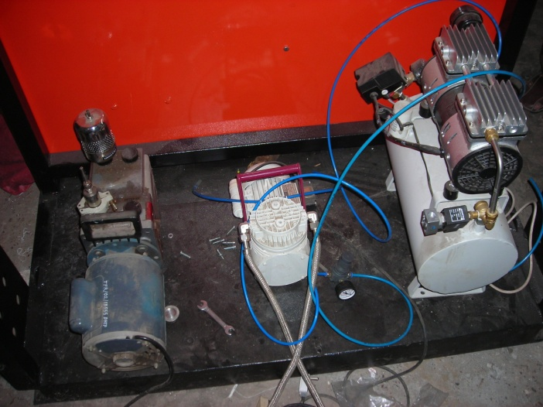
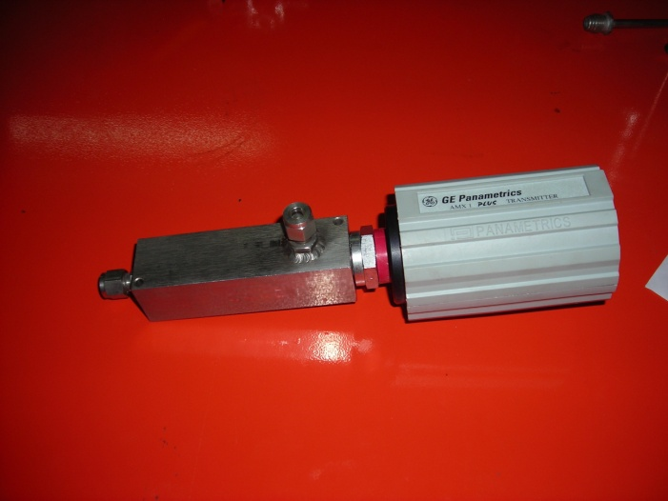
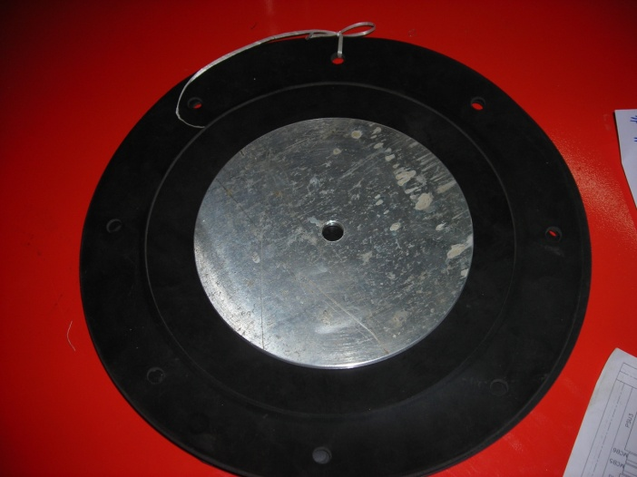
Some crucial parts of the system
PLC – CPU with Display
Vacuum- Suction-Compressor
Moisture Sensor + 20mA
Neoprene - Diaphragm

Slide 13
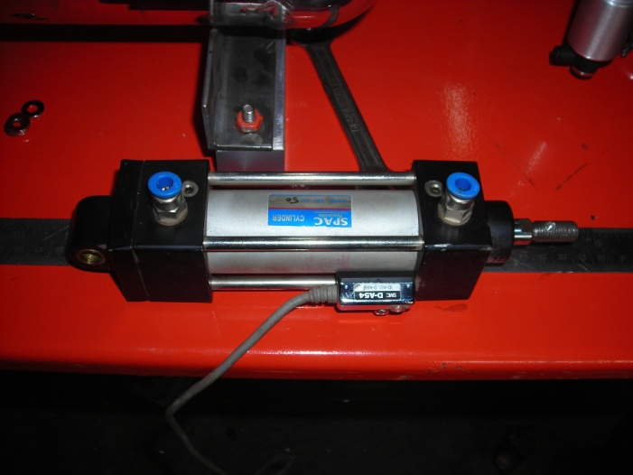
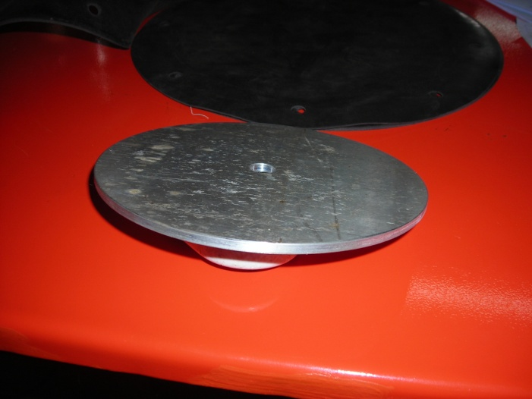
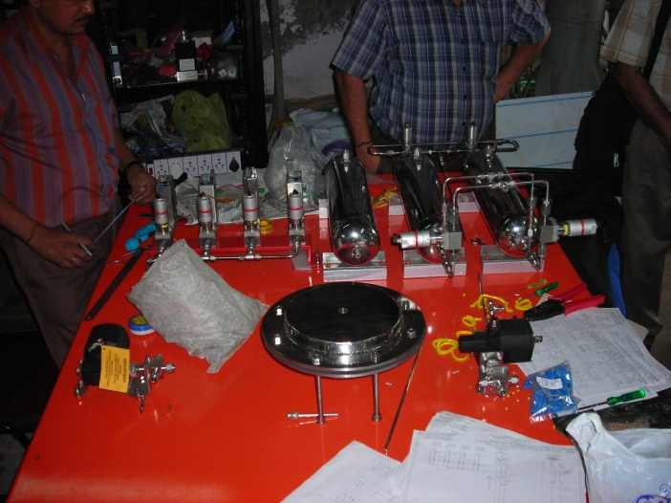
(High to Low) Pressure regulator
Regulates 3bar to 20/300mm WC with adjustable pin/handle on the top of the assembly

Slide 14
CLS with a leaky RPC: Refill in 20 hours!
AL10

Slide 15
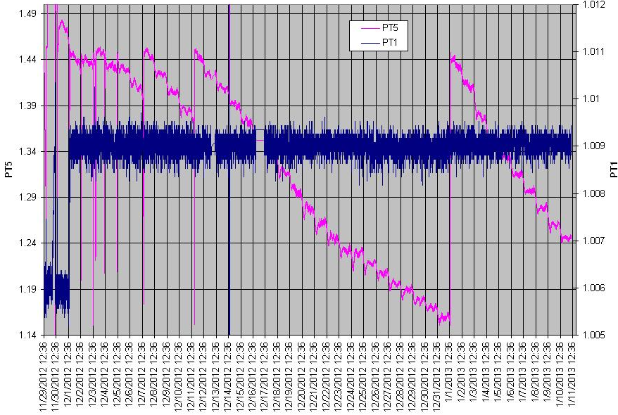
System with 2 RPCs auto-refill in 20 days

Slide 16
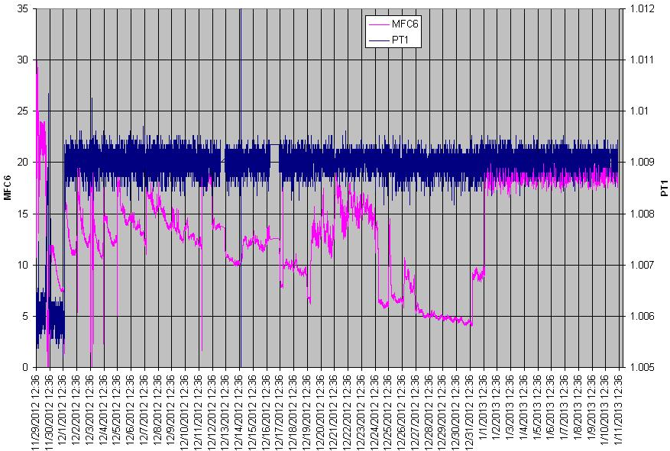
PT1 after closing CLS’s backdoor
Stable phase

Slide 17
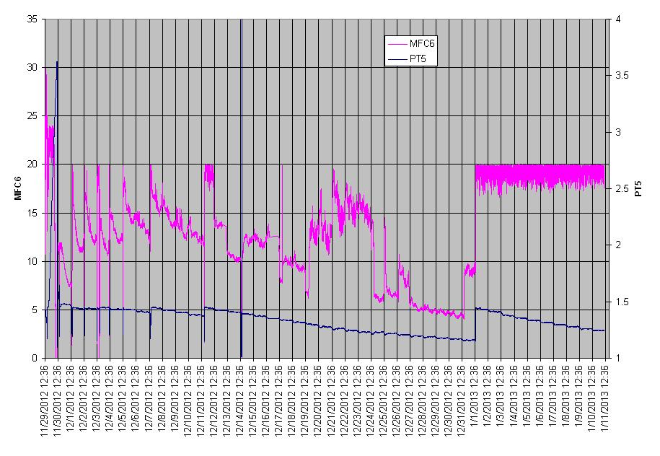
MFC6 after closing CLS’s backdoor
Stable phase

Slide 18
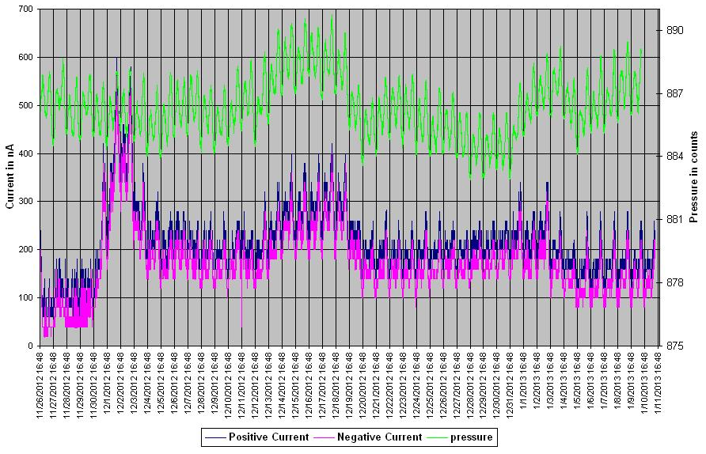
AL11: Pressure versus Chamber current
Stable phase

Slide 19
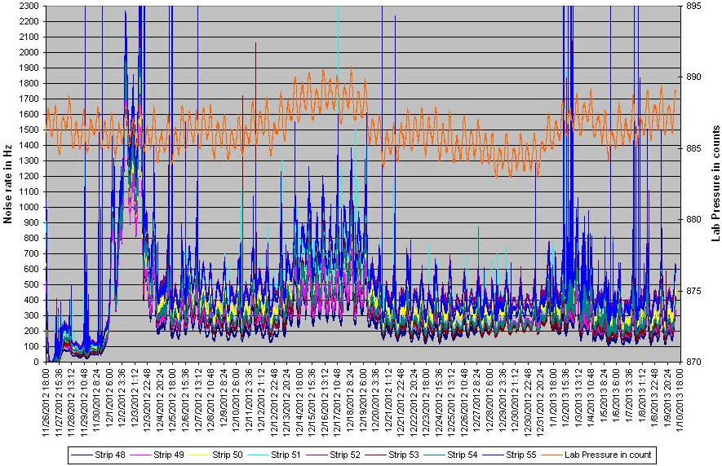
AL11: Pressure versus noise rates

Slide 20
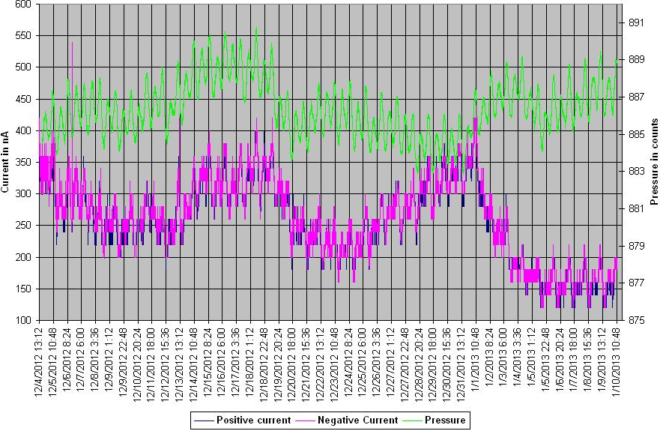
AL15: Pressure versus Chamber current
Stable phase

Slide 21
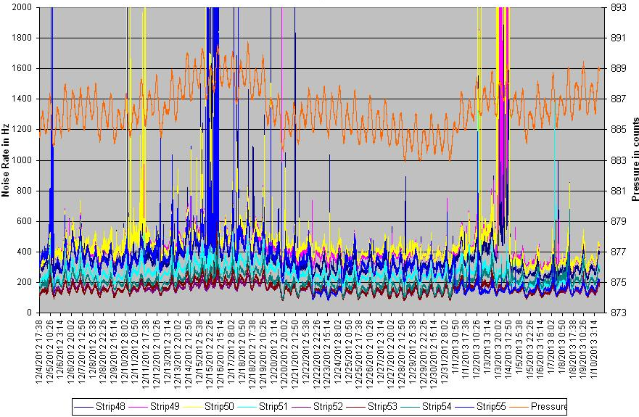
AL15: Pressure versus noise rates

Slide 22
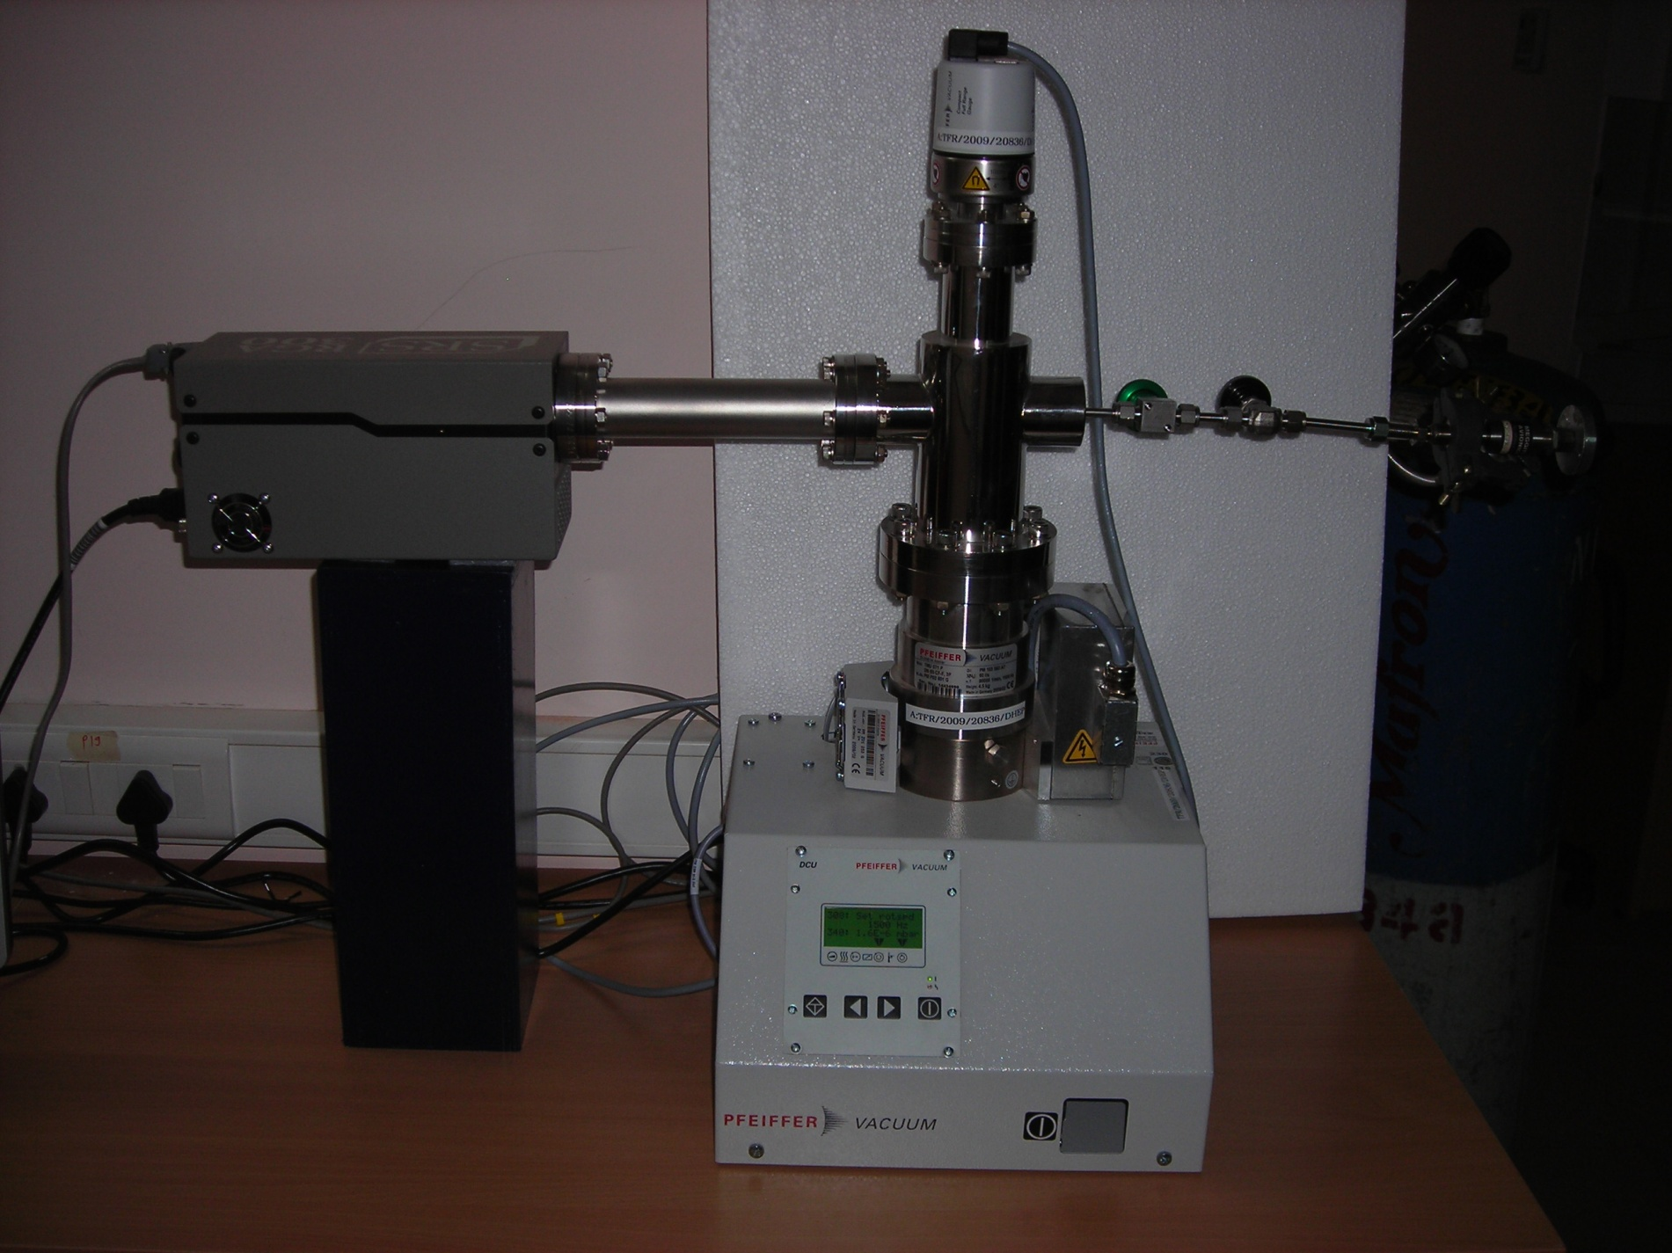
Residual Gas Analyser (RGA) Setup

Slide 23
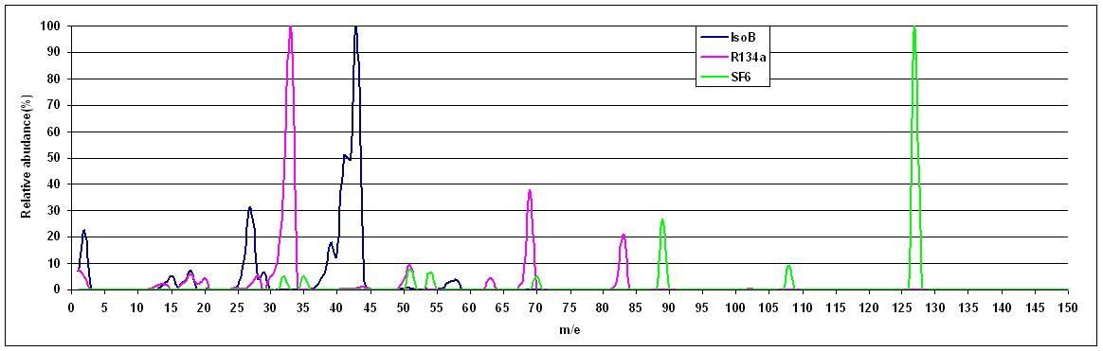
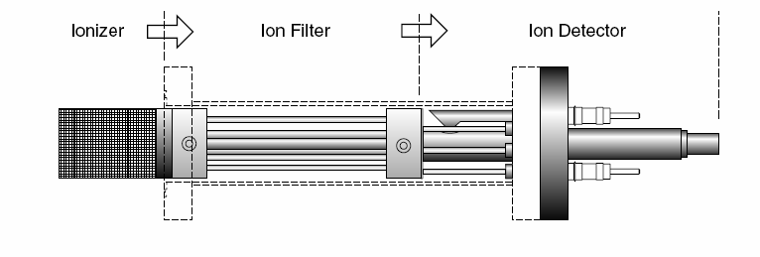
Typical RGA spectrum

Slide 24
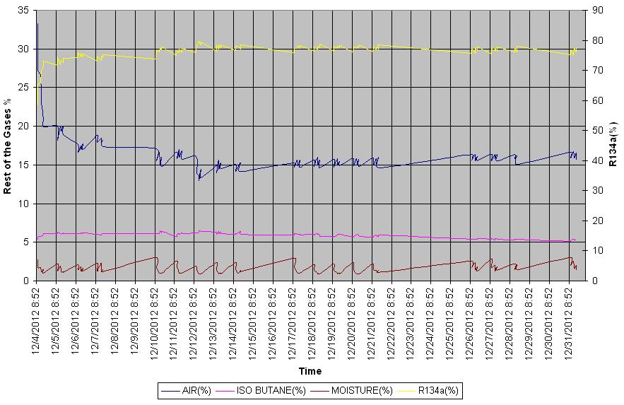
Monitoring using Residual Gas Analyser

Slide 25
Summary and future outlook
Basic process cycle control is working as per design.
So far 2 RPCs were installed in the close loop system.
All the RPC operating and performance parameters like current and noise rate; ambient parameters such as barometric pressure, temperature and relative humidity; host of closed loop system parameters like RGA, moisture etc. are being monitored round the clock and analysed.
The system is being fine tuned using the results from the monitor data
Found leak rate in the system to be less than 0.01bar
Moisture is found to be less than 2%
More RPCs are being added in the loop
Design of the scaled up version for the ICAL engineering module is in progress

Slide 26
Backup slides

Slide 27
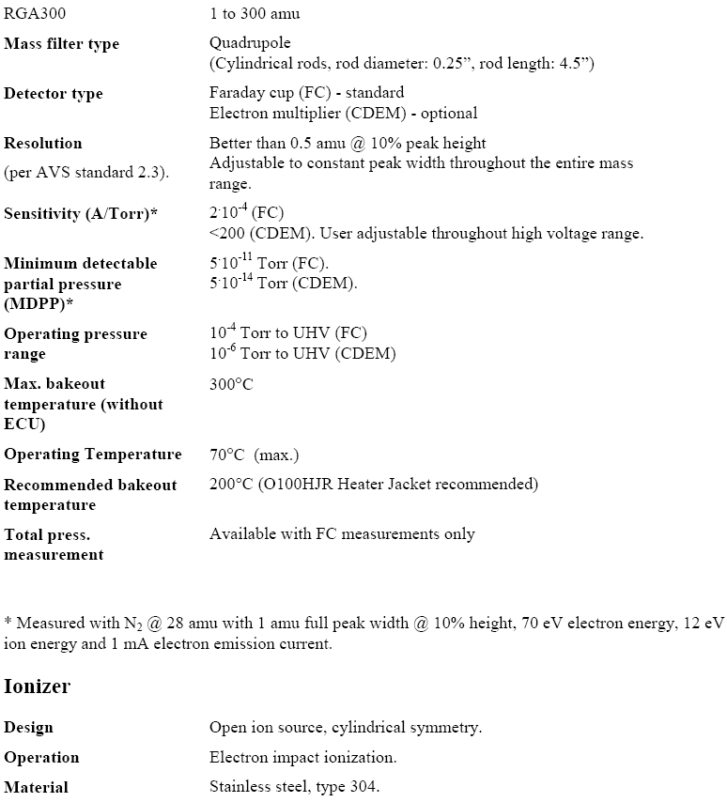

Slide 28
Why FLOW Rate ? : velocity distribution (m/s) for 1mX1m RPC , 0.2 Volume changes/day

Slide 29
Case (2) : velocity distribution (m/s) for 1mX1m RPC , 0.5 Volume changes/day

Slide 30
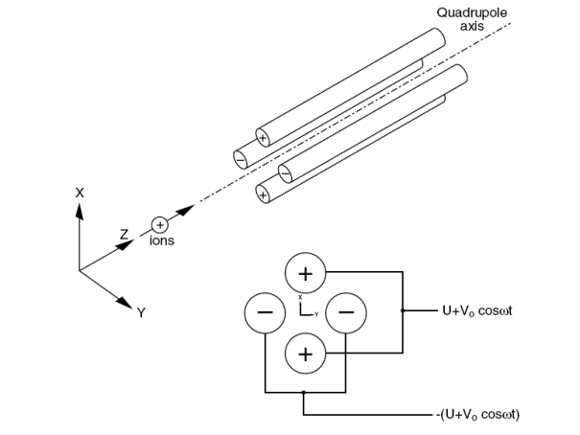
RGA Operation

Slide 31
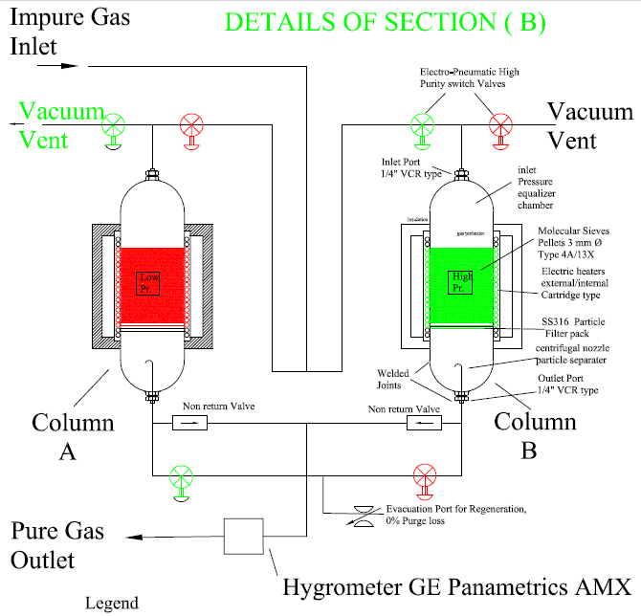
Dual :Purifier section

Slide 32
Catalysts and Adsorbents
Molecular Sieves: Trap gas molecules of particular size
Sodium, Potassium, Calcium, Aluminum Silicate are used in different proportions to formulate the following sieves:
  Type 3A to trap moisture [23% w/w maximum]
  Type 4A to trap Argon [Absence of moisture]
  Type 5A to trap n-Butane
  Type 3X to trap oil vapours
  Activated Aluminum to remove radicals such as F-, HF etc.
Catalysts
  Activated Alumina + Palladium to promote condensation of IsoButane (Adsorption surface ~200 m²/gm)
  Activated Carbon to Adsorb Isobutane
  Zirconia based Zeolites (ZSM) to promote Isobutane-n Butane conversions
  Silica gel: Wide range of pore size, good for water adsorption (Chemically bonds Water)

Slide 33
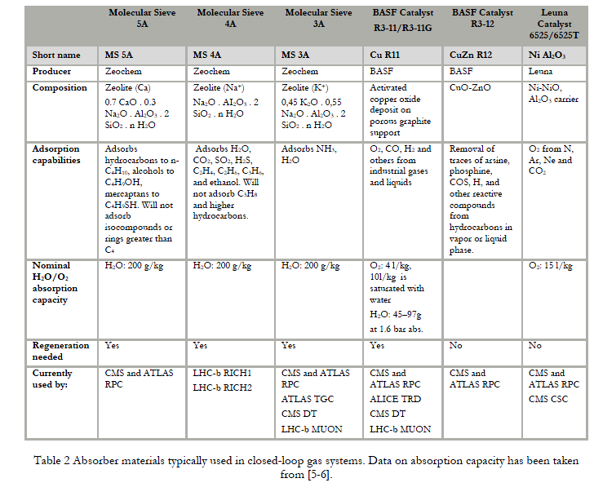

Slide 34
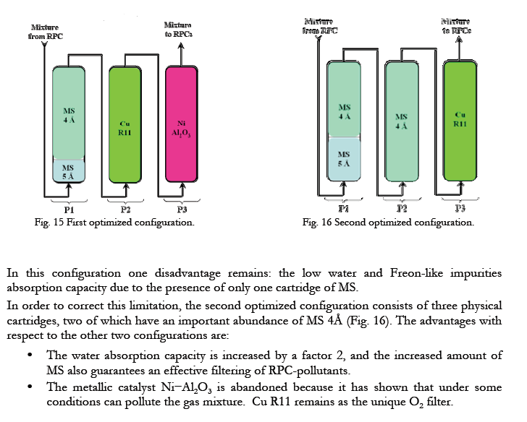

Slide 35

Equation for Gas Leak

Slide 36
Leak test by pressure drop scheme
RPC volume (V1): 8000 cc, Pressure (P1): 1020mbar Abs
Reference Pressure (P2): 1000 mbar Abs
Gas content = P1 X V1/P2 = 8160 cc
If 1 cc gas leaks out, effective gas content will be 8160-1 = 8159 cc
After 1 cc leakage RPC pressure will drop to
8159 X 1000/8000 = 1019.875 mbar
Pressure drop is 0.175 mbar equivalent to 1.75 mm water column
The target leak rate being 5x10e-4 SCCM , 1 cc leak should take 1/ (5x 10e-4) or 2000 min. (nearly 33 hrs)
The acceptance criteria therefore:
“ Pressure drop of less than 1.75 mm WC in more than 33 Hrs.”

Slide 37
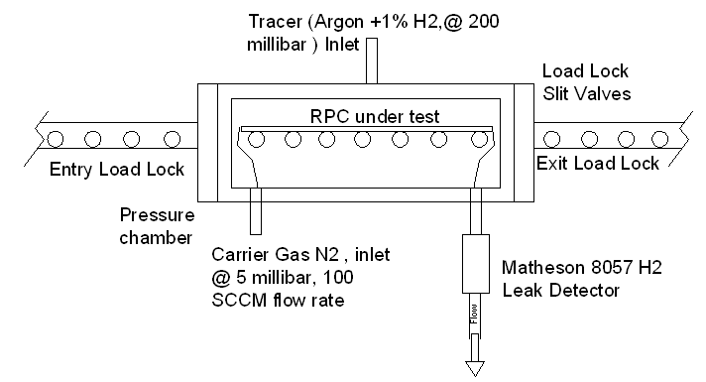
Automated Leak Test Bench for RPCs

Slide 38
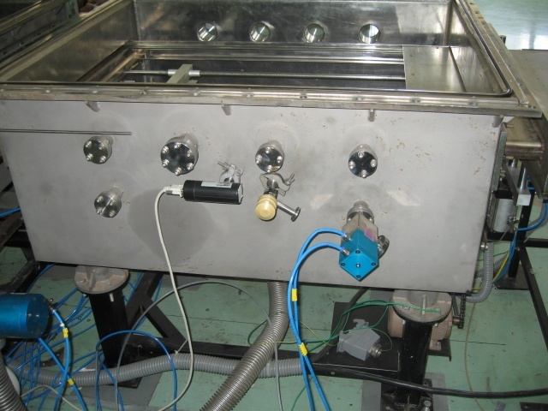
Transfer and test system for
1m X 1m detector

Slide 39
Properties of Gases
PARAMETER | UNIT | R134a (C₂H₂F₄) | ISOBUTANE (C₄H₁₀) | ARGON (Ar) | SULPHUR HEXA FLUORIDE(SF₆)
MOL. WT | gm/mole | 102.3 | 58.12 | 39.948 | 146.05
STRUCTURE |  | RING | RING | ------ | RING
GAS DENSITY | Kg/M³ | 4.25 | 2.82 | 1.78 | 6.27
LIQUID DENSITY | Kg/M³ | 1206 | 593 | 1400 | 1880
VISCOSITY | cP | 0.012 | 0.006 | 0.02 | 0.015
BOILING Pt. | °C | -26.3 | -11.7 | -185.8 | TRIPLE PT: -49.4, 2.2BAR SUB. PT: -63.9
HEAT OF VAPOURIZATION | KJ/MOL | 22.021 | 23.300 | 6.43 | 23.681
CRITICAL TEMP. | °C | 101.1 | 134.9 | -122.13 | 45.5
CRITICAL PRESSURE | BAR A | 40.6 | 36.84 | 48.98 | 37.59
GLOBAL WARMING POTENTIAL | CO₂=1 | 4200 | ----- | ----- | 22400
PURITY LEVEL USED | % | 99.8 | 99.9 | 99.999 | 99.9
IMPURITIES |  | O_{2,}H₂O N₃,CF₄ | CH₄,H₂, H₂O,N₂ | N₂,O₂,H₂O,HC | H₂O,O₂,CF₄

Slide 40
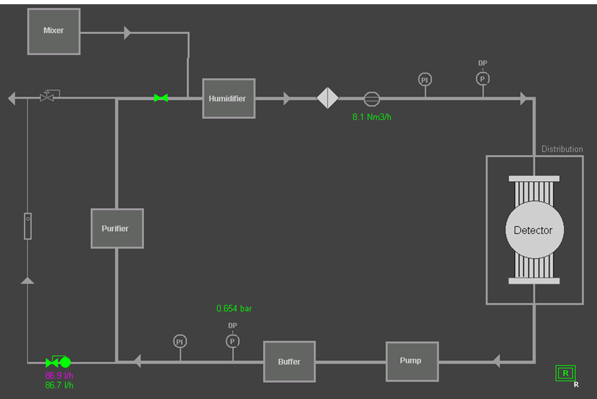
Typical Closed Loop System

Slide 41
Basic Components
Moisture sensor, Pan metrics
Oxygen sensor , GE sensing
PLC Siemens
Sequence controller
Completely Automated

Slide 42
Partial Pressure
Required Gas concentrations:
Say Fr(95%)+Iso(4.5%)+SF6(0.5%)
Evacuate the cylinder (20Ltrs.) to 10⁻¹Torr
Pressure after mixing =2 Atmosphere (Abs).
P_{Fr} +P_{Iso}+P_{SF6}=2 Atmp.[10000cnts on display]
P_{SF6}=2Atmp X 0.5%=0.01Atmp[50cnts]
P_{Iso}=2 Atmp X 4.5%=0.09Atmp[450cnts]
P_{Fr}=2 Atmp X95%=1.9 Atmp[9500Cnts]
If 10000 cnts➔2atmp.
Heater ~0.5W gives turbulence to the gas molecules and get mixed properly

Slide 43
Features and Functions
Completely automated system using SEIMENS PLC’s
Process control cycle (pumping, flow rate through RPC, topping of gas, regulating valves and sequencing is maintained, bias pressure control etc.)
Lab pressure changes between 1.004 to 1.010bar twice a day.
Typical flow rates are 20SCCM to 100SCCM

Slide 44
MIXING UNIT
This system will have dual supply of mixed gas viz. one for fast fill of the gas in the closed loop system say about 90LPM to fill the gas in loop, which is about 180Liters and the second one with 50 to 100 SCCM (flow need to be understood) to replenish the exhaust gas which will be on-line. This study will tell us the optimum or number of volume changes of gas needed.

Slide 45
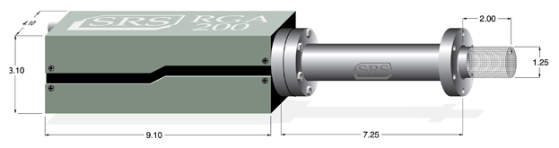
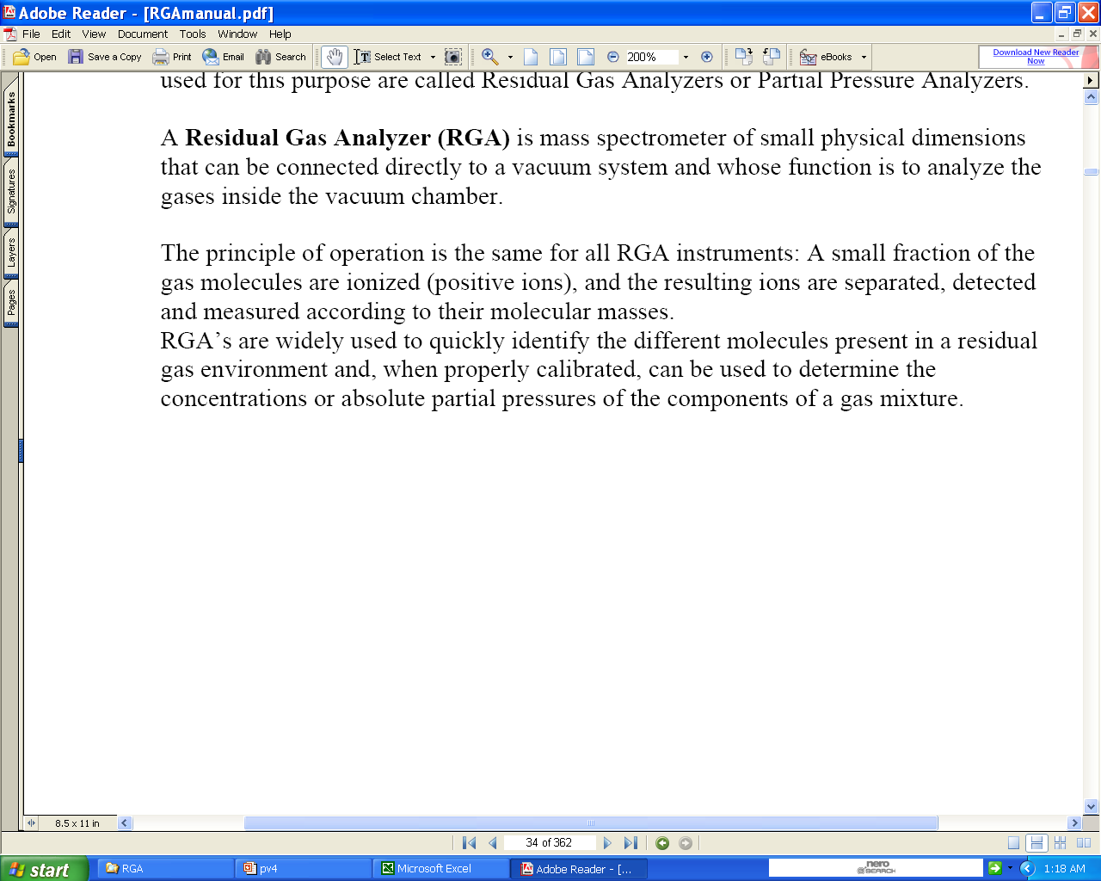
RGA:Vacuum Analysis Mass spectrometer
Stanford Research Systems
RS-232c Interface
Dual Thoriated-Iridium Filament

