Slide 1
Constant Fraction Discriminators
B.Satyanarayana

Slide 2
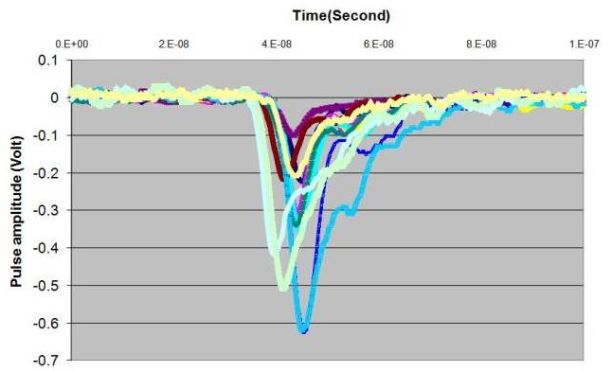
HMC preamp output pulses
Rise time: 2 to 3ns
Pulse height: 100-500mV

Slide 3
Considerations for discriminators
Two common problems
  Walk (due to variations in the amplitude and rise time, finite amount of charge required to trigger the discriminator)
  Jitter (due to intrinsic detection process – variations in the number of charges generated, their transit times and multiplication factor etc.)
Time-Pickoff methods
  Leading edge triggering
  Fast zero-crossing triggering
  Constant fraction triggering
  Amplitude and rise time compensated triggering

Slide 4
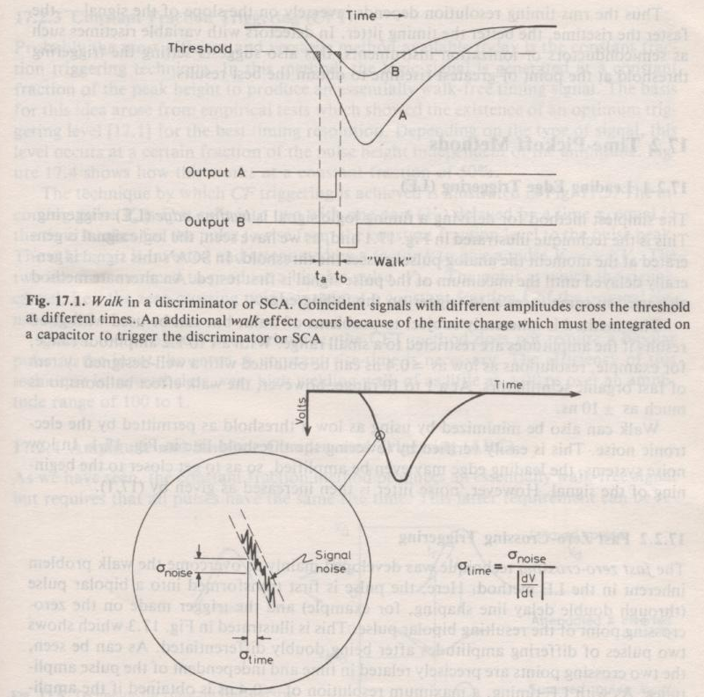
Timewalk and jitter

Slide 5
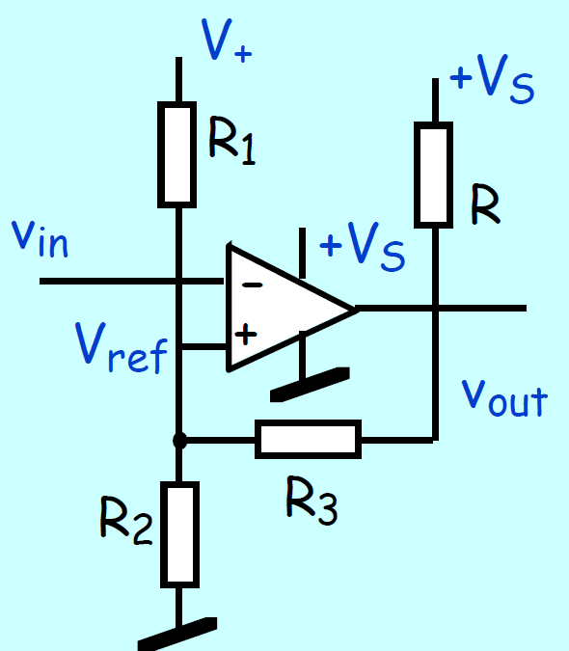
Leading edge discriminators
Fine with if input amplitudes restricted to small range.
For example:
  With 1 to 1.2 range, resolution is about 400ps.
  But at 1 to 10 range, the walk effect increases to ±10ns.
That will need off-line corrections for time-walk using charge or time-over-threshold (TOT) measurements.

Slide 6
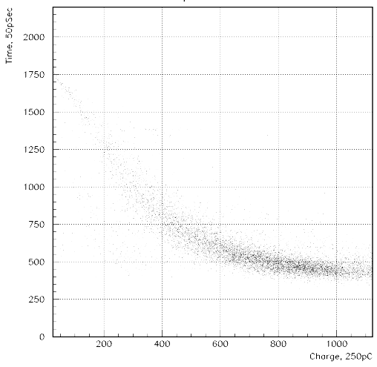
Off-line corrections of time-walk

Slide 7
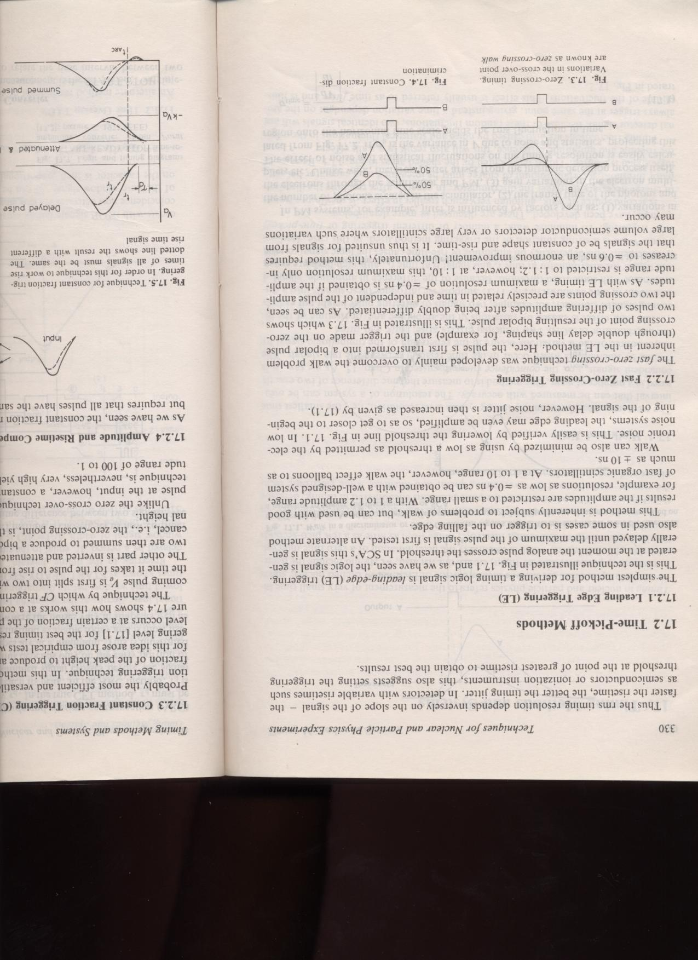
Zero-crossing and Constant fraction
Zero-crossing Triggering:
  Timing resolution 400ps, if amplitude range is 1 to 1.2
  Timing resolution 600ps, even if the amplitude range is 1 to 10
  But, requires signals to be of constant shape and rise-time.

Slide 8
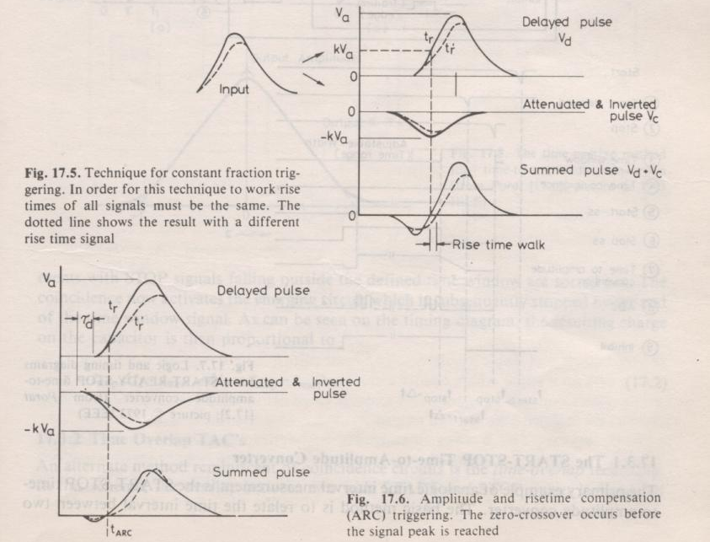
CF and ARC triggering

Slide 9
CFD technique
The particular fraction desired in a CFD determines the amount of attenuation of the attenuated input signal.
If the delay is chosen correctly, the CF will fire at the place where the maximum of the attenuated signal crosses the delayed signal.
That point will be at a constant fraction of the delayed signal amplitude.
The relationship between delay and rise time in such a case is: t_{d} = t_{r} (1- f ) ,
where f is both the fraction desired (usually .2) and the attenuation factor of the input signal.
If the delay is set to a value less than the shortest anticipated risetime, walk can be eliminated even when signals have varying rise-times.
In what follows, f will only represent the attenuation of the input signal.
If the input signal is simulated by a linear ramp, its equation is P_{i} = -mt .
The attenuated signal is then P_{a} = - fmt , and the delayed signal is P_{d} = -m(t - t_{d} ).
We want to set P_{a} = P_{d} and solve for t , which results in t_{c} = t_{d} / (1 - f)
Note that this is independent of the slope m (and thus risetime).
The amplitude fraction F in this general case can be found by calculating the ratio of p_{d} evaluated at the crossing time to the maximum value of P_{d} :
F = -m (t_{c} – t_{d}) / -mtr = ft_{d} / t_{r}(1 - f)

Slide 10
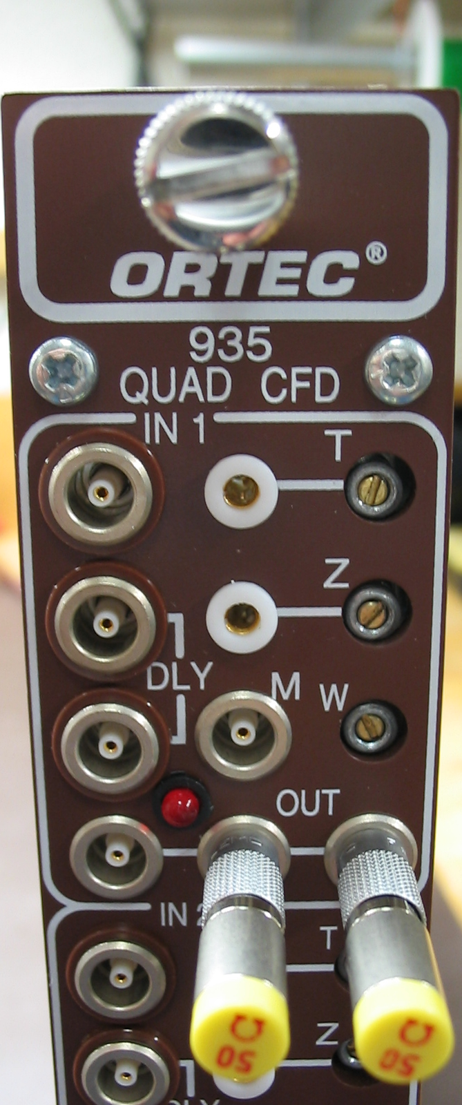
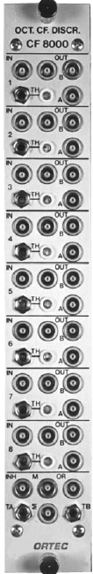
ORTEC CFDs
• Good time resolution with a wide range of pulse amplitudes
• Internal delay — no cable Necessary
• Automatic walk adjustment.
• Multiplicity and OR logic outputs
• Analog sum output
• Inhibit input
• ECL outputs
• Energy outputs
The constant-fraction ratio is factory set at 0.4.

Slide 11
References
W.R.Leo, Techniques for Nuclear and Particle Physics Experiments, 2nd ed., Narosa Publishing House.
J. Bialkowski et al, Remarks on constant fraction discriminators applied for BaF2 crystals, NIM A281 (1989) 657-659.
ORTEC manuals.

