Slide 1
Tracking the tiniest particles
Neutrino is the most tiny quantity of reality ever imagined by a human being.
Frederick Reines
Co-discoverer & Nobel Laureate
B.Satyanarayana
Department of High Energy Physics

Slide 2
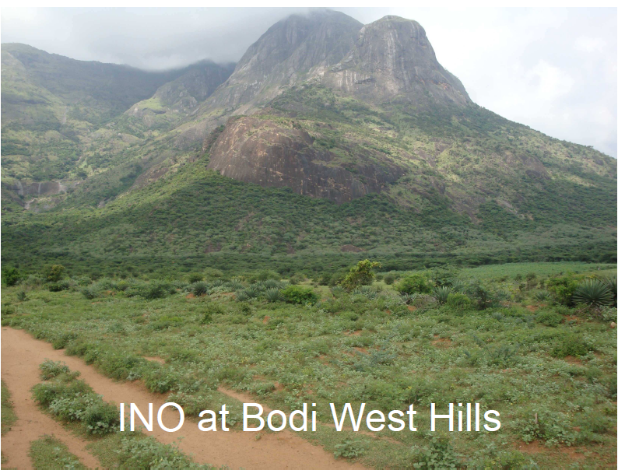
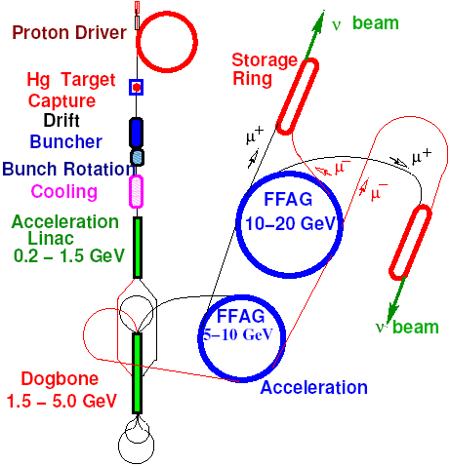
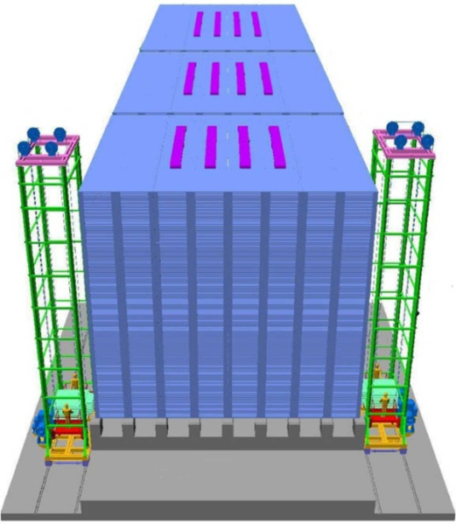
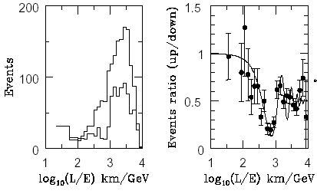
Overview and Status of India-Based Neutrino Observatory Prof. N.K.Mondal, DHEP, TIFR ASET Colloquium, 3rd July 2009

Slide 3
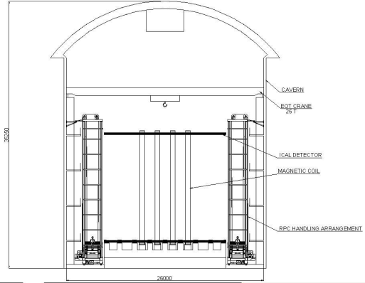
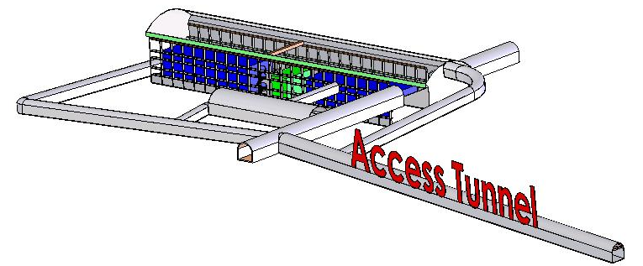
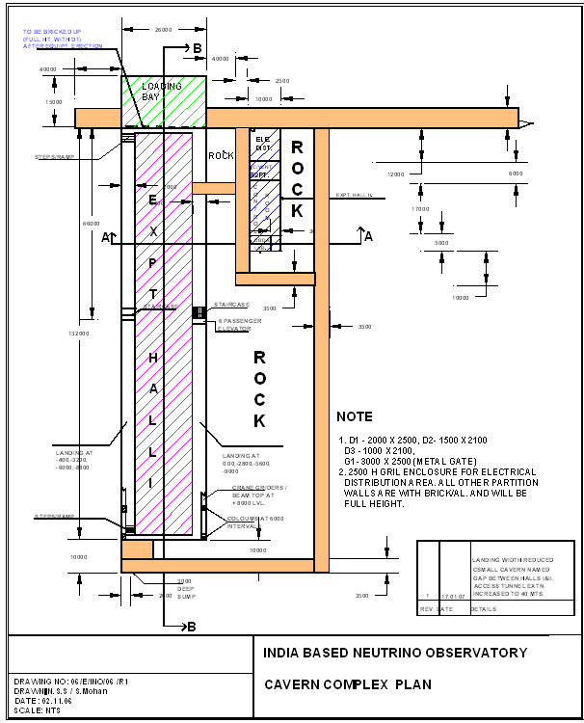
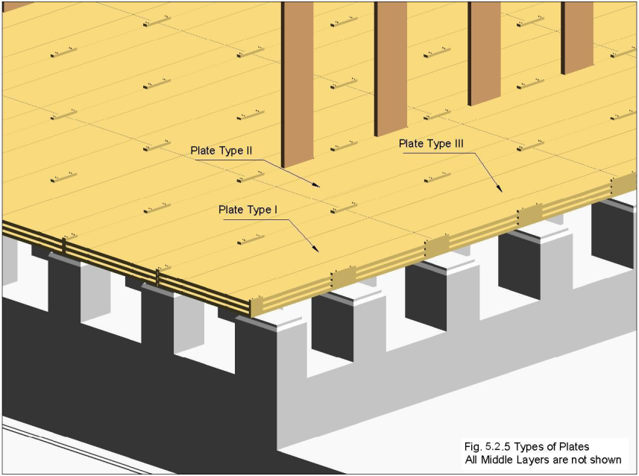
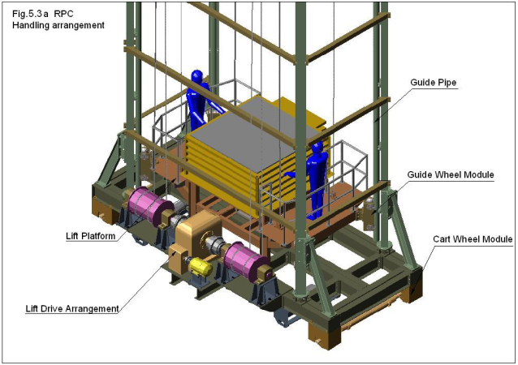
Mechanical structure of INO's ICAL detector Mr. Piyush Verma, DHEP, TIFR ASET Colloquium, 17th July 2009

Slide 4
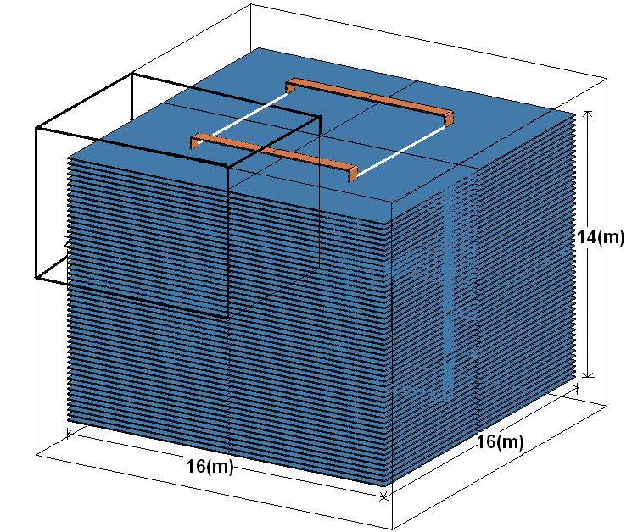
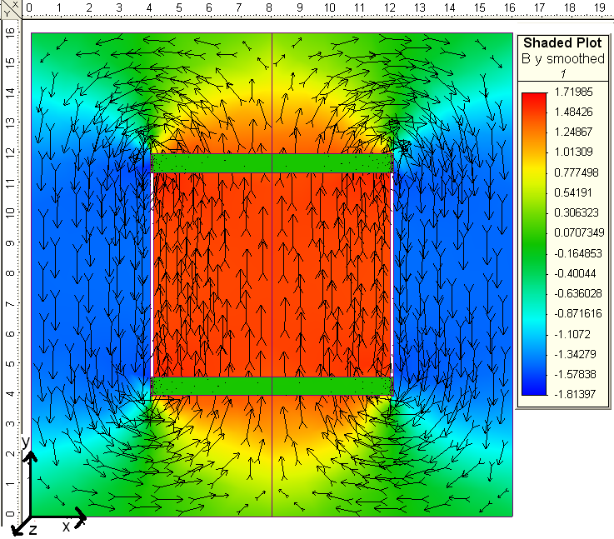
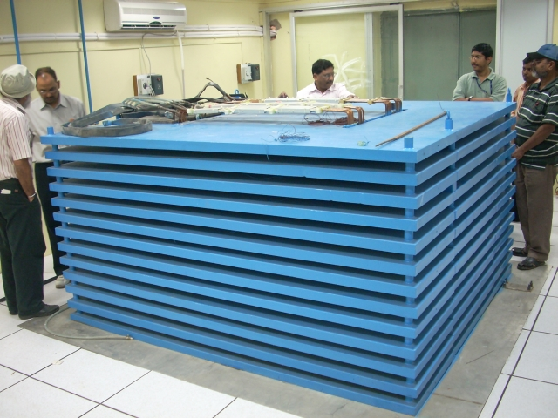
The ICAL magnet at the India based Neutrino Observatory Prof. V.M. Datar, NPD & Prof. M.S. Bhatia, LPTD, BARC ASET Colloquium, 28th August 2009

Slide 5
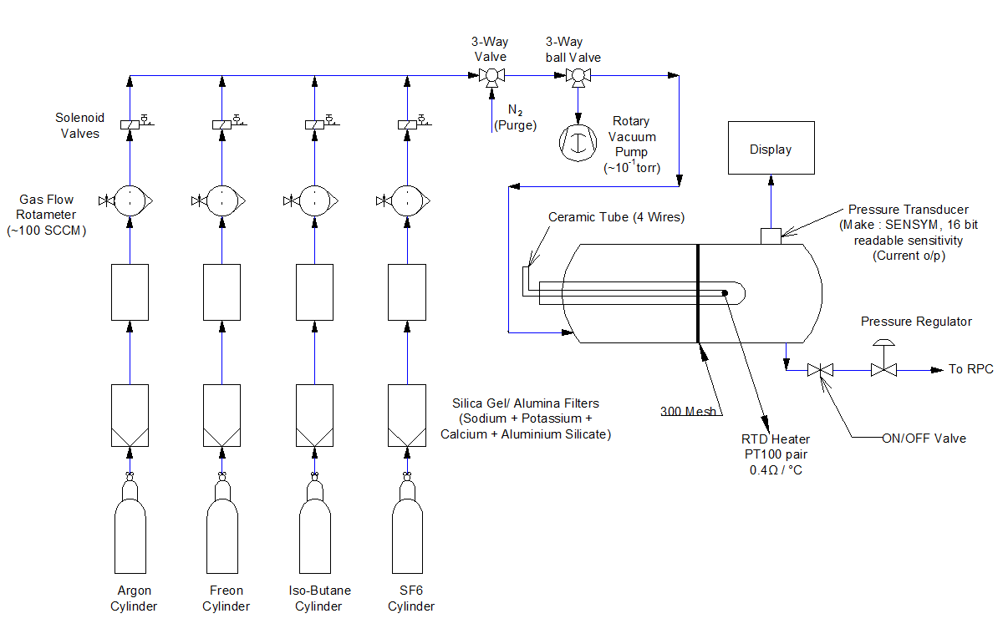
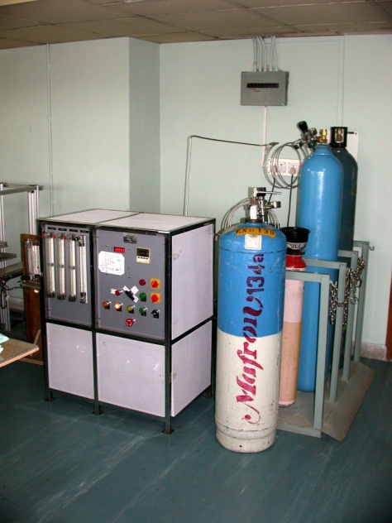
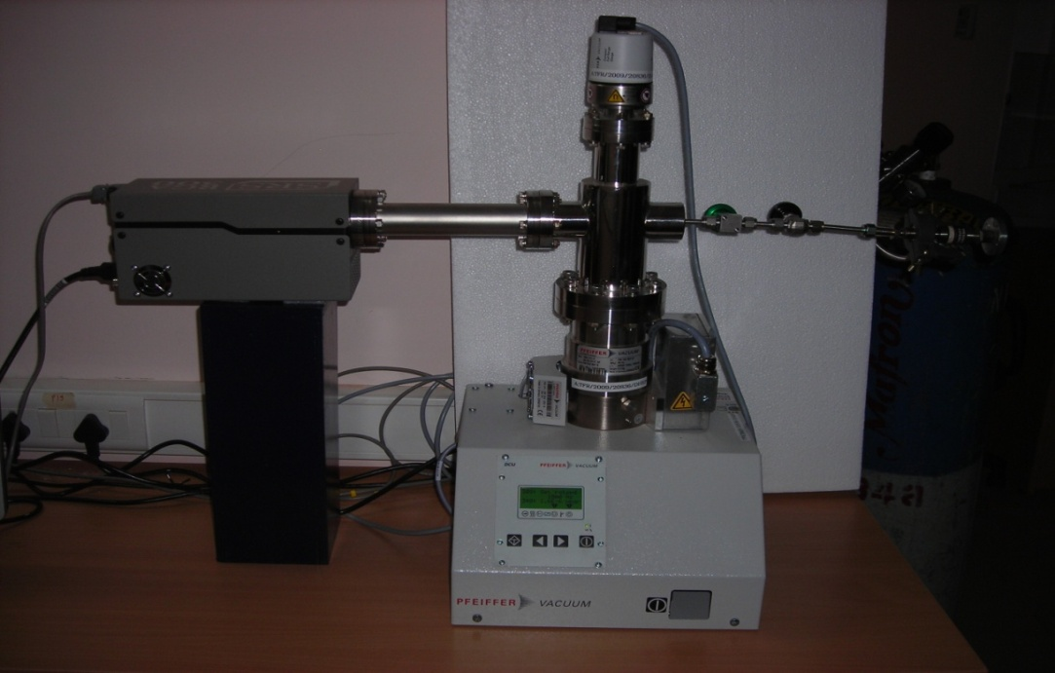
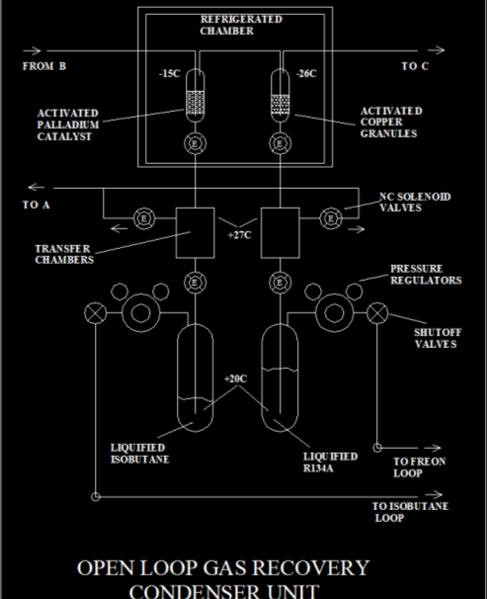
Large scale gas systems for the INO ICAL detector Mr. S.D. Kalmani, DHEP, TIFR ASET Colloquium, 25th September 2009

Slide 6
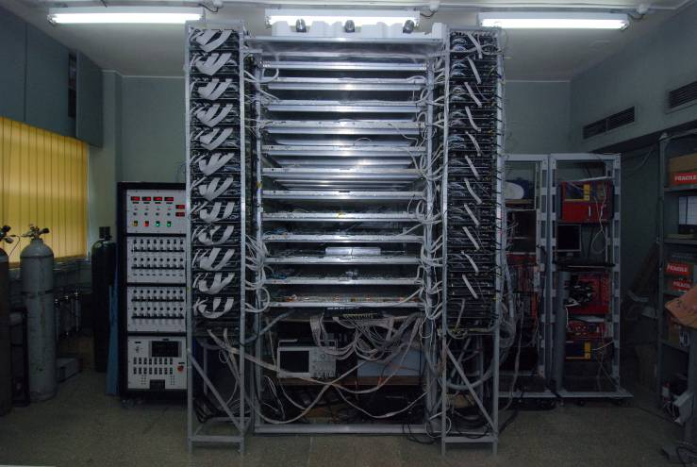
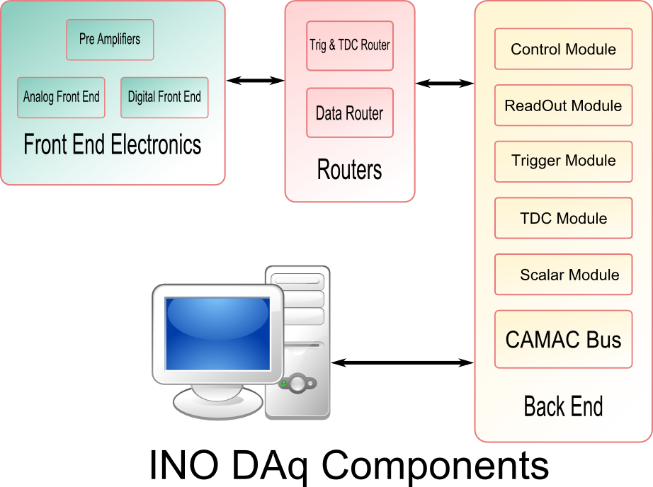
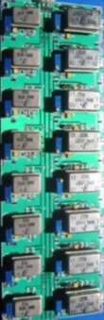
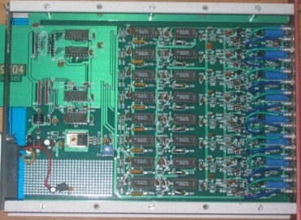
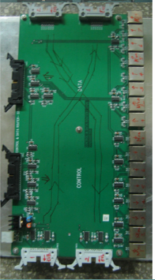
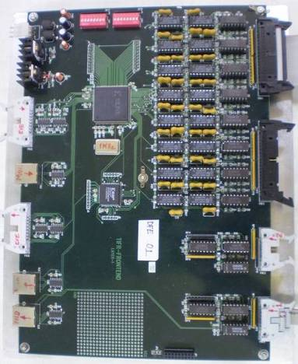
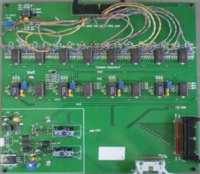
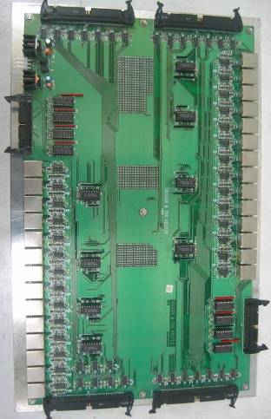
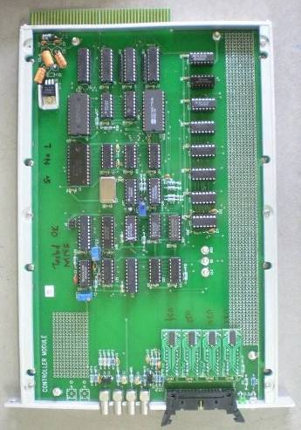
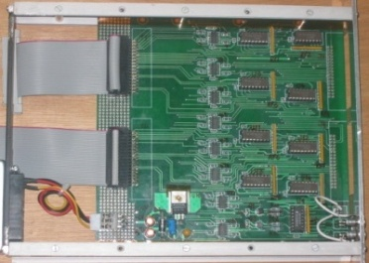
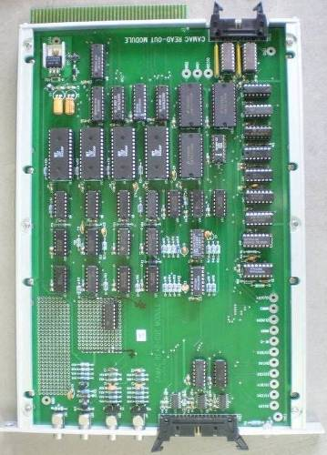
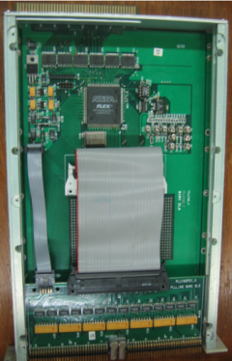
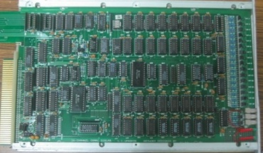
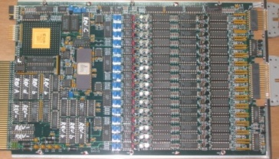
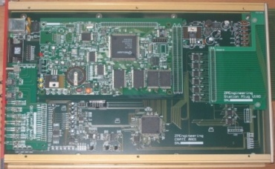
Electronics & DAQ system for INO-ICAL prototype detector Mr. S.S.Upadhya, DHEP, TIFR ASET Colloquium, 16th October 2009
6

Slide 7
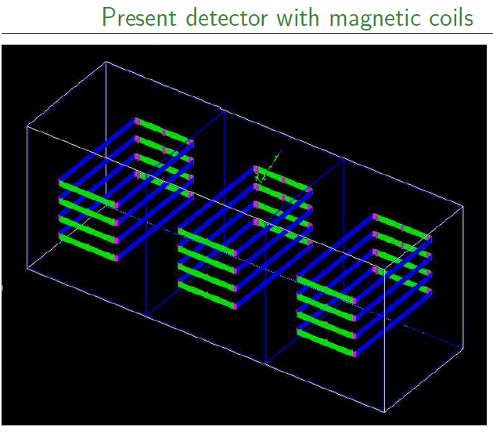
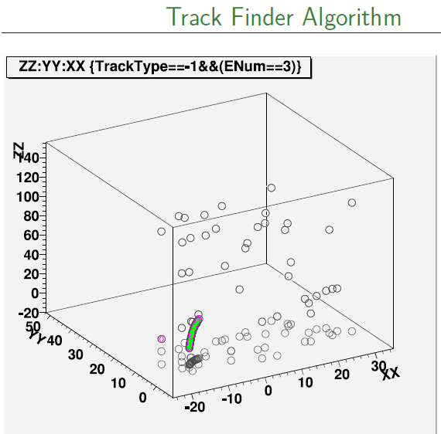
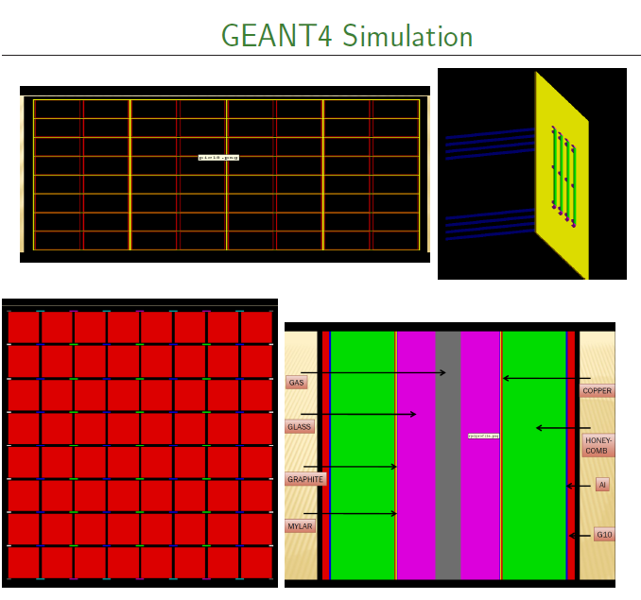
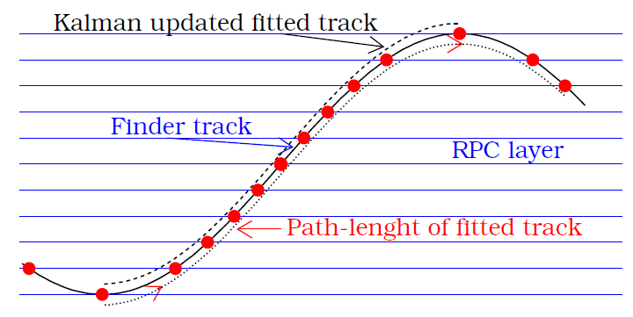
Status of the INO simulation and reconstruction software Prof. Gobinda Majumder, DHEP, TIFR ASET Colloquium, 22nd January 2010

Slide 8


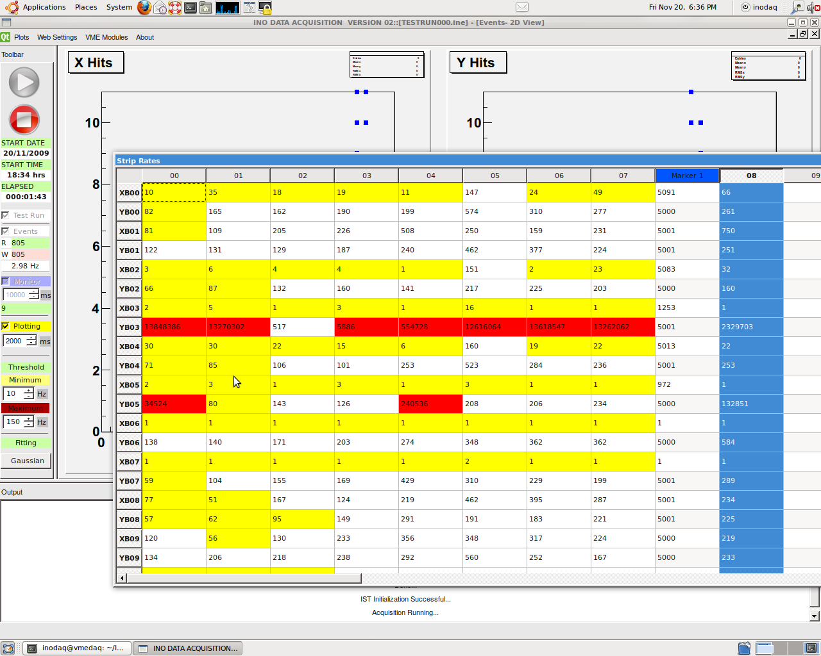
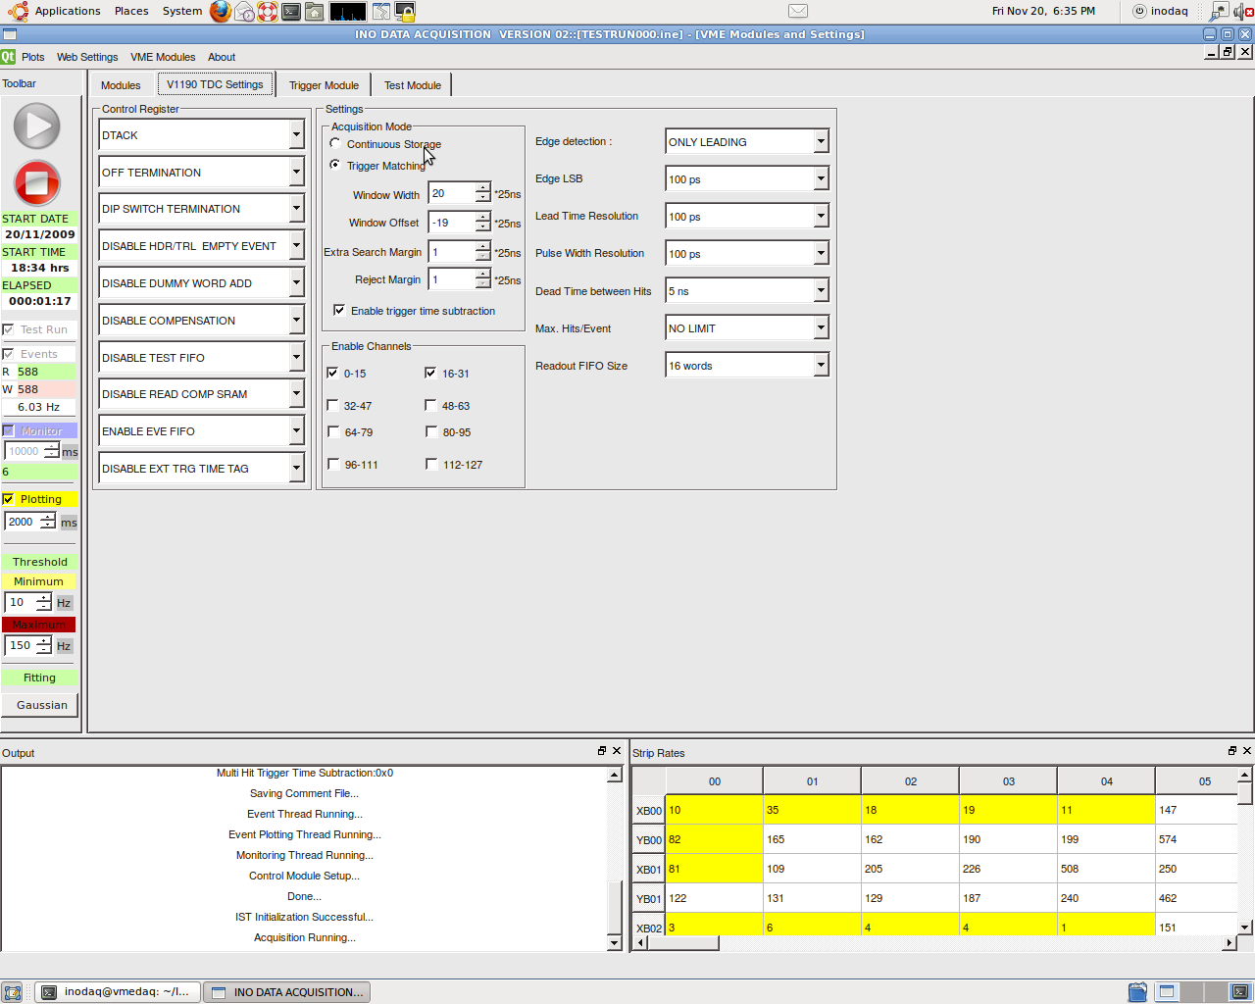
Design and development of software tools for INO Dr. Deepak Samuel, DHEP, TIFR ASET Colloquium, 26th February 2010
Wait on Interrupts
IPC-Trigger
Event Thread
Monitor Thread
Read IRQ Vector
Write Data to Shared Circular Buffer
Read Scaler/ TDC, Event Information

Slide 9
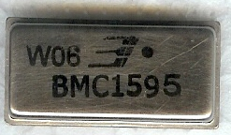
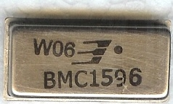
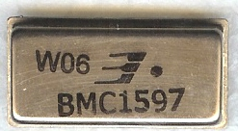
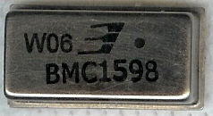
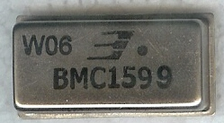
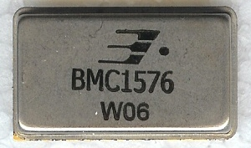
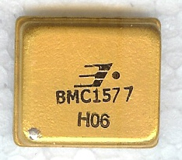
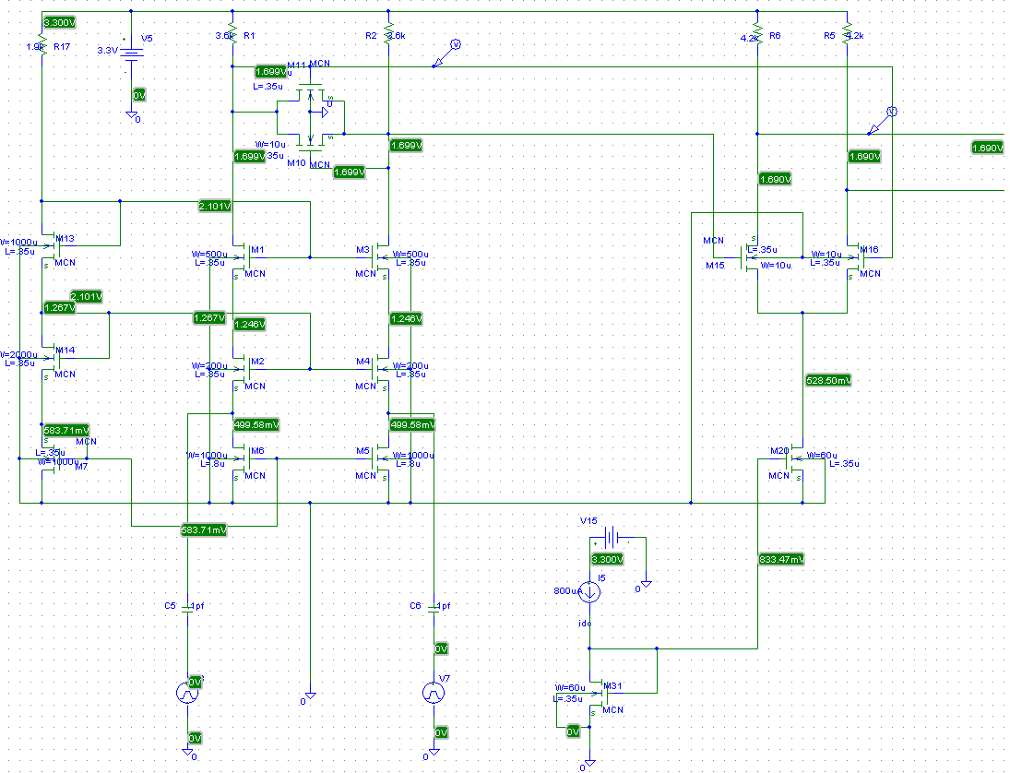
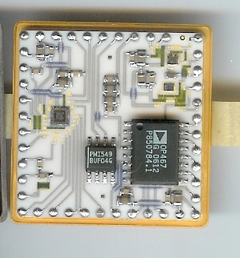
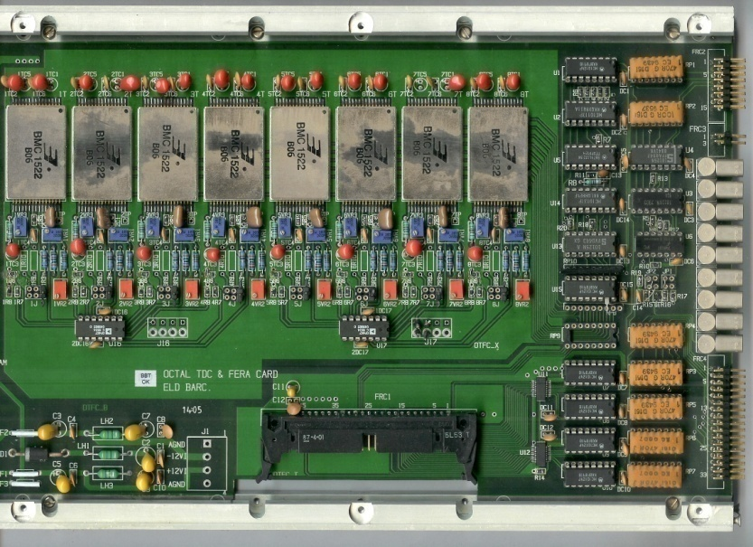
Modernising nuclear instrumentation - Indigenous efforts Mr. V.B.Chandratre, ED, BARC ASET Colloquium, 19th March 2010

Slide 10
Plan of the talk
Signal production in RPC
Front-end electronics
DAQ system requirements and architectures
Timing sub-system
Rate and ambient parameter monitors
Pulse shape monitor
Back-end system issues
Power supplies
Summary and future outlook

Slide 11
Signal production in RPC
Part - 1

Slide 12
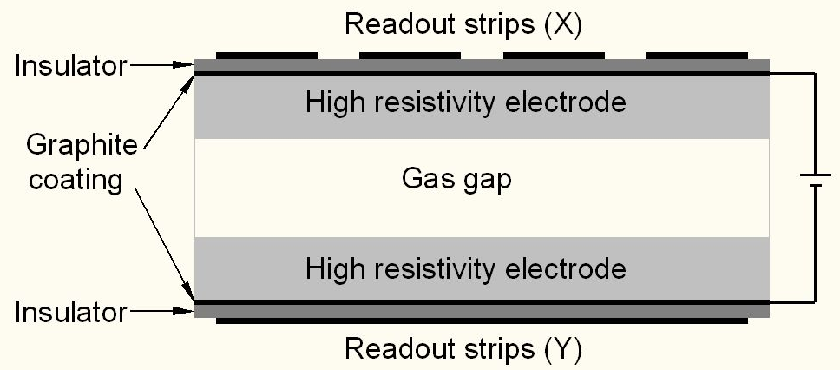
Schematic of a basic RPC

Slide 13
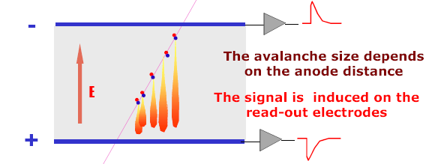
Signal development in an RPC
Each primary electron produced in the gas gap starts an avalanche until it hits the electrode.
Avalanche development is characterized by two gas parameters, Townsend Coefficient (α) and Attachment coefficient (η).
Average number of electrons produced at a distance x, n(x) = e^{(α− η)x}
Current signal induced on the electrode, i(t) = E_{w} • v • e₀ • N(t) / V_{w}, where E_{w} / V_{w} = ε_{r} / (2b + dε_{r}).

Slide 14
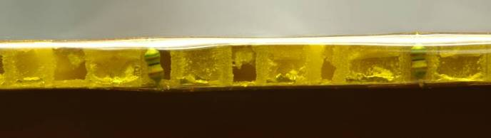

Honeycomb pickup panel
Terminations on the non-readout end
Machined pickup strips on honeycomb panel
Preamp connections on the readout end

Slide 15





Measurement of Z₀
48 Ω
Open
100 Ω
51 Ω
100 Ω

Slide 16

HMC based preamplifier

Slide 17

Post amplifier RPC pulse profile

Slide 18


Characteristics of RPC pulse
σ_{t} = 1.7nS
μ = 375fC

Slide 19
Front-end electronics
Part - 2

Slide 20
Front-end specifications
No input matching circuit needed, HCP strips give ~50Ω characteristic impedance
Avalanche mode, pulse amplitude: 2.5 -3mV
Gain (100-200, fixed) depends on the electronic noise obtainable
No gain needed if operated in streamer mode, option to by-pass gain stage
Rise time: < 500ps
Discriminator overhead: 3-4 preferable
Variable V_{th} for discriminator ±10mV to ±50mV
Pulse shaping (fixed) 50-100nS
Pulse shaping removes pulse height information; do we need the latter?

Slide 21
Functional diagram of the FE ASIC
Common threshold
Ch-0
Regulated Cascode Transimpedance Amplifier
Differential Amplifier
Comparator
LVDS output driver
LVDS_out0
Channel-0
8:1 Analog Multiplexer
Amp_out
Output Buffer
Channel-7
Ch-7
Regulated Cascode Transimpedance Amplifier
Differential Amplifier
Comparator
LVDS output driver
LVDS_out7

Slide 22


FE ASIC layout

Slide 23
Information on FE ASIC
IC Service: Europractice (MPW), Belgium
Service agent: IMEC, Belgium
Foundry: austriamicrosystems
Process: AMSc35b4c3 (0.35um CMOS)
Input dynamic range:18fC – 1.36pC
Input impedance: 45Ω @350MHz
Amplifier gain: 8mV/μA
3-dB Bandwidth: 274MHz
Rise time: 1.2ns
Comparator’s sensitivity: 2mV
LVDS drive: 4mA
Power per channel: < 20mW
Package: CLCC48(48-pin)
Chip area: 13mm²
Cost: € 11,000 for just 30 pcs!

Slide 24
DAQ system requirements and architectures
Part - 3

Slide 25
Factsheet of ICAL detector
No. of modules | 3
Module dimensions | 16m × 16m × 14.5m
Detector dimensions | 48.4m × 16m × 14.5m
No. of layers | 150
Iron plate thickness | 56mm
Gap for RPC trays | 40mm
Magnetic field | 1.3Tesla
RPC dimensions | 1,840mm × 1,840mm × 24mm
Readout strip pitch | 30mm
No. of RPCs/Road/Layer | 8
No. of Roads/Layer/Module | 8
No. of RPC units/Layer | 192
No. of RPC units | 28,800 (97,505m²)
No. of readout strips | 3,686,400

Slide 26
DAQ system requirements
Information to record on trigger
Strip hit (1-bit resolution)
Timing (< 500ps)
Time Over Threshold
Rates
Individual strip background rates ~300Hz
Event rate ~10Hz
On-line monitor
RPC parameters (High voltage, current)
Ambient parameters (T, RH, P)
Services, supplies (Gas systems, magnet, low voltage power supplies, thresholds)

Slide 27
Other critical issues
Power requirement and thermal management
25mW/channel → 100KW/detector
Magnet power (500KW?)
Front-end positioning; use absorber to good use!
Do we need forced, water cooled ventilation?
Suggested cavern conditions
Temperature: 20±2ºC
Relative humidity: 50±5%

Slide 28

Triggered DAQ scheme
Conventional architecture
Dedicated sub-system blocks for performing various data readout tasks
Need for Hardware based on-line trigger system
Trigger latency issues and how do we take care in implementation

Slide 29
Trigger system
Physicist’s mind decoded!
Autonomous; shares data bus with readout system
Distributed architecture
For ICAL, trigger system is based only on topology of the event; no other measurement data is used
Huge bank of combinatorial circuits
Programmability is the key, FPGAs, ASICs are the players

Slide 30


Trigger-less DAQ scheme
Gary Drake & Charlie Nelson
Suitable for low event rate and low background/noise rates
On-off control and V_{th} control to disable noisy channels

Slide 31
Implementing trigger-less scheme
Amp+Comp
Amp+Comp
Front End
Buffer
Time-Stamp
(500ps)
Buffer
FIFO Buffer
Data concentrator
Back end
Rate monitor
Event Builder
Pulse width monitor
Pattern Builder & validation
Monitor data storage
Event data storage
Preliminary Analysis

Slide 32
Timing sub-system
Part - 4

Slide 33
ASIC TDC devices
HPTDC (J.Christiansen, CERN)
Channels: 32/8
σ_{t}: 261/64/48/40/17ps
AMT (Yasuo Arai, KEK)
Channels: 24
σ_{t} = 305ps
Work in progress to design a 3-stage interpolated TDC ASIC

Slide 34

Concept of vernier TDC
Two clocks of slightly different periods T₁ and T₂ (T₁ > T₂) are employed.
START pulse will start the slow oscillator(T₁) and STOP pulse will start the fast oscillator (T₂).
Since T₂<T₁, fast oscillator will catch up with the slow one.
The time interval between the START and STOP can be measured as:
T = (N₁ − 1) T₁ − (N₂ − 1) T₂
Two counters for N₁ and N₂ needed.
= n(T₂-T₁) = n ΔT
Single counter is enough

Slide 35
Schematic of vernier TDC
Coincidence
detector
Ring Osc
slow
n_{st}
Ring Osc
fast
Fine counter
Subtractor
X
Start Interpolator
Calibrator
Start
Clk
Coarse Counter
N_{c}
X
Adder
Stop
n_{sp}
Fine Counter
Ring Osc
fast
Controller
Data
Transfer
Ring Osc
slow
Coincidence
detector
Stop Interpolator

Slide 36

Vernier TDC implementation
(5240ps)
(134ps)
(5106ps)

Slide 37

Differential Delay Line Method
Each delay cell consists of latch L having delay τ₁, part of first delay line and a non-inverting buffer B with delay τ₂, part of second delay line, where τ₂<τ₁.
Time-gap between Start and Stop is coded in the first delay line by the cell with Q=H at last.
Resolution is given by τ₁-τ₂ and advantage is that conversion time is very small.
Routing among the cells is unpredictable. So, propagation delay of each delay step is not uniform, resulting in non-linearity. Some technique to control the placement and routing of logic elements need to be developed.
Logic cell delays vary with temperature and power supply voltage. This variation must be compensated to ensure long-term stability.

Slide 38
Rate and ambient parameter monitors
Part - 5

Slide 39




RPC strip rate monitoring
Temperature dependence on noise rate
Strip noise rate profile
Strip noise rate histogram
Temperature

Slide 40

T-RH-T monitor module

Slide 41
Pulse shape monitor
Part - 6

Slide 42
Pulse shape monitor
0.2-2 ns
Switched Capacitor Array (Stefan Ritt)
IN
Waveform
stored
Out
FADC
33 MHz
Clock
Shift Register
Also:
Indigenous ANUSMRITI ASIC: 500MHz Transient Waveform Sampler
V.B.Chandratre et al (ED, BARC)

Slide 43
Back-end system issues
Part - 7

Slide 44
Back-end issues
VME is the ICAL’s backend standard
Global services (trigger, clock etc.), calibration
Data collectors and frame transmitters
Trigger farms in trigger-less scheme
Computer and data archival
On-line DAQ software
On-line data quality monitors
Networking and security issues
Remote access protocols to detector sub-systems and data
Voice and video communications

Slide 45
ICAL’s custom VME module
JTAG
FPGA Configuration Logic
On board logic analyser port
Transceiver
Data Bus
VME Interface
Logic
(FPGA)
VME Data
OE
DIR
LVDS Tx OUT
Transceiver
VME Addr
Address Bus
LVDS Rx IN
VME
BUS
OE
DIR
Front panel LEDs
Buffer
AM, DS, WR, SYSRST, IACK..
VME Control Signals
Data
Interface for V1495s piggy boards
DATCK, IACKOUT, IRQs, BERR
Buffer
Board Address

Slide 46
Power supplies
Part - 8

Slide 47
Power supplies
High voltage for RPCs
Voltage: 10kV (nominal)
Current: 6mA (approx.)
Ramp up/down, on/off, monitoring
Low voltage for electronics
Voltages and current budgets still not available at this time
Commercial and/or semi-commercial solutions
DC-DC and DC-HVDC converters; cost considerations

Slide 48
Summary and future outlook
Part - 9

Slide 49
Summary and future outlook
Almost all the RPC parameters and requirements understood.
Overall electronics and DAQ specifications need to be firmed up.
Design and prototyping of well defined sub-systems is already in progress (eg. FE, TDC, ambient monitors etc.).
Identification of off-the-shelf solutions (data links, power supplies, even some chips) – both from commercial and research groups should be exploited.
Work and responsibilities by the ICAL collaborating institutes and universities.
Roll of electronics industries is crucial:
Chip fabrication
Board design, fabrication, assembly and testing
Slow control and monitoring
Industries are looking forward to work with INO
Truly exciting and challenging opportunities ahead in VLSI design, system integration, data communication, process control, power supplies, on-line software …

Slide 50
Acknowledgements

Slide 51
Anita Behere, V.B.Chandratre, V.M.Datar, Hari Prasad Kolla, S.K.Mohammed, P.K.Mukhopadhyay, S.M.Raut, Veena Salodia, R.S.Shastrakar,
Vaishali Shedam, Menka Sukhwan
Bhabha Atomic Research Centre, Mumbai
B.S.Acharya, Vishal Asgolkar, Sampriti Bhattacharyya, Manas Bhuyan, S.S.Chavan, Sudeshna Dasgupta, Sonal Dhuldhaj, G.K.Ganesh, S.R.Joshi, S.D.Kalmani,
Darshana Koli, Shekhar Lahamge, G.Majumder, N.K.Mondal, P.Nagaraj, B.K.Nagesh, Sumanta Pal, Shobha Rao, L.V.Reddy, Asmita Redij, Deepak Samuel, Mandar Saraf, R.R.Shinde, Noopur Srivastava, S.Upadhya, Piyush Verma
Tata Institute of Fundamental Research, Mumbai
Salim Mohammed
Aligarh Muslim University, Aligarh
Richa Goel
VJTI, Mumbai
Abhishek Surana
IIT Delhi
M.C.S.Williams
INFN, Italy
Gary Drake, Charlie Nelson
Fermilab, USA
… and others

