Slide 1
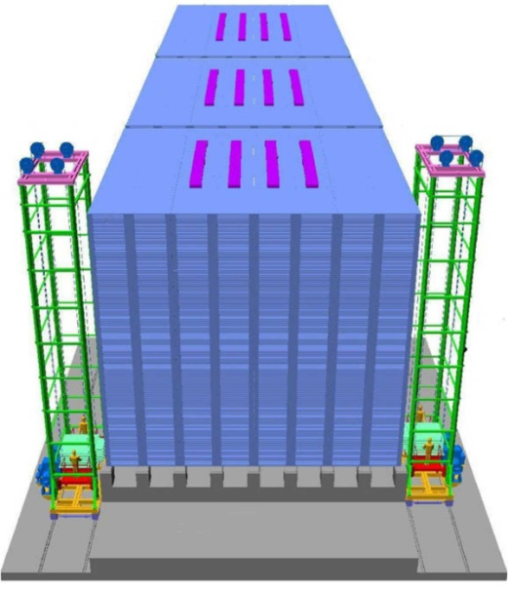
Regulated Cascode based Frontend ASIC Anusparsh for glass Resistive Plate Chamber (RPC) readout in the ICAL detector
V.B. Chandratre, Veena Salodia, Menka Sukhwani, Megha Thomas
Bhabha Atomic Research Centre, Trombay, Mumbai, 400 085
Sonal Dhuldhaj, N.K.Mondal, B.Satyanarayana, R.R.Shinde
Tata Institute of Fundamental Research, Colaba, Mumbai, 400 005

Slide 2
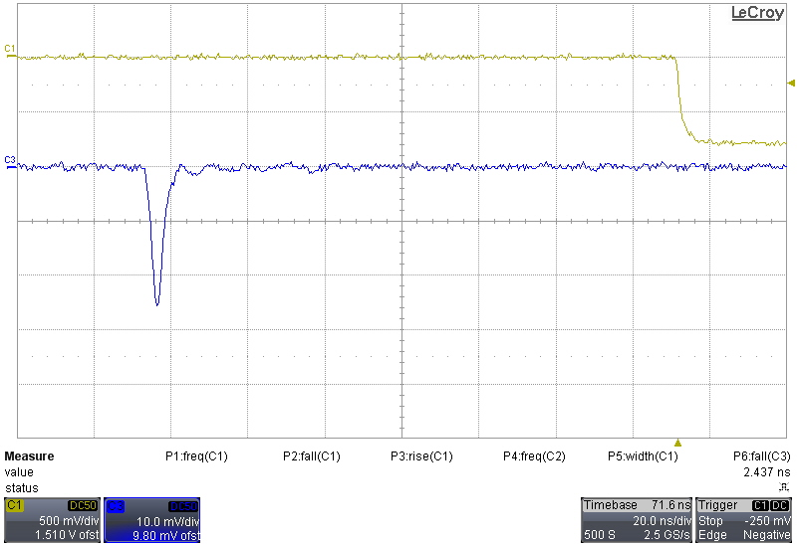
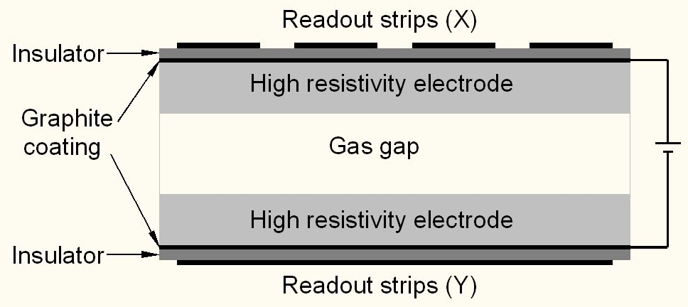
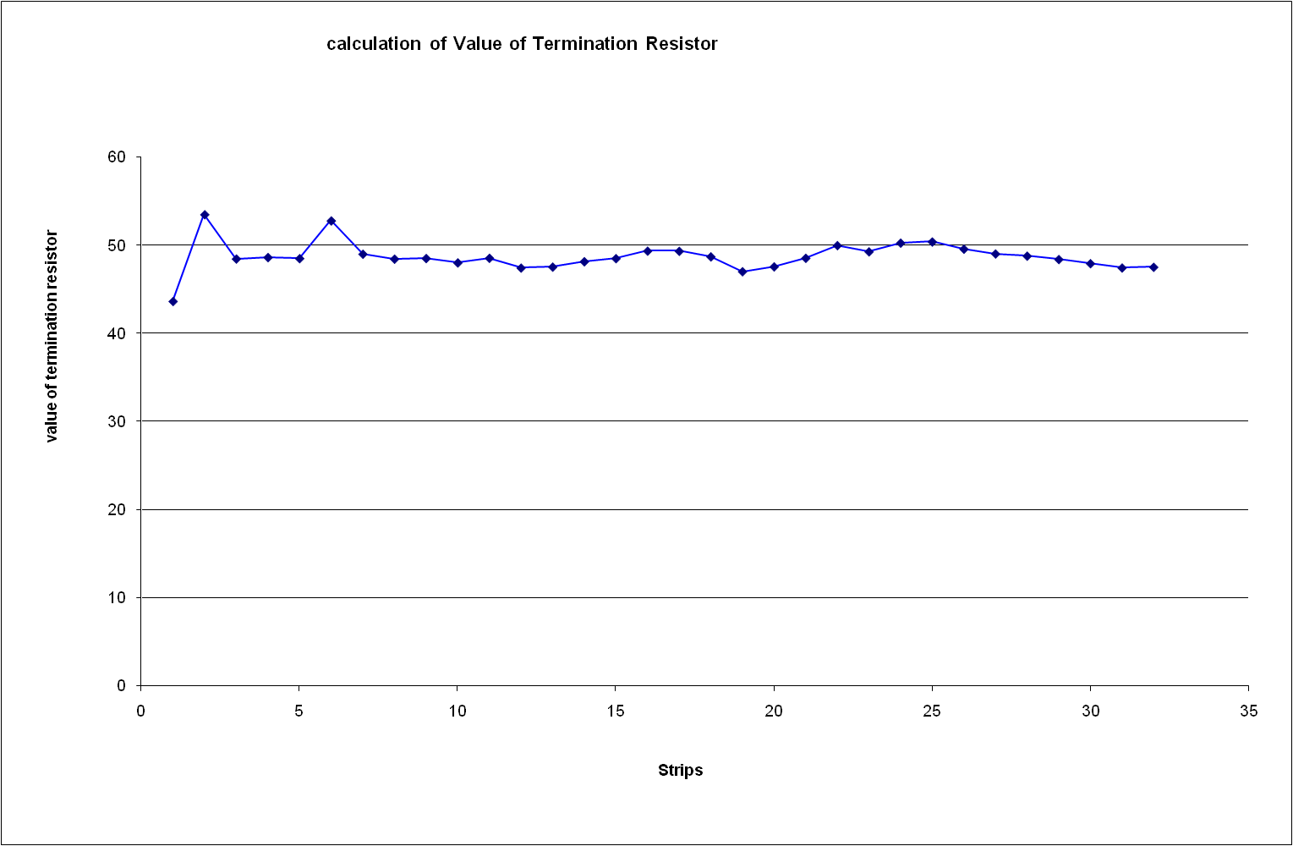
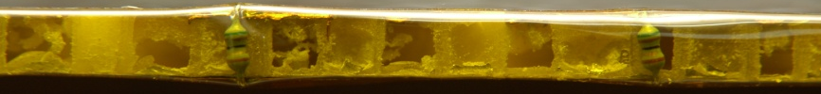
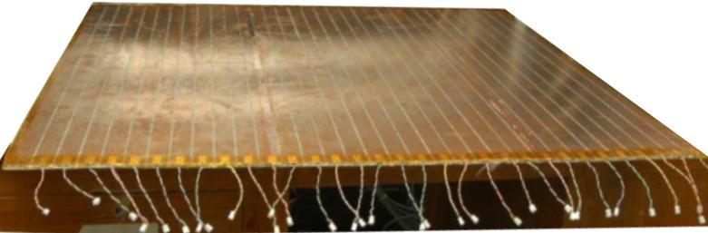
RPC detector and its signal pickup
Characteristic impedance, Ω
Strip number

Slide 3
Frontend options for ICAL’s RPC detectors
Challenges:
Ultra low noise amplification. RPC detectors operated in Avalanche mode
Fast leading edge discrimination. Precision time measurement (~200ps LC) needed for determining direction of the particle trajectory
Low power design. 3.6 million RPC readout channels
High packaging density. Only 22 mm vertical space available inside the RPC
Complementary but single ended inputs from X and Y strips. Requires higher noise immunity
Impedance matching with RPC strip line impedance (~50Ω)
Two solutions:
Fast amplifier family in Hybrid Micro Circuit (HMC) – used in the test stands
Multi-channel, fast amplifier and discriminator ASIC in 0.35μm mixed CMOS process – proposed for the final ICAL detector

Slide 4
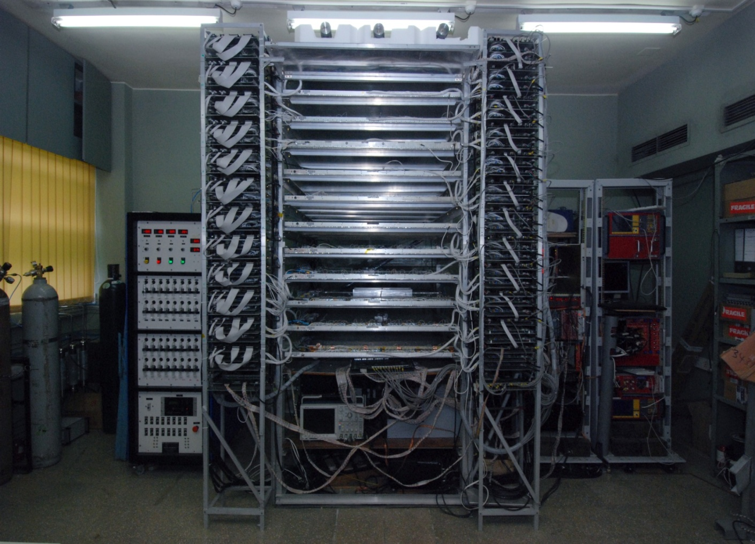
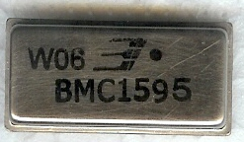
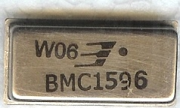
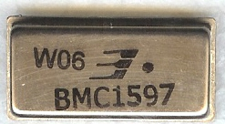
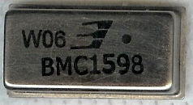
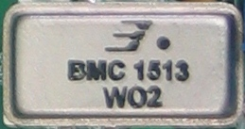
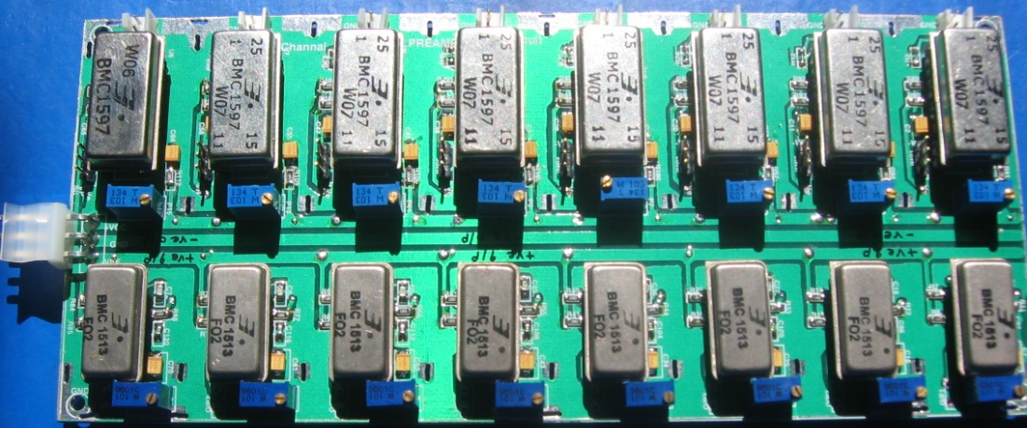
HMC based frontend for ICAL test stands
BMC1595
(Negative In – Negative Out)
BMC1596
(Positive In – Positive Out)
BMC1597
(Positive In – Dual Out)
BMC1598
(Negative In – Dual Out)
BMC1513
(Negative In – Negative Out)
Input & Output impedance: 50Ω
Nominal gain: 10
Rise time: ~1.2 ns
Bandwidth: 350MHz
Package: 22-pin DIP
Power Supply : ± 6V
Power Consumption:110mW

Slide 5
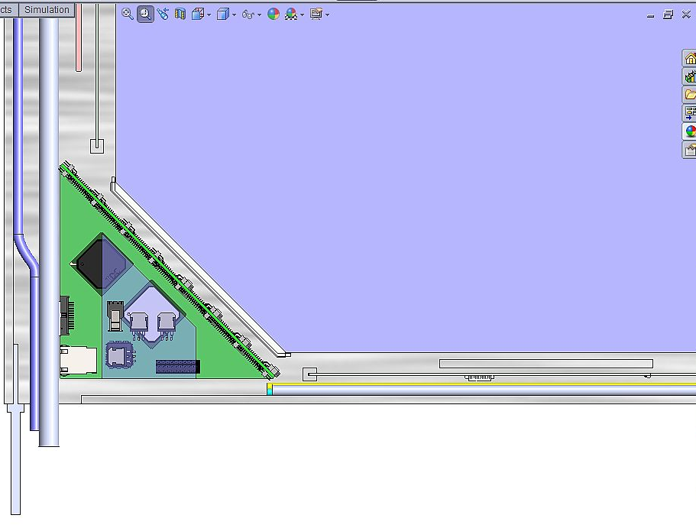
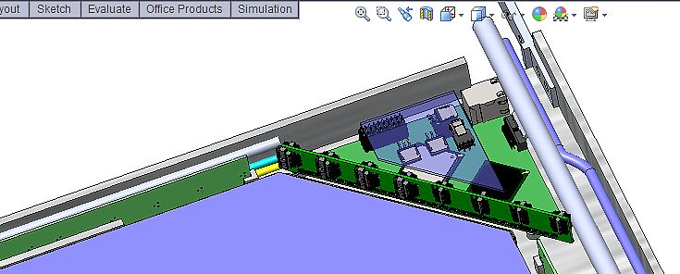
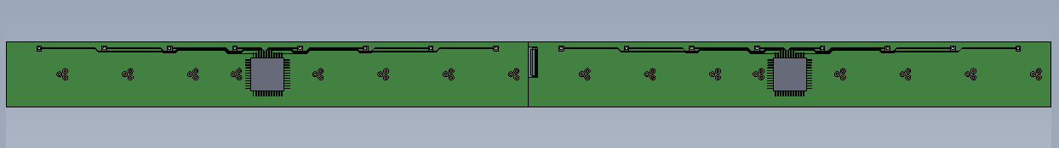
Preamp and RPCDAQ* boards
*More on this in FO-13 by M.Saraf
3.6 million signals
23
403

Slide 6
Functional block diagram of Anusparsh-I Low power, high speed, multi-channel preamp + comparator + multiplexer + buffer ASIC
Common threshold (Pin 38)
Ch-0
Regulated Cascode Transimpedance Amplifier
Differential Amplifier
Comparator
LVDS output driver
LVDS_out0
Channel-0
8:1 Analog Multiplexer
Output Buffer
Amp_out
(Pin 9)
Channel-7
50Ω || 10pF load
Ch-7
Regulated Cascode Transimpedance Amplifier
Differential Amplifier
Comparator
LVDS output driver
LVDS_out7

Slide 7
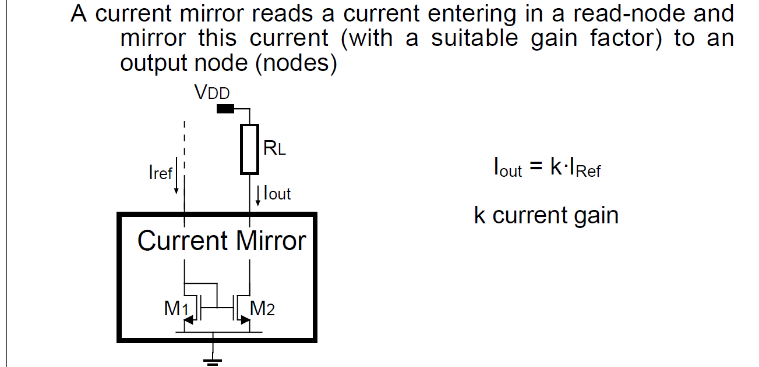
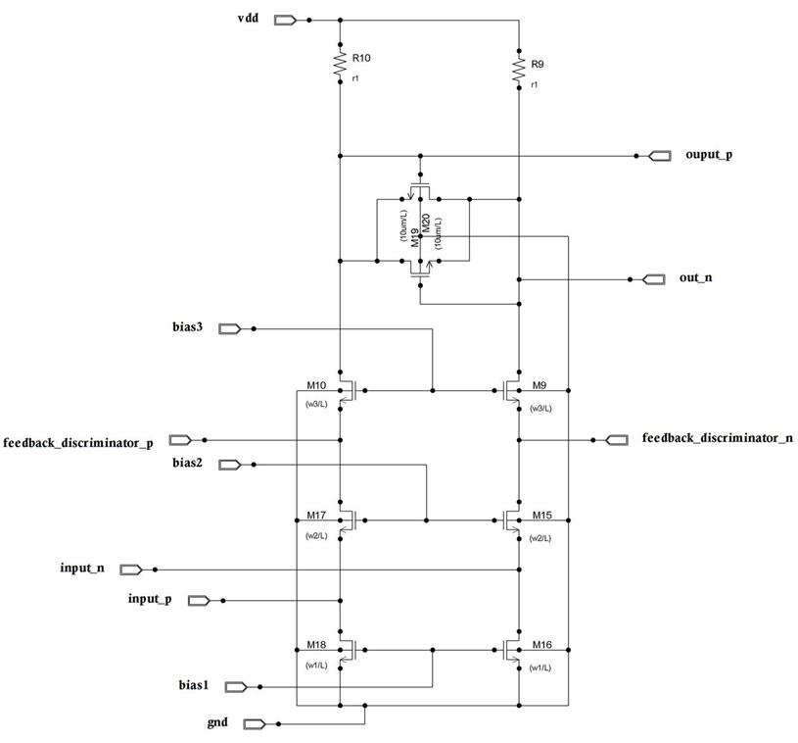
Front-end’s front-end: Current mirror

Slide 8
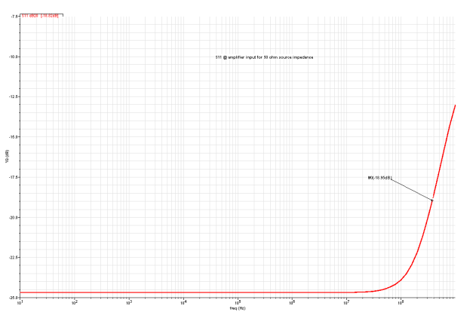
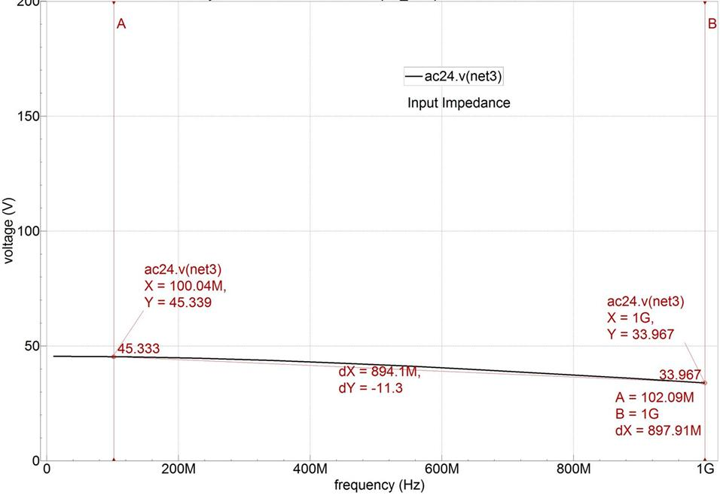
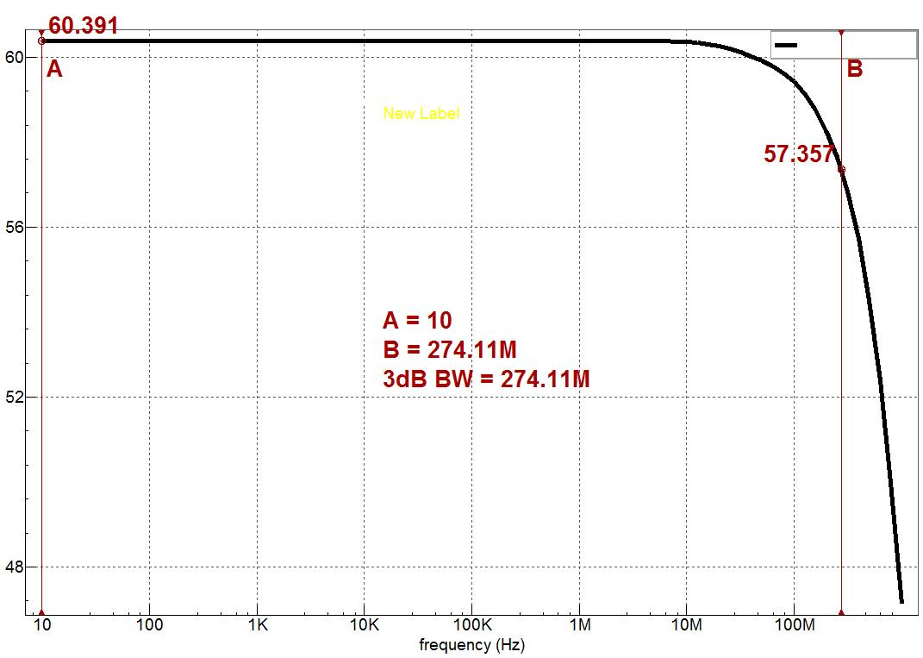
Some performance simulation results
S11 parameter with a source impedance of 50Ω
-17dB @ 380MHz
Input impedance vs. frequency
FE gain vs. frequency

Slide 9
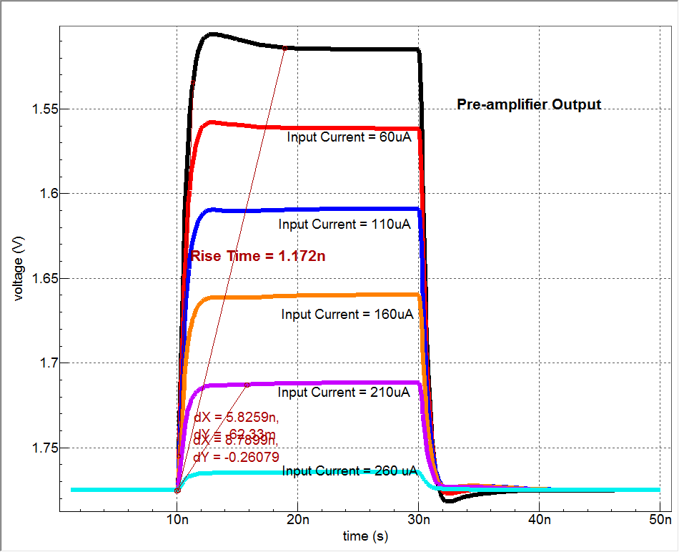
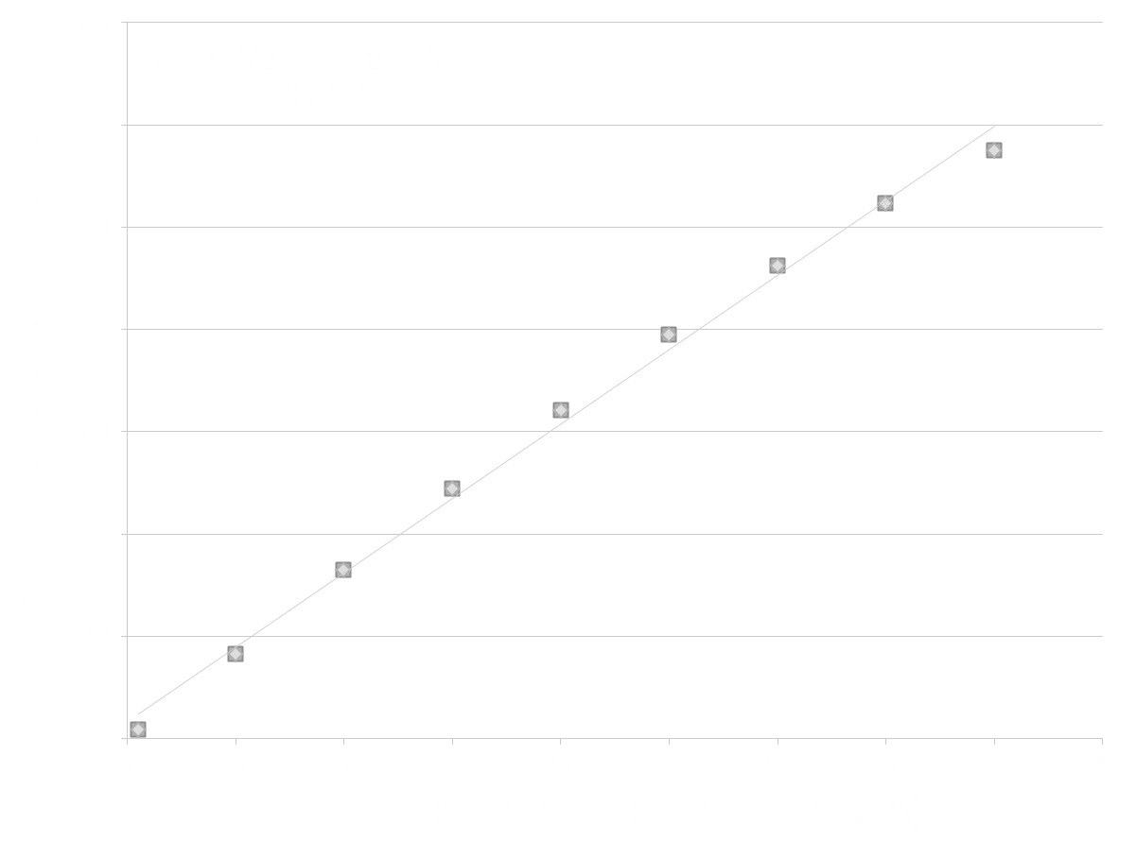
Some more performance simulation results

Slide 10
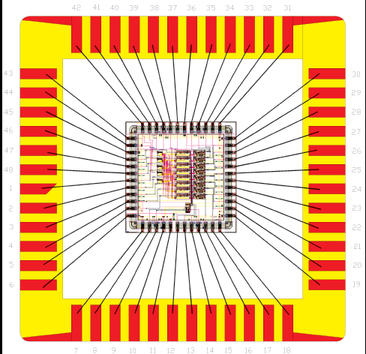
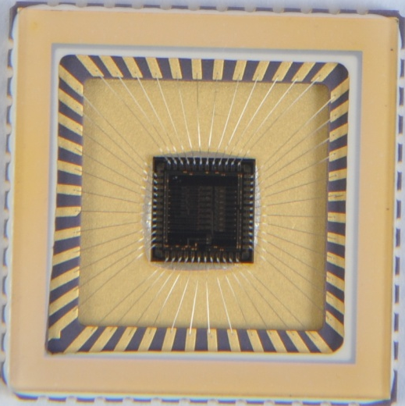
Anusparsh-I specifications
IC Service: Europractice (MPW), Belgium
Service agent: IMEC, Belgium
Foundry: austriamicrosystems
Process: AMSc35b4c3 (0.35um mixed CMOS)
Input dynamic range:18fC (1μA)–1.36pC (80μA)
Input impedance: 45Ω @500MHz
Amplifier gain: 8mV/μA
3-dB Bandwidth: 274MHz
Input referred noise spectral density: 145pA/Hz^{½}
Rise time: 1.2ns
Comparator’s sensitivity: 2mV
LVDS drive: 4mA
Power per channel: 50mW
Package: CLCC48 (48-pin)
Chip area: 13mm²
Simulated S₁₁ at preamplifier input: -11dB (1GHz, 50Ω)
The 8-channel front-end ASIC designed with fast preamplifier, two stages of differential amplifiers with common mode feedback, fast discriminator, LVDS output driver per channel and multiplexed analog buffer for amplifier output.

Slide 11
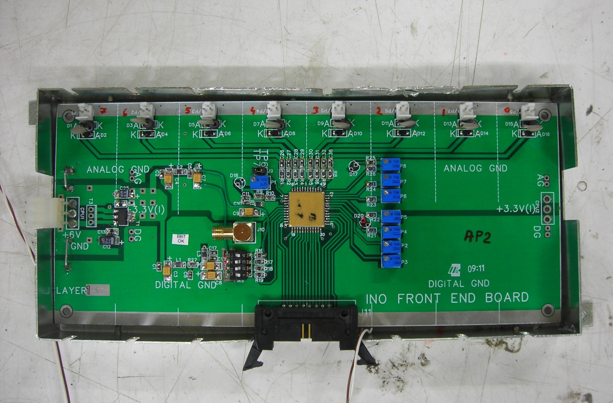
8-channel board using Anusparsh-I
Bias voltage settings
+3.3V regulated supply
Pin 9 (Buffer out)
Pin 38 (V_{th})
Analog inputs from RPC strips
+6V supply
LVDS outputs
Threshold control
Analog pulse out
Multiplexer switches

Slide 12
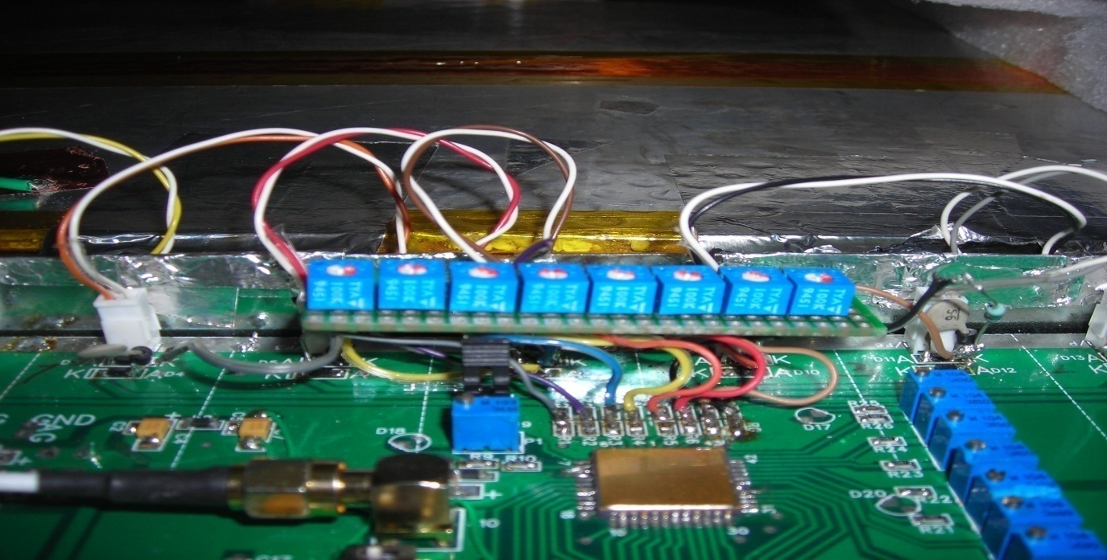
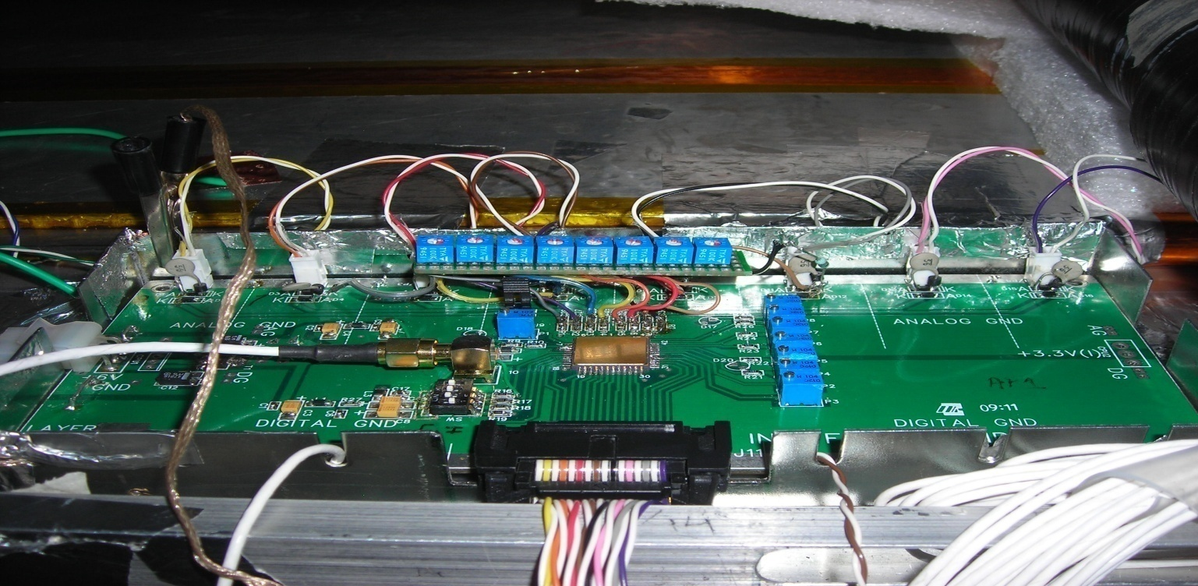
Anusparsh-I boards in the RPC test stand

Slide 13
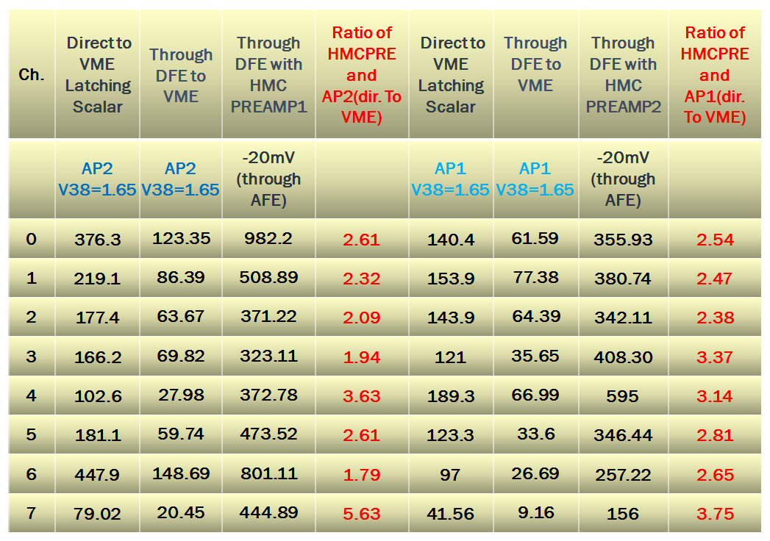
Comparison of RPC noise rate measurements

Slide 14
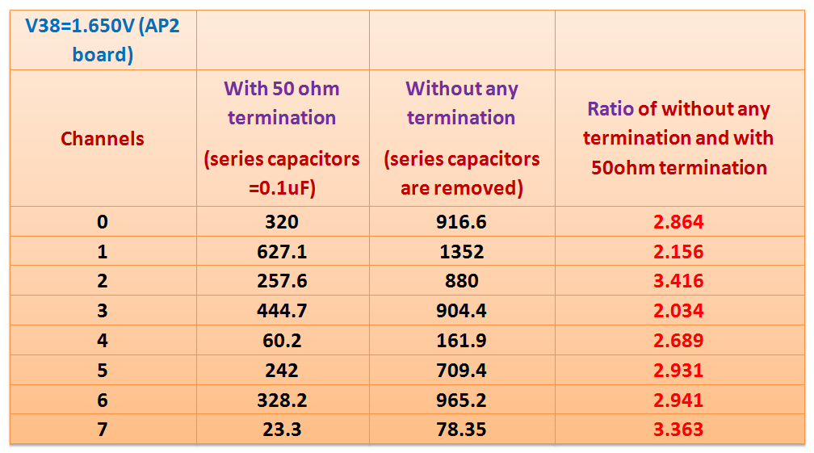
RPC noise rates and strip termination

Slide 15
Noise rate as function of threshold
Channels | V38= 1.650V | V38= 1.670V | V38= 1.686V | V38= 1.701V | V38= 1.730V | V38= 1.752V | V38= 1.803V | V38= 1.850V | V38= 1.900V
0 | 458.8 | 360.6 | 364.6 | 269.6 | 230.9 | 201.6 | 137.1 | 12.07 | 1.325
1 | 217 | 183.9 | 172.6 | 150.7 | 134.2 | 129.5 | 107.2 | 87.04 | 58.24
2 | 208 | 174.2 | 157.2 | 140.7 | 126.3 | 116.6 | 85.62 | 48.1 | 2.888
3 | 178.8 | 157.9 | 161.8 | 138.1 | 125.9 | 121.5 | 104.7 | 81.97 | 51.64
4 | 81.3 | 63.38 | 40.11 | 16.79 | 2.175 | 0.725 | 0.275 | 0.225 | 0.3375
5 | 191.7 | 167.8 | 163.3 | 138.9 | 119.2 | 106.6 | 63.29 | 11.84 | 1.587
6 | 516.4 | 441.6 | 485.6 | 343.4 | 259.9 | 249.7 | 191.6 | 148.6 | 3.663
7 | 70.69 | 49.48 | 11.6 | 3.587 | 0.6 | 0.2125 | 0.175 | 0.1875 | 0.375

Slide 16
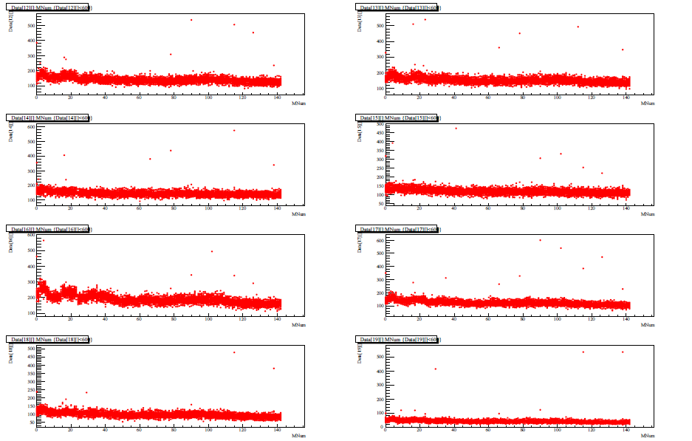
Noise rate stability with Anusparsh-I
Ch0 (120-220Hz)
Ch1(120-220Hz)
Ch2 (120-200Hz)
Ch3 (100-150Hz)
Ch4 (150-300Hz)
Ch5 (110-200Hz)
Ch6 (100-150Hz)
Ch7 (40-90Hz)

Slide 17
Summary of Anusparsh-I test results
Comparator’s threshold values
Minimum adjustable threshold at V₃₈ found to be 1.650V. This results in an effective threshold for the comparator to be 250mV
Stable noise rate data
Both Anusparsh-I boards (AP1 and AP2) gave stable RPC noise rates
Noise rates comparison with HMC based preamplifier
Noise rates of with the Anusparsh-1 board (AP2) found to be approximately about half of those obtained with HMC based preamplifier
Efficiency comparison HMC based preamplifier
Efficiency of Anusparsh-I board (AP2) found to be approximately about half of those obtained with HMC based preamplifier

Slide 18
Feedback for the revision of Anusparsh
Channel to channel variations in the DC offset levels
Too many external bias voltages
The threshold could not be lowered below ±50mV
Difficulty to calculate or experimentally set comparator’s threshold
Channel to channel variation in the amplifier gain - corner channel issues?
Lower amplifier gain of 2.6 - 3.2 mV/μA (as against designed value of 8 mV/μA)
Stability issues with buffer after the analog multiplexer
Polarity for the comparator’s thresholds different for X & Y strip signals

Slide 19
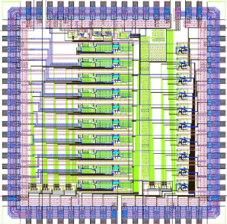
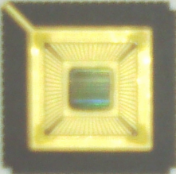
What’s new in Anusparsh-II?
DC offsets and gain spread across channels minimized/ removed
Improved isolation between amplifier and discriminator stages
Discriminator jitter and offset issues resolved
Differential inputs were introduced providing local RF GND (suitable for muti-gap RPC readout as well)
Existing buffer on analog multiplexer output with 35mA drive, but with improved stability and swing retained.
An additional buffer with reduced current drive (8mA) included.
Continuous gain adjustment; input impedance adjustment (to 50Ω)
Full Layout revised, substrate coupling issues solved
Single chip for X- & Y-strips, single polarity for the threshold
ASIC packaged in 68-pin CLCC package – Anusharsh-1 was packaged in 44-pin CLCC, due to additional circuit complexity and control

Slide 20
Functional block diagram of Anusparsh-II
Adjustable Gain ~ 5mV/uA – 11 mV/uA
Common Threshold to X-Y strip complementary i/p
INN1
Regulated Cascode
Trans-impedance Amplifier
2 stages of Differential Amplifier
Comparator
LVDS output driver
Channel-1
INP1
LVDS_out1
Differential input
for local RF GND
CMFB
Channel-1
8:1 Analog Multiplexer
New Low power 50 Ω Output Buffer
REF
Amp out
Improved DC & gain
Stability across channels
Channel-8
Current reduced from
35 mA to 8mA
CMFB
Adjustable Gain ~ 5mV/uA – 11 mV/uA
INP8
LVDS output driver
Channel-8
Regulated Cascode
Trans-impedance Amplifier
2 stages of Differential Amplifier
Comparator
INN8
LVDS_out8
Complete layout revised in 0.35µm mixed CMOS technology, packaged in CLCC-68

Slide 21
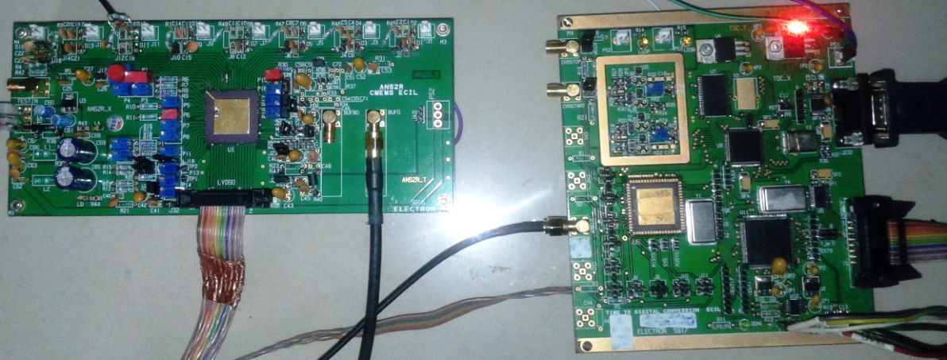
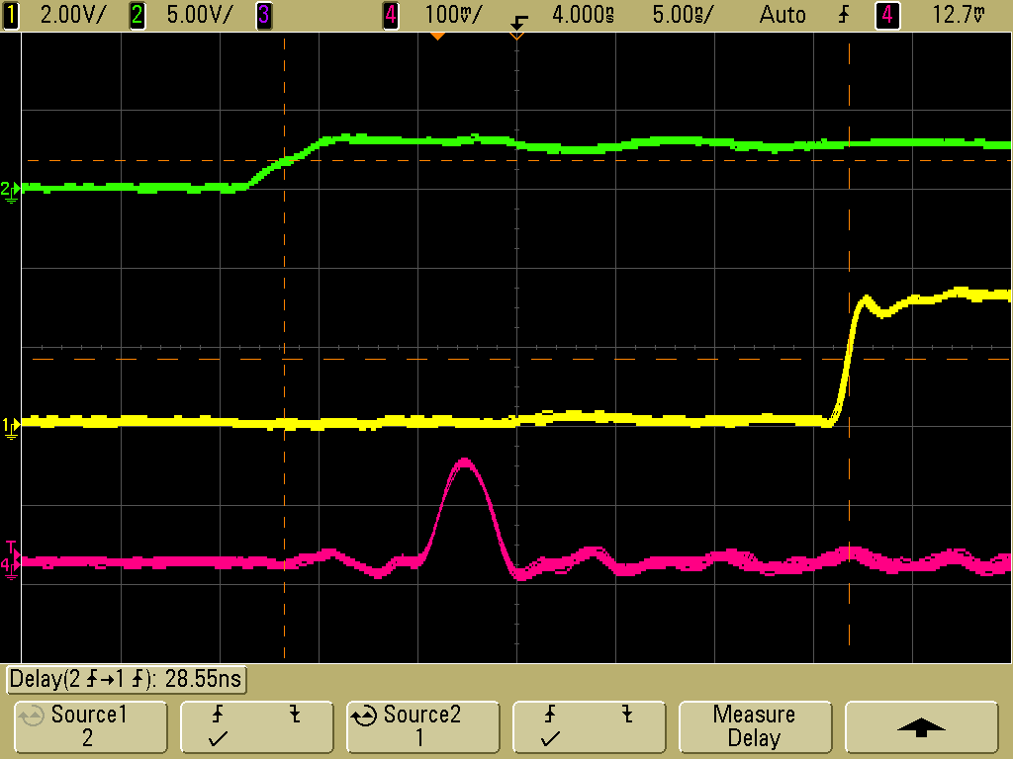
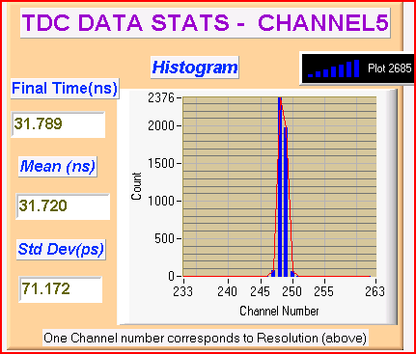
Anusparsh-II ASIC: Lab timing measurement
ANUSPARSH-II ASIC
TDC ASIC
(130 ps resolution)
Common start
LVDS out leading edge (stop)
Amplifier o/p

Slide 22
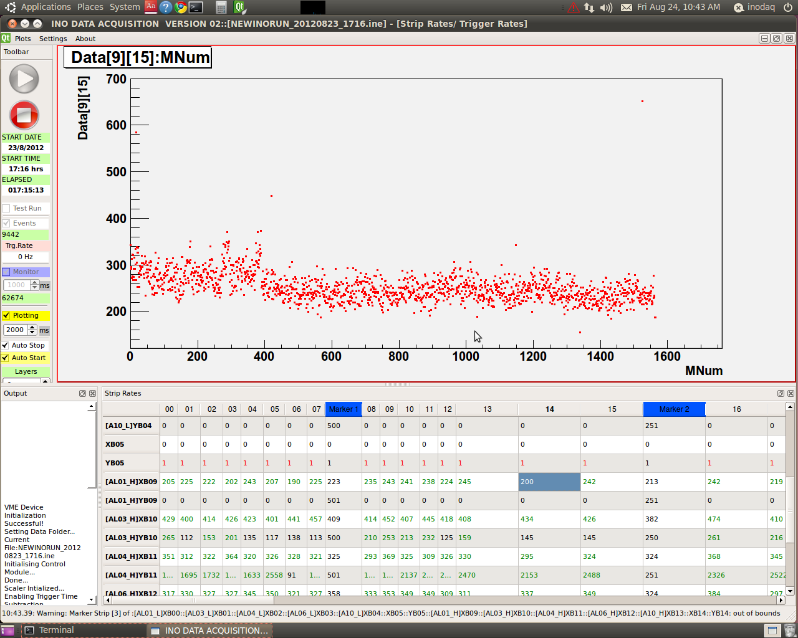
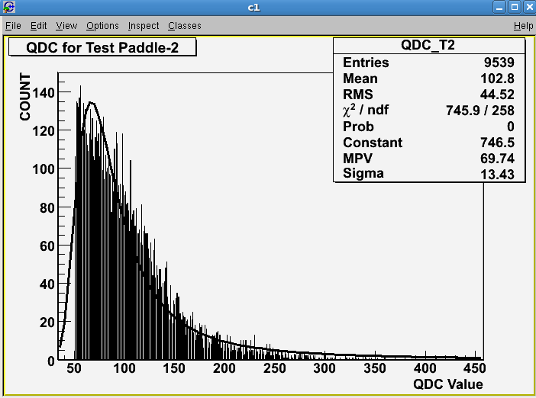
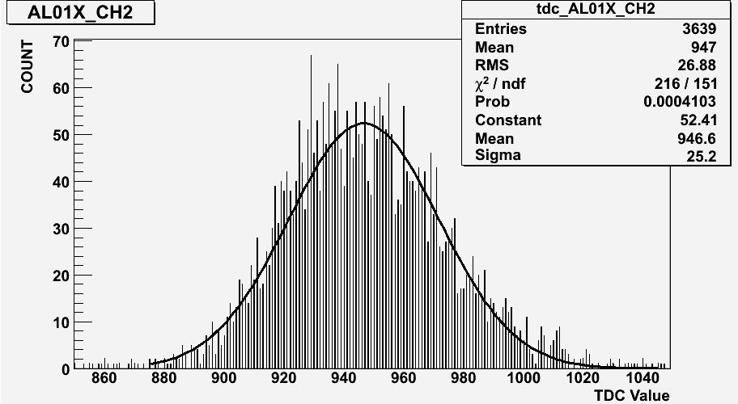
Performance of Anusparsh-II on the detector
40Sec/bin ~17 hrs
0.25*69*3=51pC
Noise rate and charge distribution with new version of Anusparsh nearly matching with HMC’s performance. Rates are matching indicating similar detector efficiency.

Slide 23
Summary and future outlook
Current Anusparsh-II chip dimensions (about 1” x 1” ) does not fit into the preferred preamp design
Next iteration might shrink the chip size or can be packaged in a rectangular shape
We could go for chip bonding (for example: ATLAS’s RPC front-end)
Separating the amplifier and comparator stages may offer operating benefits of signal routing. And might also solve the integration problem
We might even try to package four instead of eight channels in one chip
A low power design in 0.35μm using SiGE technology is also being worked on
Detailed testing of Anusparsh-II ASIC with the RPC detector for timing, gain and efficiency requirements is in progress
A new preamplifier board with improved design is ready, is being assembled.

