Slide 1
Status of INO
Detector & Electronics
B. Satyanarayana, TIFR, Mumbai
(For and on behalf of the ICAL detector & electronics teams)

Slide 2
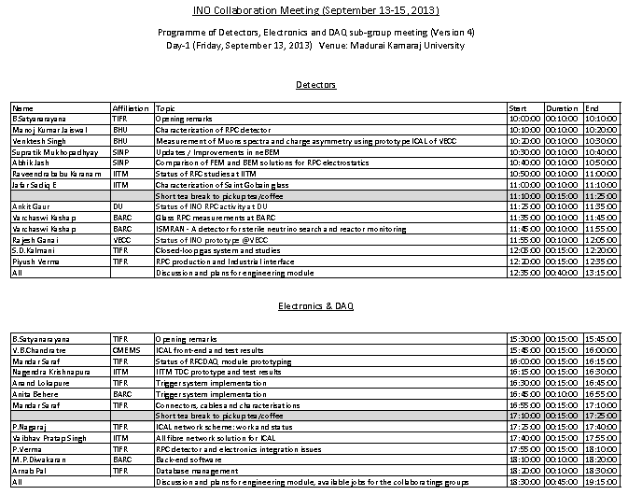
Parallel sessions

Slide 3
ICAL versus ICAL-EM
Parameter | ICAL | ICAL-EM
No. of modules | 3 | 1
Module dimensions | 16.2m × 16m × 14.5m | 8m × 8m x 2m
Detector dimensions | 49m × 16m × 14.5m | 8m × 8m x 2m (89:1)
No. of layers | 150 | 20
Iron plate thickness | 56mm | 56mm
Gap for RPC trays | 40mm | 40mm
Magnetic field | 1.3Tesla | 1.3Tesla
RPC dimensions | 1,950mm × 1,910mm × 24mm | 1,950mm × 1,910mm × 24mm
Readout strip pitch | 3 0mm | 3 0mm
No. of RPCs/Road/Layer | 8 | 4
No. of Roads/Layer/Module | 8 | 4
No. of RPC units/Layer | 192 | 16
No. of RPC units | 28,800 (107,266m²) | 320 (1,192m²) (90:1)
No. of readout strips | 3,686,400 | 40,960 (90:1)

Slide 4
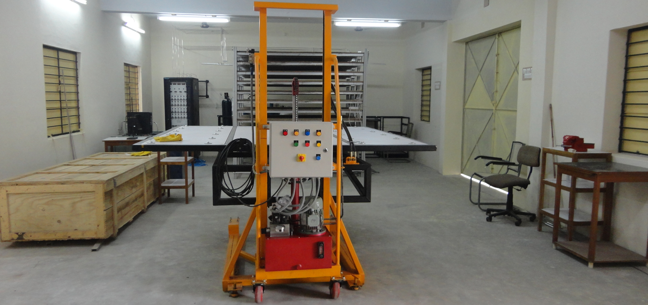
Test stand at the transit campus
Total area: 54,500 ft²
Covered area: 10,222 ft²
While waiting for the power and air conditioning:
Detector fabrication and testing activities will start any time now
Good opportunity for students to get hands-on and contribute to the lab building
Setting up test stand variety electronics and DAQ

Slide 5
Activities at various RPC labs
(BHU) Fire and moister proof ceramic foam and ceramic fibre pickup panels
(SINP) neBEM and ISLES: GEMS, Micromegas and even space charge problems and dynamic processes
(SINP) Comparison of FEM and BEM solutions for RPC electrostatics
(IITM) Gas system, RPC fabrication and characterisation
(IITM) Comparison of glass samples – Saint Gobain
(DU) RPC fabrication and characterisation, studies on electrodes
(BARC) RPC characterisation using Anusparsh
(BARC) Proposal for a detector for sterile neutrino search and remote reactor monitoring
(VECC) Status and data analysis of prototype detector
Requirements from labs, electronics etc. Follow up discussion today
Future plan of activities of labs, for engineering module ... Next slide

Slide 6
Jobs for grabs
Front-end interconnections
Cabling and connectors
Power supply and distributions
Detailed study of RPC tray and integration
RPC production testing scheme
EMC and EMI issues of ICAL electronics
Many loose ends, needs fine tuning

Slide 7
Design parameters of the pilot close loop gas system
RPCs (12) →8litres x 12 = 96litres +20litres (main cylinder) +20litres (buffer cylinder)
Total Gas in the close loop system ~180litres
If filled at 10/20SCCM → will take 1000 hours. So high filling rate of say 15litres/min → 10Hours is required.
Loop flow = 1litre per minute (80cc/RPC) and top-up = 10cc
Positive pressure to be maintained for smooth gas flow through RPCs (1.006 bar to 1.009 bar, i.e. 3mbar difference).
Lab pressure changes between 1.004bar to 1.010bar twice a day.
Auto-refill starts at 1.150bar (set value)
Filled pressure (PT₅) is 1.450 bar (set value)
Manual refill after evacuation (fast refilling)
Provision for exhaust
Removal of water vapour, Oxygen, oil vapours and radicals
Goal was to achieve moisture and Oxygen levels to less than 2 ppm

Slide 8
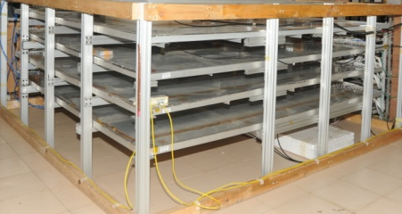
Line diagram of the close loop gas recirculation and purification system
Displacers
PT 2
Molecular Sieves
Molecular Sieves
Pneumatic Cylinders
Low pressure
Radical Remover
High pressure
PT 1
Diaphragm
Pump
Exhaust
Gas purifiers
Receiver tank inlet
PT 3
MFC 5
Hygrometer
Non-return valve
N₂ input
Bypass
Feeder valve
Vacuum
Pump
PT 6
Storage Tank Outlet
1
2
3
4
RPC stack (this part is outside the gas unit cabinet)
PT 5
Mass flow controllers
MFC 1,2,3,4
Exhaust
PT 4
Gas Mixing (On-line)
Gas Recirculation
Gas Purification system
Control System (PLC)
MFC 6
Low pressure regulator

Slide 9
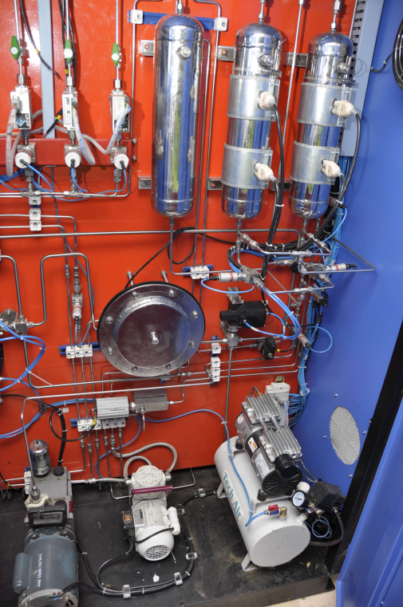
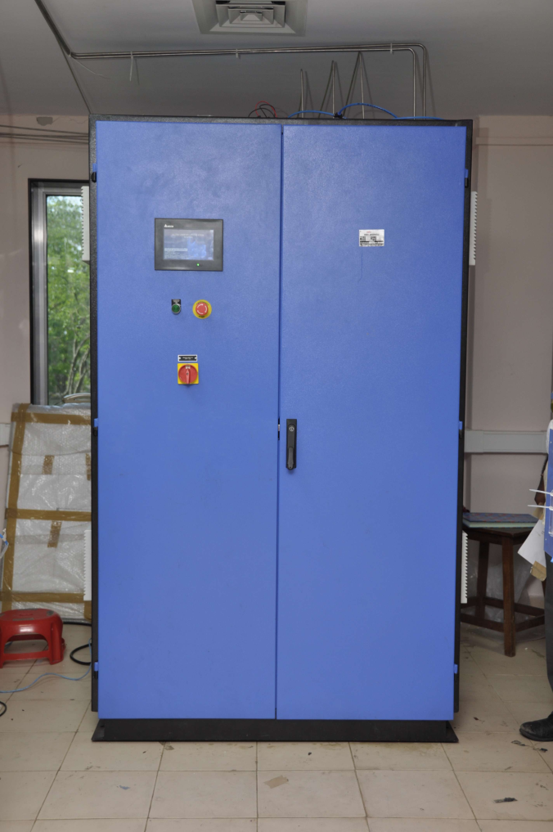
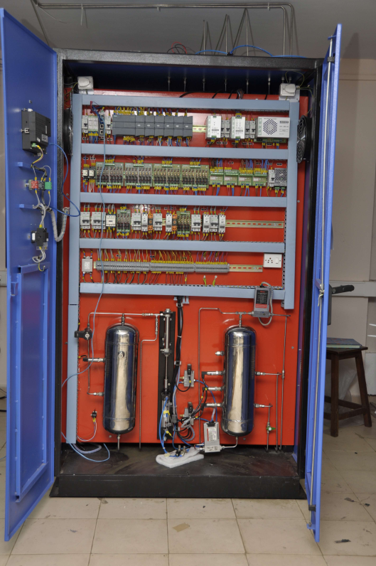
Some pictures of close loop gas system
Rear
Front

Slide 10
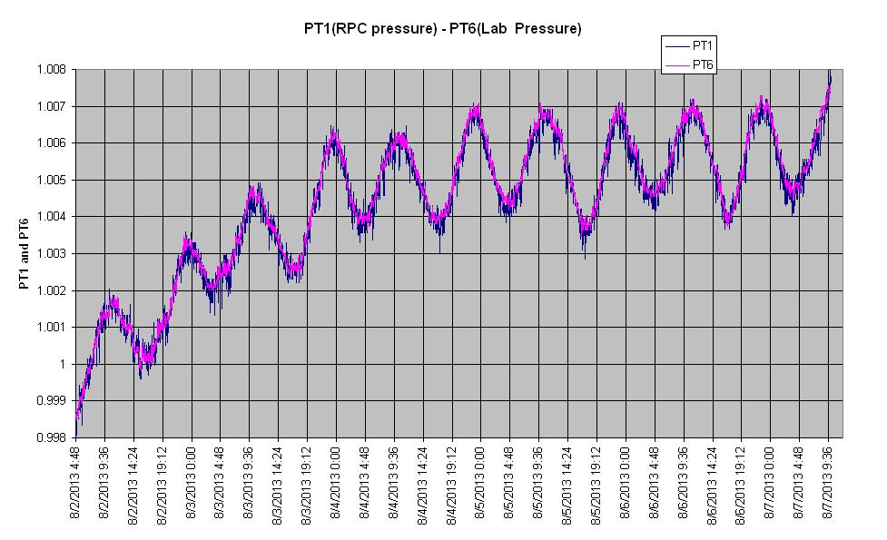
Drastic variation in pressure during Mumbai monsoon
Hence the need for correction
System pressure/RPC pressure i.e. PT1 follows the PT6 (Room pressure)

Slide 11
CONCLUSIONS
Closed Loop Gas System is functioning well as per the design, need to add more RPCs in the load.
On-line RGA is frequently done to qualify the quality of gas. Need to perform detailed analysis for any breakdown radicals.
We need to fine tune the system to regulate the gas flow (through MFC₆) as the data for room pressure variation for one full monsoon season is available now.
Preparing for fabrication the system for the engineering module.

Slide 12
RPC technology development
Walchand Industries:
  Pickup panel, aluminium soldering
  FRP tray for RPC
  Automatic assembly of RPC gas gap, glue trials
  Automatic painting of glasses, PET film protection
  Glass chamfering and engraving
  Computer model of RPC integration
  Trying RPC push-pull using physical models
Work and report nearing completion

Slide 13
Industrial interface
Vendor development and material characterisation
  Glass (Asahi, Saint Gobain)
  Spray paint: Nerolac and screen printing paint
  RPC gap components (Oshwin plastics, Studio CNC, Nexgen Plastics etc.)
  Single RPC stacker (Jalaram Industries)
  Pick-up panels (Sunboard/hard foam, polypropylene based) - Many local manufacturers
  Al to Cu/Al soldering
  Closed loop gas system and gas CFD studies: Alpha Pneumatics, ICT, Timetooth Technologies

Slide 14
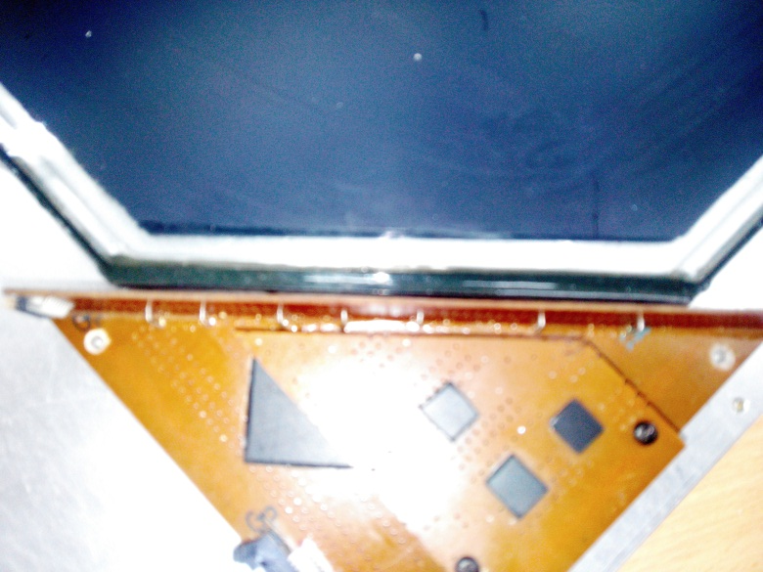
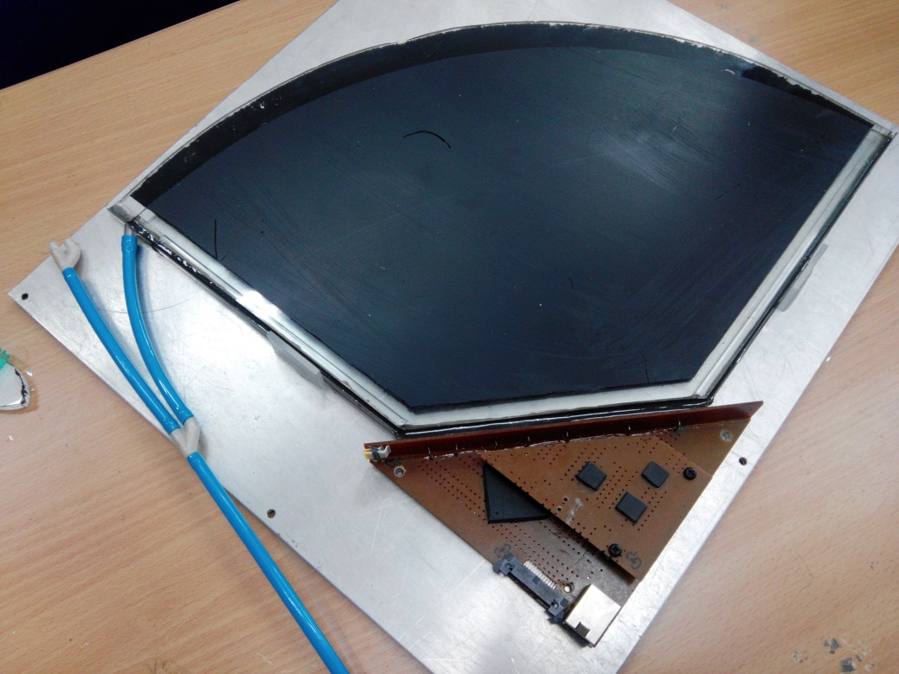
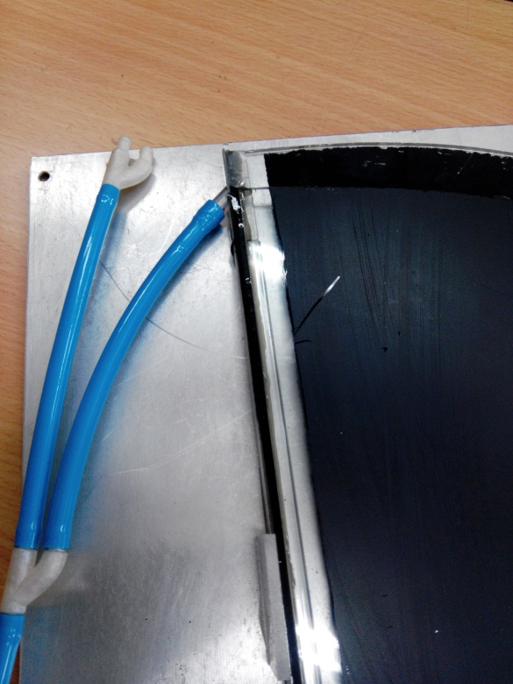
Corner of RPC GAP with New Components
INO Collaboration Meeting, Sep 13-15, 2013, MKU

Slide 15
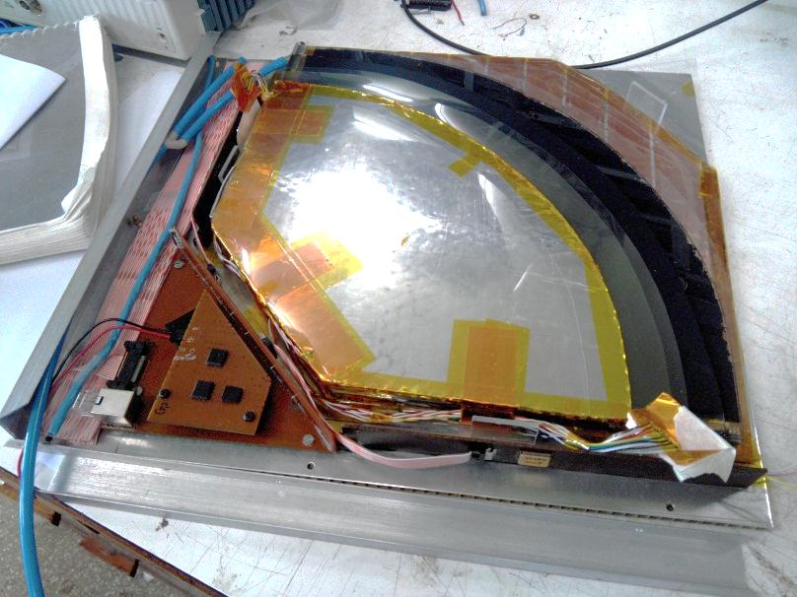
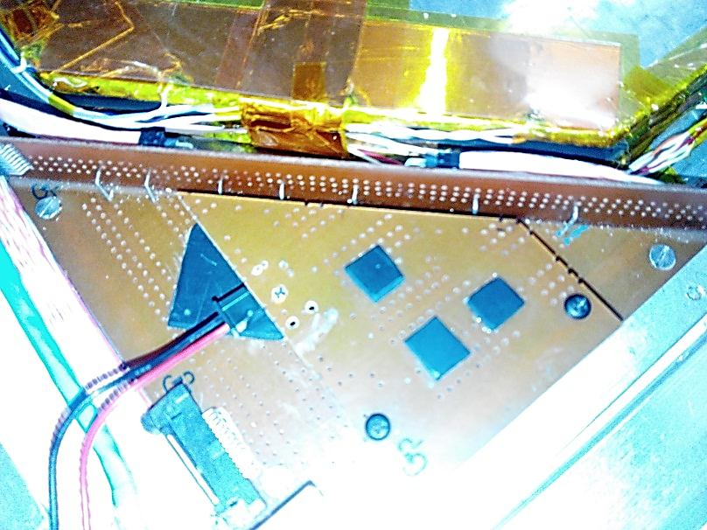
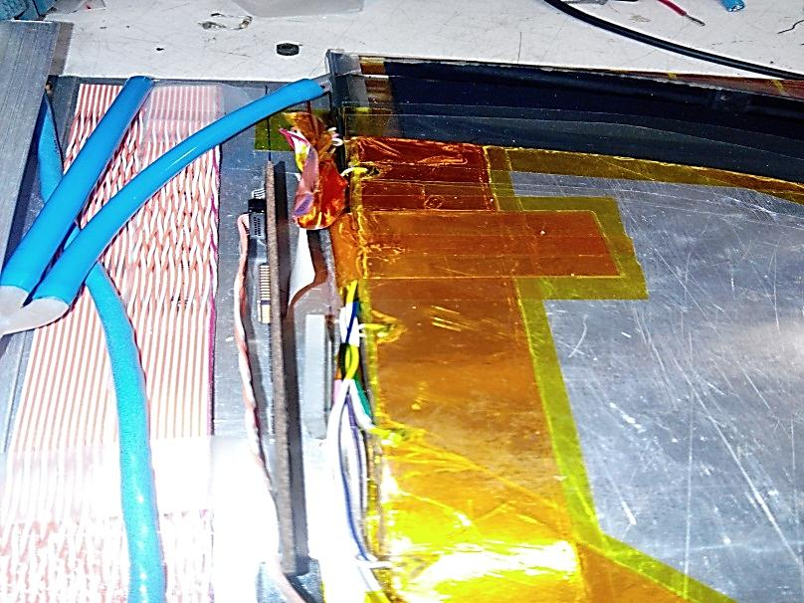
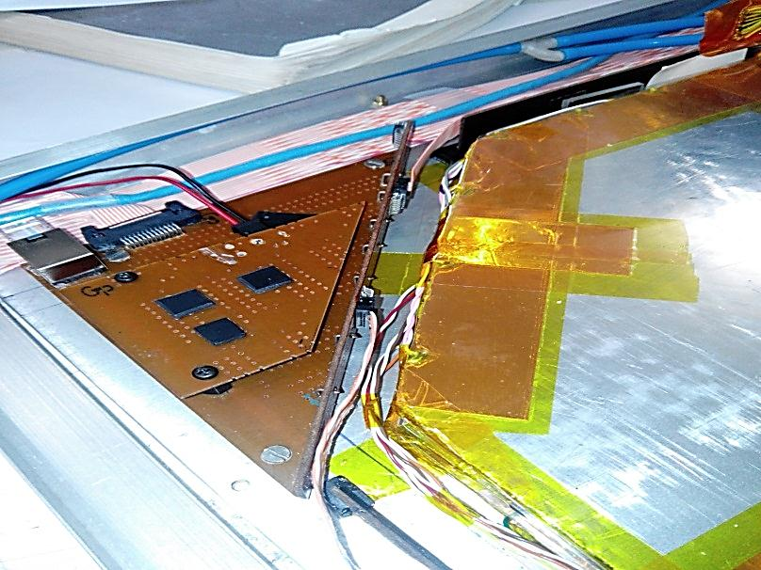
Corner of RPC GAP with New Components
INO Collaboration Meeting, Sep 13-15, 2013, MKU

Slide 16
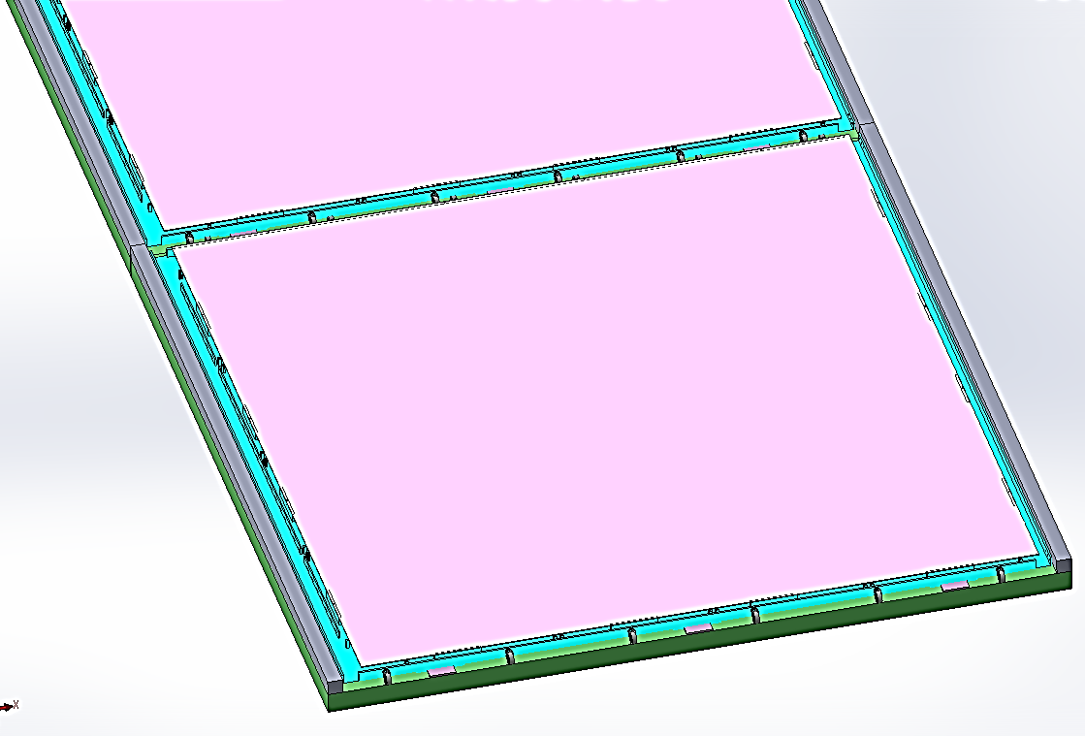
Castor wheels
(suggested by Dr. Suresh Kumar, BARC)

Slide 17
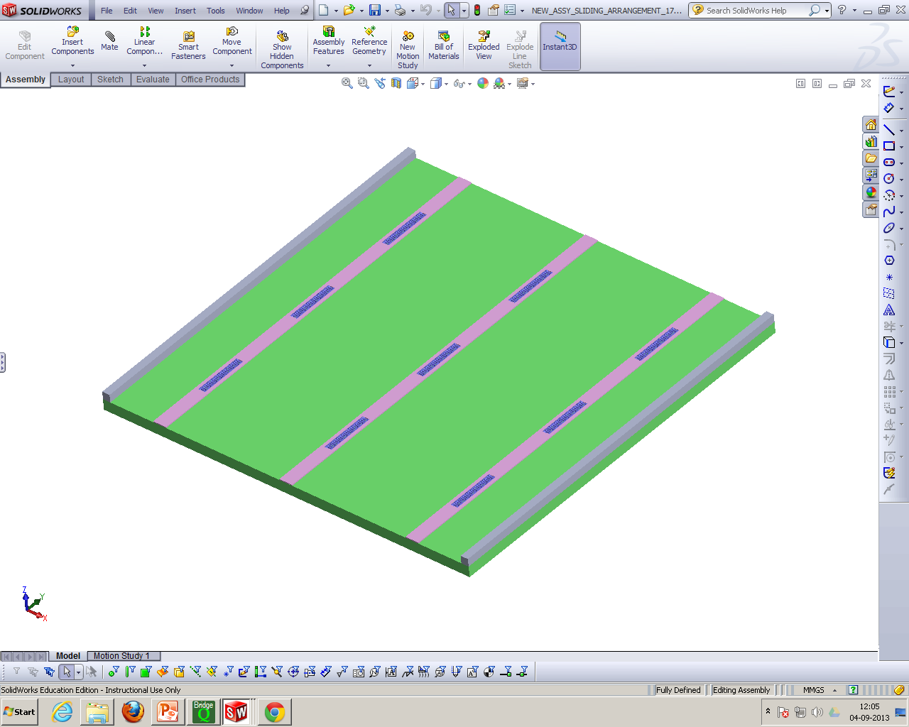
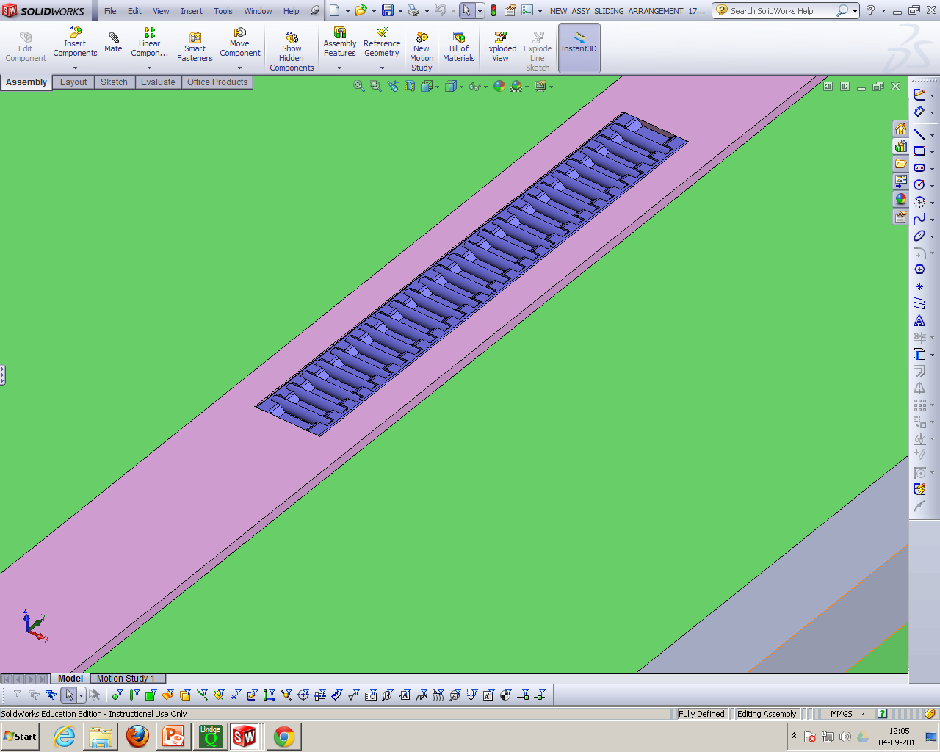
Roller bearings
(Suggested by WTG)

Slide 18
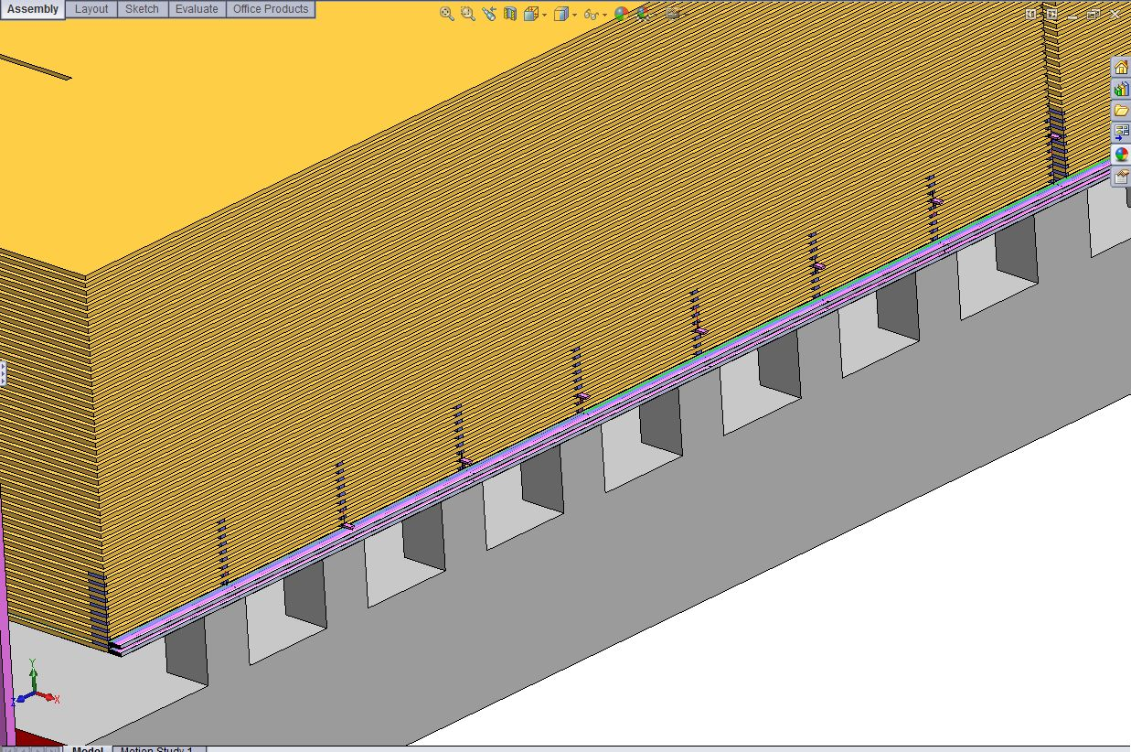
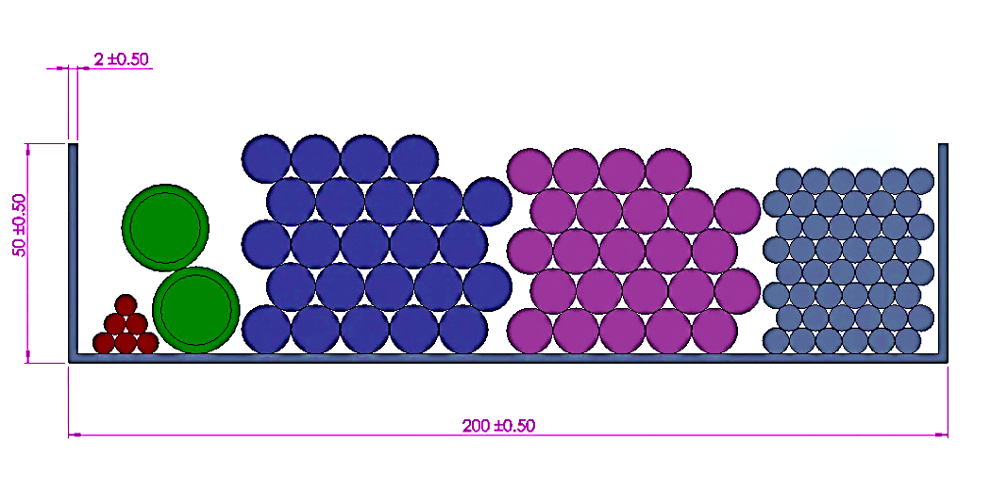
Network RJ45
Line Ø5mm
Gas Inlet & Outlet Ø20mm
24 Digital I/O Ø11.2mm
24 Power Lines Ø10.5mm
48 HV Lines Ø6mm
ICAL Cabling
Network Switch
Chill Air Line?
Piyush Verma proposed to increase of cable tray width from 20 to 30cm
INO Collaboration Meeting, Sep 13-15, 2013, MKU

Slide 19
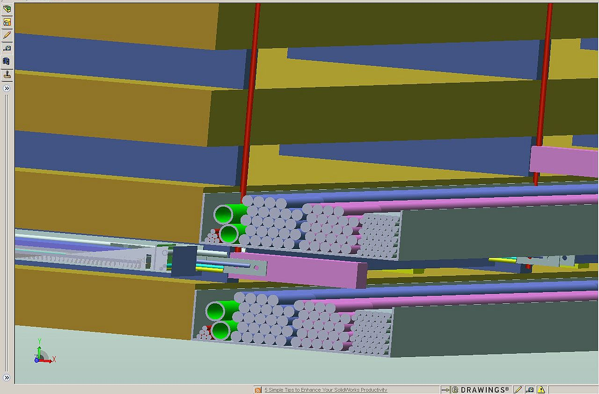
ICAL Cable Tray C/S
Gas Inlet & Outlet Ø20mm
Network RJ45 Line Ø5mm
24 Digital I/O Ø11.2mm
48 HV Lines Ø6mm
24 Power Lines Ø10.5mm
INO Collaboration Meeting, Sep 13-15, 2013, MKU

Slide 20
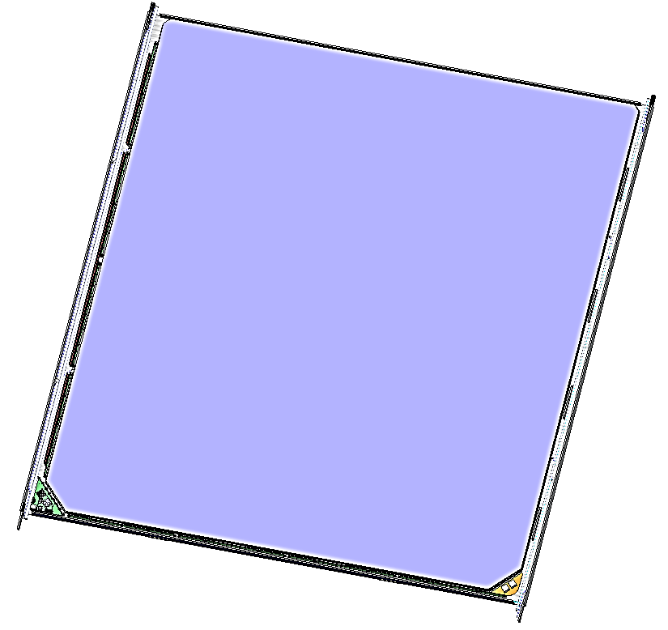
RPC
Gas Inlet: 1 each RPC
  (1/4” Flexible tube)
LV line: 2 nos for ½ road
Digital I/O: 2 flat cables
  (for ½ road)
Signal cables from
  Pre-amp to DAQ
Gas Outlet: 1 each RPC
  (1/4” Flexible tube)
HV line: 4 nos for ½ road
Chill air Line
Chill air line
Signal cables from
  Pre-amp to DAQ
LV line (for DC-DC option)
INO Collaboration Meeting, Sep 13-15, 2013, MKU

Slide 21
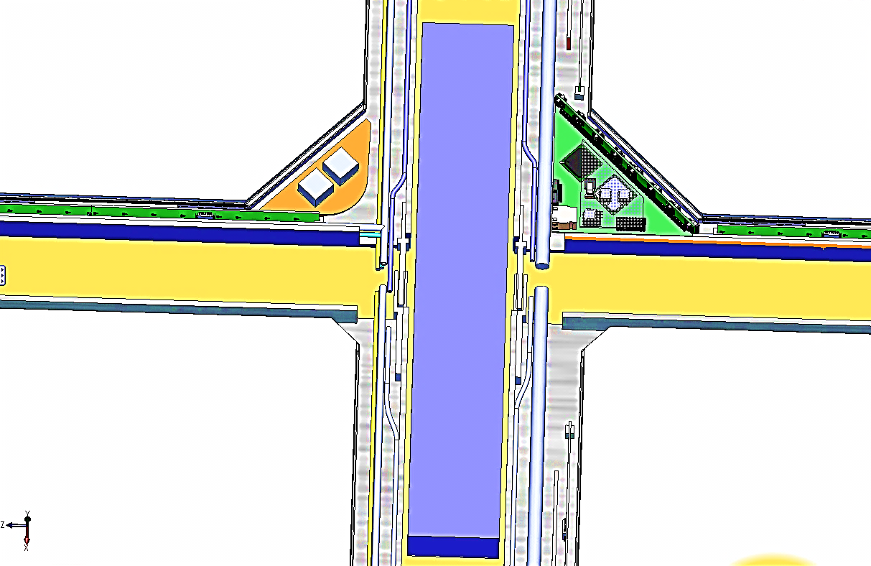
Interconnects between RPCs
INO Collaboration Meeting, Sep 13-15, 2013, MKU

Slide 22
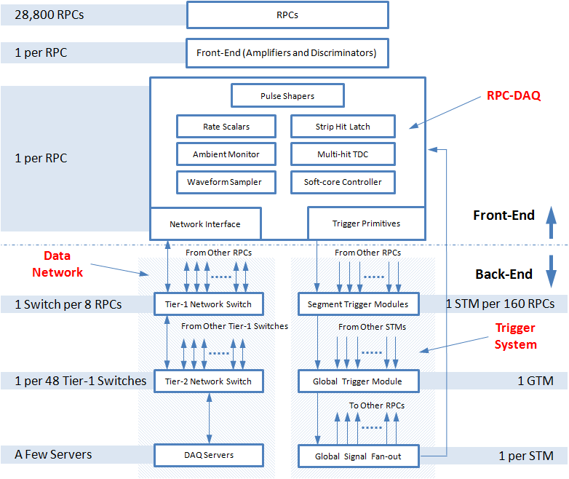
Scheme of ICAL electronics

Slide 23
Update on RPCDAQ module
Circuit Schematic
RPC-DAQ-Side Board
HPTDC Interface
Boot-up Tasks
Back-end Communication Protocols
Vendor Development for PCB Fab, Assembly and Testing

Slide 24
RPCDAQ Board Level Bock Diagram

Slide 25
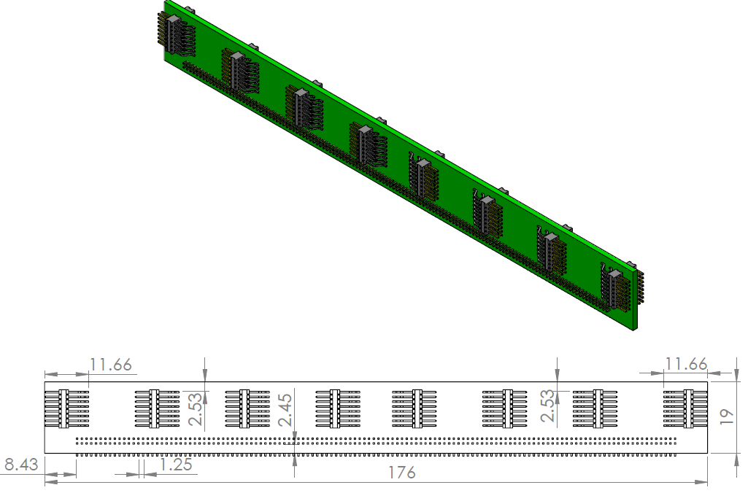
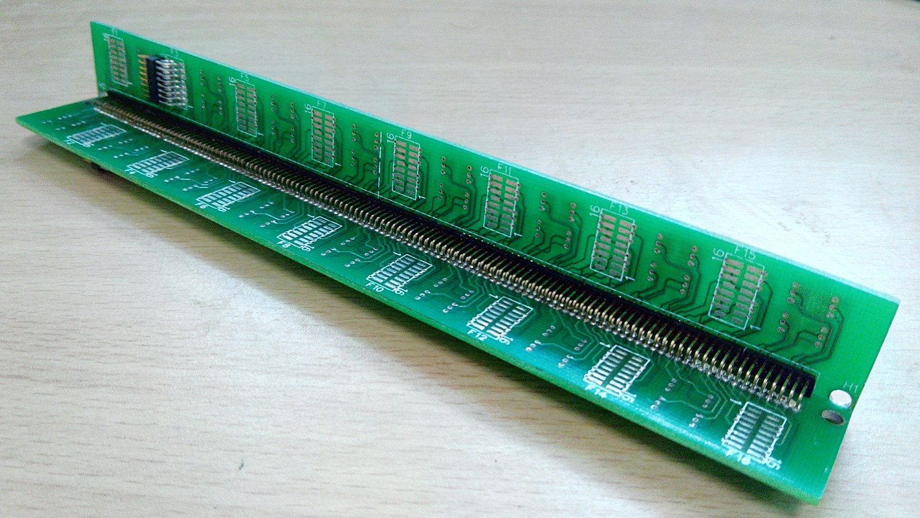
RPCDAQ Side Board

Slide 26
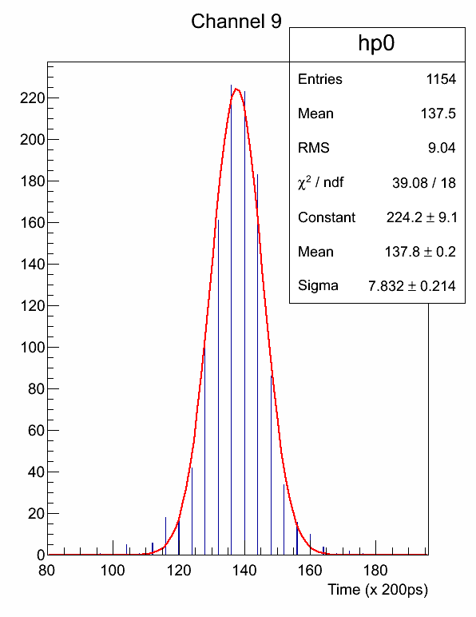
HPTDC Test Results
Scintillator timing resolution measured to be 1.566ns
Cosmic Ray Telescope Using
Plastic Scintillators
To Ch. 9 of TDC
Trigger
Delay

Slide 27
RPC-DAQ Boot-up Sequence
Boot
FPGA gets configured
NIOS-II comes to life and boots from on-chip memory
Setup
NIOS checks all the peripherals
It sets up networking by configuring W5300 with IP address read from Flash
On packet receipt reply back with own information
Wait for initial query packet from back-end
Wait
Wait for further commands from the backend

Slide 28
Vendor Development for Board Production
We need to find good vendors for the production of the RPC-DAQ and other DAQ boards.
The minimum expectations from these vendors would be
  Review of provided board schematics
  PCB Design: layout and artwork
  Signal Integrity of design
  PCB fabrication and assembly
  Basic board testing
  In addition we may ask them to carry out component purchase as well
So far we have discussed for above things for RPC-DAQ with Dexcel Electronics, Bangalore and Bit Mapper, Pune
  Both the parties have shown interest and given quotations
From the time of PO placement it will take 4 months till we get working RPC-DAQ boards

Slide 29
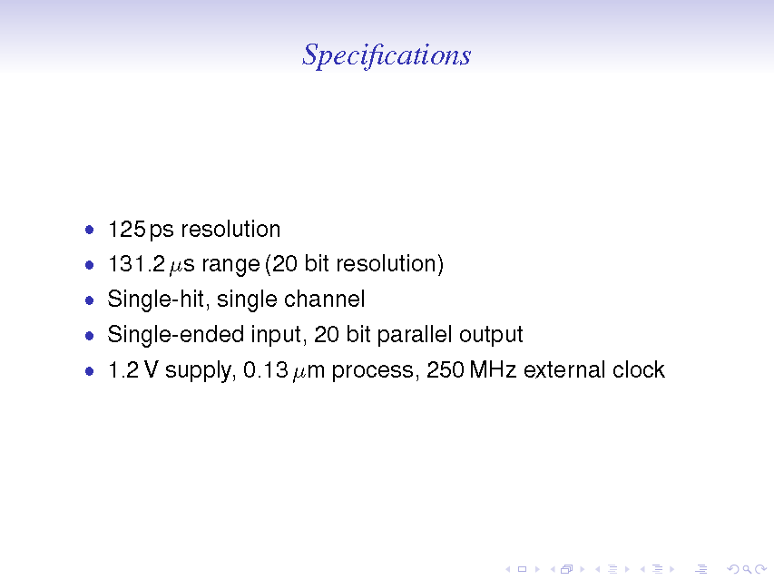


Slide 30
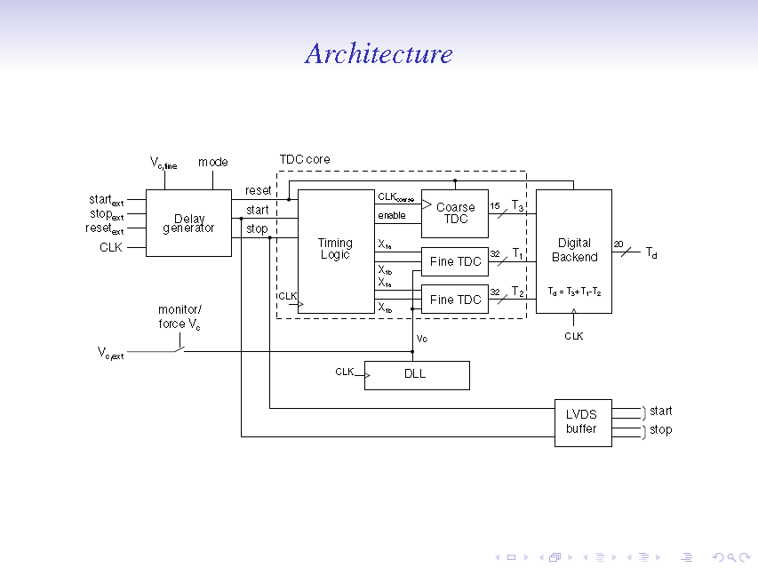

Slide 31
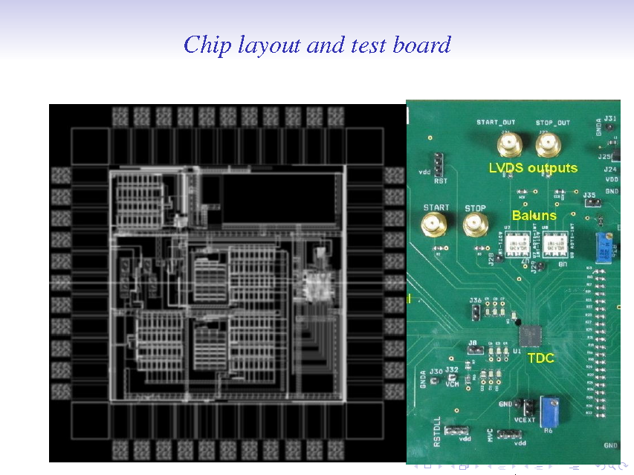

Slide 32
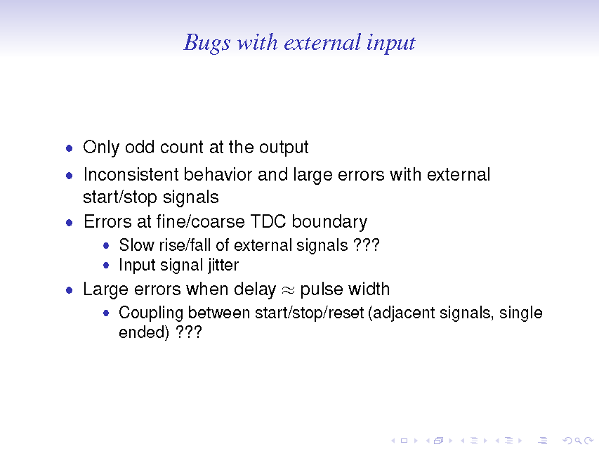


Slide 33
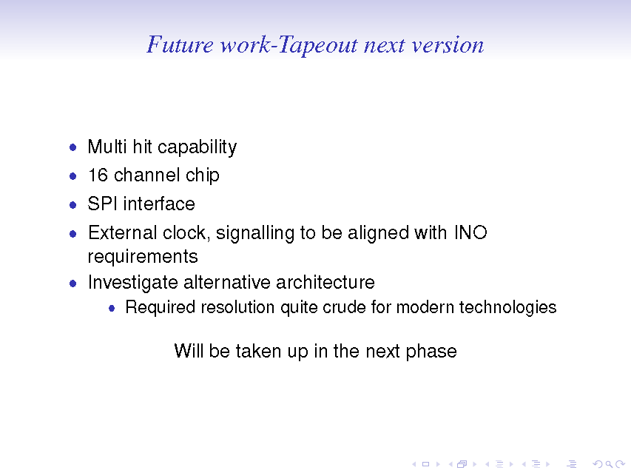

Slide 34
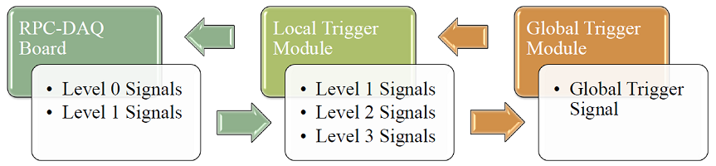
Trigger Concept
Trigger Boards
Concept developed by Sudeshna Dasgupta
Altera Cyclone 5 FPGA
Texas Instruments LVDS driver / fanout ICs
Connectors as per availability
Routing will be challenging since 4k IO LVDS signals

Slide 35
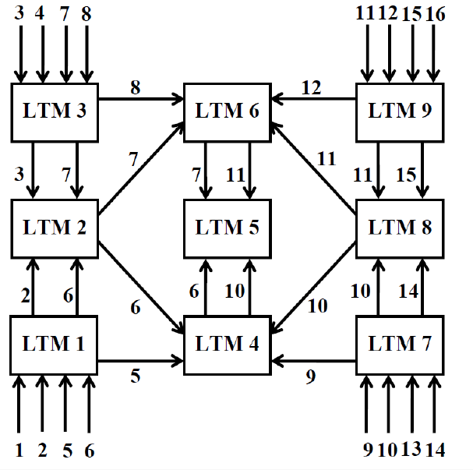
Connections between RPC-DAQs and among LTMs

Slide 36
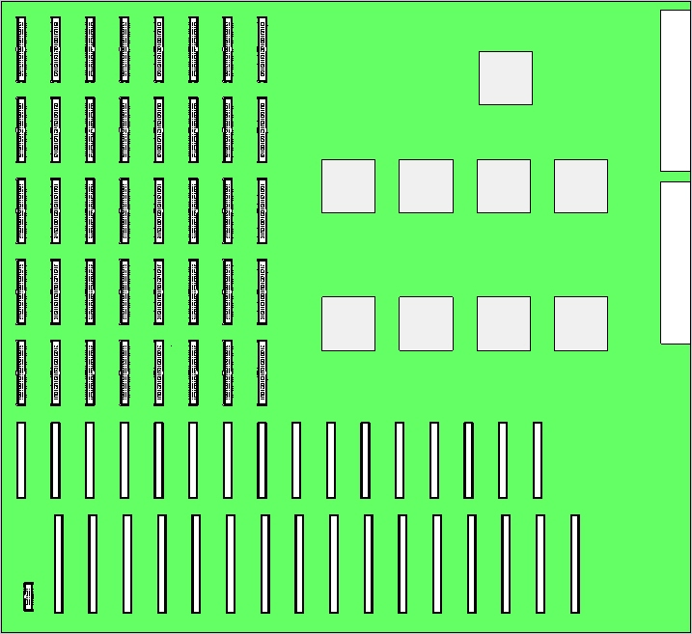
Design Details
Schematic Design
PCB design
50 pin connector
60 pin connector
80 pin connector
16 pin connector
FPGAs
367 x 400 mm

Slide 37
Approach : Modular Design
FPGA 1F,2F,3F,4F ………. X Side
FPGA 1F,2F,3F,4F ………. Y Side
FPGA – VME / Configuration
Power Supply
VME – Versa Module EuroCard
Configuration of FPGAs

Slide 38
Block DIA – TYPE I
RPC DAQ
X[0..80]
HO[0..80]
OVERLAP
1FX
1FY
Y[0..80]
VO[0..28]
2FX
2FY
VI[0..28]
3FX
3FY
4FX
4FY
vcc
VME
VME
COM
CONFIG

Slide 39
Block DIA – TYPE II
HO[0..80]
OVERLAP
vcc
1FX
1FY
HI[0..80]
2FX
2FY
CONFIG
VO[0..28]
3FX
3FY
VI[0..28]
4FX
4FY
VME
VME
COM

Slide 40
Ways to manage RPC signals into segments
Non overlapped segments, fully resolved at next level (3)
Adjoining segments do not share RPCs and there is no overlap between segments
Data is collected from entire module
Segment Trigger Module (STM)
Segment Trigger Module (STM)
Pass information about type of hit to next level, so that borders in X, Y and Z directions can be resolved fully
Segment Trigger Module (STM)
Segment Trigger Module (STM)
Segment Trigger Module (STM)
Segment Trigger Module (STM)
Segment Trigger Module (STM)
Segment Trigger Module (STM)

Slide 41
Ways to manage RPC signals into segments
Non overlapped segments, fully resolved at next level (3)
Resolving vertical borders, 1 fold signals
Segment Trigger Module (STM)
1x1F/1, 1x1F/2, 1x1F/3, 1x1F/4, 2x1F/2, 2x1F/3, 2x1F/4, 2x1F/5, 3x1F/3, 3x1F/4, 3x1F/5, 3x1F/6, 4x1F/4, 4x1F/5, 4x1F/6, 4x1F/7, TOP , BOTTOM
1x1F/1, 1x1F/2, 1x1F/3, 1x1F/4, 2x1F/2, 2x1F/3, 2x1F/4, 2x1F/5, 3x1F/3, 3x1F/4, 3x1F/5, 3x1F/6, 4x1F/4, 4x1F/5, 4x1F/6, 4x1F/7, TOP , BOTTOM
Segment Trigger Module (STM)
Trigger = (1x1F/1 and 4x1F/7) or (1x1F/2 and 4x1F/6) or (1x1F/3 and 4x1F/5)
or (1x1F/4 and 4x1F/4)
or (2x1F/2 and 3x1F/6) or (2x1F/3 and 3x1F/5) or (2x1F/4 and 3x1F/4)
or (2x1F/5 and 3x1F/3)
Number of signals from each segment = 16+(Z+)+(Z-) (total 18)

Slide 42
Ways to manage RPC signals into segments
Non overlapped segments, fully resolved at next level (3)
Resolving Horizontal borders, 1 fold signals
Segment Trigger Module (STM)
1x1F/1, 1x1F/2, 1x1F/3, 1x1F/4, 2x1F/2, 2x1F/3, 2x1F/4, 2x1F/5, 3x1F/3, 3x1F/4, 3x1F/5, 3x1F/6, 4x1F/4, 4x1F/5, 4x1F/6, 4x1F/7, TOP , BOTTOM
Segment Trigger Module (STM)
1x1F/1, 1x1F/2, 1x1F/3, 1x1F/4, 2x1F/2, 2x1F/3, 2x1F/4, 2x1F/5, 3x1F/3, 3x1F/4, 3x1F/5, 3x1F/6, 4x1F/4, 4x1F/5, 4x1F/6, 4x1F/7, TOP , BOTTOM
Trigger = (1x1F/1 and 4x1F/7) or (1x1F/2 and 4x1F/6) or (1x1F/3 and 4x1F/5)
or (1x1F/4 and 4x1F/4)
or (2x1F/2 and 3x1F/6) or (2x1F/3 and 3x1F/5) or (2x1F/4 and 3x1F/4)
or (2x1F/5 and 3x1F/3)
Number of signals from each segment = 16+X+,X-,Y+,Y- (total 20)

Slide 43
Ways to manage RPC signals into segments
Non overlapped segments, fully resolved at next level (3) Resolving borders, ACR
Summary of final ACRs for both X and Y planes, segment size of 2x2x20
Coincidence window | Strip rate | Original scheme of TIFR | Non-overlapped segments with fully resolved borders
0.00000001 | 200 | 86.7 | 1030
0.00000001 | 10 | 2.70E-05 | 3.20E-04
0.000000005 | 10 |  | 2.00E-05
In principle, the scheme is same, thus efficiency is also the same as fully overalapped version

Slide 44
Ways to manage RPC signals into segments
Non overlapped segments, fully resolved at next level (3) amount of hardware
Segment size of 2x2x20
Hardware block | Number |  | remark
 | implementation (1) | Implementation (3)
Fan-out for RPC T0 signals | 9600/N per unit | -- | one segment per RPC
No. of STM | 490 | 120
No.of signals per STM | 352 | 320
No.of ITM | -- | ~10 | Intermediate TM
No.of signals per ITM | - | 800
Fan-out for RPC GT signal | 9600/N per unit | part of GTM | GT is routed back the same way
Additional benefit of less cabling

Slide 45
Trigger Scheme using Non-Overlapping segments
From STM#1
X plane
From RPCs 2x2x30
ITM#1
STM#1
From STM#20
From RPCs 2x2x30
ITM#7
GTM
From 20 STMs
STM#80
Y plane
GT fanout
What about trigger-less scheme?

Slide 46
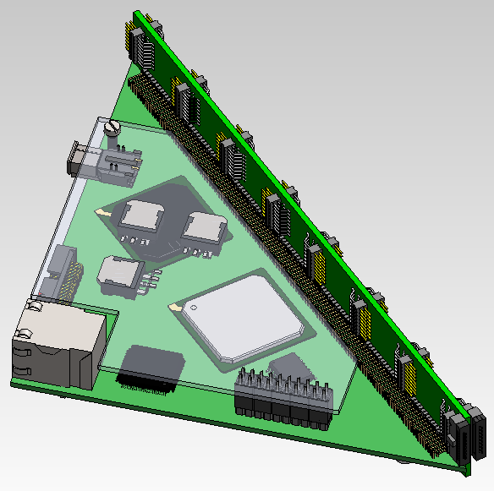
The RPC-DAQ Board Model
Power
From Preamps
To Trigger Sys
To back-end n/w

Slide 47
RPC-DAQ Board Connectors
Sr. No. | Connection | Location | Mfg. | Mfg. Part No. | Qty. per RPC-DAQ | Status
1 | RPC-DAQ to LTM | PCB | Samtec | SHF-113-01-L-D-RA | 1 | Available
2 | RPC-DAQ to LTM | Cable End | Samtec | FFSD-13-01-N | 1 | Available
3 | Pre-Amp to RPC-DAQ | PCB | Samtec | FTSH-108-01-F-DH | 16 | Available
4 | Pre-Amp to RPC-DAQ | Cable end | Samtec | FFSD-08-01-N | 16 | Available
5 | RPC-DAQ to N/W Switch | PCB | UDE | RB1-125BAG1A | 1 | To Be Ordered
6 | Power | PCB | Molex | 43650-0211 | 1 | To Be Ordered
7 | Power Cable | Cable End Housing | Molex | 43645-0200 | 1 | To Be Ordered
8 | Power Cable | Cable End Pin | Molex | 43030-0003 | 2 | To Be Ordered
9 | Side board to RPC-DAQ | PCB | MLE/Local | TTSHR-5 40-D-02-C-GT-LF | 4 x 64 pin | To Be Ordered
10 | RPC-DAQ to Piggy Board | PCB | Local | Straight Header 2 row 20 pin | 1 | Available
11 | Piggy Board to RPC-DAQ | PCB | Local | Header Receptable 2 row 20 pin | 1 | Available

Slide 48
Trigger Board Connectors
Sr. No. | Connection | Location | Manufacturer | Mfg. Part No. | Qty. per LTM | Status
LTM
1 | RPC-DAQ to LTM | PCB | Samtec | SHF-125-01-L-D-SM | 40 | Available
2 | RPC-DAQ to LTM | Cable End | Samtec | FFSD-25-01-N | 40 | Available
3 | LTM to GTM | PCB | Samtec | SHF-108-01-L-D-SM | 1 | Available
4 | LTM to GTM | Cable End | Samtec | FFSD-08-01-N | 1 | Available
5 | Horizontal Overlap | PCB | FCI/AUK | Various | 16 | Samples
6 | Horizontal Overlap | Cable End | FCI/AUK | Various | 16 | Samples
7 | Vertical Overlap | PCB | FCI/AUK | Various | 16
8 | Vertical Overlap | Cable End | FCI/AUK | Various | 16
9 | LTM to VME Back Plane | PCB |  | DIN41612 | 2 | Available
GTM
1 | LTM to GTM | PCB | Samtec | SHF-108-01-L-D-SM | 1 | Available
2 | LTM to GTM | Cable End | Samtec | FFSD-08-01-N | 1 | Available

Slide 49
Preamplifier
Sr. No. | Connection | Location | Manufacturer | Mfg. Part No. | Qty per GTM | Status
1 | RPC-DAQ to Preamp | Board | Samtec | FTSH-108-01-F-DH | 16 | Available
2 | RPC-DAQ to Preamp | Cable | Samtec | FFSD-08-01-N | 16 | Available
3 | Power | Board |  |  | 1 | Undecided
4 | Power Cable | Cable |  |  | 1 | Undecided
5 | Threshold | Board |  |  | 1 | Undecided

Slide 50
How Much Cable is Required?
Phase 0: Engineering module
Length (m) |  |  |  |  | 23 | 25 | 27 | 29
Qty (Nos.) |  |  |  |  | 20 | 20 | 20 | 20
Total Length |  |  |  |  | 460 | 500 | 540 | 580 | 2080
Phase 1: ICAL Module 1A
Length (m) | 23 | 25 | 27 | 29 | 31 | 33 | 35 | 37
Qty (Nos.) | 150 | 150 | 150 | 150 | 150 | 150 | 150 | 150
Total Length | 3450 | 3750 | 4050 | 4350 | 4650 | 4950 | 5250 | 5550 | 36000
Phase 1: ICAL Module 1B
Length (m) | 25 | 27 | 29 | 31 | 33 | 35 | 37 | 39
Qty (Nos.) | 150 | 150 | 150 | 150 | 150 | 150 | 150 | 150
Total Length | 3750 | 4050 | 4350 | 4650 | 4950 | 5250 | 5550 | 5850 | 38400
Phase 2: ICAL Module 2A
Length (m) | 39 | 41 | 43 | 45 | 47 | 49 | 51 | 53
Qty (Nos.) | 150 | 150 | 150 | 150 | 150 | 150 | 150 | 150
Total Length | 5850 | 6150 | 6450 | 6750 | 7050 | 7350 | 7650 | 7950 | 55200
Phase 2: ICAL Module 2B
Length (m) | 41 | 43 | 45 | 47 | 49 | 51 | 53 | 55
Qty (Nos.) | 150 | 150 | 150 | 150 | 150 | 150 | 150 | 150
Total Length | 6150 | 6450 | 6750 | 7050 | 7350 | 7650 | 7950 | 8250 | 57600
Phase 2: ICAL Module 3A
Length (m) | 55 | 57 | 59 | 61 | 63 | 65 | 67 | 69
Qty (Nos.) | 150 | 150 | 150 | 150 | 150 | 150 | 150 | 150
Total Length | 8250 | 8550 | 8850 | 9150 | 9450 | 9750 | 10050 | 10350 | 74400
Phase 2: ICAL Module 3B
Length (m) | 57 | 59 | 61 | 63 | 65 | 67 | 69 | 71
Qty (Nos.) | 150 | 150 | 150 | 150 | 150 | 150 | 150 | 150
Total Length | 8550 | 8850 | 9150 | 9450 | 9750 | 10050 | 10350 | 10650 | 76800
 |  |  |  |  |  |  | Grand Total |  | 340480 | m
 |  |  |  |  |  |  |  |  | 340.48 | km

Slide 51
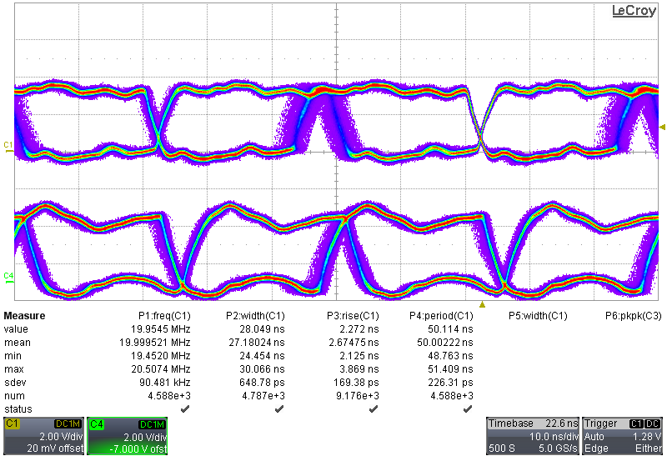
Eye Diagram for 100m cable

Slide 52
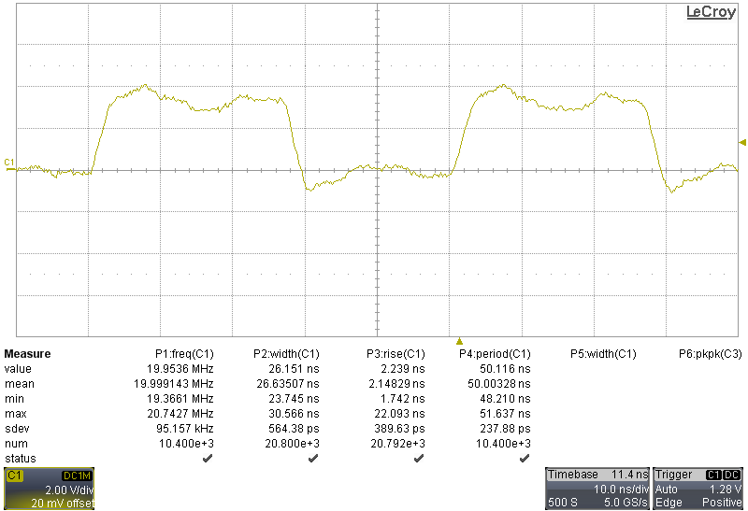
Results(cont.) -100m cable
LVDS driver IC output:- Figure shows the 20MHz pulse having 25ns width and Standard deviation of period is 238ps.

Slide 53
To recapitulate
Ethernet (“LAN”) for control and data transfer between RPC’s (Front End DAQ) and the backend servers
Every RPC to run Nios II based FrontEnd DAQ (FE-DAQ) with a ethernet port (Wiznet W5300)
Every RPC “acquires” its own data on global trigger, and then transfers the data to back end servers
Ethernet is being proposed because it is simple and familiar, ubiquitous, cheap, future proof, can even connect to a laptop

Slide 54
Proposed Ethernet Scheme
17 Port
FE Switch
All copper, no fiber
Rght side “Half roads”
17 Port
FE Switch
17 Port
FE Switch
`
17 Port
TE Switch
17 Port
FE Switch
Left side “Half roads”
17 Port
FE Switch
17 Port
FE Switch
17 Port
FE Switch
“Trunked” data packets of 64 right “half roads” of
L0 to L7
17 Port
FE Switch
17 Port
FE Switch
`
17 Port
FE Switch
17 Port
FE Switch
One CAT5e cable for two RPCs
Two ports for set of 8 layers
48 port L2
“Backend” Switch
17 Port
TE Switch
CAT6 cables
Flow of “Trunked” data packets of 64 left “half roads” of
L0 to L7
Back end Servers
2 units in 1U chassis
Back end Servers
2 units in 1U chassis
All ethernet swithes are proposed as unmanaged L2, gigabit on copper.
All paths are full duplex
Back end
Back end Servers
2 units in 1U chassis
Back end Servers
2 units in 1U chassis
Back end Servers
2 units in 1U chassis

Slide 55
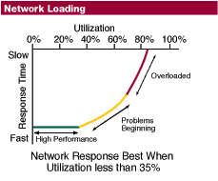
Downstream Data Rates at backend
Each RPC 0.045Mbps (0.3Mbps with DRS)
Assumed worst case scenario:
  10Hz event rate (as against the estimated 1Hz)
  All RPC’s participate in every trigger (a truly rare event or else noise)
Table shows the cases for one backend server handling 1048 or 2048 RPC’s, assuming *all* RPC’s pumping data
Basically, we are safe.
Server responsibility | No DRS (Gbps) | With DRS (Gbps) | # of backend servers for 1 ICAL module
1024 RPC’s (16 layers) | 0.045 | 0.3 | 9
2048 RPC’s (32 layers) | 0.090 | 0.6 | 5
Should we not think of
(a) read only those RPC’s that participated in trigger?
(b) enable/disable DRS as required

Slide 56
Ethernet Traffic and Congestion issues
Things unique to our “ICAL LAN”
  No distributed packets
  only client-server traffic
  only one server, rest all clients
  No fragmentation: packet size same as MTU or smaller
Upstream data (source at backend) practically zero (only command/config)
Downstream data (event and monitoring data)
  Issue hinges on how many RPC’s are handled by one server

Slide 57
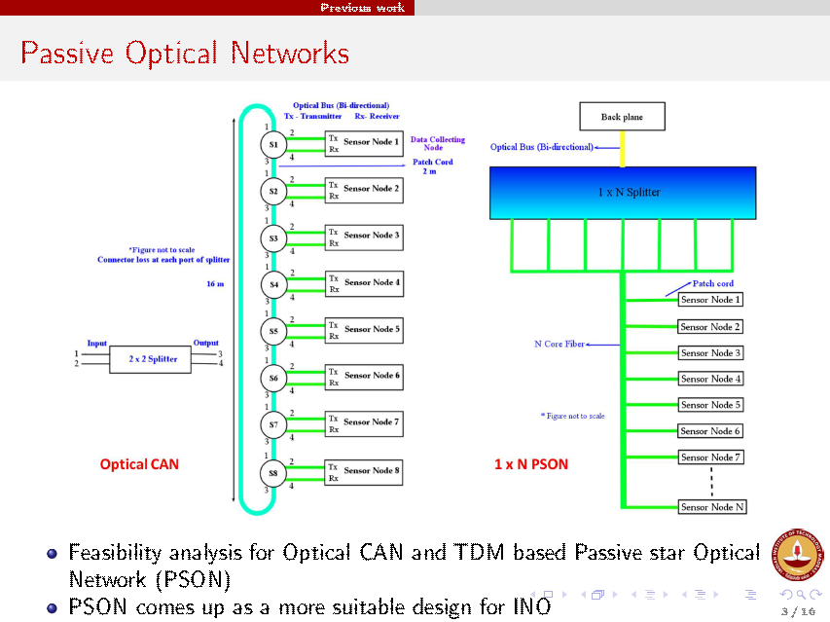

Slide 58
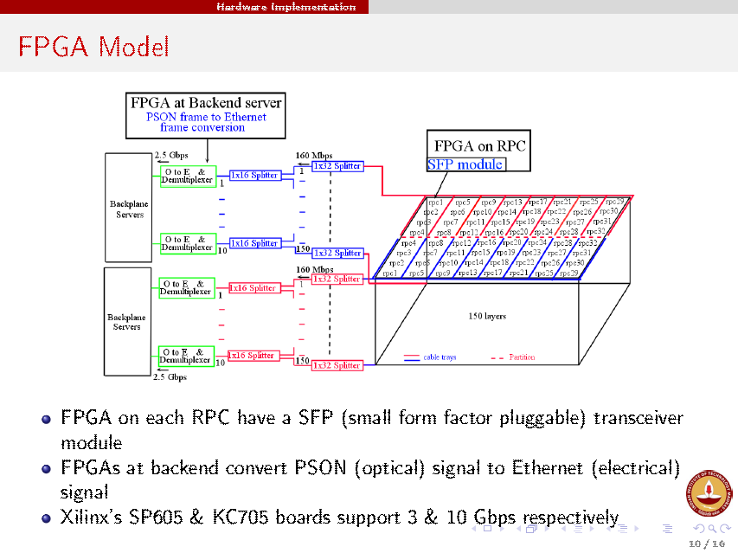

Slide 59
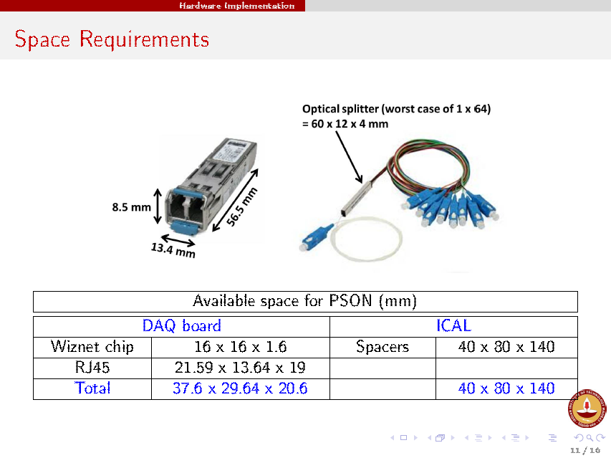

Slide 60
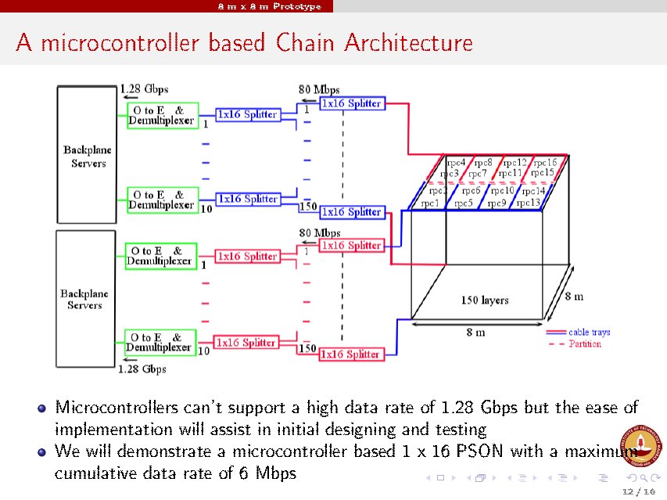

Slide 61
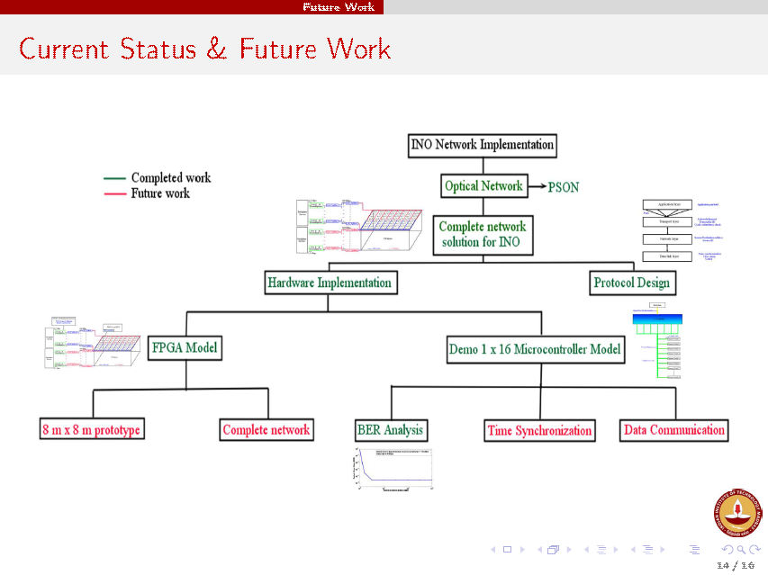

Slide 62
Backend Software
Run control
Local and Remote Consoles
DAQ Systems Configuration
Online Monitoring
Online monitoring & control of RPC Parameters
Network Monitoring
Limitations of the Continuous Monitoring
Event Data Acquisition
Programmable Dataflow
Event Data Quality Monitoring
INO Storage Requirements
Error Management and Recovery

Slide 63
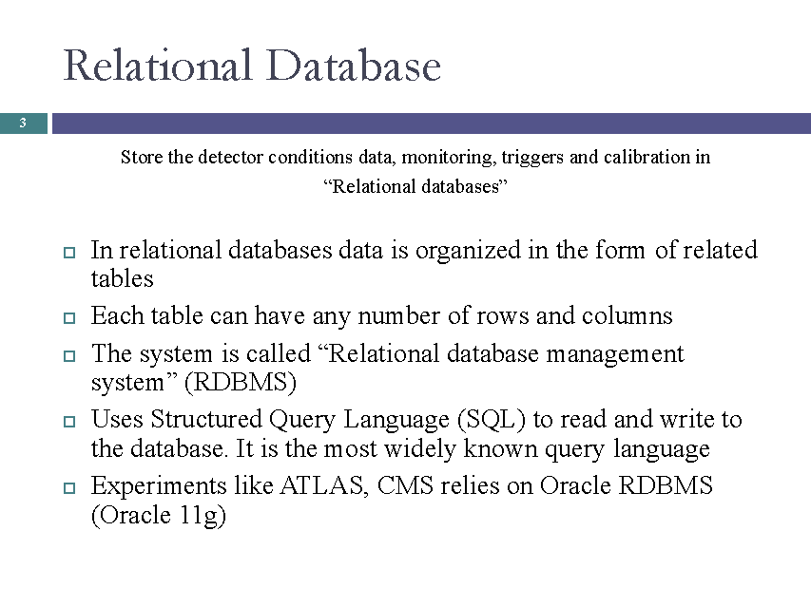

Slide 64
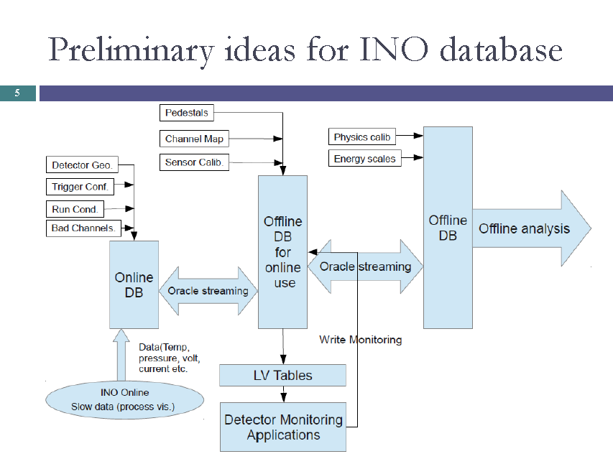

Slide 65
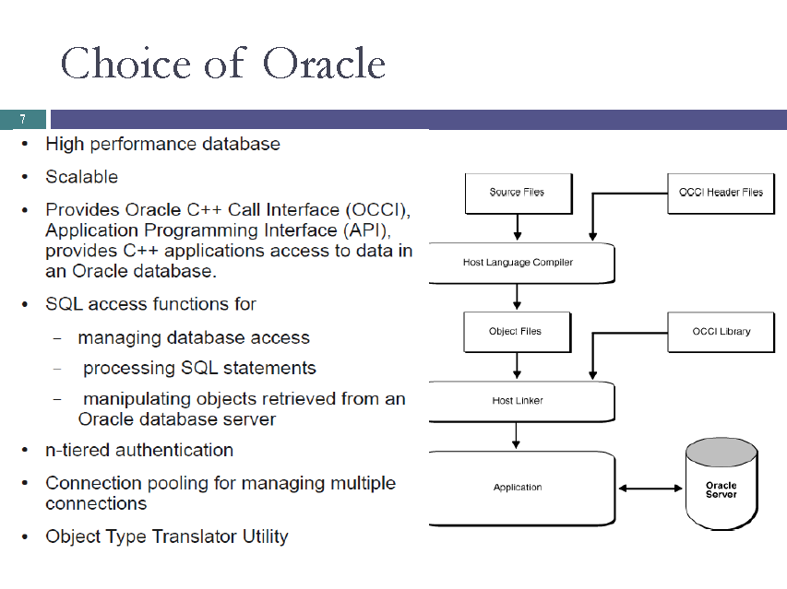

Slide 66
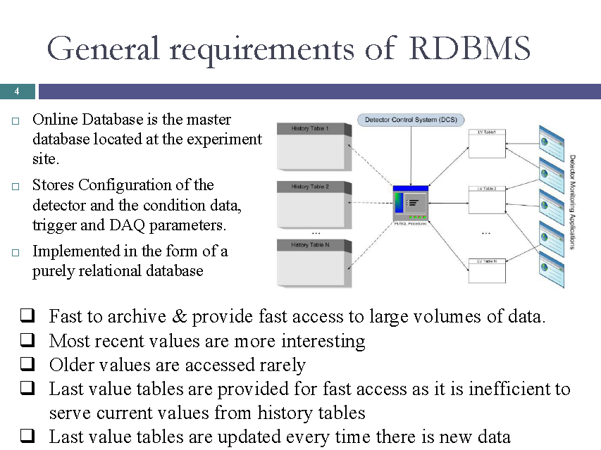

Slide 67
Summary
Overall made good progress since last collaboration meeting
Many sub-systems moved to prototyping or even large scale production
Limited component procurement initiated
ICAL electronics document (V2.0) is being circulated internally
It will be vetted by external expert group
Fresh or alternate ideas keep coming up, happened even in the meeting
But, need to go ahead with baseline design, allowing the new ideas to be worked on and tested in parallel
Brain-storming meetings among sub-groups to be followed up in order to come up with timeline for individual sub-groups
Focusing on engineering module to begin with.

