Slide 1
Status of ICAL RPCs
B.Satyanarayana, TIFR, Mumbai
INO Collaboration

Slide 2
Factsheet of ICAL detector
No. of modules | 3
Module dimensions | 16m × 16m × 14.5m
Detector dimensions | 48.4m × 16m × 14.5m
No. of layers | 150
Iron plate thickness | 56mm
Gap for RPC trays | 40mm
Magnetic field | 1.3Tesla
RPC dimensions | 1,950mm × 1,840mm × 24mm
Readout strip pitch | 3 0mm
No. of RPCs/Road/Layer | 8
No. of Roads/Layer/Module | 8
No. of RPC units/Layer | 192
No. of RPC units | 28,800 (97,505m²)
No. of readout strips | 3,686,400

Slide 3
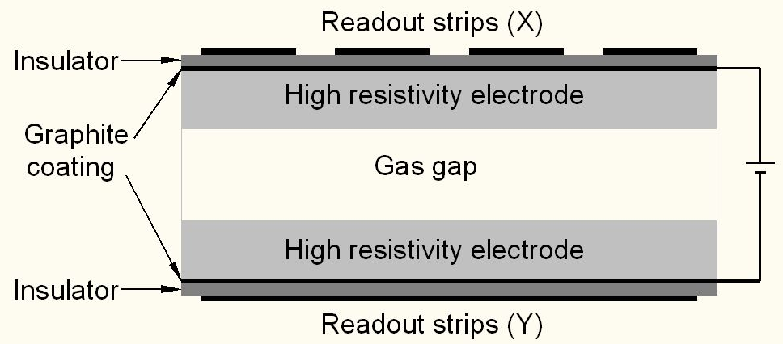
Schematic of a basic RPC

Slide 4
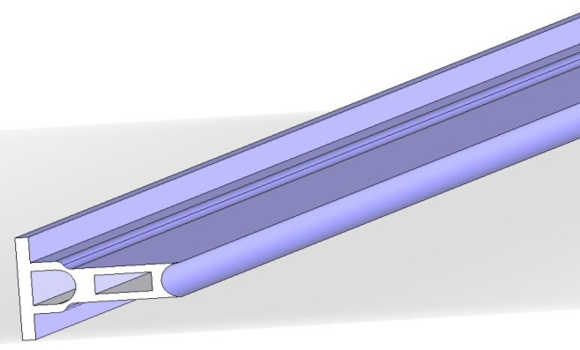
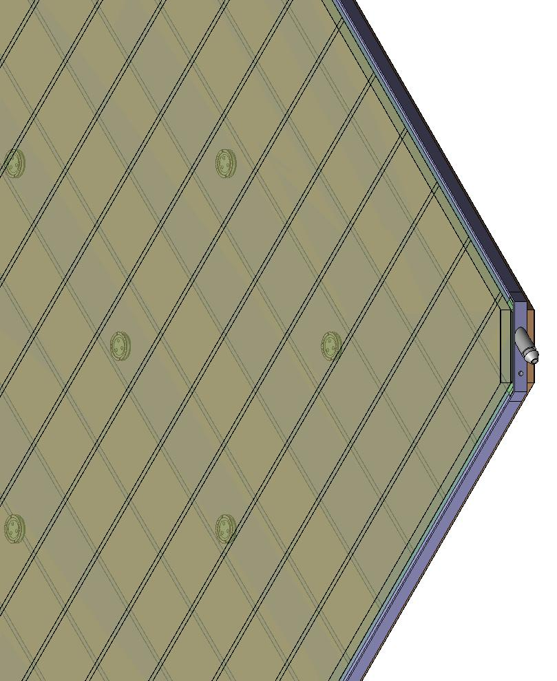
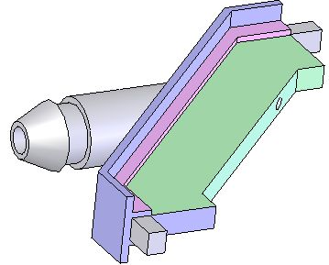
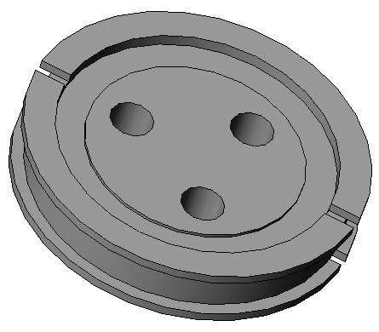
Parts for gas volume fabrication
Edge spacer
Schematic of an assembled gas volume
Gas nozzle
Glass spacer

Slide 5
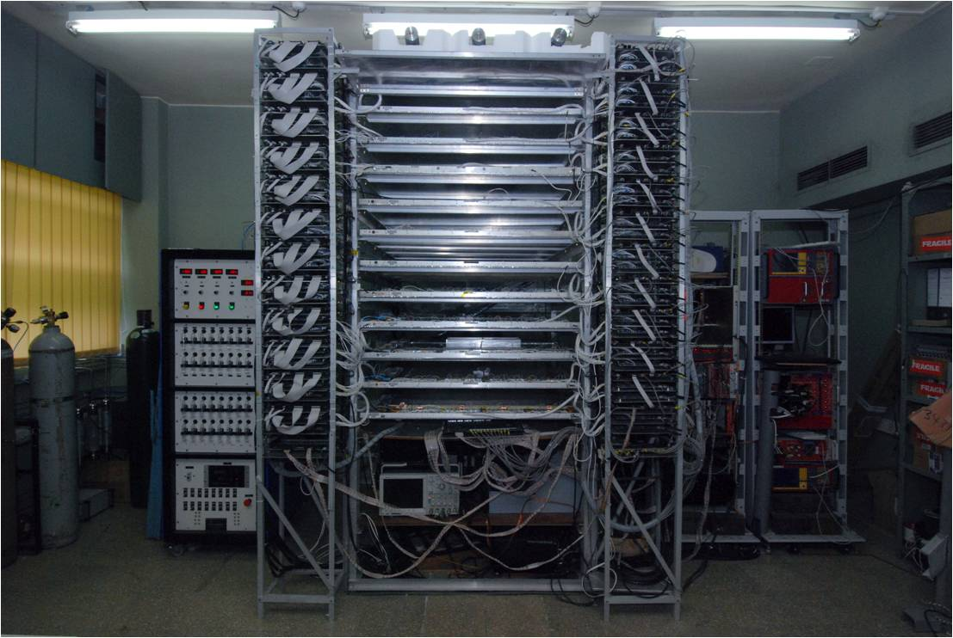
Stack of 1m × 1m RPCs

Slide 6
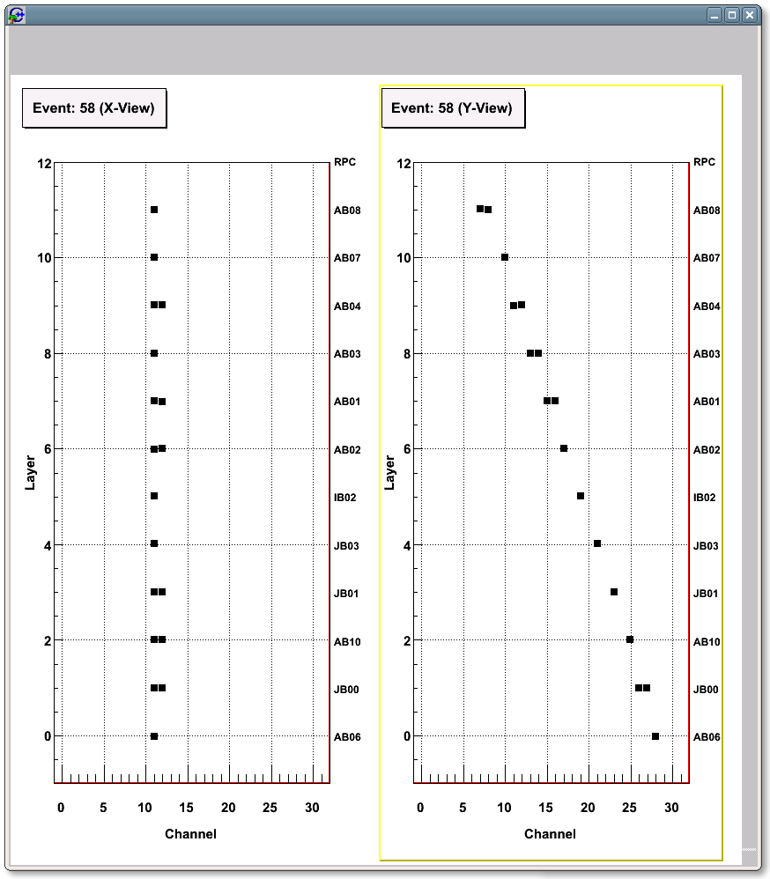
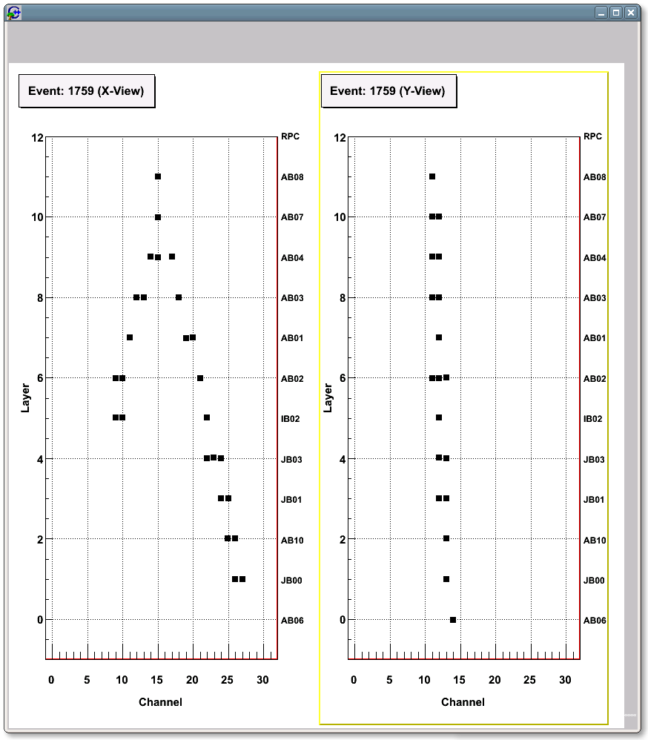
Studying RPCs using muons

Slide 7
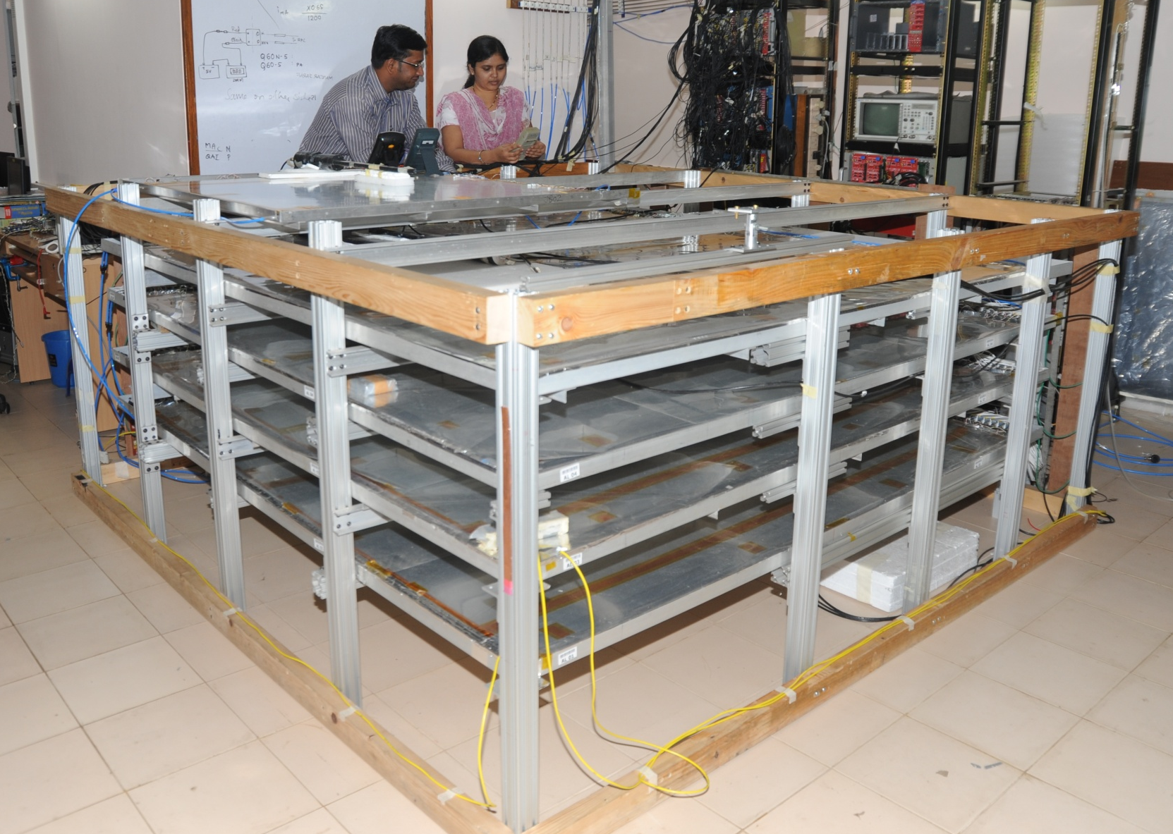
Stack of 2m × 2m RPCs

Slide 8
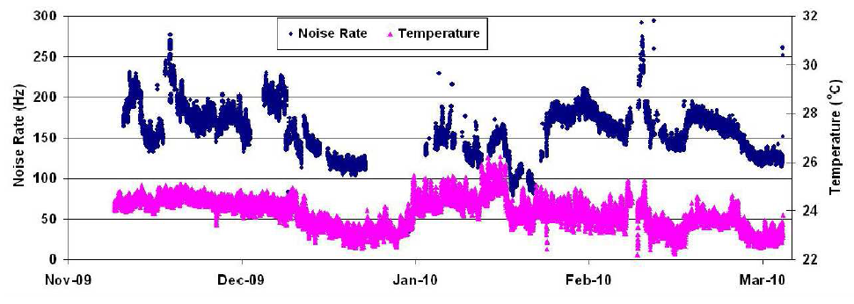
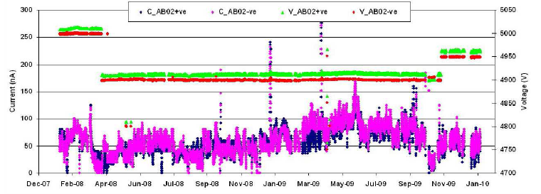
Studying long-term stability

Slide 9
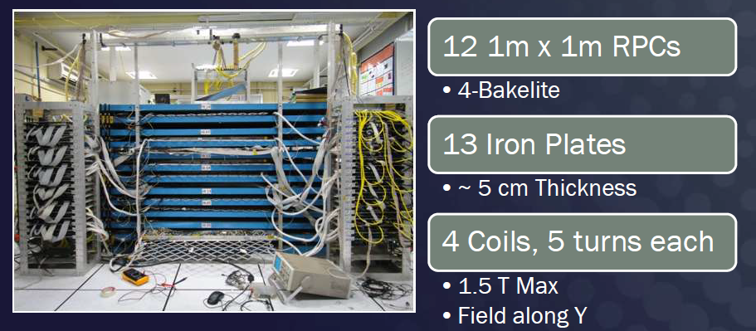
ICAL mini at VECC

Slide 10
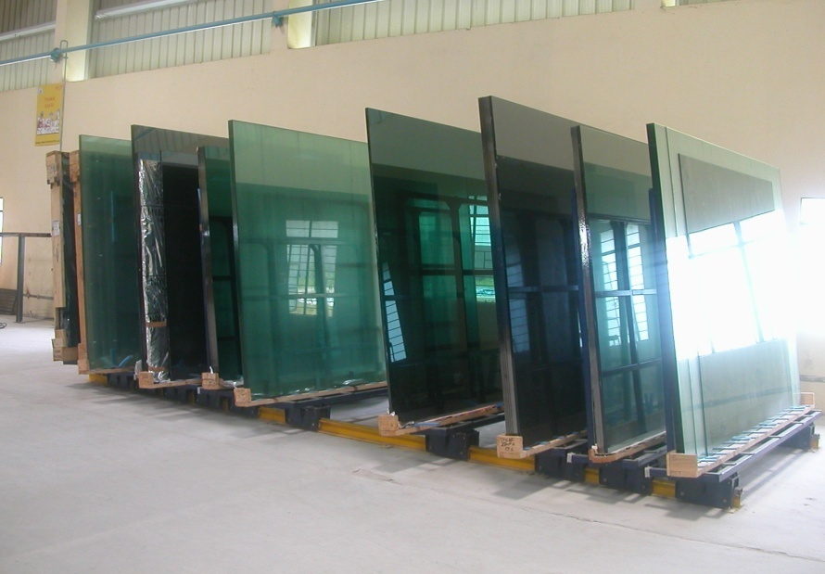
Studies on float glass

Slide 11
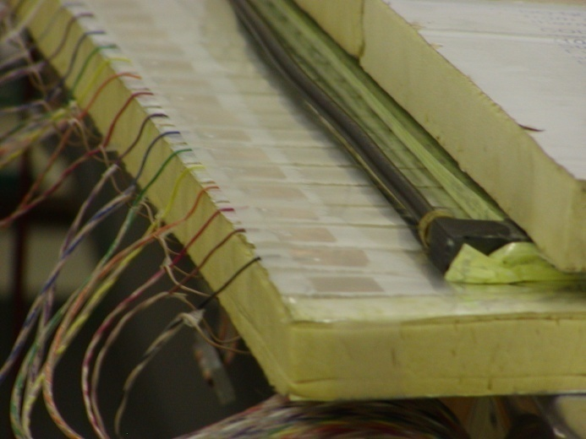
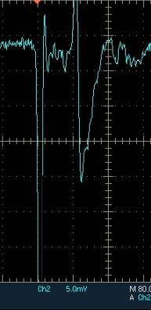
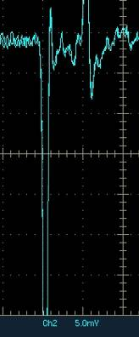
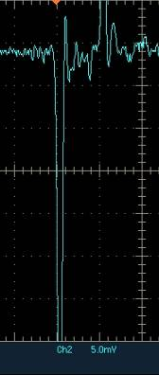
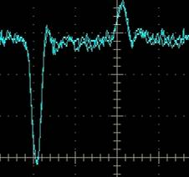
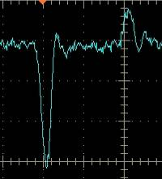
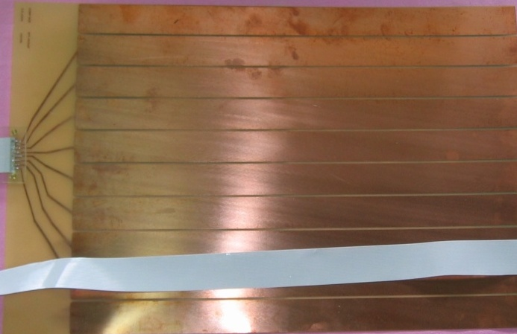
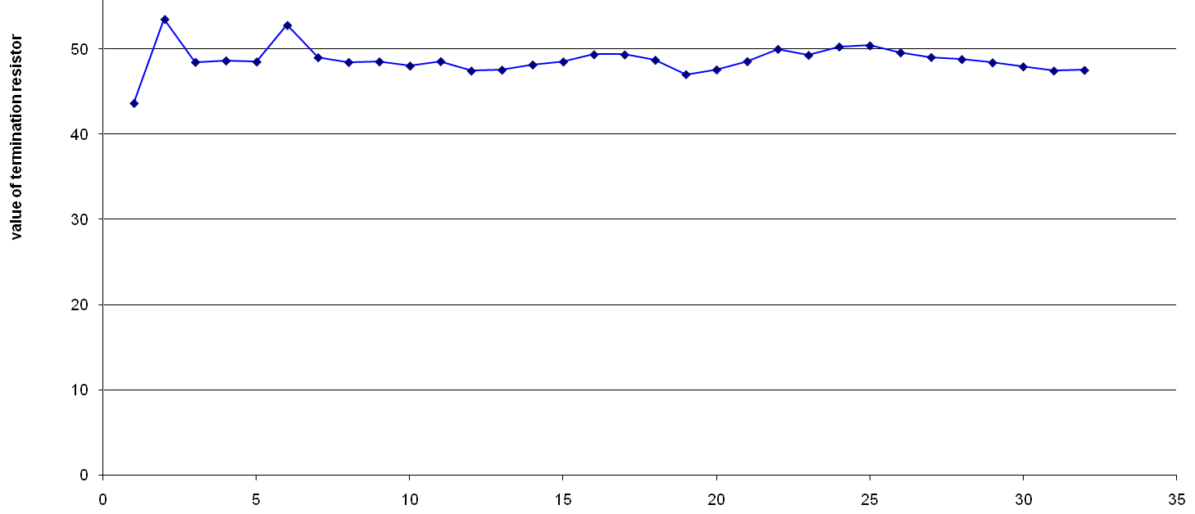
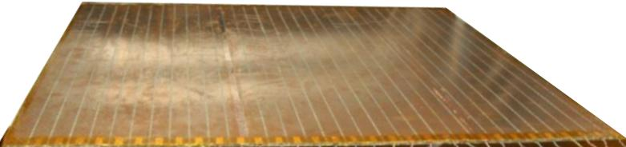
Pickup panel development
Foam panel
48.2Ω
G-10 panel
Open
100Ω
51Ω
47Ω
Z₀: Inject a pulse into the strip; tune the terminating resistance at the far end, until its reflection disappears.
Honeycomb panel

Slide 12
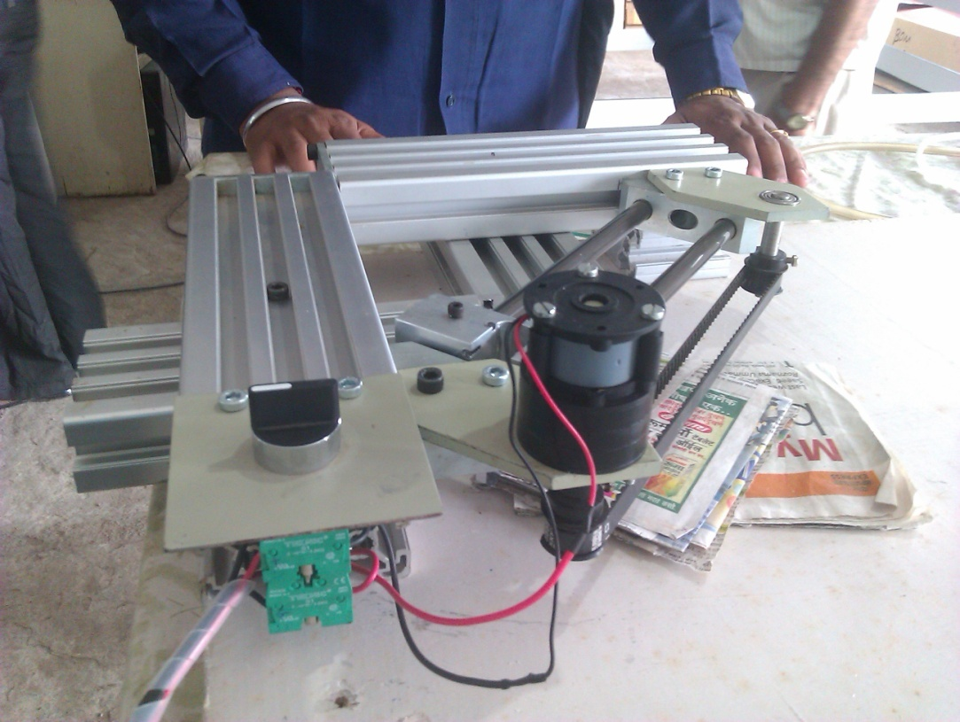
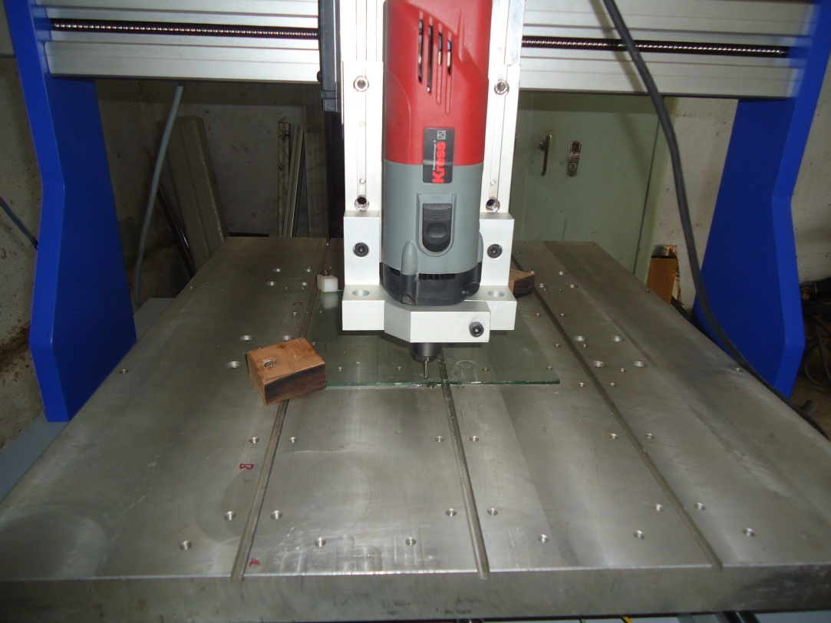
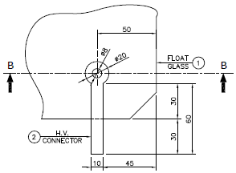
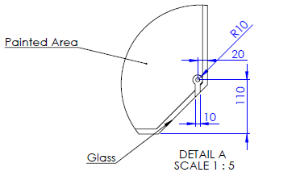
Chamfering and engraving of glass

Slide 13
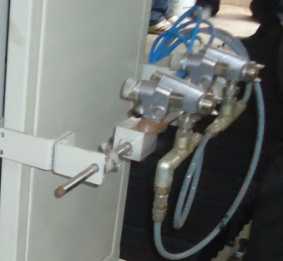
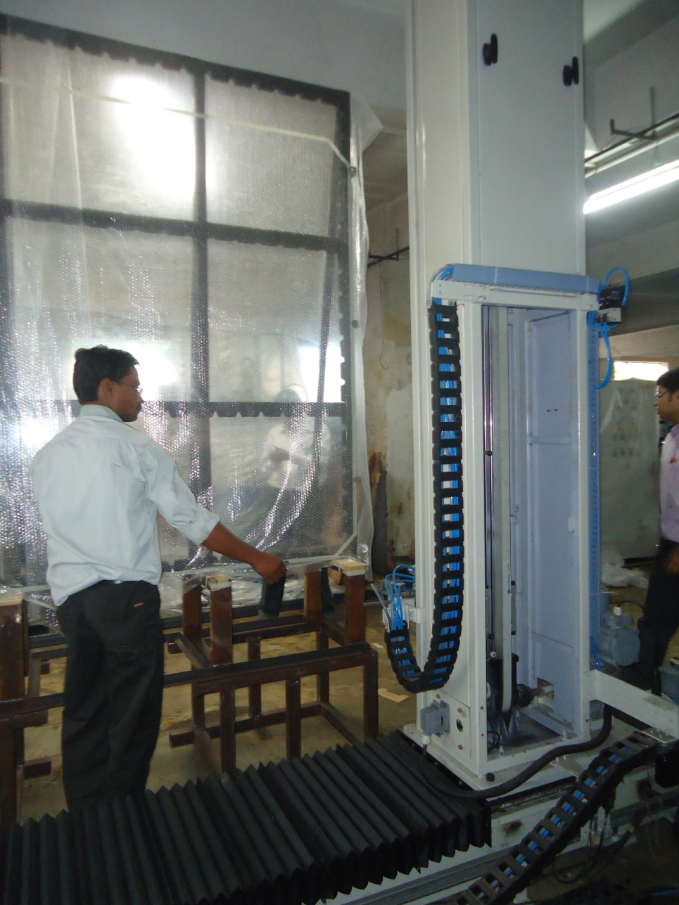
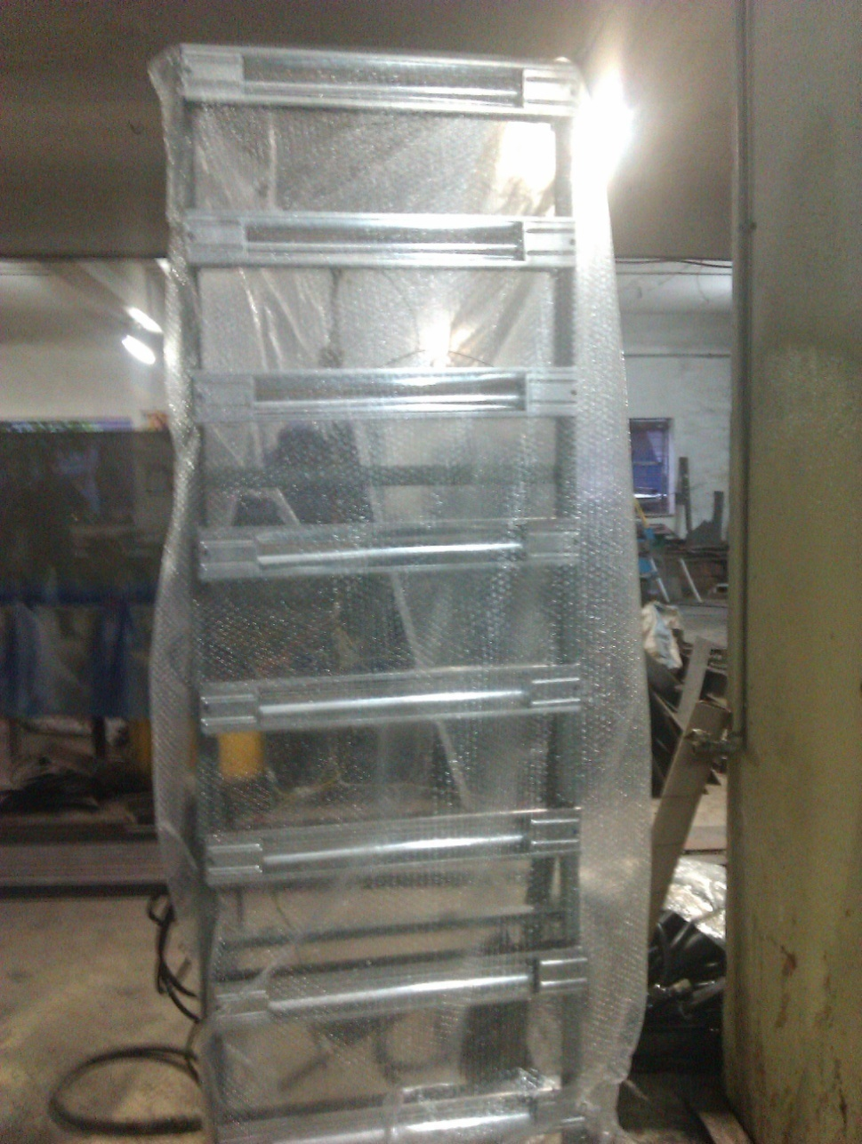
Painting/curing of glass plates

Slide 14
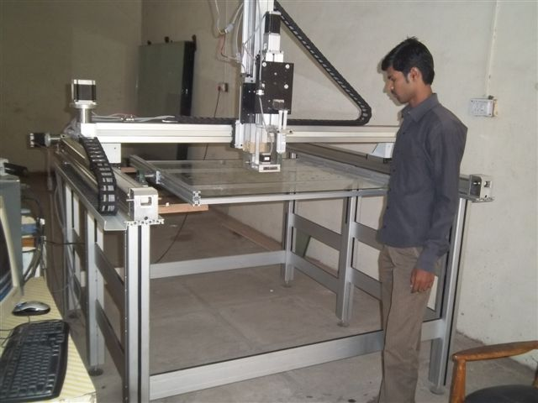
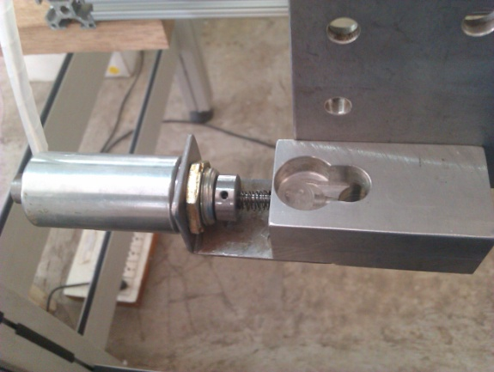
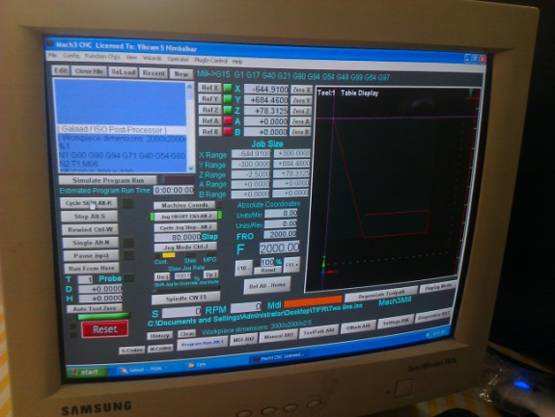
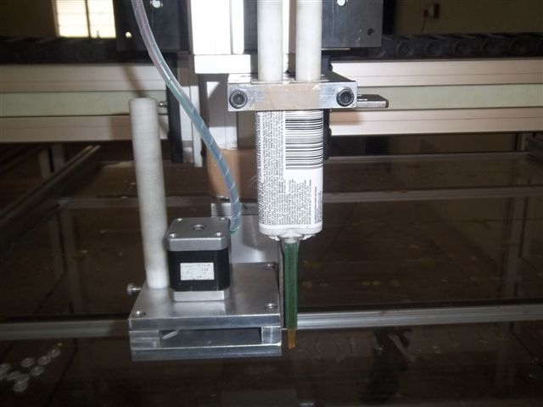
Automatic RPC gap making

Slide 15
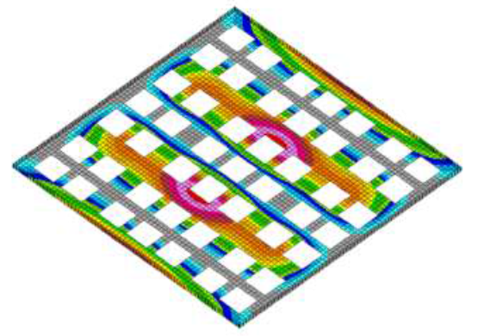
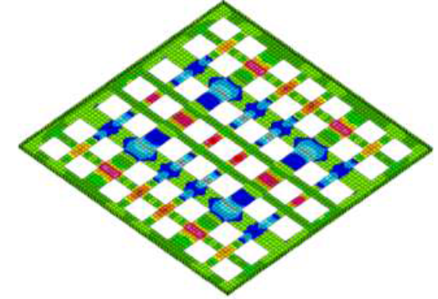
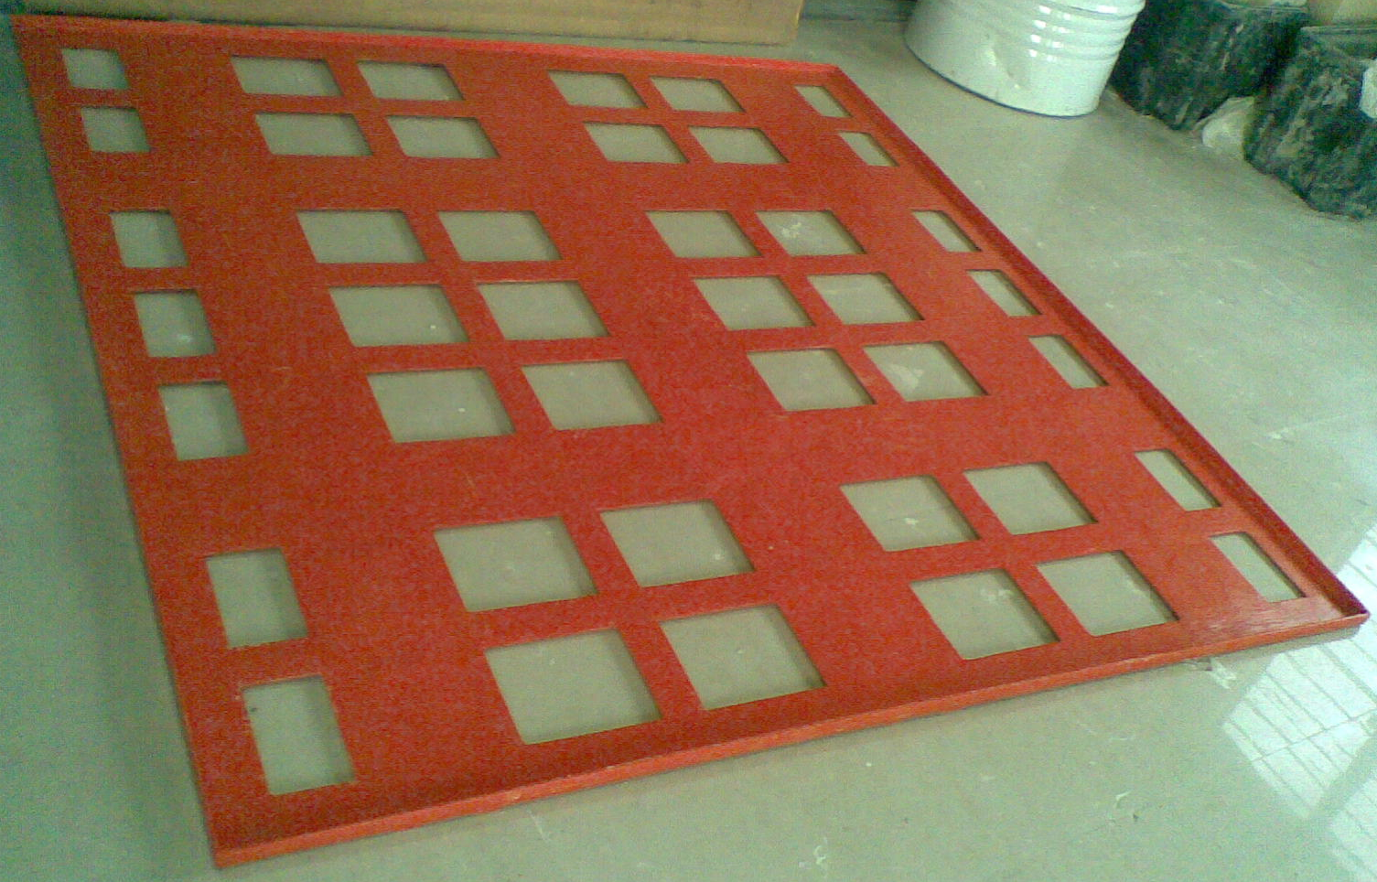
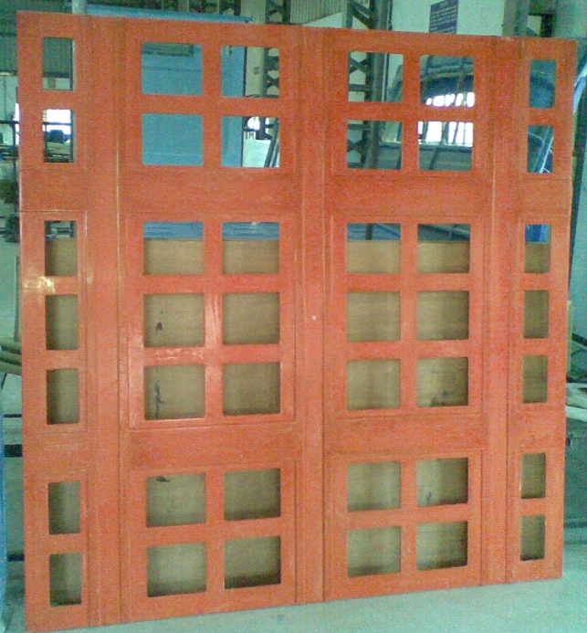
RPC holding tray
Self weight + 100kg load
Finite Element Analysis
Max. deflection
4.4mm
Max. stress
8.2MPa
Spec.
5mm
FRP
25MPa
Extra thickness in selected sections
Three-line support
Fabricated tray
Down side view

Slide 16
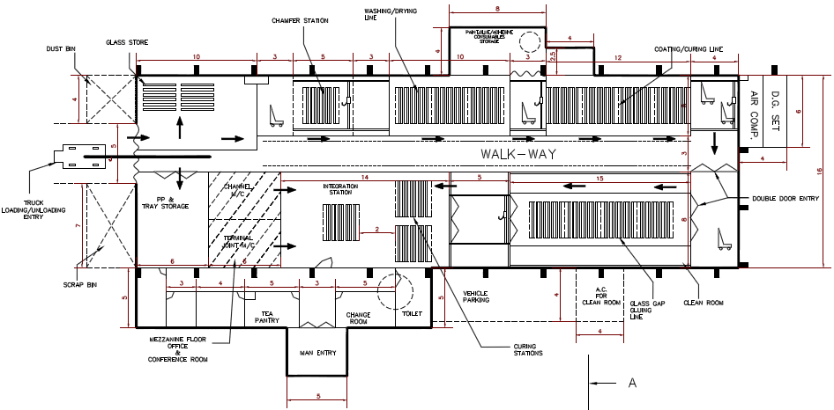
RPC fabrication facility

Slide 17
Current status
RPC detector R&D concluded quite a while ago. The RPC stacks are being used even for some physics studies.
Scaling up and industrial adaptation of lab technology – by an industry, is almost complete.
Extensive vendor development for material fabrication, process development, design of SPMs and for large scale production of RPCs.
Ready for engineering module.
Tenders for RPC production for engineering module are about to be floated.
Further fine-tuning of chamber design, operating parameters and maintenance related practices will continue.

