Slide 1
ICAL Integration Issues
B.Satyanarayana, TIFR, Mumbai
INO Collaboration

Slide 2
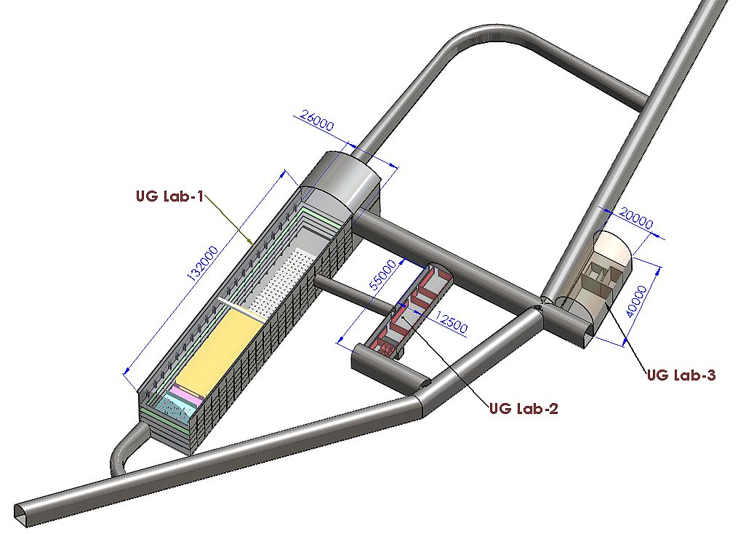
INO cavern layout
Length of the tunnel | 2.1 km (approx.)
Tunnel cross-section | 7.5m wide and 7.5m high
Tunnel gradient | 1:15
Rock overburden | 1300m (4000 mwe)
Rock type and density | Charnockite, 2.9 gm/cc
Number of caverns | 3 (one big and two small)
Size of the main cavern | 132m × 26m × 20m (high)
Distance from CERN | 7100 km

Slide 3
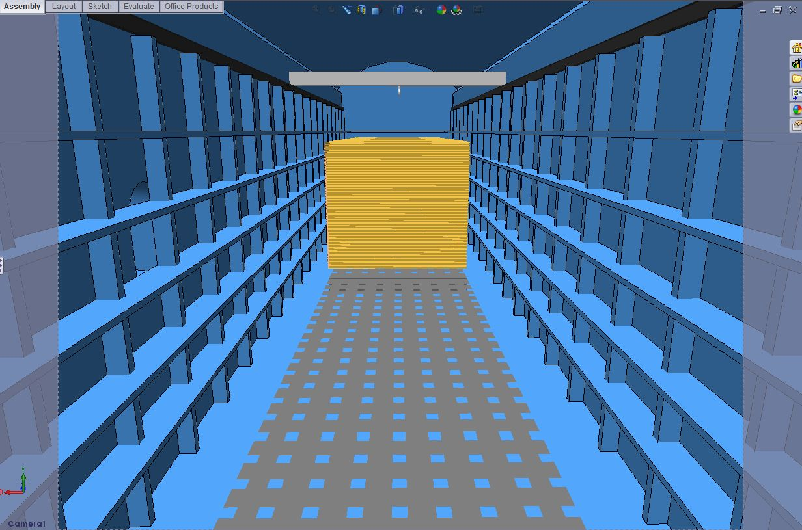
View from the loading bay

Slide 4
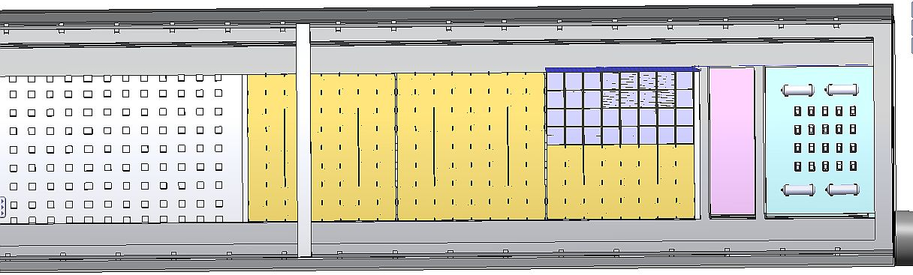
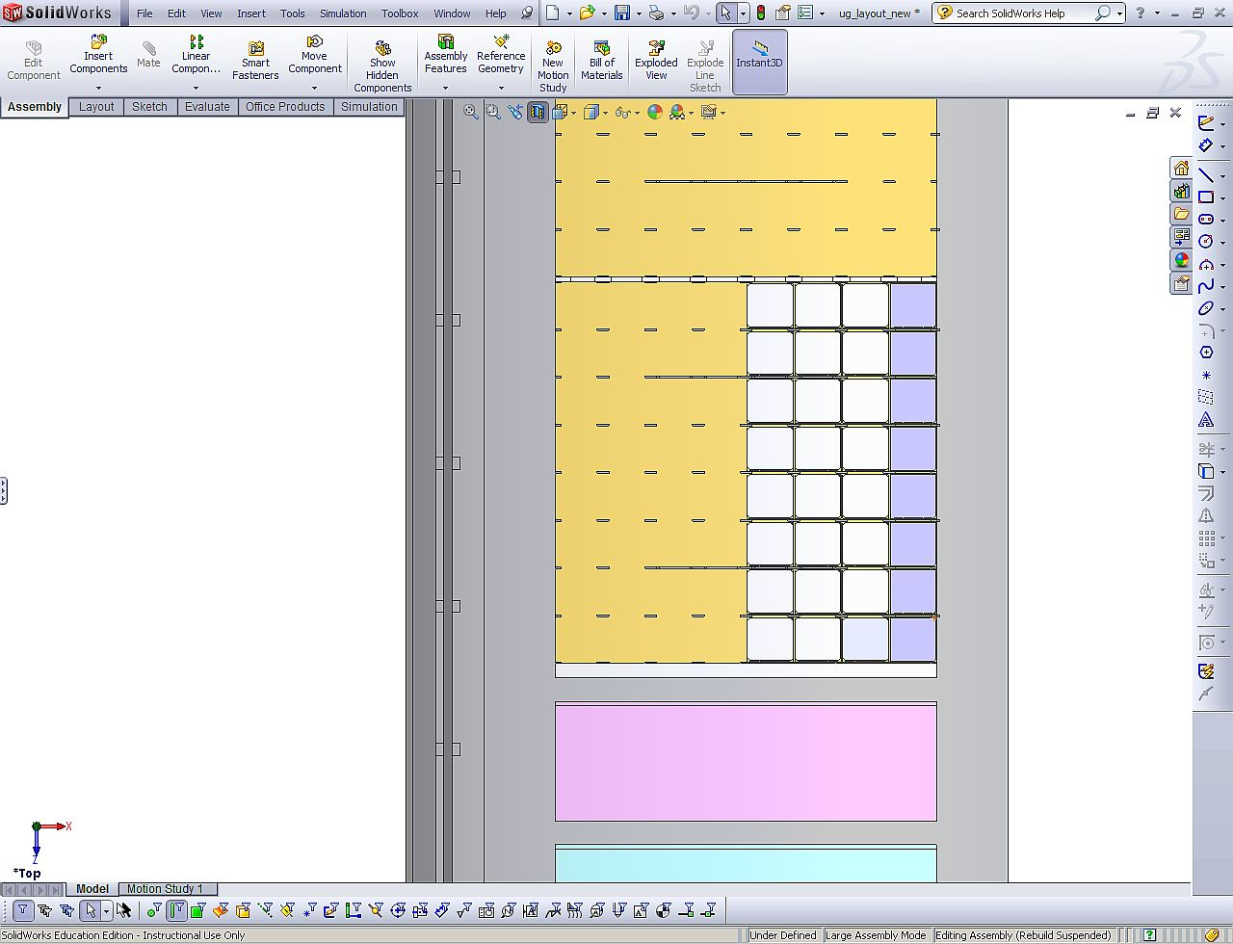
View from the ceiling

Slide 5
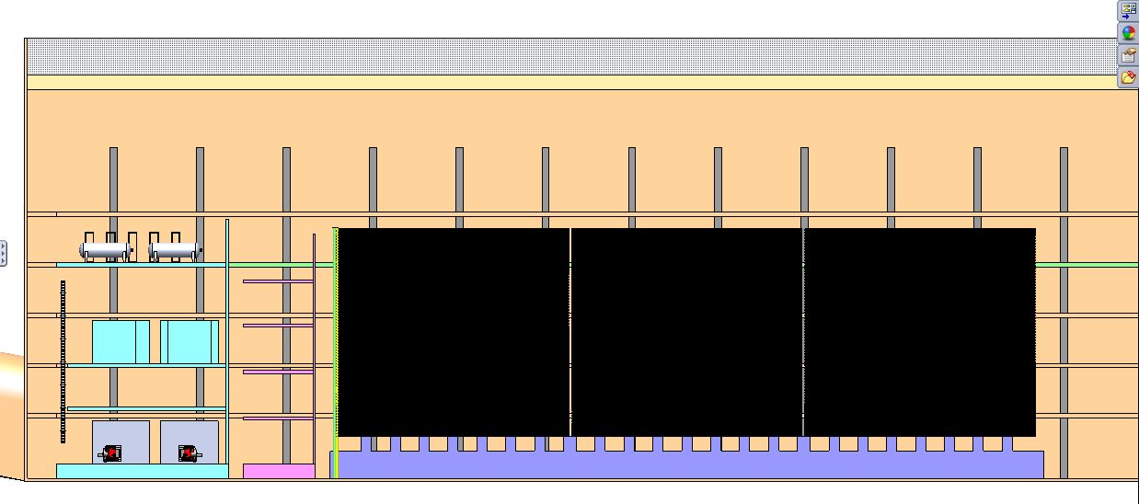
Side view of the Phase-1 ICAL

Slide 6
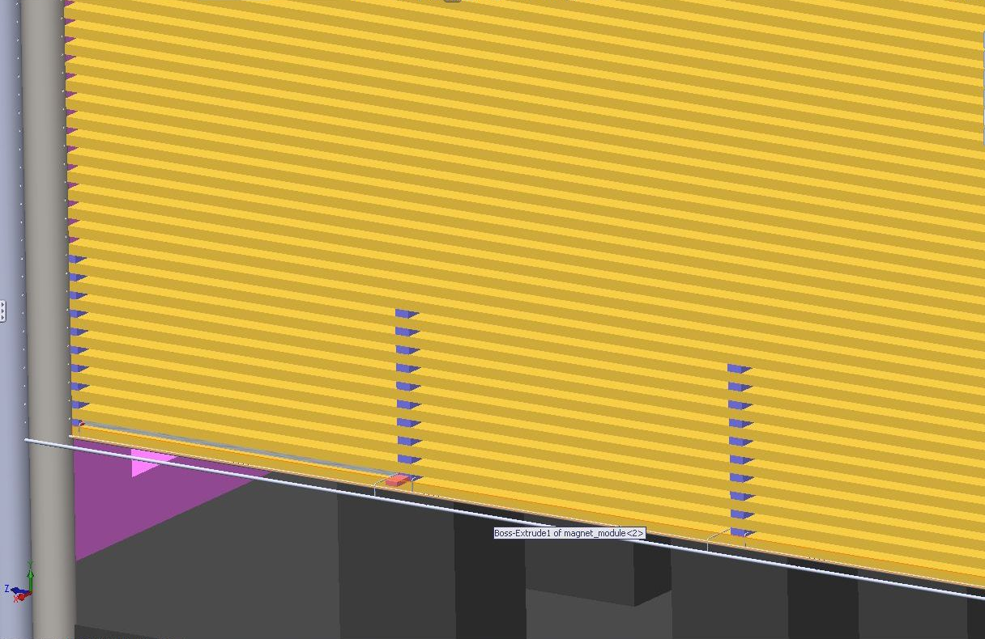
A slice of ICAL

Slide 7
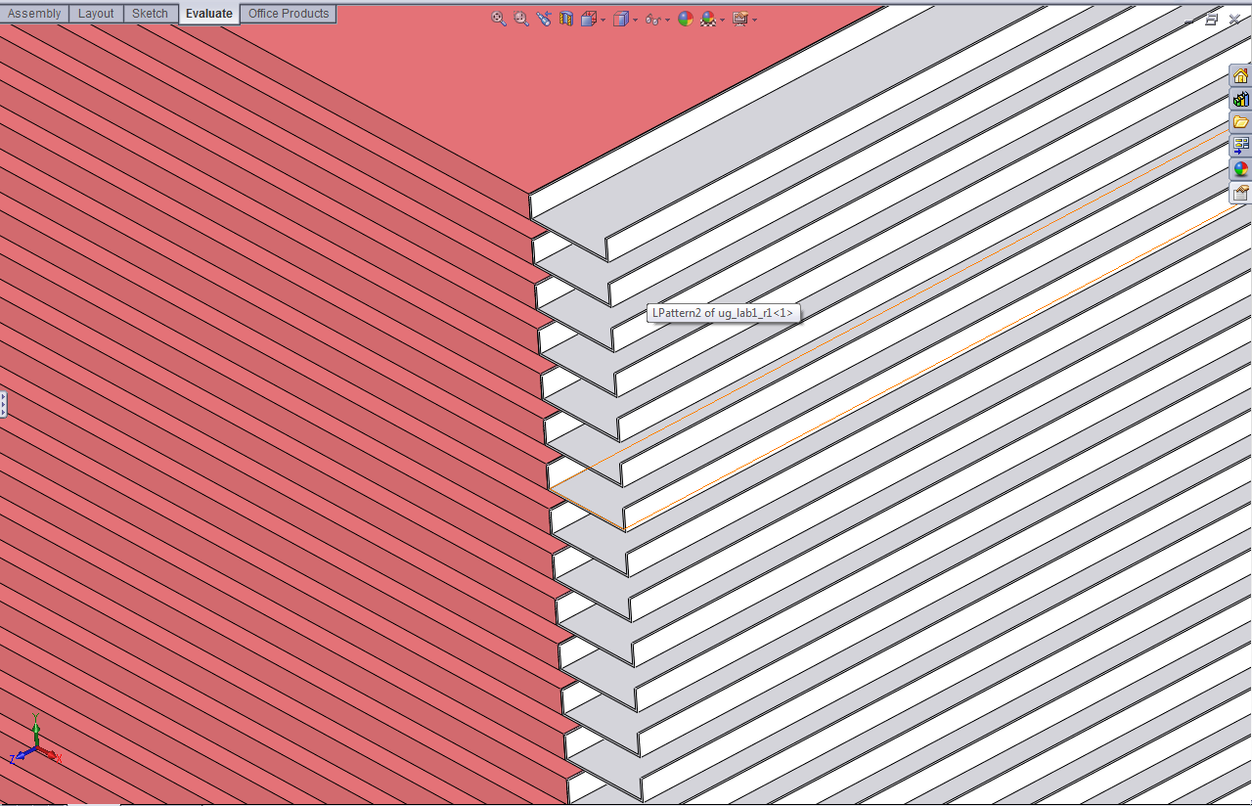
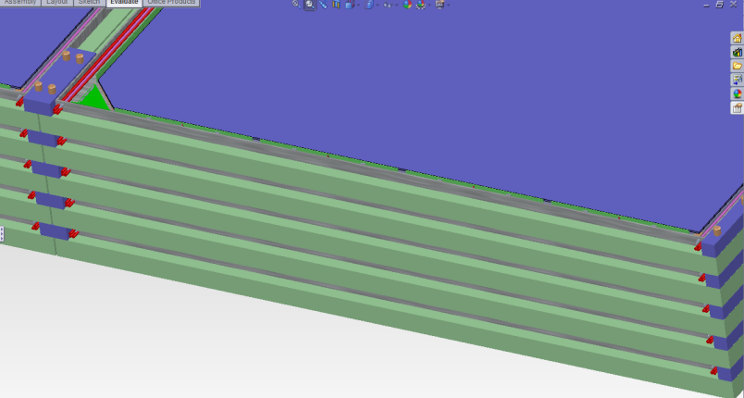
Spacers and cable tray

Slide 8
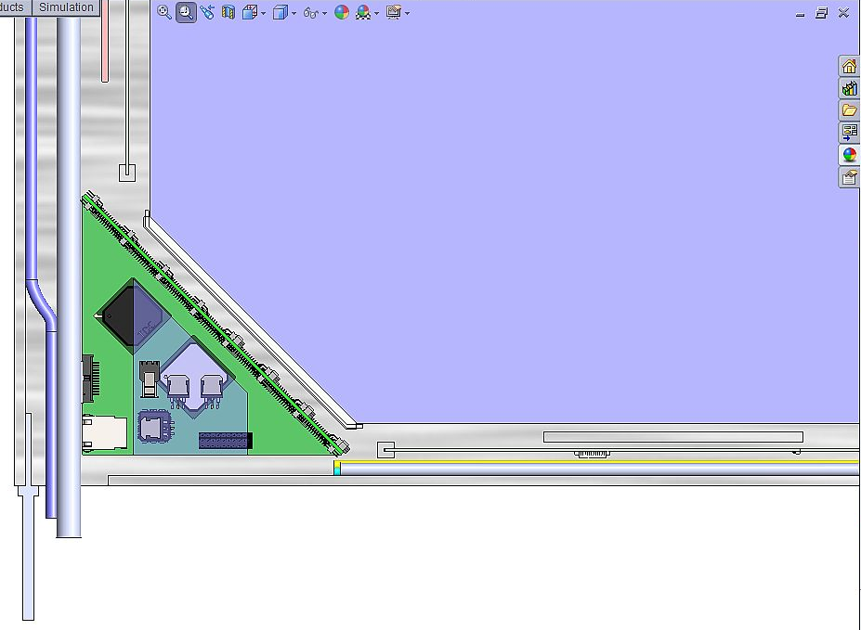
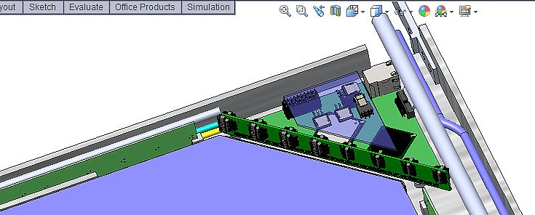
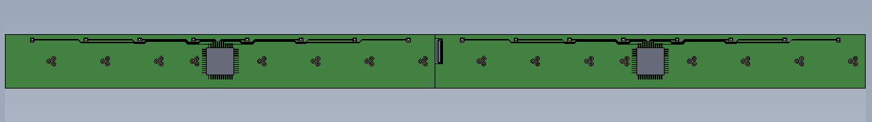
Preamp and RPCDAQ boards

Slide 9
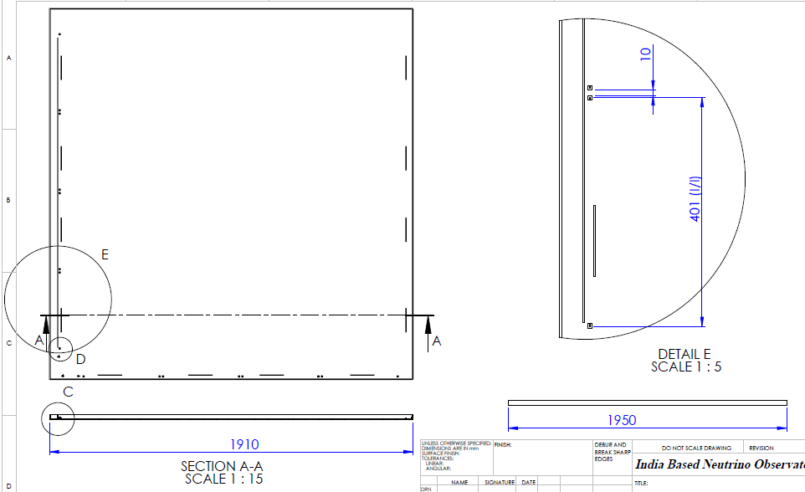
Tray dimensions

Slide 10
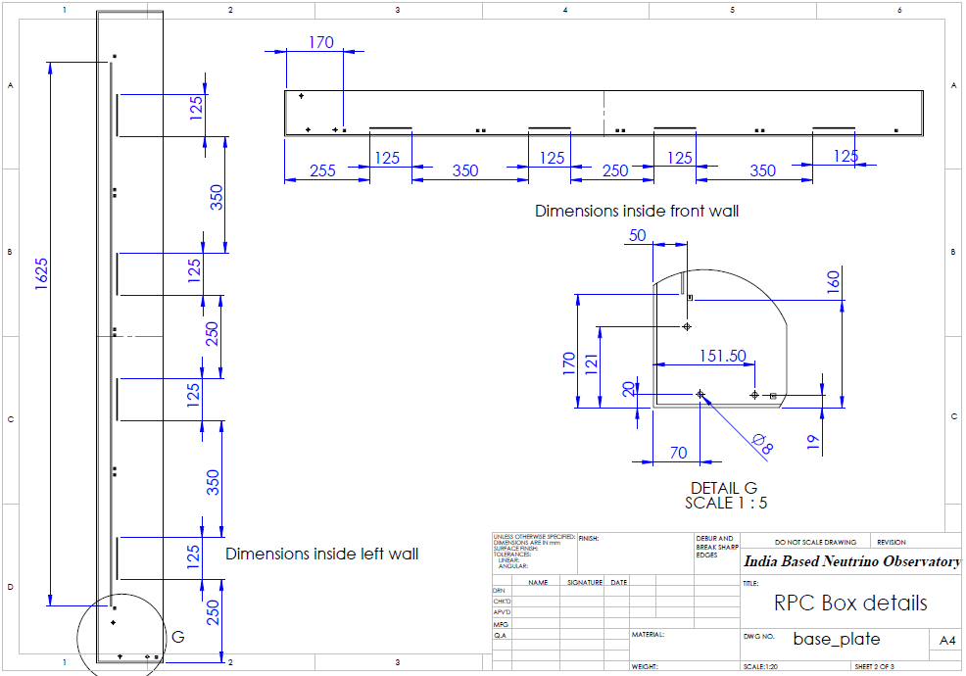
Details of the components

Slide 11
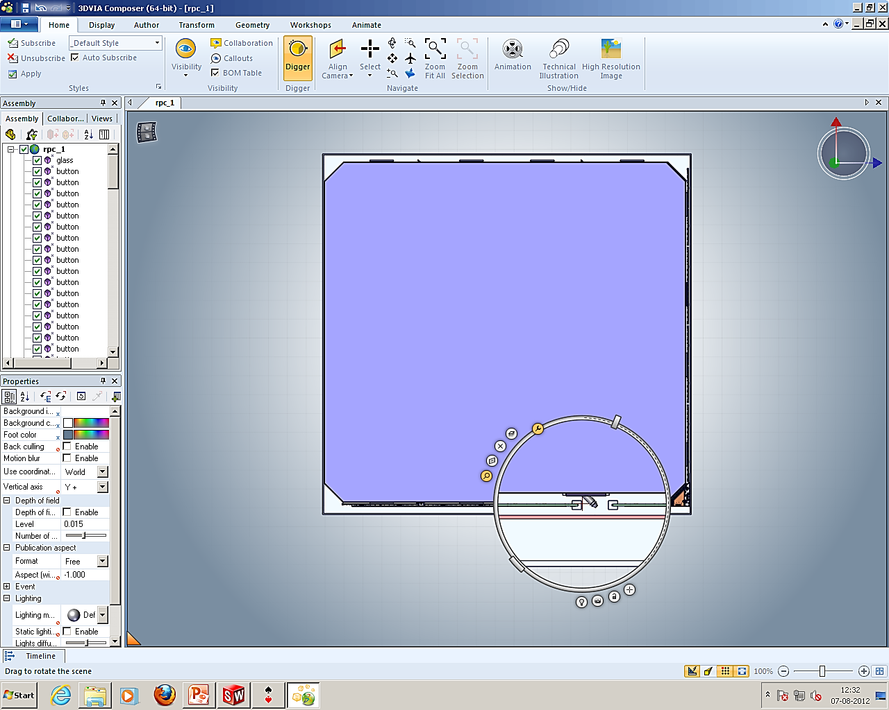
Details of one of gas ports

Slide 12
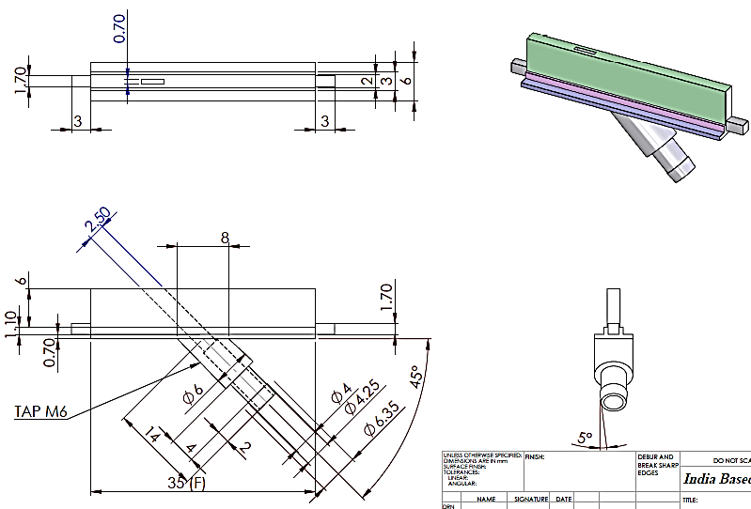
Details of gas nozzle

Slide 13
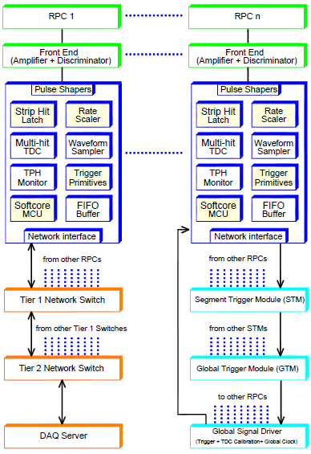
Overall scheme of ICAL electronics
Major elements
Front-end board
RPCDAQ board
Segment Trigger Module
Global Trigger Module
Global Trigger Driver
Tier1 Network Switch
Tier2 Network Switch
DAQ Server

Slide 14
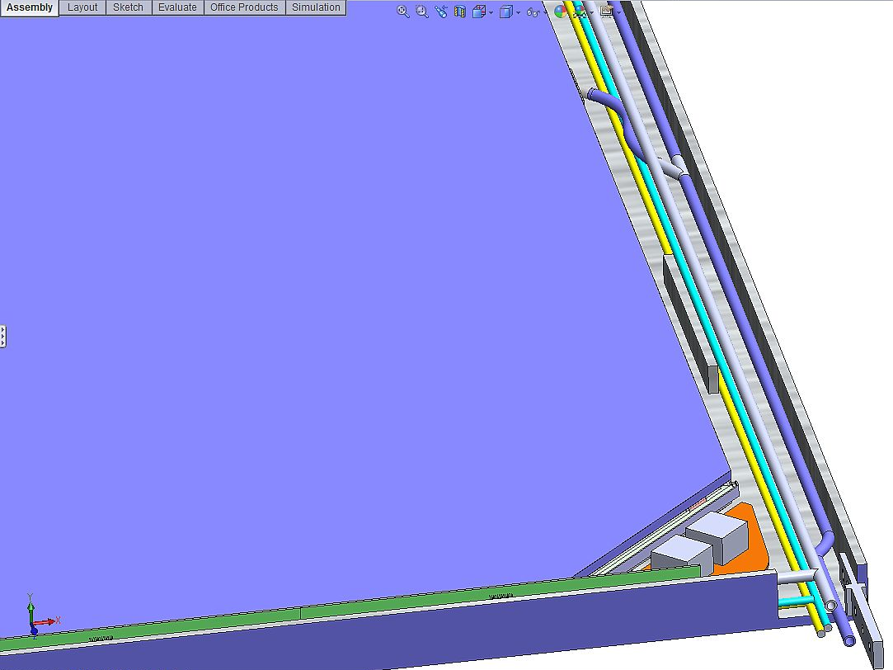
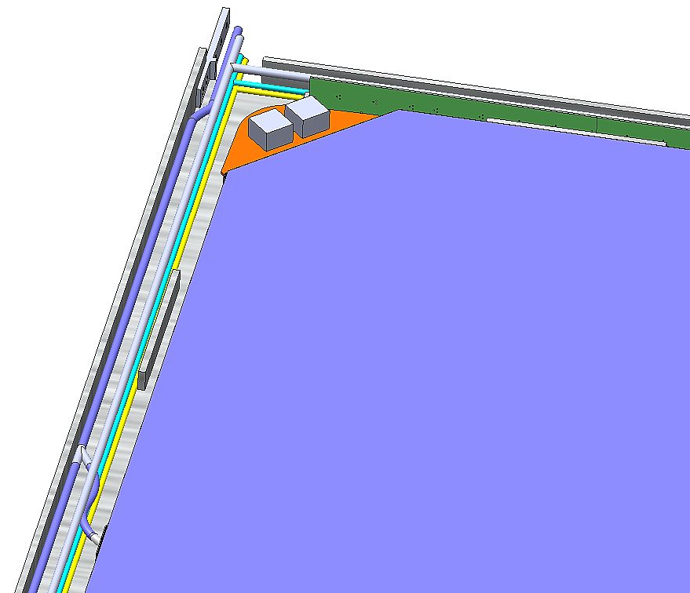
Power supply area
Centralized scheme
Distributed scheme

Slide 15
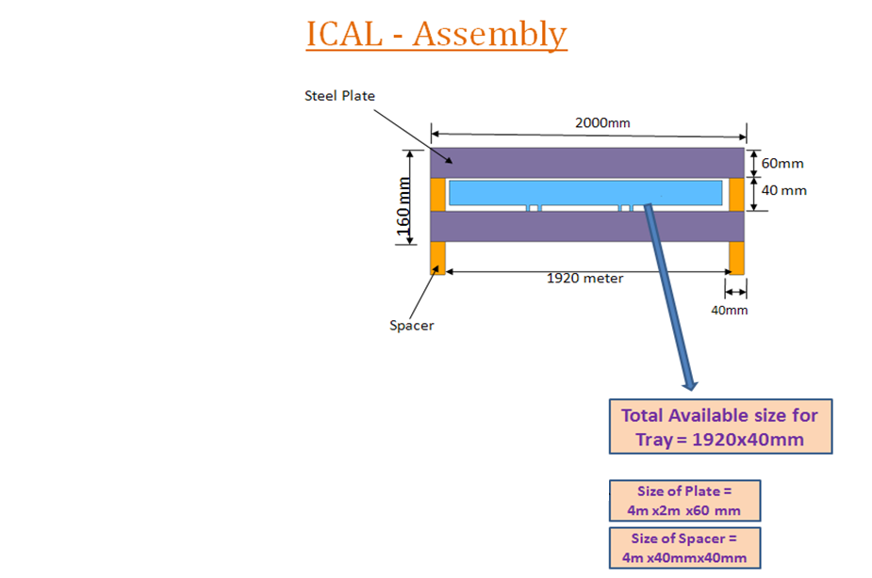
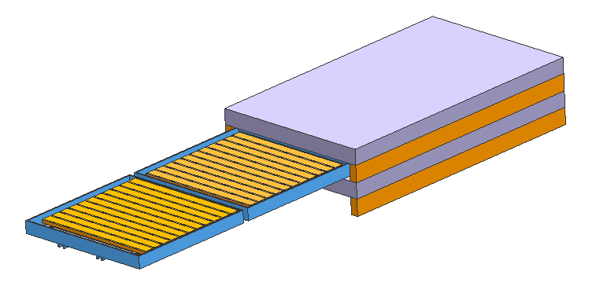
Two RPCs in 4m x 2m magnet gap

Slide 16
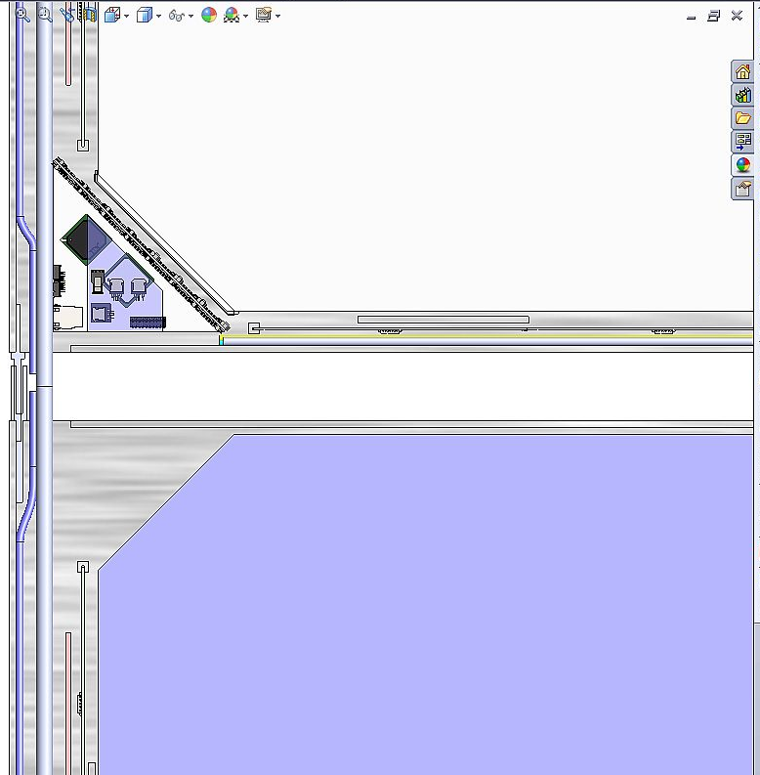
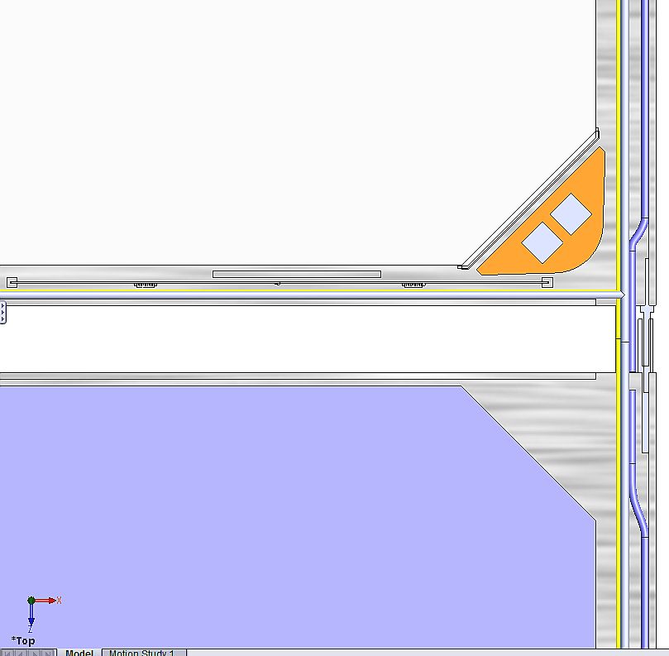
Interconnection of RPCs

Slide 17
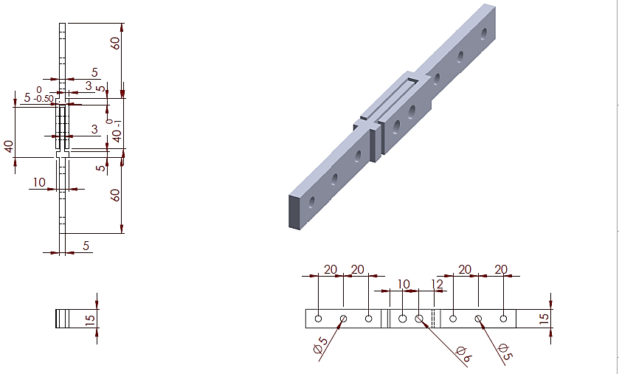
And the connector

Slide 18
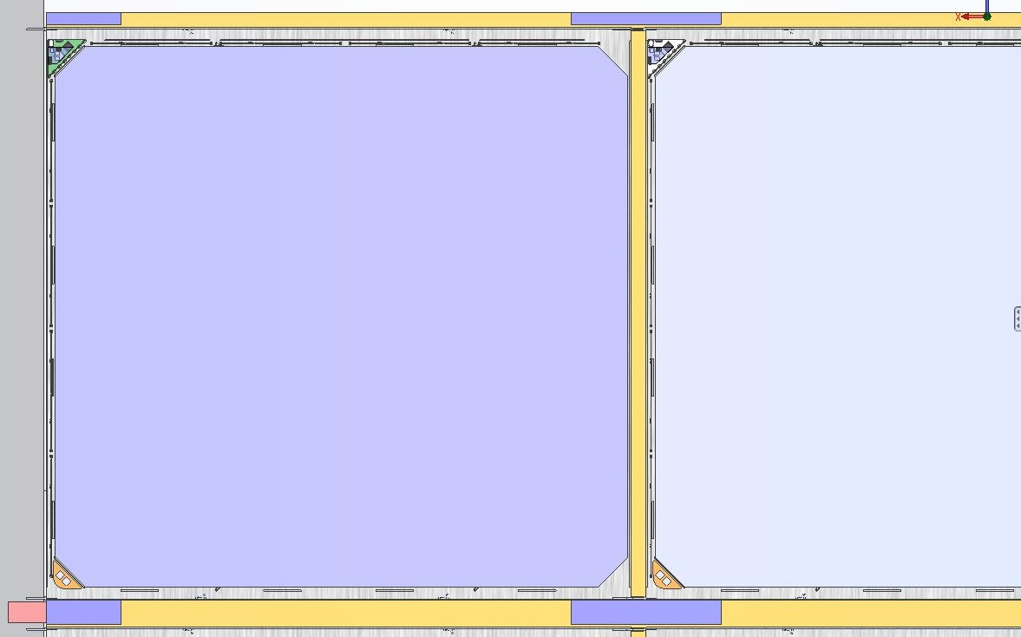
Plan view of the RPC road

Slide 19
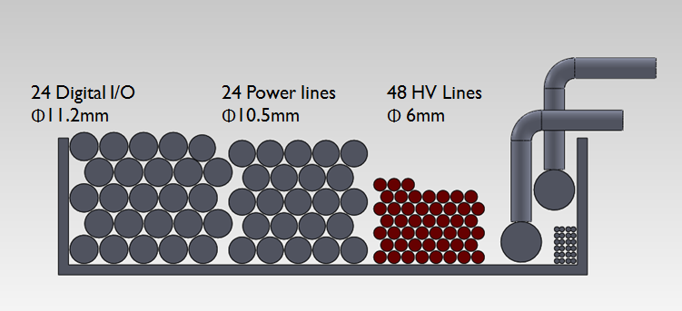
Sharing of the cable tray

Slide 20
Factsheet of ICAL and ICAL-EM
Parameter | ICAL (90) | ICAL-EM (1)
No. of modules | 3 | 1
Module dimensions | 16.2m × 16m × 14.5m | 8m × 8m x 2m
Detector dimensions | 49m × 16m × 14.5m | 8m × 8m x 2m
No. of layers | 150 | 20
Iron plate thickness | 56mm | 56mm
Gap for RPC trays | 40mm | 40mm
Magnetic field | 1.3Tesla | 1.3Tesla
RPC dimensions | 1,950mm × 1,910mm × 24mm | 1,950mm × 1,910mm × 24mm
Readout strip pitch | 3 0mm | 3 0mm
No. of RPCs/Road/Layer | 8 | 4
No. of Roads/Layer/Module | 8 | 4
No. of RPC units/Layer | 192 | 16
No. of RPC units | 28,800 (107,266m²) | 320 (1,192m²)
No. of readout strips | 3,686,400 | 40,960

Slide 21
Current status
Model RPC, based on the current design seems to satisfy the specifications in general.
But, more iterations are needed to fine-tune specific integration issues.
Dimensions of some of the chips (Preamp, TDC etc.) are not yet known, board sizes not frozen yet.
Zeroed on cable specifications, some electrical tests are in progress to finalise them.
Tolerances of iron plates, holding tray and some other components are still to be known accurately.
Work in progress to arrive at the first design for the engineering module

Slide 22
Backup slides

Slide 23
RPCDAQ components
Component | Function, Description | Device | Package, size | Qty
3.3V Regulator | FPGA, ADC (digital) |  | TO-252 | 1
3.3V Regulator | ADC, DAC (analog) |  | TO-252 | 1
2.5V Regulator | FPGA, DRS4 (digital) |  | TO-252 | 1
2.5V Regulator | DRS4 (analog) |  | TO-252 | 1
FPGA | Central Logic & Control | EP3C80F780C7N | FBGA-780 29mm sq | 1
EPCS | FPGA config device | EPCS16 equivalent | SOIC-8 | 1
TDC | Timing measurement | HPTDC | BGA-225 27mm sq | 1
Sampler | Sample input pulses | DRS4 | QFN-76 9mm sq | 2
ADC | Digitize samples |  | LFCSP-32 5mm sq | 2
Diodes | RPC Inputs protection |  |  | 512
Wiznet | Network interface | W5300 | QFP-100 14mm sq | 1
Temp Sensor
Pressure Sensor
Humidity Snesor
ADC | Sample TPH Sensors

Slide 24
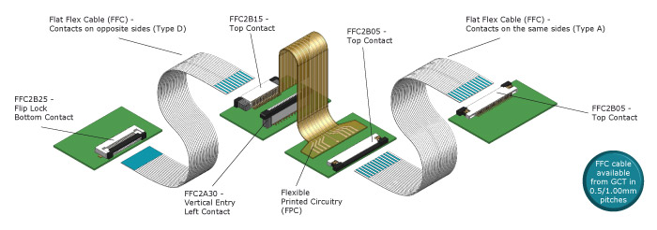
Preamplifiers to RPC-DAQ
Cable: Molex 5020-0171
0.50mm Pitch Premo-Flex™ FFC Jumper, Same Side Contacts (Type A), 16 Circuits, 0.152m Cable Length, 0.27mm Cable Thickness, Gold (Au) Plating
We studied the LVDS signal transmission characteristics over FFC cable of 1m length.
The observations have indicated that the crosstalk between channels is zero.
Also the data transmission is reliable as every bit sent is received by the destination upto the input signal frequency of 40 MHz.

Slide 25
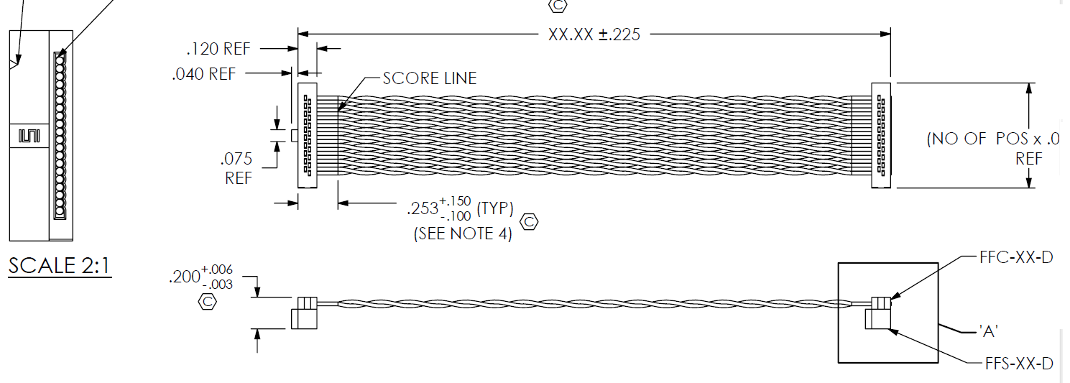
RPCDAQ to Backend: Digital I/O and Ethernet
Cable: Samtec FFTP-13-D-18.00-01-N
Twisted Pair female IDC Assembly, Centerline 1,27mm

Slide 26
Cables in the Cable Tray
Power cables for the FE
24 cables of 2 core wires rated at 20A, for 24 half roads
Finolex Flexible Cables, PVC insulation, dia = 10.5mm
Digital I/O from backend to FE
8 pre-trigger out + 1 trigger in + 2 calibration + 1 global clocks) x 4 RPCs = 48
24 cables of 48 twisted pairs for 24 half roads
3M Round, Shielded/Jacketed, Discrete Cable, 50 pairs, dia = 11.2mm
Network Connection from backend to FE for data
12 cables of 2 core fiber optic cable, 4mm x 2mm
HV Connection
48 cables rated at 6kV, for dual HV supply of 24 half roads

