Slide 1

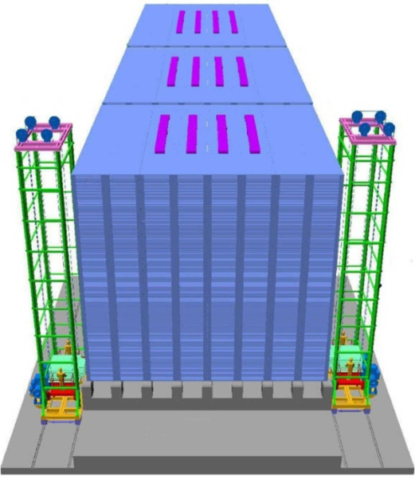
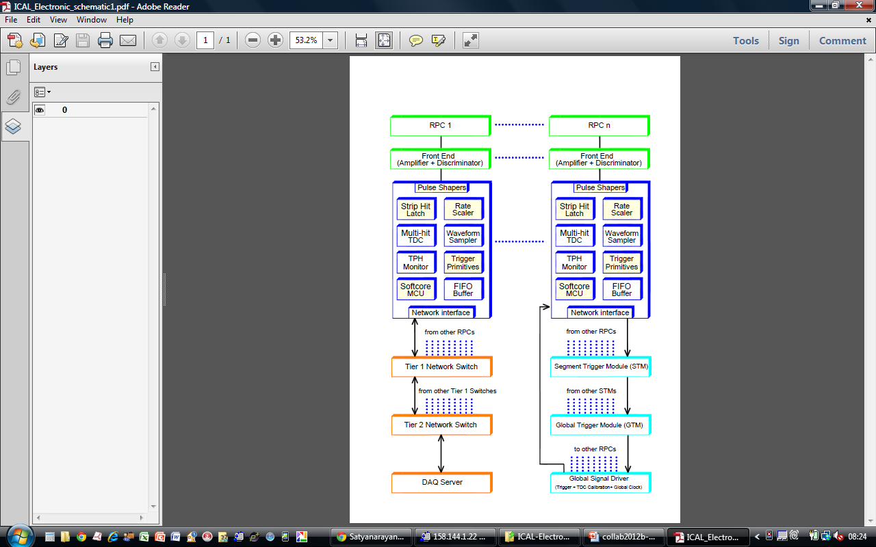
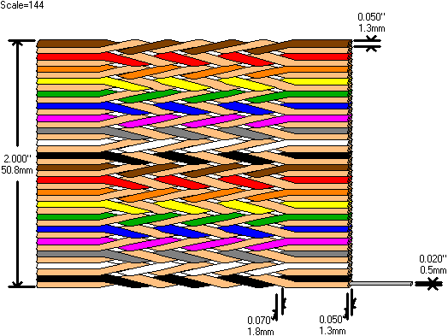
Detector and instrumentation of the ICAL experiment
Dr. B.Satyanarayana ▪ Scientific Officer (G)
Department of High Energy Physics ▪ Tata Institute of Fundamental Research
Homi Bhabha Road ▪ Colaba ▪ Mumbai ▪ 400005 ▪ INDIA
T: 09987537702 ▪ E: bsn@tifr.res.in ▪ W: http://www.tifr.res.in/~bsn

Slide 2
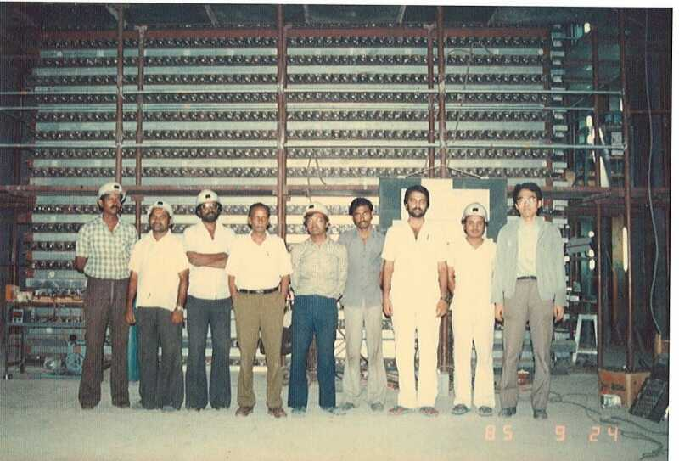
KGF Proton Decay Experiment

Slide 3
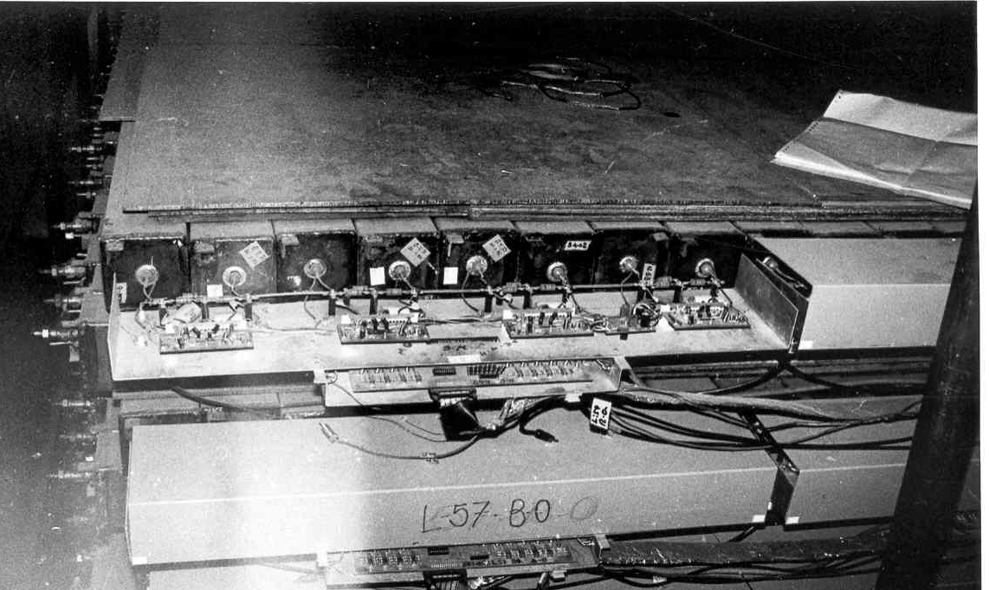
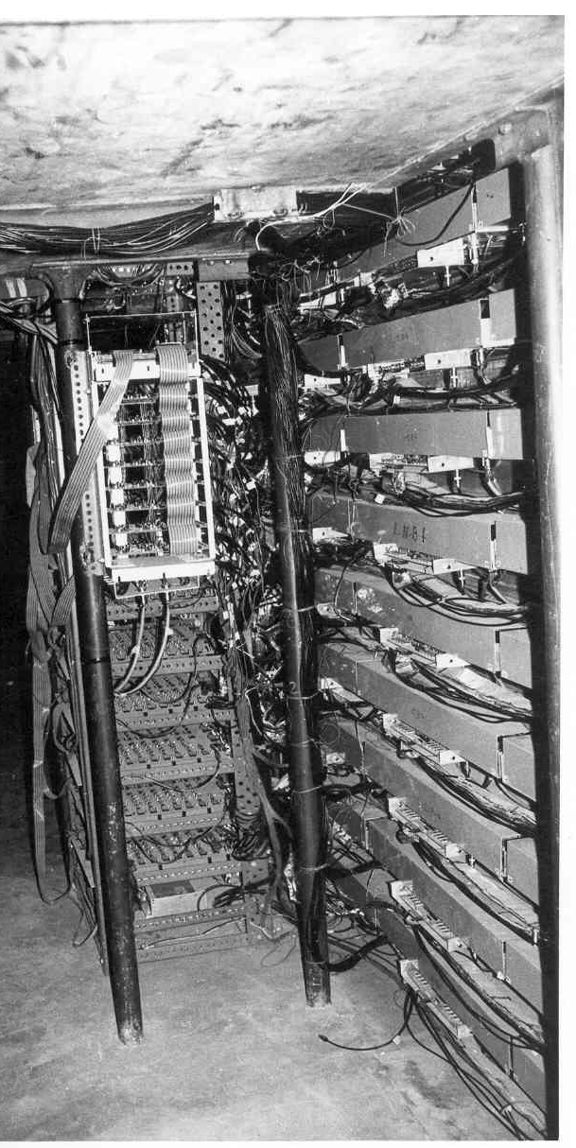
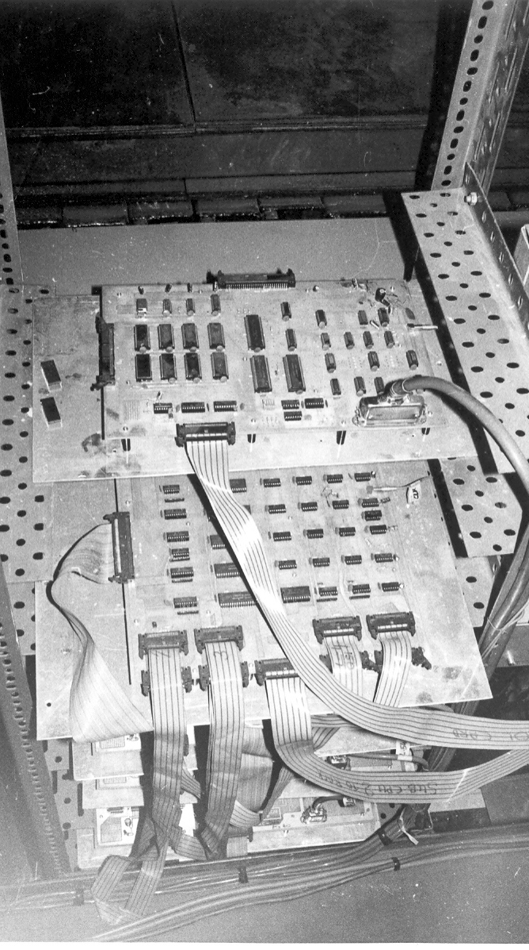
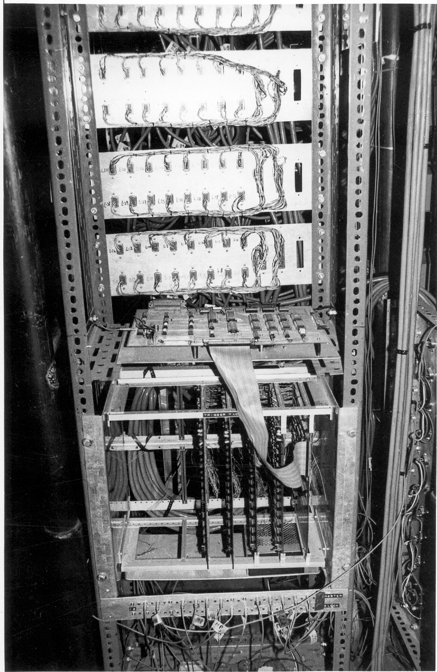
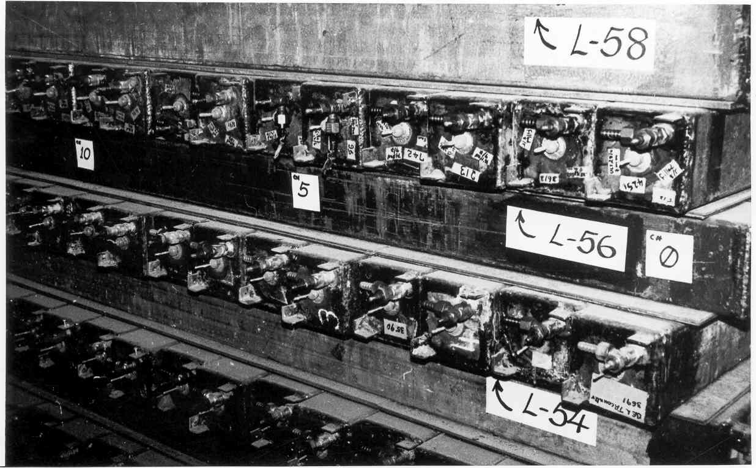
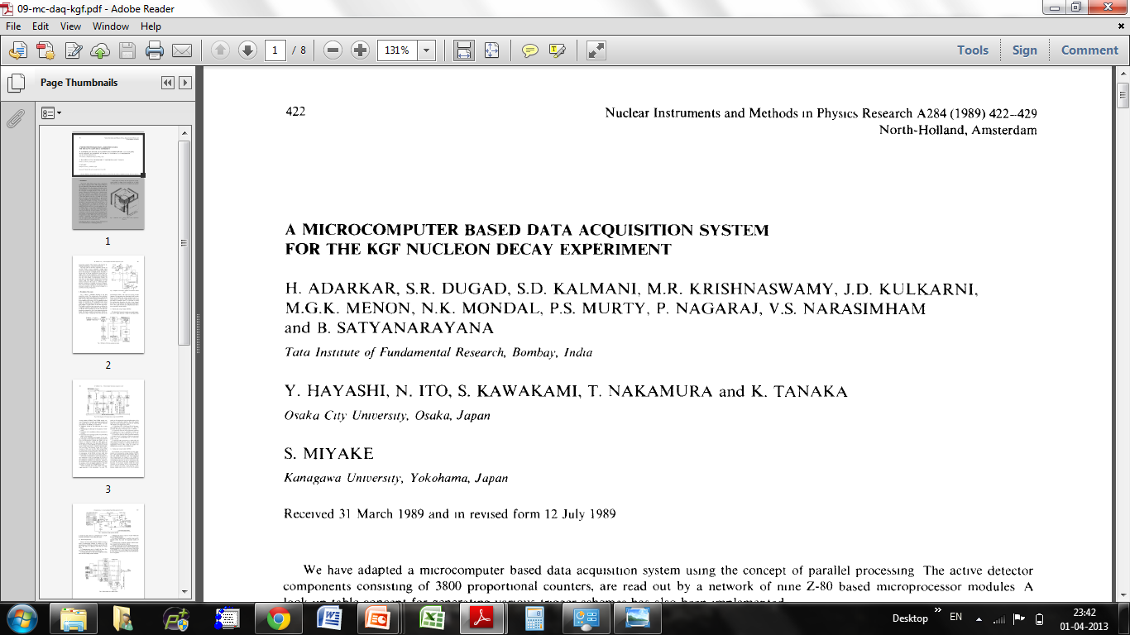
Black and white electronics!

Slide 4
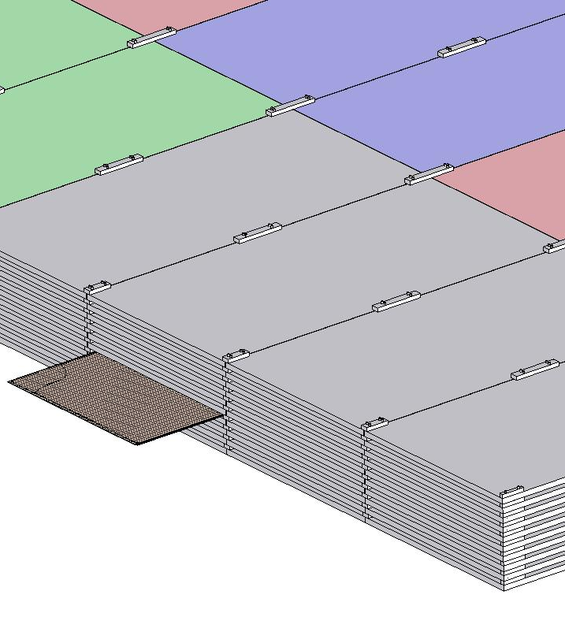
ICAL detector and construction
Magnet coils
4000mm×2000mm
×56mm low carbon iron sheets
RPC handling trolleys
RPC
Total weight: 50Ktons

Slide 5
Factsheet of ICAL detector
No. of modules | 3
Module dimensions | 16m × 16m × 14.5m
Detector dimensions | 48.4m × 16m × 14.5m
No. of layers | 150
Iron plate thickness | 56mm
Gap for RPC trays | 40mm
Magnetic field | 1.3Tesla
RPC dimensions | 1,950mm × 1,840mm × 24mm
Readout strip pitch | 3 0mm
No. of RPCs/Road/Layer | 8
No. of Roads/Layer/Module | 8
No. of RPC units/Layer | 192
No. of RPC units | 28,800 (97,505m²)
No. of readout strips | 3,686,400

Slide 6
30 years of HEP instrumentation
Parameter | KGF experiment | ICAL experiment
Year | 1983 | 2013
Size (m) | 6 × 6 × 6 | 48 × 16 × 16
Weight of the detector (tons) | 350 | 50000
Interacting path in detector (mm) | 100 | 2
Detector pitch (mm) | 100 | 30
Readout channels | 3600 | 3,686,400
Rise time of the signal | 1μs | 1ns
Approx. budget (crores) | 1.5 | 1500
My take home salary (Rs) | 1 | 50☺

Slide 7
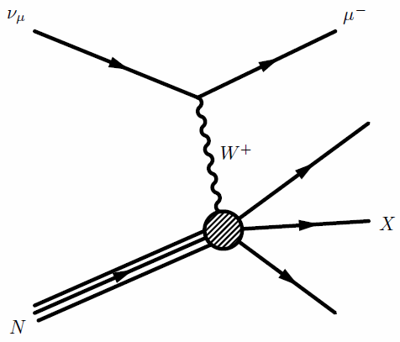

Neutrino induced interactions
CC interactions
NC interactions

Slide 8
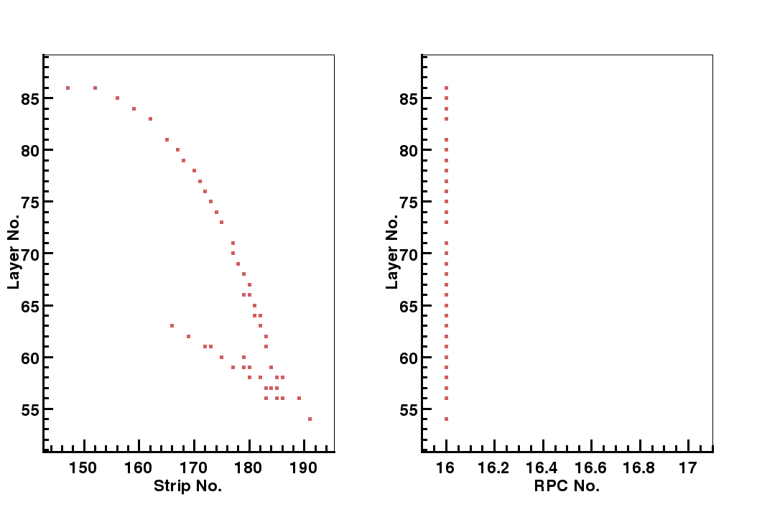
Typical signatures of interactions

Slide 9
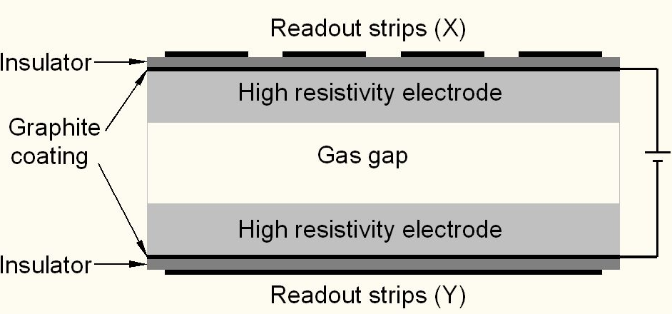
Schematic of a basic RPC

Slide 10
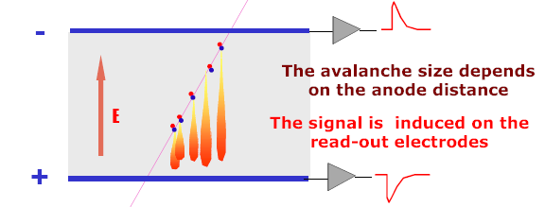
Signal development in an RPC
  Incident radiation produces ionisation in the gas volume. Each primary electron thus produced, initiates an avalanche until it hits the electrode.
  Avalanche development is characterized by two gas parameters, Townsend coefficient (α) and Attachment coefficient (η).
  Average number of electrons produced at a distance x, n(x) ⁼ e^{(α- η)x}
  Current signal induced on the electrode, i(t) = E_{w} • v • e₀ • n(t) / V_{w}, where E_{w} / V_{w} = ε_{r} / (2b + dε_{r}).

Slide 11
Principle of operation
Electron-ion pairs produced in the ionisation process drift in the opposite directions.
All primary electron clusters drift towards the anode plate with velocity v and simultaneously originate avalanches
A cluster is eliminated as soon as it reaches the anode plate
The charge induced on the pickup strips is q = (-eΔx_{e} + eΔx_{I})/g
The induced current due to a single pair is i = dq/dt = e(v + V)/g ≈ ev/g, V « v
Prompt charge in RPC is dominated by the electron drift

Slide 12
RPC operating mode definitions
Let, n₀ = No. of electrons in a cluster
α = Townsend coefficient (No.
of ionisations/unit length)
β = Attachment coefficient (No.
of electrons captured by the
gas/unit length)
Then, the no. of electrons reaching
the anode,
n = n₀e^{(α- β)x}
Where x = Distance between anode
and the point where the cluster
is produced.
Gain of the detector, M = n / n₀
A planar detector with resistive electrodes ≈ Set of independent discharge cells
Expression for the capacitance of a planar condenser → Area of such cells is proportional to the total average charge, Q that is produced in the gas gap.
  Where, d = gap thickness
  V = Applied voltage
  ε₀ = Dielectric constant of the gas
Lower the Q; lower the area of the cell (that is ‘dead’ during a hit) and hence higher the rate handling capability of the RPC

Slide 13
Control of avalanche process
Role of RPC gases in avalanche control
  Argon is the ionising gas
  R134a to capture free electrons and localise avalanche
    e⁻ + X → X⁻ + hν (Electron attachment)
    X⁺ + e⁻ → X + hν (Recombination)
  Isobutane to stop photon induced streamers
  SF₆ for preventing streamer transitions
Growth of the avalanche is governed by dN/dx = αN
The space charge produced by the avalanche shields (at about αx = 20) the applied field and avoids exponential divergence
Townsend equation should be dN/dx = α(E)N

Slide 14
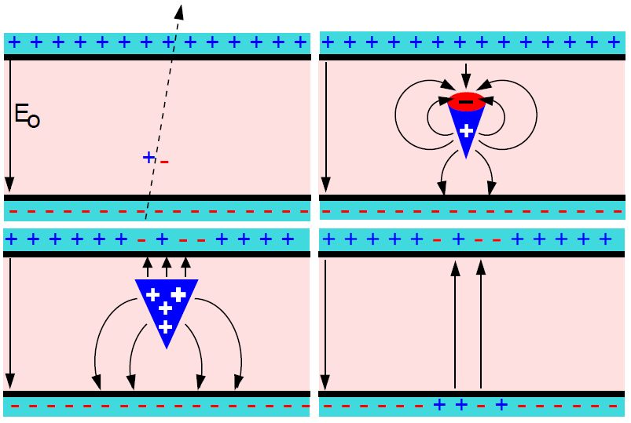
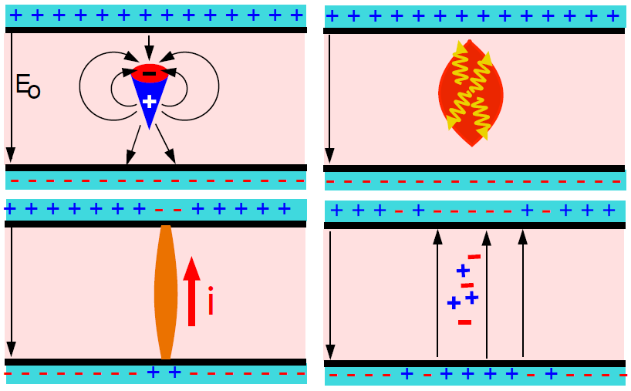
Two modes of RPC operation
Avalanche mode
Streamer mode
Gain of the detector << 10⁸
Charge developed ~1pC
Needs a preamplifier
Longer life
Typical gas mixture Fr:iB:SF₆::94.5:4:0.5
Moderate purity of gases
Higher counting rate capability
Gain of the detector > 10⁸
Charge developed ~ 100pC
No need for a preamplier
Relatively shorter life
Typical gas mixture Fr:iB:Ar::62.8:30
High purity of gases
Low counting rate capability

Slide 15
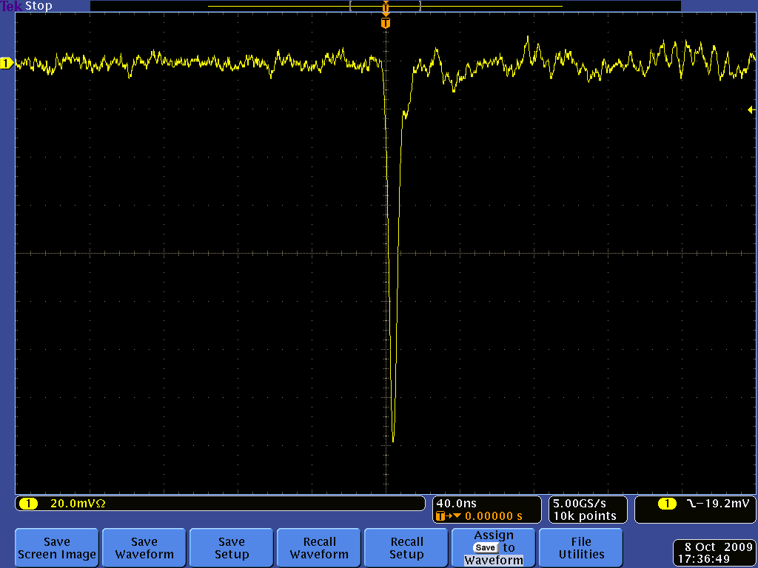
Post amplifier RPC pulse profile

Slide 16
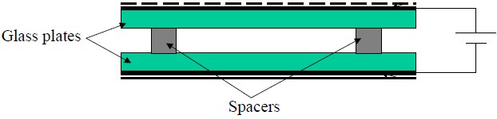
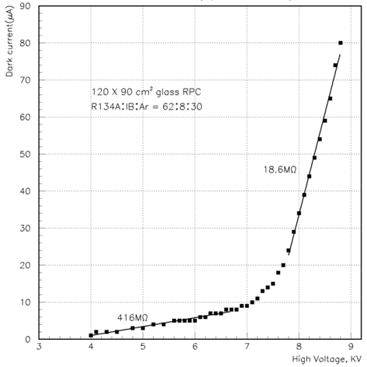
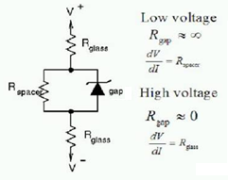
V-I characteristics of RPC
Glass RPCs have a distinctive and readily understandable current versus voltage relationship.

Slide 17
Typical expected parameters
No. of clusters in a distance g follows Poisson distribution with an average of
Probability to have n clusters
Intrinsic efficiency
ε_{max} depends only on gas and gap
Intrinsic time resolution
σ_{t} doesn’t depend on the threshold
Gas: 96.7/3/0.3
Electrode thickness: 2mm
Gas gap: 2mm
Relative permittivity: 10
Mean free path: 0.104mm
Avg. no. of electrons/cluster: 2.8
Charge threshold: 0.1pC
HV: 10.0KV
Townsend coefficient: 13.3/mm
Attachment coefficient: 3.5/mm
Efficiency: 90%
Time resolution: 950pS
Total charge: 200pC
Induced charge: 6pC

Slide 18
Why ICAL chose RPC?
Large detector area coverage, thin (~10mm), small mass thickness
Flexible detector and readout geometry designs
Solution for tracking, calorimeter, muon detectors
Trigger, timing and special purpose design versions
Built from simple/common materials; low fabrication cost
Ease of construction and operation
Highly suitable for industrial production
Detector bias and signal pickup isolation
Simple signal pickup and front-end electronics; digital information acquisition
High single particle efficiency (>95%) and time resolution (~1nSec)
Particle tracking capability; 2-dimensional readout from the same chamber
Scalable rate capability (Low to very high); Cosmic ray to collider detectors
Good reliability, long term stability
Under laying Physics mostly understood!

Slide 19
Deployment of RPCs in running experiments
Experiment | Area (m²) | Electrodes | Gap(mm) | Gaps | Mode | Type
PHENIX | ? | Bakelite | 2 | 2 | Avalanche | Trigger
NeuLAND | 4 | Glass | 0.6 | 8 | Avalanche | Timing
FOPI | 6 | Glass | 0.3 | 4 | Avalanche | Timing
HADES | 8 | Glass | 0.3 | 4 | Avalanche | Timing
HARP | 10 | Glass | 0.3 | 4 | Avalanche | Timing
COVER-PLASTEX | 16 | Bakelite | 2 | 1 | Streamer | Timing
EAS-TOP | 40 | Bakelite | 2 | 1 | Streamer | Trigger
STAR | 50 | Glass | 0.22 | 6 | Avalanche | Timing
CBM TOF | 120 | Glass | 0.25 | 10 | Avalanche | Timing
ALICE Muon | 140 | Bakelite | 2 | 1 | Streamer | Trigger
ALICE TOF | 150 | Glass | 0.25 | 10 | Avalanche | Timing
L3 | 300 | Bakelite | 2 | 2 | Streamer | Trigger
BESIII | 1200 | Bakelite | 2 | 1 | Streamer | Trigger
BaBar | 2000 | Bakelite | 2 | 1 | Streamer | Trigger
Belle | 2200 | Glass | 2 | 2 | Streamer | Trigger
CMS | 2953 | Bakelite | 2 | 2 | Avalanche | Trigger
OPERA | 3200 | Bakelite | 2 | 1 | Streamer | Trigger
YBJ-ARGO | 5630 | Bakelite | 2 | 1 | Streamer | Trigger
ATLAS | 6550 | Bakelite | 2 | 1 | Avalanche | Trigger
ICAL | 97,505 | Both | 2 | 1 | Both | Trigger

Slide 20
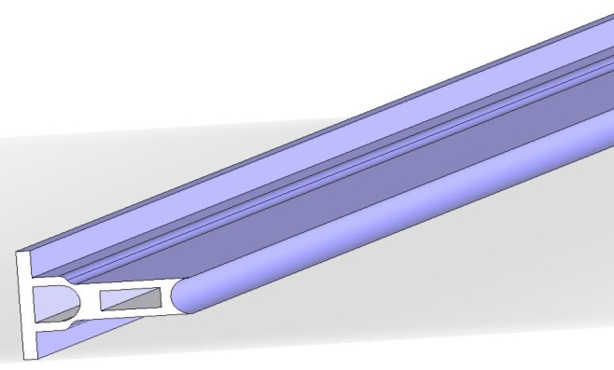
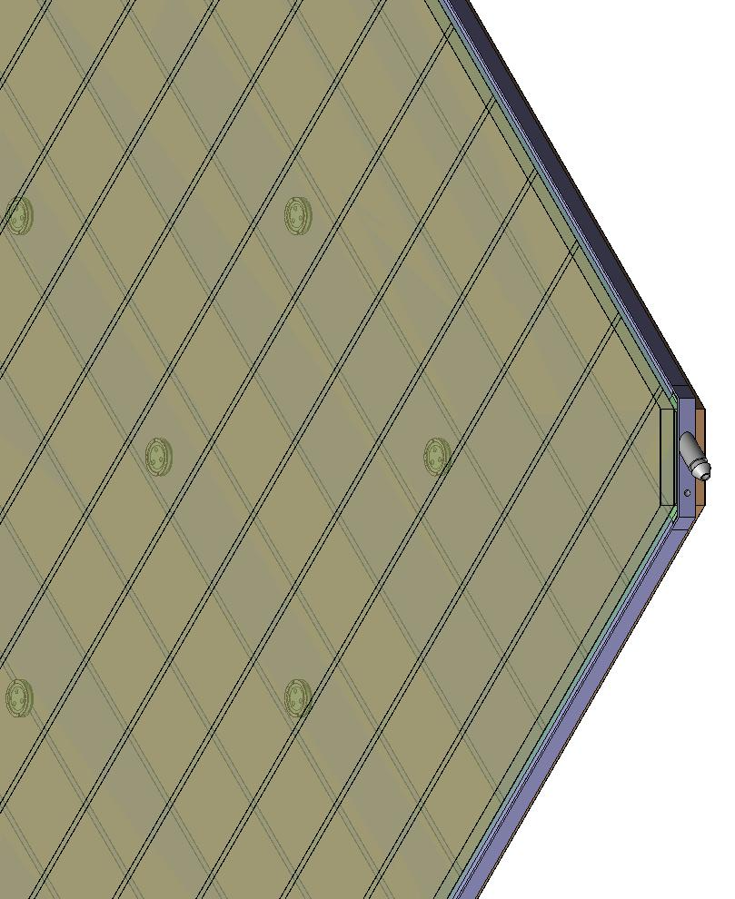
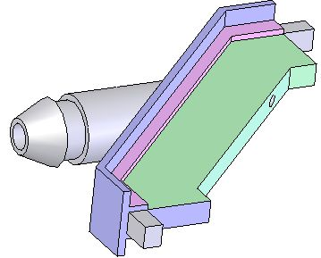
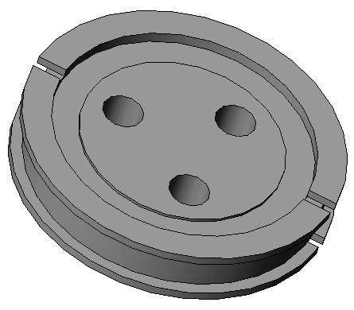
Materials for gas volume fabrication
Edge spacer
Schematic of an assembled gas volume
Gas nozzle
Glass spacer

Slide 21
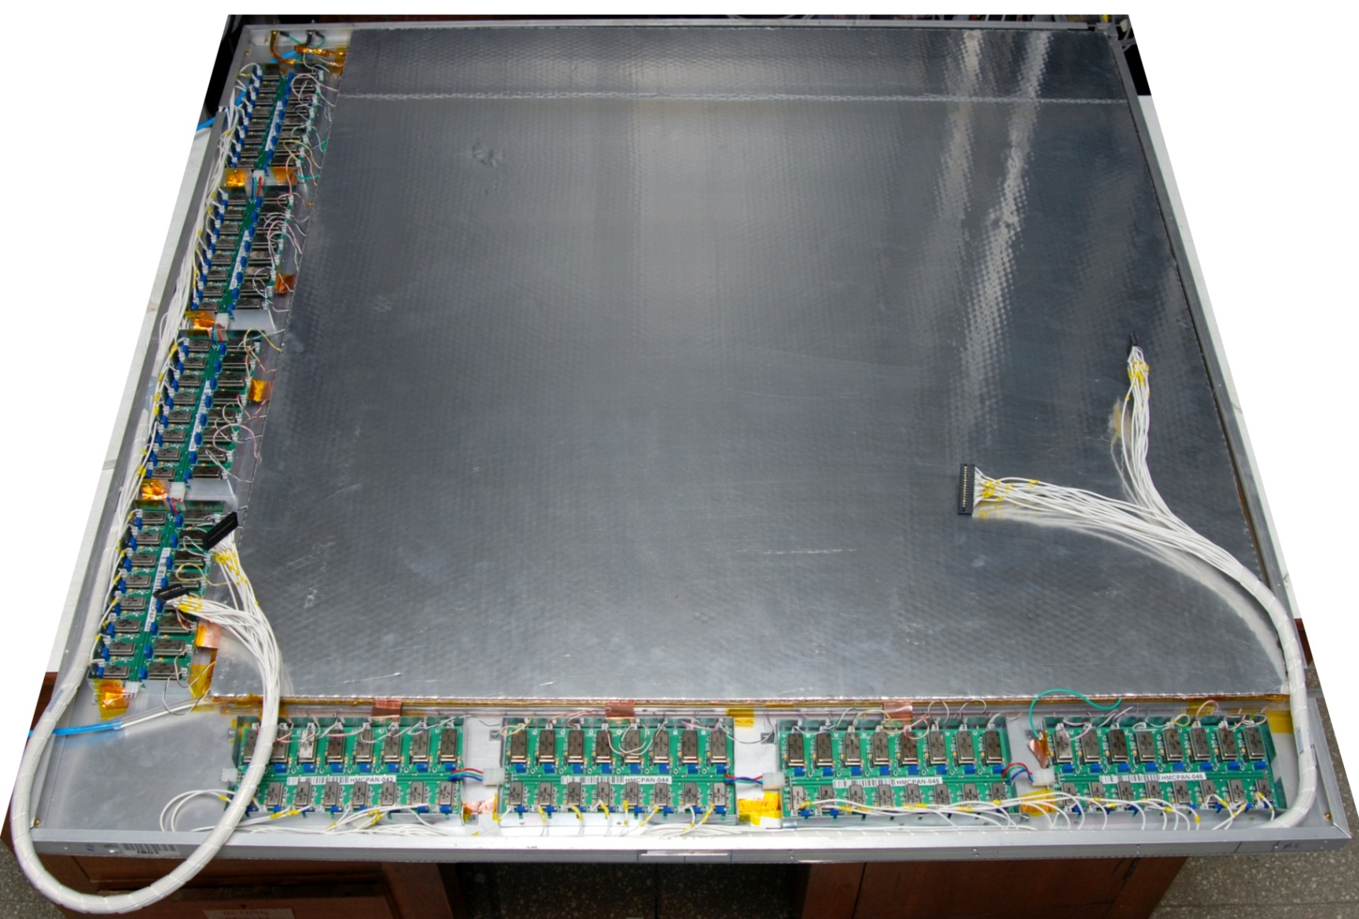
Fully assembled large area RPC
1m × 1m

Slide 22
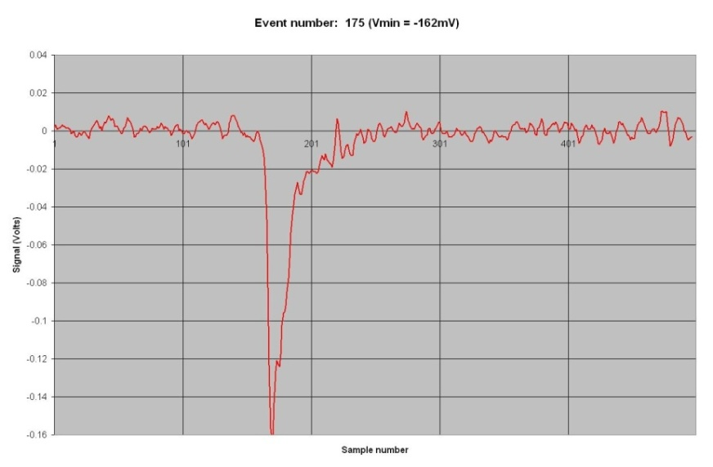
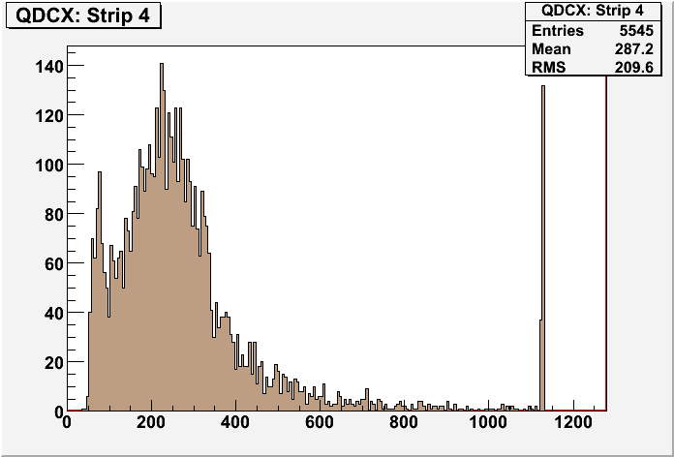
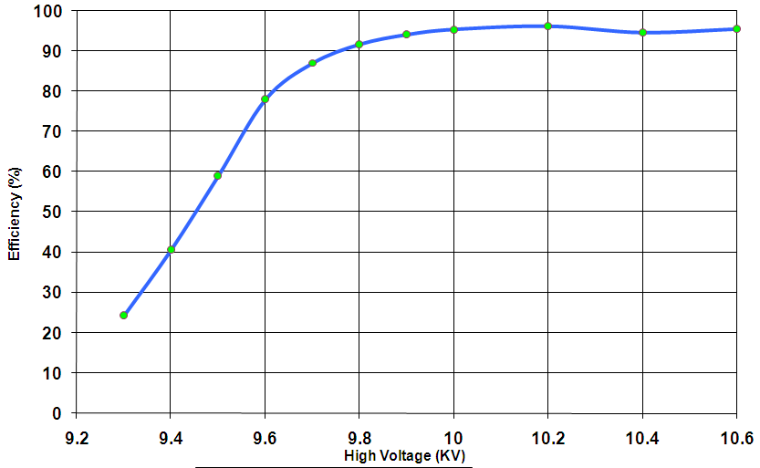
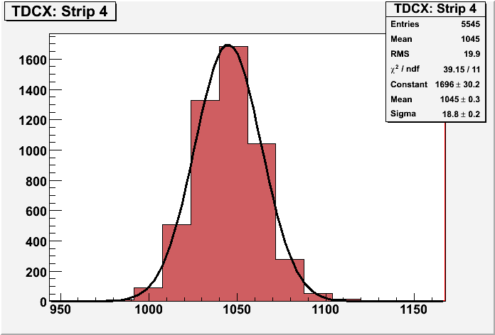
RPC parameter characterisation

Slide 23
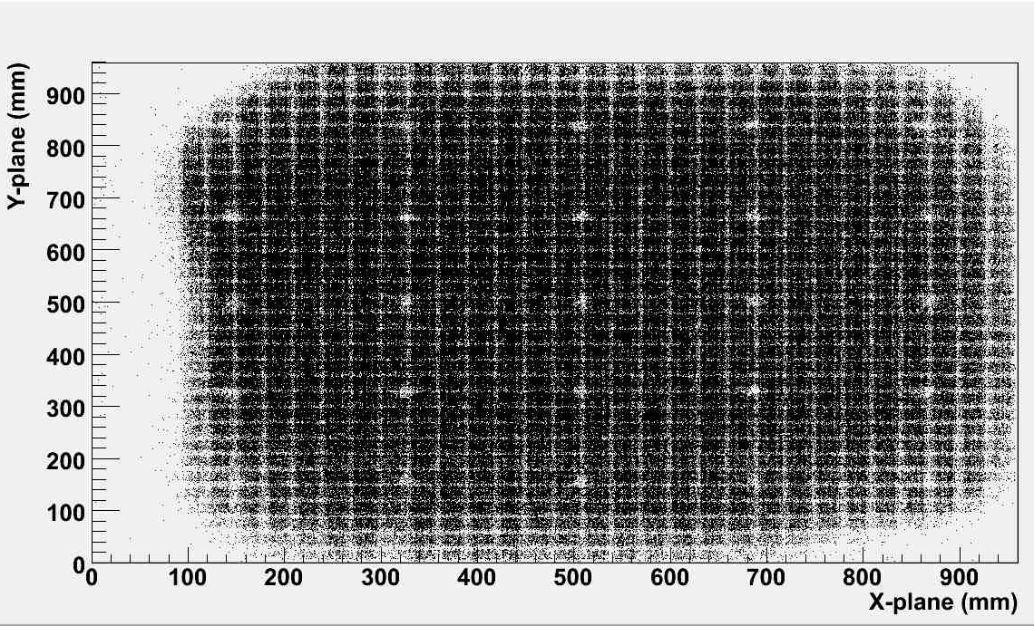
RPC tomography using cosmic ray muons

Slide 24
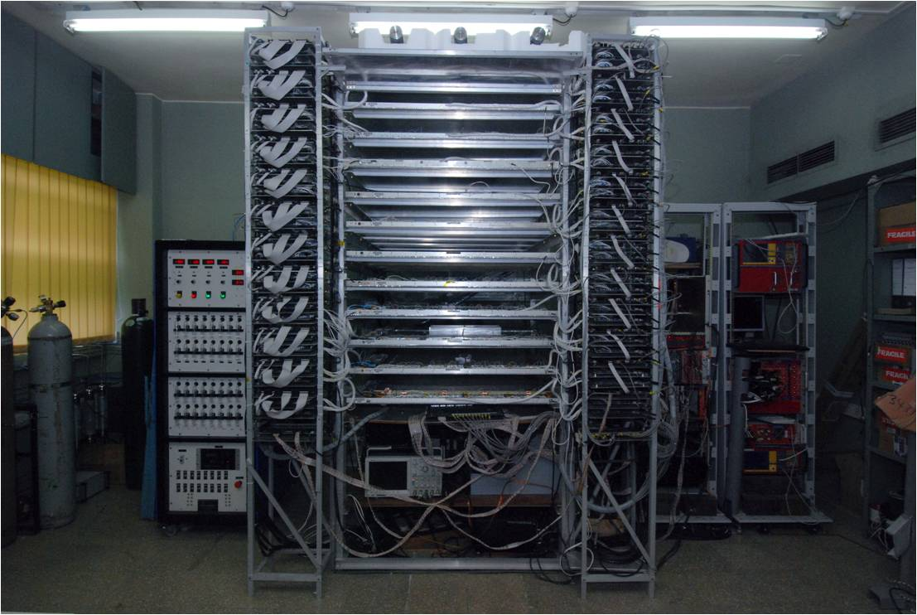
1m × 1m RPC stack at TIFR, Mumbai

Slide 25
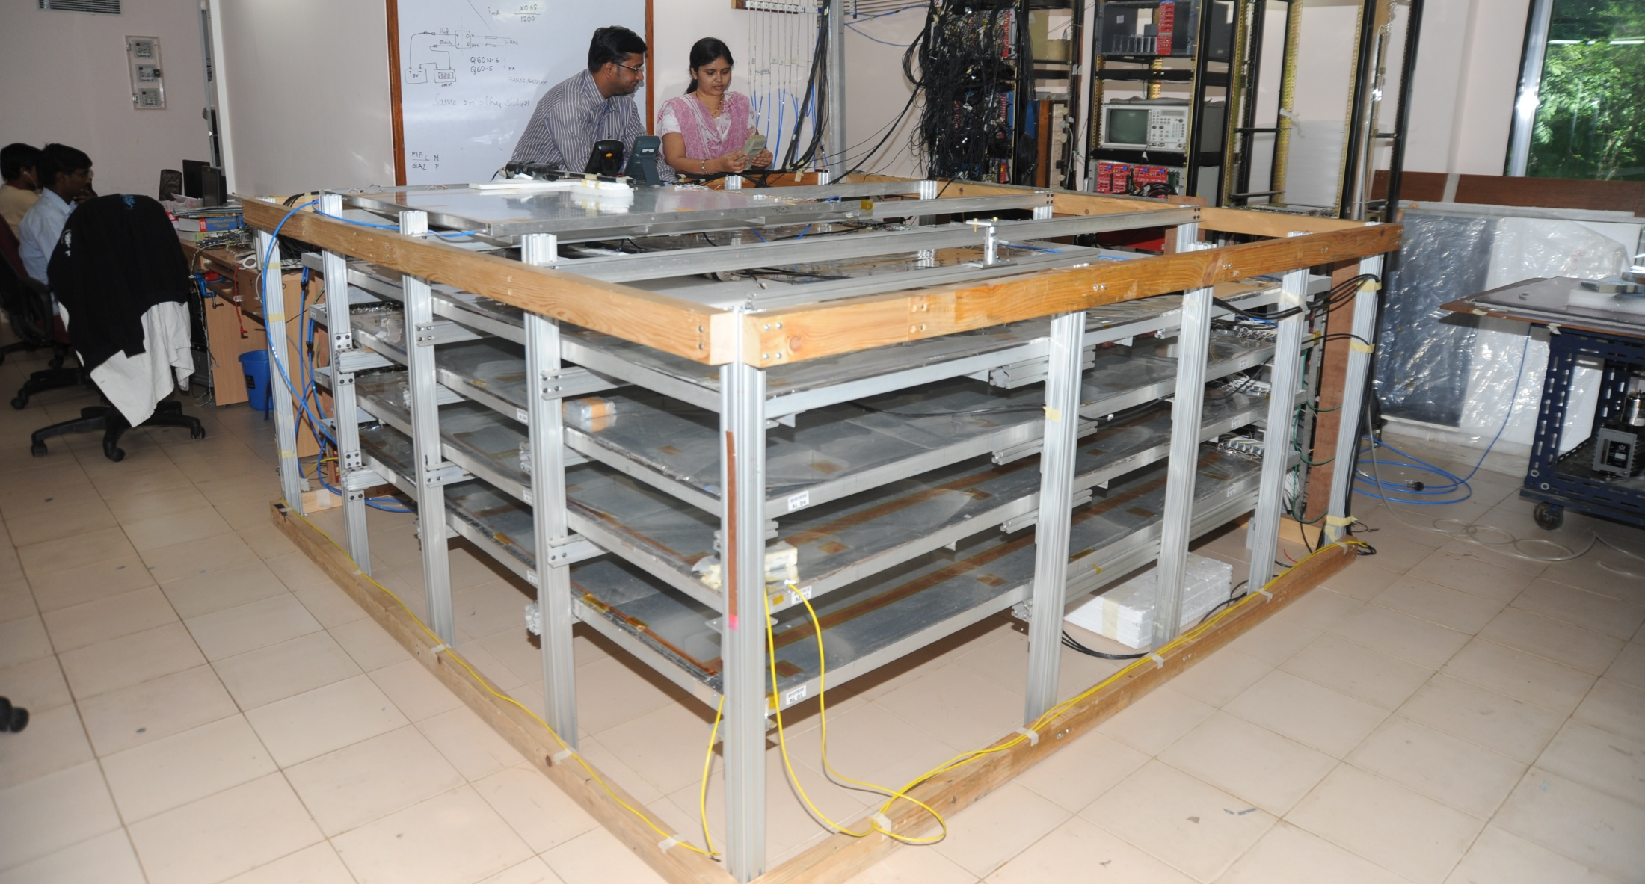
2m × 2m RPC stack at TIFR, Mumbai

Slide 26
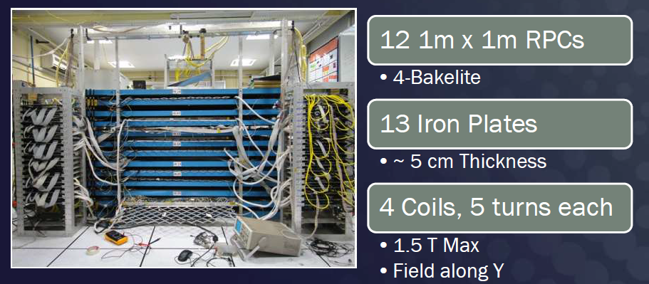
ICAL prototype at VECC, Kolkata

Slide 27
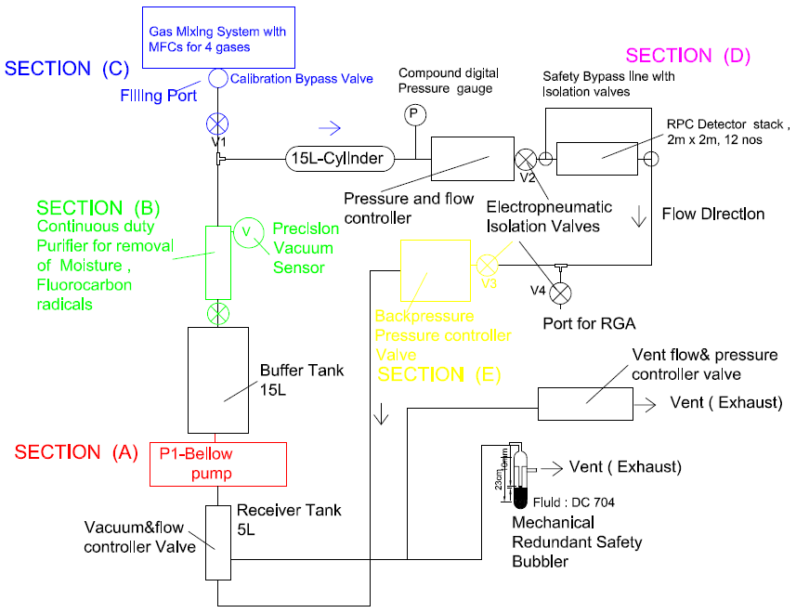
Closed-loop gas recirculation system
4 channel gas mixing module (filling/top-up of Iso-butane, Freon R134A, Argon and SF6)
Total Capacity: 140 litres
Continuous duty gas purification system to remove moisture, and other radicals
Contamination removal up to 2ppm.

Slide 28
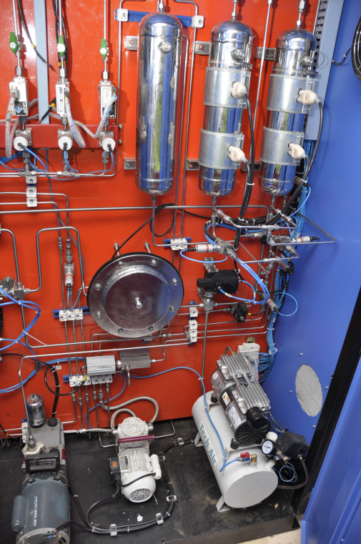
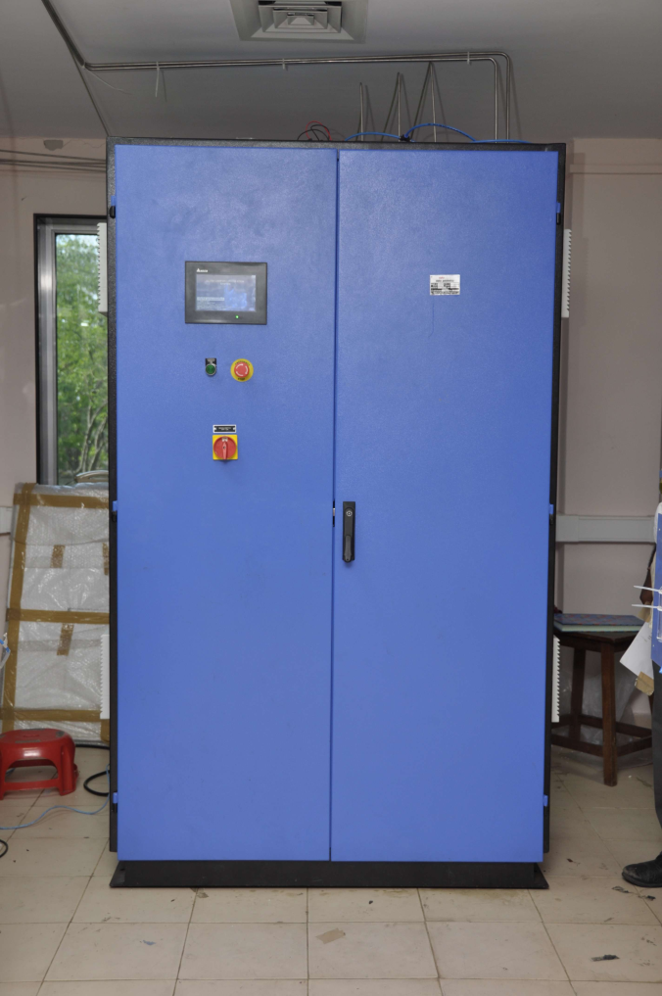
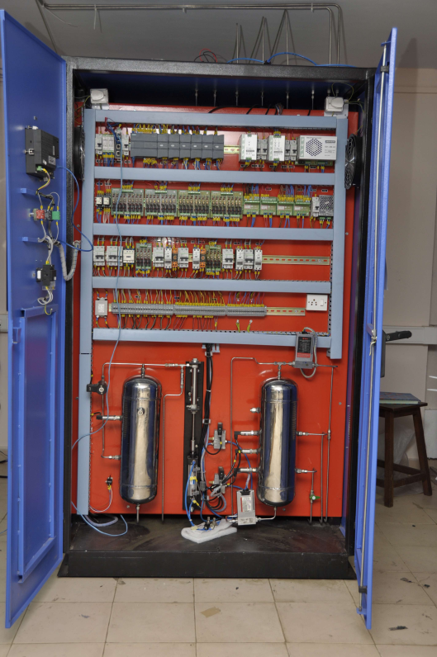
Newly developed gas recirculation system

Slide 29
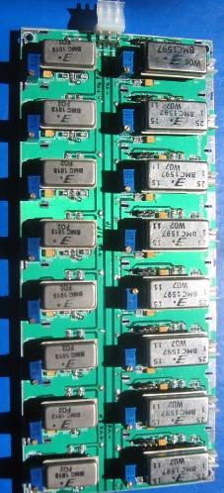
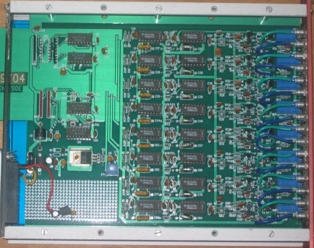
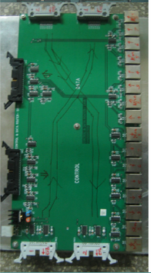
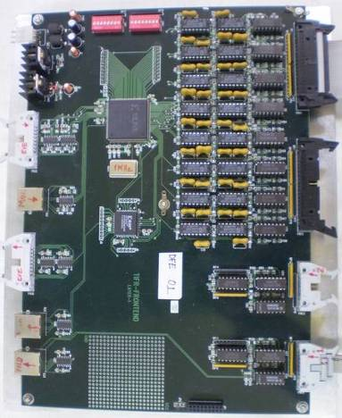
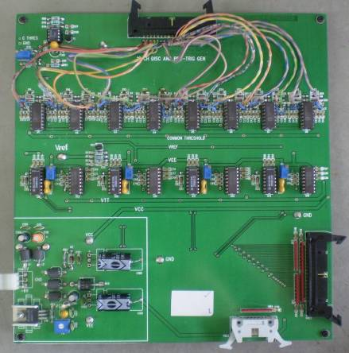
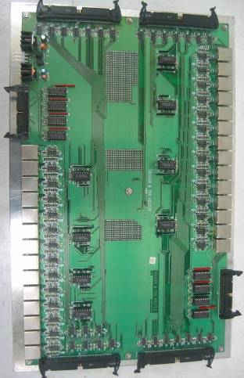
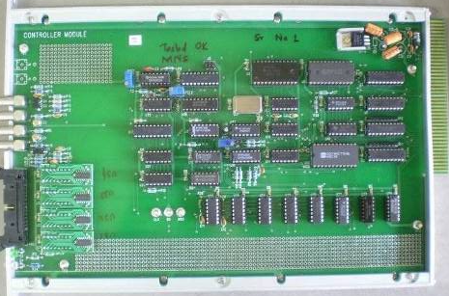
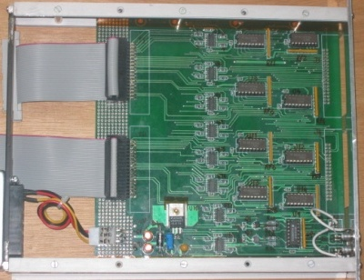
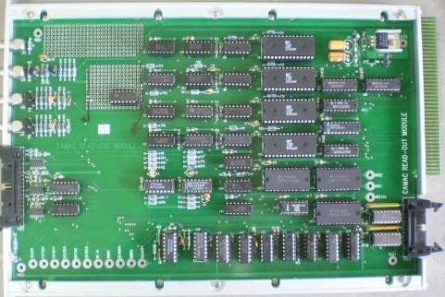
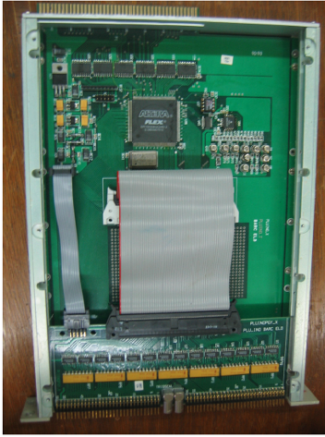
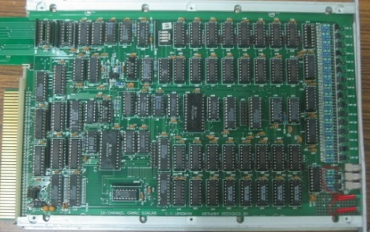
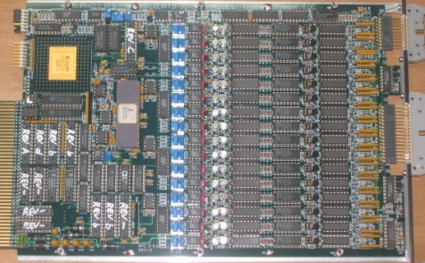

DAQ system for the RPC stacks
200 boards of 13 types
Custom designed using
FPGA,CPLD,HMC,FIFO,SMD

Slide 30

ICAL DAQ system requirements
Information to record on trigger
  Strip hit (1-bit resolution)
  Timing (200ps LC)
  Time-Over-Threshold
Rates
  Individual strip background rates ~300Hz
  Event rate ~10Hz
On-line monitor
  RPC parameters (High voltage, current)
  Ambient parameters (T, RH, P)
  Services, supplies (Gas systems, magnet, low voltage power supplies, thresholds)
Start
Stop

Slide 31
Design considerations & constraints
Data rates are low.
Physical dimensions: Owing to severe space constraints on the RPC, triangular space of about 160cm² only is available for this extremely high density board.
Service life of the electronics is expected to be more than15 years, component spares availability/replaceability is a concern.
Since the temperature and humidity inside the cavern will be controlled for RPCs, the electronic components need not be even of industrial grade - Commercial grade will do.
Low power consumption. It is highly desirable to have minimum power consumption.
Cost: Since the volumes are high, cost is also a major consideration

Slide 32
Challenges of ICAL electronics
Huge number of electronic data readout channels. This necessitates large scale integration and/or multiplexing of electronics. The low to moderate rates of individual channels allow this integration/multiplexing.
Large dimensions of one unit of RPC. This has bearing on the way the signals from the detector are routed to the front-end electronic units and matching the track lengths of the signals, irrespective of the geographical position of the signal source. We need to do this in order to maintain equal timing of signals from individual channels.
Large dimensions of the entire detector. This will pose constraints on the cable routing, signal driving and related considerations.
Road structure for the mounting of RPCs. This necessarily imposes constraint that signals from both X & Y planes of the RPC unit, along with other service and power supply lines are brought out only from the transverse direction of the detector.
Eight RPC units are going to be installed in a road. We can at best bring out signal cables from four of them from one side of the detector and the other four from other direction.
About 25cms gap is available between the faces of the detector and the trolleys. Any installations on the face of the detector have to be designed with this consideration.
About 40mm gap between iron layers is available for the RPC detector, out of which thickness of the RPC unit is expected to at least 24mm. Leaving another 5-6mm for various tolerances, realistically about 10mm is the available free space in the RPC slot for routing out cables etc.
On the sides adjacent to the RPC unit in the gap, free space is available for routing out power supply cables, gas lines etc.
The gap between three modules is about 20cms. It is not advisable plan any installations on these faces.

Slide 33
Sub-systems of ICAL instrumentation
Signal pickup and front-end electronics
Strip latch
Timing units
Background rate monitors
Front-end controller
Network interface and data network architecture
Trigger system
Event building, databases, data storage systems
Slow control and monitoring
  Gas, magnet, power supplies
  Ambient parameters
  Safety and interlocks
Computer, back-end networking and security issues
On-line data quality monitors
Voice and video communications
Remote access protocols to detector sub-systems and data

Slide 34

First sketch of ICAL readout scheme
July 10, 2008

Slide 35
Overall scheme of ICAL electronics
Major elements of DAQ system
  Front-end board
  RPCDAQ board
  Segment Trigger Module
  Global Trigger Module
  Global Trigger Driver
  Tier1 Network Switch
  Tier2 Network Switch
  DAQ Server

Slide 36



Functions & integration of FE-DAQ

Slide 37
Design inputs for the front-end
RPC signal’s rise time is of the order of 500-800nSec. Therefore, we will need a resolution of about 200nSec for the timing devices used for recording RPC signal arrival times w.r.t to ICAL trigger.
The opening width of the amplified signals is of the order of 25nSecs. The minimum width of the RPC pulse over the threshold in the avalanche mode is as low as a few nSecs. This is an important input for the front-end electronics design.
The amplifier in the avalanche mode preferably should have a fixed gain in the range 100-200 depending on the noise levels obtainable and hence the minimum discriminator levels settable.
Discriminator overhead (ratio of average peak pulse height to discriminator level) of 3-4 is preferable for reliable performance. Variable (but common) threshold in the range of ±10 to ±50mV for the discriminators should be supported.
The pulse shaping of the discriminator output pulse should be in the range of 50-100nSec (but fixed). However, if the facility of pulse width monitoring has to be supported, this specification has to be relooked.

Slide 38





Picking up the tiny charges
Process: AMSc35b4c3 (0.35um CMOS)
Input dynamic range:18fC – 1.36pC
Input impedance: 45Ω @350MHz
Amplifier gain: 8mV/μA
3-dB Bandwidth: 274MHz
Rise time: 1.2ns
Comparator’s sensitivity: 2mV
LVDS drive: 4mA
Power per channel: < 20mW
Package: CLCC48(48-pin)
Chip area: 13mm²

Slide 39

Picking up the tiny charges
Process: AMSc35b4c3 (0.35um CMOS)
Input dynamic range:18fC – 1.36pC
Input impedance: 45Ω @350MHz
Amplifier gain: 8mV/μA
3-dB Bandwidth: 274MHz
Rise time: 1.2ns
Comparator’s sensitivity: 2mV
LVDS drive: 4mA
Power per channel: < 20mW
Package: CLCC48(48-pin)
Chip area: 13mm²

Slide 40

Preamplifier Board
23
403
Current Anusparsh-2 chip dimensions does not fit to this design
Next iteration might shrink the size
Package the chip in the rectangular shape
Go for chip bonding (for example: ATLAS’s RPC front-end)

Slide 41

RPCDAQ module – the workhorse
Unshaped, digitized, LVDS RPC signals from 128 strips (64x + 64y)
16 analog RPC signals, each signal is a summed or multiplexed output of 8 RPC amplified signals.
Global trigger
TDC calibration signals
TCP/IP connection to backend for command and data transfer

Slide 42
RPC strip rate considerations
RPC strip signal rates mainly contributed by the surrounding low energy activities such as stray radioactivity, local electrical discharges, dark currents of the detector and other electrical/electronic disturbances.
For a given RPC, installed at particular location, operating at a particular high voltage, and a gas mixture, the average counting rate or noise rate is fairly constant and is in fact commonly used to monitor the stability of the above mentioned RPC operating parameters.
One of the main background tasks (while not collecting event data) of the ICAL DAQ system is to sequentially monitor individual strip rates of all the RPCs in the detector, with a reasonable (of the order of 1 hour cycle time for a strip) frequency.
The noise rate has consequences on the design of trigger system. The threshold of the trigger system is such that it shouldn’t generate triggers due to chance coincidence of noise rates.

Slide 43




RPC strip rate monitoring
Temperature dependence on noise rate
Strip noise rate profile
Strip noise rate histogram
Temperature

Slide 44

TPH monitor module

Slide 45

Pulse shape monitor
0.2-2 ns
Inverter “Domino” ring chain
IN
Waveform
stored
Out
Clock
Shift Register
“Time stretcher” GHz → MHz

Slide 46

ICAL TDC specifications

Slide 47

ASIC based TDC device
Principle
  Two fine TDCs to measure start/stop distance to clock edge (T₁, T₂)
  Coarse TDC to count the number of clocks between start and stop (T₃)
  TDC output = T₃+T₁-T₂
Specifications
  Currently a single-hit TDC, can be adapted to multi-hit
  20 bit parallel output
  Clock period, T_{c} = 4ns
  Fine TDC interval, T_{c}/32 = 125ps
  Fine TDC output: 5 bits
  Coarse TDC interval: 2¹⁵ * T_{c} = 131.072μs
  Coarse TDC output: 15 bits
The chip was pilot produced, tests and revisions are underway
CMEMS is also coming up with an ASIC with similar specs.

Slide 48


Network interface specifications
Data traffic into RPC-DAQ is Configuration/ commands – Beginning or rarely Broad cast/ Multicast – UDP protocol with/higher layer check
Data traffic out of RPC-DAQ is relatively high (45/332kbps)
We will use a TCP/IP based network interface to send and receive data from front-end to the back-end. TCP/IP over UTP or optical fiber is a reliable protocol over long distances.
Hardwired network protocol – Wiznet 5300 chip is used

Slide 49

Data network schematic

Slide 50


Passive Star Optical Networks

Slide 51
Front-end switches
Atleast 16 (24, preferable) 1G copper ports PLUS a 1G fiber uplink ports, all duplex capable
Layer 2, unmanaged Ethernet switch with “store and forward” non-blocking architecture.
Atleast 512KB packet buffer, 1K MAC address table
Fan-less design, dc power supply
Severe constraints on place for mounting FE Switch, ( 40cm x 60cm x ~200cm)
Next gen 8 port switches in market will fit our size requirement
Present day chipsets small enough, only limited by size of RJ45 connectors
Contacted couple of Ethernet chip set makers, positive response for 16+1 port switch

Slide 52
Back-end Ethernet switches
Proposal is for up-linking the FE Switches to back end switches to which the computers are also connected.
BE Switches: Commercial 48 port gigabit switches (copper/fiber) with atleast 4 10G uplink ports
Rack size is 1U (all current models)
Many models have MAC address table exceeding 10k, so can store location information of all RPC's of one ICAL module. Implications are (to be tested):
  the Master computer can quickly address any RPC
  no need of L3 functionality, L2 functionality will do
  but time taken to gather the MAC table.. to be understood
IP segmentation using separate class C subnet for each 3 layers

Slide 53
Data collecting computers
Worst case data rate from even 4 layers together is within the capacity of modern multi core CPUs ( real case tests to be done)
Broadly, the specs are:
  High density 1U rack mountable servers
  diskless, remote OS installation/configuration (Quattor, ROCKS, or even Kickstart)
  one gigabit port for RPC's + one 10G port for networking with other “DCC”'s and upstream event builder/master computer
  Example: rack space requirement 3U for 12 RPC layers
    with 3 layers RPC for each DCC – 3U rack space
    1U for 48 port switch, 2U for 4 high performance servers

Slide 54
Data sizes and rates – Event
TDC data = 1 channel for 8 strips and both the edges per hit, up to 4 hits per channel per event = 16 channels x 2 edges x 4 hits x 16 bits = 2048 bits
Hit data per RPC = 128 bits
RPC ID = 32 bits
Event ID = 32 bits
Time Stamp = 64 bits
DRS data = 16 channels x 1000 samples x 16 bits = 256000 bits
(DRS data comes in event data only if we get summed analog outputs from the preamplifier)
Data size per event per RPC
  With DRS data, DR = 2048 + 128 + 32 + 32 + 64 + 256000 = 258,304 bits
  Without DRS data, DR = 2048 + 128 + 32 + 32 + 64 = 2,304 bits
Considering 1Hz trigger rate, Maximum data rate per RPC = 252.25 kbps

Slide 55
Data sizes and rates - Monitoring
We require to monitor 1 pick-up strip per plane per RPC.
Monitor Data per strip = 24 bits
Channel ID = 8 bits
RPC ID = 32 bits
Mon Event ID = 32 bits
Ambient Sensors’ data = 3 x 16 bits = 48 bits
Time Stamp = 64 bits
DRS data = 1000 pulses (if noise rate is 100Hz) x 16 bits x 100 samples = 1600000 bits
(DRS data comes in monitoring data only if we get multiplexed analog outputs from the preamplifier)
Data size per 10 seconds per RPC
  With DRS data = 24 + 8 + 32 + 32 + 48 + 64 + 2048 + 1600000 = 1,602,256 bits
  Without DRS data = 24 + 8 + 32 + 32 + 48 + 64 + 2048 = 2,256 bits
Maximum data rate with 10 second monitoring period per RPC = 156.47 kbps

Slide 56
Features of ICAL trigger system
Physicist’s mind decoded!
Insitu trigger generation
Autonomous; shares data bus with readout system
Distributed architecture
For ICAL, trigger system is based only on topology of the event; no other measurement data is used
Huge bank of combinatorial circuits
Programmability is the game, FPGAs, ASICs are the players

Slide 57

ICAL Trigger Scheme

Slide 58


Implementation layout

Slide 59
Software requirements
RPC-DAQ controller firmware
Backend online DAQ system
Local and remote shift consoles
Data packing and archival
Event and monitor display panels
Event data quality monitors
Slow control and monitor consoles
Database standards
Data analysis and presentation software standards
Operating System and development platforms

Slide 60
Closing remarks
INO is an exciting multi-engineering project and a mega science experiment.
It is being planned on an unprecedented scale and budget.
ICAL and other experiments will produce highly competitive physics.
Beyond neutrino physics, INO is going to be an invaluable facility for many future experiments.
It provides wonderful opportunities for science and engineering students alike.
Detector and instrumentation R&D and scientific human resource development are INO’s major trust areas.
It offers a large number of engineering challenges and many spin-offs such as medical applications.

Slide 61
Career opportunities in INO
Research Scholars
  Applicants must have a minimum qualification of M.Sc. degree in Physics or B.E./B.Tech. degree in any one of Electronics, E & CE, Instrumentation and Electrical Engineering subjects with strong motivation for and proficiency in Physics.
  The selected candidates will be enrolled as Ph.D. students of the Homi Bhabha National Institute (HBNI), a Deemed to be University, with constituent institutions that include BARC, HRI, IGCAR, IMSc, SINP and VECC.
  They will take up 1 year course work at TIFR, Mumbai in both theoretical and experimental high energy physics and necessary foundation courses specially designed to train people to be good experimental physicists.
  Successful candidates after the course work will be attached to Ph.D. guides at various collaborating institutions for a Ph. D. degree in Physics on the basis of their INO related work.
Career opportunities for bright engineers in Electronics, Instrumentation, Computer Science, Information technology, Civil, Mechanical and Electrical engineers

Slide 62
Thank you for your attention

