Slide 1
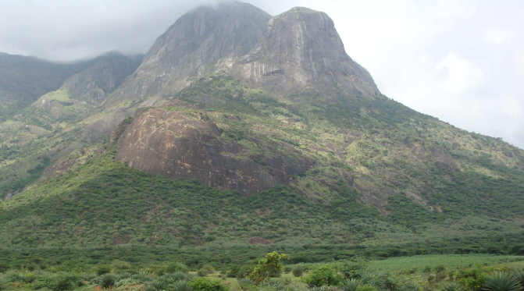
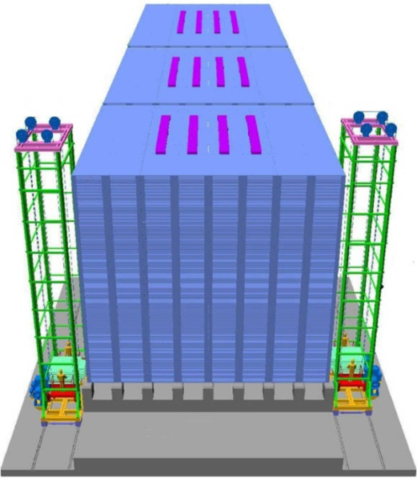
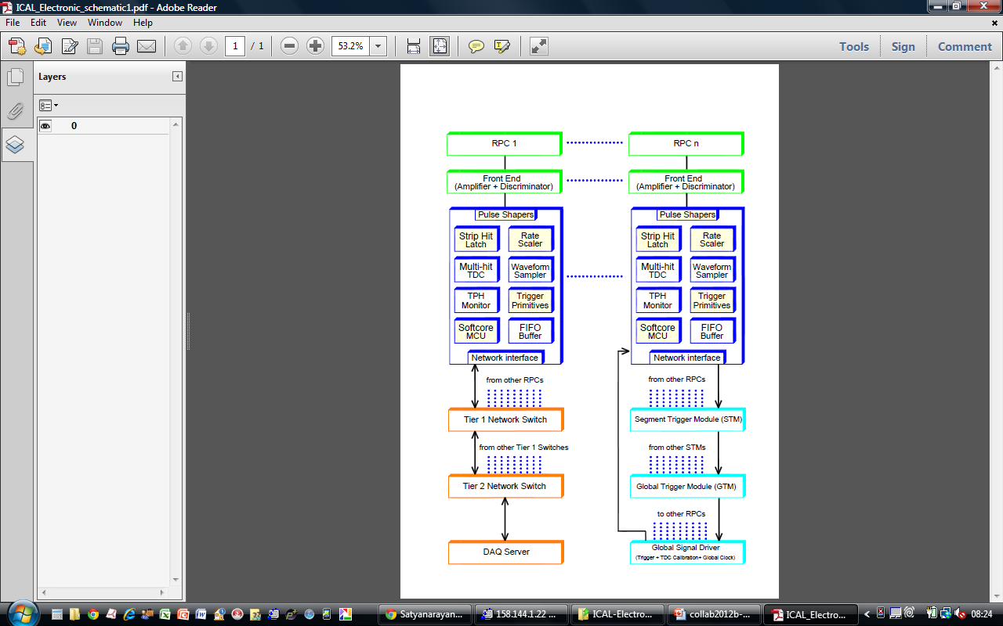
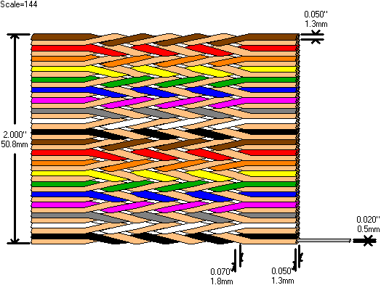
Detecting and Recording
Neutrino Interactions
Dr. B.Satyanarayana ▪ Scientific Officer (G)
Department of High Energy Physics ▪ Tata Institute of Fundamental Research
Homi Bhabha Road ▪ Colaba ▪ Mumbai ▪ 400005 ▪ INDIA
T: 09987537702 ▪ E: bsn@tifr.res.in ▪ W: http://www.tifr.res.in/~bsn

Slide 2
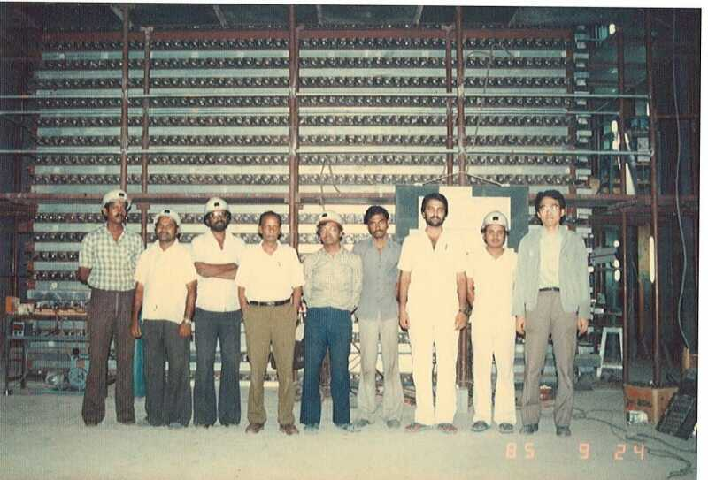
KGF Proton decay experiment

Slide 3
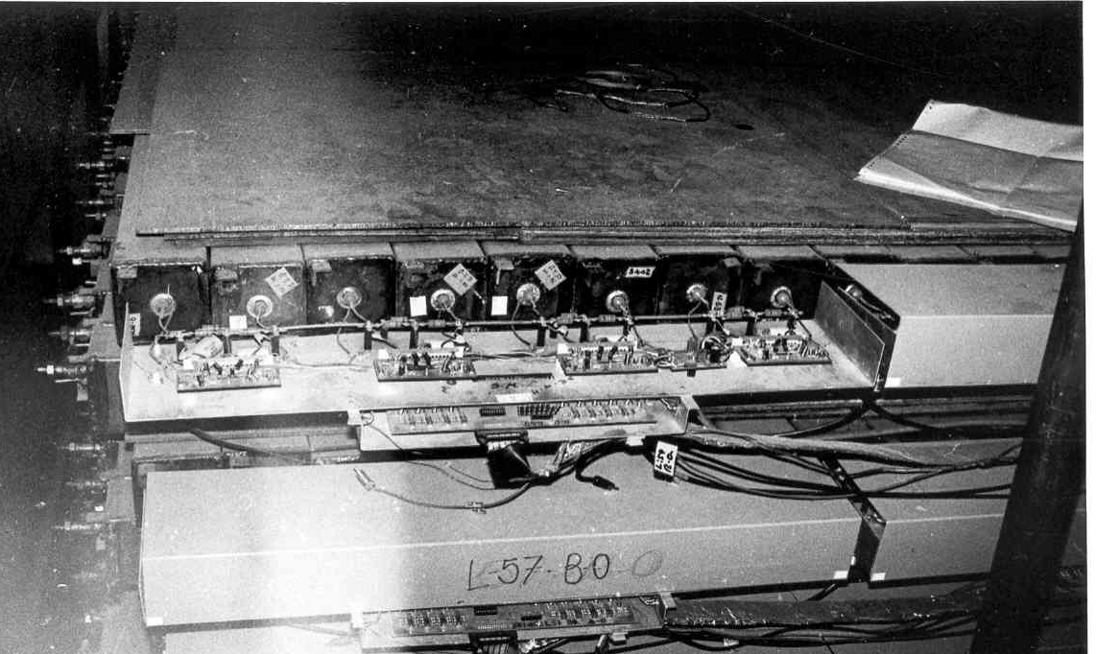
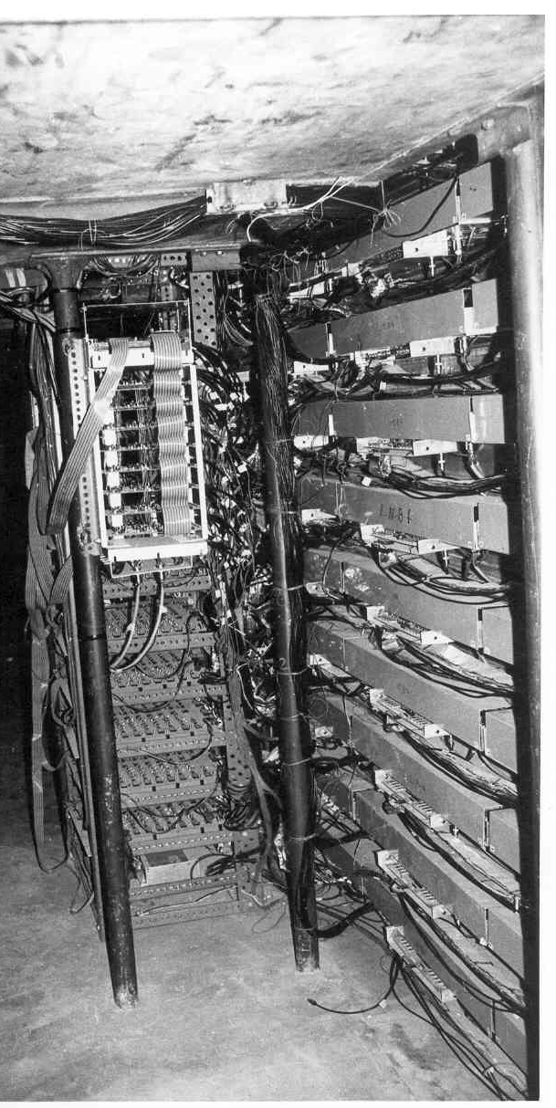
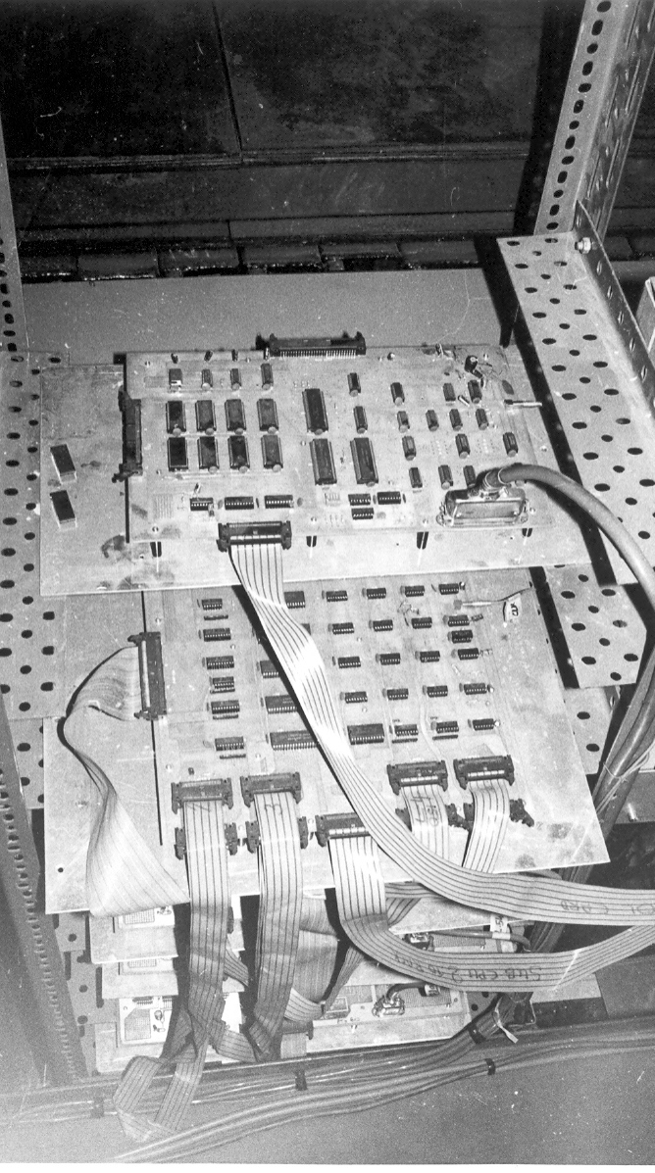
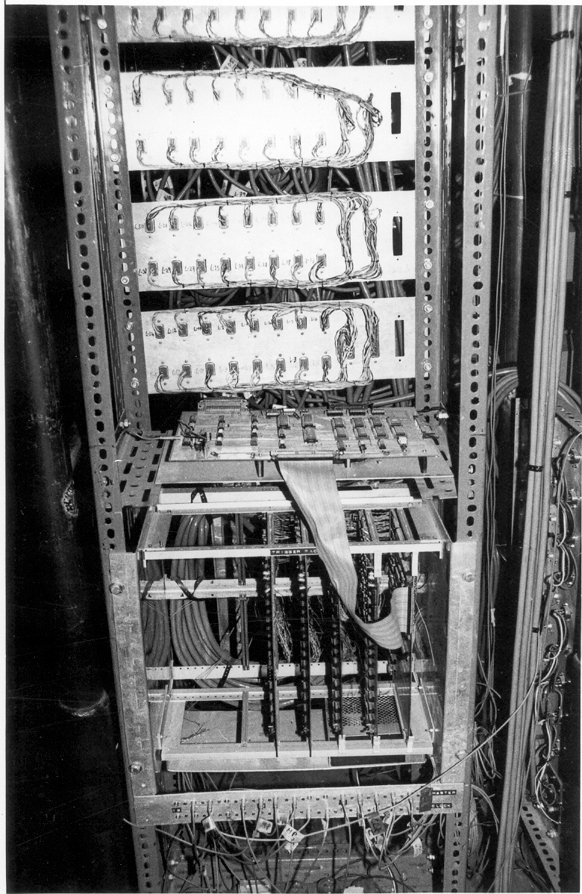
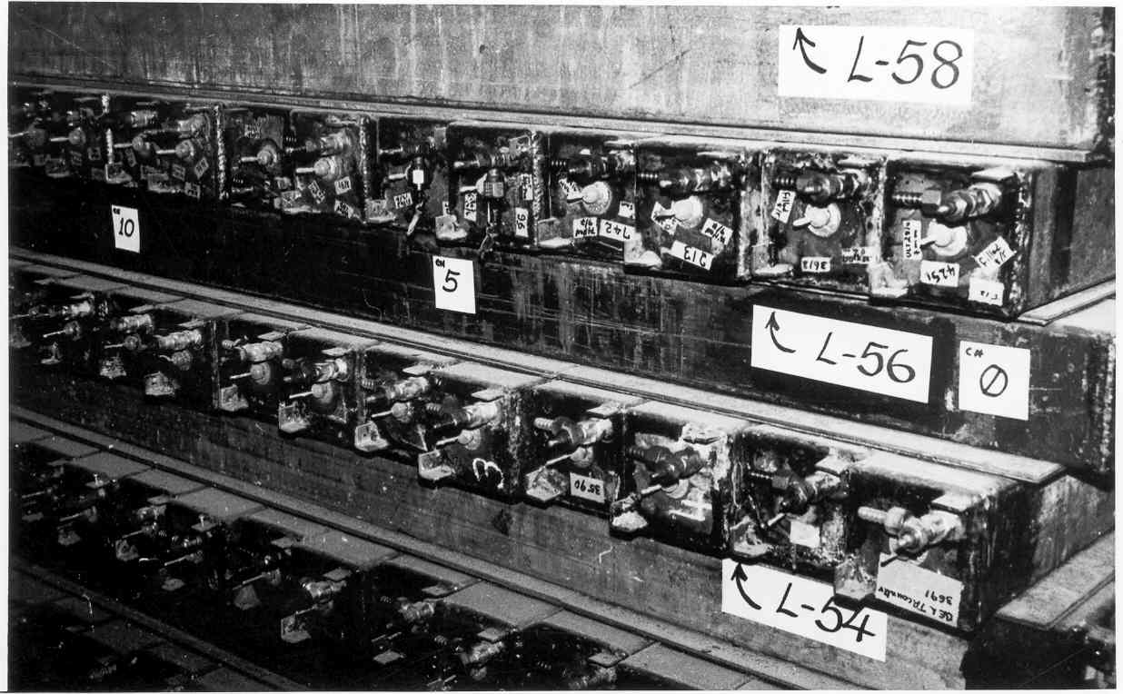
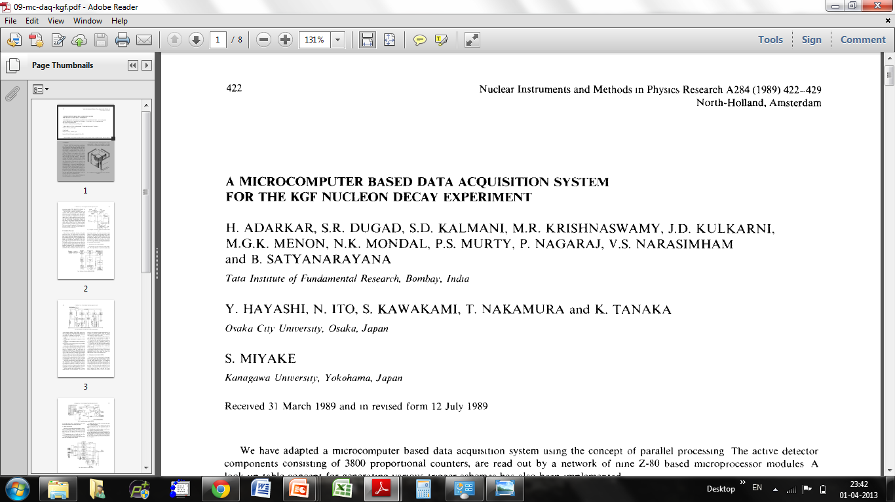
Black and white electronics!

Slide 4
ICAL detector and numbers
No. of modules | 3
Module dimensions | 16m × 16m × 14.5m
Detector dimensions | 48.4m × 16m × 14.5m
No. of layers | 150
Iron plate thickness | 56mm
Gap for RPC trays | 40mm
Magnetic field | 1.3Tesla
RPC dimensions | 1,950mm × 1,840mm × 24mm
Readout strip pitch | 3 0mm
No. of RPCs/Road/Layer | 8
No. of Roads/Layer/Module | 8
No. of RPC units/Layer | 192
No. of RPC units | 28,800 (97,505m²)
No. of readout strips | 3,686,400
Magnet coils
RPC handling trolleys
Total weight: 50Ktons

Slide 5
30 years of HEP instrumentation
Parameter | KGF experiment | ICAL experiment
Year | 1983 | 2013
Size (m³) | 6 × 6 × 6 | 48 × 16 × 16
Weight of the detector (tons) | 350 | 50000
Interacting path in detector (mm) | 100 | 2
Detector pitch (mm) | 100 | 30
Readout channels | 3600 | 3,686,400
Rise time of the signal | 1μs | 1ns
Approx. budget (crores) | 2 | 1500
My take home salary (Rs) | 1 | 50☺

Slide 6
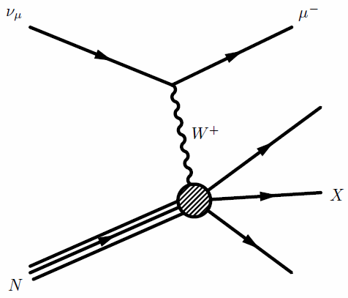

Neutrino induced interactions
CC interactions
NC interactions

Slide 7
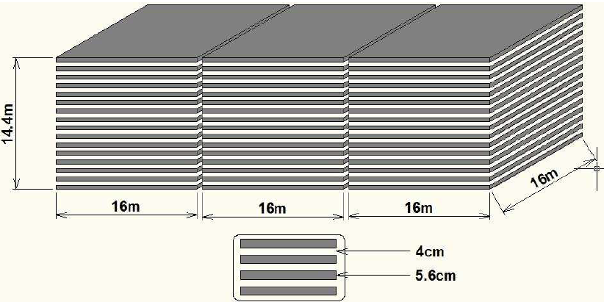
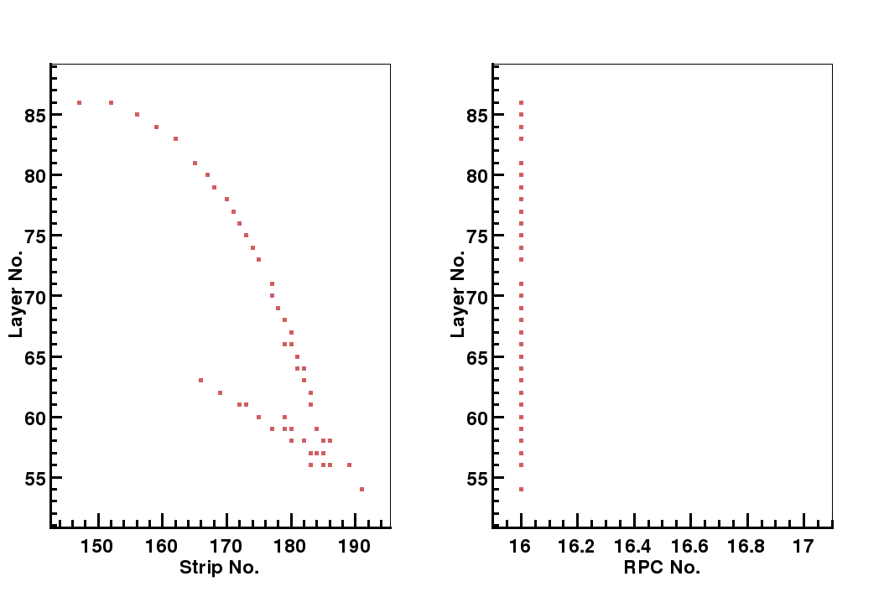
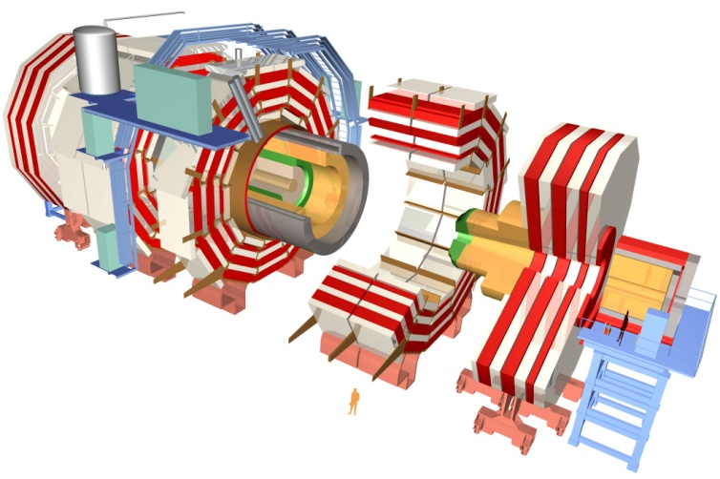
Iron CALorimeter detector concept

Slide 8
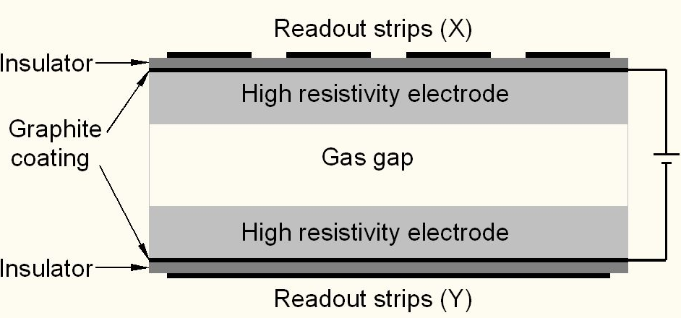
Schematic of a basic RPC

Slide 9
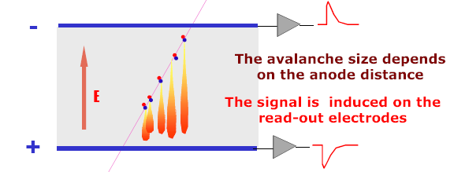
Signal development in an RPC
  Incident radiation produces ionisation in the gas volume. Each primary electron thus produced, initiates an avalanche until it hits the electrode.
  Avalanche development is characterized by two gas parameters, Townsend coefficient (α) and Attachment coefficient (η).
  Average number of electrons produced at a distance x, n(x) ⁼ e^{(α- η)x}
  Current signal induced on the electrode, i(t) = E_{w} • v • e₀ • n(t) / V_{w}, where E_{w} / V_{w} = ε_{r} / (2b + dε_{r}).

Slide 10
Control of avalanche process
Role of RPC gases in avalanche control
  Argon is the ionising gas
  R134a to capture free electrons and localise avalanche
    e⁻ + X → X⁻ + hν (Electron attachment)
    X⁺ + e⁻ → X + hν (Recombination)
  Isobutane to stop photon induced streamers
  SF₆ for preventing streamer transitions
Growth of the avalanche is governed by dN/dx = αN
The space charge produced by the avalanche shields (at about αx = 20) the applied field and avoids exponential divergence
Townsend equation should be dN/dx = α(E)N

Slide 11
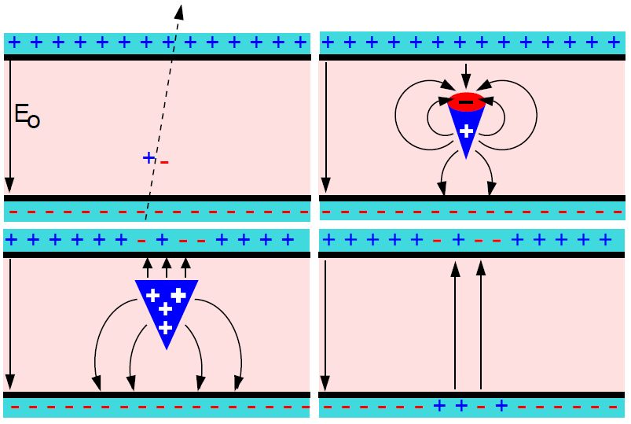
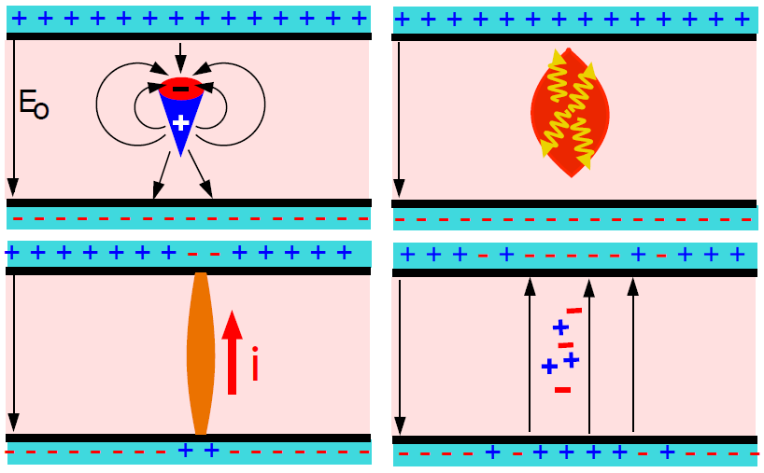
Modes of operations of RPC
Avalanche mode
Streamer mode
Gain of the detector << 10⁸
Charge developed ~1pC
Needs a preamplifier
Longer life
Typical gas mixture Fr:iB:SF₆::94.5:4:0.5
Moderate purity of gases
Higher counting rate capability
Gain of the detector > 10⁸
Charge developed ~ 100pC
No need for a preamplier
Relatively shorter life
Typical gas mixture Fr:iB:Ar::62.8:30
High purity of gases
Low counting rate capability


Slide 12
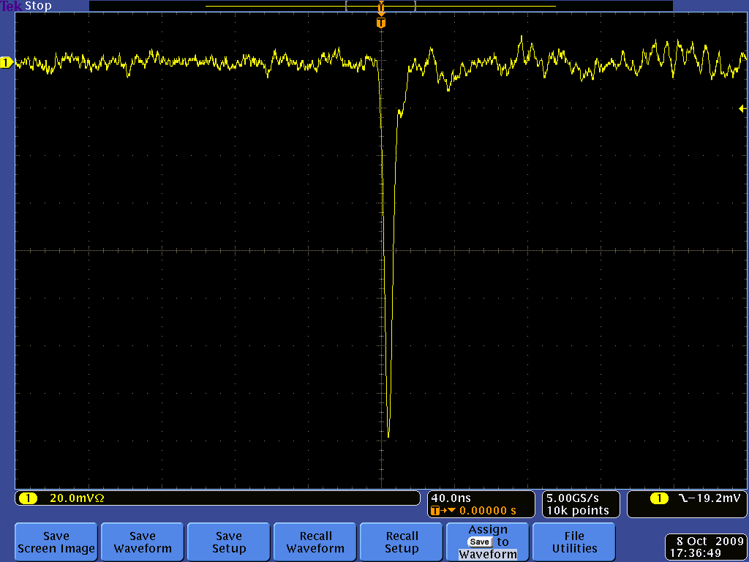
Amplified signal of an RPC

Slide 13
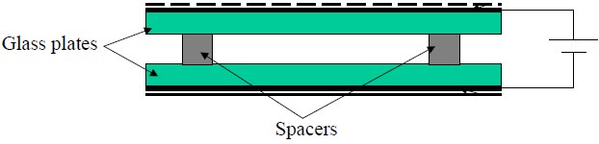
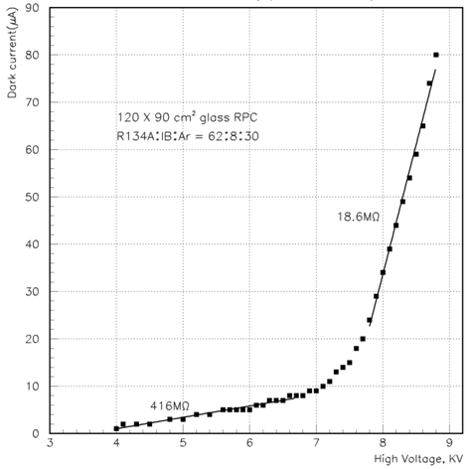
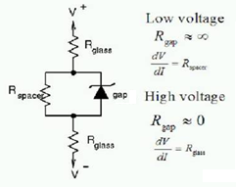
V-I characteristics of an RPC
Glass RPCs have a distinctive and readily understandable current versus voltage relationship.

Slide 14
Why ICAL chose RPC?
Large detector area coverage, thin (~10mm), small mass thickness
Flexible detector and readout geometry designs
Solution for tracking, calorimeter, muon detectors
Trigger, timing and special purpose design versions
Built from simple/common materials; low fabrication cost
Ease of construction and operation
Highly suitable for industrial production
Detector bias and signal pickup isolation
Simple signal pickup and front-end electronics; digital information acquisition
High single particle efficiency (>95%) and time resolution (~1nSec)
Particle tracking capability; 2-dimensional readout from the same chamber
Good reliability, long term stability

Slide 15
Deployment of RPCs in experiments
Experiment | Area (m²) | Electrodes | Gap(mm) | Gaps | Mode | Type
PHENIX | ? | Bakelite | 2 | 2 | Avalanche | Trigger
NeuLAND | 4 | Glass | 0.6 | 8 | Avalanche | Timing
FOPI | 6 | Glass | 0.3 | 4 | Avalanche | Timing
HADES | 8 | Glass | 0.3 | 4 | Avalanche | Timing
HARP | 10 | Glass | 0.3 | 4 | Avalanche | Timing
COVER-PLASTEX | 16 | Bakelite | 2 | 1 | Streamer | Timing
EAS-TOP | 40 | Bakelite | 2 | 1 | Streamer | Trigger
STAR | 50 | Glass | 0.22 | 6 | Avalanche | Timing
CBM TOF | 120 | Glass | 0.25 | 10 | Avalanche | Timing
ALICE Muon | 140 | Bakelite | 2 | 1 | Streamer | Trigger
ALICE TOF | 150 | Glass | 0.25 | 10 | Avalanche | Timing
L3 | 300 | Bakelite | 2 | 2 | Streamer | Trigger
BESIII | 1200 | Bakelite | 2 | 1 | Streamer | Trigger
BaBar | 2000 | Bakelite | 2 | 1 | Streamer | Trigger
Belle | 2200 | Glass | 2 | 2 | Streamer | Trigger
CMS | 2953 | Bakelite | 2 | 2 | Avalanche | Trigger
OPERA | 3200 | Bakelite | 2 | 1 | Streamer | Trigger
YBJ-ARGO | 5630 | Bakelite | 2 | 1 | Streamer | Trigger
ATLAS | 6550 | Bakelite | 2 | 1 | Avalanche | Trigger
ICAL | 97,505 | Both | 2 | 1 | Both | Trigger

Slide 16
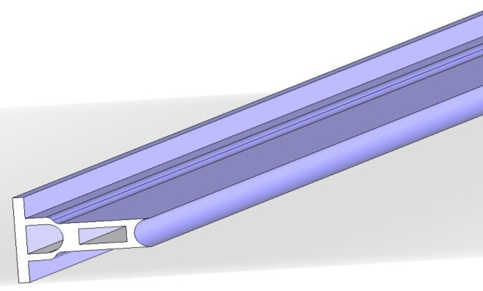
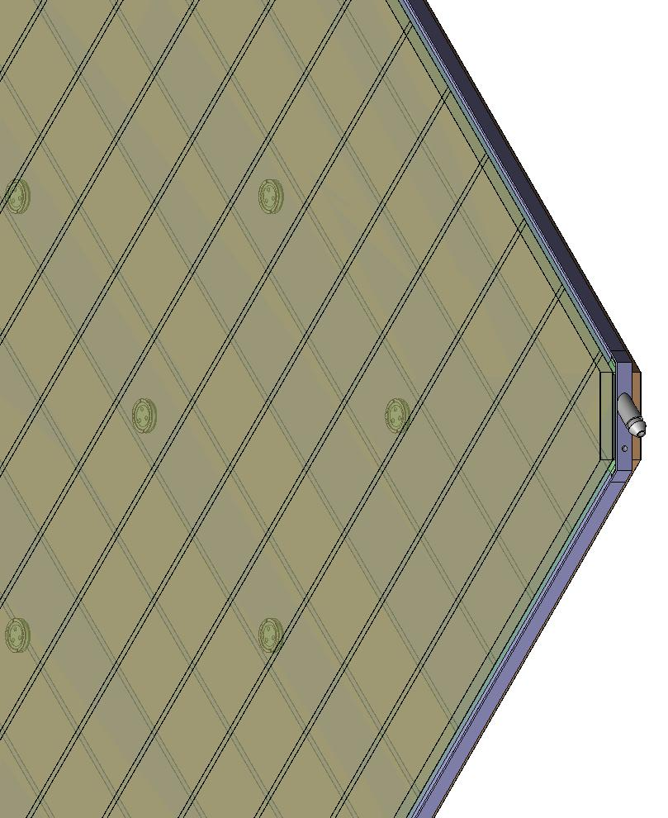
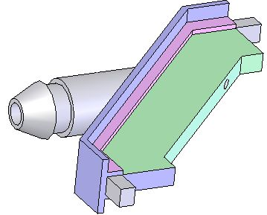
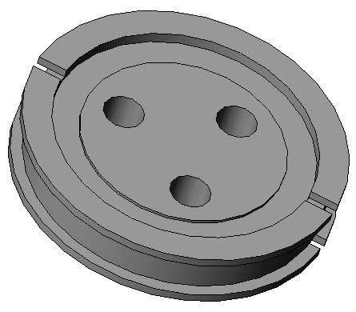
Materials used for RPC fabrication
Edge spacer
Schematic of an assembled gas volume
Gas nozzle
Glass spacer

Slide 17
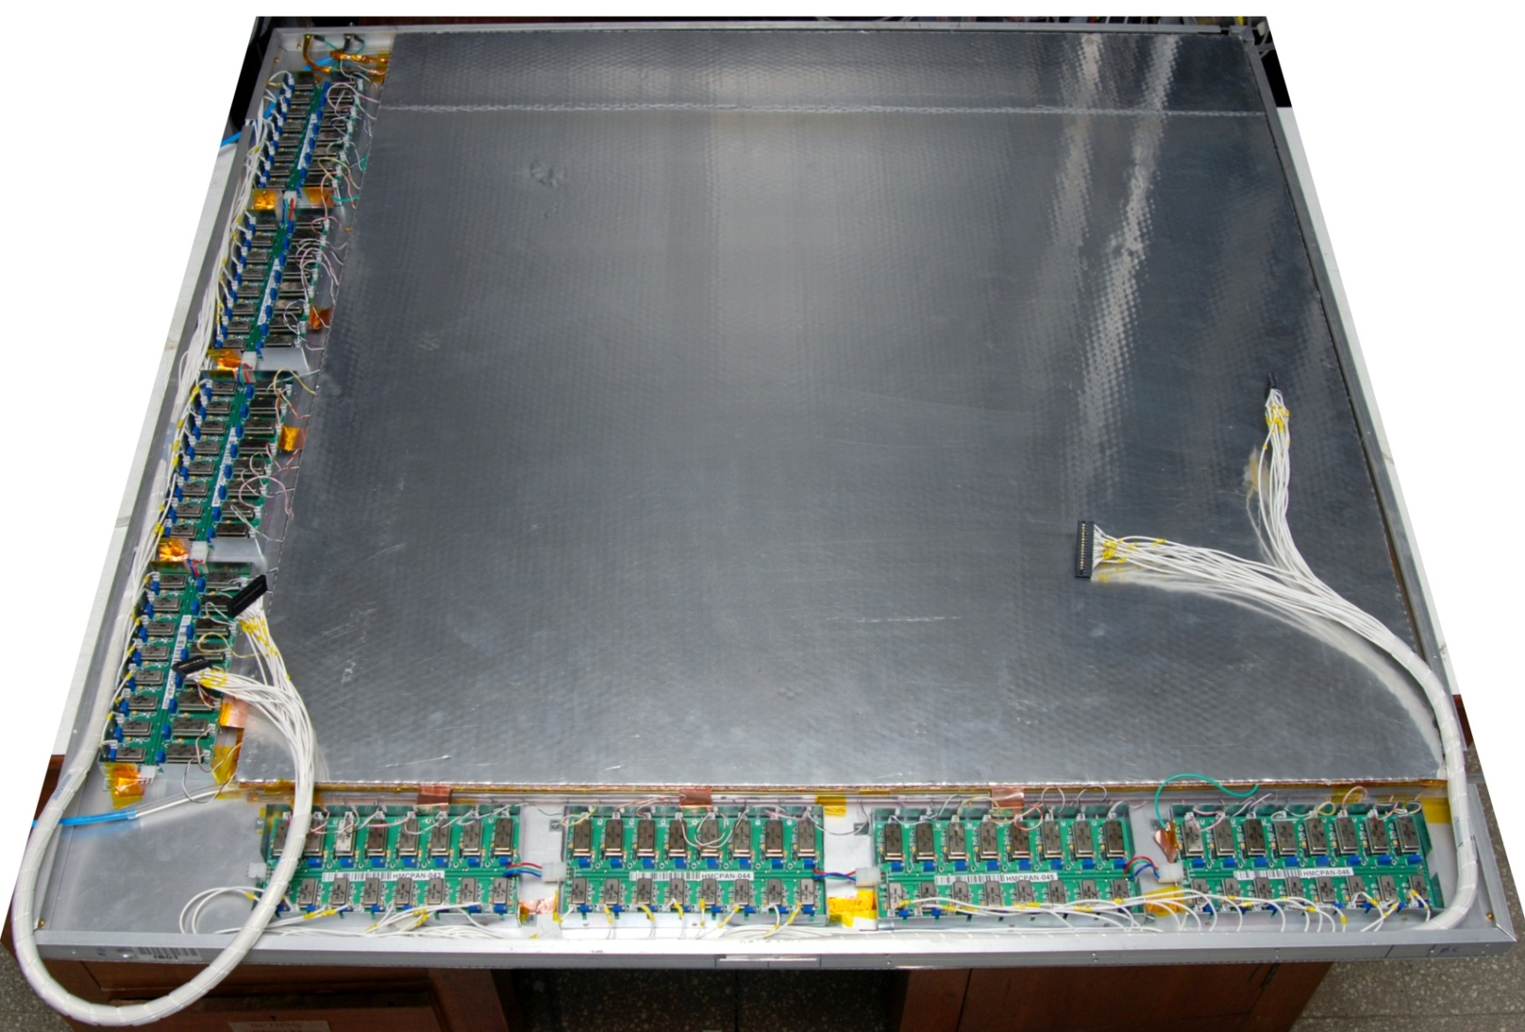
Fully assembled large area RPC
1m × 1m

Slide 18
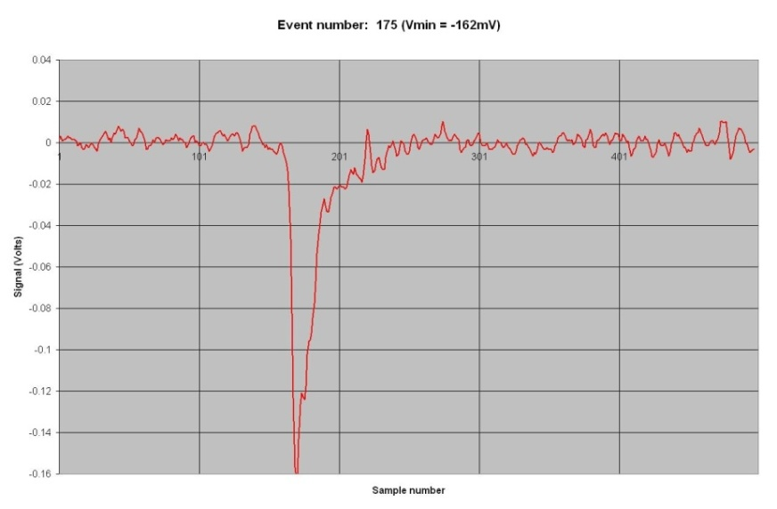
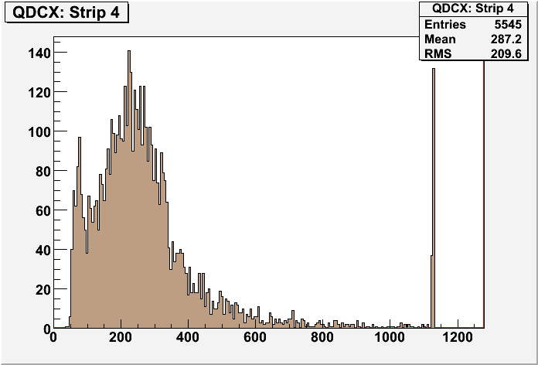
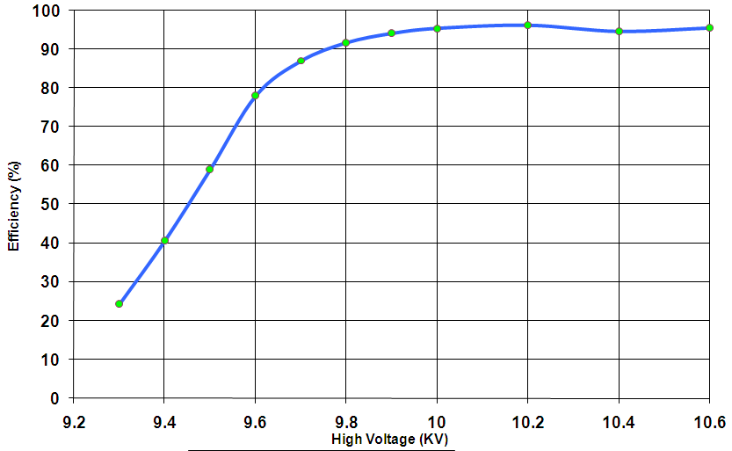
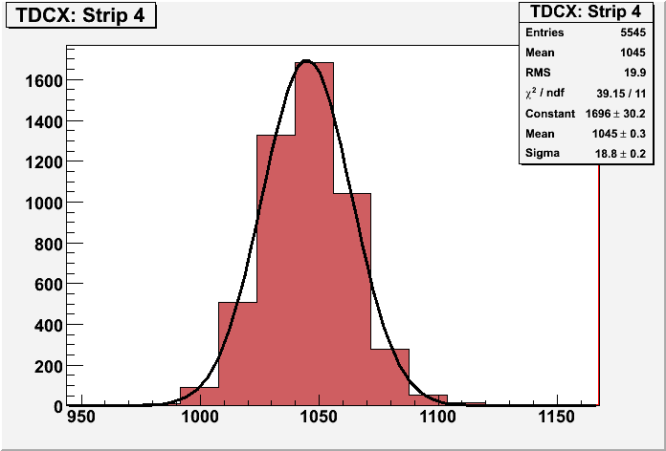
RPC performance parameters

Slide 19
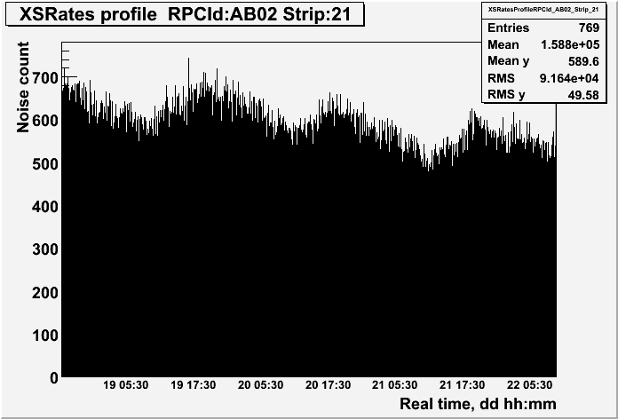
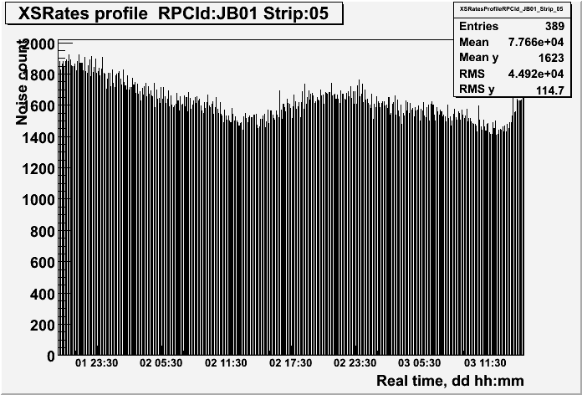
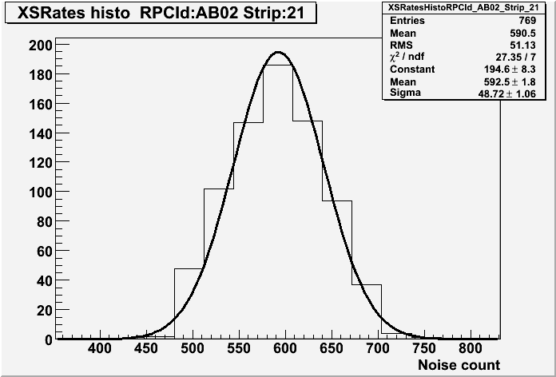
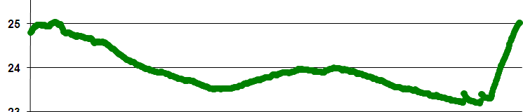
RPC’s stability monitoring
Temperature dependence on noise rate
Strip noise rate profile
Strip noise rate histogram
Temperature

Slide 20
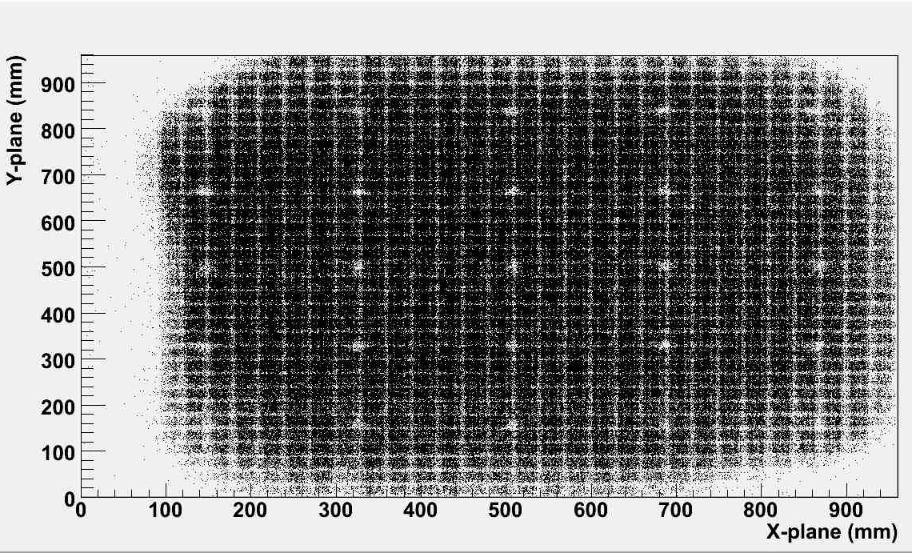
RPC tomography using cosmic muons

Slide 21
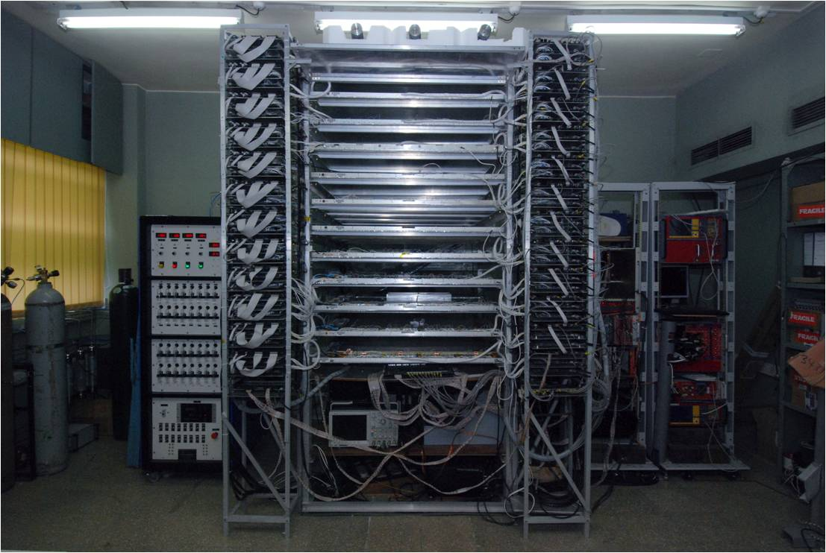
1m × 1m RPC stack at TIFR, Mumbai

Slide 22
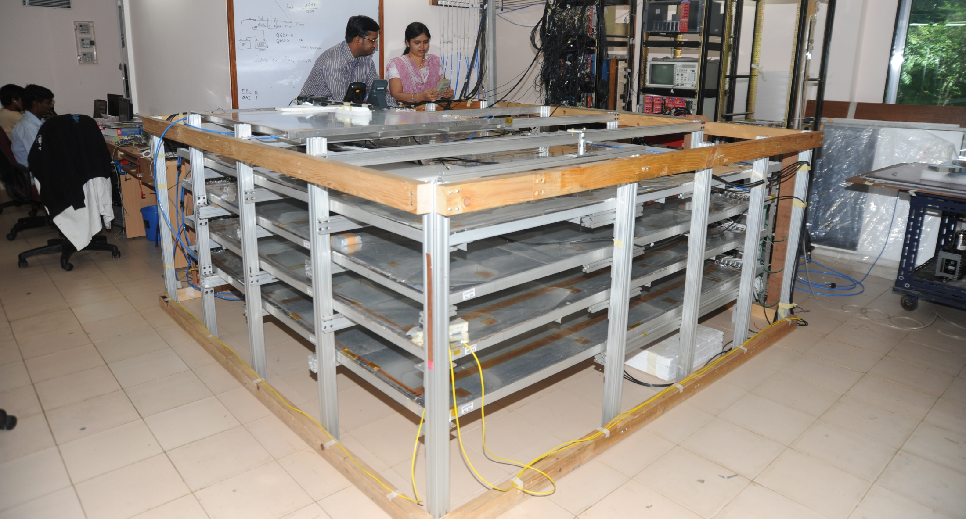
2m × 2m RPC stack at TIFR, Mumbai

Slide 23
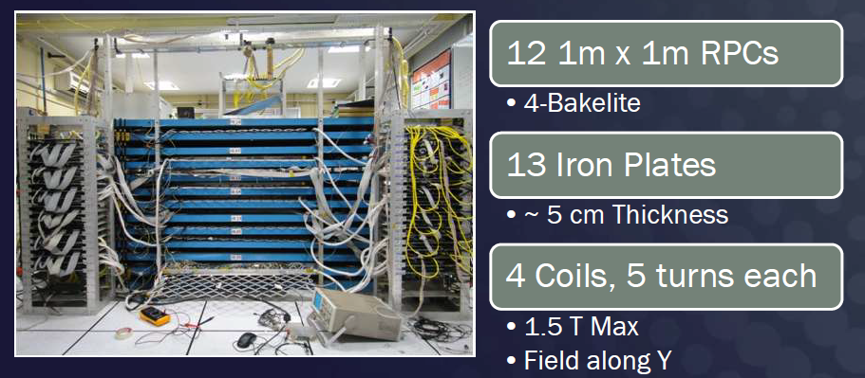
ICAL prototype at VECC, Kolkata

Slide 24
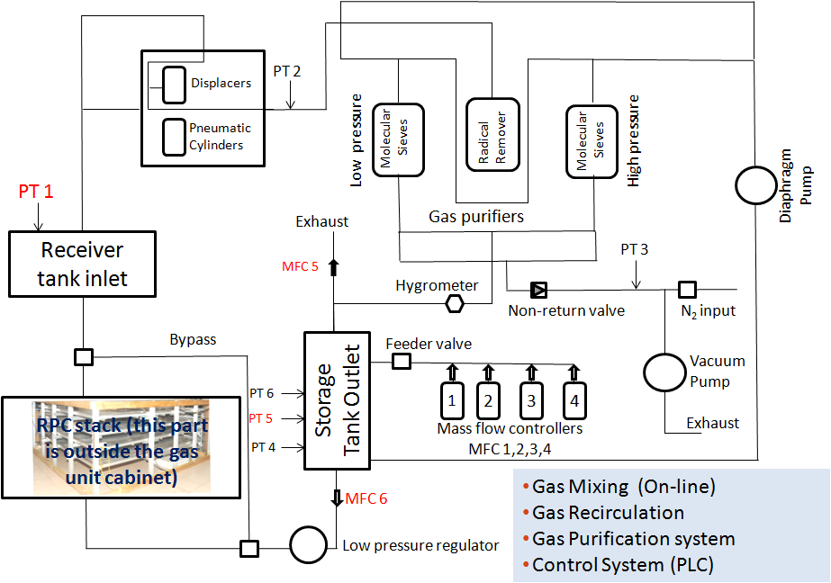
Gas recirculation system

Slide 25
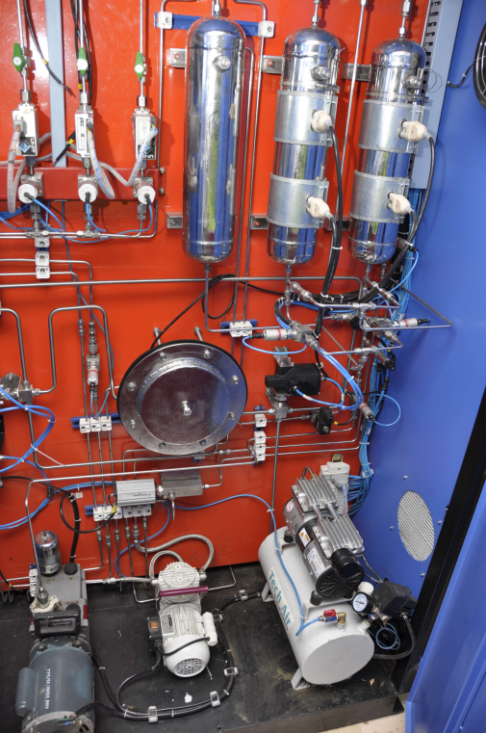
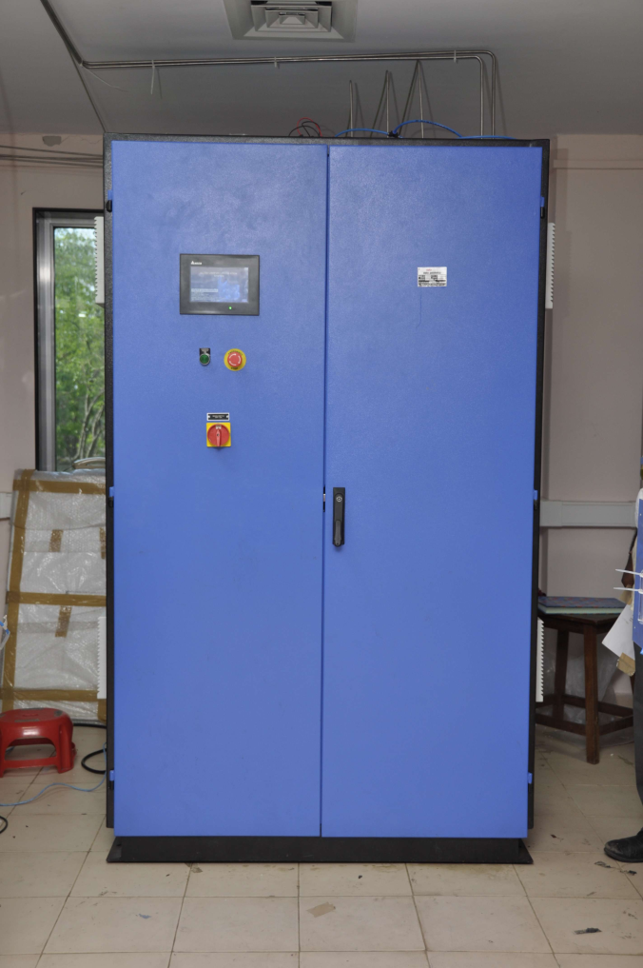
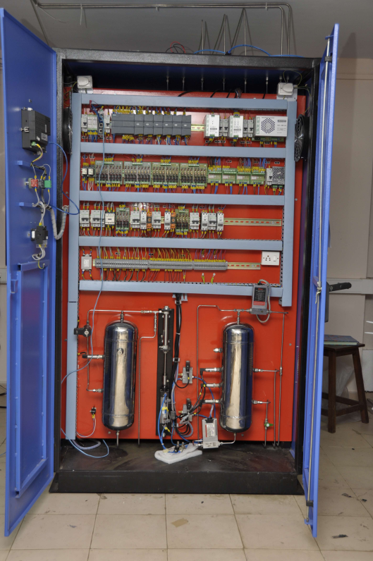
Closed loop gas purification system

Slide 26
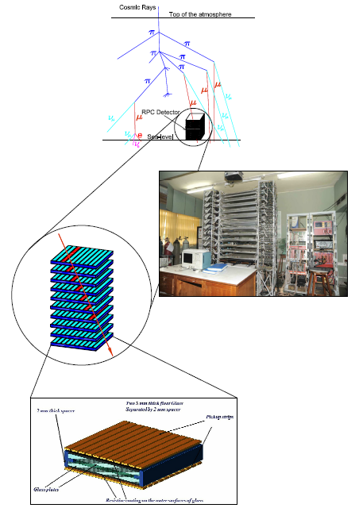
ICAL DAQ system requirements
Information to record on trigger
  Strip hit (1-bit resolution)
  Timing (200ps LC)
  Time-Over-Threshold
Rates
  Individual strip background rates ~300Hz
  Event rate ~10Hz
On-line monitor
  RPC parameters (High voltage, current)
  Ambient parameters (T, RH, P)
  Services, supplies (Gas systems, magnet, low voltage power supplies, thresholds)
Start
Stop

Slide 27
Challenges of ICAL electronics
Huge number of electronic data readout channels. This necessitates large scale integration and/or multiplexing of electronics. The low to moderate rates of individual channels allow this integration/multiplexing.
Large dimensions of one unit of RPC. This has bearing on the way the signals from the detector are routed to the front-end electronic units and matching the track lengths of the signals, irrespective of the geographical position of the signal source. We need to do this in order to maintain equal timing of signals from individual channels.
Large dimensions of the entire detector. This will pose constraints on the cable routing, signal driving and related considerations.
Road structure for the mounting of RPCs. This necessarily imposes constraint that signals from both X & Y planes of the RPC unit, along with other service and power supply lines are brought out only from the transverse direction of the detector.
About 40mm gap between iron layers is available for the RPC detector, out of which thickness of the RPC unit is expected to at least 24mm. Leaving another 5-6mm for various tolerances, realistically about 10mm is the available free space in the RPC slot for routing out cables etc.

Slide 28
Sub-systems of ICAL instrumentation
Signal pickup and front-end electronics
Strip latch
Timing units
Background rate monitors
Front-end controller
Network interface and data network architecture
Trigger system
Event building, databases, data storage systems
Slow control and monitoring
  Gas, magnet, power supplies
  Ambient parameters
  Safety and interlocks
Computer, back-end networking and security issues
On-line data quality monitors
Voice and video communications
Remote access protocols to detector sub-systems and data

Slide 29
Overall scheme of ICAL electronics
Major elements of DAQ system
  Front-end board
  RPCDAQ board
  Segment Trigger Module
  Global Trigger Module
  Global Trigger Driver
  Tier1 Network Switch
  Tier2 Network Switch
  DAQ Server

Slide 30
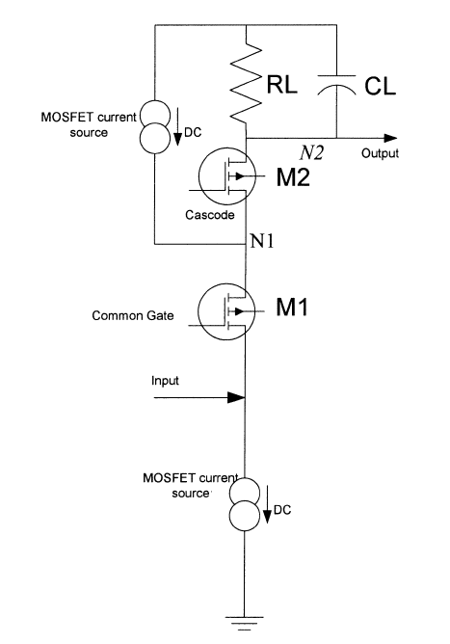
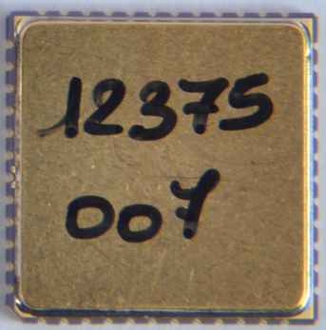
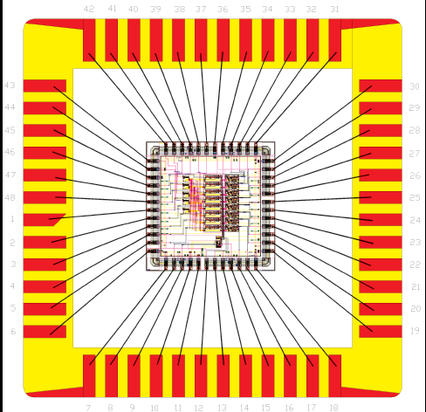
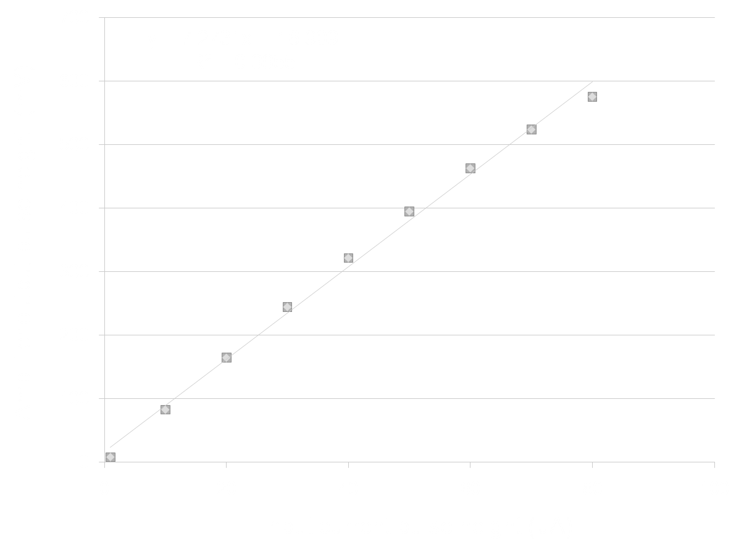
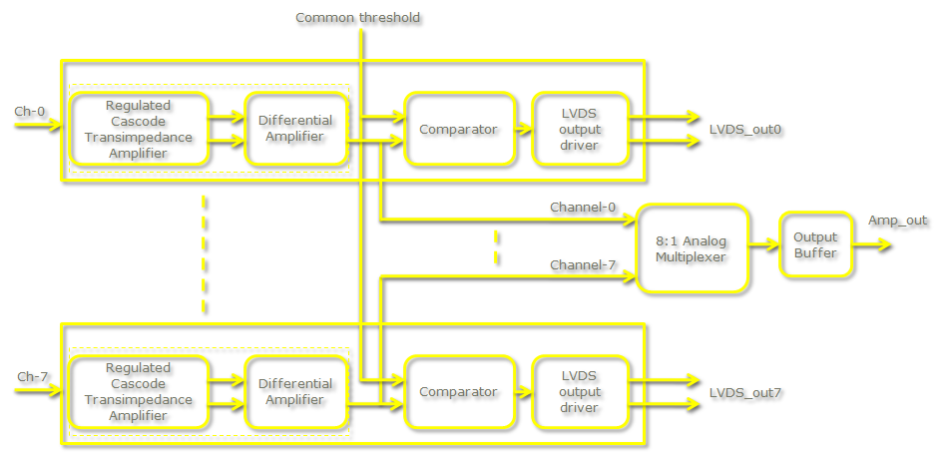
INO’s ASIC front-end chip
Process: AMSc35b4c3 (0.35um CMOS)
Input dynamic range:18fC – 1.36pC
Input impedance: 45Ω @350MHz
Amplifier gain: 8mV/μA
3-dB Bandwidth: 274MHz
Rise time: 1.2ns
Comparator’s sensitivity: 2mV
LVDS drive: 4mA
Power per channel: < 20mW
Package: CLCC48(48-pin)
Chip area: 13mm²

Slide 31

RPCDAQ module – the workhorse
Unshaped, digitized, LVDS RPC signals from 128 strips (64x + 64y)
16 analog RPC signals, each signal is a summed or multiplexed output of 8 RPC amplified signals.
Global trigger
TDC calibration signals
TCP/IP connection to backend for command and data transfer

Slide 32

ICAL’s ASIC TDC chip
Principle
  Two fine TDCs to measure start/stop distance to clock edge (T₁, T₂)
  Coarse TDC to count the number of clocks between start and stop (T₃)
  TDC output = T₃+T₁-T₂
Specifications
  Currently a single-hit TDC, can be adapted to multi-hit
  20 bit parallel output
  Clock period, T_{c} = 4ns
  Fine TDC interval, T_{c}/32 = 125ps
  Fine TDC output: 5 bits
  Coarse TDC interval: 2¹⁵ * T_{c} = 131.072μs
  Coarse TDC output: 15 bits
CMEMS is also coming up with an ASIC with similar specs.

Slide 33

Pulse shape monitor
0.2-2 ns
Inverter “Domino” ring chain
IN
Waveform
stored
Out
Clock
Shift Register
“Time stretcher” GHz → MHz

Slide 34




Integration challenges of front-end DAQ
Front-end pre-amplifier board

Slide 35

Data network schematic

Slide 36
Features of ICAL trigger system
Physicist’s mind decoded!
Insitu trigger generation
Autonomous; shares data bus with readout system
Distributed architecture
For ICAL, trigger system is based only on topology of the event; no other measurement data is used
Huge bank of combinatorial circuits
Programmability is the game, FPGAs, ASICs are the players

Slide 37


ICAL Trigger Scheme
367 x 400 mm boards
A Ph.D. student’s work

Slide 38

INO database scheme

Slide 39
Software requirements
RPC-DAQ controller firmware
Backend online DAQ system
Local and remote shift consoles
Data packing and archival
Event and monitor display panels
Event data quality monitors
Slow control and monitor consoles
Database standards
Data analysis and presentation software standards
Operating System and development platforms

Slide 40
Closing remarks
INO is an exciting multi-engineering project and a mega science experiment.
It is being planned on an unprecedented scale and budget.
ICAL and other experiments will produce highly competitive physics.
Beyond neutrino physics, INO is going to be an invaluable facility for many future experiments.
It provides wonderful opportunities for science and engineering students alike.
Detector and instrumentation R&D and scientific human resource development are INO’s major trust areas.
It offers a large number of engineering challenges and many spin-offs such as medical applications.

Slide 41
Thank you for your attention

Slide 42
Career opportunities in INO
Research Scholars
  Applicants must have a minimum qualification of M.Sc. degree in Physics or B.E./B.Tech. degree in any one of Electronics, E & CE, Instrumentation and Electrical Engineering subjects with strong motivation for and proficiency in Physics.
  The selected candidates will be enrolled as Ph.D. students of the Homi Bhabha National Institute (HBNI), a Deemed to be University, with constituent institutions that include BARC, HRI, IGCAR, IMSc, SINP and VECC.
  They will take up 1 year course work at TIFR, Mumbai in both theoretical and experimental high energy physics and necessary foundation courses specially designed to train people to be good experimental physicists.
  Successful candidates after the course work will be attached to Ph.D. guides at various collaborating institutions for a Ph. D. degree in Physics on the basis of their INO related work.
Career opportunities for bright engineers in Electronics, Instrumentation, Computer Science, Information technology, Civil, Mechanical and Electrical engineers

Slide 43
Data sizes and rates – Event
TDC data = 1 channel for 8 strips and both the edges per hit, up to 4 hits per channel per event = 16 channels x 2 edges x 4 hits x 16 bits = 2048 bits
Hit data per RPC = 128 bits
RPC ID = 32 bits
Event ID = 32 bits
Time Stamp = 64 bits
DRS data = 16 channels x 1000 samples x 16 bits = 256000 bits
(DRS data comes in event data only if we get summed analog outputs from the preamplifier)
Data size per event per RPC
  With DRS data, DR = 2048 + 128 + 32 + 32 + 64 + 256000 = 258,304 bits
  Without DRS data, DR = 2048 + 128 + 32 + 32 + 64 = 2,304 bits
Considering 1Hz trigger rate, Maximum data rate per RPC = 252.25 kbps

Slide 44
Data sizes and rates - Monitoring
We require to monitor 1 pick-up strip per plane per RPC.
Monitor Data per strip = 24 bits
Channel ID = 8 bits
RPC ID = 32 bits
Mon Event ID = 32 bits
Ambient Sensors’ data = 3 x 16 bits = 48 bits
Time Stamp = 64 bits
DRS data = 1000 pulses (if noise rate is 100Hz) x 16 bits x 100 samples = 1600000 bits
(DRS data comes in monitoring data only if we get multiplexed analog outputs from the preamplifier)
Data size per 10 seconds per RPC
  With DRS data = 24 + 8 + 32 + 32 + 48 + 64 + 2048 + 1600000 = 1,602,256 bits
  Without DRS data = 24 + 8 + 32 + 32 + 48 + 64 + 2048 = 2,256 bits
Maximum data rate with 10 second monitoring period per RPC = 156.47 kbps

