Slide 1
RPCs: Performance and future directions
B.Satyanarayana, Department of High Energy Physics
Tata Institute of Fundamental Research, Mumbai, INDIA

Slide 2
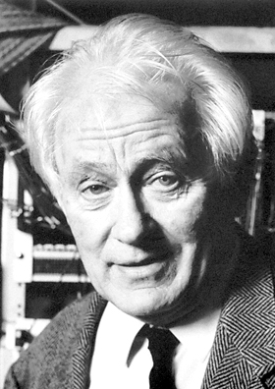
Science and Instrumentation
The Nobel Prize in Physics 1992 was awarded to Georges Charpak "for his invention and development of particle detectors, in particular the multi-wire proportional chamber".
“The discoveries of the W and Z bosons at CERN, the charm quark at SLAC and Brookhaven and the top quark at Fermilab would not have been possible without this type of detector, and current research in high energy physics continues to depend on these devices”.
Georges Charpak (1924–2010)

Slide 3
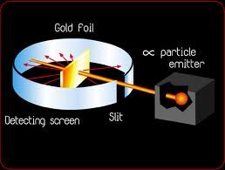
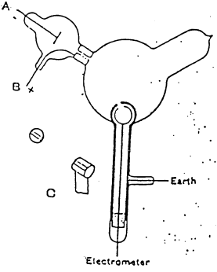
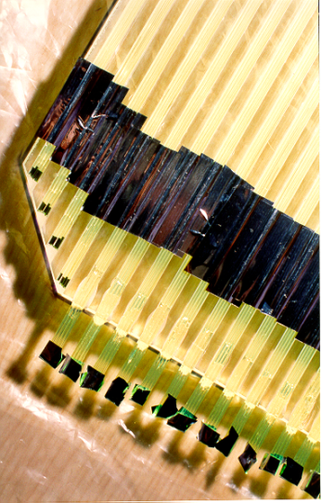
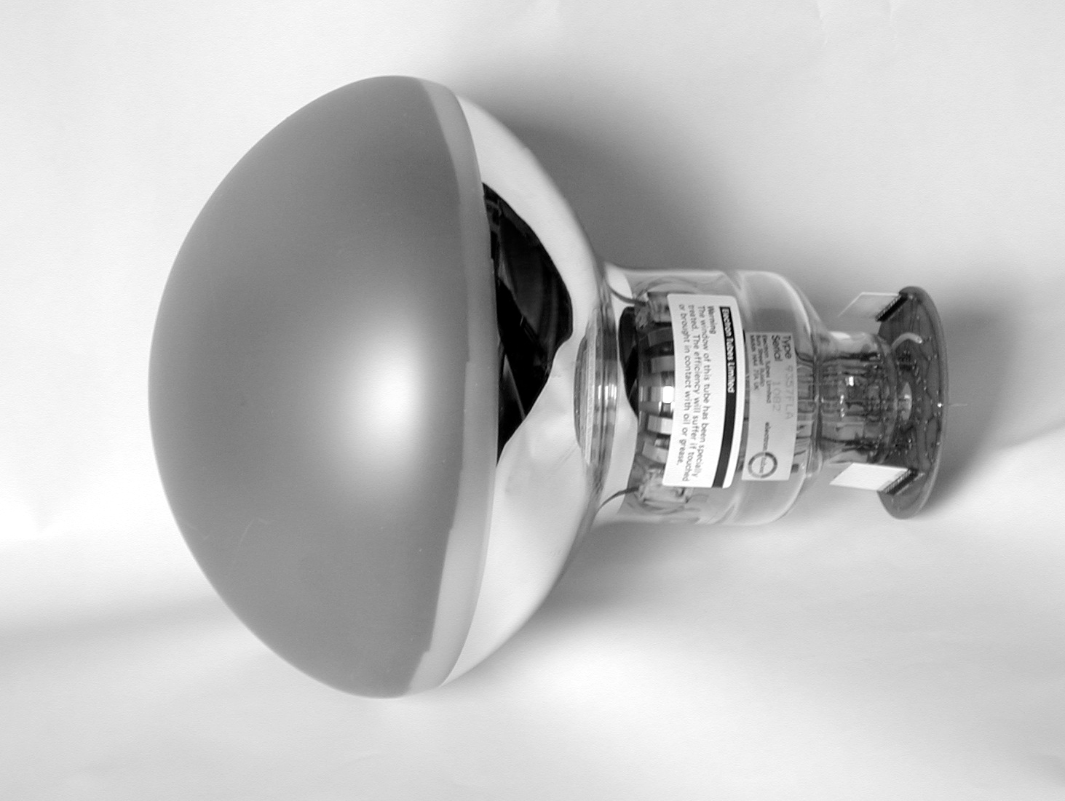
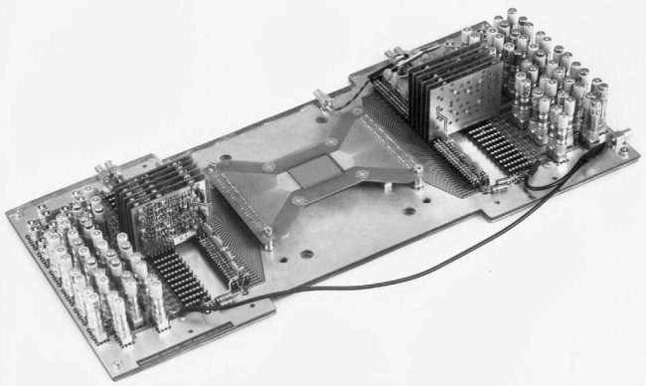
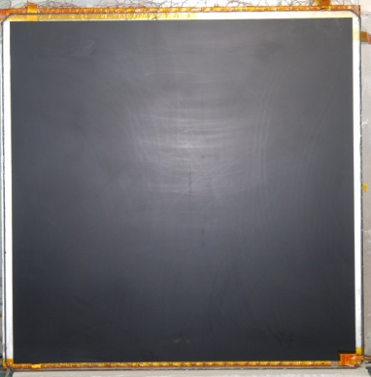
Detectors aided major discoveries
Crookes Tubes: Sir William Crookes (1869-75)
Cloud chamber: Charles Thomas Rees Wilson (1894), Nobel Prize in Physics (1927)
Electron: J.J.Thomson (1897) using Crookes Tubes
“Gold foil apparatus”: Hans Geiger & Ernest Marsden (1909)
Proton: E.Rutherford (1911) using “Gold foil apparatus”
Photon: A.Compton (1923)
Neutron: J.Chadwick (1932)
Positron: C.Anderson (1932)
Muon: C.Anderson & S.Neddermeyer (1937)
Neutral Kaon: G.Rochester & C.Butler (1947) using cloud chamber triggered by Geiger counters
Charged Pion: C.Powell (1947) using photographic emulsions carried aloft by balloons
Lambda: (1947)
Neutral Pion: R.Bjorkland (1949)
Bubble chamber : D.Glaser (1952), Nobel Prize in Physics (1960)
Synchrotron: (1952)
Xi minus: R.Armenteros (1952)
Sigma plus: G.Tomasini (1953) using emulsion technique
Sigma minus: W.Fowler (1953)
Antiproton: W.Segrè (1955)
Antineutron: B.Cork (1956)
MOS transistors: Kahng & Atalla (1960), electronic counters
Multi-Wire Proportional Counter: G.Charpak (1968), Nobel Prize in Physics (1992)
Time Projection Chamber: D.R.Nygren (1974)
Charm quark: SLAC & BNL collaborations (1974)
Super Proton Synchrotron: John Adams et al (1976)
Stochastic cooling: Van der Meer, Nobel Prize in Physics (1984)
Large area (20”) PMT: Hamamatsu (1980)
Resistive Plate Chamber: R.Santonico (1981)
W & Z bosons: UA1 and UA2 collaborations (1983)
Micro Strip Gas Chamber: A.Oed (1988)
Top quark: D0 & CDF collaborations (1995)
Gas Electron Multiplier: F.B.Sauli (1996)
Neutrino oscillation: Super-Kamiokande Collaboration (1998)

Slide 4
Tasks of HEP detectors
Tracking detector: Direction, sign and momenta of the particles. Often aided by magnetic field.
Electromagnetic calorimeter: Energy carried by electrons and photons. Signals proportional to the energy of the incident particles.
Hadronic calorimeter: Energy carried by hadrons (protons, pions and neutrons).
Muon system: Muons are charged particles that penetrate large amounts of matter, loosing little of their energy. Essentially made of tracking detectors.
Particle identification: Identification of charged and neutral particles. Charged particles are identified by combining momentum information with Time-Of-Flight, energy loss dE/dx, Čherenkov or transition radiation.
Displaced vertex: B-, D- or τ-tagging achieved with high spatial resolution detectors.
RICH detector: Determines the velocity of a charged particle
Transition radiation detector: Uses the γ-dependent threshold of transition radiation in a stratified material
Time of flight detector: Discriminates between a lighter and a heavier particle of the same momentum using their time of flight between two detector planes.
Neutrinos: Detected through inferred momentum conservation.
Dark matter: Principle of nuclear recoil by candidate particles (mainly WIMPs)

Slide 5
Classification of HEP detectors
Non-electronic detectors
  Emulsions, cloud chamber, bubble chamber
Gaseous detectors
  GM, SWPC, MWPC, PMD, drift chamber, TPC, MSGC, GEMs, streamer tube, spark chamber, PPAC, RPC, CSC (Types: wired, micro-pattern, wire-less)
Scintillation detectors
  Organic (crystals, liquids, plastics, extruded), inorganic crystals, gas, glass
Silicon detectors
  Strip, pixel, readout integrated
Photo detectors
  PMT, PD, APD, VLPC, SiPM
Liquid ionisation detectors
  Scintillator, Argon, Xenon
Hybrid detectors
  HPD, LArTPC
Aided by rapid, concurrent developments in detector readout technologies
On-detector, high-speed, ultra low-noise front-end ASICs
Novel data acquisition system architectures, pipelines and data links
High performance flash ADCs, multi-hit TDCs, DSPs, FPGAs
Field programmable, complex, multi-level, trigger schemes

Slide 6
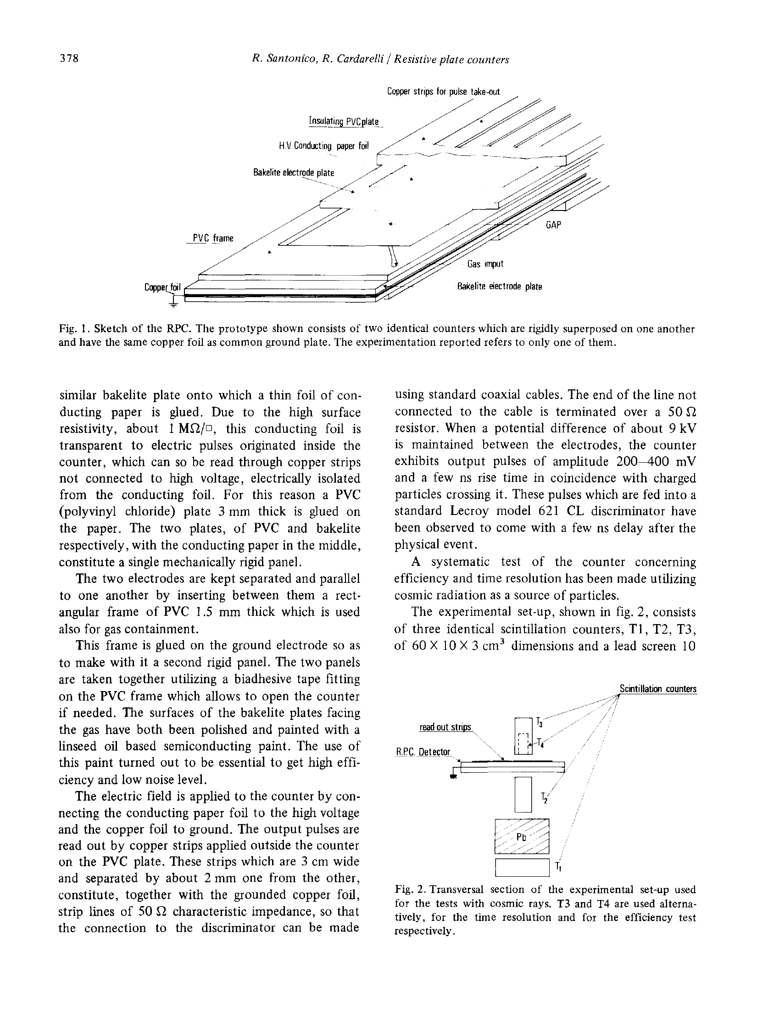
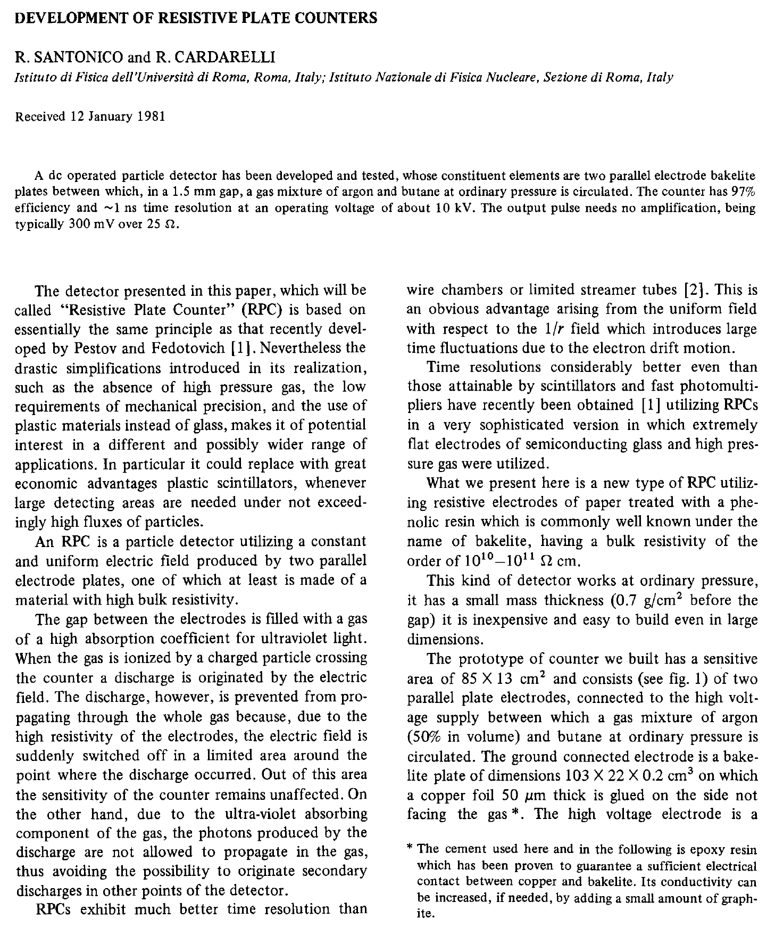
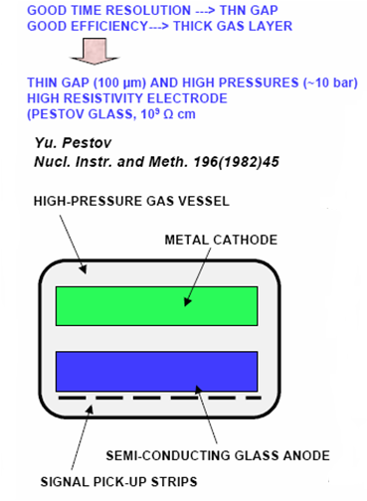
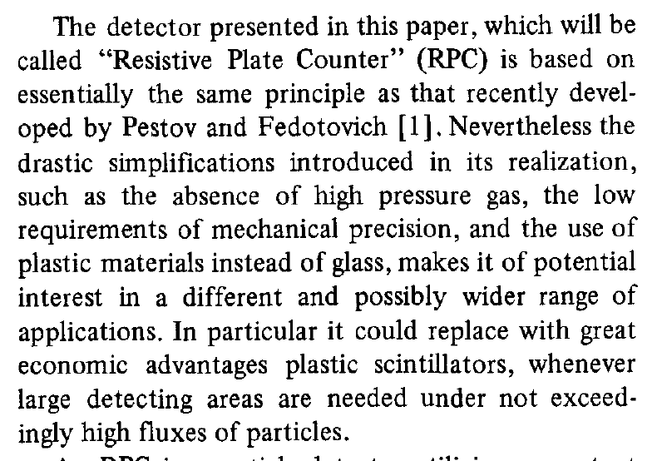
Birth of the RPC

Slide 7
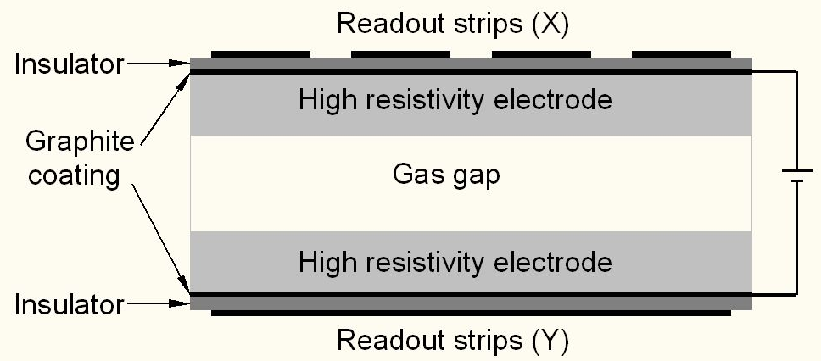
Schematic of a basic RPC

Slide 8
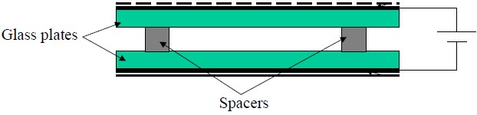
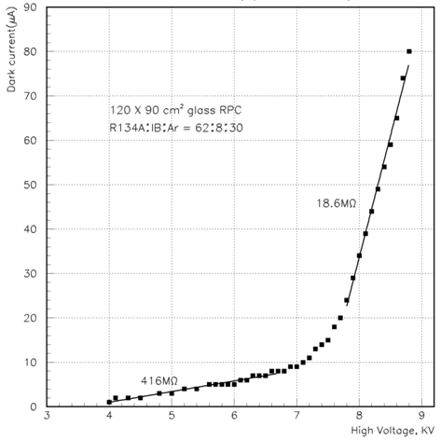
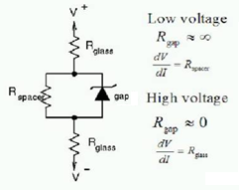
V-I characteristics of RPC
Glass RPCs have a distinctive and readily understandable current versus voltage relationship.

Slide 9
Principle of operation
Electron-ion pairs produced in the ionisation process drift in the opposite directions.
All primary electron clusters drift towards the anode plate with velocity v and simultaneously originate avalanches
A cluster is eliminated as soon as it reaches the anode plate
The charge induced on the pickup strips is q = (-eΔx_{e} + eΔx_{I})/g
The induced current due to a single pair is i = dq/dt = e(v + V)/g ≈ ev/g, V « v
Prompt charge in RPC is dominated by the electron drift

Slide 10
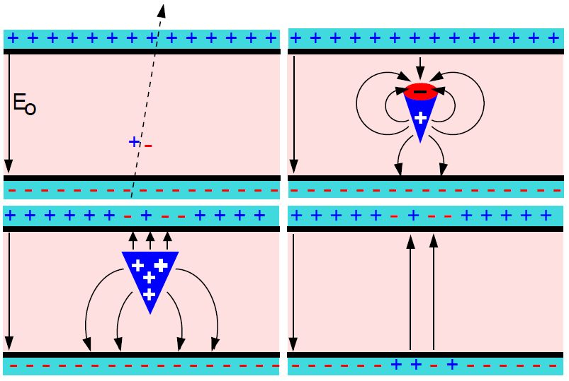
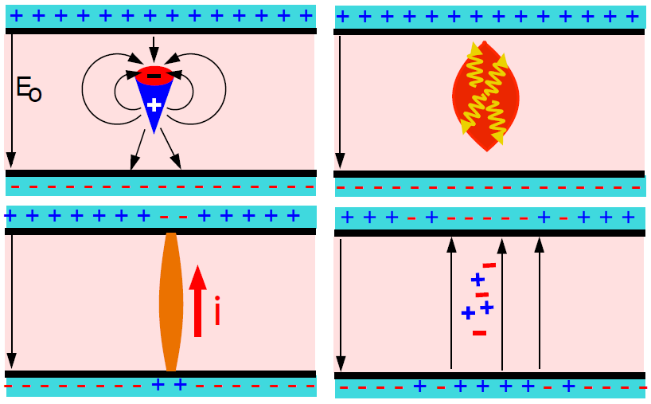
Two modes of RPC operation
Avalanche mode
Streamer mode
Gain of the detector << 10⁸
Charge developed ~1pC
Needs a preamplifier
Longer life
Typical gas mixture Fr:iB:SF₆::94.5:4:0.5
Moderate purity of gases
Higher counting rate capability
Gain of the detector > 10⁸
Charge developed ~ 100pC
No need for a preamplier
Relatively shorter life
Typical gas mixture Fr:iB:Ar::62.8:30
High purity of gases
Low counting rate capability

Slide 11
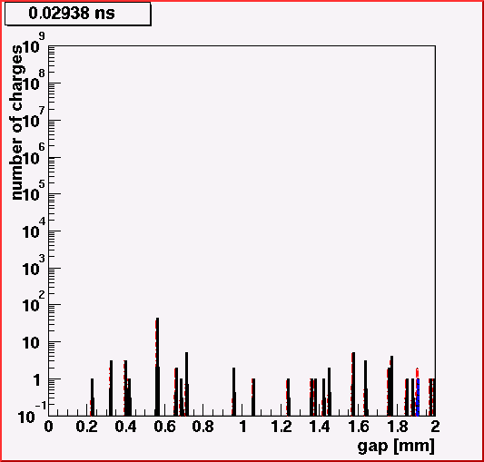
Avalanche development in RPC
RPC volume
  2mm glass resistive plates
  2mm gap
Gas mixture
  C₂F₄H₂ (97%)
  iC₄H₁₀ (2.5%)
  SF₆ (0.5%)
HV applied
  10.0kV
Particle legend
Red: Positive ions
Blue: Negative ions
Black: Electrons
Credit: Christian Lippmann

Slide 12
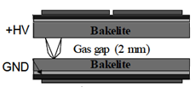
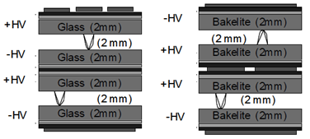
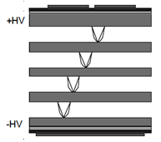
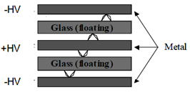
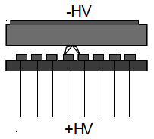
Application driven RPC designs
Single gap RPC
Double gap RPC
Multi gap RPC
Hybrid RPC
Micro RPC

Slide 13
Merits of RPC detectors
Large detector area coverage, thin (~10mm), small mass thickness
Flexible detector and readout geometry designs
Solution for tracking, calorimeter, muon detectors
Trigger, timing and special purpose design versions
Built from simple/common materials; low fabrication cost
Ease of construction and operation
Highly suitable for industrial production
Detector bias and signal pickup isolation
Simple signal pickup and front-end electronics; digital information acquisition
High single particle efficiency (>95%) and time resolution (~1nSec)
Particle tracking capability; 2-dimensional readout from the same chamber
Scalable rate capability (Low to very high); Cosmic ray to collider detectors
Good reliability, long term stability
Under laying Physics mostly understood!

Slide 14
Deployment of RPCs in running experiments
Experiment | Area (m²) | Electrodes | Gap(mm) | Gaps | Mode | Type
PHENIX | ? | Bakelite | 2 | 2 | Avalanche | Trigger
NeuLAND | 4 | Glass | 0.6 | 8 | Avalanche | Timing
FOPI | 6 | Glass | 0.3 | 4 | Avalanche | Timing
HADES | 8 | Glass | 0.3 | 4 | Avalanche | Timing
HARP | 10 | Glass | 0.3 | 4 | Avalanche | Timing
COVER-PLASTEX | 16 | Bakelite | 2 | 1 | Streamer | Timing
EAS-TOP | 40 | Bakelite | 2 | 1 | Streamer | Trigger
STAR | 50 | Glass | 0.22 | 6 | Avalanche | Timing
CBM TOF | 120 | Glass | 0.25 | 10 | Avalanche | Timing
ALICE Muon | 140 | Bakelite | 2 | 1 | Streamer | Trigger
ALICE TOF | 150 | Glass | 0.25 | 10 | Avalanche | Timing
L3 | 300 | Bakelite | 2 | 2 | Streamer | Trigger
BESIII | 1200 | Bakelite | 2 | 1 | Streamer | Trigger
BaBar | 2000 | Bakelite | 2 | 1 | Streamer | Trigger
Belle | 2200 | Glass | 2 | 2 | Streamer | Trigger
CMS | 2953 | Bakelite | 2 | 2 | Avalanche | Trigger
OPERA | 3200 | Bakelite | 2 | 1 | Streamer | Trigger
YBJ-ARGO | 5630 | Bakelite | 2 | 1 | Streamer | Trigger
ATLAS | 6550 | Bakelite | 2 | 1 | Avalanche | Trigger
ICAL | 97,505 | Both | 2 | 1 | Both | Trigger

Slide 15
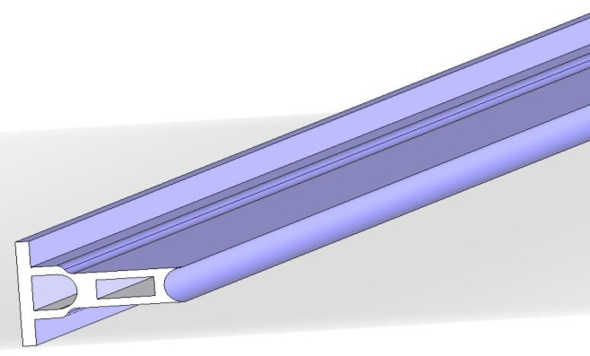
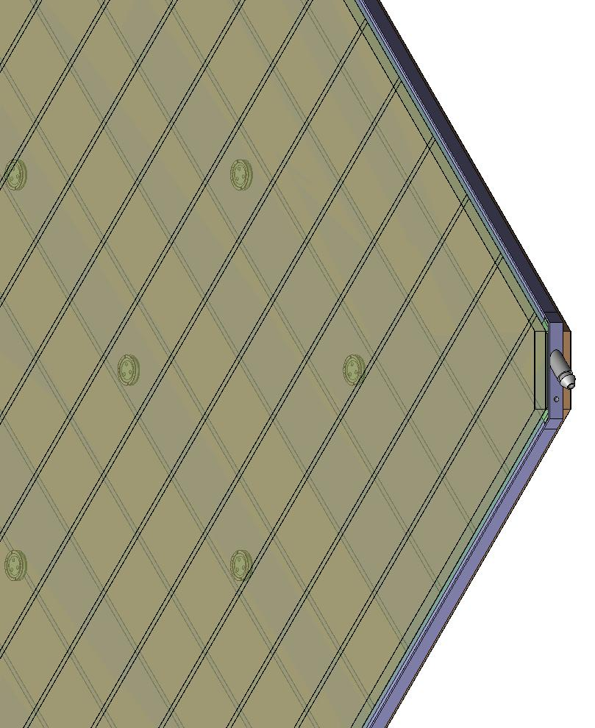
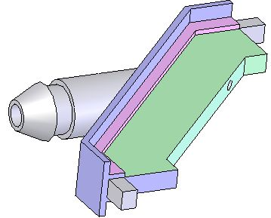
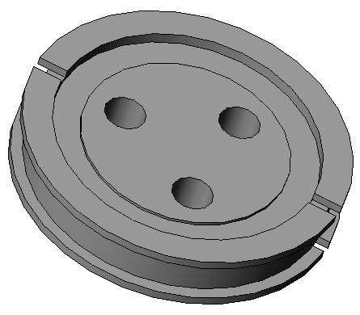
Materials for gas volume fabrication
Edge spacer
Schematic of an assembled gas volume
Gas nozzle
Glass spacer

Slide 16
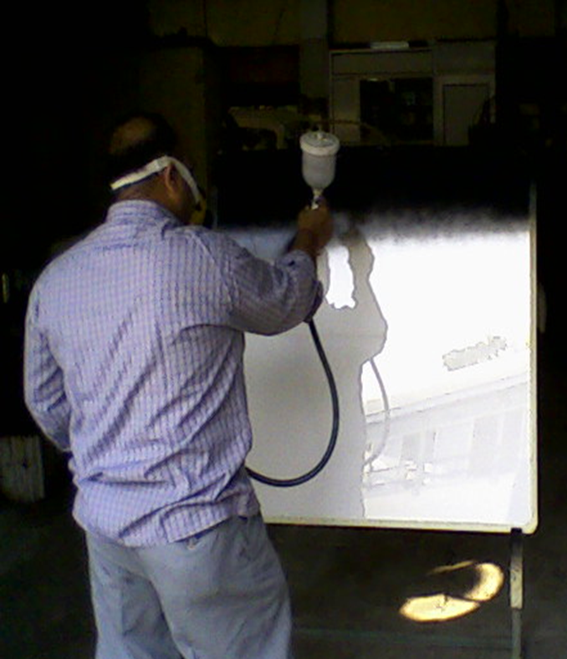
Electrode coating techniques
Graphite paint prepared using colloidal grade graphite powder(3.4gm), lacquer(25gm) and thinner(40ml)
Sprayed on the glass electrodes using an automobile spray gun.
A uniform and stable graphite coat of desired surface resistivity (1MΩ/◻) was obtained by this method.

Slide 17
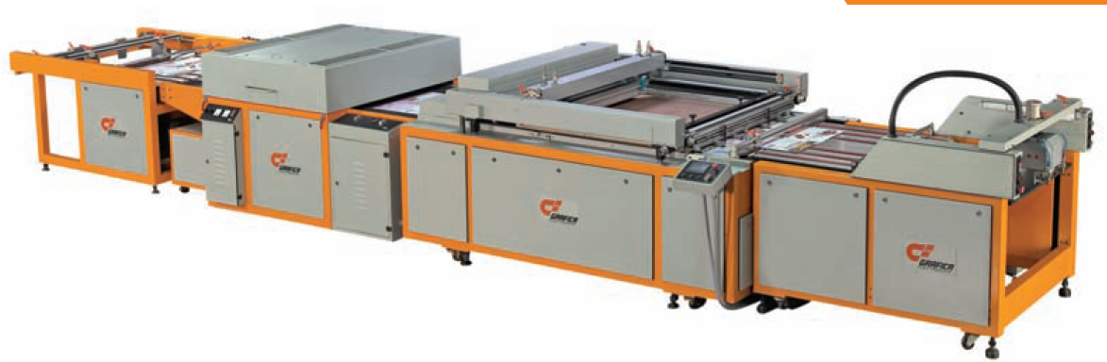
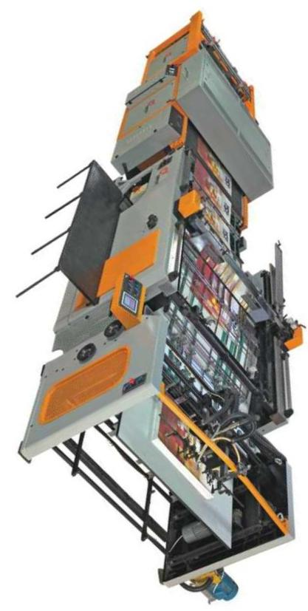
Screen printing techniques
On glass
On films

Slide 18
Schematic of RPC assembly jig

Slide 19
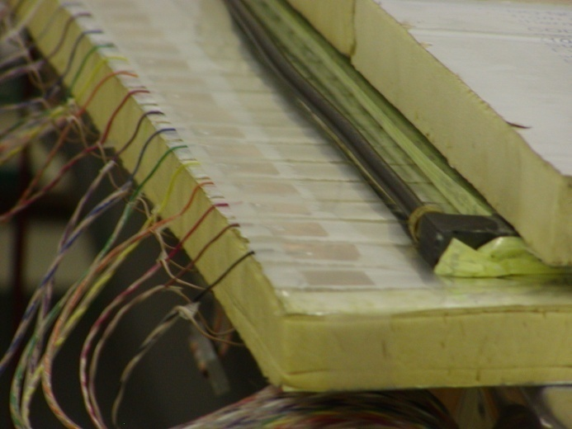
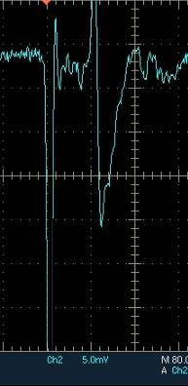
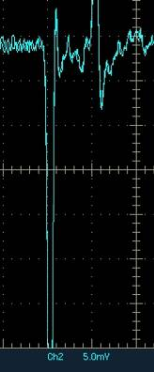
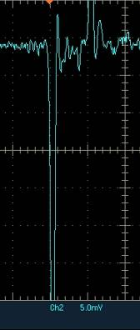
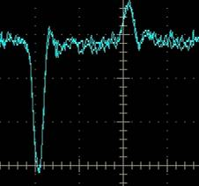
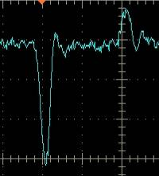
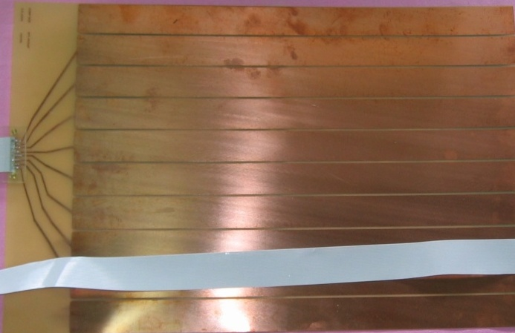
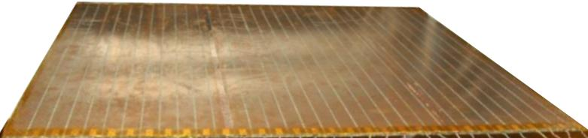
Development and characterisation of signal pickup panels
Foam panel
48.2Ω
G-10 panel
Open
100Ω
51Ω
47Ω
Z₀: Inject a pulse into the strip; tune the terminating resistance at the far end, until its reflection disappears.
Honeycomb panel

Slide 20
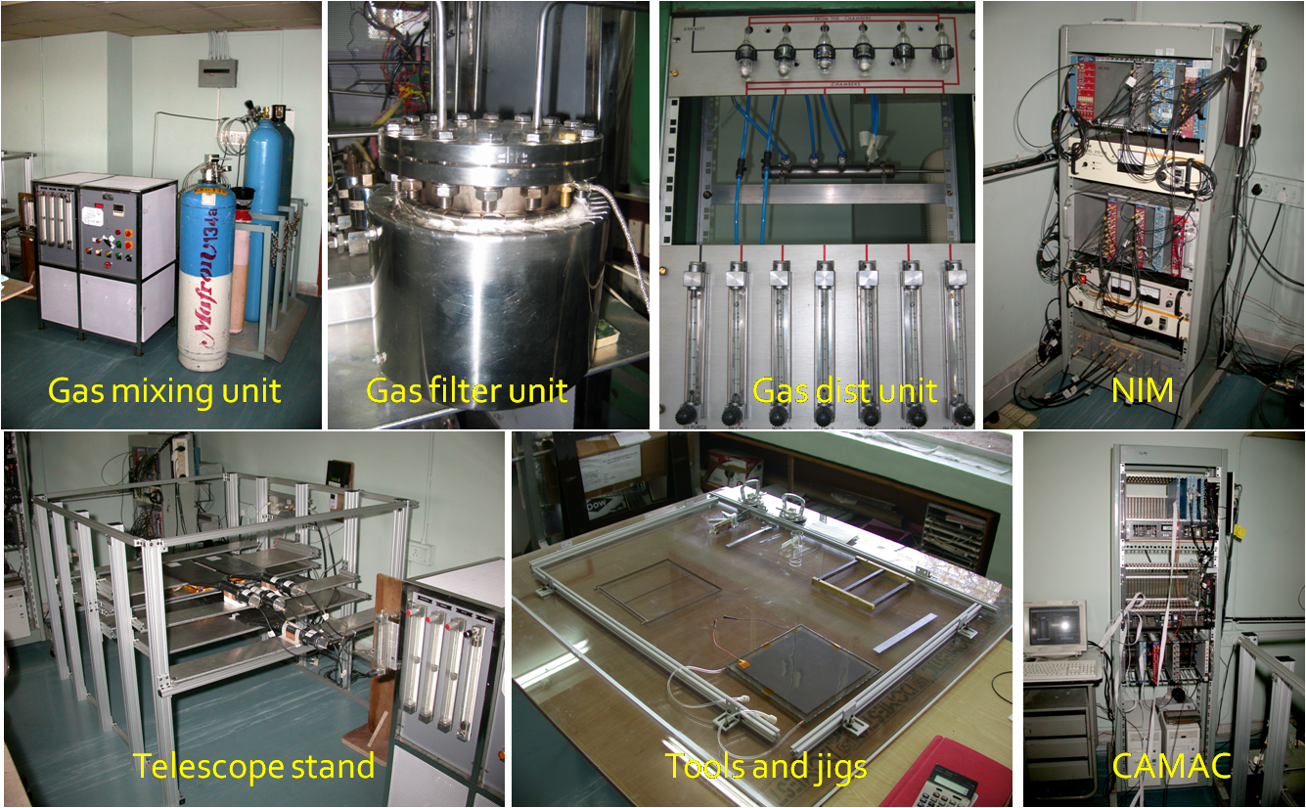
Initial infrastructure for RPC R&D

Slide 21
Aging: Efficiency drop of a RPC

Slide 22
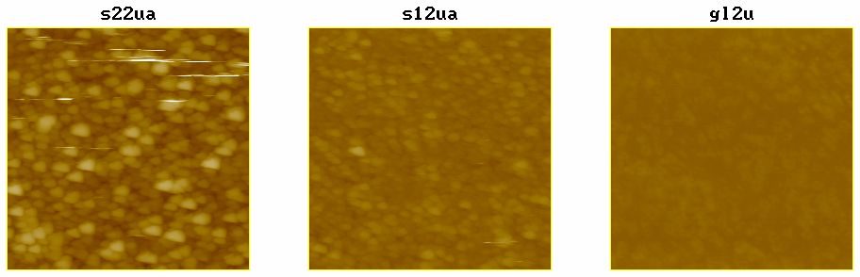
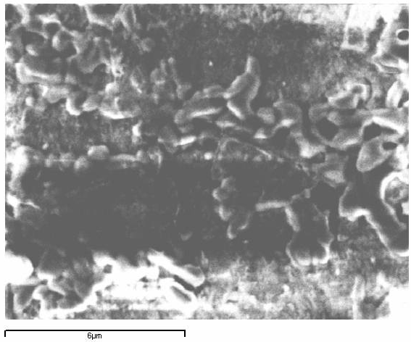
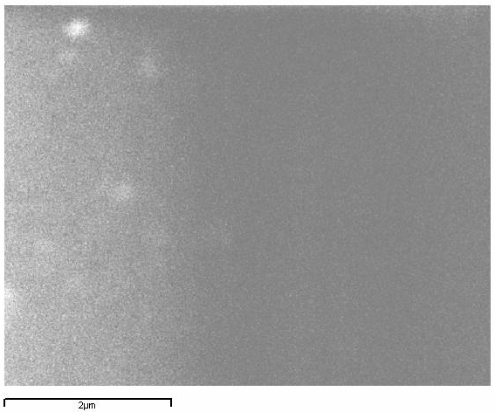
Aging: AFM and SEM scans
Damaged surfaces
AFM
Raw surfaces
SEM

Slide 23
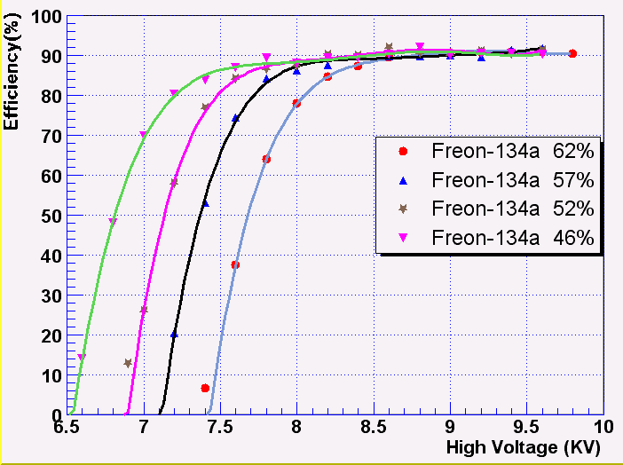
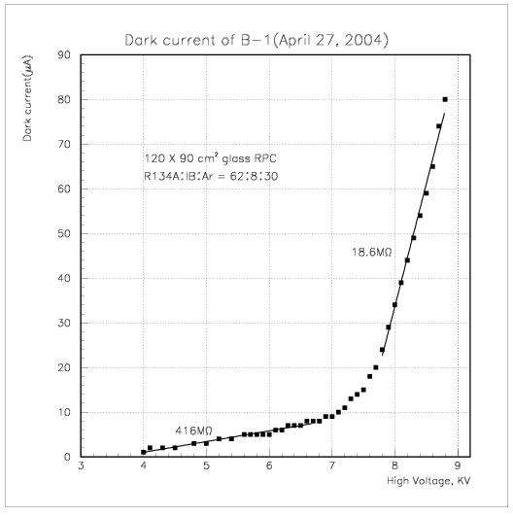
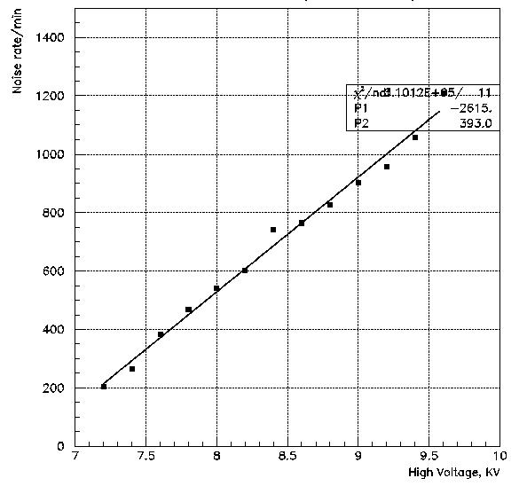
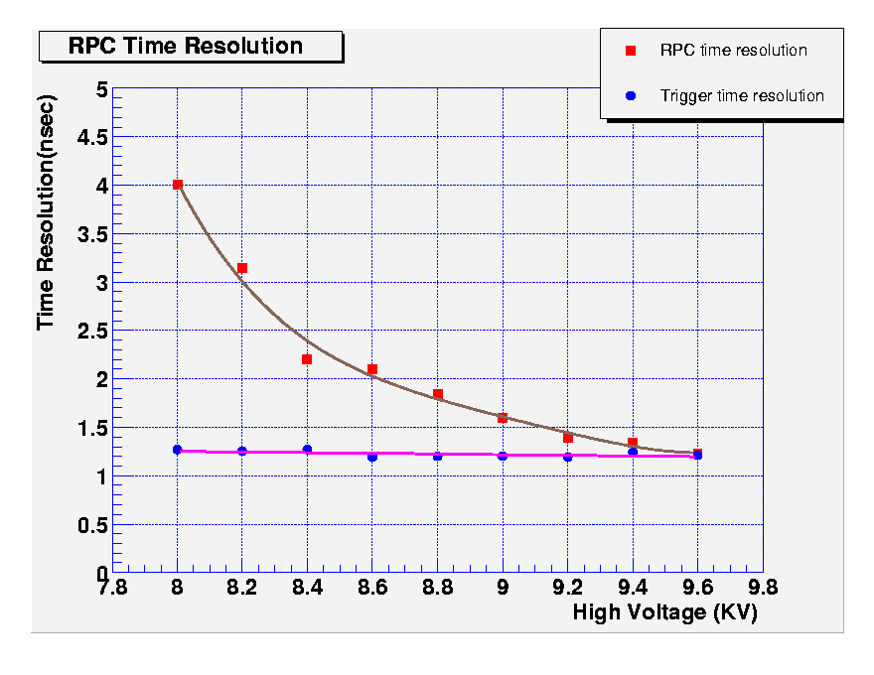
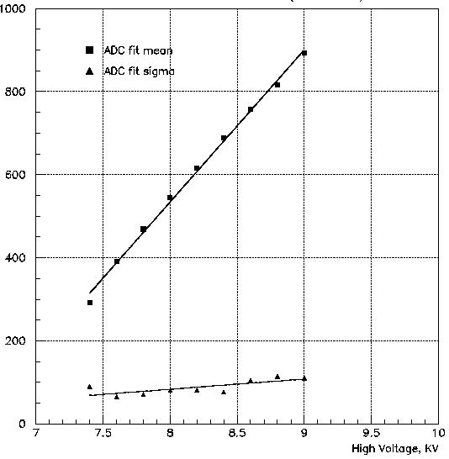
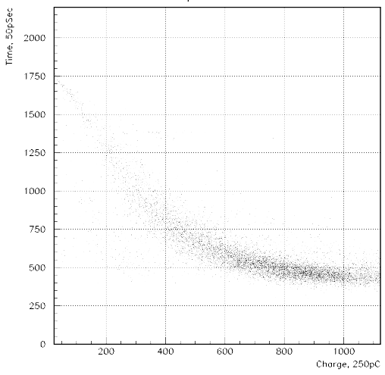
Some early encouraging results

Slide 24
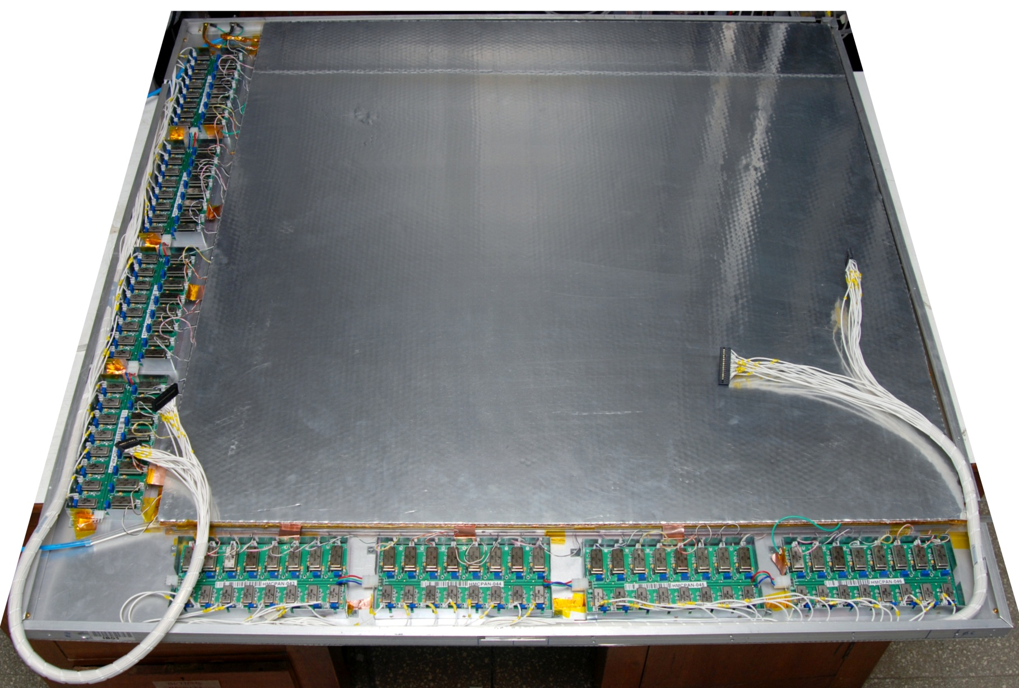
Fully assembled large area RPC
1m × 1m

Slide 25
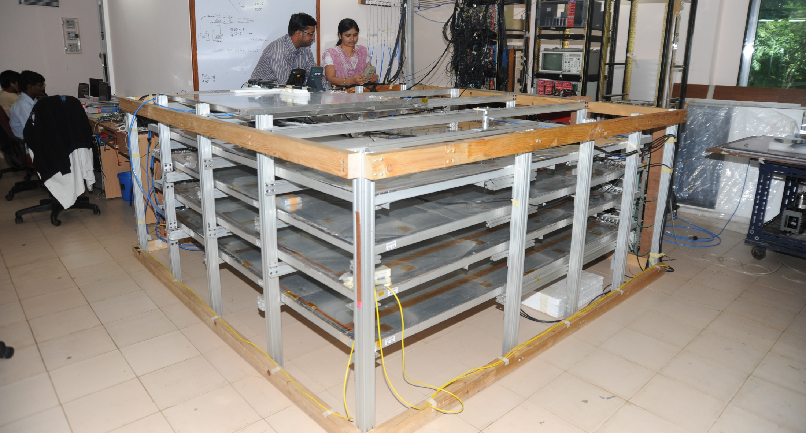
Stack of 2m × 2m RPCs

Slide 26




RPC parameter characterisation

Slide 27

RPC tomography using cosmic ray muons

Slide 28



Long-term stability study of RPC
Two RPCs of 40cm × 30cm in size were built using 2mm glass for electrodes
Readout by a common G-10 based signal pickup panel sandwiched between the RPCs
Operated in avalanche mode (R134a: 95.5% and the rest Isobutane) at a high voltage of 9.3KV
Round the clock monitoring of RPC and ambient parameters – temperature, relative humidity and barometric pressure
Were under continuous operation for more than three years
Chamber currents, noise rate, combined efficiencies etc. were stable
Long-term stability of RPCs is thus established
Relative humidity
Pressure
Temperature

Slide 29
Requirement of gases in ICAL
Total number of RPCs in ICAL = 3 × 150 × 64 = 28,800
Total gas volume = 28,800 × 184cm × 184cm × 0.2cm = 195,010 litres
For ex: One volume change/day with 10% gas top-up in a re-circulating scheme
Approximate running gas cost = Rs 30,000/day (R134a from Mafron)
Gas | Avalanche (%) | Streamer (%) | Maximum (%) | Volume (L) | Density (g/L) | Weight (Kg) | Cost (Rs/Kg)
Argon | 0.0 | 30.0 | 30.0 | 58,503 | 1.784 | 104.4
R134a | 95.5 | 62.0 | 95.5 | 186,234.6 | 4.25 | 791.5
Isobutane | 4.3 | 8.0 | 8.0 | 15,600.8 | 2.51 | 39.16
SF₆ | 0.2 | 0.0 | 0.2 | 390 | 6.164 | 2.40

Slide 30







Constructional details of the gas system
Internal view
Front view
Rear view

Slide 31

Optimization of gas flow rate for RPCs
Variation in Noise rate and Dark current attributed to different leak rates
If proper sealing, as part of QC is done, then the detectors can operate satisfactorily for more than a month with single gas fill and hence reduce the cost of replenishing gas!

Slide 32

Prototype RPC stack

Slide 33


A couple of interesting events

Slide 34


RPC strip rate time profile
Temperature

Slide 35

Calibration of RPC working voltage
(COSTANTINI, Silvia)

Slide 36



Performance of the
ALICE muon trigger system
Average efficiency (~95%) is stable within ~0.5% after two years of continuous operation.
GAGLIARDI, Martino BOSSù, Francesco

Slide 37


RPC based muon trigger of the CMS
As the PAC algorithm is implemented in the reprogrammable FPGAs, it can be easily changed, e.g. to correct bugs, improve performance, or implement new features.
BUNKOWSKI, Karol

Slide 38

Performance of the MRPC based TOF at ALICE
ALICI, Andrea

Slide 39




Performance of ARGO-YBJ RPCs
IUPPA, Roberto

Slide 40




RPCs for Luminosity monitor
BINDI, Marcello

Slide 41

Cavern background measurement with RPCs
AIELLI, Giulio

Slide 42




Digital Hadron Calorimeter with RPCs
REPOND, Jose
Muons
XIA, Lei
Pions

Slide 43

MRPCs for neutron detection
ROEDER, Marko

Slide 44
RPC simulations and modelling
Most of the rich RPC physics understood.
Though there are still some open challenges:
  Response of timing RPCs to gamma photons. Calculations still do not match with measurements.
  Details of the space-charge effect and match to careful measurements in different gap sizes.
  Streamer mechanism is still a hard nut to crack! Gas self-photoionization is a very unsatisfactory mechanism.
  The role of SF₆ in streamer suppression needs to be addressed
  Time-charge correlation in timing RPCs. Some say it is just electronics slew correction.
  Induced current vs induced charge. Which one to chose as the fundamental magnitude for evaluating the induction process?
  The present simulation in general seems to under-predict the induced signal in Bakelite RPCs in comparison to the measurements.
P.Fonte, Diego González-Díaz, Majumdar, Nayana

Slide 45

RPC based TOF tracker
Particle ID by Time of Flight is a combination of tracking and timing. To have both measurements in a single detector may have advantages. For instance, each particle would be measured several times, improving accuracy (although on a shorter path) and there is no need for an external T₀ detector.
Explore the limits of RPC position resolution by classical charge interpolation (space resolution of the order of 0.1 mm obtained) and combine it with accurate timing in a limited number of channels.
t₀
t₁
t₂
t₃
N strips are processed simultaneously.
The threshold is chosen to have one or two strips firing (i.e. cluster size 1 or 2)
The decoder transforms the simple digital pattern into a number representing the hit coordinate on the chamber.
FONTE, Paulo
CARDARELLI, Roberto

Slide 46




RPCs doing physics in schools
M. Abbrescia

Slide 47



Muon tomography with RPCs
BAESSO, Paolo

Slide 48



RPCs in medical imaging (PET)
N. Ilieva
Two main goals (The aim is to use RPC in a PET system)
To increase the efficiency for 511keV photons
  To suppress Compton scattered photons

Slide 49

New electrodes for RPCs
Within 300h’s operation, the performance of high rate MRPC module has shown the hardiness against irradiation. A dose rate of 2.16×10⁻³Gy/h or a counting rate of 15kHz/cm² does not cause obvious aging effect.
Compared to common glass MRPC, high rate MRPC responds and reaches a stable state faster.
LASO GARCIA, Alejandro
Wang Yi

Slide 50

RPC performance and Front-end electronics
The main task of the front end electronics to increase the rate capability is to achieve an excellent sensitivity and SNR for extremely small and short signals.
This allows to operate the detector at very low gas gain because a substantial fraction of the gas gain is transferred to the front end circuit.
A new series of circuits of much better performance with respect to the ones working for instance in Atlas gave very promising results in view of increasing the rate capability.
The higher sensitivity of the new front end circuit allows to lower the operating voltage by about 600V, thus substantially reducing the gas gain.
Rinaldo Santonico

Slide 51
INO induced RPC R&D in India
Laboratories set up at:
  TIFR
  SNIP
  VECC
  BARC
  IIT Bombay
  IIT Madras
  Aligarh Muslim University
  Banaras Hindu University
  Panjab University
  Delhi University
  More to follow …
Training of large number of students and faculty members
Industrial interface
Outreach
Theses
  Design and Characterisation Studies of Resistive Plate Chambers
  Development of High Resolution Gas Filled Detector for High Energy Physics Experiments (Saikat Biswas)
  Development of Track Reconstruction and Data Analysis Techniques for Neutrino Experiments (Tapasi Ghosh)
  Sumanta Pal (Physics with ICAL prototype)
  Moon Moon Devi (Development of MRPCs)
  Salim Mohammed (RPC simulations)
  Animesh Chatterjee
  Rajesh Ganai
  Ravindrababu Karnam
  Varchaswi Kashyap …
Dozens of publications, proceedings and reports resulted already

Slide 52
Summary
Resistive Plate Chambers (RPCs) find extensive applications in nuclear, high energy and astro-particle physics experiments.
Besides, they are increasingly replacing the existing detectors in the medical imaging, homeland security and other societal applications.
RPCs seem to have deservedly reached the centre stage right now – thanks to their continued flawless performance in the previous experiments, exceeding their design goals in the just commissioned experiments as well as for being natural first choices for many planned experiments.
The field will be driven in near future by innovative device architectures, alternate gas mixtures, ultra-fast readout techniques and new simulation tools.

