Slide 1
Agenda for the Detector Session
B.Satyanarayana, TIFR, Mumbai
INO Collaboration

Slide 2
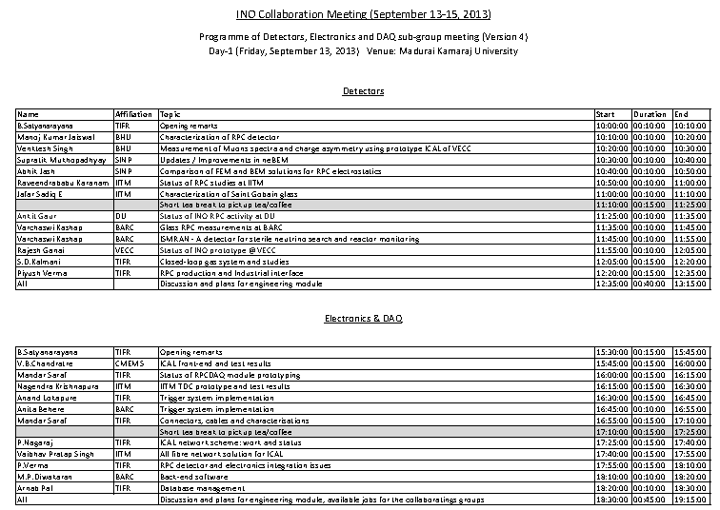

Slide 3
RPC technology development
Walchand Industries:
Pickup panel, aluminium soldering
FRP tray for RPC
Automatic assembly of RPC gas gap, glue trials
Automatic painting of glasses, PET film protection
Glass chamfering and engraving
Computer model of RPC integration
Trying RPC push-pull using physical models
Asahi, Oswin Plastics, Global Engineering
Many local manufacturers for pickup panels
Gas system and studies: Alpha Pneumatics, ICT, Timetooth Technologies
Paint: Nerolac

Slide 4
Gas system and studies
Closed Loop Gas system
Improvements – eg. Closed loop pressure settings
Studies with RPC system and optimisation of parameters
Gas CFD studies

Slide 5
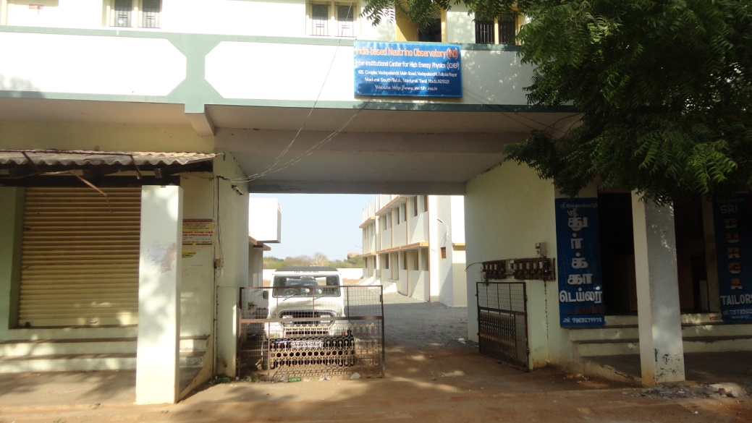
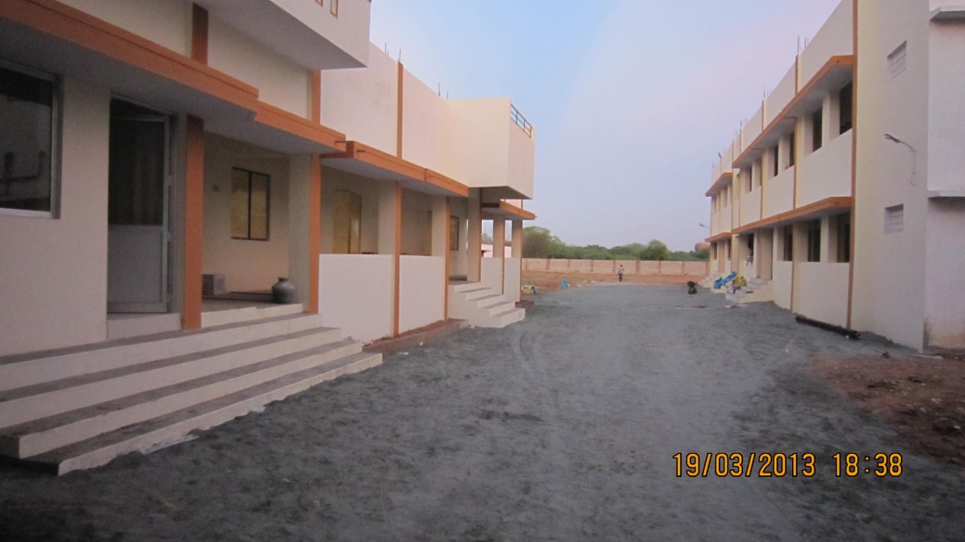
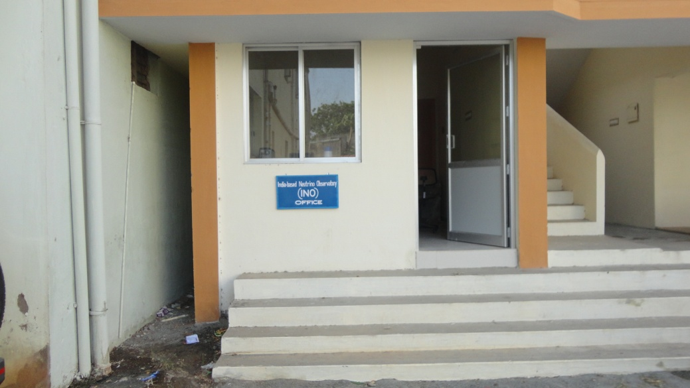
Transit campus
Total area: 54,500 ft²
Covered area: 10,222 ft²

Slide 6
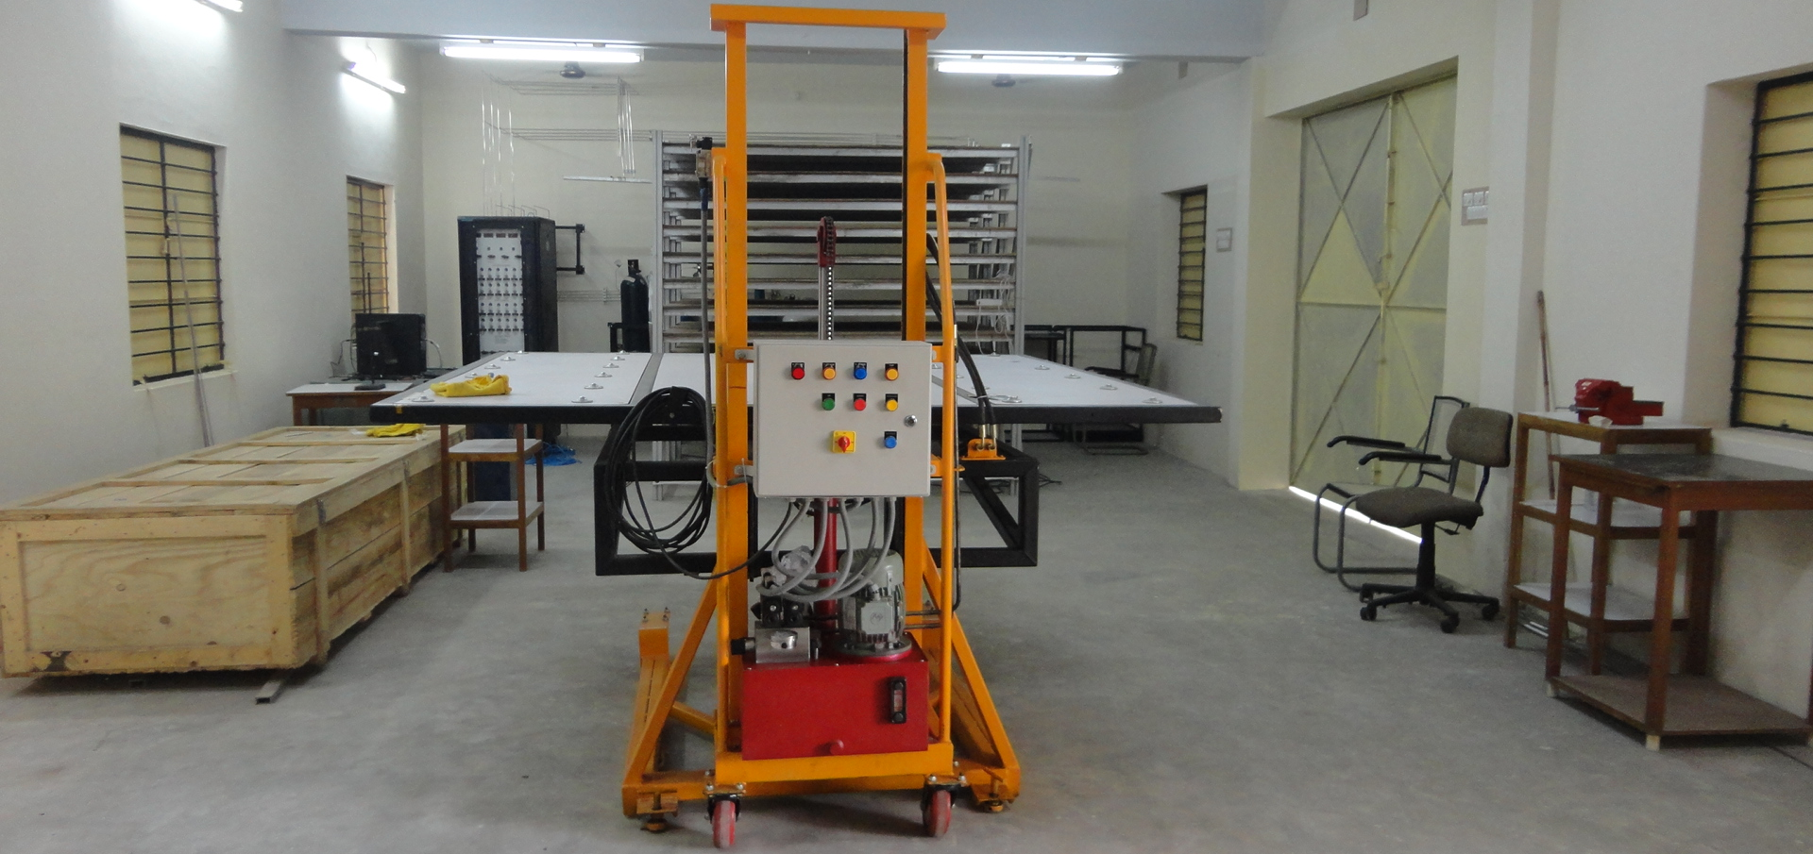
Test stand at the transit campus
While waiting for the power and air conditioning:
Detector fabrication and testing activities will start any time now
Good opportunity for students to get hands-on and contribute to the lab building
Setting up test stand variety electronics and DAQ

Slide 7
Engineering module
Parameter | ICAL | ICAL-EM
No. of modules | 3 | 1
Module dimensions | 16.2m × 16m × 14.5m | 8m × 8m x 2m
Detector dimensions | 49m × 16m × 14.5m | 8m × 8m x 2m (89:1)
No. of layers | 150 | 20
Iron plate thickness | 56mm | 56mm
Gap for RPC trays | 40mm | 40mm
Magnetic field | 1.3Tesla | 1.3Tesla
RPC dimensions | 1,950mm × 1,910mm × 24mm | 1,950mm × 1,910mm × 24mm
Readout strip pitch | 3 0mm | 3 0mm
No. of RPCs/Road/Layer | 8 | 4
No. of Roads/Layer/Module | 8 | 4
No. of RPC units/Layer | 192 | 16
No. of RPC units | 28,800 (107,266m²) | 320 (1,192m²) (90:1)
No. of readout strips | 3,686,400 | 40,960 (90:1)

Slide 8
Activities of various RPC labs
IIT Madras
Delhi University
Panjab University
VECC
BARC
SINP
BHU
Requirements from labs, electronics etc.
Future plan of activities, for engineering module

Slide 9
Jobs for grabs
Front-end interconnections
Cabling and connectors
Power supply and distributions
Detailed study of RPC tray and integration
RPC production testing scheme
EMC and EMI issues of ICAL electronics
Many loose ends, needs fine tuning

