Slide 1

Design and Characterisation Studies of Resistive Plate Chambers (Ph.D. Annual Progress Seminar)
Satyanarayana Bheesette
Roll number: 04412701
Supervisors
Prof Raghava Varma, IIT Bombay
Prof Naba Mondal, TIFR, Mumbai
Department of Physics
Indian Institute of Technology Bombay
August 2009

Slide 2
Neutrino physics using ICAL
Reconfirm atmospheric neutrino oscillation
Improved measurement of oscillation parameters
Search for potential matter effect in neutrino oscillation
Determining the mass hierarchy using matter effect
Study of ultra high energy neutrinos and muons
Long baseline target for neutrino factories

Slide 3
Neutrino sources and Detector choice
Sources of neutrinos
Use atmospheric neutrinos as source
Need to cover a large L/E range
Large L range
Large E_{ν} range
Physics driven detector requirements
Should have large target mass (50-100 kT)
Good tracking and energy resolution (tracking calorimeter)
Good directionality (< 1 nSec time resolution)
Charge identification capability (magnetic field)
Modularity and ease of construction
Compliment capabilities of existing and proposed detectors
Use magnetised iron as target mass and
RPC as active detector medium

Slide 4
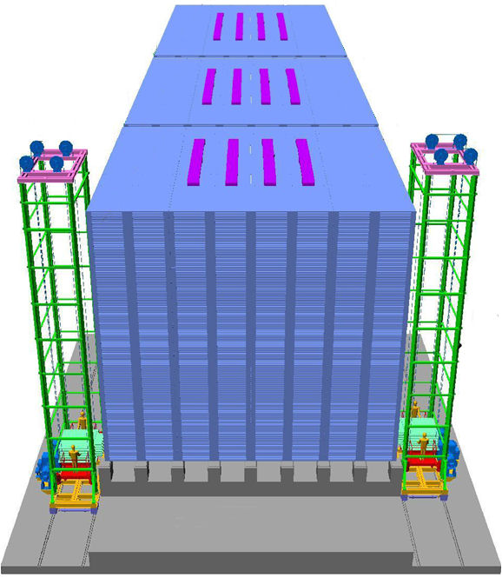
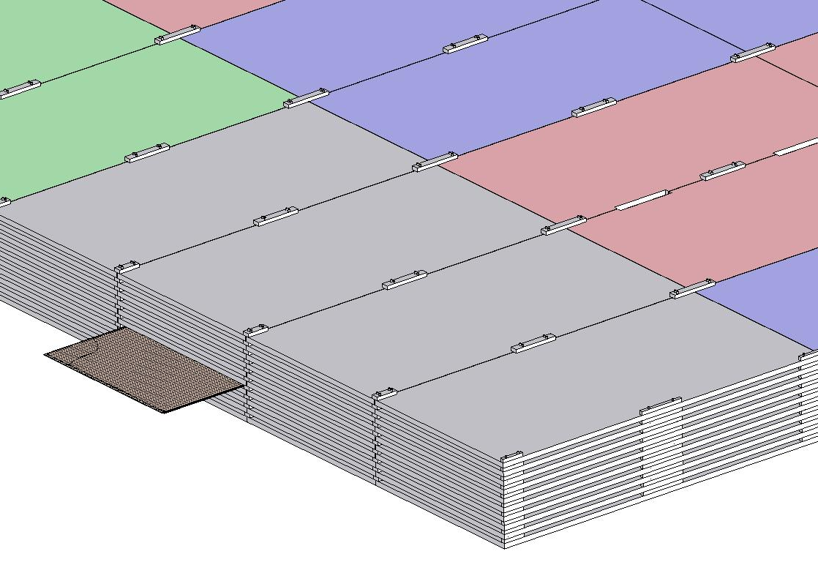
ICAL detector construction
4000m m×2000mm×56mm low carbon iron slab
RPC

Slide 5
Factsheet of ICAL detector
No. of modules | 3
Module dimensions | 16m × 16m × 14.5m
Detector dimensions | 48.4m × 16m × 14.5m
No. of layers | 150
Iron plate thickness | 56mm
Gap for RPC trays | 40mm
Magnetic field | 1.3Tesla
RPC dimensions | 1,840mm × 1,840mm × 24mm
Readout strip pitch | 3 0mm
No. of RPCs/Road/Layer | 8
No. of Roads/Layer/Module | 8
No. of RPC units/Layer | 192
No. of RPC units | 28,800 (97,505m²)
No. of readout strips | 3,686,400

Slide 6
RPC characteristics and merits
Large detector area coverage, thin (~10mm), small mass thickness
Flexible detector and readout geometry designs
Solution for tracking, calorimeter, muon detectors
Trigger, timing and special purpose design versions
Built from simple/common materials; low fabrication cost
Ease of construction and operation
Highly suitable for industrial production
Detector bias and signal pickup isolation
Simple signal pickup and front-end electronics; digital information acquisition
High single particle efficiency (>95%) and time resolution (~1nSec)
Particle tracking capability; 2-dimensional readout from the same chamber
Scalable rate capability (Low to very high); Cosmic ray to collider detectors
Good reliability, long term stability
Under laying Physics mostly understood!

Slide 7
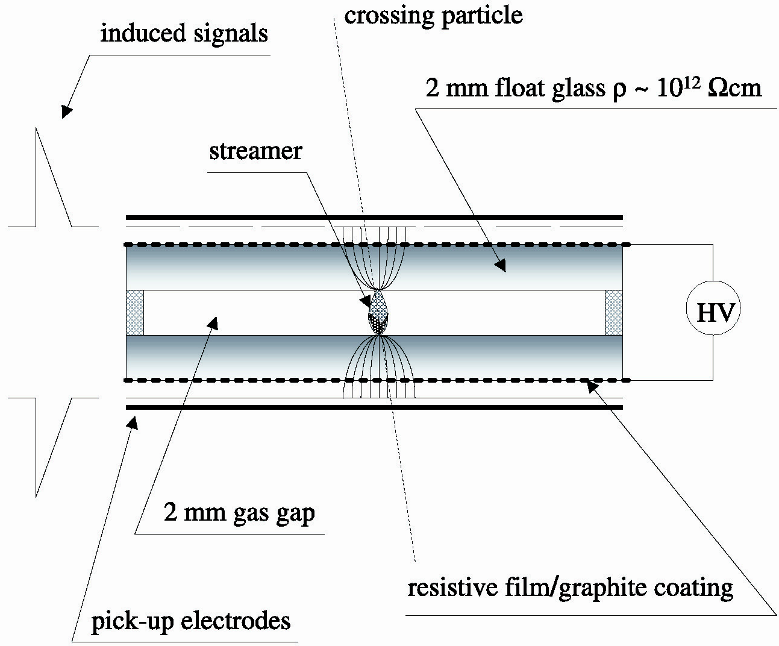
Principle of operation

Slide 8
Signal induction in RPC
Electron-ion pairs produced in the ionisation process drift in the opposite directions.
All primary electron clusters drift towards the anode plate with velocity v and simultaneously originate avalanches
A cluster is eliminated as soon as it reaches anode plate
The charge induced on the pickup strips is q = (-eΔx_{e} + eΔx_{I})/g
The induced current due to a single pair i = dq/dt = e(v + V)/g ≈ ev/g, V « v
Prompt charge in RPC is dominated by the electron drift

Slide 9
RPC operating mode definitions
Let, n₀ = No. of electrons in a cluster
α = Townsend coefficient (No.
of ionisations/unit length)
β = Attachment coefficient (No.
of electrons captured by the
gas per unit length)
Then, the no. of electrons reaching
the anode,
n = n₀e^{(α- β)x}
Where x = Distance between anode
and the point where the cluster
is produced
Gain of the detector, M = n / n₀
M > 10⁸ → Streamer mode;
M << 10⁸ → Avalanche mode
A planar detector with resistive electrodes ≈ Set of independent discharge cells
Expression for the capacitance of a planar condenser → Area of such cells is proportional to the total average charge, Q that is produced in the gas gap.
Where, d = gap thickness
V = Applied voltage
ε₀ = Dielectric constant of the gas
Lower the Q; lower the area of the cell (that is ‘dead’ during a hit) and hence higher the rate handling capability of the RPC
Q ~ 100pC = Streamer mode
Q ~ 1pC = Avalanche mode

Slide 10
Control of avalanche process
Role of RPC gases in avalanche control
R134a to capture free electrons and localise avalanche
e⁻ + X → X⁻ + hν (Electron attachment)
X⁺ + e⁻ → X + hν (Recombination)
Isobutane to stop photon induced streamers
SF₆ for suppression of streamer discharges
Space charge effects causing avalanche saturation
Growth of the avalanche is governed by dN/dx = αN
The space charge produced by the avalanche shields (at about αx = 20, Raether limit) the applied field and avoids exponential divergence
Townsend equation should be dN/dx = α(E)N

Slide 11
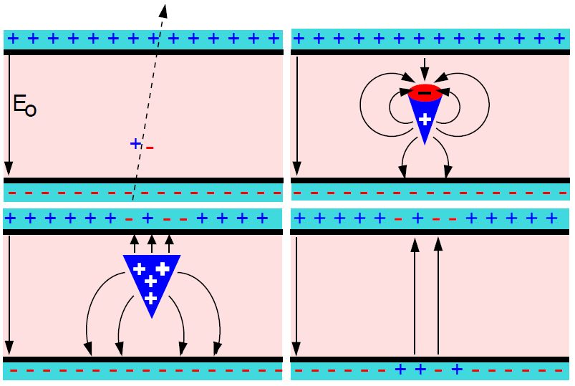
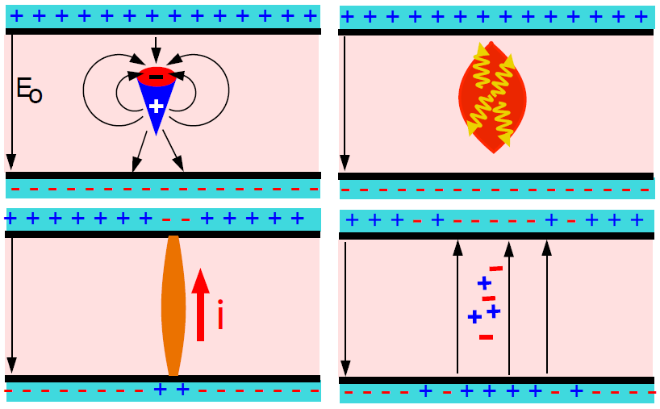
Two modes of RPC operation
Avalanche mode
Streamer mode
Gain of the detector << 10⁸
Charge developed ~1pC
Needs a preamplifier
Longer life
Gas mixture Fr:iB:SF₆::94.5:4:0.5
Moderate purity of gases
Higher counting rate capability
Gain of the detector > 10⁸
Charge developed ~ 100pC
No need for a preamplier
Relatively shorter life
Gas mixture Ar:iB:Ar::62.8:30
High purity of gases
Low counting rate capability

Slide 12
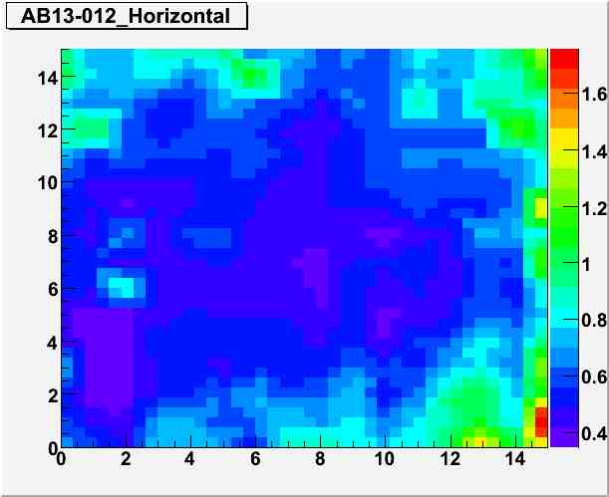
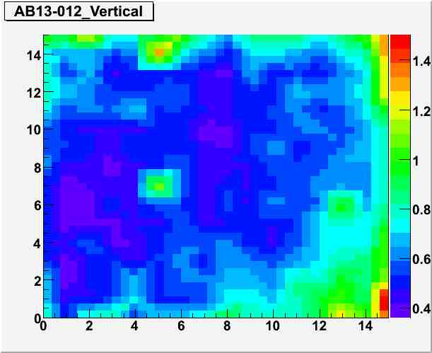
Glass electrode coating results

Slide 13
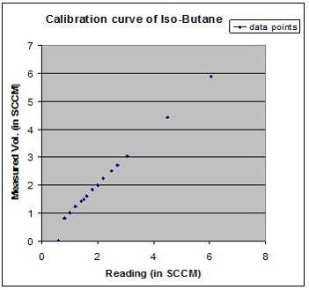
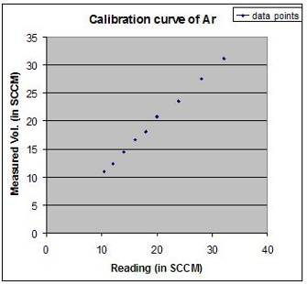
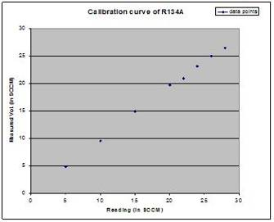
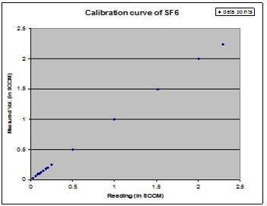
Precision calibration of the gas system
Argon
Iso-butane
R134a
SF₆

Slide 14
Cross-calibration of the gas system
Calibration done using water displacement method
Calibrated against the MFC monitor voltage
Cross-calibration procedure
Glass/hard plastic tube with precise inner diameter chosen. Placed on a perfectly horizontal surface.
Water droplet introduced through an opening on one end of the tube
Gas connected to this end
Gas moves the water droplet forward α gas flow
Distance, time intervals measured
Gas volume computed and compared with displayed value
Gas | Calibration equation
Argon | y = 1.0886x - 0.1782
Iso-butane | y = 1.06x - 0.2315
SF₆ | y = 1.539x + 0.0578
R134a | y = 1.0541x - 0.6054
x = Actual flow, y = Set flow

Slide 15
Requirement of gases in ICAL
Total number of RPCs in ICAL = 3 × 150 × 64 = 28,800
Total gas volume = 28,800 × 184cm × 184cm × 0.2cm = 195,010 litres
For ex: One volume change/day with 10% gas top-up in a re-circulating scheme
Approximate running gas cost = Rs
Gas | Avalanche (%) | Streamer (%) | Maximum (%) | Volume (L) | Density (g/L) | Weight (Kg) | Cost (Rs/Kg)
Argon | 0.0 | 30.0 | 30.0 | 58,503 | 1.784 | 104.4
R134a | 95.5 | 62.0 | 95.5 | 186,234.6 | 4.25 | 791.5
Isobutane | 4.3 | 8.0 | 8.0 | 15,600.8 | 2.51 | 39.16
SF₆ | 0.2 | 0.0 | 0.2 | 390 | 6.164 | 2.40

Slide 16
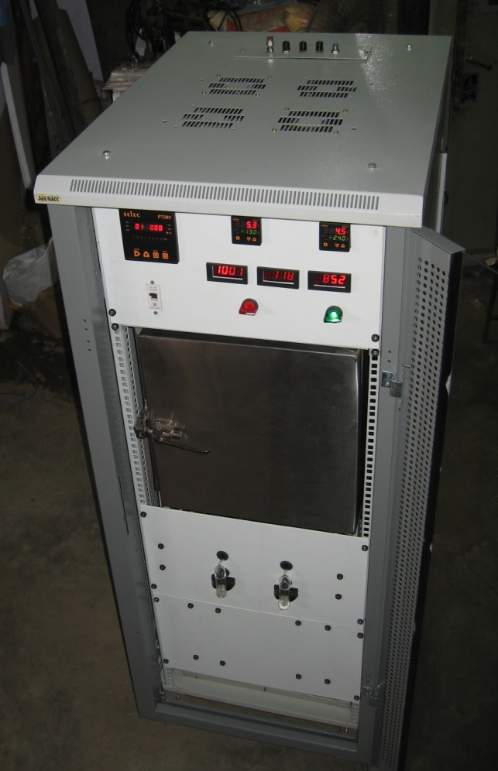
Open loop gas recovery system

Slide 17
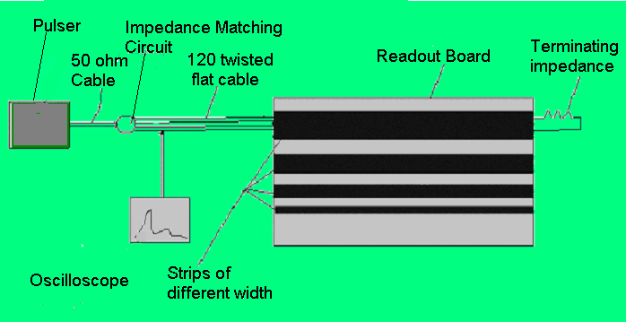
Measurement of characteristic impedance
Recipe: Tune terminating impedance for each strip width until the reflected signal for injected charge pulse disappear.

Slide 18
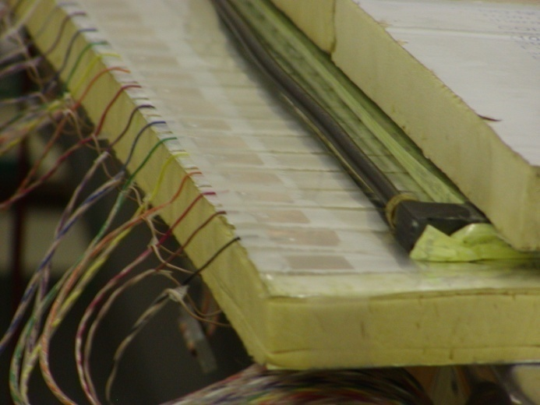
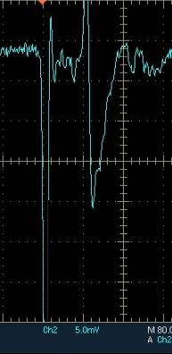
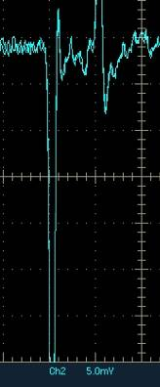
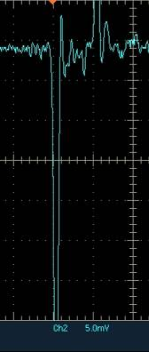
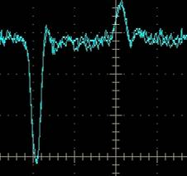
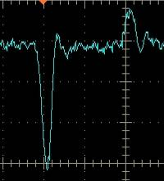
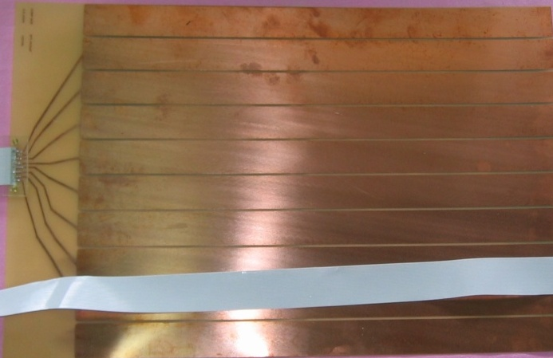
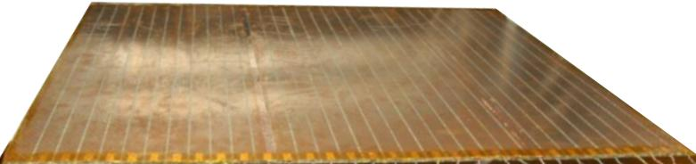
Development of signal pickup panels
Foam panel
48.2Ω
G-10 panel
Open
100Ω
51Ω
47Ω
Z₀: Inject a pulse into the strip; tune the terminating resistance at the far end, until its reflection disappears.
Honeycomb panel

Slide 19
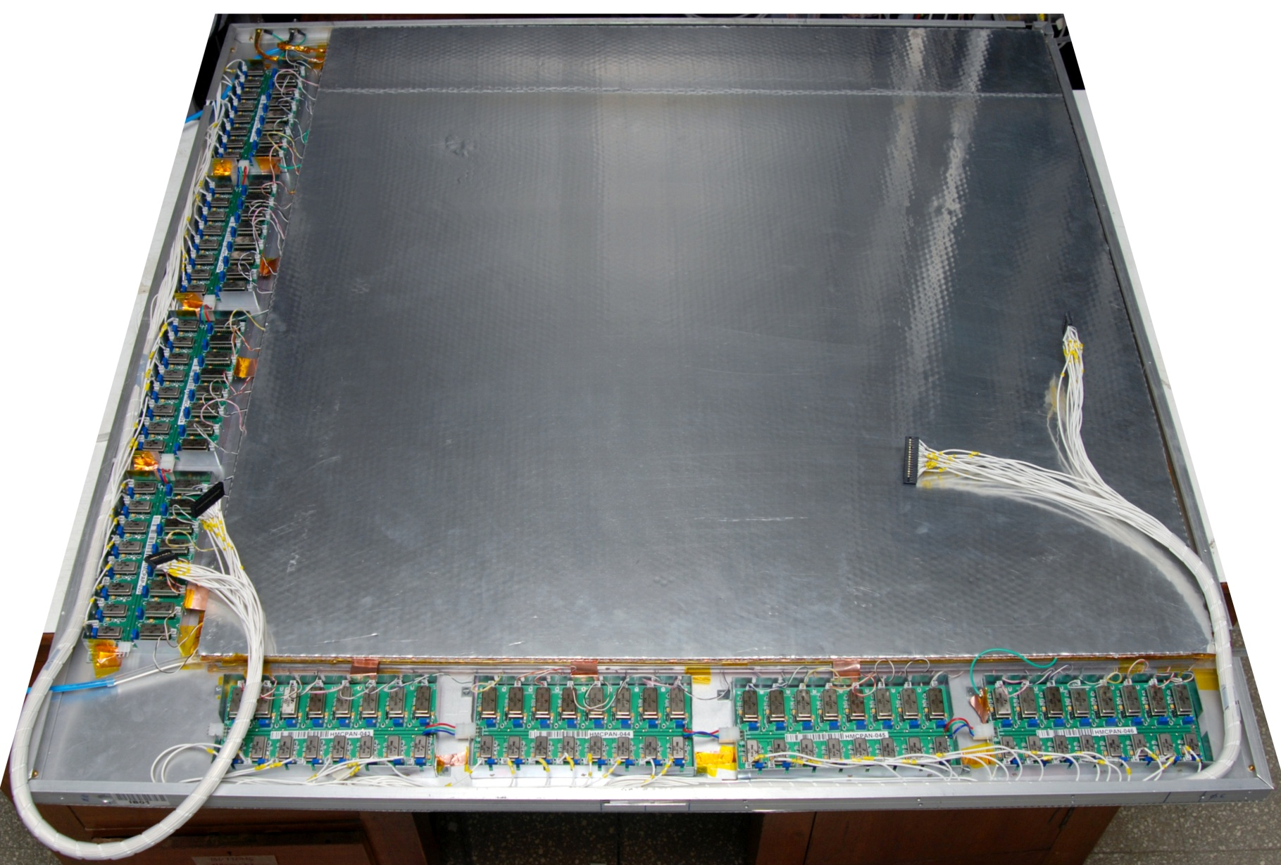
Fully assembled large area RPC

Slide 20
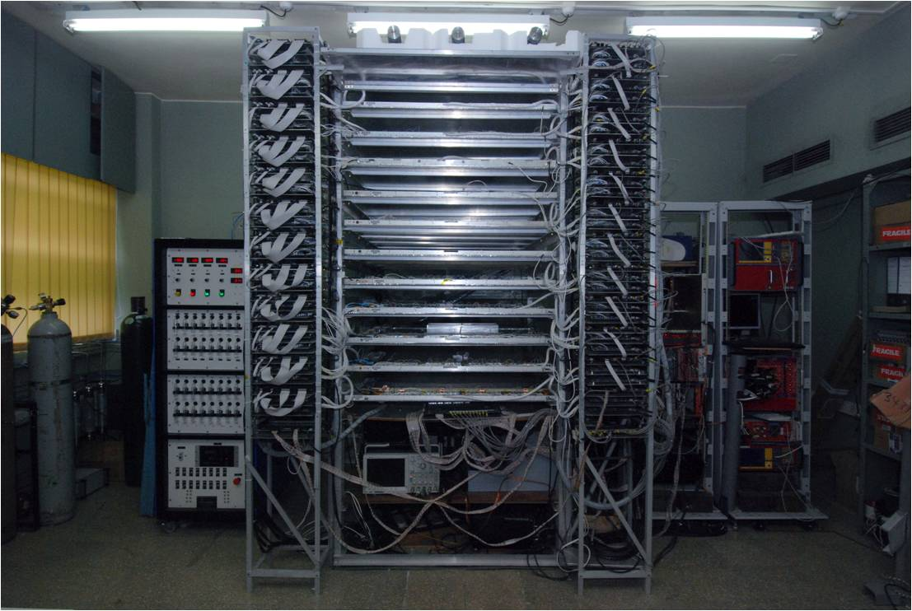
RPC detector stack

Slide 21
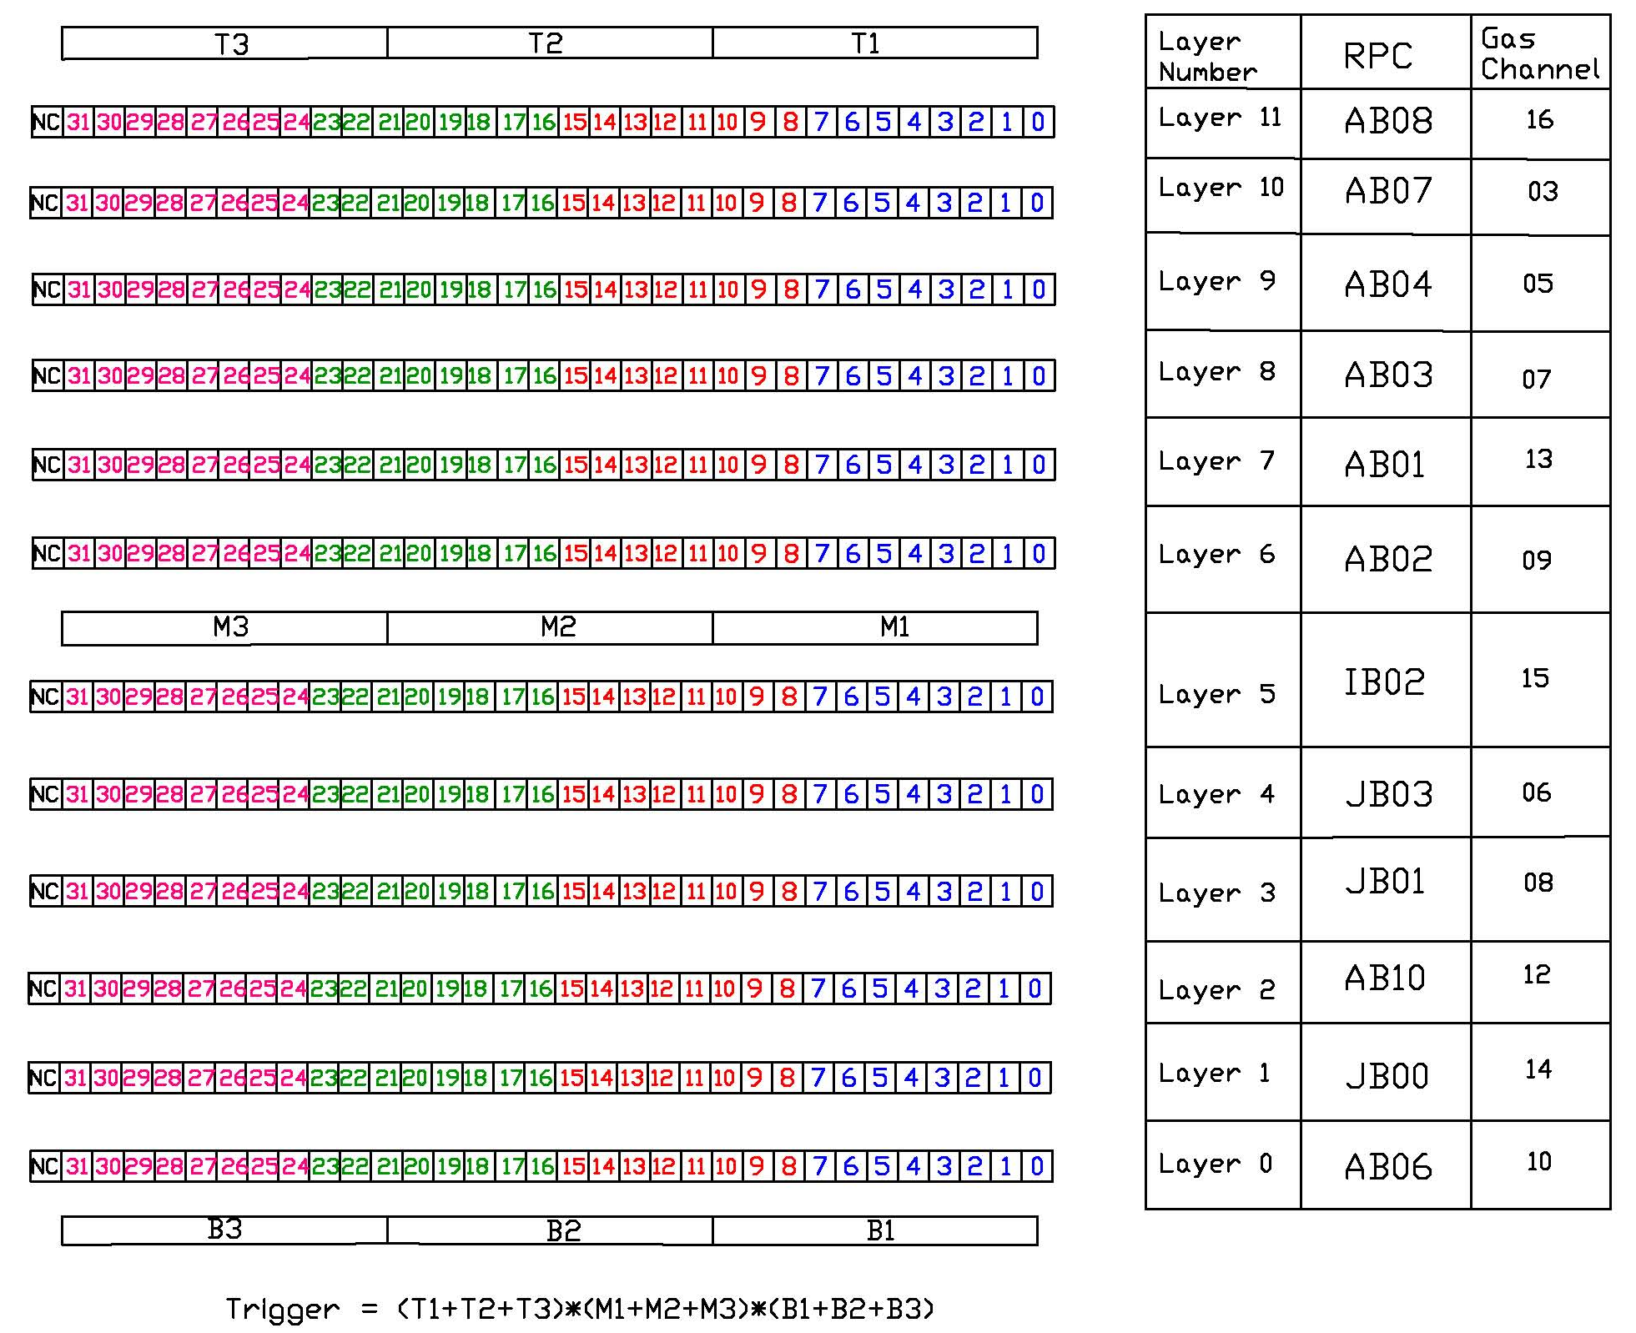
Schematic of RPC stack segmentation
12, 1m² RPC layers
Two readout planes (X & Y)
32 channels/plane
Total 768 readout channels
Trigger on muons using:
Scintillator paddle layers
RPC strip signals
Recorded information:
Strip hits
Timing
Monitoring data:
Chamber parameters
High voltage and current
Strip noise rates
Cosmic muon efficiency
Ambient parameters
Temperature
Relative humidity
Barometric pressure
Magnet control and monitor
Gas system control & monitor

Slide 22
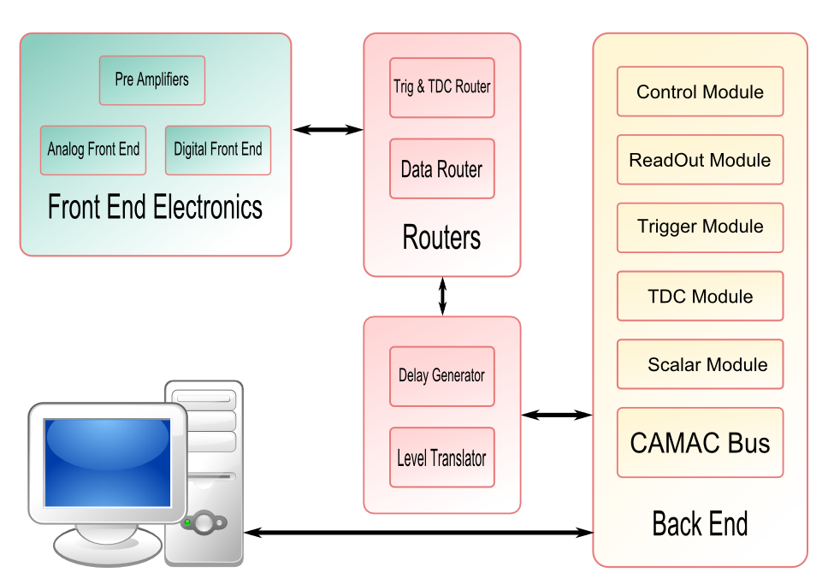
Schematic of RPC stack DAQ system

Slide 23
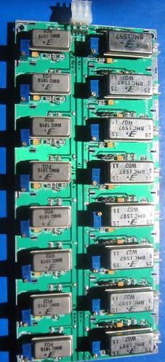
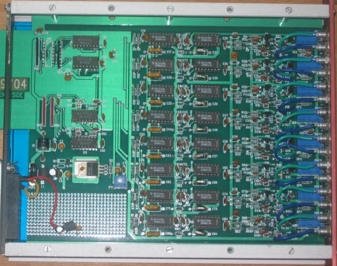
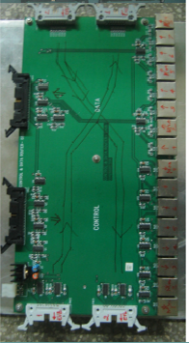
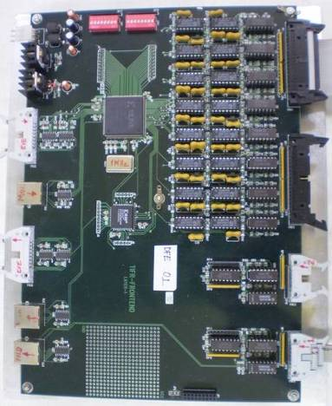
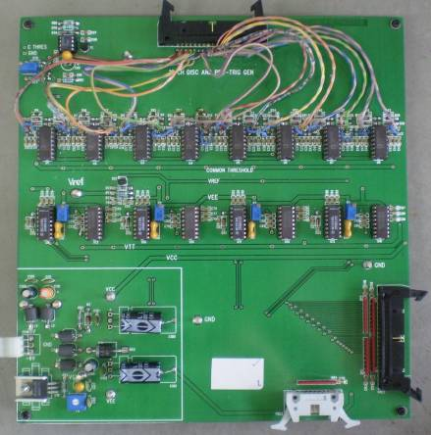
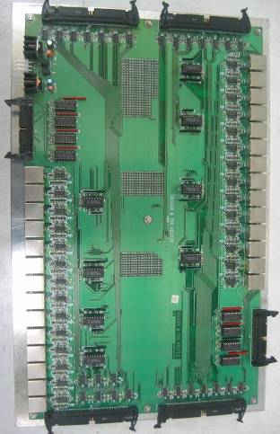
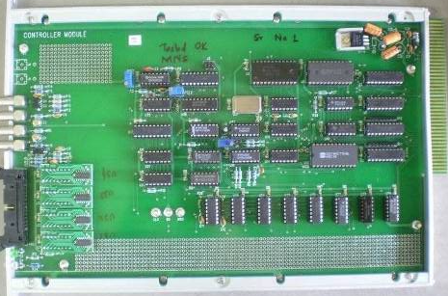
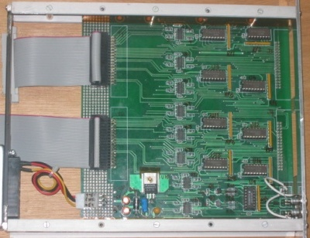
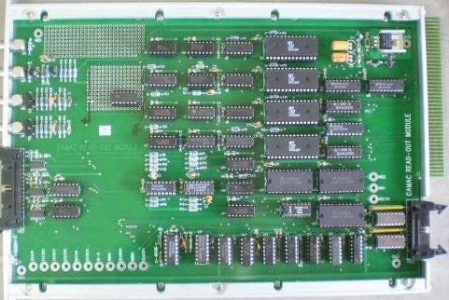
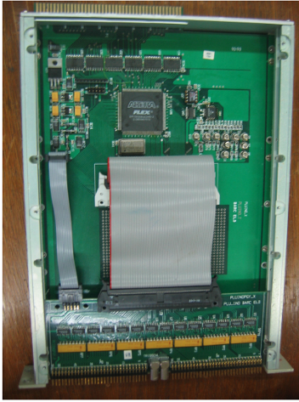
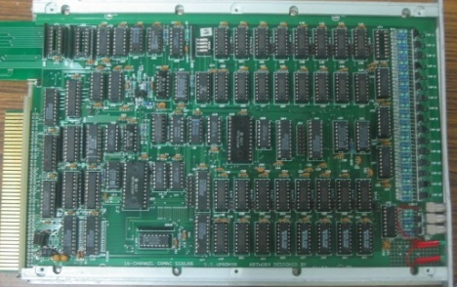
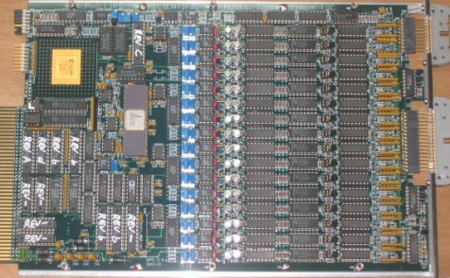
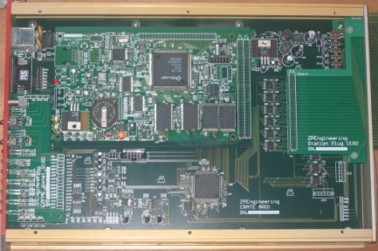
Components of the data acquisition system
200 boards of 13 types
Custom designed using
FPGA,CPLD,HMC,FIFO,SMD

Slide 24
VME based DAQ system
X-strip data
Analog
Front End
Digital
Front End
Trigger
Module
Y-strip data
RPC Stack
Timing info
Event/
Monitor
Data
Event
Trigger
VME CRATE
TDC
Readout
Module
Scaler
Linux based DAQ software (C++, Qt, ROOT)
Interrupt Based
Multi-Threaded
Graphical User Interface
Online 2D/3D Event Display
RPC Strip Monitoring
Online Error Reporting

Slide 25
BigStackV4.0: Data analysis software
ROOT based C code
Works on highly segmented configuration file
Handles event, monitor and trigger rate data
Interactively displays event tracks
Generates frame and strip hit files
Produces well designed summary sheets
Plots and histograms produced:
Efficiency profiles
Absolute and relative timing distributions
Strip cluster size calculations
Strip profiles and lego plots
Strip rate and calibration signal rate profiles and distributions
Paddle and pre-trigger rate profiles and distributions
Track fitting, impact position, residual distribution, strip-multiplicity, RPC mapping my cosmic muons etc.

Slide 26
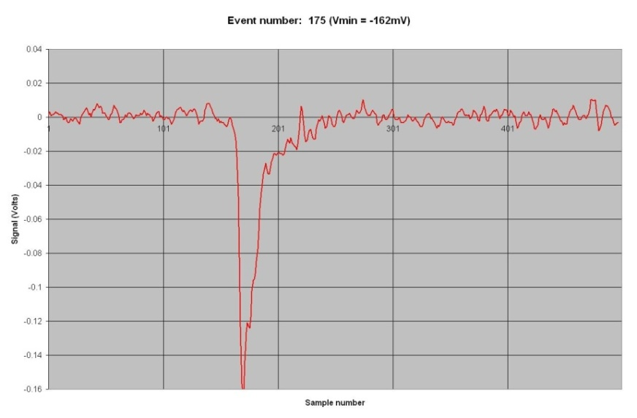
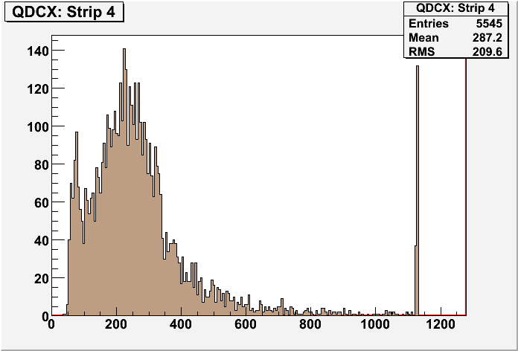
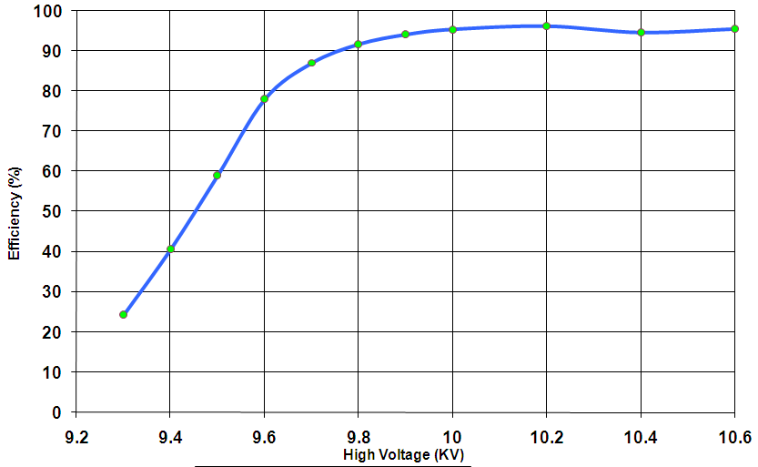
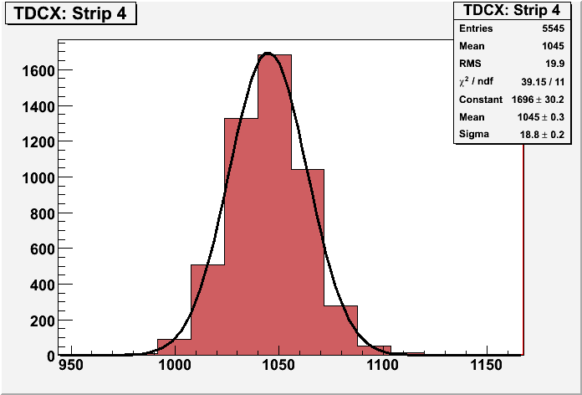
RPC parameter characterisation

Slide 27
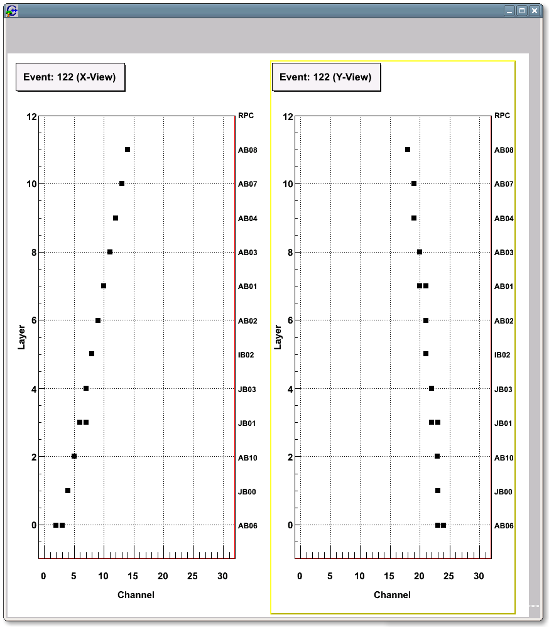
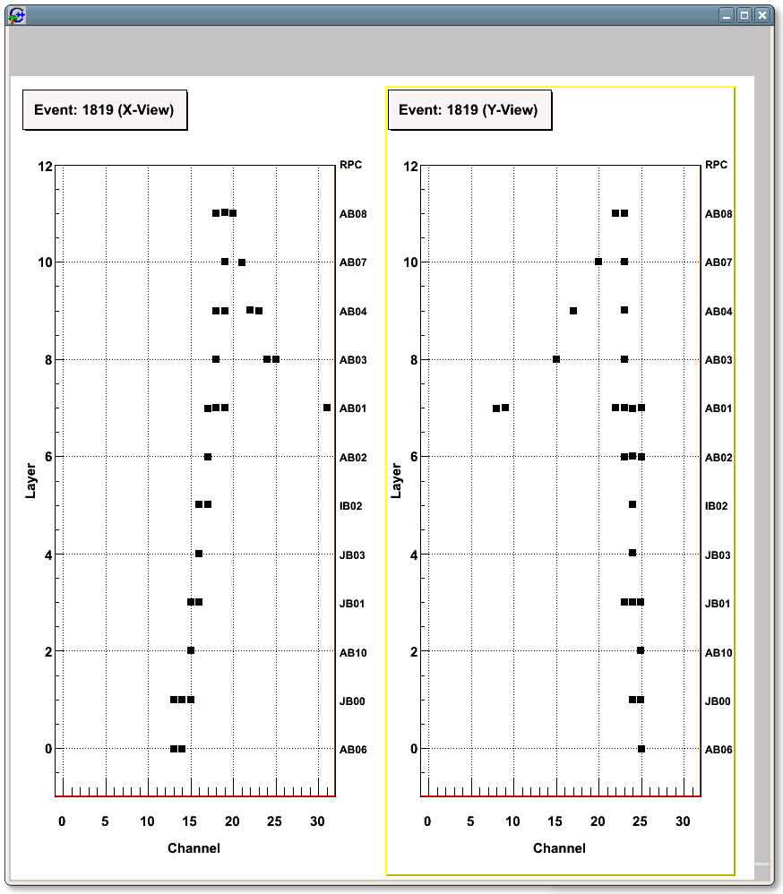
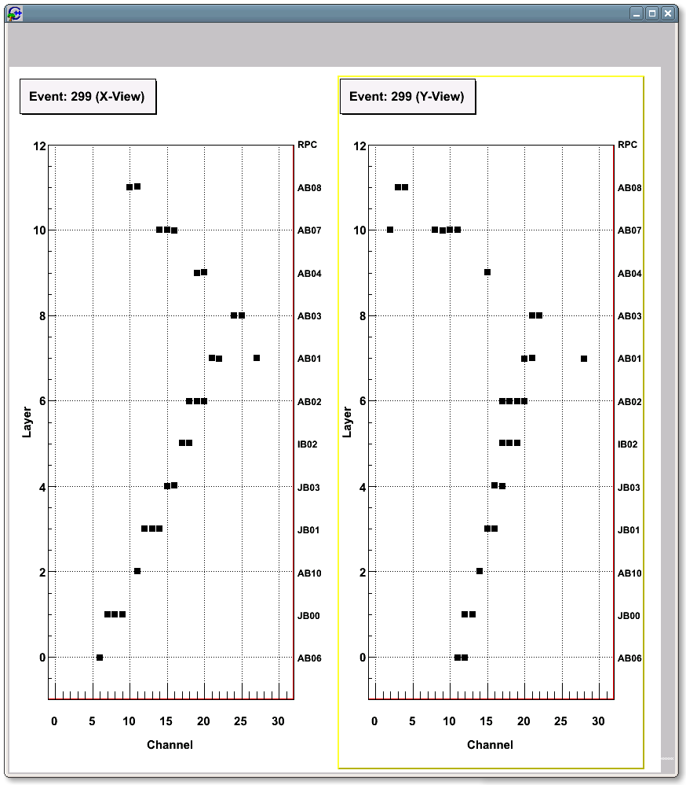
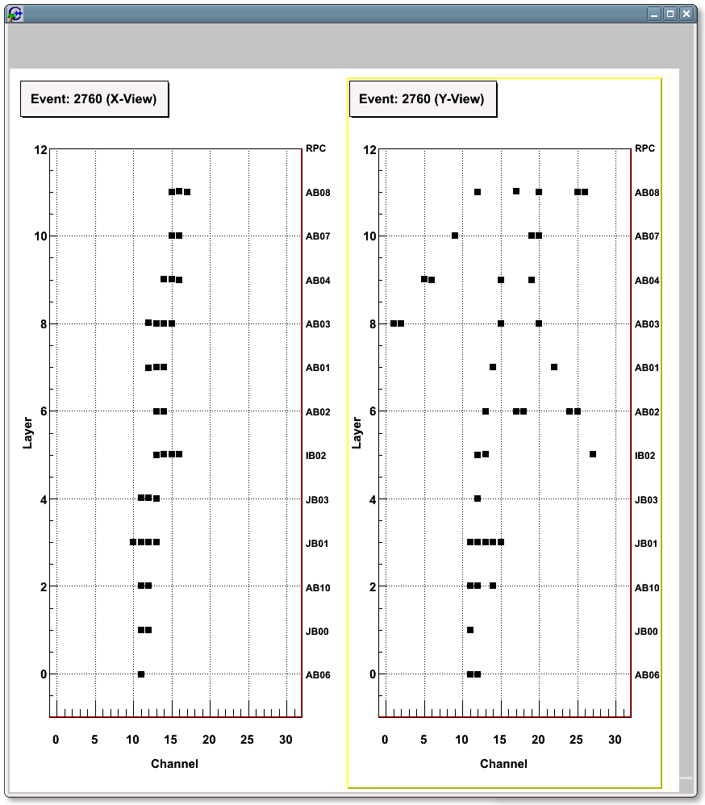
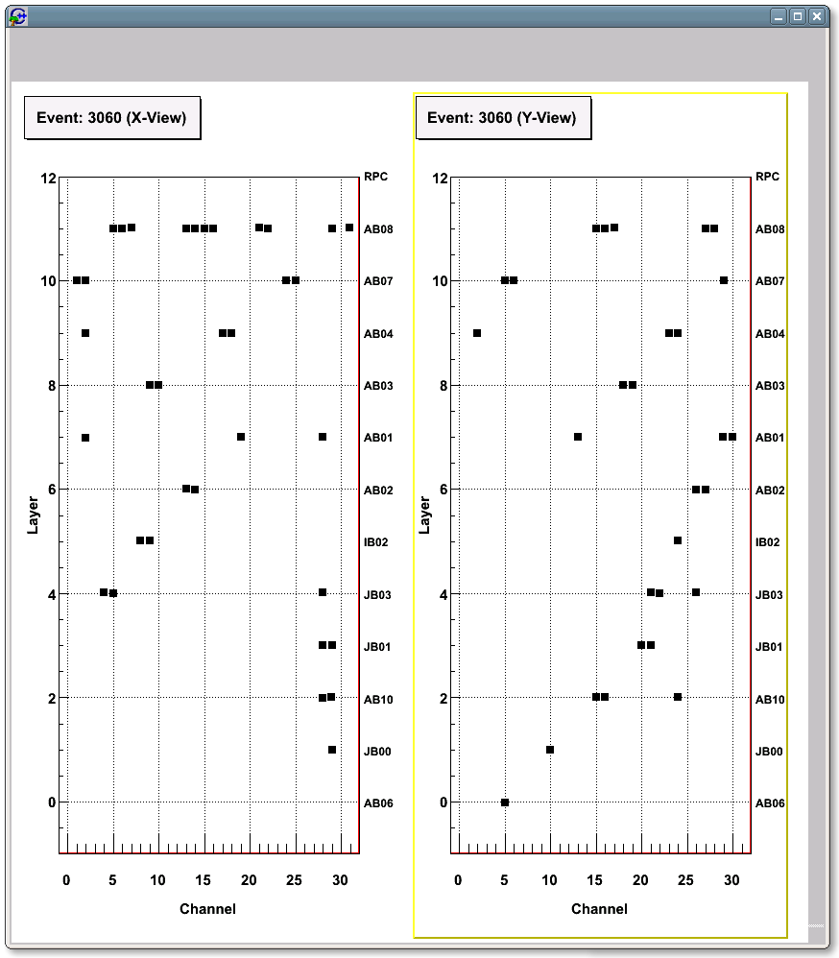
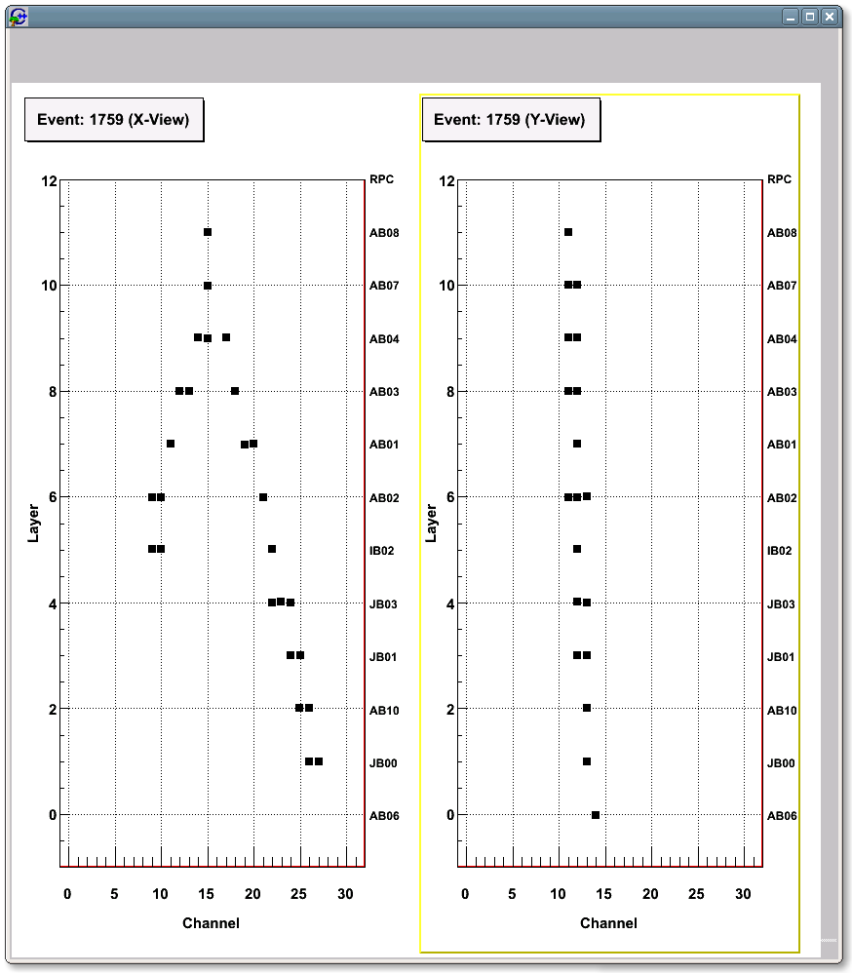
Some interesting cosmic ray tracks

Slide 28
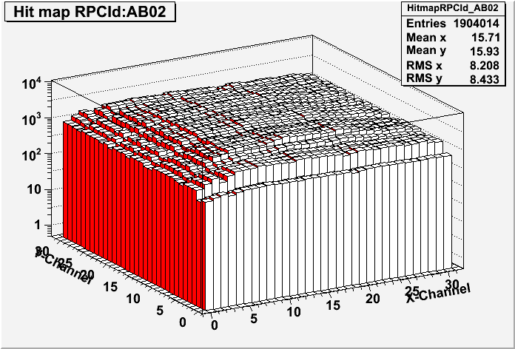
Strip hit map of an RPC

Slide 29
RPC absolute time resolution plots

Slide 30
RPC relative time resolution plots

Slide 31
RPC-wise timing parameters
RPC Id HV(KV) Mean(nS) Sigma(nS) RelMean(nS) RelSigma(nS)
AB06 09.8 49.53 2.06 -7.64 1.41
JB00 09.6 46.00 2.32 -4.47 1.67
IB01 09.8 42.31 2.15 -0.64 1.63
JB01 09.6 42.55 2.28 -0.87 1.58
JB03 09.8 43.75 2.26 -2.18 1.44
IB02 09.8 38.49 2.31 3.27 1.38
AB02 09.8 42.77 2.53 -1.21 1.51
AB01 09.8 35.30 2.16 6.33 1.71
AB03 09.8 45.82 3.23 -4.55 1.99
AB04 09.8 41.66 2.42 Reference RPC
AB07 09.8 40.61 2.47 0.96 1.35
AB08 09.8 41.56 2.80 0.31 1.82

Slide 32
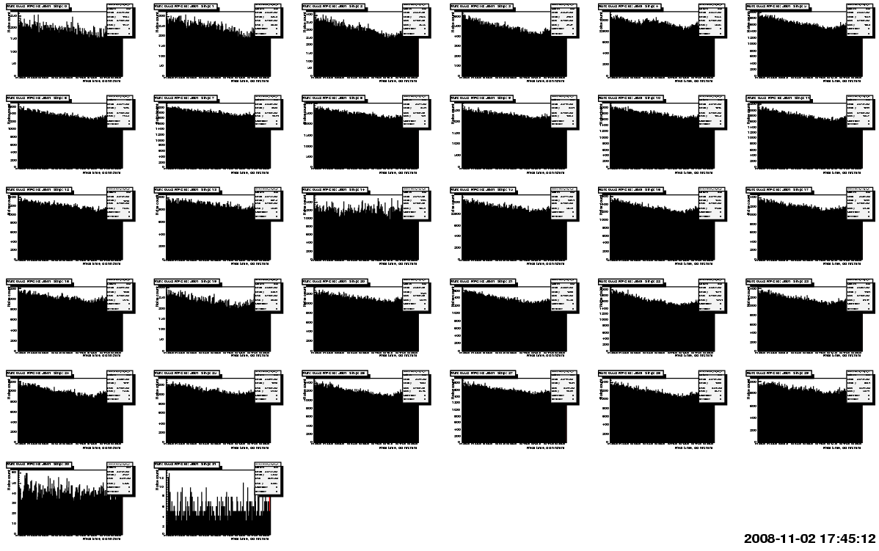
RPC strip rate time profiles

Slide 33


RPC strip rate time profile
Temperature

Slide 34
Efficiency time profile of an RPC

Slide 35
Data analysis scheme
Event tracks are fitted with the following criteria.
Hits from layers where a single strip hit are chosen.
While half of strip width is supplied as error on the x/y axes (mean value = 30mm), 2mm is sent as error on the z-axis (mean value = 160mm) to the fitting algorithm.
Minimum of 5 layers is demanded.
Tracked events with χ²/ndf in the range 0.06-0.7 are accepted.
A point in the Impact point plots is recorded if the strip number computed from tracked position in a layer matches with the recorded hit position.
A point in the surface map plots is recorded if the hit strips in both x & planes match with those pointed by the fitted track positions.
RPCs are thus x-rayed using cosmic muons! Buttons are visible.
Residuals are computed from the hit positions using fitted tracks and the centre of the hit strips. The residuals were then applied during subsequent analysis of data.

Slide 36

Impact position plots

Slide 37

Cluster size distributions
RPC | Size
AB01 | 1.9
AB02 | 1.9
AB03 | 1.8
AB04 | 1.8
AB06 | 1.2
AB07 | 1.6
AB08 | 2.2
AB10 | 1.6
IB02 | 2.7
JB00 | 1.5
JB01 | 3.3
JB03 | 2.0

Slide 38

Strip multiplicity

Slide 39

Track residue plot

Slide 40

Tomography of RPC using muons

Slide 41






Final Frontier: Making of 2m × 2m RPCs

Slide 42




Characterisation of 2m × 2m RPCs

Slide 43


Pulse profiles of 2m × 2m RPC

Slide 44




Study of SF₆ role in RPC gas mixtures

Slide 45
Summary and conclusions
Started the work by fabricating 1ft² glass RPC prototypes using some of the barrowed materials
Operated them in streamer mode and characterised successfully
Met with severe chamber aging problems – a setback
Carried extensive diagnostic studies and measurements on gases, glasses, graphite coats, insulating films etc.
Switched to avalanche mode and operated small area chambers successfully for more than 2.5 years
Developed indigenously and optimised all the materials, assembly jigs and processes required for large area RPCs
Routinely building and successfully operating dozens of 1m² RPCs
Designed, built and commissioned RPC detector stack, electronics, trigger, data acquisition and on-line monitoring systems
Analysed all the prototype detector data and presented and published results at national and international meetings and journals
Successfully built and characterised 2m × 2m RPCs

Slide 46
Papers and presentations (2008-09)
INO prototype detector and data acquisition system, NIM A 602 (2009) 784-787
Development of glass Resistive Plate Chambers for INO experiment, NIM A 602 (2009) 744-748
Development of conductive coated polyester film as RPC electrodes using screen printing, NIM A 602 (2009) 835-838
On-line gas mixing and multi-channel distribution system, NIM A 602 (2009) 845-849
RPC exhaust gas recovery by open loop method, NIM A 602 (2009) 809-813
Glass RPC Detector R&D for a Mega Neutrino Detector, Accepted for the IEEE Nuclear Science Symposium and Medical Imaging Conference, October 25  31, USA
IPHY 204: Experimental Methods II. Shared with Prof V.M.Datar for the INO Graduate Training School (Spring 2009)
Course on Signal processing electronics, VII SERC School, IIT Bombay, February 2009
Laboratory Orientation, VII SERC School, IIT Bombay, February 2009
India-based Neutrino Observatory (INO): A world-class underground laboratory to study fundamental issues in physics, TechFest09, IIT Bombay, January 2009
Current status of the KEK-INO collaboration, DST-JSPS Core University program, TIFR, February 19, 2009
ICAL Electronics: Current thoughts, INO-US collaboration meeting, TIFR, February 6, 2009
ICAL Electronics: Status summary, INO-KEK collaboration meeting, TIFR, January 28-29, 2009
Report on Electronics for the ICAL and the Prototype, INO Collaboration meeting, VECC, February 27, 2009

Slide 47
Acknowledgements
Prof. Raghava Varma, IIT Bombay
Prof. Naba Mondal, TIFR, Mumbai
Prof. Basant Nandi, IIT Bombay
Prof. S.Uma Sankar, IIT Bombay
Colleagues from the INO detector development & electronics design teams
CMS, ATLAS & ARGO, ALICE, OPERA, BELLE & KEK collaborators and other researchers of RPC detectors
ICT, Mumbai & Local industries

Slide 48
Refereed Journals
Glass RPC Detector R&D for a Mega Neutrino Detector, IEEE Nuclear Science Symposium and Medical Imaging Conference, Florida, USA, October 25-31, 2009
Development of Glass Resistive Plate Chambers for INO, ICHEP08, University of Pennsylvania, USA, July 31, 2008, arXiv:0810:4693
INO prototype detector and data acquisition system, NIM A 602 (2009) 784-787
Development of glass Resistive Plate Chambers for INO experiment, NIM A 602 (2009) 744-748
Development of conductive coated polyester film as RPC electrodes using screen printing, NIM A 602 (2009) 835-838
On-line gas mixing and multi-channel distribution system, NIM A 602 (2009) 845-849
RPC exhaust gas recovery by open loop method, NIM A 602 (2009) 809-813
Preliminary results from INO detector R&D programme, Pramana Vol. 69 No. 6 (2007) 1015-1023
On aging problem of glass Resistive Plate Chambers, Nuclear Physics B 158 (2006) 195-198

Slide 49
Proceedings
Development of prototype RPC and LVDS/NIM-ECL translator for the INO-DAQ system, DAE Symposium in HEP, BHU, Varanasi, December 14-18, 2008
Development and characterisation of large area glass Resistive Plate Chambers for the ICAL detector at INO, Nuclear Physics Symposium, Sambalpur University, December 11-15, 2007
Electronics and data acquisition system for prototype INO-ICAL detector, Nuclear Physics Symposium, Sambalpur University, December 11-15, 2007
The INO project, JIGSAW-2007, TIFR, Mumbai, February 12-23, 2007
Development of Resistive Plate Chambers for the INO detector, JIGSAW-2007, TIFR, Mumbai, February 12-23, 2007
Experiences of using float glass as electrodes for radiation detectors, JIGSAW-2007, TIFR, Mumbai, February 12-23, 2007,
On aging problem of glass Resistive Plate Chambers, JIGSAW-2007, TIFR, Mumbai, February 12-23, 2007
Status of INO RPC R&D activities, JIGSAW-2007, TIFR, Mumbai, February 12-23, 2007
Introduction to Resistive Plate Chambers, Perspectives of Neutrino Physics and India-based Neutrino Observatory, Sambalpur University, February 17-18, 2007
Electronics and data acquisition systems for RPC detectors, Perspectives of Neutrino Physics and India-based Neutrino Observatory, Sambalpur University, February 17-18, 2007
Design and development of a family of ultra fast amplifier Hybrid Micro Circuits for INO experiments, Nuclear Physics Symposium, University of Baroda, December 11-15, 2006
Scintillator paddles as trigger detectors for RPCs, Nuclear Physics Symposium, University of Baroda, December 11-15, 2006
Integration and commissioning of data acquisition system for the INO prototype detector, DAE Symposium in High Energy Physics, IIT Kharagpur, December 11-15, 2006
Results from long term stability tests of Resistive Plate Chambers, DAE Symposium in High Energy Physics, IIT Kharagpur, December 11-15, 2006
Glass characterisation techniques used in the Resistive Plate Chamber development, DAE Symposium in High Energy Physics, IIT Kharagpur, December 11-15, 2006
Experience of using float glass for electrodes in radiation detectors, NSGC-06, BARC, September 15-16, 2006
Development of Resistive Plate Chambers for the INO detector, 50th DAE-BRNS Symposium on Nuclear Physics, BARC, Mumbai, December 12-16, 2005
Design of electronics, trigger and data acquisition system for the proposed INO prototype detector, DAE Symposium on High Energy Physics, SINP, Kolkata, December 2004
Results from development of glass RPCs for INO detector, DAE Symposium on High Energy Physics, SINP, Kolkata, December 2004
Technological challenges in Particle detectors for future experiments, Review talk, DAE Vision2020, Sub-topic 3.8 meet, Kalpakkam, May 3-4, 2004
Proposed detector and data readout system for the India-based Neutrino Observatory, Invited talk, NSNI-2004, Kalpakkam, February 17-20, 2004
Development of RPCs for INO, ACFA6-LC workshop, TIFR, December 15-17, 2003

Slide 50
Poster presentations
India-based Neutrino Observatory (INO): A world-class underground laboratory to study fundamental issues in physics, TechFest09, IIT Bombay, January 2009
Development of conductive coated polyester film as RPC electrodes using screen printing, RPC2007, TIFR, Mumbai, INDIA, Feb 13-16, 2008
On-line gas mixing and multi-channel distribution system, RPC2007, TIFR, Mumbai, INDIA, Feb 13-16, 2008
The INO project, JIGSAW-2007, TIFR, Mumbai, February 12-23, 2007
Development of Resistive Plate Chambers for the INO detector, JIGSAW-2007, TIFR, Mumbai, February 12-23, 2007
Experiences of using float glass as electrodes for radiation detectors, JIGSAW-2007, TIFR, Mumbai, February 12-23, 2007,
On aging problem of glass Resistive Plate Chambers, JIGSAW-2007, TIFR, Mumbai, February 12-23, 2007
Status of INO RPC R&D activities, JIGSAW-2007, TIFR, Mumbai, February 12-23, 2007
Experiences of using float glass as electrodes for radiation detectors, National Symposium on Science & Technology of Glass/Glass-Ceramics (NSGC-06), BARC, Mumbai, September 15-16, 2006
Muon lifetime experiment, Year of Physics programme, IIT Bombay, December 2005
Development of Resistive Plate Chambers for the INO detector, 50th DAE-BRNS Symposium on Nuclear Physics, BARC, Mumbai, December 12-16, 2005
On aging problem of glass Resistive Plate Chambers, The VIII Workshop on Resistive Plate Chambers and Related Detectors, Korea University, Seoul, October 10-12, 2005
Indigenous R & D efforts for HEP detectors - Glass Resistive Plate Chambers for INO experiment, DAE Vision2020, Sub-topic 3.8 meet, Kalpakkam, May 3-4, 2004

Slide 51
External presentations
Current status of the KEK-INO collaboration, DST-JSPS Core University program, TIFR, February 19, 2009
ICAL Electronics: Current thoughts, INO-US collaboration meeting, TIFR, February 6, 2009
ICAL Electronics: Status summary, INO-KEK collaboration meeting, TIFR, January 28-29, 2009
Destroy, to probe its creation, St Cathedral School, October 3, 2008
It is not end of the world … It is about beginning of the Universe, St Cathedral School, September 23, 2008
Ph.D progress seminar, Department of Physics, IIT Bombay, August 2008
The joy and challenge of doing experimental particle physics, CBS Colloquium, August 12, 2008
INO prototype detector and data acquisition system, RPC2007, TIFR, Mumbai, INDIA, February 13-16, 2008
Electronics for the INO ICAL detector, KEK, Japan, November 27, 2007
Development of Resistive Plate Chambers for INO ICAL detector, University of Roma Tor Vergata, November 2, 2007
Ph.D progress seminar, Department of Physics, IIT Bombay, August 2007
Introduction to Resistive Plate Chambers, Perspectives of Neutrino Physics and India-based Neutrino Observatory, Sambalpur University, February 17-18, 2007
Electronics and data acquisition systems for RPC detectors, Perspectives of Neutrino Physics and India-based Neutrino Observatory, Sambalpur University, February 17-18, 2007
The INO project, JIGSAW-2007, TIFR, Mumbai, February 12-23, 2007
Development of Resistive Plate Chambers for the INO detector, JIGSAW-2007, TIFR, Mumbai, February 12-23, 2007
Experiences of using float glass as electrodes for radiation detectors, JIGSAW-2007, TIFR, Mumbai, February 12-23, 2007,
On aging problem of glass Resistive Plate Chambers, JIGSAW-2007, TIFR, Mumbai, February 12-23, 2007
Status of INO RPC R&D activities, JIGSAW-2007, TIFR, Mumbai, February 12-23, 2007
Integration and commissioning of data acquisition system for the INO prototype detector, DAE Symposium in High Energy Physics, IIT Kharagpur, December 11-15, 2006
Results from long term stability tests of Resistive Plate Chambers, DAE Symposium in High Energy Physics, IIT Kharagpur, December 11-15, 2006
Glass characterisation techniques used in the Resistive Plate Chamber development, DAE Symposium in High Energy Physics, IIT Kharagpur, December 11-15, 2006
Ph.D progress seminar, Department of Physics, IIT Bombay, August 2006
Preliminary results from INO detector R&D programme, Linear Collider Workshop 2006, IISc, Bangalore, March 9-13, 2006
Ph.D progress seminar, Department of Physics, IIT Bombay, August 2005
Development and study of glass Resistive Plate Chambers, Ph.D credit seminar report, IIT Bombay, November 2004
Design of electronics, trigger and data acquisition system for the proposed INO prototype detector, DAE Symposium on High Energy Physics, SINP, Kolkata, December 2004
Results from development of glass RPCs for INO detector, DAE Symposium on High Energy Physics, SINP, Kolkata, December 2004
Technological challenges in Particle detectors for future experiments, Review talk, DAE Vision2020, Sub-topic 3.8 meet, Kalpakkam, May 3-4, 2004
INO Collaboration, Asian Particle Accelerator Conference, Korea, March 2004
Proposed detector and data readout system for the India-based Neutrino Observatory, Invited talk, NSNI-2004, Kalpakkam, February 17-20, 2004
Development of RPCs for INO, ACFA6-LC workshop, TIFR, December 15-17, 2003
Prototyping and study of Glass Resistive Plate Chambers, ACFA Workshop, TIFR, January 9, 2003
Status of RPC R & D at TIFR, Seminar, SINP, Kolkata, December 9, 2003
Probing deeper into matter, Royal College of Arts, Science and Commerce, Mumbai, February 15, 2003
Instrumentation for High Energy Physics Experiments, Ozone 2002, Rajiv Gandhi Institute of Technology, Mumbai, October 26, 2002
Development of CAMAC based 32-channel high resolution Time-to-Digital converter module, Workshop on Electronics for Experimental Data Acquisition & Computer Control, Nuclear Science Centre, New Delhi, March 2002

Slide 52
Institute colloquia
Design and characterisation studies of Resistive Plate Chambers, Physics Colloquium, TIFR, November 2008
Development of a high performance TDC module for the Grapes-3 experiment, ASET Colloquium, TIFR, October 2006

Slide 53
Courses taught
Course on Signal processing electronics, VII SERC School, IIT Bombay, February 2009
Laboratory Orientation, VII SERC School, IIT Bombay, February 2009
IPHY 203: Experimental Methods I. Shared with Prof. Vandana Nanal for the INO Graduate Training School (Autumn 2008)
IPHY 204: Experimental Methods II. Shared with Prof. V.M.Datar for the INO Graduate Training School (Spring 2009)
Course on Resistive Plate Chambers, INO School, VECC/SINP, Kolkata, May 1-13, 2006
Course on Data Acquisition Systems, INO School, VECC/SINP, Kolkata, May 1-13, 2006

Slide 54
Presentations to the collaboration
Report on Electronics for the ICAL and the Prototype, INO Collaboration meeting, VECC, February 27, 2009 ICAL electronics and DAQ schemes, INO Electronics meeting, TIFR, September 17, 2008
Commissioning of ICAL prototype detector electronics, Presentation at INO Collaboration meeting, BARC, April 13-14, 2008
Electronics, trigger and data acquisition systems for the INO ICAL detector, Presentation at INO Collaboration meeting, BARC, April 13-14, 2008
Possible schemes for INO-ICAL electronics, INO Electronics Meeting, TIFR, September 21, 2007
Status of INO detector R&D, INO Collaboration meeting, University of Delhi, 9-10 March 2007
Status report on RPC R&D at TIFR, INO detector meeting, VECC, Kolkata, December 24, 2005
Status report on electronics, trigger and data acquisition systems for the INO prototype detector, INO detector meeting, VECC, Kolkata, December 24, 2005
Electronics, trigger and DAQ system for INO prototype detector and A few thoughts for ICAL detector, INO Interaction meeting, IMSc, Chennai, February 22-24, 2006
Status of glass and bakelite RPC development, India-CMS collaboration meeting, BARC, 20-21 July 2005
CERN experience, Joint presentation, India-CMS collaboration meeting, BARC, 20-21 July 2005
Study of Chinese oil-less bakelite RPC, CERN, CMS RE Collaboration meeting, June 2005
Prototyping and study of Glass Resistive Plate Chamber, INO collaboration meeting, TIFR, Mumbai, January 9, 2003
INO TRIDAS activities at Mumbai, INO collaboration meeting, SINP, Kolkata, March 31-April 2, 2003

Slide 55
Collaboration reports
India-based Neutrino Observatory, INO Project Report, INO/2006/1, Volume I
India-based Neutrino Observatory, INO Interim Reports, INO/2005/1, Volume I, II

Slide 56
Internal reports
Design and characterisation studies of Resistive Plate Chambers, Ph.D progress report, IIT Bombay, August 2008
A short report on the performance of BARC HMCs for INO detectors, March 2008
How-to-BigStack, User manual for BigStack analysis package, 2007
How-to-ProcessTraces, User manual for ProcessTraces analysis script, 2007
The Little Neutrino, Write-up for TIFR Open House programme, 2007
Design and simulation studies of Resistive Plate Chambers, Ph.D progress report, IIT Bombay, August 2007
Calibration procedure and test results of NINO amplifier, July 2007
On data format of InoDaq and rpcanal packages, 2006
Quality control log sheets for RPC production, 2006
Glass surface quality and element analysis, September 2006
Design and simulation studies of Resistive Plate Chambers, Ph.D progress report, IIT Bombay, August 2006
Design and simulation studies of Resistive Plate Chambers, Ph.D progress report, IIT Bombay, August 2005
Development and study of glass Resistive Plate Chambers, Ph.D credit seminar report, IIT Bombay, November 2004
DAE Vision document on Sensors and detectors, Co-author, 2004
Proposed scheme for Electronics, Trigger and Data Acquisition System for the INO prototype detector, May 2003
Requirements of proposed electronics and data acquisition system for the Indian Neutrino Observatory, February 2003

