Slide 1

Design and characterisation studies of Resistive Plate Chambers
(Ph.D. Presynopsis Seminar)
Satyanarayana Bheesette
Roll number: 04412701
Supervisors
Professor Raghava Varma, IIT Bombay
Professor Naba Mondal, TIFR, Mumbai
Department of Physics
Indian Institute of Technology Bombay
November 2009

Slide 2
Plan of the talk
Introduction
Detector physics of RPCs
Development and characterisation of RPCs
ICAL prototype detector stack
Data analysis and results
Summary and future outlook
Acknowledgements
Publications and proceedings

Slide 3
1. Introduction

Slide 4
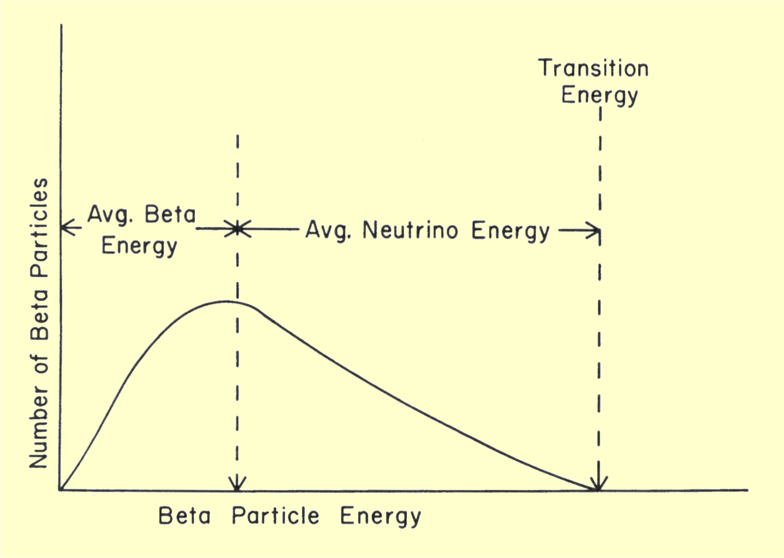
Neutrino (ν)
Proposed by Wolfgang Pauli in 1930 to explain beta decay.
Named by Enrico Fermi in 1931.
Discovered by F.Reines and C.L.Cowan in 1956.
Created during the Big Bang, Supernova, in the Sun , from cosmic rays, in nuclear reactors, in particle accelerators etc.
Interactions involving neutrinos are mediated by the weak force.

Slide 5
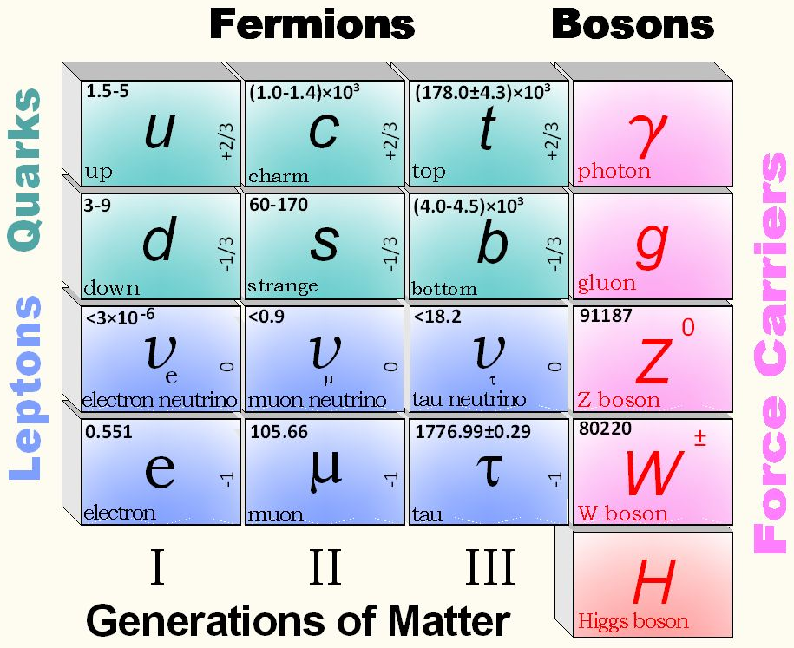
Standard model of particle physics
Top left: Mass of the particle in MeV,
Right: Its electric charge

Slide 6
Neutrino oscillations
It is now known that neutrinos of one flavour oscillate to those of another flavour.
The oscillation mechanism is possible only if the neutrinos are massive.
Neutrino experiments are setting the stage for extension of Standard Model itself.
Massive neutrinos have ramifications on nuclear physics, astro physics cosmology, geo physics apart from particle physics.
Electron and muon neutrinos (ν_{e} and ν_{μ}) are the flavour eigen states. They are super positions of the mass eigen states (ν₁ and ν₂).
If at t = 0, an eigen state ν (0) = ν_{e}, then at any time t,
Then the oscillation probability is
And the oscillation length is

Slide 7
Neutrino physics using ICAL
Using atmospheric neutrinos as the source
  Reconfirm atmospheric neutrino oscillation
  Improved measurement of oscillation parameters
  Search for potential matter effect in neutrino oscillation
  Determining the sign of Δm²₂₃ using matter effect
  Measuring deviation from maximal mixing for θ₂₃
  Probing CP and CPT violation
  Constraining long range leptonic forces
  Ultra high energy neutrinos and muons
Beam from neutrino factories
  7,100km from CERN – Magic baseline distance!

Slide 8
Neutrino sources and detector choice
Source of neutrinos
  Use atmospheric neutrinos as source
  Need to cover a large L/E range
    Large L range
    Large E_{ν} range
Physics driven detector requirements
  Should have large target mass (50-100 kTons)
  Good tracking and energy resolution (tracking calorimeter)
  Good directionality (~1nSec time resolution)
  Charge identification capability (magnetic field)
  Modularity and ease of construction
  Cost and time considerations
  Compliment capabilities of existing and proposed detectors
Use magnetised iron as target mass and RPC as active detector medium

Slide 9
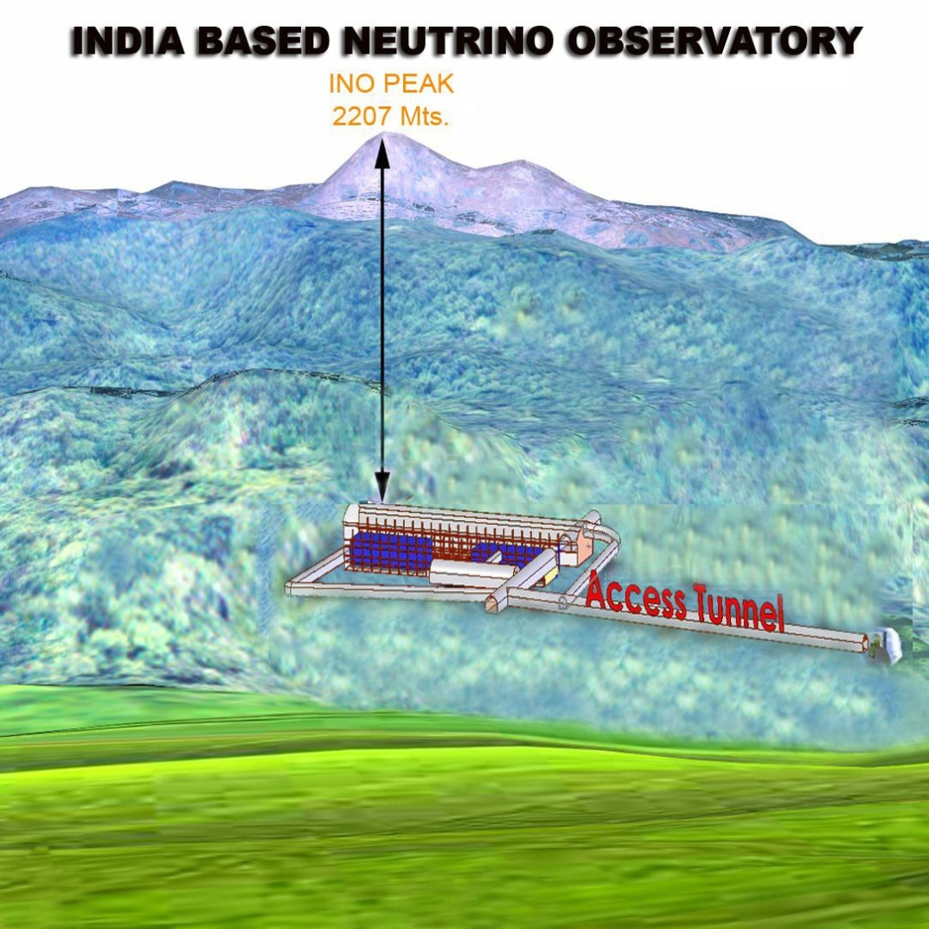
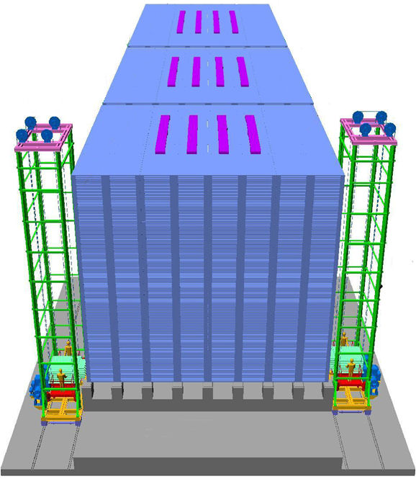
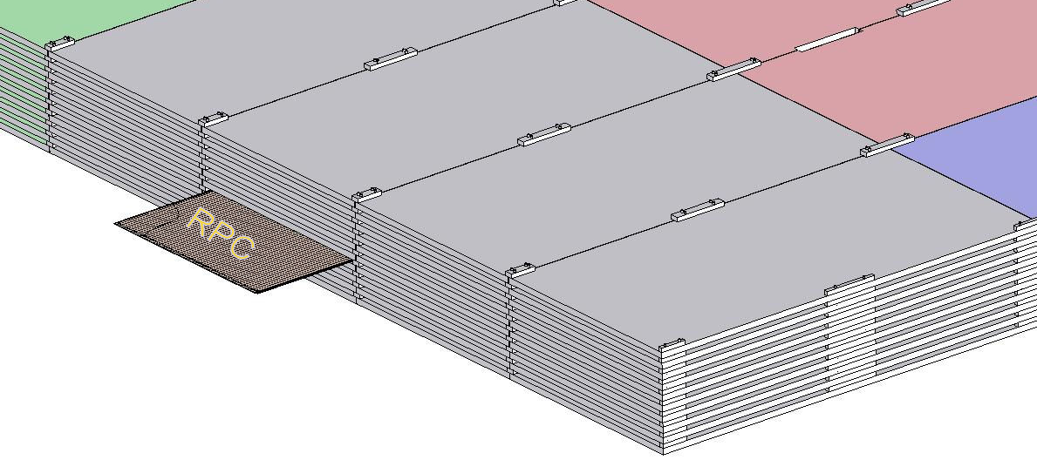
INO cavern and the ICAL detector
Magnet coils
Vertical rock coverage: 1300m
RPC handling trolleys
4000mm×2000mm low carbon iron slab
Total weight: 50Ktons

Slide 10
Factsheet of ICAL detector
No. of modules | 3
Module dimensions | 16m × 16m × 14.5m
Detector dimensions | 48.4m × 16m × 14.5m
No. of layers | 150
Iron plate thickness | 56mm
Gap for RPC trays | 40mm
Magnetic field | 1.3Tesla
RPC dimensions | 1,840mm × 1,840mm × 24mm
Readout strip pitch | 3 0mm
No. of RPCs/Road/Layer | 8
No. of Roads/Layer/Module | 8
No. of RPC units/Layer | 192
No. of RPC units | 28,800 (97,505m²)
No. of readout strips | 3,686,400

Slide 11
2. Detector physics of RPCs

Slide 12
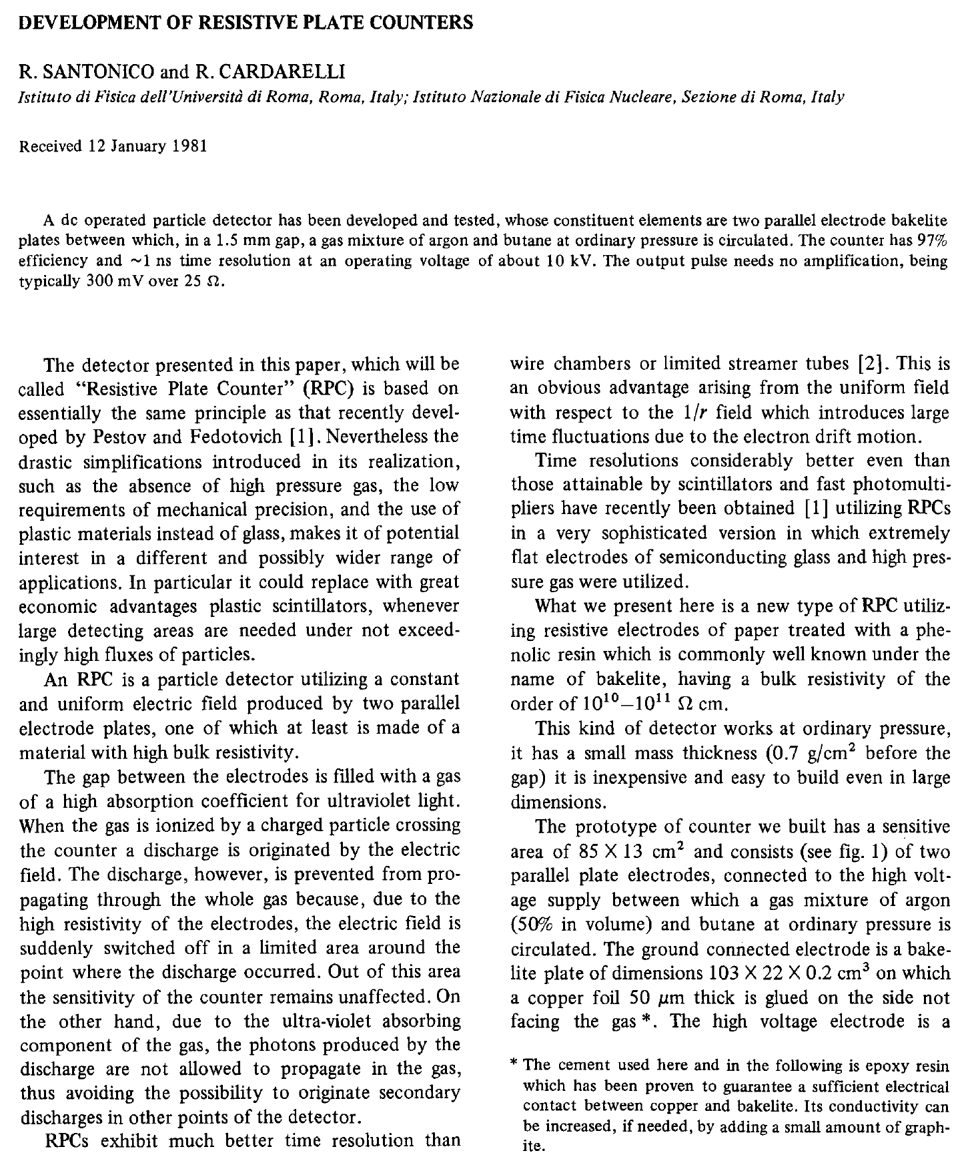
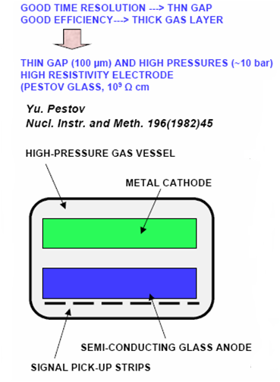
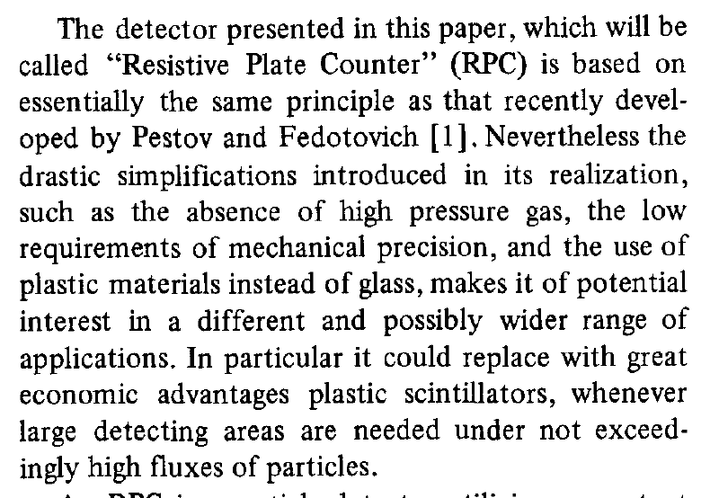
Birth of the RPC

Slide 13
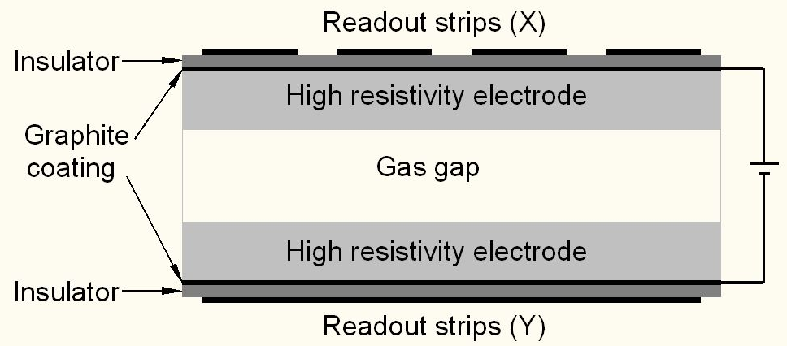
Schematic of a basic RPC

Slide 14
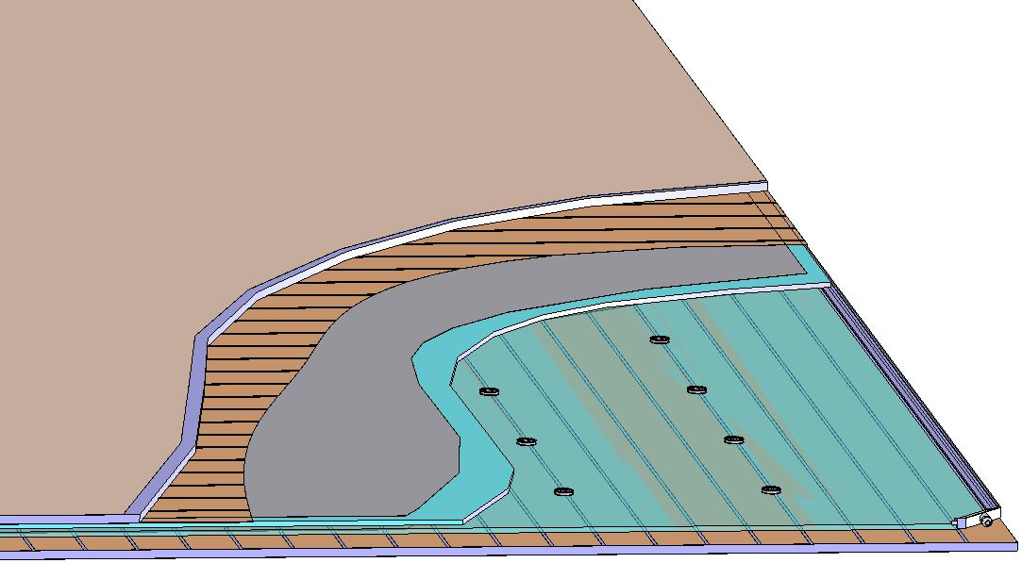
Basic construction of an RPC
Signal reference plane.1
Plastic honey comb.2
Copper pickup strips.3
Graphite/Paint.4
Top glass.5
Button spacer.6
Bottom glass.7
Edge spacer.8
Gas nozzle.9
Bottom pickup panel.A
8
1
2
3
4
5
6
7
9
A

Slide 15
Principle of operation
Electron-ion pairs produced in the ionisation process drift in the opposite directions.
All primary electron clusters drift towards the anode plate with velocity v and simultaneously originate avalanches.
A cluster is eliminated as soon as it reaches the anode plate.
The charge induced on the pickup strips is q = (-eΔx_{e} + eΔx_{I})/g
The induced current due to a single pair is i = dq/dt = e(v + V)/g ≈ ev/g, V « v
Prompt charge in RPC is dominated by the electron drift.

Slide 16
RPC operating mode definitions
Let, n₀ = No. of electrons in a cluster
α = Townsend coefficient (No.
of ionisations/unit length)
β = Attachment coefficient (No.
of electrons captured by the
gas/unit length)
Then, the no. of electrons reaching
the anode,
n = n₀e^{(α- β)x}
Where x = Distance between anode
and the point where the cluster
is produced.
Gain of the detector, M = n / n₀
A planar detector with resistive electrodes ≈ Set of independent discharge cells
Expression for the capacitance of a planar condenser → Area of such cells is proportional to the total average charge, Q that is produced in the gas gap.
  Where, d = gap thickness
  V = Applied voltage
  ε₀ = Dielectric constant of the gas
Lower the Q; lower the area of the cell (that is ‘dead’ during a hit) and hence higher the rate handling capability of the RPC

Slide 17
Control of avalanche process
Role of RPC gases in avalanche control
  Argon is the ionising gas
  R134a to capture free electrons and localise avalanche
    e⁻ + X → X⁻ + hν (Electron attachment)
    X⁺ + e⁻ → X + hν (Recombination)
  Isobutane to stop photon induced streamers
  SF₆ for preventing streamer transitions
Growth of the avalanche is governed by dN/dx = αN
The space charge produced by the avalanche shields (at about αx = 20) the applied field and avoids exponential divergence
Townsend equation should be dN/dx = α(E)N

Slide 18
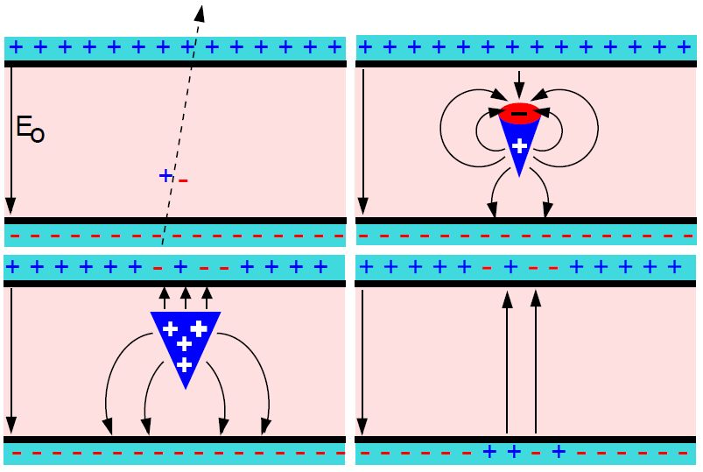
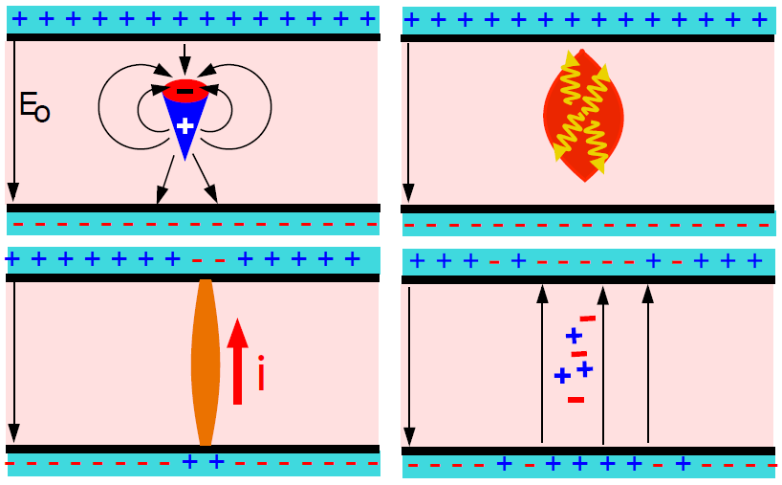
Two modes of RPC operation
Avalanche mode
Streamer mode
Gain of the detector << 10⁸
Charge developed ~1pC
Needs a preamplifier
Longer life
Typical gas mixture Fr:iB:SF₆::94.5:4:0.5
Moderate purity of gases
Higher counting rate capability
Gain of the detector > 10⁸
Charge developed ~ 100pC
No need for a preamplier
Relatively shorter life
Typical gas mixture Fr:iB:Ar::62.8:30
High purity of gases
Low counting rate capability

Slide 19
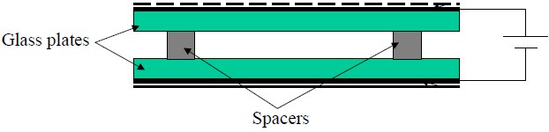
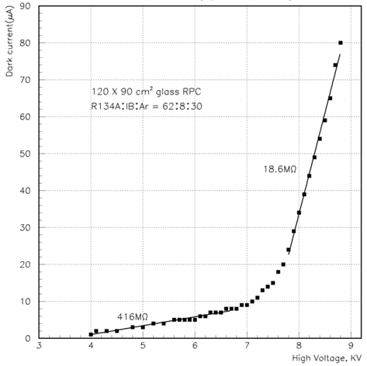
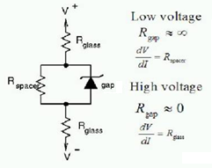
V-I characteristics of RPC
Glass RPCs have a distinctive and readily understandable current versus voltage relationship.

Slide 20
3. Development and characterisation of RPCs

Slide 21
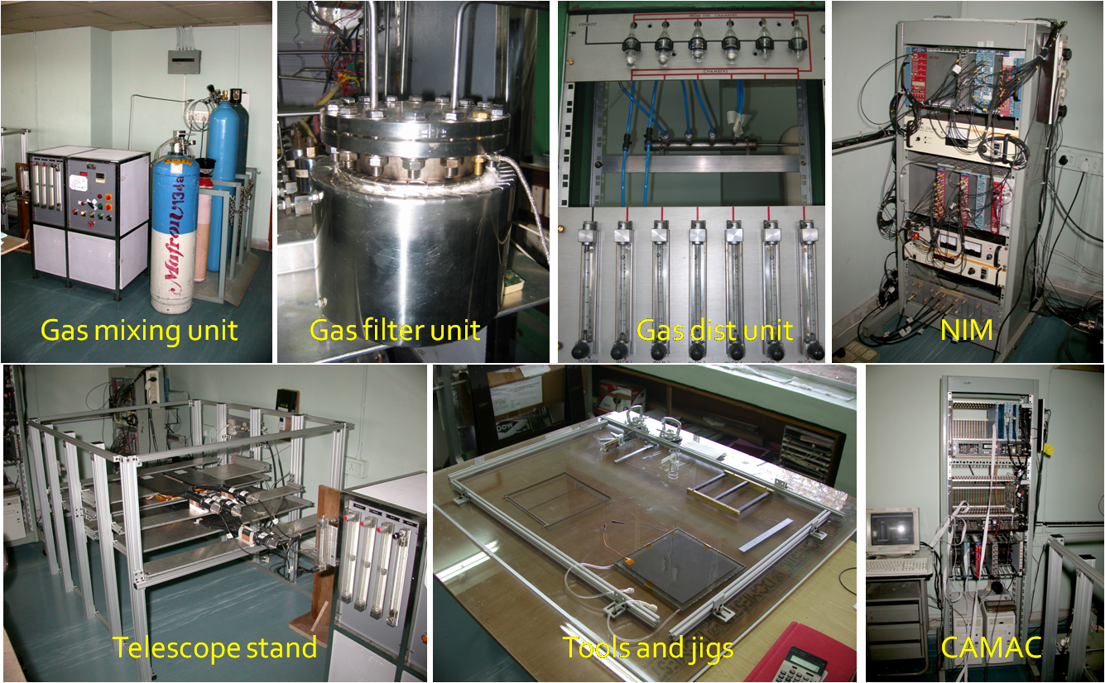
Initial infrastructure for RPC R&D

Slide 22
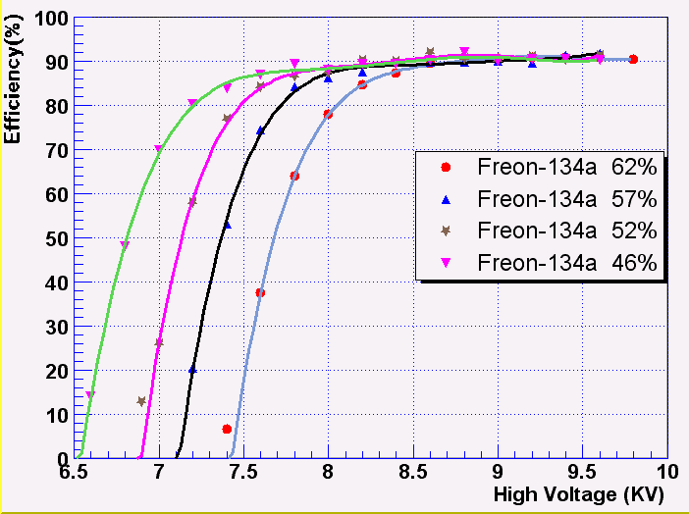
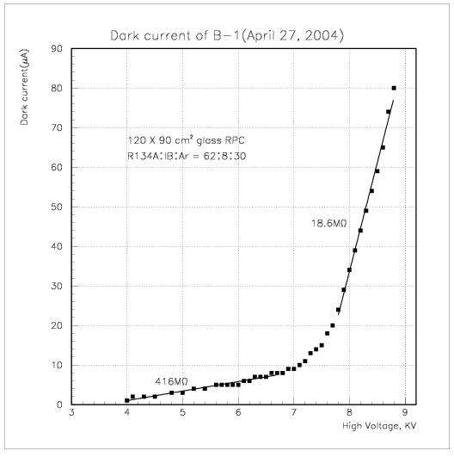
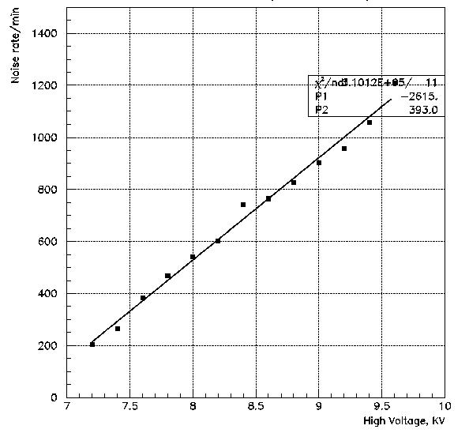
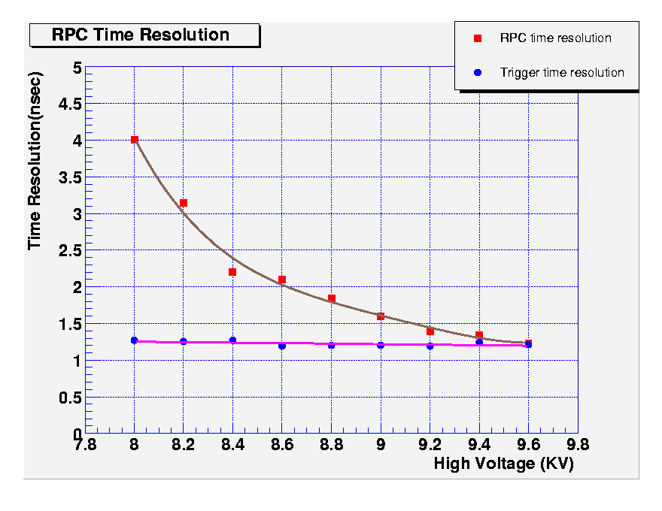
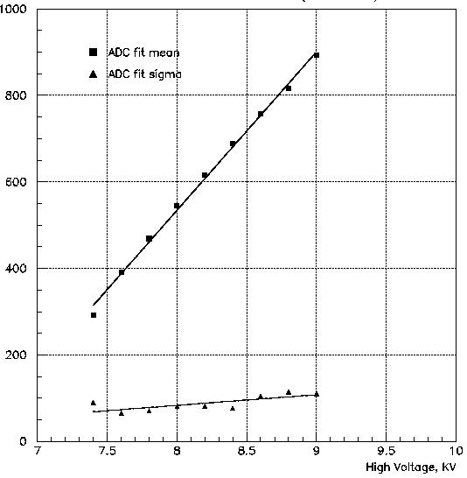
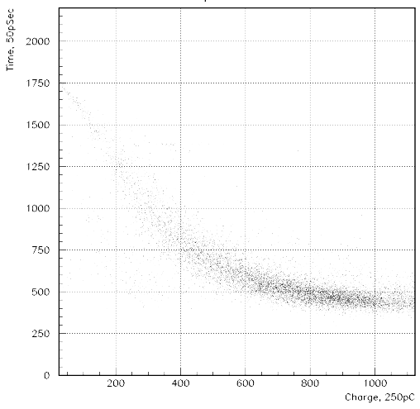
Some early encouraging results

Slide 23
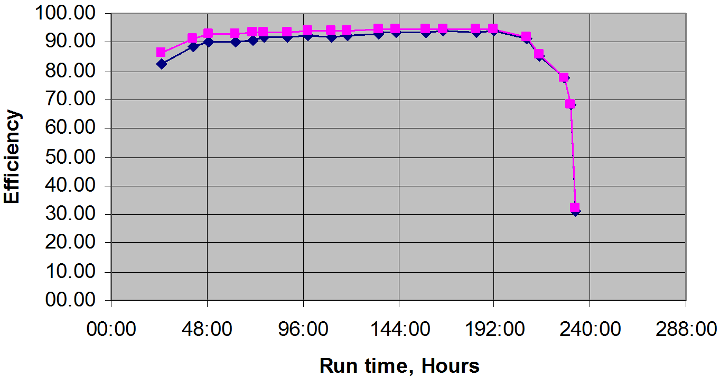
Aging: Efficiency drop of a RPC

Slide 24
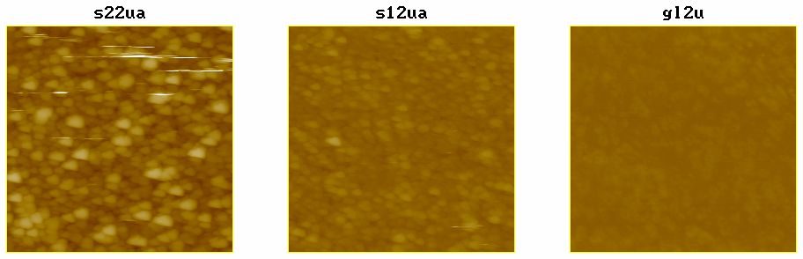
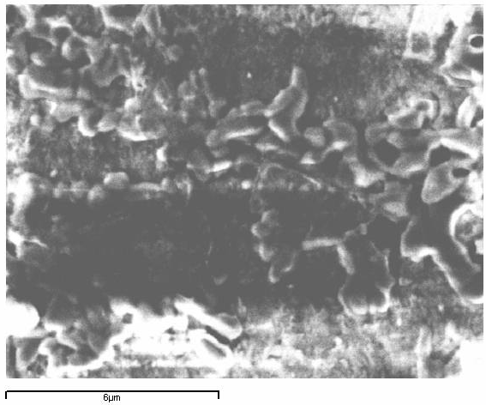
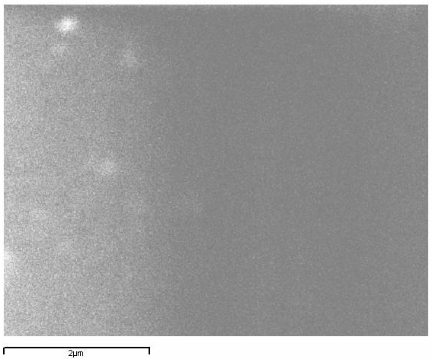
Aging: AFM and SEM scans
Damaged surfaces
AFM
Raw surfaces
SEM

Slide 25
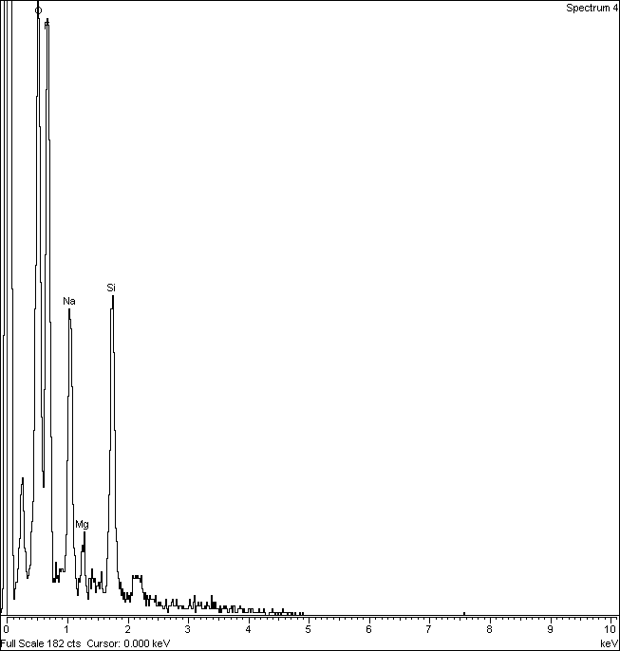
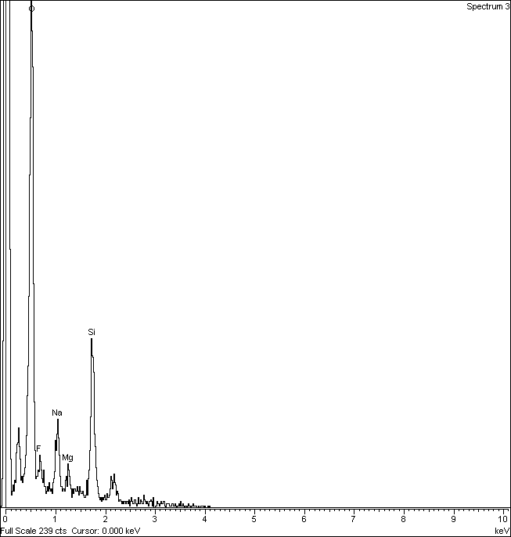
Aging: Element analysis
Element | Atomic%
Oxygen | 28.45
Fluorine | 40.31
Sodium | 11.82
Magnesium | 2.00
Silicon | 17.41
Element | Atomic%
Oxygen | 64.19
Fluorine | 4.17
Sodium | 6.29
Magnesium | 2.11
Silicon | 23.25
Damaged glass
Raw glass

Slide 26
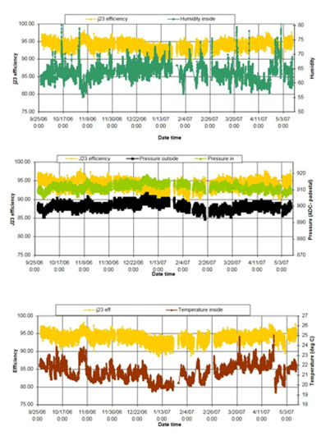
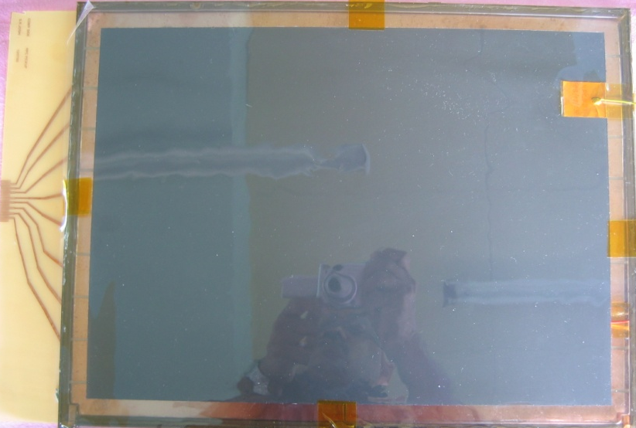
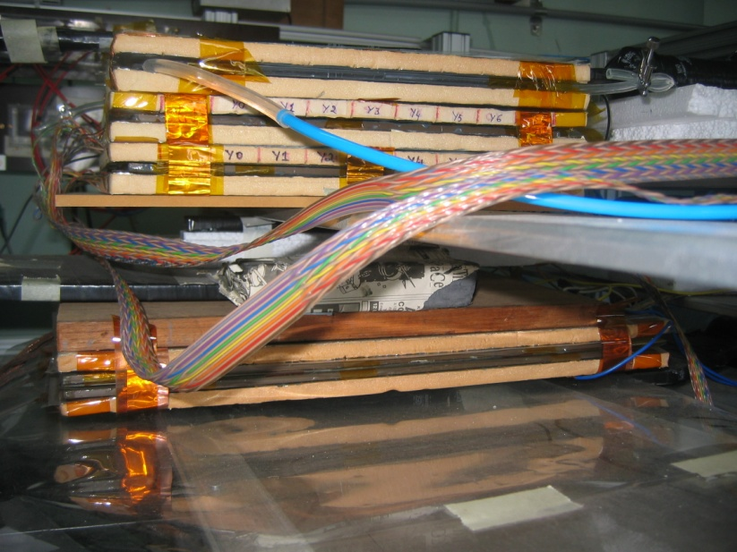
Long-term stability study of RPC
Two RPCs of 40cm × 30cm in size were built using 2mm glass for electrodes
Readout by a common G-10 based signal pickup panel sandwiched between the RPCs
Operated in avalanche mode (R134a: 95.5% and the rest Isobutane) at a high voltage of 9.3KV
Round the clock monitoring of RPC and ambient parameters – temperature, relative humidity and barometric pressure
Were under continuous operation for more than three years
Chamber currents, noise rate, combined efficiencies etc. were stable
Long-term stability of RPCs is thus established
Relative humidity
Pressure
Temperature

Slide 27
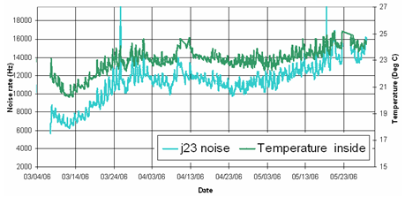
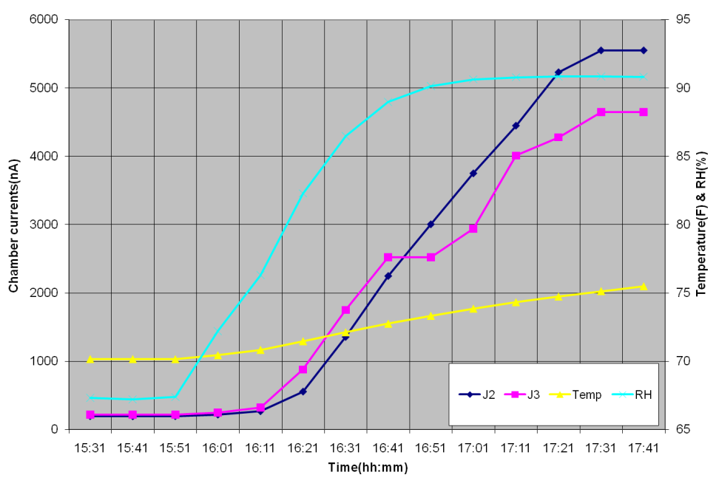
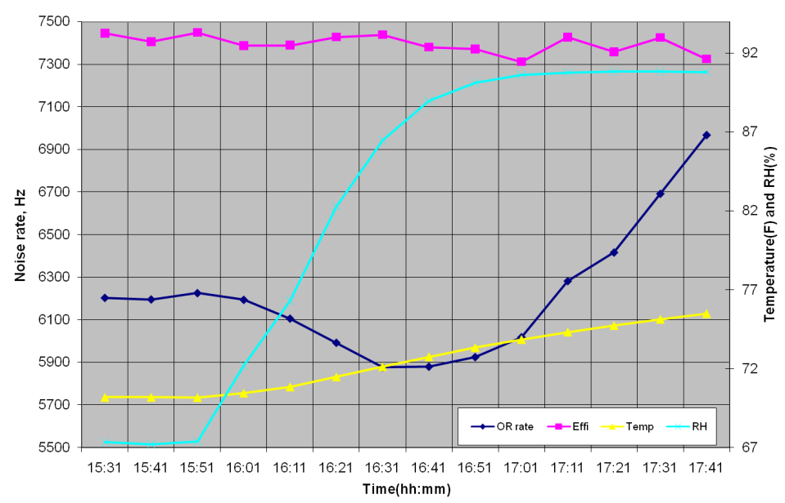
Effect of ambient parameters on
RPC characteristics
If the applied voltage at room temperature T₀ and barometric pressure P₀ is V₀, then the voltage V to be applied at any temperature T and pressure P =
Or what is the effective applied voltage?
N.B: This accounts for gas behaviour only.

Slide 28
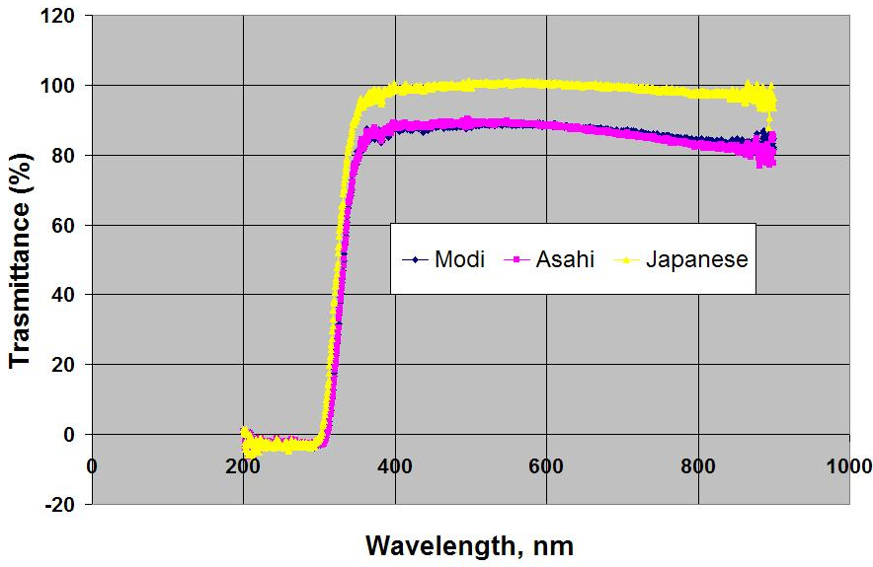
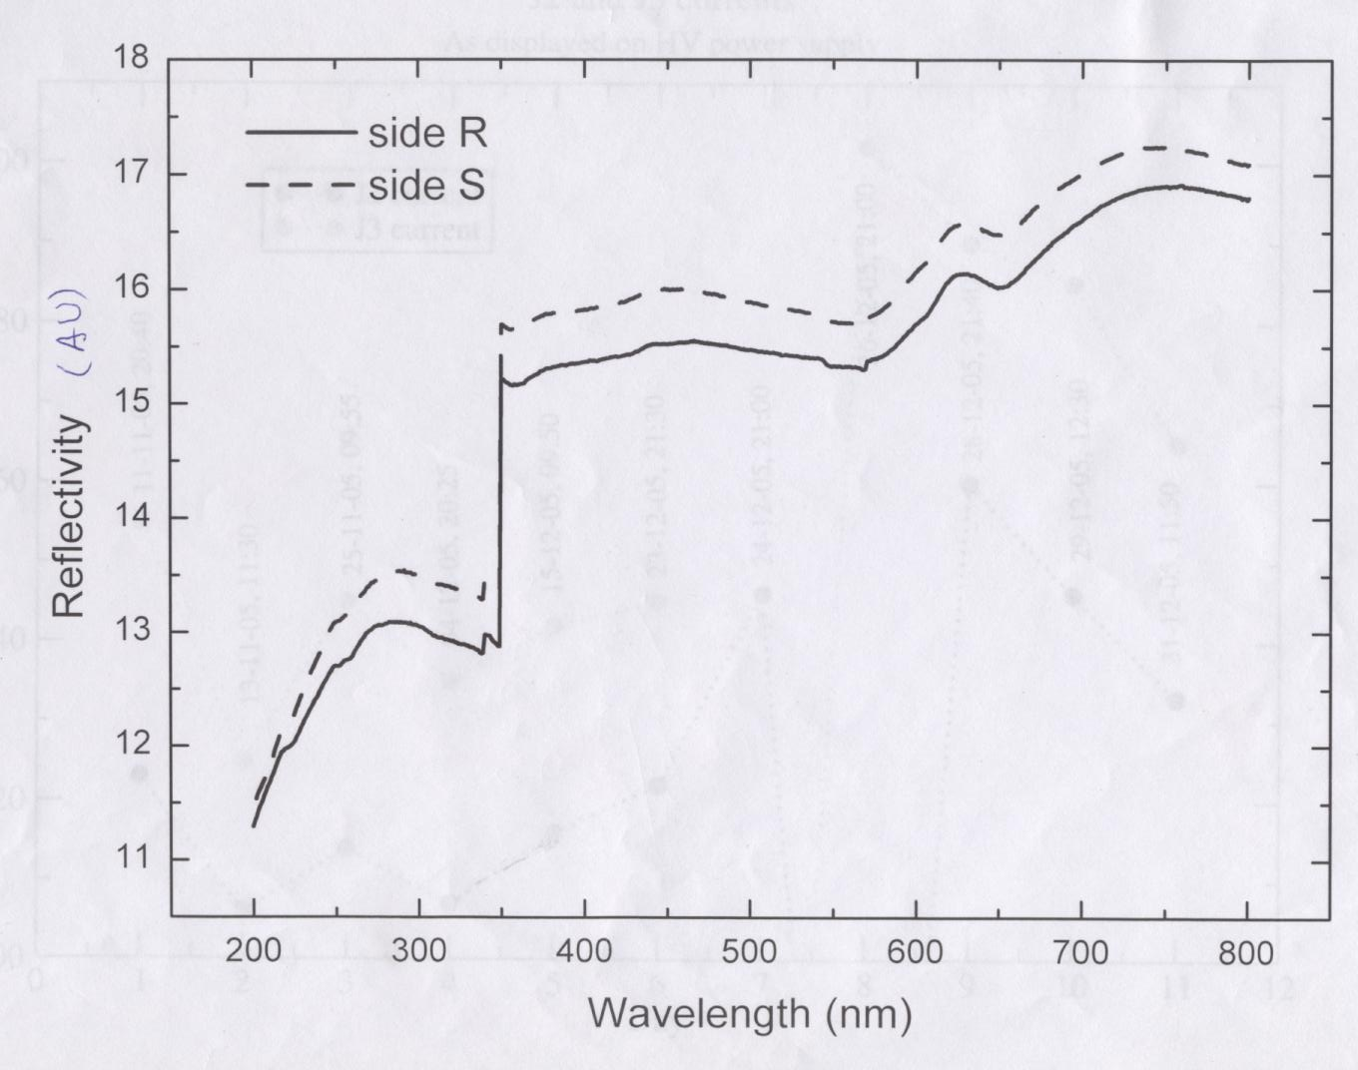
Characterisation of electrode glass samples
Transmittance test
Reflectance test

Slide 29
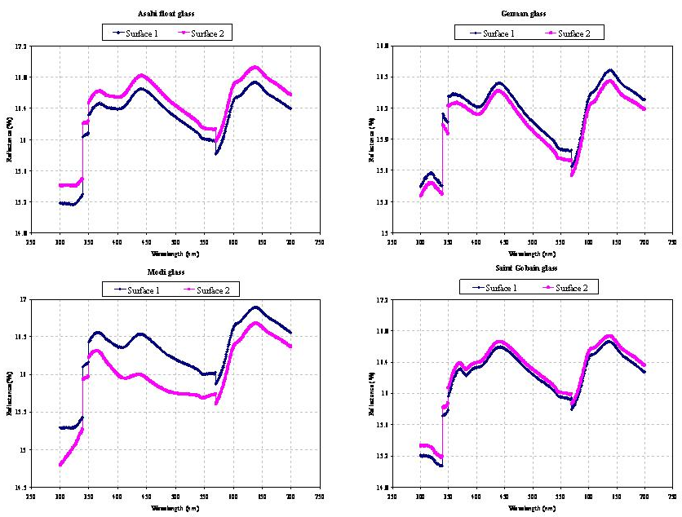
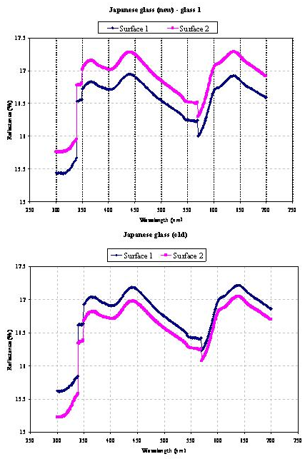
Reflectance study of glass samples

Slide 30
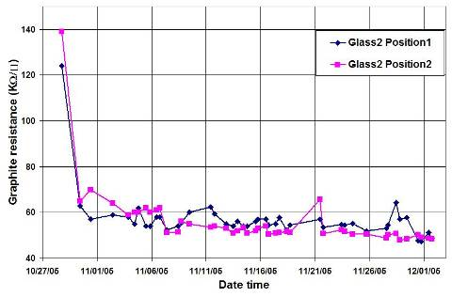
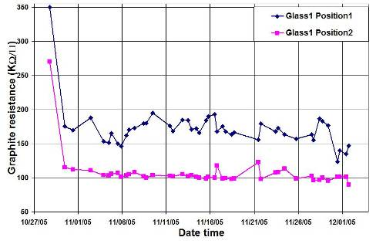
Electrode coating techniques
Graphite paint prepared using colloidal grade graphite powder(3.4gm), lacquer(25gm) and thinner(40ml) is sprayed on the glass electrodes using an automobile spray gun. A uniform, stable graphite coat of desired surface resistivity (1MΩ/◻) was obtained by this method.

Slide 31
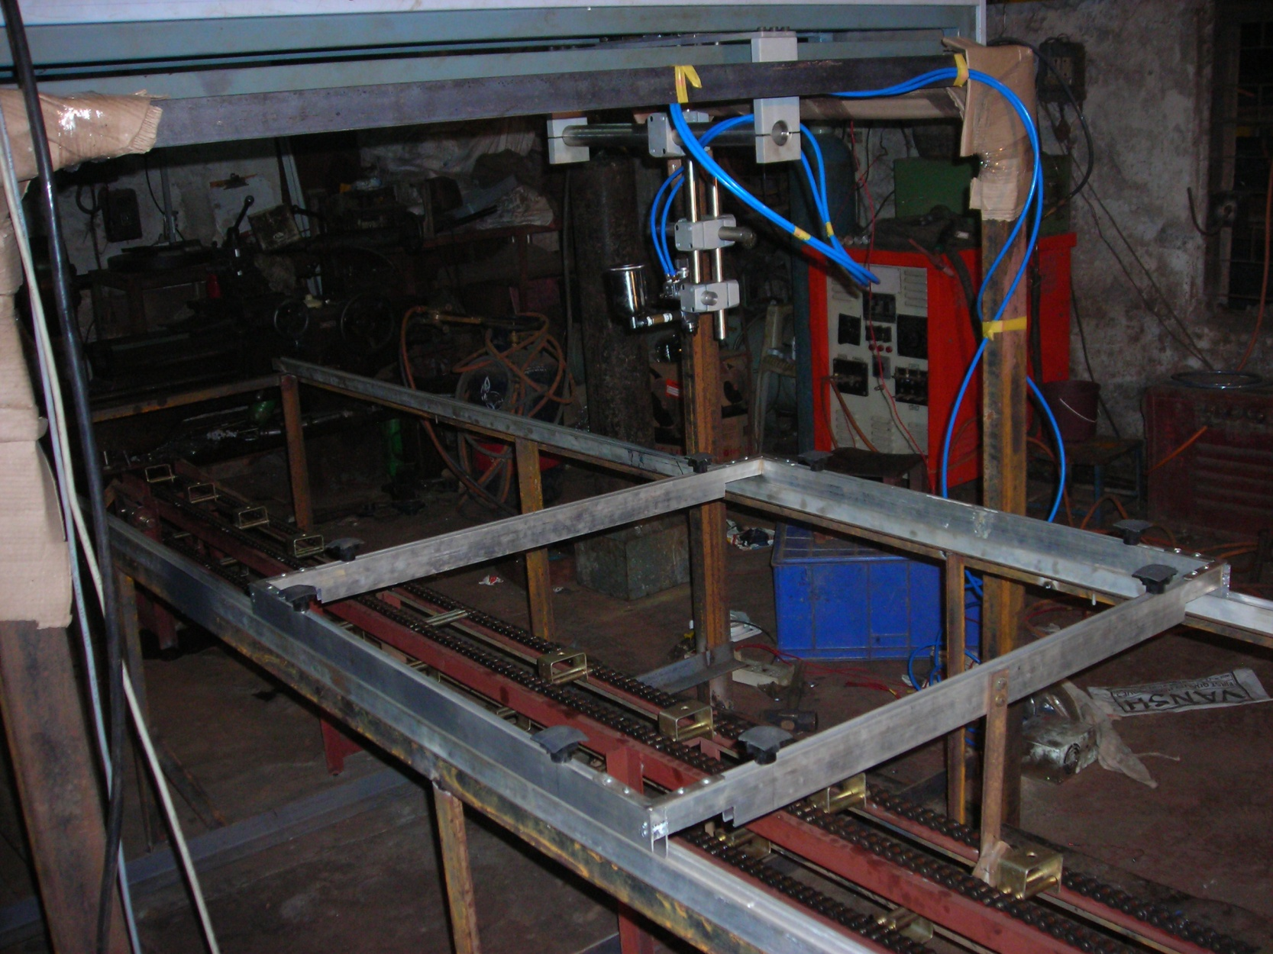
Automatic spray paint plant
Drive for Y-movement
Automatic spray gun
Control and drive panel
Glass holding tray
Drive for X-movement

Slide 32
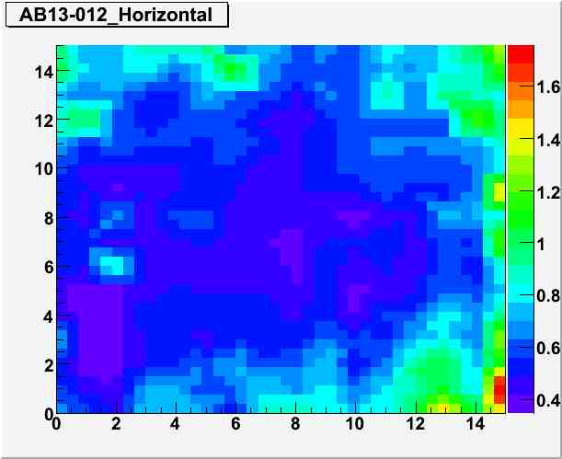
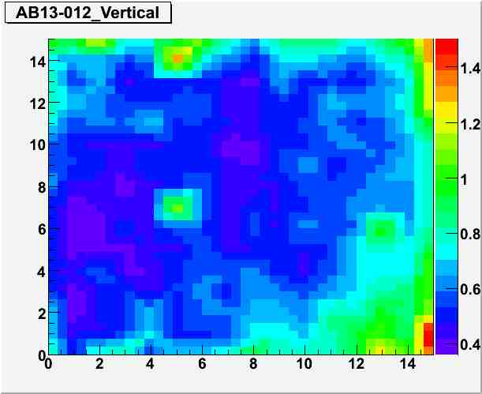
Glass electrode coating results

Slide 33
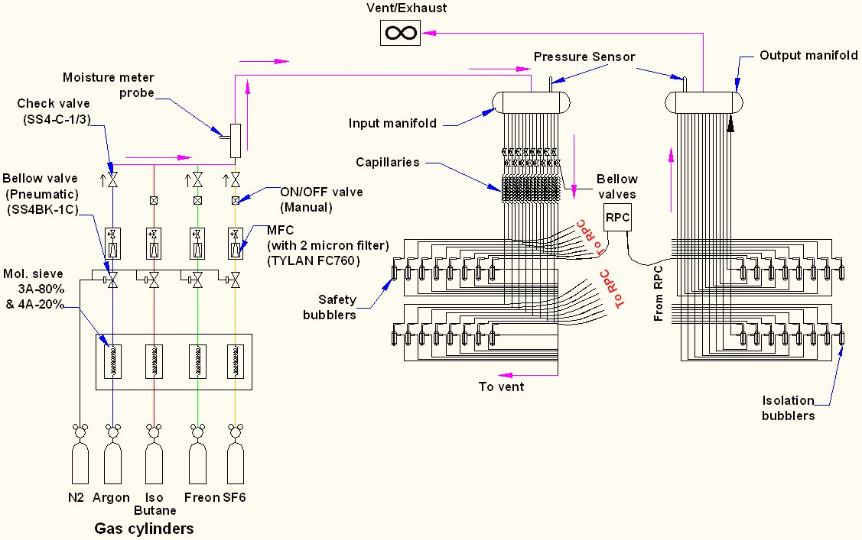
Schematic of the new gas system

Slide 34
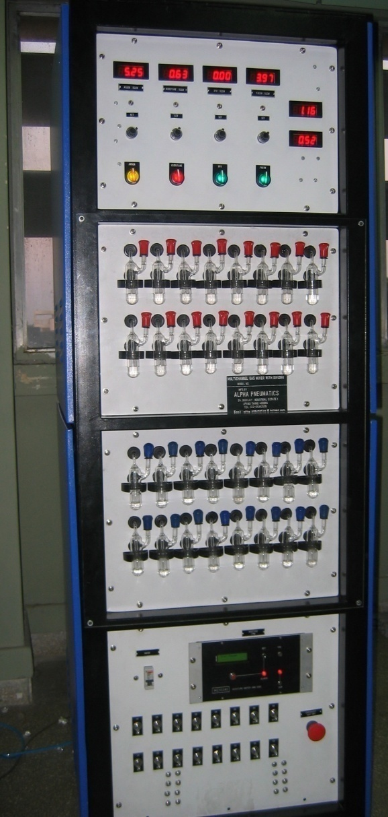
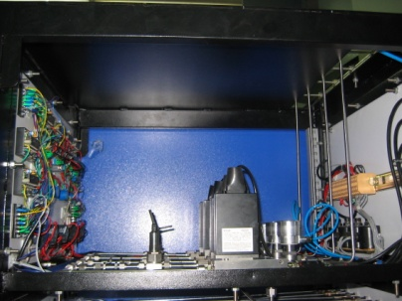
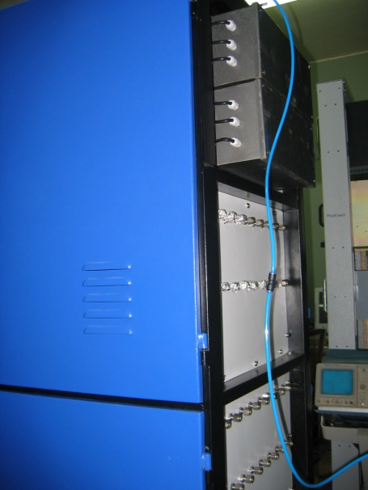
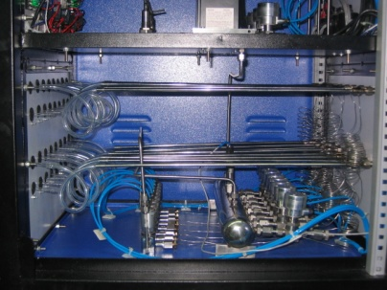
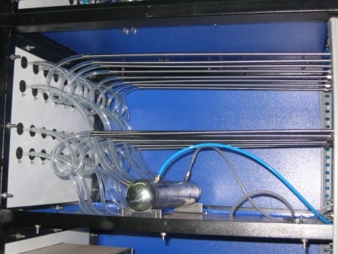
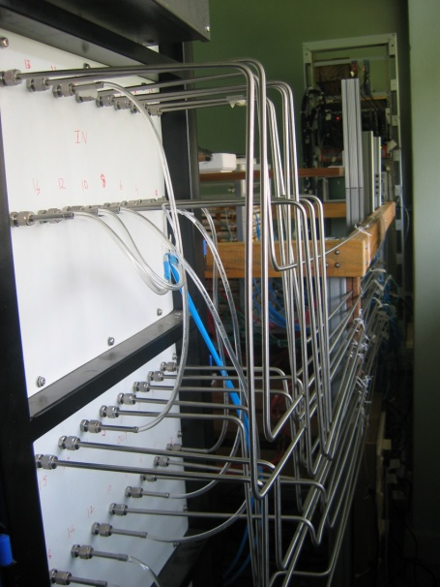

Constructional details of the gas system
Internal view
Front view
Rear view

Slide 35


Calibration procedures of the gas systems
Calibration done using water displacement method
Calibrated against the MFC monitor voltage
Cross-calibration procedure
  Glass/hard plastic tube with precise inner diameter chosen. Placed on a perfectly horizontal surface.
  Water droplet introduced through an opening on one end of the tube
  Gas connected to this end
  Gas moves the water droplet forward α gas flow
  Distance, time intervals measured
  Gas volume computed and compared with displayed value

Slide 36




Calibration results of the gas systems
Argon
SF₆
Isobutane
R134a

Slide 37
Requirement of gases in ICAL
Total number of RPCs in ICAL = 3 × 150 × 64 = 28,800
Total gas volume = 28,800 × 184cm × 184cm × 0.2cm = 195,010 litres
For ex: One volume change/day with 10% gas top-up in a re-circulating scheme
Approximate running gas cost = Rs 30,000/day (R134a from Mafron)
Gas | Avalanche (%) | Streamer (%) | Maximum (%) | Volume (L) | Density (g/L) | Weight (Kg) | Cost (Rs/Kg)
Argon | 0.0 | 30.0 | 30.0 | 58,503 | 1.784 | 104.4
R134a | 95.5 | 62.0 | 95.5 | 186,234.6 | 4.25 | 791.5
Isobutane | 4.3 | 8.0 | 8.0 | 15,600.8 | 2.51 | 39.16
SF₆ | 0.2 | 0.0 | 0.2 | 390 | 6.164 | 2.40

Slide 38



Open loop gas recovery system
Purification unit
Condensation unit
Prototype unit

Slide 39




Materials for gas volume fabrication
Edge spacer
Schematic of an assembled gas volume
Gas nozzle
Glass spacer

Slide 40








Development and characterisation of signal pickup panels
Foam panel
48.2Ω
G-10 panel
Open
100Ω
51Ω
47Ω
Z₀: Inject a pulse into the strip; tune the terminating resistance at the far end, until its reflection disappears.
Honeycomb panel

Slide 41

Measurement of characteristic impedance
Recipe: Tune terminating impedance for each strip width until the reflected signal for injected charge pulse disappear.

Slide 42

Characterisation of Mylar sheet
Electrical breakdown voltage of Garware’s films is > 14KV

Slide 43

RPC gas gap assembly jig
RPC gas gap being glued
Schematic diagram

Slide 44

Fully assembled large area RPC
1m × 1m

Slide 45




RPC parameter characterisation
Amplified RPC signal
Charge distribution
Timing distribution
Efficiency plateau of an RPC

Slide 46


The final frontier: 2m × 2m RPCs
RPC fabrication stand
RPC test stand

Slide 47




Characterisation of 2m × 2m RPCs

Slide 48


Pulse profiles of 2m × 2m RPC

Slide 49






Effect of SF₆ on RPC characteristics
Chamber current
Signal charge
Efficiency
Noise rate
Time response
Time resolution

Slide 50
4. ICAL prototype detector stack

Slide 51

Prototype RPC stack

Slide 52

Schematic of prototype detector segmentation
12, 1m² RPC layers
Two readout planes (X & Y)
32 channels/plane
Total 768 readout channels
Trigger on muons using:
Scintillator paddle layers
RPC strip signals
Recorded information:
Strip hits
Timing
Monitoring data:
Chamber parameters
High voltage and current
Strip noise rates
Cosmic muon efficiency
Ambient parameters
Temperature
Relative humidity
Barometric pressure
Magnet control and monitor
Gas system control & monitor

Slide 53

Schematic of prototype detector DAQ system

Slide 54













Design and implementation of the data acquisition system
200 boards of 13 types
Custom designed using
FPGA,CPLD,HMC,FIFO,SMD

Slide 55

RPC and front-end signal characterisation

Slide 56
5. Data analysis and results

Slide 57
BigStackV4.0: Data analysis software
ROOT based C code
Works on highly segmented configuration file
Handles event, monitor and trigger rate data
Interactively displays event tracks
Generates frame and strip hit files
Produces well designed summary sheets
Plots and histograms produced:
  Efficiency profiles
  Absolute and relative timing distributions
  Strip cluster size calculations
  Strip profiles and lego plots
  Strip rate and calibration signal rate profiles and distributions
  Paddle and pre-trigger rate profiles and distributions
  Track fitting, impact position, residual distribution, strip-multiplicity, RPC mapping using cosmic muons etc.

Slide 58








A collage of interesting events

Slide 59




RPC strip rate monitoring
Temperature dependence on
noise rate
Strip noise rate profile
Strip noise rate histogram
Temperature

Slide 60

Absolute time resolution plots

Slide 61
Summary of timing resolutions
RPC Id HV(KV) Mean(nS) Sigma(nS) RelMean(nS) RelSigma(nS)
AB06 09.8 49.53 2.06 -7.64 1.41
JB00 09.6 46.00 2.32 -4.47 1.67
IB01 09.8 42.31 2.15 -0.64 1.63
JB01 09.6 42.55 2.28 -0.87 1.58
JB03 09.8 43.75 2.26 -2.18 1.44
IB02 09.8 38.49 2.31 3.27 1.38
AB02 09.8 42.77 2.53 -1.21 1.51
AB01 09.8 35.30 2.16 6.33 1.71
AB03 09.8 45.82 3.23 -4.55 1.99
AB04 09.8 41.66 2.42 Reference RPC
AB07 09.8 40.61 2.47 0.96 1.35
AB08 09.8 41.56 2.80 0.31 1.82

Slide 62
Data analysis scheme
Event tracks are fitted with the following criteria.
Hits from layers where a single strip hit are chosen.
While half of strip width is supplied as error on the x/y axes (mean value = 30mm), 2mm is sent as error on the z-axis (mean value = 160mm) to the fitting algorithm.
Minimum of 5 layers is demanded.
Tracked events with χ²/ndf in the range 0.06-0.7 are accepted.
A point in the Impact point plots is recorded if the strip number computed from tracked position in a layer matches with the recorded hit position.
A point in the surface map plots is recorded if the hit strips in both x & planes match with those pointed by the fitted track positions.
RPCs are thus x-rayed using cosmic muons! Buttons are visible.
Residuals are computed from the hit positions using fitted tracks and the centre of the hit strips. The residuals were then applied during subsequent analysis of data.

Slide 63




Some results from prototype stack
Impact position distribution
Tomography of the RPC
Hit position residue distribution
Hit multiplicity distribution

Slide 64
6. Summary and future outlook

Slide 65
Summary and conclusions
Started the work by fabricating 1ft² glass RPC prototypes using some of the barrowed materials.
Operated them in streamer mode and characterised successfully.
Met with severe chamber aging problems – a setback.
Carried extensive diagnostic studies and measurements on gases, glasses, graphite coats, insulating films etc.
Switched to avalanche mode and operated small area chambers successfully for more than 2.5 years.
Developed indigenously and optimised all the materials, assembly jigs and processes required for large area RPCs.
Developed electrode paints and built the gas systems.
Routinely building and successfully operating dozens of 1m² RPCs.
Designed, built and commissioned RPC detector stack, electronics, trigger, data acquisition and on-line monitoring systems.
Analysed all the prototype detector data and presented and published results at national and international meetings and in journals.
And finally, successfully built and characterised 2m × 2m RPCs.

Slide 66
Future outlook and R&D plans
The prototype detector stack will be used to test long-term stability of RPCs and for validation of ICAL electronics.
Detailed studies using the prototype detector stack will continue. Exploiting the data for physics analysis will also be explored.
ICAL electronics using front-end ASICs and timing devices is in full swing.
Gas recirculation prototype system is being tested and optimised, before trying to build a large scale version of the same for ICAL detector.
Optimisation of RPC fabrication and QC procedures are in the process and tenders for large scale production is underway.
Precision studies on the RPC timing capabilities, cross-talk, signal pickup schemes and their characterisation need to continue. These studies will significantly influence the design of front-end electronics.
Device level simulations of RPC will be an important future task of our group, which we will take up shortly.
Validation of the results from the simulation studies using the measured values will provide the confidence needed for large scale deployment of RPCs for ICAL detector.

Slide 67
7. Acknowledgements

Slide 68
Acknowledgements
Prof. Raghava Varma, IIT Bombay
Prof. Naba Mondal, TIFR, Mumbai
Prof. Basant Nandi, IIT Bombay
Prof. S.Uma Sankar, IIT Bombay
Colleagues of the INO detector development and electronics design teams
CMS, ATLAS, ARGO, ALICE, OPERA, BELLE, KEK collaborators and other researchers of the RPC detectors
ICT, Mumbai and Local industries

Slide 69
8. Publications and proceedings

Slide 70
Refereed Journals
Glass RPC Detector R&D for a Mega Neutrino Detector, To appear in IEEE Trans. Nucl. Science
Development of Glass Resistive Plate Chambers for INO, ICHEP08, University of Pennsylvania, USA, July 31, 2008, arXiv:0810:4693
INO prototype detector and data acquisition system, NIM A 602 (2009) 784-787
Development of glass Resistive Plate Chambers for INO experiment, NIM A 602 (2009) 744-748
Development of conductive coated polyester film as RPC electrodes using screen printing, NIM A 602 (2009) 835-838
On-line gas mixing and multi-channel distribution system, NIM A 602 (2009) 845-849
RPC exhaust gas recovery by open loop method, NIM A 602 (2009) 809-813
Preliminary results from INO detector R&D programme, Pramana Vol. 69 No. 6 (2007) 1015-1023
On aging problem of glass Resistive Plate Chambers, Nuclear Physics B 158 (2006) 195-198

Slide 71
Proceedings
Development of prototype RPC and LVDS/NIM-ECL translator for the INO-DAQ system, DAE Symposium in HEP, BHU, Varanasi, December 14-18, 2008
Development and characterisation of large area glass Resistive Plate Chambers for the ICAL detector at INO, Nuclear Physics Symposium, Sambalpur University, December 11-15, 2007
Electronics and data acquisition system for prototype INO-ICAL detector, Nuclear Physics Symposium, Sambalpur University, December 11-15, 2007
The INO project, JIGSAW-2007, TIFR, Mumbai, February 12-23, 2007
Development of Resistive Plate Chambers for the INO detector, JIGSAW-2007, TIFR, Mumbai, February 12-23, 2007
Experiences of using float glass as electrodes for radiation detectors, JIGSAW-2007, TIFR, Mumbai, February 12-23, 2007,
On aging problem of glass Resistive Plate Chambers, JIGSAW-2007, TIFR, Mumbai, February 12-23, 2007
Status of INO RPC R&D activities, JIGSAW-2007, TIFR, Mumbai, February 12-23, 2007
Introduction to Resistive Plate Chambers, Perspectives of Neutrino Physics and India-based Neutrino Observatory, Sambalpur University, February 17-18, 2007
Electronics and data acquisition systems for RPC detectors, Perspectives of Neutrino Physics and India-based Neutrino Observatory, Sambalpur University, February 17-18, 2007
Design and development of a family of ultra fast amplifier Hybrid Micro Circuits for INO experiments, Nuclear Physics Symposium, University of Baroda, December 11-15, 2006
Scintillator paddles as trigger detectors for RPCs, Nuclear Physics Symposium, University of Baroda, December 11-15, 2006
Integration and commissioning of data acquisition system for the INO prototype detector, DAE Symposium in High Energy Physics, IIT Kharagpur, December 11-15, 2006
Results from long term stability tests of Resistive Plate Chambers, DAE Symposium in High Energy Physics, IIT Kharagpur, December 11-15, 2006
Glass characterisation techniques used in the Resistive Plate Chamber development, DAE Symposium in High Energy Physics, IIT Kharagpur, December 11-15, 2006
Experience of using float glass for electrodes in radiation detectors, NSGC-06, BARC, September 15-16, 2006
Development of Resistive Plate Chambers for the INO detector, 50th DAE-BRNS Symposium on Nuclear Physics, BARC, Mumbai, December 12-16, 2005
Design of electronics, trigger and data acquisition system for the proposed INO prototype detector, DAE Symposium on High Energy Physics, SINP, Kolkata, December 2004
Results from development of glass RPCs for INO detector, DAE Symposium on High Energy Physics, SINP, Kolkata, December 2004

Slide 72
Poster presentations
India-based Neutrino Observatory (INO): A world-class underground laboratory to study fundamental issues in physics, TechFest09, IIT Bombay, January 2009
Development of conductive coated polyester film as RPC electrodes using screen printing, RPC2007, TIFR, Mumbai, INDIA, Feb 13-16, 2008
On-line gas mixing and multi-channel distribution system, RPC2007, TIFR, Mumbai, INDIA, Feb 13-16, 2008
The INO project, JIGSAW-2007, TIFR, Mumbai, February 12-23, 2007
Development of Resistive Plate Chambers for the INO detector, JIGSAW-2007, TIFR, Mumbai, February 12-23, 2007
Experiences of using float glass as electrodes for radiation detectors, JIGSAW-2007, TIFR, Mumbai, February 12-23, 2007,
On aging problem of glass Resistive Plate Chambers, JIGSAW-2007, TIFR, Mumbai, February 12-23, 2007
Status of INO RPC R&D activities, JIGSAW-2007, TIFR, Mumbai, February 12-23, 2007
Experiences of using float glass as electrodes for radiation detectors, National Symposium on Science & Technology of Glass/Glass-Ceramics (NSGC-06), BARC, Mumbai, September 15-16, 2006
Muon lifetime experiment, Year of Physics programme, IIT Bombay, December 2005
Development of Resistive Plate Chambers for the INO detector, 50th DAE-BRNS Symposium on Nuclear Physics, BARC, Mumbai, December 12-16, 2005
On aging problem of glass Resistive Plate Chambers, The VIII Workshop on Resistive Plate Chambers and Related Detectors, Korea University, Seoul, October 10-12, 2005

Slide 73
External presentations
Current status of the KEK-INO collaboration, DST-JSPS Core University program, TIFR, February 19, 2009
ICAL Electronics: Current thoughts, INO-US collaboration meeting, TIFR, February 6, 2009
ICAL Electronics: Status summary, INO-KEK collaboration meeting, TIFR, January 28-29, 2009
Destroy, to probe its creation, St Cathedral School, October 3, 2008
It is not end of the world … It is about beginning of the Universe, St Cathedral School, September 23, 2008
Ph.D. progress seminar, Department of Physics, IIT Bombay, August 2008
The joy and challenge of doing experimental particle physics, CBS Colloquium, August 12, 2008
INO prototype detector and data acquisition system, RPC2007, TIFR, Mumbai, INDIA, February 13-16, 2008
Electronics for the INO ICAL detector, KEK, Japan, November 27, 2007
Development of Resistive Plate Chambers for INO ICAL detector, University of Roma Tor Vergata, November 2, 2007
Ph.D. progress seminar, Department of Physics, IIT Bombay, August 2007
Introduction to Resistive Plate Chambers, Perspectives of Neutrino Physics and India-based Neutrino Observatory, Sambalpur University, February 17-18, 2007
Electronics and data acquisition systems for RPC detectors, Perspectives of Neutrino Physics and India-based Neutrino Observatory, Sambalpur University, February 17-18, 2007
The INO project, JIGSAW-2007, TIFR, Mumbai, February 12-23, 2007
Development of Resistive Plate Chambers for the INO detector, JIGSAW-2007, TIFR, Mumbai, February 12-23, 2007
Experiences of using float glass as electrodes for radiation detectors, JIGSAW-2007, TIFR, Mumbai, February 12-23, 2007,
On aging problem of glass Resistive Plate Chambers, JIGSAW-2007, TIFR, Mumbai, February 12-23, 2007
Status of INO RPC R&D activities, JIGSAW-2007, TIFR, Mumbai, February 12-23, 2007
Integration and commissioning of data acquisition system for the INO prototype detector, DAE Symposium in High Energy Physics, IIT Kharagpur, December 11-15, 2006
Results from long term stability tests of Resistive Plate Chambers, DAE Symposium in High Energy Physics, IIT Kharagpur, December 11-15, 2006
Glass characterisation techniques used in the Resistive Plate Chamber development, DAE Symposium in High Energy Physics, IIT Kharagpur, December 11-15, 2006
Ph.D. progress seminar, Department of Physics, IIT Bombay, August 2006
Preliminary results from INO detector R&D programme, Linear Collider Workshop 2006, IISc, Bangalore, March 9-13, 2006
Ph.D. progress seminar, Department of Physics, IIT Bombay, August 2005
Development and study of glass Resistive Plate Chambers, Ph.D. credit seminar report, IIT Bombay, November 2004
Design of electronics, trigger and data acquisition system for the proposed INO prototype detector, DAE Symposium on High Energy Physics, SINP, Kolkata, December 2004
Results from development of glass RPCs for INO detector, DAE Symposium on High Energy Physics, SINP, Kolkata, December 2004

Slide 74
Institute colloquia
Design and characterisation studies of Resistive Plate Chambers, Physics Colloquium, TIFR, November 2008
Development of a high performance TDC module for the Grapes-3 experiment, ASET Colloquium, TIFR, October 2006

Slide 75
Courses taught
Course on Signal processing electronics, VII SERC School, IIT Bombay, February 2009
Laboratory Orientation, VII SERC School, IIT Bombay, February 2009
IPHY 203: Experimental Methods I. Shared with Prof. Vandana Nanal for the INO Graduate Training School (Autumn 2008)
IPHY 204: Experimental Methods II. Shared with Prof. V.M.Datar for the INO Graduate Training School (Spring 2009)
Course on Resistive Plate Chambers, INO School, VECC/SINP, Kolkata, May 1-13, 2006
Course on Data Acquisition Systems, INO School, VECC/SINP, Kolkata, May 1-13, 2006

Slide 76
Presentations to the collaboration
Report on Electronics for the ICAL and the Prototype, INO Collaboration meeting, VECC, February 27, 2009 ICAL electronics and DAQ schemes, INO Electronics meeting, TIFR, September 17, 2008
Commissioning of ICAL prototype detector electronics, Presentation at INO Collaboration meeting, BARC, April 13-14, 2008
Electronics, trigger and data acquisition systems for the INO ICAL detector, Presentation at INO Collaboration meeting, BARC, April 13-14, 2008
Possible schemes for INO-ICAL electronics, INO Electronics Meeting, TIFR, September 21, 2007
Status of INO detector R&D, INO Collaboration meeting, University of Delhi, 9-10 March 2007
Status report on RPC R&D at TIFR, INO detector meeting, VECC, Kolkata, December 24, 2005
Status report on electronics, trigger and data acquisition systems for the INO prototype detector, INO detector meeting, VECC, Kolkata, December 24, 2005
Electronics, trigger and DAQ system for INO prototype detector and A few thoughts for ICAL detector, INO Interaction meeting, IMSc, Chennai, February 22-24, 2006
Status of glass and bakelite RPC development, India-CMS collaboration meeting, BARC, 20-21 July 2005
CERN experience, Joint presentation, India-CMS collaboration meeting, BARC, 20-21 July 2005
Study of Chinese oil-less bakelite RPC, CERN, CMS RE Collaboration meeting, June 2005

Slide 77
Collaboration reports
India-based Neutrino Observatory, INO Project Report, INO/2006/1, Volume I
India-based Neutrino Observatory, INO Interim Reports, INO/2005/1, Volume I, II

Slide 78
Internal reports
Design and characterisation studies of Resistive Plate Chambers, Ph.D. progress report, IIT Bombay, August 2009
Design and characterisation studies of Resistive Plate Chambers, Ph.D. progress report, IIT Bombay, August 2008
A short report on the performance of BARC HMCs for INO detectors, March 2008
How-to-BigStack, User manual for BigStack analysis package, 2007
How-to-ProcessTraces, User manual for ProcessTraces analysis script, 2007
The Little Neutrino, Write-up for TIFR Open House programme, 2007
Design and simulation studies of Resistive Plate Chambers, Ph.D. progress report, IIT Bombay, August 2007
Calibration procedure and test results of NINO amplifier, July 2007
On data format of InoDaq and rpcanal packages, 2006
Quality control log sheets for RPC production, 2006
Glass surface quality and element analysis, September 2006
Design and simulation studies of Resistive Plate Chambers, Ph.D. progress report, IIT Bombay, August 2006
Design and simulation studies of Resistive Plate Chambers, Ph.D. progress report, IIT Bombay, August 2005
Development and study of glass Resistive Plate Chambers, Ph.D. credit seminar report, IIT Bombay, November 2004

Slide 79
9. Backup slides

Slide 80

Up-Down asymmetry measurement
Atmospheric neutrino energy > 1.3GeV, Δm² ~2-3×10⁻³ eV²
Downward muon neutrino are not affected by oscillation
They may constitute a near reference source
Upward neutrino are instead affected by oscillation since the L/E ratio ranges up to 10⁴ Km/GeV
They may constitute a far source
Thus, oscillation studies with a single detector and two sources

Slide 81

Matter effects and neutrino mass hierarchy
Matter effects help to cleanly determine the sign of the Δm²
Neutrinos and anti-neutrinos interact differently with matter
ICAL can distinguish this by detecting charge of the produced muons, due to its magnetic field
Helps in model building for neutrino oscillations

Slide 82
Why ICAL chose RPC?
Large detector area coverage, thin (~10mm), small mass thickness
Flexible detector and readout geometry designs
Solution for tracking, calorimeter, muon detectors
Trigger, timing and special purpose design versions
Built from simple/common materials; low fabrication cost
Ease of construction and operation
Highly suitable for industrial production
Detector bias and signal pickup isolation
Simple signal pickup and front-end electronics; digital information acquisition
High single particle efficiency (>95%) and time resolution (~1nSec)
Particle tracking capability; 2-dimensional readout from the same chamber
Scalable rate capability (Low to very high); Cosmic ray to collider detectors
Good reliability, long term stability
Under laying Physics mostly understood!

Slide 83
Typical expected parameters
No. of clusters in a distance g follows Poisson distribution with an average of
Probability to have n clusters
Intrinsic efficiency
ε_{max} depends only on gas and gap
Intrinsic time resolution
σ_{t} does not depend on the threshold
Gas: 96.7/3/0.3
Electrode thickness: 2mm
Gas gap: 2mm
Relative permittivity: 10
Mean free path: 0.104mm
Avg. no. of electrons/cluster: 2.8
Charge threshold: 0.1pC
HV: 10.0KV
Townsend coefficient: 13.3/mm
Attachment coefficient: 3.5/mm
Efficiency: 90%
Time resolution: 950pS
Total charge: 200pC
Induced charge: 6pC

Slide 84





Application driven RPC designs
Single gap RPC
Double gap RPC
Multi gap RPC
Hybrid RPC
Micro RPC

Slide 85
Deployment of RPCs in running experiments
Experiment | Area(m²) | Electrodes | Gap(mm) | Gaps | Mode | Type
BaBar | 2000 | Bakelite | 2 | 1 | Streamer | Trigger
Belle | 2000 | Glass | 2 | 2 | Streamer | Trigger
ALICE Muon | 140 | Bakelite | 2 | 1 | Streamer | Trigger
ATLAS | 6550 | Bakelite | 2 | 1 | Avalanche | Trigger
CMS | 6000 | Bakelite | 2 | 2 | Avalanche | Trigger
STAR | 60 | Glass | 0.22 | 6 | Avalanche | Timing
ALICE TOF | 150 | Glass | 0.25 | 10 | Avalanche | Timing
OPERA | 4600 | Bakelite | 2 | 1 | Streamer | Trigger
YBJ-ARGO | 6700 | Bakelite | 2 | 1 | Streamer | Trigger
BESIII | 1000 | Bakelite | 2 | 1 | Streamer | Trigger
HARP | 10 | Glass | 0.3 | 4 | Avalanche | Timing
Also deployed in COVER_PLASTEX, EAS-TOP, L3, HADES, FOPI and PHENIX experiments

Slide 86

EDS measurements on glass samples

Slide 87

Density measurements of glass samples

Slide 88


Screen printing techniques
On glass
On films

Slide 89
Features of the gas system
16 pneumatically controlled outputs
Molecular sieve based input filter columns
Nippon Tylan made model FC-760 MFCs
Parker made fine filters on the mixed gas
On-line moister readout on mixed gas
Output flow control by SS 0.3mm capillaries
Bleeder bubblers for RPC protection
Facility to add controlled moister into the mixture
Computer interface for control and monitoring

Slide 90

Operating principle of a gas MFC
Credit: Advanced Energy Industries, Inc.

Slide 91


Working principle of flow resistors
The capillaries allow the gas to mix thoroughly by providing long residence time. The flow rate through the capillary is calculated using Hagen-Poiseuille equation given by
  Φ = πR⁴ΔP / 8ηL,
Where, Φ is the voluminal gas flow rate (cu-meters/second), R is the capillary radius (meters), ΔP is the differential pressure (Pascal), η is the dynamic fluid viscosity of gas (Pascal-Second) and L is the total length of the capillary tube in the x-direction (meters).

Slide 92
Efficiency time profile of an RPC

Slide 93

Strip hit map of an RPC

Slide 94
RPC relative time resolution plots

Slide 95

Impact position plots

Slide 96

Cluster size distributions
RPC | Size
AB01 | 1.9
AB02 | 1.9
AB03 | 1.8
AB04 | 1.8
AB06 | 1.2
AB07 | 1.6
AB08 | 2.2
AB10 | 1.6
IB02 | 2.7
JB00 | 1.5
JB01 | 3.3
JB03 | 2.0

Slide 97

Rate capability of a streamer RPC

Slide 98
Transmission line impedance
Readout strips
w
ε_{r}
h
Ground plane

Slide 99

Properties of gases used in ICAL

Slide 100



On-line monitoring utilities

Slide 101

INO electronic logbook

Slide 102

Specifications of polycarbonate (Lexan)
(M/s GE Ltd.)

Slide 103

Specifications of insulating film
(M/s Garware Plastics)

Slide 104

Specifications of spray paint
(M/s Kansai-Nerolac Paints Ltd.)

Slide 105

Summary of screen printing results
(M/s Dozen Tech, Korea)

