Slide 1
IEEE Bombay Section
The fulcrum of local communities
Dr. Satyanarayana Bheesette (TIFR, Mumbai)
Execom Member & Technical Programmes and Activities Chair, Bombay Section

Slide 2
IEEE: Mission and Vision
IEEE's core purpose is to foster technological innovation and excellence for the benefit of humanity.
IEEE will be essential to the global technical community and to technical professionals everywhere, and be universally recognized for the contributions of technology and of technical professionals in improving global conditions.

Slide 3
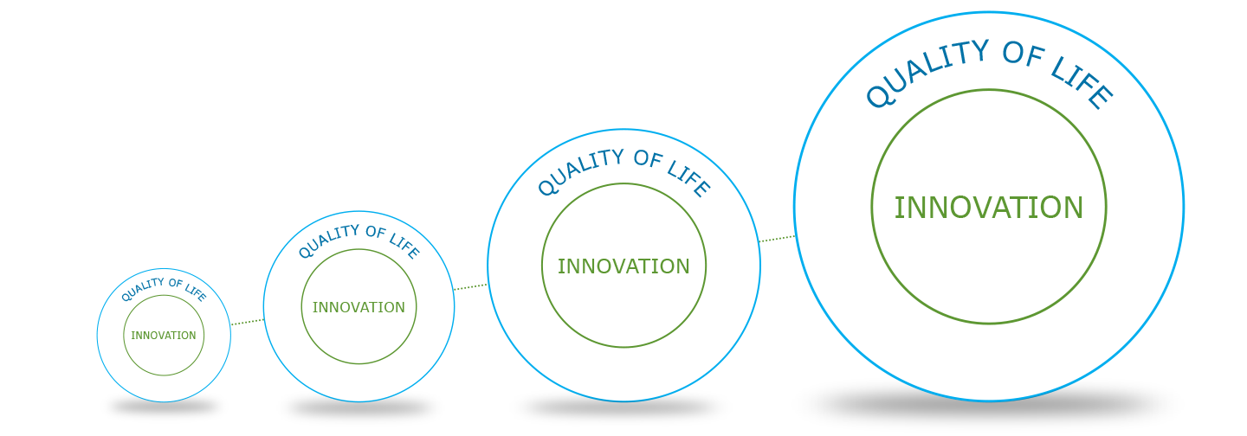
Advancing Technology
IEEE is behind the technology that drives innovation and better living
Technology drives innovation
People can do more, do better
Technology drives higher quality of life
People can live better, longer

Slide 4

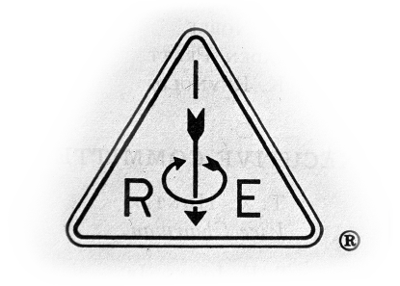

+ =
American Institute of Electrical Engineers (AIEE) was formed in 1884 by a small group of individuals in the electrical professions. Norvin Green was its founding President.
Aim? To aid them in their efforts to apply innovation for the betterment of humanity.
Thomas Edison and Alexander Graham Bell representing power and telephone industries respectively were among the founding members.
With Guglielmo Marconi’s wireless telegraphy experiments in 1895-1896, followed by inventions of John Fleming’s diode and Lee de Forest’s triode, a new ‘radio’ industry was born. With the new industry arose a new society in 1912 - the Institute of Radio Engineers (IRE).
Then – the unusually the best had happened! On 1 January 1963, the AIEE and the IRE merged to form the Institute of Electrical and Electronics Engineers (IEEE).
Over the decades that followed, the social roles of the technologies under IEEE’s aegis continued to spread across the world and reach into more and more areas of people's lives.
This is what some prefer to call - Growth and globalization.

Slide 5







IEEE Today at a Glance
Our Global Reach
45
Technical Societies and Councils
431,000+
Members
160+
Countries
Our Technical Breadth
1,400+
Annual Conferences
3,700,000+
Technical Documents
170
Top-cited Periodicals

Slide 6
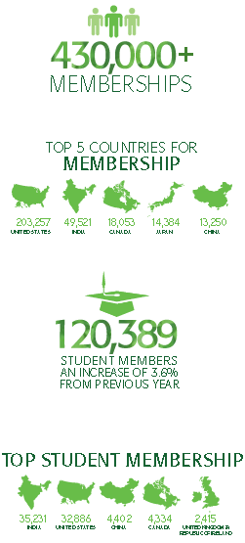
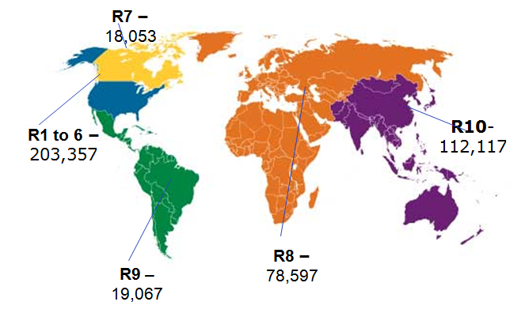
IEEE membership by Region
Bombay Section – Over 7000 members
Professional members: 1700+
Student members: 5300+

Slide 7
Societies & Councils
Aerospace & Electronic Systems
Antennas & Propagation
Broadcast Technology
Circuits & Systems
Communications
Components, Packaging & Manufacturing Technology
Computational Intelligence
Computer
Consumer Electronics
Control Systems
Dielectrics & Electrical Insulation
Education
Electromagnetic Compatibility
Electron Devices
Engineering in Medicine & Biology
Geoscience & Remote Sensing
Industrial Electronics
Industry Applications
Information Theory
Instrumentation & Measurement
Intelligent Transportation Systems
Magnetics
Microwave Theory & Techniques
Notes:
Here is a list of the societies and councils.

Slide 8

Societies & Councils
Nuclear & Plasma Sciences
Oceanic Engineering
Photonics
Power Electronics
Power & Energy
Product Safety Engineering
Professional Communication
Reliability
Robotics & Automation
Signal Processing
Social Implications of Technology
Solid-State Circuits
Systems, Man & Cybernetics
Technology and Engineering Management
Ultrasonics, Ferroelectrics & Frequency Control
Vehicular Technology
Technical Councils
Biometrics
Electronic Design Automation
Nanotechnology
Sensors
Super Conductivity
Systems

Slide 9


How We Impact
Standards
Emerging Technologies
Educating for Success
Conferences
Publications
Improving Quality of Life
IEEE drives the technologies that improve the quality of life.
Benefiting the Global Society
IEEE touches everyone in their everyday lives because
technology touches everyone.

Slide 10

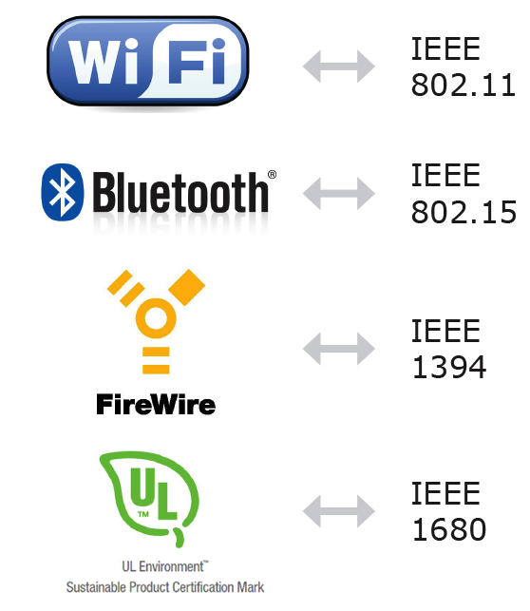
IEEE Standards - Since 1890
Consumers around the world enjoy the benefits of IEEE’s standards.
Some Ubiquitous IEEE Standards
4,400
IEEE
Standards

Slide 11


Emerging Technologies
IEEE focuses on what’s next—enabling innovation and the creation of new technologies.
Cloud Computing
Renewable Energy
WiMAX
Smart Grid
Photovoltaics
IoT, Big Data, SDN
Notes:
SLIDE CUSTOMIZABLE TO AUDIENCE

Slide 12

Educating for Success
IEEE education programs provide members with opportunities for lifelong continuing education.
IEEE educational programs enable students and professionals to achieve their goals.
IEEE Educational Programs
and Resources:
- Career Preparation
- Continuing Education
- iTunes U
- Pre-University Programs
- Professional Certification Programs
- Teacher-in-Service Program
- and more...

Slide 13


IEEE Conferences
Bright minds share the latest research at IEEE sponsored and co-sponsored conferences around the world.
1,400+ Annual Conferences
Research
Collaboration
Publications
IEEE Conference Proceedings
Deliver
Cutting-edge
Research

Slide 14


IEEE Publications
IEEE advances author ideas by publishing research for delivery to key technical audiences.
2013 JCR® study reveals IEEE journals continue to maintain rankings at the top of their fields.
170+ top-cited
periodicals
19 of the top 20
journals in electrical engineering
are published by IEEE.
IEEE is the
premier source of
journals in our fields of interest.
IEEE leads as the most-cited publisher (3x–more) in new patents from the top patenting organizations.

Slide 15

IEEE Xplore® Digital Library
Authors gain maximum exposure for their research and application-oriented articles with open access publications, freely available to readers.
IEEE intellectual property, all searchable in one place.
Hybrid
Journals
Subscription-based and Open Access
Mega
Journal
Multidisciplinary
Open Access
Fully Open Access Journals
Devoted to One
Technology Topic
Powerful search tools
Over 3 million full-text articles and papers
Users download more than 8 million documents per month

Slide 16
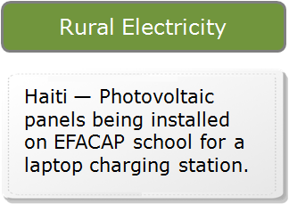
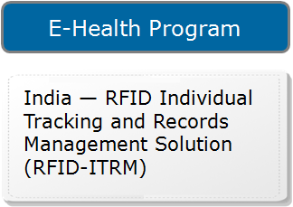
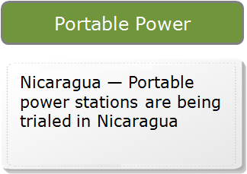
Improving Quality of Life
IEEE programs apply technology to improve conditions for people around the globe.

Slide 17
IEEE Bombay Section
Your local Connection

Slide 18
Section Highlights
One of the oldest sections in India dating back to 1976
IEEE Bombay Section is a registered trust; fully Volunteer driven
Section Office is in Don Bosco Institute of Technology, Kurla(W), Mumbai
14 Societies, Affinity Groups and Communities
One of the largest sections in India – 7000+ members
Membership from various Industries, research and academic institutes – Telecom, IT, Energy, Manufacturing, Defence, Railways, IITB, TIFR

Slide 19
Roots of IEEE in India
Activity in India dates back to 1935, when Kharagpur Section under the then AIEE Region 9 as well as IRE India Section were formed. Kanpur Section was formed in 1955.
IEEE India Section was formed at Bombay in 1963, Dr. F.C.Kohli as Chair and Mr. H.B.Shah as Secretary. India Council was formed on 20 May 1976.
There have been four Region 10 Directors from India i.e. Dr. F. C. Kohli, Dr. V. P. Kodali, Mr. M. V. Chauhan and Mr. Harbans L Bajaj. The past Region 10 Secretaries from India include Dr. V. P. Kodali and Mr. T. V. Balan. The current R-10 Director, Mr. K. Ramakrishna is also from India

Slide 20
A bit of history: Bombay Section
Formed on July 13, 1976 from the erstwhile India Section along with Delhi and Bangalore sections. Mr. T.V. Balan of ACC was its first Chairperson.
Initial territory was Maharashtra, Goa, Gujarat. Gujarat separated in 1990 and Pune city in 2010. Now includes Madhya Pradesh, Chhattisgarh, Diu & Daman.
Bombay section conducted first ever workshop on Microprocessor and its applications way back in 1977 - hardly anyone in our country had heard of the word Microprocessor. Prof. Insyng Lee of Digital, USA conducted the workshop.
International Conference on Systems, Man and Cybernetics of the SMC Society was held in Bombay in 1984. This was the first conference of IEEE held in India.
Hosted TENCON, the premier annual international technical conference of IEEE Region 10 in 1989

Slide 21
Executive Committee 2014
A.K.Banerjee | Section Chair | Past Chairs
Anthony Lobo | Section Vice Chair | Permanent Invitees
Prof. Shabbir Merchant | Section Vice Chair
Aiyappan Pillai | Section Secretary | Dr. M. V. Pitke
Prof. S. Doolla | Section Treasurer | Raju R. Hira
Ashok D. Jagatia | Immediate Past Chair | Prof. U. B. Desai
Abhay Phansikar | Member | Prof. M. M. Shah
Anand S Gharpure | Member | Prof. B. R. Prabhu
Prof. Ashwini Kotrashetti | Member | Prof. J. M. Vasi
Prof. Vinod Jain | Member | R. Muralidharan
Prof. Venkatesh Kamat | Member | Quraish Bakir
Dr. Sanjay Pawar | Member | Dr. S. C. Sahasrabudhe
Vinit Kotak | Member | Prabhakar R. Bapat
Dr. Narendra Bawane | Member | Kirit J. Sheth
Prof. Anjali Deshpande | Member | Kamlesh S. Sonawala
Ankit Dasgupta | Member | Hemant S. Sonawala
Prof. Babita Jain | Member | F. C. Kohli
Dr. Zia Saquib | Member
Dr. Satyanarayana Bheesette | Member
BS members received many and honours and accolades from the HQ and R10

Slide 22
Chapters, Groups and Committees
Chapter/Affinity Group | Chairperson
Antennas & Propagation/Electron Devices Society | Prof. Ram Gopal Rao
Communications Society | Prof. Sanjay Pawar
Computer Society | Raju Hira
Industrial Applications/Instrumentation & Measurement/Power & Energy Society | Prof. Surya Doolla
Microwave Theory & Techniques Society | Prof. M. V. Pitke
Signal Processing Society | Prof. Ajay Deshmukh
Systems, Man & Cybernetics Society (First to be formed in Region 10) | Prof. Narendra Bawane
Life Members Affinity Group (On the 2014 list of Outstanding LMA Groups) | Kirit Sheth
Young Professionals Affinity Group (formerly GOLD) (First in India) | Ankit Dasgupta
Women In Engineering Affinity Group | Prof. Anjali Deshpande
Industry Relations Committee | Dr. Zia Saquib
Membership Development Committee | Prof. Vinit Kotak
Student Activities Committee | Prof. Vinod Jain
Technical & Professional Activities Committee | Dr. Satyanarayana Bheesette
Bombay SIGHT Pratham | Prof. Chankya Kumar

Slide 23
Strong Pillars of Commitment
Governance and Operations
Relevance to the Community
Drive Industry – Academia collaboration
Thought Leadership
Leverage the intellectual capital of the section to Influence policies, standards
Set up Advisory, Finance and Statutory Compliance Committees
Establish registered society Infrastructure
Establish governance and operations processes
Member Charter
Influence Engineering education
Invigorate SIGHT, Affinity Group and all Society Chapter activities
Share Best (Next) practices
Promote and publicize innovation
Enhance Industry connect
Student Employability
Conduct events of Relevance
Enhance Faculty Effectiveness
Create an innovation manual
Enhance Website, Social Media connect
Leverage website to simplify approvals, interactions
Rewards and Recognition
Replicate programs across the section geography
Technical Engagement, Networking & Exchange Programs
Continuous Education and Skill Upgrade
Increase number of Volunteers
Member Development and Empowerment
Develop next-line office bearers, Execom members

Slide 24

Recent Events/Conferences
IEEE President’s visit (28 Oct 2014)
Meeting with CXOs
Visit to TIFR
IEEE MoU with CDAC
Industry Outreach on (14 Oct 2014)
IEEE Day Celebrations (07 Oct 2014)
Celebrations and programmes by student brnaches
Two lectures organized on 11Oct 2014
Technical Quiz contest on MUST FM Radio
Research Symposium in Electronics and Electronics & Telecommunication Engineering (WIE)- Sep 2014
RF Filter Design Workshop (MTTS) – Sep 2014

Slide 25
Conferences/Events 2013-14
Renewable Energy and Energy Efficiency – May 2013
Internal Security: Technologies to Pre-empt and Protect - October 2013
Industry Outreach Program – Aug’ 2013, Oct ’14 (2)
R10 South Asia Conference Leadership Program - December 2013
IEEE India Council flagship conference INDICON 2013 – December 2013

Slide 26
SKEP*/Distinguished lectures
Fundamentals of Embedded
Building Medium to Complex Solutions using Embedded Technologies
Programming ARM Processors
Android Development
Machine Learning
Cloud Computing
Embedded Android on Beaglebone Black
Programming on Arduino
Purposeful Projects
Industry-Institution interface and interaction
Graphical User Interfaces
Human Computer Interaction
Presentation Skills
Professional Communication
Social Implications of Technology
Embedded Systems
Renewable Energy Plan & Management
Carbon Footprints & Carbon Credits
Waste Water Management
Solar Energy Plan
Social Impact of Technology
Advance global prosperity by…
Fostering technological innovation.
Enabling members careers.
Promoting community.
…worldwide
*Skills and Knowledge Enhancement Program

Slide 27
Collaboration with Professional Organizations
Indo German Chamber of Commerce (IGCC)
Bombay Chamber of Commerce & Industry (BCCI)
Project Management Institute (PMI)
Computer Society of India (CSI)
Institute of Electronics & Telecommunications Engineers (IETE)
Extending the reach of activities
Organizing joint events
Member access (mutual) to selected activities
Facilitate interface with Industry
Bridge the industry- academia gap

Slide 28

Event Horizon

Slide 29
Key Activities and Events
SKEP Events – year long
Workshop on IP Storage Networking for ICT Disaster Recovery (IRC) – 6-7 Feb 2015
SDN Workshop (Communications Society) – 2nd week of March 2015
Quarterly IPR Workshop Series (IRC) to begin in Feb/Mar 2015

Slide 30
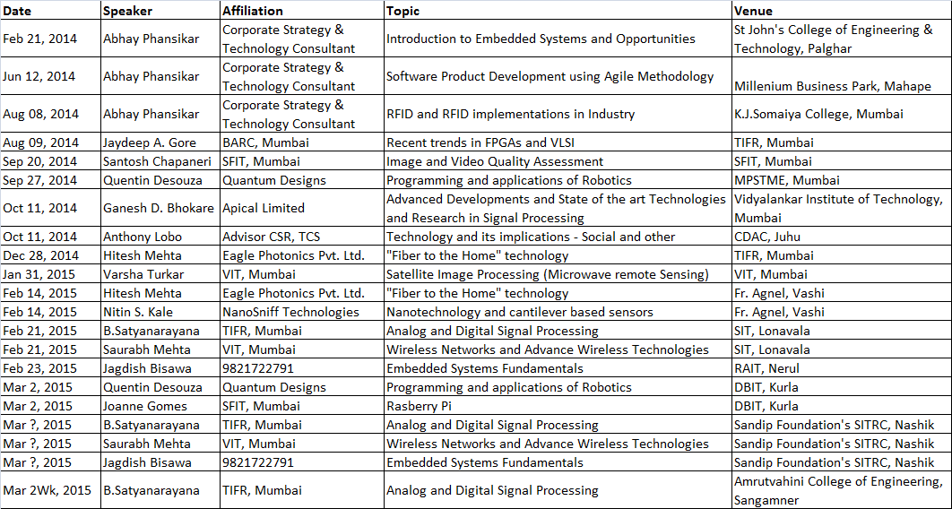
SKEP Events 2014-15

Slide 31
Major Conferences
Mega Event INTELECT 2015 – 22-24 Jan 2015
PES, ComSoc, CompSoc in partnership with IEEMA
Smart Electricity for Emerging Markets
Conference - Internal Security – Technologies to Prevent and Protect - 13 Mar 2015
2nd Edition of the previous year’s conference
Bombay Section Signature Symposium in 2015
An event that will be conducted every year

Slide 32

Bombay Section @ !ntelect
Presenting World’s Only Platform that dares to explore the Future Of Electricity as it is
http://www.ii-intellect.org
Plenary Session on Gandhian engineering
Anthony Lobo – Chair
Global Humanitarian Initiatives – I
Anthony Lobo – Moderator
Integration of Renewables & Microgrids
Surya Doolla – Moderator & Speaker
Smart Cities – Worldwide
Ashok Jagatia, Speaker
Administrative, outreach and logistical support

Slide 33
Student Focus
Job Fair – 1Q2015
Talks and Workshops in various Colleges
Student employability program in collaboration with L & T Automation Academy – 1st Batch from Aug 2015
Enhancing skills for Non-IT jobs such as electrical, electronics and instrumentation

Slide 34
Technically Sponsored Conferences
GCWN – Global Conference on Wireless Computing & Networking – SIT, Lonavala – 22-24 Dec 2014
ICNTE - International Conference on Nascent Technologies in the Engineering Field – FCRIT, Mumbai – 09-10 Jan 2015
ICTSD – International Conference on Technologies for Sustainable Development – DBIT Mumbai – 4-6 Feb 2015

Slide 35
Fulcrum of Local Communities
IEEE
Bombay
Section
Academic Institutions
Research
Establishments
Industry
Government

Slide 36

Collaboration is Our Foundation
IEEE brings people and technology together for mutual benefit.
Together
, we engineer a brighter future.
We look forward to your Support in this Endeavour

Slide 37
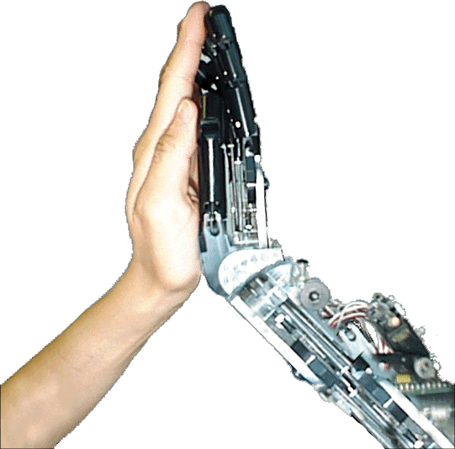
Thank you for your attention
To know more, visit:
http://ieee.org and http://ieeebombay.org
Acknowledgements:
Mr. Aiyappan Pillai, Secretary
IEEE India Office
Members of the Execom

