Slide 1
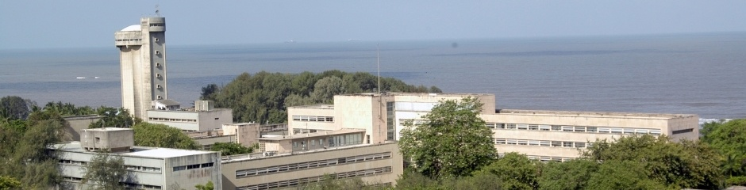
Doing Science is fun; it pays too!
Dr. B.Satyanarayana ▪ Scientific Officer (G)
Department of High Energy Physics ▪ Tata Institute of Fundamental Research
Homi Bhabha Road ▪ Colaba ▪ Mumbai ▪ 400005 ▪ INDIA
T: 09987537702 ▪ E: bsn@tifr.res.in ▪ W: http://www.tifr.res.in/~bsn

Slide 2
Definitions
Science is the reasoned investigation or study of natural phenomena with the objective of discovering new principles and knowledge of natural phenomena.
Technology is the practical application of science. Technology includes the skill, technique and knowledge of the manipulation of nature for human purposes, using scientific results and knowledge.
Engineering is the professional art of using technology for achieving the optimum conversion of the resources of nature for the benefit of humankind.

Slide 3
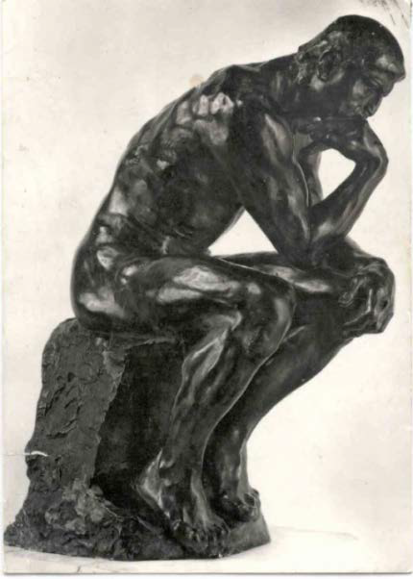
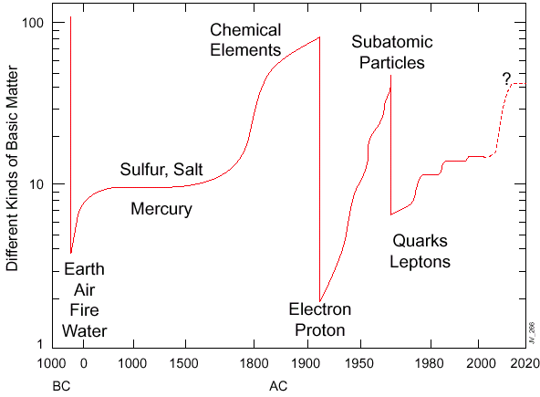
Eternal questions of mankind

Slide 4
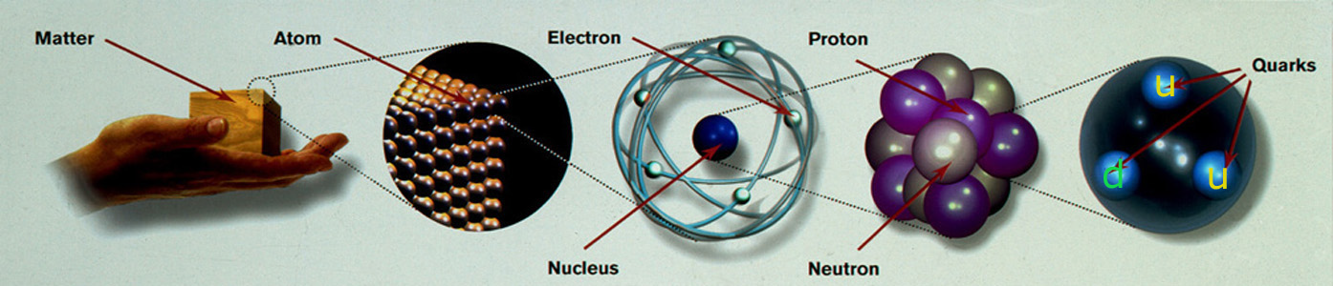
Some branches of Sciences
Nuclear Physics
High Energy Physics
Material Sciences
Astronomy and Astrophysics
Chemical Sciences
Biological Sciences
Computer Science
Theoretical Sciences (of all branches)
Mathematics is the mother tongue of all Sciences

Slide 5
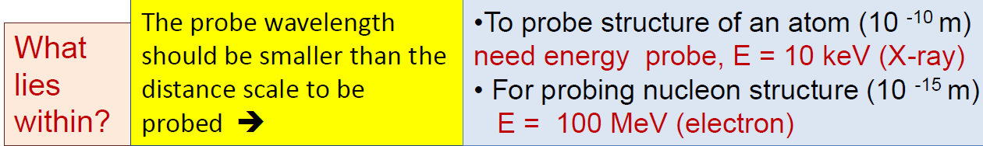
High Energy Physics
High Energy Physics (HEP) or Particle Physics (PP) is a modern name for centuries old effort to understand the laws of nature.
Aims to answer the two following questions:
What are the elementary constituents of matter ?
What are the forces that control their behaviour at the most basic level?
Experimental HEP involves getting the particles to interact and study the resulting products and features.
Aims to measure the energy, the direction and the identity of these products as precisely as possible.

Slide 6
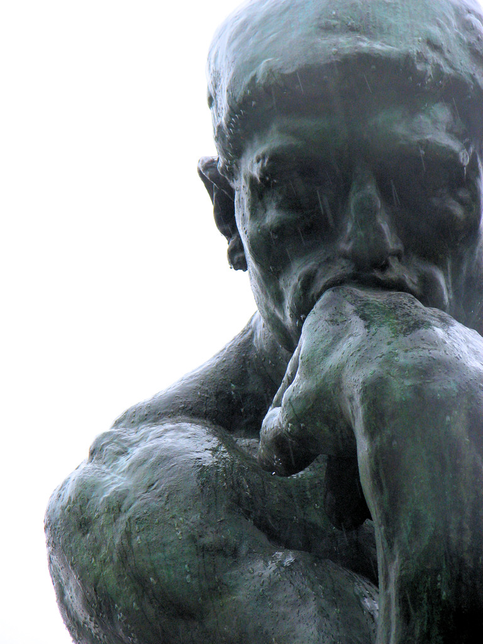
Aims of particle physics
What is the origin of mass?
What holds it all together?
How many space-time dimensions do we live in?
Are the particles fundamental or do they possess structure?
Why there is overwhelmingly more matter than the anti-matter in the universe?
What is the nature of the dark matter that pervades our galaxy?

Slide 7
Powers of Ten
Power of ten | Number | Symbol
10⁻¹⁵ | 0.000000000000001 | f(femto)
10⁻¹² | 0.000000000001 | p(pico)
10⁻⁹ | 0.000000001 | n(nano)
10⁻⁶ | 0.000001 | µ(micro)
10⁻³ | 0.001 | m(milli)
10⁻² | 0.01 | c(centi)
10⁻¹ | 0.1 | (deci)
10⁰ | 1
10¹ | 10 | (deca)
10² | 100 | h(hecta)
10³ | 1000 | k(kilo)
10⁶ | 1000000 | M(mega)
10⁹ | 1000000000 | G(giga)
10¹² | 1000000000000 | T(tera)
10¹⁵ | 1000000000000000 | P(peta)

Slide 8
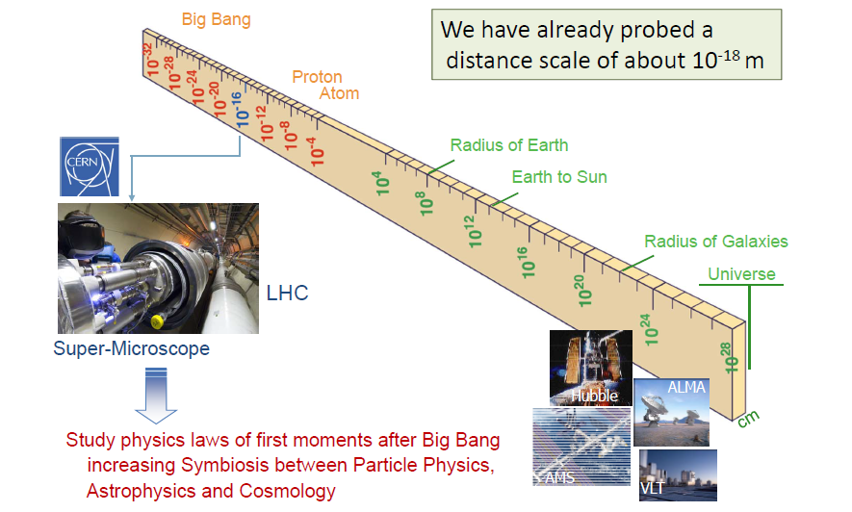
Some dimensions in Physics

Slide 9
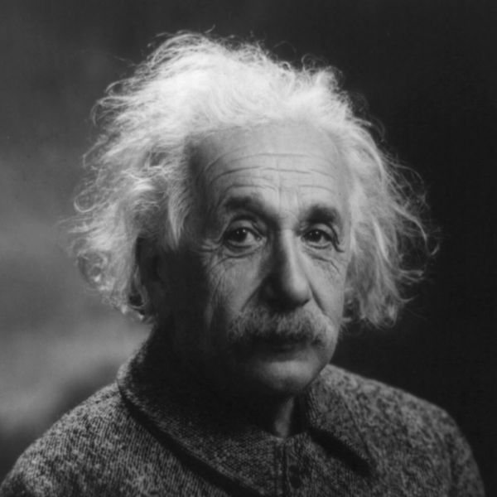
Speed of light; E=mc²

Slide 10
Newton's unfinished business...
What is mass?
What is the origin of mass? Why do tiny particles weigh the amount they do? Why do some particles have no mass at all?
At present, there are no established answers to these questions. The most likely explanation may be found in the Higgs boson, a key undiscovered particle that is essential for the Standard Model to work. First hypothesised in 1964, it has yet to be observed. We feel we did now.

Slide 11
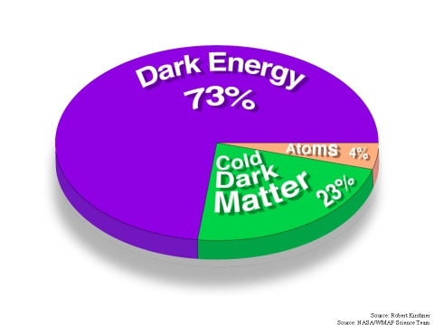
An invisible problem...
What is 96% of the universe made of?
Everything we see in the Universe, from an ant to a galaxy, is made up of ordinary particles. These are collectively referred to as matter, forming 4% of the Universe.
Dark matter and dark energy are believed to make up the remaining proportion, but they are incredibly difficult to detect and study.
Investigating the nature of dark matter and dark energy is one of the biggest challenges today in the fields of particle physics and cosmology.

Slide 12
Why is there no more antimatter?
We live in a world of matter – everything in the Universe, including ourselves, is made of matter.
Antimatter is like a twin version of matter, but with opposite electric charge.
At the birth of the Universe, equal amounts of matter and antimatter should have been produced in the Big Bang.
But when matter and antimatter particles meet, they annihilate each other, transforming into energy.
Somehow, a tiny fraction of matter must have survived to form the Universe we live in today, with hardly any antimatter left.
Why does Nature appear to have this bias for matter over antimatter?

Slide 13
Big Bang – Part 1

Slide 14
Big Bang – Part 2

Slide 15
Secrets of the Big Bang
What was matter like within the first second of the Universe’s life?
Matter, from which everything in the Universe is made, is believed to have originated from a dense and hot cocktail of fundamental particles.
Today, the ordinary matter of the Universe is made of atoms, which contain a nucleus composed of protons and neutrons, which in turn are made of quarks bound together by other particles called gluons.
The bond is very strong, but in the very early Universe conditions would have been too hot and energetic for the gluons to hold the quarks together.
Instead, it seems likely that during the first microseconds after the Big Bang the Universe would have contained a very hot and dense mixture of quarks and gluons called quark–gluon plasma.

Slide 16
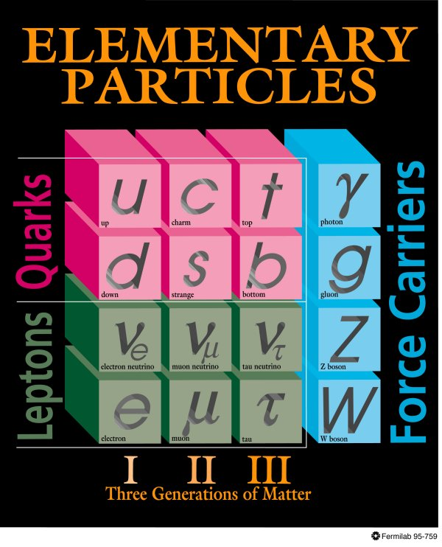
Standard model of particle physics
All interactions behaved as a single one when the universe was much younger and hotter → idea of unification!
Everyday matter is made up of only up and down type quarks, electron.

Slide 17
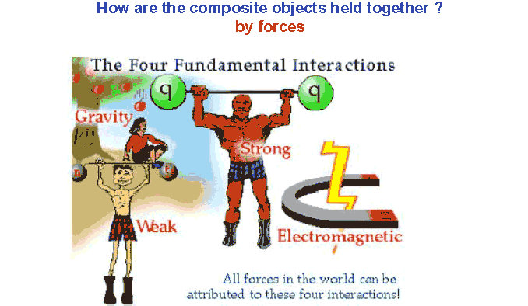
Forces in Nature

Slide 18
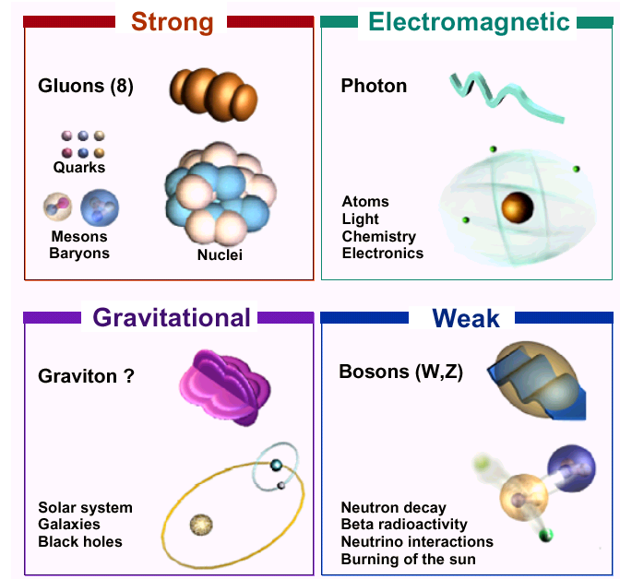
Four forces of nature

Slide 19
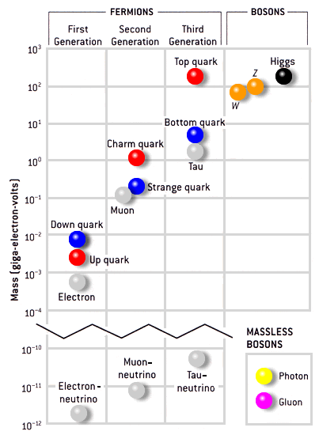
Masses of particles
Mass is a fundamental property of a particle
Determines how a particle responds to a force.
Electron mass: 0.511MeV/c² = 9.11 × 10^{‐31} kg
Proton mass: 938.27 MeV/c² = 1.67 × 10^{‐27} kg
Mass of top quark (heaviest known particle): 173 GeV/c²
Mass of photon: 0 → infinite range of electromagnetic force
Mass of W, Z: 80-90 times that of proton → short range of weak force
1 electron Volt (eV) = 1.6 ×10⁻¹⁹ Joules

Slide 20
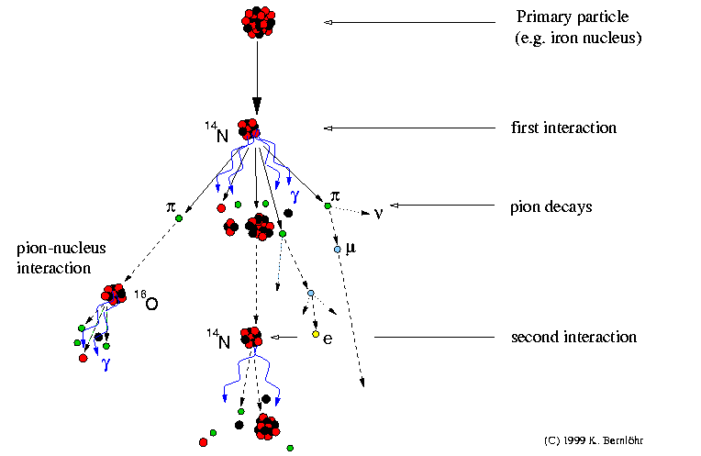
Production of cosmic rays

Slide 21
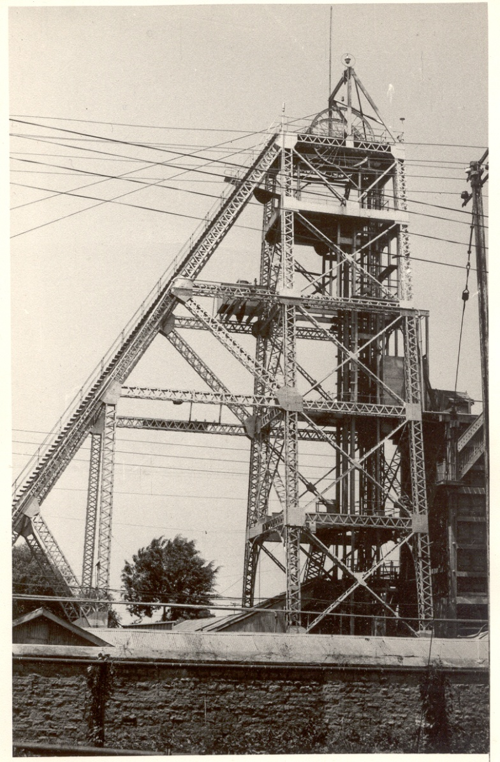
History of neutrino physics in India
High Energy Physics research using underground detectors at Kolar Gold Fields during 1952-92.
Muon intensities and angular distributions at various depths.
International collaboration experiment to detect atmospheric neutrinos started at KGF in 1964.
Indian initiative in neutrino physics goes back to about 50 years.
Demonstrated for the first time the feasibility of doing neutrino experiment at KGF in south India.
Detection of atmospheric neutrino in 1965.
KGF data during the proton decay era was used to look for ultra high energy neutrino sources in the sky.
Bounds on neutrino masses using cosmological data.
Estimation of atmospheric neutrino flux.
KGF underground shaft

Slide 22
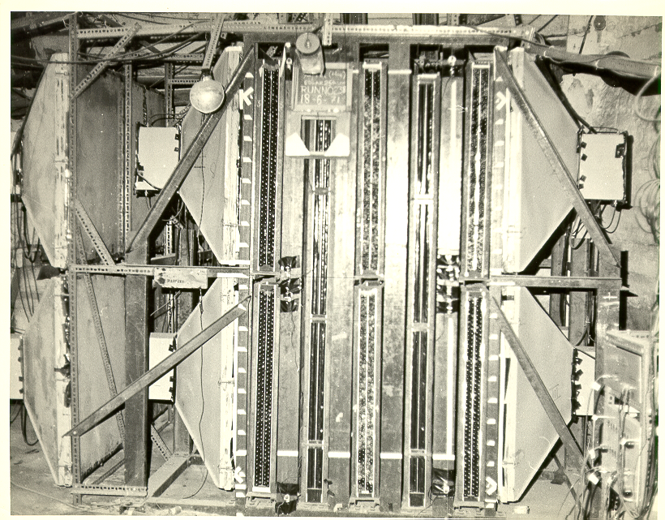
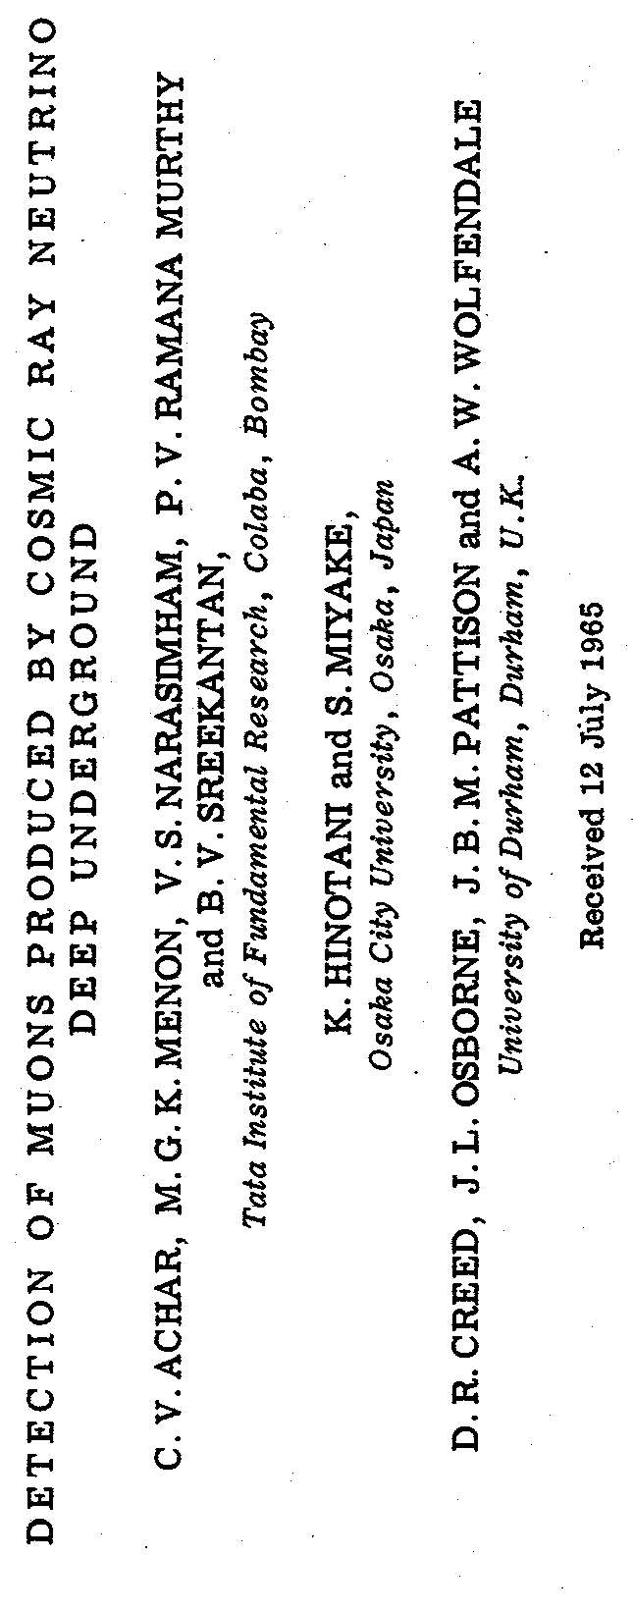
Atmospheric neutrino detector Kolar Gold Fields –1965

Slide 23
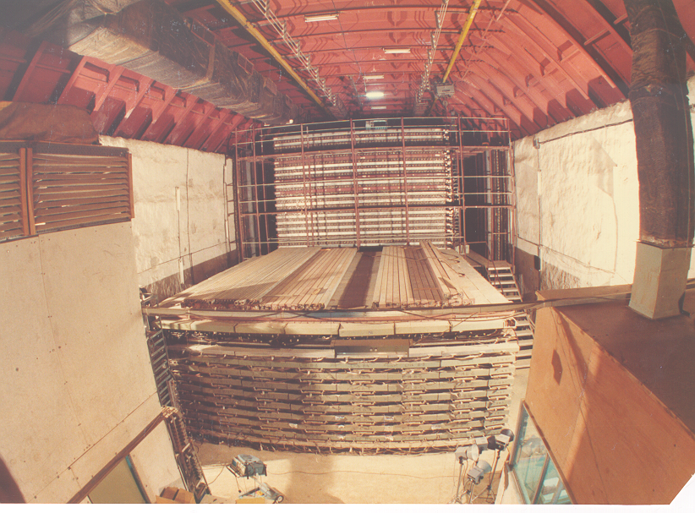
The pioneering proton decay experiment at 2km below ground

Slide 24
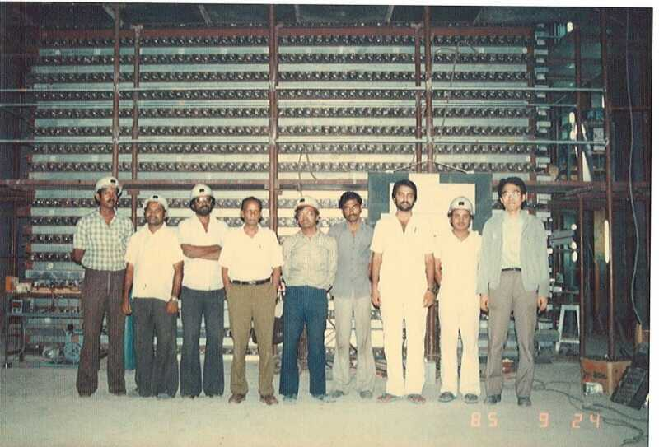
Some of us proudly posing!

Slide 25
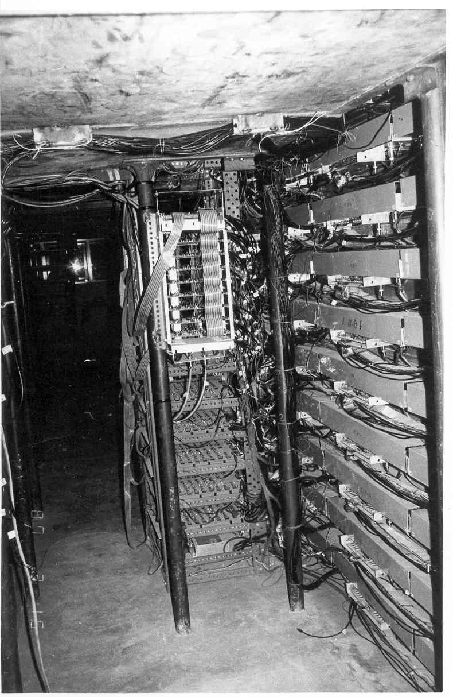
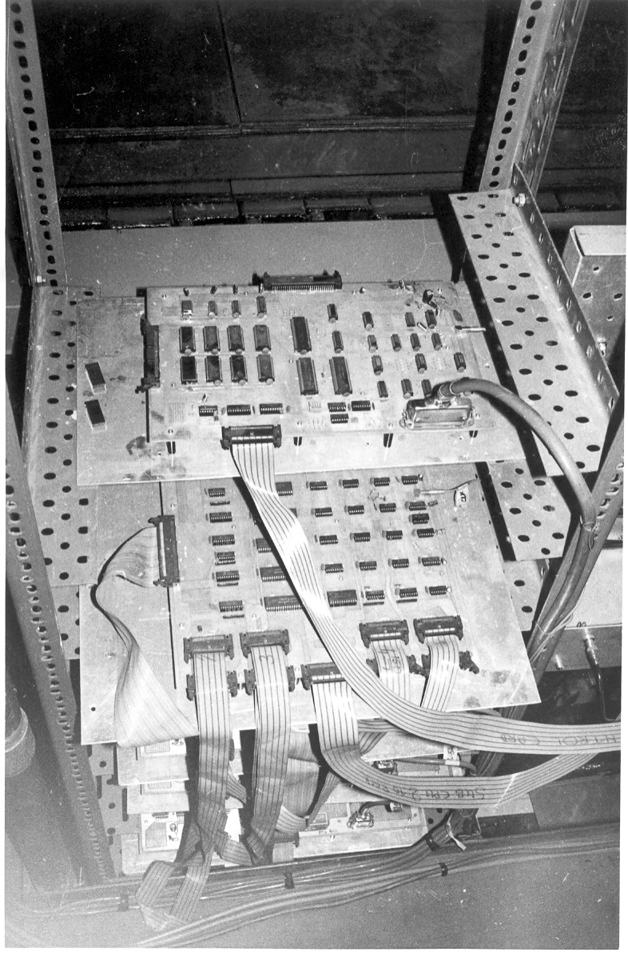
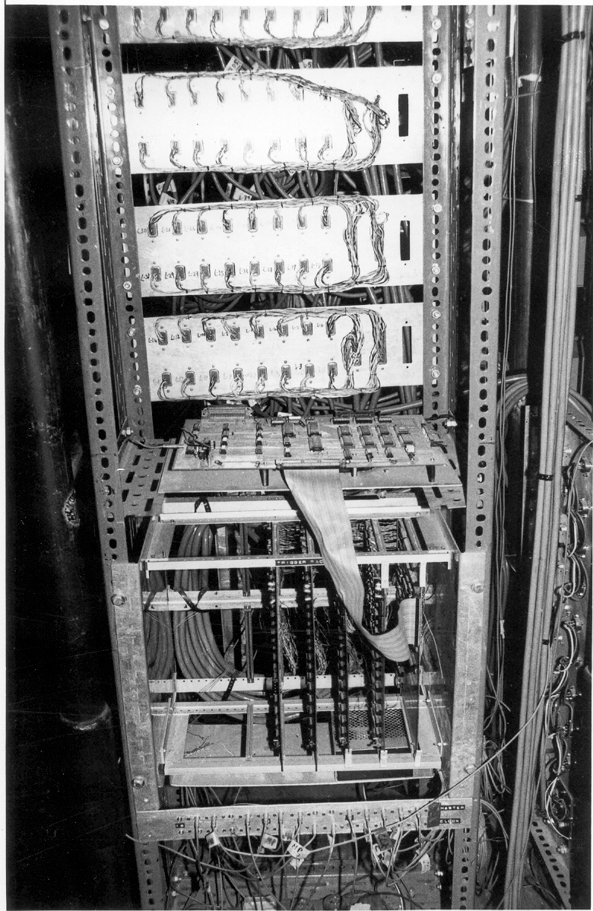
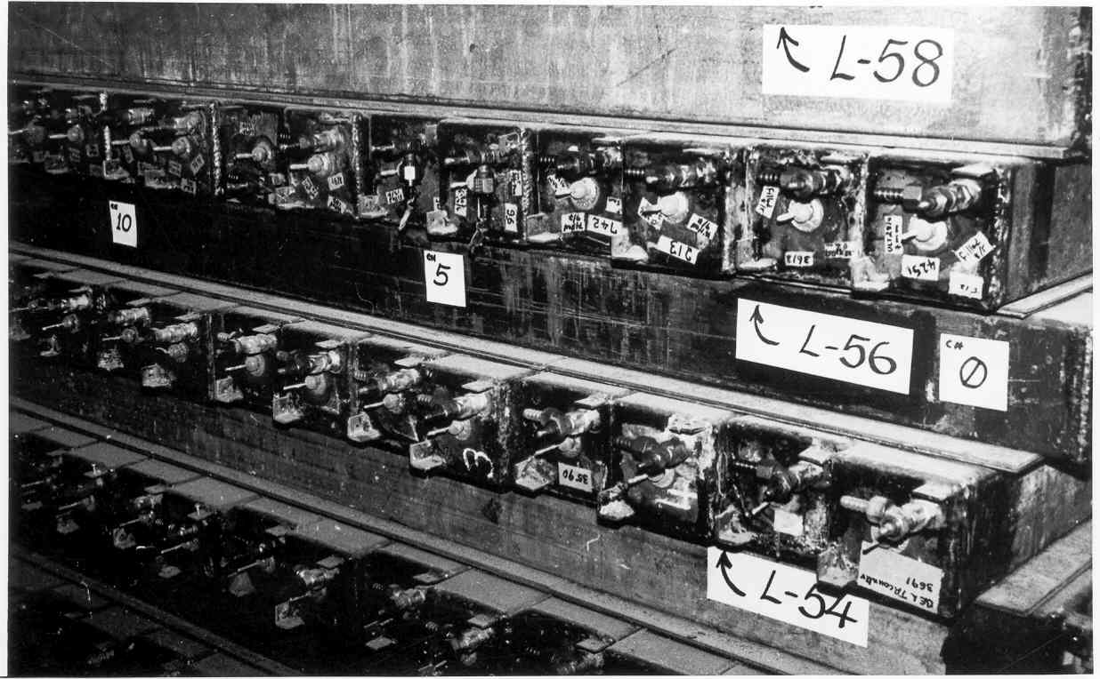
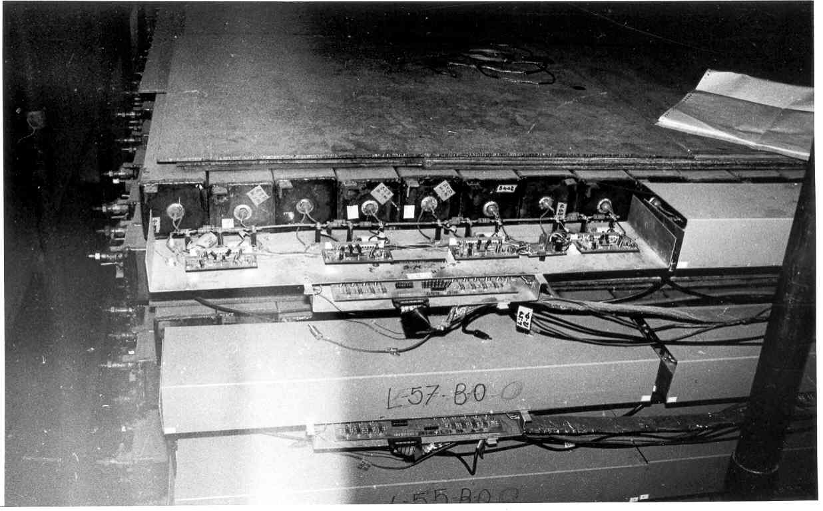
Pioneering detectors and electronics in the b/w era

Slide 26
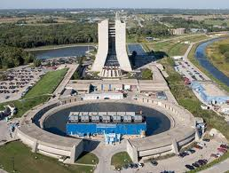
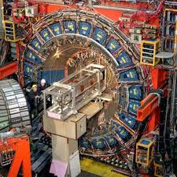
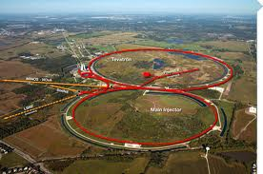
Fermilab: Where the TOP quark was discovered

Slide 27
Why did the Higgs search become so important?
The standard model of particle physics has the ability to predict the results of various experiments.
Since all the past experiments match well to the theoretical description of standard model, it is certain that the corresponding theoretical description is correct.
However the Higgs particle has been elusive to the experiments.
But the issue of mass is one of the corner stones of the theory.
So success of standard model crucially depended on the confirmation of the way of explaining the generation of mass, the “Higgs mechanism” → the Higgs boson has to be there.
Onus was on the experiments to really hunt out the Higgs particle.
Notably, the immensely complex detectors lived upto their expectations!!!

Slide 28
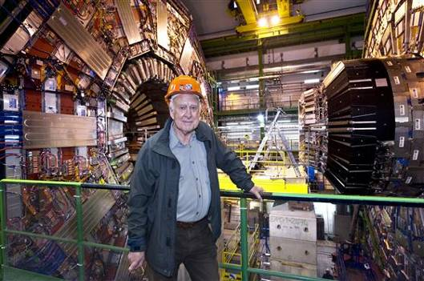
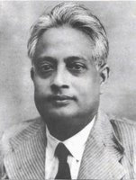
Peter Higgs and S.N.Bose

Slide 29
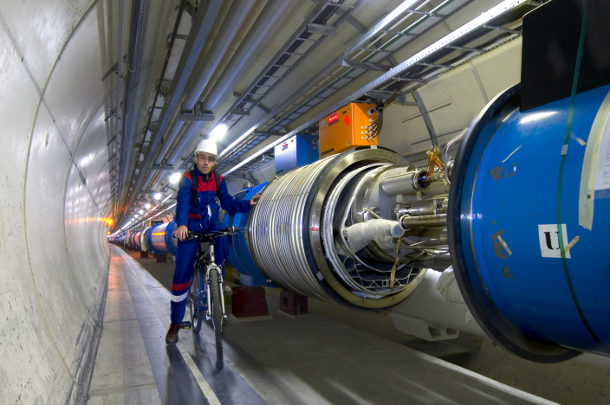
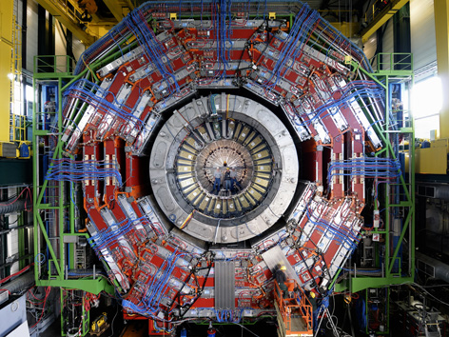

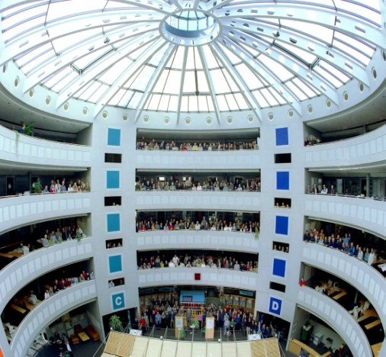
Recipe for modern discoveries
Accelerators: Powerful machines capable of accelerating particles to extremely high energies and bring them into collision with other particles.
Detectors: Gigantic instruments that record the particles as they “stream” out from the point of collision.
Computers: To collect, store, distribute and analyse the vast amount of data produced by the detectors.
People: Only a worldwide collaboration of thousands of scientists, engineers, technicians and support staff can design, build and soon operate such complex “machines”.

Slide 30
Particle accelerators
Accelerate particles to high energies.
The higher energies allow us to:
look deeper into matter (E α 1/size) (powerful microscopes)
discover new heavier particles (E = mc²)
probe conditions of early universe (E = kT)
revisit the earlier moments of our ancestral universe (powerful telescopes)
observe phenomena and particles normally no longer visible or existing in our time
All in a controlled way in the laboratory

Slide 31
Why the LHC?
For the past few decades, physicists have been able to describe with increasing detail the fundamental particles that make up the Universe and the interactions between them.
This understanding is encapsulated in the Standard Model of particle physics, but it contains gaps and cannot tell us the whole story. To fill in the missing knowledge requires experimental data, and the next big step to achieving this is with LHC.
The LHC (Large Hadron Collider) was built to help scientists to answer key unresolved questions in particle physics. The unprecedented energy it achieves may even reveal some unexpected results that no one has ever thought of!

Slide 32
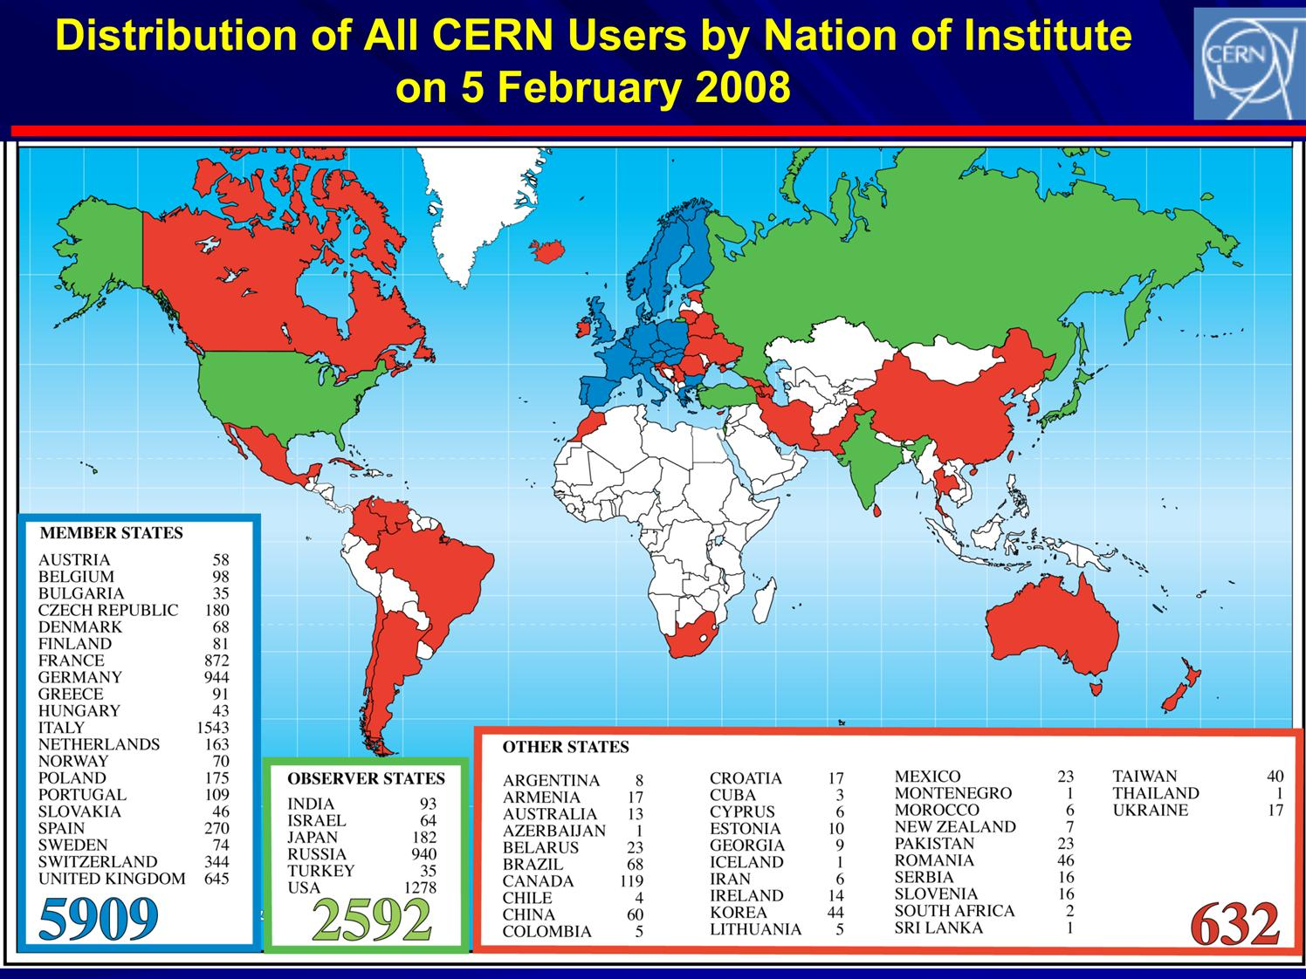
CERN: The world laboratory

Slide 33
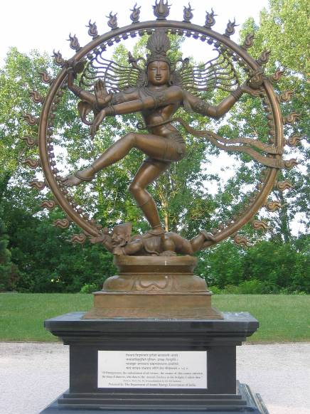
Lord Nataraj @ CERN!

Slide 34
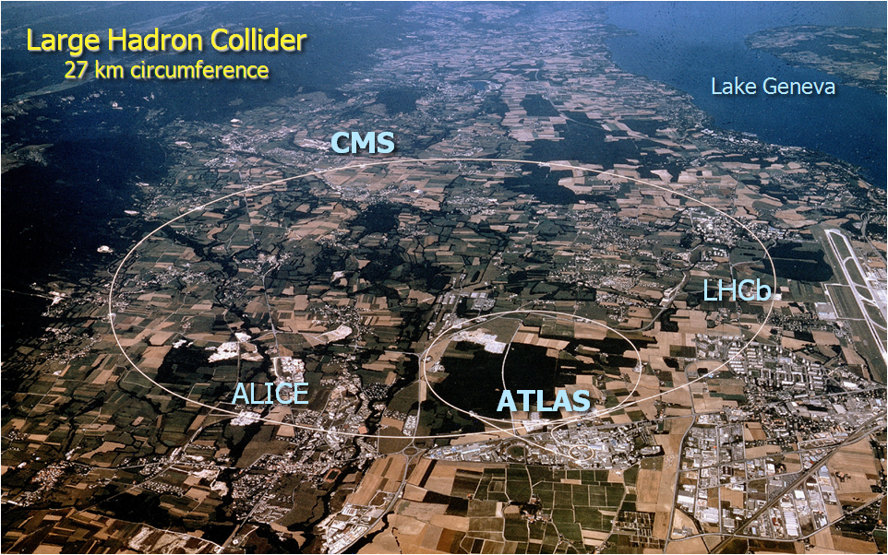
CERN Site

Slide 35
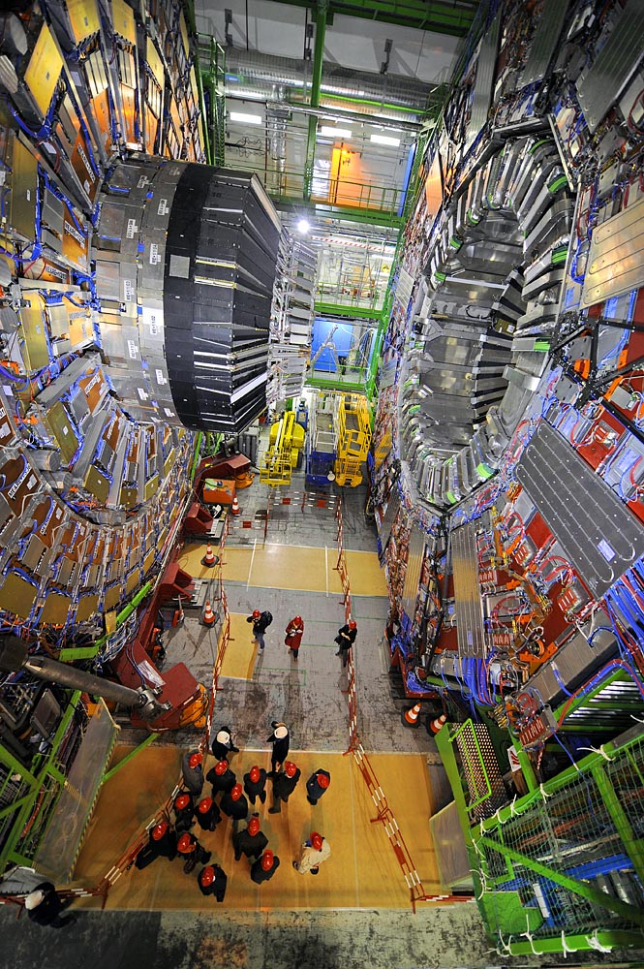
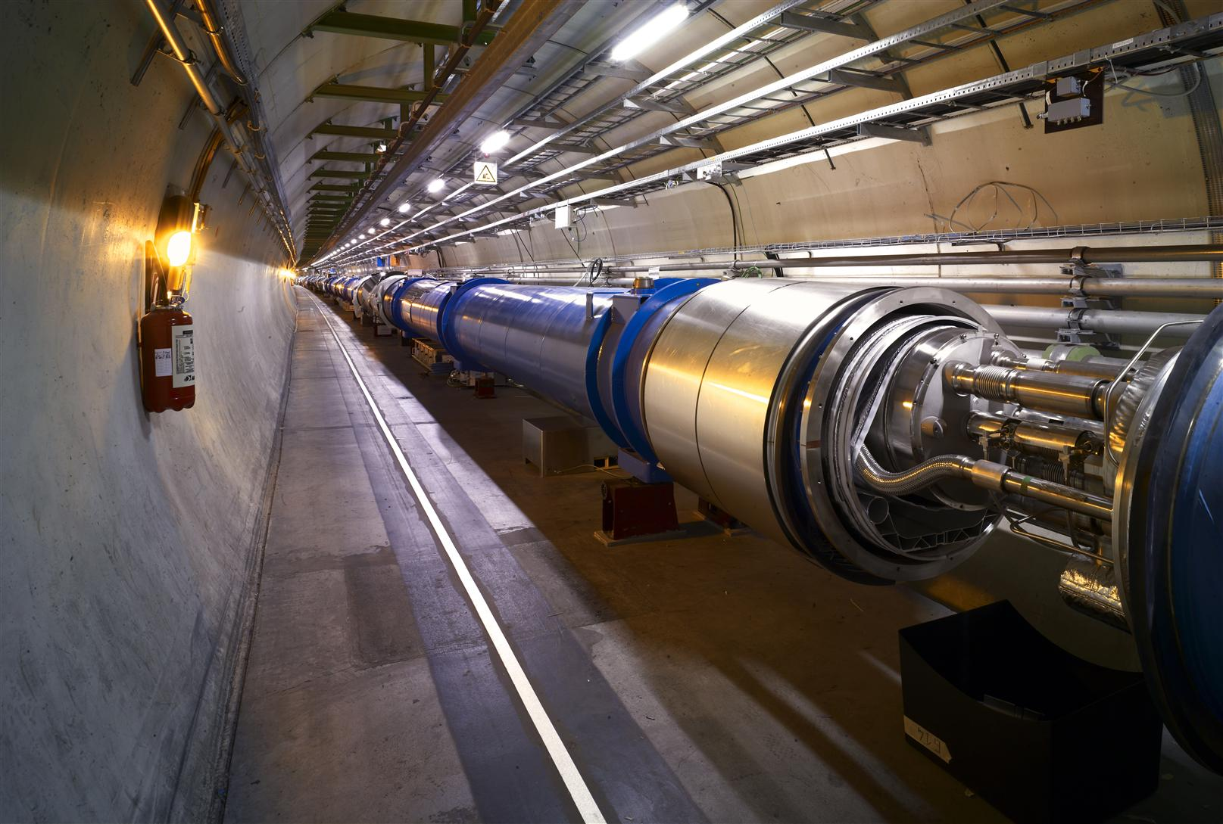
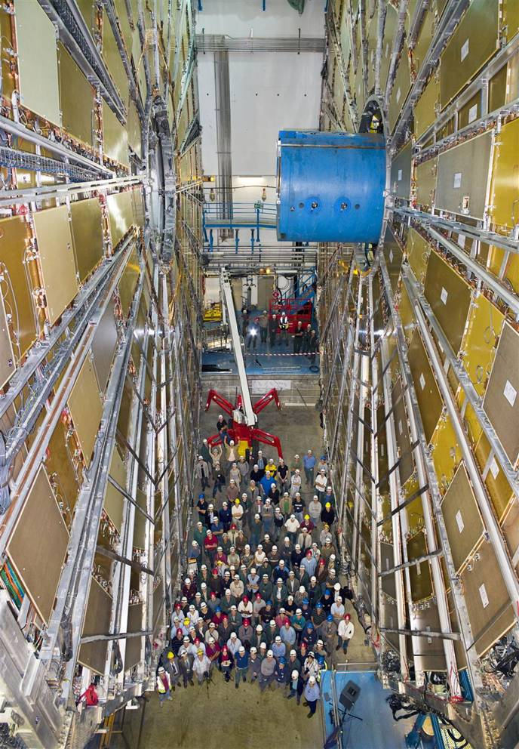
The machine, the detectors and the detectives!
CMS Experiment LHC beam pipe ATLAS experiment

Slide 36
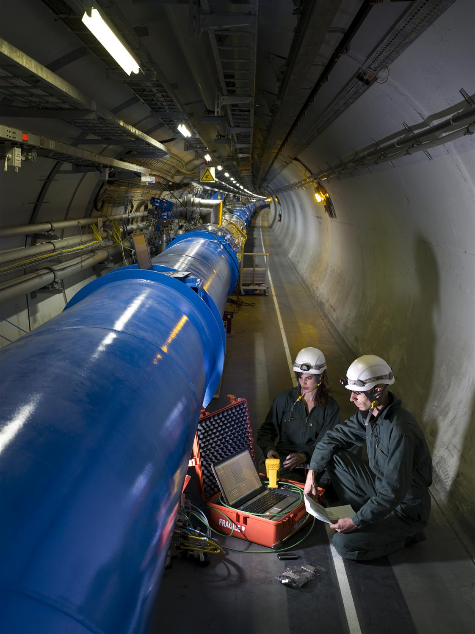
The LHC Accelerator
Proton-Proton machine. Protons are accelerated by powerful electric fields. And are guided around their circular orbits by powerful superconducting dipole magnets.
To reach the required energy in the existing tunnel, the superconducting dipoles operate at 13,000 amperes of current, producing 9Tesla field, which is 200000 times the Earth’s magnetic field.

Slide 37
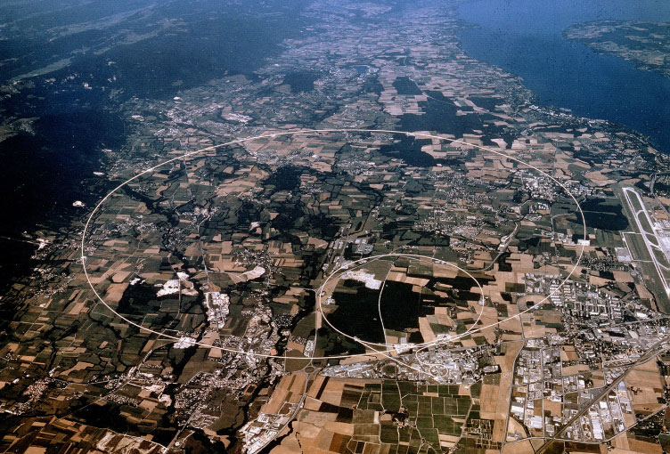
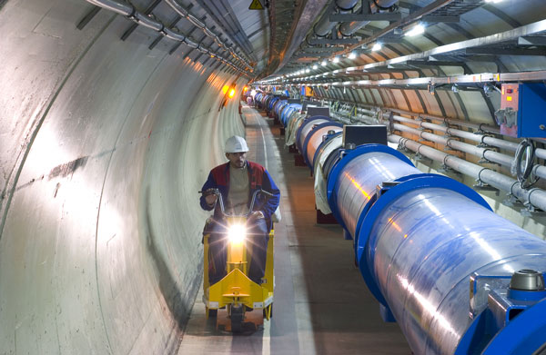
One of the fastest racetracks on the planet
Several thousand billion protons traveling at 99.9999991% of the speed of light will travel round the 27km ring over 11000 times a second

Slide 38
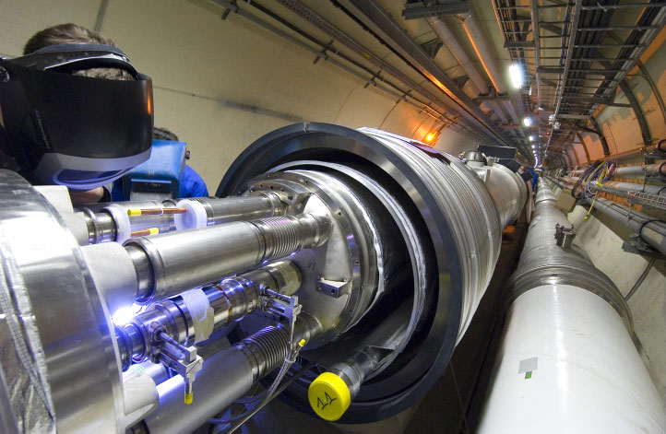
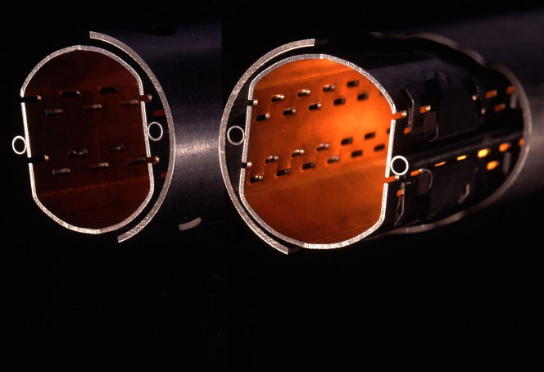
The emptiest space in the solar system…
To accelerate protons to almost the speed of light, we need a vacuum similar to interplanetary space. The pressure in the beam-pipes of the LHC will be about ten times lower than on the moon.

Slide 39
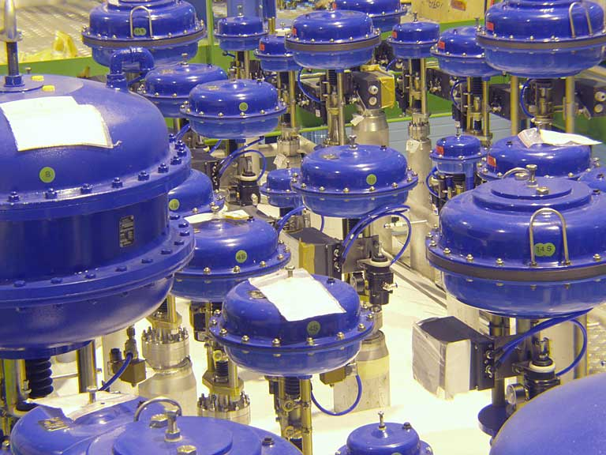
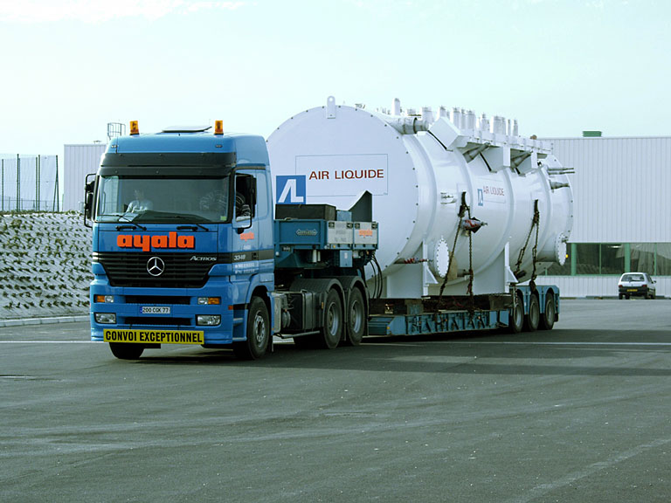
One of the coldest places in the Universe…
With a temperature of around -271 degrees Celsius, or 1.9 degrees above absolute zero in super-fluid helium, the LHC is colder than interstellar space.

Slide 40
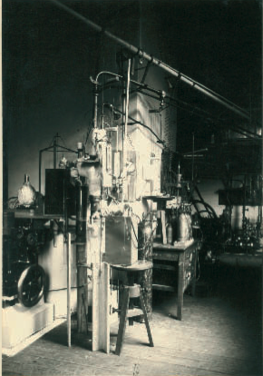
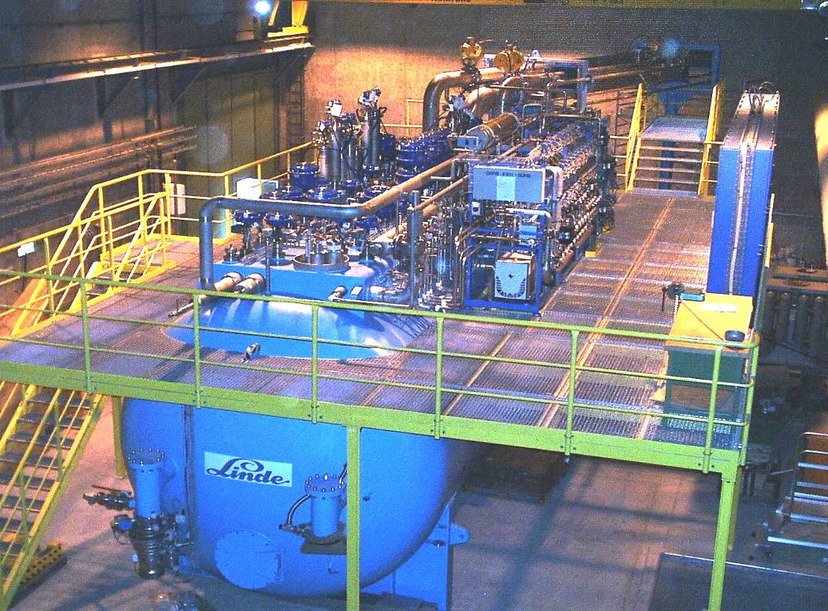
Cryogenics (1908 to 2008)
104 years ago: in July 1908 Kamerlingh Onnes first liquefied Helium in Leiden (60 ml in 1 hour)
LHC today: 32000 liters of He liquefied per hour by eight big cryogenic plants

Slide 41
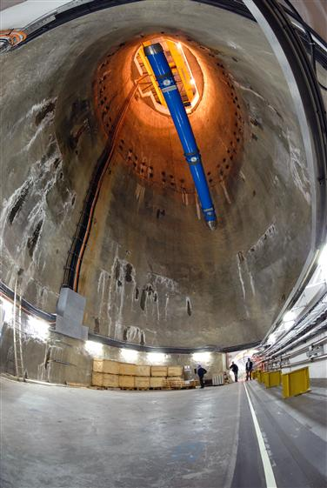
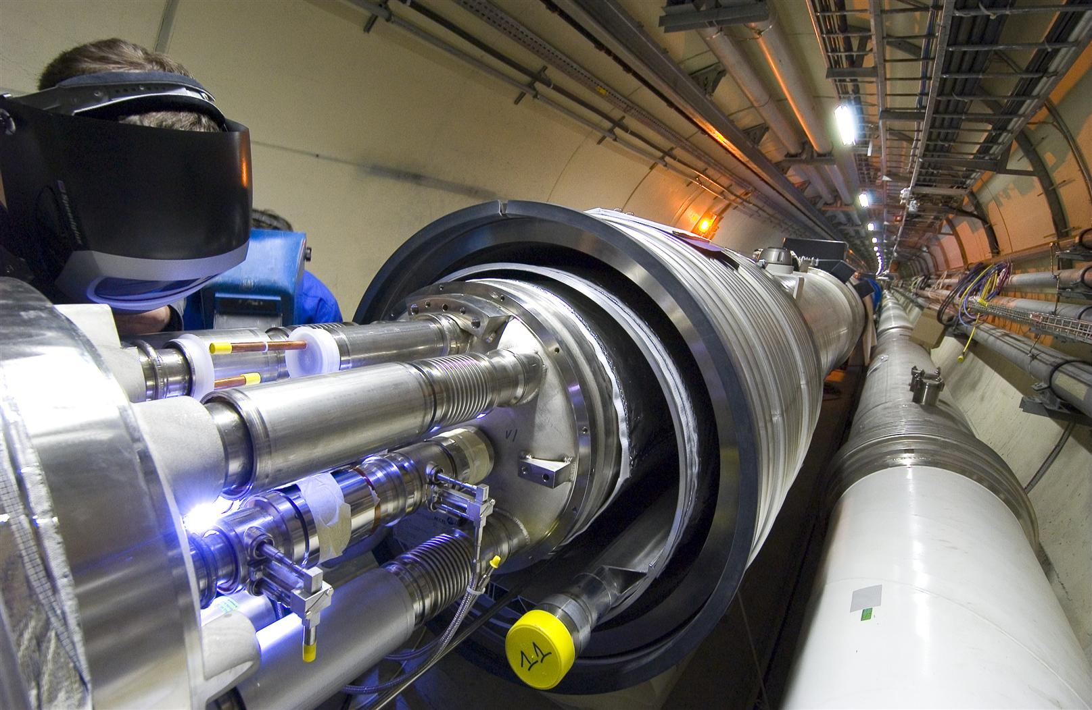
Superconducting Dipole Magnets
8000 Superconducting magnets are cooled down in a bath of 120 tons of super-fluid helium: a very interesting engineering material!

Slide 42
One of the hottest places in the Galaxy…
CMS
ALICE
When two beams of protons collide, they generate within a tiny volume, temperatures more than a billion times those in the very heart of the Sun.

Slide 43
Some more fascinating facts about the LHC
When the 27-km long circular tunnel was excavated, between Lake Geneva and the Jura mountain range, the two ends met up to within 1 cm.
Each of the 8000 superconducting filaments of niobium–titanium in the cable produced for the LHC is about 0.007 mm thick, about 10 times thinner than a normal human hair. If you added all the filaments together they would stretch to the Sun and back five times with enough left over for a few trips to the Moon.
All protons accelerated at CERN are obtained from standard hydrogen. Although proton beams at the LHC are very intense, only 2 nano grams of hydrogen are accelerated each day. Therefore, it would take the LHC about 1 million years to accelerate 1 gram of hydrogen.
At full energy, each of the two proton beams in the LHC will have a total energy equivalent to a 400t train (like the French TGV) travelling at 150 km/h. This is enough energy to melt 500 kg of copper.
The CMS experiment magnet system contains about 10,000t of iron, which is more iron than in the Eiffel Tower (7,000 tons).
The data recorded by each of the big experiments at the LHC will be enough to fill around 5,000,000 DVDs every year

Slide 44
Timeline of LHC: It took long time to build Taj Mahal!
1984 | Workshop on a Large Hadron Collider in the LEP tunnel, Lausanne
1987 | Rubbia “Long-Range Planning Committee” recommends Large Hadron Collider as the right choice for CERN’s future
1990 | ECFA LHC Workshop, Aachen
1992 | General Meeting on LHC Physics and Detectors, Evian les Bains
1993 | Letters of Intent s (ATLAS and CMS selected by LHCC)
1994 | Technical Proposals Approved
1996 | Approval to move to Construction (ceiling of 475 MCHF)
1998 | Memorandum of Understanding for Construction Signed
1998 | Construction Begins (after approval of Technical Design Reports)
2000 | CMS assembly begins above ground. LEP closes
2004 | CMS Underground Caverns completed
2008 | CMS ready for First proton-proton Collisions
2011 | Reach design luminosity ( 1 billion pairs of protons interacting per second)
>2013 | Upgrade LHC Phase 1: increase pp interaction rate by factor of 2-4
>2017 | Upgrade LHC phase 2: increase pp interaction rate to about 10 billion/second

Slide 45
Challenges from experiments
LHC Detectors (especially ATLAS, CMS) are radically different from the ones from the previous generations
High Interaction Rate
Proton-proton interaction rate: 1 billion interactions/sec
Data can be recorded for only about 10 out of 40 million crossings/sec
Level-1 trigger decision takes about 2-3μs
a Electronics need to store data locally (pipelining)
Large Particle Multiplicity
About 20 superposed events in each crossing
About 1000 tracks stream into the detector every 25ns
Need highly granular detectors with good time resolution for low occupancy
a Large number of channels ( about 100 million channels)
High Radiation Levels
a Radiation hard (tolerant) detectors and electronics

Slide 46
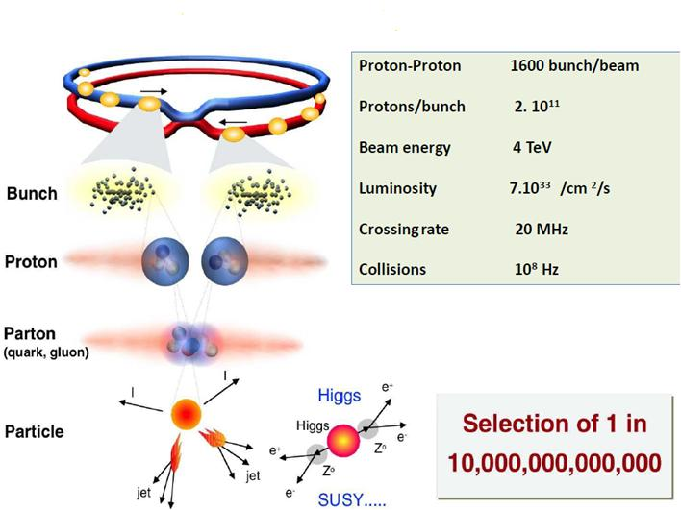
What happens in the LHC experiment?

Slide 47

Essential components of a detector

Slide 48


Compact Muon Solenoid (CMS) Detector

Slide 49

A slice of CMS experiment

Slide 50

CMS site in the year 2000

Slide 51

Home for the CMS detector

Slide 52

Support Structure
This “support foot” was made in Pakistan and travelled to CERN via train, ship and truck!

Slide 53



CMS Superconducting cables
Al stabilized NbTi conductor
Indirectly cooled at 4.5K by thermo siphon circuits
Inner winding vacuum impregnated with epoxy resin
Mechanically reinforced conductor (to contain magnetic forces)
4 Layers (because of needed Ampere-turns)
5 modules (to limit unit length of conductor)
SC cable
Al alloy
Al alloy
Insert Pure Al
EB welds

Slide 54

Superconducting Solenoid
13m long, 6m inner diameter; largest superconducting solenoid ever made.
Niobium-Titanium wires
Cooled to -271ºC carry 20000 Amps to provide a 4 Tesla magnetic field – about 100000 times stronger than that of the earth

Slide 55

Si modules and Electronics chain
Riding on the technology wave;
75,000 chips using
0.25μm technology
Si Sensors
Pixels: About 1 m² of silicon sensors,
65 million pixels, 100x150μm², r=4,7,11cm
Si μstrips: 223m² of silicon sensors,
10 million strips, 10pts, r = 20 – 120cm

Slide 56

Fully assembled Si disk

Slide 57




Assembly of EM calorimeter
Sub-module
2x5 crystals
Super-module
1700 crystals
Module
400 crystals
Total 36 Supermodules

Slide 58

CMS endcaps’ assembly on surface

Slide 59

Lowering very heavy elements

Slide 60

Cables, Pipes and Optical Fibres!
250km and 50000 man-hours for the central part alone!

Slide 61

Cross-section of central barrel

Slide 62

Final integration of Si tracker

Slide 63

Joining the gigantic pieces

Slide 64

Typical event in the detector

Slide 65

Trigger rates and data sizes

Slide 66

Data flow in CMS experiment

Slide 67


A Toroidal LHC Apparatus

Slide 68

Cross-sectional view of ATLAS

Slide 69

ALICE Experiment
A Large Ion Collider Experiment

Slide 70

Cross-sectional view of ALICE

Slide 71

The LHC Computing Grid
The Grid unites computing resources of particle physics institutions around the world.
The World Wide Web (invented at CERN) provides seamless access to information that is stored in many millions of different geographical locations.
The Grid is an infrastructure that provides seamless access to computing power and data storage capacity distributed over the globe.

Slide 72

LHC Tier2 Grid computing centres for CMS and ALICE in India

Slide 73

LHC machine parts by DAE

Slide 74

Si pre-shower by BARC-DU

Slide 75

CMS HO detector by TIFR-PU

Slide 76


Radioactive source scanner

Slide 77

Modern day experimental physics collaborations

Slide 78

The D-day

Slide 79

The prize catch

Slide 80

CMS’s Higgs paper
32 pages of paper
16 pages of authors!

Slide 81
What did we achieve?
The LHC project has been planned and prepared meticulously over long time
The harvest is excellent and is very fast!
The Higgs boson particle has been discovered by the experiments at LHC fulfilling its raison de etre.
This is considered as the proof of the idea proposed almost 50 years ago why weak interaction is short-ranged and electromagnetic interaction is long-ranged.
This development is very significant for the whole human kind since it gives us the confidence about our way of understanding the evolution of the universe at the first moments.
However, we have miles to go before we sleep!
We learnt Higgs boson exists
We need to know its properties
LHC will also explore many more interesting physics in coming decades
Stay tuned!

Slide 82

What does Higgs discovery means to us?

Slide 83
Is the LHC dangerous? Mini big bangs
What is Big Bang?
Although the energy concentration (or density) in the particle collisions at the LHC is very high, in absolute terms the energy involved is very low compared to the energies we deal with every day or with the energies involved in the collisions of cosmic rays.
However, at the very small scales of the proton beam, this energy concentration reproduces the energy density that existed just a few moments after the Big Bang—that is why collisions at the LHC are sometimes referred to as mini big bangs.

Slide 84
Is the LHC dangerous? Mini big bangs
What is Big Bang?
Although the energy concentration (or density) in the particle collisions at the LHC is very high, in absolute terms the energy involved is very low compared to the energies we deal with every day or with the energies involved in the collisions of cosmic rays.
However, at the very small scales of the proton beam, this energy concentration reproduces the energy density that existed just a few moments after the Big Bang—that is why collisions at the LHC are sometimes referred to as mini big bangs.

Slide 85
Is the LHC dangerous? Unprecedented energy collisions
Accelerators only recreate the natural phenomena of cosmic rays under controlled laboratory conditions.
Cosmic rays are particles produced in outer space in events such as supernovae or the formation of black holes, during which they can be accelerated to energies far exceeding those of the LHC.
Cosmic rays travel throughout the Universe, and have been bombarding the Earth’s atmosphere continually since its formation 4.5 billion years ago.
Since the much higher-energy collisions provided by nature for billions of years have not harmed the Earth, there is no reason to think that any phenomenon produced by the LHC will do so.
Cosmic rays also collide with the Moon, Jupiter, the Sun and other astronomical bodies.
The total number of these collisions is huge compared to what is expected at the LHC. The fact that planets and stars remain intact strengthens our confidence that LHC collisions are safe.
The LHC’s energy, although powerful for an accelerator, is modest by nature’s standards.

Slide 86
Is the LHC dangerous? Radiation
Radiation is unavoidable at particle accelerators like the LHC.
The particle collisions that allow us to study the origin of matter also generate radiation.
CERN uses active and passive protection means, radiation monitors and various procedures to ensure that radiation exposure to the staff and the surrounding population is as low as possible and well below the international regulatory limits.
For comparison, note that natural radioactivity — due to cosmic rays and natural environmental radioactivity — is about 2400μSv/year in Switzerland.
The LHC tunnel is housed 100m underground, so deep that both stray radiation generated during operation and residual radioactivity will not be detected at the surface.
Studies have shown that radioactivity released in the air will contribute to a dose to members of the public of no more than 10μSv/year.

Slide 87
Is the LHC dangerous? Black holes
Massive black holes are created in the Universe by the collapse of massive stars, which contain enormous amounts of gravitational energy that pulls in surrounding matter.
The gravitational pull of a black hole is related to the amount of matter or energy it contains — the less there is, the weaker the pull.
Some physicists suggest that microscopic black holes could be produced in the collisions at the LHC.
However, these would only be created with the energies of the colliding particles (equivalent to the energies of mosquitoes), so no microscopic black holes produced inside the LHC could generate a strong enough gravitational force to pull in surrounding matter.
If the LHC can produce microscopic black holes, cosmic rays of much higher energies would already have produced many more. Since the Earth is still here, there is no reason to believe that collisions inside the LHC are harmful.

Slide 88
India-based Neutrino Observatory project
The primary goal of INO is neutrino physics.
A national collaboration of scientists from more than 25 groups belonging to DAE institutions, IITs and Universities.
The total cost of the project is expected to be about `1500 crores.
The project includes:
construction of an underground laboratory and associated surface facilities,
construction of a Iron Calorimeter (ICAL) detector for neutrinos,
setting up of National Centre for High energy Physics (NCHEP).
The project is expected to be completed within seven years beginning April 2012.
A successful INO-Industry interface developed because of the large scale of experimental science activity involved.
INO Graduate Training Programme under the umbrella of Homi Bhabha National Institute (HBNI) - a deemed-to-be University within DAE is in its fifth year.

Slide 89


INO coming soon: Inside a mountain near you!
Location: 9º58′ North; 77º16′ East, 110km from Madurai (South India)
Site for INO underground facility

Slide 90

Schematic of the underground labs
Basic features
Length of the tunnel | 2.1 km (approx.)
Tunnel cross-section | 7.5m wide and 7.5m high
Tunnel gradient | 1:15
Rock overburden | 1300m (4000 mwe)
Rock type and density | Charnockite, 2.9 gm/cc
Number of caverns | 3 (one big and two small)
Size of the main cavern | 132m × 26m × 20m (high)
Distance from CERN | 7100 km
Distance from JPARC | 6600 km
Future nuclear reactor | 9000 Mwe, 205 km

Slide 91



ICAL detector and construction
Magnet coils
4000mm×2000mm
×56mm low carbon iron sheets
RPC handling trolleys
RPC
Total weight: 50Ktons

Slide 92
Factsheet of ICAL detector
No. of modules | 3
Module dimensions | 16m × 16m × 14.5m
Detector dimensions | 48.4m × 16m × 14.5m
No. of layers | 150
Iron plate thickness | 56mm
Gap for RPC trays | 40mm
Magnetic field | 1.3Tesla
RPC dimensions | 1,950mm × 1,840mm × 24mm
Readout strip pitch | 3 0mm
No. of RPCs/Road/Layer | 8
No. of Roads/Layer/Module | 8
No. of RPC units/Layer | 192
No. of RPC units | 28,800 (97,505m²)
No. of readout strips | 3,686,400

Slide 93

Prototype RPC stack

Slide 94













Design and implementation of the data acquisition system
200 boards of 13 types
Custom designed using
FPGA,CPLD,HMC,FIFO,SMD

Slide 95


A couple of interesting events

Slide 96

Homi J Bhabha
I seriously say to you that business or job as an engineer is not the thing for me. It is totally foreign to my nature and radically opposed to my temperament and opinions. Physics is my line. I know I shall do great things here. For, each man can do best and excel in only that thing of which he is passionately fond, in which he believes, as I do, that he has the ability to do it, that he is in fact born and destined to do it. My success will not depend on what A or B thinks of me. My success will be what I make of my work. Besides, India is not a land where science cannot be carried on.
I am burning with a desire to do physics. I will and must do it sometime. It is my only ambition. I have no desire to be a “successful” man or the head of a big firm. There are intelligent people who like that and let them do it. I hear you saying “But you are not Socrates or Einstein”. No—and that is what Berlioz's father said to Berlioz. He called him a useless musician when he was young—Hector Berlioz who now accepted as one of the world's greatest geniuses and France's greatest musician. How can anybody else know at what time what one will do, if there is nothing to show. ... It is no use saying to Beethoven ”You must be a scientist for it is great thing” when he did not care two hoots for science; or to Socrates “Be an engineer; it is work of intelligent man”. It is not in the nature of things. I therefore earnestly implore you to let me do physics.

Slide 97





Slide 98




Slide 99




Slide 100





Slide 101
Career opportunities in TIFR
Visiting Students’ Research Programme (VSRP)
Physics/Chemistry : Pre-final year students of M.Sc./B.E./B.Tech.
Biology: Pre-final year students of M.Sc./B.E./B.Tech. Students doing M.Pharm., Medicine/Engineering will be also be considered.
Mathematics: Pre-final and final year students of M.A./M.Sc./M-Stat./B.Tech. Exceptionally bright pre-final and final year students of B.Sc./B.Stat./B.Math. will also be considered.
Computer & Systems Sciences: Pre-final year students of B.E./B.Tech./M.Sc./M.C.A./M.E./M.Tech.
Research opportunities for exceptionally talented and strongly motivated students
TIFR is India's premier institution for advanced research in fundamental sciences. The Institute runs a graduate programme leading to the award of Ph.D. degree, as well as M.Sc. and Integrated Ph.D. in certain subjects.
The Graduate Programme at TIFR is classified into the following Subjects - Mathematics, Physics, Chemistry, Biology, Computer & Systems Sciences and Science Education.
Career opportunities for bright engineers in Electronics, Instrumentation, Computer Science, Information technology, Civil, Mechanical and Electrical engineers

Slide 102
Some of the best Institutions and Universities of India
Tata Institute Fundamental Research (TIFR), Mumbai
Bhabha Atomic Research Centre (BARC) and other DAE establishments
Indian Institute of Science, Bengaluru
Indian Institutes of Technology (IITs)
Central Universities
National Institutes of Technology (NITs)
National Institutes of Science and Education Research (NISERs)
Indian Institutes of Science and Education Research (IISERs)
Centre of Excellence in Basic Sciences (CBS), Mumbai
Space (ISRO) and Defence (DRDO) Labs
Central Scientific and Industrial Research (CSIR) Labs

Slide 103

Philosophy of Science
To me there has never been a higher source of earthly honour or distinction than that connected with advances in science.
I seem to have been only like a boy playing on the seashore, and diverting myself in now and then finding a smoother pebble or a prettier shell than ordinary, whilst the great ocean of truth lay all undiscovered before me.
Sir Isaac Newton

