Slide 1
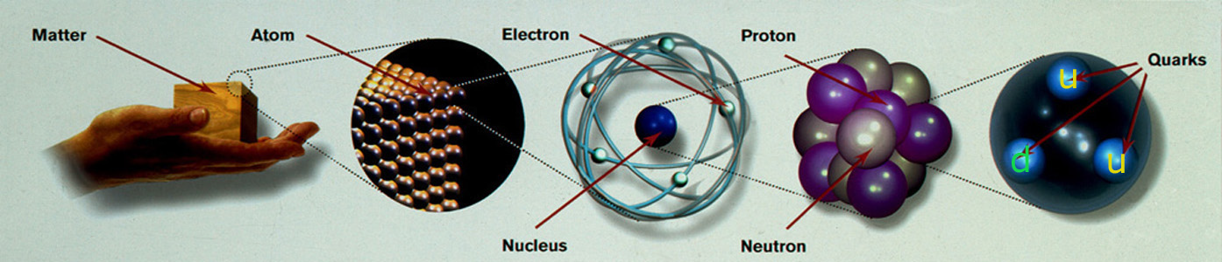
Exciting world of experimental high energy physics
Dr. B.Satyanarayana ▪ Scientific Officer (G)
Department of High Energy Physics ▪ Tata Institute of Fundamental Research
Homi Bhabha Road ▪ Colaba ▪ Mumbai ▪ 400005 ▪ INDIA
T: 09987537702 ▪ E: bsn@tifr.res.in ▪ W: http://www.tifr.res.in/~bsn

Slide 2
Definitions
Science is the reasoned investigation or study of natural phenomena with the objective of discovering new principles and knowledge of natural phenomena.
Technology is the practical application of science. Technology includes the skill, technique and knowledge of the manipulation of nature for human purposes, using scientific results and knowledge.
Engineering is the professional art of using technology for achieving the optimum conversion of the resources of nature for the benefit of humankind.
A Scientist studies nature, a Technologist manipulates nature and an Engineer exploits technology for human purposes.

Slide 3

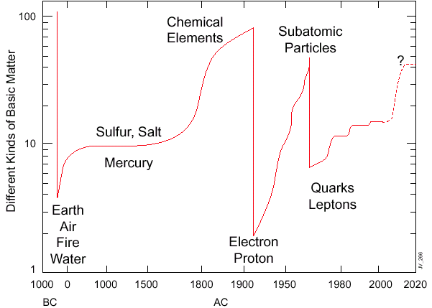
Eternal questions of mankind
What principles govern the energy, matter, space and time
at the most elementary level?

Slide 4
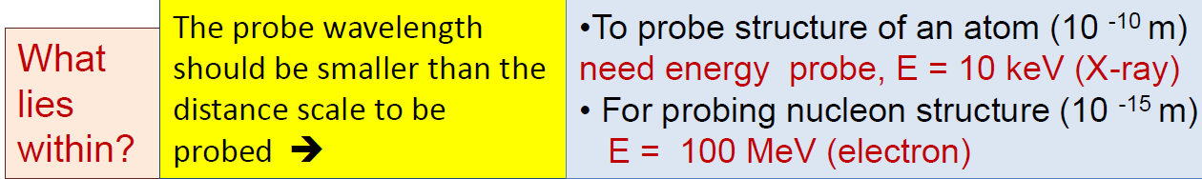
High Energy Physics
High Energy Physics (HEP) or Particle Physics (PP) is a modern name for centuries old effort to understand the laws of nature.
Aims to answer the two following questions:
What are the elementary constituents of matter ?
What are the forces that control their behaviour at the most basic level?
Experimental HEP involves getting the particles to interact and study the resulting products and features.
Aims to measure the energy, the direction and the identity of these products as precisely as possible.

Slide 5
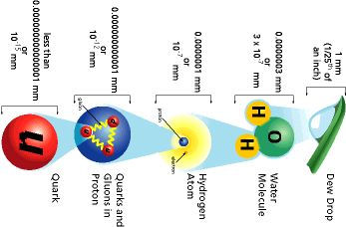
Powers of ten: How small [big] is small [big]?

Slide 6
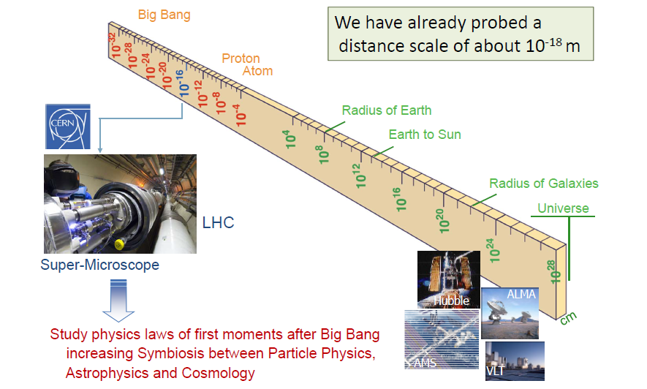
Some dimensions in Physics

Slide 7
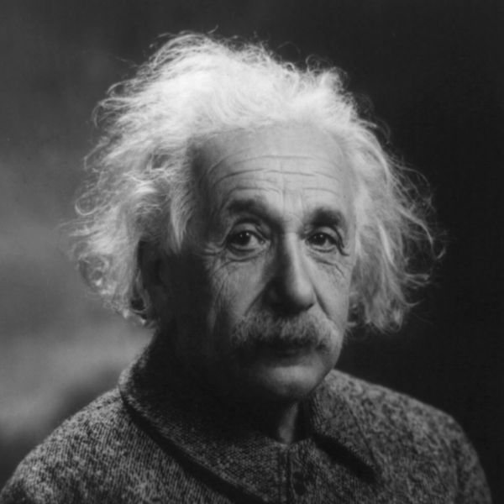
Speed of light; E=mc²

Slide 8
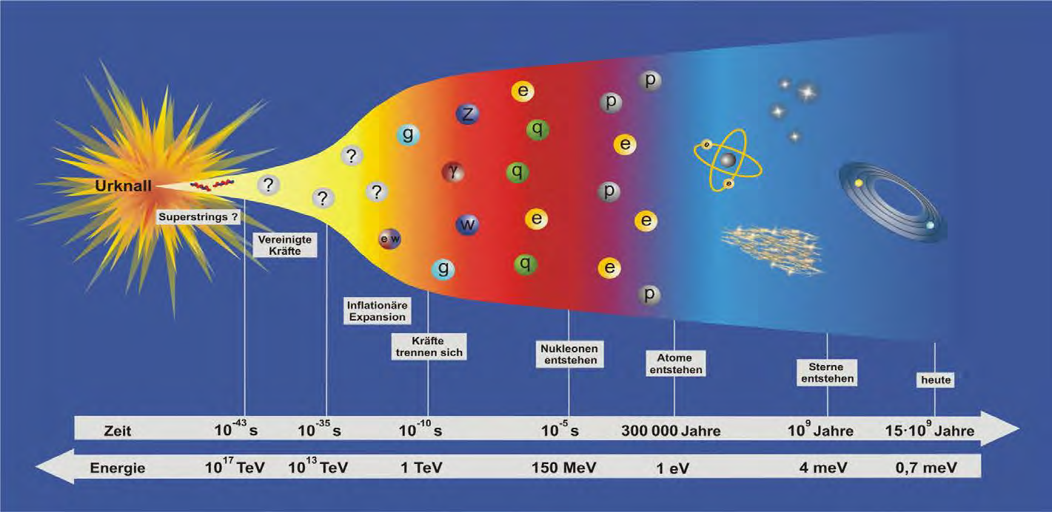
What do we know about our universe
Experimental High Energy Physics at the energy frontier with highest collision energies ever is changing our view of the universe.

Slide 9
Open questions we need to address
Why the main interactions between the particles are so different in strength (1:10⁴⁰) and how well they can be unified?
Why electron is so light and top quark so massive? (fermions)
Why photon is mass-less, why W & Z are so massive? (bosons)
How many are really the dimensions of our world ?

Slide 10
Newton's unfinished business...
What is mass?
What is the origin of mass? Why do tiny particles weigh the amount they do? Why do some particles have no mass at all?
At present, there are no established answers to these questions. The most likely explanation may be found in the Higgs boson, a key undiscovered particle that is essential for the Standard Model to work. First hypothesised in 1964, it has yet to be observed. We feel we did now.

Slide 11
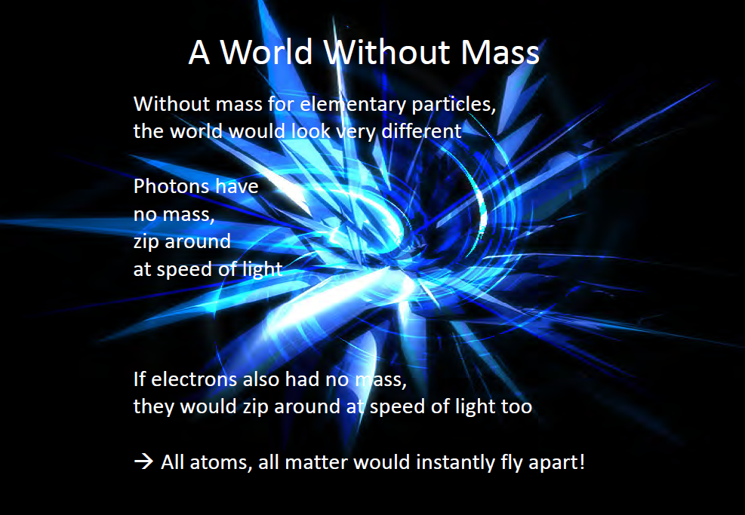
If the impossible was to be possible

Slide 12
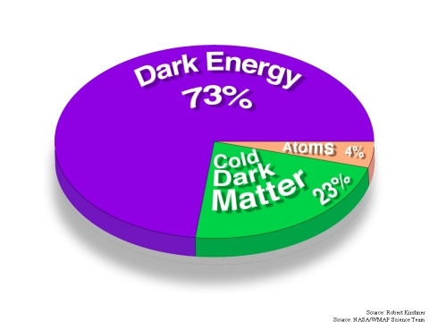
An invisible problem...
What is 96% of the universe made of?
Everything we see in the Universe, from an ant to a galaxy, is made up of ordinary particles. These are collectively referred to as matter, forming 4% of the Universe.
Dark matter and dark energy are believed to make up the remaining proportion, but they are incredibly difficult to detect and study.
Investigating the nature of dark matter and dark energy is one of the biggest challenges today in the fields of particle physics and cosmology.

Slide 13
Why is there no more antimatter?
We live in a world of matter – everything in the Universe, including ourselves, is made of matter.
Antimatter is like a twin version of matter, but with opposite electric charge.
At the birth of the Universe, equal amounts of matter and antimatter should have been produced in the Big Bang.
But when matter and antimatter particles meet, they annihilate each other, transforming into energy.
Somehow, a tiny fraction of matter must have survived to form the Universe we live in today, with hardly any antimatter left.
Why does Nature appear to have this bias for matter over antimatter?

Slide 14
Secrets of the Big Bang
What was matter like within the first second of the Universe’s life?
Matter, from which everything in the Universe is made, is believed to have originated from a dense and hot cocktail of fundamental particles.
Today, the ordinary matter of the Universe is made of atoms, which contain a nucleus composed of protons and neutrons, which in turn are made of quarks bound together by other particles called gluons.
The bond is very strong, but in the very early Universe conditions would have been too hot and energetic for the gluons to hold the quarks together.
Instead, it seems likely that during the first microseconds after the Big Bang the Universe would have contained a very hot and dense mixture of quarks and gluons called quark–gluon plasma.

Slide 15
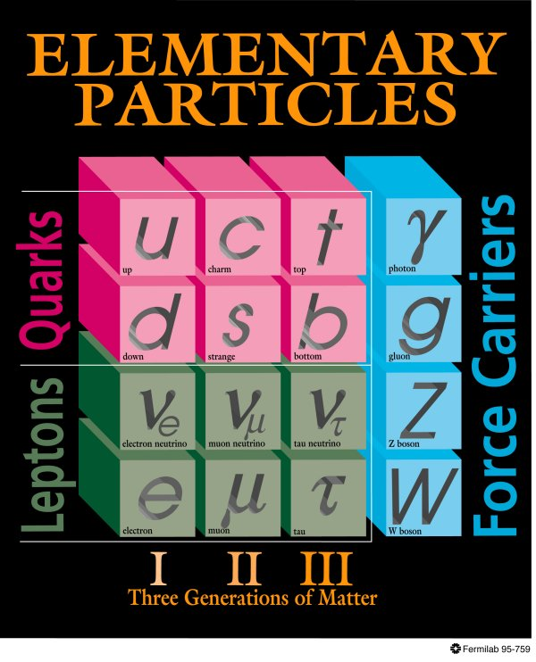
Standard model of particle physics
All interactions behaved as a single one when the universe was much younger and hotter → idea of unification!
Everyday matter is made up of only up and down type quarks, electron.

Slide 16
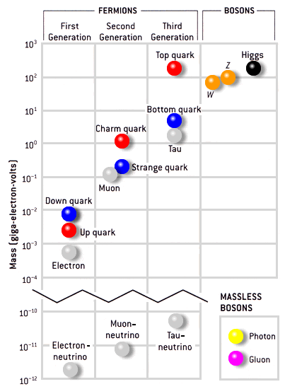
Masses of particles
Mass is a fundamental property of a particle
Determines how a particle responds to a force.
Electron mass: 0.511MeV/c² = 9.11 × 10^{‐31} kg
Proton mass: 938.27 MeV/c² = 1.67 × 10^{‐27} kg
Mass of top quark (heaviest known particle): 173 GeV/c²
Mass of photon: 0 → infinite range of electromagnetic force
Mass of W, Z: 80-90 times that of proton → short range of weak force
1 electron Volt (eV) = 1.6 ×10⁻¹⁹ Joules

Slide 17
Why did the Higgs search become so important?
The standard model of particle physics has the ability to predict the results of various experiments.
Since all the past experiments match well to the theoretical description of standard model, it is certain that the corresponding theoretical description is correct.
However the Higgs particle has been elusive to the experiments.
But the issue of mass is one of the corner stones of the theory.
So success of standard model crucially depended on the confirmation of the way of explaining the generation of mass, the “Higgs mechanism” → the Higgs boson has to be there.
Onus was on the experiments to really hunt out the Higgs particle.
Notably, the immensely complex detectors lived upto their expectations!!!

Slide 18
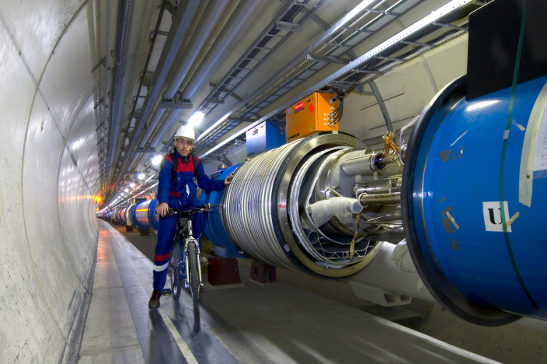
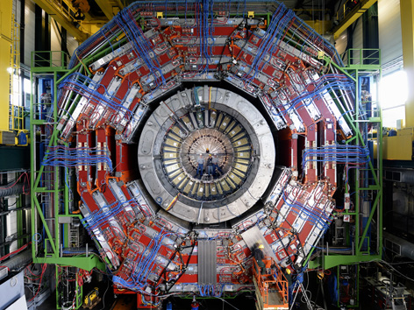

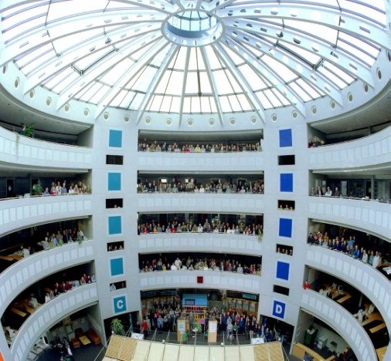
Recipe for modern discoveries
Accelerators: Powerful machines capable of accelerating particles to extremely high energies and bring them into collision with other particles.
Detectors: Gigantic instruments that record the particles as they “stream” out from the point of collision.
Computers: To collect, store, distribute and analyse the vast amount of data produced by the detectors.
People: Only a worldwide collaboration of thousands of scientists, engineers, technicians and support staff can design, build and soon operate such complex “machines”.

Slide 19
Particle accelerators
Accelerate particles to high energies.
The higher energies allow us to:
look deeper into matter (E α 1/size) (powerful microscopes)
discover new heavier particles (E = mc²)
probe conditions of early universe (E = kT)
revisit the earlier moments of our ancestral universe (powerful telescopes)
observe phenomena and particles normally no longer visible or existing in our time
All in a controlled way in the laboratory

Slide 20
Why the LHC?
For the past few decades, physicists have been able to describe with increasing detail the fundamental particles that make up the Universe and the interactions between them.
This understanding is encapsulated in the Standard Model of particle physics, but it contains gaps and cannot tell us the whole story. To fill in the missing knowledge requires experimental data, and the next big step to achieving this is with LHC.
The LHC (Large Hadron Collider) was built to help scientists to answer key unresolved questions in particle physics. The unprecedented energy it achieves may even reveal some unexpected results that no one has ever thought of!

Slide 21

CERN: The world laboratory

Slide 22
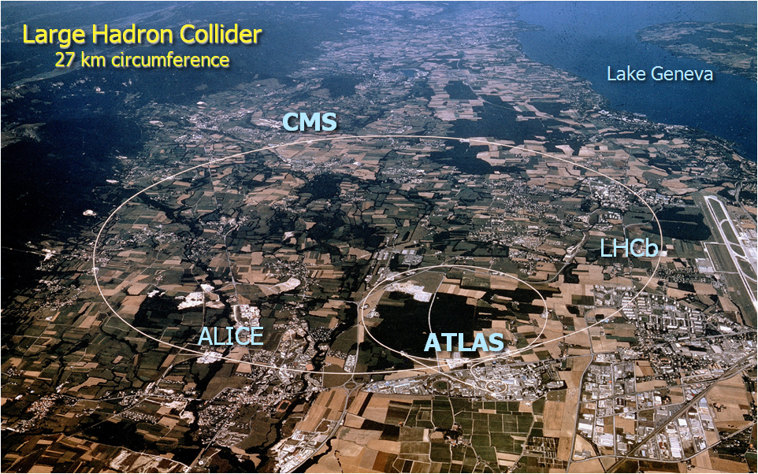
CERN Site

Slide 23
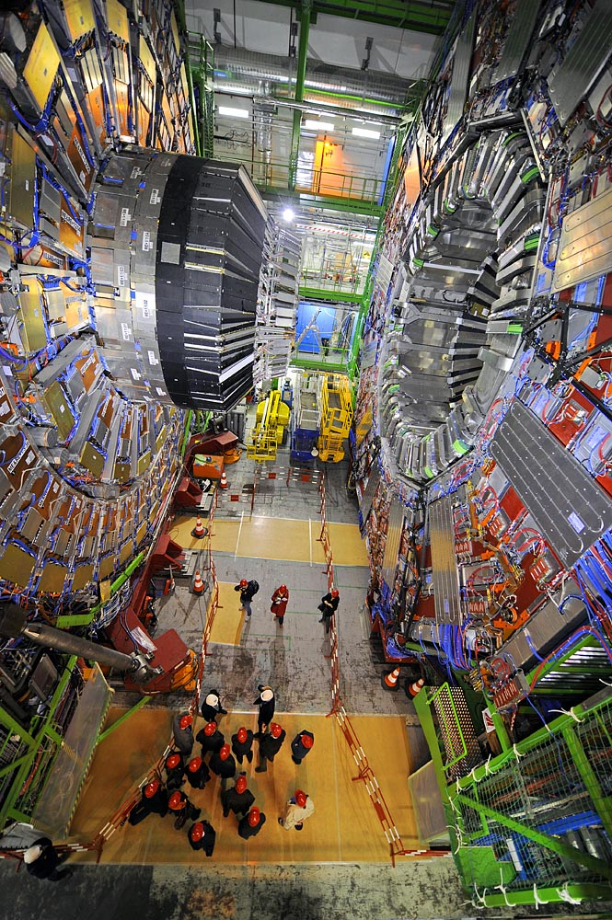
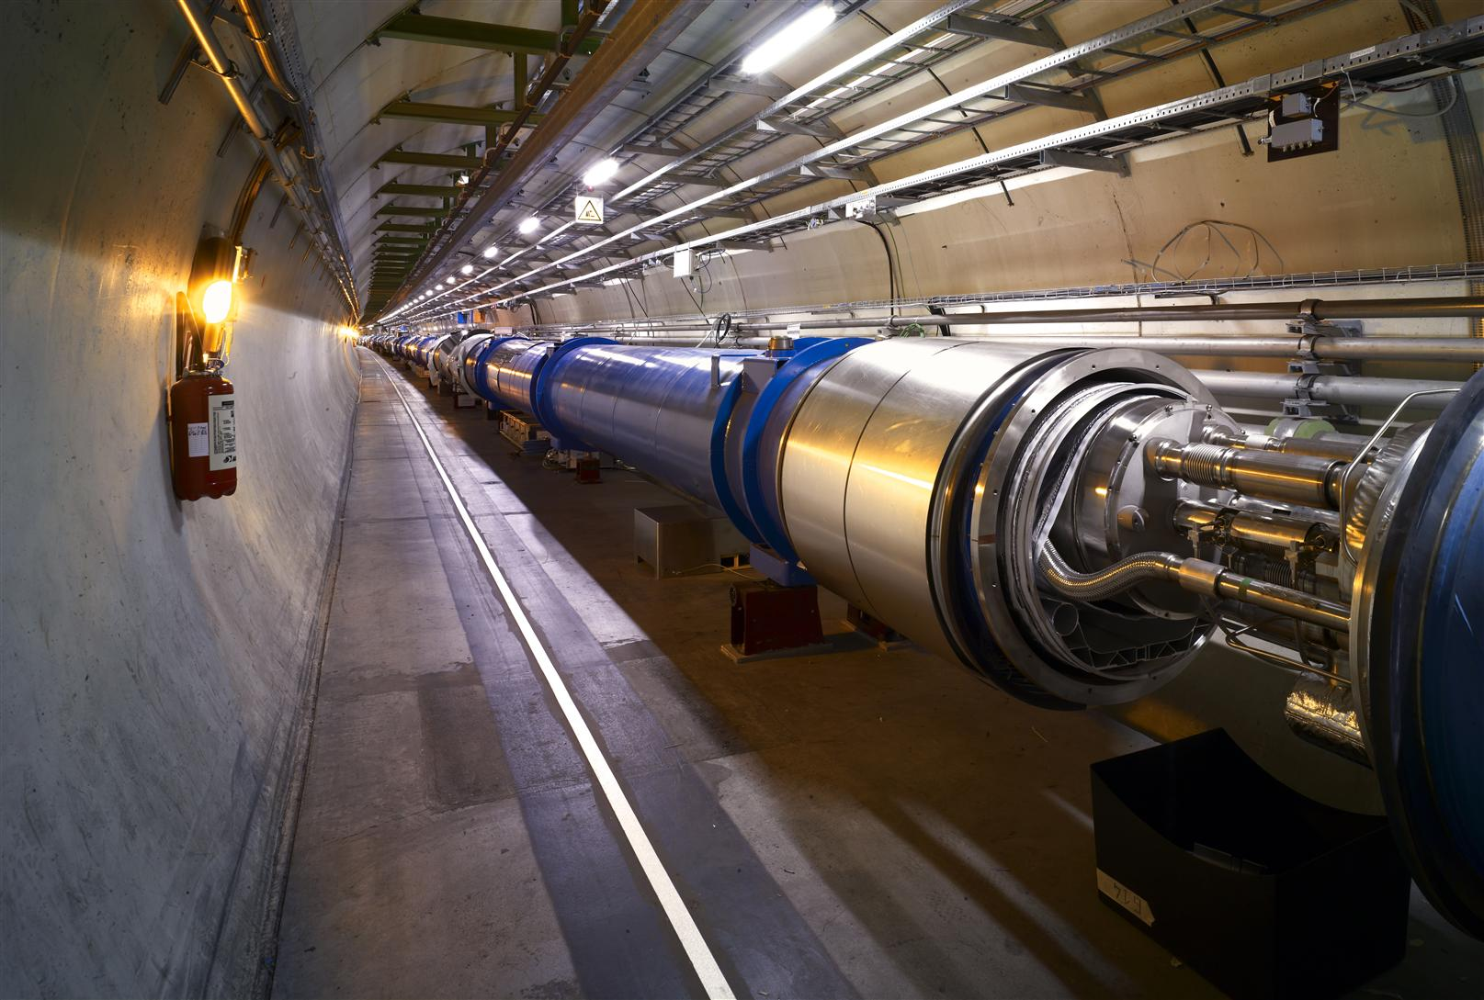
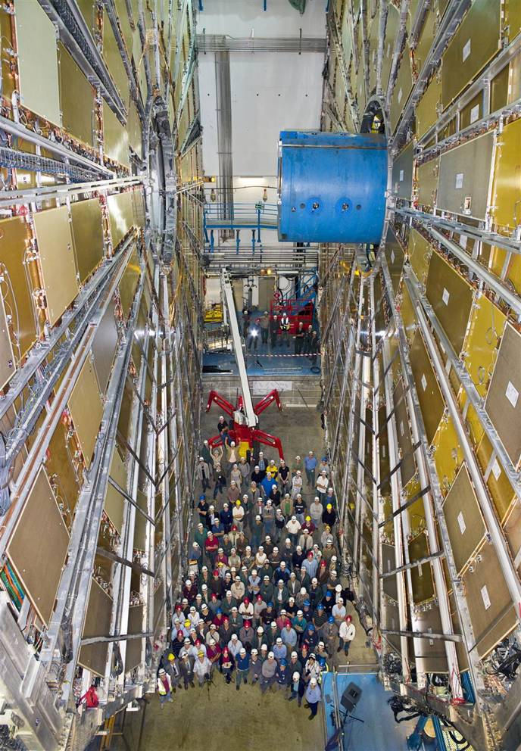
The machine, the detectors and the detectives!
CMS Experiment LHC beam pipe ATLAS experiment

Slide 24
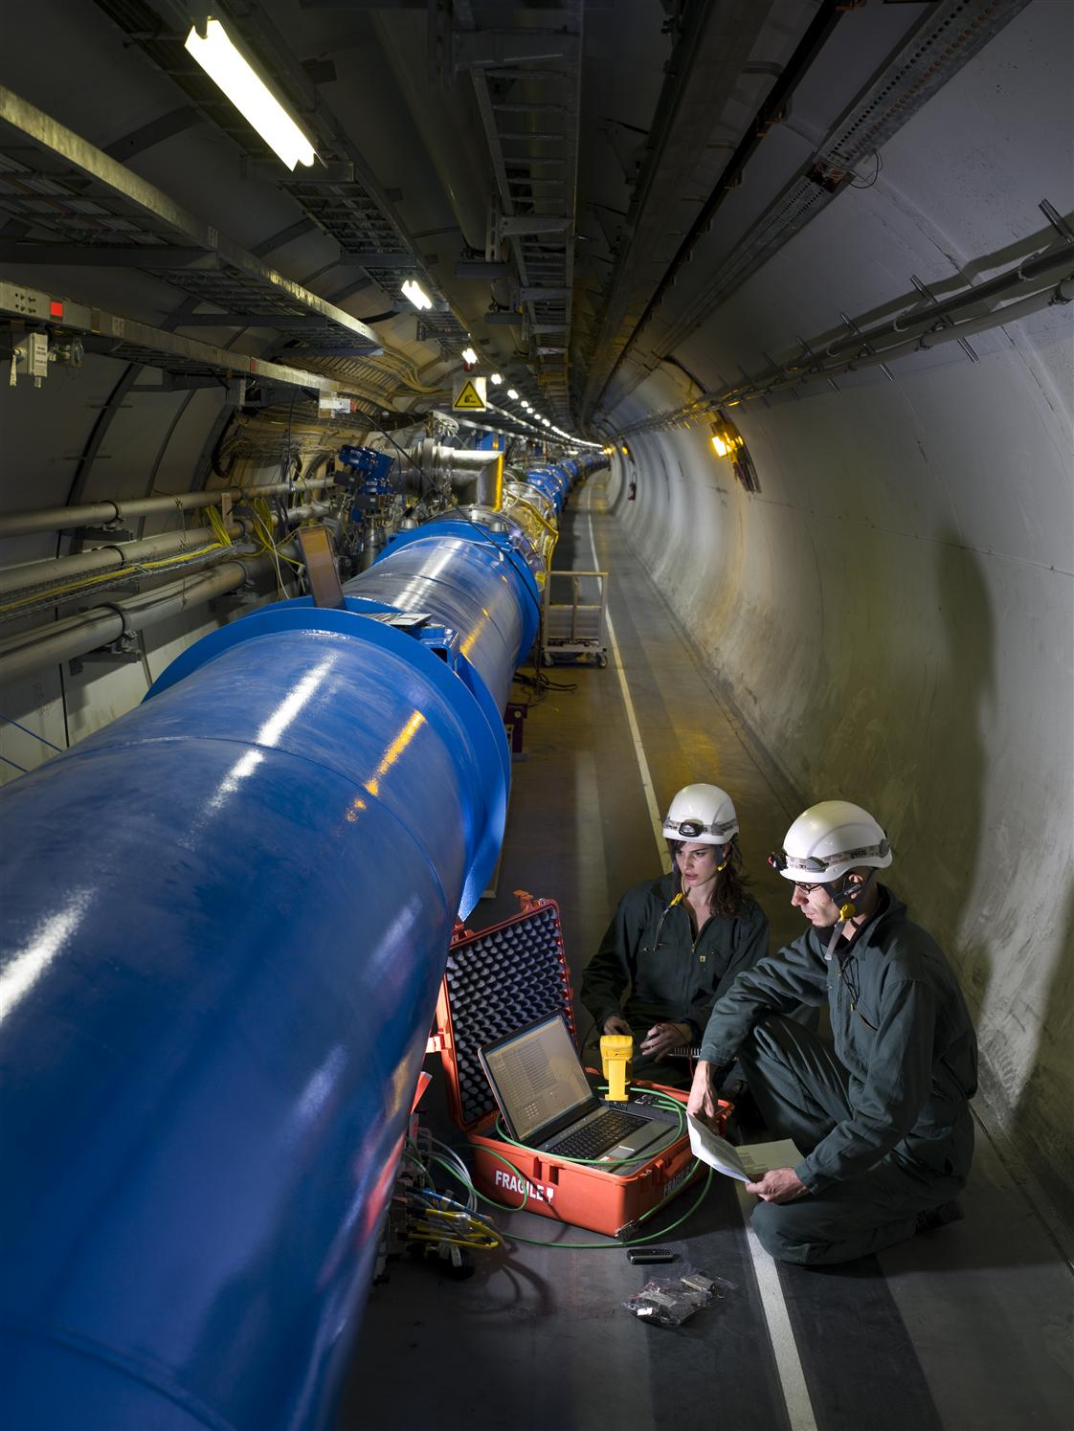
The LHC Accelerator
Proton-Proton machine. Protons are accelerated by powerful electric fields. And are guided around their circular orbits by powerful superconducting dipole magnets.
To reach the required energy in the existing tunnel, the superconducting dipoles operate at 13,000 amperes of current, producing 9Tesla field, which is 200000 times the Earth’s magnetic field.

Slide 25
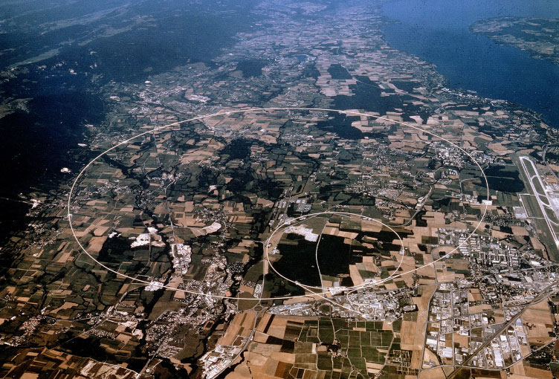
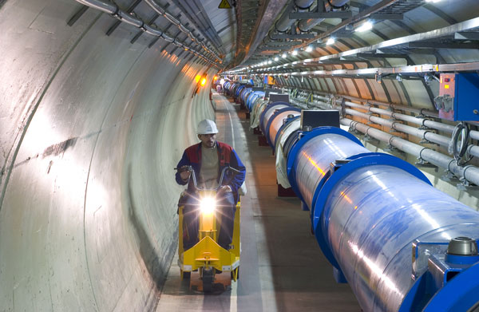
One of the fastest racetracks on the planet
Several thousand billion protons traveling at 99.9999991% of the speed of light will travel round the 27km ring over 11000 times a second

Slide 26
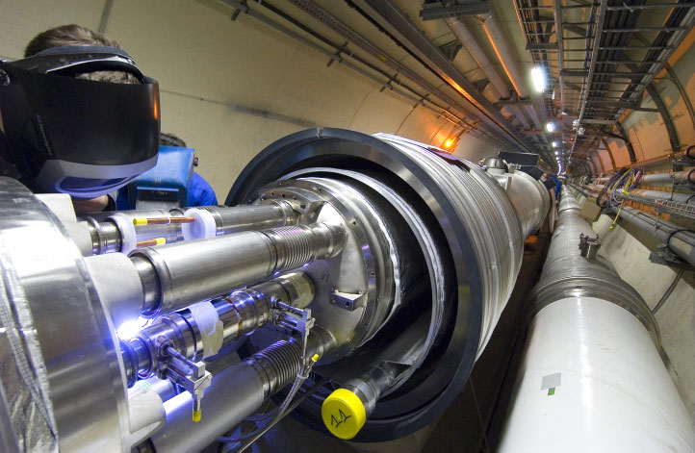
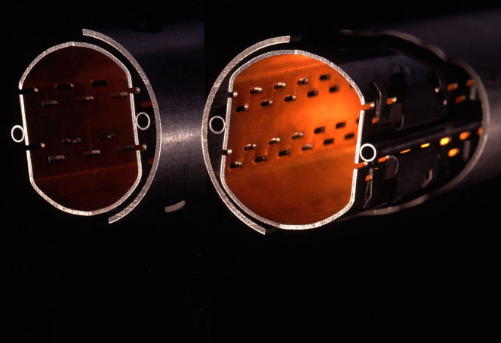
The emptiest space in the solar system…
To accelerate protons to almost the speed of light, we need a vacuum similar to interplanetary space. The pressure in the beam-pipes of the LHC will be about ten times lower than on the moon.

Slide 27
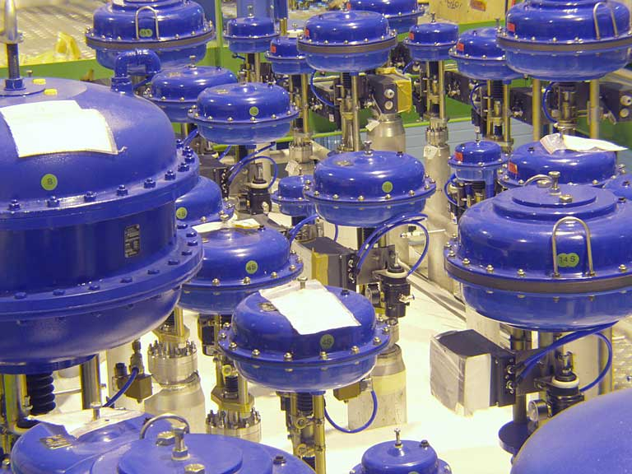
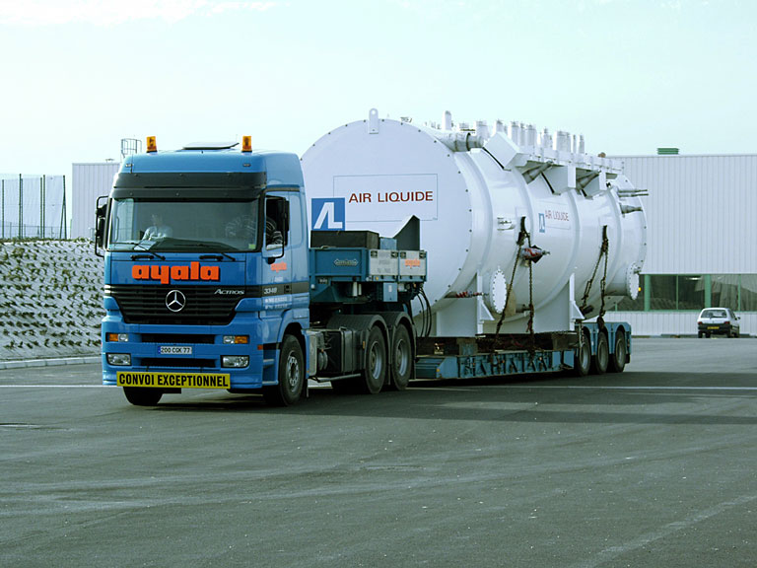
One of the coldest places in the Universe…
With a temperature of around -271 degrees Celsius, or 1.9 degrees above absolute zero in super-fluid helium, the LHC is colder than interstellar space.

Slide 28
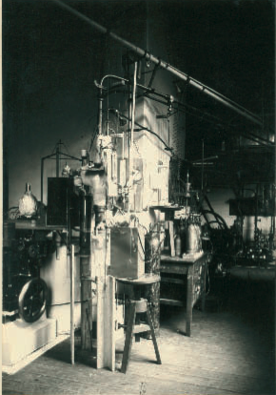
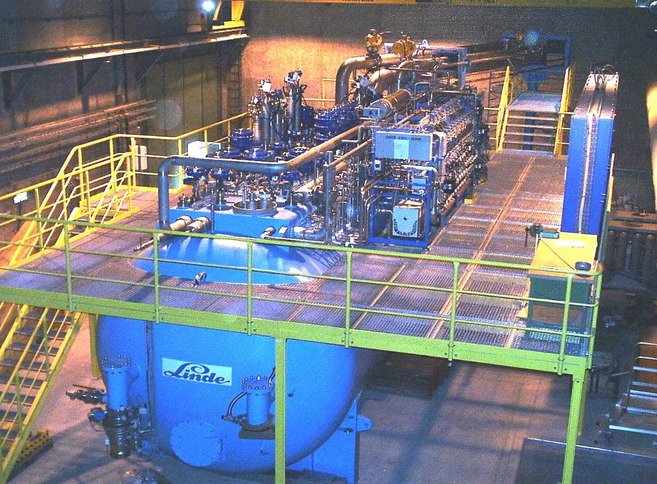
Cryogenics (1908 to 2008)
104 years ago: in July 1908 Kamerlingh Onnes first liquefied Helium in Leiden (60 ml in 1 hour)
LHC today: 32000 liters of He liquefied per hour by eight big cryogenic plants

Slide 29
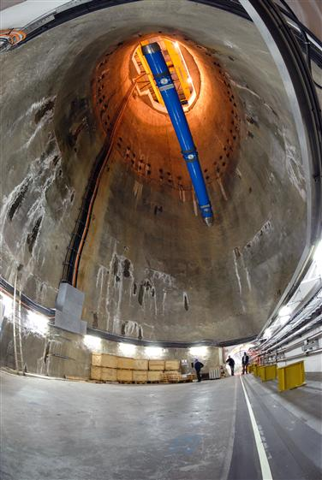
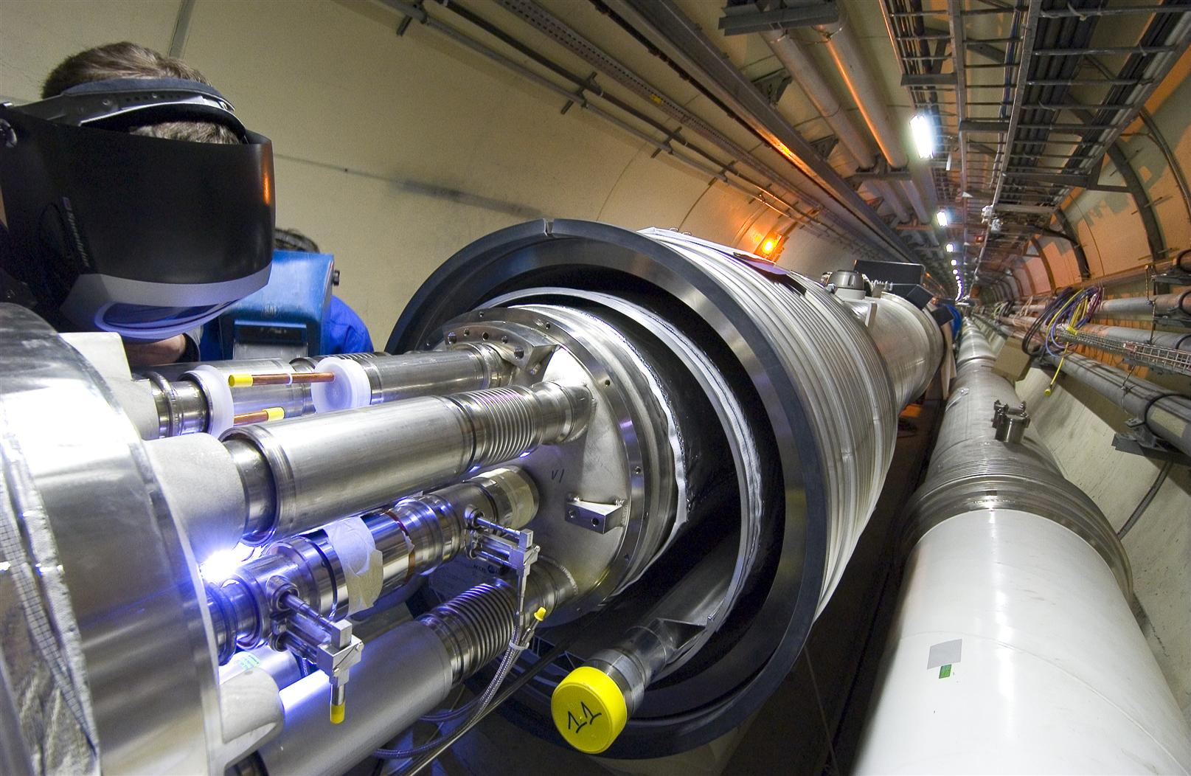
Superconducting Dipole Magnets
8000 Superconducting magnets are cooled down in a bath of 120 tons of super-fluid helium: a very interesting engineering material!

Slide 30
One of the hottest places in the Galaxy…
CMS
ALICE
When two beams of protons collide, they generate within a tiny volume, temperatures more than a billion times those in the very heart of the Sun.

Slide 31
Some more fascinating facts about the LHC
When the 27-km long circular tunnel was excavated, between Lake Geneva and the Jura mountain range, the two ends met up to within 1 cm.
Each of the 8000 superconducting filaments of niobium–titanium in the cable produced for the LHC is about 0.007 mm thick, about 10 times thinner than a normal human hair. If you added all the filaments together they would stretch to the Sun and back five times with enough left over for a few trips to the Moon.
All protons accelerated at CERN are obtained from standard hydrogen. Although proton beams at the LHC are very intense, only 2 nano grams of hydrogen are accelerated each day. Therefore, it would take the LHC about 1 million years to accelerate 1 gram of hydrogen.
At full energy, each of the two proton beams in the LHC will have a total energy equivalent to a 400t train (like the French TGV) travelling at 150 km/h. This is enough energy to melt 500 kg of copper.
The CMS experiment magnet system contains about 10,000t of iron, which is more iron than in the Eiffel Tower (7,000 tons).
The data recorded by each of the big experiments at the LHC will be enough to fill around 5,000,000 DVDs every year

Slide 32
Timeline of LHC
1984 | Workshop on a Large Hadron Collider in the LEP tunnel, Lausanne
1987 | Rubbia “Long-Range Planning Committee” recommends Large Hadron Collider as the right choice for CERN’s future
1990 | ECFA LHC Workshop, Aachen
1992 | General Meeting on LHC Physics and Detectors, Evian les Bains
1993 | Letters of Intent s (ATLAS and CMS selected by LHCC)
1994 | Technical Proposals Approved
1996 | Approval to move to Construction (ceiling of 475 MCHF)
1998 | Memorandum of Understanding for Construction Signed
1998 | Construction Begins (after approval of Technical Design Reports)
2000 | CMS assembly begins above ground. LEP closes
2004 | CMS Underground Caverns completed
2008 | CMS ready for First proton-proton Collisions
2011 | Reach design luminosity ( 1 billion pairs of protons interacting per second)
>2013 | Upgrade LHC Phase 1: increase pp interaction rate by factor of 2-4
>2017 | Upgrade LHC phase 2: increase pp interaction rate to about 10 billion/second

Slide 33
Challenges from experiments
LHC Detectors (especially ATLAS, CMS) are radically different from the ones from the previous generations
High Interaction Rate
Proton-proton interaction rate: 1 billion interactions/sec
Data can be recorded for only about 10 out of 40 million crossings/sec
Level-1 trigger decision takes about 2-3μs
a Electronics need to store data locally (pipelining)
Large Particle Multiplicity
About 20 superposed events in each crossing
About 1000 tracks stream into the detector every 25ns
Need highly granular detectors with good time resolution for low occupancy
a Large number of channels ( about 100 million channels)
High Radiation Levels
a Radiation hard (tolerant) detectors and electronics

Slide 34
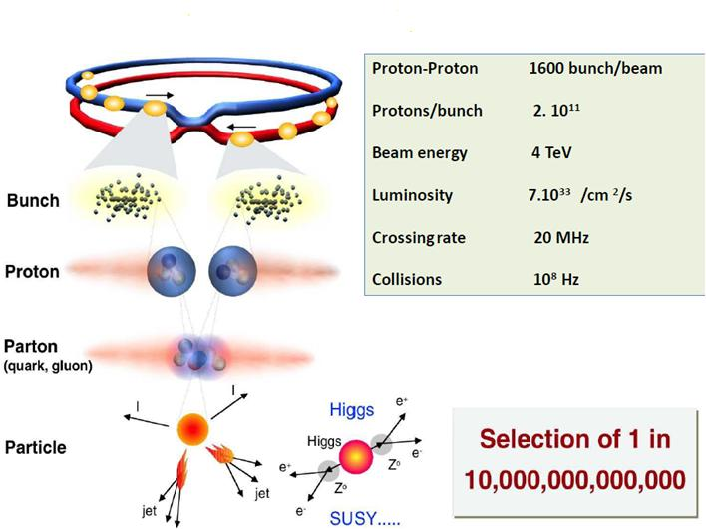
What happens in the LHC experiment?

Slide 35
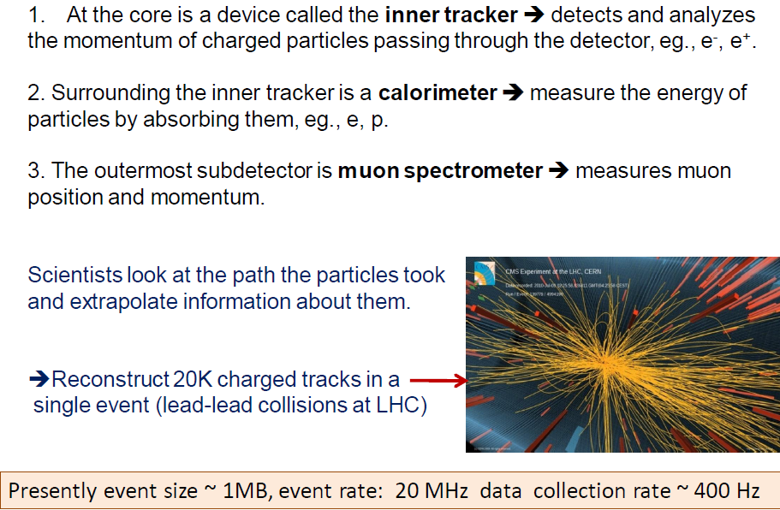
Essential components of a detector

Slide 36
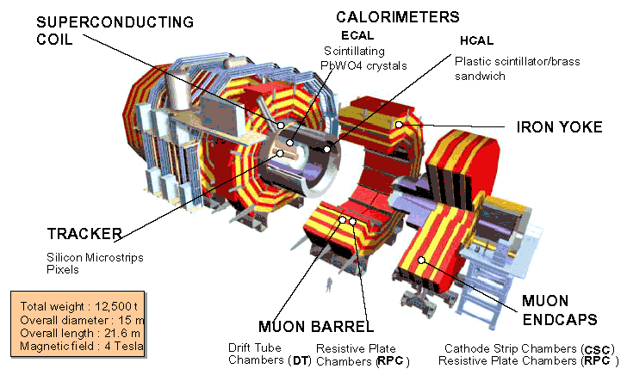
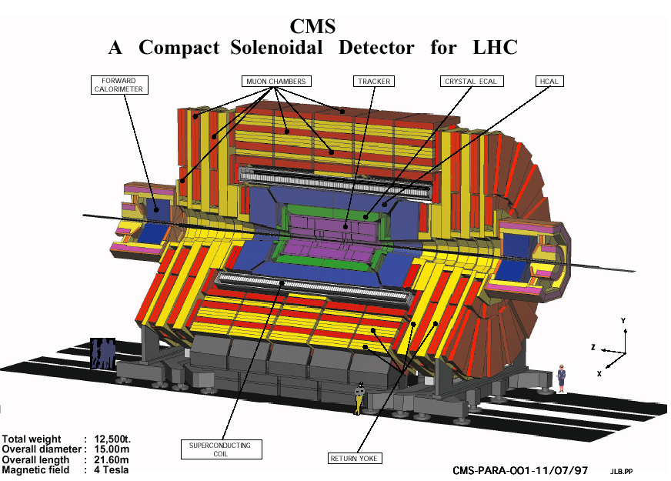
Compact Muon Solenoid (CMS) Detector

Slide 37
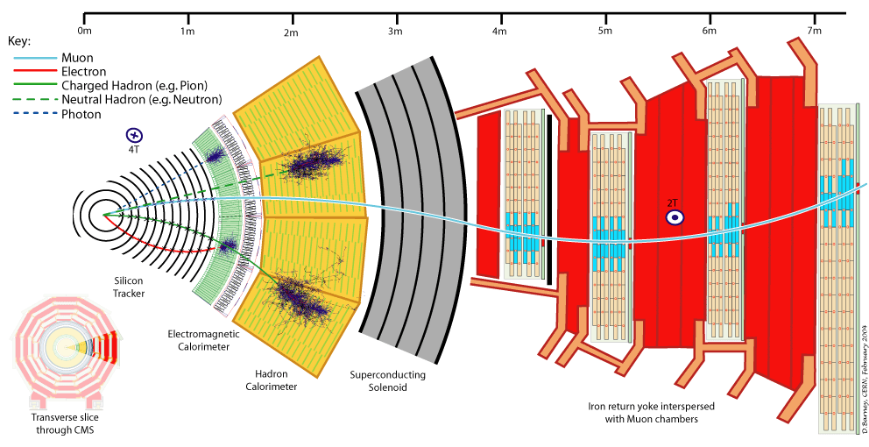
A slice of CMS experiment

Slide 38
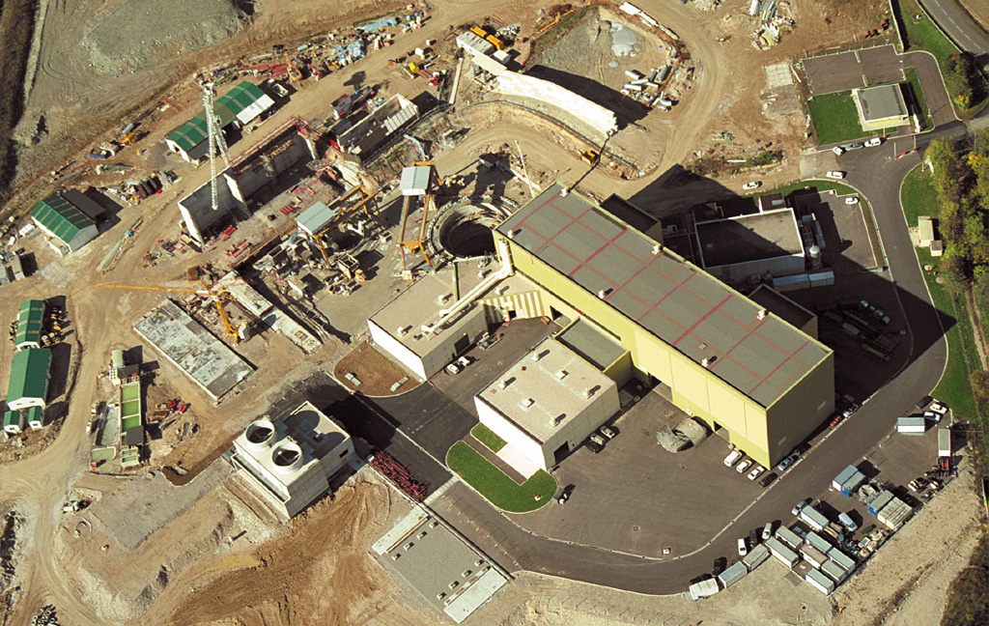
CMS site in the year 2000

Slide 39
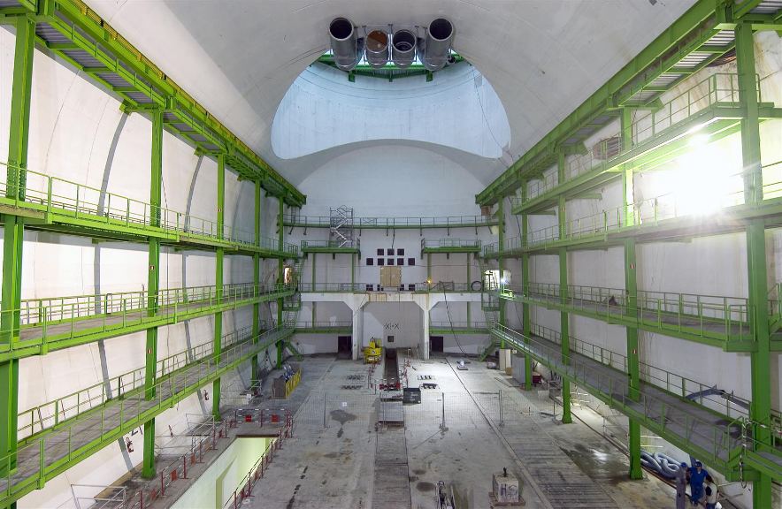
Home for the CMS detector

Slide 40
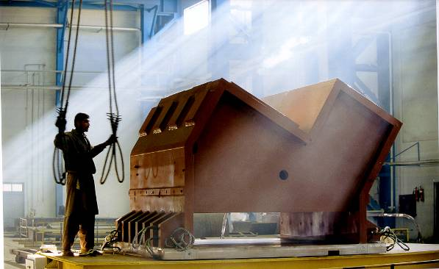
Support Structure
This “support foot” was made in Pakistan and travelled to CERN via train, ship and truck!

Slide 41
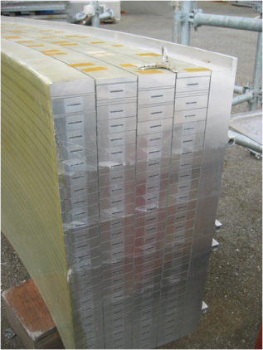
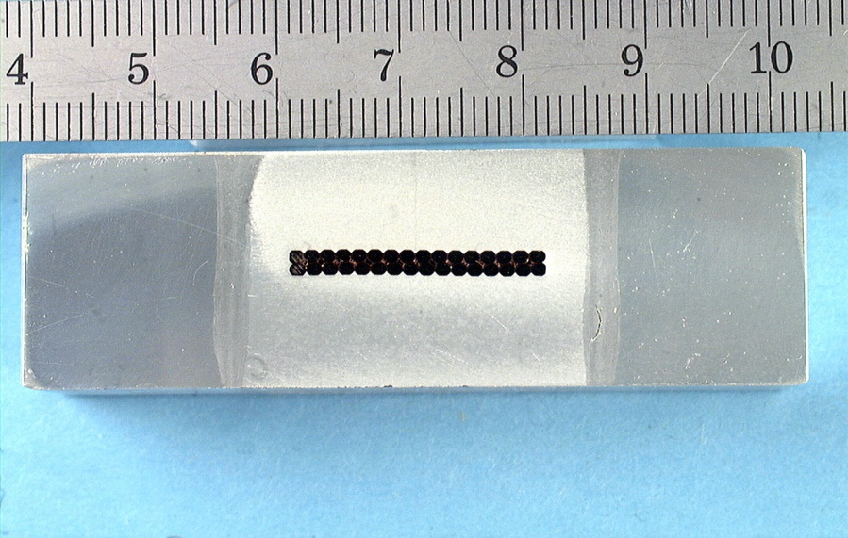
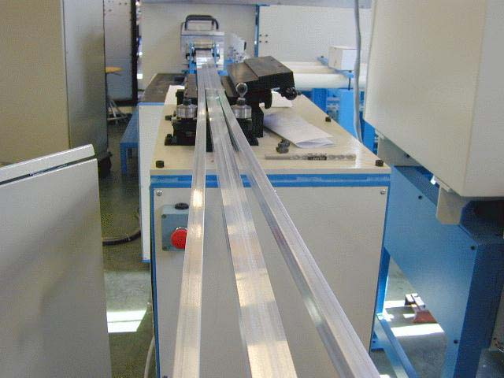
CMS Superconducting cables
Al stabilized NbTi conductor
Indirectly cooled at 4.5K by thermo siphon circuits
Inner winding vacuum impregnated with epoxy resin
Mechanically reinforced conductor (to contain magnetic forces)
4 Layers (because of needed Ampere-turns)
5 modules (to limit unit length of conductor)
SC cable
Al alloy
Al alloy
Insert Pure Al
EB welds

Slide 42
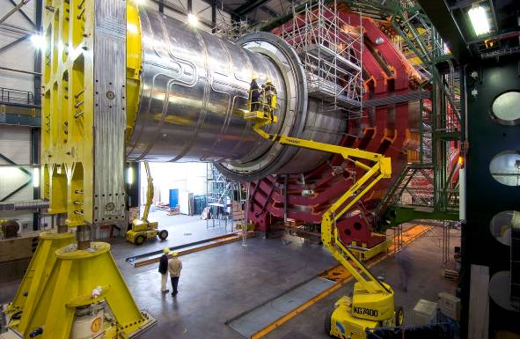
Superconducting Solenoid
13m long, 6m inner diameter; largest superconducting solenoid ever made.
Niobium-Titanium wires
Cooled to -271ºC carry 20000 Amps to provide a 4 Tesla magnetic field – about 100000 times stronger than that of the earth

Slide 43
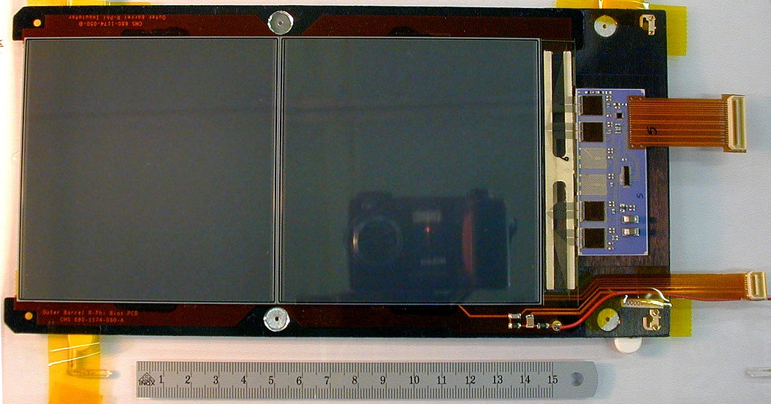
Si modules and Electronics chain
Riding on the technology wave;
75,000 chips using
0.25μm technology
Si Sensors
Pixels: About 1 m² of silicon sensors,
65 million pixels, 100x150μm², r=4,7,11cm
Si μstrips: 223m² of silicon sensors,
10 million strips, 10pts, r = 20 – 120cm

Slide 44
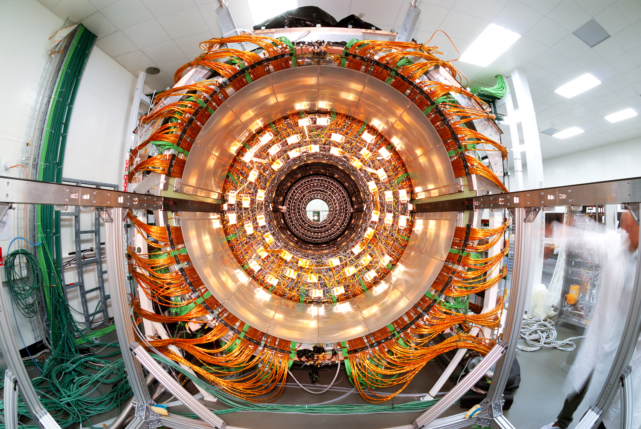
Fully assembled Si disk

Slide 45
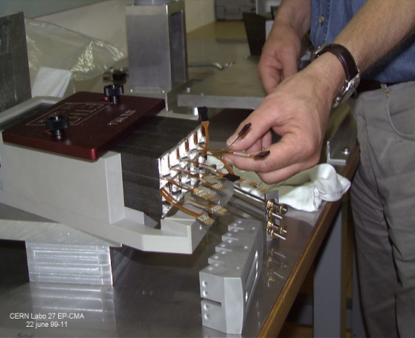
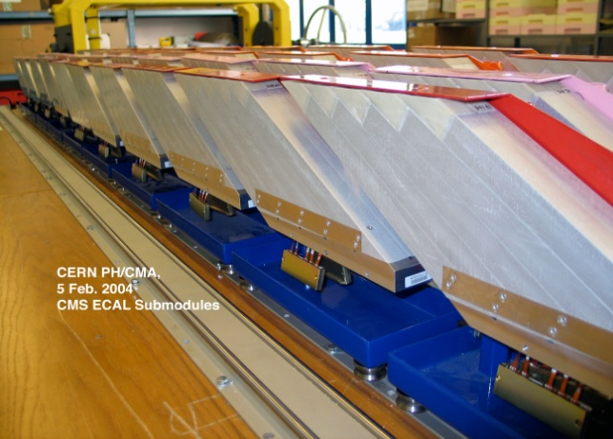
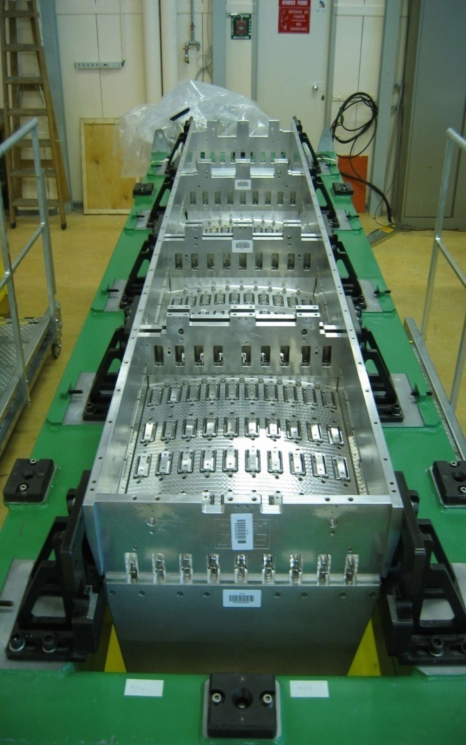
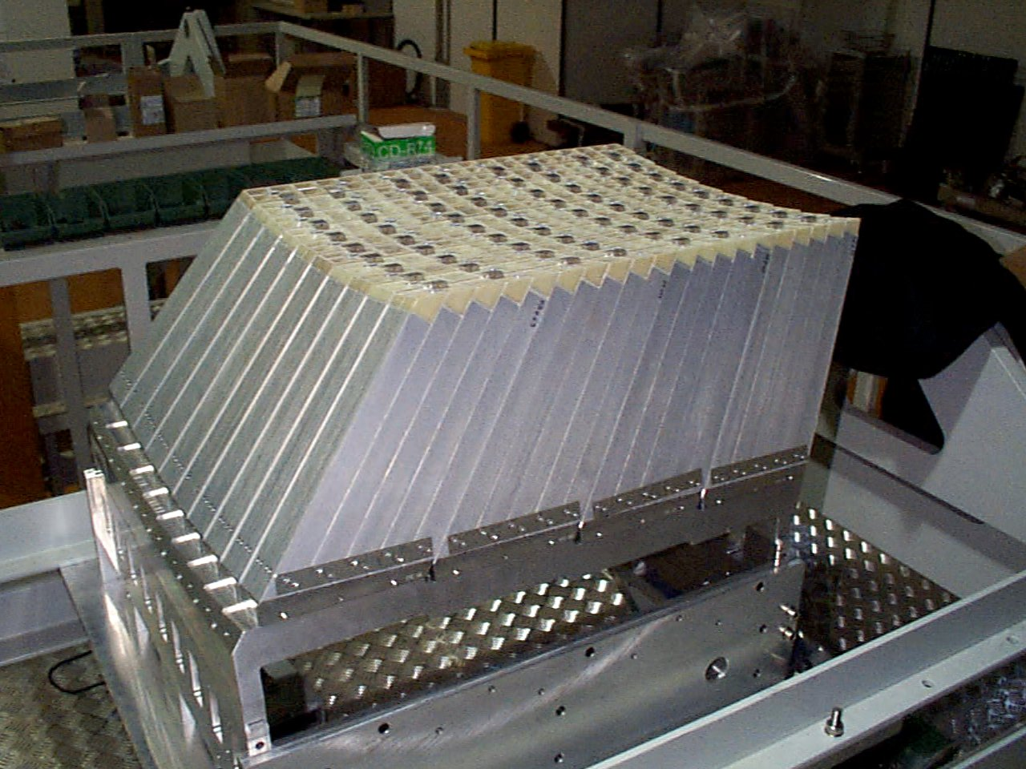
Assembly of EM calorimeter
Sub-module
2x5 crystals
Super-module
1700 crystals
Module
400 crystals
Total 36 Supermodules

Slide 46
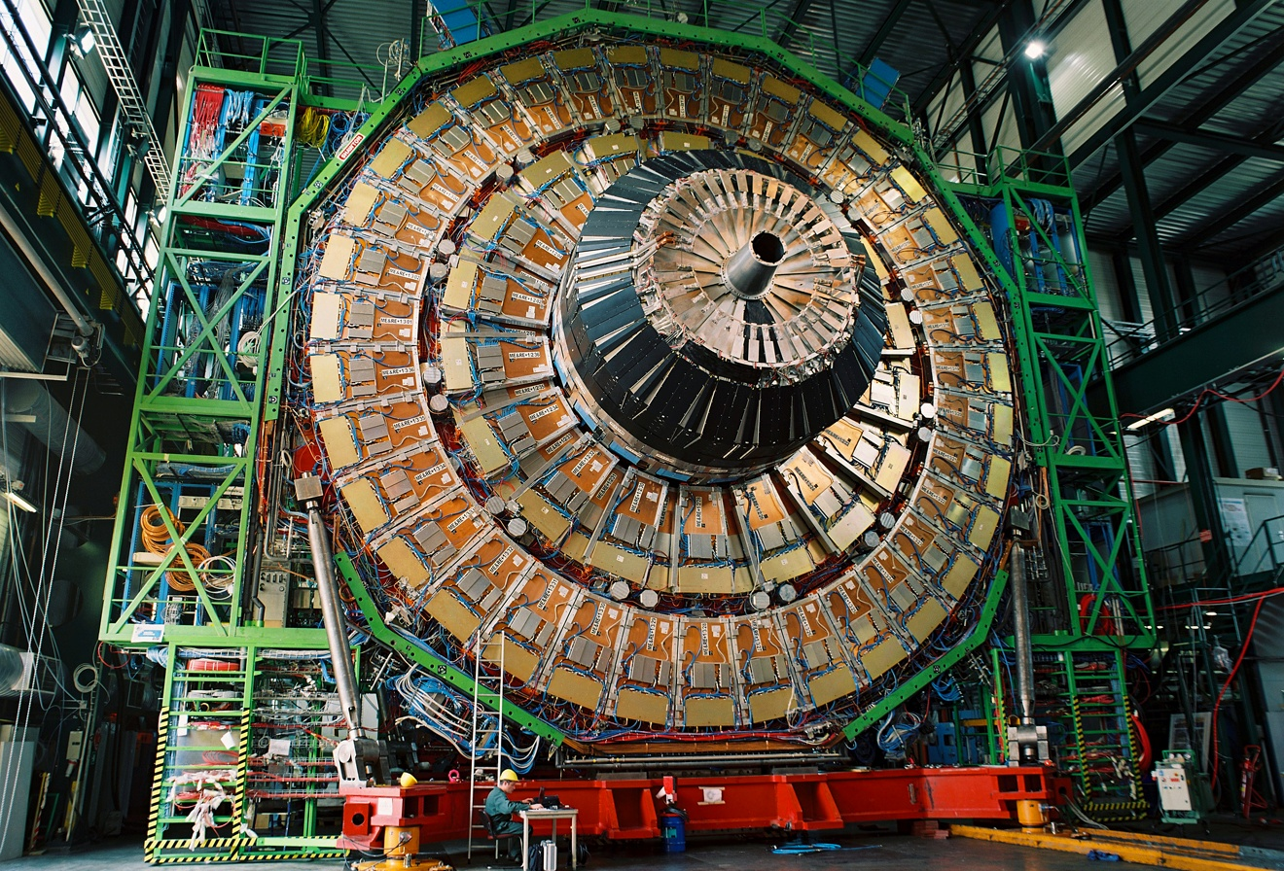
CMS endcaps’ assembly on surface

Slide 47
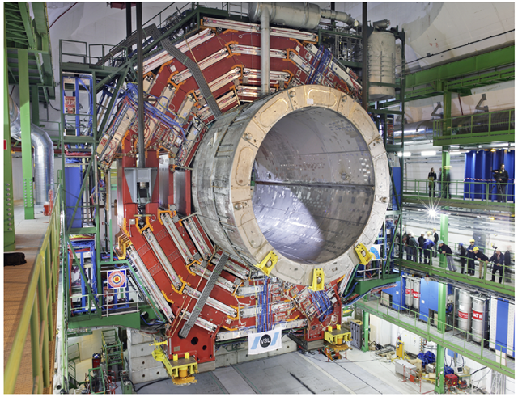
Lowering very heavy elements

Slide 48
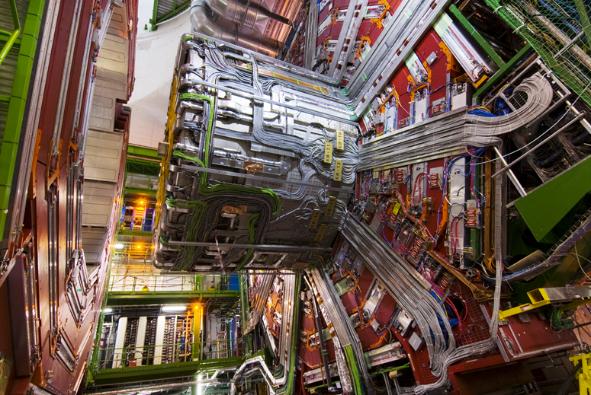
Cables, Pipes and Optical Fibres!
250km and 50000 man-hours for the central part alone!

Slide 49

Cross-section of central barrel

Slide 50

Final integration of Si tracker

Slide 51

Joining the gigantic pieces

Slide 52

Typical event in the detector

Slide 53

Trigger rates and data sizes

Slide 54

Data flow in CMS experiment

Slide 55


A Toroidal LHC Apparatus

Slide 56

Cross-sectional view of ATLAS

Slide 57

ALICE Experiment
A Large Ion Collider Experiment

Slide 58

Cross-sectional view of ALICE

Slide 59

The LHC Computing Grid
The Grid unites computing resources of particle physics institutions around the world.
The World Wide Web (invented at CERN) provides seamless access to information that is stored in many millions of different geographical locations.
The Grid is an infrastructure that provides seamless access to computing power and data storage capacity distributed over the globe.

Slide 60

LHC Tier2 Grid computing centres for CMS and ALICE in India

Slide 61

LHC machine parts by DAE

Slide 62

Si pre-shower by BARC-DU

Slide 63

CMS HO detector by TIFR-PU

Slide 64


Radioactive source scanner

Slide 65

Modern day experimental physics collaborations

Slide 66

The D-day

Slide 67

The prize catch

Slide 68

CMS’s Higgs paper
32 pages of paper
16 pages of authors!

Slide 69
What did we achieve?
The LHC project has been planned and prepared meticulously over long time
The harvest is excellent and is very fast!
The Higgs boson particle has been discovered by the experiments at LHC fulfilling its raison de etre.
This is considered as the proof of the idea proposed almost 50 years ago why weak interaction is short-ranged and electromagnetic interaction is long-ranged.
This development is very significant for the whole human kind since it gives us the confidence about our way of understanding the evolution of the universe at the first moments.
However, we have miles to go before we sleep!
We learnt Higgs boson exists
We need to know its properties
LHC will also explore many more interesting physics in coming decades
Stay tuned!

Slide 70

What does Higgs discovery means to us?

Slide 71
Concluding remarks
The LHC project (the accelerator and experiments) was conceived & designed to attack these questions in the particle physics (and science).
Everything from the accelerator (its cryogenic systems, superconducting magnets,…), and the experiments (their detectors, electronics, data handling, selection of a precious few events,..) operate at unprecedented scales and complexity in an unprecedented environment.
Their construction has required a long and painstaking effort on a global scale. They are unparalleled scientific instruments.
The LHC accelerator and the experiments are unprecedented in complexity and operate in an unprecedented & hostile environment.
Driven by the science many technologies have been pushed to their limits.
Indeed, CERN is the Mecca of interplay between science, engineering and technology.

Slide 72
Backup slides

Slide 73




Tradition of underground physics
Atmospheric neutrino detector
at Kolar Gold Fields –1965
Proton decay experiments

Slide 74

History of neutrino physics in India
High Energy Physics research using underground detectors at Kolar Gold Fields during 1952-92.
Muon intensities and angular distributions at various depths.
Indian initiative in neutrino physics goes back to more than 35 years.
Demonstrated for the first time the feasibility of doing neutrino experiment at KGF in south India.
International collaboration experiment to detect atmospheric neutrinos started at KGF in 1964.
Detection of atmospheric neutrino in 1965.
KGF data during the proton decay era was used to look for ultra high energy neutrino sources in the sky.
Bounds on neutrino masses using cosmological data.
Estimation of atmospheric neutrino flux.
KGF underground shaft

Slide 75

The pioneering proton decay experiment at 2km below ground

Slide 76
India-based Neutrino Observatory project
The primary goal of INO is neutrino physics.
A national collaboration of scientists from more than 25 groups belonging to DAE institutions, IITs and Universities.
The total cost of the project is expected to be about `1500 crores.
The project includes:
construction of an underground laboratory and associated surface facilities,
construction of a Iron Calorimeter (ICAL) detector for neutrinos,
setting up of National Centre for High energy Physics (NCHEP).
The project is expected to be completed within seven years beginning April 2012.
A successful INO-Industry interface developed because of the large scale of experimental science activity involved.
INO Graduate Training Programme under the umbrella of Homi Bhabha National Institute (HBNI) - a deemed-to-be University within DAE is in its fifth year.

Slide 77


INO coming soon: Inside a mountain near you!
Location: 9º58′ North; 77º16′ East, 110km from Madurai (South India)
Site for INO underground facility

Slide 78

Schematic of the underground labs
Basic features
Length of the tunnel | 2.1 km (approx.)
Tunnel cross-section | 7.5m wide and 7.5m high
Tunnel gradient | 1:15
Rock overburden | 1300m (4000 mwe)
Rock type and density | Charnockite, 2.9 gm/cc
Number of caverns | 3 (one big and two small)
Size of the main cavern | 132m × 26m × 20m (high)
Distance from CERN | 7100 km
Distance from JPARC | 6600 km
Future nuclear reactor | 9000 Mwe, 205 km

Slide 79



ICAL detector and construction
Magnet coils
4000mm×2000mm
×56mm low carbon iron sheets
RPC handling trolleys
RPC
Total weight: 50Ktons

Slide 80
Career opportunities in INO
Research Scholars
Applicants must have a minimum qualification of M.Sc. degree in Physics or B.E./B.Tech. degree in any one of Electronics, E & CE, Instrumentation and Electrical Engineering subjects with strong motivation for and proficiency in Physics.
The selected candidates will be enrolled as Ph.D. students of the Homi Bhabha National Institute (HBNI), a Deemed to be University, with constituent institutions that include BARC, HRI, IGCAR, IMSc, SINP and VECC.
They will take up 1 year course work at TIFR, Mumbai in both theoretical and experimental high energy physics and necessary foundation courses specially designed to train people to be good experimental physicists.
Successful candidates after the course work will be attached to Ph.D. guides at various collaborating institutions for a Ph. D. degree in Physics on the basis of their INO related work.
Career opportunities for bright engineers in Electronics, Instrumentation, Computer Science, Information technology, Civil, Mechanical and Electrical engineers

Slide 81
Career opportunities in TIFR
Visiting Students’ Research Programme (VSRP)
Physics/Chemistry : Pre-final year students of M.Sc./B.E./B.Tech.
Biology: Pre-final year students of M.Sc./B.E./B.Tech. Students doing M.Pharm., Medicine/Engineering will be also be considered.
Mathematics: Pre-final and final year students of M.A./M.Sc./M-Stat./B.Tech. Exceptionally bright pre-final and final year students of B.Sc./B.Stat./B.Math. will also be considered.
Computer & Systems Sciences: Pre-final year students of B.E./B.Tech./M.Sc./M.C.A./M.E./M.Tech.
Research opportunities for exceptionally talented and strongly motivated students
TIFR is India's premier institution for advanced research in fundamental sciences. The Institute runs a graduate programme leading to the award of Ph.D. degree, as well as M.Sc. and Integrated Ph.D. in certain subjects.
The Graduate Programme at TIFR is classified into the following Subjects - Mathematics, Physics, Chemistry, Biology, Computer & Systems Sciences and Science Education.
Career opportunities for bright engineers in Electronics, Instrumentation, Computer Science, Information technology, Civil, Mechanical and Electrical engineers

Slide 82





Slide 83




Slide 84




Slide 85





Slide 86


Slide 87


Slide 88


Slide 89


Slide 90


Slide 91


Slide 92


Slide 93


Slide 94


Slide 95


Slide 96

Significance of a result

