Slide 1
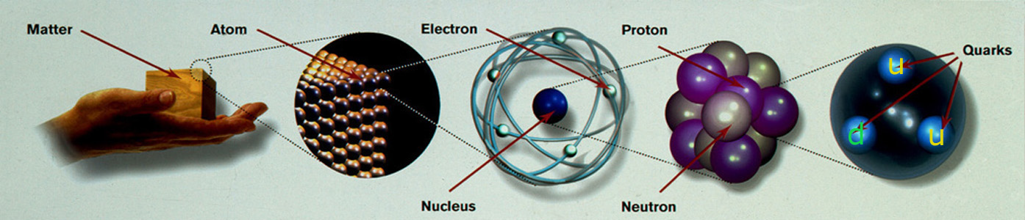
Why do we need the Higgs boson?
Dr. B.Satyanarayana ▪ Scientific Officer (G)
Department of High Energy Physics ▪ Tata Institute of Fundamental Research
Homi Bhabha Road ▪ Colaba ▪ Mumbai ▪ 400005 ▪ INDIA
T: 09987537702 ▪ E: bsn@tifr.res.in ▪ W: http://www.tifr.res.in/~bsn

Slide 2
Definitions
Science is the reasoned investigation or study of natural phenomena with the objective of discovering new principles and knowledge of natural phenomena.
Technology is the practical application of science. Technology includes the skill, technique and knowledge of the manipulation of nature for human purposes, using scientific results and knowledge.
Engineering is the professional art of using technology for achieving the optimum conversion of the resources of nature for the benefit of humankind.
A Scientist studies nature, a Technologist manipulates nature and an Engineer exploits technology for human purposes.

Slide 3

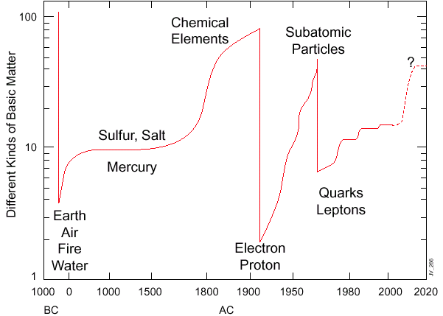
Eternal questions of mankind
What principles govern the energy, matter, space and time
at the most elementary level?

Slide 4
Particle Physics
Particle physics is a modern name for centuries old effort to understand the laws of nature.
Aims to answer the two following questions:
  What are the elementary constituents of matter ?
  What are the forces that control their behaviour at the most basic level?
Get particles to interact and study the resulting products and features.
Aim to measure the energy, the direction and the identity of these products as precisely as possible.

Slide 5
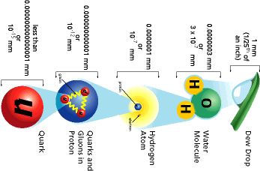
Powers of ten:
How small is small?

Slide 6
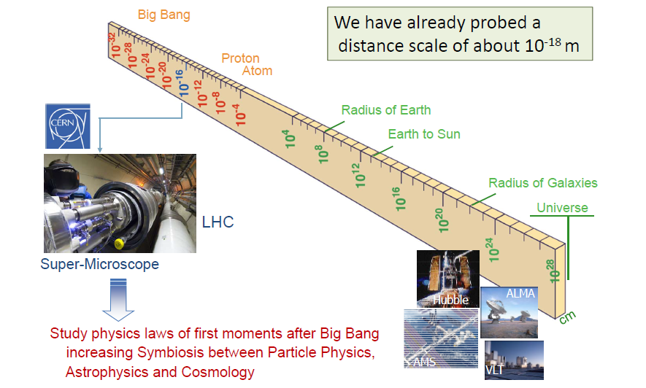
Dimensions in Physics

Slide 7
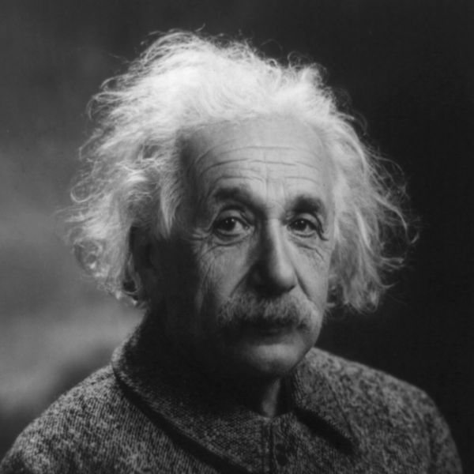
Speed of light; E=mc²

Slide 8
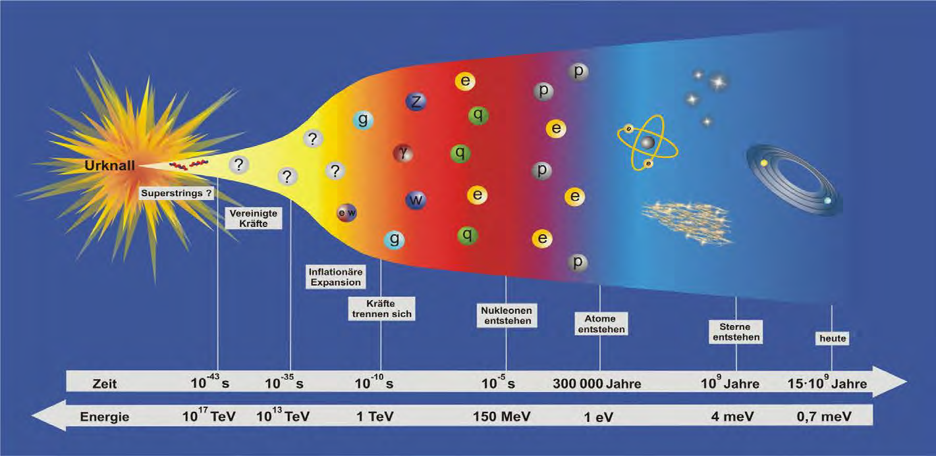
What do we know about our universe
Particle Physics at the energy frontier with highest collision energies ever is changing our view of the universe.

Slide 9
Open questions we need to address
Why abundance of matter over anti-matter?
Why the main interactions are so different in strength and how well they can be unified?
Why electron is so light and top quark so massive? (fermions)
Why photon is mass-less, why W & Z are so massive? (bosons)
What is the origin of mass?
What is dark matter that keeps together the clusters of galaxies?
How many are really the dimensions of our world ?

Slide 10
Newton's unfinished business...
What is mass?
What is the origin of mass? Why do tiny particles weigh the amount they do? Why do some particles have no mass at all?
At present, there are no established answers to these questions. The most likely explanation may be found in the Higgs boson, a key undiscovered particle that is essential for the Standard Model to work. First hypothesised in 1964, it has yet to be observed.

Slide 11
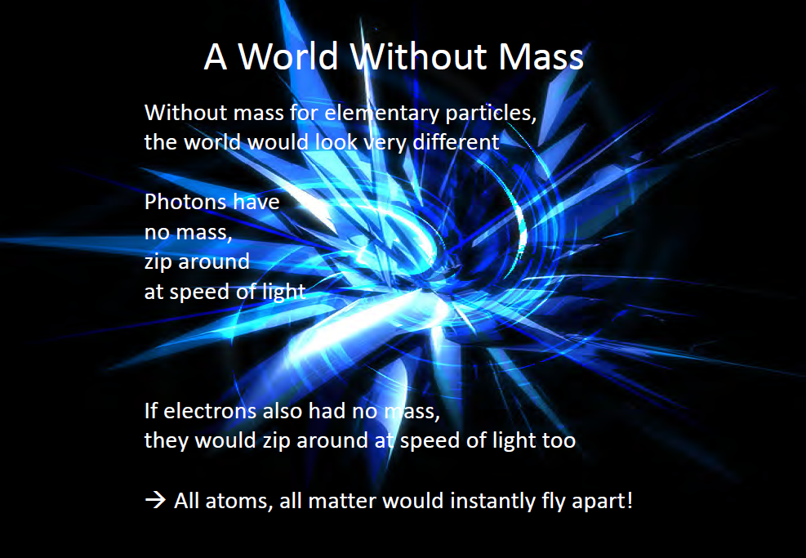
If the impossible was to be possible

Slide 12
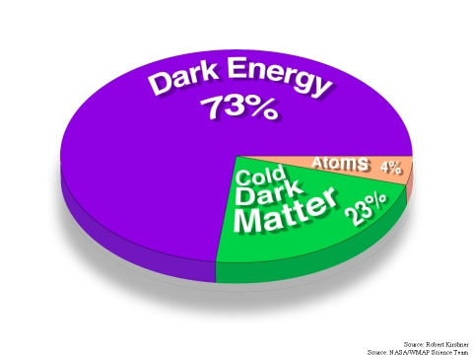
An invisible problem...
What is 96% of the universe made of?
Everything we see in the Universe, from an ant to a galaxy, is made up of ordinary particles. These are collectively referred to as matter, forming 4% of the Universe.
Dark matter and dark energy are believed to make up the remaining proportion, but they are incredibly difficult to detect and study.
Investigating the nature of dark matter and dark energy is one of the biggest challenges today in the fields of particle physics and cosmology.

Slide 13
Why is there no more antimatter?
We live in a world of matter – everything in the Universe, including ourselves, is made of matter.
Antimatter is like a twin version of matter, but with opposite electric charge.
At the birth of the Universe, equal amounts of matter and antimatter should have been produced in the Big Bang.
But when matter and antimatter particles meet, they annihilate each other, transforming into energy.
Somehow, a tiny fraction of matter must have survived to form the Universe we live in today, with hardly any antimatter left.
Why does Nature appear to have this bias for matter over antimatter?

Slide 14
Secrets of the Big Bang
What was matter like within the first second of the Universe’s life?
Matter, from which everything in the Universe is made, is believed to have originated from a dense and hot cocktail of fundamental particles.
Today, the ordinary matter of the Universe is made of atoms, which contain a nucleus composed of protons and neutrons, which in turn are made of quarks bound together by other particles called gluons.
The bond is very strong, but in the very early Universe conditions would have been too hot and energetic for the gluons to hold the quarks together.
Instead, it seems likely that during the first microseconds after the Big Bang the Universe would have contained a very hot and dense mixture of quarks and gluons called quark–gluon plasma.

Slide 15
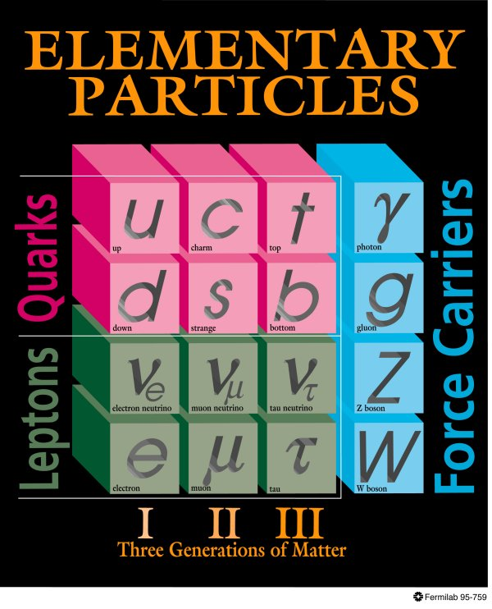
Standard model of particle physics
All interactions behaved as a single one when the universe was much younger and hotter → idea of unification!
Everyday matter is made up of only up and down type quarks, electron.

Slide 16
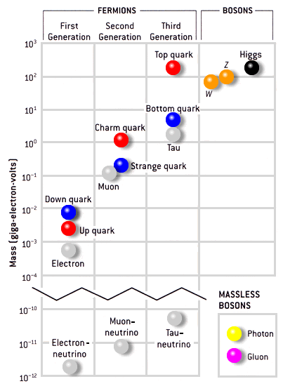
Masses of particles
Mass is a fundamental property of a particle
Determines how a particle responds to a force.
Electron mass: 0.511MeV/c² = 9.11 × 10^{‐31} kg
Proton mass: 938.27 MeV/c² = 1.67 × 10^{‐27} kg
Mass of top quark (heaviest known particle): 173 GeV/c²
Mass of photon: 0 → infinite range of electromagnetic force
Mass of W, Z: 80-90 times that of proton → short range of weak force
1 electron Volt (eV) = 1.6 ×10⁻¹⁹ Joules

Slide 17
Why did the Higgs search become so important?
The standard model of particle physics has the ability to predict the results of various experiments.
Since all the past experiments match well to the theoretical description of standard model, it is certain that the corresponding theoretical description is correct.
However the Higgs particle has been elusive to the experiments.
But the issue of mass is one of the corner stones of the theory.
So success of standard model crucially depended on the confirmation of the way of explaining the generation of mass, the “Higgs mechanism” → the Higgs boson has to be there.
Onus was on the experiments to really hunt out the Higgs particle.
Notably, the immensely complex detectors lived upto their expectations!!!

Slide 18
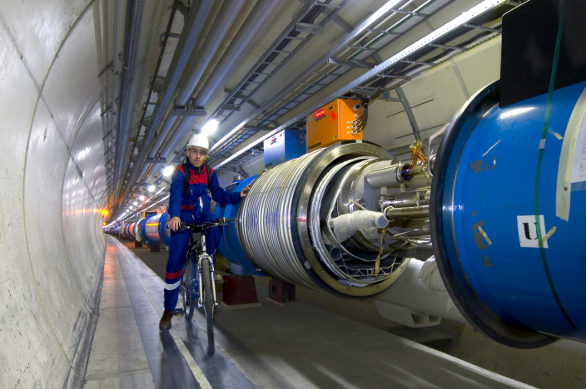
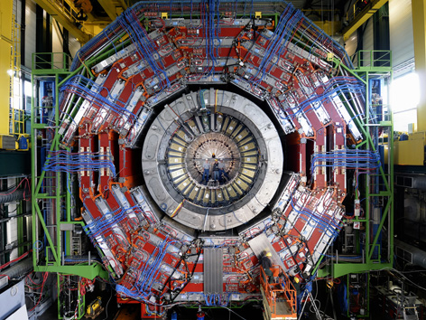

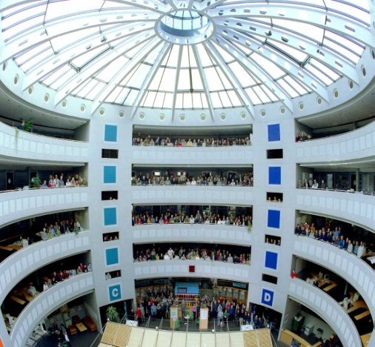
Recipe for modern discoveries
Accelerators: Powerful machines capable of accelerating particles to extremely high energies and bring them into collision with other particles.
Detectors: Gigantic instruments that record the particles as they “stream” out from the point of collision.
Computers: To collect, store, distribute and analyse the vast amount of data produced by the detectors.
People: Only a worldwide collaboration of thousands of scientists, engineers, technicians and support staff can design, build and soon operate such complex “machines”.

Slide 19
Particle accelerators
Accelerate particles to high energies.
The higher energies allow us to:
  look deeper into matter (E α 1/size) (powerful microscopes)
  discover new heavier particles (E = mc²)
  probe conditions of early universe (E = kT)
  revisit the earlier moments of our ancestral universe (powerful telescopes)
  observe phenomena and particles normally no longer visible or existing in our time
All in a controlled way in the laboratory

Slide 20
Why the LHC?
The LHC (Large Hadron Collider) was built to help scientists to answer key unresolved questions in particle physics. The unprecedented energy it achieves may even reveal some unexpected results that no one has ever thought of!
For the past few decades, physicists have been able to describe with increasing detail the fundamental particles that make up the Universe and the interactions between them.
This understanding is encapsulated in the Standard Model of particle physics, but it contains gaps and cannot tell us the whole story. To fill in the missing knowledge requires experimental data, and the next big step to achieving this is with LHC.

Slide 21
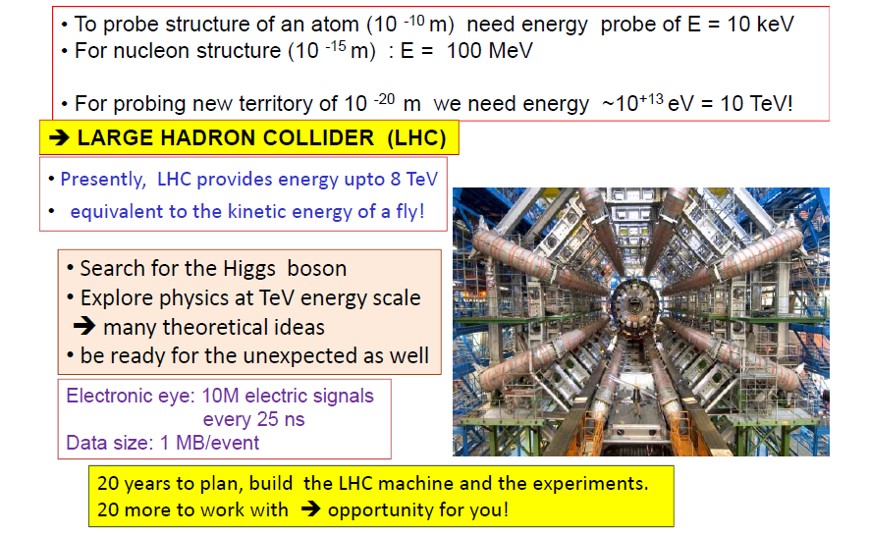
Probing shorter than ever length scales

Slide 22

CERN: The world laboratory

Slide 23
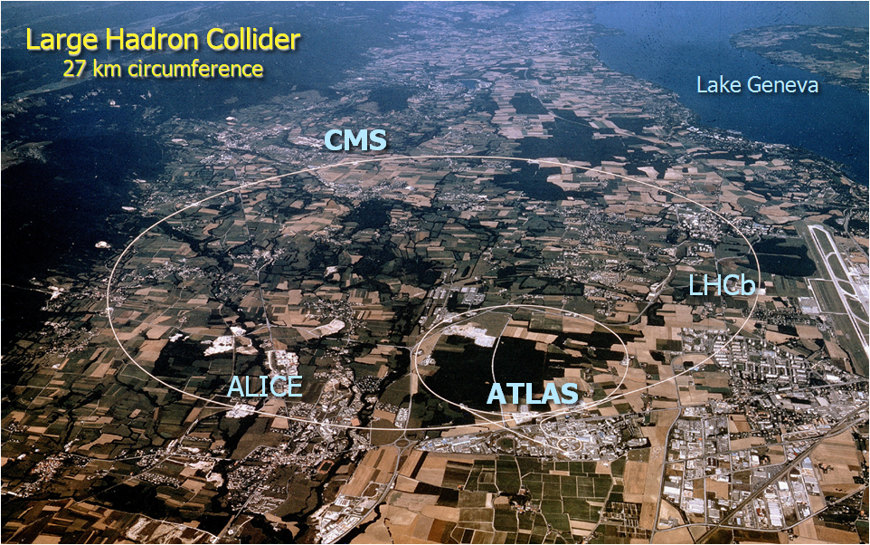
CERN Site

Slide 24
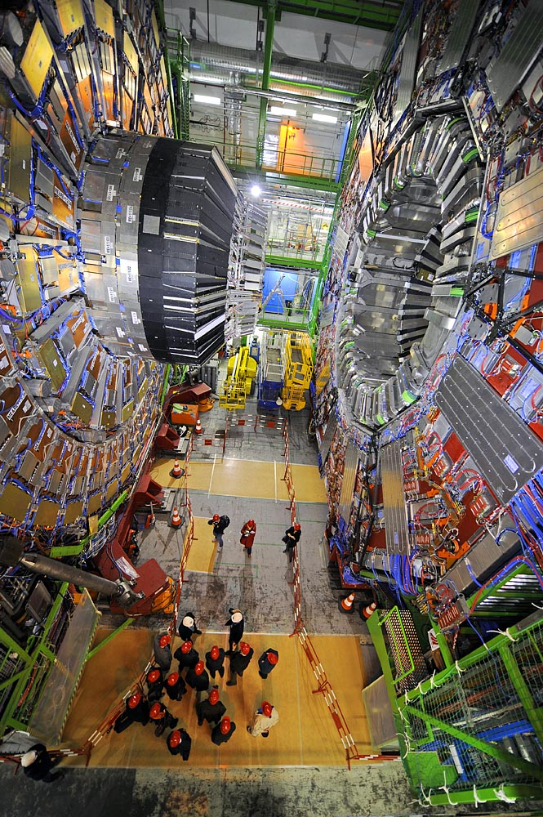
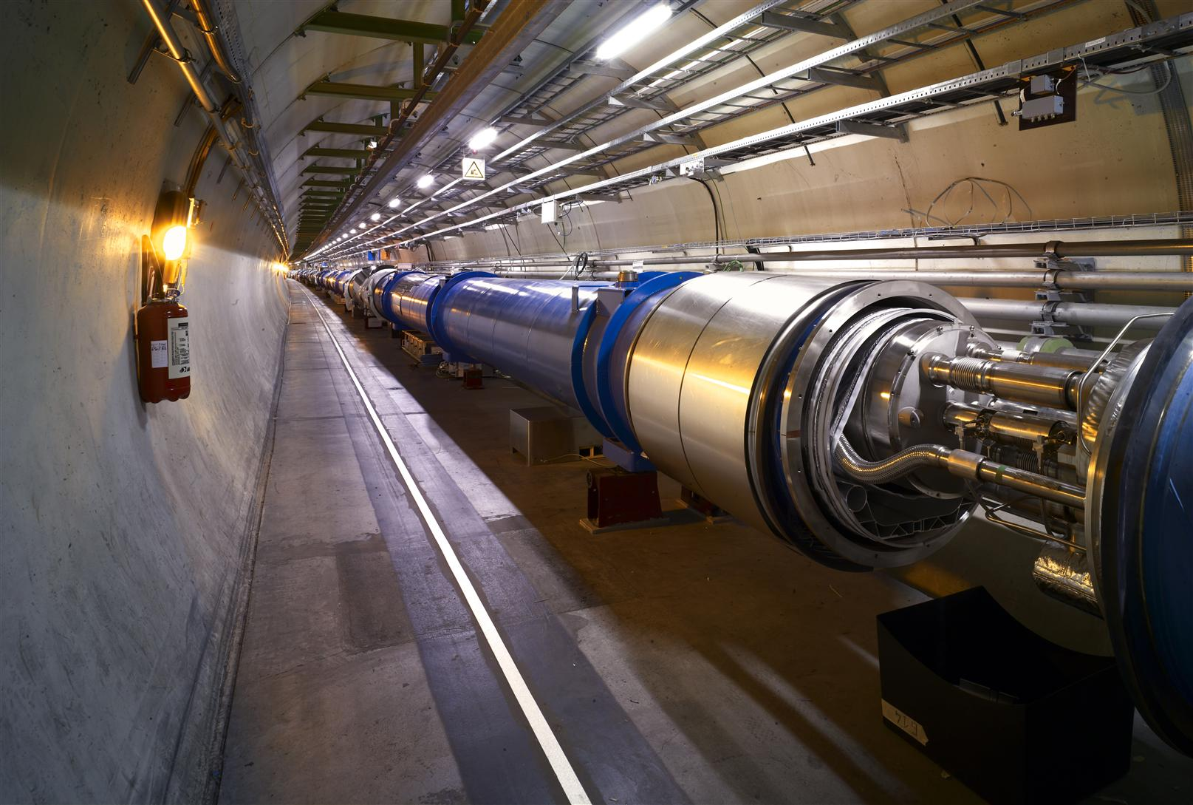
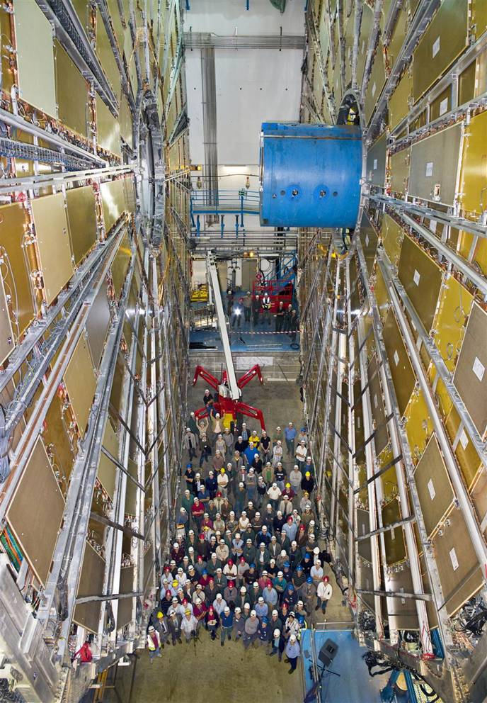
The machine, the detectors and the detectives!
CMS Experiment LHC beam pipe ATLAS experiment

Slide 25
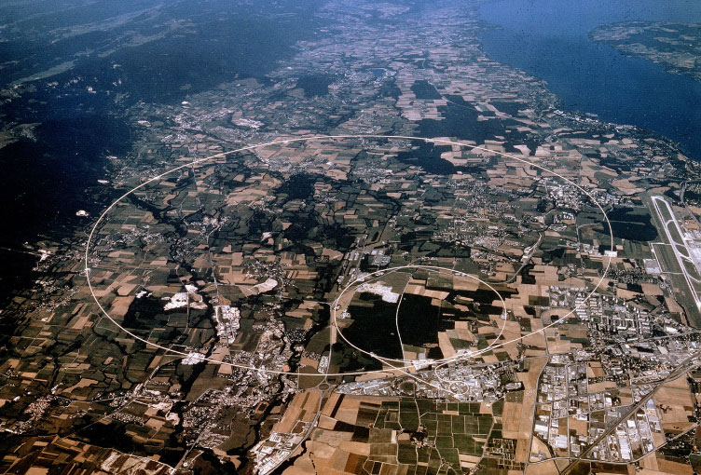
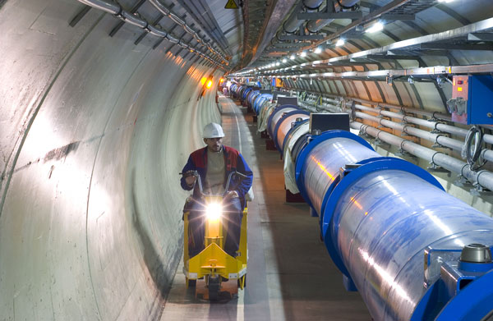
One of the fastest racetracks on the planet
Several thousand billion protons traveling at 99.9999991% of the speed of light will travel round the 27km ring over 11000 times a second

Slide 26
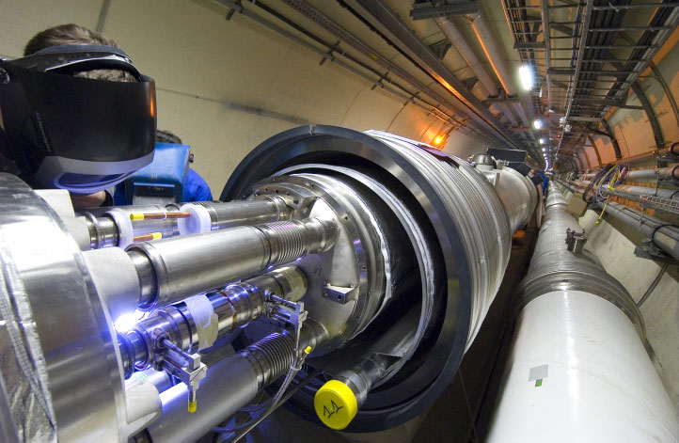
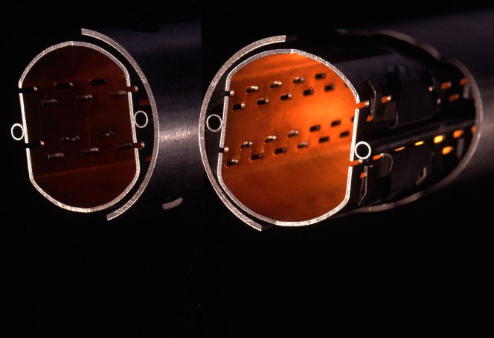
The emptiest space in the solar system…
To accelerate protons to almost the speed of light, we need a vacuum similar to interplanetary space. The pressure in the beam-pipes of the LHC will be about ten times lower than on the moon.

Slide 27
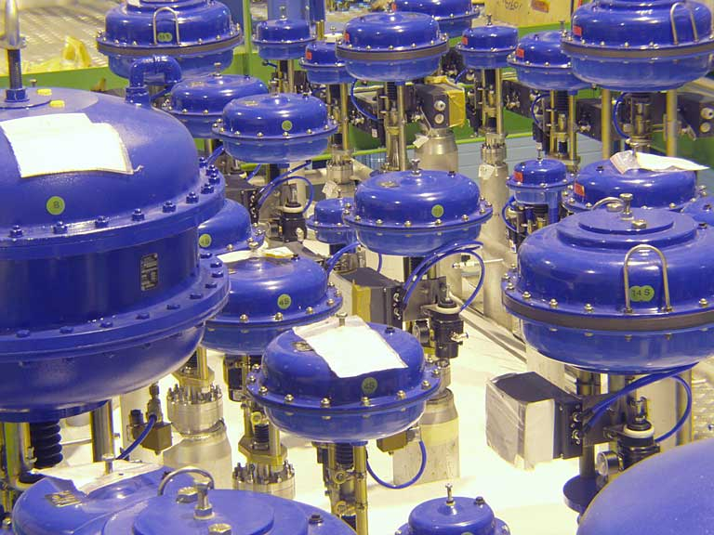
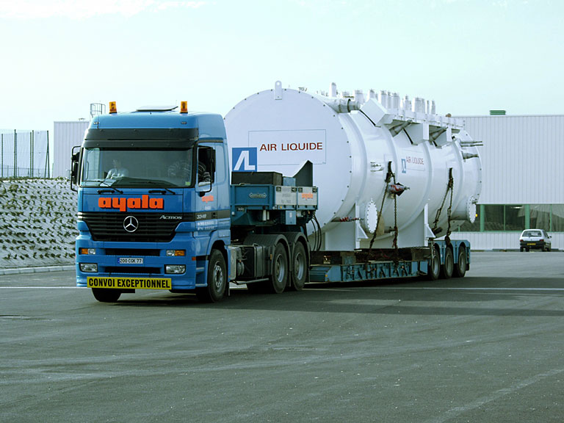
One of the coldest places in the Universe…
With a temperature of around -271 degrees Celsius, or 1.9 degrees above absolute zero, the LHC is colder than interstellar space.

Slide 28
One of the hottest places in the Galaxy…
CMS
ALICE
When two beams of protons collide, they generate within a tiny volume, temperatures more than a billion times those in the very heart of the Sun.

Slide 29
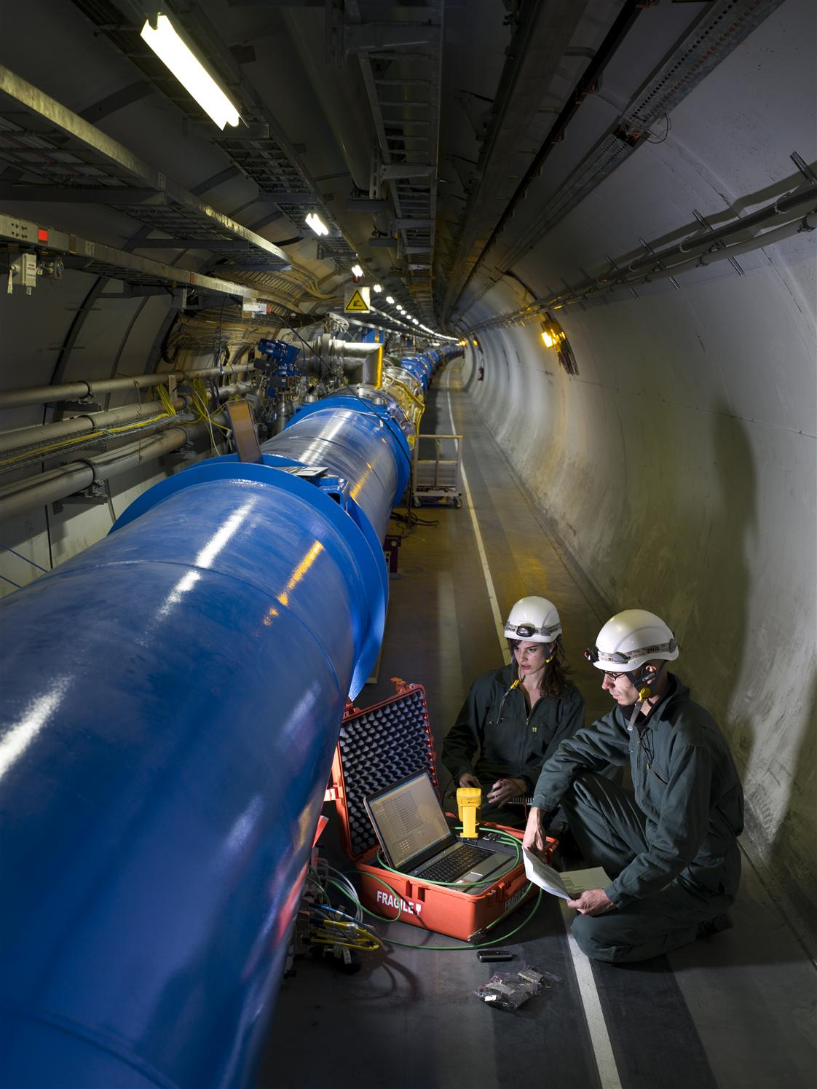
The LHC Accelerator
Protons are accelerated by powerful electric fields. And are guided around their circular orbits by powerful superconducting dipole magnets.
To reach the required energy in the existing tunnel, the superconducting dipoles operate at 8.3T (200000 x Earth’s magnetic field) and 1.9K (-271°C) in super-fluid helium.
Protons travel in a tube with better vacuum and colder than inter-planetary space.

Slide 30
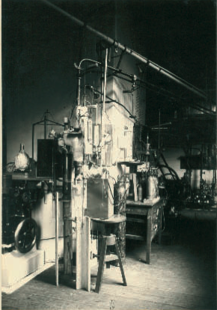
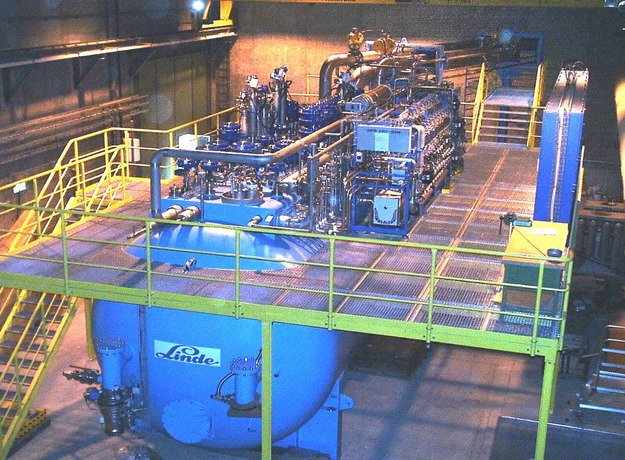
Cryogenics (1908 to 2008)
100 years ago: in July 1908 Kamerlingh Onnes first liquefied Helium in Leiden (60 ml in 1 hour)
LHC today: 32000 liters of He liquefied per hour by eight big cryogenic plants

Slide 31
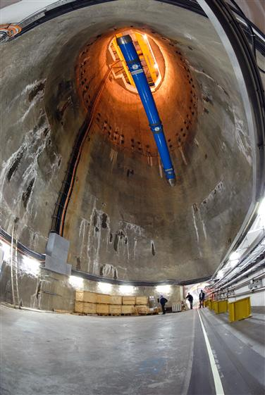
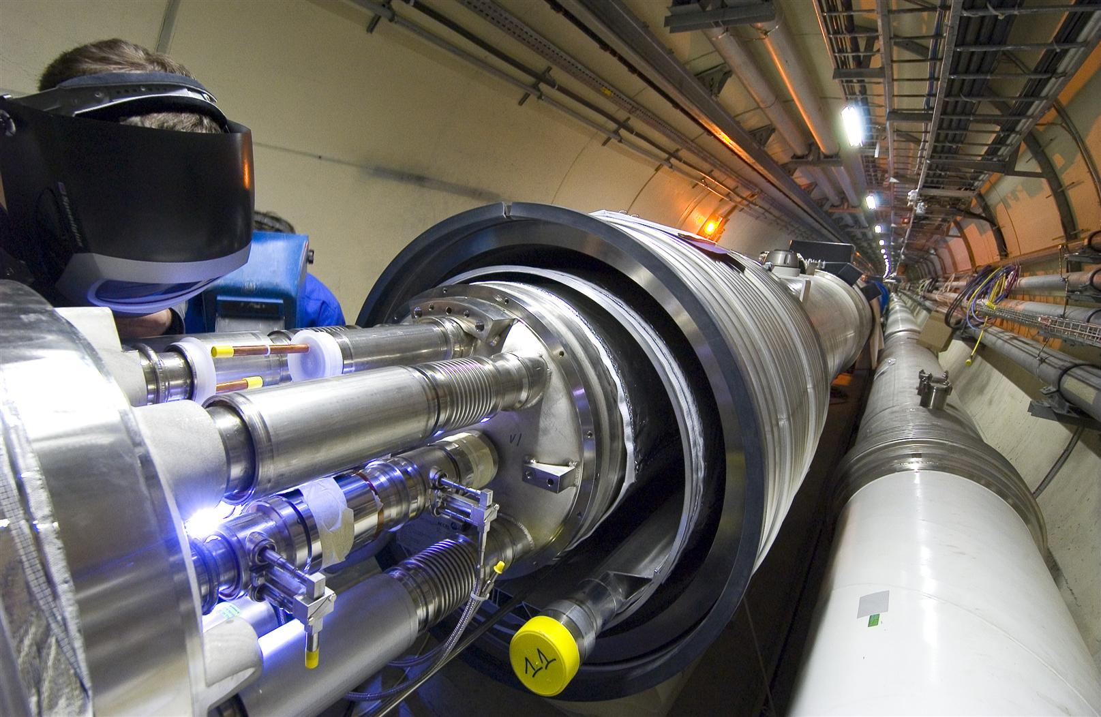
Superconducting Dipole Magnets
Superconducting magnets are cooled down in a bath of 120 tons of super-fluid helium:
a very interesting engineering material!

Slide 32
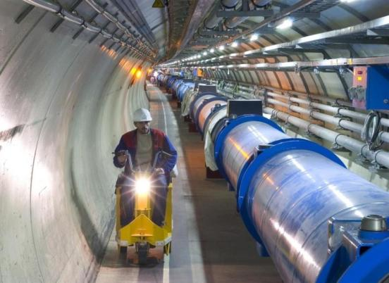
What is special with LHC machine ?
The highest field accelerator magnets: 8.3T (ultimate: 9T)
Proton-Proton machine : Twin-aperture main magnets
The largest superconducting magnet system (~8000 magnets)
The largest 1.9 K cryogenics installation (super-fluid helium)
The highest currents controlled with high precision (up to 13 kA)
The highest precision ever demanded from the power converters, a few ppm
A sophisticated and ultra-reliable magnet quench protection system

Slide 33
Fascinating facts about LHC
When the 27-km long circular tunnel was excavated, between Lake Geneva and the Jura mountain range, the two ends met up to within 1 cm.
Each of the 6400 superconducting filaments of niobium–titanium in the cable produced for the LHC is about 0.007 mm thick, about 10 times thinner than a normal human hair. If you added all the filaments together they would stretch to the Sun and back five times with enough left over for a few trips to the Moon.
All protons accelerated at CERN are obtained from standard hydrogen. Although proton beams at the LHC are very intense, only 2 nano grams of hydrogen are accelerated each day. Therefore, it would take the LHC about 1 million years to accelerate 1 gram of hydrogen.
The central part of the LHC will be the world’s largest fridge. At a temperature colder than deep outer space, it will contain iron, steel and the all important superconducting coils.
The pressure in the beam pipes of the LHC will be about ten times lower than on the Moon. This is an ultrahigh vacuum.
At full energy, each of the two proton beams in the LHC will have a total energy equivalent to a 400t train (like the French TGV) travelling at 150 km/h. This is enough energy to melt 500 kg of copper.
The CMS experiment magnet system contains about 10,000t of iron, which is more iron than in the Eiffel Tower.
The data recorded by each of the big experiments at the LHC will be enough to fill around 5,000,000 DVDs every year

Slide 34
Timeline of LHC
1984 | Workshop on a Large Hadron Collider in the LEP tunnel, Lausanne
1987 | Rubbia “Long-Range Planning Committee” recommends Large Hadron Collider as the right choice for CERN’s future
1990 | ECFA LHC Workshop, Aachen
1992 | General Meeting on LHC Physics and Detectors, Evian les Bains
1993 | Letters of Intent s (ATLAS and CMS selected by LHCC)
1994 | Technical Proposals Approved
1996 | Approval to move to Construction (ceiling of 475 MCHF)
1998 | Memorandum of Understanding for Construction Signed
1998 | Construction Begins (after approval of Technical Design Reports)
2000 | CMS assembly begins above ground. LEP closes
2004 | CMS Underground Caverns completed
2008 | CMS ready for First proton-proton Collisions
2011 | Reach design luminosity ( 1 billion pairs of protons interacting per second)
>2013 | Upgrade LHC Phase 1: increase pp interaction rate by factor of 2-4
>2017 | Upgrade LHC phase 2: increase pp interaction rate to about 10 billion/second

Slide 35
Challenges from experiments
LHC Detectors (especially ATLAS, CMS) are radically different from the ones from the previous generations
High Interaction Rate
  Proton-proton interaction rate: 1 billion interactions/sec
  Data can be recorded for only about 10 out of 40 million crossings/sec
  Level-1 trigger decision takes about 2-3μs
  a Electronics need to store data locally (pipelining)
Large Particle Multiplicity
  About 20 superposed events in each crossing
  About 1000 tracks stream into the detector every 25ns
  Need highly granular detectors with good time resolution for low occupancy
  a Large number of channels ( about 100 million channels)
High Radiation Levels
  a Radiation hard (tolerant) detectors and electronics

Slide 36
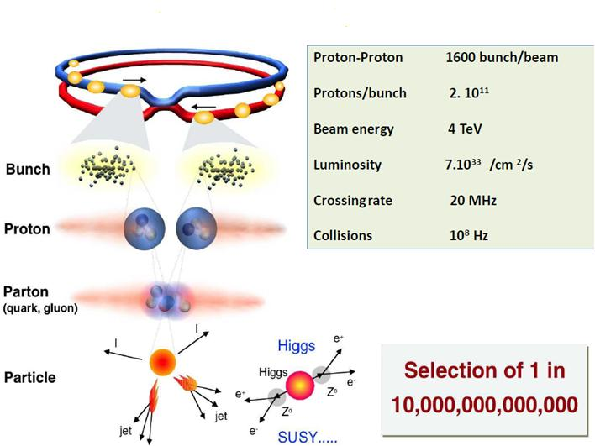
What happens in the LHC experiment?

Slide 37
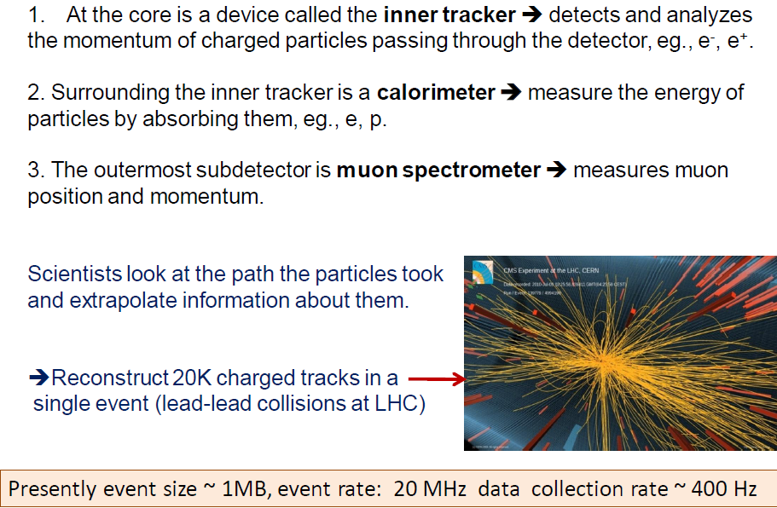
Essential components of a detector

Slide 38
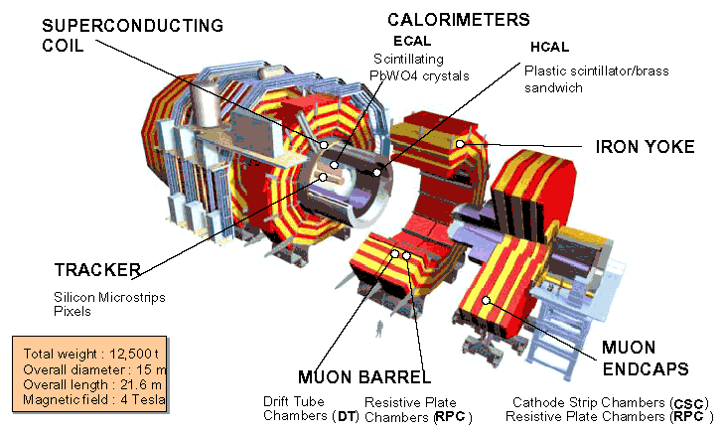
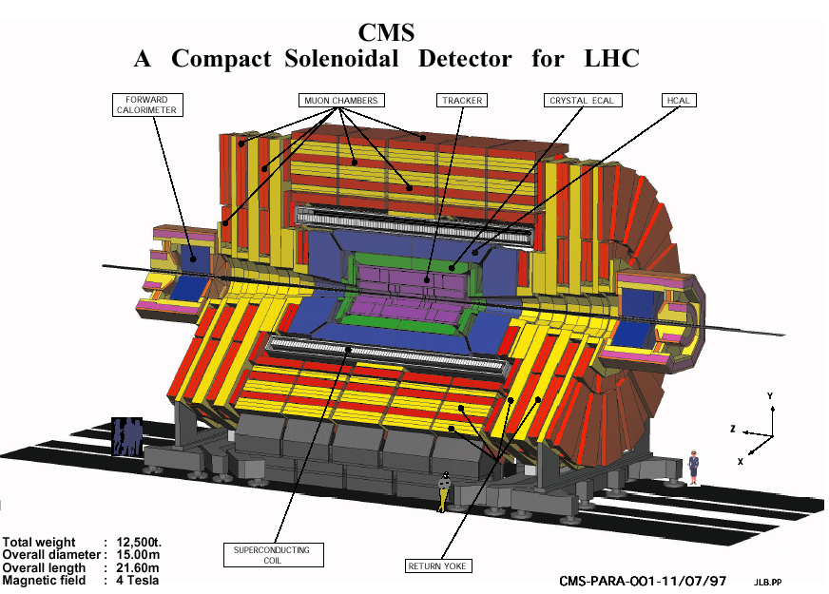
Compact Muon Solenoid (CMS) Detector

Slide 39
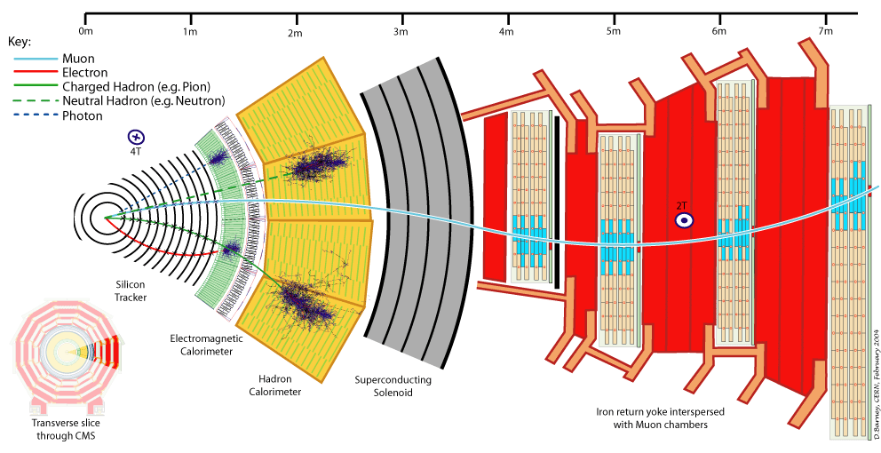
A slice of CMS experiment

Slide 40
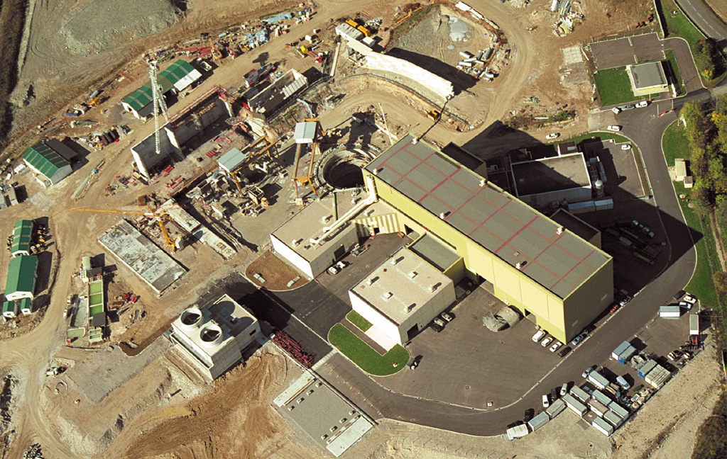
CMS site in the year 2000

Slide 41
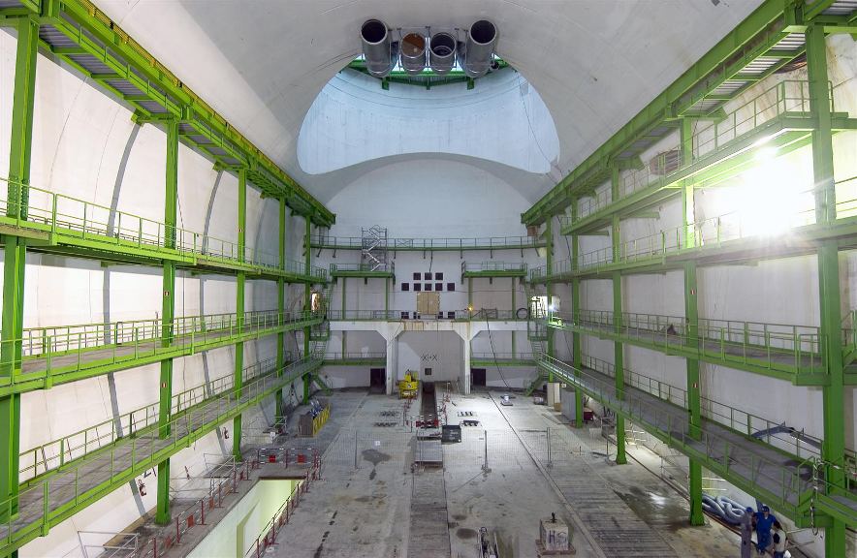
Home for the CMS detector

Slide 42
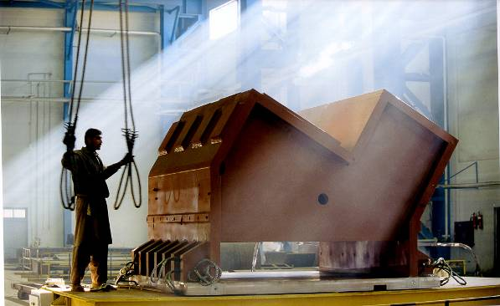
Support Structure
CMS uses more than 10000 tonnes of solid steel – by comparison the Eiffel tower only uses 7000 tonnes!
This “support foot” was made in Pakistan and
travelled to CERN via train, ship and truck!

Slide 43
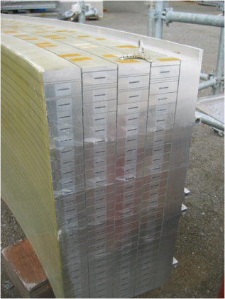
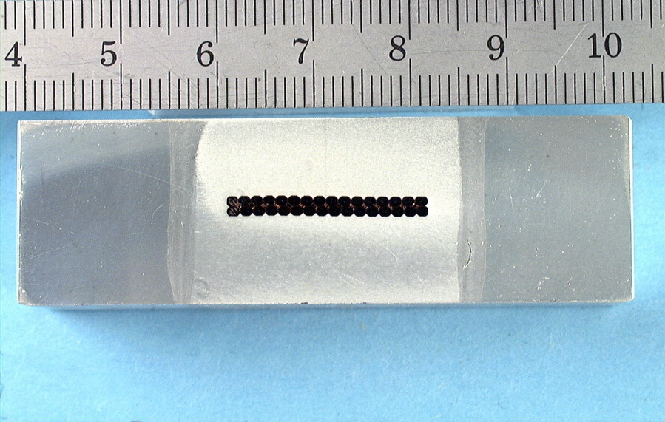
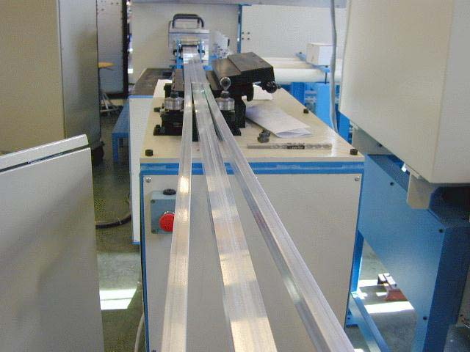
CMS Superconducting cables
Al stabilized NbTi conductor
Indirectly cooled at 4.5K by thermo siphon circuits
Inner winding vacuum impregnated with epoxy resin
Mechanically reinforced conductor (to contain magnetic forces)
4 Layers (because of needed Ampere-turns)
5 modules (to limit unit length of conductor)
SC cable
Al alloy
Al alloy
Insert Pure Al
EB welds

Slide 44
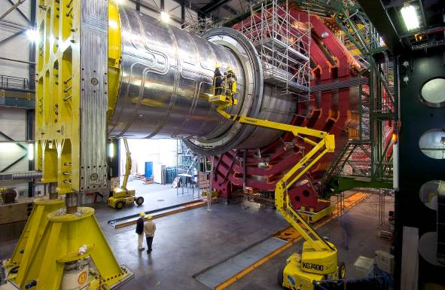
Superconducting Solenoid
13m long, 6m inner diameter; largest superconducting
solenoid ever made.
Niobium-Titanium wires
Cooled to -271ºC carry 20000 Amps to provide a 4 Tesla
magnetic field – about
100000 times stronger than
that of the earth

Slide 45
Integration of the solenoid
7 main parts
  Outer vacuum tank: made in 3 pieces, assembled at CERN
  Inner vacuum tank: single piece transported to CERN from about 120km away in the Jura
  Solenoid itself: 5 coils, welded to each other
Also a huge “return yoke”
  About 10,500 tons of solid steel pieces surround the solenoid to control the magnetic field
  Also act as the “skeleton” of CMS
  Yoke is divided into 5 barrel rings and 6 end-cap disks (3 on each side)

Slide 46
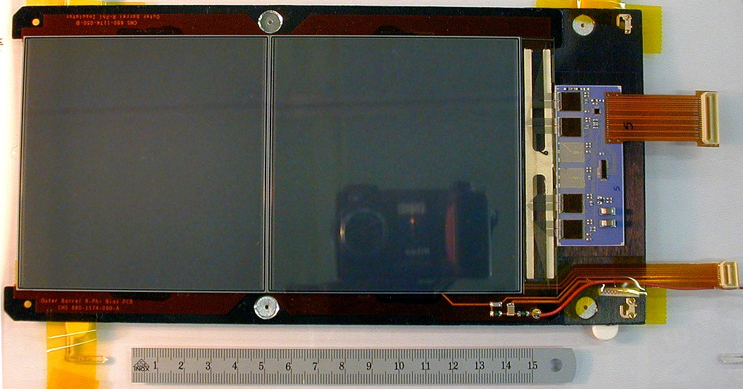
Si modules and Electronics chain
Riding on the technology wave;
75,000 chips using
0.25μm technology
Si Sensors
Pixels: About 1 m² of silicon sensors,
65 million pixels, 100x150μm², r=4,7,11cm
Si μstrips: 223m² of silicon sensors,
10 million strips, 10pts, r = 20 – 120cm

Slide 47
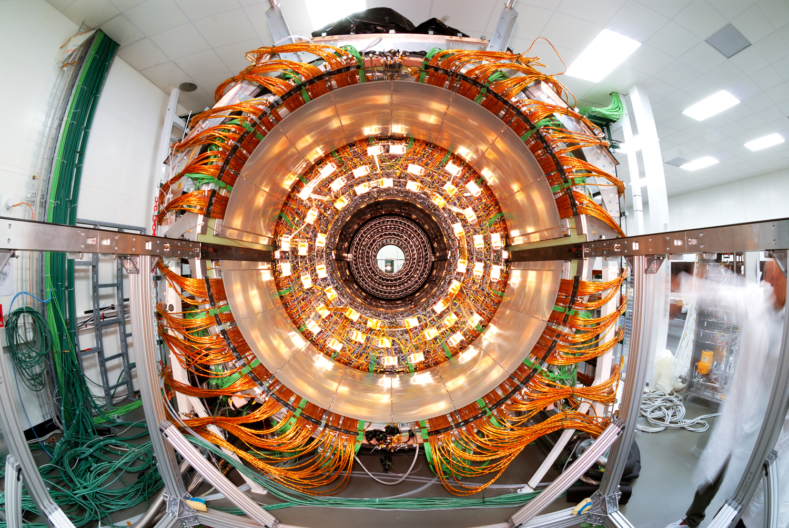
Fully assembled Si disk

Slide 48
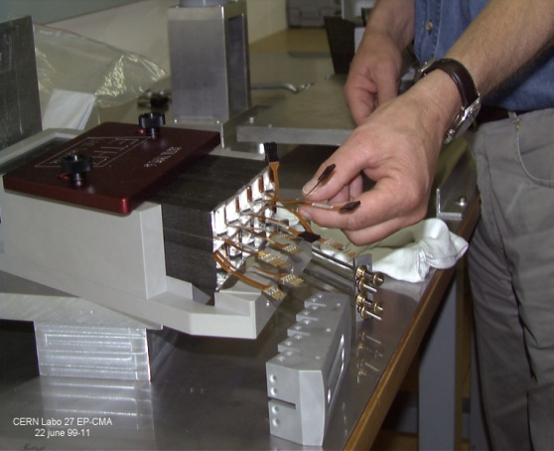
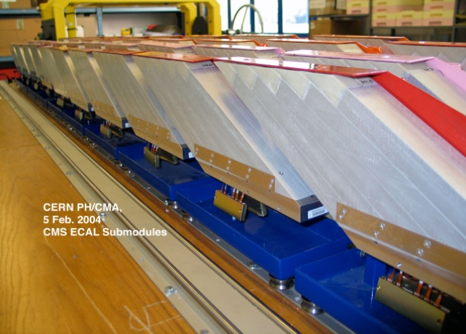
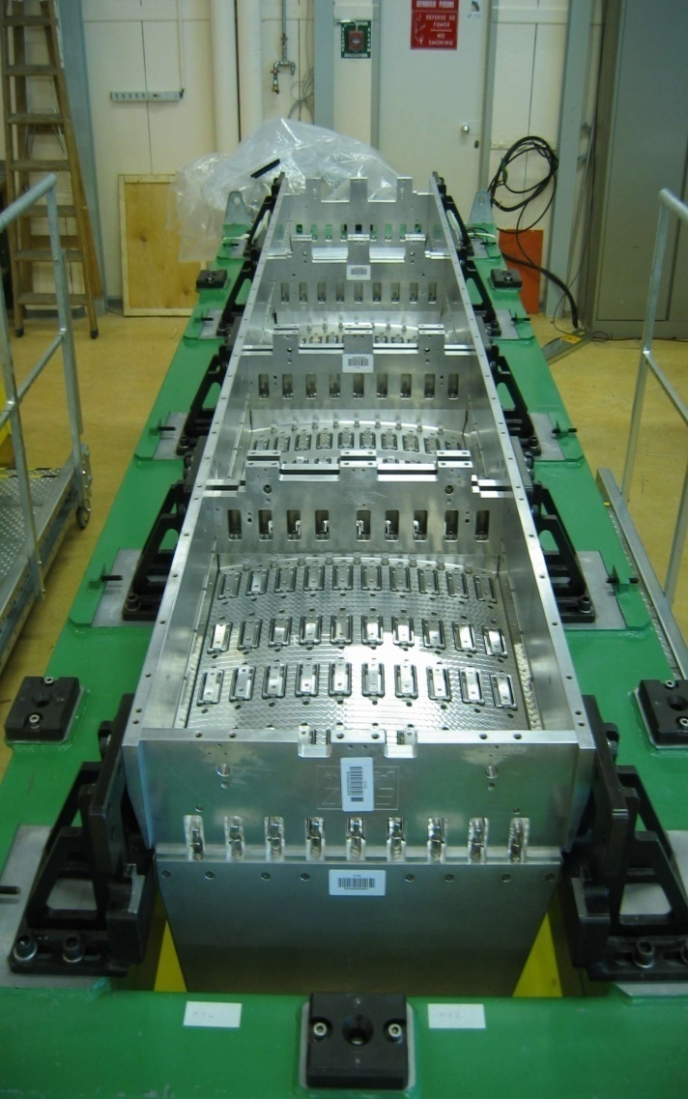
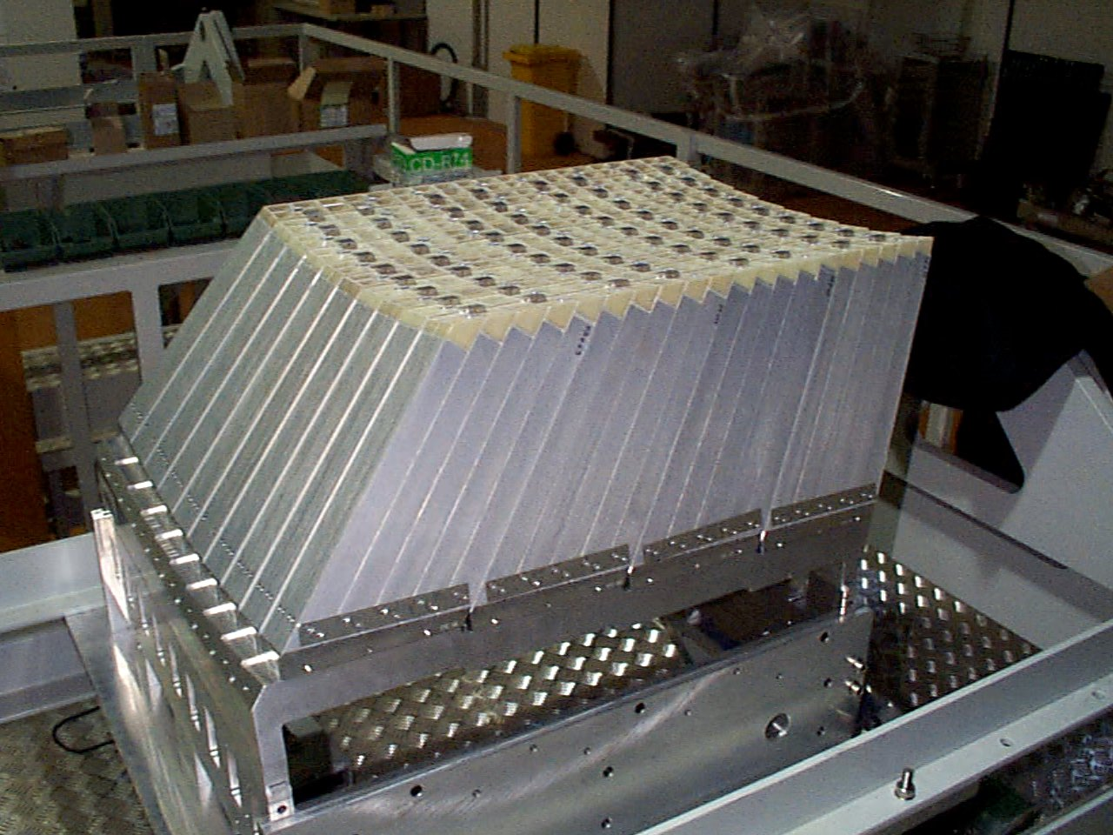
Assembly of EM calorimeter
Sub-module
2x5 crystals
Super-module
1700 crystals
Module
400 crystals
Total 36 Supermodules

Slide 49
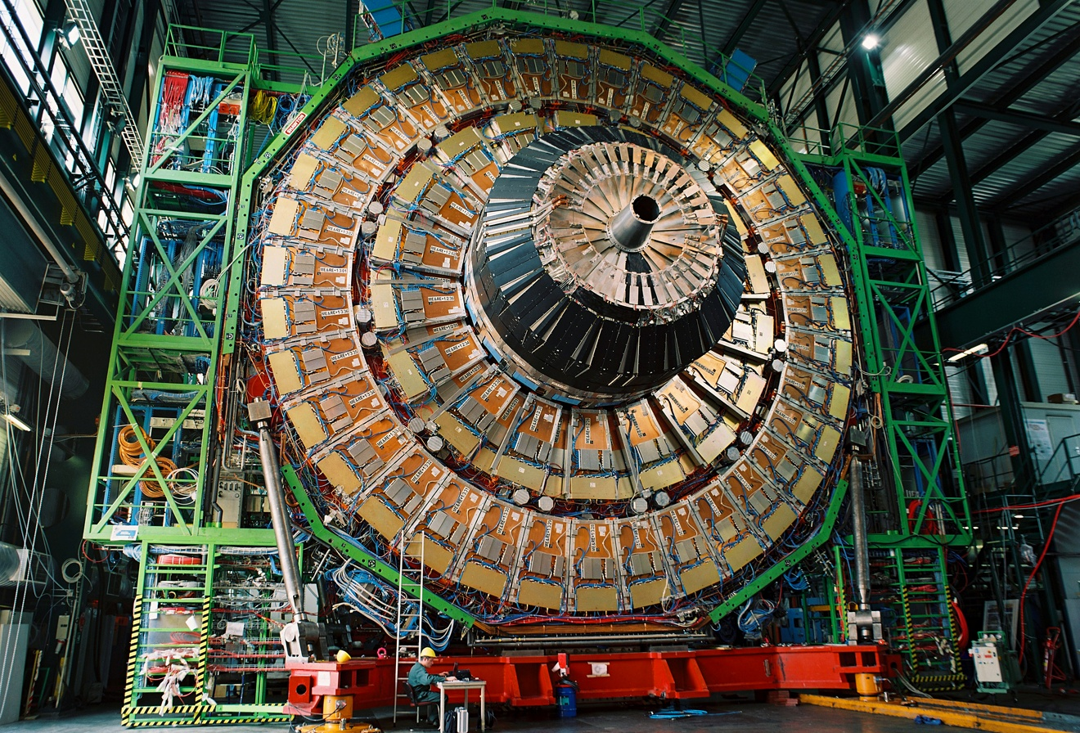
CMS endcaps’ assembly on surface

Slide 50
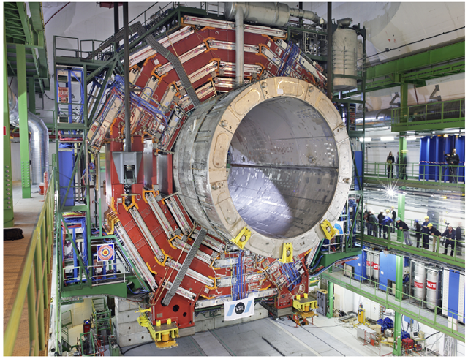
Lowering very heavy elements

Slide 51

Cables, Pipes and Optical Fibres!
250km and 50000 man-hours for the central part alone!

Slide 52

Cross-section of central barrel

Slide 53

Final integration of Si tracker

Slide 54

Joining the gigantic pieces

Slide 55

Typical event in the detector

Slide 56

Trigger rates and data sizes

Slide 57

Data flow in CMS experiment

Slide 58


A Toroidal LHC Apparatus

Slide 59

Cross-sectional view of ATLAS

Slide 60

ALICE Experiment
A Large Ion Collider Experiment

Slide 61

Cross-sectional view of ALICE

Slide 62

The LHC Computing Grid
The Grid unites computing resources of particle physics institutions around the world.
The World Wide Web (invented at CERN) provides seamless access to information that is stored in many millions of different geographical locations.
The Grid is an infrastructure that provides seamless access to computing power and data storage capacity distributed over the globe.

Slide 63

LHC Tier2 Grid computing centres for CMS and ALICE in India

Slide 64

LHC machine parts by DAE

Slide 65

Si pre-shower by BARC-DU

Slide 66

CMS HO detector by TIFR-PU

Slide 67


Radioactive source scanner

Slide 68

Modern day experimental physics collaborations

Slide 69

The D-day

Slide 70

The prize catch

Slide 71

CMS’s Higgs paper
32 pages of paper
16 pages of authors!

Slide 72
What did we achieve?
The LHC project has been planned and prepared meticulously over long time
  The harvest is excellent and is very fast!
The Higgs boson particle has been discovered by the experiments at LHC fulfilling its raison de etre.
This is considered as the proof of the idea proposed almost 50 years ago why weak interaction is short-ranged and electromagnetic interaction is long-ranged.
This development is very significant for the whole human kind since it gives us the confidence about our way of understanding the evolution of the universe at the first moments.
However, we have miles to go before we sleep!
  We learnt Higgs boson exists
  We need to know its properties
LHC will also explore many more interesting physics in coming decades
  Stay tuned!

Slide 73

What does Higgs discovery means to us?

Slide 74
Concluding remarks
Everything from the accelerator (its cryogenic systems, superconducting magnets,…), and the experiments (their detectors, electronics, data handling, selection of a precious few events,..) operate at unprecedented scales and complexity in an unprecedented environment.
Their construction has required a long and painstaking effort on a global scale. They are unparalleled scientific instruments.
The LHC at CERN opened a window on the “magic” 1 TeV energy scale.
The LHC project (the accelerator and experiments) was conceived & designed to attack these questions in particle physics (and science).
The LHC accelerator and the experiments are unprecedented in complexity and operate in an unprecedented & hostile environment.
Driven by the science many technologies have been pushed to their limits.
The Project has required a long and painstaking effort on a global scale.
The accelerator and the experiments are unparalleled scientific instrument(s) - a powerful “microscope” as well as a powerful “telescope”.
Indeed, CERN is the Mecca of interplay between science, engineering and technology.

Slide 75
Backup slides

Slide 76


Slide 77


Slide 78


Slide 79


Slide 80


Slide 81


Slide 82


Slide 83


Slide 84


Slide 85


Slide 86

Significance of a result

