Slide 1
Destroy; to probe its creation
B.Satyanarayana
Department of High Energy Physics
Tata Institute of Fundamental Research, Mumbai
email: bsn@tifr.res.in

Slide 2
Homi J Bhabha
I seriously say to you that business or job as an engineer is not the thing for me. It is totally foreign to my nature and radically opposed to my temperament and opinions. Physics is my line. I know I shall do great things here. For, each man can do best and excel in only that thing of which he is passionately fond, in which he believes, as I do, that he has the ability to do it, that he is in fact born and destined to do it. My success will not depend on what A or B thinks of me. My success will be what I make of my work. Besides, India is not a land where science cannot be carried on.
I am burning with a desire to do physics. I will and must do it sometime. It is my only ambition. I have no desire to be a “successful” man or the head of a big firm. There are intelligent people who like that and let them do it. I hear you saying “But you are not Socrates or Einstein”. No—and that is what Berlioz's father said to Berlioz. He called him a useless musician when he was young—Hector Berlioz who now accepted as one of the world's greatest geniuses and France's greatest musician. How can anybody else know at what time what one will do, if there is nothing to show. ... It is no use saying to Beethoven ”You must be a scientist for it is great thing” when he did not care two hoots for science; or to Socrates “Be an engineer; it is work of intelligent man”. It is not in the nature of things. I therefore earnestly implore you to let me do physics.
Homi Bhabha received his early education at Bombay's Cathedral Grammar School, which became the Cathedral and John Connon School in 1922 after merging with the John Connon School, run by the city's Scottish Education Society.

Slide 3
Powers of ten
Power of ten | Number | Symbol
10⁻¹⁵ | 0.000000000000001 | f(femto)
10⁻¹² | 0.000000000001 | p(pico)
10⁻⁹ | 0.000000001 | n(nano)
10⁻⁶ | 0.000001 | µ(micro)
10⁻³ | 0.001 | m(milli)
10⁻² | 0.01 | c(centi)
10⁻¹ | 0.1 | (deci)
10⁰ | 1
10¹ | 10 | (deca)
10² | 100 | h(hecta)
10³ | 1000 | k(kilo)
10⁶ | 1000000 | M(mega)
10⁹ | 1000000000 | G(giga)
10¹² | 1000000000000 | T(tera)
10¹⁵ | 1000000000000000 | P(peta)

Slide 4
Energy scales
Mass, energy, distance, temperature and time are related quantities.
Unit of energy is the electron Volt. Energy gained by an electron in passing through a voltage difference of one volt.
Some examples:
Mass of atom :0.01MeV
Mass of electron :0.5MeV
Mass of nucleus :10MeV
Mass of proton :1GeV
Mass of Top quark :175GeV
Accelerators :2-14TeV
Astrophysics :PeV
Wavelength of the probe radiation should be smaller than the object to be resolved.

Slide 5
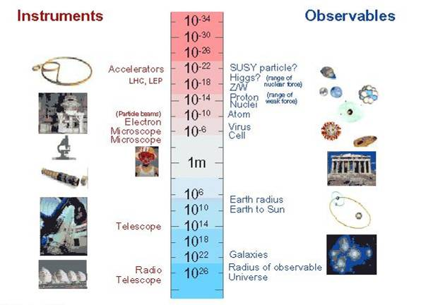
Sizes of things

Slide 6
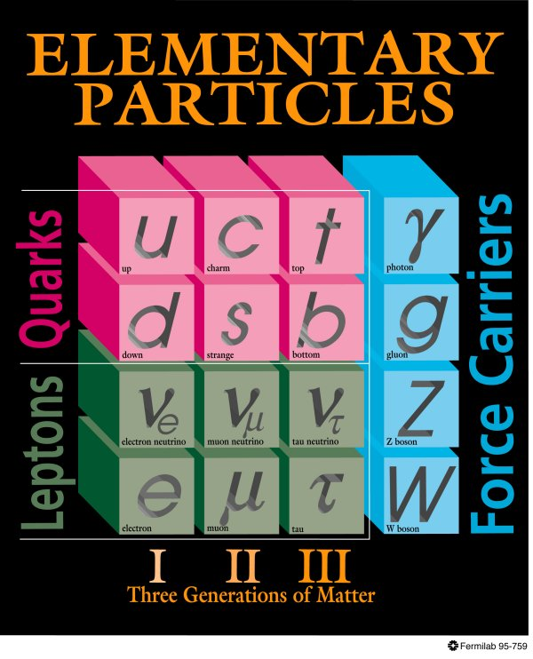
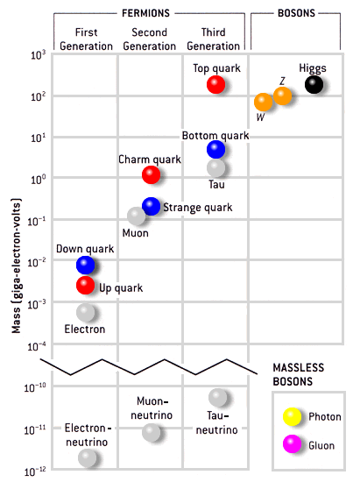
Standard Model of particle Physics

Slide 7
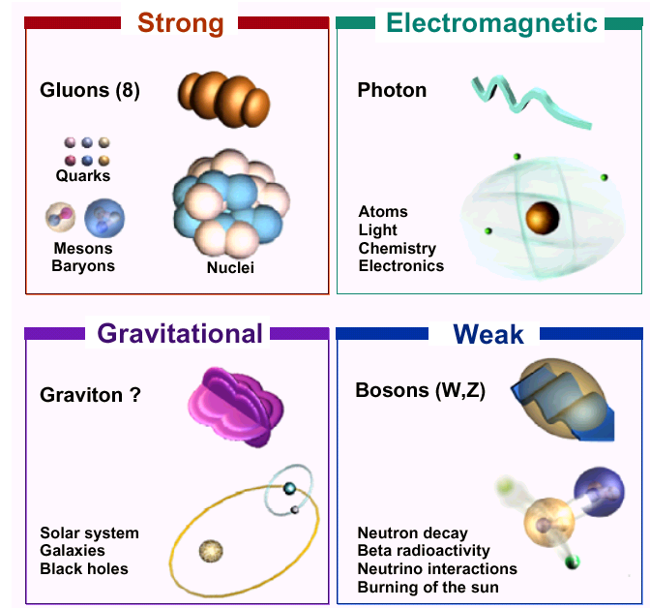
Four forces of nature

Slide 8
Particle Physics
Particle physics is a modern name for centuries old effort to understand the laws of nature
Aims to answer the two following questions:
What are the elementary constituents of matter ?
What are the forces that control their behaviour at the most basic level?
Get particles to interact and study the resulting products and features.
Aim to measure the energy, the direction and the identity of these products as precisely as possible.

Slide 9
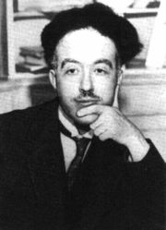
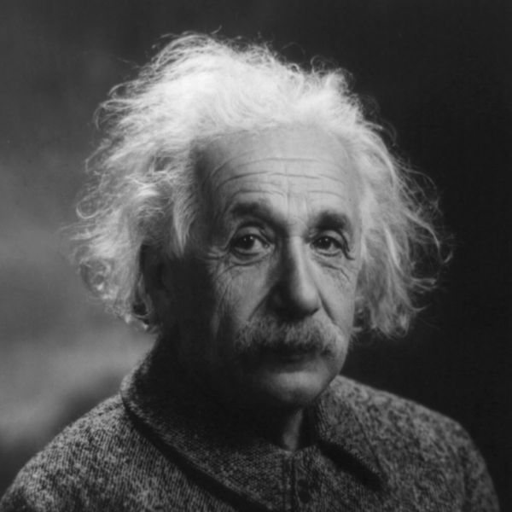
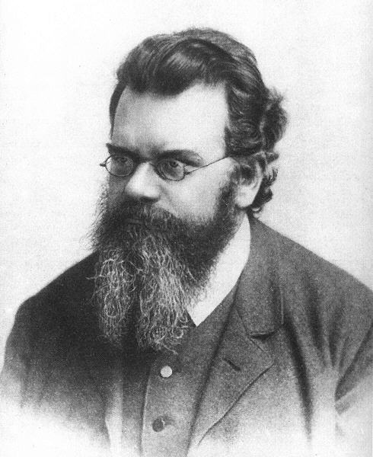
Particle accelerators
Accelerate particles to high energies.
The higher energies allow us to:
look deeper into matter (E α 1/size) (powerful microscopes)
discover new heavier particles (E = mc²)
probe conditions of early universe (E = kT)
revisit the earlier moments of our ancestral universe (powerful telescopes)
observe phenomena and particles normally no longer visible or existing in our time
All in a controlled way in the laboratory

Slide 10

CERN: A world laboratory

Slide 11
Why the LHC?
The LHC (Large Hadron Collider) was built to help scientists to answer key unresolved questions in particle physics. The unprecedented energy it achieves may even reveal some unexpected results that no one has ever thought of!
For the past few decades, physicists have been able to describe with increasing detail the fundamental particles that make up the Universe and the interactions between them.
This understanding is encapsulated in the Standard Model of particle physics, but it contains gaps and cannot tell us the whole story. To fill in the missing knowledge requires experimental data, and the next big step to achieving this is with LHC.

Slide 12
Newton's unfinished business...
What is mass?
What is the origin of mass? Why do tiny particles weigh the amount they do? Why do some particles have no mass at all?
At present, there are no established answers to these questions. The most likely explanation may be found in the Higgs boson, a key undiscovered particle that is essential for the Standard Model to work. First hypothesised in 1964, it has yet to be observed.

Slide 13
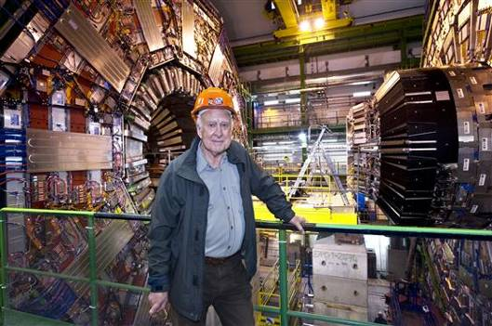
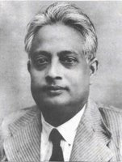
Higgs and Bose

Slide 14
An invisible problem...
What is 96% of the universe made of?
Everything we see in the Universe, from an ant to a galaxy, is made up of ordinary particles. These are collectively referred to as matter, forming 4% of the Universe.
Dark matter and dark energy are believed to make up the remaining proportion, but they are incredibly difficult to detect and study.
Investigating the nature of dark matter and dark energy is one of the biggest challenges today in the fields of particle physics and cosmology.

Slide 15
Why is there no more antimatter?
We live in a world of matter – everything in the Universe, including ourselves, is made of matter.
Antimatter is like a twin version of matter, but with opposite electric charge.
At the birth of the Universe, equal amounts of matter and antimatter should have been produced in the Big Bang.
But when matter and antimatter particles meet, they annihilate each other, transforming into energy.
Somehow, a tiny fraction of matter must have survived to form the Universe we live in today, with hardly any antimatter left.
Why does Nature appear to have this bias for matter over antimatter?

Slide 16
Secrets of the Big Bang
What was matter like within the first second of the Universe’s life?
Matter, from which everything in the Universe is made, is believed to have originated from a dense and hot cocktail of fundamental particles.
Today, the ordinary matter of the Universe is made of atoms, which contain a nucleus composed of protons and neutrons, which in turn are made of quarks bound together by other particles called gluons.
The bond is very strong, but in the very early Universe conditions would have been too hot and energetic for the gluons to hold the quarks together.
Instead, it seems likely that during the first microseconds after the Big Bang the Universe would have contained a very hot and dense mixture of quarks and gluons called quark–gluon plasma.

Slide 17
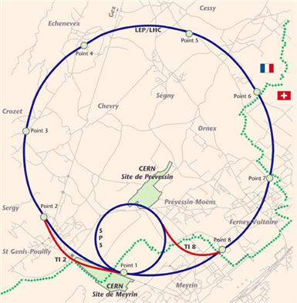
LHC accelerator ring
This diagram shows the LHC and the SPS pre-accelerator (in blue) and the transfer lines that will connect them (in red). Spanning the France-Swiss border (shown by green crosses), the 27-km LHC tunnel will receive a beam that has been pre-accelerated to 450 GeV in the smaller SPS storage ring. The transfer lines will remove each beam from the SPS and inject them into the LHC where they will be accelerated to the full energy of 7 TeV.

Slide 18
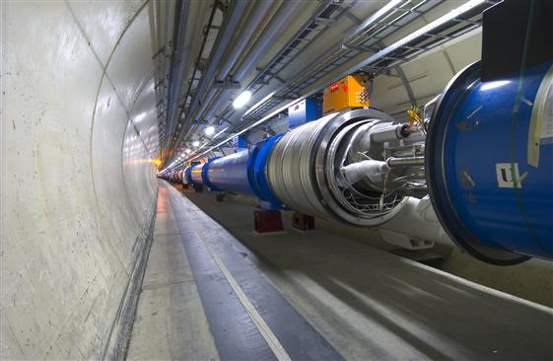
LHC magnets
Two LHC magnets are seen before they are connected together.
The blue cylinders contain the magnetic yoke and coil of the dipole magnets together with the liquid helium system required to cool the magnet so that it becomes superconducting.
Eventually this connection will be welded together so that the beams are contained within the beam pipes.

Slide 19
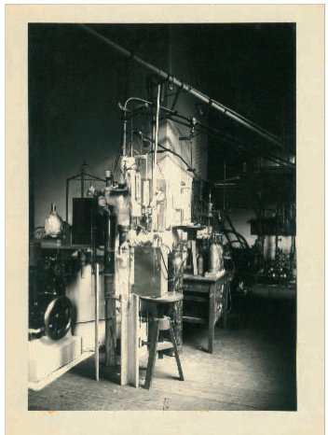
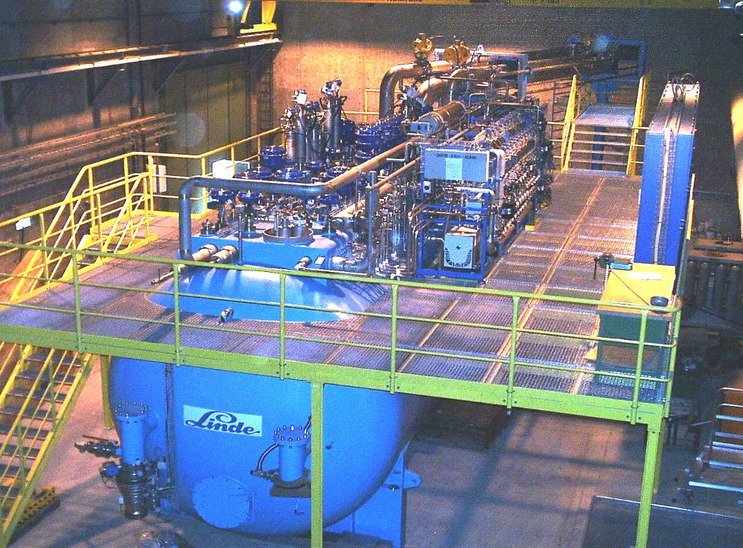
Cryogenics (1908 to 2008)
100 years ago: in July 1908 Kamerlingh Onnes first liquefied Helium in Leiden (60 ml in 1 hour)
LHC today: 32000 liters of He liquefied per hour by eight big cryogenic plants

Slide 20
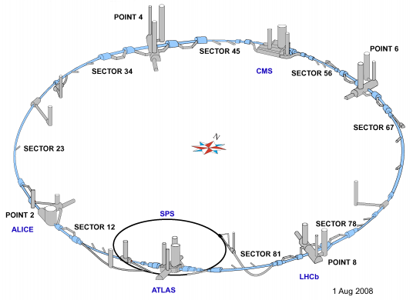
Experiments on LHC

Slide 21
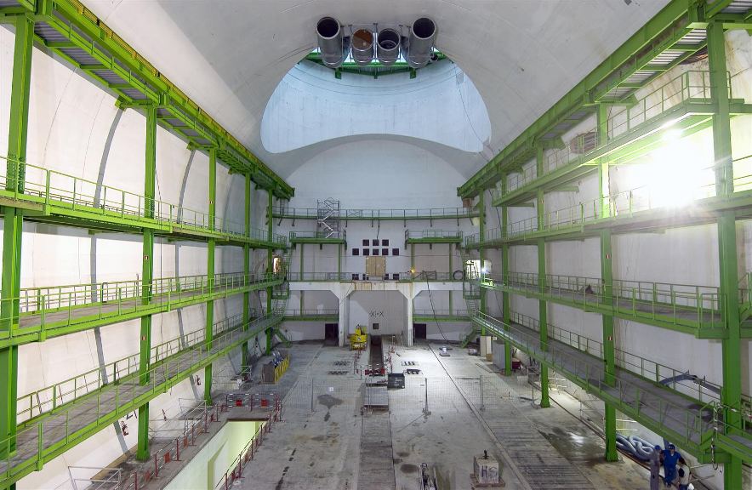
Home ready for CMS detector

Slide 22
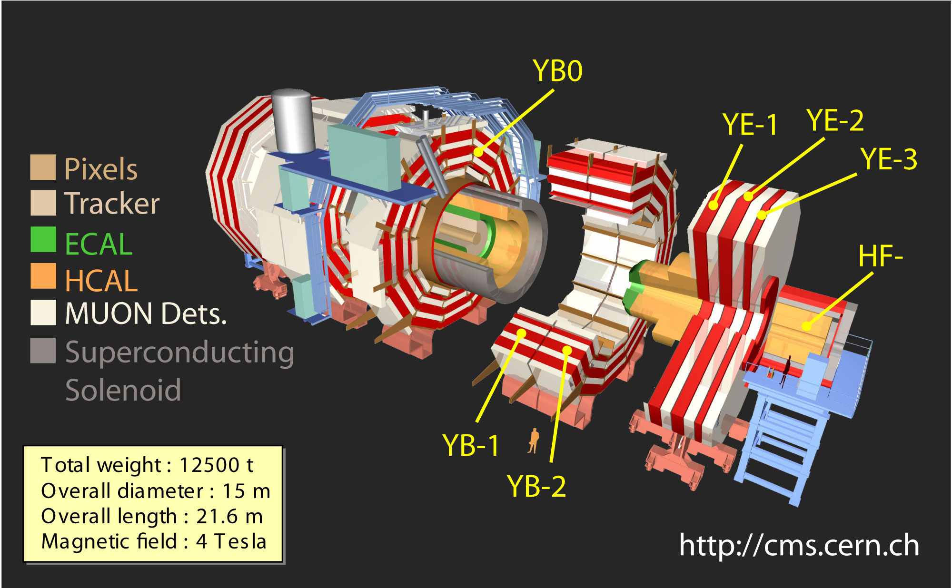
Exploded view of the CMS detector
Plus Side
Minus Side

Slide 23
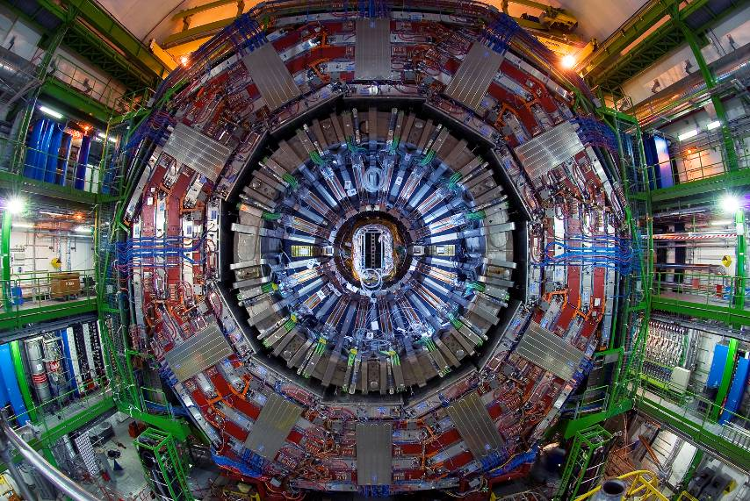
CMS detector

Slide 24
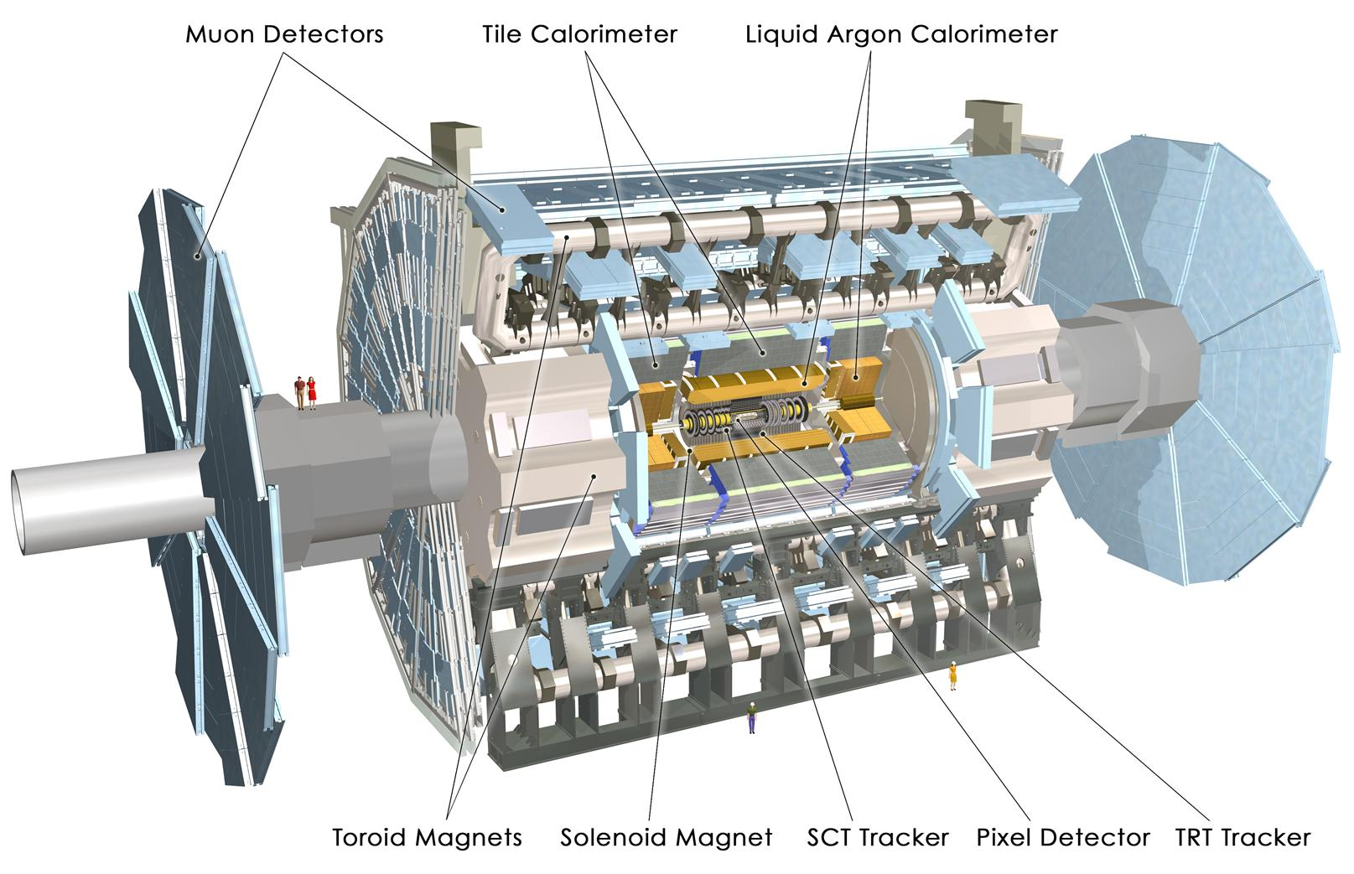
Structure of ATLAS detector
L = 45m
D = 24m
W = 7000T

Slide 25
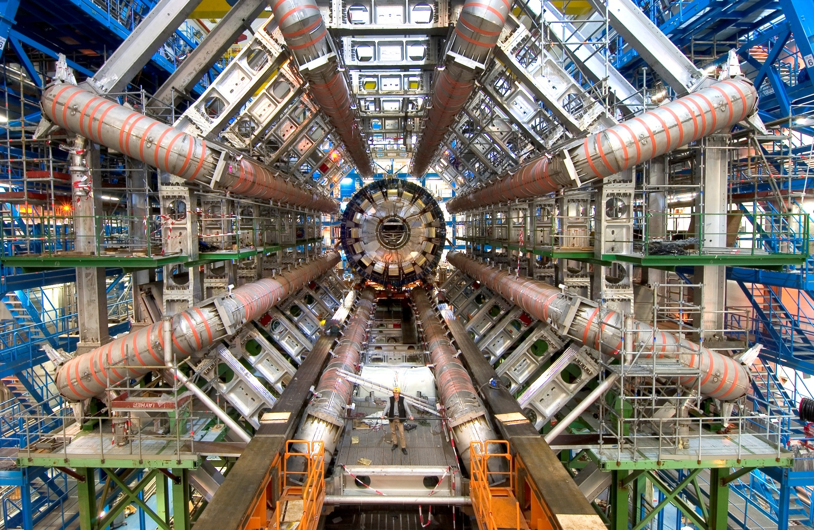
ATLAS detector

Slide 26
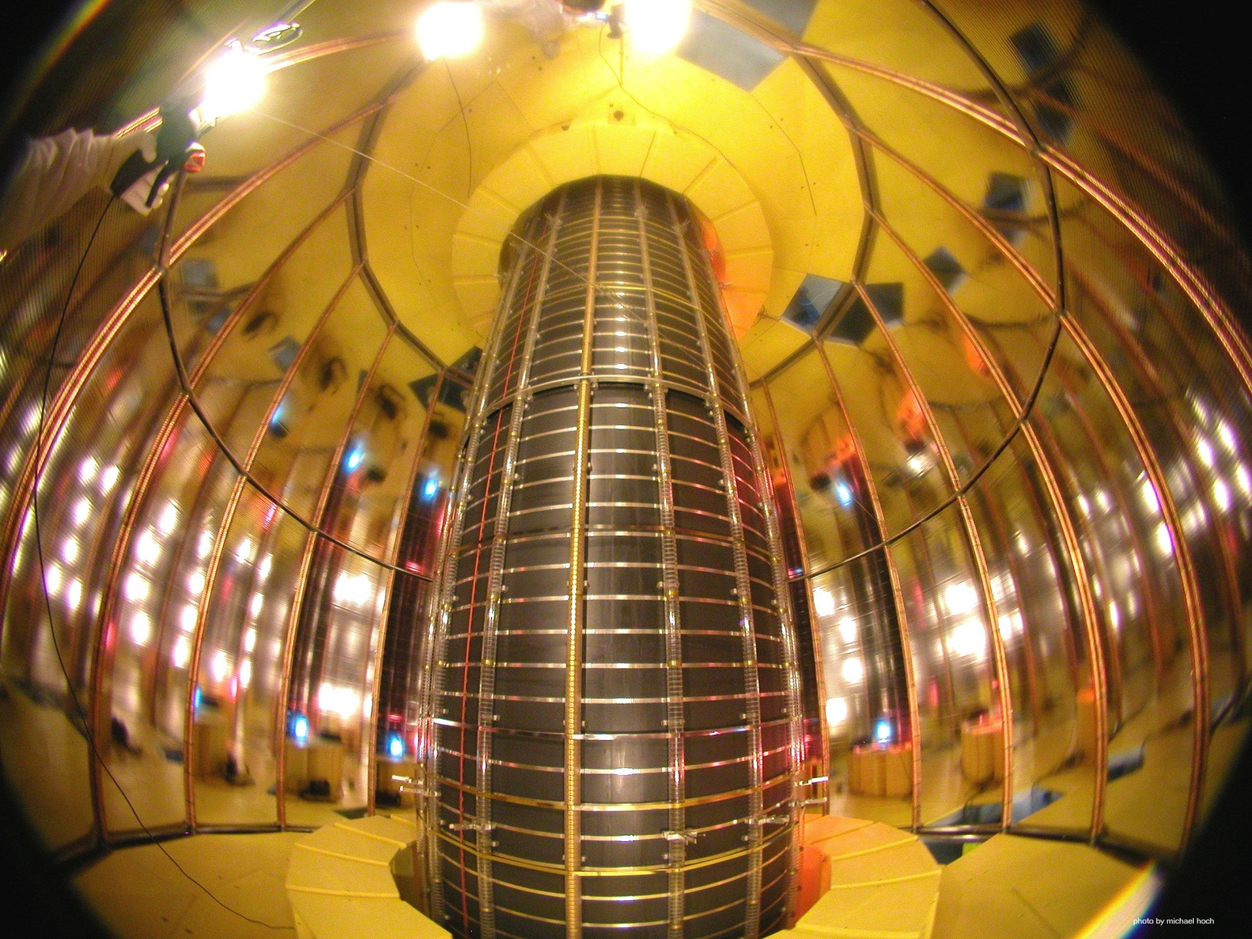
ALICE experiment
The LHC Can also accelerate other particles such as nuclei of lead.
A new form of matter - the quark gluon plasma must have existed in the early moments of the universe. ALICE is specifically designed to study this.

Slide 27
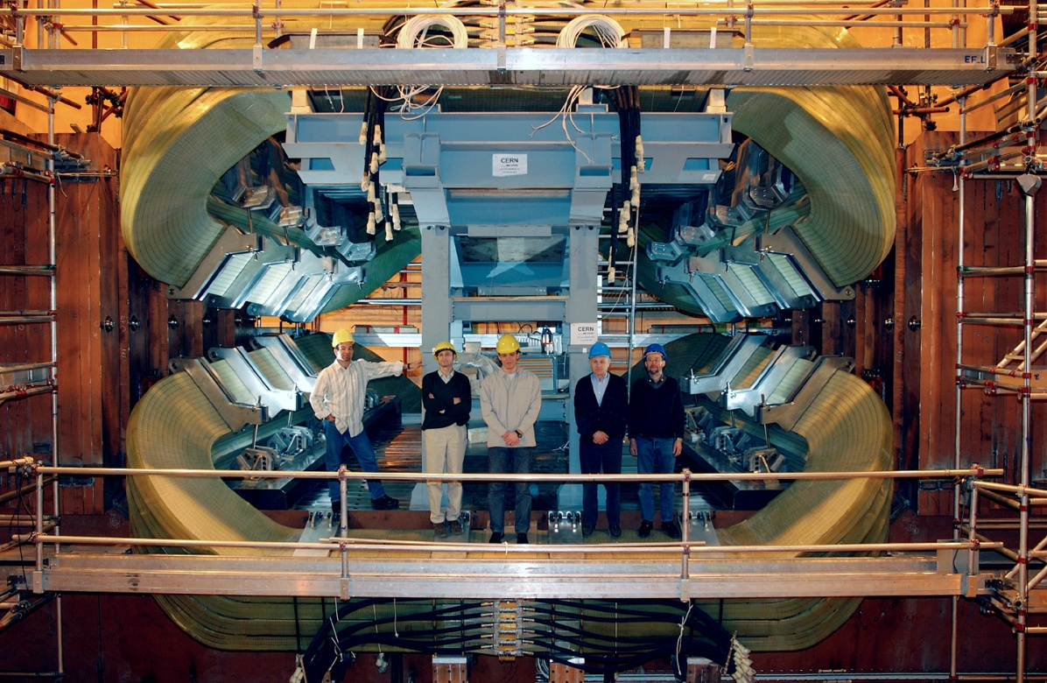
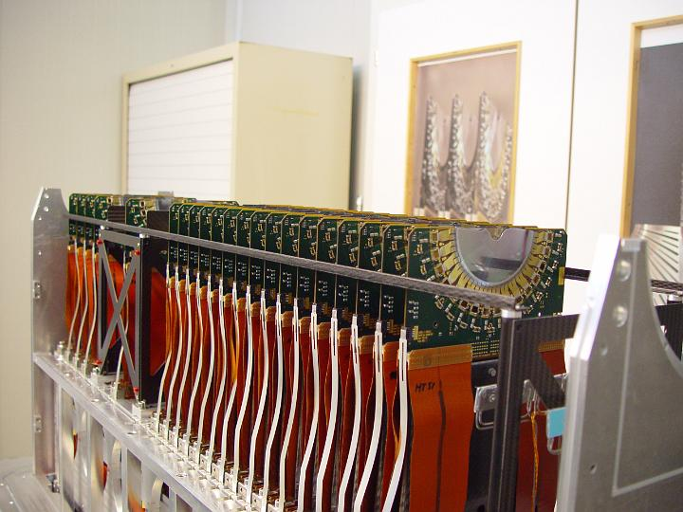
LHCb experiment
A difference in the behaviour of antimatter and matter has already been observed but it falls far short of accounting for the excess of matter over antimatter in the early universe. LHCb is specifically designed for this study.

Slide 28
Acquiring and recording data of Interest

Slide 29
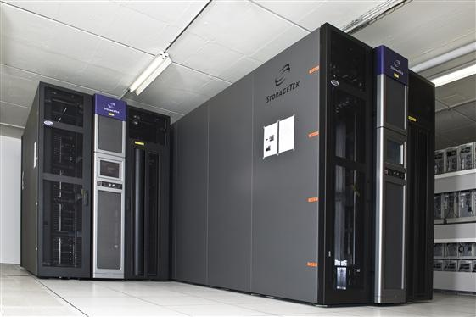
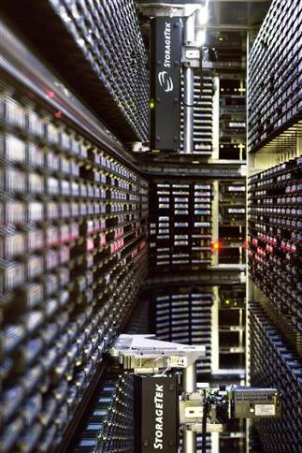
Giant computing systems
The World Wide Web (invented at CERN) provides seamless access to information that is stored in many millions of different geographical locations.
The Grid is an infrastructure that provides seamless access to computing power and data storage capacity distributed over the globe.

Slide 30
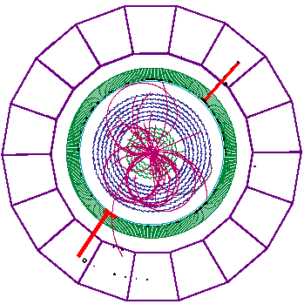
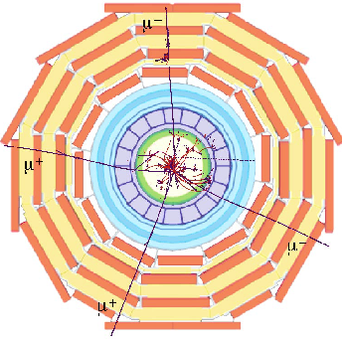
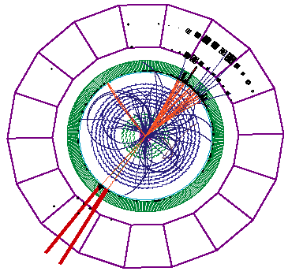
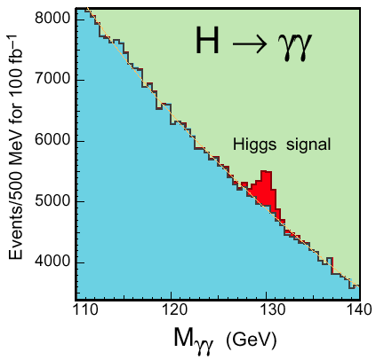
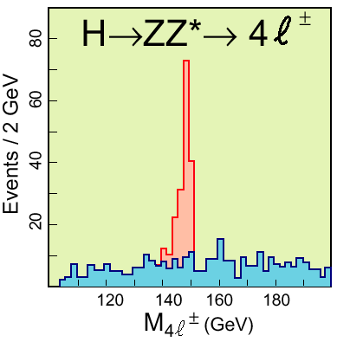
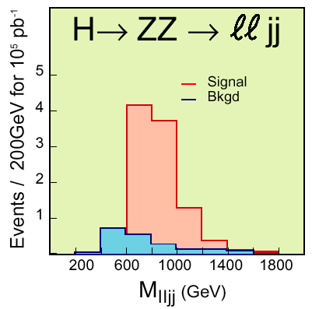
Looking for the Higgs Boson

Slide 31
Fascinating facts about LHC
When the 27-km long circular tunnel was excavated, between Lake Geneva and the Jura mountain range, the two ends met up to within 1 cm.
Each of the 6400 superconducting filaments of niobium–titanium in the cable produced for the LHC is about 0.007 mm thick, about 10 times thinner than a normal human hair. If you added all the filaments together they would stretch to the Sun and back five times with enough left over for a few trips to the Moon.
All protons accelerated at CERN are obtained from standard hydrogen. Although proton beams at the LHC are very intense, only 2 nano grams of hydrogen are accelerated each day. Therefore, it would take the LHC about 1 million years to accelerate 1 gram of hydrogen.
The central part of the LHC will be the world’s largest fridge. At a temperature colder than deep outer space, it will contain iron, steel and the all important superconducting coils.
The pressure in the beam pipes of the LHC will be about ten times lower than on the Moon. This is an ultrahigh vacuum.
Protons at full energy in the LHC will be travelling at 0.999999991 times the speed of light. Each proton will go round the 27 km ring more than 11,000 times a second.
At full energy, each of the two proton beams in the LHC will have a total energy equivalent to a 400t train (like the French TGV) travelling at 150 km/h. This is enough energy to melt 500 kg of copper.
The CMS experiment magnet system contains about 10,000t of iron, which is more iron than in the Eiffel Tower.
The data recorded by each of the big experiments at the LHC will be enough to fill around 5,000,000 DVDs every year

Slide 32
Is the LHC dangerous? Mini big bangs
What is Big Bang?
Although the energy concentration (or density) in the particle collisions at the LHC is very high, in absolute terms the energy involved is very low compared to the energies we deal with every day or with the energies involved in the collisions of cosmic rays.
However, at the very small scales of the proton beam, this energy concentration reproduces the energy density that existed just a few moments after the Big Bang—that is why collisions at the LHC are sometimes referred to as mini big bangs.

Slide 33
Is the LHC dangerous? Mini big bangs
What is Big Bang?
Although the energy concentration (or density) in the particle collisions at the LHC is very high, in absolute terms the energy involved is very low compared to the energies we deal with every day or with the energies involved in the collisions of cosmic rays.
However, at the very small scales of the proton beam, this energy concentration reproduces the energy density that existed just a few moments after the Big Bang—that is why collisions at the LHC are sometimes referred to as mini big bangs.

Slide 34
Is the LHC dangerous? Unprecedented energy collisions
Accelerators only recreate the natural phenomena of cosmic rays under controlled laboratory conditions.
Cosmic rays are particles produced in outer space in events such as supernovae or the formation of black holes, during which they can be accelerated to energies far exceeding those of the LHC.
Cosmic rays travel throughout the Universe, and have been bombarding the Earth’s atmosphere continually since its formation 4.5 billion years ago.
Since the much higher-energy collisions provided by nature for billions of years have not harmed the Earth, there is no reason to think that any phenomenon produced by the LHC will do so.
Cosmic rays also collide with the Moon, Jupiter, the Sun and other astronomical bodies.
The total number of these collisions is huge compared to what is expected at the LHC. The fact that planets and stars remain intact strengthens our confidence that LHC collisions are safe.
The LHC’s energy, although powerful for an accelerator, is modest by nature’s standards.

Slide 35
Is the LHC dangerous? Radiation
Radiation is unavoidable at particle accelerators like the LHC.
The particle collisions that allow us to study the origin of matter also generate radiation.
CERN uses active and passive protection means, radiation monitors and various procedures to ensure that radiation exposure to the staff and the surrounding population is as low as possible and well below the international regulatory limits.
For comparison, note that natural radioactivity — due to cosmic rays and natural environmental radioactivity — is about 2400μSv/year in Switzerland.
The LHC tunnel is housed 100m underground, so deep that both stray radiation generated during operation and residual radioactivity will not be detected at the surface.
Studies have shown that radioactivity released in the air will contribute to a dose to members of the public of no more than 10μSv/year.

Slide 36
Is the LHC dangerous? Black holes
Massive black holes are created in the Universe by the collapse of massive stars, which contain enormous amounts of gravitational energy that pulls in surrounding matter.
The gravitational pull of a black hole is related to the amount of matter or energy it contains — the less there is, the weaker the pull.
Some physicists suggest that microscopic black holes could be produced in the collisions at the LHC.
However, these would only be created with the energies of the colliding particles (equivalent to the energies of mosquitoes), so no microscopic black holes produced inside the LHC could generate a strong enough gravitational force to pull in surrounding matter.
If the LHC can produce microscopic black holes, cosmic rays of much higher energies would already have produced many more. Since the Earth is still here, there is no reason to believe that collisions inside the LHC are harmful.

Slide 37
How long it takes?
Although the particle collision rate at the LHC will be very high, the production rate of the Higgs will be so small that physicists expect to have enough statistics only after about 2-3 years of data-taking.
The Higgs boson production rate strongly depends on the theoretical model and calculations used to evaluate it.
Under good conditions, there is expected to be about one every few hours per experiment.
The same applies to super-symmetric particles.
Physicists expect to have the first meaningful results in about one year of data-taking at full luminosity.

Slide 38
Indians@LHC
Large number of Indian scientists and engineers have worked for LHC
Built a large number of magnets as well as very crucial components required for LHC
Built parts of two big experiments on LHC, namely CMS and ALICE
Built computer GRIDs for performing very fast calculations
Developed physics analysis software and many sophisticated software tools

Slide 39
Summary
The LHC project (the accelerator and experiments) was conceived and designed to answer the questions in particle physics (and science).
The LHC accelerator and the experiments are unprecedented in complexity and will operate in an unprecedented and hostile environment.
Driven by the science many technologies have been pushed to their limits.
The project has required a long and painstaking effort on a global scale.
The accelerator and the experiments are unparalleled scientific instrument(s) - a powerful microscope as well as a powerful telescope.
All expectations are that what we find at the LHC will reform our understanding of nature at the most fundamental level.
Only experiments reveal/confirm Nature’s inner secrets.

Slide 40
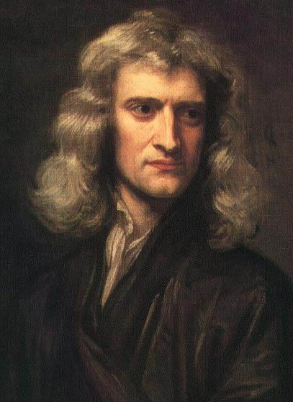
Philosophy of Science
To me there has never been a higher source of earthly honour or distinction than that connected with advances in science.
I seem to have been only like a boy playing on the seashore, and diverting myself in now and then finding a smoother pebble or a prettier shell than ordinary, whilst the great ocean of truth lay all undiscovered before me.
Sir Isaac Newton

Slide 41
Thank you
For your attention

Slide 42
Big Bang – Part 1

Slide 43
Big Bang – Part 2

Slide 44


Slide 45
